Slide 1
Idee x nuove misure
D. Vescovi
S. Cristallo

Slide 2
Da ieri…

Slide 3
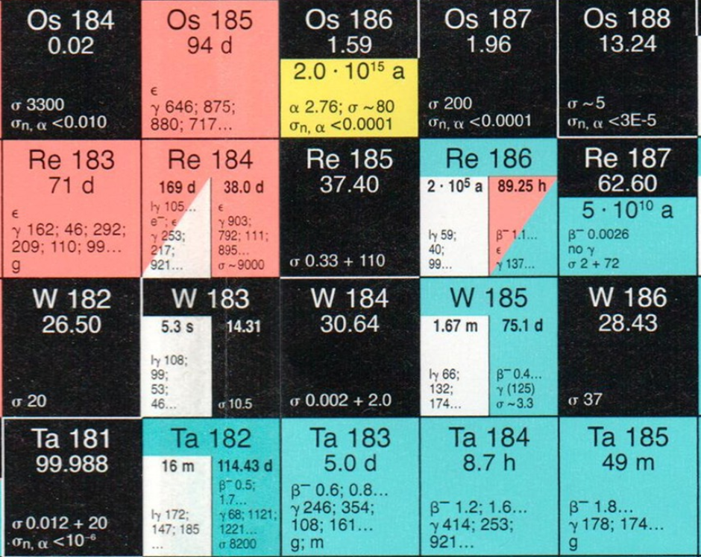
^{184,185,186}W(n,γ)
EAR1,
EAR2
oppure
NEAR?

Slide 4
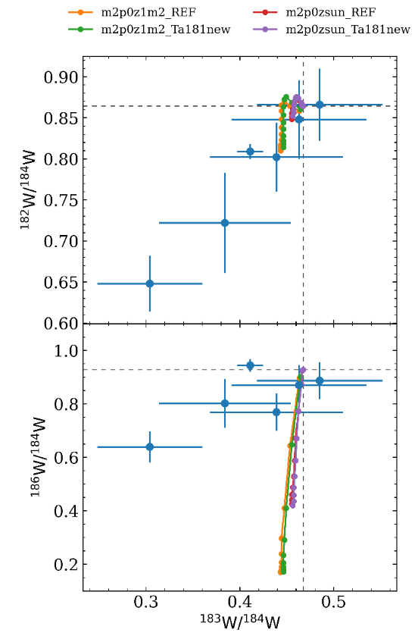
Tungsten isotopes: why?

Slide 5
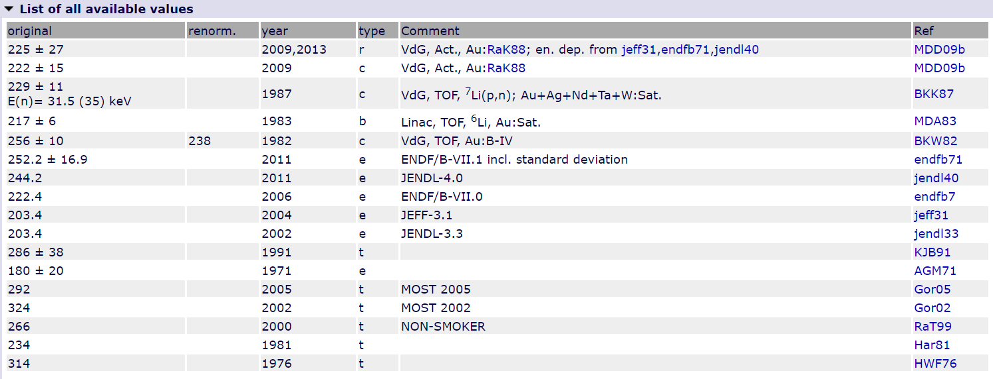
Literature

Slide 6
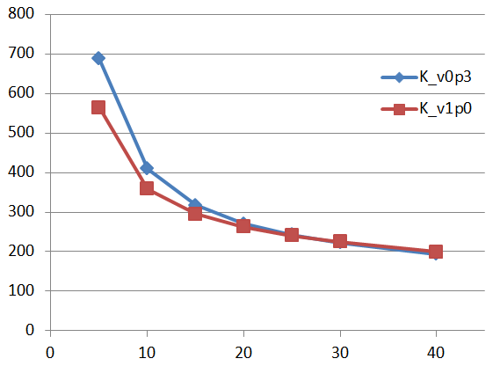
Tungsten isotopes
184W(n,g)185W

Slide 7
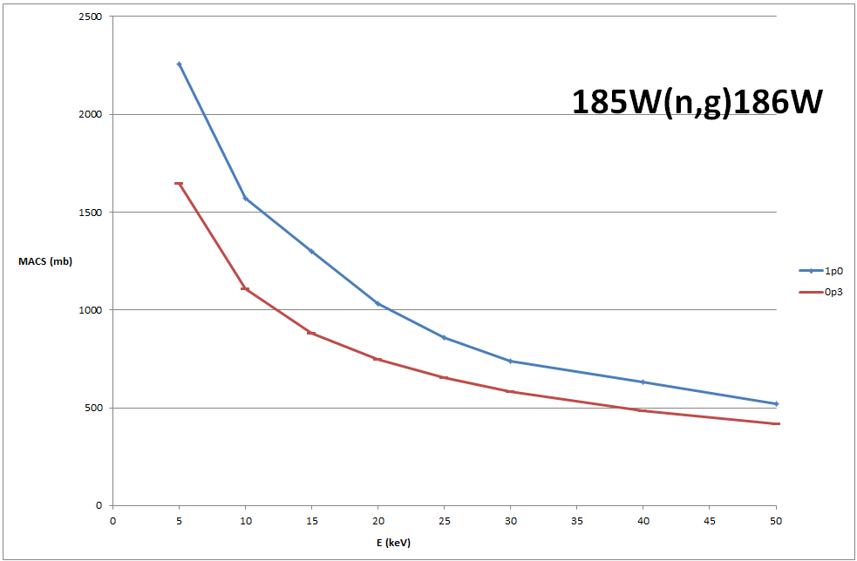
Tungsten isotopes

Slide 8
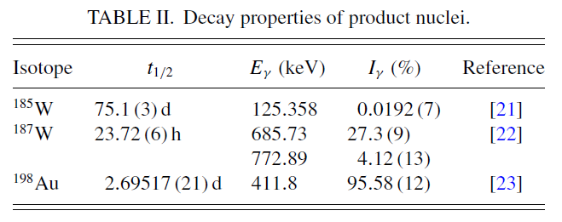
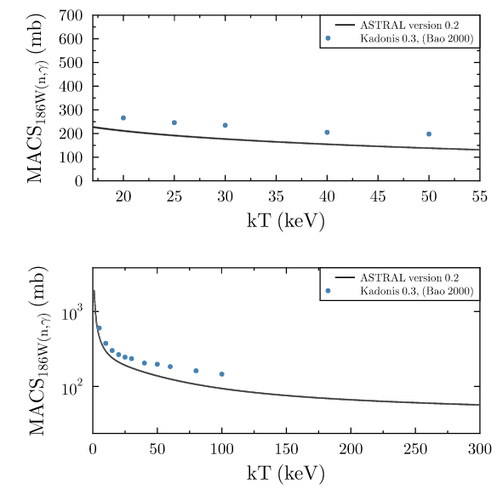
ASTRAL
ASTrophysical Rate and rAw data Library
Firestone 1991
Basunia 2009

Slide 9
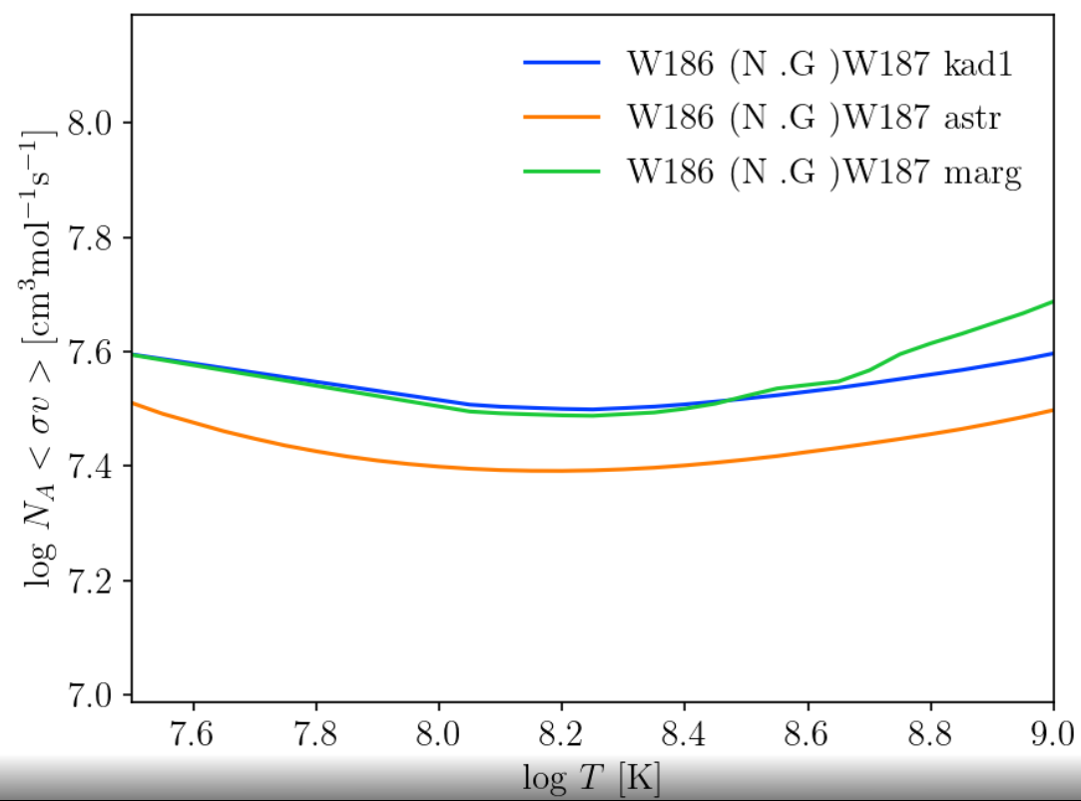

Slide 10
Z
Barium isotopes
Ba
134
135
136
137
138
83 m
Cs
133
2.06 y
2.3 My
13.2 d
Xe
128
129
130
131
132
5.2 d
134
9.1 h
136
3.8 m
I
127
25 m
15.7
My
12.4 h
Te
126
109 d
128
70 m
130
25 m
10 h
r-process
A

Slide 11
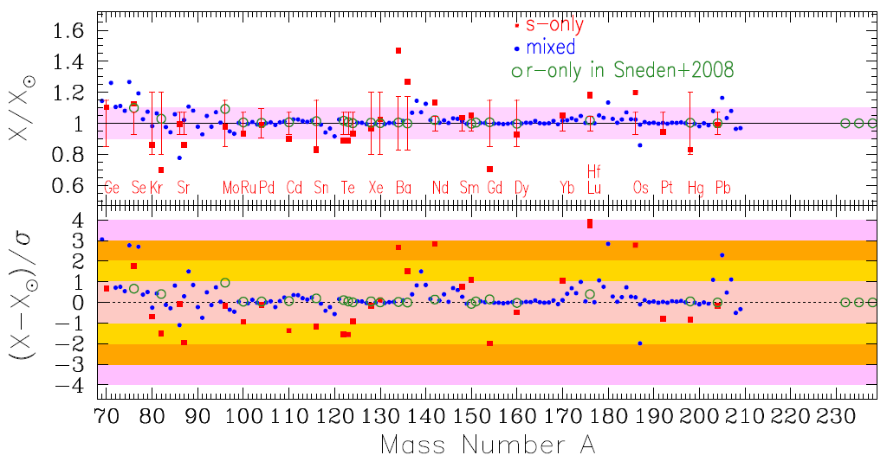
Z
Barium isotopes
Ba
134
135
136
137
138
83 m
Ba
Cs
133
2.06 y
2.3 My
13.2 d
Cs
Xe
128
129
130
131
132
5.2 d
134
9.1 h
136
3.8 m
Xe
I
127
25 m
15.7
My
12.4 h
Te
126
109 d
128
70 m
130
25 m
10 h
r-process
Prantzos+ 2020, MNRAS
A

Slide 12
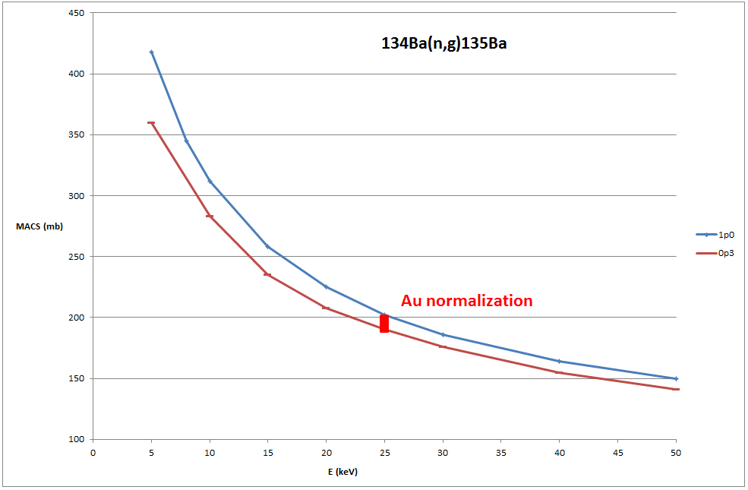

Slide 13
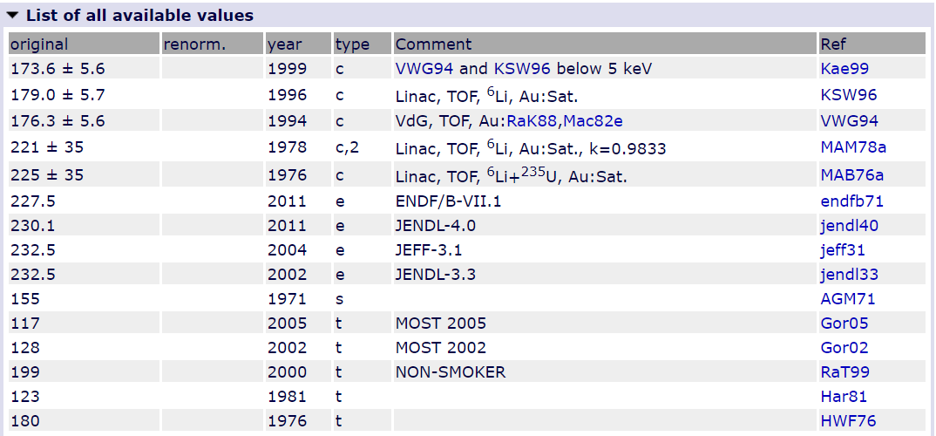
Literature

Slide 14
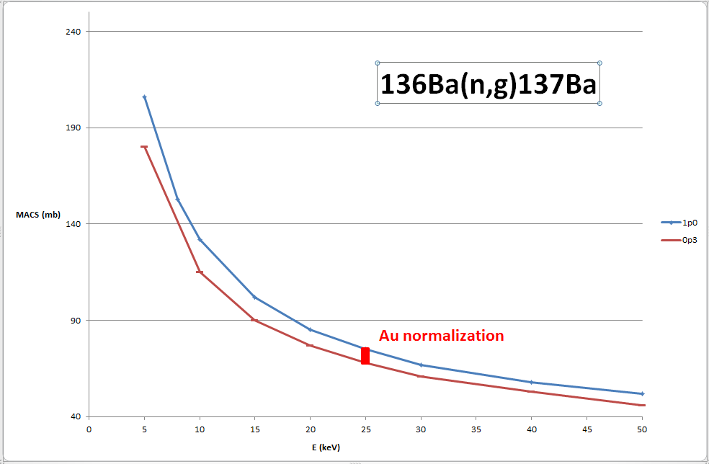

Slide 15
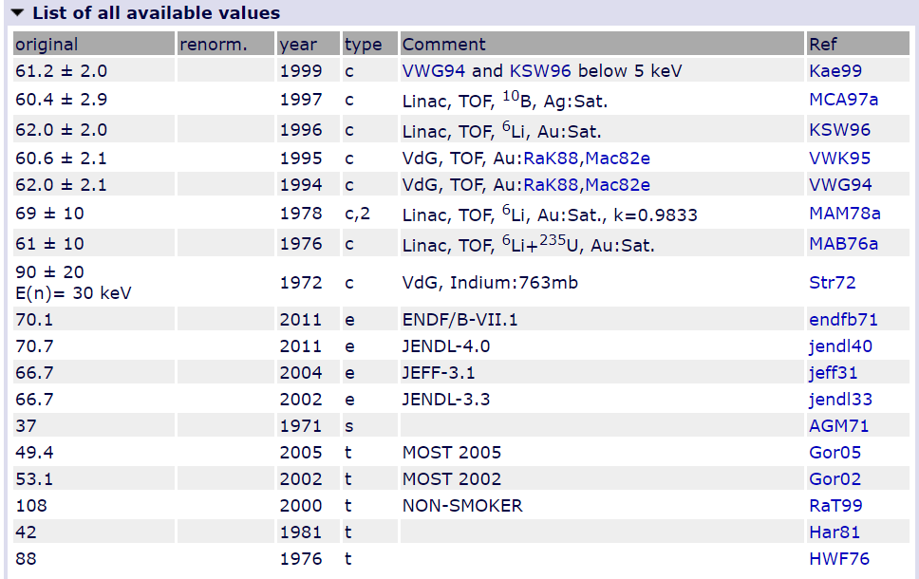
Literature

Slide 16
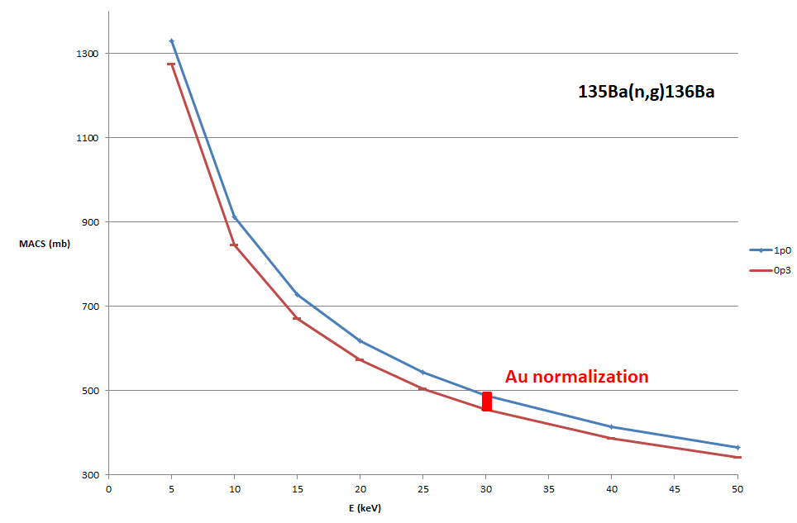

Slide 17
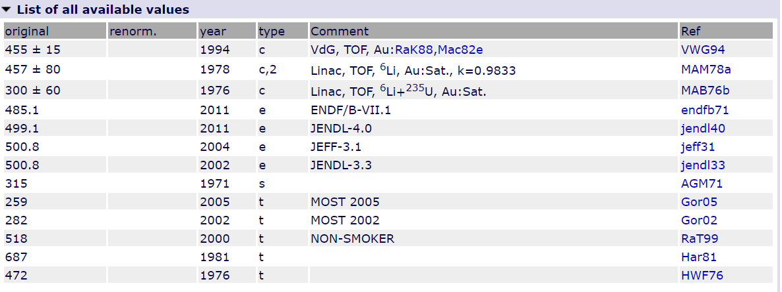
Literature

Slide 18
Strontium isotopic ratios
⁸⁶Sr reference term for strontium pre-solar grain measurements

Slide 19
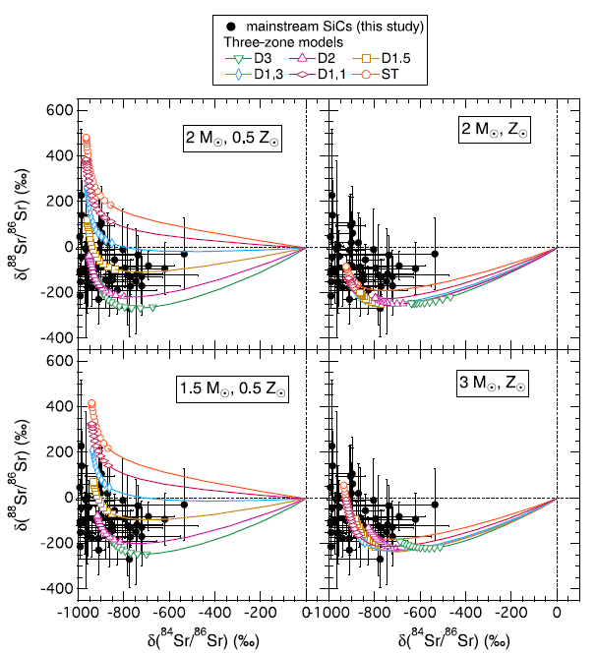
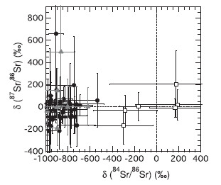
Strontium isotopic ratios
^{86,87}Sr(n,γ)
Liu+ 2015

Slide 20
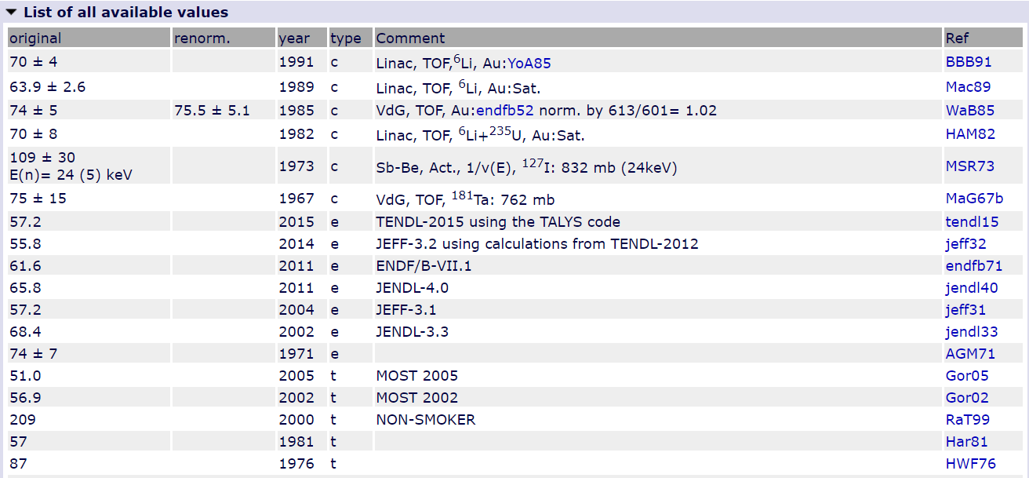
Literature

Slide 21
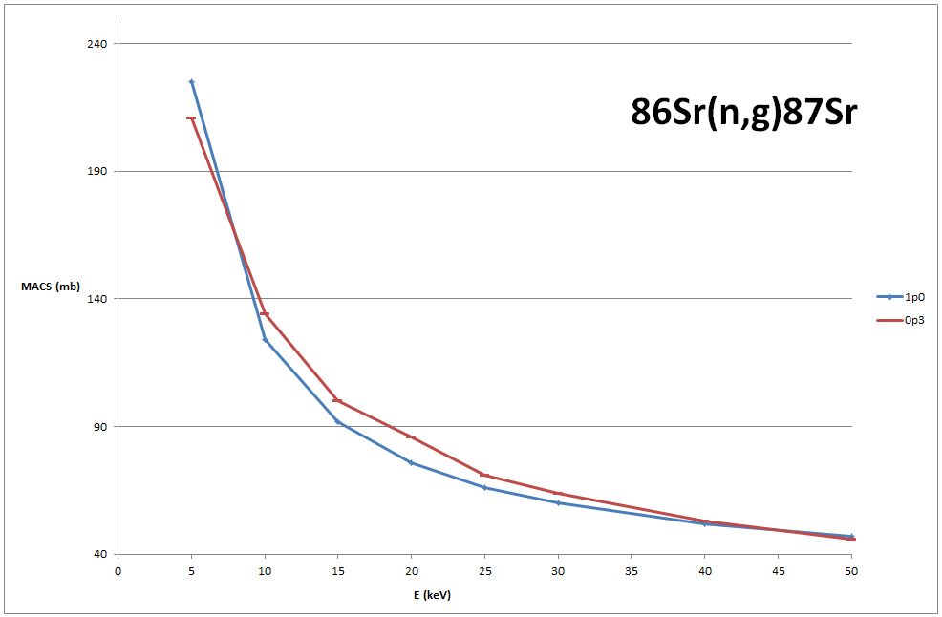

Slide 22
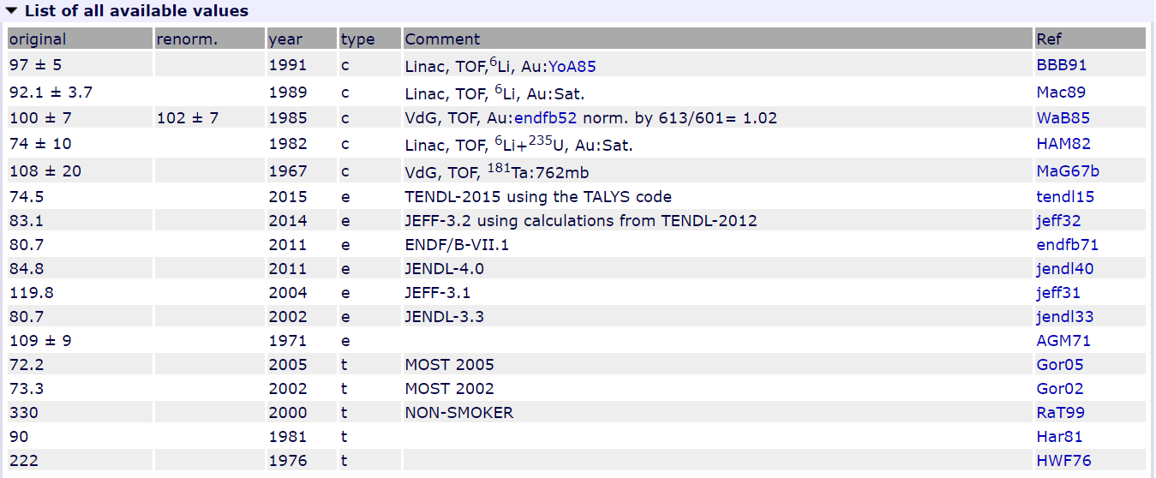
Literature

Slide 23
