Slide 1
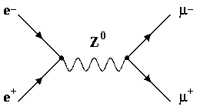
Sapienza University of Rome
PhD Course on «Accelerator Physics»
Low Emittance Muon Accelerator (LEMMA)
Study of the features of a multiple targets system for the LEMMA project.
September 06, 2022
Supervisors:
Prof. Gianluca CAVOTO
Dr. Francesco COLLAMATI
Student:
Fausto CASABURO

Slide 2
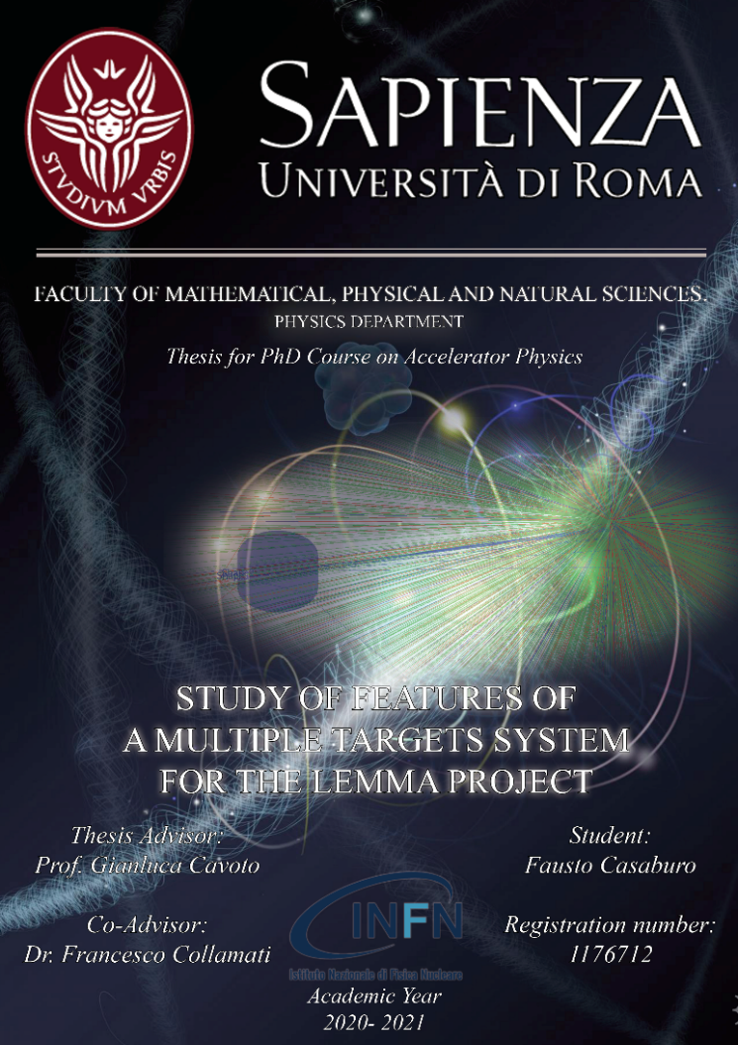
Outline of the presentation
Introduction
Muon Colliders
LEMMA
Multi-target
Deposited energy
Positrons
Positrons regeneration
Muons
Additional materials
Shapes
Thermal model
Test at MAMI
Cross-section
Conclusion
Introduction:
Muon Colliders.
The LEMMA project.
LEMMA Multi-target studies:
Investigation of a multi-target system building.
Thermal model.
Planning of thermal studies at MAMI accelerator.
e⁺e⁻→µ⁺µ⁻ cross-section:
Measurement at CERN.
Relevance of the thesis:
If a multi-target system could resiste the heating it will be a huge step for future accelerators.

Slide 3
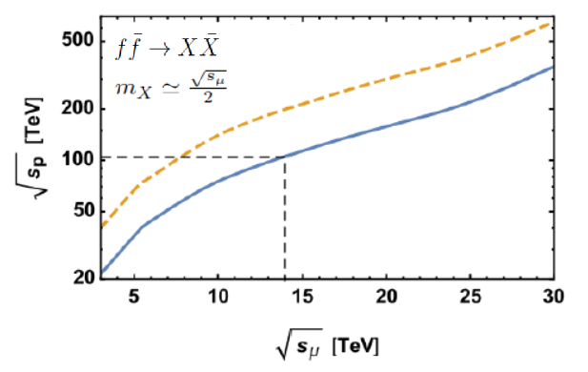
Muon Colliders
Why a muon collider?
Muons are elementary particles.
m_{μ} ≈ 207m_{e}.
Negligible synchrotron radiation and beamstrahlung → Extend lepton accelerators to multi-TeV scale.
Challenges of a muon collider:
Low muon lifetime (~ 2.2µs at rest).
Need of low emittance to reach high luminosity (~10³⁴cm⁻²s⁻¹).
Introduction
Muon Colliders
LEMMA
Multi-target
Deposited energy
Positrons
Positrons regeneration
Muons
Additional materials
Shapes
Thermal model
Test at MAMI
TB 2018
Conclusion
Comparable Feynman e.w. amplitudes
*10 enhancement due to additionaly strong interactions
Comparison between a muon collider and an hadron one. (From D. Lucchesi et. al. «Muon Collider to expand frontiers of particle physics»).

Slide 4
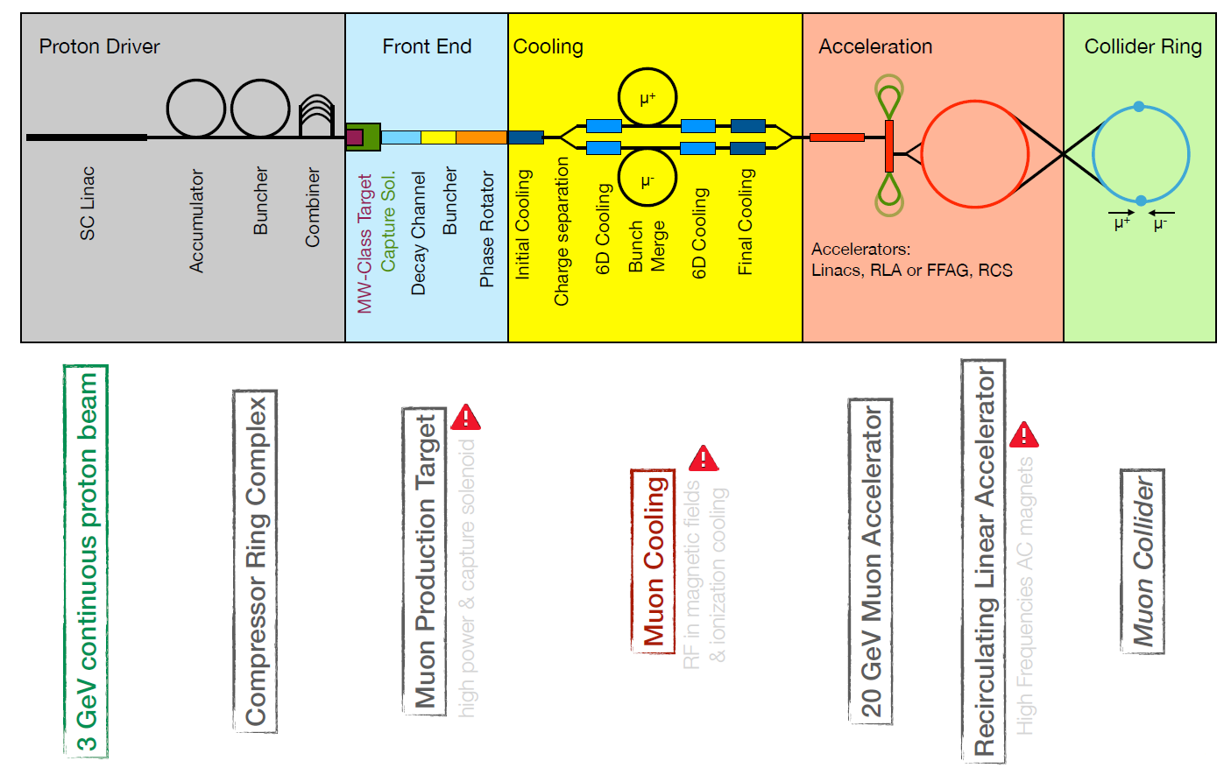
Proton driven Muon Collider
Introduction
Muon Colliders
LEMMA
Multi-target
Deposited energy
Positrons
Positrons regeneration
Muons
Additional materials
Shapes
Thermal model
Test at MAMI
TB 2018
Conclusion
Classical scheme (proton driven):
Few GeV protons on target.
Muons produced as tertiary particles (p_{μ}~100MeV).
Advantages:
Cross-section (~1mb at most) → High muon rate (10¹³-10¹⁴µ/s).
Disadvantages:
High emittance → Cooling system.
Proton driven muon collider scheme (From M. Bauce talk at APS 2021).

Slide 5
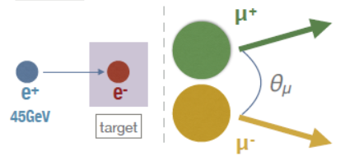
Low EMittance Muon Accelerator (LEMMA)
Introduction
Muon Colliders
LEMMA
Multi-target
Deposited energy
Positrons
Positrons regeneration
Muons
Additional materials
Shapes
Thermal model
Test at MAMI
TB 2018
Conclusion
The LEMMA project:
Exploit e⁺e⁻→µ⁺µ⁻ (√s~0.212).
Positron beam.
Low Z fixed target (Be, C).
Goal 10¹¹ μ±/s.
Muon production in e⁺ e⁻ annihilation (From M. Bauce talk at APS 2021).

Slide 6
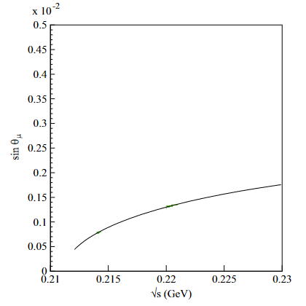
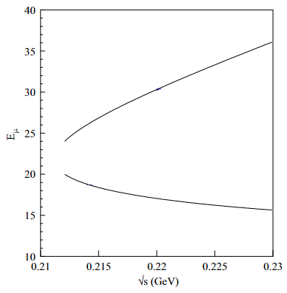
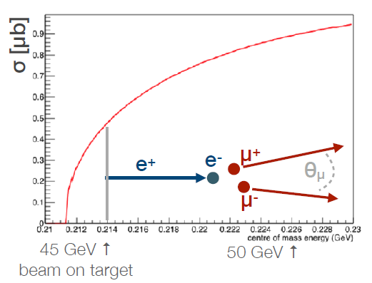
Muon production in LEMMA scheme
Introduction
Muon Colliders
LEMMA
Multi-target
Deposited energy
Positrons
Positrons regeneration
Muons
Additional materials
Shapes
Thermal model
Test at MAMI
TB 2018
Conclusion
Process at √s~0.212GeV:
Cross section increases with √s.
Opening angle and energy spread increase too → Evaluate emittance deterioration (45GeV positron beam currently under study).
45GeV beam
45GeV beam
Cross section (left), scattering angle (center) and energy spread (right) of muons produced in electron-positron annihilation (From M. Bauce talk at Giornate sull’European Strategy 2020, and M. Antonelli et al. «Novel proposal for a low emittance muon beam using positron beam on target»).

Slide 7
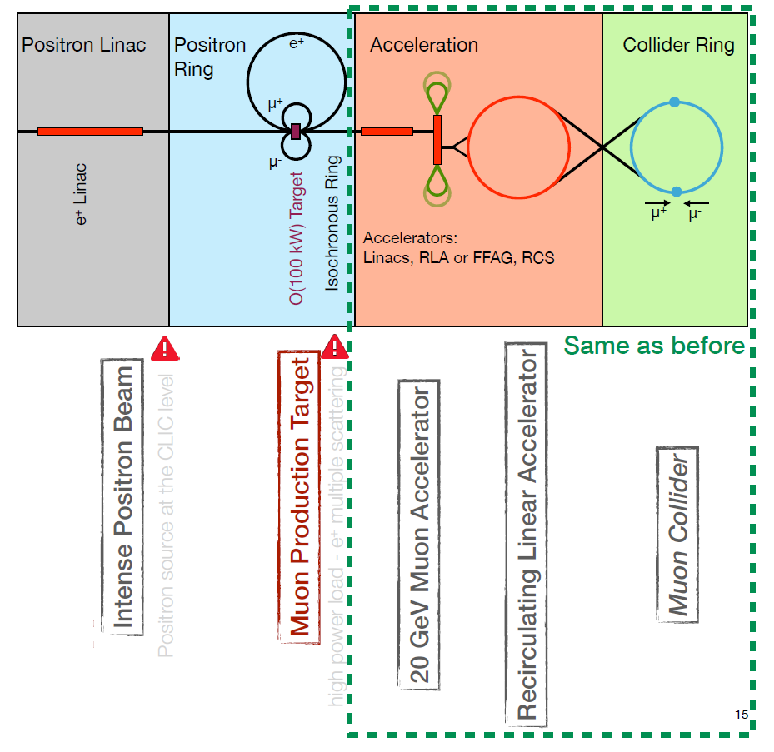
LEMMA advantages and disadvatages
Introduction
Muon Colliders
LEMMA
Multi-target
Deposited energy
Positrons
Positrons regeneration
Muons
Additional materials
Shapes
Thermal model
Test at MAMI
TB 2018
Conclusion
Advantages:
High Lorentz boost (γ~214) → laboratory lifetime ~500μs.
Low emittance → No cooling.
Disadvantages:
Small cross-section (~1µb at most) → High intensity positron beam.
NIM A Reviewer: “A major advantage of this proposal is the lack of cooling of the muons…. the idea presented in this paper may truly revolutionise the design of muon colliders … “ ( From R. Raimondi talk at La Thuile 2018).
LEMMA concept (From M. Bauce talk at APS 2021).

Slide 8
Target options for LEMMA
Goal:
Continuos muons production preserving muons and beam quality.
Heavy & thin:
Low emittance.
High beam loss → low muon efficiency.
Very light & thik:
Higher muon efficiency.
Muon emittance increase.
Not too heavy & thin:
Optimization of muon efficiency and emittance → Be, C (ρ⁻ ~O(10²⁴e⁻/cm³)).
Introduction
Muon Colliders
LEMMA
Multi-target
Deposited energy
Positrons
Positrons regeneration
Muons
Additional materials
Shapes
Thermal model
Test at MAMI
TB 2018
Conclusion
Muon production (From M. Bauce talk at Giornate sull’European Strategy 2020).

Slide 9
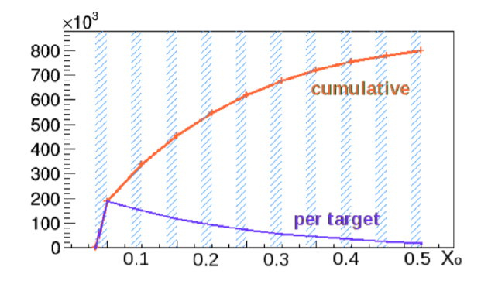
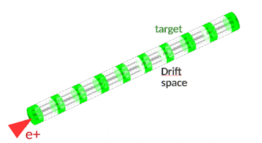
The multi-target proposal
Introduction
Muon Colliders
LEMMA
Multi-target
Deposited energy
Positrons
Positrons regeneration
Muons
Additional materials
Thermal model
Test at MAMI
TB 2018
Conclusion
Target best thickness (muon optimization):
0.3X₀, but it would melt.
Reduce the deposited energy splitting the target.
Challanges:
Maximise muon number.
Minimise emittance and thermomechanical stress.
Muon production as a function of X₀ (From arXiv 1905.04747).
Multi-target concept (From arXiv 1905.04747).

Slide 10
GEANT4 simulation of the multi-target
Introduction
Muon Colliders
LEMMA
Multi-target
Deposited energy
Positrons
Positrons regeneration
Muons
Additional materials
Thermal model
Test at MAMI
TB 2018
Conclusion
Starting point (from single target studies):
45GeV Gaussian positron beam (σ=300µm, 3*10¹¹ e⁺/bunch).
3mm Be slices (~0.85%X₀).
1mm C slices (~0.52%X₀).
First step:
2 slices.
Relative distance d=2cm.
Pictorial view of the multi-target.

Slide 11
Goal of the GEANT4 studies on the multi-target
Introduction
Muon Colliders
LEMMA
Multi-target
Deposited energy
Positrons
Positrons regeneration
Muons
Additional materials
Thermal model
Test at MAMI
TB 2018
Conclusion
Goal:
Deposited energy.
Beam intensity and energy loss.
Beam emittance increasing.
Muon production.
Muon emittance.
Parametric studies:
Beam features.
Multi-target features.

Slide 12
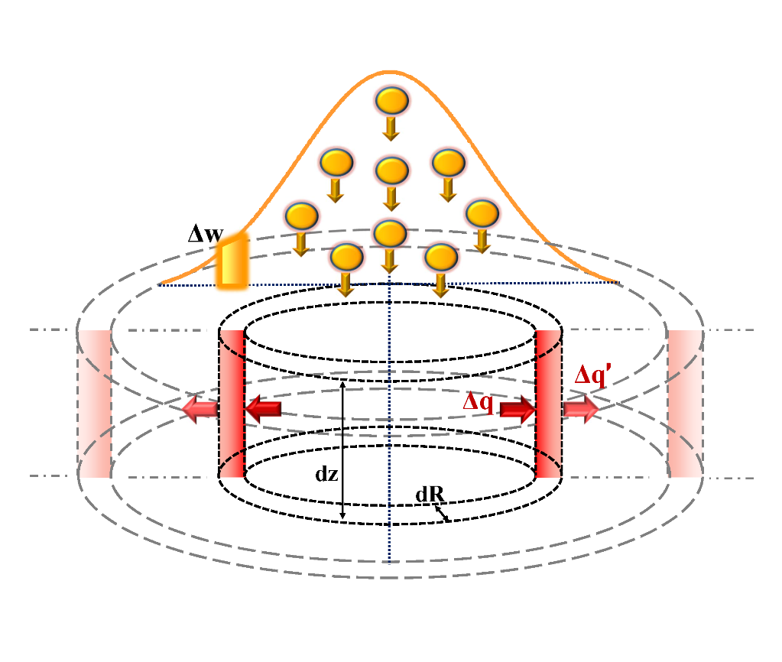
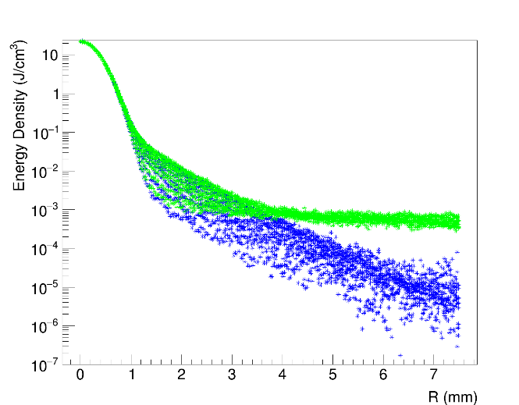
Deposited energy density in the multi-target
Introduction
Muon Colliders
LEMMA
Multi-target
Deposited energy
Positrons
Positrons regeneration
Muons
Additional materials
Shapes
Thermal model
Test at MAMI
TB 2018
Conclusion
Target discretization in (R,z):
Peak Energy Deposited Density (PEDD) σ=300µm, 3*10¹¹e⁺/bunch :
Be: 22J/cm³ (threshold 230J/cm³).
C: 27J/cm³ (threshold 210J/cm³).
Thresholds from https://dx.doi.org/10.1007/s10765-021-02913-x
PEDD
First target
Second target
Gaussian
core
Sketch of the positron Gaussian beam and target discretization in (R,z) cylindrical shells.
Deposited energy density by 3*10¹¹ primary positrons- Be 3 mm (single slice thickness) .

Slide 13
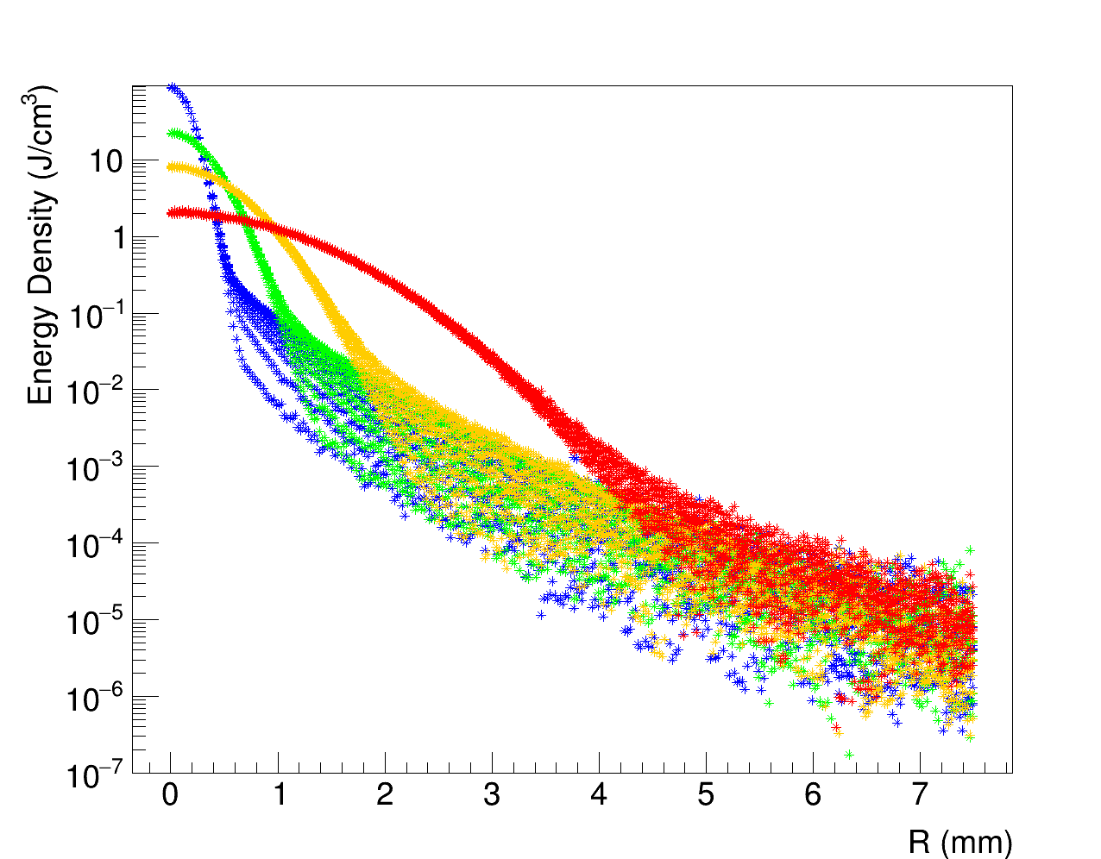
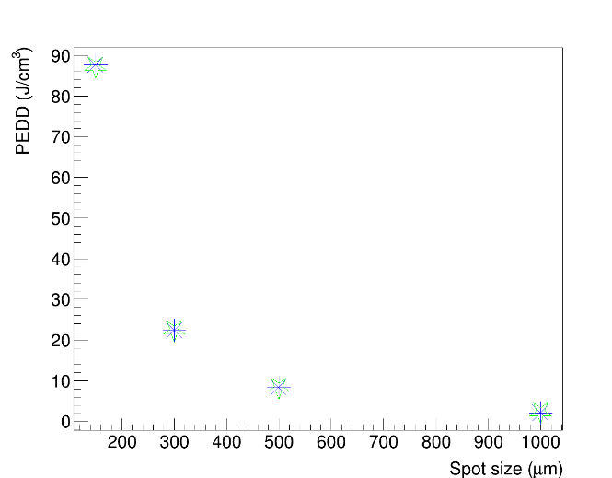
Deposited energy density as function of spot-size
Introduction
Muon Colliders
LEMMA
Multi-target
Deposited energy
Positrons
Positrons regeneration
Muons
Additional materials
Shapes
Thermal model
Test at MAMI
TB 2018
Conclusion
150 µm
Parametric study:
Beam spot size [150µm;1000µm].
Results (3*10¹¹e⁺/bunch):
PEDD decreasing as 1/σ².
Be [2.1 J/cm³- 88J/cm³] (PEDD).
C [2.6 J/cm³- 110J/cm³] (PEDD).
300 µm
500 µm
First target
1000 µm
Second target
Deposited energy density in Be 3 mm (slice thickness) target for several spot sizes.
PEDD by 3*10¹¹ primary positrons- Be 3 mm
(slice thickness) target as a function of spot size.

Slide 14
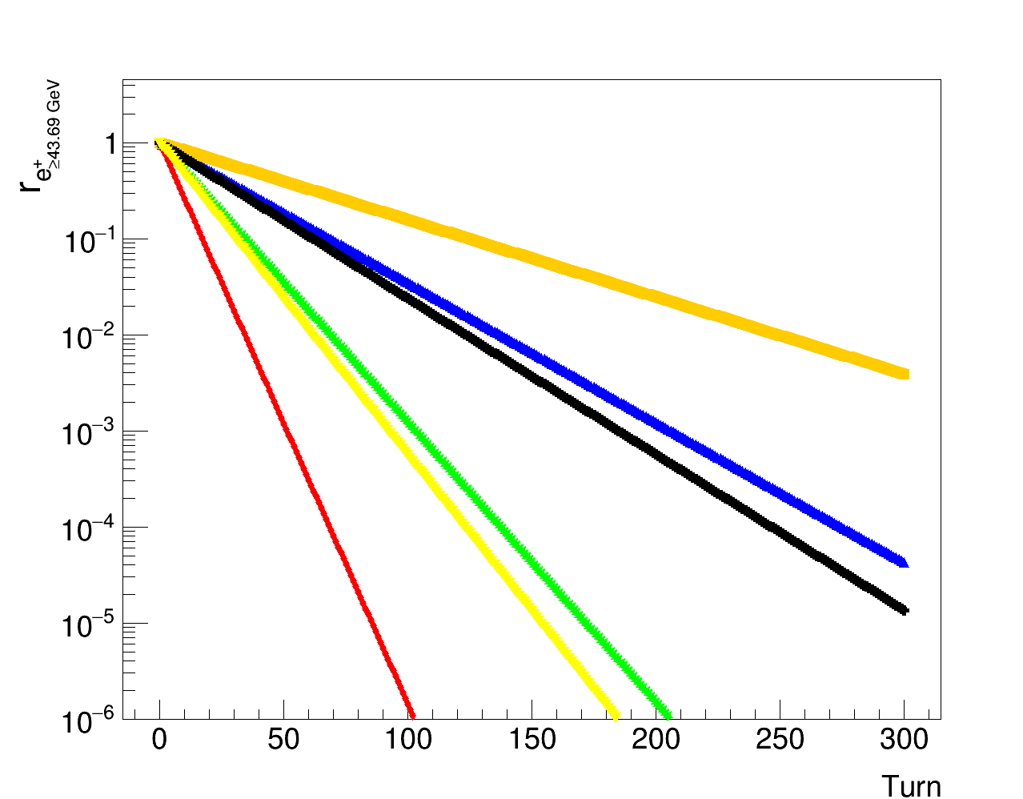
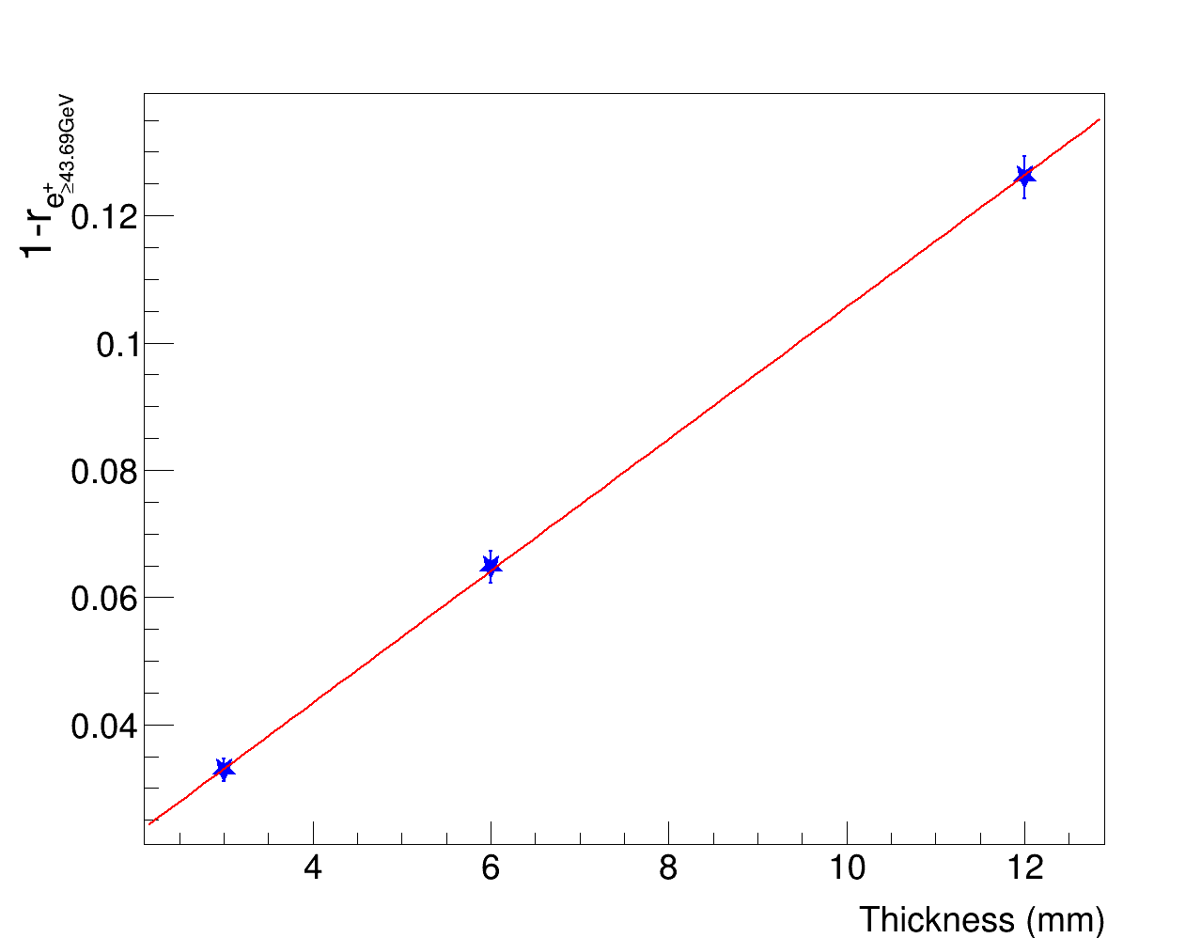
Beam losses
Theory:
Mean energy crossing the target:e
Muon production threshold 43.69GeV.
Parametric study:
Be slices [1.5mm-6mm] (45GeV e⁺).e
C slices [0.5mm-2mm] (45GeV e⁺).
Results:
dre⁺_{43.69GeV}/dx ~0.010 mm⁻¹ (Be).
dre⁺_{43.69GeV}/dx ~0.018 mm⁻¹ (C).
d<E>/dx ~0.12 GeV/mm (Be).
d<E>/dx ~0.21 GeV/mm (C).
Introduction
Muon Colliders
LEMMA
Multi-target
Deposited energy
Positrons
Positrons regeneration
Muons
Additional materials
Thermal model
Test at MAMI
TB 2018
Conclusion
Be 3mm
Be 6mm
Be 12mm
C 1mm
C 2mm
C 4mm
Surviving positrons with energy over muon pair production threshold for several turns.
Intensity loss of surviving positrons with energy over the muon production threshold in a Be multi-targets as a function of total thickness.

Slide 15
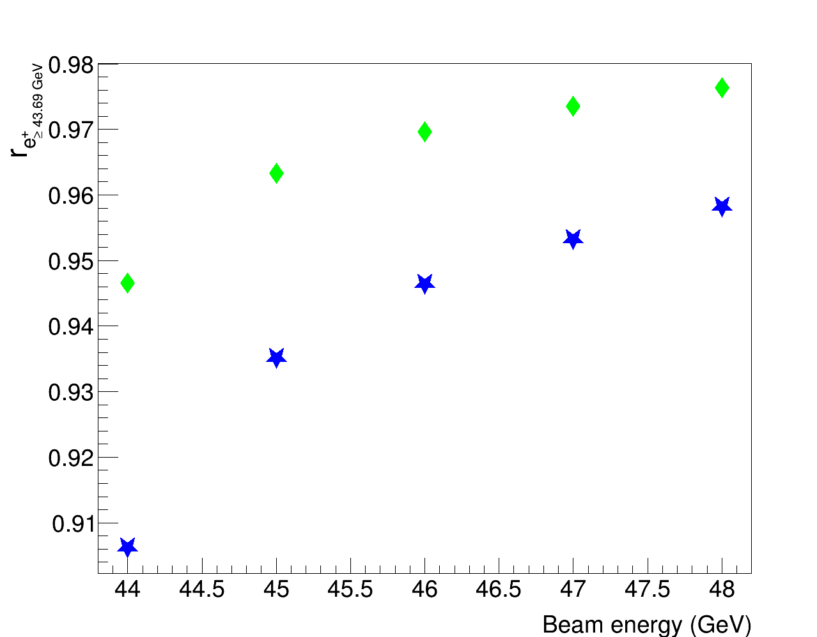
Beam losses as a function of beam energy
Theory:
Mean energy crossing the target:e
Muon production threshold 43.69GeV.
Parametric study:
Beam energy [44GeV;48GeV] (Be 6mm, C 2mm total thickness).
Results:
Be: dre⁺_{43.69GeV}/dx from ~ 0.007mm⁻¹ (48GeV) to ~ 0.02 mm⁻¹ (44GeV).
C: dre⁺_{43.69GeV}/dx from ~ 0.01mm⁻¹ (48GeV) to ~ 0.03 mm⁻¹ (44GeV).
Introduction
Muon Colliders
LEMMA
Multi-target
Deposited energy
Positrons
Positrons regeneration
Muons
Additional materials
Thermal model
Test at MAMI
TB 2018
Conclusion
Beryllium
Carbon
Surviving positrons with energy over muon pair production outgoing a 6 mm Be and 2 mm C multi-target as a function of the beam energy.

Slide 16
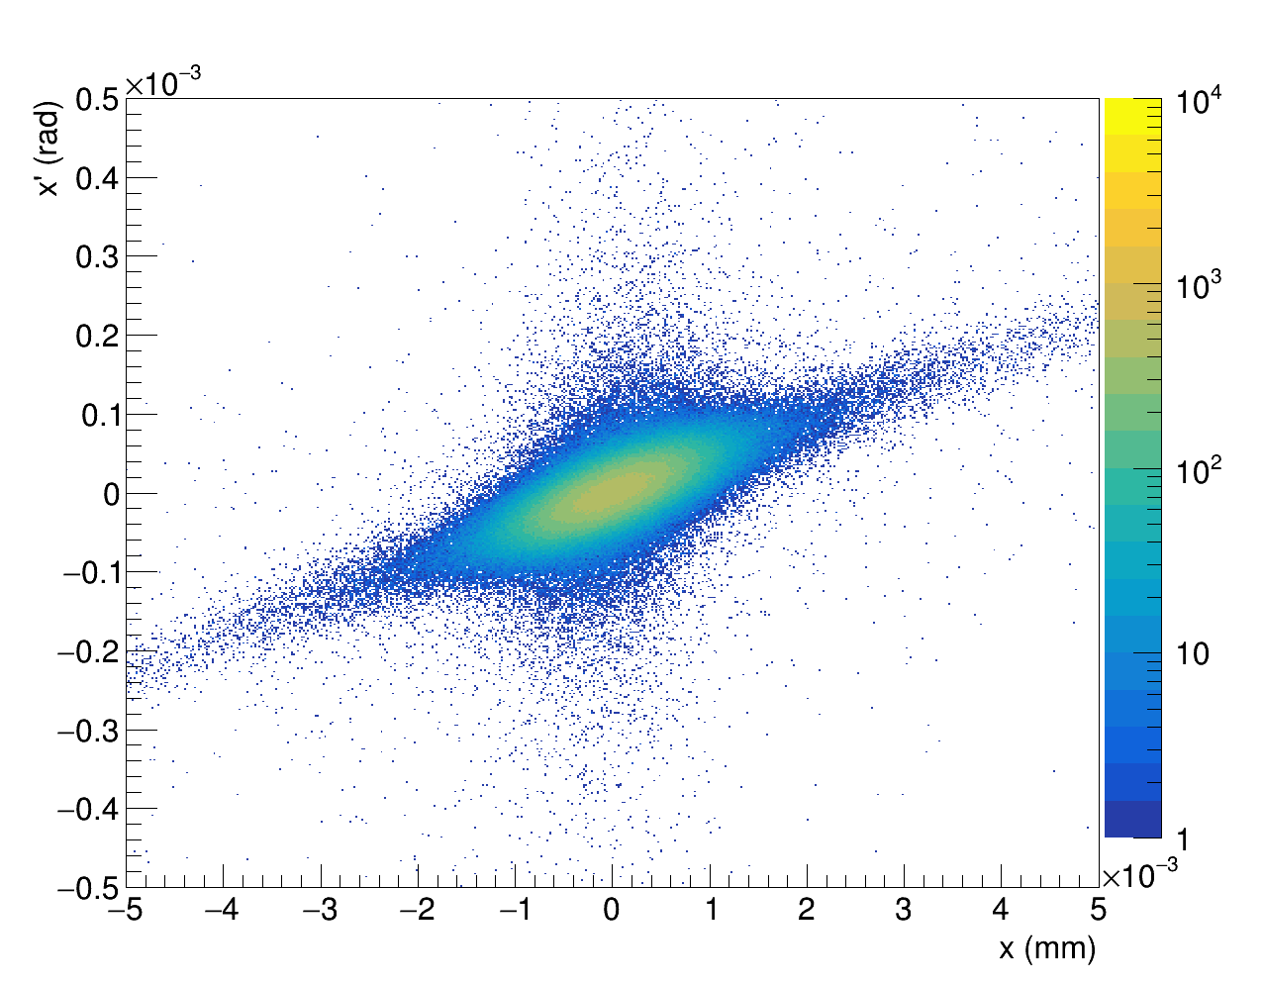
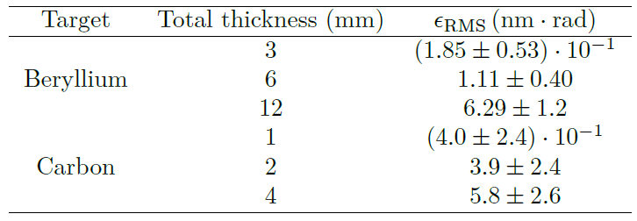
Beam emittance increase due to scattering angle
Scattering angle contribution to emittance (ε_{RMS}):
Exiting angle:
Coulumbian scattering → Emittance increasing.
ε_{RMS} given by:
being
Parametric study:
Be slices [1.5mm-6mm] (45GeV e⁺).
C slices [0.5mm-2mm] (45GeV e⁺).
Results:
ε_{RMS} increases with the thickness (but few nm*rad).
Introduction
Muon Colliders
LEMMA
Multi-target
Deposited energy
Positrons
Positrons regeneration
Muons
Additional materials
Thermal
model
Test at MAMI
TB 2018
Conclusion
x-x’ correlation of primary positrons exiting a 6 mm total thickness Be meniscus multi-target.
ε_{RMS} results of primary positrons outgoing a multi-target.

Slide 17
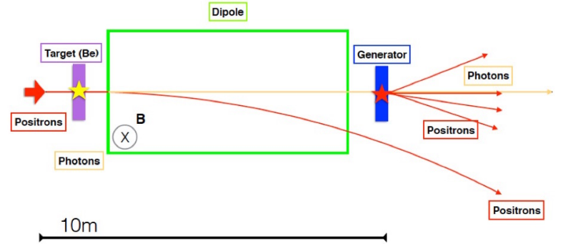
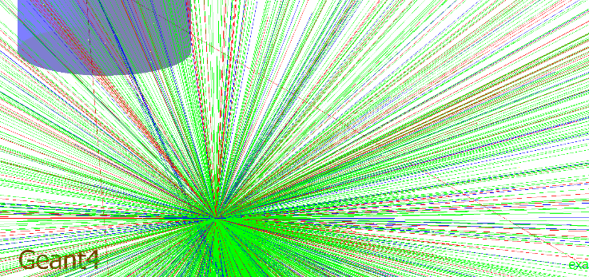
Positron regeneration proposal
Introduction
Muon Colliders
LEMMA
Multi-target
Deposited energy
Positrons
Positrons regeneration
Muons
Additional materials
Thermal model
Test at MAMI
TB 2018
Conclusion
Goal:
Possibility to produce e⁺ via γ→e⁺e⁻.
Source for LEMMA.
Positron regeneration simulation:
Magnet (2T).
Tungsten regenerator (r=1mm, l=2cm).
Positron regeneration scheme. (From arXiv 1905.05747).
Pictorial view of positron regeneration.

Slide 18
Positron regeneration in the multi-target scheme
Parametric study:
Be slices [1.5mm-6mm] (45GeV e⁺).e
C slices [0.5mm-2mm] (45GeV e⁺).
Acceptance conditions arXive 1905.05757):
r<0.5cm (z-axis)
Angle [-0.5rad;0.5rad].
Energy [5MeV;20MeV].
Positron regeneration results:
Regenerated positrons increases with the thickness of the target.
Their number is higher than the loss ones.
Introduction
Muon Colliders
LEMMA
Multi-target
Deposited energy
Positrons
Positrons regeneration
Muons
Additional materials
Thermal model
Test at MAMI
TB 2018
Conclusion
Normalized number of photons produced in the multi-target and hitting the regenerator (n_{γreg}), regenerated positrons (n_{e}⁺_{reg}) and regenerated positrons passing the acceptance conditions (n_{e}⁺_{regcut}).

Slide 19
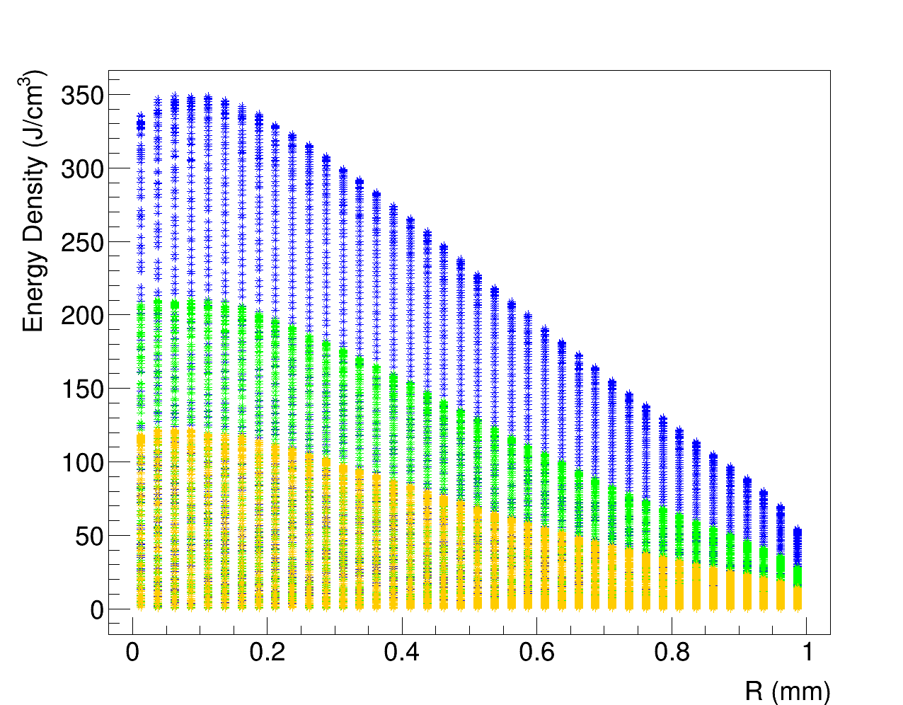
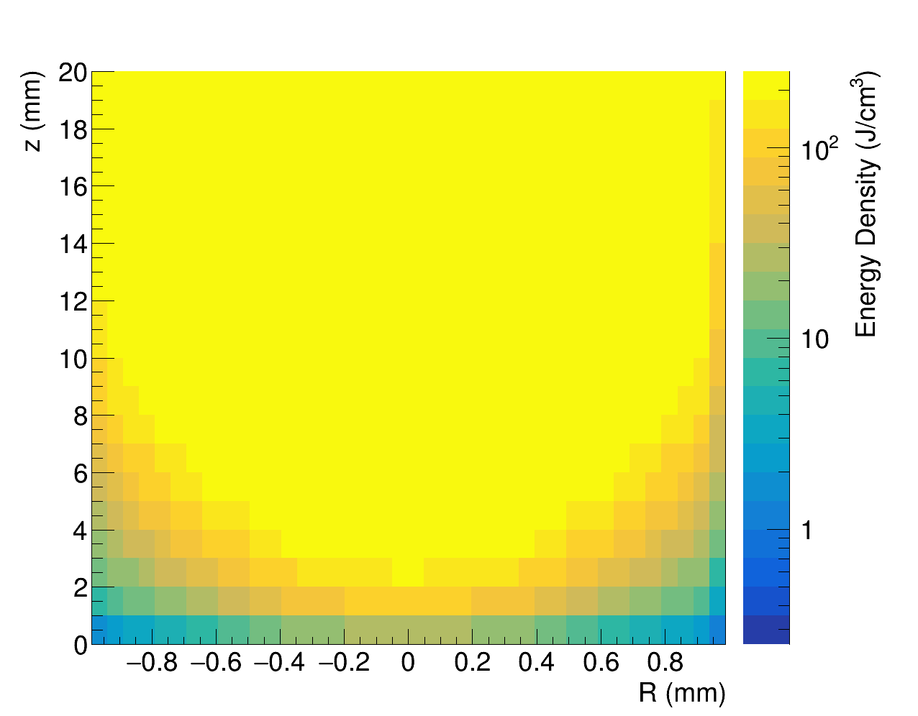
Deposited energy density in the regenerator
Parametric study:
Be slices [1.5mm-6mm] (45GeV e⁺).e
C slices [0.5mm-2mm] (45GeV e⁺).
Results (3*10¹¹e⁺/bunch):
Dependency on the radius and on the beam axis.
PEDD [120 J/cm³- 350J/cm³] (Be 6mm total thickness).
PEDD [70 J/cm³- 230J/cm³] (C 2mm total thickness).
PEDDs lower than threshold (675J/cm³).
Introduction
Muon Colliders
LEMMA
Multi-target
Deposited energy
Positrons
Positrons regeneration
Muons
Additional materials
Thermal model
Test at MAMI
TB 2018
Conclusion
3 mm
6 mm
12 mm
Deposited energy density in the regenerator by photons produced by a single bunch of 3*10¹¹ positrons in a Be multi-target..
Deposited energy density in the regenerator by photons produced by a single bunch of 3*10¹¹ positrons in a 6mm total thickness Be multi-target..

Slide 20
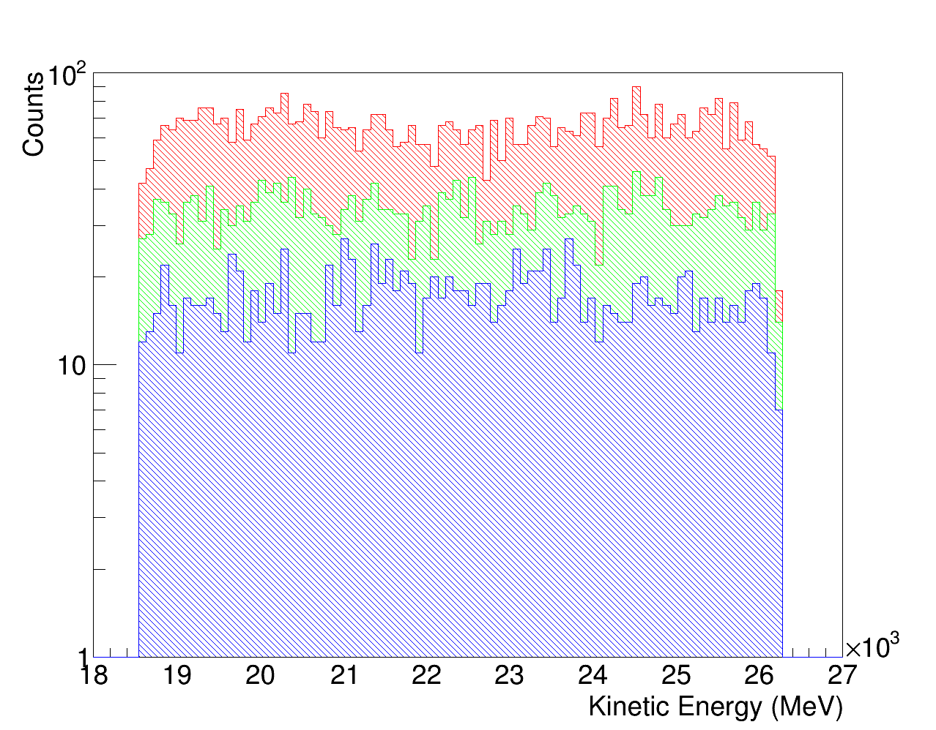
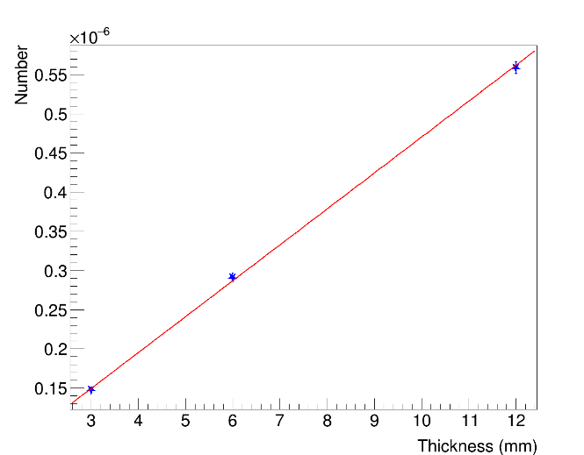
Muon production in the multi-target
Theory
Muon production:
Parametric study:
Be slices [1.5mm-6mm] (45GeV e⁺).e
C slices [0.5mm-2mm] (45GeV e⁺).
Results (n⁺=1):
Efficiency ~10⁻⁷ µ±/e⁺(Be 6mm,C 2mm).
Be: dµ/dX₀ ~1.6*10⁻⁵ X₀⁻¹.
C: dµ/dX₀ ~1.1*10⁻⁵ X₀⁻¹.
Introduction
Muon Colliders
LEMMA
Multi-target
Deposited energy
Positrons
Positrons regeneration
Muons
Additional materials
Shapes
Thermal model
Test at MAMI
TB 2018
Conclusion
22GeV
3mm
6mm
12mm
18.6 GeV
26.2 GeV
Energy spectrum of muons produced in a Be cylindrical multi-target.
Dependency on the thickness of the number of muons produced in Be cylindrical multi-target.

Slide 21
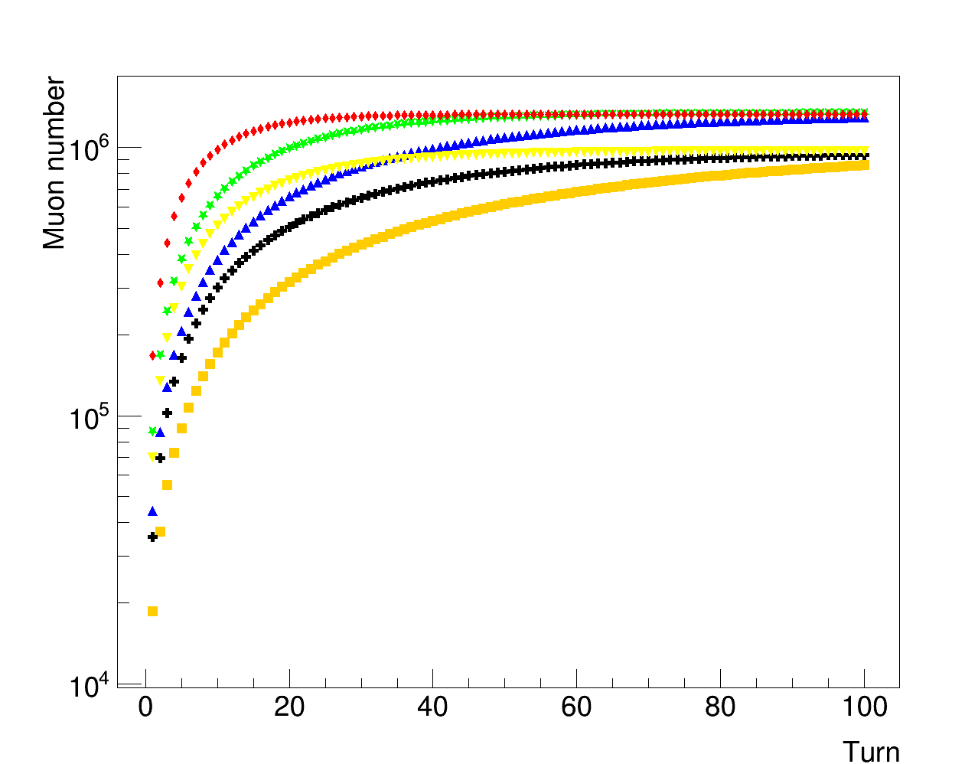
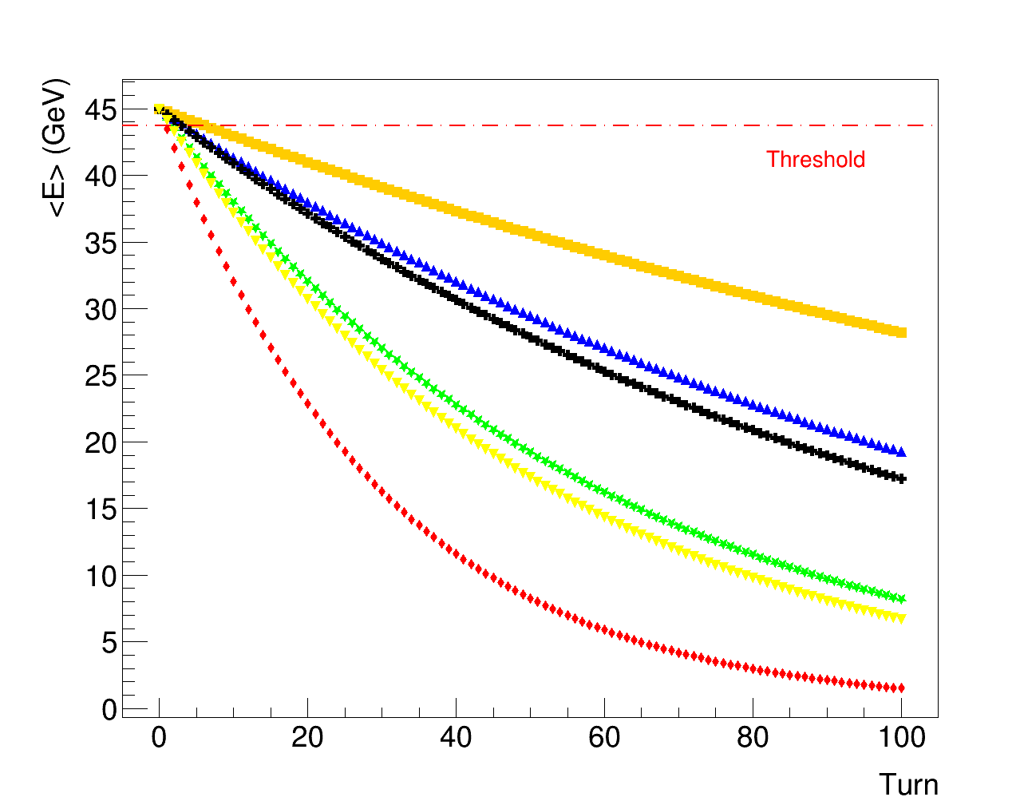
Muon production in a multi-turn scheme
Theory
Muon production:
Parametric study:
Be slices [1.5mm-6mm] (45GeV e⁺).e
C slices [0.5mm-2mm] (45GeV e⁺).
Multi-turn results:
Beam energy loss→ Saturation after few tens of turns (no decay considered).
Introduction
Muon Colliders
LEMMA
Multi-target
Deposited energy
Positrons
Positrons regeneration
Muons
Additional materials
Shapes
Thermal model
Test at MAMI
TB 2018
Conclusion
Be 3mm
Be 6mm
Be 12mm
C 1mm
Be 3mm
C 2mm
Be 6mm
C 4mm
Be 12mm
C 1mm
C 2mm
C 4mm
Muon production in a Be and C multi-target for several runs.
Mean energy of the beam after hitting the multi-target for several turns.

Slide 22
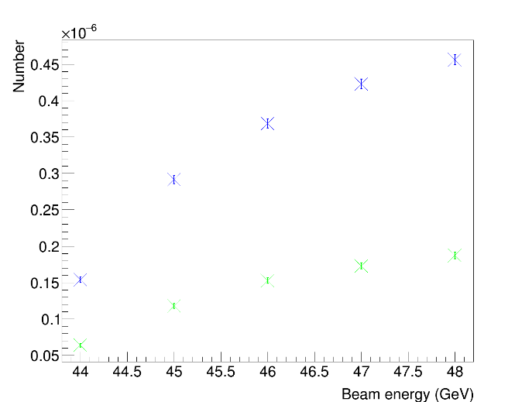
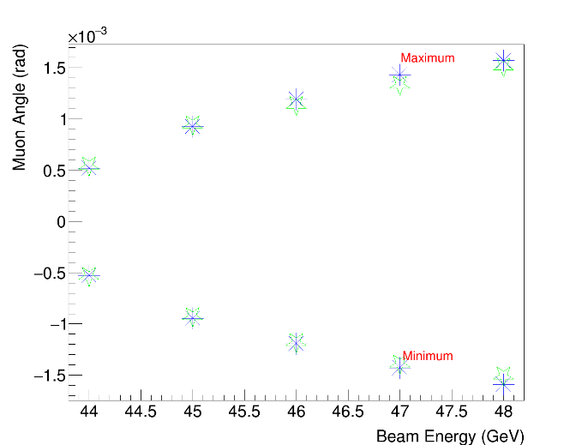
Muon production as a function of beam energy
Introduction
Muon Colliders
LEMMA
Multi-target
Deposited energy
Positrons
Positrons regeneration
Muons
Additional materials
Shapes
Thermal model
Test at MAMI
TB 2018
Conclusion
Theory
Muon production:
Parametric study:
Beam energy [44GeV;48GeV] (Be 6mm, C 2mm total thickness).
Results (n⁺=1):
Similar scattering angle in Be,C.
Be: dµ/dX₀ from ~ 0.9*10⁻⁵ X₀⁻¹ (44GeV) to ~ 2.7 *10⁻⁵ X₀⁻¹ (48GeV).
C: dµ/dX₀ from ~ 0.6*10⁻⁵ X₀⁻¹ (44GeV) to ~ 1.8 *10⁻⁵ X₀⁻¹ (48GeV).
Beryllium
Carbon
Beryllium
Carbon
Muons number (left) and scattering angle (right) in a 6mm total thickness Be and 2mm total thickness C multi-target as a function of the beam energy.

Slide 23
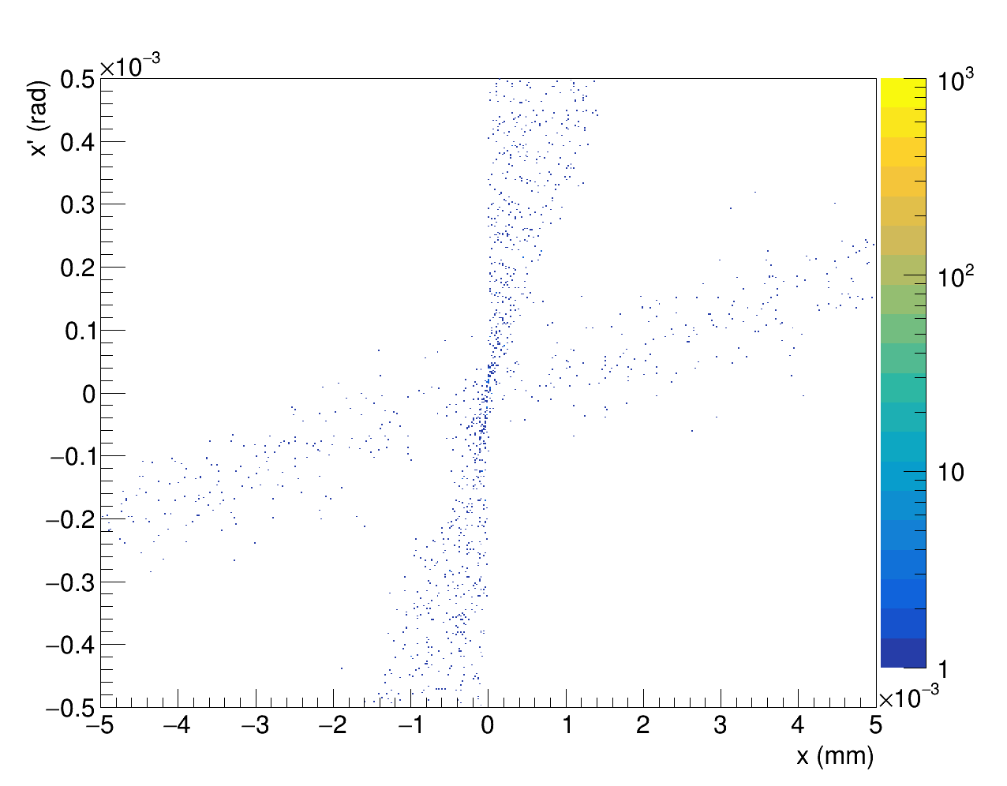
Scattering angle contribution to emittance ε_{RMS}
Scattering angle contribution to emittance (ε_{RMS}):
Exiting angle:
Coulumbian scattering → Emittance increasing.
ε_{RMS} given by:
being
Parametric study:
Be slices [1.5mm-6mm] (45GeV e⁺).e
C slices [0.5mm-2mm] (45GeV e⁺).
Results:
ε_{RMS} increases with the thickness (but few nm*rad).
Muons from first slice → larger contribution to ε_{RMS}.
Introduction
Muon Colliders
LEMMA
Multi-target
Deposited energy
Positrons
Positrons regeneration
Muons
Additional materials
Shapes
Thermal model
Test at MAMI
TB 2018
Conclusion
Second target
First target
x-x’ correlation of muons produced in a 6mm total thickness Be multi-target.
.
Mean RMS angle and its contribution to emittance multi-target.

Slide 24
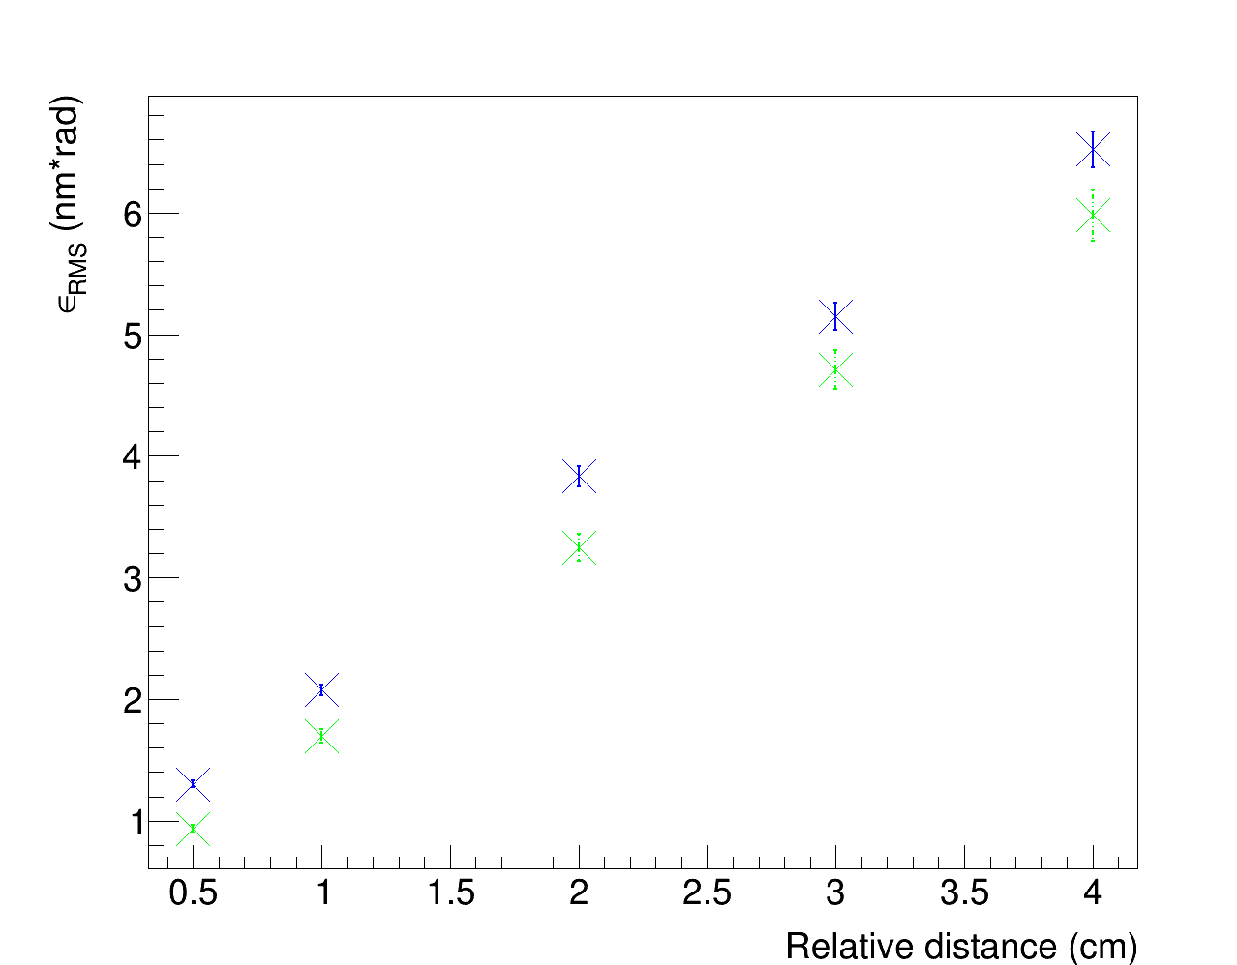
ε_{RMS} as a function of relative distance
Mean RMS angle contribution to emittance (ε_{RMS}):
Exiting angle:
Coulumbian scattering → Emittance increasing.
ε_{RMS} given by:
being
Parametric study:
Relative distance [0.5cm-4cm] (45GeV e⁺, Be6mm, C2mm).e
Results:
Larger drift for larger relative distance → ε_{RMS} increases.
Introduction
Muon Colliders
LEMMA
Multi-target
Deposited energy
Positrons
Positrons regeneration
Muons
Additional materials
Shapes
Thermal model
Test at MAMI
TB 2018
Conclusion
Beryllium
Carbon
Dependency of ε_{RMS} on relative distance in a 6 mm total thickness Be and 2 mm C multi-target.

Slide 25
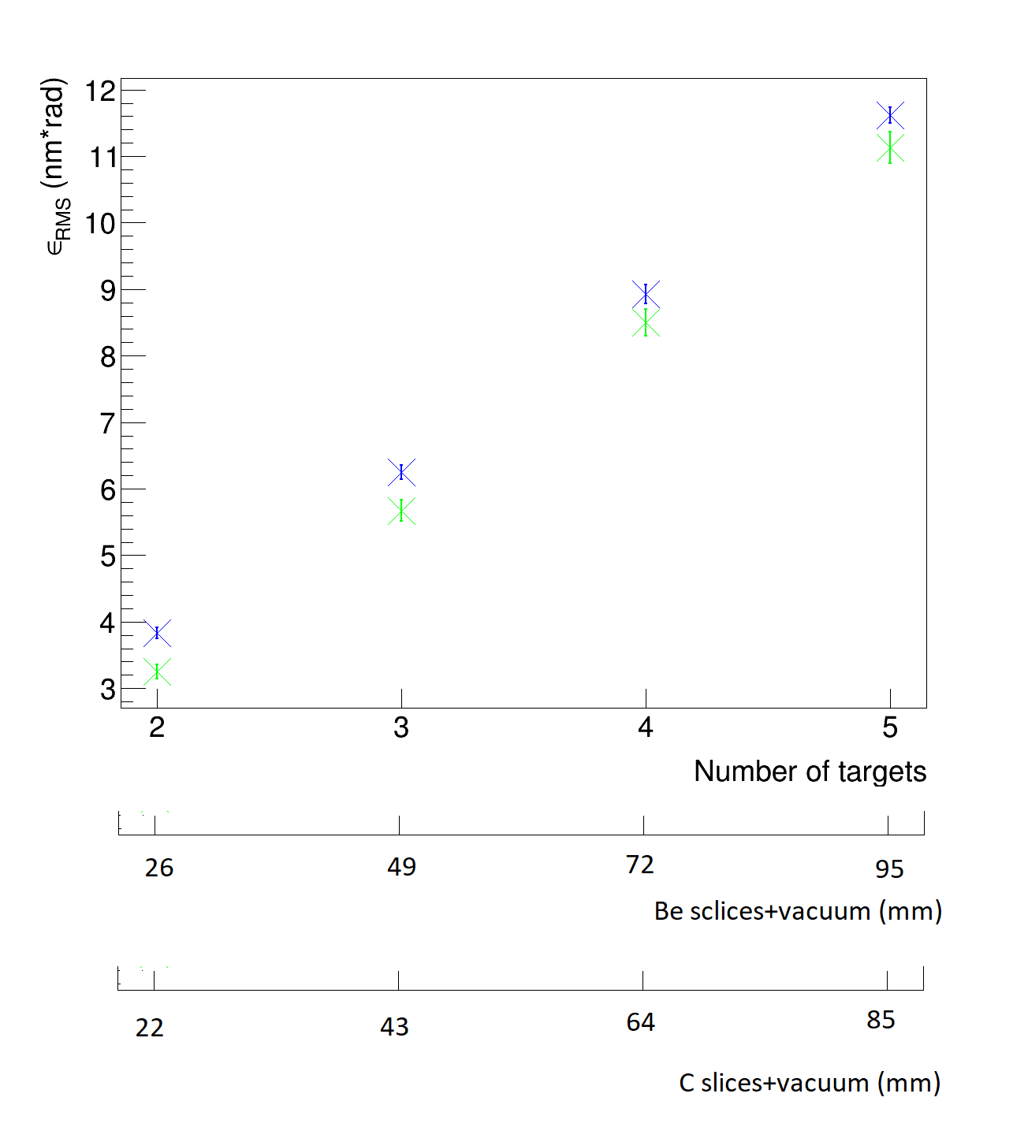
ε_{RMS} as a function of number of targets
Mean RMS angle contribution to emittance (ε_{RMS}):
Exiting angle:
Coulumbian scattering → Emittance increasing.
ε_{RMS} given by:
being
Parametric study:
Number of slices [2-5] (45GeV e⁺).
Results:
Same total slice thickness→ larger ε_{RMS} using more slices (due to vacuum space).
Example 2*6mm Be ε_{RMS}~4.6nm*rad, while 4*3mm Be ε_{RMS}~8.9nm*rad,
Introduction
Muon Colliders
LEMMA
Multi-target
Deposited energy
Positrons
Positrons regeneration
Muons
Additional materials
Shapes
Thermal model
Test at MAMI
TB 2018
Conclusion
Beryllium
Carbon
Dependency of ε_{RMS} on the number of targets.
Sizes of each slice 3mm Be and 1mm C.

Slide 26
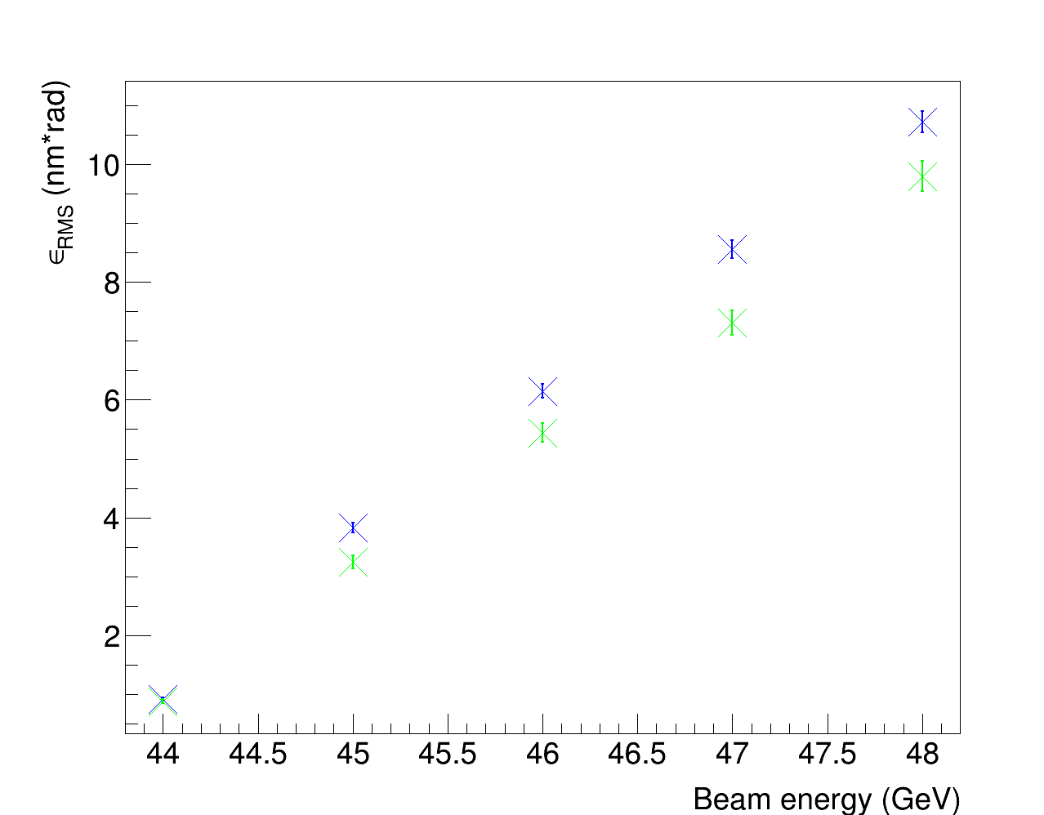
ε_{RMS} as a function of beam energy
Mean RMS angle contribution to emittance (ε_{RMS}):
Exting angle:
Coulumbian scattering → Emittance increasing.
ε_{RMS} given by:
being
Parametric study:
Beam energy [44GeV-48GeV].e
Results:
dε_{RMS}/dE ~2.5nm*rad/(GeV) (Be 6mm).
dε_{RMS}/dE ~2.2nm*rad/(GeV) (C 2m).
Introduction
Muon Colliders
LEMMA
Multi-target
Deposited energy
Positrons
Positrons regeneration
Muons
Additional materials
Shapes
Thermal model
Test at MAMI
TB 2018
Conclusion
Beryllium
Carbon
Dependency on beam energy of ε_{RMS} (right) on the beam energy in a 6 mm total thickness Be and 2 mm total thickness C target.

Slide 27
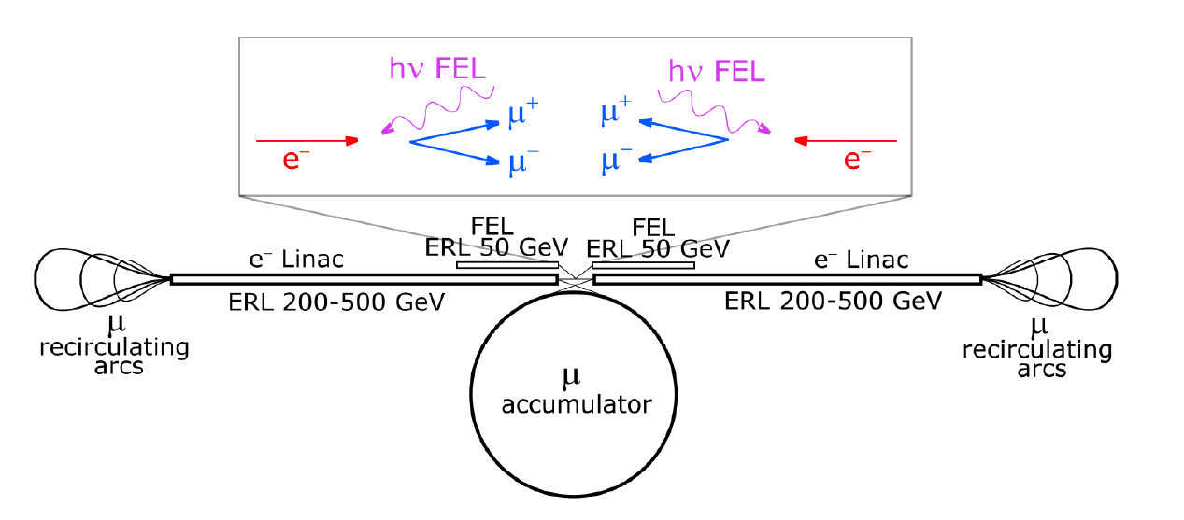
Theoretical formulas of muon emittance
Small thickness target:
Geometric emittance:
EXMP-scheme:
Muon production in photon-electron interaction.
Normalized emittance:
bening
EXMP-based formula for LEMMAscheme:
Normalized emittance:
Introduction
Muon Colliders
LEMMA
Multi-target
Deposited energy
Positrons
Positrons regeneration
Muons
Additional materials
Shapes
Thermal model
Test at MAMI
TB 2018
Conclusion
EXMP scheme (From C. Curatolo and L. Serafini «Electrons and X-rays to Muon Pairs (EXMP)).

Slide 28
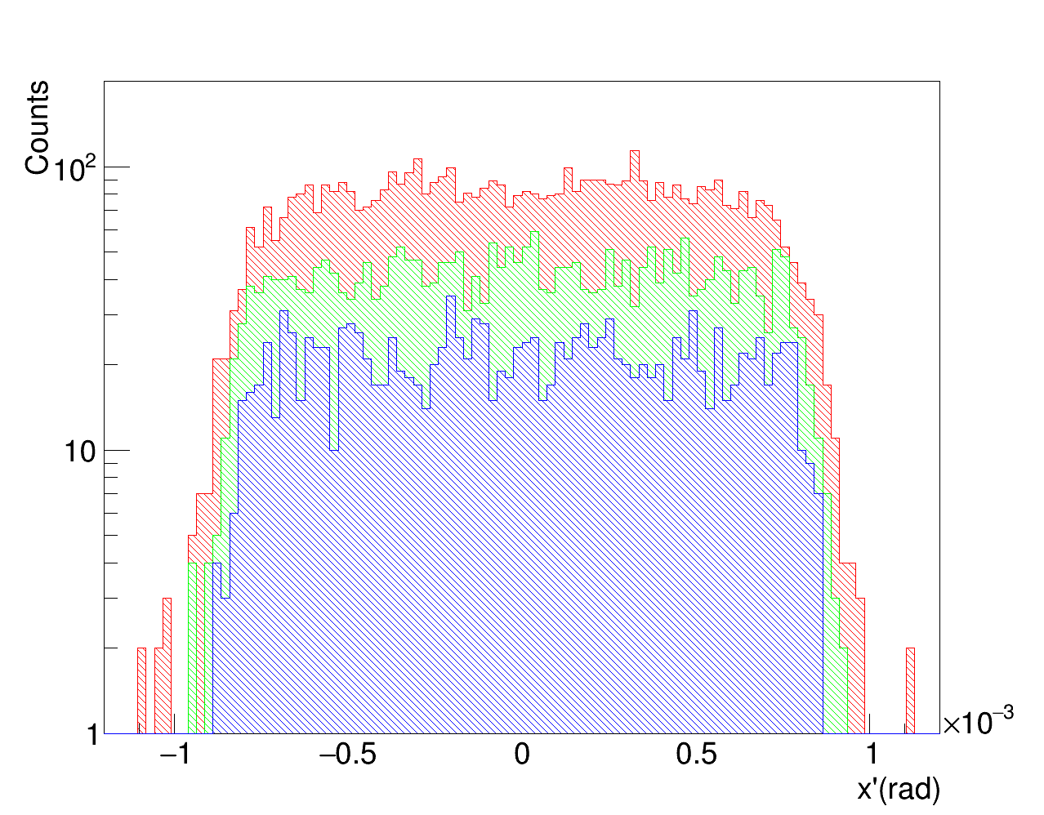
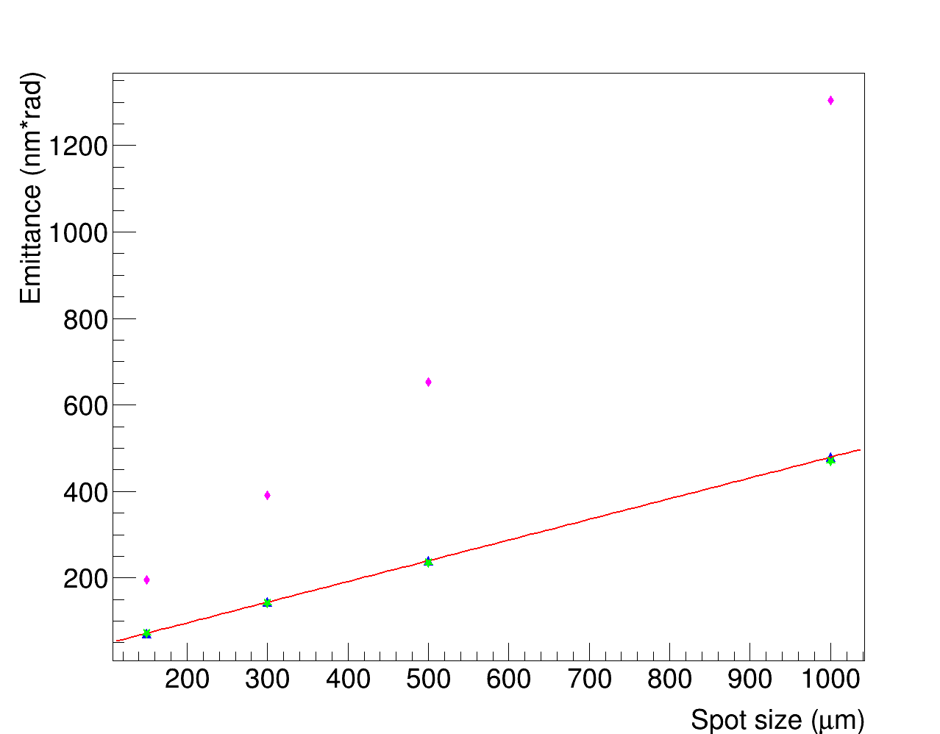
Emittance of muons as a function of spot size
Theory:
For small target thicknesses:
EXMP-based developed formula:
The emittance (ε) is:
being
Parametric study:
Spot size [150 µm;1000 µm] (45GeV e⁺).
Results:
ε increases with the spot size.
Rough values but Upper Limit (UL) on beam emittance from EXMP formula.
Introduction
Muon Colliders
LEMMA
Multi-target
Deposited energy
Positrons
Positrons regeneration
Muons
Additional materials
Shapes
Thermal model
Test at MAMI
TB 2018
Conclusion
3mm
MC
6mm
Theoretical
12mm
EXMP-based
Angular spectrum of muons produced in a Be ìmulti-target, for several total thicknesses.
Dependency of the emittance on the spot size in a 6 mm total thickness Be multi-target.

Slide 29
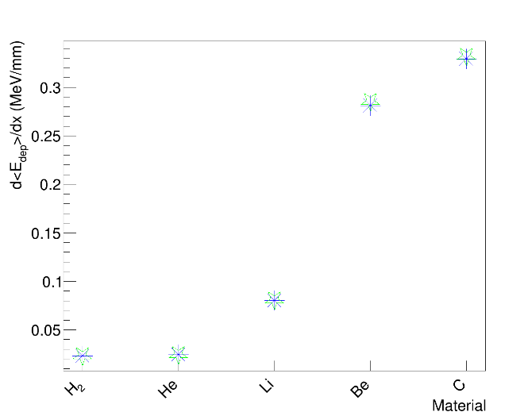
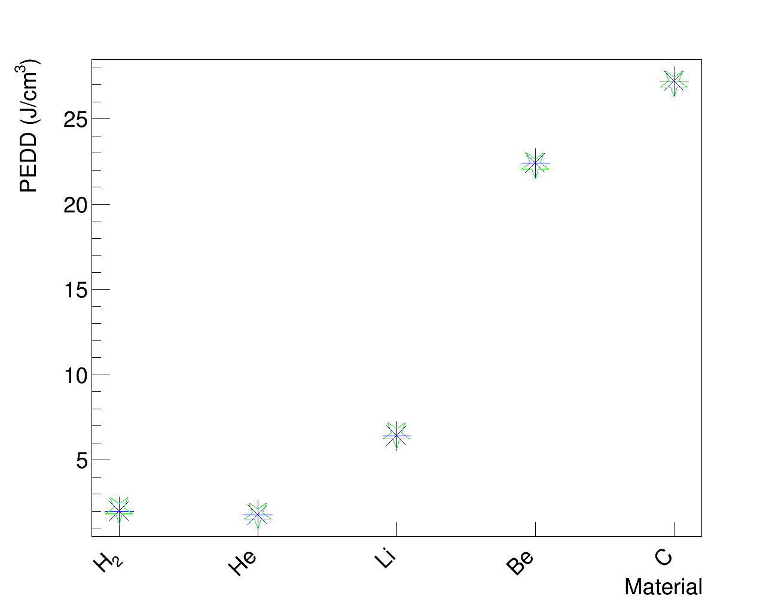
Deposited energy density in additional materials
Parametric study:
Liquid H 36 mm~0.40%X₀ (45GeV e⁺).e
Liquid He 39 mm ~0.62%X₀ (45GeV e⁺).e
Li 9 mm~0.58%X₀ (45GeV e⁺).e
Deposited energy results:
d<E>/dx ~0.023 MeV/mm (H).
d<E>/dx ~0.024 MeV/mm (He).
d<E>/dx ~0.080 MeV/mm (Li).
d<E>/dx ~0.28 MeV/mm (Be).
d<E>/dx ~0.32 MeV/mm (C).
Peak Energy Deposited Density (PEDD) σ=300µm, 3*10¹¹ e⁺/bunch :
~2.0 J/cm³ (H).
~ 1.8 J/cm³ (He)
~ 6.4 J/cm³ (Li)
PEDDs lower than Be, C.
Introduction
Muon Colliders
LEMMA
Multi-target
Deposited energy
Positrons
Positrons regeneration
Muons
Additional materials
Shapes
Thermal model
Test at MAMI
TB 2018
Conclusion
First target
Second target
First target
Second target
Deposited energy for unit of thickness for several materials.
PEDD by 3*10¹¹ primary positrons (σ=300μm) for several materials.

Slide 30
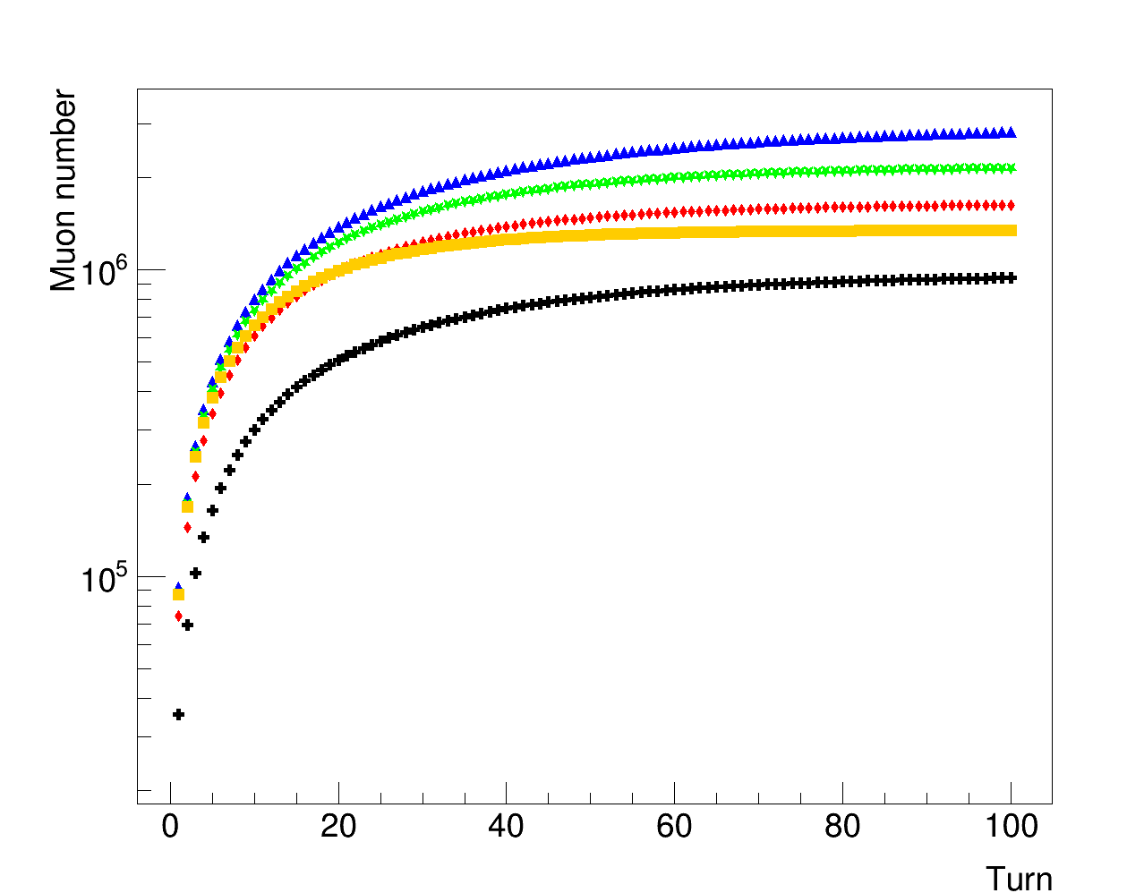
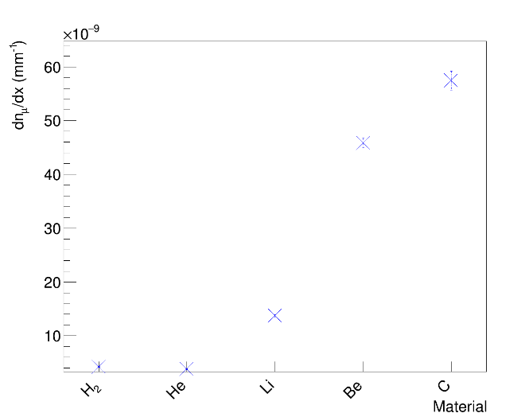
Muon production in additional materials
Theory:
Muon production:
Parametric study:
Liquid H, 36 mm (45GeV e⁺).e
Liquid He, 39 mm (45GeV e⁺).e
Li, 9 mm (45GeV e⁺).e
Results (n⁺=1):
H: dµ/dX₀ ~ 3.8*10⁻⁵ X₀⁻¹
He: dµ/dX₀ ~ 2.8*10⁻⁵ X₀⁻¹
Li: dµ/dX₀ ~ 2.1*10⁻⁵ X₀⁻¹
H: dµ/dx ~ 0.43*10⁻⁸ X₀⁻¹
He: dµ/dx ~ 0.38*10⁻⁸ X₀⁻¹
Li: dµ/dx ~ 1.4*10⁻⁸ X₀⁻¹
Introduction
Muon Colliders
LEMMA
Multi-target
Deposited energy
Positrons
Positrons regeneration
Muons
Additional materials
Shapes
Thermal model
Test at MAMI
TB 2018
Conclusion
H 72mm
He 78mm
Li 9mm
Be 6mm
C 2mm
Muon production as a function of the turn for several materials.
Muon production for unit of thickness of several materials.

Slide 31
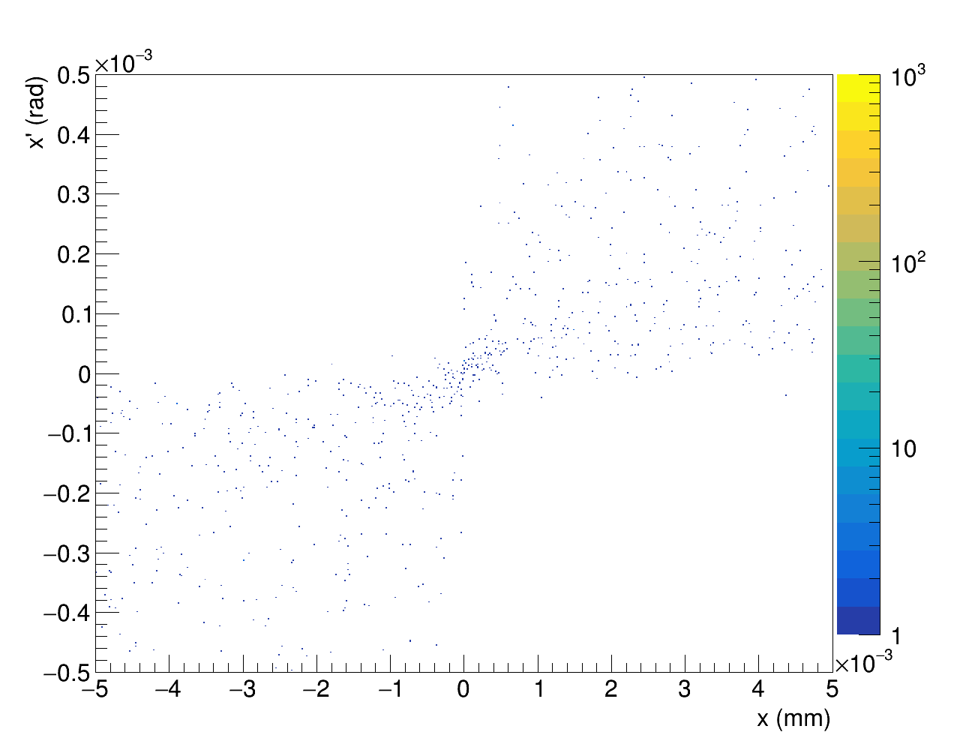
Muons ε_{RMS} increase in additional materials
Mean RMS angle contribution to emittance (ε_{RMS}):
Exting angle:
Coulumbian scattering → Emittance increasing.
ε_{RMS} given by:
being
Parametric study:
Liquid hydrogen, 36 mm (45GeV e⁺).e
Liquid helium, 39 mm (45GeV e⁺).e
Liquid lithium, 9 mm (45GeV e⁺).e
ε_{RMS} of muons results:
Higher ε_{RMS} than using 6mm Be and 2mm C total thickness multi-target.
Introduction
Muon Colliders
LEMMA
Multi-target
Deposited energy
Positrons
Positrons regeneration
Muons
Additional materials
Shapes
Thermal model
Test at MAMI
TB 2018
Conclusion
x-x’ correlation of of muons produced in a 72mm total thickness H multi-target.
.
Mean RMS angle contribution to emittance of muons for additional materials.

Slide 32
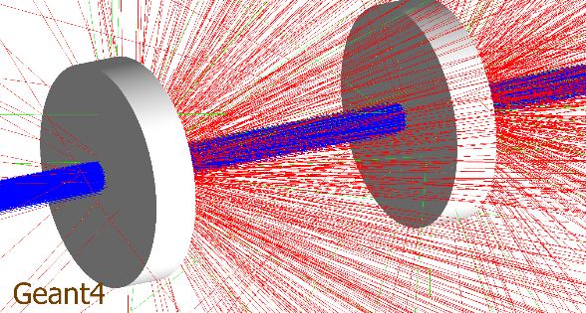
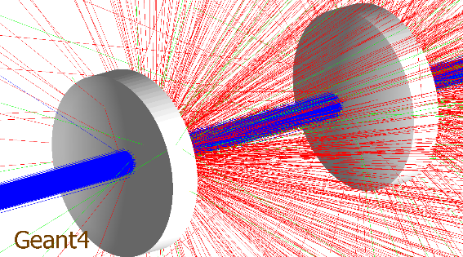
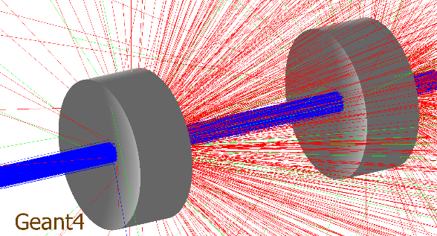
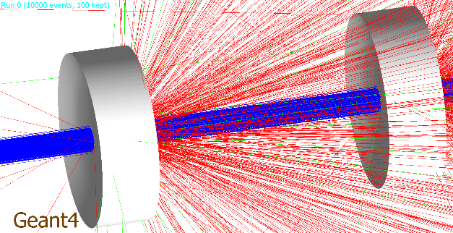
Proposed shapes of the multi-target
Goal:
Minimise heat exchanges and thermomechanical stresses.
Proposed shapes:
Cylindrical.
Meniscus.
Hourglass.
Linear-hourglass.
Considerations:
The shape does not affect deposited energy and kinematics, but to be consider for thermomechanical stress studies (view factors).
Introduction
Muon Colliders
LEMMA
Multi-target
Deposited energy
Positrons
Positrons regeneration
Muons
Additional materials
Shapes
Thermal model
Test at MAMI
TB 2018
Conclusion
Cylindrical
Meniscus
Hourglass
Proposed geometries
Linear-hourglass
Considered geometrical shapes.

Slide 33
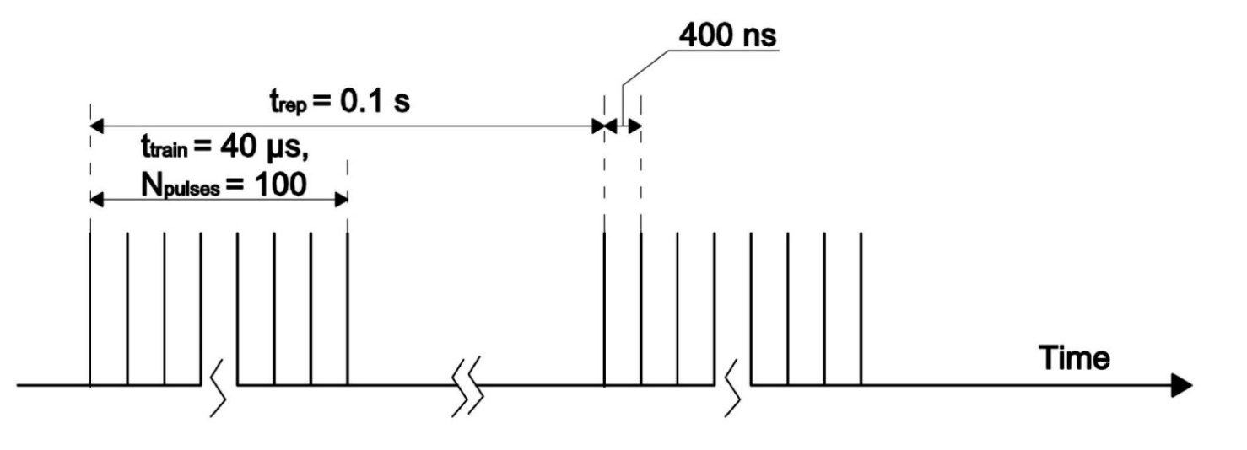
Thermal model
Features:
Collaboration with SBAI Department.
Based on the deposited energy got by multi-target simulation.
Single target (up to now).
Goal:
Thermal evolution in the target.
Reference values:
45GeV positron beam (σ=300µm, 3*10¹¹ e⁺/bunch).
3*10¹⁴ e⁺/s → O (10⁷µ±/s).
3mm Be and 1mm C targe.
Published Article:
‘’Theoretical Modeling for the Thermal Stability of Solid Targets in Positron-Driven Muon Collider” (International Journal of Thermo Physics).
Introduction
Muon Colliders
LEMMA
Multi-target
Deposited energy
Positrons
Positrons regeneration
Muons
Additional materials
Shapes
Thermal model
Test at MAMI
TB 2018
Conclusion
Considered beam.

Slide 34
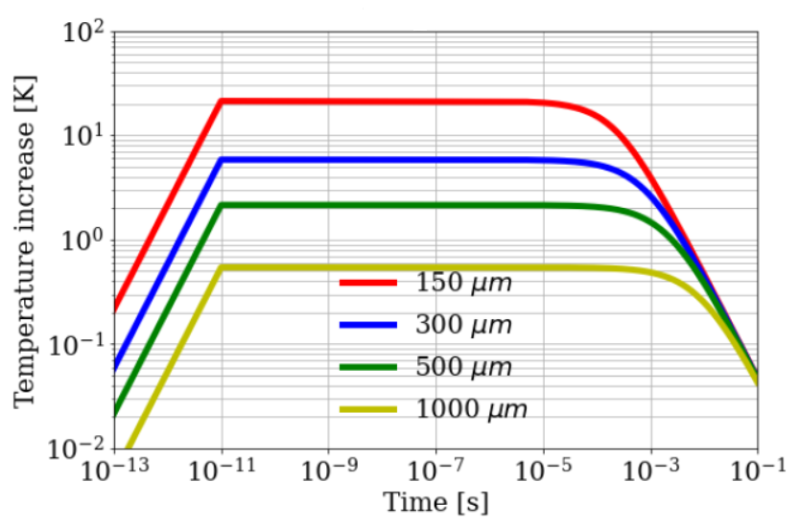
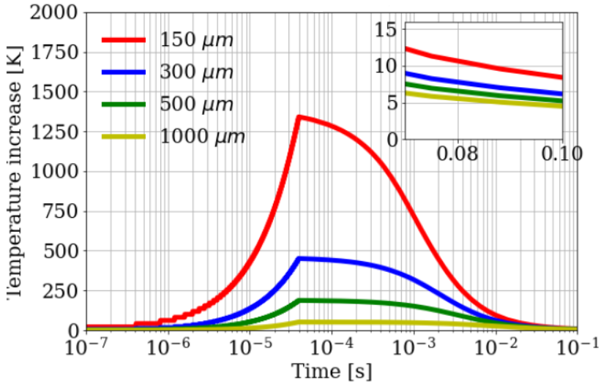
Thermal model Fourier’s equation based
Introduction
Muon Colliders
LEMMA
Multi-target
Deposited energy
Positrons
Positrons regeneration
Muons
Additional materials
Shapes
Thermal model
Test at MAMI
TB 2018
Conclusion
Thermal evolution in the target:
Fourier’s equation:
2D space (R,z),
k, c_{p} and D=k/(ρc_{p}) recalculated at each Δt→Long computational time.
Thermal evolution in the target (45GeV, σ=300µm, 3*10¹¹ e⁺/bunch, R=5cm), for a single train:
Beryllium ΔT=451K (L=3mm).
Carbon ΔT=782K. (L=1mm).
Bunch
Diffusion
Train
No Train
No diffusion
Temperature rise at center due to single bunch. Be target (R=5cm, L=3mm ).
Temperature rise at center due to
a single train. Be target (R=5cm, L=3mm ).

Slide 35
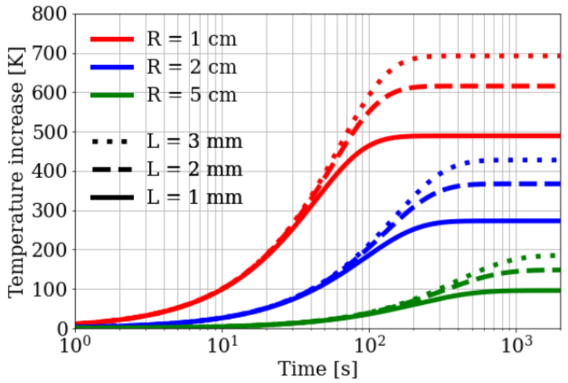
Thermal model IR-based
Approximate-fast method:
Based on emitted energy via Infra-Red (IR) radiation:
being P_{cw}=E_{d}/t_{rep}
Results:
Thermal stability in long time scale.
Future perspective:
Experimental tests needed.
Application to multi-targets.
Introduction
Muon Colliders
LEMMA
Multi-target
Deposited energy
Positrons
Positrons regeneration
Muons
Additional materials
Shapes
Thermal model
Test at MAMI
TB 2018
Conclusion
Temperature rise at long time scale. Be (left) and C(right) target. 45GeV, σ=300μm, 3*10¹¹e⁺/bunch.

Slide 36
Planning of thermal studies @MAMI
Introduction
Muon Colliders
LEMMA
Multi-target
Deposited energy
Positrons
Positrons regeneration
Muons
Additional materials
Shapes
Thermal model
Test at MAMI
TB 2018
Conclusion
Goal:
Thermomechanical properties of the target.
Test the thermal model.
MAinz MIcrotron (MAMI) Accelerator:
Mainz (Germany).
Electron Beam.
E~180MeV-1600MeV.
ΔE/E~2*10⁻⁵
Max ~50µA.
~7000h/year running.
MAMI accelerator.

Slide 37
Thermal studies @MAMI setup
Introduction
Muon Colliders
LEMMA
Multi-target
Deposited energy
Positrons
Positrons regeneration
Muons
Additional materials
Shapes
Thermal model
Test at MAMI
TB 2018
Conclusion
Setup:
800MeV e⁻.
Single C target (thickness [0.5mm;1.3mm]).
Vacuum chamber.
Thermal camera to measure the heating.
Scheme of experimental test at MAMI.

Slide 38
GEANT4-based planning of thermal studies @MAMI
Introduction
Muon Colliders
LEMMA
Multi-target
Deposited energy
Positrons
Positrons regeneration
Muons
Additional materials
Shapes
Thermal model
Test at MAMI
TB 2018
Conclusion
Theory:
Responsivity damage of IR
GEANT-4 simulation goal:
Radiation flux on the thermal camera to provide its safety.
GEANT4 simulation:
Steel vacum chamber 1mm thickness with 3 mylar windows
5cmx5cmx5mm scintillator. (reference value).
Estimation of radiation reaching the scintillator and deposited energy in it.
Target
Scintillator
Chamber
Vacuum chamber and scintillator

Slide 39
Radiation estimation @MAMI
Introduction
Muon Colliders
LEMMA
Multi-target
Deposited energy
Positrons
Positrons regeneration
Muons
Additional materials
Shapes
Thermal model
Test at MAMI
TB 2018
Conclusion
Parametric study:
Target thickness [0.5mm-1.3mm] (800 MeV e⁻).e
Results:
Particle flux and deposited energy increase with the thickness of the target.
Example if ~1.3*10⁵ e⁻/bunch (ILC test, S. Rieaman talk at AWLC 2017) → ~1.3particles/bunch and ~0.6MeV/bunch (s=1.3mm).
Total
electrons
positrons
ph0tons
total
Particle flux hitting the scintillator.
Mean values of deposited energy in scintillator.

Slide 40
Radiation estimation @MAMI
Reason:.
Thermal camera protection using an IR shield.
Materials:
Sapphire (Al₂O₃).
Quartz (SiO₂ ).
Zinc sulfide clertran (ZnS).
Parametric studies:
Shield material (800MeV e⁻, C 1.3mm).
Shield thickness [1mm-4.mm] (800MeV e⁻, C 1.3mm).e
Results:
Particle flux and deposited energy reduced by the shield.
Best results using Al₂O₃.
Introduction
Muon Colliders
LEMMA
Multi-target
Deposited energy
Positrons
Positrons regeneration
Muons
Additional materials
Shapes
Thermal model
Test at MAMI
TB 2018
Conclusion
Particle flux and deposited energy covering the scintillator with an IR shield. Target thickness 1.3mm. Shield thickness 1mm.
electrons
positrons
ph0tons
total
Particle flux hitting the scintillator as function of wall thickness of the shield Al₂O_{3.} Target thickness 1.3mm.

Slide 41
LEMMA Test Beam 2018 @CERN
Test beam (TB) goal:
Muon production in e⁺e⁻→µ⁺µ⁻.
Calibration runs:
18GeV-26 GeV electron and muon beams.
Data taking runs:
45 GeV positrons on target (Be, C).
Measurements:
Muon emittance.
Muon cross-section normalized to the Bhabha one.
Introduction
Muon Colliders
LEMMA
Multi-target
Deposited energy
Positrons
Positrons regeneration
Muons
Additional materials
Shapes
Thermal model
Test at MAMI
TB 2018
Conclusion
Test Beam facility at CERN.

Slide 42
Experimental setup of the Test Beam 2018
Introduction
Muon Colliders
LEMMA
Multi-target
Deposited energy
Positrons
Positrons regeneration
Muons
Additional materials
Shapes
Thermal model
Test at MAMI
TB 2018
Conclusion
Instruments for analysis:
Trackers.
Scintillators.
Lead Glass (LG).
HORSA absorber.
Analysed data:
22GeV electron and muon beams (calibration).
45GeV positron beam on C targets (2 and 6 cm).
Tracker 37
Experimental setup.
Scintillator
Lead Glass block
Scintillator
HORSA absorber

Slide 43
Cross-section measurement at Test Beam 2018
Introduction
Muon Colliders
LEMMA
Multi-target
Deposited energy
Positrons
Positrons regeneration
Muons
Additional materials
Shapes
Thermal model
Test at MAMI
TB 2018
Conclusion
Parametric study:
C 2 cm ~10%X₀ (45GeV e⁺).e
C 6 cm ~31%X₀ (45GeV e⁺).e
Results (22GeV):
N_{µ}/N_{e} ratio in agrees with MC simulations.
But low statistichs.
Future perspective:
New test beam to increase statistichs.
Published article:
’Muon detection in electron – positron annihilation for muon collider studies’’ (Nuclear Instrument and Methods A).
Experimental ratio of produced 22GeV muons over electrons. 45GeV e⁺ on C target.
MC ratio of produced 22GeV muons over electrons. 45GeV e⁺ on C target.

Slide 44
Conclusions
Conclusions:
The LEMMA project overcames the cooling problem.
A single thick target would melt.
A multi-target could reduce the deposited energy.
Trade-off between muon production and deposited energy.
Be has lower deposited energy for unit of thickness, higher muon production for unit of X₀, lower ε_{RMS} for unit of thickness and lower number of needed slices than C.
~10¹⁸e⁺/s needed to get 10¹¹μ±/s (1.3*10⁵W in 3mm Be and 5.1*10⁴W 1mm C slices).
Introduction
Muon Colliders
LEMMA
Multi-target
Deposited energy
Positrons
Positrons regeneration
Muons
Additional materials
Shapes
Thermal model
Test at MAMI
TB 2018
Conclusion
“Fatti non foste a viver come bruti, ma per seguir virtute e canoscenza.”

Slide 45
Future perspective
Introduction
Muon Colliders
LEMMA
Multi-target
Deposited energy
Positrons
Positrons regeneration
Muons
Additional materials
Shapes
Thermal model
Test at MAMI
TB 2018
Conclusion
Future perspectives:
Implement in the simulation more functions (example magnets).
Apply the thermal model to more slice with differtent shapes.
Validate the thermal model by experimental tests (MAMI and other planned tests).
Weigh kinematic results with thermomecanical stress ones.
“La quale se non v’è dispiaciuta affatto, vogliate bene a chi l’ha scritta, e anche un pochino a chi l’ha raccomodata. Ma se in vece fossimo riusciti ad annoiarvi, credete che non s’è fatto apposta.”

Slide 47
BACKUP

Slide 48
LEMMA proposed scheme
LEMMA scheme
View factor
Deposited energy
Positrons
Photons
Positron regeneration
Elecontrons and positrons
Muons
Additional materials
Thermal model
Test at MAMI
Thermal studies
TB 2018
LEMMA scheme:
Injector.
Multi-target.
Muon accumulator.
Classical source.
γ-source.
Positron ring.
Extraction.
Energy compressor LINAC.
One of LEMMA scheme (From M. Bauce talk at APS 2021).

Slide 49
View factor
View factor:
Each slice of the multi-target is subjected to:
being
The radiation heat transfer also depends on shapes and orientations →view factor:
LEMMA scheme
View factor
Deposited energy
Positrons
Photons
Positron regeneration
Elecontrons and positrons
Muons
Additional materials
Thermal model
Test at MAMI
Thermal studies
TB 2018
View factor of the heat transfer between two surfaces. (From M. Vio et al. “Corsi di fisica tecnica”).

Slide 50
Deposited energy in the multi-target
LEMMA scheme
View factor
Deposited energy
Positrons
Photons
Positron regeneration
Elecontrons and positrons
Muons
Additional materials
Thermal model
Test at MAMI
Thermal studies
TB 2018
Parametric study:
Be slices [1.5mm-6mm] (45GeV e⁺).e
C slices [0.5mm-2mm] (45GeV e⁺).
Deposited energy results:
Increasing with the thickness.
d<E>/dx ~0.28 MeV/mm (Be).
d<E>/dx ~0.32 MeV/mm (C).
Energy spectrum- Be 3 mm (single slice thickness) – I target.
Dependency of <E_{dep}> on the slice thickness– Be I target.

Slide 51
Beam loss as a function of number of targets
Theory:
Mean energy crossing the target:e
Muon production threshold 43.69GeV.
Parametric study:
Number of slices [2;5] (45GeV e⁺).
Results:
dre⁺_{43.69GeV}/dx ~0.010 mm⁻¹ (Be).
dre⁺_{43.69GeV}/dx ~0.018 mm⁻¹ (C).
d<E>/dx ~0.12 GeV/mm (Be).
d<E>/dx ~0.21 GeV/mm (C).
LEMMA scheme
View factor
Deposited energy
Positrons
Photons
Positron regeneration
Elecontrons and positrons
Muons
Additional materials
Thermal model
Test at MAMI
Thermal studies
TB 2018
Beryllium
Beryllium
Carbon
Carbon
Mean energy of the beam (left) and number of positrons with energy over muon pair production exiting the multi-target as a function of the beam energy. The thicknesses of each slice are 3mm for Be and 1mm for C.

Slide 52
Beam loss as a function of beam energy
LEMMA scheme
View factor
Deposited energy
Positrons
Photons
Positron regeneration
Elecontrons and positrons
Muons
Additional materials
Thermal model
Test at MAMI
Thermal studies
TB 2018
Theory:
Mean energy crossing the target:e
Muon production threshold 43.69GeV.
Parametric study:
Beam energy [44GeV;48GeV].
Results:
Be: dre⁺_{43.69GeV}/dx from ~ 0.007mm⁻¹ (48GeV) to ~ 0.02 mm-1 (44GeV).
C: dre⁺_{43.69GeV}/dx from ~ 0.01mm⁻¹ (48GeV) to ~ 0.03 mm⁻¹ (44GeV).
Beryllium
Carbon
Beryllium
Carbon
Mean energy of the beam (left) and normalized number of positrons with energy over muon pair production outgoing a 6 mm Be and 2 mm C multi-target (right) as a function of the beam energy.

Slide 53
Photons production
Features:
Bremsstrahlung, e⁺e⁻ annihilation → photon production.
Radiated energy:
Positron source.
Parametric study:
Be slices [1.5mm-6mm] (45GeV e⁺).e
C slices [0.5mm-2mm] (45GeV e⁺).
Results:
dE/dx~2.0*10⁻¹¹J/mm (Be).
dE/dx~3.4*10⁻¹¹J/mm (C).
LEMMA scheme
View factor
Deposited energy
Positrons
Photons
Positron regeneration
Elecontrons and positrons
Muons
Additional materials
Thermal model
Test at MAMI
Thermal studies
TB 2018
Energy spectrum of radiated energy by photons produced in a 6mm Be total thickness multi-target.
Dependency of photon energy on the thickness of a Be multi-target.

Slide 54
Deposited energy in the regenerator
LEMMA scheme
View factor
Deposited energy
Positrons
Photons
Positron regeneration
Elecontrons and positrons
Muons
Additional materials
Thermal model
Test at MAMI
Thermal studies
TB 2018
Parametric study:
Be slices [1.5mm-6mm] (45GeV e⁺).e
C slices [0.5mm-2mm] (45GeV e⁺).
Results:
d<E>/dx~9.1MeV/mm (Be).
d<E>/dx~17MeV/mm (C).
Higher deposited energy than in the multi-target, but easilier to replace.
Deposited energy in the regenerator by photons produced in a 6 mm total thickness Be multi-target.
Dependency of deposited energy in the regenerator on the total thickness of a Be multi-target.

Slide 55
Electrons and positrons production
Features:
Main background for muon production.
Mainly produced by Bhabha scattering.
Positrons could be recirculated in the beam.
Parametric study:
Be slices [1.5mm-6mm] (45GeV e⁺).e
C slices [0.5mm-2mm] (45GeV e⁺).
Results:
Low energy (mean energy few MeV);
Number and mean energy increase with the thickness.
LEMMA scheme
View factor
Deposited energy
Positrons
Photons
Positron regeneration
Elecontrons and positrons
Muons
Additional materials
Thermal model
Test at MAMI
Thermal studies
TB 2018
Energy spectrum of secondary electrons/positrons produced in a 6mm total thickness Be multi-target.
Normalized number n_{e}± and mean energy <E> of produced electrons/positrons in the multi-target.

Slide 56
Muon production as a function of number of slices
LEMMA scheme
View factor
Deposited energy
Positrons
Photons
Positron regeneration
Elecontrons and positrons
Muons
Additional materials
Thermal model
Test at MAMI
Thermal studies
TB 2018
Theory:
Muon production:
Parametric study:
Number of slices [2;5] (45GeV e⁺).
Results:
Number increases with the number of slice.
Efficiency ~10⁻⁷- 10⁻⁶ µ±/e
Be: dµ/dX₀ ~1.6*10⁻⁵ X₀⁻¹.
C: dµ/dX₀ ~1.1*10⁻⁵ X₀⁻¹.
Beam energy loss→ Saturation.
2 slices
3 slices
4 slices
5 slices
Dependency on number of targets of produced muons in Be multi-target. Size of each slice 3mm.
Muon production in a Be multi-target for several runs. Size of each slice 3mm.

Slide 57
ε_{RMS} as a function of beam energy
Mean RMS angle contribution to emittance (ε_{RMS}):
Exting angle:
Coulumbian scattering → Emittance increasing.
ε_{RMS} given by:
being
Parametric study:
Beam energy [44GeV-48GeV].e
Results:
ε_{RMS} increases with the beam energy.
dε_{RMS}/dE ~2.5nm*rad/(GeV) (Be 6mm).
dε_{RMS}/dE ~2.2nm*rad/(GeV) (C 2m).
LEMMA scheme
View factor
Deposited energy
Positrons
Photons
Positron regeneration
Elecontrons and positrons
Muons
Additional materials
Thermal model
Test at MAMI
Thermal studies
TB 2018
Beryllium
Beryllium
Carbon
Carbon
Dependency on beam energy of RMS/E (left) and ε_{RMS} (right) on the beam energy in a 6 mm total thickness Be and 2 mm total thickness C target.

Slide 58
Beam loss in additional material
Theory:
Mean energy crossing the target:e
Parametric study:
Liquid H, 36 mm (45GeV e⁺).e
Liquid He, 39 mm (45GeV e⁺).e
Li, 9 mm (45GeV e⁺).e
Kinematics of positrons results:
dre⁺_{43.69GeV}/dx ~0.43*10⁻³ mm⁻¹ (H).
dre⁺_{43.69GeV}/dx ~0.52*10⁻³ mm⁻¹ (He).
dre⁺_{43.69GeV}/dx ~2.5*10⁻³ mm⁻¹ (Le).
d<E>/dx ~0.5*10⁻² GeV/mm (Be).
d<E>/dx ~0.6*10⁻² GeV/mm (Be).
d<E>/dx ~2.9*10⁻² GeV/mm (Be).
LEMMA scheme
View factor
Deposited energy
Positrons
Photons
Positron regeneration
Elecontrons and positrons
Muons
Additional materials
Thermal model
Test at MAMI
Thermal studies
TB 2018
H 72mm
He 78mm
He 78mm
Li 9mm
H 72mm
Be 6mm
He 78mm
C 2mm
Li 9mm
Be 6mm
C 2mm
Ratio of surviving positrons with energy over muon pair production threshold for several turns.
Mean energy of positrons for several turns.

Slide 59
Beam ε_{RMS} increase in additional materials
Mean RMS angle contribution to emittance (ε_{RMS}):
Exting angle:
Coulumbian scattering → Emittance increasing.
ε_{RMS} given by:
being
Parametric study:
Liquid H, 36 mm (45GeV e⁺).e
Liquid He, 39 mm (45GeV e⁺).e
Li, 9 mm (45GeV e⁺).e
ε_{RMS} of positrons results:
ε_{RMS} of positrons compareble/lower than using 6mm Be and 2mm C total thickness multi-target.
LEMMA scheme
View factor
Deposited energy
Positrons
Photons
Positron regeneration
Elecontrons and positrons
Muons
Additional materials
Thermal model
Test at MAMI
Thermal studies
TB 2018
Mean RMS angle contribution to emittance of positrons for additional materials.

Slide 60
Chrinstensens safety factor test
LEMMA scheme
View factor
Deposited energy
Positrons
Photons
Positron regeneration
Elecontrons and positrons
Muons
Additional materials
Thermal model
Test at MAMI
Thermal studies
TB 2018
Results:
Christensens failure criterion not satisfied using a 300 μm spot size.
1000 μm spot size needed.
Christense safety factor evolution in a 3mm Be and 1mm C target using a spot size σ=300µm (left) and σ=1000µm (right).

Slide 61
Theoretical modeling for the thermal stability of solid targets ina a positron driven muon collider
LEMMA scheme
View factor
Deposited energy
Positrons
Photons
Positron regeneration
Elecontrons and positrons
Muons
Additional materials
Thermal model
Test at MAMI
Thermal studies
TB 2018
More information:
Cesarini G. et al. ‘’Theoretical Modeling for the Thermal Stability of Solid Targets in Positron-Driven Muon Collider” , International Journal of Thermophysics, ISSN 0195-928X, Vol 42, Number 163, 2021, http://dx.doi.org/10.1007/s10765-021-02913-x
Published article on IOTP.

Slide 62
Proposed parameters for thermal studies @MAMI
LEMMA scheme
View factor
Deposited energy
Positrons
Photons
Positron regeneration
Elecontrons and positrons
Muons
Additional materials
Thermal model
Test at MAMI
Thermal studies
TB 2018
Beam:
800MeV e⁻.
Spot size 10µm.
Angular spread 1µrad.
Energy spread 13keV.
Target:
Single C target.
Radius [3cm;5cm].
Thickness [0.5mm;1.3mm].
Scheme of experimental test at MAMI.

Slide 63
Deposited energy @MAMI
LEMMA scheme
View factor
Deposited energy
Positrons
Photons
Positron regeneration
Elecontrons and positrons
Muons
Additional materials
Thermal model
Test at MAMI
Thermal studies
TB 2018
Parametric study:
Thickness [0.5mm-1.3mm] (800MeV e⁻).e
Deposited energy results:
Increasing with the thickness.
d<E>/dx ~0.32 MeV/mm (same of LEMMA).
Energy spectrum- C 0.9 mm.
Dependency of mean deposited energy <E> on the thickness. The radius is 4cm.

Slide 64
Deposited energy density @MAMI
LEMMA scheme
View factor
Deposited energy
Positrons
Photons
Positron regeneration
Elecontrons and positrons
Muons
Additional materials
Thermal model
Test at MAMI
Thermal studies
TB 2018
Parametric study:
Thickness [0.5mm-1.3mm] (800MeV e⁻).e
Deposited energy density results:
Dependency on the radius position.
Peak Energy Deposited Density (PEDD) σ=10µm, 3*10¹³ e⁺/bunch :
2.3*10⁶J/cm³.
PEDD higher than threshold (210J/cm³ ).
Thresholds from https://dx.doi.org/10.1007/s10765-021-02913-x
PEDD
Gaussian
core
Deposited energy density by 3*10¹³ primary positrons- C 0.9 m.
Deposited energy density by 3*10¹³ primary positrons- 1.3 mm total thickness target.

Slide 65
Deposited energy density @MAMI as a function of spot size
Parametric study:
Beam spot size [10μm-2000 μm].e
Results (3*10¹³ e⁺/bunch):
PEDD decreasing as 1/σ².
PEDD from 4.8*10² J/cm³ (2000μm) to 2.3*10⁶J/cm³ (10μm).
PEDDs still larger than threshold (210J/cm³ ).
Lower number of e⁻/bunch is needed.
Considerations:
It doesn’t affect the goodness of presented results (just rescale the deposited energy density).
LEMMA scheme
View factor
Deposited energy
Positrons
Photons
Positron regeneration
Elecontrons and positrons
Muons
Additional materials
Thermal model
Test at MAMI
Thermal studies
TB 2018
10 µm
400 µm
50 µm
100 µm
200 µm
300 µm
400 µm
500 µm
1000 µm
2000 µm
Dependency of energy density on position on the radius by 3*10¹³ electrons in a 1.3 thickness target.
Dependency of PEDD of 3*10¹³ electrons in a 1.3mm thickness target.

Slide 66
Radiation estimation @MAMI as a function of surface
LEMMA scheme
View factor
Deposited energy
Positrons
Photons
Positron regeneration
Elecontrons and positrons
Muons
Additional materials
Thermal model
Test at MAMI
Thermal studies
TB 2018
Parametric study:e
Scintillator surface [9cm²;121cm²] (1.3mm C).
Results:
Particle flux and deposited energy in the scintillator increase with the surface area.
electrons
positrons
phtons
total
Particle flux hitting the scintillator as a function of the surface area.
Mean values of deposited energy in scintillator as a function of surface area. Thickness 1.3mm.

Slide 67
Additional planned thermal stress studies
Planning ahead:
Apply the thermal model multi-targets of different shapes.
Measurement of target thermo-elastic properties in a wide temperature range.
Mearument of thermal diffusivity and IR emissivity via photo-thermal radiometry and IR thermography.
Detection of demage and thermo-mechanical stress when the target is subjected to intense LASER radiation.
LEMMA scheme
View factor
Deposited energy
Positrons
Photons
Positron regeneration
Elecontrons and positrons
Muons
Additional materials
Thermal model
Test at MAMI
Thermal studies
TB 2018
Example of targets produced at LNL. From S. Corradetti talk at Muon Collider Meeting 2021.
Thermomechanical stress test with LASER scheme.

Slide 68
HORizontal Smart Absorber (HORSA)
LEMMA scheme
View factor
Deposited energy
Positrons
Photons
Positron regeneration
Elecontrons and positrons
Muons
Additional materials
Thermal model
Test at MAMI
Thermal studies
TB 2018
Features :
1-inch thick fused silica layers.
Three PMT to detect the Cherenkov light produced in each of the fused silica layers
Sequence of alternating active and passive layers along z to filter muons against electrons;
Among the pairs of fused silica layers tungsten shields;
HORSA absorber during the test beam.
HORSA absorber
HORSA absorber layout.

Slide 69
Calorimeter calibration of Test Beam 2018
LEMMA scheme
View factor
Deposited energy
Positrons
Photons
Positron regeneration
Elecontrons and positrons
Muons
Additional materials
Thermal model
Test at MAMI
Thermal studies
TB 2018
Tracker – LG correlation:
22 GeV electrons and muons.
Maximum energy deposition in LG for [6 cm; 9cm] on the tracker.
LG calibration:
22 GeV electrons.
µ=3447ADC, σ=174ADC → 1GeV=(156.7±7.9)ADC.
electrons
3447 ADC
muons
Tracker- central LG correlation.
Deposited energy in central LG by 22GeV electrons.

Slide 70
Muon identification by data of Test Beam 2018
LEMMA scheme
View factor
Deposited energy
Positrons
Photons
Positron regeneration
Elecontrons and positrons
Muons
Additional materials
Thermal model
Test at MAMI
Thermal studies
TB 2018
22GeV muon identification:
22GeV muon beam.
Deposited energy in central LG <1GeV.
Signal region E_{HORSA} <2000 ADC.
Deposited energy in central LG by 22 GeV muons.
Signal region – 22 GeV muons.

Slide 71
Muon detection in electron positron annihilation for muon collider studies
LEMMA scheme
View factor
Deposited energy
Positrons
Photons
Positron regeneration
Elecontrons and positrons
Muons
Additional materials
Thermal model
Test at MAMI
Thermal studies
TB 2018
More details:
Amapane N. et al. ‘’Muon detection in electron – positron annihilation for muon collider studies’’ – Nuclear Instruments & Methods in Physics Research A, Elsevier, ISSN 0168-9002, Vol. 1024, Pages 166129, 2021, https://doi.org/10.1016/j.nima.2021.166129
Published article on NIM A.

