Slide 1
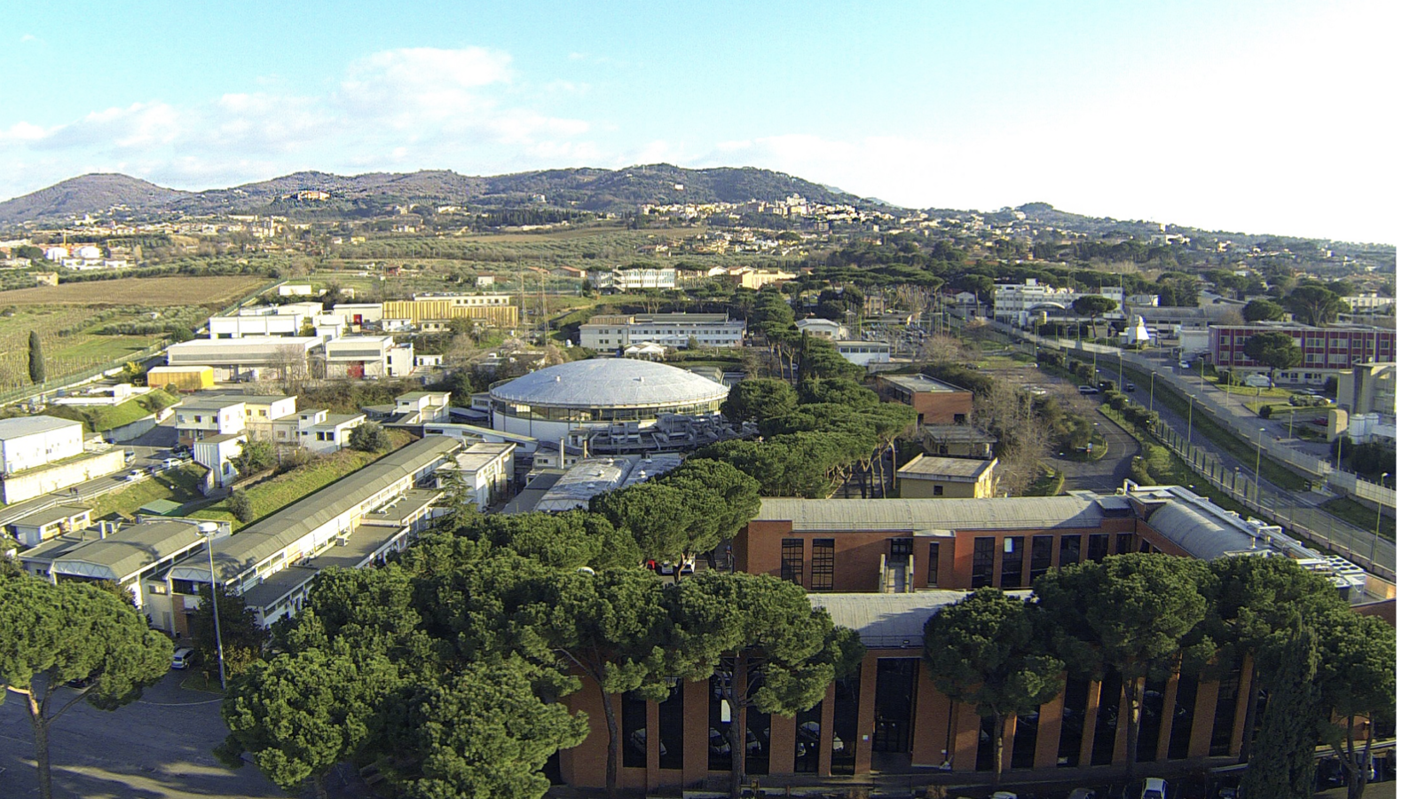
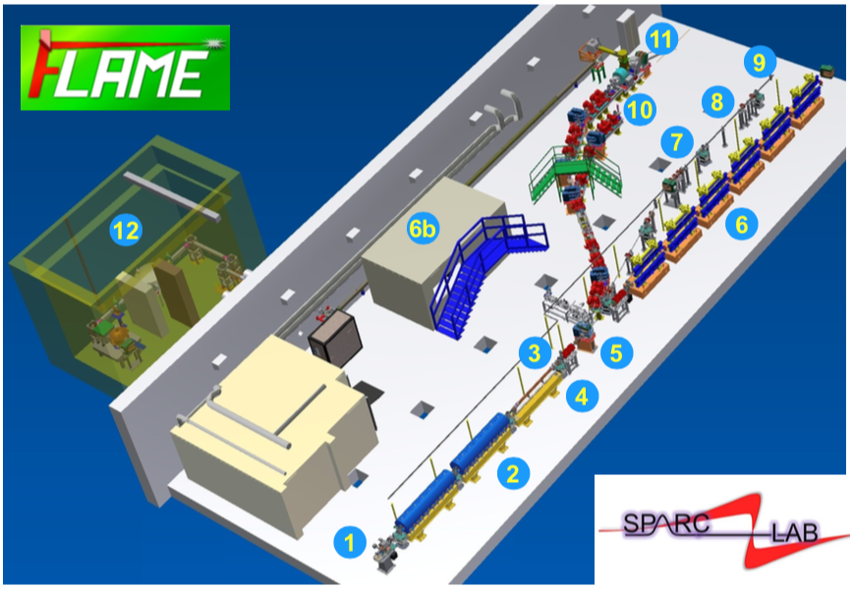
Development and Charecterization of Plasma Sources
for Plasma-based Accelerators
Sahar Arjmand
sahar. arjmand@lnf.infn.it
Supervisor: Prof. Massimo Ferrario
Advisor: Dr. Angelo Biagioni
INFN-LNF (National Laboratories of Frascati)
EuPRAXIA@SPARC_LAB

Slide 2
Research Outline
Motivation
Plasma Charecterization Results
Advantages of Plasma Technology
Plasma Wakefield Acceleration
Important of Plasma Properties
Spectroscopic Plasma Density/Temperature Measurements
Study on Capillary with Different Geometry
Study on Capillary Aging
Study on Plasma Ramp Formation
Study on Shot-to-shot Stability of Plasma (Timing Jitter)
Study on Plasma Discharge Stabilization (Laser Trigger)
Future Prospective
Plasma Module
Changing Gas Type
New Material for Capillary
Large-scale Capillary
Experimental Setup
Plasma Diagnostic (Spectroscopic Techniques)
Plasma Sources

Slide 3
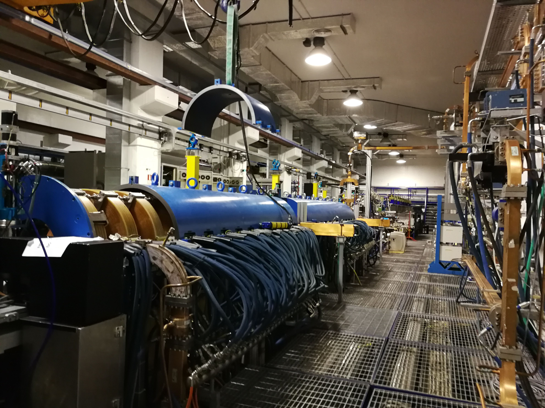
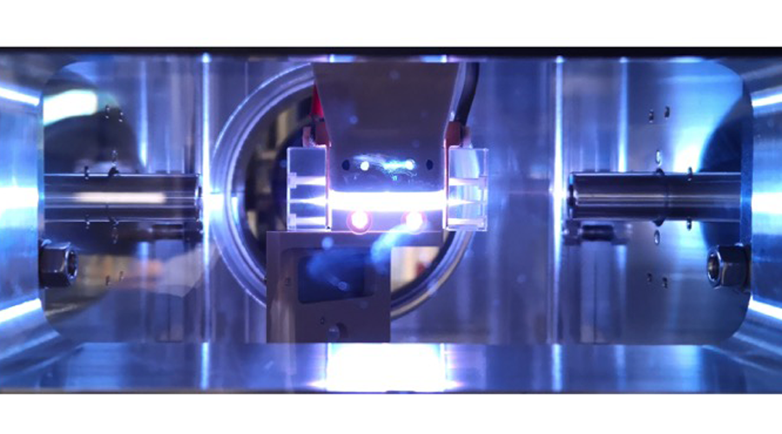
Motivation of Plasma-based Accelerators
SPARC_LAB Accelerator
COMB Chamber of the SPARC_LAB SPARC_LAB
Accelerating Gradient 30-180 MeV
Plasma Module:
(Plasma Cavities/Active Lenses)
mm – cm Scale
1 mm => 100 MeV
Electeric field > 100 GV/m
Cost-effective
Capillary mounted on the SPARC_LAB Chamber

Slide 4
Plasma Wakefiled Acceleration
$ω_{p}$ = $\sqrt{\frac{n_{e} e^{2}}{m_{e}ε_{0}}}$
Acceleration Scheme
Driver
Witness
Creation of the plasma by discharge
Driver beam (electron bunch) enters the plasma
Plasma Parameters
$n_{p}$ (${cm}^{−3})$ | $λ_{p}$ ($μm$) | $ω_{p}$ (Hz)
$${10}^{17}$$ | 100 (300 fs) | 2$×{10}^{13}$
$$α= \frac{n_{bunch}}{n_{e}}$$
Break of neutrality by the Driver induces a following wake where
the second bunch (witness) can be placed
Witness bunch introduced in the plasma
Since the bunch density is > than plasma density the depleted region is Bubble-like
Bunch Parameters
Bunch | $σ_{x}$ ($μm$) | $σ_{z}$ ($μm$)
Driver | 2 | 25 (75 fs)
Linear regime ($n_{bunch}$ < $n_{e}$)
Weakly NL regime ($n_{bunch}$ = $n_{e}$)
Non-linear regime ($n_{bunch}$ >> $n_{e}$)
Bubble length $≈$ $λ_{p}$
Acceleration achieved by placing the Witness at the right distance from the Driver
Accelerating Section
Tajima and Dawson, Phys. Rev. Lett. 43, 267, (1979)
Background density regulates the accelerating field
E [V/m ] $≈$ 96 (n_{e} [cm⁻³])^{1/2}
$$λ_{p}$$
Bubble
The higher is the density, the higher is accelerating gradient, the shorter is the plasma wavelength
Electron-Driver
Electron bunch length and plasma density must be tuned finely
Electron-Witness
One possible matching way is to use plasma capillary devices

Slide 5
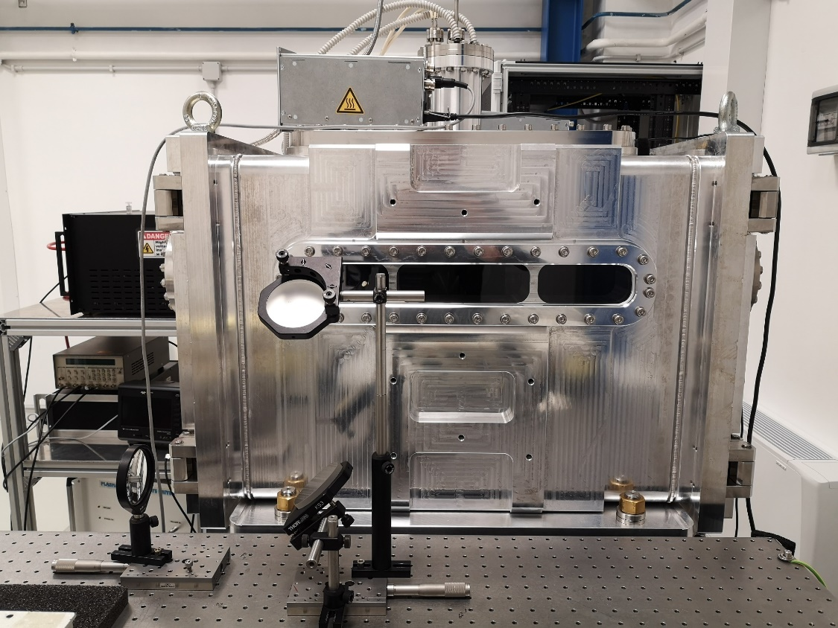
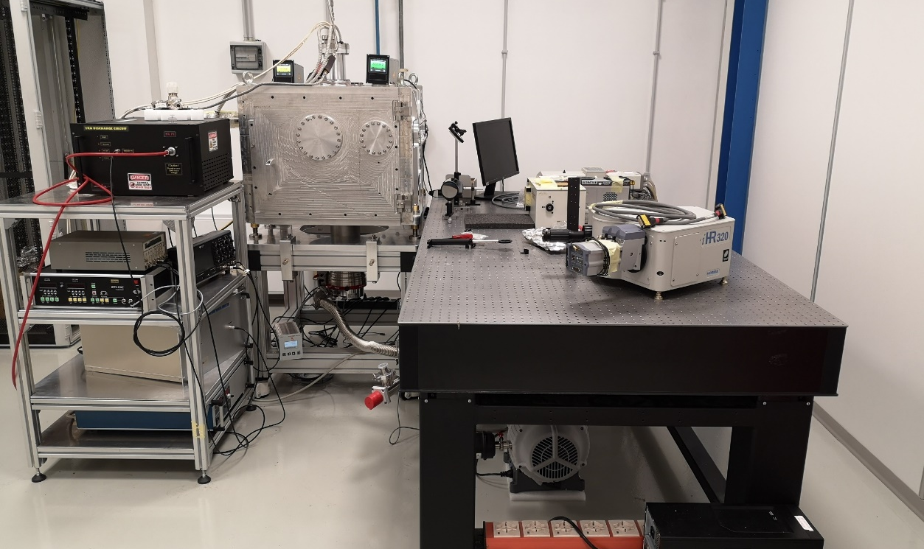
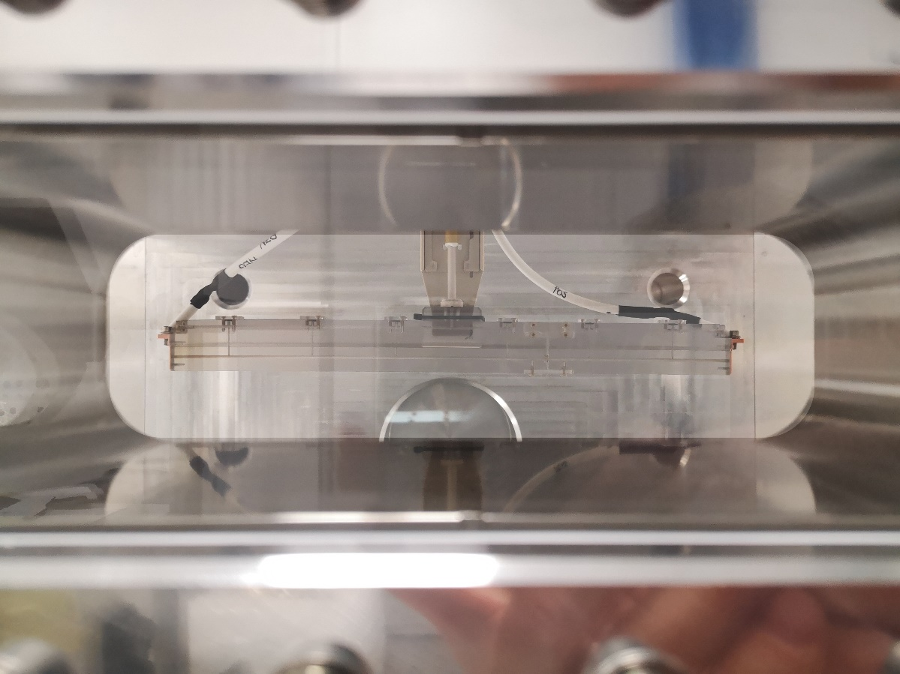
Plasma_LAB of the SPARC_LAB
Plasma module to produce and confine plasma
Plasma vacuum chamber to test devices
Porthole
The Plasma_LAB is devoted to the research and technological development activities for designing and characterizing plasma sources needed to implement particle accelerators based on plasma technology.
Plasma source for particle acceleration

Slide 6
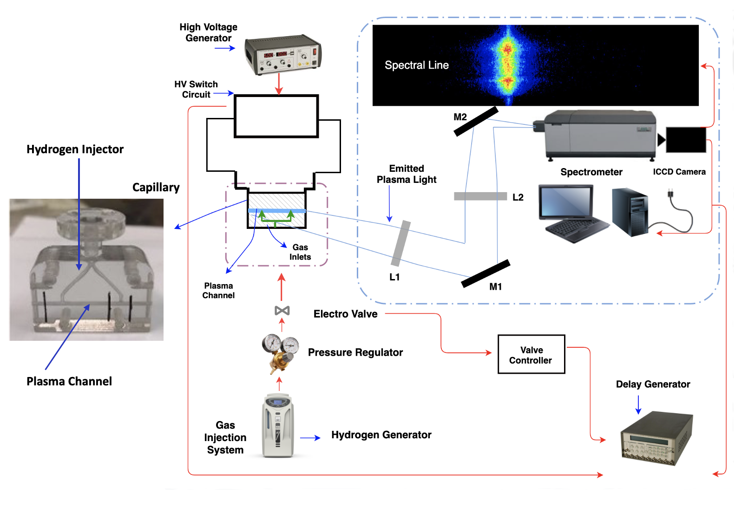
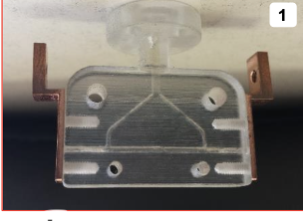
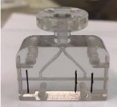
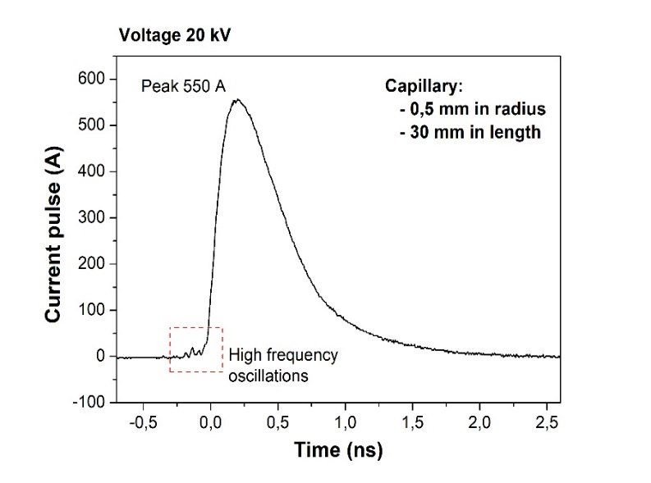
Experimental Apparatus of Plasma_LAB@SPARC
4
Plasma Density ${10}^{17}$ ${cm}^{−3}$
Voltage lasts 1 $μ$s
Electrode
Electrode
Spectral resolution 0.1 nm
Grating 1200 g/mm, 2400 g/mm
focal length: 275 mm
Aperture ratio: f/3.8
$${Δλ}_{1/2}$$
Plasma lasts 10-20 $μ$s
2
Spectral line
$${Δλ}_{1/2}$$
H_alpha
Electrode
Vacuum Chamber
(H_alpha)
Electrode
(10⁻⁷ mbar)
Resistor Capacitor
Circuit
9
8
Capillary
1
Resolution
1024 x 255 pixels
Electrode
5
Gas injection time: 3 ms
Plasma Channel
6
Accelerating Sectio
n
10
10-50 mbar
(imposes the density ${10}^{17}$ ${cm}^{−3})$
7
H_alpha Profile
Gas injection frequency 1-10 Hz
3
Hydrogen is highly ionized at reletively low temperatures
Synchronizes Timing:
Valve opening time
Voltage delay time
Trigger of ICCD camera

Slide 7
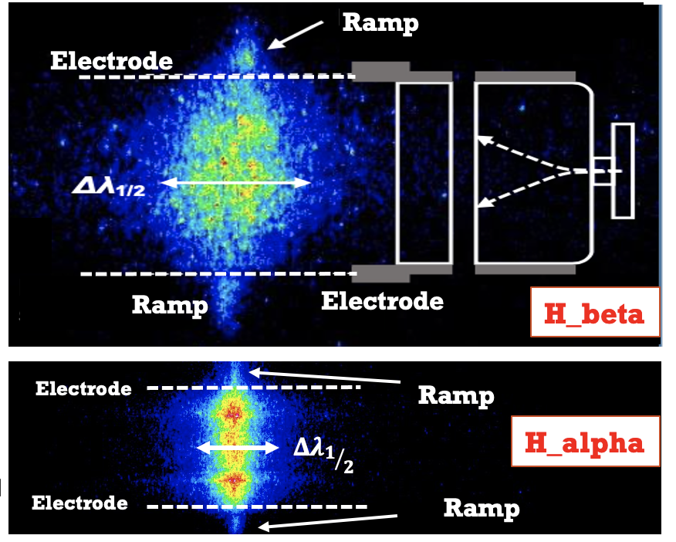
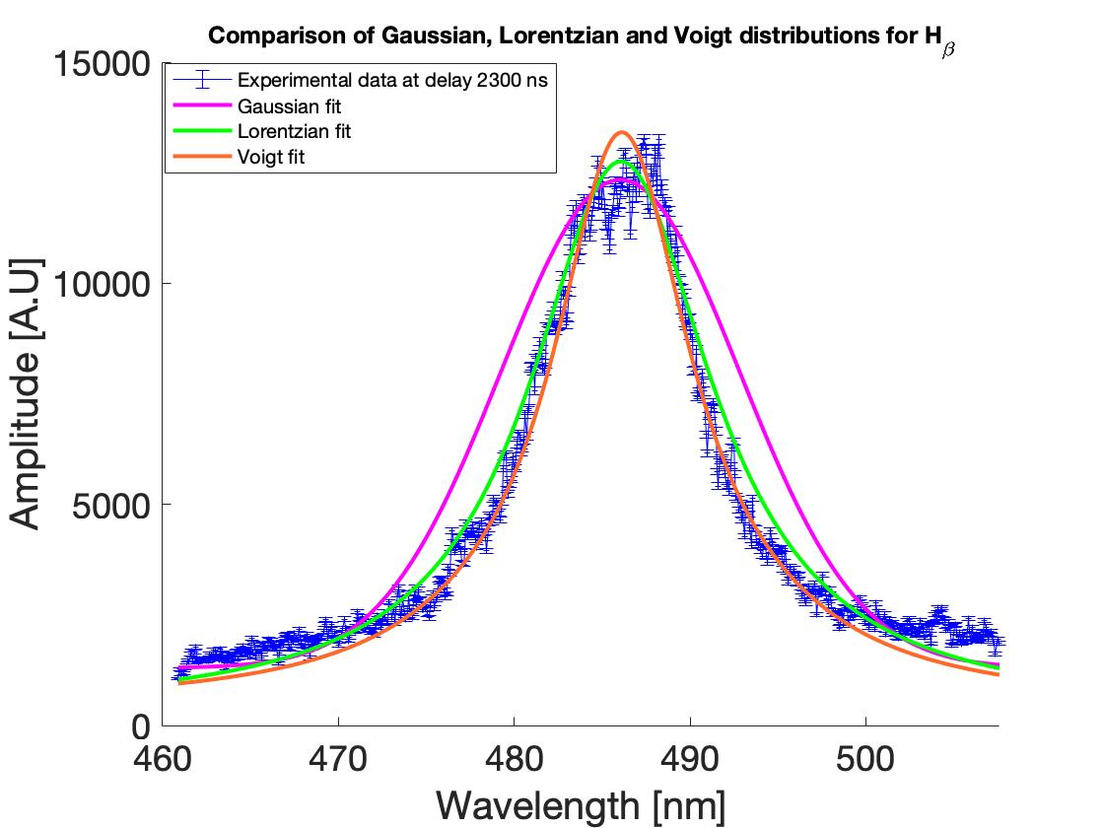
Plasma Diagnostic
Plasma Density ${10}^{17}$ ${cm}^{−3}$ Temperature 1-4 eV
Ramp
Research intrest:
alpha: n 3 → 2 656.2 nm
beta: n 4 → 2 486.1 nm
Electrode
Ionized Hydrogen emits in visible range four lines (Balmer series)
Broadening Mechanisms
For beta line:
(Lorentzian shape)
Spectral Lines
Natural Broadening: energy transition between two states at the most elemental level results in the absorbing or emitting light of a single wavelength.
But for visible light, at temperatures of the order of 1- 4 eV is $≈$0.3 nm (negligible)
(Gaussian shape)
Doppler Broadening:
caused by thermal particle motion, depends on plasma temperature.
Ramp
Electrode
$${Δλ}_{Doppler }=\frac{2λ_{0}}{c}\sqrt{\frac{2k T_{e }ln(2)}{M_{a}}}$$
Electrode
Ramp
$T_{e }$= 1 – 4 eV ${{ n}_{e }\text{=} 10}^{16}$ - ${10}^{17} {cm }^{−3}$
$${Δλ}_{1/2}$$
H_beta Profile
$T_{e }=$3 eV ${ Δλ}_{Doppler }≈ \text{0.06 }\text{nm}$ (negligible)
Ramp
Stark Broadening:
caused by the emitter interaction with the electric field produced by nearby charges (measured $≥$ 23 nm).
(Lorentzian shape)
FWHM
D. G. Jang et al., Appl. Phys. Lett. 99, 141502 (2011)
is a function of the electron density and the temperature (tabulated by Griem)
Broadening
$$n_{e}=8.02 × {10}^{12}( \frac{\text{Δ}λ_{Stark}}{α_{1/2}}{ )}^{3/2} {cm}^{−3}$$
HR Griem, Academic Press Inc, App. III (1974)
$The{ α}_{1/2} for the plasma in the range of:$ ${10}^{17}{cm}^{−3} and$ 2-4 eV (almost constant)
$α_{1/2}$for alpha line = 0.0166 nm $α_{1/2}$for beta line = 0.0919 nm

Slide 8
Plasma Sources Charecterization
Studied Parameters
2
4
Temperature Measurement
Plasma Ramp
Ramp Formation
Ramp Stabilization
1
Oxygen Element (O II, O III)
Nitrogen Element (N II, N III)
Different Geometry
3
Capillary Length
Capillary Diameter
Inlet Number
Inlets Distance
Channel Shape (Tapered/Enlarged)
Capillary Aging and Wall Deformation
VeroClear Material
Sapphire Material
5
Plasma Stability
Shot-to-shot Stability
Plasma Density Stabilization

Slide 9
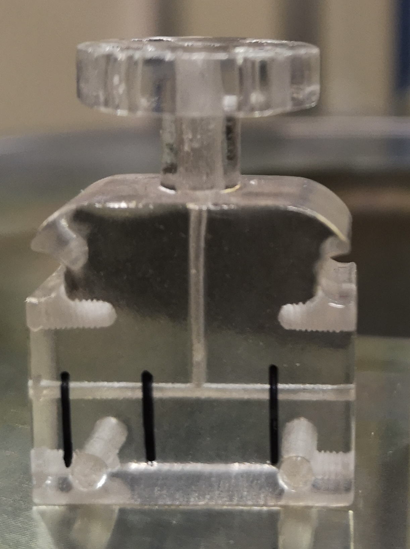
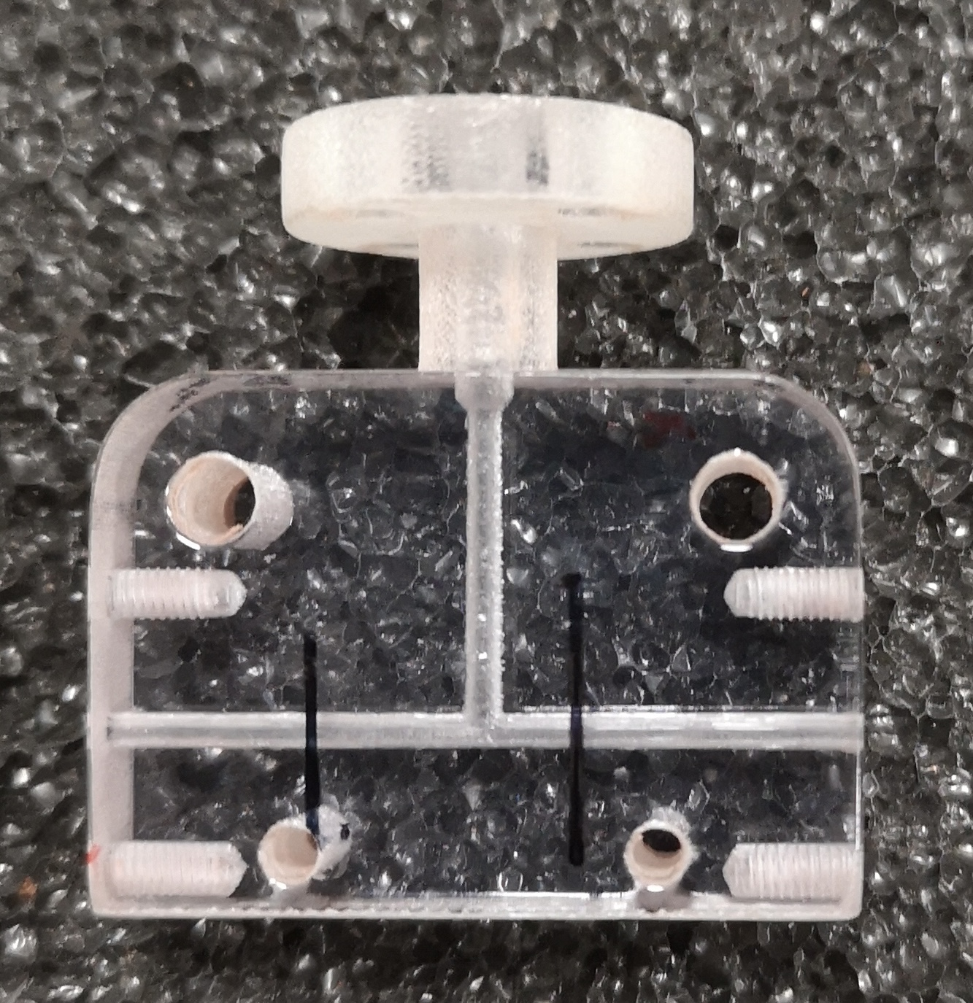
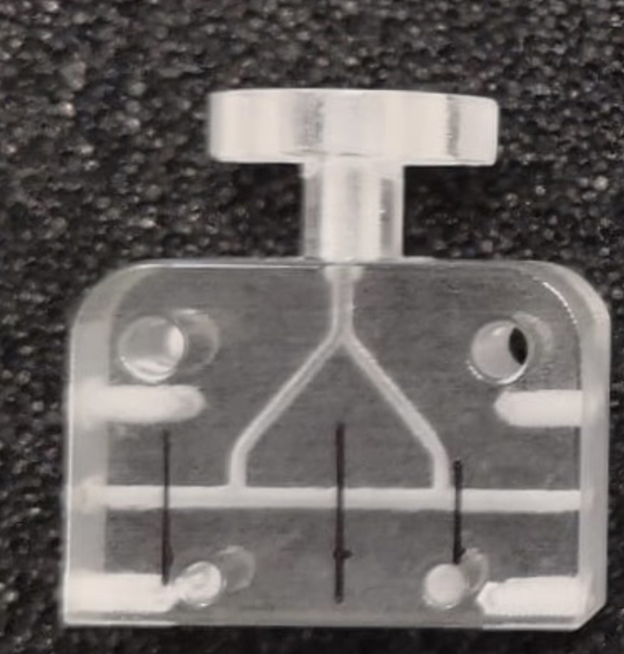
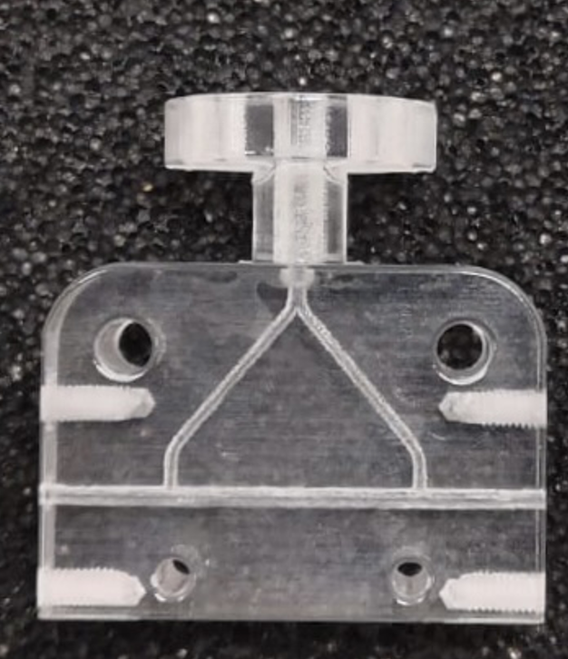
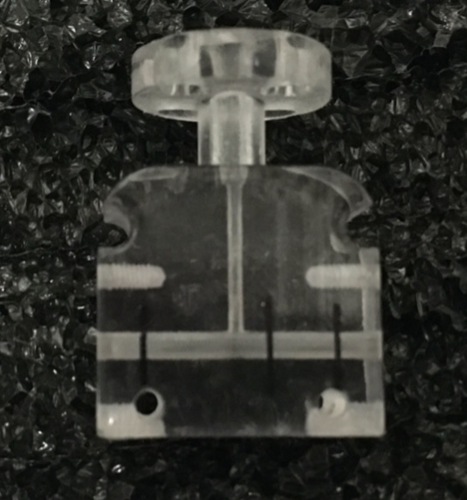
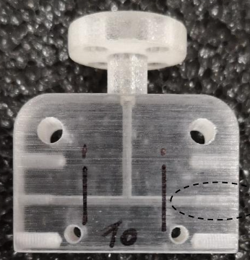
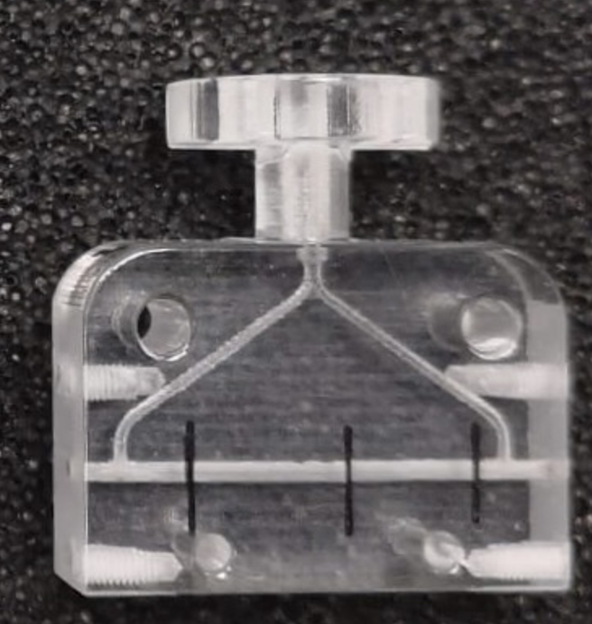
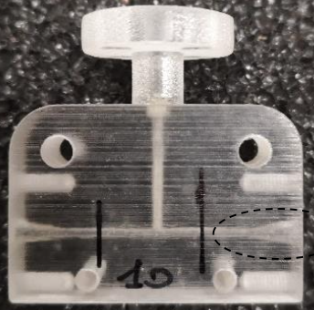
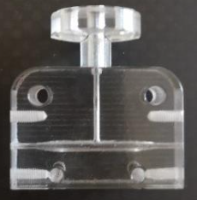
Study on Capillaries with Different Geometry
The principal goal of changing the Capillary geometry is to have the plasma and electron bunch with a same phase.
Tested Capillaries
Capillary Length
Capillary Diameter
Inlet Number
Inlets Distance
Channel Shape
1
1
1
1
1
12 mm
3
Linear
4
2 cm
2
2
Single
2
Cigar-like
(Tapered)
3 cm
1 mm
24 mm
0.9 mm
2 mm
Double
2
15 mm
2
1.4 mm
2cm/1mm/1inlet
2cm/1mm/1inlet
3mm/1mm/1inlet
Funnel-end
(Enlarged)
1.3 mm
3
1
1
1
1
Wide-square-end
(Enlarged)
1
1.3 mm
3
2
2
2
2
3
2
4
3cm/1mm/1inlet
2cm/2mm/1inlet
3mm/1mm/2inlets

Slide 10
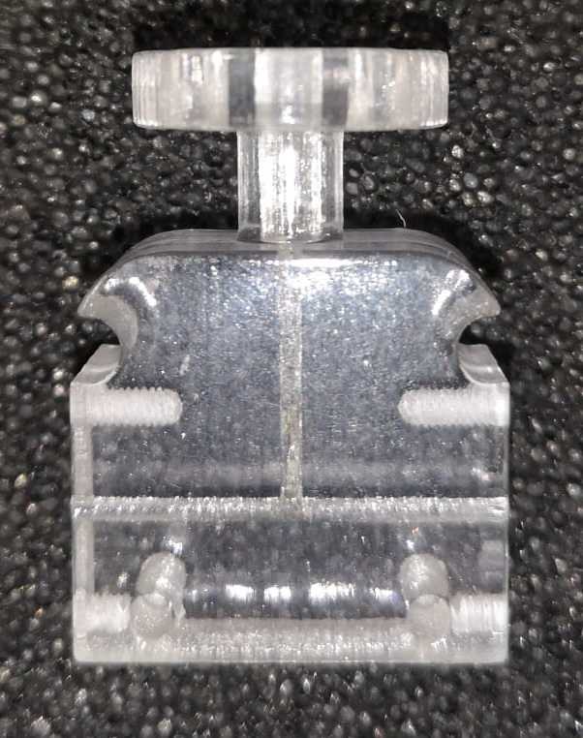
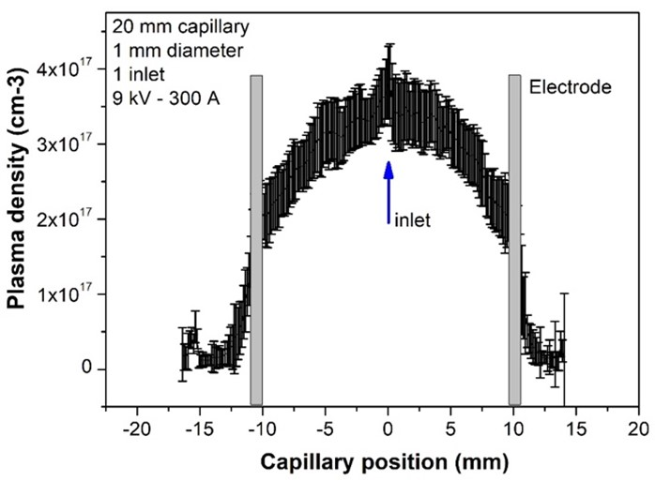
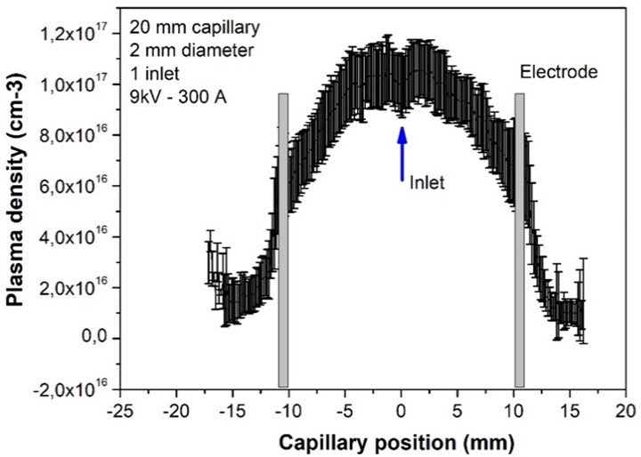
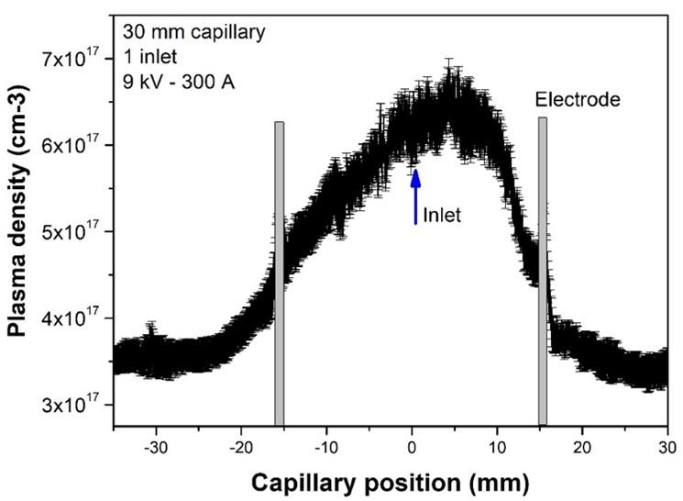
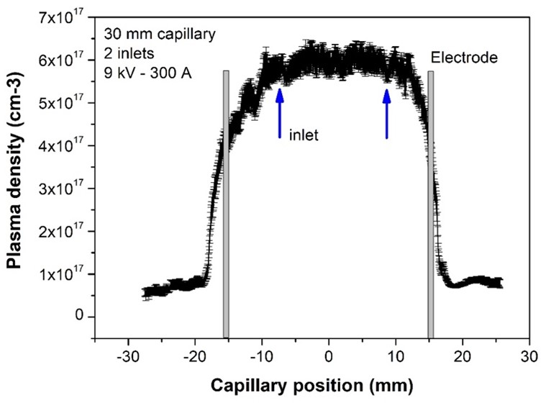
Changing the Channel Diameter and Number of Gas Inlets
1
peak
peak
1×10¹⁷
2
3.5×10¹⁷
2×10¹⁷
6×10¹⁶
1 mm
2 mm
2 cm long
1 mm diameter
1 inlet
Voltage: 9 kV
Current: 300 A
2 cm long
2 mm diameter
1 inlet
Voltage: 9 kV
Current: 300 A
Reduction of 75%
Reduction of 65%
3
1 inlet
6.7×10¹⁷
2 inlets
6.5×10¹⁷
4
4.5×10¹⁷
Rough reduction
4.5×10¹⁷
Short ramp
3 long
1 mm diameter
1 inlet
Voltage: 9 kV
Current: 300 A
3 long
1 mm diameter
2 inlets
Voltage: 9 kV
Current: 300 A
Plateau
Quasi-Uniform

Slide 11
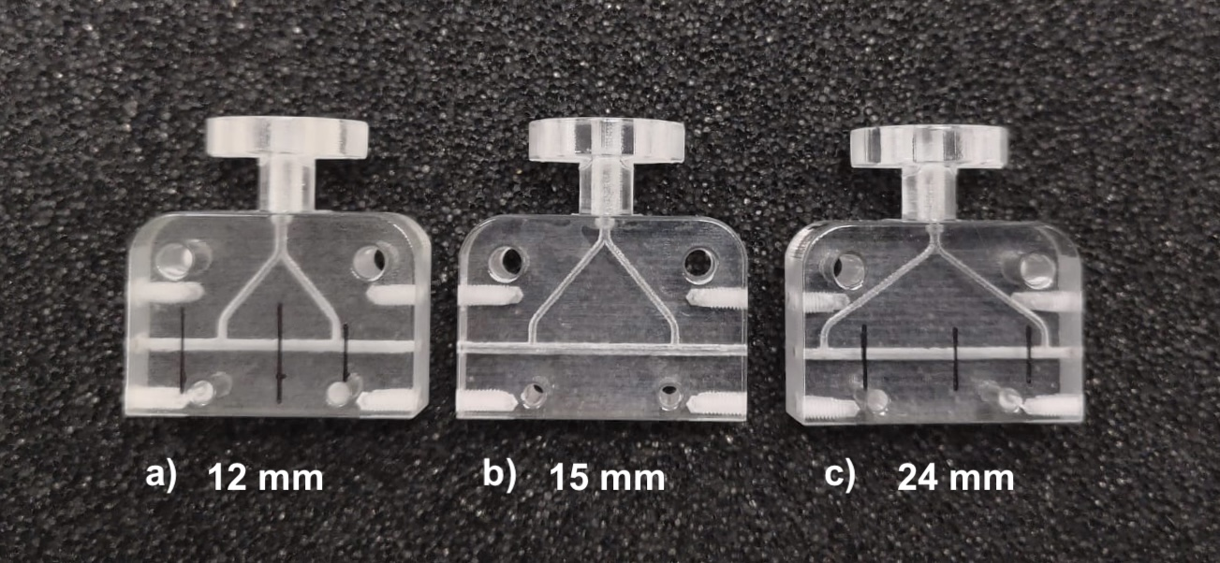
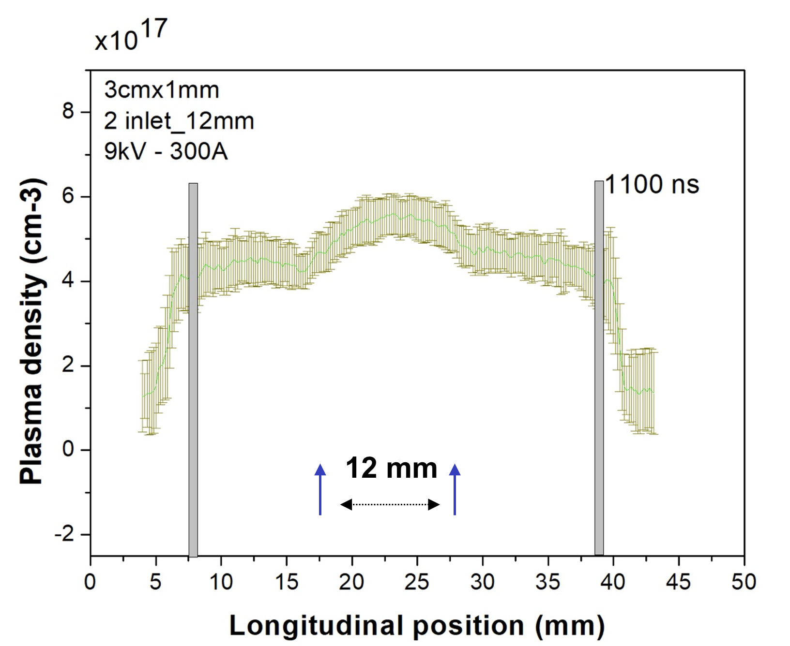
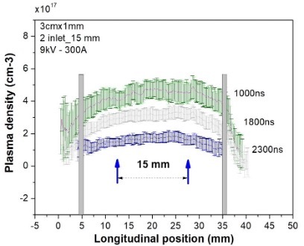
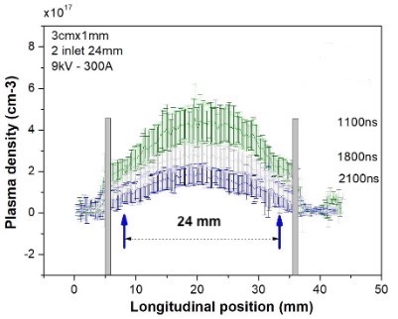
Changing the Positioning of Gas Inlets
Classical
3 cm long
1mm diameter
2 inlets
Voltage: 9 kV
Current: 300 A
b)
c)
a)
Over-accumulation
Quasi-uniform
Gaussian

Slide 12
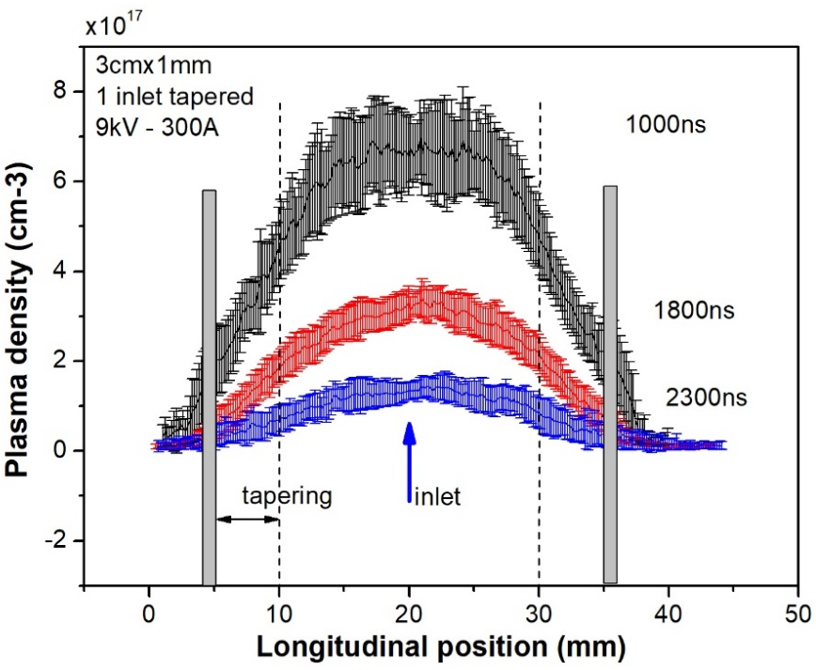
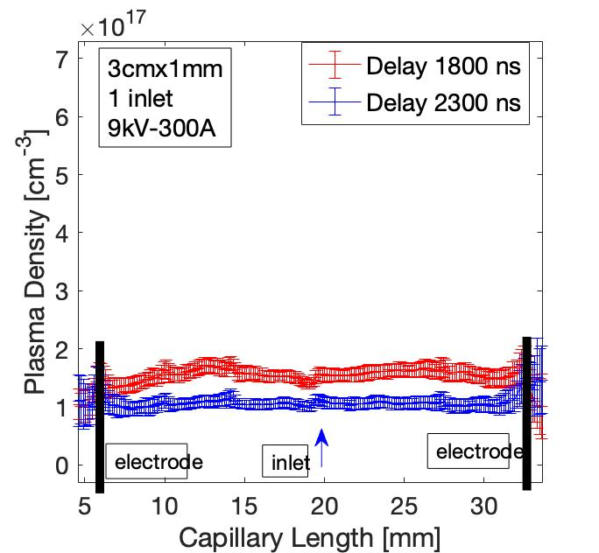
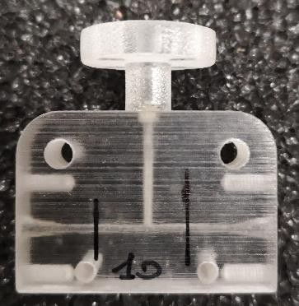
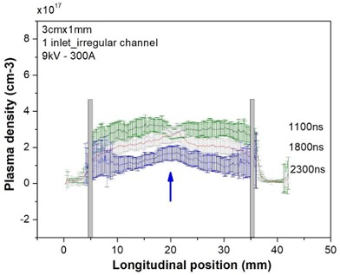
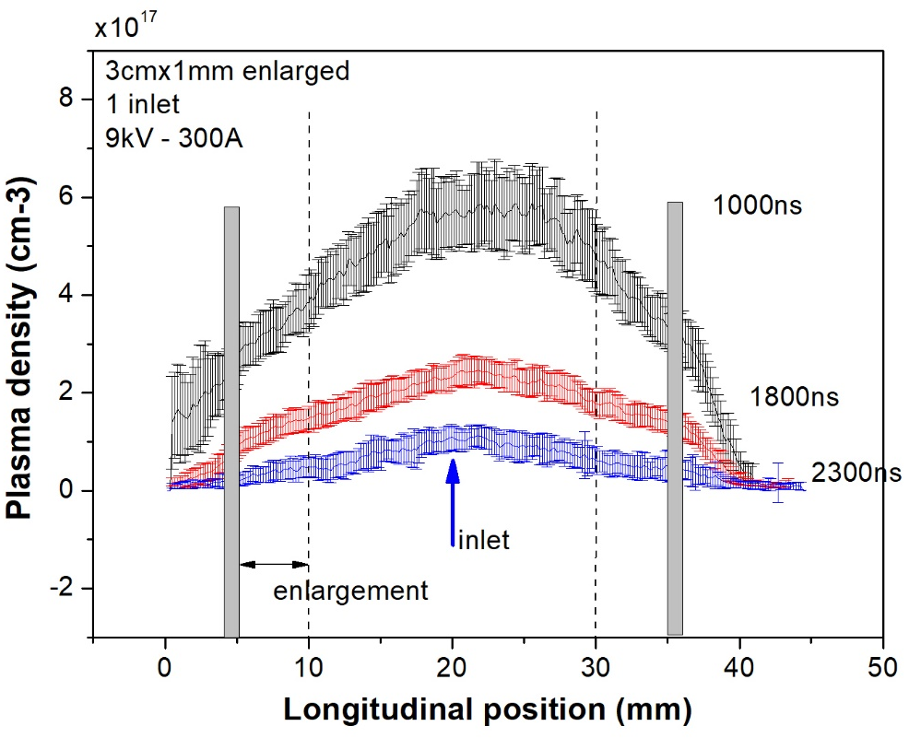
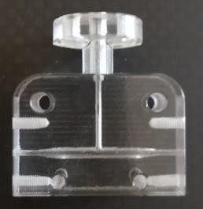
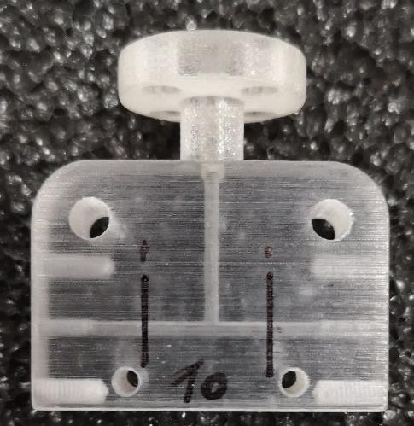
Changing the Longitudinal Shape of the Channel
9 kV - 300 A
20 mbar
3 cm x 1 mm
1 inlet
Funnel-end
Gaussian
3
1
Linear
0.9 mm
1.3 mm enlargement
Quasi-uniform
2
Cigar-like
4
Wide Square-end
1.4 mm enlargement
Accumulation
1.3 mm enlargement
inlet

Slide 13
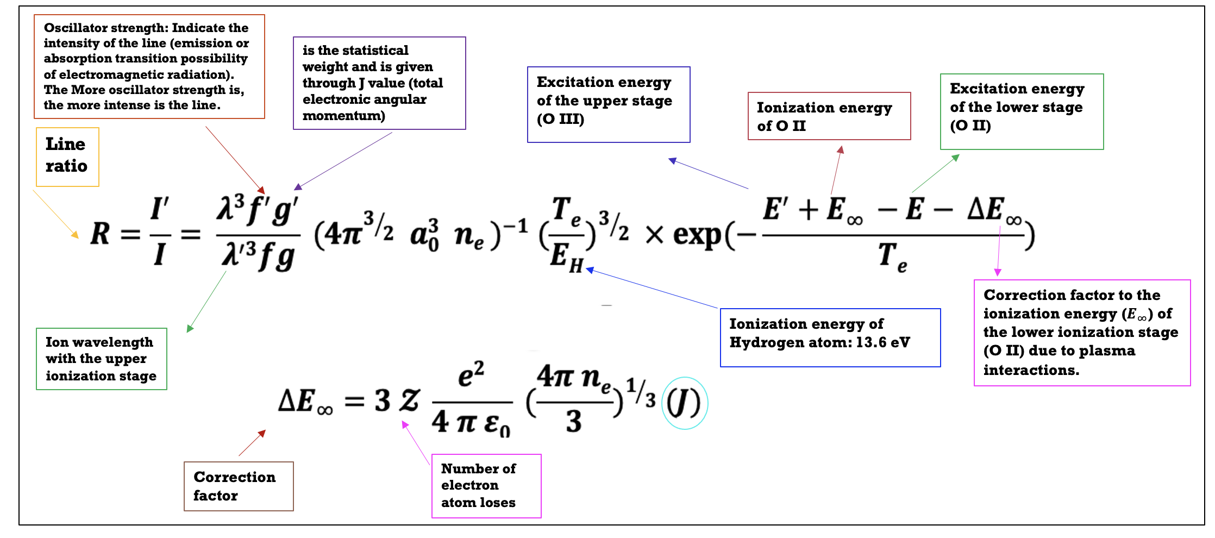
Plasma Temperature Analyses
We have retrieved electron temperature from line intensities of same element but with subsequent ionization stage.
Relative line intensities from the same element and same ionization state usually do not reveal accurate temperatures since there is relatively a slight separation between the upper levels of the two lines.
S. S. Harilal et al., 52, 3, (1998)
Lower ionization stage: $I, g, f, λ$
Higher ionization stage: $I^{′}$, $g^{′}$, $f^{′}$, $λ^{′}$
NIST Database (https://physics.nist.gov/PhysRefData/ASD/levels_form.html)
13

Slide 14
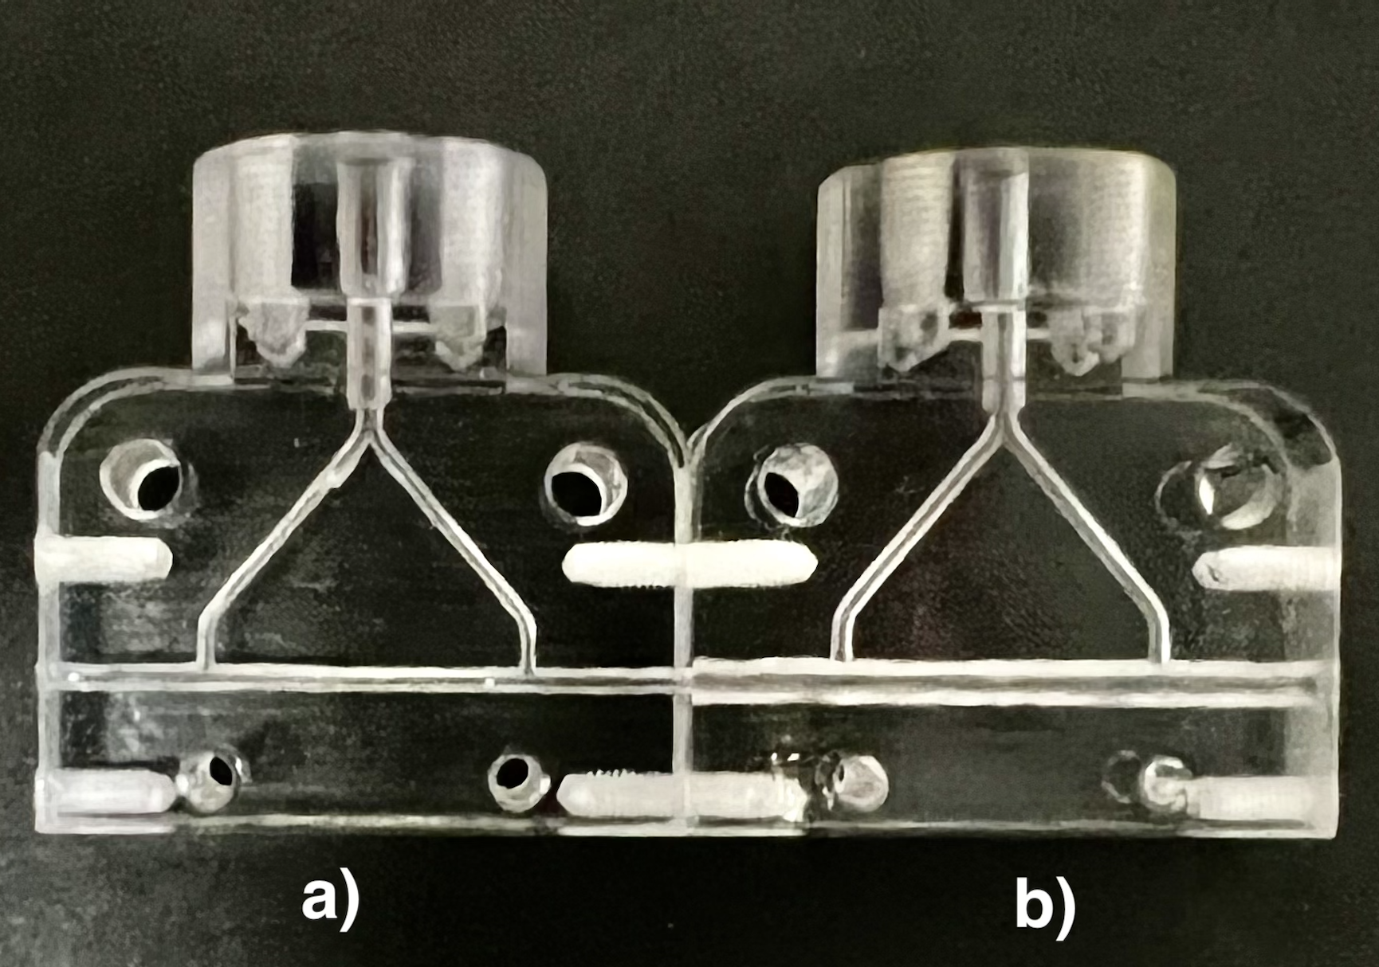
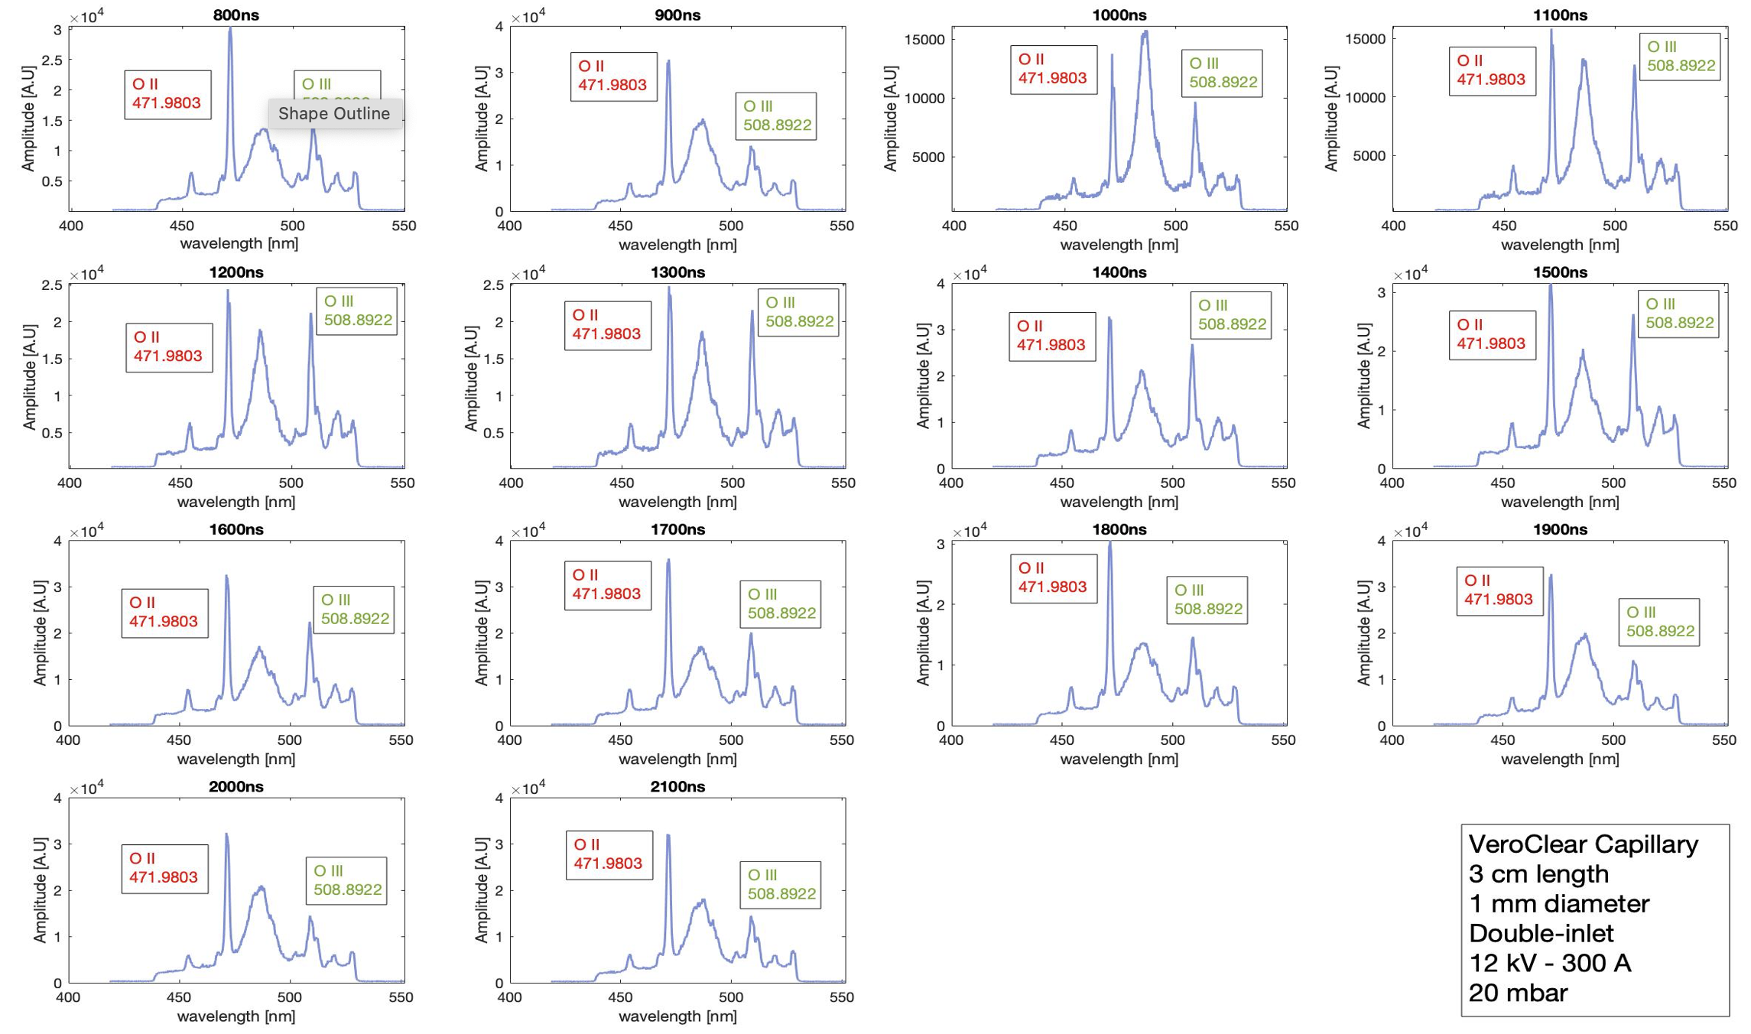
Plasma Temperature Analyses
Evolution of the Oxygen ions
1 mm/diameter
2 mm/diameter
3 cm long
1 and 2 mm diameter
Double-inlet system
20 mbar
12 kV – 400 A
800-2100 ns delay time
Two mechanisms:
Ablation
Desorption
VeroClear Chemical Components ($C_{5}O_{2}H_{8}$):
82.92% Carbon
16.50% Oxygen
78% Nitrogen in the air (impurity)
O II (471.9803 nm) or N II (471.8377 nm)
O III (508.8922 nm) or N III (454.970 nm)
14

Slide 15
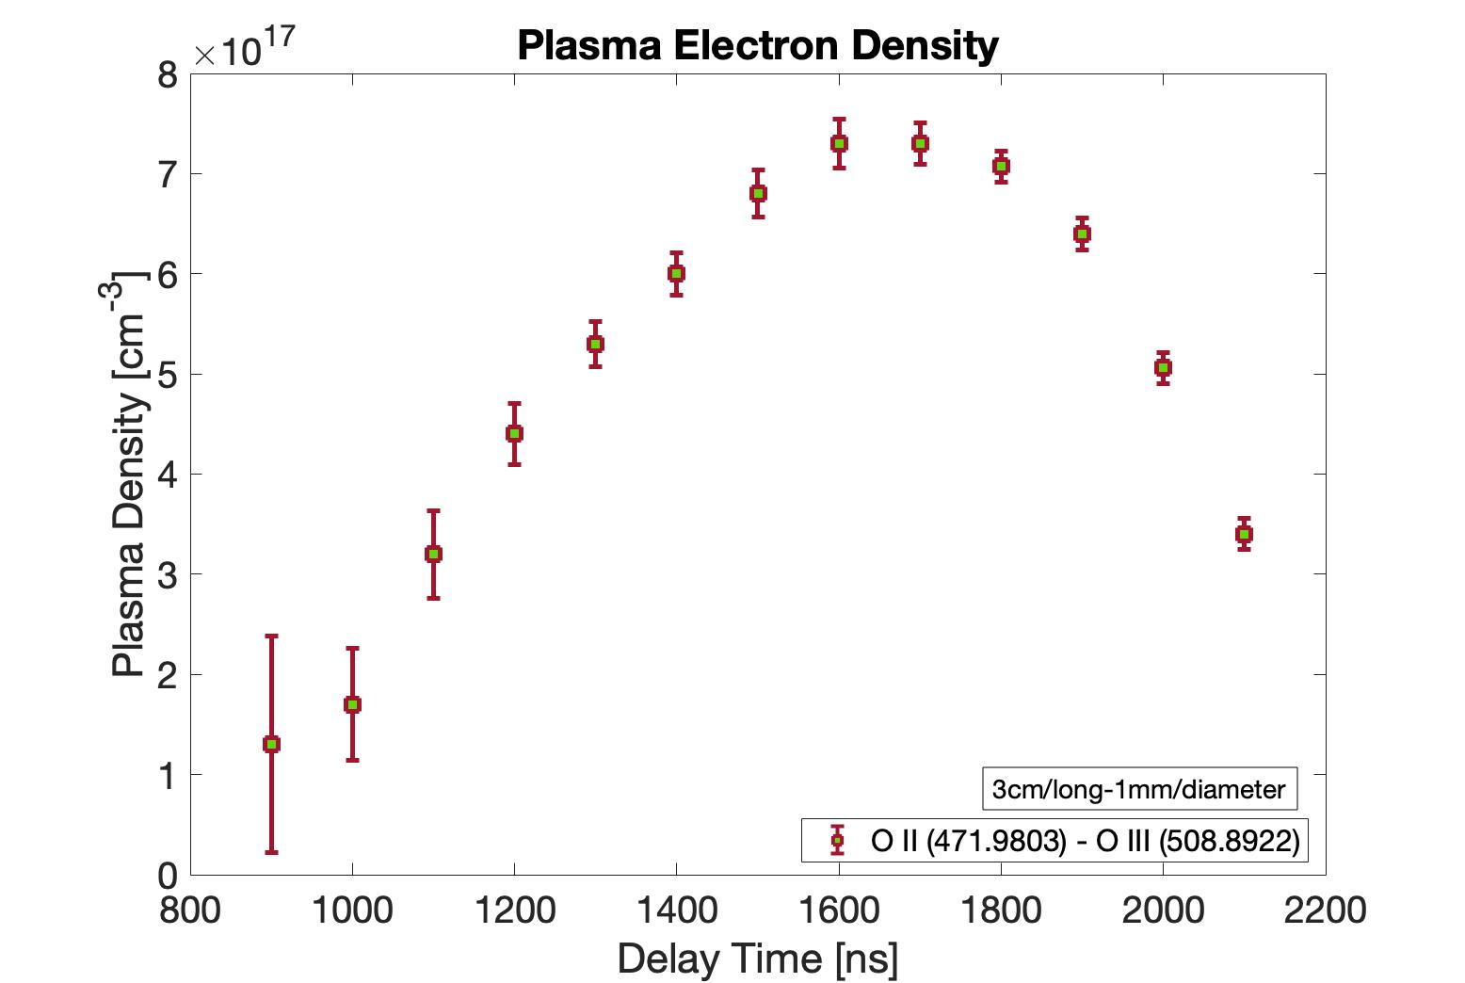
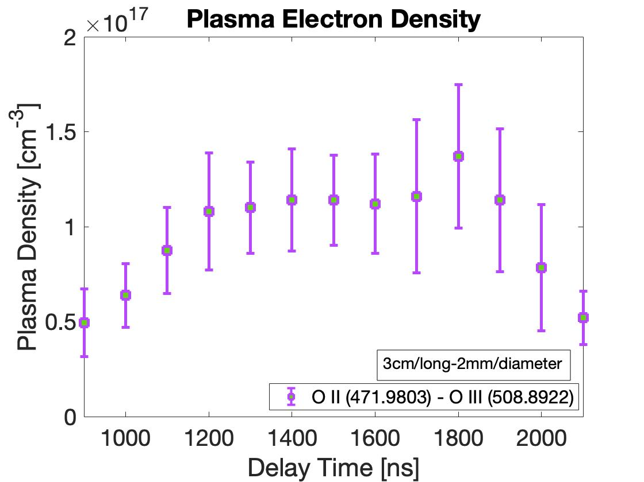
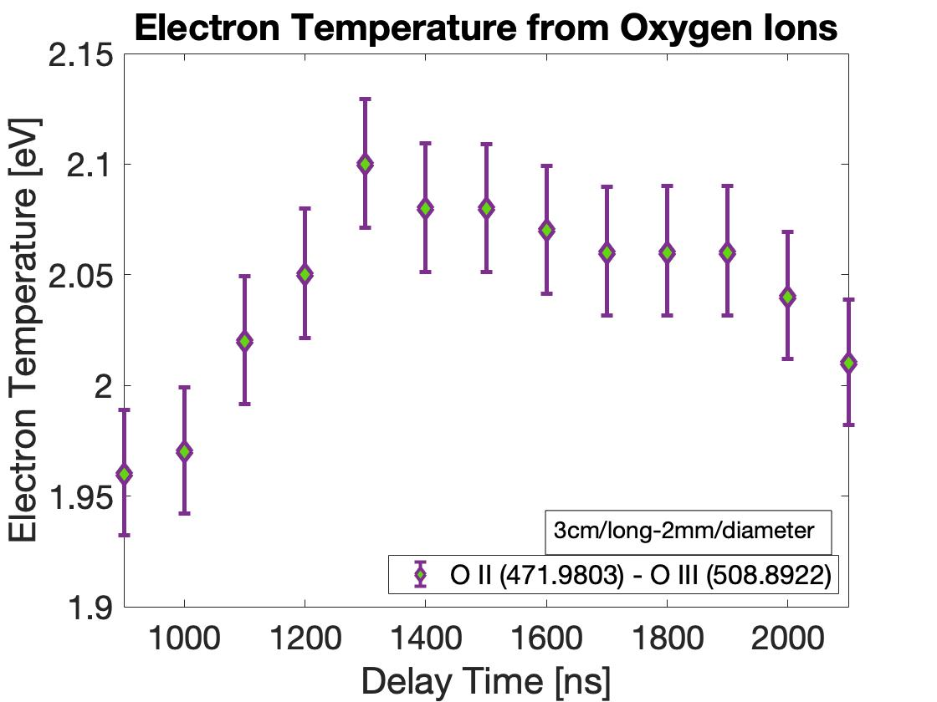
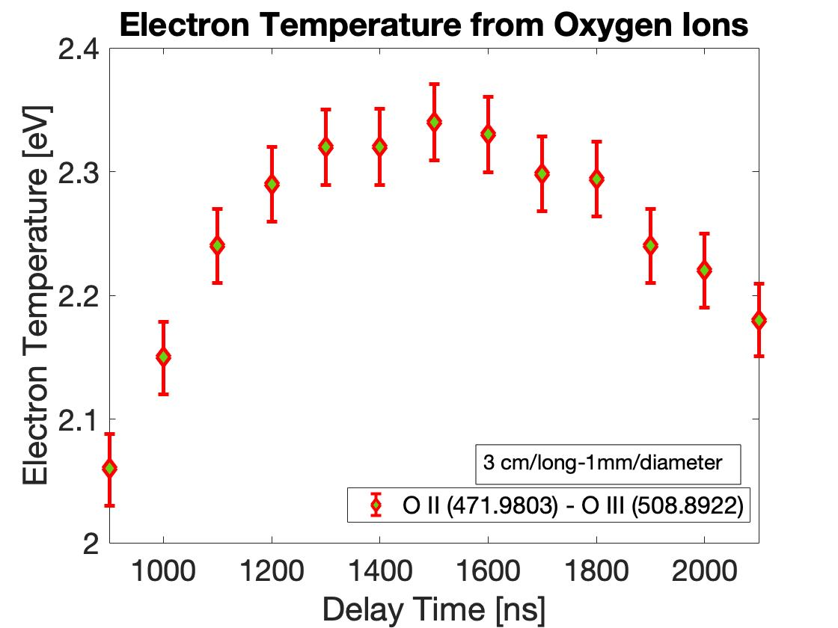
Plasma Temperature Analyses From Oxygen Ions
3 cm length
1 mm diameter
Double-inlets
20 mbar
12 kV – 400 A
3 cm length
2 mm diameter
Double-inlets
20 mbar
12 kV – 400 A
A. J. Gonsalves, et al., Journal of Applied Physics 119, 033302 (2016)
On-axis temperature estimation
On-axis temperature estimation
$$T_{e}=5.7 [\frac{I \left(kA\right)}{r_{cap }\left(mm\right)}]^{2/5}$$
$$r_{cap}=0.5 \left(mm\right)$$
I = 400 A = 0.4 (kA)
$T_{e}=$ 5.2 (eV)
$$T_{e}=5.7 [\frac{I \left(kA\right)}{r_{cap }\left(mm\right)}]^{2/5}$$
$$r_{cap}=1 \left(mm\right)$$
I = 400 A = 0.4 (kA)
$T_{e}=$ 3.9 (eV)
Average temperature
2.06 - 2.34 eV
Average temperature
1.96 - 2.14 eV

Slide 16
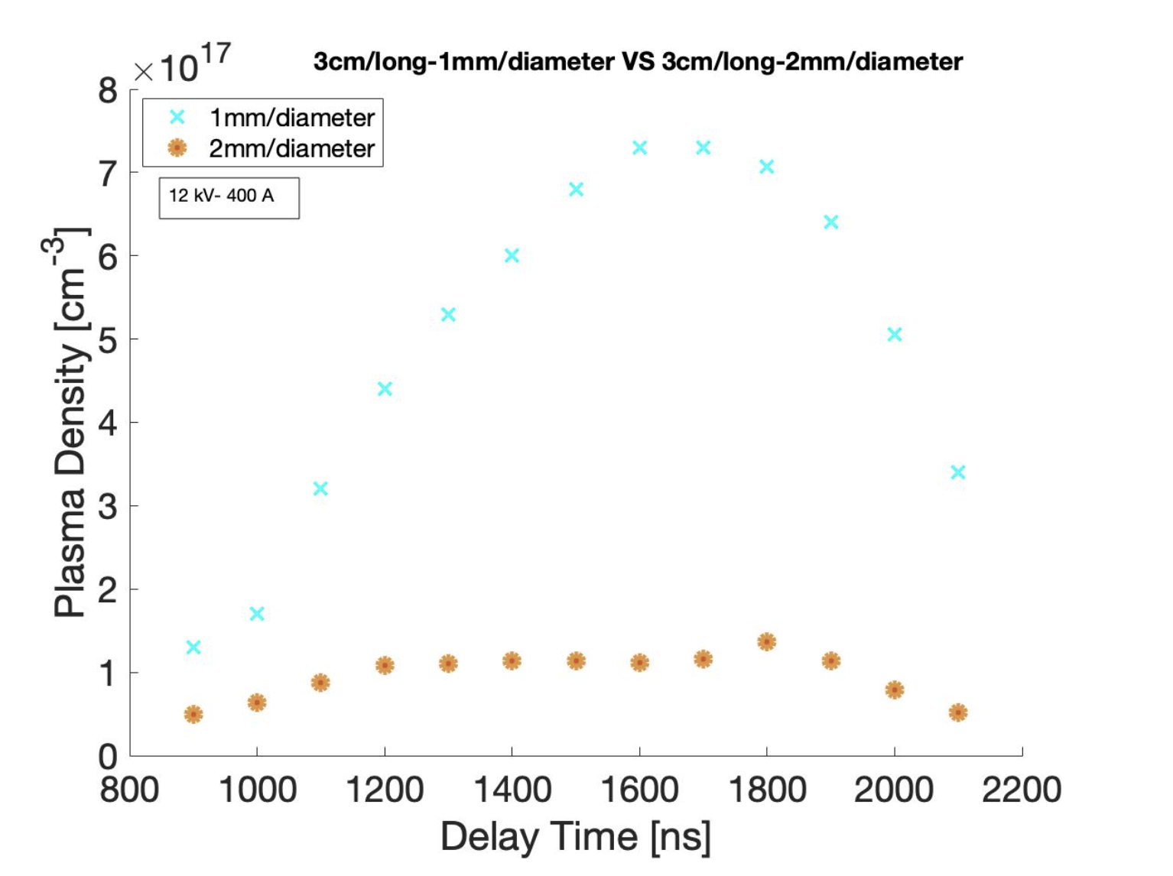
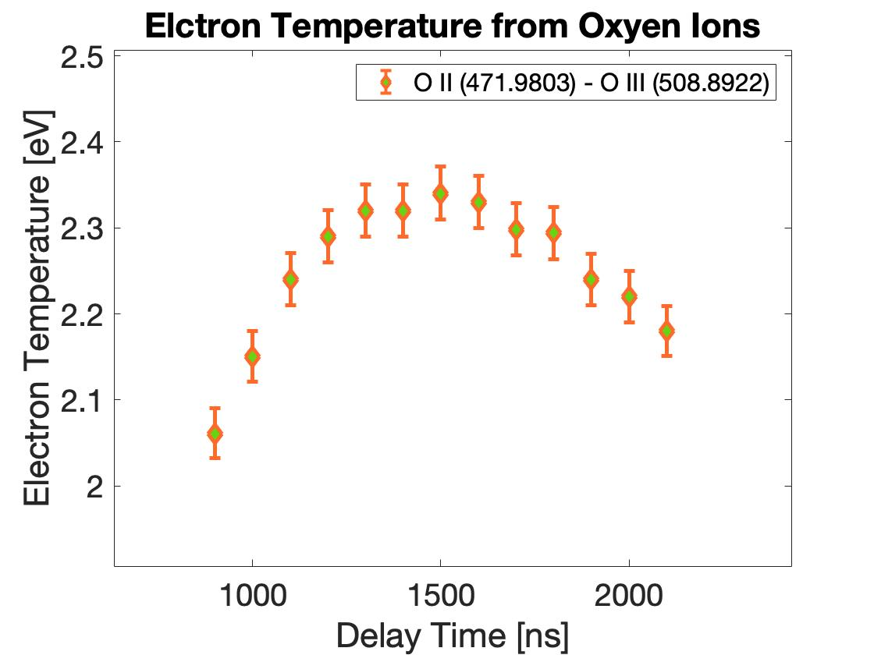
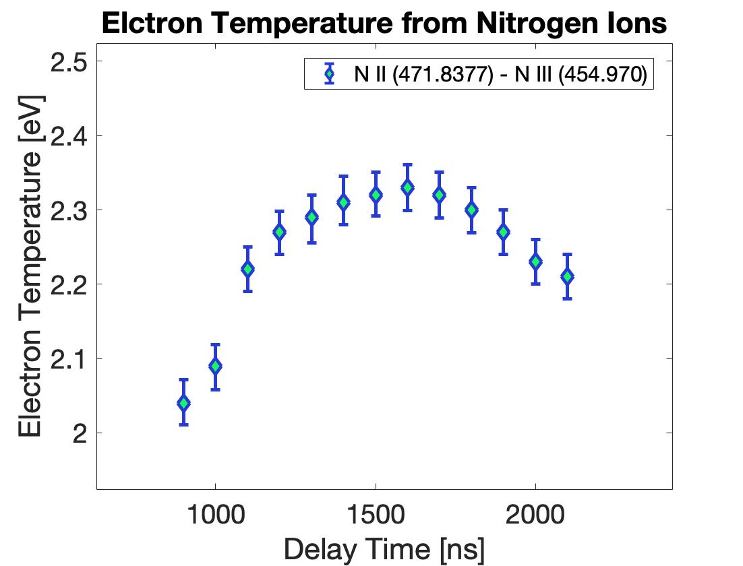
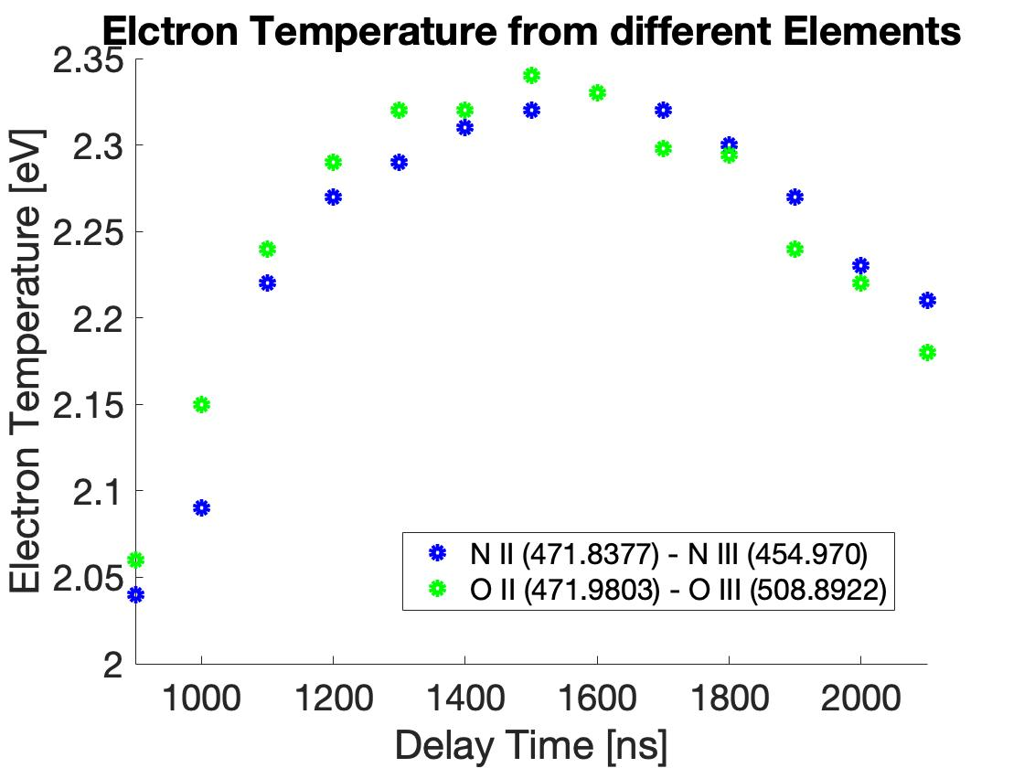
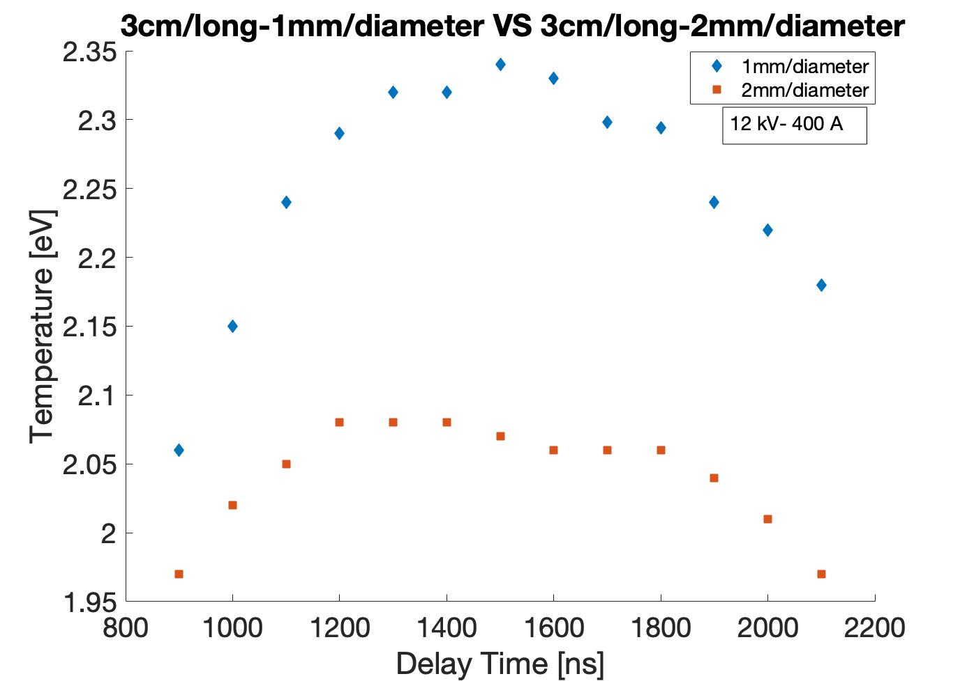
Temperature Results Comparison (Oxygen/Nitrogen Ions)
Density
3 cm length
1 mm, 2mm diameter
Double-inlets
20 mbar
12 kV – 400 A
Temperature
3 cm long
1 mm diameter
Double-inlet system
20 mbar
12 kV – 400 A

Slide 17
Plasma Temperature Simulation
VeroClear Chemical Components ($C_{5}O_{2}H_{8}$):
82.92% Carbon
16.50% Oxygen
78% Nitrogen in the air (impurity)
Experimental
Theoretical
Lower ionization stage: O II (471.9803 nm) or N II (471.8377 nm)
Higher ionization stage: O III (508.8922 nm) or N III (454.970 nm)
NIST LIBS Database (https://physics.nist.gov/PhysRefData/ASD/LIBS/libs-form.html)
17

Slide 18
Capillary Aging Studies Using VeroClear ($C_{5}O_{2}H_{8}$) Material
3 cm long
1 mm diameter
1 inlet
12 kV
300 A
20 mbar
inlet
inlet
inlet
mean 5.2x10¹⁷
Quasi-uniform
40%
reduction
mean 6.5x10¹⁷
mean 4x10¹⁷
Super-Gaussian
Heat deflection temperature (HDT) of 313 - 323 K and
thermal conductivity of 0.2 W${ m}^{−1} {\text{K}}^{−1}$
0 shot
40000 shots
100000 shots
The longitudinal profile is changed from super-gaussian to quasi-uniform profile and the mean value goes from 6.5x10¹⁷ to 4x10¹⁷ cm⁻³ (channel changed from 1 to 1.5 mm)
This deformation is proportional to the thermal energy deposition on the capillary walls:
A. J. Gonsalves, et al., Journal of Applied Physics 119, 033302 (2016)
On-axis temperature:
0 shot
Channel deformation
T$e=3.9 eV$
S. Arjmand
6 September 2022

Slide 19
Capillary Aging Studies Using Sapphire Material
inlet
inlet
inlet
inlet
inlet
inlet
3 cm long
1 mm diameter
2 inlets
12 kV
300 A
20 mbar
mean 7x10¹⁷
mean 7x10¹⁷
mean 7x10¹⁷
0 shot
40000 shots
100000 shots
(mm)
Melting point of 2300 K as stainless steel and
thermal conductivity of 40 W${ m}^{−1} {\text{K}}^{−1}$
After 10⁵ shots there is no any changing of the longitudinal profile and the mean value goes from 7x10¹⁷ cm⁻³ (maybe we have to reach 10⁶ shots).
Inner Sapphire Core

Slide 20
Plasma Ramps Formation
Plasma density inside and outside the capillary changes during the current pulse. Such a behaviour it is essential for injecting the electron bunch at the right time. Moreover, Plasma density ramps at the ends of the capillary can reach a total expansion length around 40 mm (20 mm each one) that is comparable with the channel length of 30 mm, so they can strongly affect the bunch properties that passes through the capillary.
NB
3 cm/long
1 mm/diameter
Double inlets
Voltage: 18 kV
The movie is of the real behavior of the ramp (recorded via the ICCD without the usage spectrometer).
Captured 20 images separated by 100 ns, so 2 µs of total observation time of the plasma ramp.
Electrode shadow
Vacuum
Discharge Voltage 18 kV
Capillary
Electrode
Voltage lasts 1 $μ$s
Electrode shadow
20 mm/2 μs
Plasma lasts 10-20 $μ$s
Plasma channel
Electrode

Slide 21
Plasma Ramps Stabilization through Spacer Device
Spacer: Is a 1 cm elongation that can be mounted on the capillary’s exterimities, near the electrodes to stabilize the plasma ramps (expanding the capillary length without changing the position of electrodes).
a) Linear Spacer
b) Linear+deflectors
Linear Spacer
Standrad Capillary
Spacer with 2 deflectors
Electrode shadow
Spacers mounted on the capillary
Plasma Channel
Electrode
Electrode shadow
a)
b)
c)
d)
a)

Slide 22
Plasma Ramp Evolution without and with Spacer
Snap-shot of the plasma Ramps Without Spacer
Snap-shot of the plasma Ramps With Linear Spacer
Electrode is at the bottom of the image.
NB
Movies are of the real behavior of the ramps, recorded via the ICCD without the spectrometer.
No_Spacer_delay2000 ns
Linear Spacer_delay2000 ns

Slide 23
Plasma Ramp Stabilization
3 cm/long-1 mm/diameter
Single-inlet
Voltage: 10 kV
Current: 350 A
pressure: 20 mbar
Repetition rate: 1 Hz
Vacuum: 10⁻⁷ mbar
Comparison of Ramps:
Standard Geometry (without Spacer)
Capillary with Linear Spacer
Capillary with Spacer and deflector (deflectors made 2 cm far from the spacer edge)
6 mm
9 mm
10 mm
S. Arjmand et al., JINST 15 C09055 (2020)
23

Slide 24
Study on shot-to-shot Stability of the Plasma Density
3 cm in length
1 mm in diameter
2 inlets
5 , 16 kV
10, 20, 30 mbar
~ 150 ns timing jitter
~ 20 ns timing jitter
Voltage: 16 kV
Current: 670 A
Voltage: 5 kV
Current: 120 A
100 consecutive current pulse waveforms acquired by an oscilloscope at a 1~Hz repetition rate.
Timing jitter: measuring the enlargement of the current pulse waveforms by setting the infinitive persistence on the oscilloscope
5 kV – 120 A
16 kV – 670 A
0.5×10¹⁷
0.7×10¹⁷
$≈20$%
$≈7$%
S. Arjmand et al., JINST, 2021 (Under revision)

Slide 25
Plasma Density Stabilization By Laser a Technique
3 cmx1mm
2 inlets
20 mbar
Voltage: 5 kV
Laser: 80 mJ
Current: 110 A
Q-switched Nd:YAG Laser at 1064 nm
Pulse duration 11 ns
Few tens of ns before the discharge
Laser intensity ${10}^{10} W/{cm^{2}}$
NO Laser
Amplitude jitter 10.7 A
Timing jitter 32 ns
25%
Laser 80 mJ
Amplitude jitter 1 A
Timing jitter 1.7 ns
11%
A. Biagioni, S. Arjmand et al., Plasma Phys. Control. Fusion 63 115013, (2021)
25

Slide 26
PWFA: Preliminary Results
Plasma obtained at 12kV-310 A
Electron density 10¹⁵ cm⁻³
$λ_{p}$ ~ 1050 um
By using a 3cm long capillary, an accelerating gradient of 100 MV/m has been obtained, which is comparable to 20-30 MeV of conventional accelerating system.
R. Pompili et al., Nature, 605, 659–662 2022

Slide 27
Conclusions:
The electron temperature in gas-filled capillaries through relative line intensities from different elements has studied.
We have demonstrated that spacer device is stabilized the plasma ramps instabilities.
Tests on channel shaping allow us to modify the plasma density longitudinal profile depending on the application.
The timing jitter of the plasma insatiability has studied and is proved that by increasing the voltage the timing jitter will be decreased.
We have observed that the plasma instability reduced from 25% to 11% by applying a laser pulse of 80 mJ at one electrode.
Tested sources:
Future Prospective:
Using a mixed gas (Ar+H, etc.) for generating the plasma
New component (Glass) for printing out the capillary
Study on the Large-scale capillaries (up to 40 cm), with 2 or 3 electrodes
Test the segmented capillary
Plasma generation in curved capillary channels
Increasing the repetition rate (10 Hz) by improving the vacuum pumping system
40cm/2mm

Slide 28
Core Publications:
Under Revision
S. Arjmand et al., "Spectral line shape for plasma electron density characterization in capillary tubes", Journal of Physics: Conference Series (JPCS), 2022.
S. Arjmand et al., "Study the on shot-to-shot stability of the plasma density for gas-filled plasma capillaries", JINST, 2021.
Published
S. Arjmand et al., "Spectroscopic measurements as diagnostic tool for plasma-filled capillaries", Proc. IPAC’22, JACoW-IPAC2022-WEPOST035 {Proc. IPAC’22}, 1776-1779. doi:10.18429/
Riccardo Pompili et al., "First lasing of a free-electron laser with a compact beam-driven plasma accelerator", Nature, 2021-05-08735.
Mario Galletti et al., “Advanced Stabilization Methods of Plasma Devices for Plasma-Based Acceleration”, Symmetry 2022, 14(3).
G Costa et al., “Characterisation and optimisation of targets for plasma wakefield acceleration at SPARC_LAB”, Plasma Phys. Control. Fusion, (2022) 64 044012.
Angelo Biagioni et al., "Gas-filled capillary-discharge stabilization for plasma-based accelerators by means of a laser pulse", Plasma Phys. Control. Fusion, PPCF-103442.R1.
S. Arjmand et al., "Characterization of plasma sources for plasma-based accelerators", Plasma Physics By Lasers and Applications (PPLA), 2019, JINST 15 C09055.

Slide 29
Do appreciate
your
attention,
Covid Affected Thesis
S. Arjmand

