Slide 1
IHEP SCD beamtest preparation
Rui Qiao; Ke Gong; Wen-Xi Peng; Bing Lu; Ruo-Si Lu

Slide 2
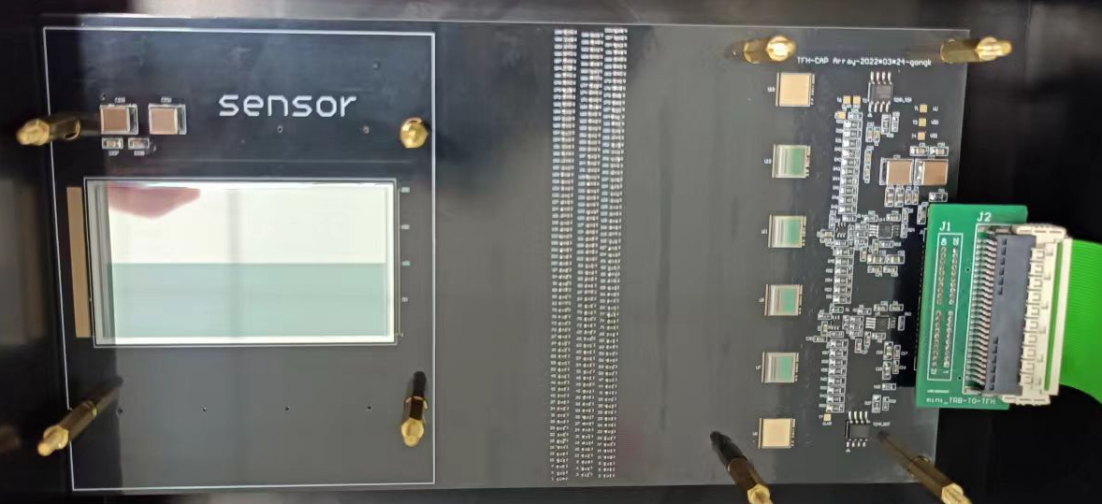
ladder preparation
Parameter | Value
Thickness [um] | 309
Length [cm] | 6
Dep. Volt. [V] | 34
Strip pitch [um] | 80
Strip width [um] | 25/60
Num. of strips | 400
Num. of channels | 200
Sensor specifications
Based on DAMPE. Used 4 VA140 to read 200 channels.
External capacitors.
Sensor with two zooms
Ext. cap.
Front-end
electronics
Notes:
来源：G:\keyan\HERD项目文档\周进展\资料\20220824_第一块束流测试板\

Slide 3
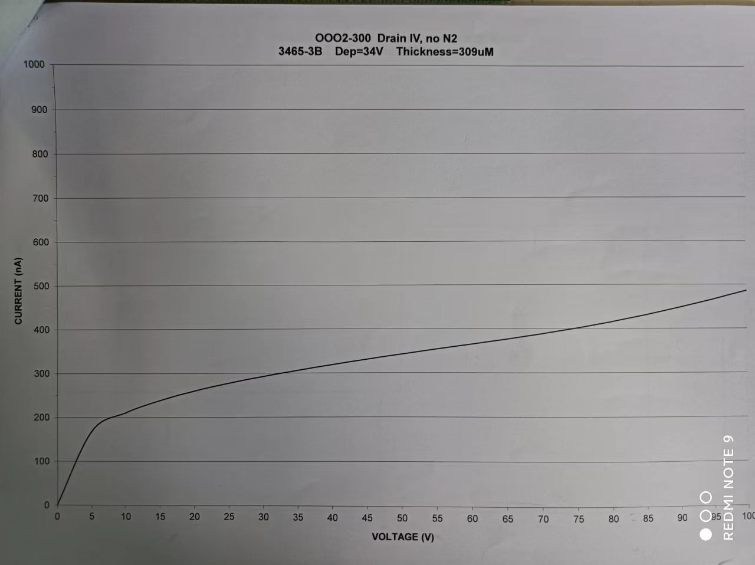
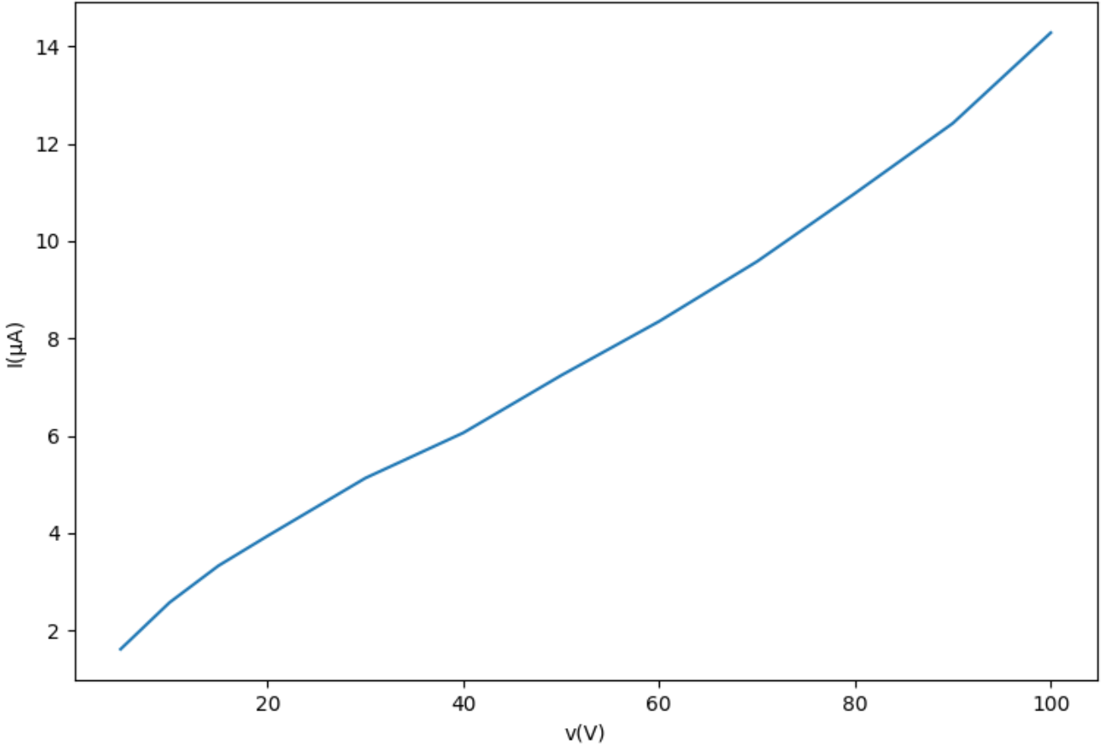
Ladder test: I-V curve
VS
IHEP measurements
MICRON measurements
The MICRON leakage current is 300 nA with 35V.
After gluing and bonding, the leakage current is 5 uA.
There were some problems during bonding, so that the engineer removed and re-bond half wires.
Notes:
来源：G:\keyan\学生工作\2022_卢若思\进展报告\220825_粘好硅后测试IV和基线.pptx
G:\keyan\HERD项目文档\周进展\资料\20220824_第一块束流测试板\

Slide 4
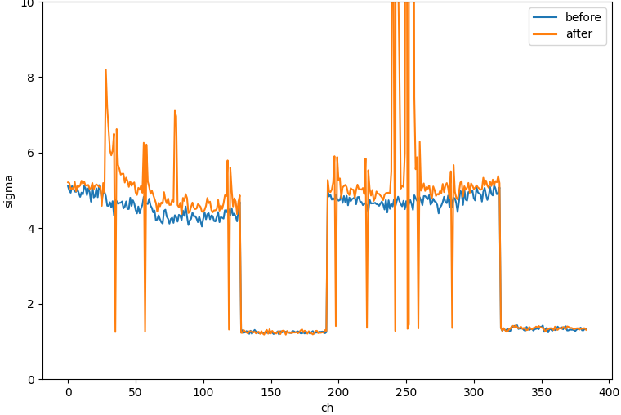
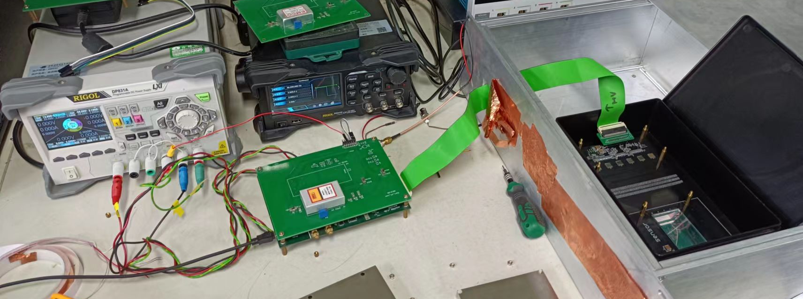
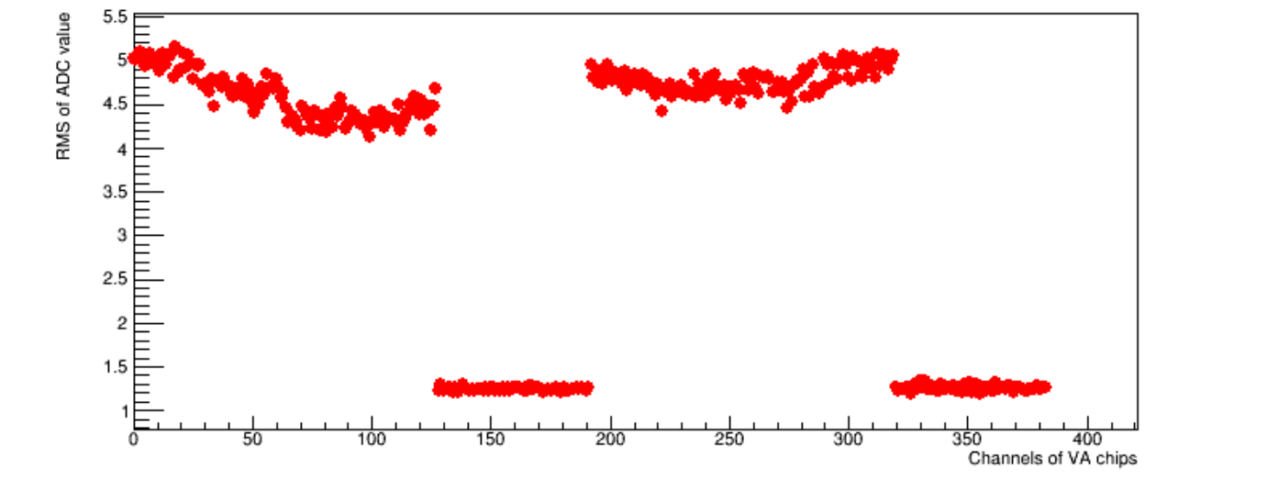
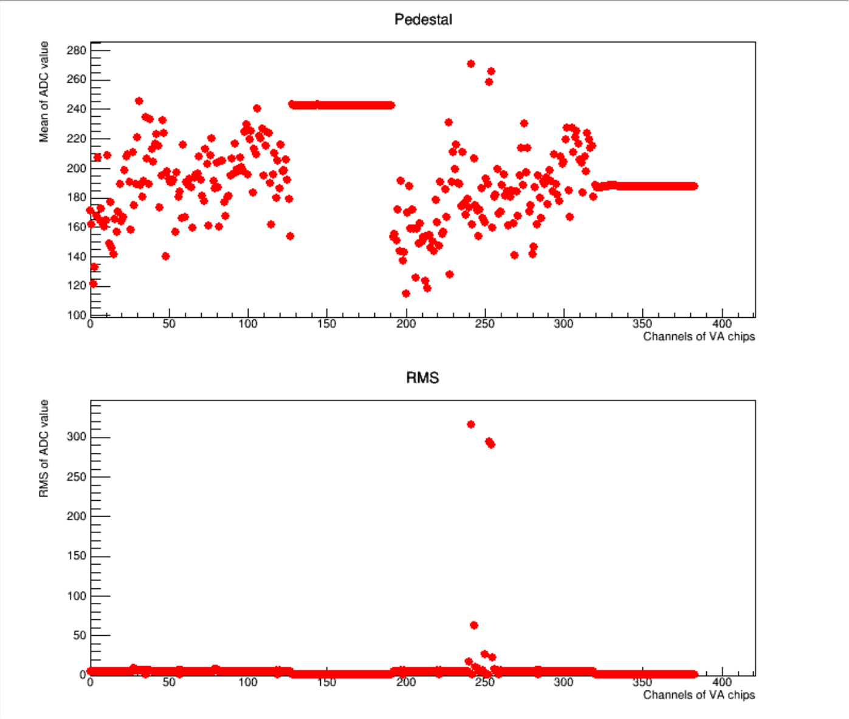
Ladder test: noise test
No ASIC
No ASIC
Use periodic triggers to measure the noise level
Comparison of noise level with/without sensor
Raw noise level without sensor
Raw noise level with sensor
No ASIC
No ASIC
Notes:
来源：G:\keyan\学生工作\2022_卢若思\进展报告\220825_粘好硅后测试IV和基线.pptx
G:\keyan\HERD项目文档\周进展\资料\20220824_第一块束流测试板\

Slide 5
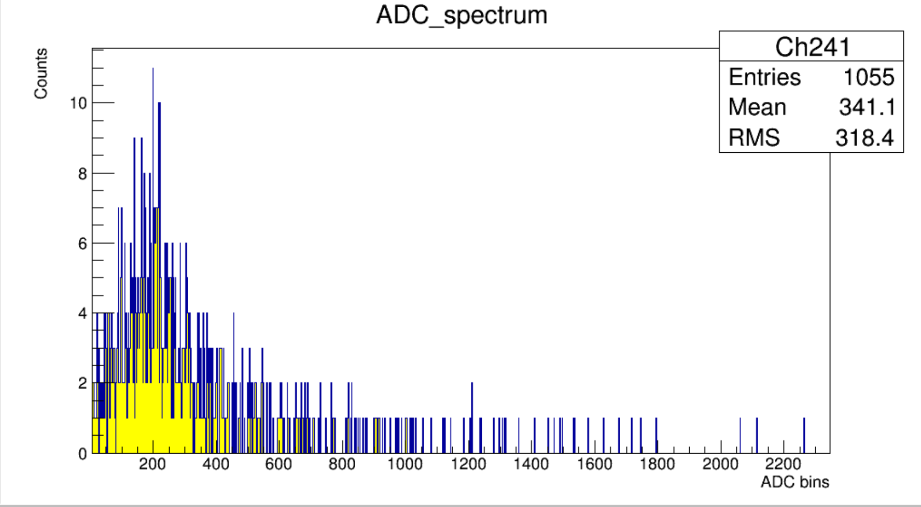
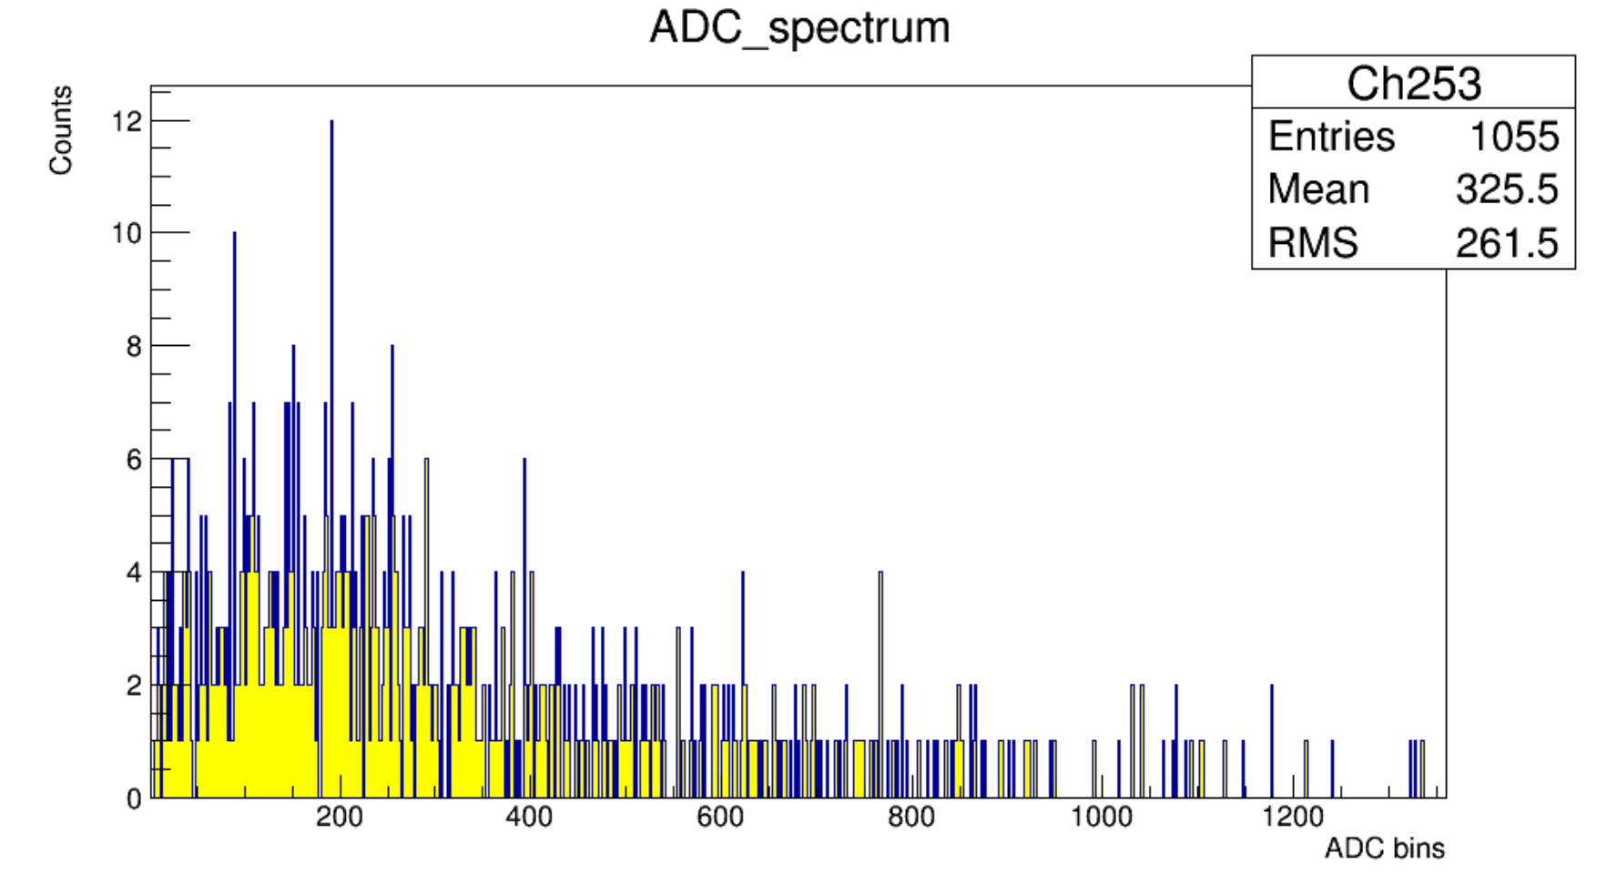
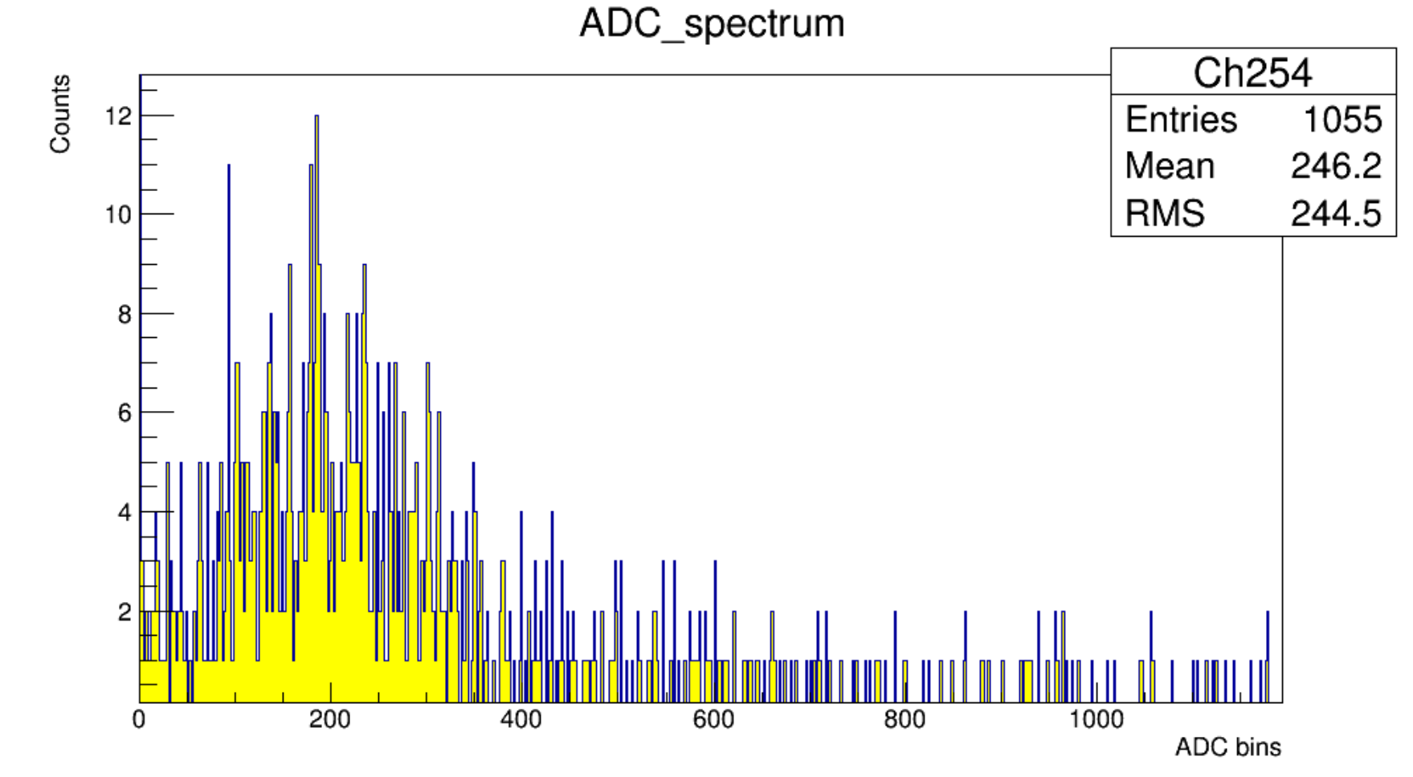
Notes:
来源：G:\keyan\学生工作\2022_卢若思\进展报告\220825_粘好硅后测试IV和基线.pptx

Slide 6
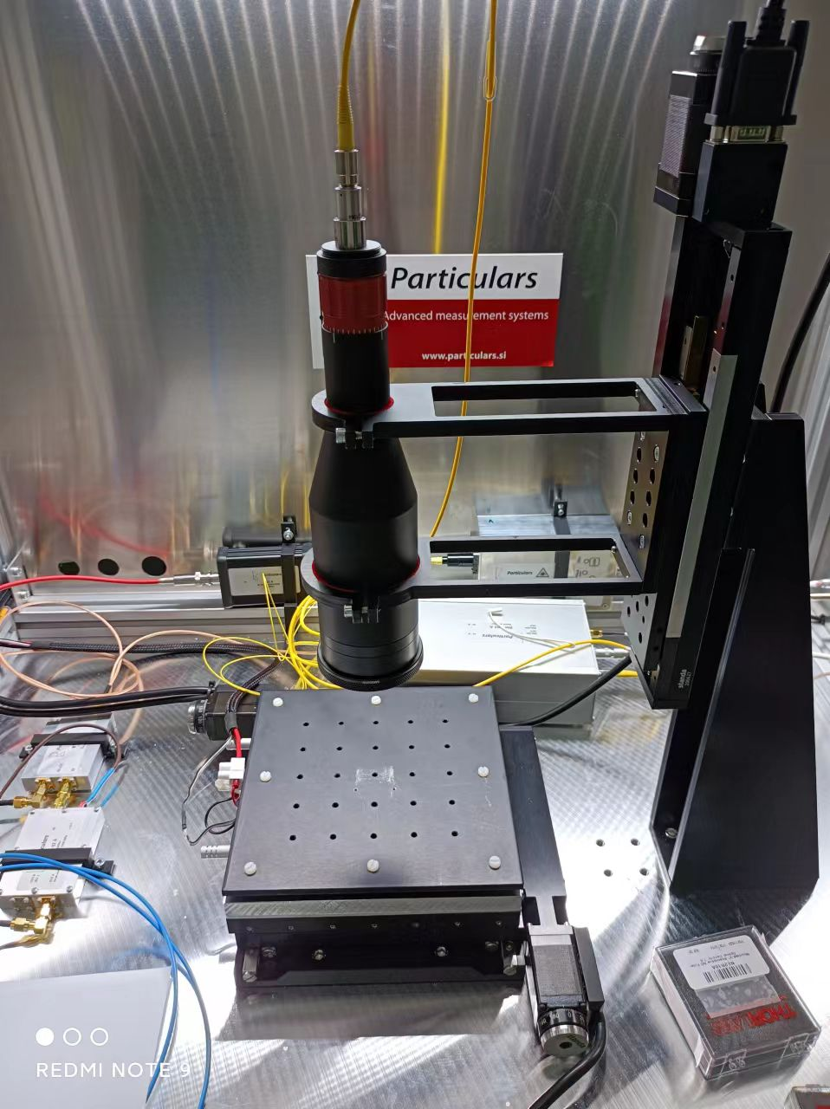
Future test plans
Qualification test:
Laser scan to qualify each channels
Cosmic-ray test.
Charge sharing test:
Use laser to measure the charge sharing coefficients with various external capacitors.
Charge injection with probe.
Particulars Pulse Laser (red/infra-red)
Notes:
来源：G:\keyan\HERD项目文档\周进展\资料\20220824_第一块束流测试板\

Slide 7
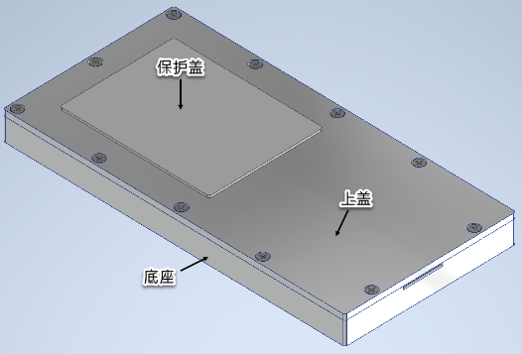
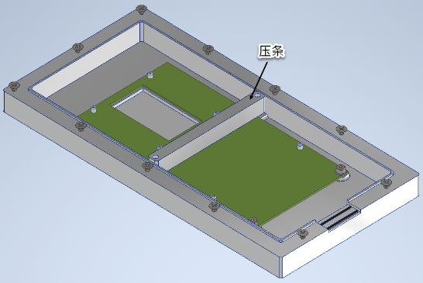
Mechanical design of the test beam
Pins and a bar
To fix the TFH
cover (top/bot) to protect the sensor during transportation
cover
TFH
support
Window for cable
rubber bar for light shielding
Total dimension: 30cm * 15cm * 2.5cm
Notes:
来源：G:\keyan\HERD项目文档\2022年束流实验\结构\

