Slide 1
Verification of four simulation tools
Rui Qiao; WenXi Peng; Ke Gong

Slide 2
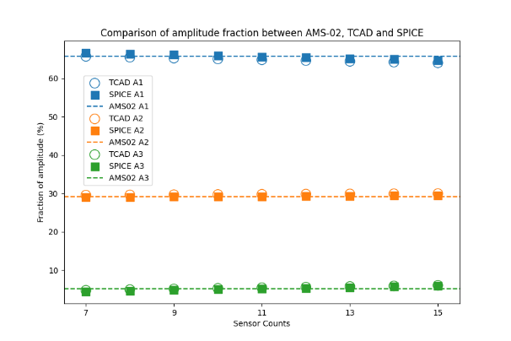
Background: the four simulation methods
Method 1a)
TCAD injection
Inclined incidence
Method 2a)
SPICE injection
Inclined incidence
AMS-02 results
Method 1b)
TCAD injection
Vertical incidence
Method 2b)
SPICE injection
Vertical incidence

Slide 3
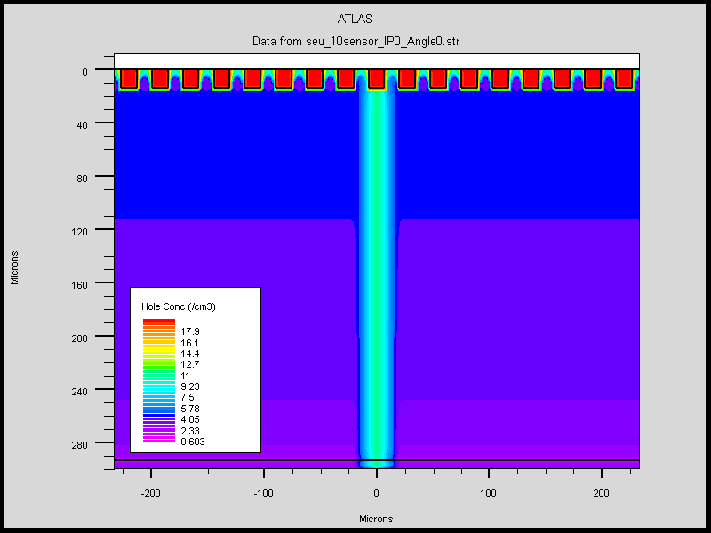
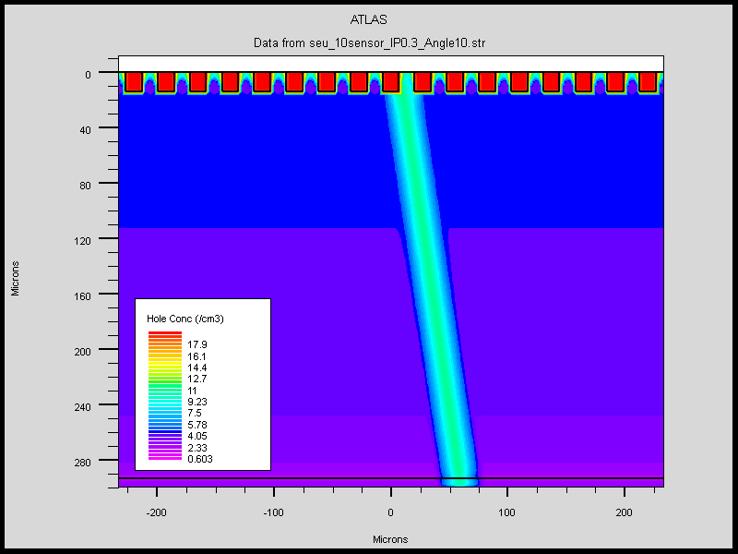

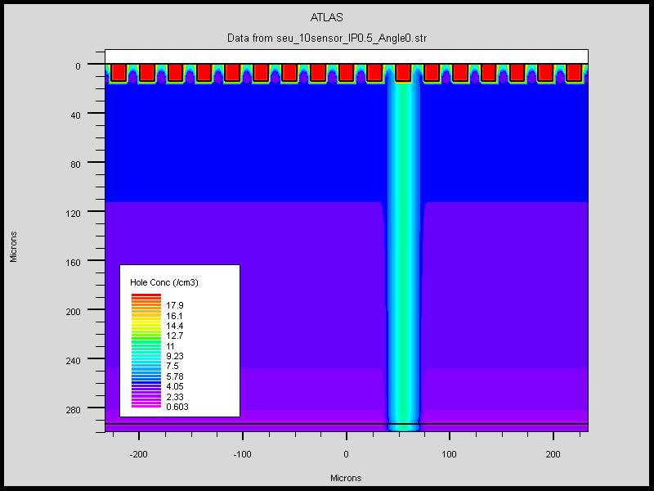
TCAD charge injection: vertical vs inclined
IP=0
Angle=0
Weight=13.6%
Readout Channels
VS
IP=0.25
Angle=0
Weight=52.0%
IP=0.5
Angle=0
Weight=34.4%
IP=0.3, Angle=10
Notes:
来源：G:\keyan\科研任务\211212_硅微条模拟\MyTCAD\220705——AMS02正入射和斜入射\sim\*.png

Slide 4
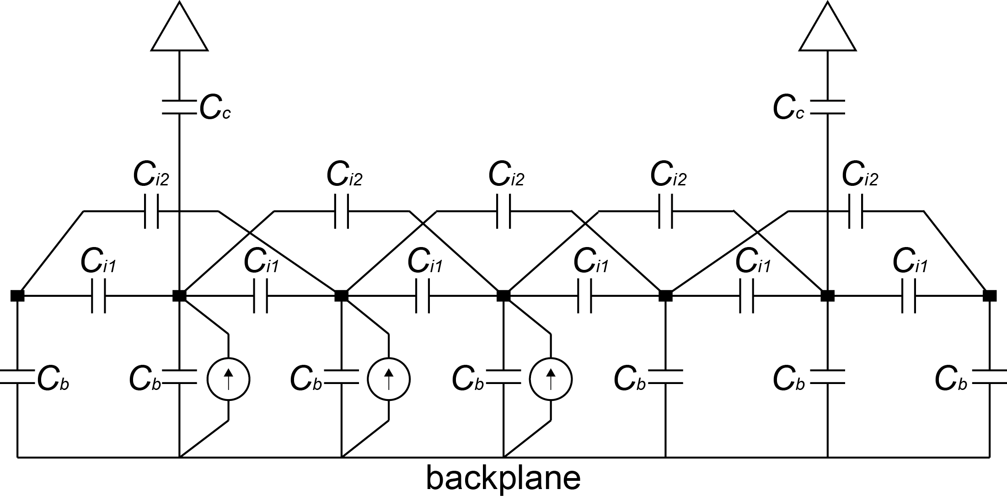
SPICE charge injection: vertical vs inclined
Capacitance Type | Value [pF] @ 10 sensor
Bulk | 4.23
Coupling | 700
Interstrip_1 | 69.76
Interstrip_2 | 3.86
Interstrip_3 | 1.53
Interstrip_4 | 0.80
Interstrip_5 | 0.48
SPICE circuit.
Only 7/17 strips are shown.
Interstrip cap. whose distance>2 are not shown.
Charge injection |  | Amplitude of current sources
IP | Angle | I1 | I2 | I3
0.3 | 10 | 0.136 | 0.520 | 0.344
0 | 0 | 1
0.25 |  |  | 1
0.5 |  |  |  | 1
Notes:
G:\keyan\科研任务\211212_硅微条模拟\MyTCAD\220705——AMS02正入射和斜入射\png\所有电容.txt
G:\keyan\科研任务\211212_硅微条模拟\MyTCAD\220705——AMS02正入射和斜入射\绘制示意图\SPICE示意图.png

Slide 5
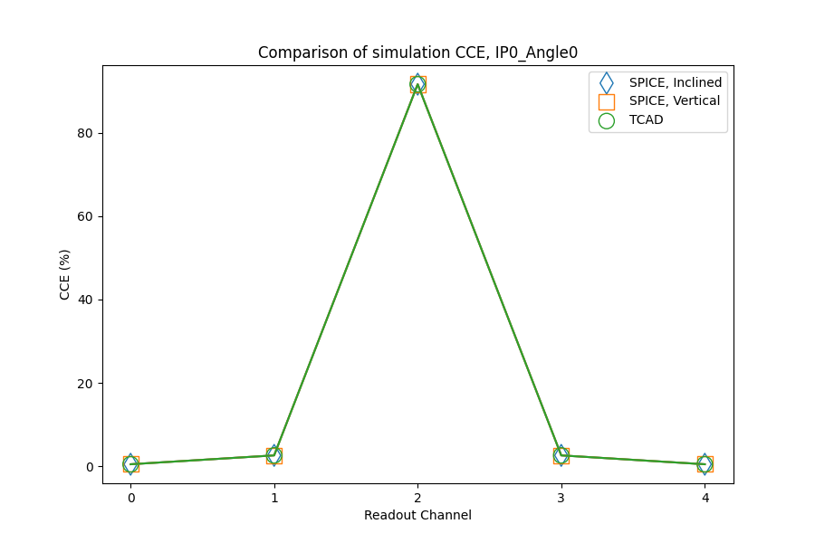
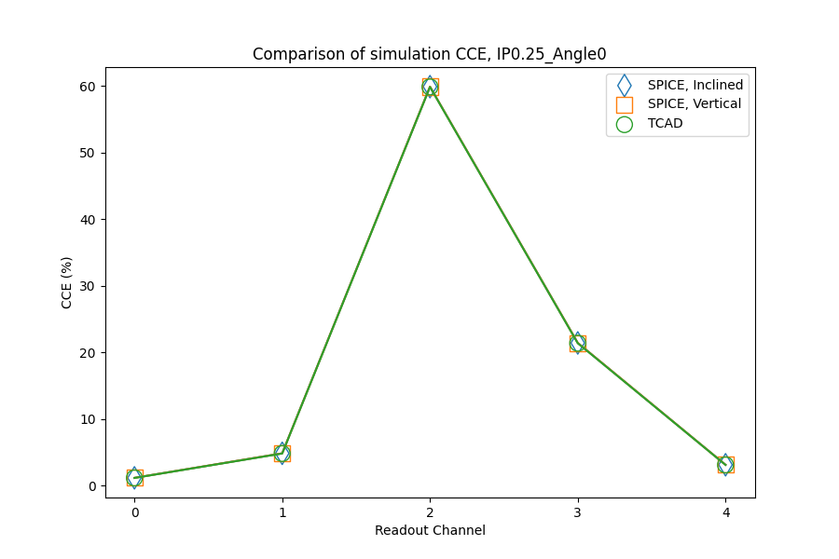
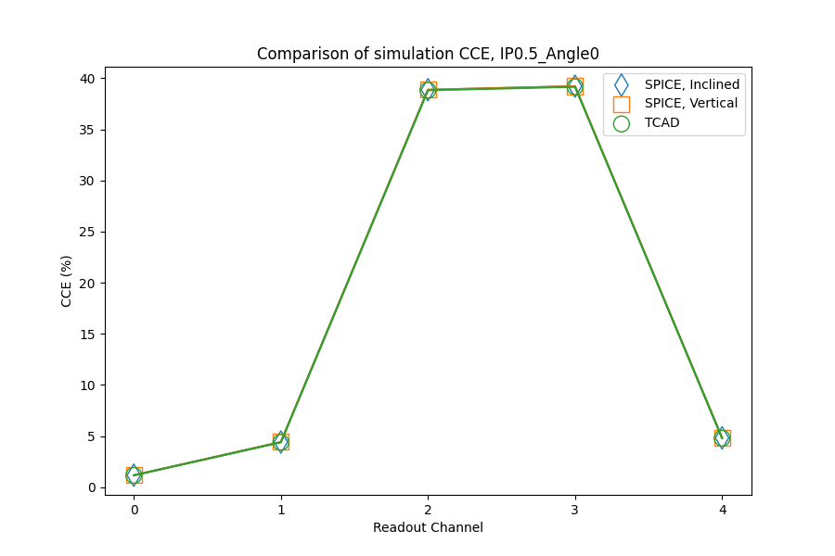
Comparison of CCE with vertical incidence
IP=0
Angle=0
IP=0.25
Angle=0
SPICE & TCAD results match each other.
IP=0.5
Angle=0
Notes:
来源：G:\keyan\科研任务\211212_硅微条模拟\MyTCAD\220705——AMS02正入射和斜入射\sim\*.png
G:\keyan\科研任务\211212_硅微条模拟\MyTCAD\220705——AMS02正入射和斜入射\png\比较各setup的CCE\*.png

Slide 6
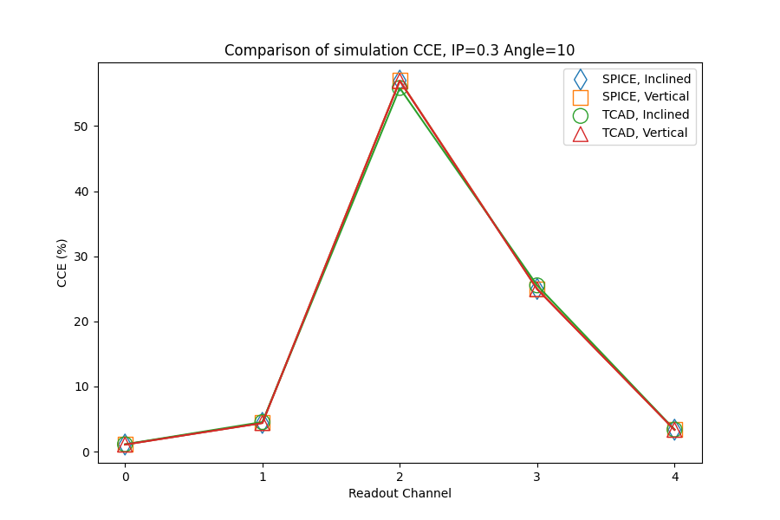
Comparison of CCE with AMS-02 incidence
The four methods match each other for AMS-02 incidence (IP=0.3, Angle=10)
Notes:
来源：G:\keyan\科研任务\211212_硅微条模拟\MyTCAD\220705——AMS02正入射和斜入射\png\比较4种模拟方法.png

Slide 7
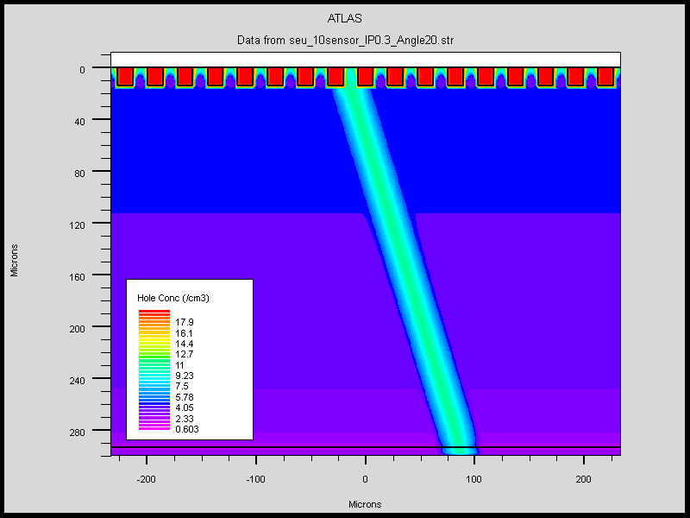
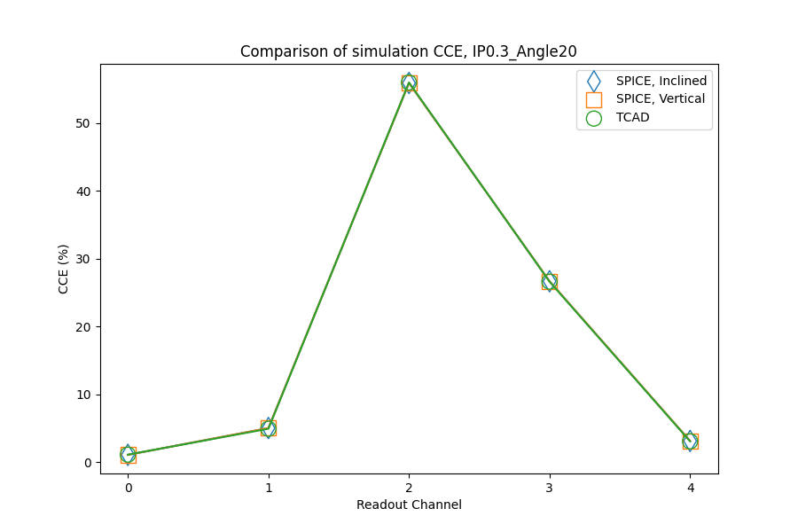
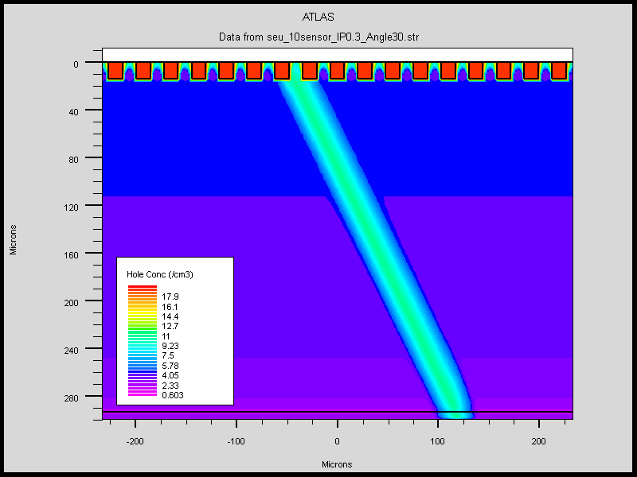
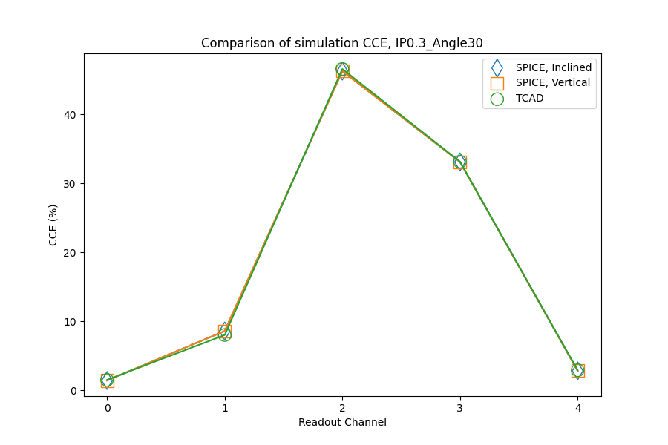
Larger incident angle
20 deg
TCAD match SPICE
30 deg
Notes:
来源：G:\keyan\科研任务\211212_硅微条模拟\MyTCAD\220705——AMS02正入射和斜入射\png\比较各setup的CCE
G:\keyan\科研任务\211212_硅微条模拟\MyTCAD\220705——AMS02正入射和斜入射\sim

Slide 8
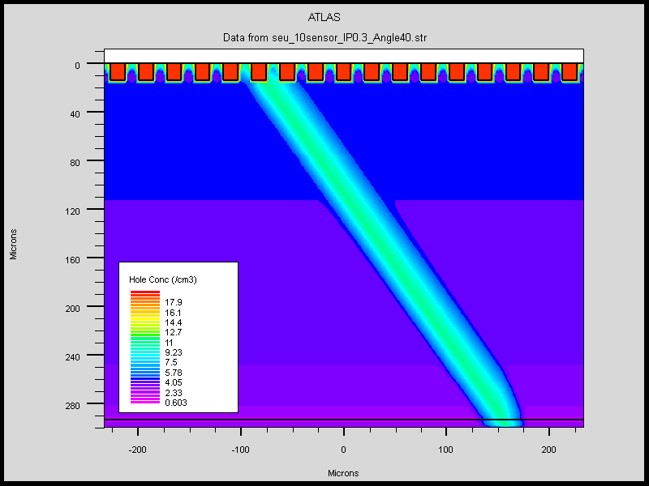
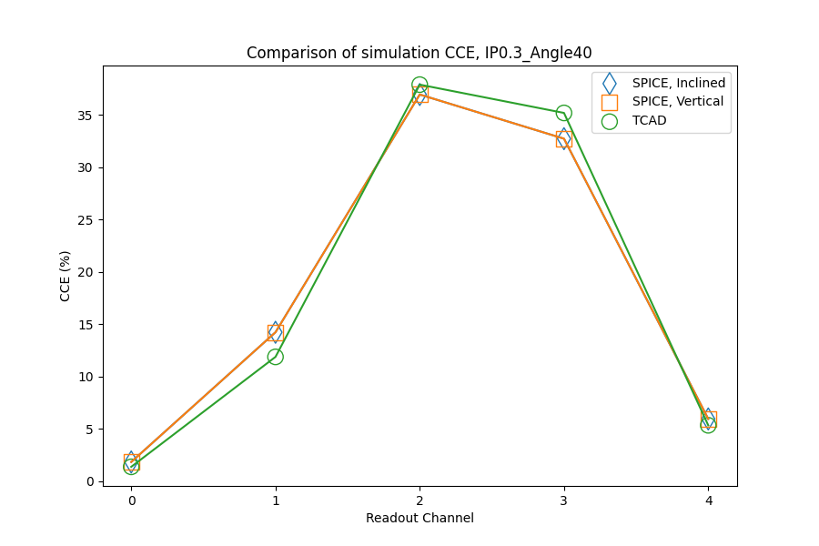
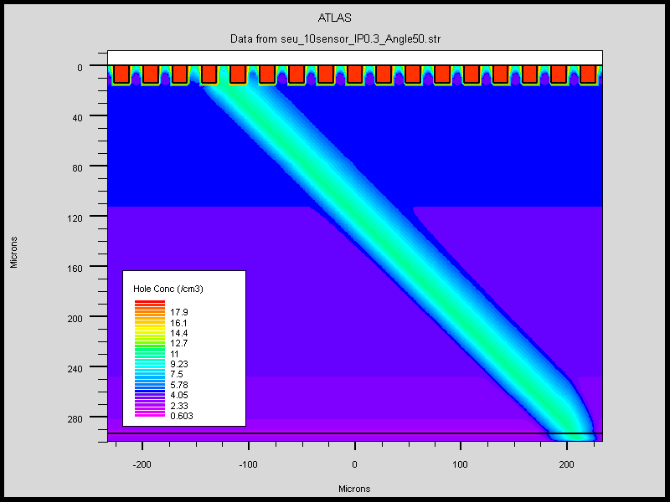
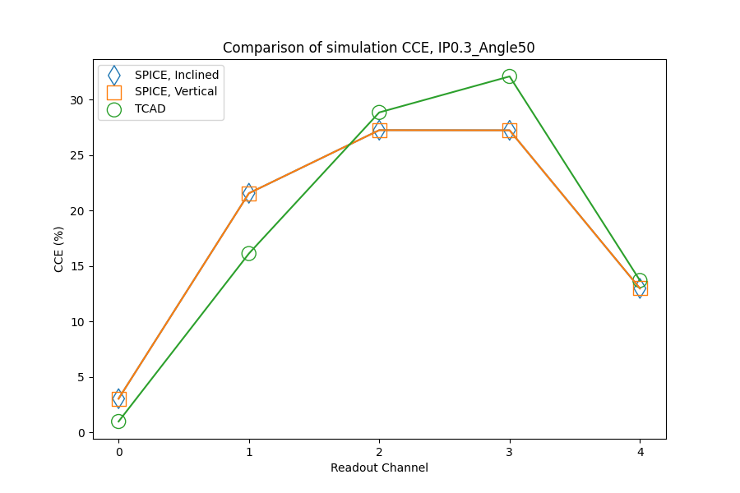
Larger incident angle
40 deg
TCAD not match SPICE
Border effect
50 deg
Notes:
来源：G:\keyan\科研任务\211212_硅微条模拟\MyTCAD\220705——AMS02正入射和斜入射\png\比较各setup的CCE
G:\keyan\科研任务\211212_硅微条模拟\MyTCAD\220705——AMS02正入射和斜入射\sim

Slide 9
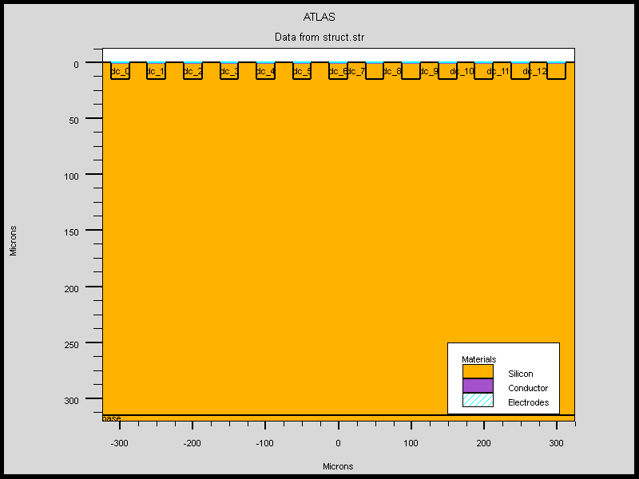
Use larger detector to avoid border effect
Length [cm] | 50
Thickness [um] | 320
Implant Width [um] | 25
Implant pitch [um] | 50
Readout pitch [um] | 150
Readout Channels
Capacitance | Value [pF]
Bulk | 8.66
Coupling | 500
Interstrip_1 | 56.23
Interstrip_2 | 4.43
Interstrip_3 | 1.64
Interstrip_4 | 0.78
Interstrip_5 | 0.41
FOOT-like detector
Notes:
来源：G:\keyan\科研任务\211212_硅微条模拟\MyTCAD\220708——FOOT正入射和斜入射\png\所有电容.txt
G:\keyan\科研任务\211212_硅微条模拟\MyTCAD\220708——FOOT正入射和斜入射\sim\结构图.png

Slide 10
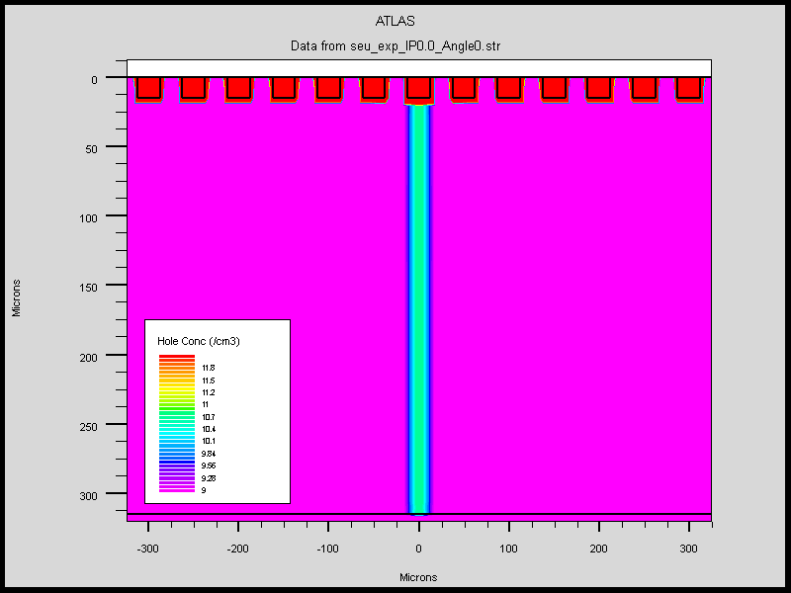
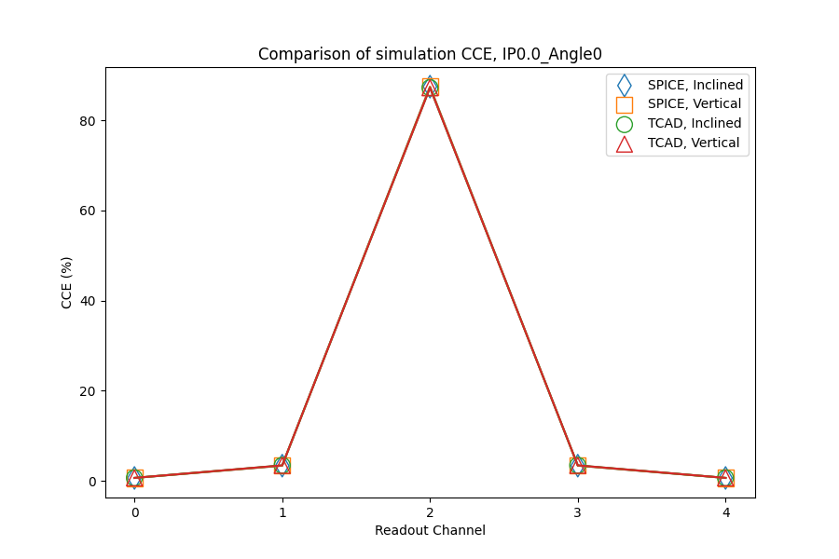
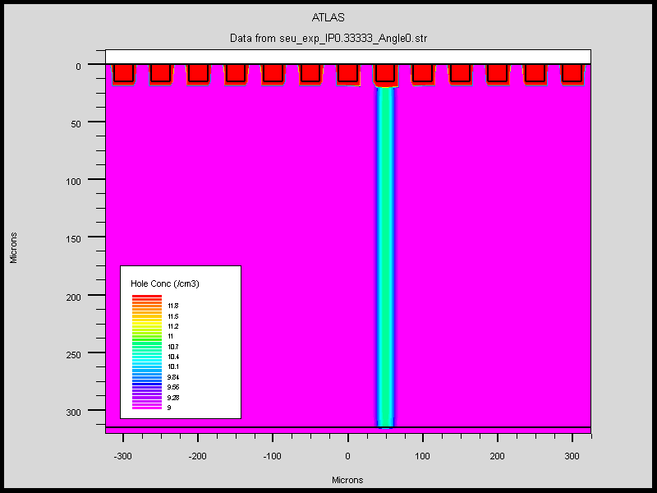
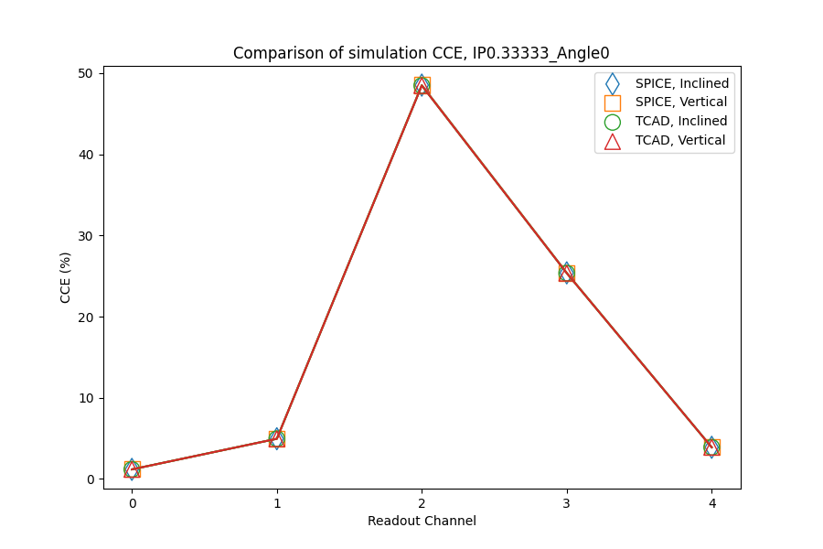
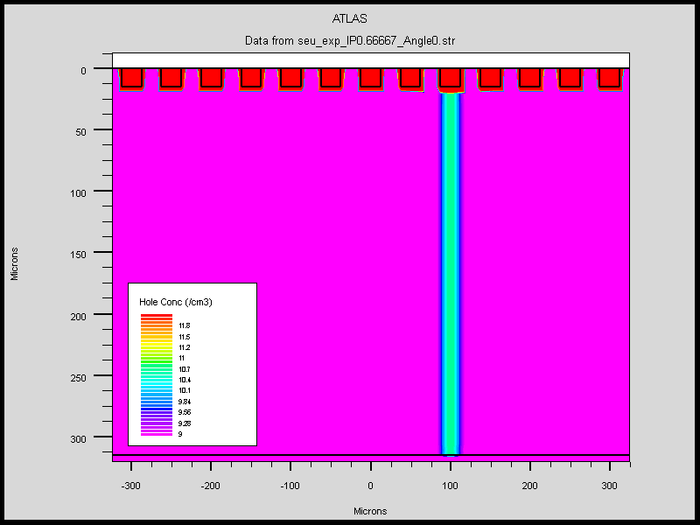
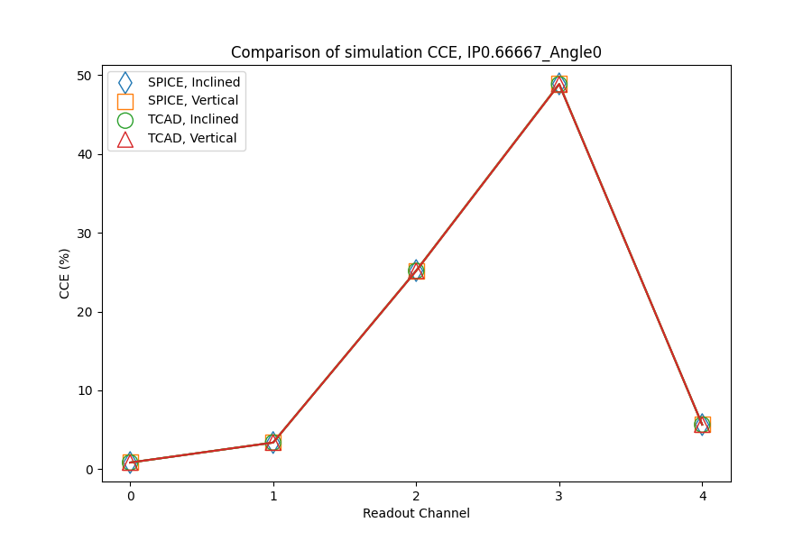
Comparison of CCE with vertical incidence
IP=0
Angle=0
IP=1/3
Angle=0
SPICE & TCAD results match each other.
IP=2/3
Angle=0
Notes:
来源：G:\keyan\科研任务\211212_硅微条模拟\MyTCAD\220708——FOOT正入射和斜入射\sim\*.png
G:\keyan\科研任务\211212_硅微条模拟\MyTCAD\220708——FOOT正入射和斜入射\png\比较各setup的CCE\*.png

Slide 11

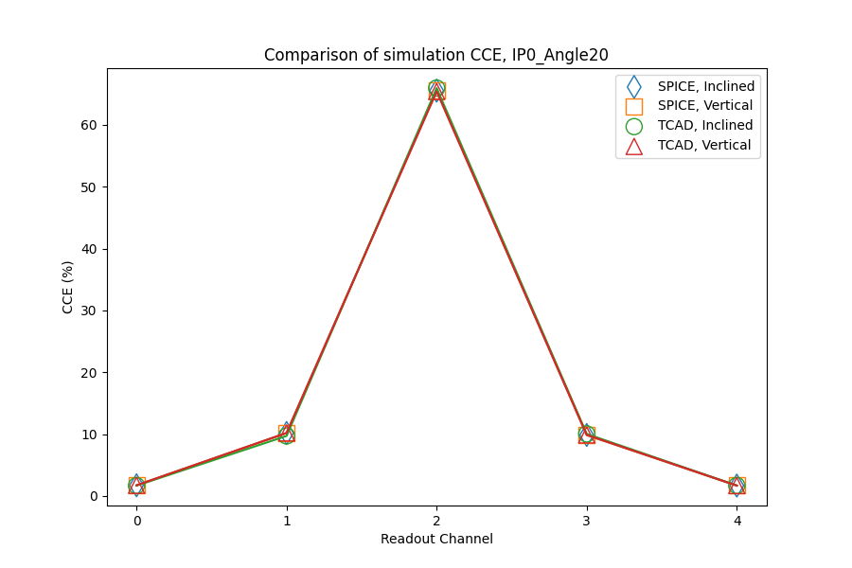

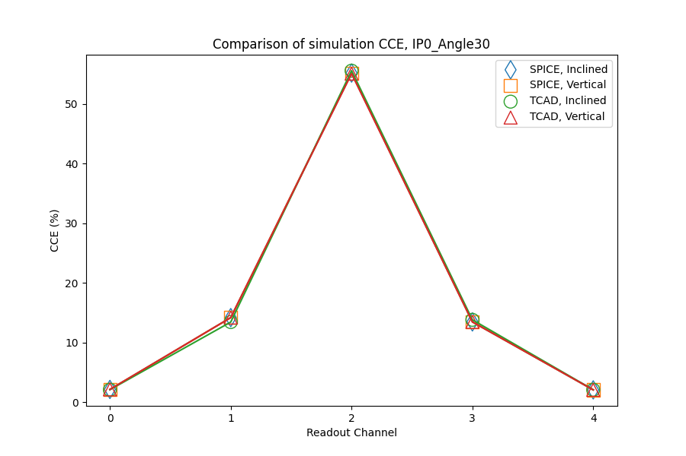
Larger incident angle
20 deg
TCAD match SPICE
30 deg
Notes:
来源：G:\keyan\科研任务\211212_硅微条模拟\MyTCAD\220708——FOOT正入射和斜入射\png\比较各setup的CCE\
G:\keyan\科研任务\211212_硅微条模拟\MyTCAD\220708——FOOT正入射和斜入射\sim

Slide 12
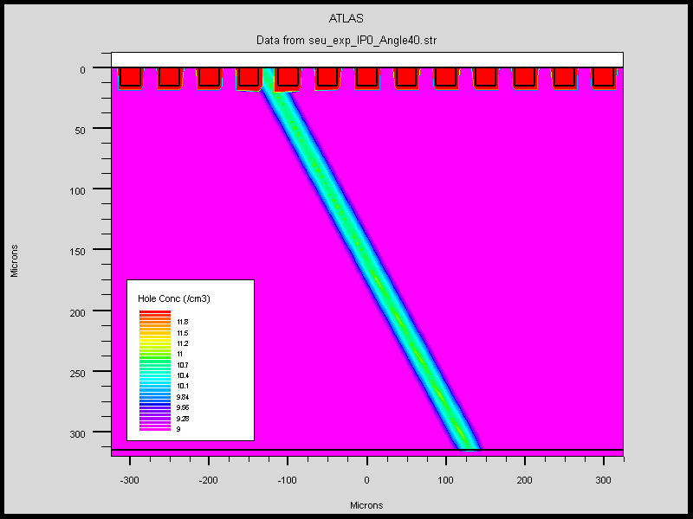
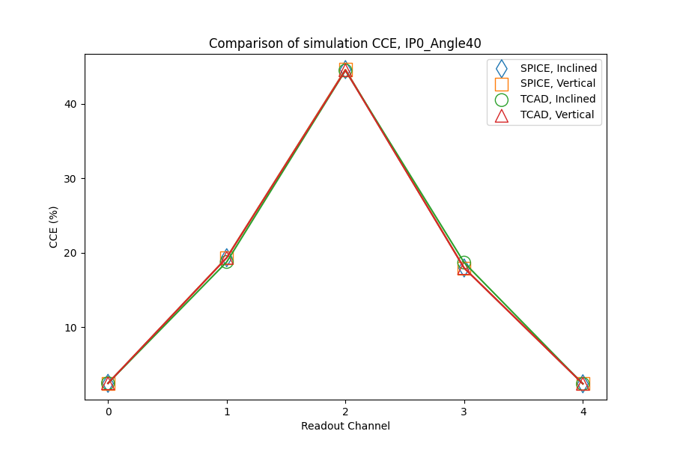
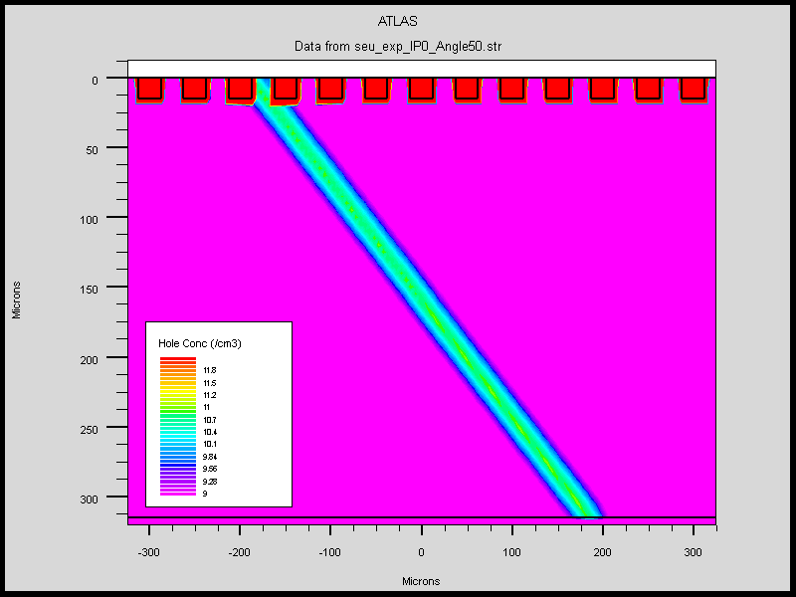
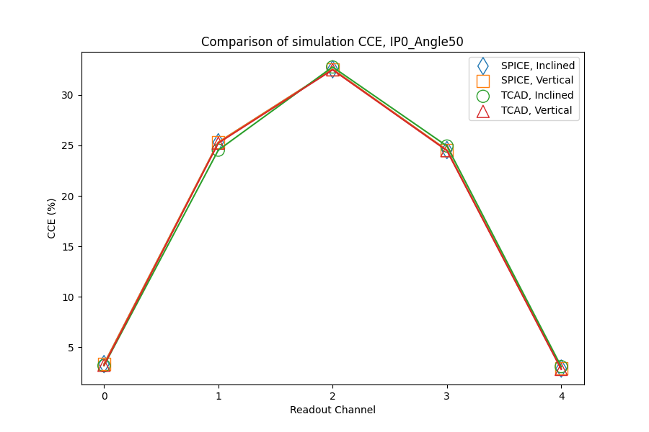
Larger incident angle
40 deg
TCAD match SPICE
50 deg
Notes:
来源：G:\keyan\科研任务\211212_硅微条模拟\MyTCAD\220708——FOOT正入射和斜入射\png\比较各setup的CCE\
G:\keyan\科研任务\211212_硅微条模拟\MyTCAD\220708——FOOT正入射和斜入射\sim

Slide 13
Conclusion
The four simulation methods match AMS-02 result (IP=0.3, Angle=10).
For AMS-02 detector, the TCAD & SPICE not match at 40~50 degree, maybe due to the border effect.
For FOOT-like detector, the four simulation methods match each other for 0~50 degree. no border effect .

