Slide 1


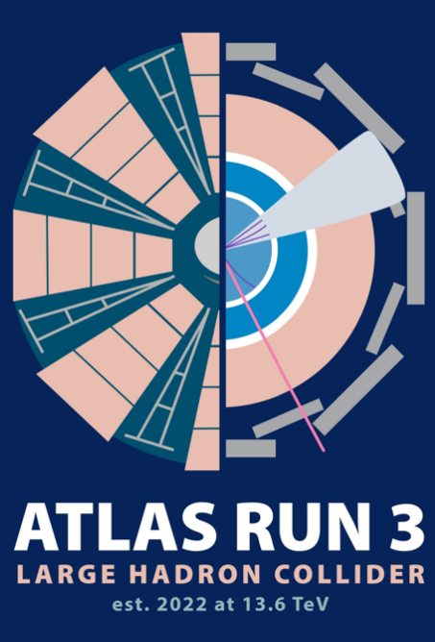
L’esperimento ATLAS
Il gruppo ATLAS Roma
S. Veneziano
29 settembre 2022

Slide 2

236 istituti di ricerca
500 studenti
1200 studenti PHD
Italian contribution
13 Sezioni / Laboratori INFN
250 Scientific Authors
11.4 % della Collaborazione

Slide 3
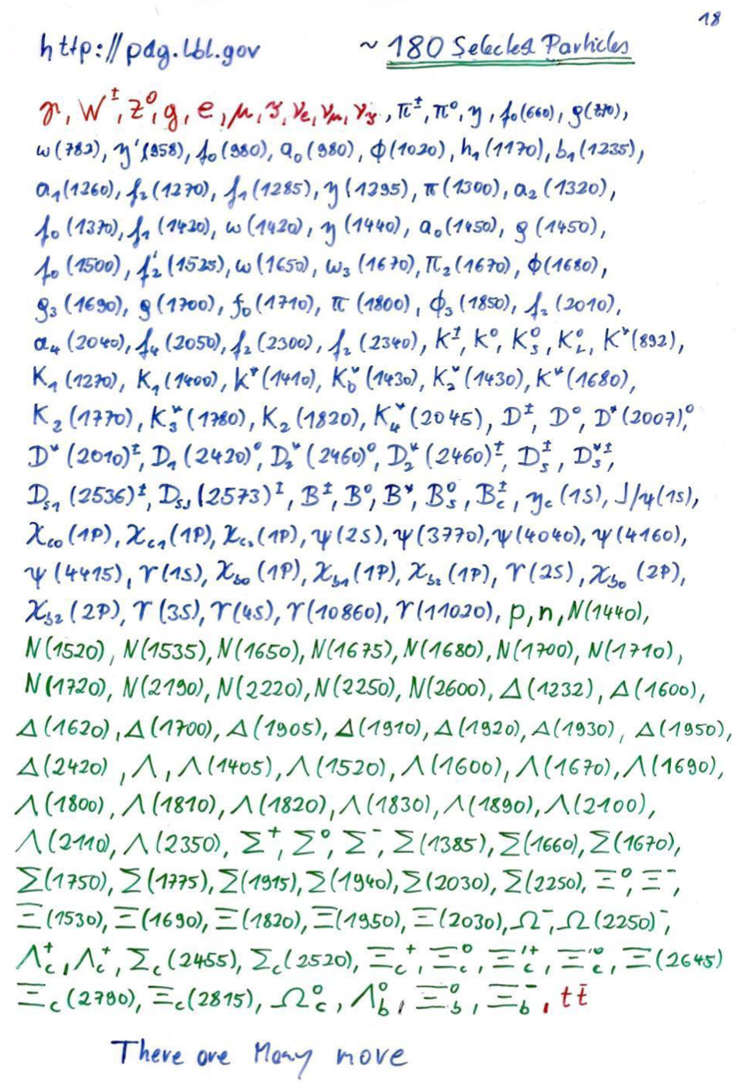
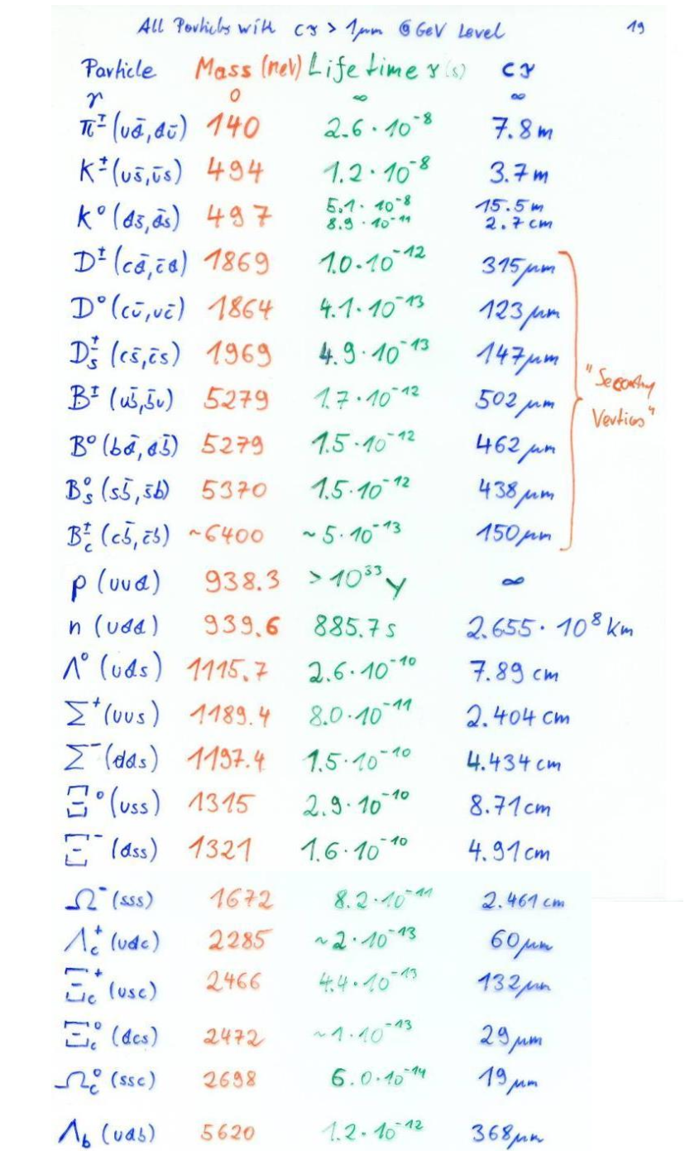
A High Energy Physics (HEP) experiment
Known particles
Particle that may leave a track in a detector
Delle centinaia di diversi tipi di particelle che vengono prodotte in una collisione ad alta energia, solo 14 hanno un tempo di vita c𝜏 > 500𝜇m e quindi potenzialmente osservabili, e quelle prodotte con maggiore frequenza sono:
  e±, 𝜇±, 𝜸, 𝜋±, K±, Kº, p±, n
Un rivelatore di particelle deve poter identificare e misurare energia e quantita' di moto di queste 8 particelle.
  La differenza di massa, carica e tipo di interazione con la materia sono le chiavi per l’identificazione.
    ATLAS contiene diversi tipi di rivelatore, ciascuno ottimizzato per l’identificazione e la misura di un sottoinsieme di particelle.

Slide 4
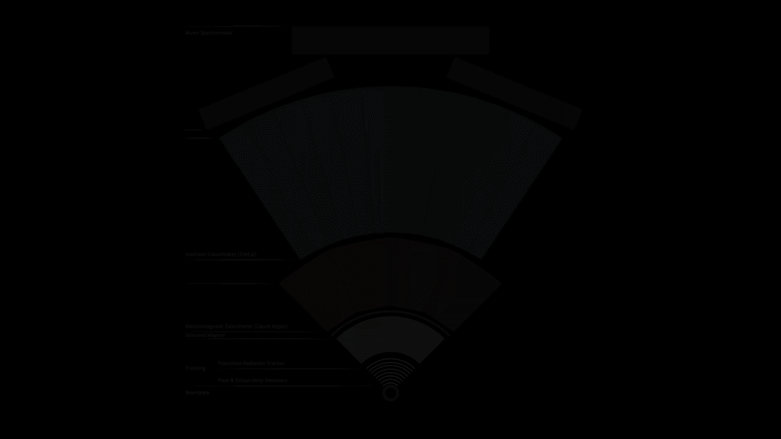

Slide 5
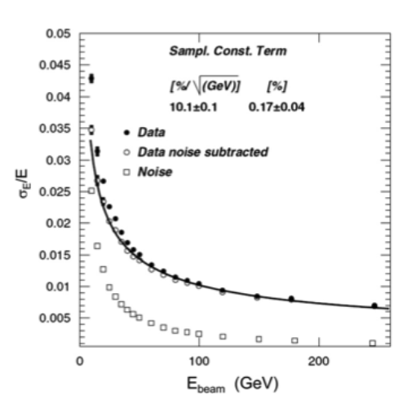
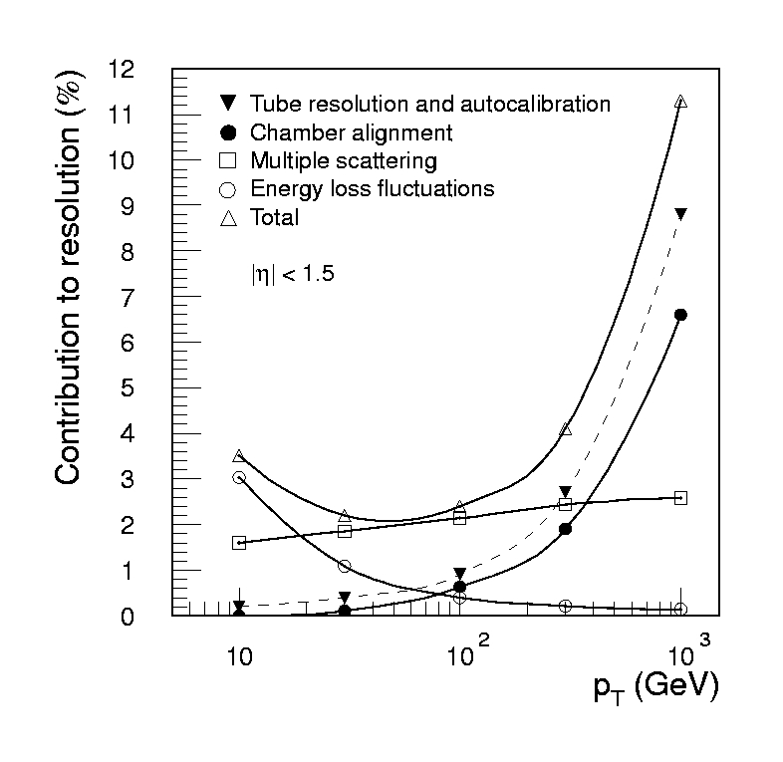
The ATLAS detector performance
Detector design is an iterative process where overall performances are evaluated against technical feasibility and budget.
The expected performances of ATLAS, obtained at the end of the design process, which include highly detailed simulations and tests on detector prototypes are the following:
4 magnets: 3 large superconductive air-core toroids
(to minimize multiple scattering)
1 solenoid (B=2T) in inner part of the detector
MAGNETS
Si pixel + Si strips
TRD (straw tubes with radiator) → particle ID
s/p_{T} ~ 5x10⁻⁴ p_{T} (GeV) Å 0.01
TRACKER
EM CALO
Lead/Liquid Argon
s/E ~ 10%/ÖE + 0.007
HAD CALO
Fe – scint. Tiles 10 λ
s/E ~ 50%/ÖE Å 0.03
MUON
Air core toroids, precision and trigger chambers
s/p_{T} ~ 3 % at 100 GeV,10% at 1 TeV, stand-alone

Slide 6
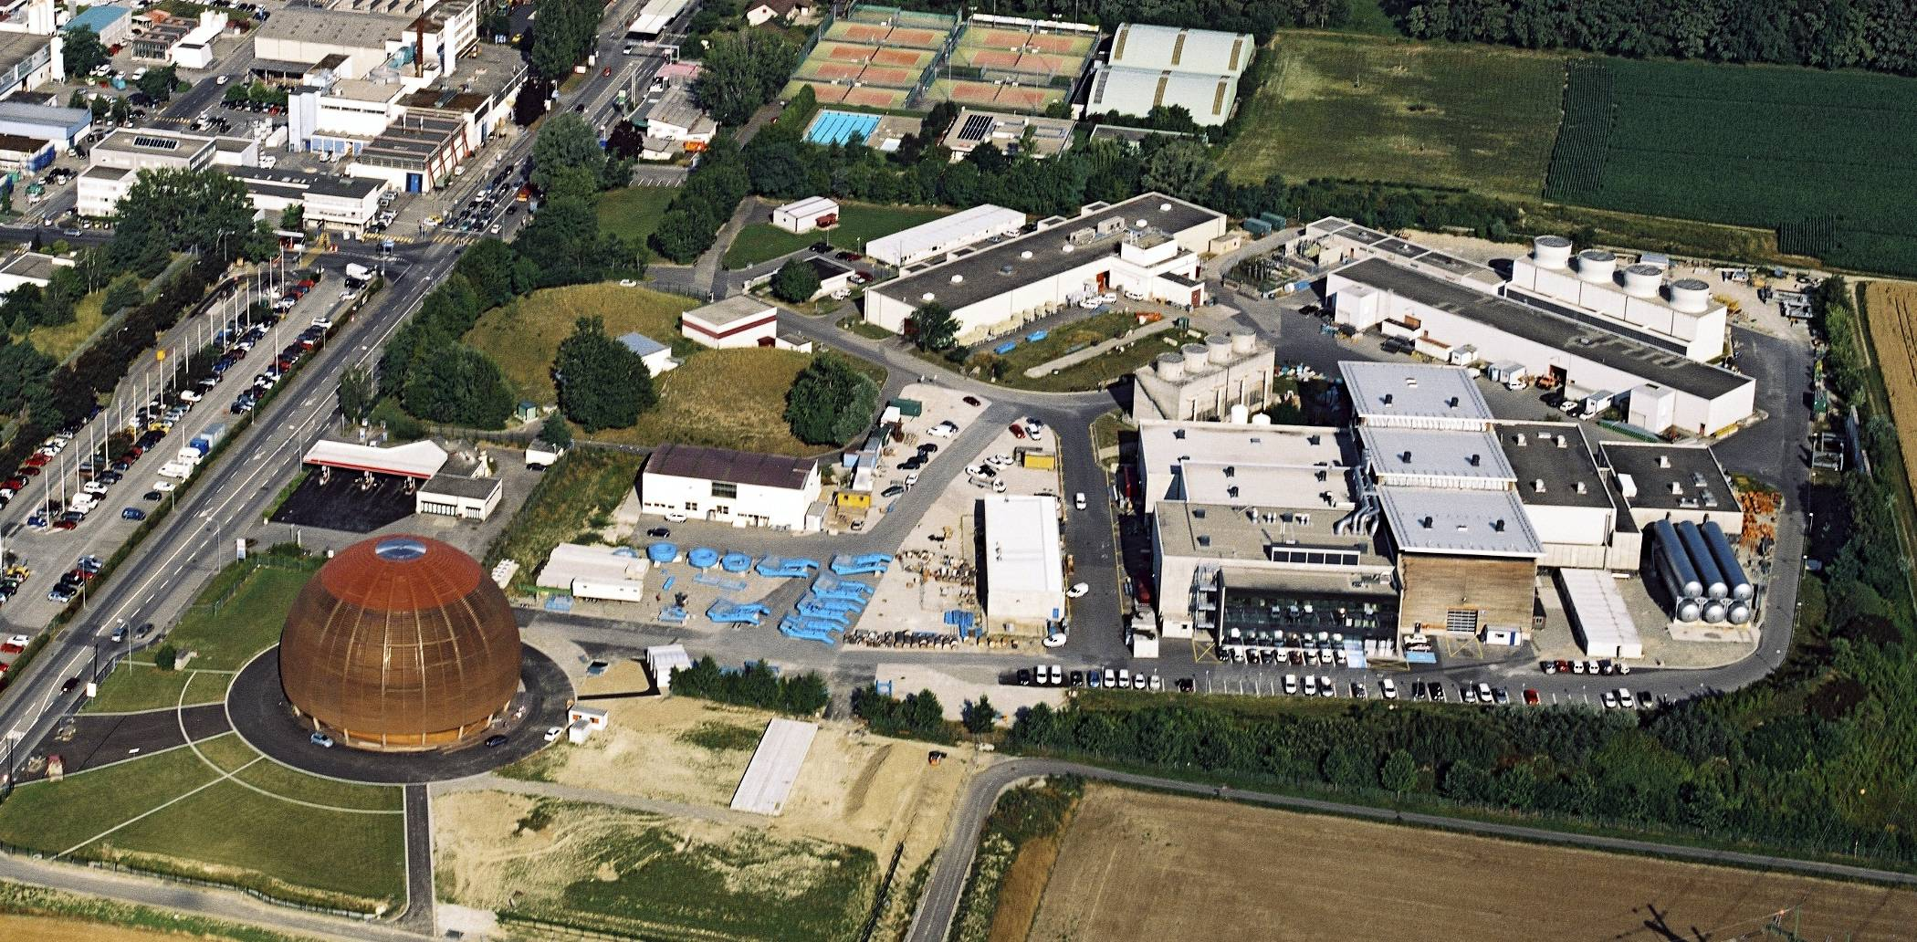
Aerial view of the installations at Point 1 -
ATLAS Experiment
CERN

Slide 7
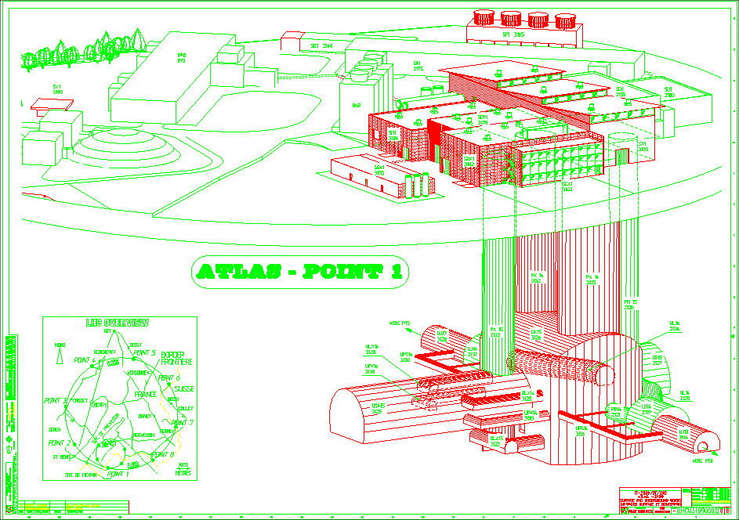
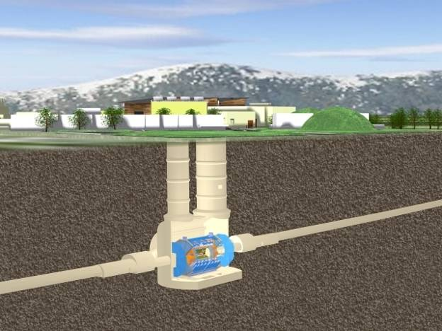
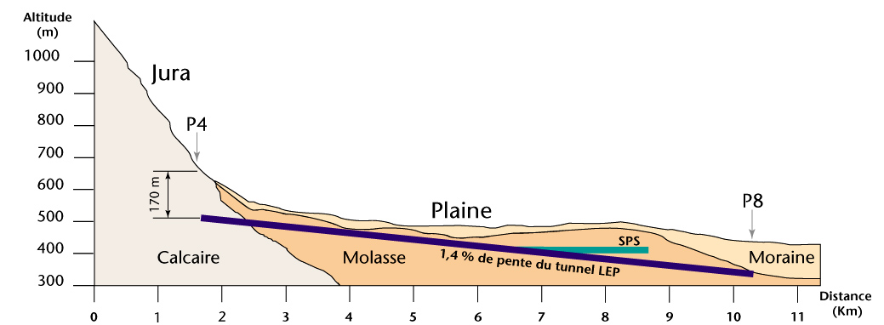
The Underground Cavern
Side A
Side C
Length = 55 m
Width = 32 m
Height = 35 m

Slide 8


The ATLAS detector

Slide 9
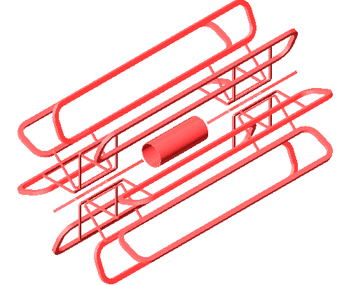
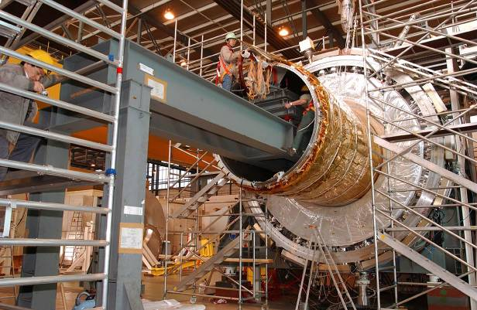

The ATLAS magnets
Inner Solenoid
  Provides 2T field with a stored energy of 38 MJ for the inner tracker
  Integrated design within the cryostat
of the barrel LAr em calorimeter
Minimize material before EM calorimeter
  Coil thickness: 45 mm
  NbTi/Cu Al-stabilized Conductor
The insertion of the ATLAS solenoid
Air Core Toroid (ATLAS)
  Excellent stand alone momentum measurement
  But… Need very large detector
  Very demanding on detectors performances, calibration and alignment
Barrel Toroid parameters
25.3 m length
20.1 m outer diameter
8 coils
1.08 GJ stored energy
370 tons cold mass
830 tons weight
4 T on superconductor
56 km Al/NbTi/Cu conductor
20.5 kA nominal current
4.7 K working point
End-Cap Toroid parameters
5.0 m axial length
10.7 m outer diameter
2x8 coils
2x0.25 GJ stored energy
2x160 tons cold mass
2x240 tons weight
4 T on superconductor
2x13 km Al/NbTi/Cu conductor
20.5 kA nominal current
4.7 K working point
The ATLAS Cavern after the installation of the 8 coils of the Barrel Toroid

Slide 10
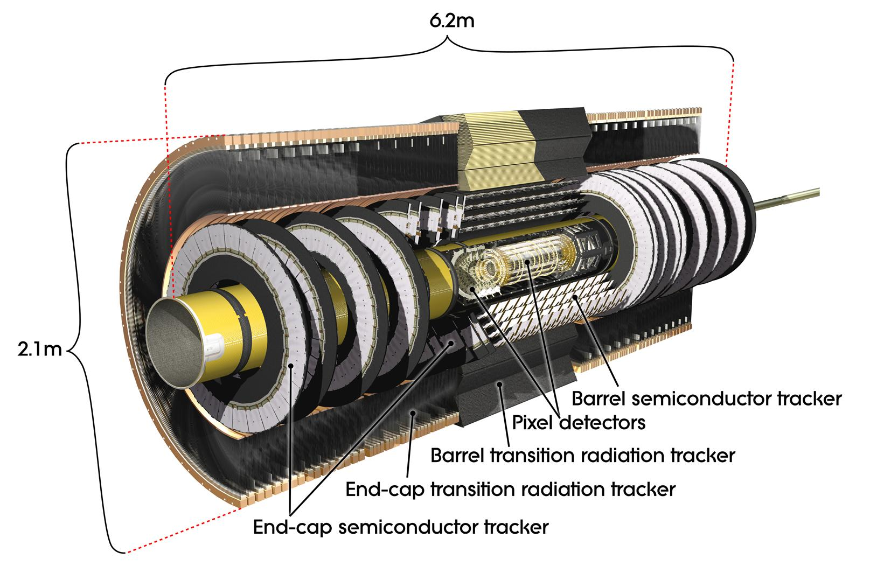
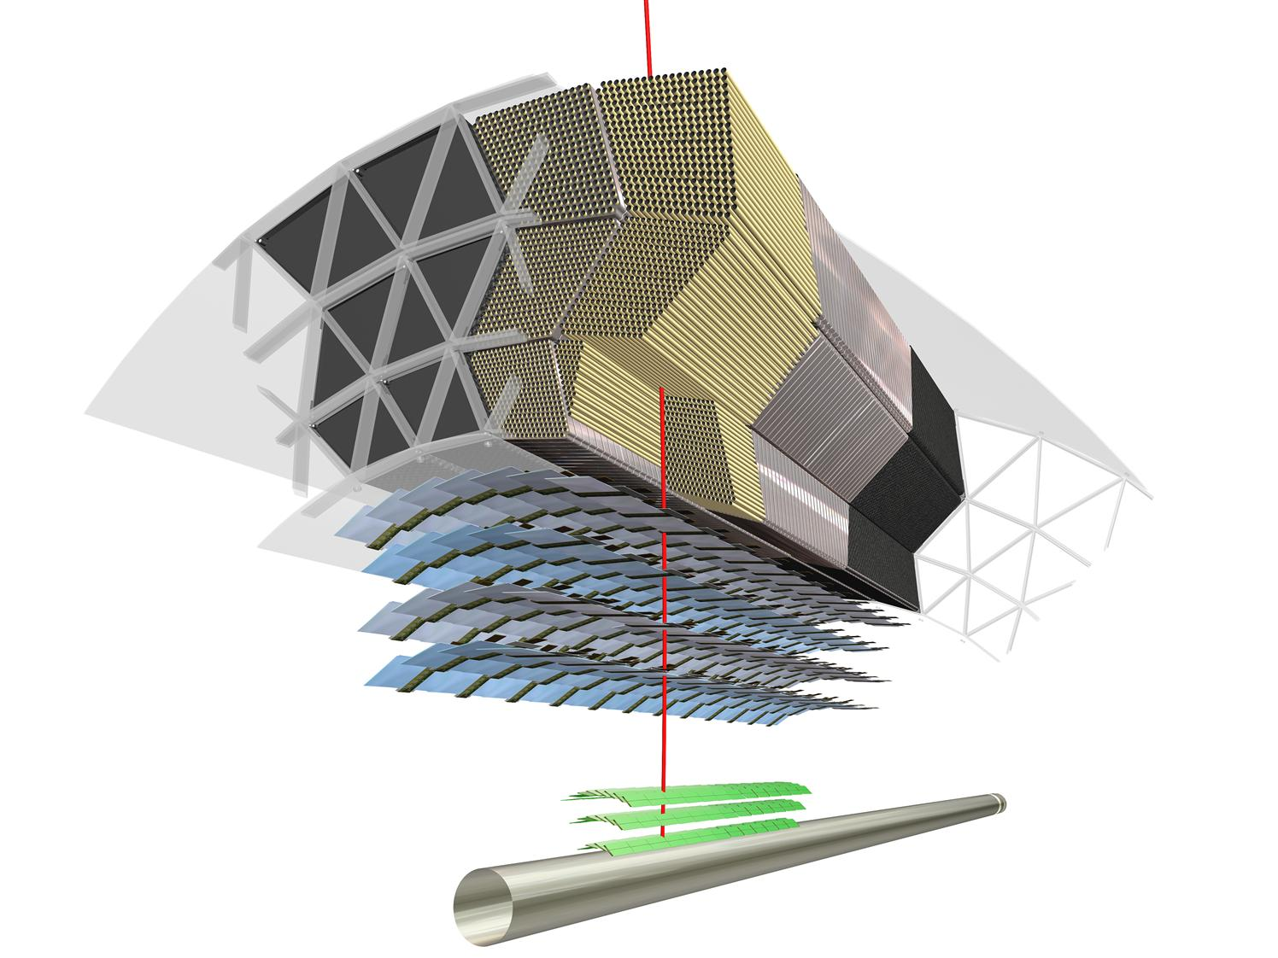
Inner tracker
Rivelatore a pixel: a soli 3.3 cm dalla linea del fascio. 92 milioni di canali. Misura il deposito di energia di particelle cariche. La posizione viene misurata con una precisione di circa 10 micron in rφ, 70-80 μm in z.
Tracciatore a semiconduttore: con 6 milioni di sensori, circonda il rivelatore a pixel e misura le tracce delle particelle cariche, precisione 16 μm in rφ, 580 μm in z.
Tracciatore a radiazione di transizione: circa 300000 cannucce dalle pareti sottilissime, riempite di gas. Il segnale osservato nel rivelatore permette di distinguere un elettrone da un pione.
Inner Trackers Requirements:
Tracking at |η| <2.5 for muons and electrons with p_{T}> 7 ÷ 10 GeV/c
Δp_{T}/p_{T} ≤ 20÷30 % for p_{T} ≈ 500 GeV/c
Efficient reconstruction of particles with p_{T} > 0.5 GeV/c
Capability to reconstruct tracks in events with many particles
Capability of high rate of particles
Radiation hardness
Small thickness in term of X₀ radiation lengths

Slide 11
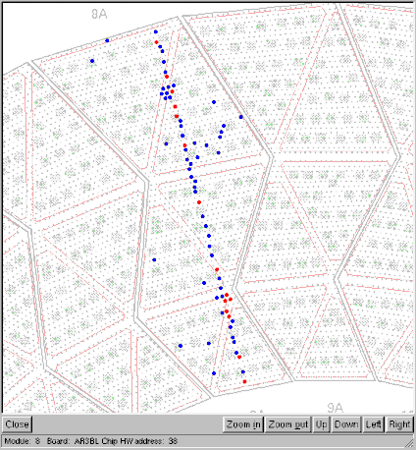
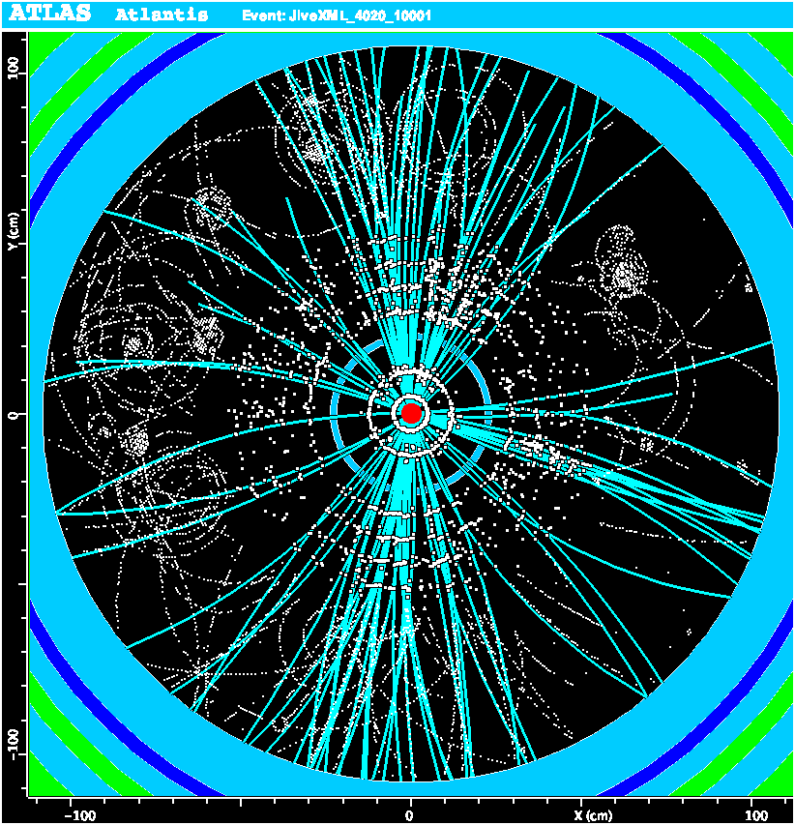
A cosmic ray in TRT
An event
reconstructed
in Inner Detector

Slide 12
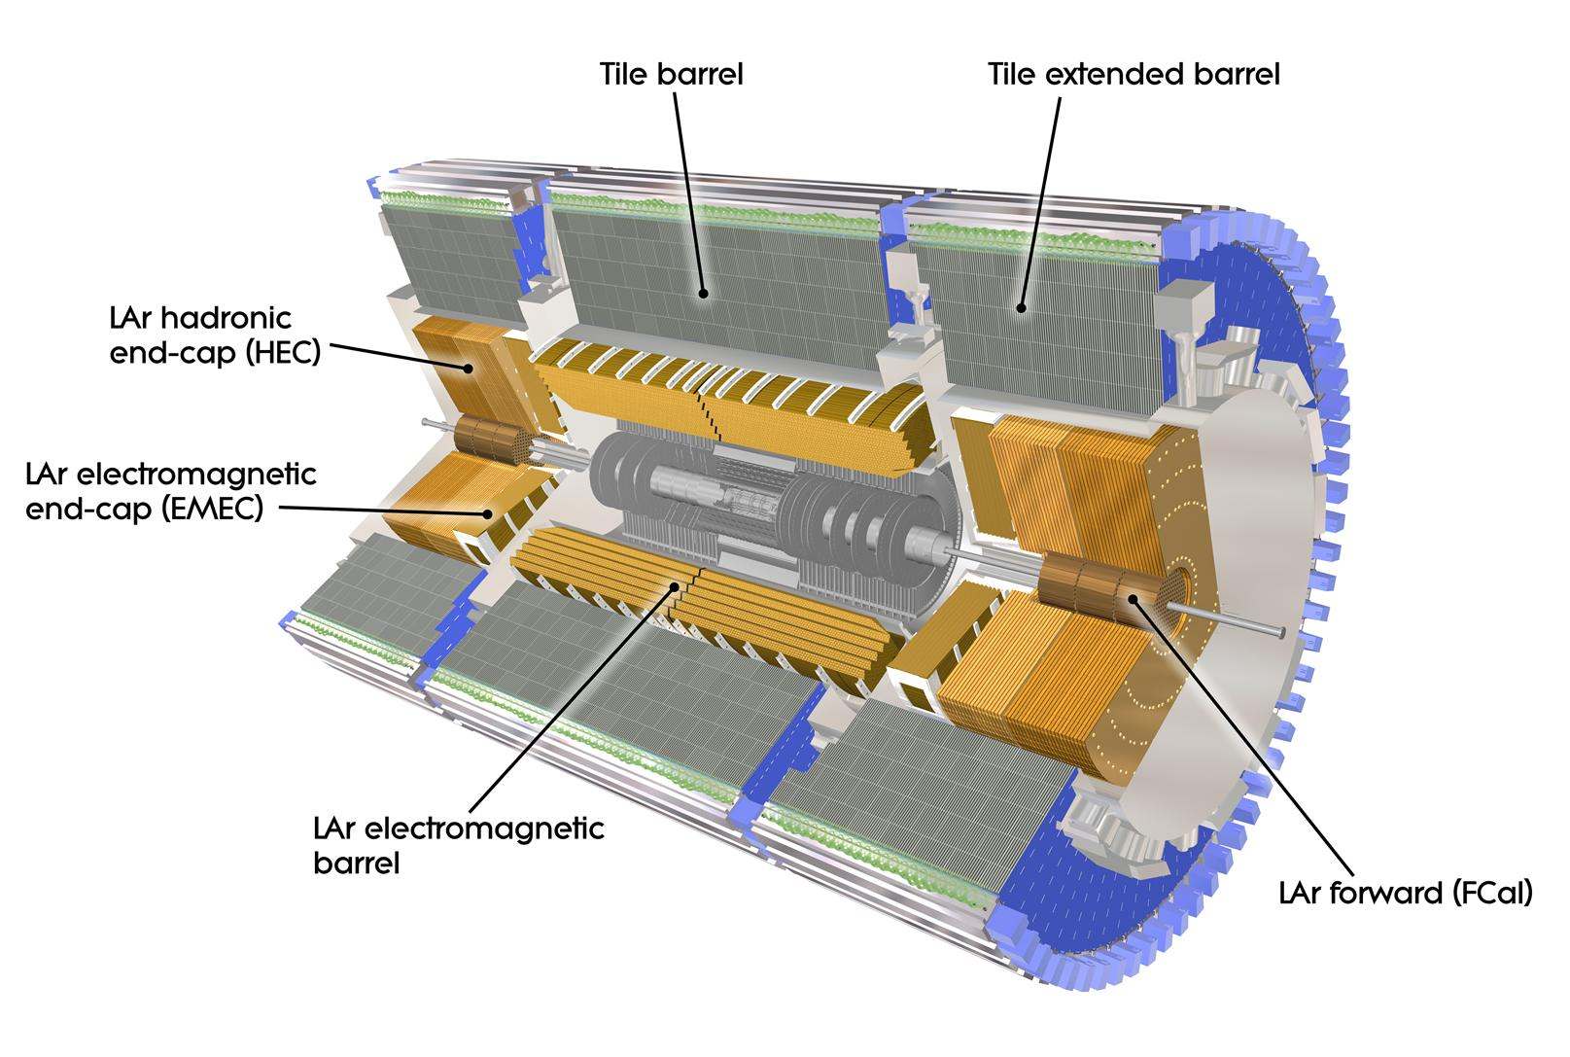
Calorimeters
Il calorimetro ad Pb/Argon liquido e’ posizionato attorno al rivelatore centrale e misura l’energia di elettroni fotoni, adroni, assorbendo l’energia delle particelle incidenti che vengono convertire in uno sciame di nuove particelle di piu’ bassa energia. Questi sciami producono cariche di ionizzazione, correnti elettriche indotte sugli elettrodi, che possono essere misurate dall’elettronica del rivelatore. La regione centrale e’ progettata per le misura di elettroni e fotoni.
Il calorimetro a Tile a Fe/Scintillator circonda il calorimetro LAr e misura l’energia delle particelle adroniche che non hanno depositato tutta l’energia nel calorimetro piu’ interno. Il materiale attivo e’ una plastica scintillante. I fotoni prodotti generano un segnale elettrico proporzionale all’energia depositata dalla particella.
  Peso: 2900 tonnellate.
Requirements for calorimeters at LHC
Measure energy for photons/ electrons from 7-10 Gev up to few TeV σ%≈10%/√E
Hermetic calorimeter able to measure missing transverse energy
Able to work and trigger at L ≥10³⁴ cm⁻² s⁻¹
Radiation hard (up to > 10 years)
To isolate γ/ e transverse segmentation from jets: 0.025 x 0.025 rad² in e.m. calorimeters and 0.1 x 0.1 rad² in hadronic calorimeters. γ/ e fully contained in 0.6 x 0.6 rad²
To distinguish: γ from e: no charged track in front of the calorimeters
γ from π⁰: preshower after about 3 R.L.
Measure of the photon direction: about 100/√E mrad to detect Higgs events
Longitudinal depths about:
27 R.L. for e.m. calorimeter 9 ÷ 11 λ_{I} for hadronic calorimeter
Fast response

Slide 13
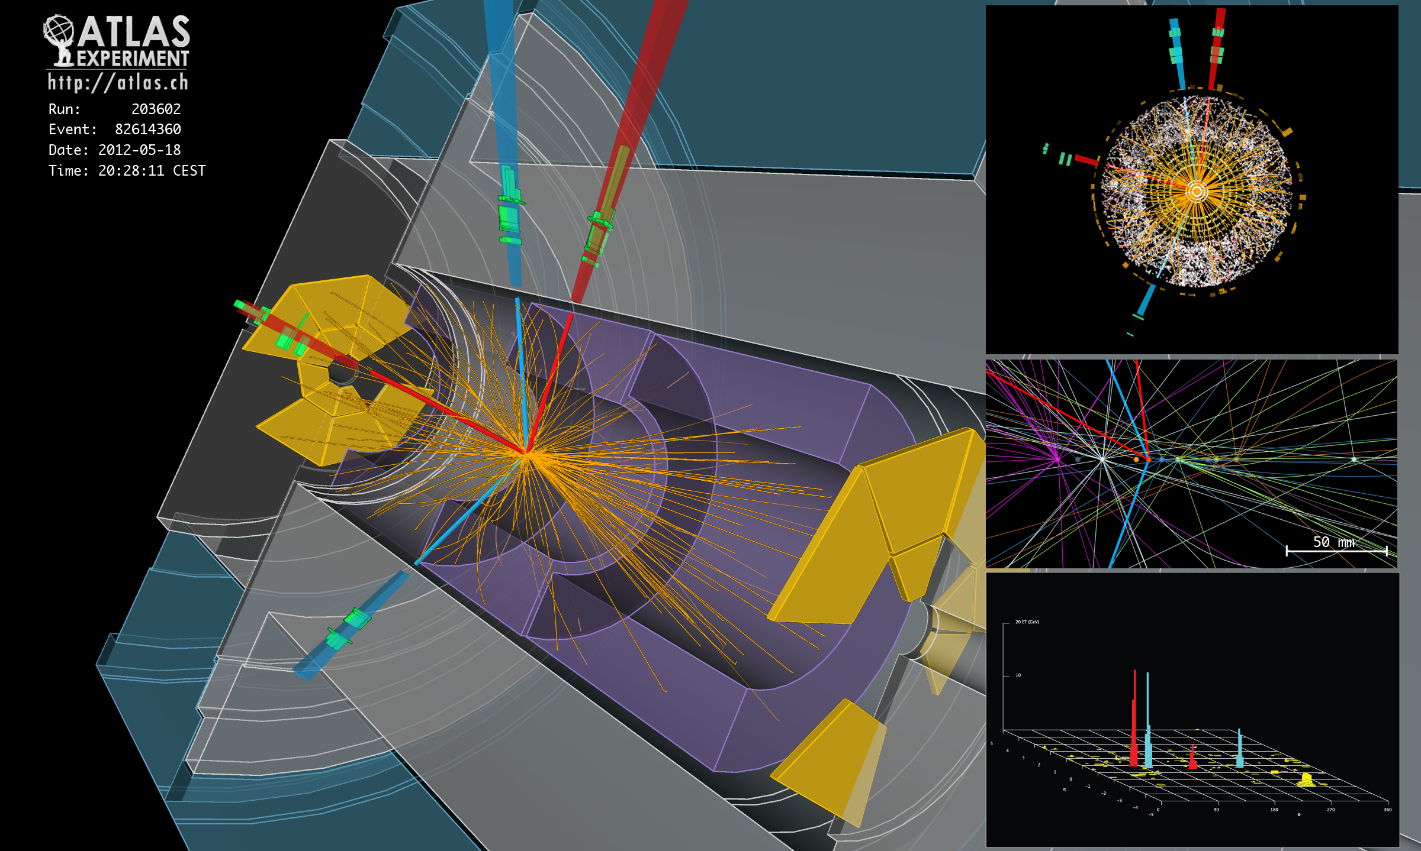
A candidate event with a Higgs in 4 electrons
F.Lacava Detectors for Particle Physics A.A. 2019/20

Slide 14
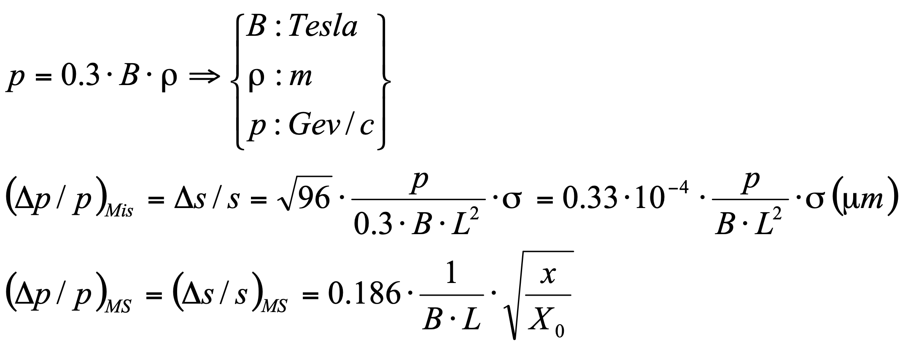
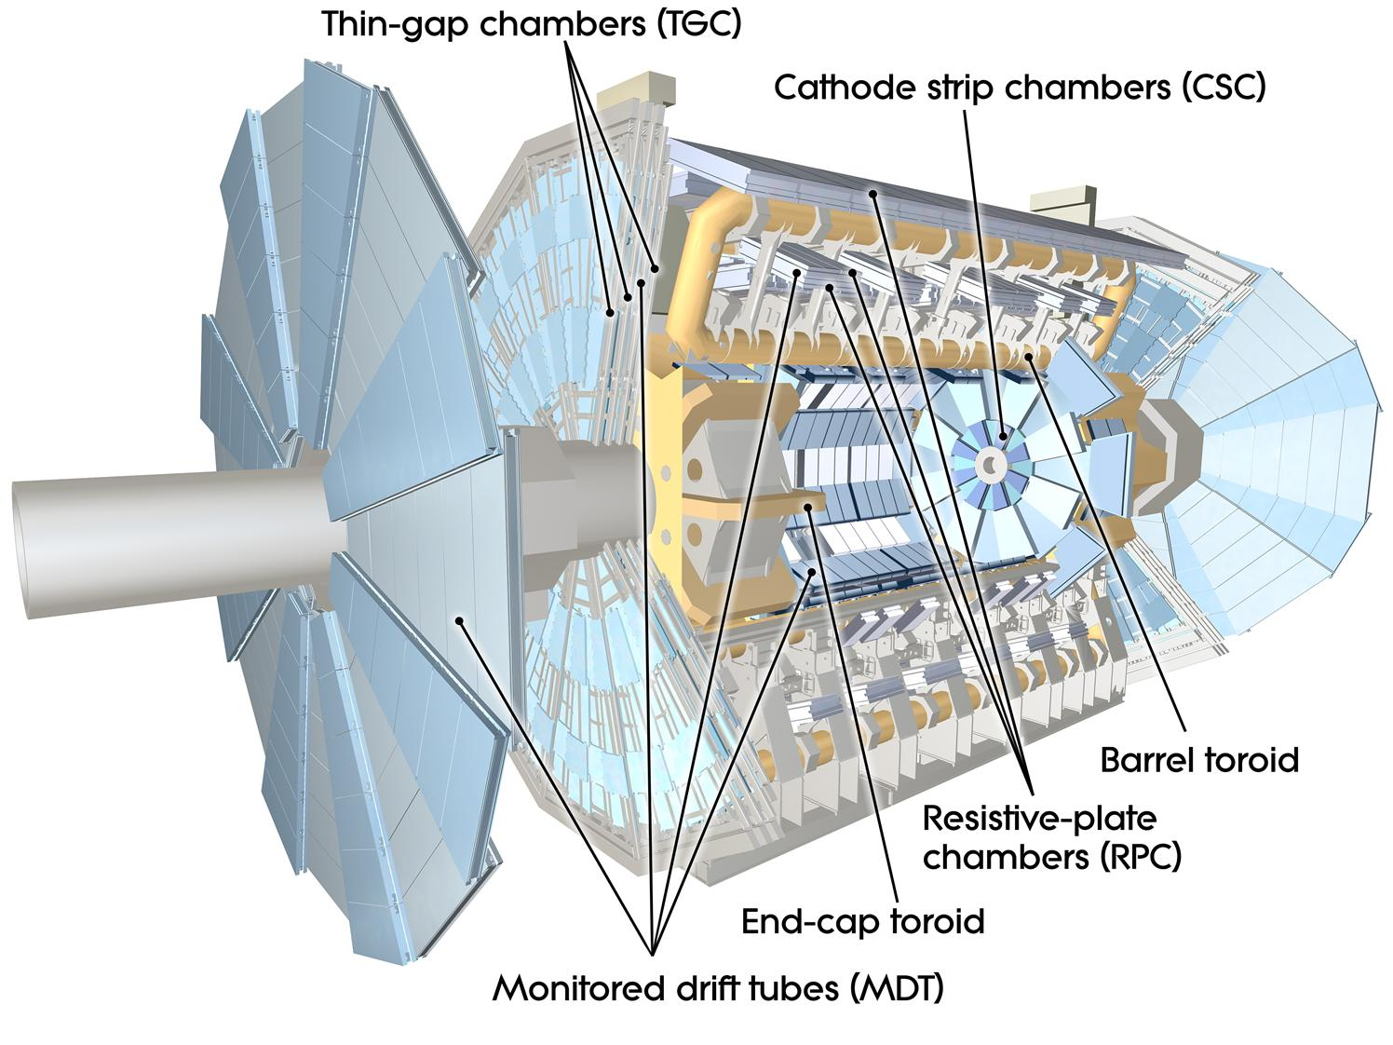
Muon spectrometer
I muoni sono particelle simili agli elettroni, ma circa 200 volte piu’ pesanti e per questo capaci di attraversare lo spesso strato dei calorimetri.
I rivelatori dello spettrometro sono di due tipi:
  rivelatore di precisione: MDT, tubi di Al di 3cm di diametro riempiti di una miscela di gas. La ionizzazione delle molecole, dovuta al passaggio di una particella carica, produce un segnale elettrico indotto dal movimento delle cariche.
  rivelatori di trigger: ATLAS usa altri tipi di rivelatore per identificare e selezionare velocemente eventi da collisioni potenzialmente interessanti per analisi di fisica. Permettono di prendere una decisione ogni 25 ns.
    Resistive Plate Chambers (RPC) e Thin Gap Chambers (TGC).
Altri rivelatori sono stati aggiunti nel 2022 per migliorare le prestazioni dello spettrometro.

Slide 15
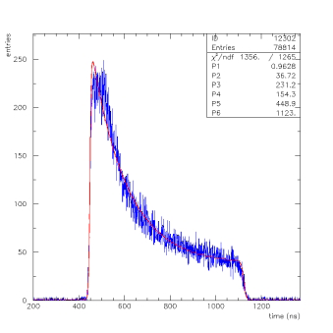
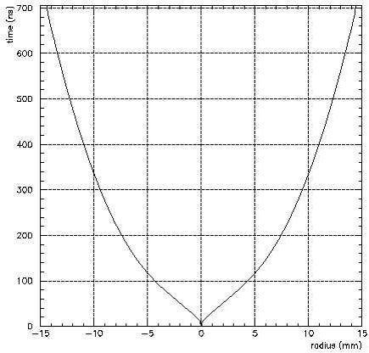
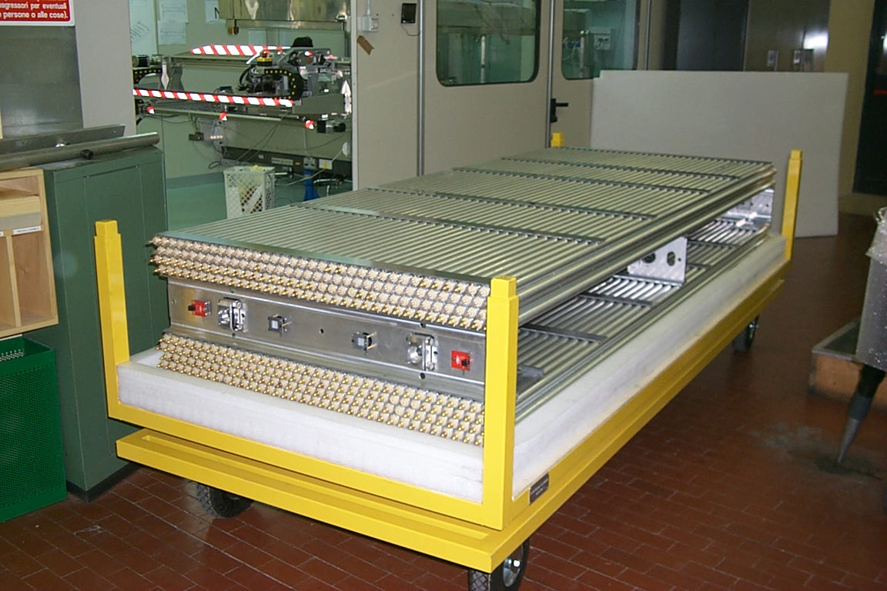
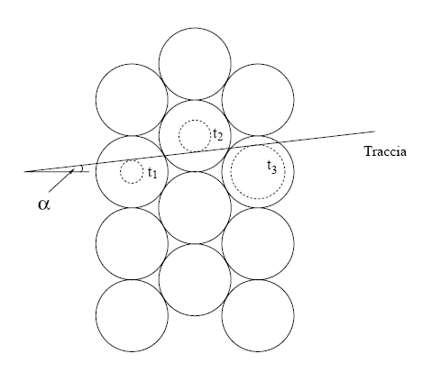
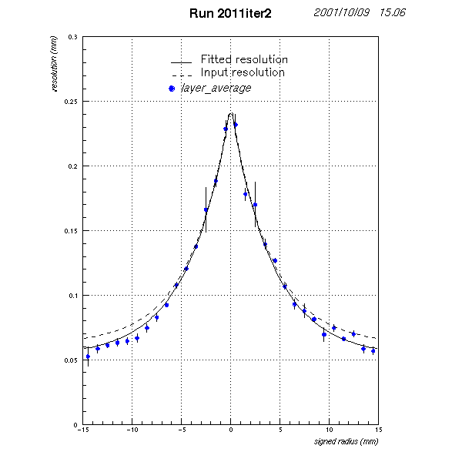
MDT Detectors: made in Rome!
Drift tubes mechanical parameters:
Tube Radius : 15 mm
Tube thickness: 400 μm
Wire diameter: 50 μm
Tube length: 1-6 mt
Chamber mech. Precision 20 μm
Two Multilayers of 3 or 4 layers each.
One Monitored Drift Tube Chamber in the mechanical workshop in Rome
Operating Conditions
Gas Mixture: 93 % Ar 7% CO₂
Absolute pressure: 3 Bar
HV: 3080 V
Gas Gain: 2x10⁴
Threshold: 25 electrons
200 μm
50 μm
Resolution vs drift distance

Slide 16
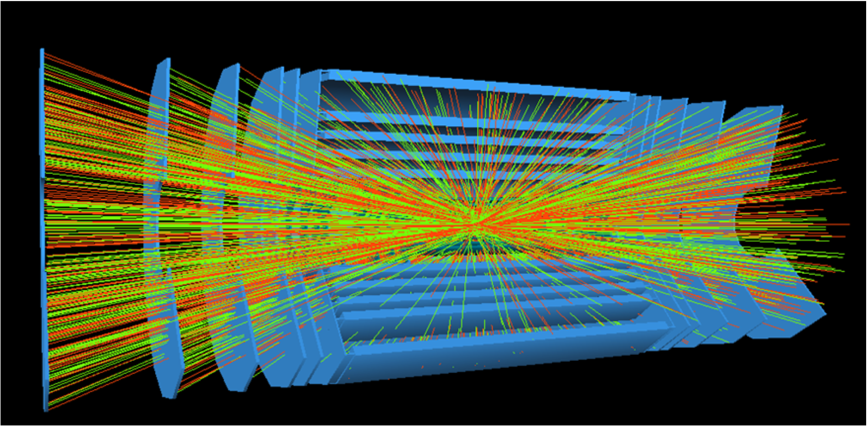
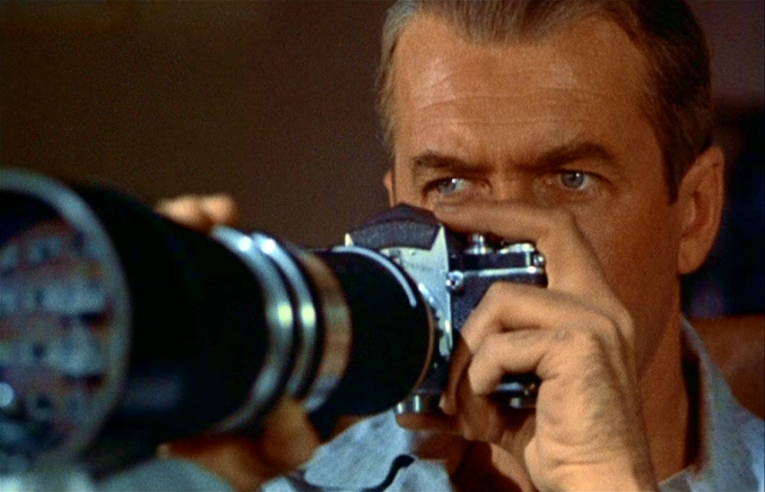
The Trigger concept
In many systems, like particle physics or astronomy experiments, to store all the possibly relevant data provided by the sensors is UNREALISTIC and often becomes also UNDESIRABLE
Three approaches are possible:
  Reduced amount of data (compression and/or filtering)
  Faster data transmission and processing
  Both!
The trigger starts the photo process
First identify the interesting event
Ensure the sensitivity to parameters
Ensure a good synchronisation

Slide 17
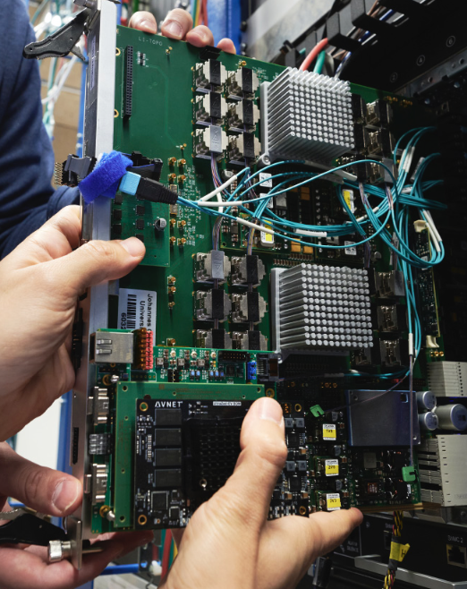
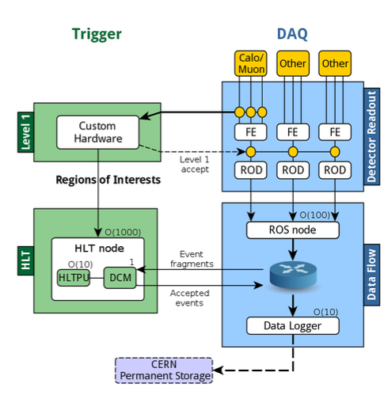
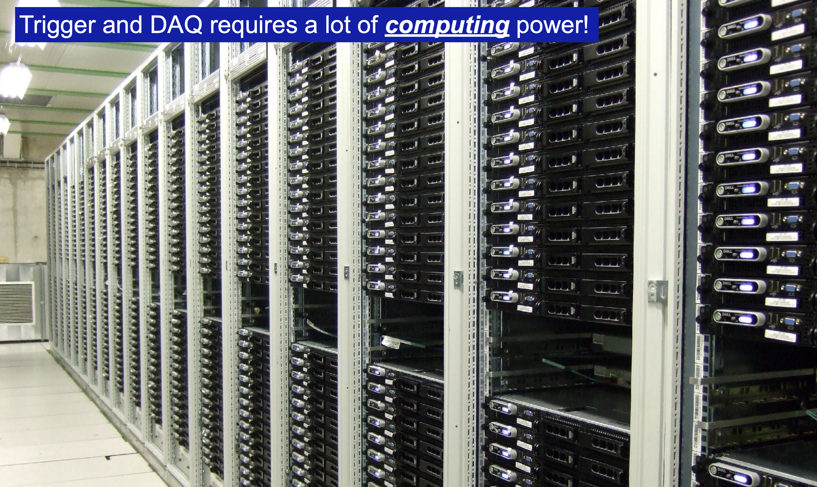
Trigger and data Acquisition
Trigger and DAQ requires a lot of smart custom designed hardware processing
Filtering of data provided by the sensors is done in custom designed hardware:
  decision taken in O(1 us), every 25ns
    raw information from detectors with good time resolution is required.
  additional level of filtering by running hundreds of algorithms on a large processor farm O(1000) compute nodes installed on site.

Slide 18
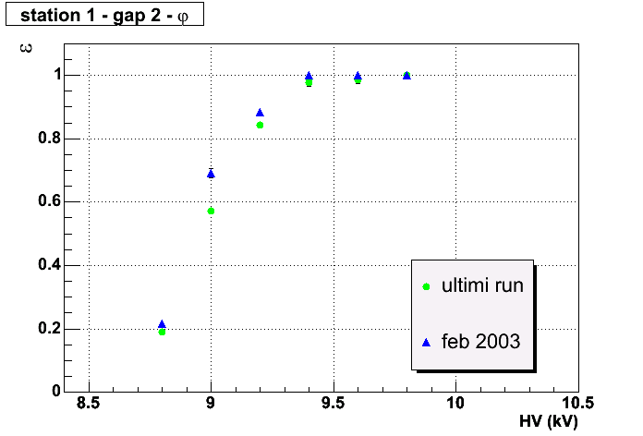

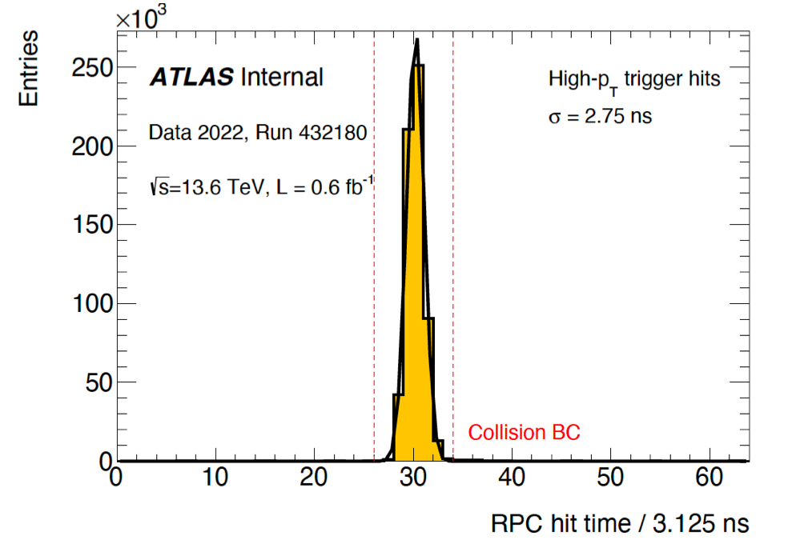
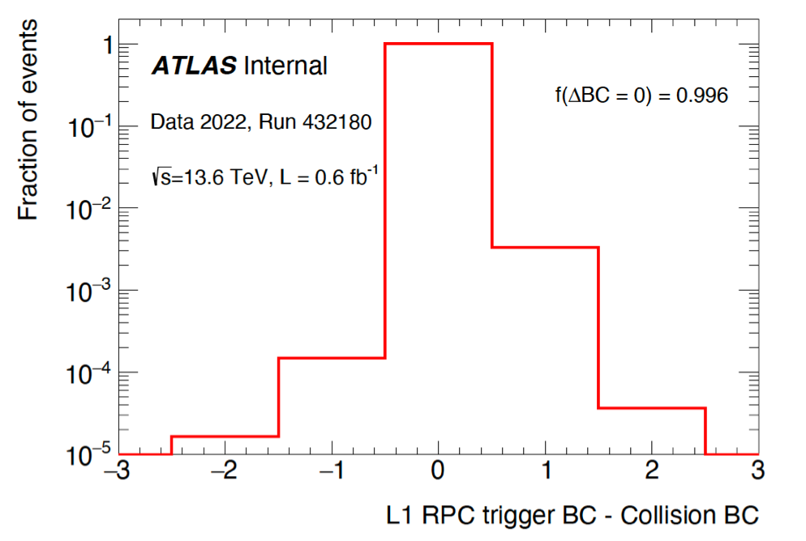
Trigger chambers: RPC
good efficiency in particle detection
X readout strips
Bakelite Plates
Gas
HV
Foam
Grounded planes
Y readout strips
PET spacers
Graphite electrodes
good time resolution
Good Bunch Crossing identification
Operating Conditions
(E_{gas}~ 5 KV/mm)
Gas: C₂H₂F₄ 95% - C₄H₁₀ 4.5% - SF₆ 0.5% ;
ρ_{bakelite} ~ 2x10¹⁰ Ωcm ;
Gas Gap d = 2 mm ;
Graphite coated HV electrodes
Cu read out strips 30 mm pitch
Time resolution ~2.0 ns

Slide 19
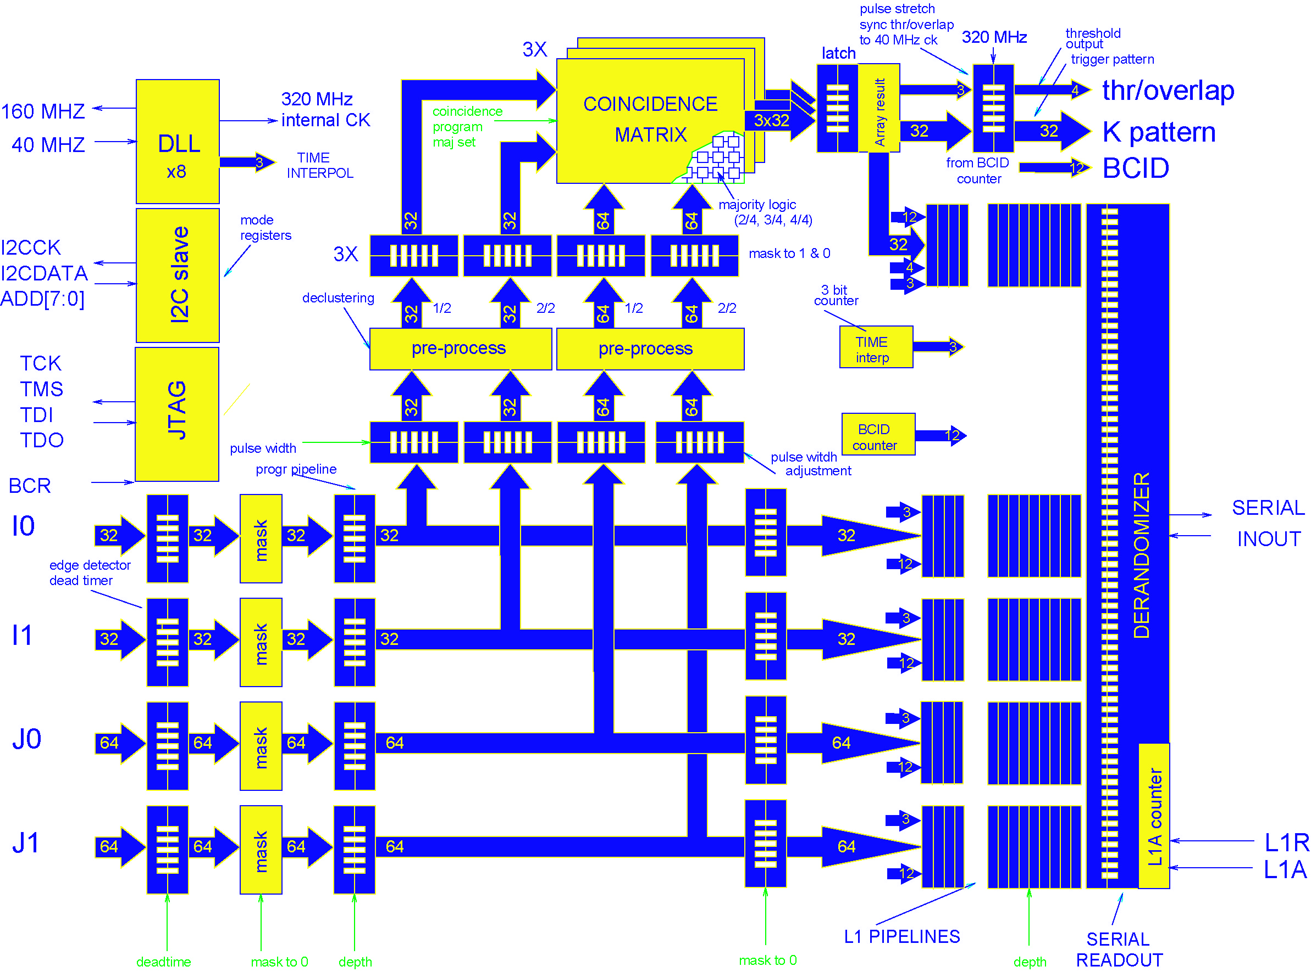
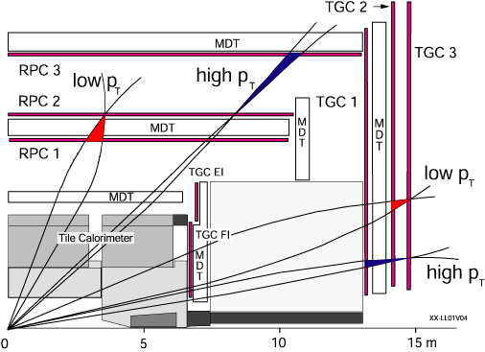
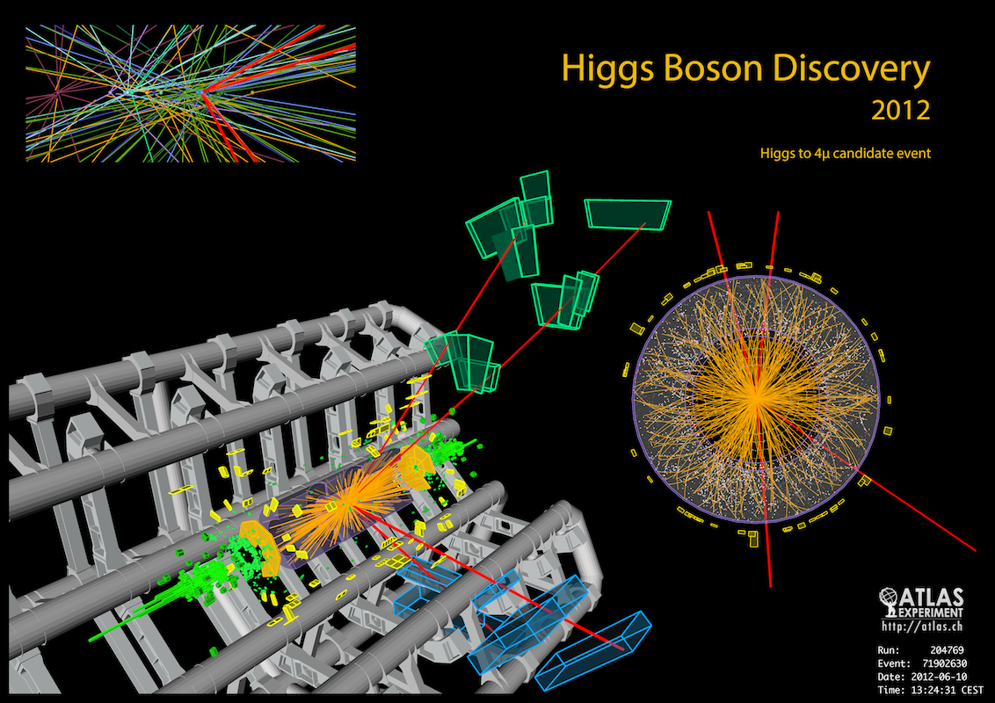
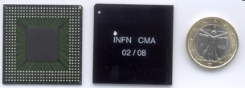
Level 1 Muon Trigger
~10 mm
The Level-1 Muon Trigger provides the fast trigger signals needed for the ATLAS Level 1 trigger decision, based on the number and transverse momentum of muon tracks in each event. The system consists of a Barrel section and two Endcap sections.

Slide 20
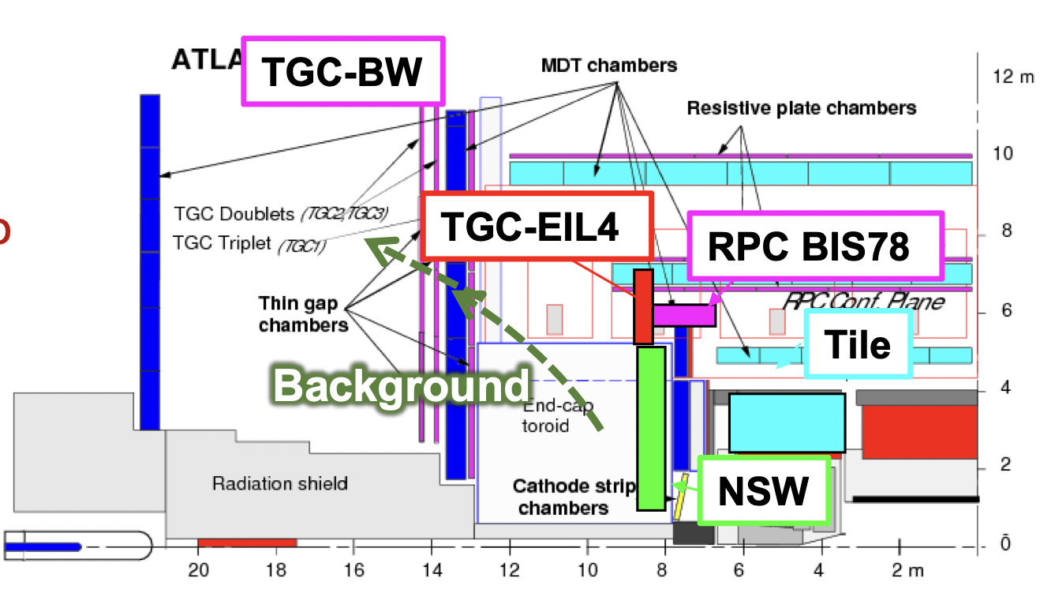
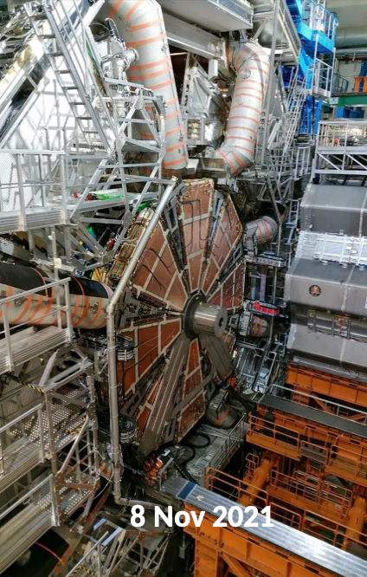
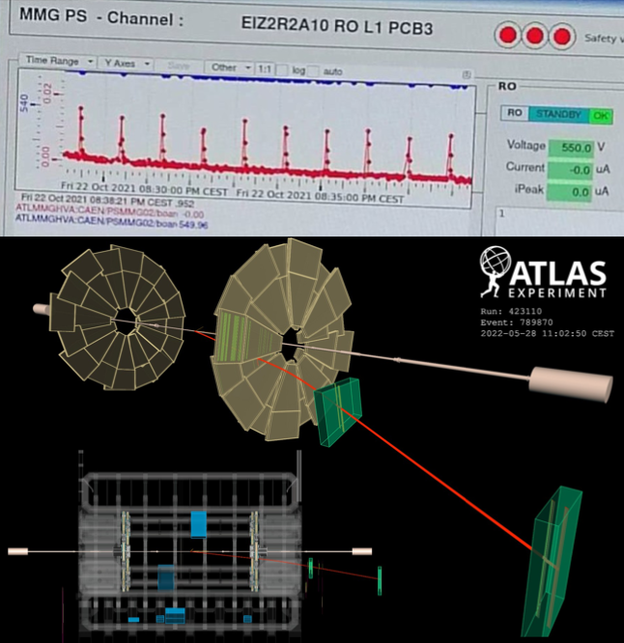
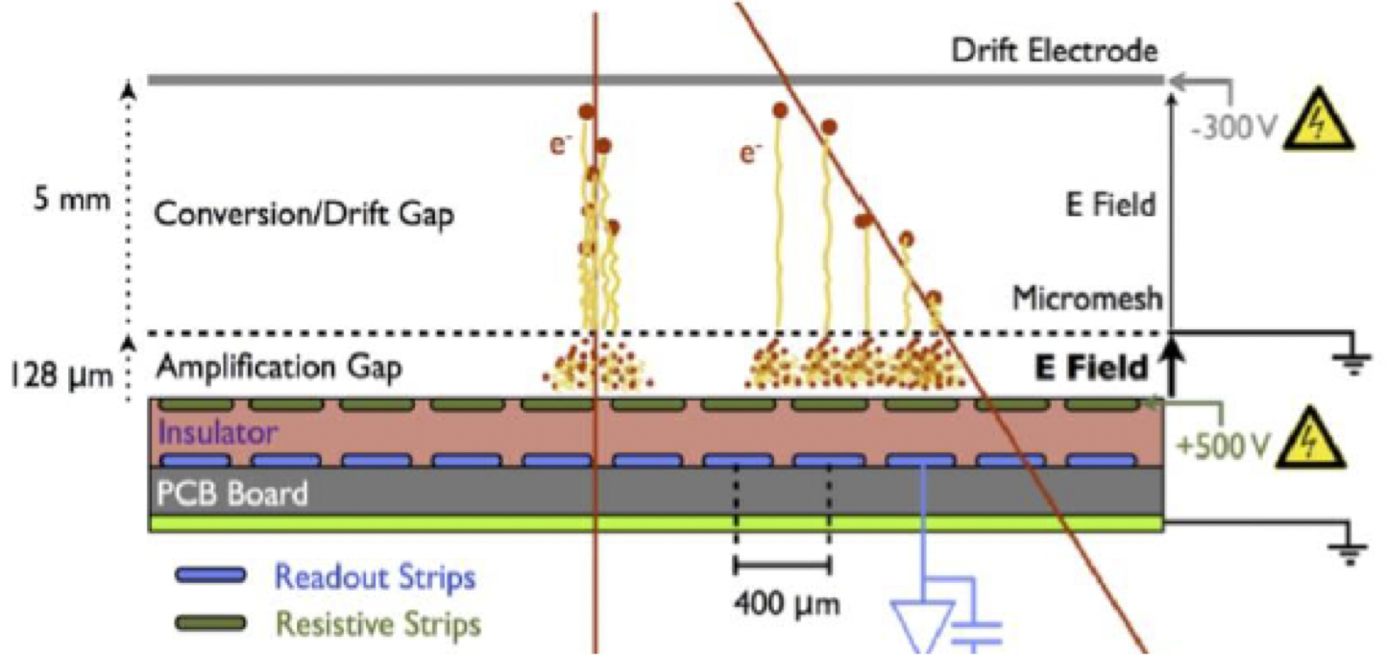
Detector Upgrade: New Small Wheels
New Small Wheel taking data now !
Italy has participated to a successful detector Upgrade, integrating two new detector technologies in the Endcap regions of ATLAS:
  Micro Pattern Gas chambers (MicroMegas)
  Upgraded Thin Gap Chambers

Slide 21
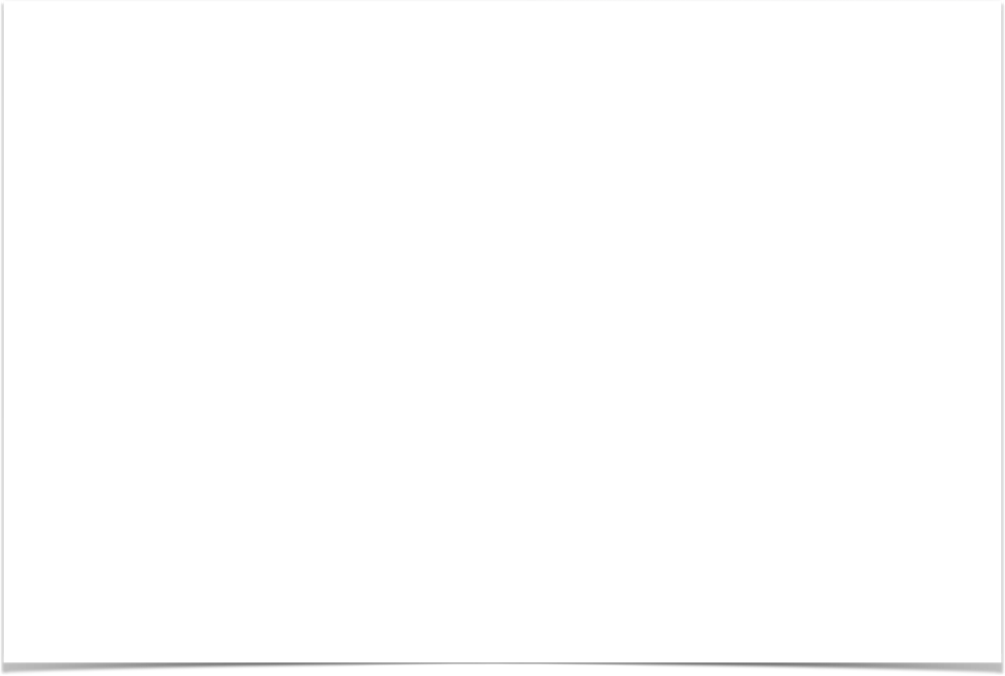
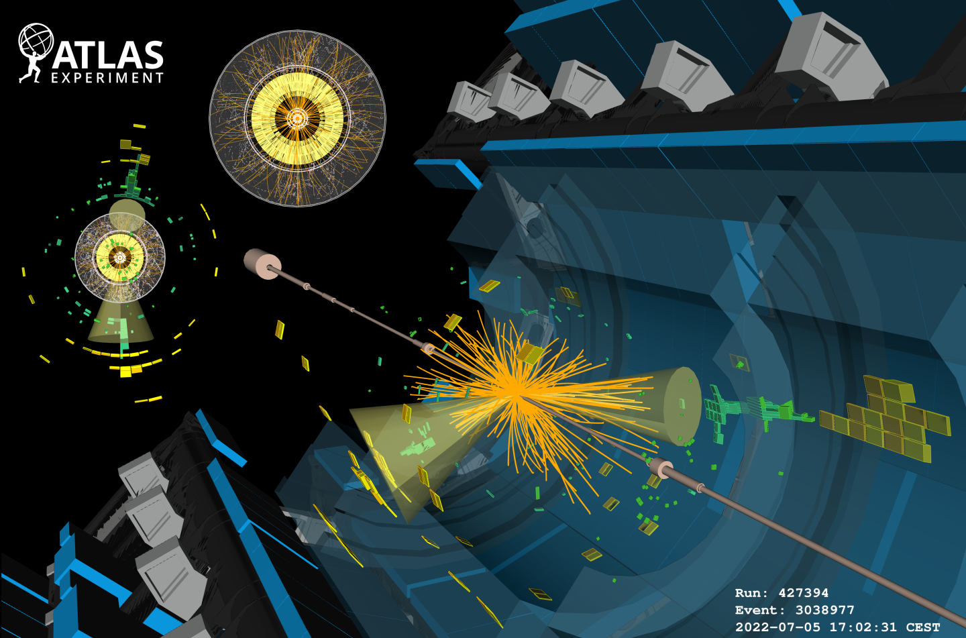
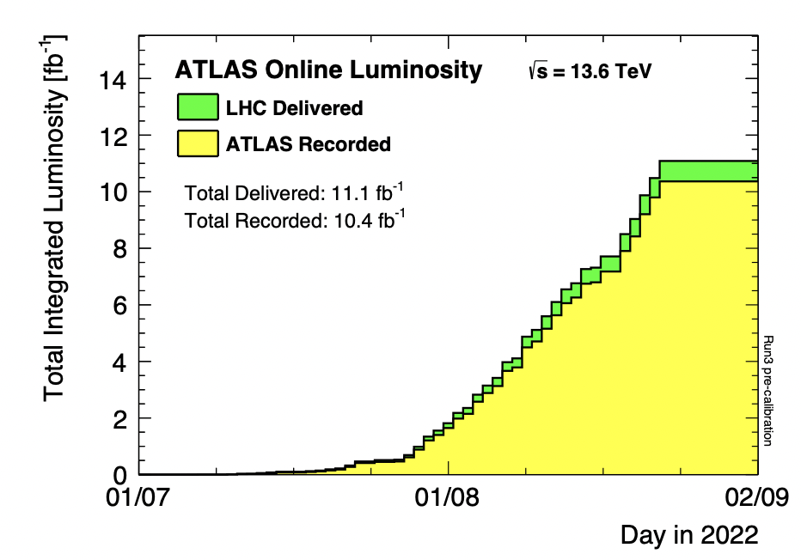
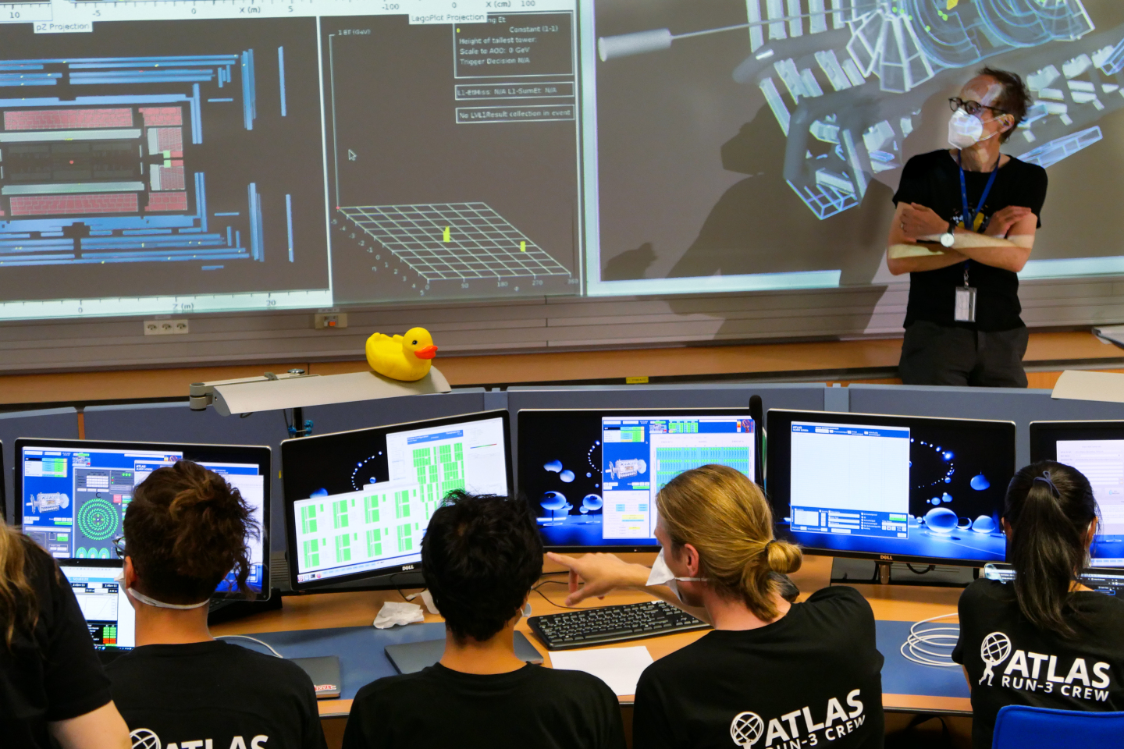
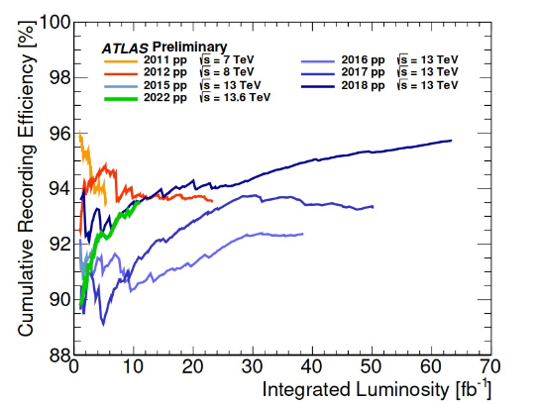
ATLAS today
LHC delivered vs ATLAS recorded luminosity in 2022
Cumulative recording efficiency vs luminosity, 2022 vs past years
very efficient student shift crews!

Slide 22
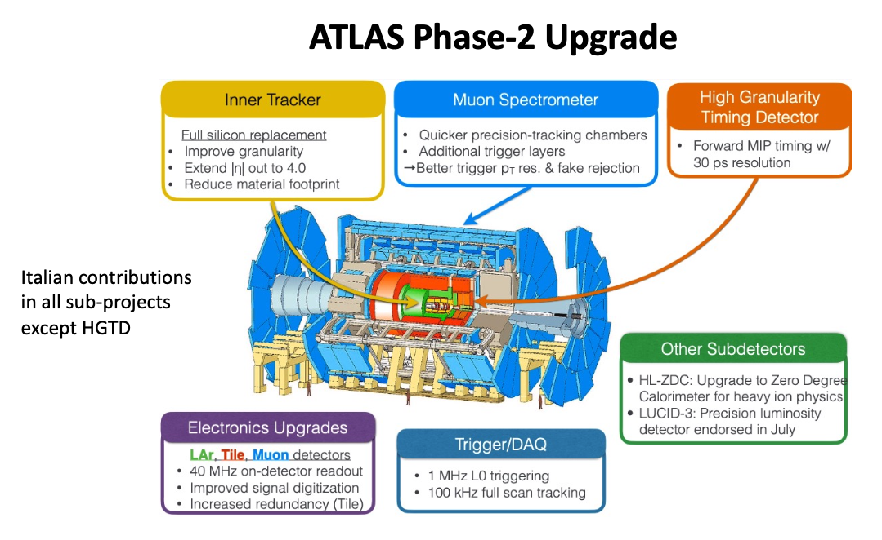
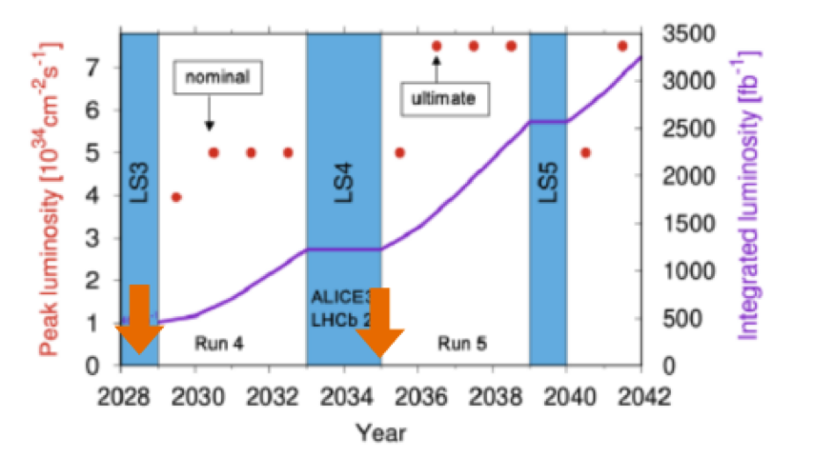
ATLAS in the future

Slide 23
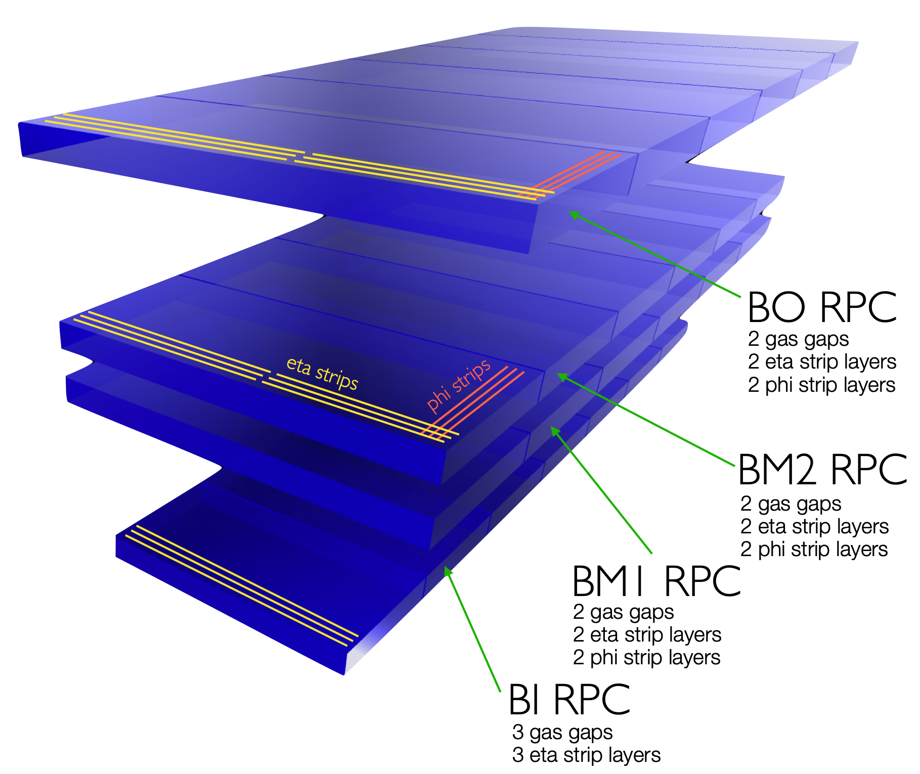
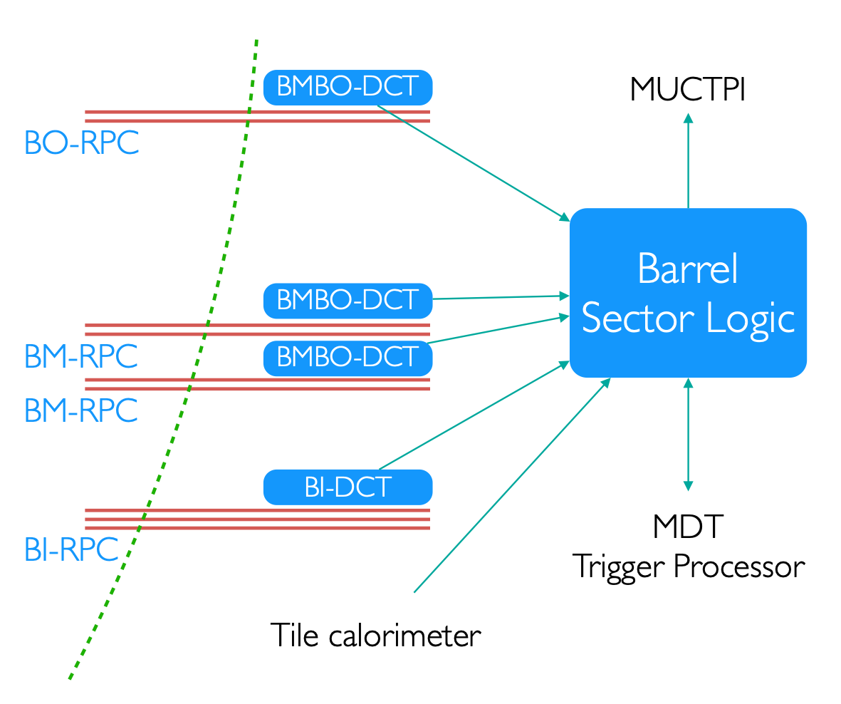


Level-0 Muon Trigger activities
New RPC and sMDT detectors in the inner region of the barrel:
  The new detectors allow to:
    reduce the trigger fake rate in barrel and end-cap regions
    increase the trigger performances
    increase the geometrical coverage in the barrel
Single level Level-0 Muon Barrel hardware trigger with an output rate of 1 MHz, Level-0 readout latency is 10 μs
  potential use of Artificial Intelligence in the realtime path, taking decisions in ~1 us.
The new RPC
detector
prototypes
The new Level-0
trigger
processor
prototype

Slide 24






Other ATLAS Trigger and DAQ activities
at HL-LHC
Muon position measured using a Neural Net trained using charge distribution of a cluster in a MicroMega detector
Development of Artificial Intelligence-based algorithms for online event selection
For example:
  Pattern recognition and tracking
  Detection of anomalous signatures
Exploiting innovative Machine Learning techniques and their application and inference on state-of-the-art hardware
Excellent timing and selection performance crucial for ATLAS as for other non-HEP applications
INFN - ROMA
Muon track found by running a Neural Net trained for muon tracking in the ATLAS spectrometer in presence of background hits

Slide 25





Slide 26

Rome contribution
Since 2003: 81 master and PHD Thesis
2018-2022
not exhaustive,
apologies if you
don’t find
your name here !

