Slide 1
PP2/Services - an update - Mauro Citterio INFN Milano
Type II cables
Layout in progress
Duplication of VVDC wires (VVDC + 1.5V)
Circular connector at PP1
Work in progress on the PP2 Box
Conclusions

Slide 3
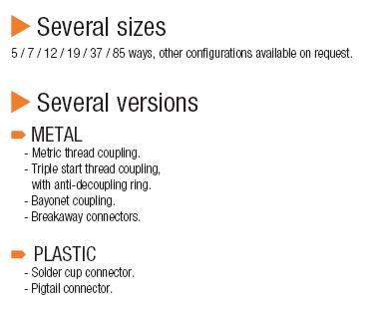
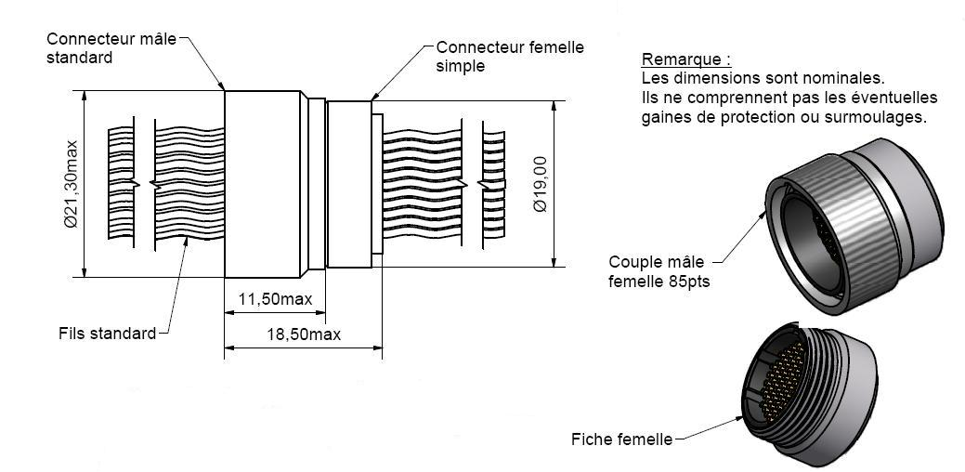
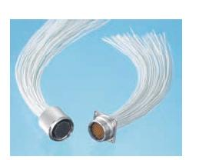
Proposition : Circular Connector 85 µD contacts
10 LV AWG 12 40 LV AWG 21
10 HV AWG 28 10 HV AWG 36
18 DCS AWG 26 18 DCS AWG 36
Type 2
Type 1

Slide 4
Additional Voltage Needed for Opto Board
Tobias: We DO need an additional line for the 1.5V and this one is behaving the same as the actual Vvdc line, means need to run from the counting room to the PP2 box and through the regulator. This in turns means our Vvdc cable needs double the wires as we have foreseen now.
In addition, the regulator must be able to handle the needed voltage and current and we will need double number of channels
Susanne: Therefore I would propose we keep the opto services as they are:
Viset, Topto, Vpin, Viset (SC-OLink to opto box)
and have LVopto:
Vvdc, V1.5 (SC-Olink to PP2, PP2 to optobox)
Shane/KK Gan: We know from simulations and fabrication of prototype chips that conservative values for the maximum "new" opto-board power supply currents will be: B-Layer 500 mA @ 2.5 V 300 mA @ 1.5 V Disk 250 mA @ 2.5 V 300 mA @ 1.5 V For the wires of the 1.5V power supplies we propose to use the same gauge of wire used for the VVDC supplies in the present system. This is simply because the 1.5 V supply has a power consumption similar to a present opto-board's VVDC. For the new opto-boards, the VVDC wires are still required and can remain the same gauge as in the present system (as long as the present wires are capable of delivering 500mA). Like the existing 2.5 V VVDC, the new 1.5 V line should be regulated. If we use our new chips the VCSEL currents will be individually controlled via the TTC signal and hence there will be no need for a VISET line

Slide 5
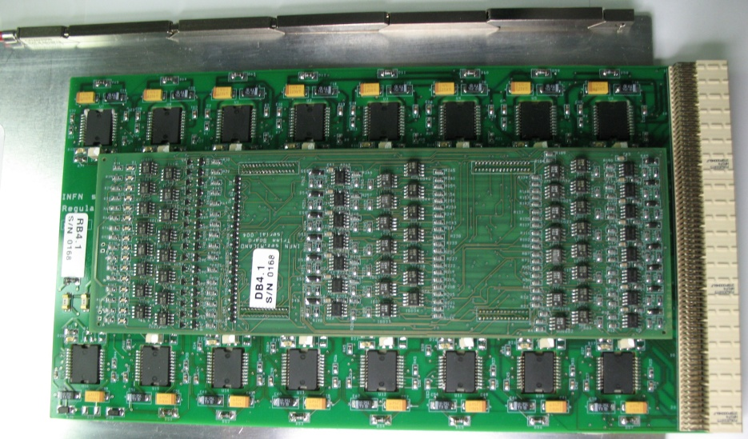
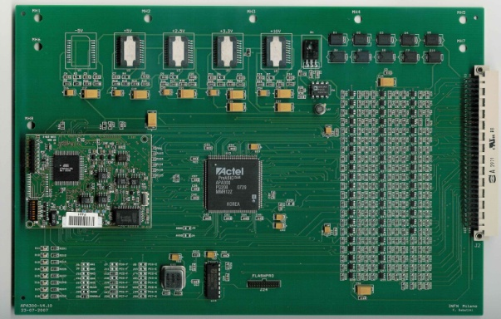
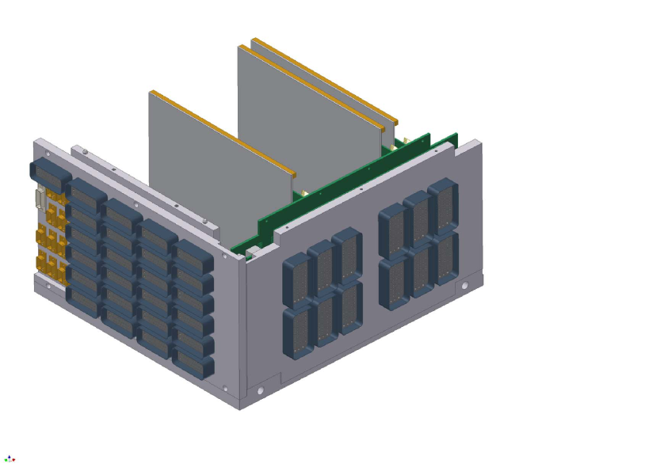
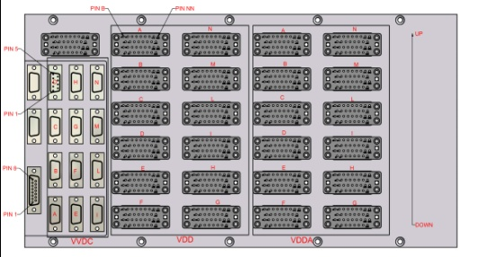
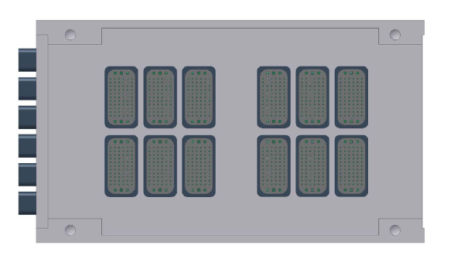
PP2 Changes Summary
Controller : no changes
Regulator board “almost” the same, but:
Two LDOs will work in parallel on a same channel.
Each LDO limited to ~ 50% of IMAX
VVDC Channels
placed in special
boards !!!
Input : will change
Output: will change
The structure will change

Slide 6
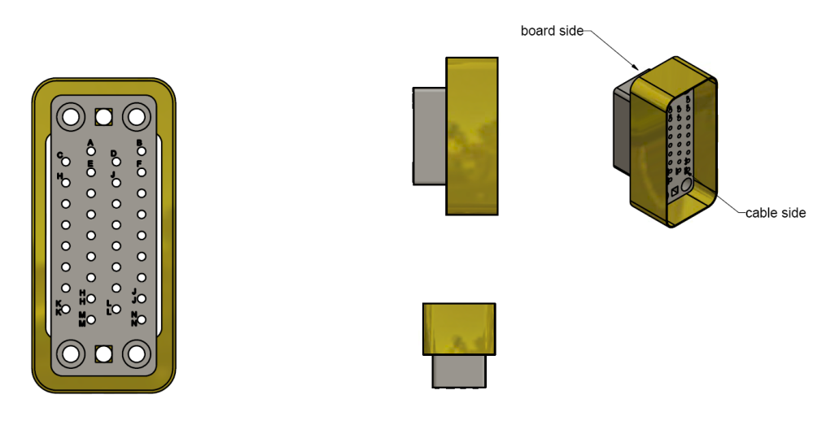
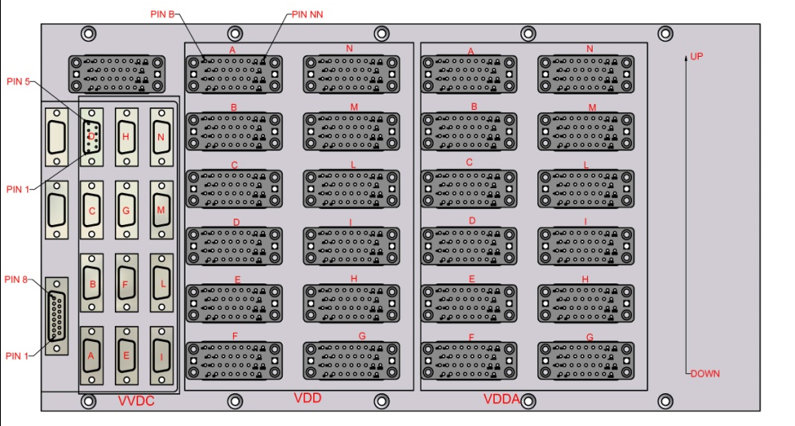
IBL PP2 box: Passive Boards
The PP2 passive boards and the metal frame for these boards will be re-designed
Small progress in the Input Board design
8 boards per crate required → decreased trace density
No voltage drop reduction required
Interface with Type III cables via V35 connector could be maintained
Same number of connectors
7 connectors instead of 48
Size contact and number of contact is under revision
Type III cable specs needs to be defined
(Milano and Barcellona)

Slide 7
IBL PP2 box: Output Board
The “Back-plane” concept is different:
Significant voltage drop reduction at the ST LDO output
Only one Output Board instead of two connected boards → more reliable design
→ Voltage drop goal is ~ 30-40 mV (at 2.4 A)
→ Most of the drop will be on the regulator board (!!)
→ Back-plane layout optimization is continuing
(16 layers , 70-150 micron Cu)
ON hold until info on
cable is fixed
The FUTURE BUS connectors will have many un-used pins in the new box
The connectors could be exchanged with a less dense
Conn. type (ATCA stile)
Needs:
~ 80 pins
redundant pins
less than 2. 5 mΩ contact
Resistance
Not back-compatible with standard regulator boards
VVDC
Controller
Input

Slide 8
The structure will change to accommodate HV and DCS lines
No real layout yet
Some possible grounding issues/caveat (at least one on the OPTO)
How to implement the HV breaking points
DCS ????

Slide 10
IBL PP2 box
Main points:
Channel density and “logical distribution”
4 “FE power channel” per half stave
1 “FE power channel” serves 4 FE-I4 chips
VVDC Type II power lines are grouped together → Services Excel Sheet
Nominal current (2.4 A) per “FE power channel”
Plan is to use the ST LHC4913
Voltage drop across an ST regulator ~ 1.3 V (at nominal current)
Maxi current at max voltage (3.6 A) exceed ST specs
→ two regulators used in parallel
Small R/T voltage drop from ST output to Type I cable ends
Hp: LDO implemented on FE-I4
Drop is the sum of the drop inside PP2 and Type II cables
Max R/T voltage drop: 350 mV → From Maurice’s table
Not clear at what current the drop is estimated (!)

Slide 11
Voltage drop sharing:
Type 0 : 200 mV
Type I : 300 mV
Type II : 350 mV

Slide 12
Some thought on the Type II cables
Some information are needed to specify the cables:
Cable modularity for FE powering:
4 x (2xAWG12 + 1x AWG22 + 1xAWG28)
Is this compatible with the allowed 350 – 30 mV = 320 mV R/T drop?
Length of cable → 12 meters ?
The size is still on the small side !
AWG | 17 | 16 | 15 | 14 | 13 | 12
Length (m) double throw | 24 | 24 | 24 | 24 | 24 | 24
Ohm/Km | 16.61 | 13.17 | 10.45 | 8.286 | 6.571 | 5.211
Ohm | 0.39864 | 0.31608 | 0.2508 | 0.198864 | 0.157704 | 0.125064
Current (A) | 2.4 | 2.4 | 2.4 | 2.4 | 2.4 | 2.4
Voltage drop (V) | 0.956736 | 0.758592 | 0.60192 | 0.477274 | 0.37849 | 0.300154
Diameter (mm) | 1.15 |  |  |  |  | 2.053

Slide 13
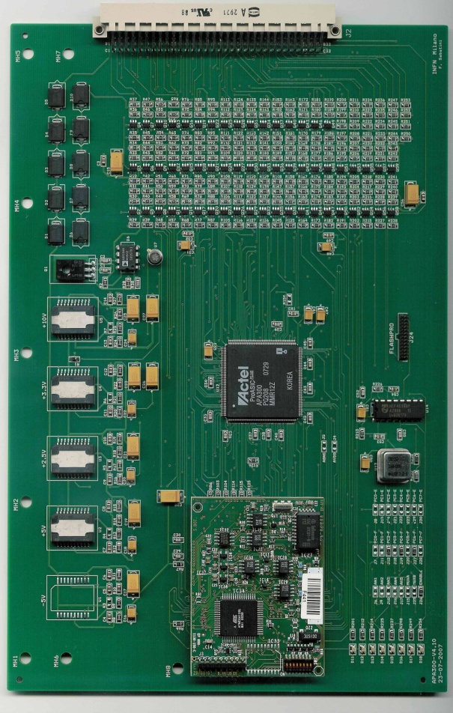
IBL PP2 box: controller board
The goal is to improve the existing design
Collaboration between Milano and Barcellona
New boards under Barcellona responsibility
New design will be fully compatible with the existing DCS
The FPGA controller will not change “visually”
New and more powerful FPGAs
The FPGA will be from the same ACTEL family but
will need to be qualified again against radiation
The FPGA firmware will be changed/updated
Some communication commands will not be used anymore
(i.e. only 8 boards/crate need to be addressed)
The ELMB functionality will be implemented in the FPGA
(logic resources should be enough – to be confirmed)
The new controller will be back-compatible with the
present PP2 system for testing

