Slide 1

IBL Status & Speed-up
IBL Italia
Milano, January, 12th 2011
G. Darbo - INFN / Genova
Indico agenda:
http://indico.cern.ch/conferenceDisplay.py?confId=119960

Slide 2
Introduzione
Perché vederci…
  Attività dell’IBL stanno entrando nel vivo del progetto.
  Collaborazione internazionale aggressiva sul progetto, … visibilità Italiana richiede sinergie tra I gruppi INFN
Si sta discutendo sull speed-up della schedule (vedi prossime slides)
  Quale sarà l’impegno sulle attività e deliverable Italiane: possiamo aumentare risorse umane o renderle più efficienti o non ce la facciamo?

Slide 3
IBL Status
TDR: waiting for 200 printed copies
LHCC approval. TDR presented in September, reviewers questions answered by early December
On technical side several progresses
  FE-I4 (received 6/10 wafers) under testing in Bonn, Gottingen, LBNL and SLAC.
  First FE-I4 bump-bonded with planar sensors start testing this week.
  3D sensors from FBK (FE-I3 wafers) in process at Selex for BB, FE-I4 wafers will be shipped next days to IZM for bump-bonding (see Gian-Franco’s talk).
  Stave design deeply discussed in Annecy Workshop (Dec), final design expected end of this month. Several changes: V-shape, add a carbon fiber face-plate in front of the module, end support in peek.
  Al/Cu stave flex-hybrid prototypes received from CERN workshop (see Ettore/Claudia).
  First long prototype of IST arrived.

Slide 4
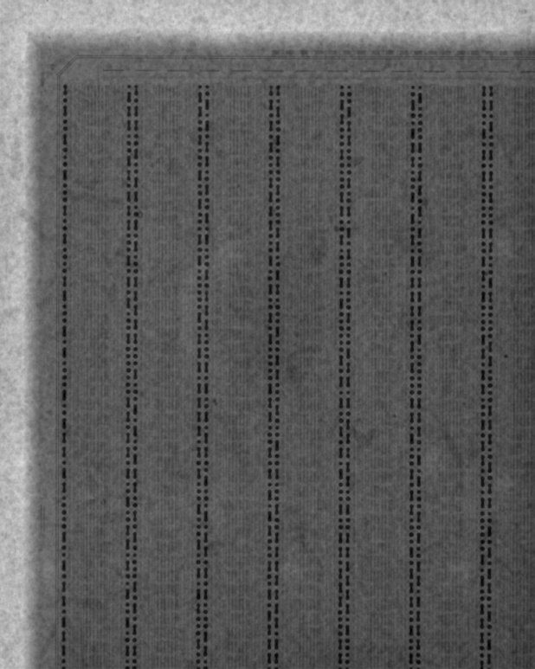
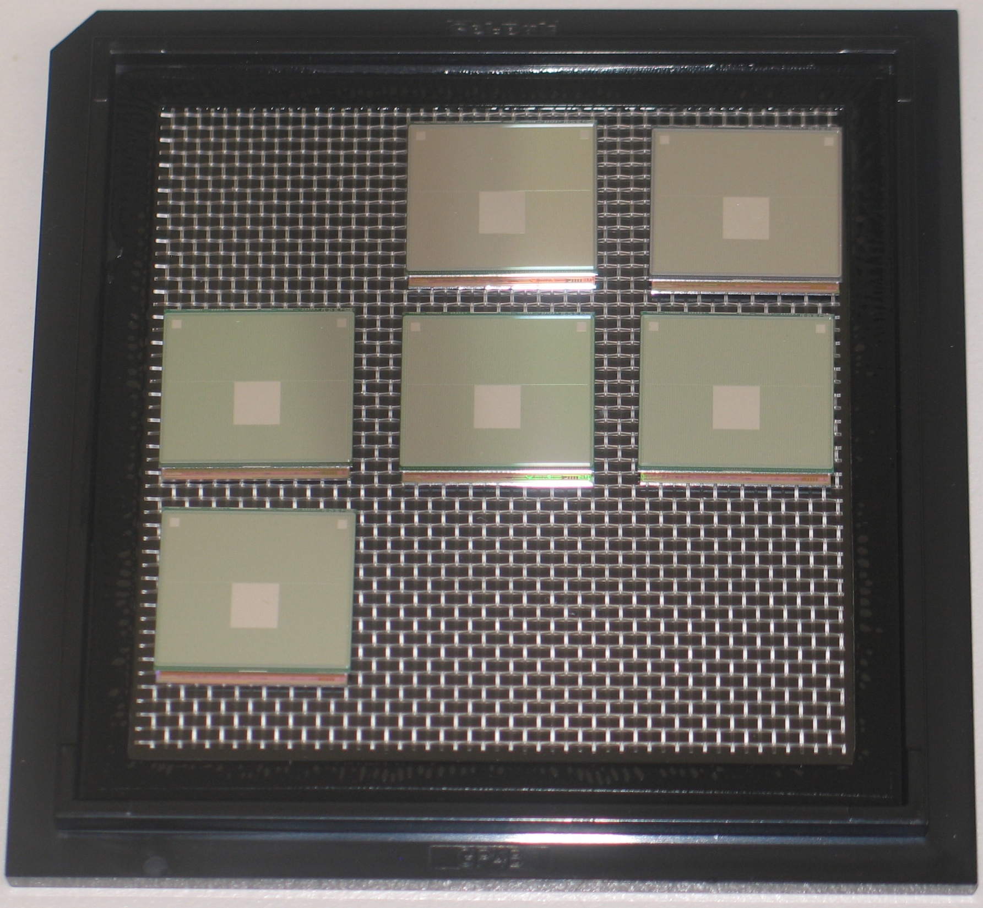
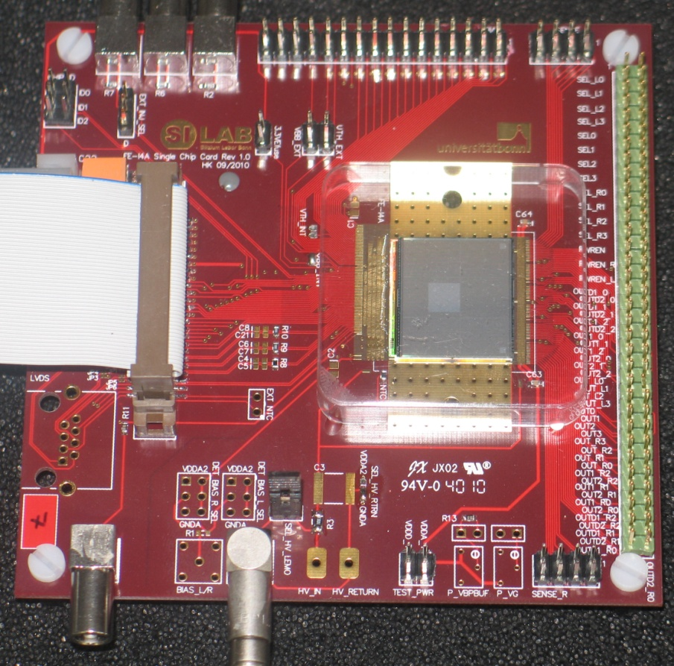
First Assemblies Sensor/FE-I4
7 assemblies with CiS planar sensors received
  1 assembly already mounted to board and currently under test:
2 more will be mounted in these days:
  1 at LBNL, 1 at Bonn
Remaining 4 will be mounted on carrier for irradiation.
Threshold and noise maps have some structures that need to understand.
INFN groups need to get involved…
  Hope to have FBK 3D with FE-I4 by February!
FE-I4/IZM
Module
X-ray

Slide 5
When Shut-downs? Speed-up?
nSQP and IBL management met yesterday - discuss on IBL installation in 2013:
  nSQP - IBL meeting (http://indico.cern.ch/conferenceDisplay.py?confId=119960)
  Talks
    Marzio – LHC schedule
    Heinz – IBL speedup schedule
    Nanni – spending profile impact from speed-up schedule
    Fido – nSQP schedule
Questions:
  Chamonix coming soon – Shutdowns forecast:
    2012 SD → 2013 SD : Collect more data, competition with CDF (what about not approved extension of the run?)
    2016 (IBL) SD → would move too
  When install IBL?
    2013 too early? 2017… too late… → maybe a new Pixel would be better and possible.
    nSQP project would greatly simplify installation if Pixel is taken to surface.
    Cut 1.5 year in the TDR schedule and no contingency how impact the performance? What are the risks? → prepare

Slide 6
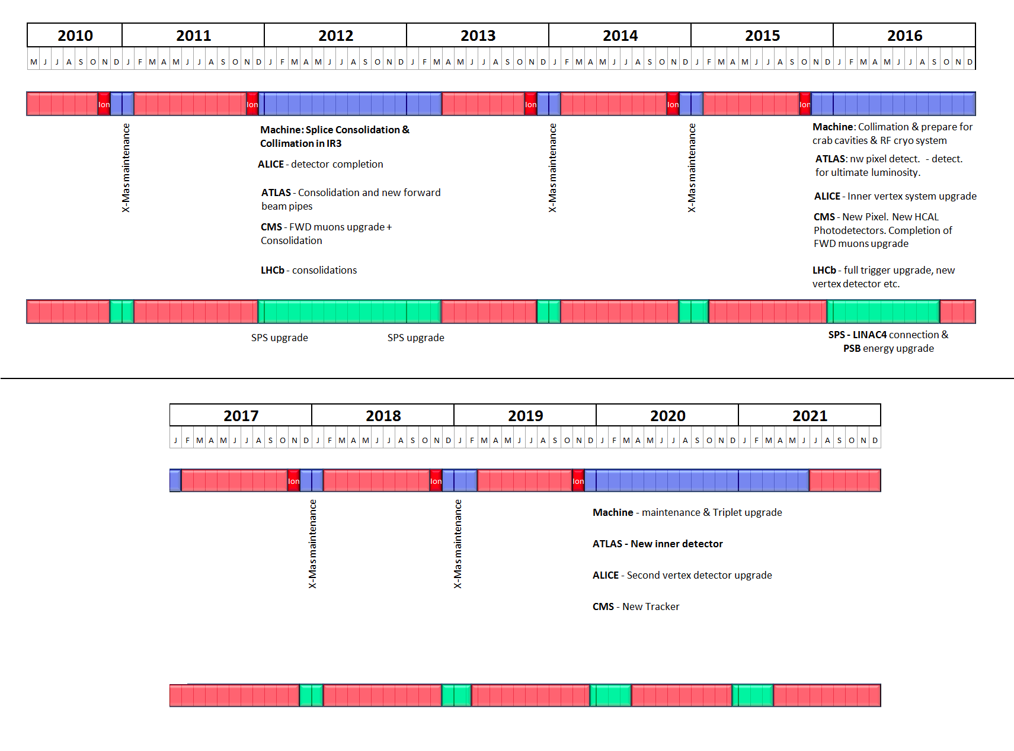
LHC Shutdown – Pre-Chamonix Forecast
In order to anticipate readout problems of the pixel detector because of possible failing optical transmitters inside the detector itself starting in 2015: extract the pixel detector, bring it to the surface, substitute all services (SQP project) and optical transmitters, then reinstall. We started preparing in a preventive way for this already (new SQP project). Decision to extract or not during 2012. This is a major operation!
- Install the new pixel b-layer (IBL=Insertable B Layer). First approved ATLAS upgrade project, now under construction. This will profit from the pixel detector being extracted and on surface. It will require a new Be beam pipe with smaller diameter (45 mm). The IBL will improve the vertexing and b-tagging properties of the detector at nominal Luminosity and beyond. This project was first tuned to be ready for the 2016 shutdown. The collaboration is now discussing the possibility to accelerate the construction to profit of the new shift in the shutdown schedule!
Ref: Marzio – 11/01/2011
Ref: Marzio N. -IBL-nSQP Meeting / CERN 11/01/2010

Slide 7
IBL schedule for installation 2013
Assumptions for schedule for installation 2013
  Official project start: 1. March 2011
  Ready for installation : 1. July 2013
  Construction time shortened by: remove explicit contingency (2x3mo) + parallelizing operations + early start for sensor pre-production (6-8 mo) + FEI4 Version 2 direct production run (5 mo)
  Main construction duration of components not changed (e.g. BB, stave loading, integration …)
  Treated as construction schedule with qualification steps of components (sensor, chip, module, stave, integration)
Personally I believe the schedule is achievable if there are no major component failures and no major delays (e.g. due to extended RD steps)
Time critical items:
  Sensor pre-production run (start Feb) and sensor review/decision (June)
  FEI4 Version 2 submission (June 2011)
  Bump bonding of thin modules (workplan in preparation with IZM, aim to get first thin modules in approx 3 months)
  Stave 0 program to qualify full stave mechanically and electrically (requires rapid advancement on stave flex and module loading) (mechanical stave April-May, loaded Aug, tested Oct)
  Beam pipe qualification of split flange and order of beam pipe
Ref: Heinz P. -IBL-nSQP Meeting / CERN 11/01/2010

Slide 8
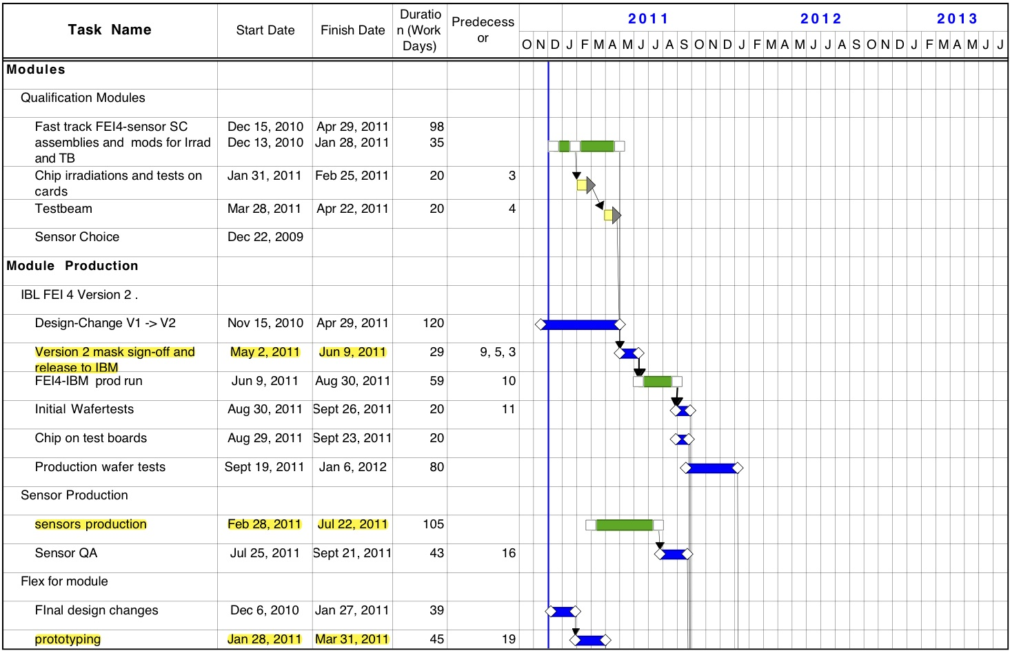
Speed-up Schedule (1/4)
Ref: Heinz P. -IBL-nSQP Meeting / CERN 11/01/2010

Slide 9
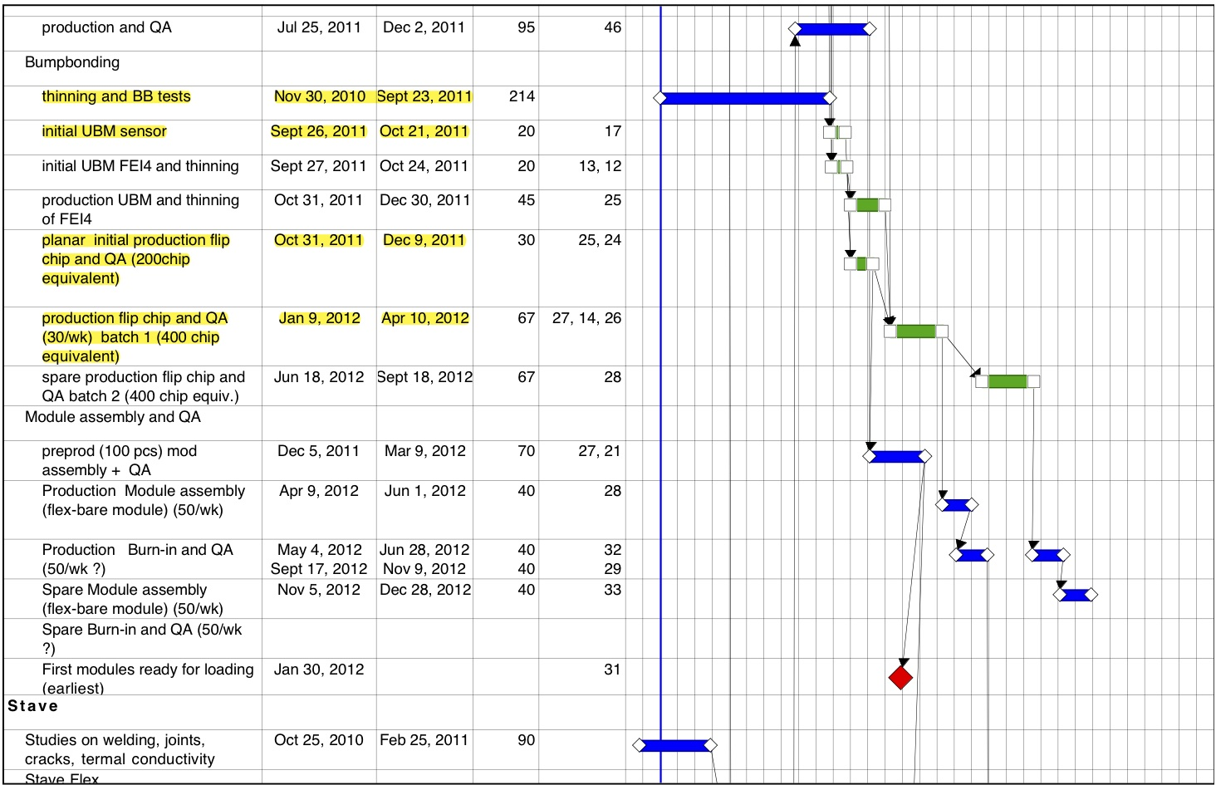
Speed-up Schedule (2/4)
Ref: Heinz P. -IBL-nSQP Meeting / CERN 11/01/2010

Slide 10
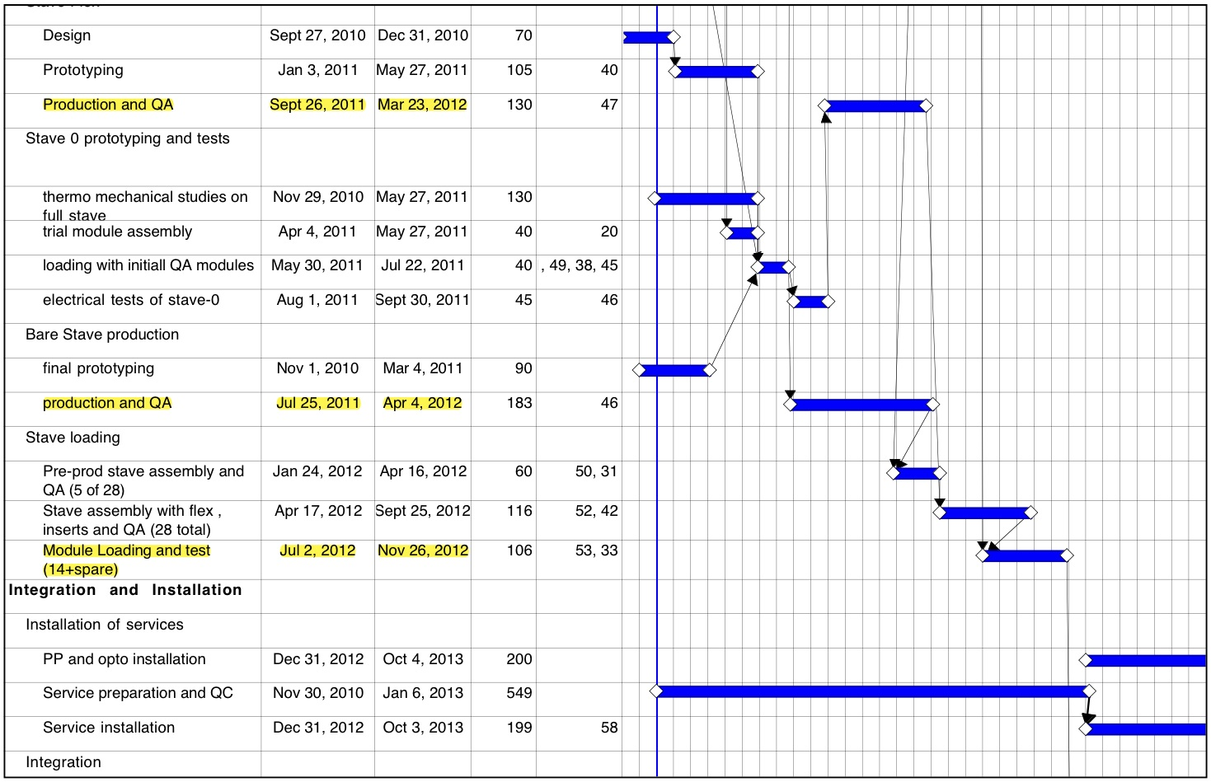
Speed-up Schedule (3/4)
Ref: Heinz P. -IBL-nSQP Meeting / CERN 11/01/2010

Slide 11
Speed-up Schedule (4/4)
Ref: Heinz P. -IBL-nSQP Meeting / CERN 11/01/2010
Success oriented schedule…
  Very aggressive, no contingency, either we make or we miss.
  Can we make our deliverable in time with schedule? Today discussion…
  Note: ROD and Off-detector electronics not discussed yet

Slide 12
Schedule Speed-up
IBL official schedule (TDR):
  Above schedule has 6 month contingency built in. – Spending profile considers IBL completed in 2014.
“speed-up schedule” : make IBL by mid of 2013 (see Heinz’s talk).
  Spending profile adjusted to fit faster schedule.
  Impact both on M&O-A and M&O-B/Project money.
    M&O-A can absorb it more “easily”
    The M&O-B and New Project money are analyzed in the next slides.
  Some extra costs (and risk associated costs) for IBL speed-up (look at sensors only)

Slide 13
IBL Costs as in the i-MoU
The cost for the modules (items 1, 2 and 3) is 50% of the M&O-B/Project cost:
  2.85 MCH out of 5.9 MCH
Cost in the i-MoU assume:
  2 FE-I4 engineering runs + production of 3 batches of 24 wafers each
    Cost are still in the i-MoU estimates
  ~6÷8 batches of 3D sensors - planar are cheaper and with higher yield
    A 3D batch (slim edge) could be 50÷70 k€ - yield still not known (need pre-production to evaluate)
    A planar n-on-n is 50÷60 % of the 3D cost
  Bump bonding:
    Deposition of bumps on 72 FE-I4 wafers and 200 sensor UBM.
    Considered pretty large extra production – limited sensor wafer testing before bump-bonding (no bias grid in 3D: test by structure on wafer and by removable metal putting all pixel in parallel)
    Yield and cost of bump bonding must be revisited. New process is in development.

Slide 14
Resources for Speed-up (M&O-B/Project)
Additional resources in 2011
For speed-up necessary +1.05 MCH in 2011
  Save 385k in 2012, 529 k in 2013 and 121 k in 2014
Sensors: +337 k in 2011
  2011 – pre-production of 2 design/technologies
  2011 – place order for production (some payment in 2012): need money available or pledged for placing the order.
FE-I4: +496 k in 2011
  2011 – engineering run + 1 production batches
  2012 – additional 2 production batches
Bump-bonding: +131k in 2011
  Largest fraction in 2012 (530k)
i-MoU items 4-11: +92k
1.05 MCH

Slide 15
Spending Profile
i-MoU profile
Speed-up
profile

Slide 16
(Sensor) Extra Cost in Speed-up
In the speed-up we should consider some extra costs that are mainly given by parallel pre-production of two technologies:
  Planar:
    One or two batches of n-on-n
    Production of masks
  3D:
    Two batches of slim edge/double side 3D (masks already exist)
Cost
  Planar n-on-n is a “commercial” product where yield and price is known.
  For 3D there is probably a margin to deal with the producers: consider the pre-production a development. They are interested to understand the maturity of the process to become a commercial product. We should profit!
  For pre-production ~150k€ should be a good figure. Part of this would be adsorbed (one of the two technologies is selected for IBL).
Financing pre-production:
  Purchase contracts placed by Institutes (FA’s) following the i-MoU shares (CERN case B as for bump-bonding of sensor prototypes). Need to agree in the PixExtIB.
  Production after sensor review and technology baseline selection – cost sharing accordingly to (final) MoU. “Technology Options” in the i-MoU could cover additional costs, if needed.

Slide 17
Discussion
IBL Speed-up schedule
  FE-I4 (Maurice) – Unrealistic submission 1st of June – Nothing before end of July or August.
  Need risk analysis and performance compromise:
    More material (thin module – will IZM process qualified in time? Copper Flex?)
    Lower dose life (planar at 1x10¹⁵ instead of 5x10¹⁵ n/cm²?)
    Would 1000V bias degraded to lower value?
    What are the risk of submission of FE-I4 without R/O architecture test with ROD?
nSQP
  Decision to install not anymore the VCSEL issues only.
  The whole package IBL + nSQP will decide on 2013 pixel package opening.
  The nSQP will not take a decision this year on opening or not the Pixel package,
Comment:
  The IBL project is more an more linked to the nSQP project. If the VCSEL do not need nSQP, IBL will have.
Sensor pre-production:
  Pre-production of CiS planar (2 batches) and 1+1 batches from CNM and FBK is supported. Financing follow IBL production sharing → Start FBK run asap!.

Slide 18
Conclusions
Prepare for a speed-up of the IBL project
  Discuss the impact of speed-up on detector performance – schedule cannot be halved without simplification → impact on material budget and total dose need to evaluate.
  Take actions that would not penalize the final IBL performance today: pre-production of 2 sensor technology until test and review could speed-up and put aside sensors for initial module production.
  FE-I4 is clearly the one that drives both performance and schedule.
  IBL and nSQP going on the same track. IBL saves nSQP or nSQP saves IBL?
Payment profile requires moves ~1 MCH into 2011
  Limited extra cost possible for sensors due to parallel pre-production.
  Cash flow can be covered by CERN if needed

