Slide 1
IBL DAQ status
P. Morettini

Slide 2
From the last IBL General Meeting
A joint Pixel / IBL workshop has been organized last week. The main goal was to bring together the DAQ developers of the two communities to elaborate a common development plan.
The discussion developed around two basic points:
There are crucial activity in both areas (namely, data-taking at the pit and testing of the FE-I4) that are already receiving strong DAQ support. The DAQ development plan must minimize the impact on these activities.
Given the commonality of the two systems and the fact that they will be seen by ATLAS as a single sub-detector, there is an obvious advantage in merging the Pixel and IBL DAQ development lines as soon as possible.
The workshop was successful: we counted up to 20 developers, potentially interested in the combined project, and we easily managed to converge to a development plan that represents a reasonable trade-off between the to points above.

Slide 3
Release strategy
Now
Xmas
“Old PixLib”
PIT developement
Combined developement
IBL developement
Jan/Feb
Aug/Sep
End 2011
Will keep the current release model (development on the HEAD plus local branches for release support) for the PIT, and the development of the “old PixLib” based release for the FE-I4 tests.
Based on the current PIT release (1.5.1) we will branch a IBL development line, were we will do the restructuring and the initial support for the IBL devices. Will use the same release strategy as for the PIT line, starting with vers. 2.0.0. Around September 2011 we should be able to merge the two lines (2.1.0)

Slide 4
Come procedono le cose?
I meeting settimanali sono chiamati a turno da Kendall e Joern per garantire una copertura uniforme dei temi relativi ad IBL e Pixel. La partecipazione ed il livello di attività sono discreti malgrado l’orario non proprio felice (Wed 7 pm).
La prima versione sw compatibile con le nuove versioni di compilatore e ATLAS TDAQ è in corso di certificazione. Sarà la base per lo sviluppo combinato con IBL.
Il lavoro vero, fino ad oggi, e’ stato piuttosto limitato; ciò è dovuto anche al lavoro concomitante sul FE-I4 con la versione dedicata del codice.
Penso che il livello di attività attuale sia compatibile con la vecchia schedule. In caso di installazione nel 2013 e’ necessaria una rapida accelerazione.

Slide 5
Spares
Slides from the IBL General Meeting (27/10/10)

Slide 6
Pixel / IBL DAQ workshop
I will just summarize the key points of the discussion, trying to avoid technical details. In particular I will focus on:
USBPix support
Test beam support
New VME based ROD/BOC
ATCA
Improvements to the Pixel DAQ infrastructure
Organization of the group
Release plan
For more details:
http://indico.cern.ch/conferenceDisplay.py?confId=110728

Slide 7
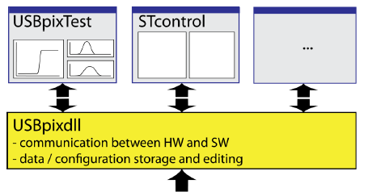
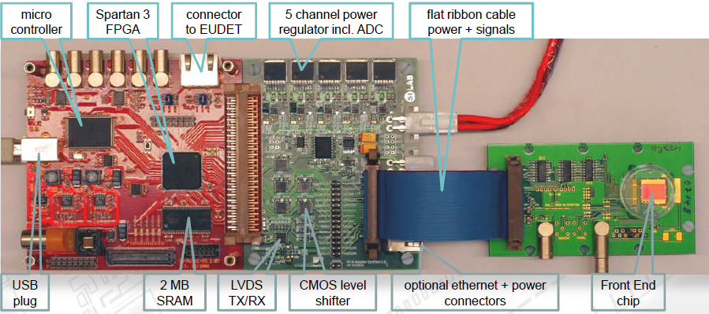
USBPix support
USBPix is currently supported via an old version of PixLib and the legacy calibration control tool STcontrol.
Even if not directly compatible with the present edition of PixLib, the old version has the same basic structure, so that it should be easy to port the support for the USBPix board itself and for the FE-I4 from the old to the new library, enabling in this way all the recent tools for calibration and data taking.
The only problem that we need to explore is the dependency on Windows: it would be natural to drop it, but the present USBPix low level support does not work well under Linux.

Slide 8
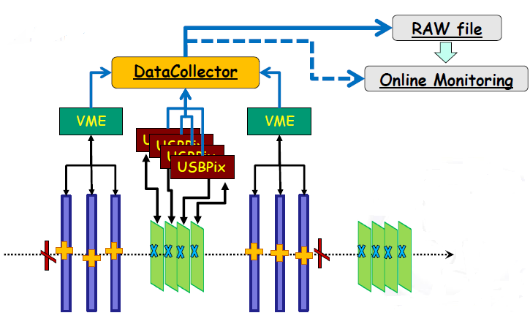
Test Beam support
USBPix is used for the test beams as well, in conjunction with the EUDET telescope. The migration to the new PixLib version will preserve this option, possibly extending it to other devices, if needed.
Still we have to understand how to operate the IBL modules in high rate tests (the EUDET telescope rate is limited to 1 kHz) or when the full read out chain will be tested in the full ATLAS TDAQ environment.

Slide 9
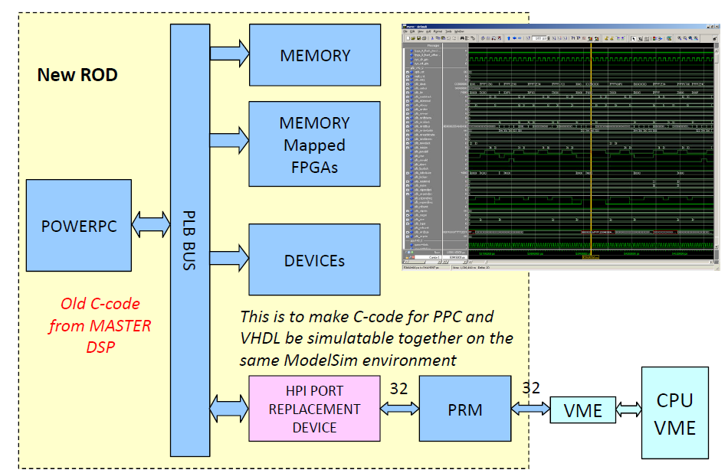
New VME based ROD/BOC
The design of the new VME based ROD and BOC is well advanced. A first prototype of the ROD is expected in the first half of 2011.
Being an evolution of the existing ROD, the support is not expected to be problematic. However the lack of on-board DSP processors will require a review of the scan histogram manipulation code, which is unused at the moment.
Commands to the ROD via Ethernet only, seems to be a reasonable evolution.
Integrated “Master DSP” + FPGA simulation

Slide 10
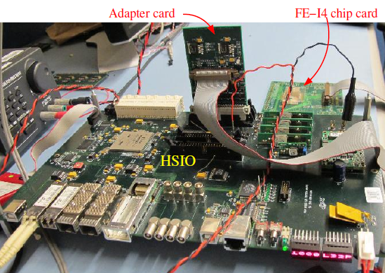
ATCA
Even if the IBL baseline for the readout is the new VME based ROD/BOC system, there is a strong interest in ATCA as a natural candidate for SLHC detectors. We believe that maintaining software compatibility with ATCA systems is a good investment:
More devices supported means more flexibility, hence a better infrastructure.
Compatibility with Pixel and IBL will give the ATCA developers the possibility to test their readout boards on a real detector.
An enlarged developers community will improve the quality of the software.

Slide 11
Multi-platform infrastructure
To provide support for the new hardware, we will have to do some refactoring; the basic OO structure we have already looks however adequate.
PixLib
Run Controller
ROD
VME
RodModule
Monitor
USB
FE-I3
MCC
EUDET Producer
USBPix
USBPixdll
ETH/VME
PixAnalysis
nROD
nROD driver
FE-I4
Calibration Console
Calibration Analysis
RCE
ETH
IPC
RCE driver
Analysis Framework
Hardware
Low level drivers
Libraries
Applications

Slide 12
More infrastructure improvements
Few more points have been identified that require refactoring, modifications or redesign:
Scan support: extremely ugly and difficult to maintain at the moment, even for the Pixel detector alone. Switch to a better OO design to incorporate new readout boards and to simplify scan maintenance.
Increase robustness of the communication layer between the applications and the remote drivers: a key component of our DAQ system, to which we want to add some “disaster recovery” capability.
DB support need some optimization and some improvement: the tools to manipulate the configurations need to be improved and simplified, with particular attention to small lab systems.

Slide 13
Organizational issues
We will have a common DAQ meeting and a common mail list from now, trying to facilitate the fusion of the two DAQ communities (more support for the IBL, more experts for running the detector ☺)
Joern, Jens and Kendall will be the DAQ contact points for WG4, Test Beam and Pixel Operation groups. They will help me in coordinating the development of the DAQ.
Documentation and collaborative tools are traditionally a weak point. Will try to improve resurrecting old tools (Doxigen, Savannah) and possibly adding new ones (Netbeans, Eclipse, SharePoint,…).
Migration to SVN, SLC5 + gcc 4.3, TDAQ 03-xx-xx by the end of the year.
We think there should be a forum for the ROD hw and fw designers, the FE-I4 designers and the DAQ developers to share experience with the running system and to analyze common issues. Not obvious how to organize it.

Slide 14
Timeline
Nov 2010: tag 1.5.1 (PIT only) and branch IBL-dev
Nov 2010: discussion and design of the modifications needed to support IBL devices in the joint Pixel / IBL DAQ meeting
Dec 2010: tag 1.6.0 (PIT only) using TDAQ 3 + GCC 4.3
Dec 2010-Jan 2011: Implementation of the modifications in IBL-dev
Feb 2011: first functional IBL release (2.0.0)
Mar-May 2011: migration of IBL applications to the new release
Sep 2011: first merged Pixel + IBL release (2.1.0)
End 2011: Drop support for “Old PixLib” and “PIT only” lines, keep just one development line

