Slide 1
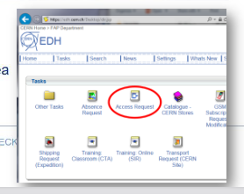
Mission rules INFN+CERN
1) Nota: GREEN PASS, OK Director, Idoneità medica da capire la situazione a Ottobre
2) Each people must check if the CERN association, the badge and personal dosimeter are not expired.
3) Safety courses @ SIR:
CERN Safety introduction
Electrical Safety – Awareness
Radiation Protection – Supervised Area
CERN – beam facilities
4) EDH-Access request for the control room and for patrol rights + COVID rules
5) Require an appointment for the Proximeter
(https://cern.service-now.com/service-portal/Useful?id=functional_element&name=proximeter-services
And/Or
https://proximeter-dist.web.cern.ch/)
Check all directly by Adams CERN web page
https://indico.cern.ch/event/700663/contributions/2874577/attachments/1617340/2571297/Test_beam_check_list.pdf

