Slide 1

NA62: The present and the future
A.Antonelli LNF-INFN
Riunione CSN 1 , 14 Luglio 2022

Slide 2
Outline
Run 2021 & 2022
Run in dump mode
Future programme
Conclusions

Slide 3
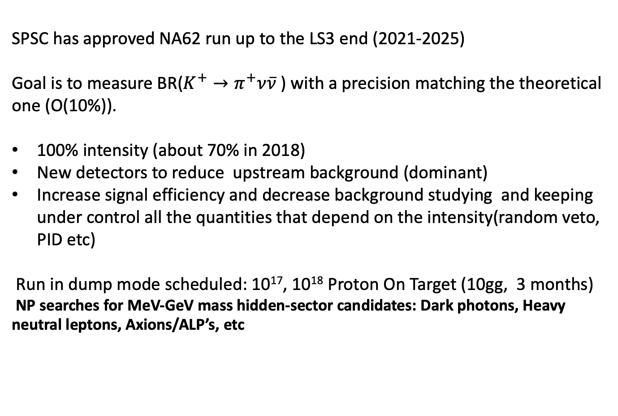
RUN2 (2021-2025)
SPSC has approved NA62 run up to the LS3 end (2021-2025)
Goal is to measure BR($K^{+}→π^{+}ν\overline{ν}$) with a precision matching the theoretical one (O(10%)).
100% intensity (about 70% in 2018)
New detectors to reduce upstream background (dominant)
Increase signal efficiency and decrease background studying and keeping under control all the quantities that depend on the intensity(random veto, PID etc)
Run in dump mode scheduled: 10¹⁷, 10¹⁸ Proton On Target (10gg, 3 months)
NP searches for MeV-GeV mass hidden-sector candidates: Dark photons, Heavy neutral leptons, Axions/ALP’s, etc

Slide 4
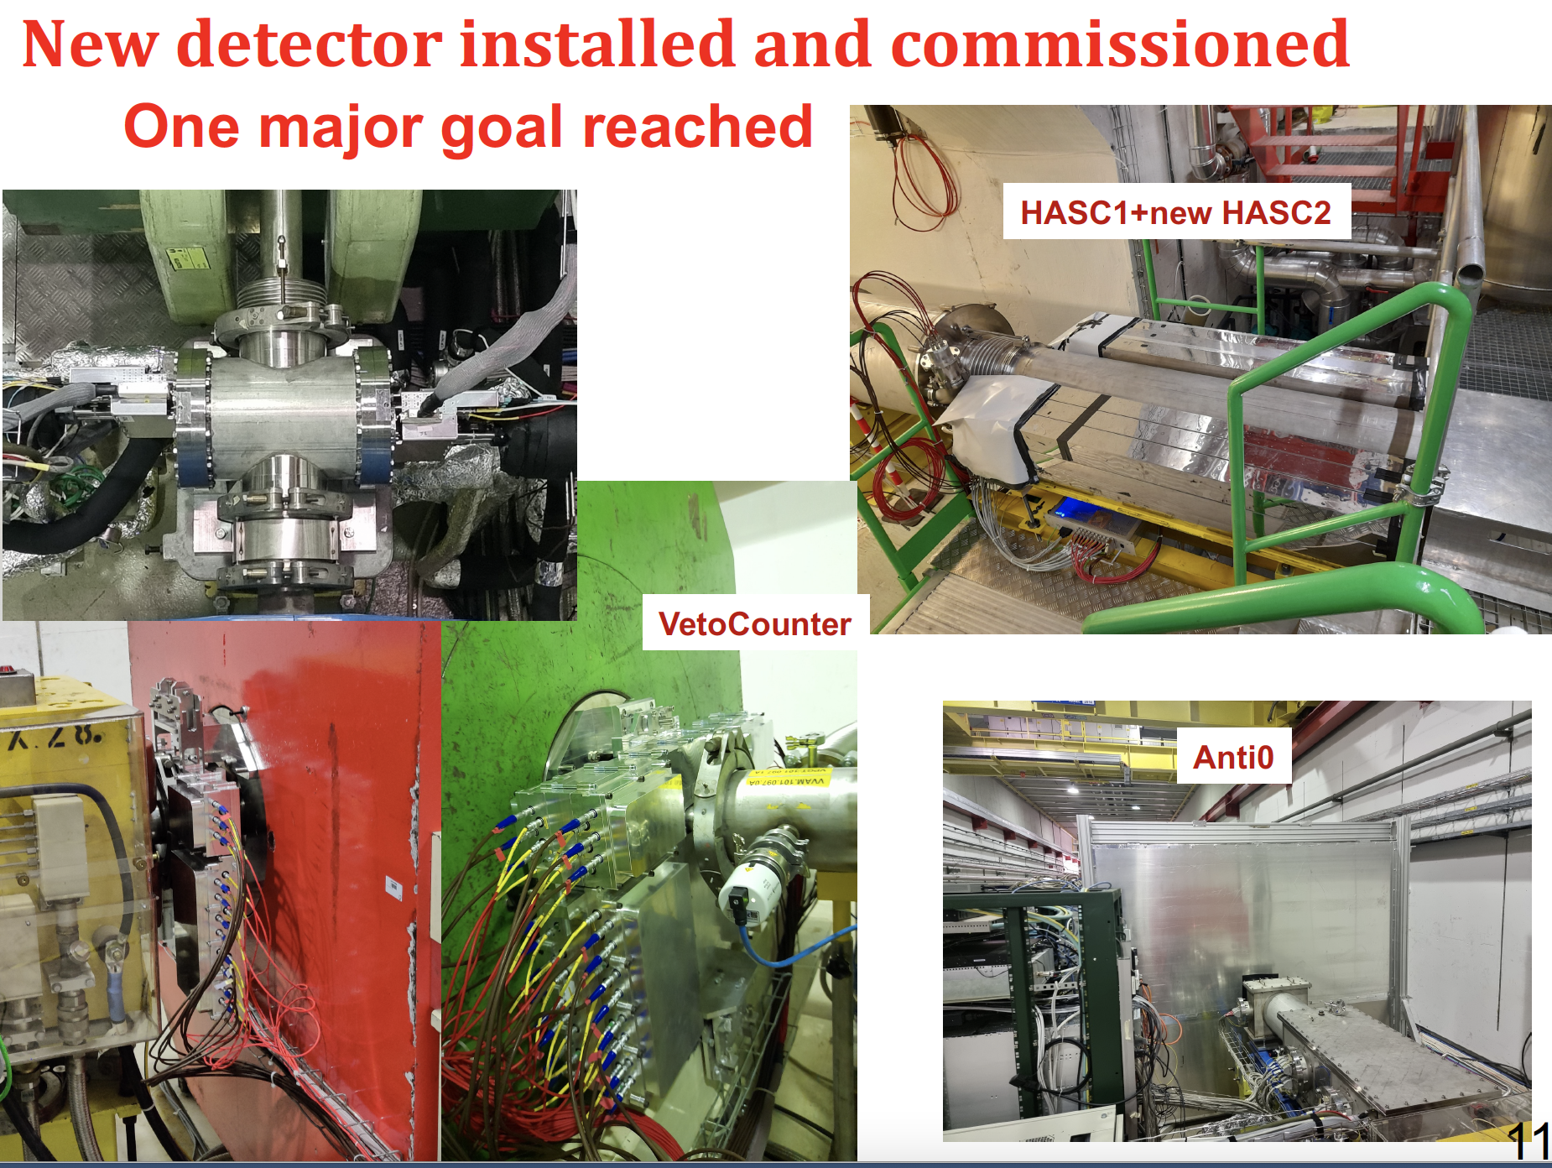
I nuovi rivelatori

Slide 5
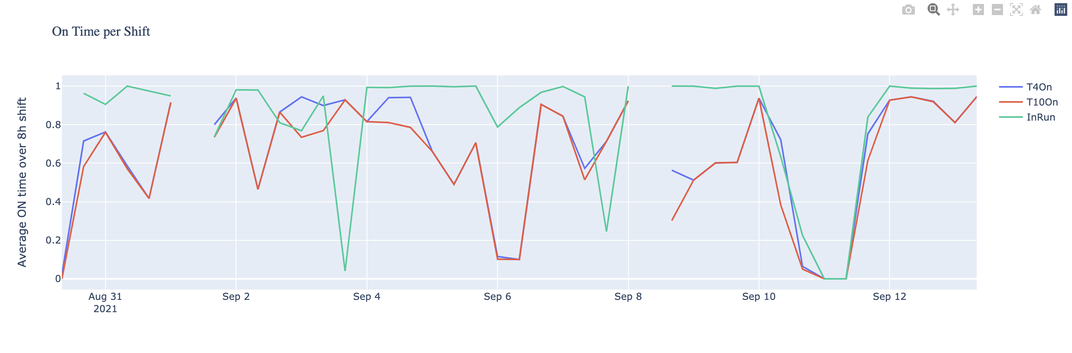
RUN 2021
Starded 12 July after 2 shutdown years , 18 weeks of data taking.
No beam for 2-3 weeks , for different hardware problems on P42 e K12 (magnets, beam monitor partially working. )
First kaon beam wiht intensity ~50-60% on August 30
100% intensity from September
Many periods without beam due to magnet instability (PS regulation cards…)
T4 beam availability = ~70% T10 beam availability = ~87% , eff NA62 92%
POT∼ 0.6 x 10¹⁸ (similar to 2017)

Slide 6
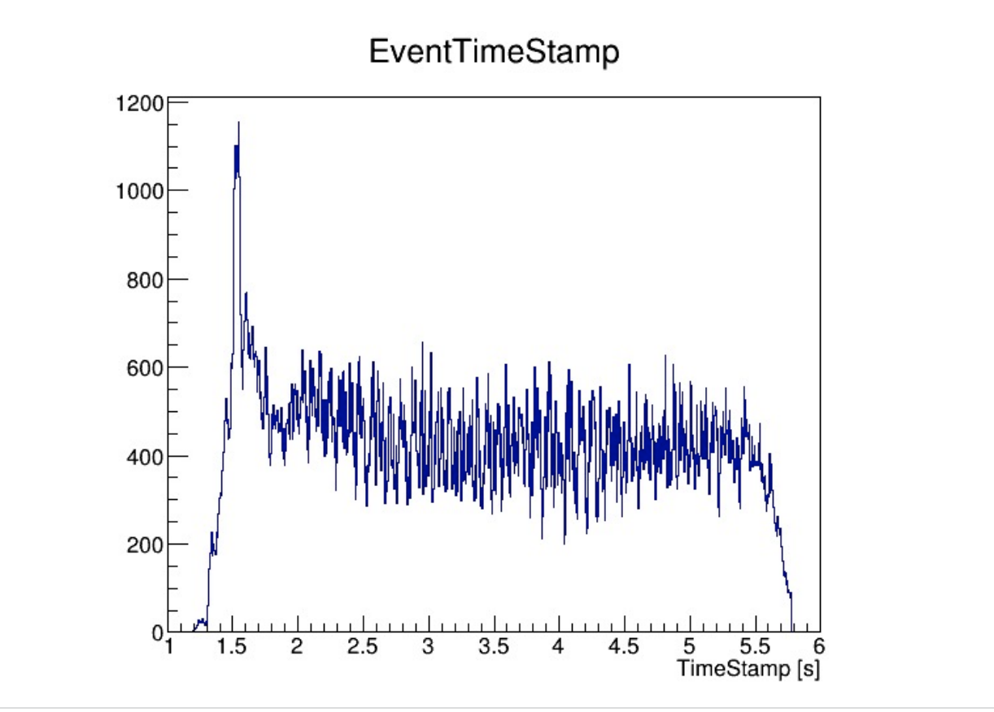
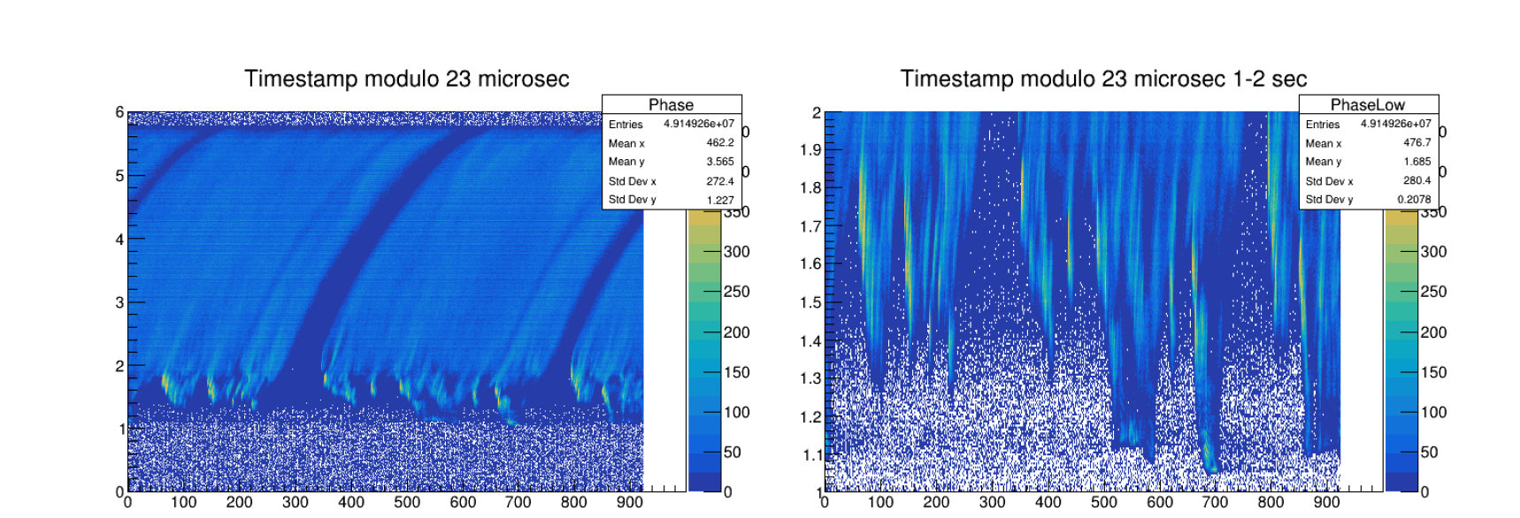
RUN 2021: spill structure
Instantaneous intensity significantly higher (~x 5) in first second of spill, well above specs, causing unsustainable high rate in readouts, trigger and DAQ.
Distribution of intensity from primitives as a function of the modulus of the time with respect to the revolution frequency of the SPS (folded timestamp):
Quality of the spill structure severely limited protons usable for physics.

Slide 7
Detector status
All the detectors worked at their maximum performances
RO GTK inefficiency (10-15%) recovered by the new firmware, some instability due to SEU
New L0TP firmware to work at full intensity
L0TP+ with new FPGA technology installed and used in parallel with the L0TP in the first period of the run due to instabilities in the switch that duplicates the trigger primitives
L0 calorimeter trigger readout system to output the energy , the position of the clusters and the number of cluster has been installed and the firmware under test

Slide 8
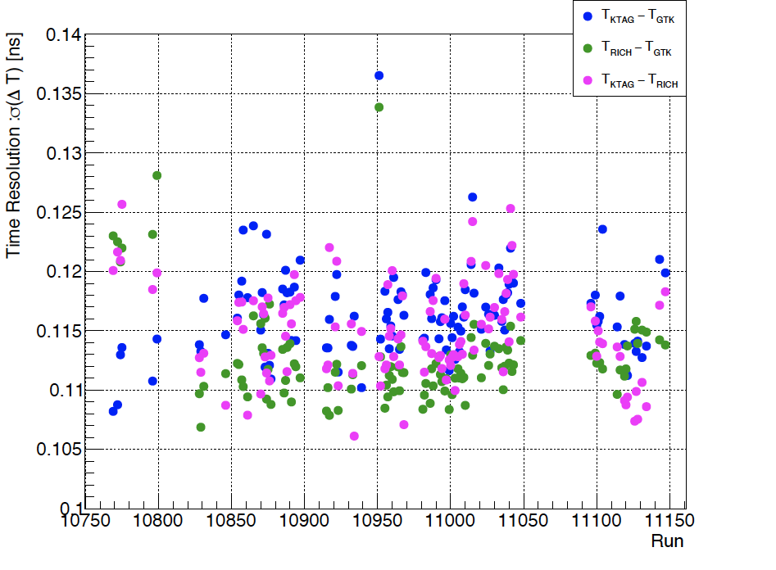
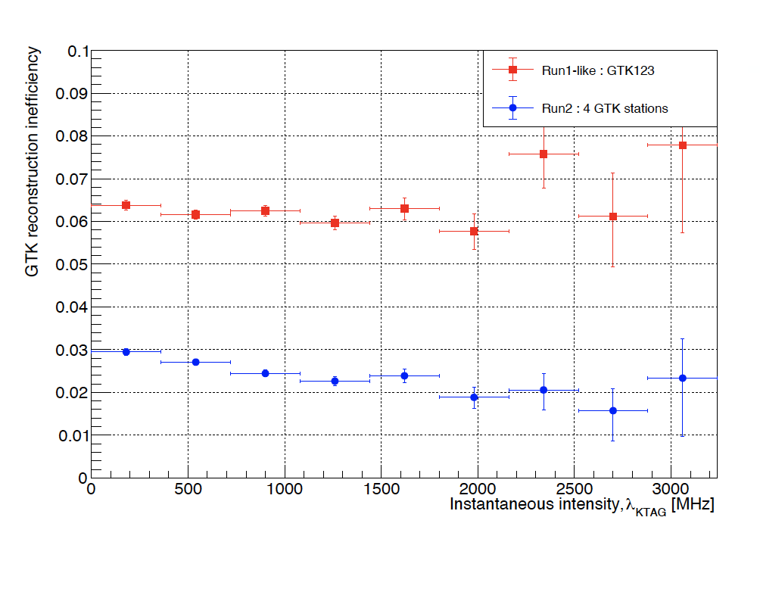
Run 2021 data quality
Data quality comparable to 2018. For example, time resolutions, invariant mass resolution
GTK reconstruction inefficiency reduced by GTK0 by a factor 2.
Re-optimization of Kaon-to-Pion matching is in progress

Slide 9
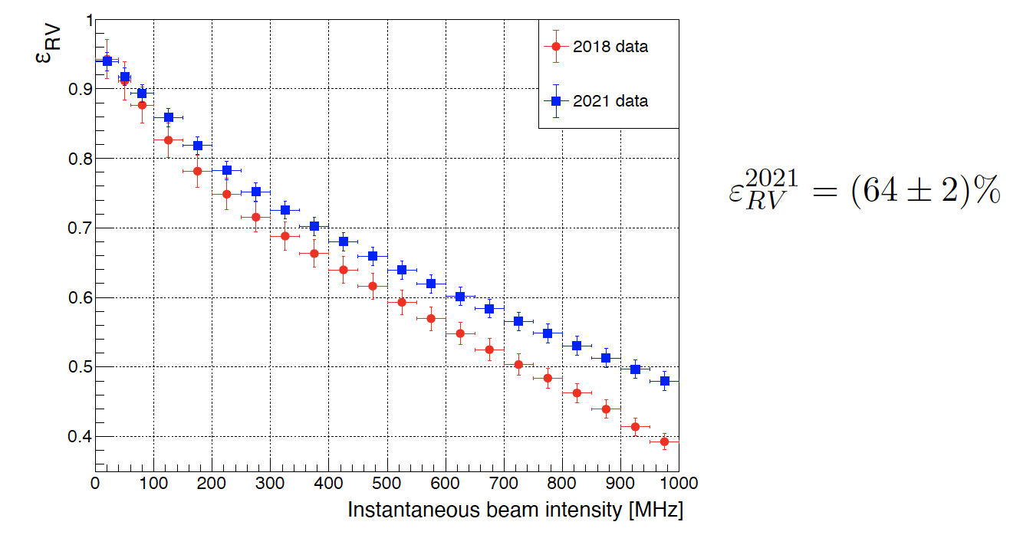
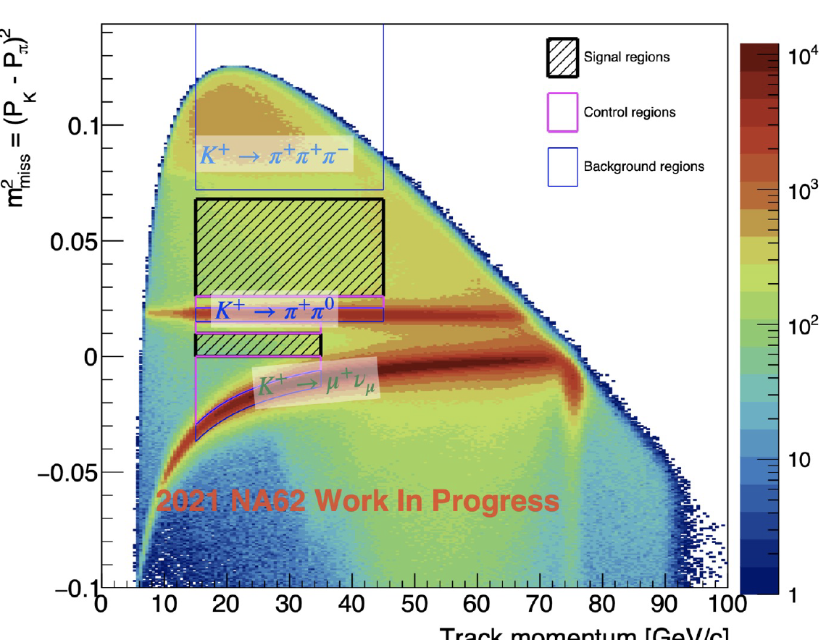
Run 2021 data quality
Random veto improved thanks to the new LKr reconstruction
Overall random veto remained stable despite increased intensity (30%)
Filtered data, before selection.
Same 2018 data quality inspite of higher intensity, much less statistic (similar to 2017) due to different beam lines instabilities
Analisys in progress
Are the data in the bump good?
Improve K-π matching
Accurate studies of backgrounds (new detectors)

Slide 10
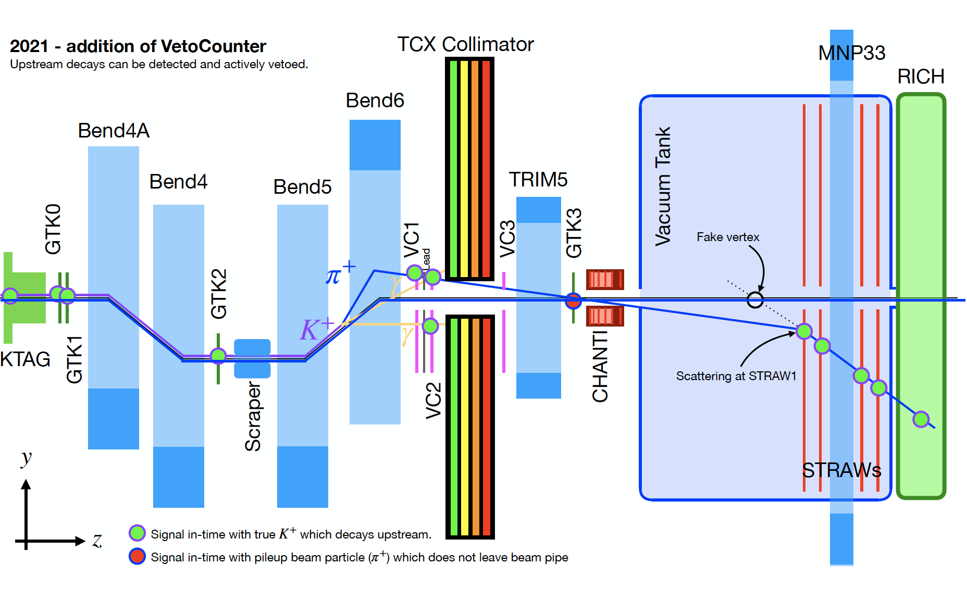
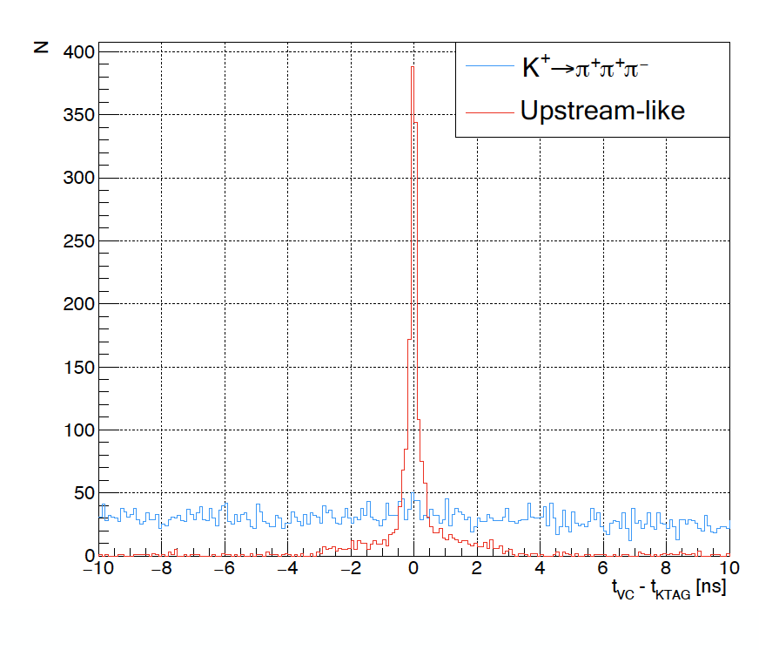
Background reduction: Veto counter
Preliminar studies shows a spression of upstream-like events by a factor of 2

Slide 11
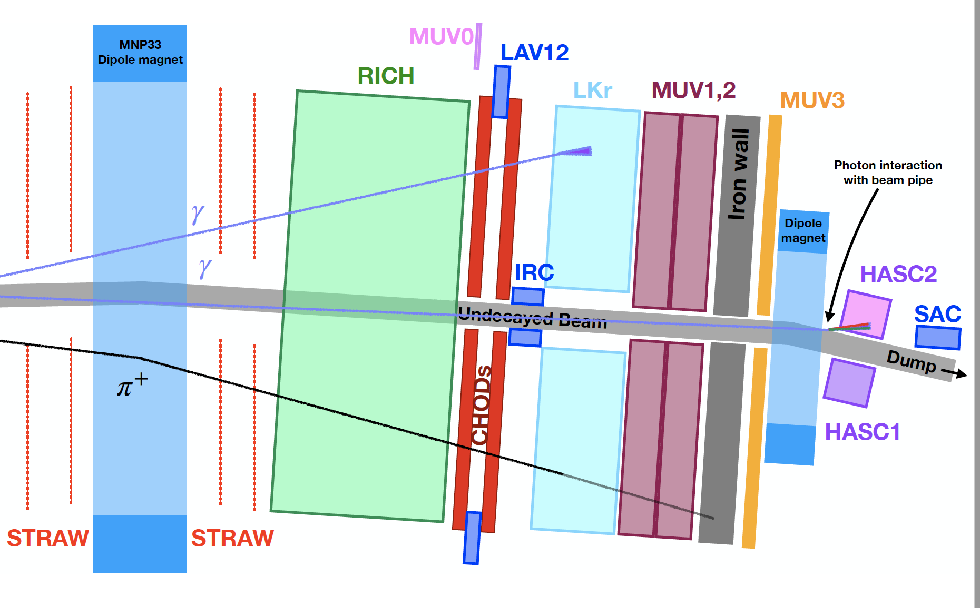
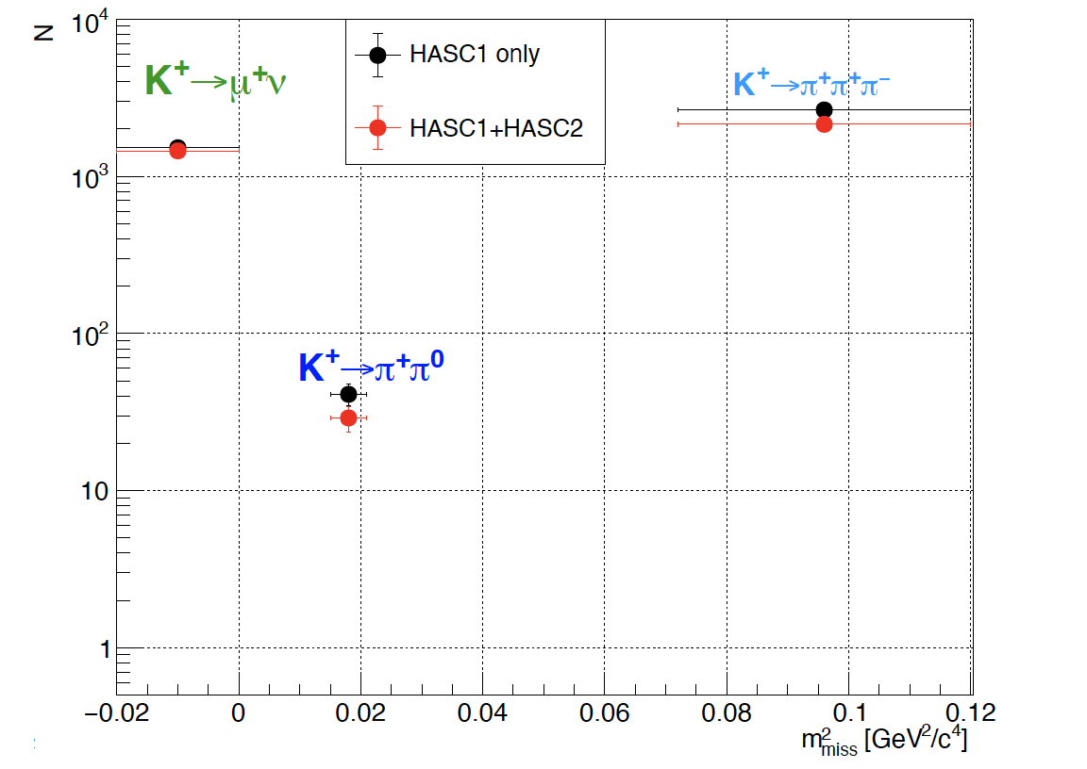
Background reduction : HASC2
HASC2 reduce K⁺ → π⁺π⁰ and K⁺ → π⁺π⁺π⁻ backgrounds by 35% e 19% , without visible increase of the random veto (K⁺ → μ⁺ν_{μ} do not change)

Slide 12
Improvements and work in progress
Photon rejection and random veto
  Random veto similar to 2018 at higher intensity (LKr: new reconstruction, LAV: photon/mip id via BDT) 👍
  HASC2 improve small angle photon rejection👍
Upstream background rejection
  New Veto counter + GTK0 reduce upstream background 👍
Signal efficiency
  Improve K – 𝜋 matching (GTK0, new algo). In progress
  Combined PID RICH + calorimeter. In progress
  Optimization of signal kinematic selection and signal region. In progress

Slide 13
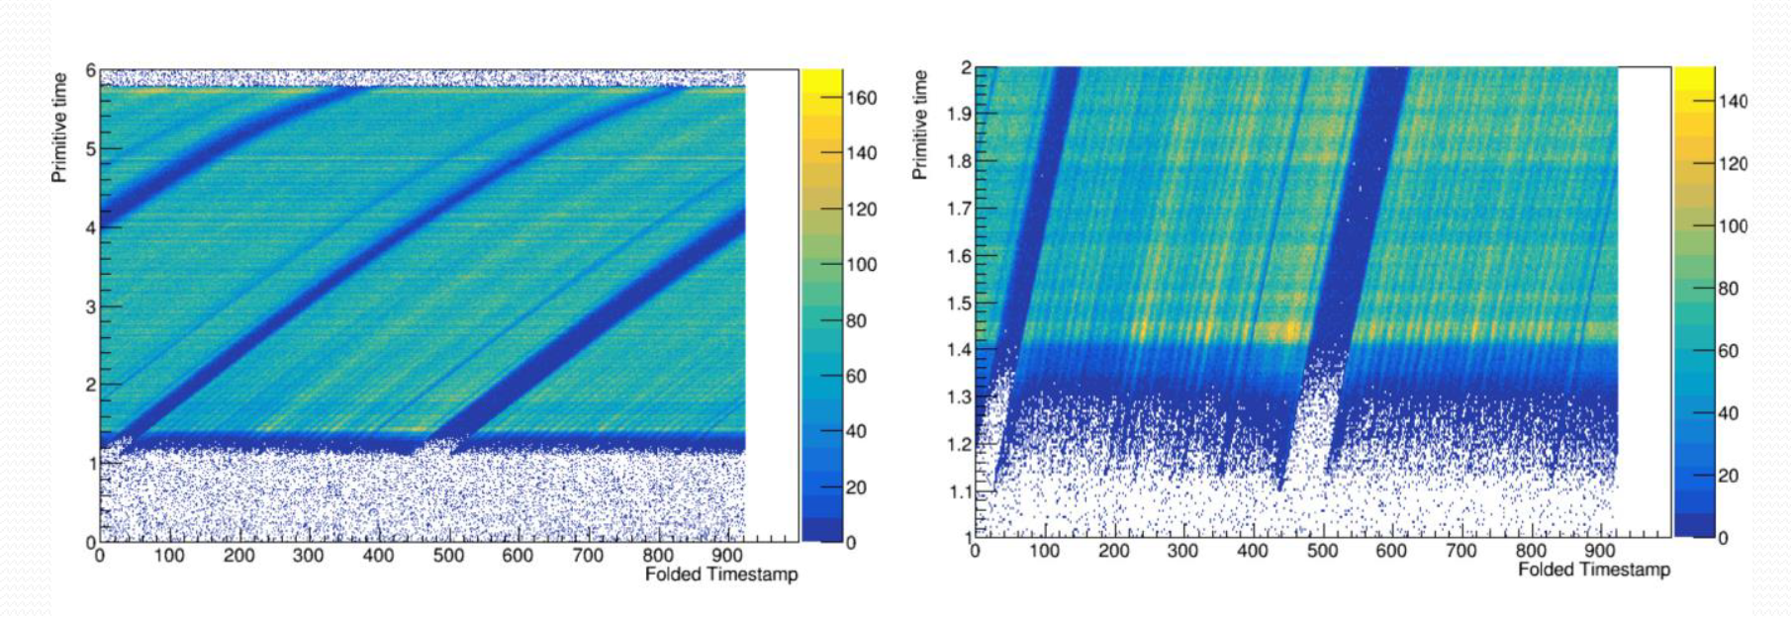
RUN 2022
Start April 15th, for 29 weeks
Plans: beam tuning to understand and eliminate the bump present in the firsts 2 sec of the spill , NA62 developped many tools to give fast feedback to accelerator people.
Reality: first 3 weeks without beam for different problems including water in one transfer line .
First Kaon beam beginning of May.
Origin of the bump understud thanks to the close collaboration between NA62 and accelerator group. An SPS RF cavity that is switched off during the flat top (allowing the debunching) had a small residual field, feedback system to have V_{RF} = 0 has been installed

Slide 14
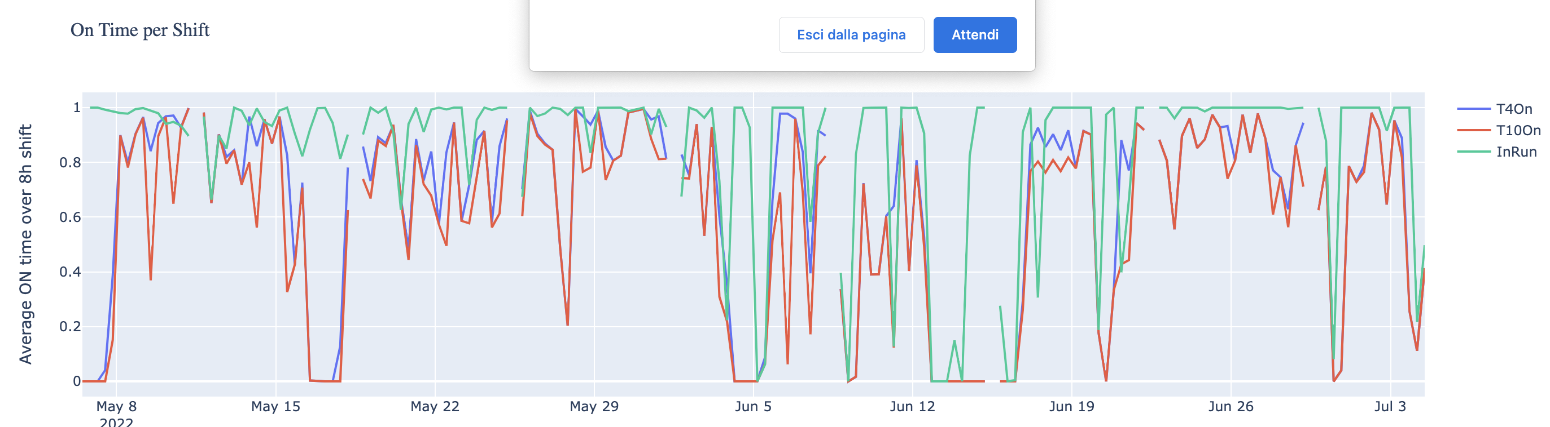
RUN 2022
Data taking is going on with some instabilities.
100% intensity
∼ 5 x 10¹⁷ POT up to now (∼2 x 10¹⁸ POT in 2018)
T4 beam availability:
Mean T4 on 65%
Mean T10 &T4 91%
Mean NA62 on 94%, inefficiency due mainly to GTK reset (SEU), improved by an authomatic recovery procedure

Slide 15
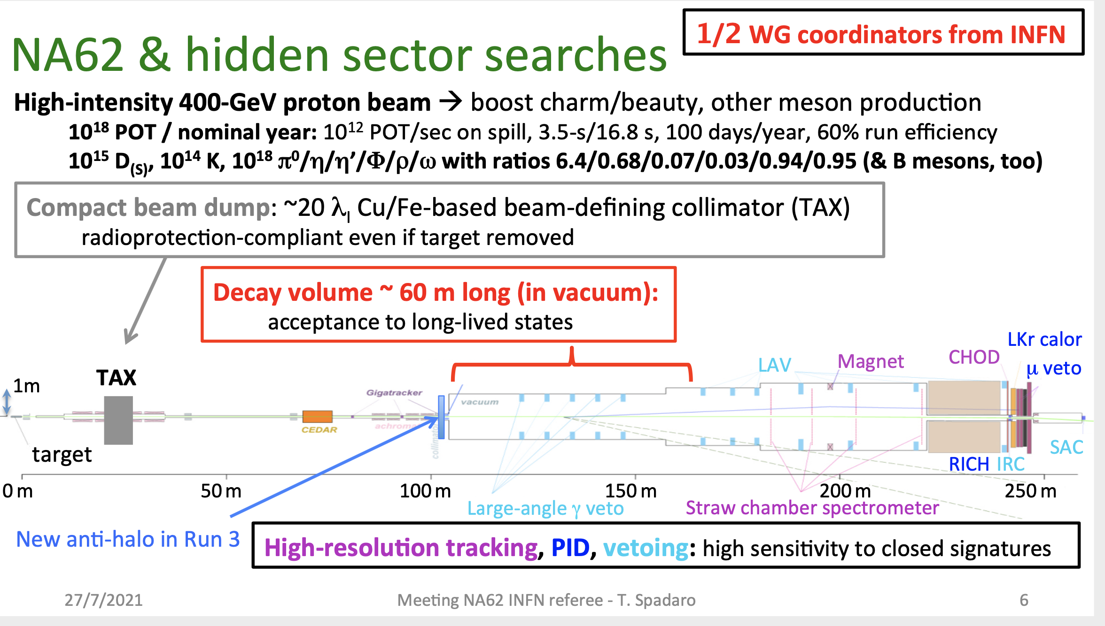
Dump Mode
exotic particles, such as dark-photon, dark-scalar, HNL or ALP, produced in the TAXs can reach NA62 FV.
20 λ Fe/Cu beam collimators
10¹⁸ POT/nominal year is at the maximun intensity, this can be increased by a factor 2 without change on the dump and beam line.
Detailed studies done for the high intensity Kaon future projects has demonstrated that a factot 6-7 on the intensity could be reached , new dump with more efficient cooling , beam line changes (K12), radiprotection issue...

Slide 16
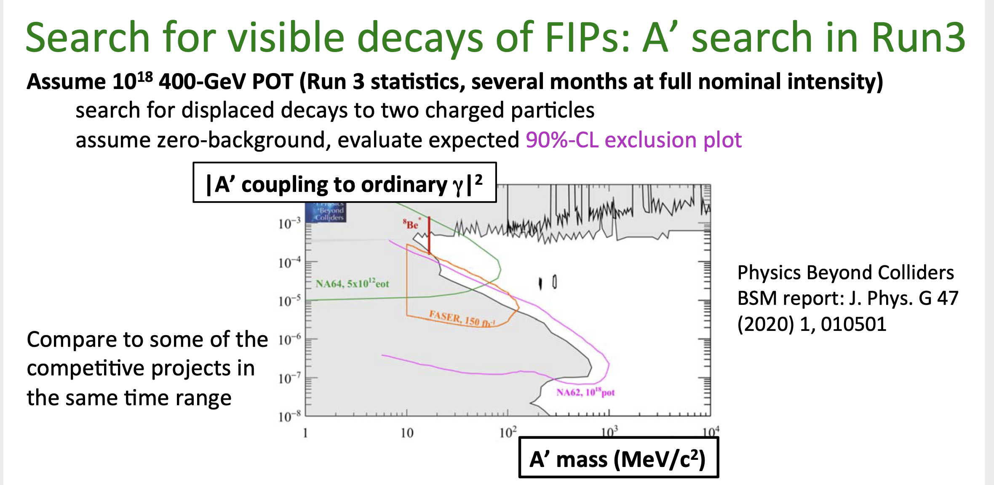
Dump Mode
Previsti nel RUN2 (2021-2025) run in dump mode: 10¹⁷, 10¹⁸ POT
1.4x 10¹⁷ POT raccolti nel 2021 in 10 giorni
5 years timescale scenario: NA62 10¹⁸ POT

Slide 17
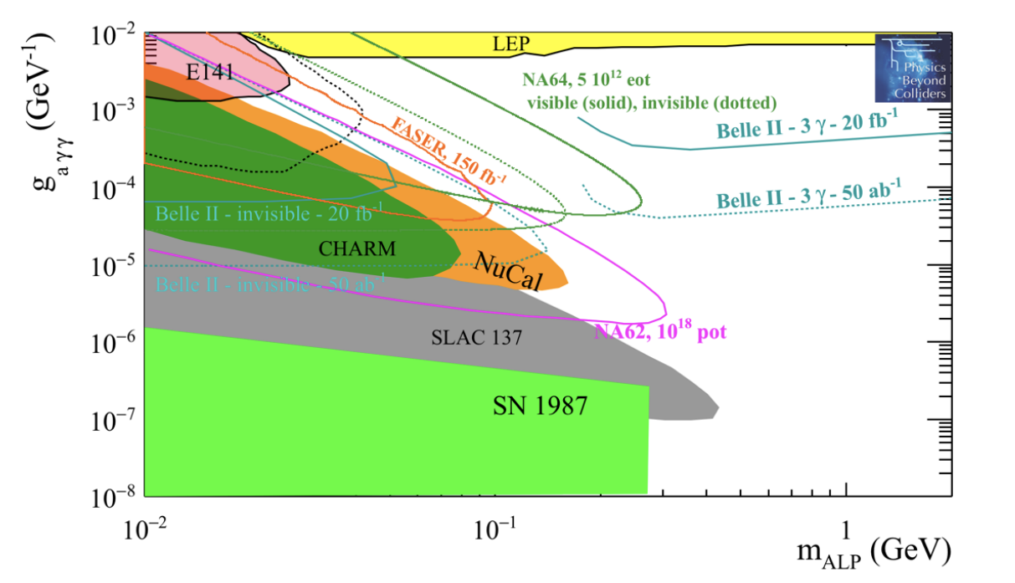
Dump Mode
Search for visible decays of ALP’s
ALPs with photon coupling dominance:
ALP→ γγ, geometrical acceptance into account,zero backgroud , 90% -CL exclusion plot
search for ALP→ γγ less constrained then other decay mode, no extrapolation to dump possible
5 years timescale scenario: NA62 10¹⁸ POT

Slide 18
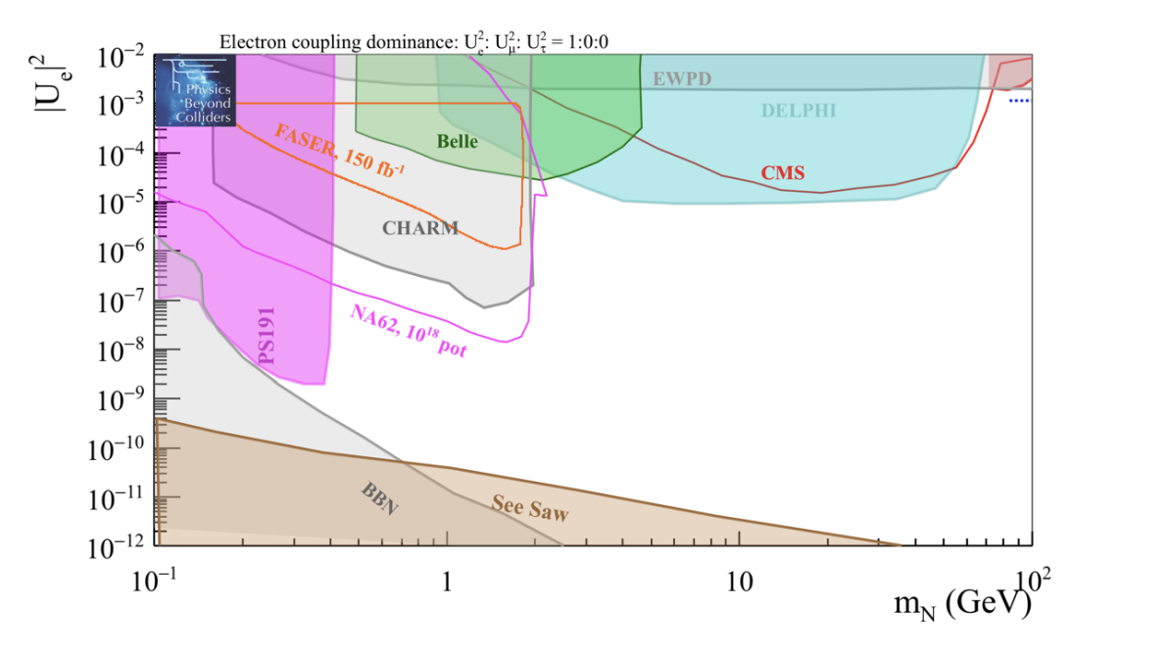
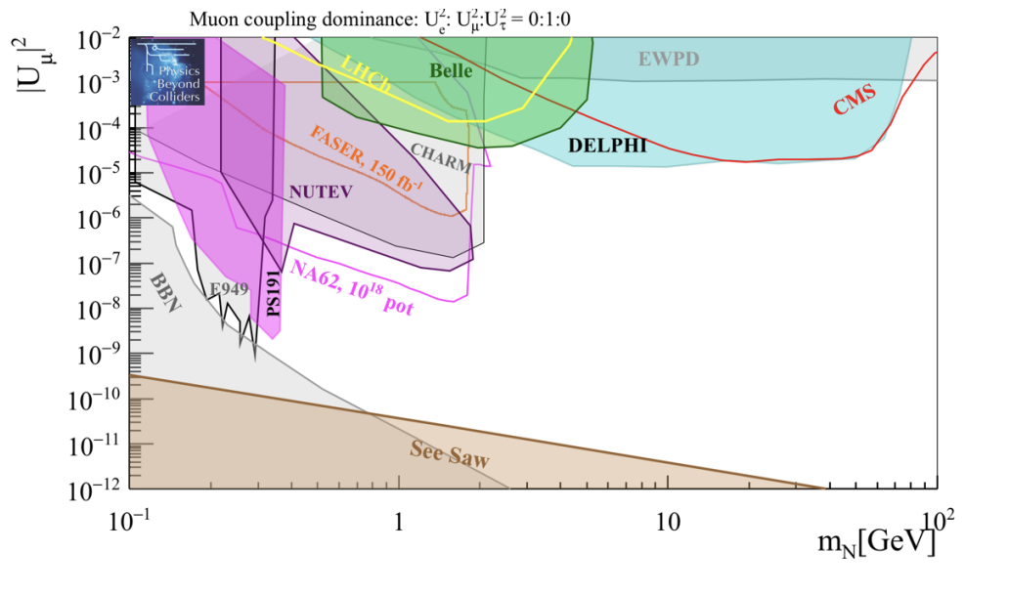
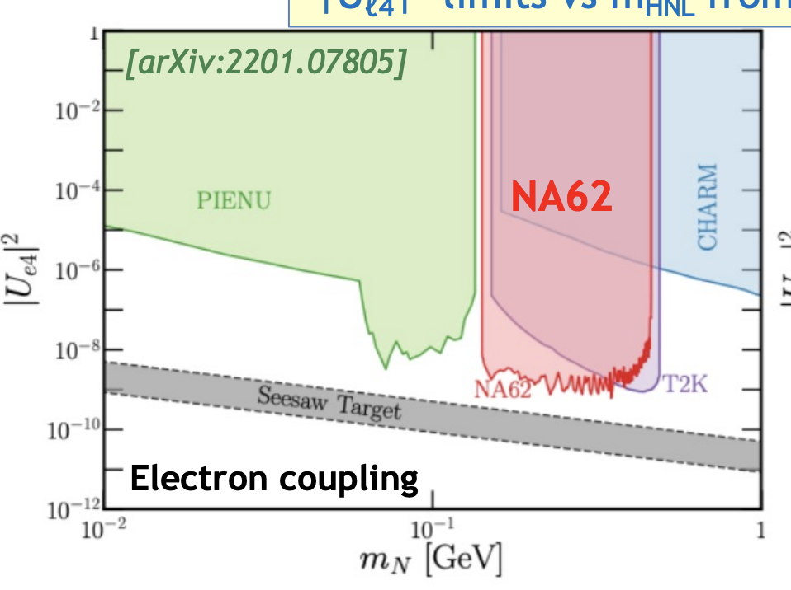
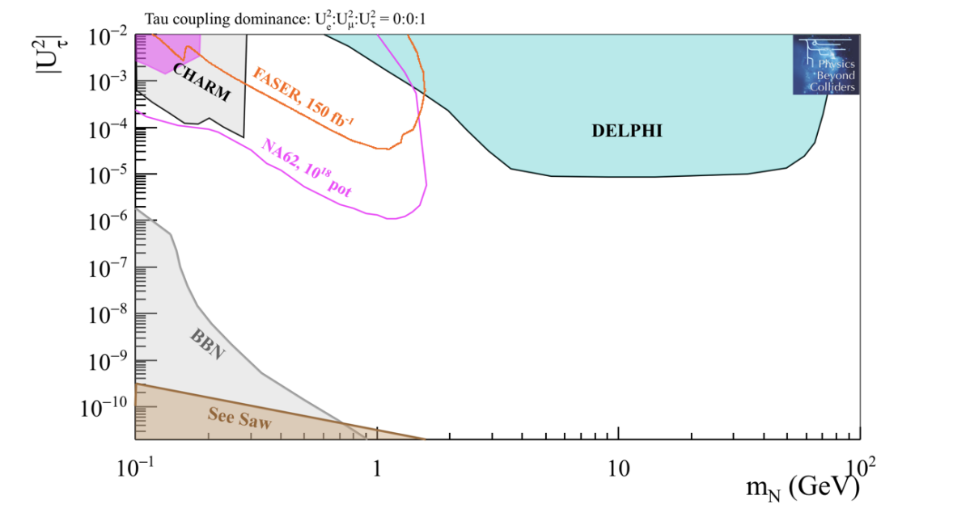
Dump Mode
Search for Heavy Neutral Lepton
HNL scenario in 5 years timescale 10¹⁸ POT, for different coupling. Geometrical acceptance into account,zero backgroud , 90%-CL exclusion plot
Kaon decay, K⁺→e⁺N; run1 data, unique opportunity below kaon mass

Slide 19
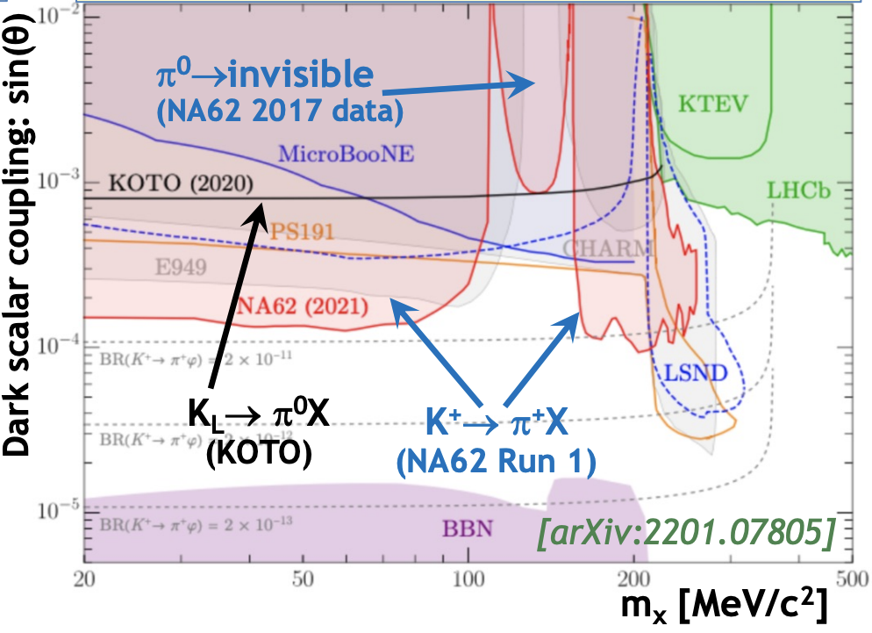
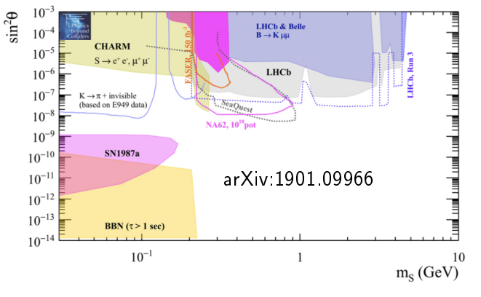
Dump Mode
Search for Dark Scalars
Light scalar mixing with SM Higgs with angle θ. Mediator between DM and SM particles. Scenario in 5 years timescale 10¹⁸ POT, Geometrical acceptance into account, zero backgroud , 90%-CL exclusion plot
Kaon decay; run1 data, unique opportunity below kaon mass

Slide 20
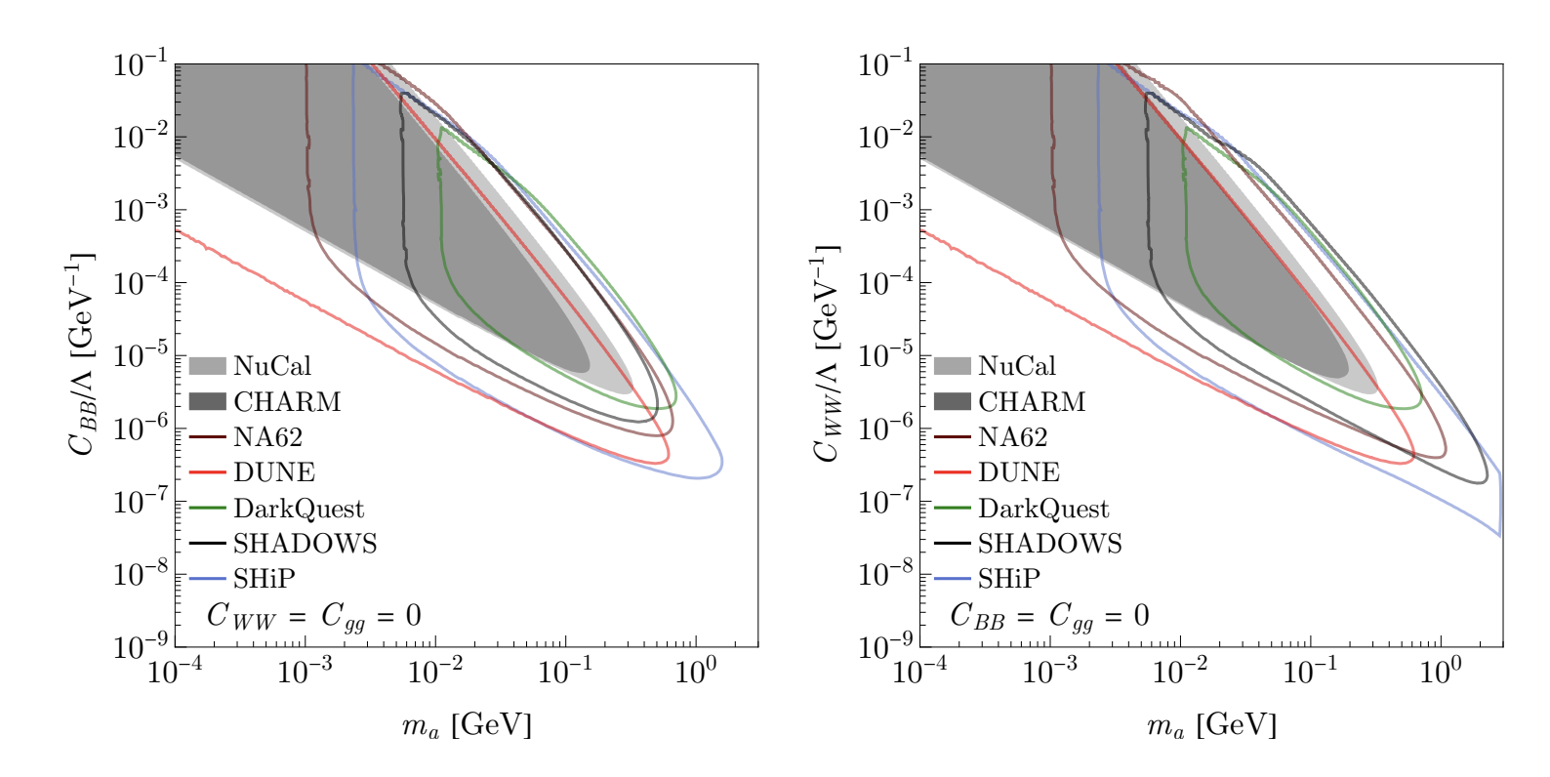
Dump Mode
Search for visible decays of ALP’s
ALPs future scenario (>2028) for different coupling dominance.
ALP→ γγ , geometrical acceptance into account, zero backgroud , 90%-CL exclusion plot
10¹⁹ POT (1 year of data taking at 6xI_{max} )
γ dominance
W dominance

Slide 21
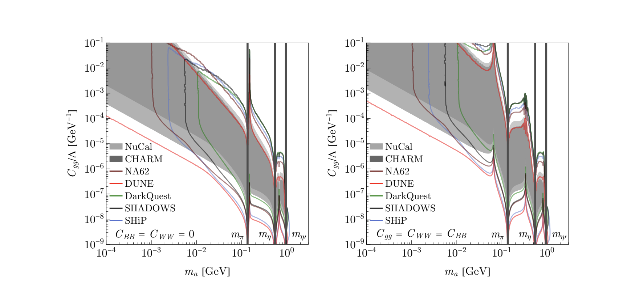
Dump Mode
Search for visible decays of ALP’s
ALPs future scenario for different coupling dominance.
Geometrical acceptance into account,zero backgroud , 90%-CL exclusion plot
10¹⁹ POT
Gluon dominance
Co-dominance

Slide 22
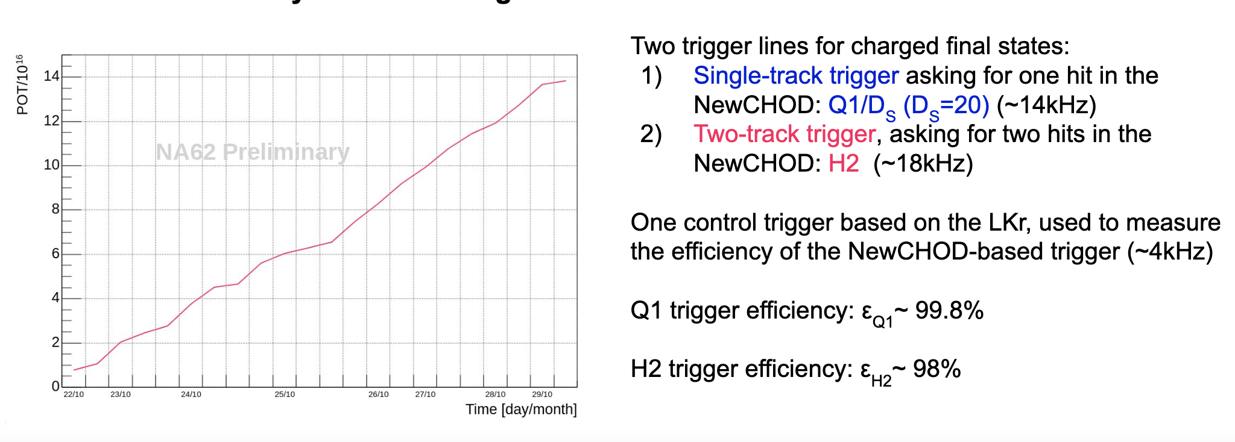
Dump Mode: 2021 DATA
2017 first run in dump mode 2.6 x 10¹⁶ POT, useful to understand triggers, data taking condition, backgrounds etc.
2021 10 days run in dump mode 1.4 x 10¹⁷ POT, intensity 1.5xI_{max .} Beam-line tuning for improved beam-dump operation, optimised muon sweeping, detector upgrade ANTI 0 counter at the beginning of the FV.

Slide 23
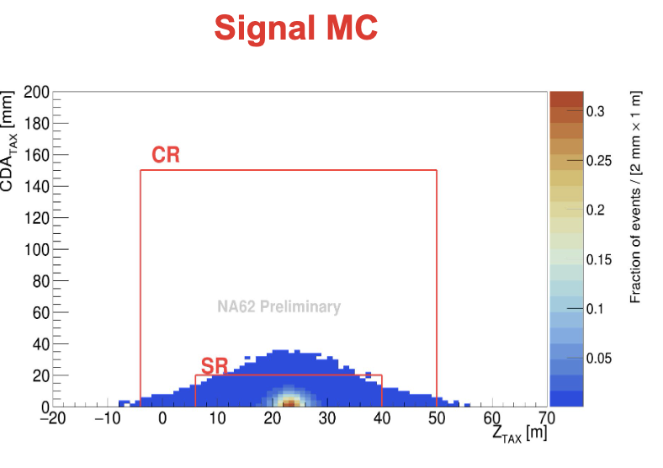
Dump Mode: 2021 DATA
Search for A’ → μ⁺μ⁻
2 opposite sign track in time (± 5ns respect to the trigger time)
vertex in the FV volume
muon ID
Primary vertex in the tax region
(point of closest approch between the reconstructed momentum of the lepton-antilepton pair and the proton beam)

Slide 24
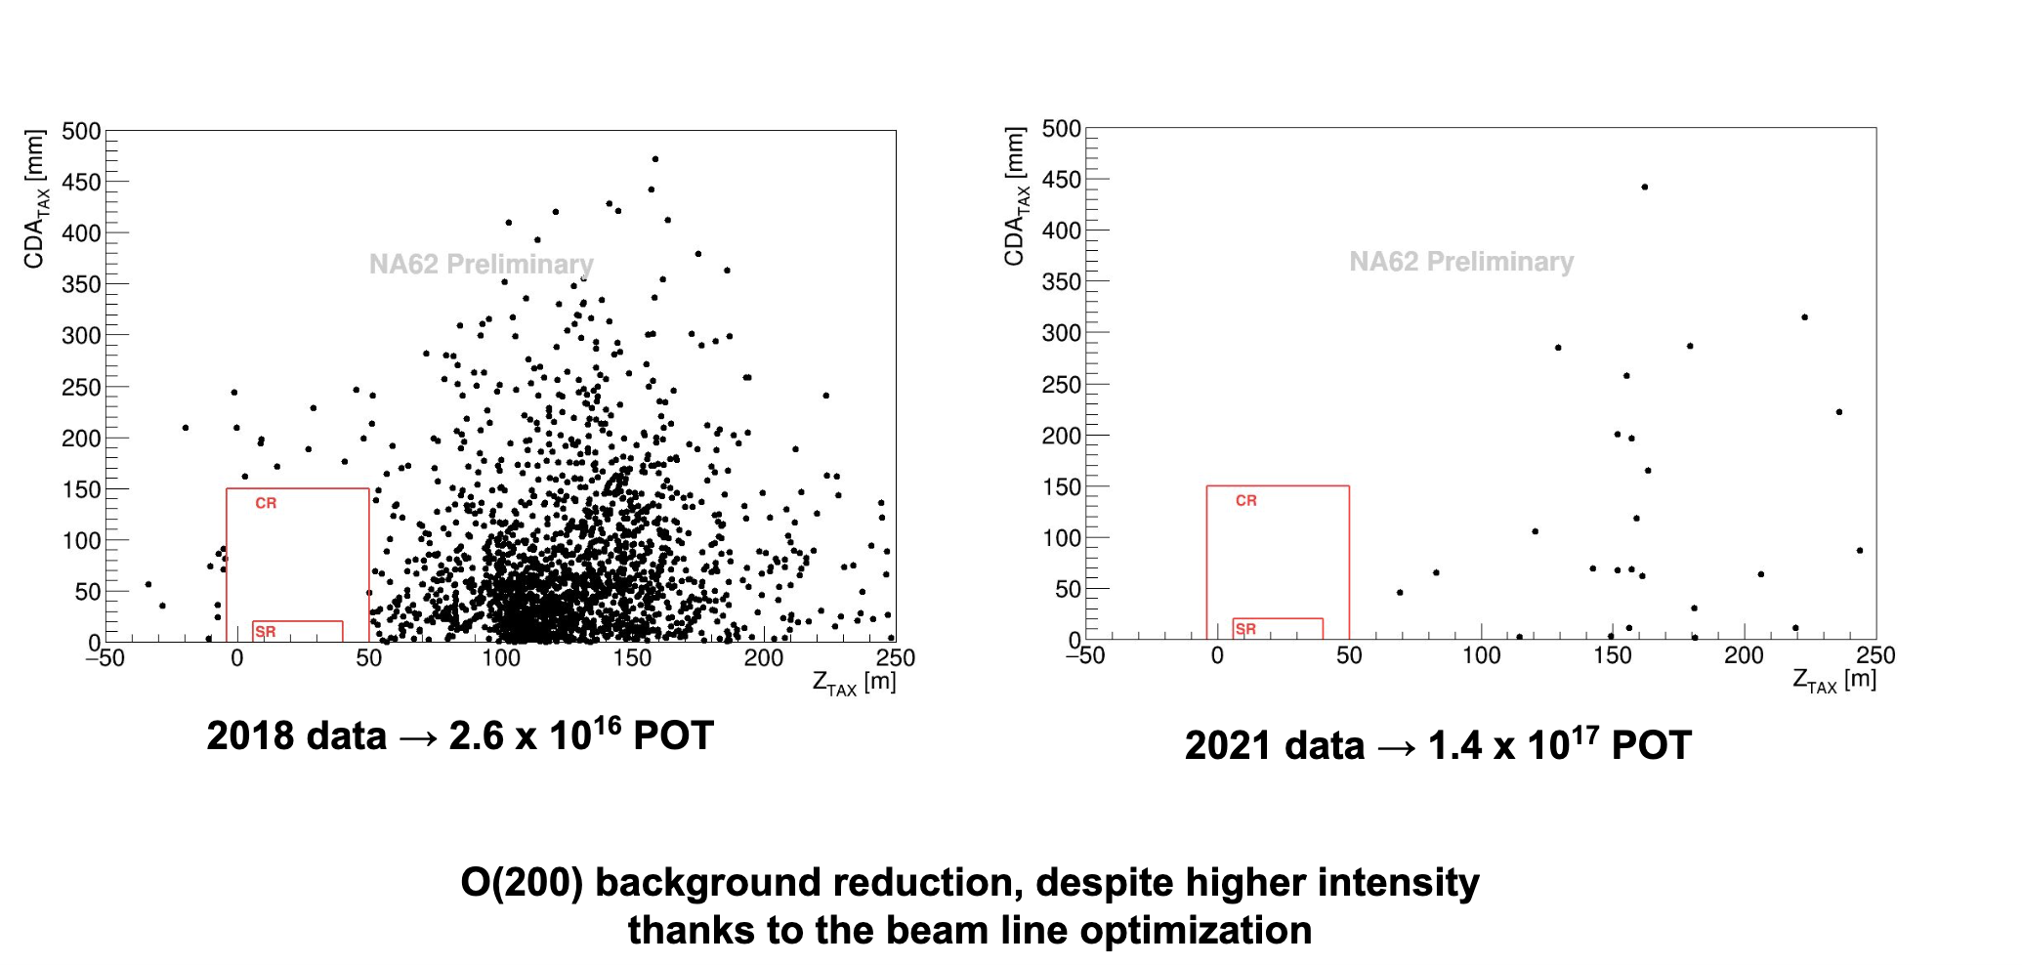
Dump Mode: 2021 DATA
Search for A’ → μ⁺μ⁻

Slide 25
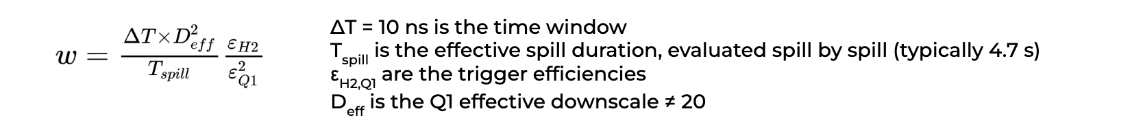
Dump Mode: 2021 DATA
Search for A’ → μ⁺μ⁻
Combinatorial background from data:
●We selected single tracks with the same criteria used for the analysis
●track pairs artificially built to emulate a random superposition within ±5 ns. Each track pair has a weight independent on the rate
Prompt background (MC): muon gun
●Muon kinematic distributions extracted from selected single muons in data
●Prompt background negligible with respect to combinatorial (UL @ 90%CL is 30% of combinatorial)

Slide 26
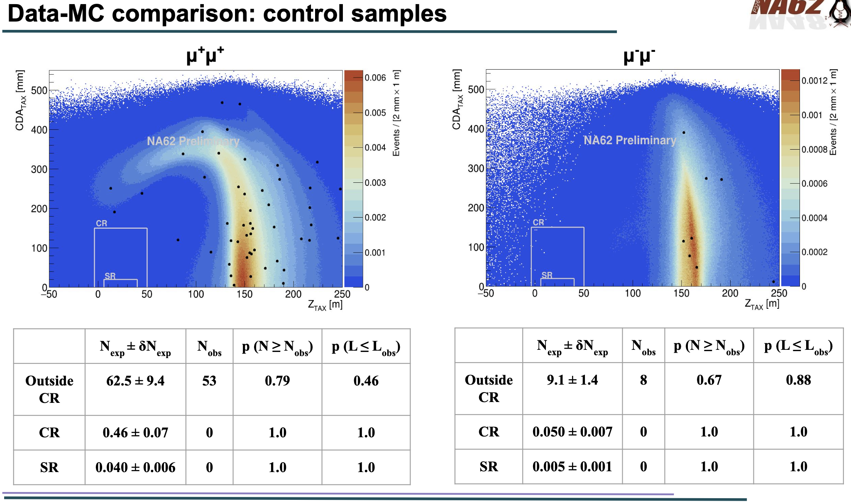
Dump Mode: 2021 DATA
Search for A’ → μ⁺μ⁻

Slide 27
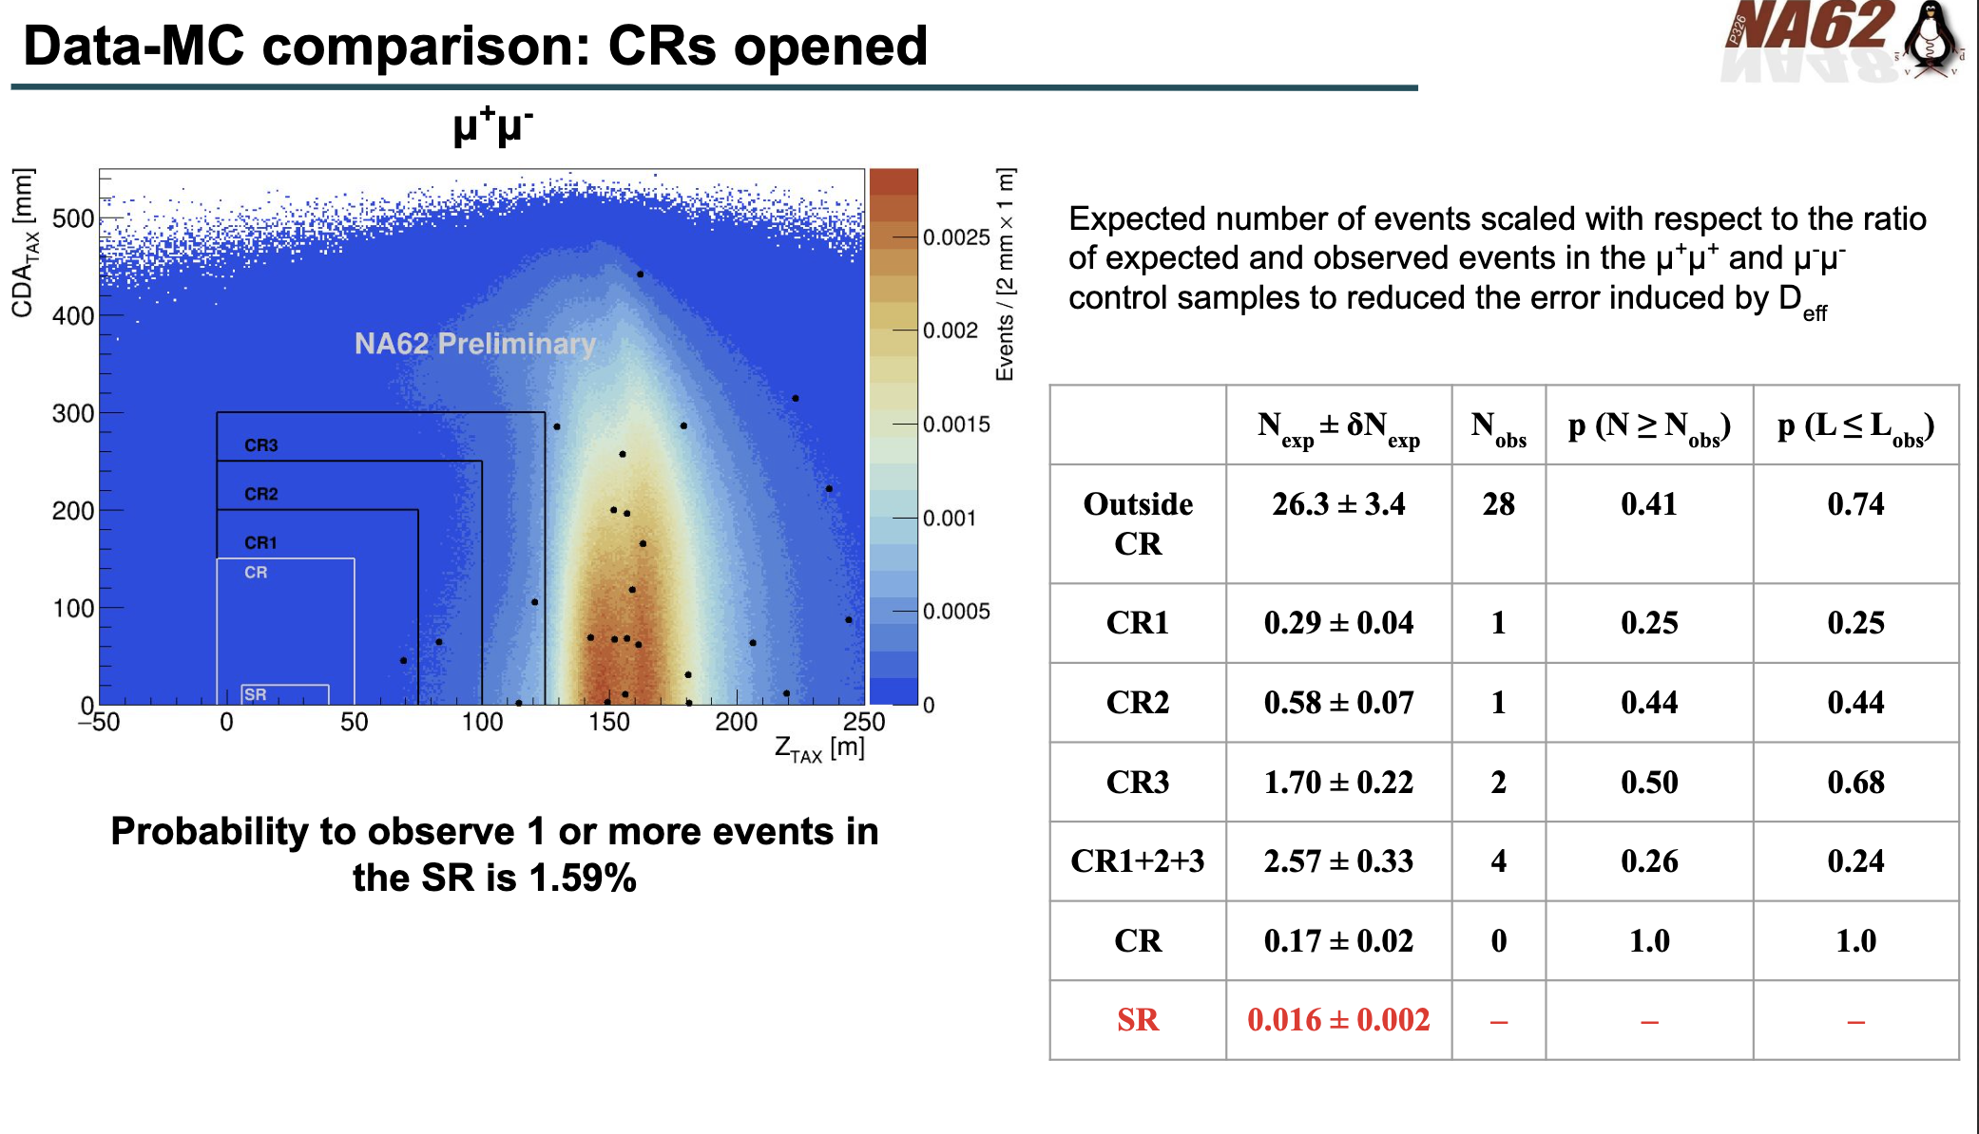
Dump Mode: 2021 DATA
Search for A’ → μ⁺μ⁻

Slide 28
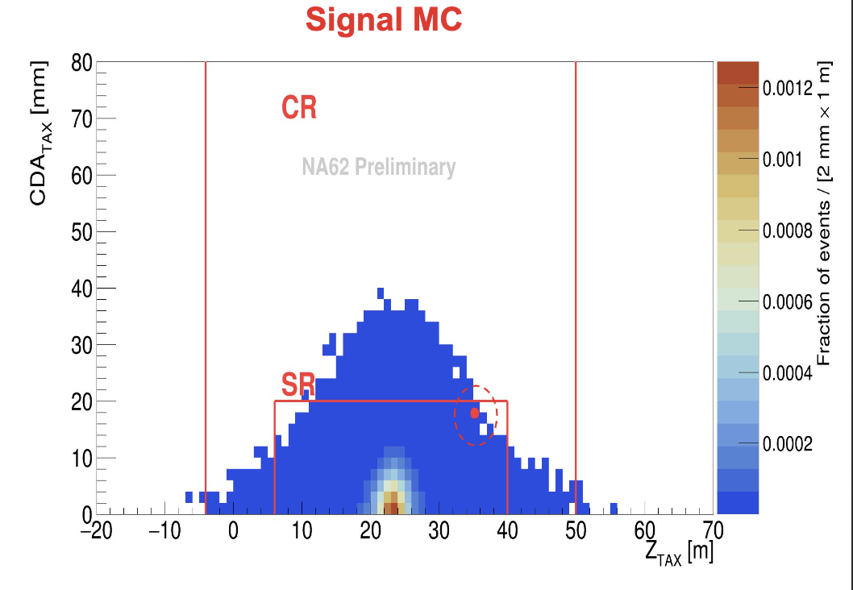
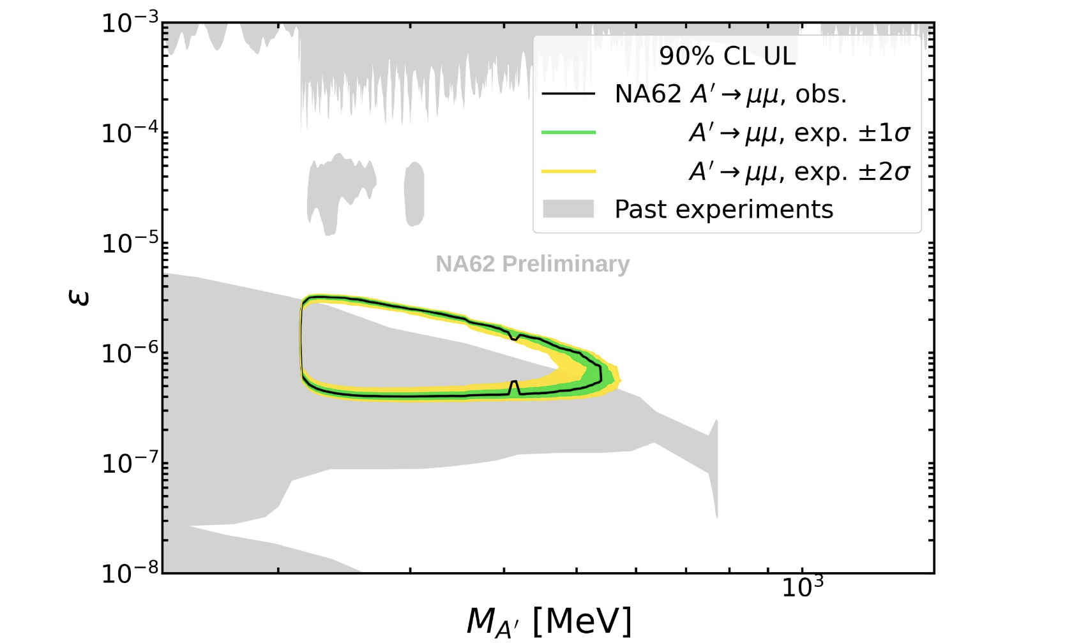
Search for A’ → μ⁺μ⁻
1 event observed
1.59 % probability for background fluctuation
Uncertainty dominated by precision of the POT measurement (at the level of 20%)

Slide 29
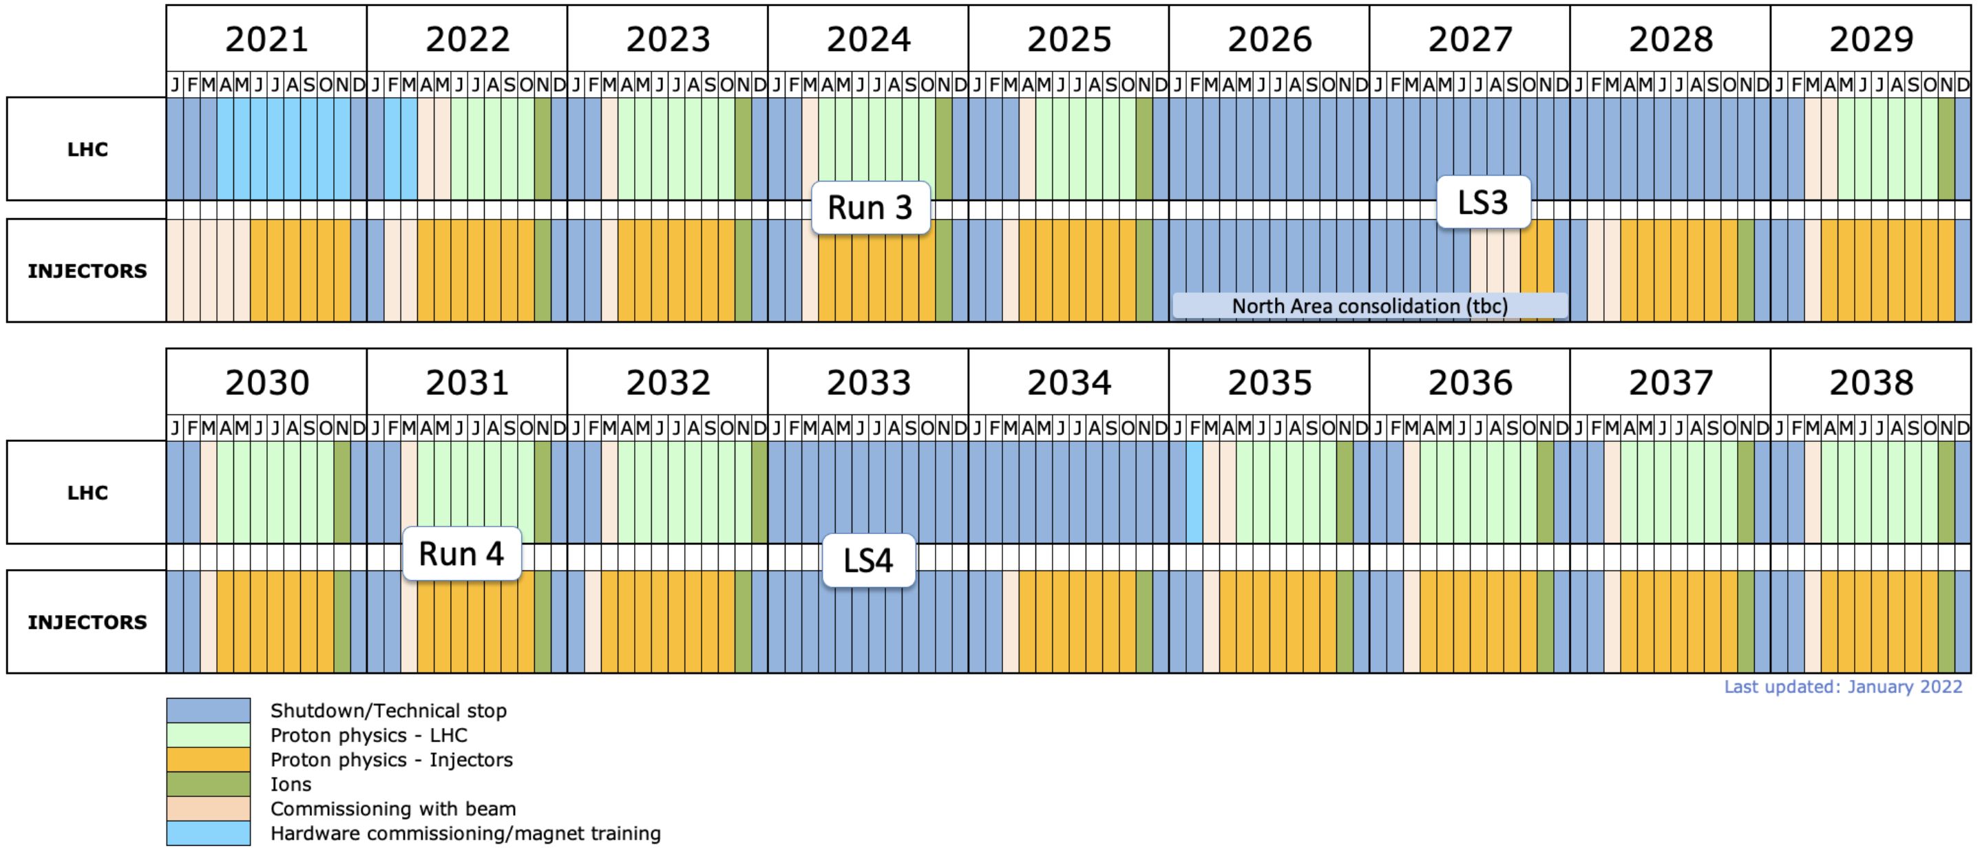
Future, after LS3
EU Strategy document: CERN-ESU-014. “Rare kaon decays at CERN” mentioned: “Other essential activities for particle physics” .
High intensity Kaon beam at the SPS gives a unique opportunity to pin down new
physics in kaon decays.
An integrated programme with multiple phases, K⁺ + K_{L} beams and dump mode is widley studied and discussed inside Physics Beyond Colliders working group.
Exceptional sensitivity to discovery new physics, complementary to LHC:
Rare K decays, precision measurements, testing LFUV in K decays, complementary to B and with comparable sensitivity, exotic particles in K/dump
Fixed target runs could be planned to accompany LHC running from 2028-29

Slide 30
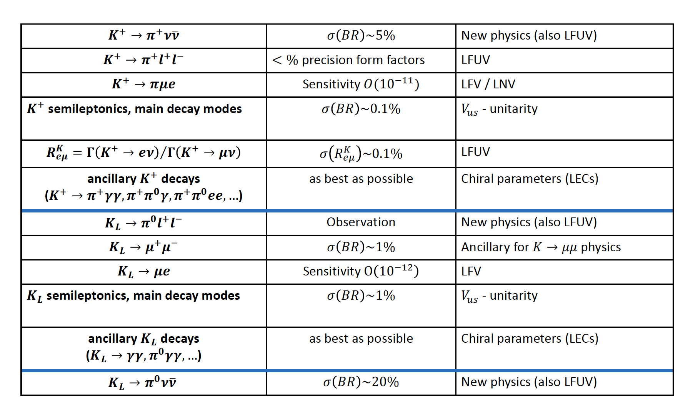
Future, after LS3
HIKE (NA62x4 + KLEVER):
a multi-stage program:
K⁺ at 4x NA62 intensity: 500 K⁺ → π⁺νν decays .
Transitional program: K_{L} beam, downstream tracking & PID like NA62.
K_{L} at 6x NA62 intensity: 60 K_{L} → π⁰νν decays
Periodic runs in beam dump mode (10¹⁹ POT)
Advantage: common upgrades for intensity and detectors , more flexibility on schedule

Slide 31
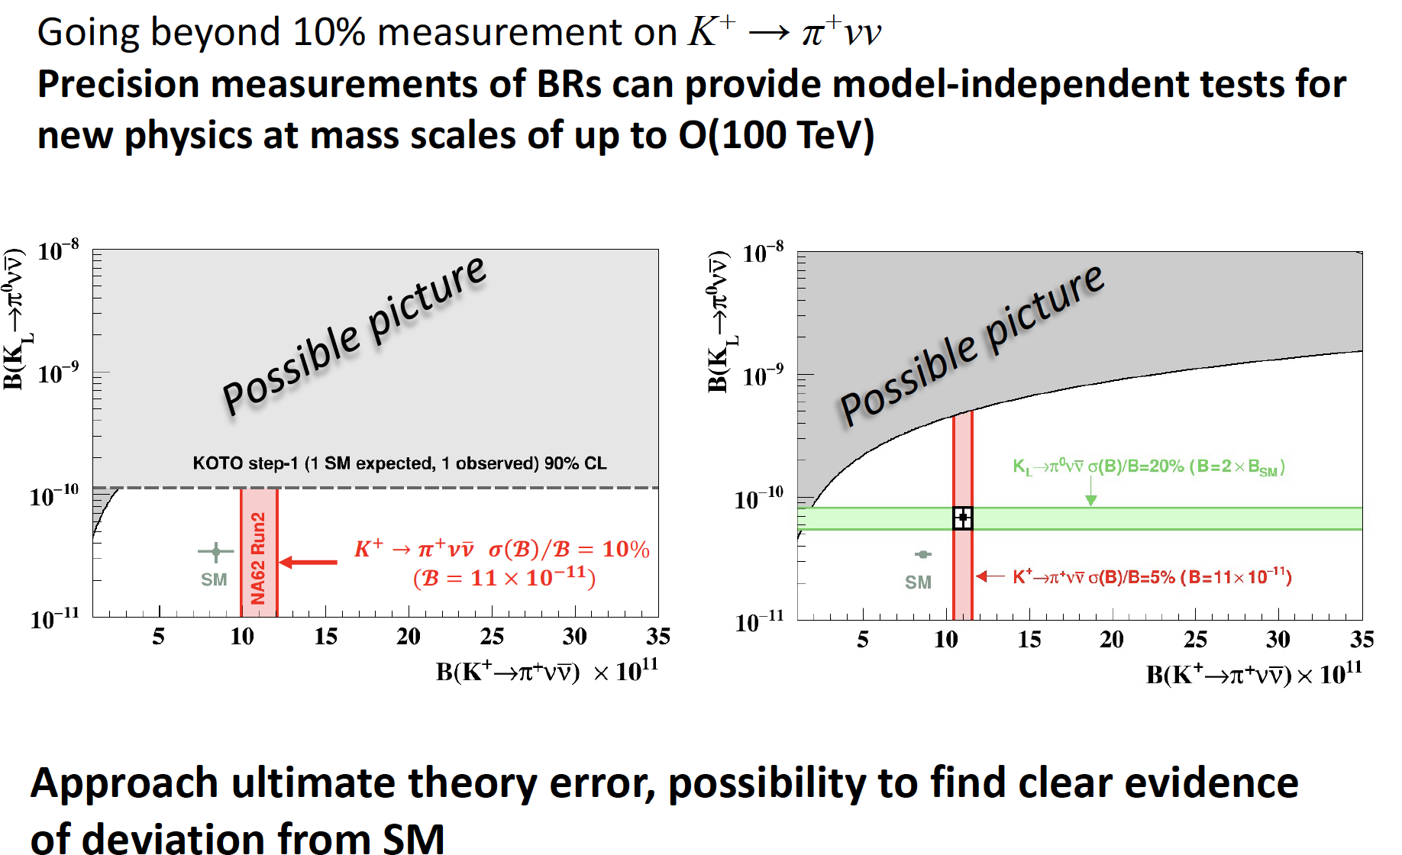
Future, after LS3

Slide 32
Future, after LS3
Steps:
Discussed and studied inside PBC (Physics Beyond Colliders), an updated document by the end of 2022, beginning 2023
Submitted document to the Snowmass process (april 2022, arXiv:2204.13394)
LoI to SPSC by the end of 2022
Collaboration:
NA62: Birmingham, Bratislava, Bristol, Bucharest, CERN, Dubna (JINR), Fairfax (GMU), Ferrara, Florence, Frascati, Glasgow, Lancaster, Liverpool, Louvain-la-Neuve, Mainz, Moscow (INR), Naples, Perugia, Pisa, Prague, Protvino (IHEP) , Rome I, Rome II, San Luis Potosi, TRIUMF, Turin, Vancouver (UBC)
Interest from Max Planck, Marseille, in contact with other groups interested on detector R&D
Discussion inside NA62 ongoing on interests and responsibility

Slide 33
STATUS: K⁺ phase
The NA62 upgrade for x4 intensity is based on the well consolidate NA62 running experience.
Challenge: 20−40 ps time resolution for key detectors to keep random veto under control, while maintaining all other NA62 specifications.
Key detectors upgrade and R&D:
GTK: better time resolution < 50 ps , beam intensity: 3 GHz over ~ 3x6 cm2, maximum local intensity: 8 MHz/mm2, radiation resistance: 2x1015 neq/cm./200days
Promising: TimeSpot ,GTK group already in contact with Cagliari group
Straw: Smaller straw diameter: 5 mm (instead of 9.8 mm)
Improved trailing time resolution, ~ 6 ns (per straw)
Rate capability increased by factor 6-8,
Reduced straw wall thickness (less material budget)
● Pre-production tests: Au/Cu coated Mylar film 5 m long straws with a 19 μm wall thickness
have successfully been produced. Design studies in progress at CERN and Dubna
Large Angle Veto & Electromagnetic Calo (common with KL phase): faster detector
various ideas under study.
IRC, SAC (common with KL phase): new design, resilient to neutrons flux
Other: Cherenkov (RICH, KTAG): new photo-detectors for time resolution. New mirrors.
New common triggerless readout system

Slide 34
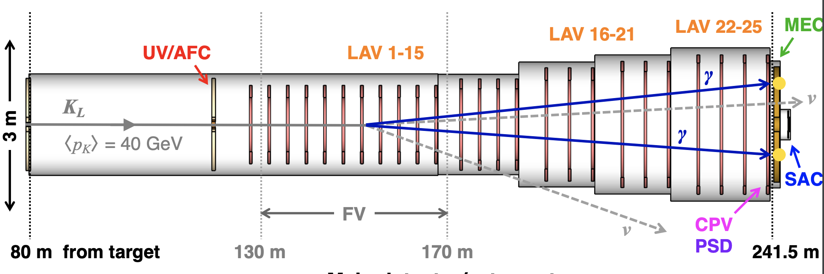
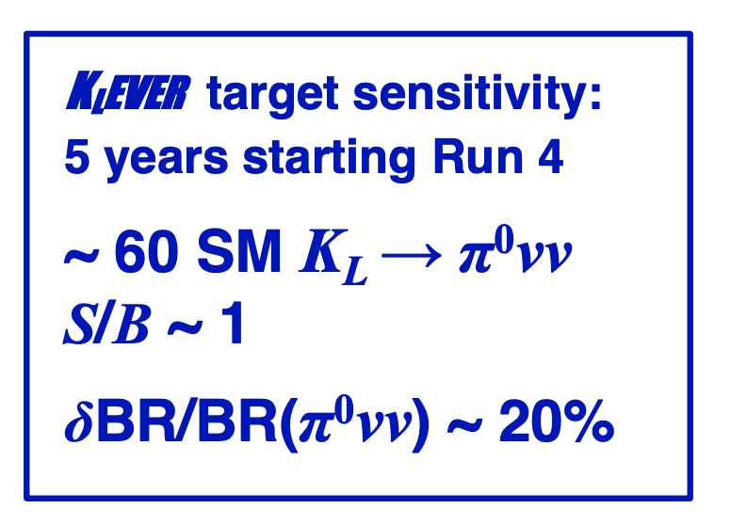
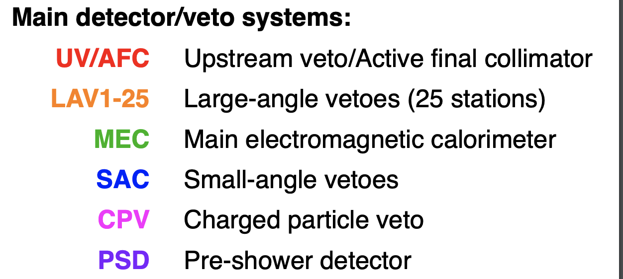
STATUS: K_{L} phase (KLEVER)
Well consolidated design study started on 2012 ( PRIN project), detailed simulation of the beamline and detectors. Detectors based on standard tecniques.
Input to the 2020 update of the European Strategy for Particle Physics
Main italian group interest
Beamline for KLEVER needs to be extended by ~100 m, or moved upwards, to mitigate Lambda background. Optmization on-going to improve signal efficiency

Slide 35
Richieste 2023: missioni
NEWS: nuovo spokeperson INFN G. Ruggiero , Firenze
da Ottobre 2022 per 3 anni
Metabolismo missioni:
  1mu/FTE (estere) + 1 ke/FTE (ita)
Richieste per responsabilità dei conveners
Richieste per tecnici per manutenzione apparato
Richieste RUN
Tests beam HIKE

Slide 36
Richieste missioni 2023: RUN
30 settimane
Il numero di turni e calcolato a teste (non FTE), uno dei requisiti per firmare articoli (NA62 ha solo MOFA)
Quota turni/persona = 10-12
1 settimana/uomo = 4/5 turni
Esperti «on call» LAV,RICH,CHANTI,CHOD,L0TP(+),Lkr, TDAQ, Lkr0 : se condivisi, si tiene conto delle frazioni (es. RICH sharing FI-PG 50%-50%)
Esperti «on call» possono fare turni per circa il 40% del loro tempo-> abbassano quota turni
Run Coordinators-> 2 settimane/uomo/RC
2/4 settimane d preparazione al Run per ciascun sistema a seconda della complessità
Totale circa 600 K € metabolismi inclusi (cifra parogonabile a quella 2022)

Slide 37
Richieste 2023
metabolismo
MOF-A: 160 kCHF -> 160 keuro
Richieste R&D futuro HIKE ∼ 60-70 K

Slide 38
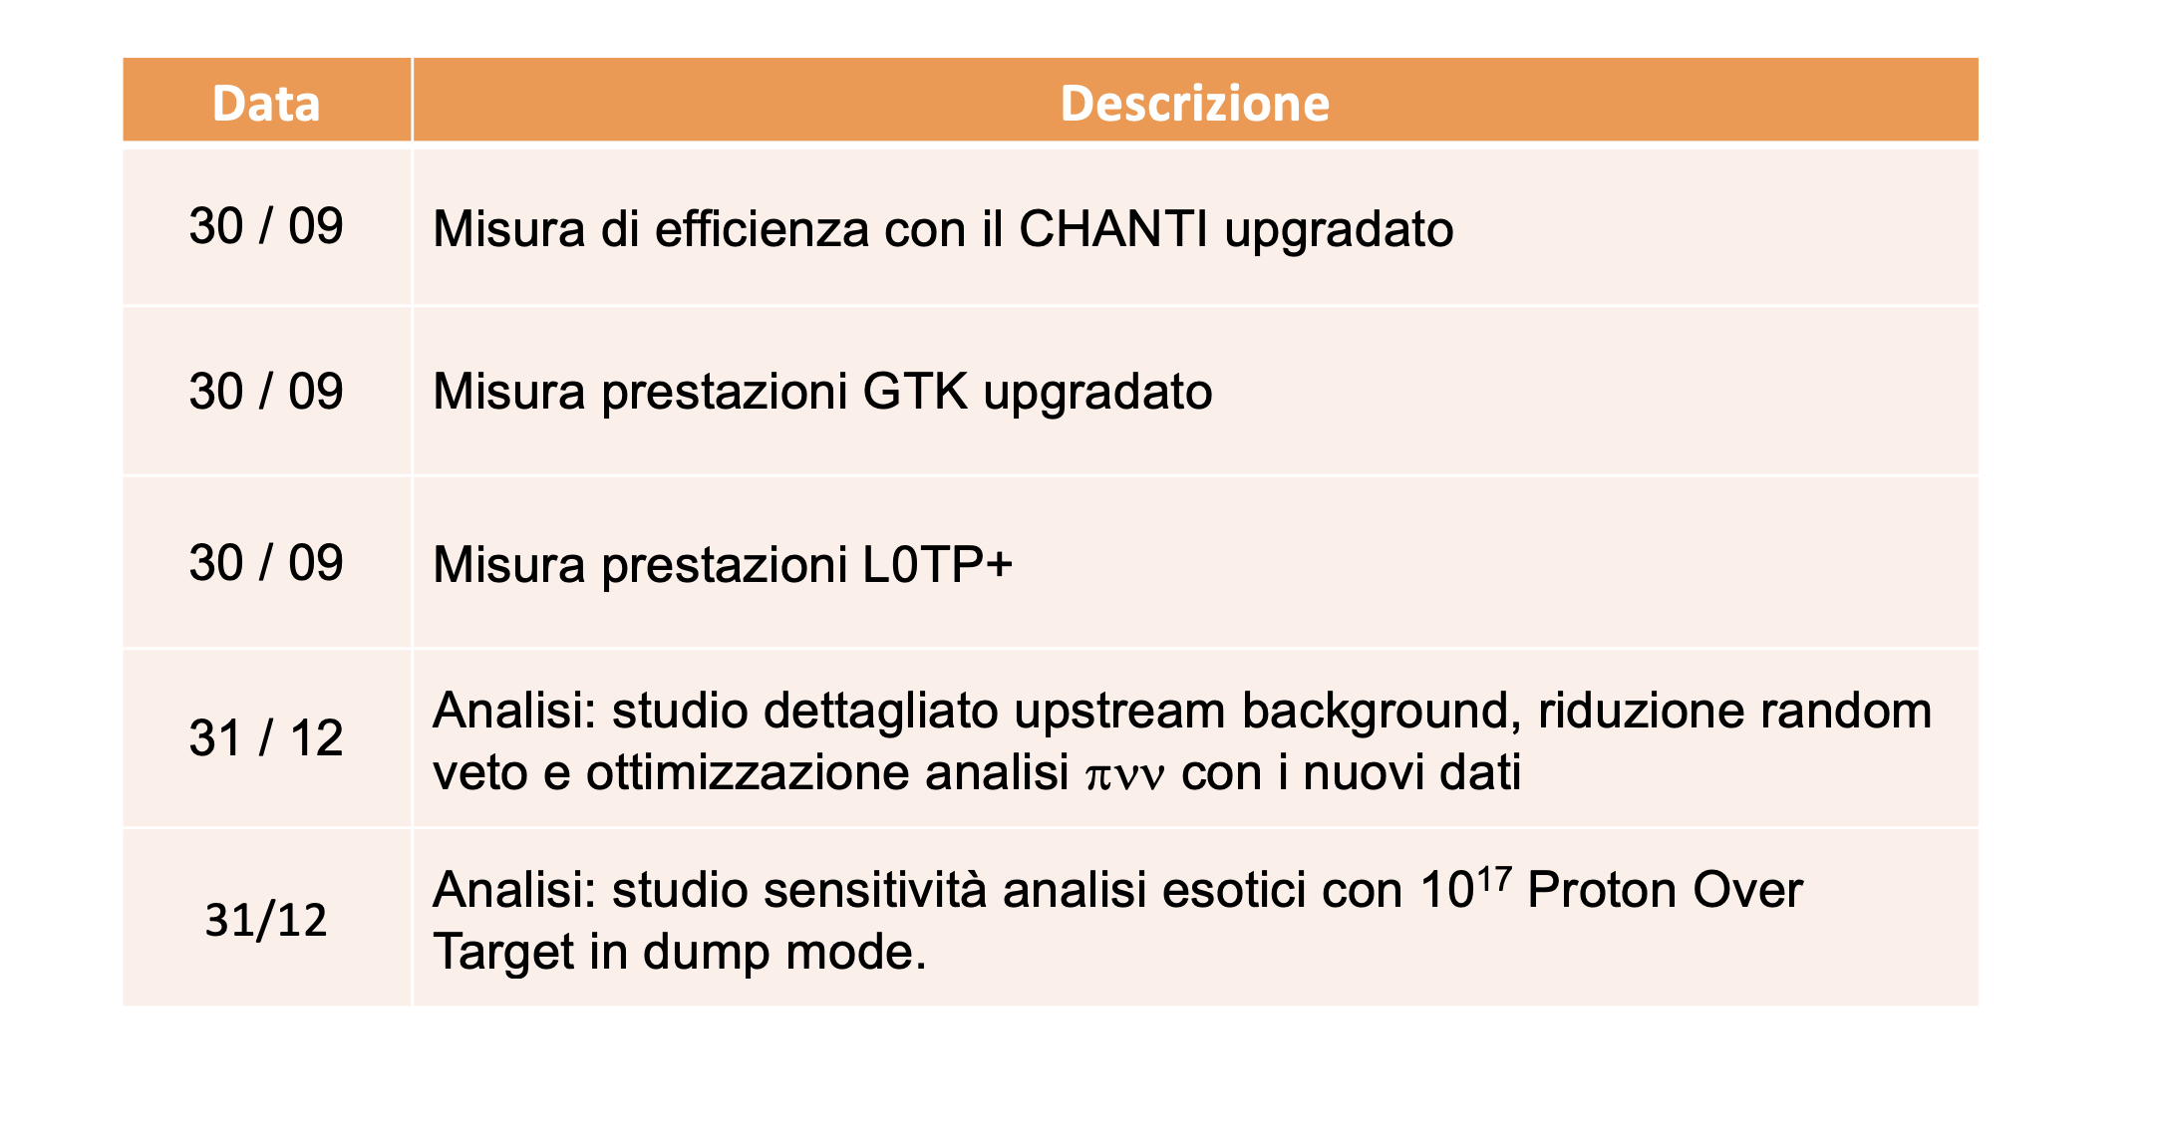
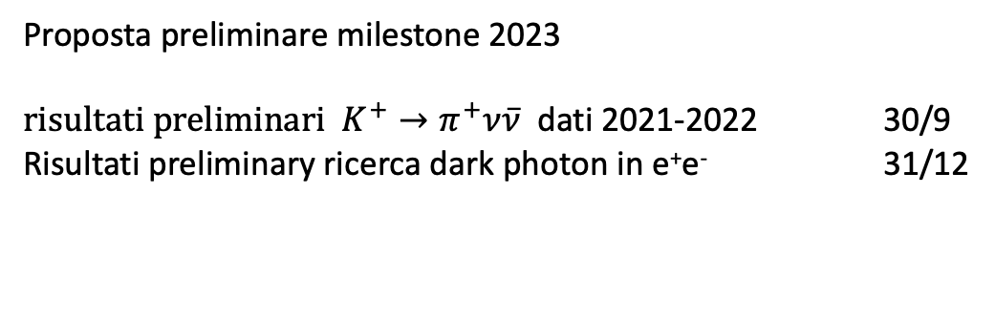
MILESTONE 2022
Proposta preliminare milestone 2023
${risultati preliminari K}^{+}→π^{+}ν\overline{ν}$ dati 2021-2022 30/9
Risultati preliminary ricerca dark photon in e⁺e⁻ 31/12

Slide 39
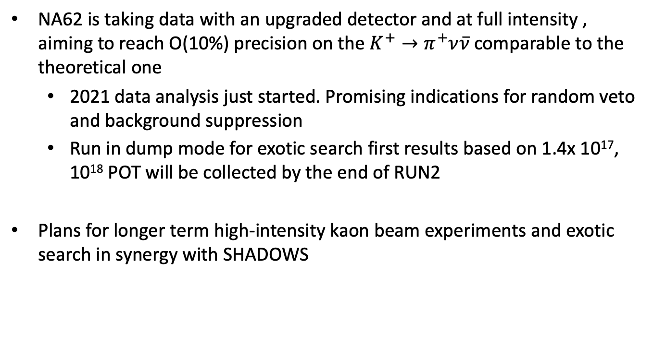
Conclusioni
NA62 is taking data with an upgraded detector and at full intensity , aiming to reach O(10%) precision on the $K^{+}→π^{+}ν\overline{ν}$comparable to the theoretical one
  2021 data analysis just started. Promising indications for random veto and background suppression
  Run in dump mode for exotic search first results based on 1.4x 10¹⁷, 10¹⁸ POT will be collected by the end of RUN2
Plans for longer term high-intensity kaon beam experiments and exotic search in synergy with SHADOWS

Slide 40
FUTURO: TDAQ, RICH
TDAQ: Il presente sistema di data handling tra detector e PCFarm basato su Tel62 è obsoleto ed andrà sostituito per il prossimo esperimento
La collaborazione sta pensando di adottare il sistema FELIX sviluppato per ATLAS
  estremamente flessibile essendo dotato di FPGA di ultima generazione che rendono possibile realizzare molte funzionalità
La comunità italiana vorrebbe dotarsi di una o piu’ board FELIX per:
  Comprendere i protocolli di comunicazione, studiare le capacità di data handling ed eventualmente di data reduction on board, studiare possibile integrazione con i sistemi di front end attualmente esistenti
Richieste ∼ 5K
RICH upgrade:
Ridurre il passo dei sensori che attualmente domina la risoluzione sull'angolo, sensori di superficie da 9 a 25 mm² andrebbero bene, saremmo a livello del mm per hit o meglio
Migliorare la risoluzione temporale a livello di 20-30 ps per anello per abbattere il fondo da accidentali (coincidenze strette con gli altri rivelatori).
Rifare o ri-alluminizzare gli specchi visto il degradamento della riflettività osservato
1) e 2) raggiungibili con SiPM o MCPP), R&D sul tipo di sensore e sulla nuova meccanica delle flange sarà necessario.
3) Studi su nuovo coating degli specchi alla luce dell’esperienza acquisita con NA62
Richieste ∼ 20 K
- SIPM e MCPP, prototipo FEE, coating specchi

Slide 41
FUTURO: TRIGGER
attività di R&D sul trigger calorimetrico. In particolare si vuole
effettuare uno studio di fattibilità riguardo l´uso deidispositivi di classe "RFSoC" che integrano fino a 16 ADC a 14 bit a 2.5 GSPS su una singola FPGA on CPU ARM. Questa tecnologia permetterebbe l´implementazione di sistemi ad altissima banda e largamente paralleli per la digitalizzazione dei segnali analogici il loro processamento di livello 0 e l´impacchettamento
verso i livelli successivi, in uno schema di readout sia di tipo triggered sia triggerless.
Richieste ∼ 15K
Totale richieste R&D per HIKE ∼ 70 K

