Slide 1
SPARC_LAB synchronization system status/upgrade
Luca Piersanti, Marco Bellaveglia, Alessandro Gallo, Simone Tocci

Slide 2
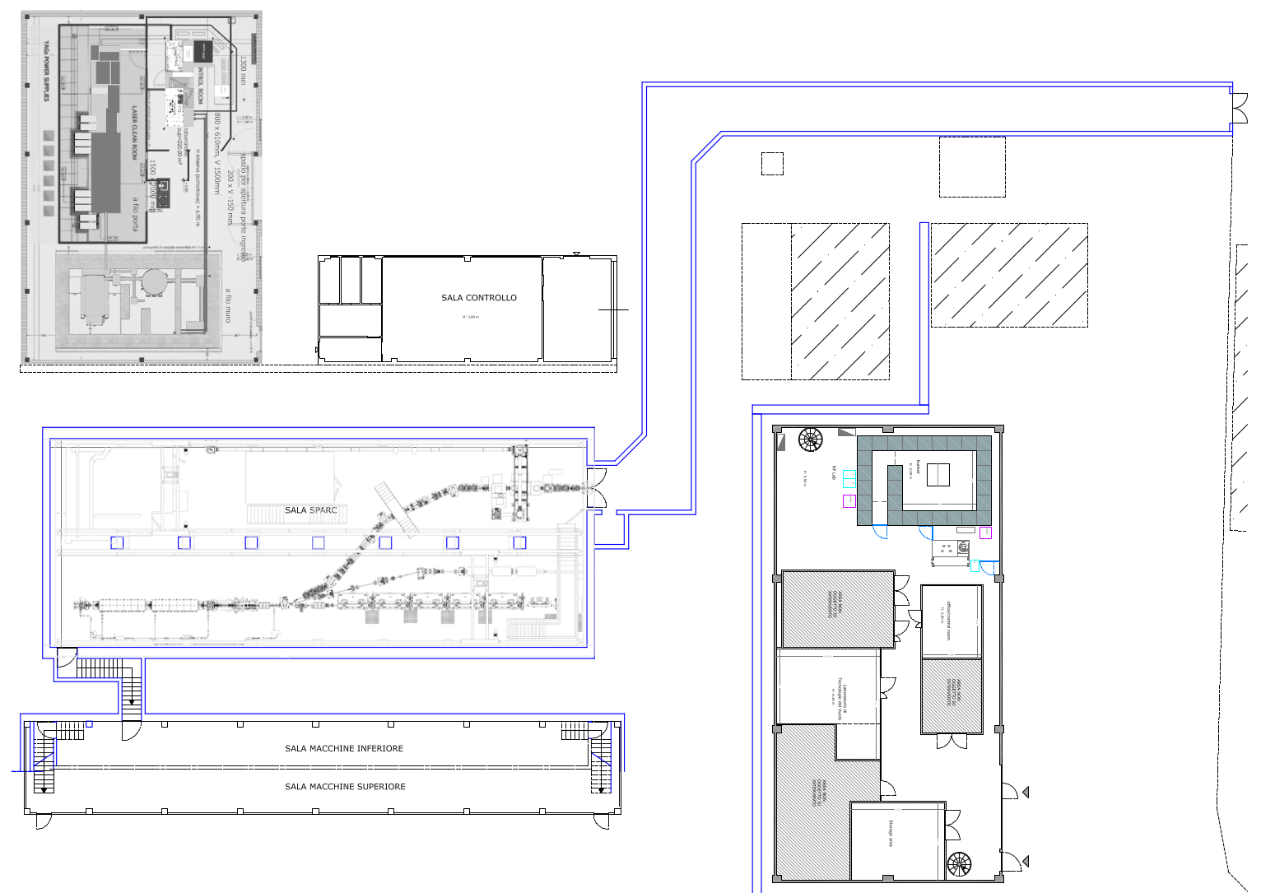
Synchronization system general architecture
FLAME Area
FLAME
LASER
CONTROL ROOM
PC
LASER
SYNCH HUB
SPARC Bunker
BLD. 7:
TEX + THz users
THz UNDULATOR
LINAC
FEL UNDULATOR
Modulator Hall
K3
K1
K2

Slide 3
Synchronization system general architecture
2856 MHz
RMO
2142 MHz
5712 MHz
Locking electronics
Locking
electronics
KLY phase loop 1
KLY phase loop 2
Synchronization Diagnostics
FLAME laser
PC laser
Klystron 1
Klystron 2
Klystron 3
Laser systems
RF systems

Slide 4
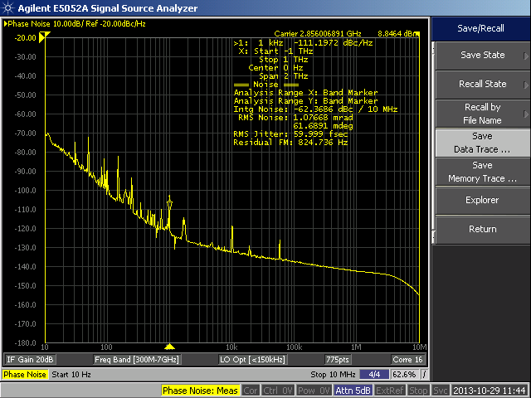
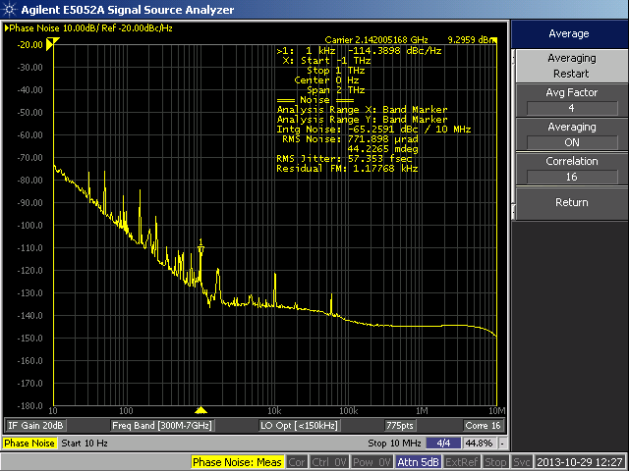
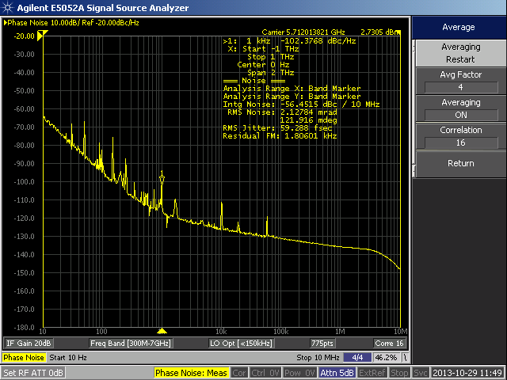
Reference Master Oscillator (RMO)
RMO currently in use @SPARC_LAB is from RALAB and has coherent outputs at three different frequencies:
2856 MHz (RF S-band): ~60 fs RMS jitter (10 Hz - 10 MHz from f₀)
5712 MHz (RF C-band): ~60 fs RMS jitter
2142 MHz (3/4 RF S-band, for diagnostics interference-free purpose): ~60 fs RMS jitter
We are planning to switch to different manufacturer

Slide 5
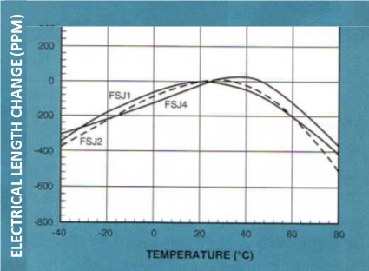
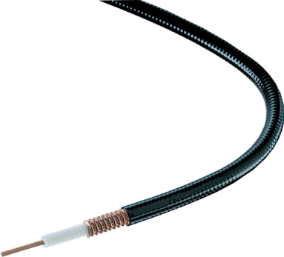
RF reference distribution
cable length
carrier frequency
in MHz
propagation velocity
(relative to c)
Coaxial cables Commscope Andrew
$$∆φ≈3.66E−7∙{\left.\frac{∆L}{L}\right|}_{PPM}∙L∙f_{0}/v$$
$${{\left.\frac{∆L}{L}\right|}_{PPM}=\left.\frac{∆τ}{τ}\right|}_{PPM}≈−{\left(\frac{T−T_{opt}}{T_{c}}\right)}^{2}$$
For a 3/8" cable (FSJ2-50): $$T_{opt}≈24 °C, T=24.5°C \\ T_{c}≈2 °C, L≈1 km,f_{0}=3GHz \\ ∆t≈100fs$$
Coaxial cables built to minimize the elongation VS temperature @ 24 °C (using a suitable dielectric material)
For demanding applications (e.g. longer paths, lower attenuation) an active stabilized link is required (see upgrade slides)

Slide 6
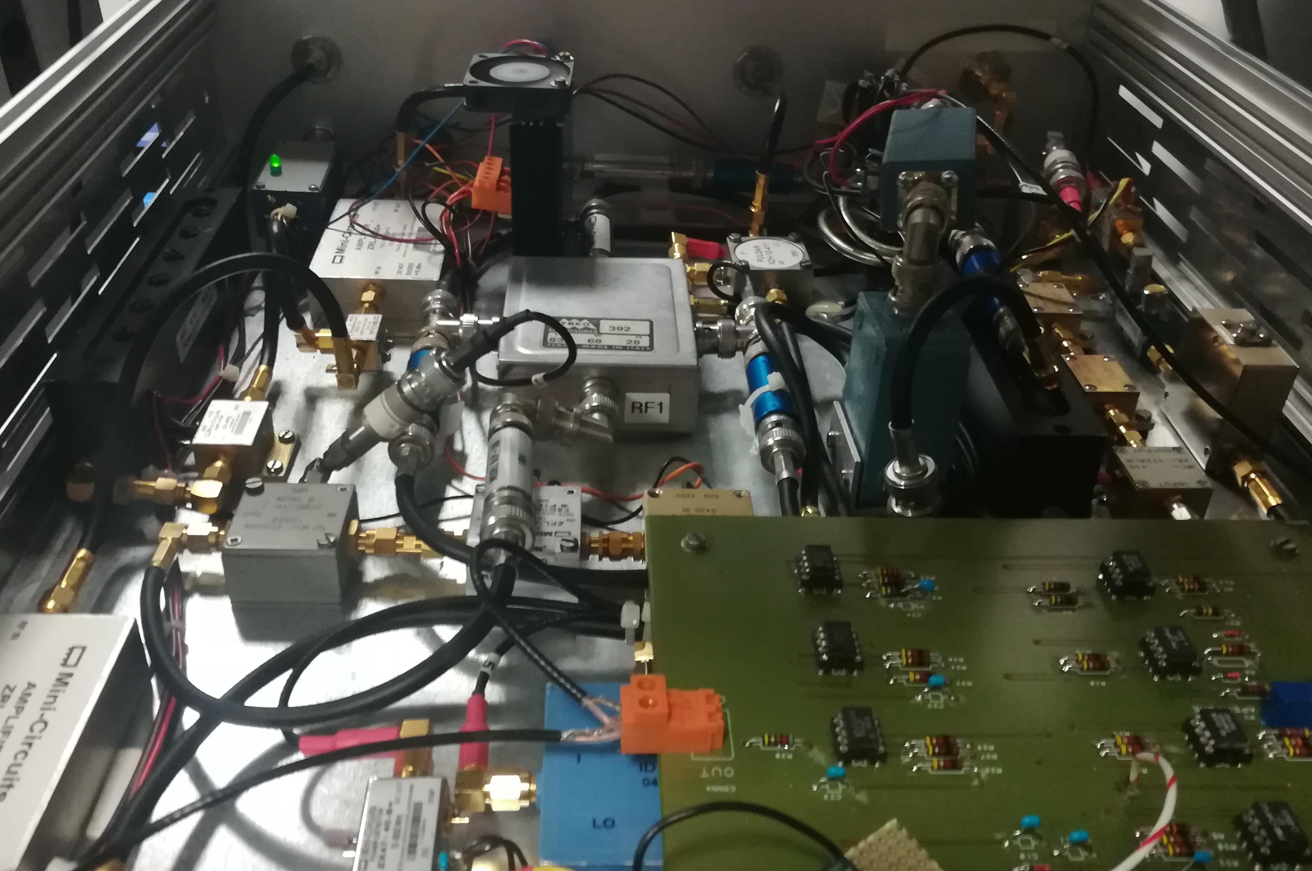
PC laser locking system
Galvo motor inside MIRA oscillator bypassed
Native noisy locking electronics bypassed
Native BW limited PD bypassed
New photo detector, phase detector and loop error amplifier designed and optimized
Stepper motor:
coarse positioning
low freq. drift compensation
Mode-locked laser oscillator cavity
12.6 ns
Piezo motor:
fine positioning,
up to 5-10 kHz BW
Stepper driver
Piezo driver
Control system
software
RMO
Signal
Phase detector and error amp
Photo-detection
and filtering

Slide 7
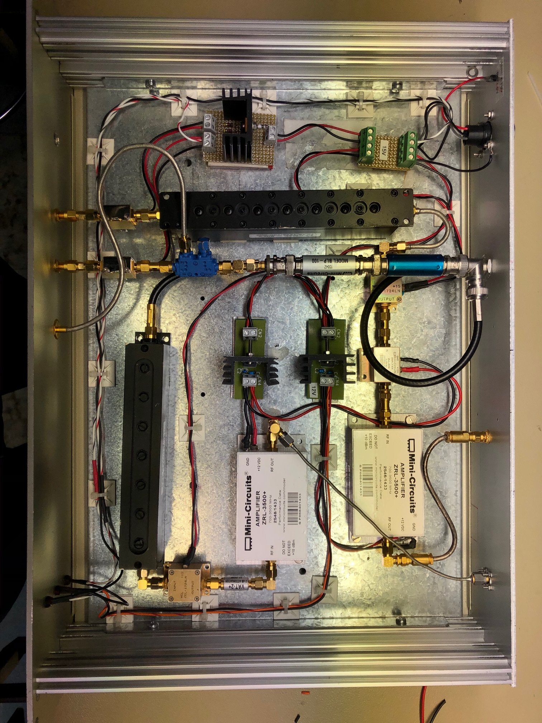
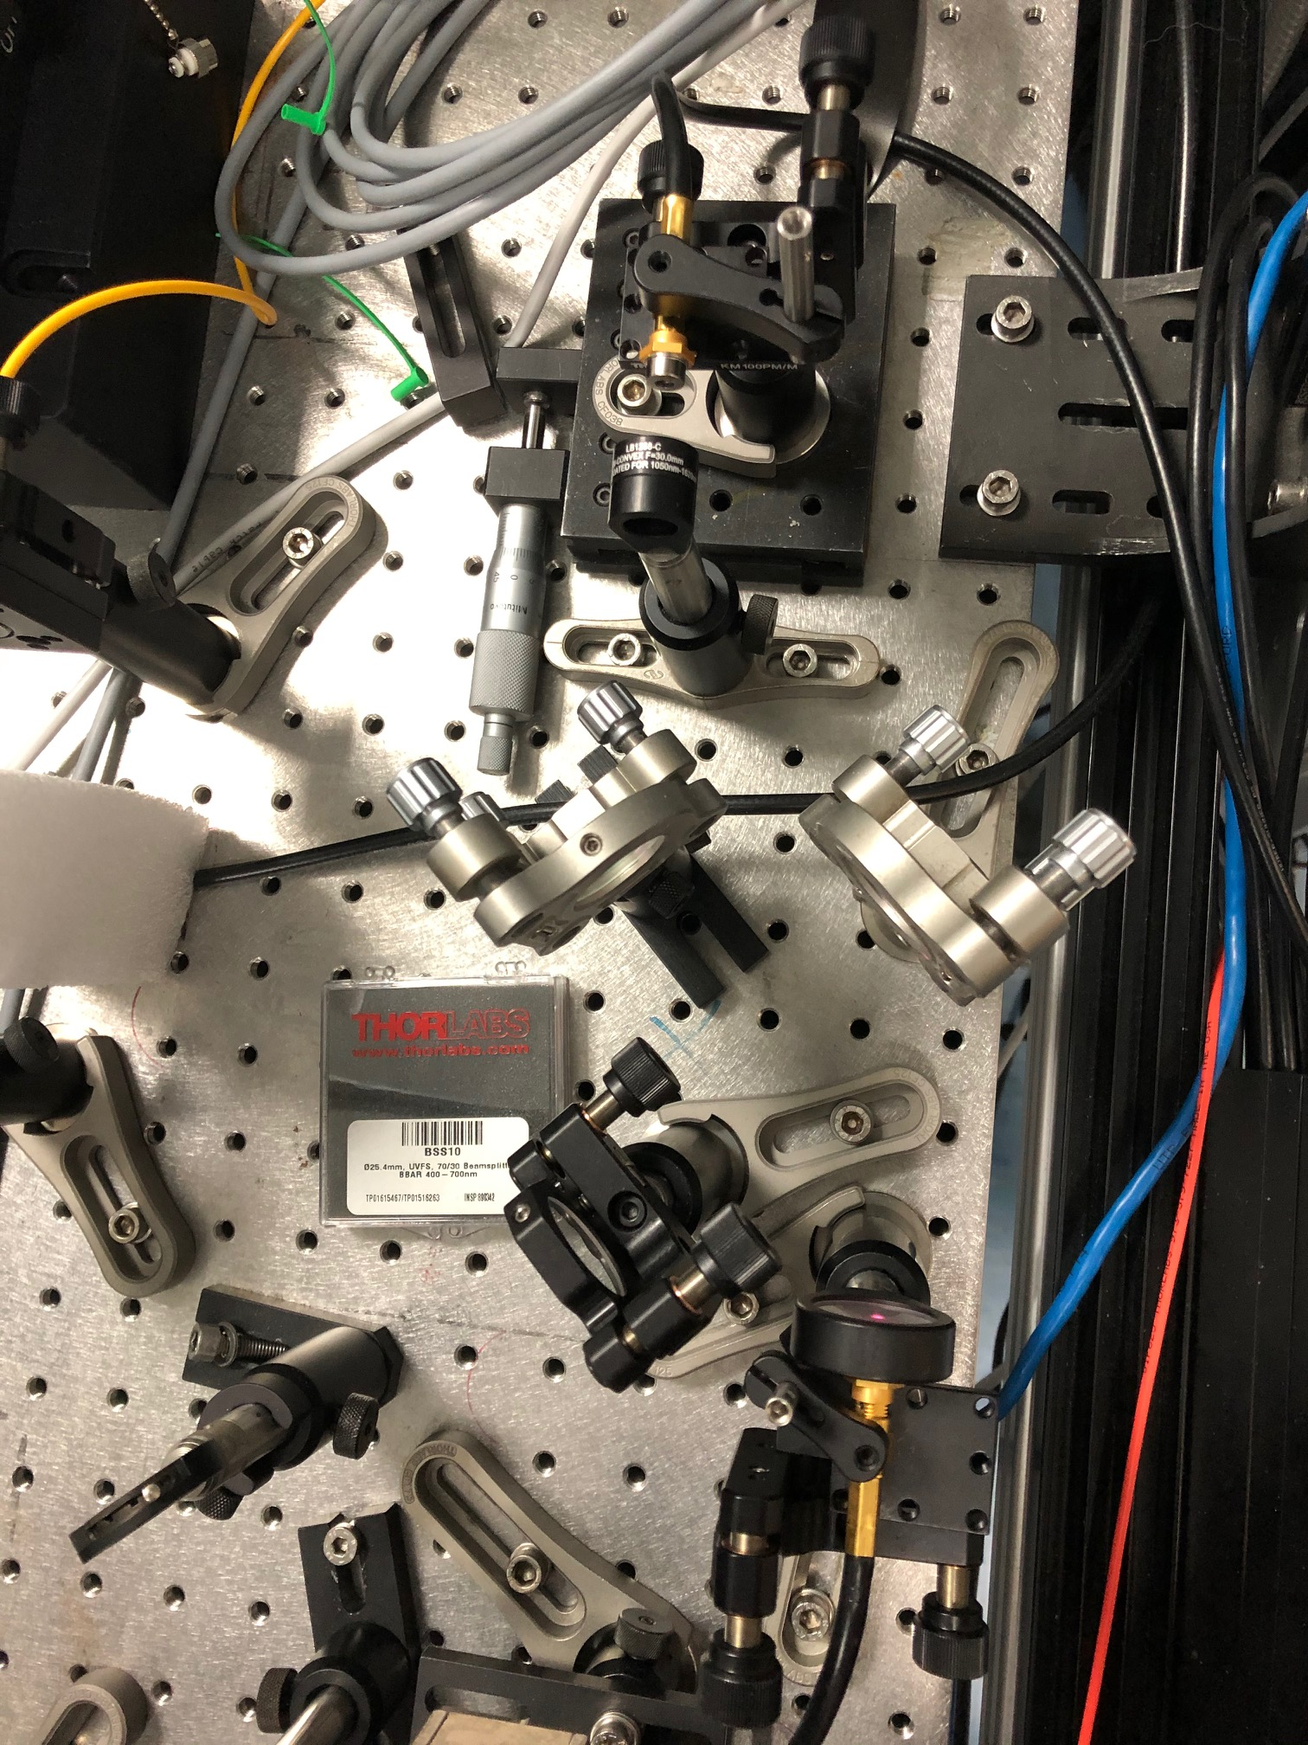
PC-laser locking recent upgrades and open points
New fast PD in-loop installed (Hamamatsu G4176-03, 30 ps rise time)
New fast PD for out-of-loop diagnostics installed
Optimization of the amplifier chain (low noise amp.)
Measured jitter relative to the reference is ~20 fs RMS
In-loop PD
Out-of-loop PD
7

Slide 8
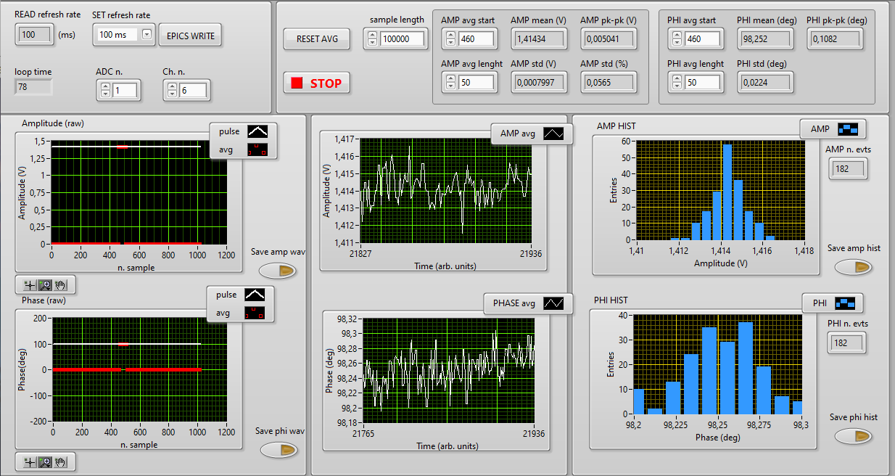
PC-laser locking high resolution measurement

Slide 9
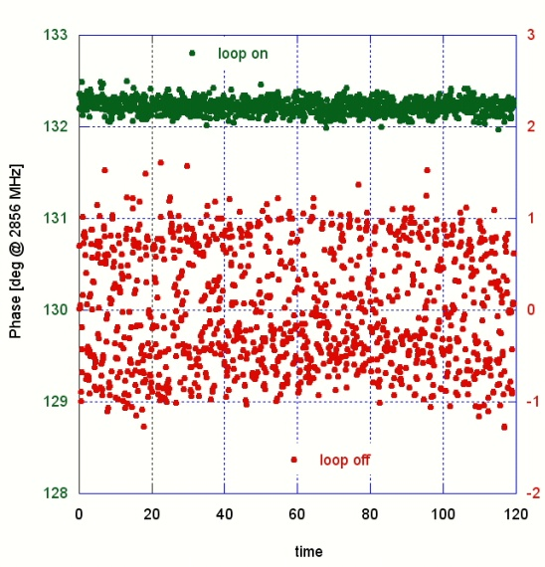
RF sources locking: intra-pulse phase loop (Klystron loop)
PLL on:
Δt < 70 fsRMS
PLL off:
Δt ≈ 500 fsRMS
Phase noise source is the klystron high voltage switch (thyratron)
Very short time ≈ 3μs available to reach steady state wideband loop transfer function (≈1 MHz) required.

Slide 10
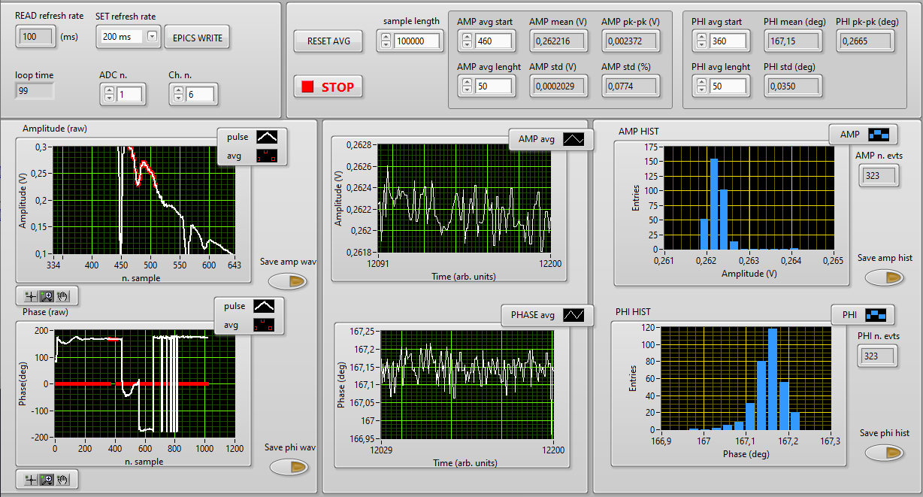
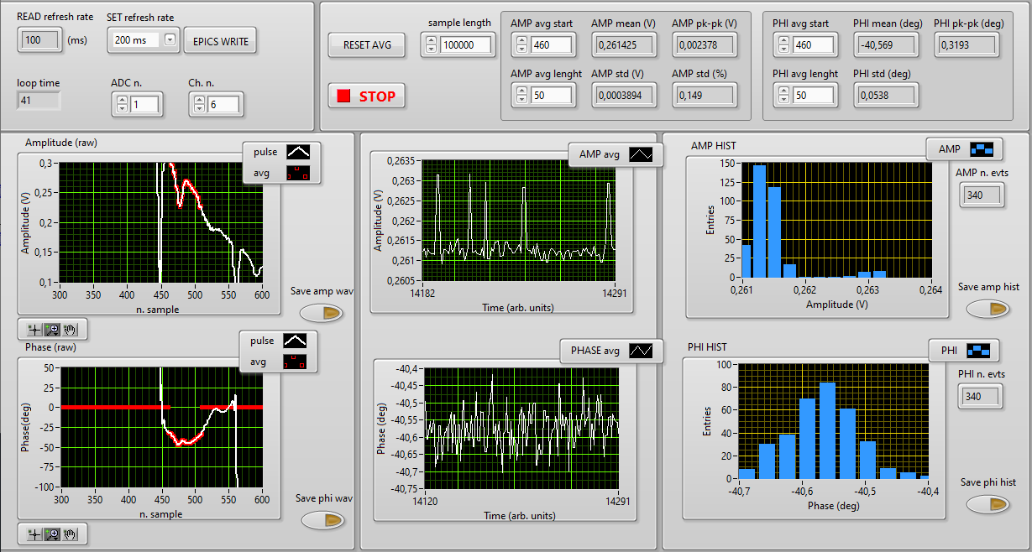
Intra-pulse feedback performance and open points
Intra-pulse feedback high resolution measurements show a residual jitter ̴50 fs RMS between klystron output and RF reference
A number of optimization are still in progress:
Substitution of a damged DC (distortion in the RF signal -> error ampl.)
Upgrade of the fast phase shifters (high BW) and error amplifier (fast OP-AMP)
Investigation on a «feed forward» circuit to pre-compensate the modulator HV jitter

Slide 11
Future upgrades for LLRF and synchronization systems
During 2023 a major upgrade of the RF and synchronization systems is foreseen at SPARC:
3 new digital LLRF system
New RMO
New RF distribution electronics
Re-cabling of several RF devices with phase stable cables
Refurbishment of the Synchronization hatch (ongoing)
Intra-pulse feedback around the C-band klystron (supplied by a solid-state modulator) is under design to test the limit of such technology
Commissioning of a commercial optical synchronization system (MENLO) to serve PC-laser, FLAME (with fiber link active stabilization). In the future 2 more clients are foreseen: betatron source and THz users
OMO and one stabilized fiber link already commissioned at LNF (currently the link is being re-commissioned after a fault)
2 cross-correlators used as phase detectors (PC-laser and FLAME) to be commissioned
Design and realization of a dedicated error amplifier to close the loop around the 800 nm oscillators (PC-laser and FLAME)
Spare parts purchasing

