Slide 1
Spoke 2.3
Initial planning and highlights
e. Luppi with substantial suggestions from P. Natoli

Slide 2
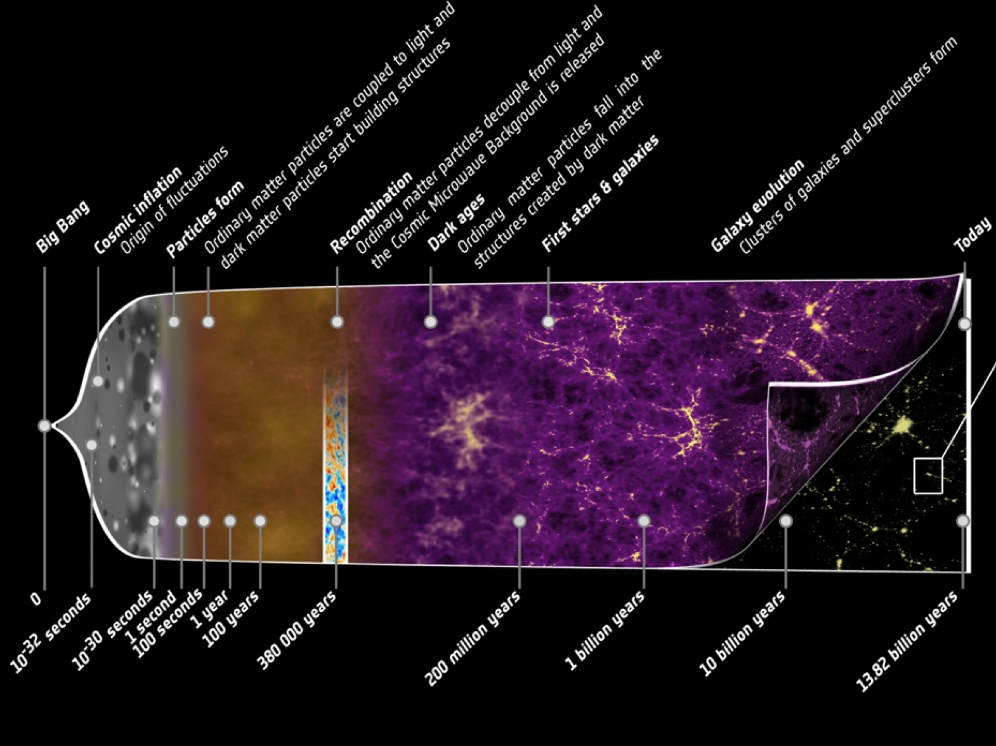
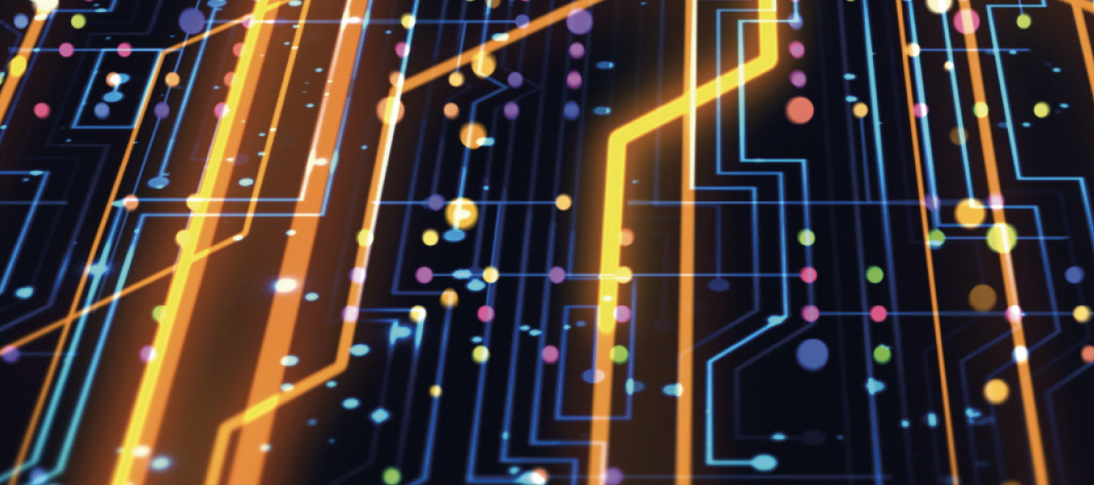
Astroparticles
Cosmoparticles
Gravitational waves
HPC

Slide 3
Science outline
Astroparticle, cosmoparticle, gravitional waves experiments
Data analysis and reduction, data selection, simulations
Multi-messenger approach: sinergies from cross-correlations
How can HPC enhance all of this?

Slide 4
Experimental landscape
Many etherogeneous experiments running or planned
Earthly, underground laboratories
Observations: ground based, sub-orbital, space borne
Different experimental context means very different analysis techniques
Maturity level for HPC varies considerably across experiments
Simulation requirements and needs also vary considerably
Cross-correlation approach not trivial

Slide 5
Possible planning structure
Several nodes in Spoke 2.3 have expertise in different experiments
Perform a survey of interested/forseaable experiments
Assess maturity level of HPC inside each experiment
Own-analysis kind of approach. Defer cross-correlation until later
Lay down a scheme for single experiment HPC boosting
Cross-correlation (multi-messenger approach)
Set up specific working groups to lay down a plan for cross-correlation
Start with reasonable targets: some cross-correlations make more sense then others
Exploit cross-fertilization and feedback it back to single experiments

Slide 6
More in detail
On top of experiment-specific activities, set up transversal (but interconnected) HPC working groups:
Simulation
Analysis
”New fronteers”: AI algorithms, and the like
Keep in account some degree of rendundancy (and osmosis)
Target the WG on specific objectives, e.g.:
Exploitation of cross-correlations (as defined by previous steps)
Assessment of GPU vs CPU architecture
…

Slide 8
Extra slides

Slide 9
Experimental Astro-Particle Physics: data reduction, reconstruction and time cross-correlation algorithms, data selection and simulations of astroparticle and gravitational waves experiments, tools for cross-correlations and pattern recognition in multi-messenger physics, including novel implementations using techniques like Machine Learning.
New algorithms for data reconstruction, analysis and simulations of astroparticle experiments, also based on AI techniques. Portability of applications on GPU/CPU and on heterogeneous architectures. Development of data interpretation tools, and statistical analysis, also based on AI, and high-performance techniques for accessing high-energy and astroparticle physics data. Development of algorithms and methodologies for integrating heterogeneous data (e.g., from different instruments / observers, and multi-messenger). INAF and INFN are participating actively in Spoke 2 RI WPs: this will guarantee cross-fertilization and maximize the sharing of RI products and know-how.

Slide 10
WP2.3: Design and development of science-driven tools and innovative algorithms for Experimental Astroparticle Physics and Gravitational Waves (INFN, INAF, UNIBA, POLIBA, UNIMIB, UNINA, ROMA1, UNITS, UNIBO, UNIFI, UNICT, UNIPD, UNICAL, UNISALENTO, UNIFE): T3.1 Innovative algorithms for Experimental Astroparticle Physics and Gravitational Waves simulation, selection, data reduction, reconstruction and analysis; T3.2 AI inspired techniques for Astroparticle Physics and Gravitational Waves.
Main Activities: data reduction, reconstruction and time cross-correlation algorithms, data selection and simulations of astroparticle and gravitational waves experiments, tools for cross-correlations and pattern recognition in multi-messenger physics, including novel implementations using techniques like Machine Learning.
Milestones: M9-M15: Landscape recognition of the state-of-the-art and technological investigation on the opportunity of the CN infrastructure - report submitted with detailed plan of work and selection of specific case studies; M22-M26: report on first implementations and “ready for tests”; M25-36: results from testbed and benchmarking activities; final report and evaluation

