Slide 1



Machine Learning
Kick-off & First Results
Sabrina Appel (GSI), Verena Kain (CERN),
Nico Madysa (CERN), Sebastian Rothe (CERN)

Slide 2
Context
Introduction
CERN python toolkit: GeOFF
Online optimization:
  Reinforcement learning at CERN
  Numerical optimization at CERN
  Nature-inspired optimization at GSI
GeOFF implementation at ISOLDE
Milestone and Deliverable

Slide 3
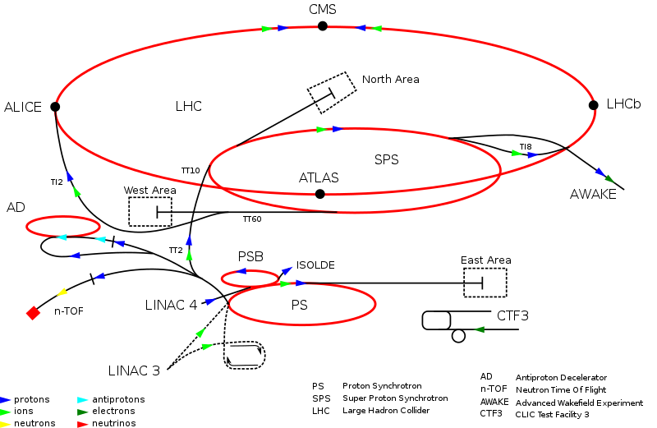
CERN

Slide 4
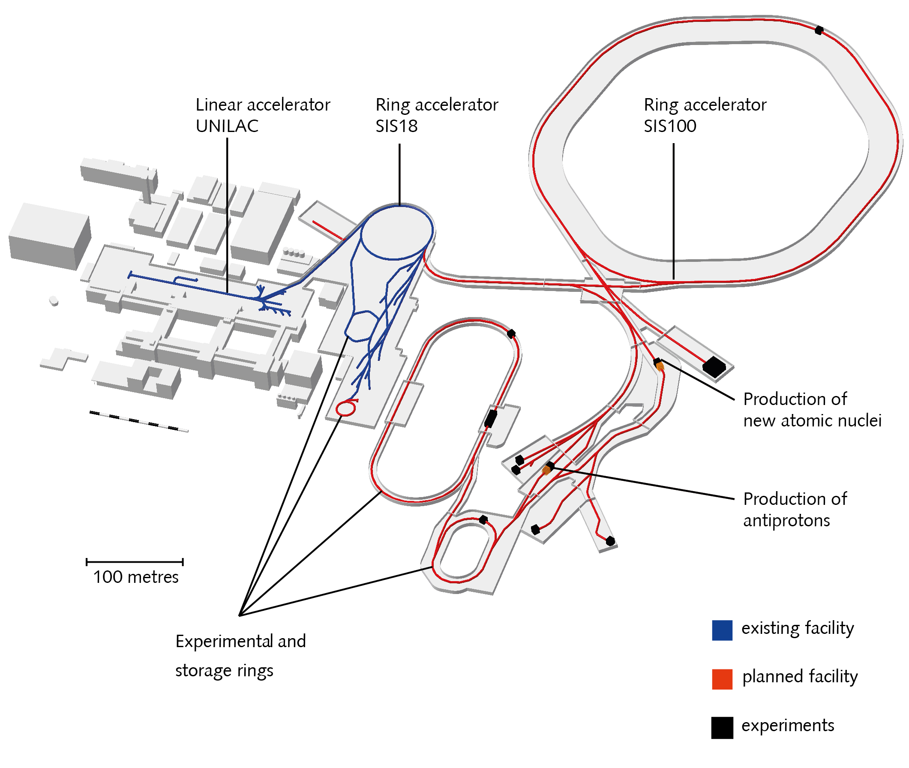
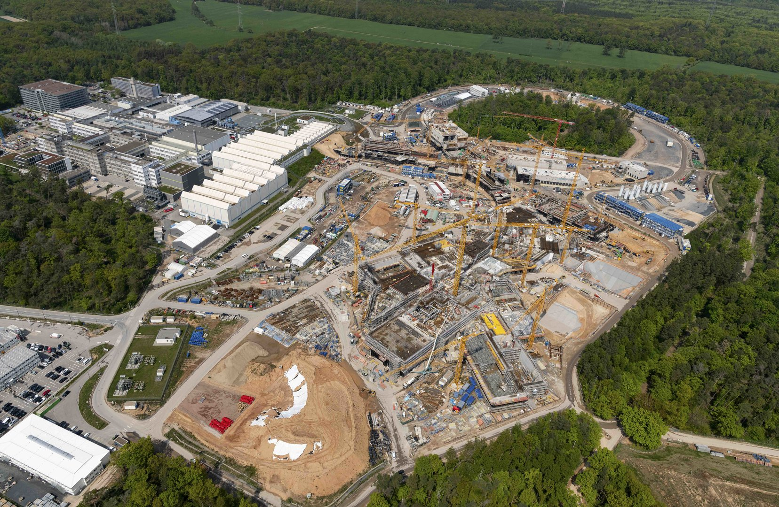
FAIR + GSI

Slide 5
Facilities share common problem
Requiring skilled machine supervisors to achieve optimum beam as required by the user
GSI Beamtime schedule: Almost on daily basis adjustments are made
Increase beam availability for the users with automated optimizer toolkit

Slide 6
Machine learning within the EURO-LABS
Automated optimization of accelerator means:
  Reproducible or improving beam quality
  Improving accelerator availability (less downtime)
  Hugh data framework and high quality diagnostics is of large importance
The aim is to find the optimum framework for usable ML algorithms for accelerator problems.
Open data:
    Share algorithms and application across facilities
    Beam optimization algorithms and ML library
USERS beamline: Toolkit with their observable

Slide 7
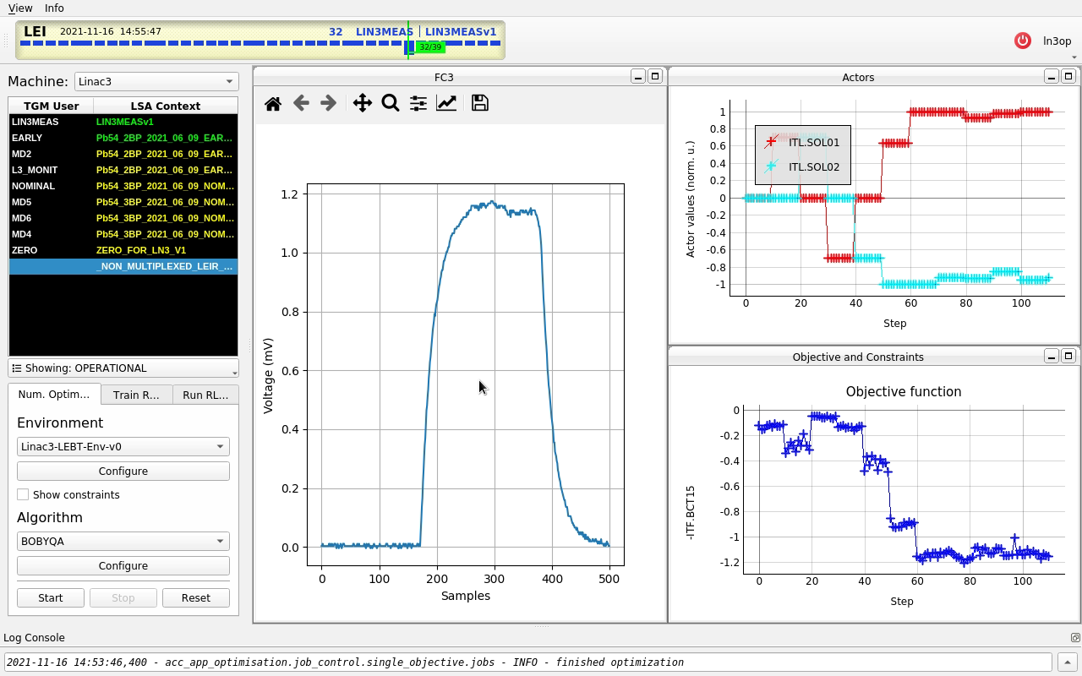
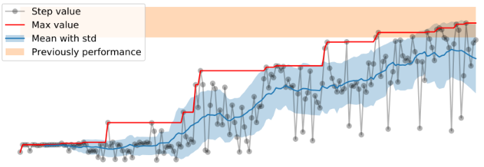
Machine learning within the EURO-LABS
Starting point:
  Optimizer toolkit is already developed for CERN accelerator
Ongoing:
  ML-assisted optimization at CERN + GSI and sharing of experience
Euro-Labs milestone:
  Create an accessible beam optimizer toolkit based on CERN python toolkit.
  Find usable optimization and ML algorithms for accelerator problems.
CERN optimizer toolkit
ML-optimization at GSI

Slide 8
CERN python toolkit: GeOFF
  Generic Optimization Frontend and Framework (GeOFF) is the graphical application for generic numerical optimization and reinforcement learning on CERN accelerators.
  It bundles:
  interfaces to the machines and simulations thereof, and
  numerical optimizers and reinforcement learners that can use these interfaces.
  License situation still has to be negotiated with CERN Knowledge Transfer.
  Extension for GSI and other facility
GEOFF (CERN gitlab)

Slide 9
GeOFF example: Linac3

Slide 10
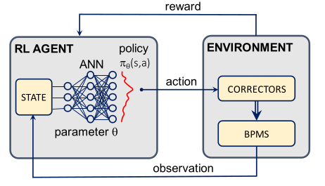
How does it work?
At the example of reinforcement learning (RL)
Self-learning algorithm (agent) is learning from interactions with the environment in order to maximize the reward R.
  Init: Read current state S_{t} and taken an action A₀
  Loop until finished:
  ⇒ Read S_{t} and R_{t} and set observe new state S_{t+1}.
⇒ Finally we obtain the function π(s)→a, the policy.
S. Hirlaender: Towards artificial intelligence in accelerator operation, GSI Seminar (2020)
and V. Kain et al: Phys. Rev. Accel. 23, 124801 (2020)

Slide 11
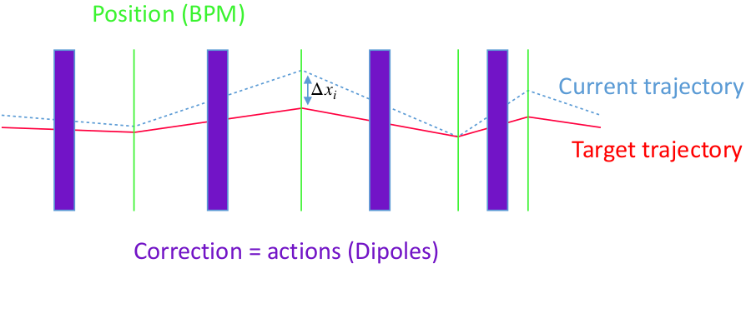
Reinforcement learning at CERN
The sample-efficient RL algorithm NAF was successfully trained on real-world accelerator tuning.
Application: Trajectory steering for AWAKE
          10 magnets α to steer electron beam
        10 BPM to measure the trajectory s
        RMS to be minimised
S. Hirlaender: Towards artificial intelligence in accelerator operation, GSI Seminar (2020)
and V. Kain et al: Phys. Rev. Accel. 23, 124801 (2020)

Slide 12
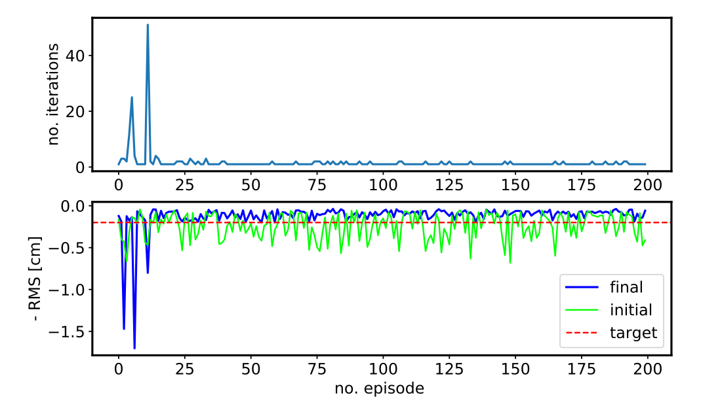
Reinforcement learning at CERN
Problem learned in ∼ 200 iterations with threshold of 1 mm.
AWAKE electron line horizontal trajectory steering
S. Hirlaender: Towards artificial intelligence in accelerator operation, GSI Seminar (2020)
and V. Kain et al: Phys. Rev. Accel. 23, 124801 (2020)

Slide 13
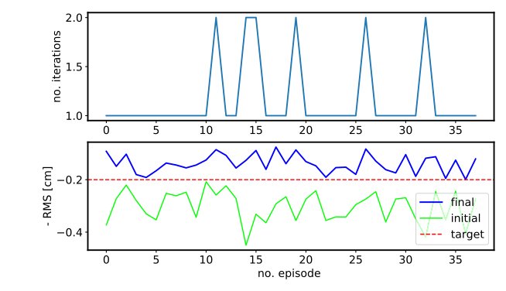
Reinforcement learning at CERN
An important question is how long a training remains valid.
Validation: Agent was trained more than three months earlier
S. Hirlaender: Towards artificial intelligence in accelerator operation, GSI Seminar (2020)
and V. Kain et al: Phys. Rev. Accel. 23, 124801 (2020)

Slide 14
Numerical optimization at CERN
COBYLA optimizer by M.J.D. Powell, 1994 (Constrained Optimization BY Linear Approximations)
The method is derivative-free with constraint functions and use linear interpolation.
Problem: ((x−3⁾² + ⁽y−2)²)^{1/2}
Constrains: Black box
Starting point: Black point
Function minimum: Grey points
https://scipy-lectures.org/index.html

Slide 15
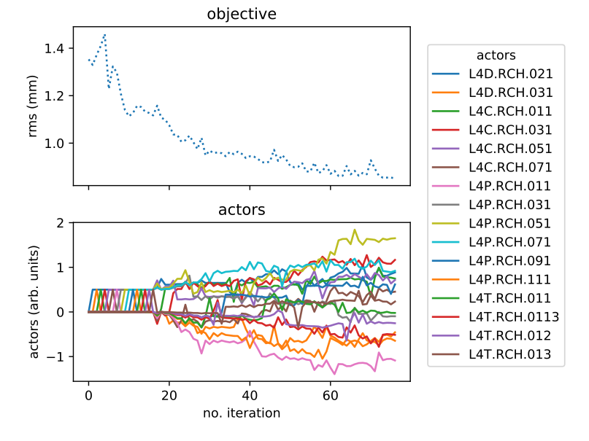
Numerical optimization at CERN
Application: Trajectory steering for LINAC4
V. Kain et al: Phys. Rev. Accel. 23, 124801 (2020)

Slide 16
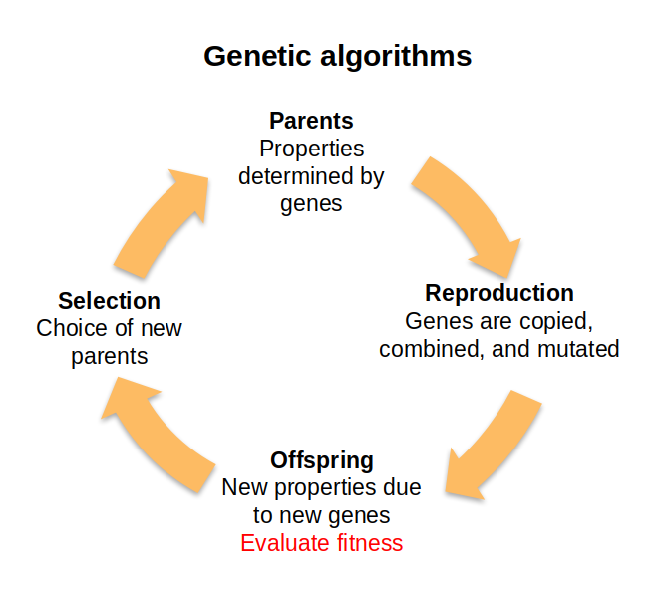
Nature-inspired optimization at GSI
Nature-inspired algorithms are smart parameter scans:
  Genetic algorithms
  Particle swarm algorithms
Genetic algorithms allow multi-objective optimization.
Equally valid solution form a so-called Pareto front (PA front)

Slide 17
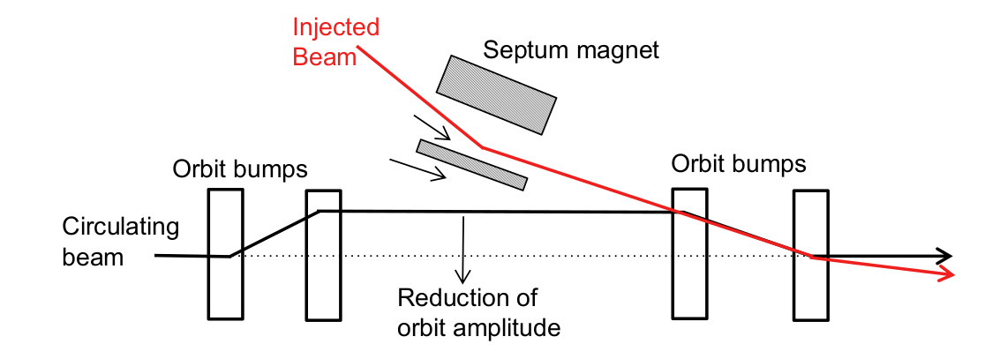
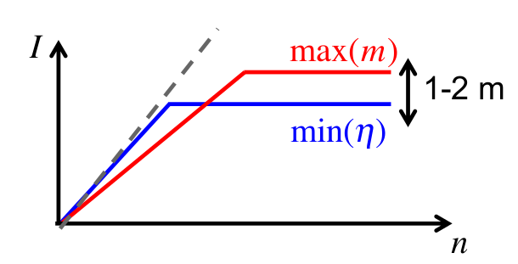
Nature-inspired optimization at GSI
Application: Horizontal injection into Synchrotron
MTI has to respect Liouville’s theorem: Injected beams only in free space
Loss (at septum + acceptance) should be as low and number of injected turns as large as possible
Simulations: Especially for longer injection GA discovers a much better solution

Slide 18
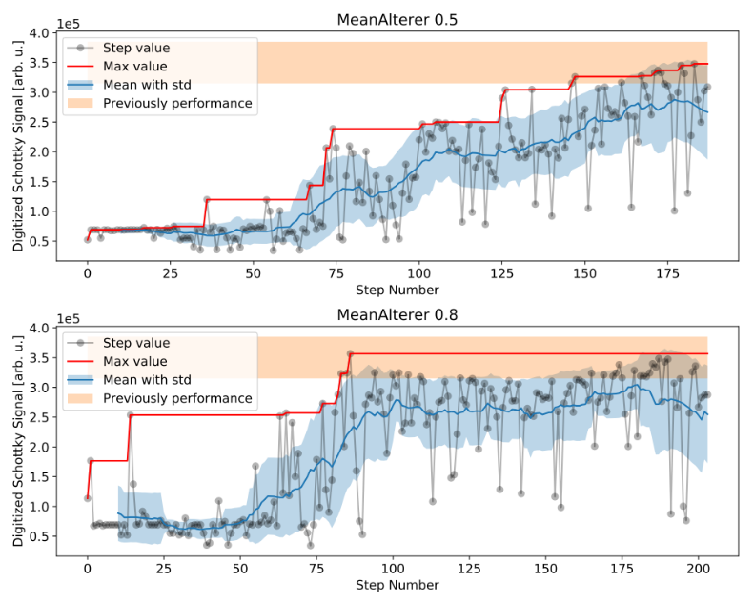
Nature-inspired optimization at GSI
Application: Injection optimization into CRYRIN@ESR
CRYRING@ESR GA optimization after 200 iterations in around 90 minutes.
S. Appel et al: Int J Mod Phys A, 1942019, (2019)

Slide 19
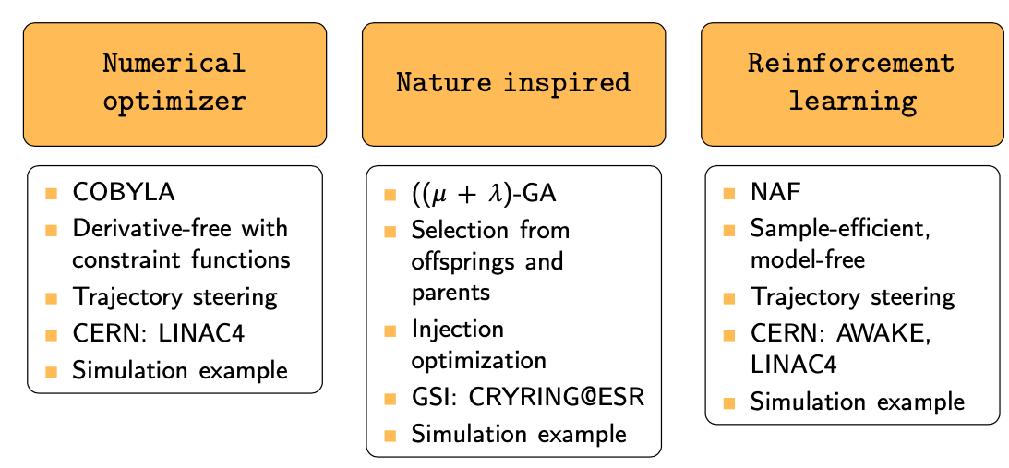
ML library for accelerator optimization
The idea is to provide a library with different optimizer for accelerators including description, application and simulation example.
⇒ Not complete: Several algorithms are already in tested

Slide 20
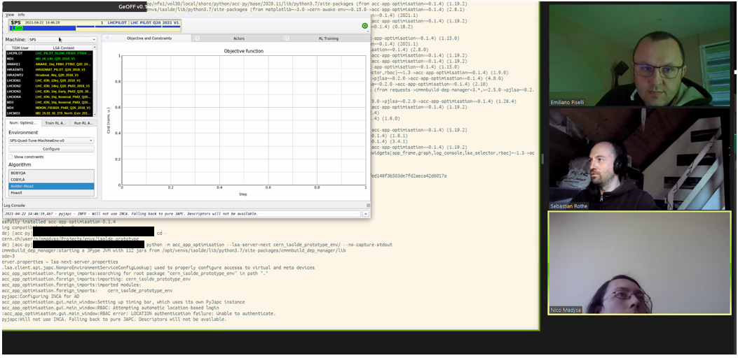
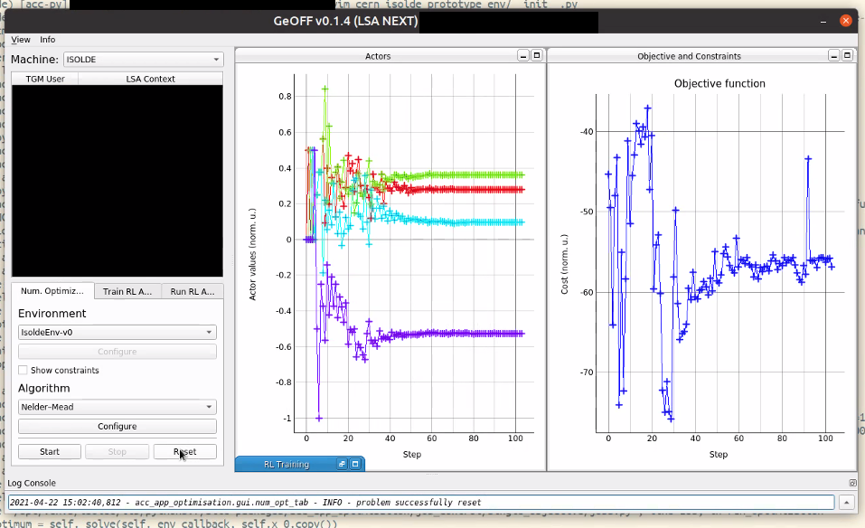
GeOFF implementation for ISOLDE
Coding
Working prototype
Easy integration of new accelerators and optimization problems
Working prototype in around 2 hours
Environment: Definition of optimization problem including actors + diagnostics
Documentation and tutorials available

Slide 21
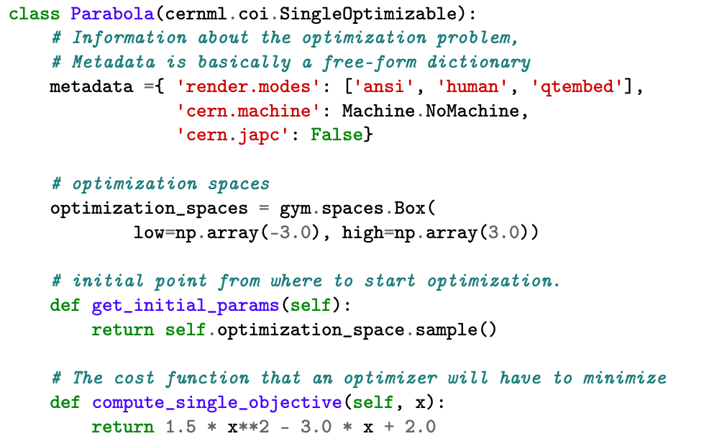
Definition of optimization problem

Slide 22
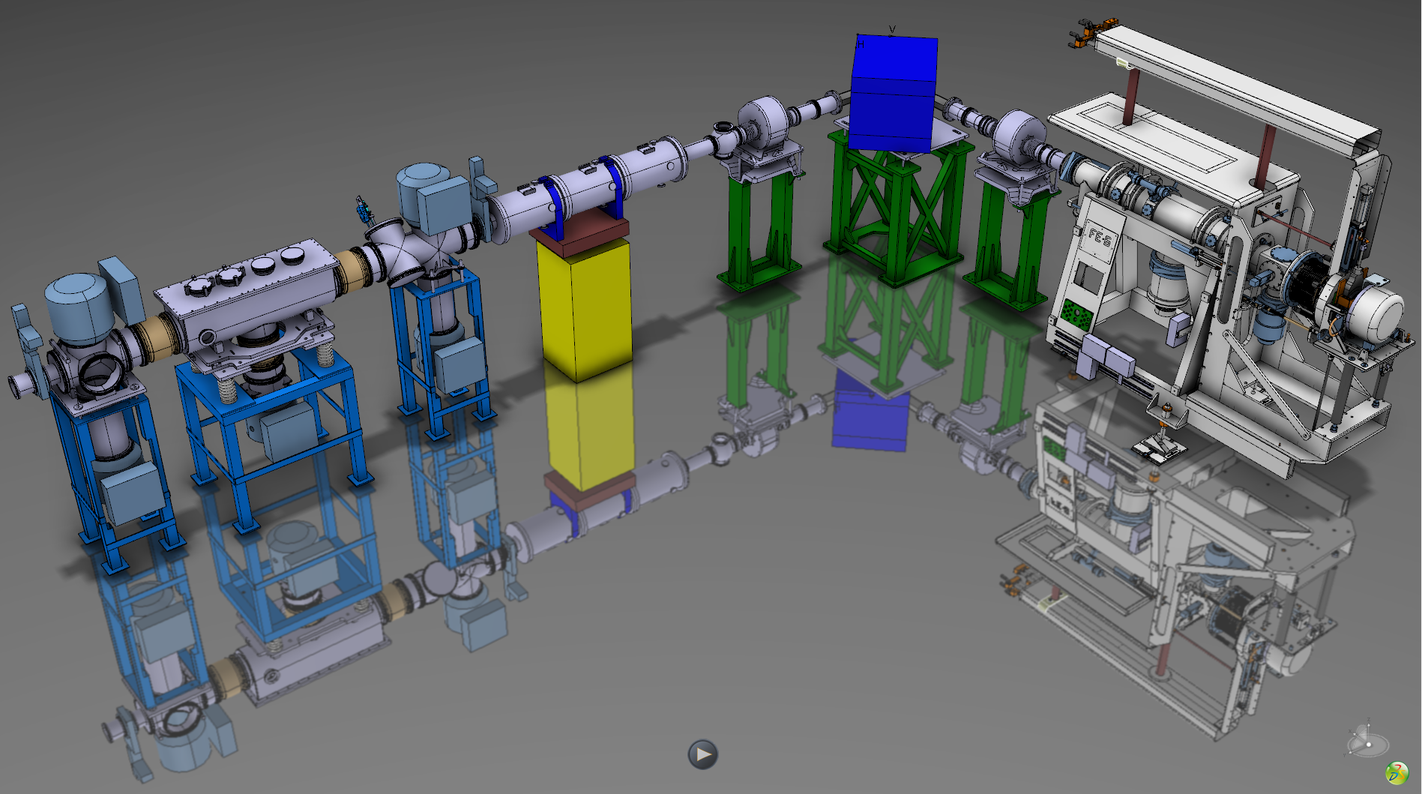
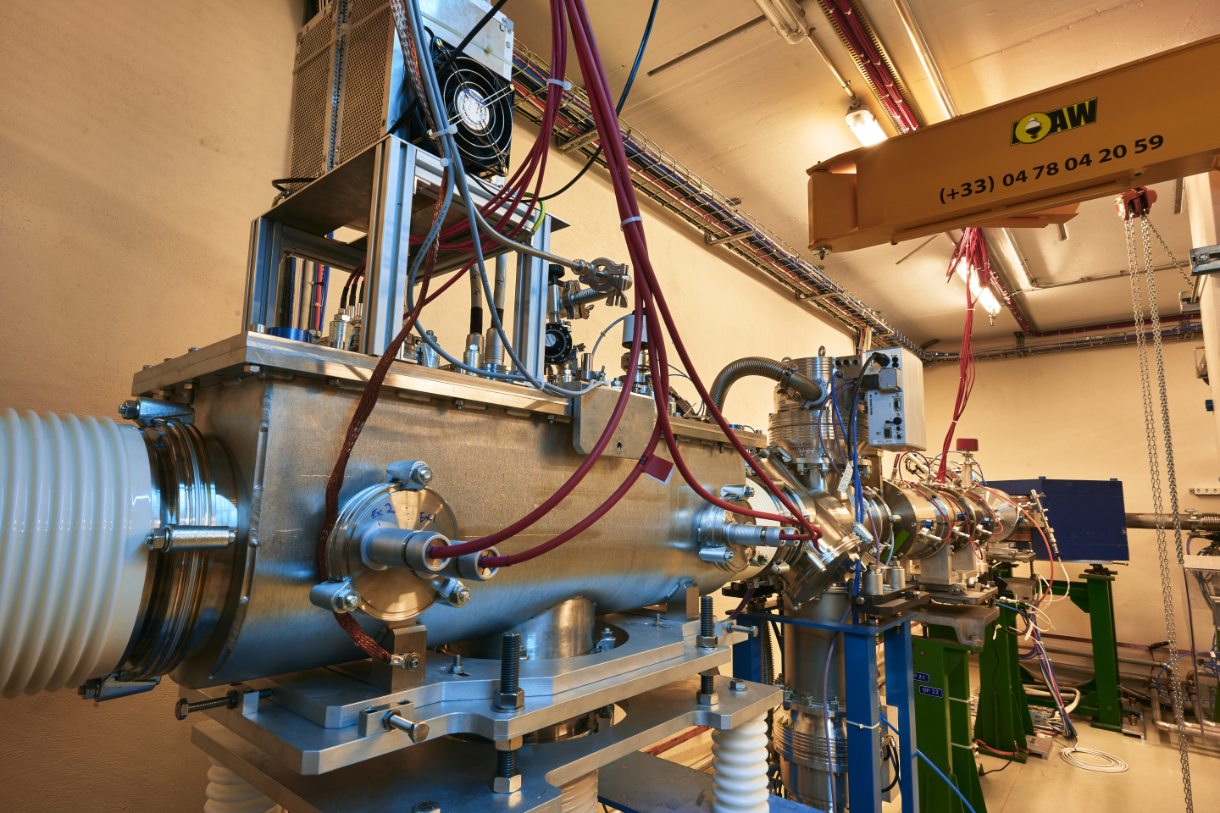
Replica of ISOLDE
ISOLDE offline 2: Replica of ISOLDE infrastructure used for target and ion source development.
⇒ Also for testing optimizer and ML algorithms (Euro-GeOFF)

Slide 23
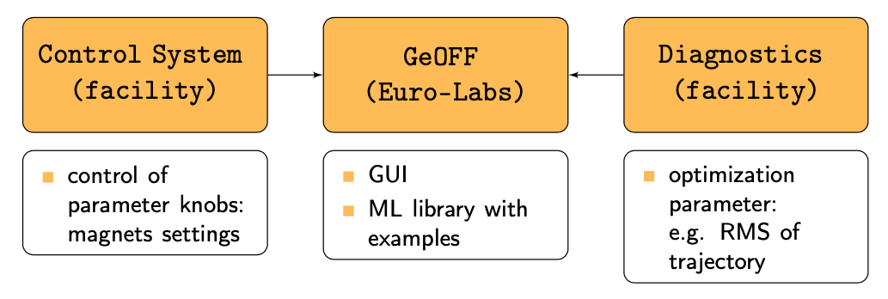
Possible implantation at other facility
At the example of GSI: Similar infrastructure
Homework: All python interfaces must be checked:
Python access to control system (LSA) and diagnostics (FESA)
⇒ Almost done!

Slide 24
Milestone and Deliverable
WP5 is in very good process to many preparations
Milestone after M8:
The source code of the ML toolkit prototype is available on a shared platform (in very good process)
Deliverable after M24:
The toolkit is deployed at least two facilities and been used (technical requirements are given and almost tested at GSI)
Milestone after M36:
The toolkit is established at the involved facilities and has been applied to at last one user beam line.
Milestone after M42:
Report on the different tested algorithms and reported results in applications beyond ion beam tuning optimization.
Reporting after M12, M30 and M48 is not a issue for WP5.

Slide 25
Thank you for your attention.
Questions?

