Slide 1
Task 4.4: Service Improvements
to Research Infrastructures for Detectors
Marko Mikuž
University of Ljubljana and Jožef Stefan Institute, Ljubljana, Slovenia

Slide 2
Task 4.4:Service Improvements to RIs in WP4
Transverse task

Slide 3
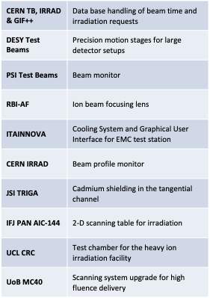
Task 4.4: Service Improvements
Aimed at improving access to WP4 RIs for EURO-LABS
Each RI proposed improvements with maximum impact on user access
Improvements have to be ready in Y2 of the project
EC contributions are matched by RI’s own funding, typically exceeding EC
Supplemented by WP4 (!) of AIDAinnova

Slide 4
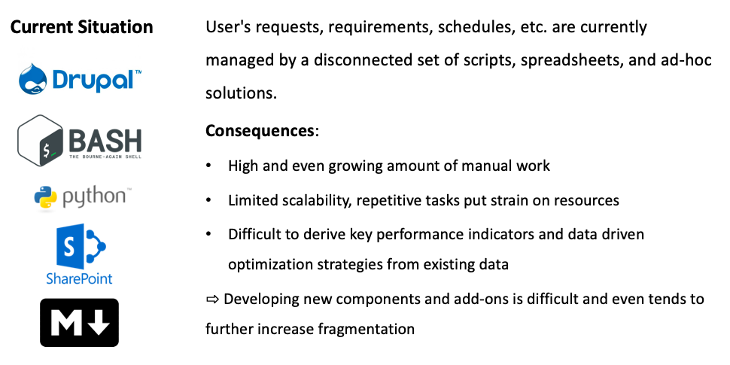
4.4.1 Development Of A User Schedule Management Tool
CERN: PS&SPS, IRRAD and GIF++ (WP4.1.1, 4.3.1 & 4.3.2)

Slide 5
4.4.1 Development Of A User Schedule Management Tool (2)

Slide 6
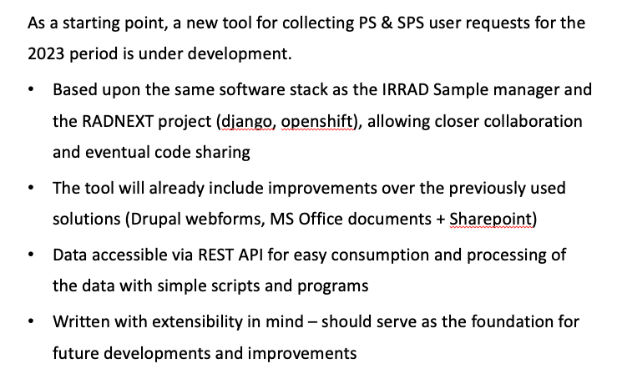
4.4.1 Development Of A User Schedule Management Tool (3)

Slide 7
4.4.2 Longer-range motion stages
Used for mounting DUTs in beam telescope setup
DESY: WP4.1.2

Slide 8
4.4.3 Scintillating Fiber Beam Profile Monitor
PSI: WP4.1.3

Slide 9
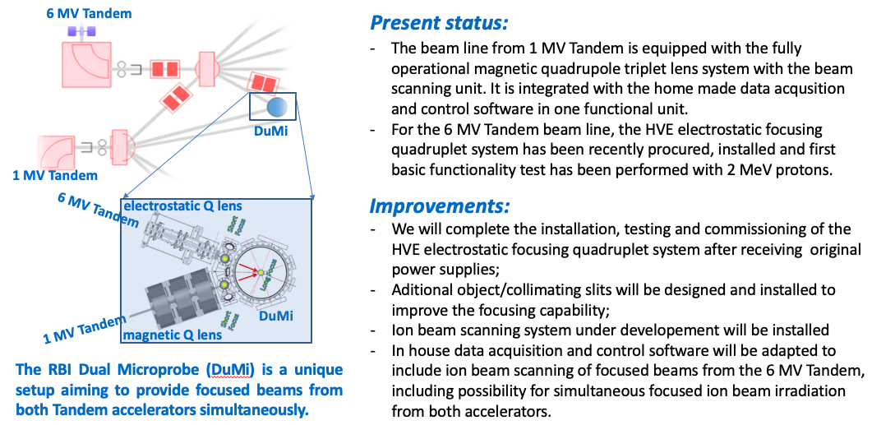
4.4.4: Improvements of the dual microbeam (DuMi)
Detector testing at RBI: WP4.2.2

Slide 10
4.4.5: Cooling System and GUI for EMC test station
ITTAINNOVa: WP4.2.1

Slide 11
WP4.4.6: IRRAD Beam Profile Monitor Improvement
CERN IRRAD: WP4.3.1

Slide 12
4.4.7: Cd Sielding in the Tangentiial Channel
JSI: WP4.3.3

Slide 13
4.4.8: Improvements of the irradiation line at AIC-144
IFJ-PAN: WP4.3.4

Slide 14
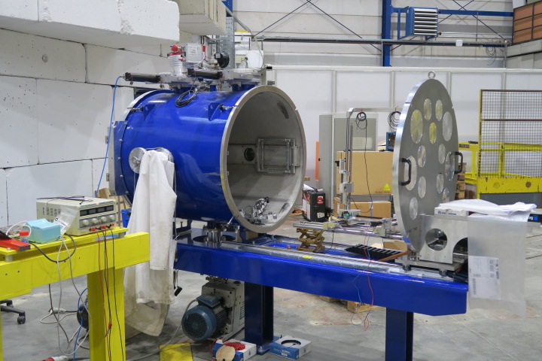
4.4.9: New test chamber for CRC-HIF
CRC - Louvain-la-Neuve: WP4.3.5

Slide 15
4.4.10: Scanning system upgrade for high fluence delivery
UoB MC40: WP4.3.4

Slide 16
Task 4.4 Summary
Service improvements targeted at improved performance of RIs for EURO-LABS users and beyond
All RI’s of WP4 except GIF++ (still benefits from improved CERN database)
Many of the improvements planned before, but EURO-LABS funds enabled kick-starting the projects
Remember: RI contribution ≥ EURO-LABS contribution
Task follow-up: ~1 Milestone per SI, common report as Deliverable

