Slide 1
Task 2.5 Service Improvements
Task 2.5.1 Streamlined access - coord. Paweł Napiorkowski (Warsaw)
Task 2.5.2 Targets - coord. Manuella Cavalarro (LNS)
Task 2.5.3 FLASH - coord. Marco Durante (GSI)
Task 2.5.4 ERIBS - coord. Hannu Koivisto (JYFL)
Task 2.5.5 INTRANS - coord. Magda Górska (GSI)
Marco Durante, GSI & TUDa

Slide 3


Subtask 2.5.2 «Targets»
Why?
Different research areas and applications require high-quality targets:
Fundamental physics (nuclear reaction studies, nuclear data measurements, etc.)
Production of strippers and neutron converters
High quality standard medical radioisotope production
…
The main Goal
Gather the community of European “nuclear target makers” having specific expertise in the field of target manufacturing and characterization, both for nuclear and applied physics purposes
Activities:
Study of existing and novel materials - enriched isotopes including actinides, alloys, doped materials, highly oriented pyrolytic graphite to withstand high working temperatures, low-Z target at cryogenic temperatures, implanted targets etc.
Improvement of current and development of novel fabrication techniques - Vacuum deposition, Spark Plasma Sintering, High-Energy Vibrational Powder Plating, Ion Implantation, drop-on-demand deposition etc.
Target characterization procedures - Scanning Electron Microscopy, Energy-dispersive X-ray spectroscopy, X-ray photoelectron spectroscopy, Rutherford Backscattering Spectroscopy, Particle Induced X-ray Emission, infrared and Raman Spectroscopy, Alpha-particle Transmission Spectroscopy, Inductively Coupled Plasma – Mass Spectrometry, electron-beam diagnostics during irradiation etc.,
Sharing of knowledge

Slide 4

Outcomes and milestones
Fostering the connection between different nuclear physics institutions in Europe and associated countries with the aim to create and maintain a distributed infrastructure for target development, production, and characterization.
Feedback and exchange of information among researchers involved in
Target developments
Target fabrication
Target characterization
Final use
Connection with
Milestones
Month 3
Production of a report to define the state of the art in the field and collect the requests from the community
Month 18
Creation of a database, publicly available, containing the information about the preparation and the characteristics of available targets and those newly developed in various laboratories within this subtask

Slide 5
Institutions involved in subtask 2.5.2 «Targets»
12 Institutions, 7 Countries, 50 Researchers
Short Name | Participant organization name | Facility | Country
Beneficiaries
INFN | Istituto Nazionale di Fisica Nucleare | INFN-LNS | Italy
INFN | Istituto Nazionale di Fisica Nucleare | INFN-LNL | Italy
INFN | Istituto Nazionale di Fisica Nucleare | INFN- Turin | Italy
GSI | Helmholtzzentrum für Schwerionenforschung GmbH | GSI | Germany
UNIWARSAW | Uniwersytet Warszawski | SLCJ | Poland
GANIL | Grand Accélérateur National d'Ions Lourds | GANIL | France
CNRS | Centre National De La Recherche Scientifique | CNRS - IJCLab | France
CNRS | Centre National De La Recherche Scientifique | CNRS - IPHC-Strasbourg | France
CEA | Commissariat à l’Énergie Atomique et aux Énergies Alternatives | Saclay | France
IFIN | Institutul National de Cercetare-Dezvoltare Pentru Fizica si Inginerie Nucleara-Horia Hulubei | IFIN-HH Tandem | Romania
Associated Partners
LIP | Laboratório de Instrumentação e Física Experimental de Partículas | LIP | Portugal
PSI | Paul Scherrer Institut | PSI – Lab. of radiochemistry | Switzerland

Slide 6
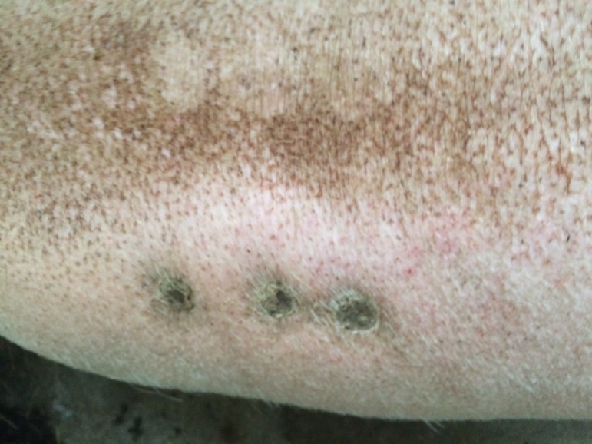
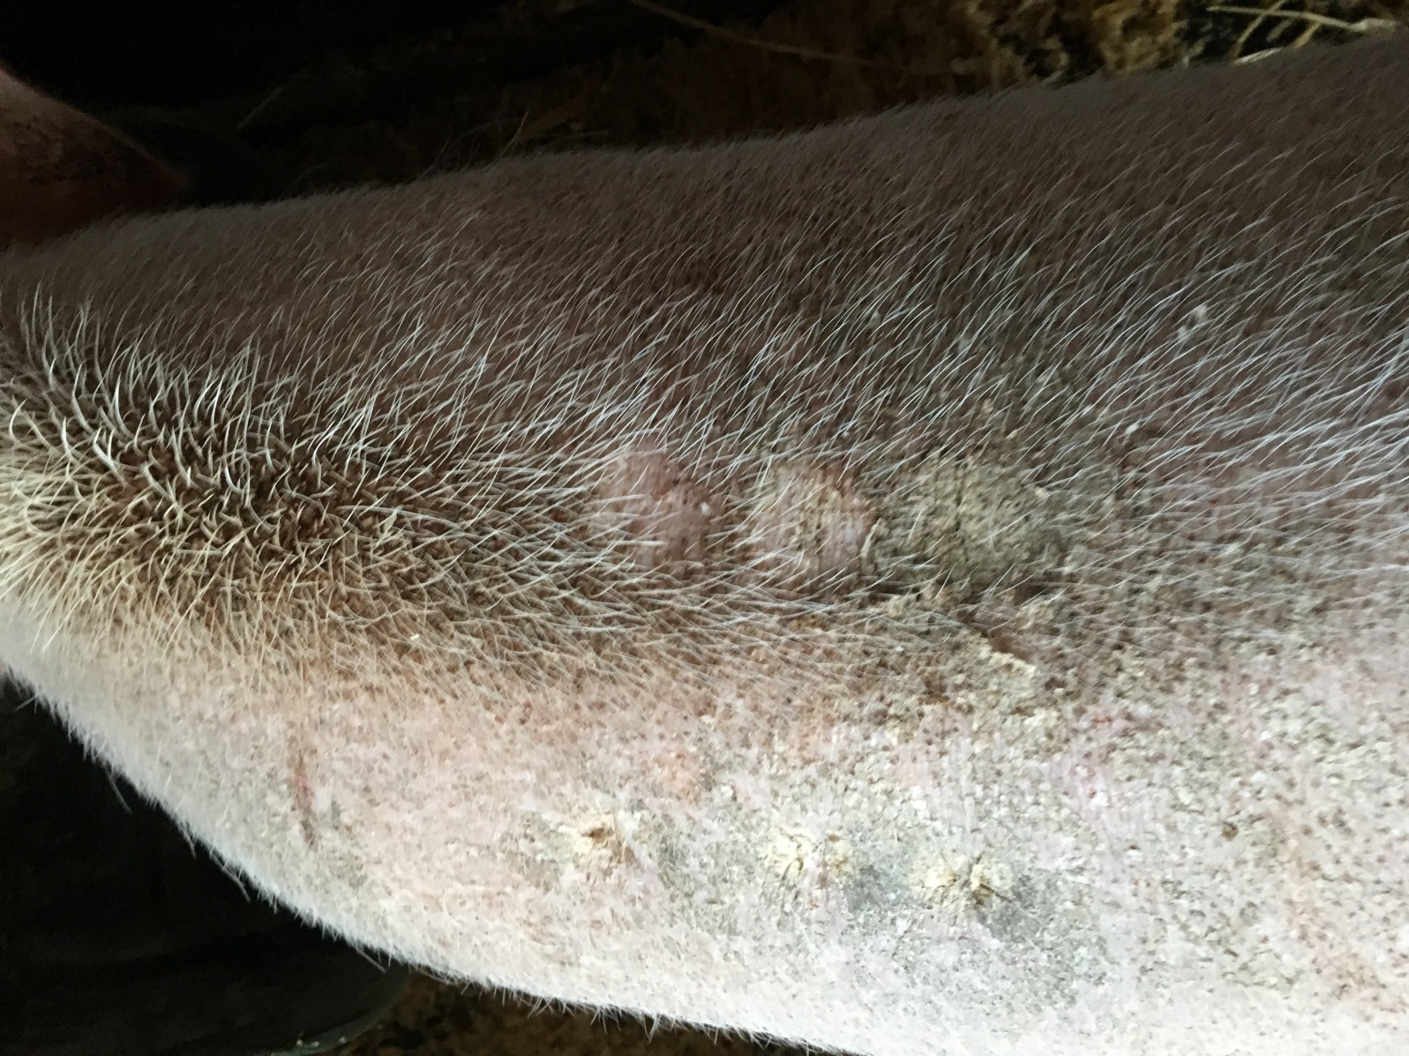
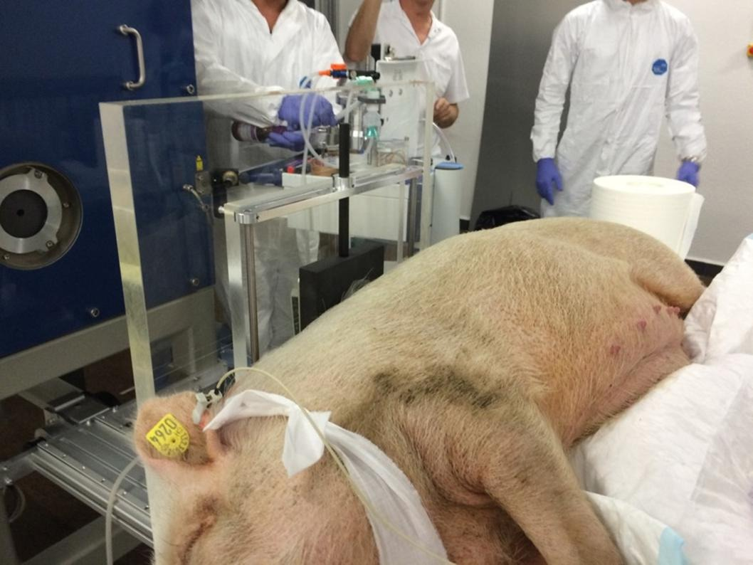

Sub-task 2.5.3: FLASH
9 mo post-RT
3 years post-RT
CONV
FLASH
34Gy 31Gy 28Gy
34Gy 31Gy 28Gy
Vozenin et al., Clin. Cancer Res. 2019

Slide 7

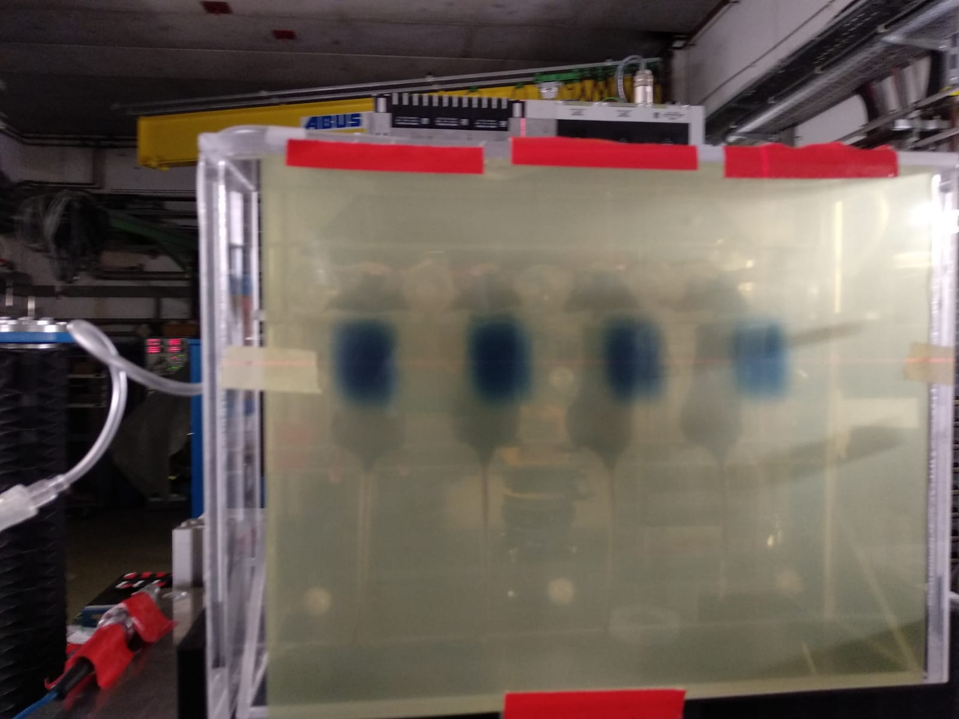
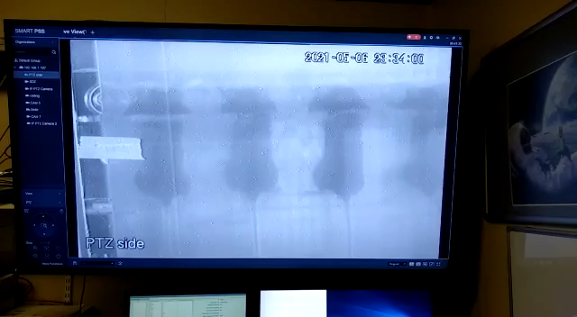
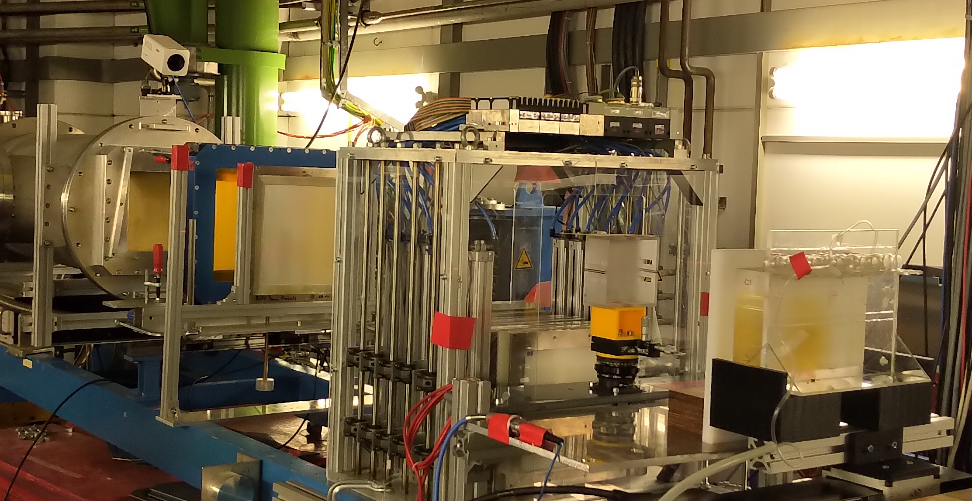

FLASH@GSI with 240 MeV/n C-ions
vacuum window
beam
monitors
( He-CO₂ filled )
3D printed
range
modulator
mice holder box
for thorax irrad.
(with inlet for
anesthetic gas)
ripple
filter
range
shifter
absorber
Scanned ion beam
HIT ≈ 5×10⁸ ions per spill
⇨ 8 Gy | 50 Gy/s for 10 × 10 mm²
FAIR-phase-0 > 5× 10⁹ ions per spill (reliable)
⇨ 18 Gy | 100 Gy/s for 20 × 20 mm²
D= 18 Gy
Tinganelli et al., Int. J. Radiat. Oncol. Biol. Phys. 2022
Weber et al., Med. Phys. 2022
Tinganelli et al., Radiother. Oncol. 2022

Slide 8
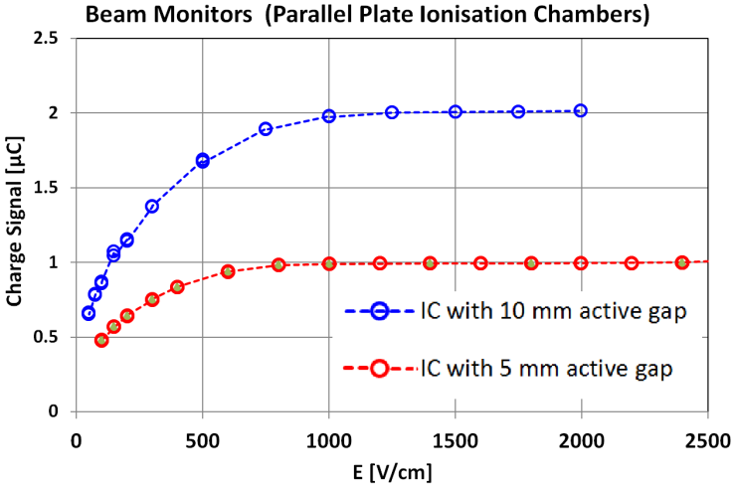
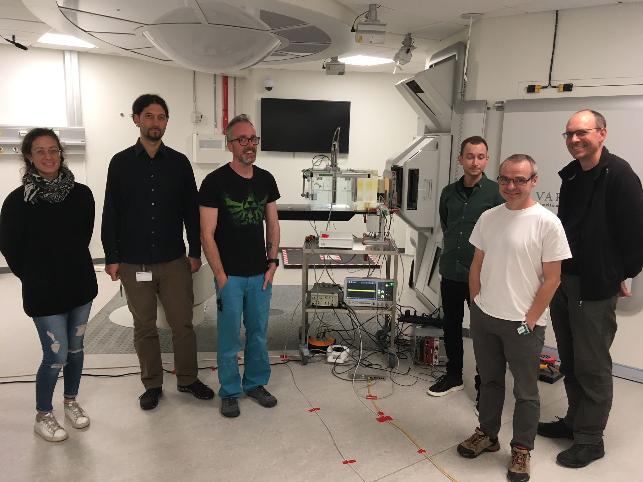
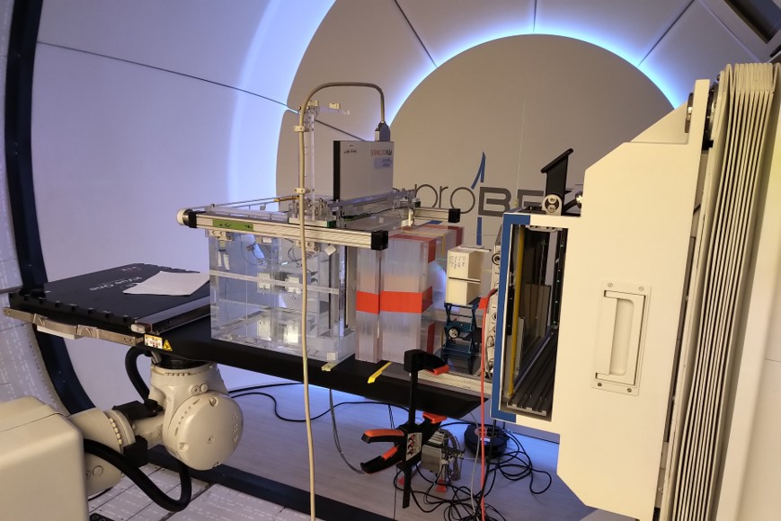
Saturation curves of ionization chambers for conditions at GSI (4 × 10¹⁰ ions/s)
Previous results: Dosimetry and beam monitoring
Aarhus, Denmark
Delft, The Netherlands
Excellent behavior of the He-CO₂ (96%/4%)
filled beam monitor (flat plateau)
Working point at 2000 V / cm
Task 2.5.3 goals in EURO-LABS:
Testing IC and pinpoint thimble chambers for FLASH dosimetry in different facilities
Installing the hedgehog range modulator in different facilities for clinical implementation of FLASH
Milestone 14 at 18 months
Baack et al., Phys. Med. 2022
Notes:
… This slide shows the results from the GSI tests. The upper left diagram shows the saturation curves for the beam monitors. We use here two parallel plate ionisation chambers with 5 and 10 mm active gap between the electrodes. But at GSI we filled the ion chambers with a mixture of Helium and Carbondioxide a quenching gas in order to enable a higher voltage … up to 2000 V per cm … and, actually, even for the very high beam intensity at GSI, we can easily reach the plateau of the saturation curve and we used here as working point the voltage for 2000 V/cm. This is actually a very good result for the beam monitors.
Below you see the saturation curve for 2 kinds of pinpoint thimble chambers , here the same that we used at HIT and another relatively new one, where the diameter is even slimmer and the electric field strength higher. This new thimble chamber from PTW also reaches for the extremely high dose rates at GSI the plateau of the saturation curve and on the other hand enables the dose measurement in small fields, insofar a nice detector for us.

Slide 9





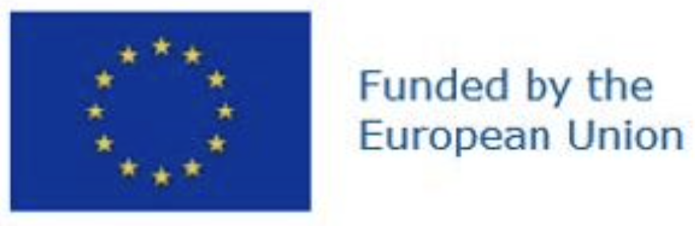



ERIBS: European Research Infrastructure - Beam Services
Objective: improve the properties and variety of available ion beams to better service the scientific program of the EURO-LABS research infrastructures
Ion source team | Country
ATOMKI | Hungary
CNRS-IPHC | France
GANIL | France
GSI/FAIR | Germany
JYFL (coord.) | Finland
INFN (LNS+LNL) | Italy
UMCG-PARTREC | The Netherlands
CNRS-LPSC (associate partner) | France
Tasks to improve:
Ion beam variety and production efficiency (Task 1)
Short and long-term ion beam stability (Task 2)
Coordinator: H. Koivisto (JYFL)
Deputy coordinator: V. Toivanen (JYFL)
Leader of task 1: A. Galata (INFN-LNL)
Leader of task 2: R. Kremers (UMCG-PARTREC)
Steering committee: Benoit Gall (CNRS-IPHC), Fabio Maimone (GSI), Richard Racz (ATOMKI), Ville Toivanen (JYFL)

Slide 10
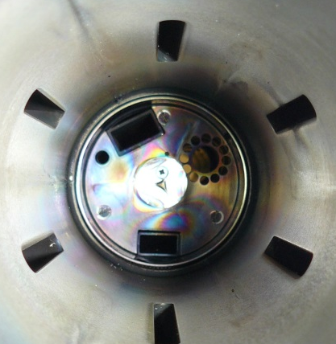
Task 2.5.4.1: Ion beam variety and production efficiency
New metal ion beams by:
Improving ovens beyoned the present capabilities (inductive oven, foil oven, GANIL HT oven, etc.)
Developing new MIVOC (Metal Ion beams from VOlatile Compounds) beams
Developing axial sputtering which is presently largely unavailable in Europe
Optimization work for production efficiency
Induction oven: 2000˚C at the test bench
Possible port/access for axial sputtering
Port for radial sputtering: typically not available
View from the extraction side of plasma chamber

Slide 11
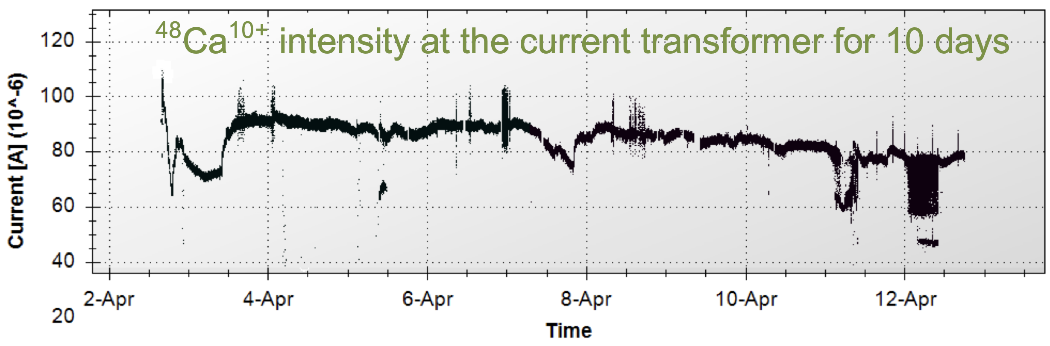
Task 2.5.4.2: Short and long-term ion beam stability
Instability peaks (plasma)
Short-term beam stability
Short-term beam instabilities are typically caused by plasma
They have detrimental impact on the intensities of highly charge ion beams and they can also be the origin of beam contaminants
Monitoring method for plasma instabilities is needed
Feedback and level of action (to restore stable plasma)
Methods to avoid/mitigate plasma instabilities
Unstable plasma
Long-term beam stability
Monitoring of parameters and responses (intensity, plasma parameters, etc.)
Feedback and level of action (alarm, suggestion, automatic reset of preset parameters, etc.)
Example from GSI

Slide 16
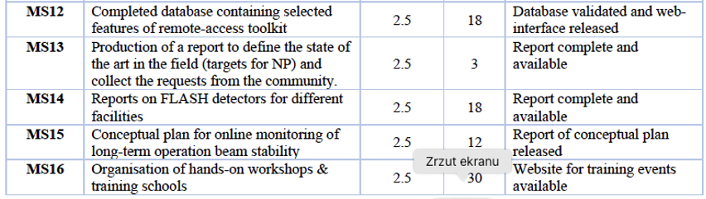
Thank you very much!

