Slide 1

Kick Off Meeting
Bologna, 3-5 0ctober 2022
Task 3.2 - Technology Infrastructures
R. Vallcorba-Carbonell on behalf of S. Leray

Slide 2



Task 3.2 - Technology Infrastructures
General context:
  The European accelerator and magnet Technology Infrastructure (TI) is the ensemble of Technological Facilities (TFs), encompassing large-scale Technical Platforms (TPs) for development, fabrication, integration and performance verification of accelerator and magnets components, with large concentrations of dedicated, highly-skilled personnel.
  To ensure the long-term sustainability of the TI, the H2020 AMICI project (2017-2019) investigated how the TI could be reinforced, harmonized and made more efficient, and industry could benefit more from the possibilities offered by TPs, fostering industrial innovation potential.
After the end of the H2020 project, the AMICI collaboration continues:
  Within the H2020 I.FAST project, in WP13-ETIAM (European Technology Infrastructure for Accelerators and Magnets) with objectives of
    Establish a roadmap for the TI in view of the construction of future accelerator-based RIs.
    Extend and strengthen the cooperation with industry in order to foster innovation in related technologies.
    Develop and promote services for the benefit of RIs, future scientific projects and high-tech industry.
  EURO-LABS - Task 3.2:
    Provide access to some of the TPs of AMICI
    Contribute to service improvements if necessary
https://eu-amici.eu/
https://ifast-project.eu/

Slide 3
Task 3.2 - Technology Infrastructures
  The partners: CEA/Irfu, CERN, CNRS/IJCLab, INFN/LASA and U. Salerno, UU
  The Technical Platforms
Partner | Laboratory | TP | Platforms available for EUROLABS | Service improvements
CEA | Irfu | SYNERGIUM | MACHAFILM: Characterization facilities of thin film of superconducting layers on radiofrequency cavities | A new coil and structure of the magnetometer.
 |  |  | CRYOMECH: Characterization, analysis and measurement facilities for materials at low temperature. | New software for the tensile machine.
CERN |  | XBOX | Klystron-based X-Band test stands. | None
CNRS | IJCLab | SUPRATECH | Equipment and technical area for the development, the preparation, assembling and testing SRF cavity. | None
INFN | LASA (Milano) | LASA (Milano) | Four test installations devoted to: i) Superconducting Magnets, ii) Superconducting RF cavities, iii) High Brightness Photocathodes for Electron Sources, and iv) Laser Applications to High Power Fabry Perot Cavities and Advanced Timing Systems. | Improvement of control system performances, new data storage and analysis networks, more comfortable HMI facilities, improvement of user related common instrumentation.
 | Universita di Salerno | THOR | Technological facility for horizontal test of Superconducting Magnet modules. | Improvements in the field of cryogenic flow control and measurements, easy and reliable cryogenic connections, and links
Uppsala University | FREIA | GERSEMI | Vertical cryostat for superconducting magnet and cavity testing. | More general purpose instrumentation; adding diagnostics of magnetic fields
 |  | HNOSS | Horizontal cryostat for superconducting cavity tests.

Slide 4


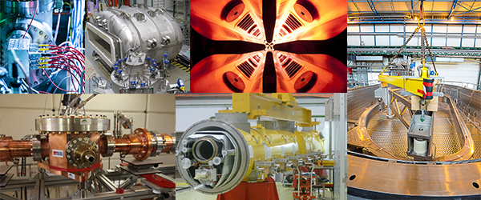
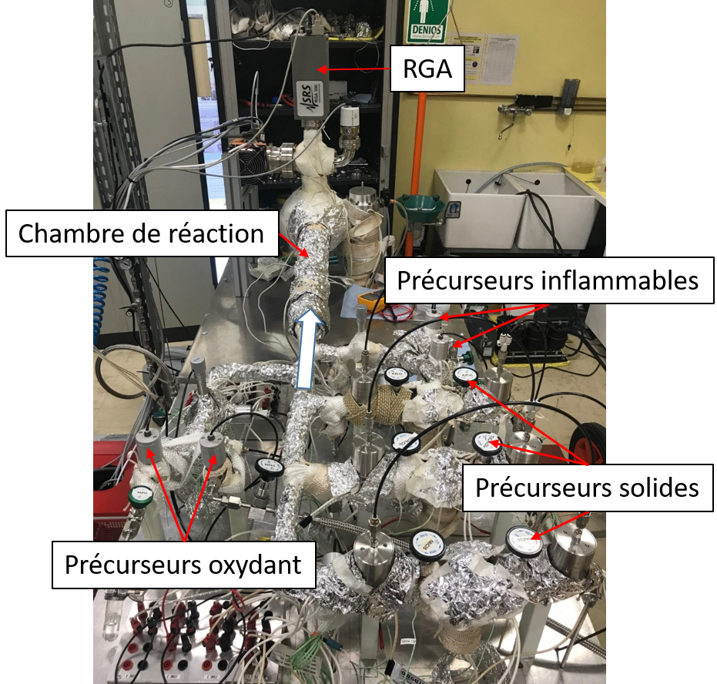
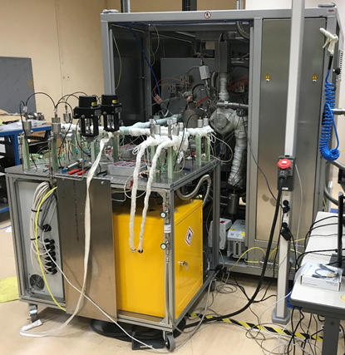
CEA/Irfu - SYNERGIUM
https://irfu.cea.fr/dacm/en/index.php/
MODALITY OF ACCES
640 access units
The access cost is a combination of personnel cost and consumables
MACHAFILM PLATFORM : Two Atomic Layer Deposition Reactor (ALD)
Specific equipment and analyis device to materials characterization
Development of material deposition technologies for next generation of cavities and cryomodules.
Research AD1
Development AD2
      AD1
      The research bench devoted to optimizing conditions for the growth of thin fils on small samples, new chemistries
      AD2
      An applications-oriented deposition reactor designed to accomodate macroscopic objects.This reactor is dedicated to scaling up processes once growth conditions have been optimized on small samples.

Slide 5
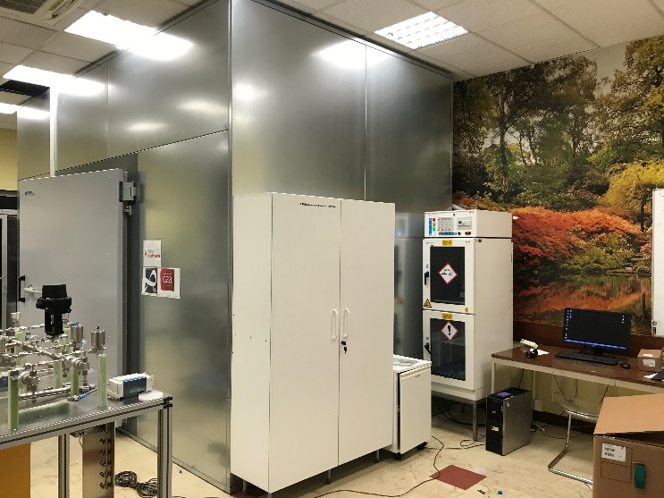
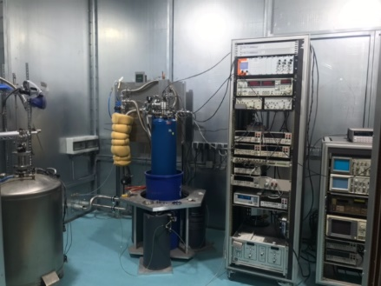
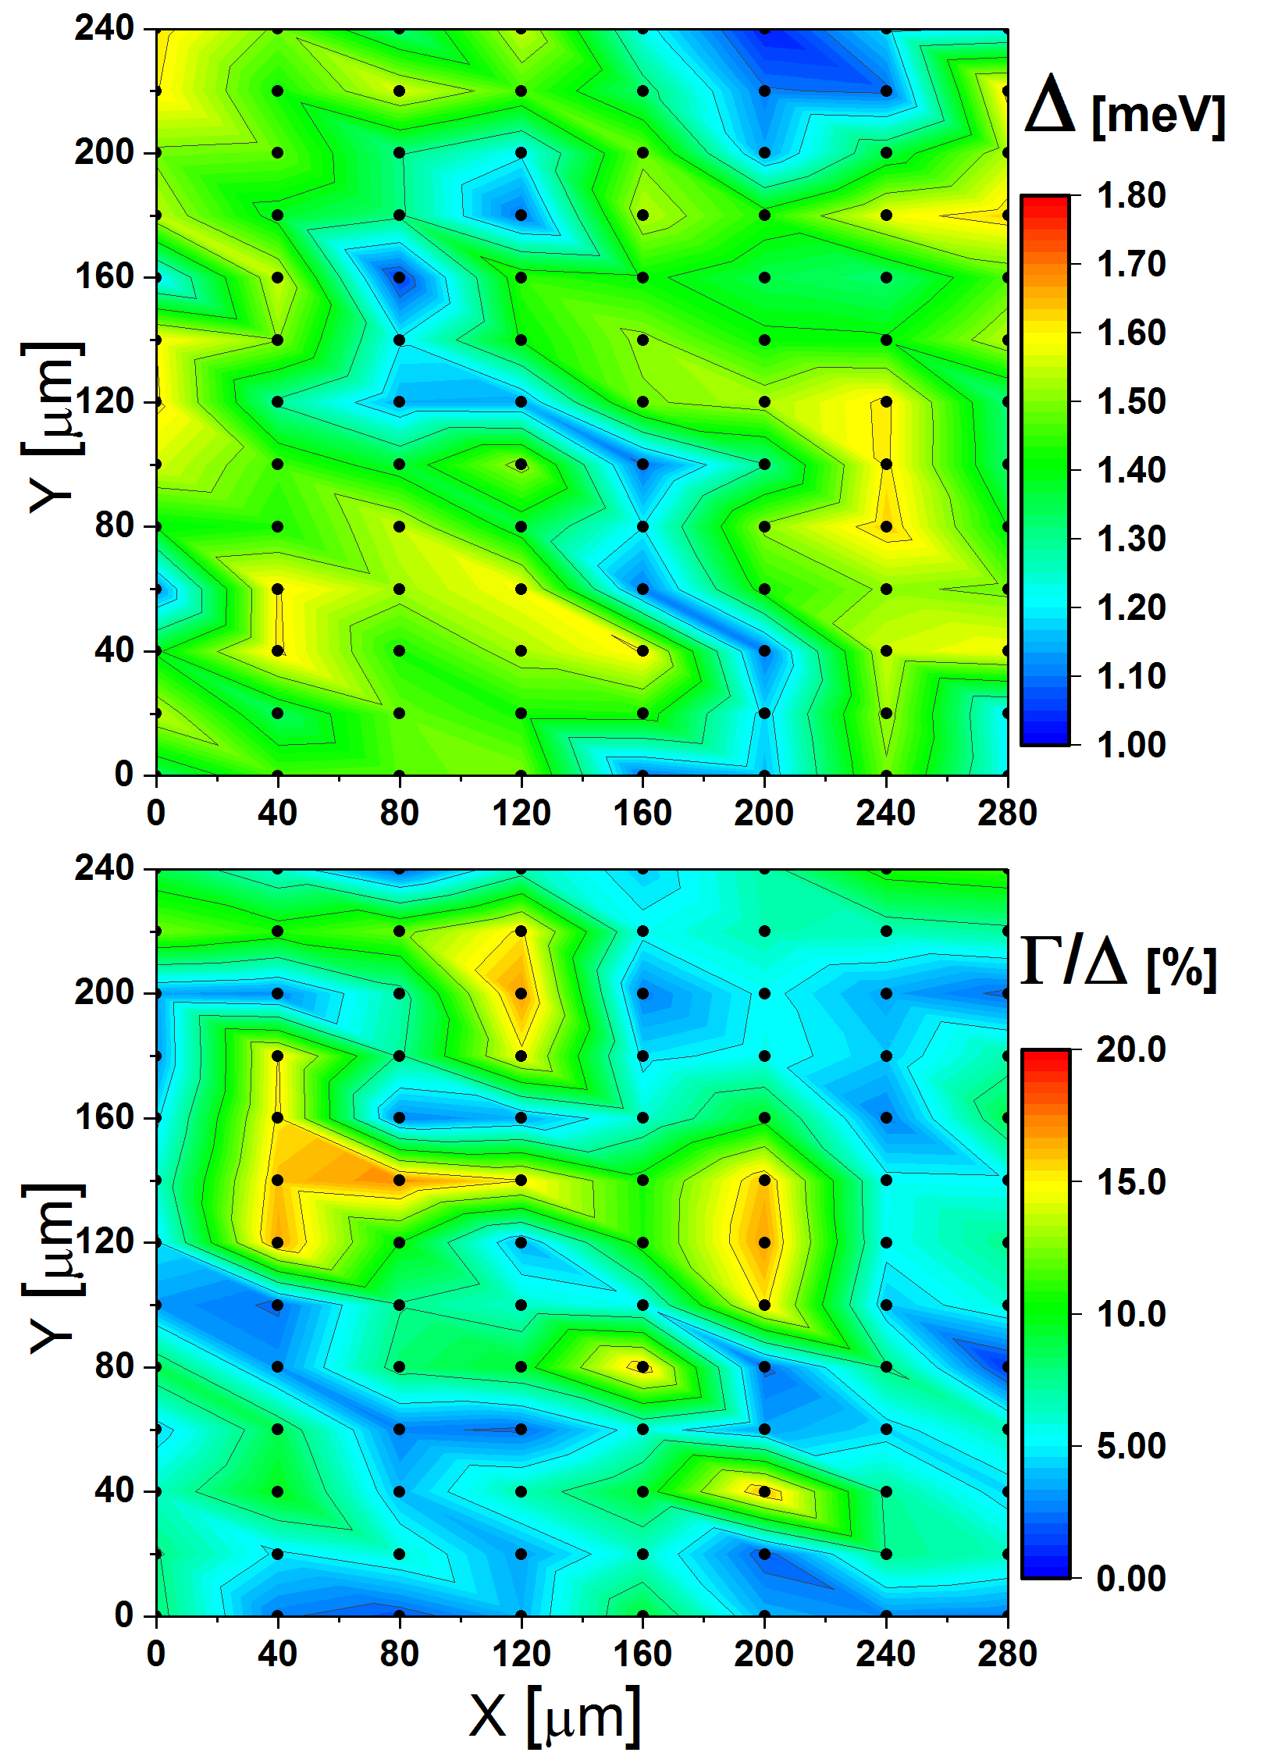
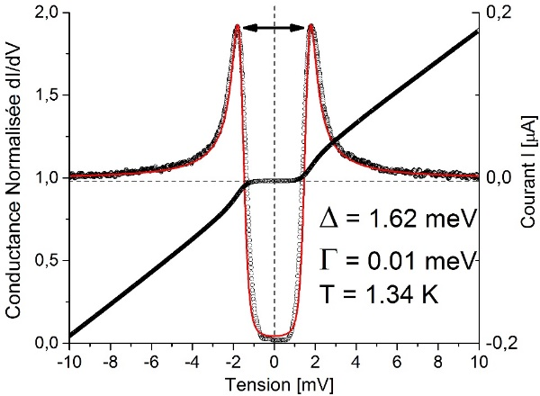
CEA/Irfu - SYNERGIUM
https://irfu.cea.fr/dacm/en/index.php/
MACHAFILM PLATFORM -Tunneling Spectroscopy Laboratory
2Δ
Characterization of surface electronic properties:
Measurement of SC fundamental properties: Tc, Hc
1.4 to 300 K.
Cartography: lateral size 10 µm– 1 mm.
Materials under « real » conditions (oxide).
Sample size about ~ 10x10 mm

Slide 6
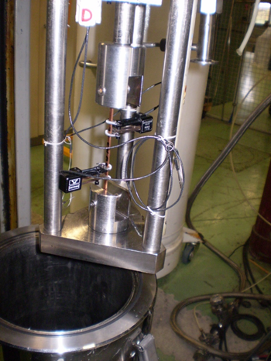
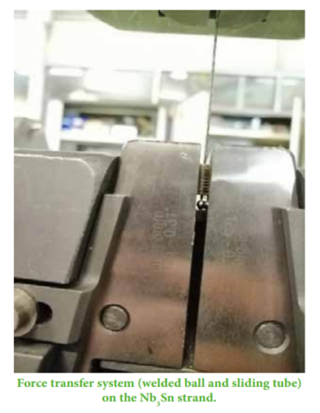
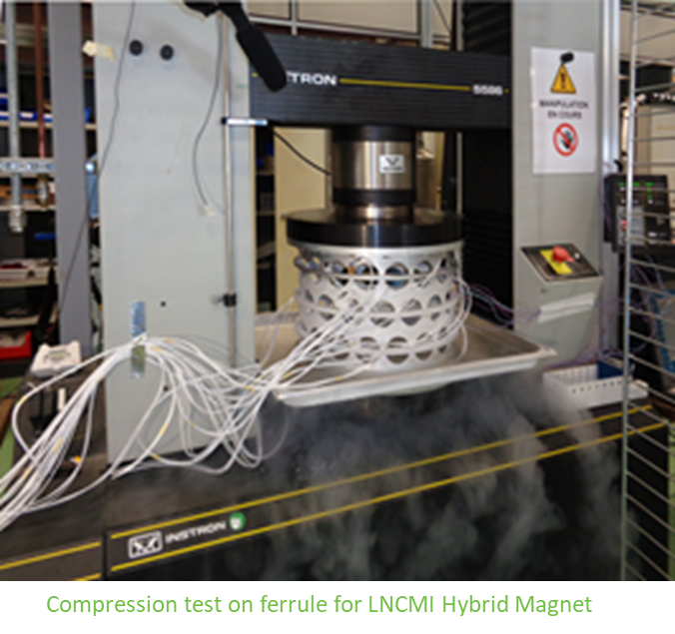
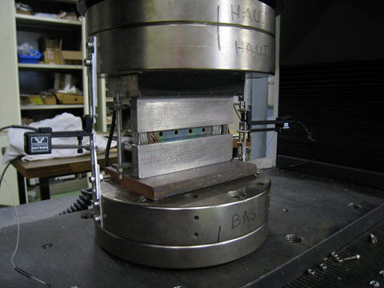
CEA/Irfu - SYNERGIUM
https://irfu.cea.fr/dacm/en/index.php/
CRYOMECH PLATFORM - Mechanical Testing
The hydraulic press with a compression capacity of 1600 kN
The Instron electromechanical machine with a traction and compression force of 300 kN
The Instron electromechanical machine with a traction and compression force of 150 kN that can be fitted with two cryostats for the test at cryogenic temperatures
  Traction and flexion capacity of 45 kN
  Traction capacity of 80 kN and compression capacity of 150 kN
Measurement of ceramic insulation
Machine 300 kN
SOME ACHIEVEMENTS
Characterizations of Nb₃Sn strands for accelerator magnets (CERN)
Impregnated NbTi conductor bloc for detector/MRI magnets (Glad at GSI, Iseult at CEA Saclay)
Characterization of titanium welds for ESS project
Validation of high field magnet cryogenic support (LNCMI at Grenoble)

Slide 7
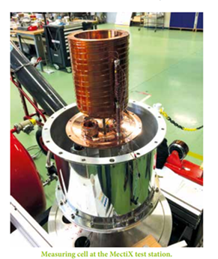
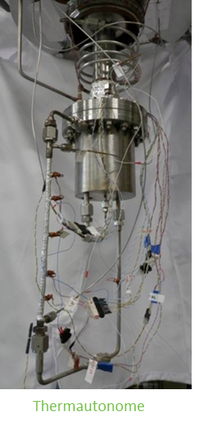
CEA/Irfu - SYNERGIUM
https://irfu.cea.fr/dacm/en/index.php/
CRYOMECH PLATFORM - Thermal Stands
MECTIX
Measurement of the thermal conductivity of insulators and conductors.
Samples of around 10 cm in length
From 4.2 K to 300 K
THERMAUTONOME
Closed circulation loop with recondensation by means of a cryogenerator
(1.5 W@4.2 K) - Characterization of single-phase and two-phases flows.
30 cm vertical station
From ~ mbars to 3 bars
From 3 K to 30 K
Max Power 20 W
height of 300 mm
THERMOSIPHON
Open circulation loop with a reservoir
Characterization of single-phase and two-phases flows
1.2 m vertical test station
Mass flow rate and qualities
Pressure drop, wall temperatures
DOUBLE BATH – Claudet double bath principle
Static pressurized superfluid helium up to a power of 10 W
At 1.8 K the useful volume has a diameter of 250 mm and a
height of 300 mm
SOME ACHIEVEMENTS
Study and validation of the WAVE cooling system. Study of Cryogenic thermal links
Study of the super-ferric dipole cooling system of the Super-FRS project for FAIR. Proofs of concept of horizontal thermosiphon – GLAD superconducting spectrometer for R3B - GSI

Slide 8
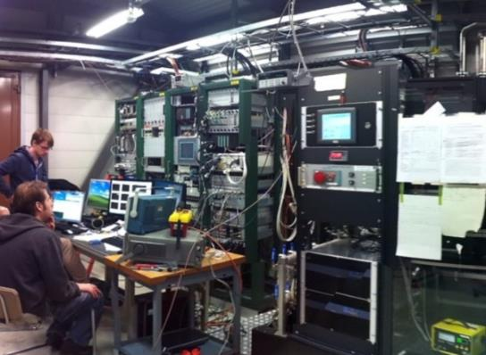
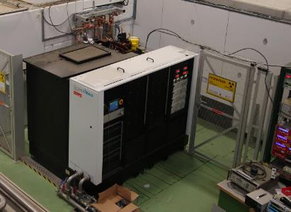
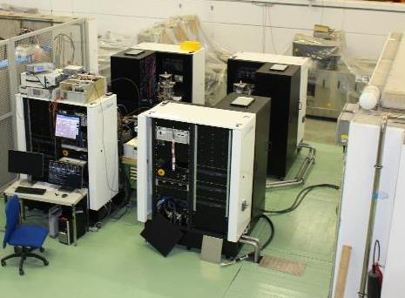
X-BOX facility at CERN
X-band high-power Radio Frequency test stations, dedicated to high-gradient acceleration R&D
Xbox-1
Xbox-2
Xbox-3
CPI 50MW 1.5us klystron
Scandinova Modulator
Rep Rate 50Hz
CPI 50MW 1.5us klystron
Scandinova Modulator
Rep Rate 50Hz
2x Toshiba 6MW 5us klystron
2x Scandinova Modulators
Rep Rate 400Hz
  12 GHz - 50 MW/1.5 us - 120 MW/250 ns
  RF signals - Dark current - Accurate phase
  E-beam capabilities
  12 GHz - 50 MW/1.5 us - 120 MW/250 ns
  RF signals - Dark current - Accurate phase
  Two DUT feeding with variable power splitting
  Input phase variation
  12 GHz - 6-10 MW/5 us - 40-60 MW/100 ns
  RF signals - Dark current - Accurate phase
  Two DUT feeding with variable power splitting
Available for test of accelerating structures, RF deflectors, loads and other RF components
Committed access units in EURO-LABS (hours) ➯ 400
Possibility to access as well a S-band power station (S-box, 3GHz, 35 MW/5 us)

Slide 9
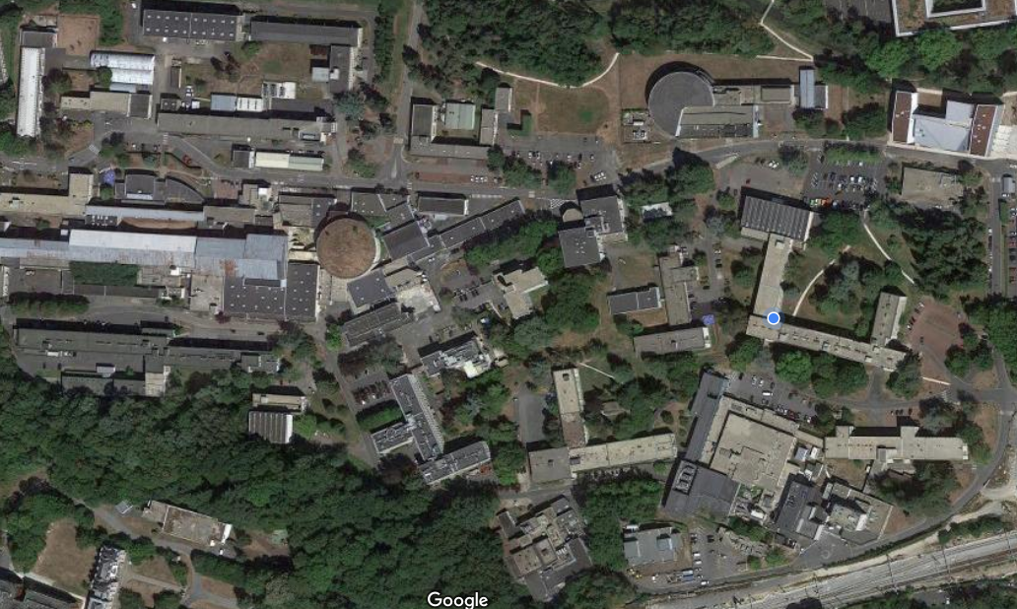
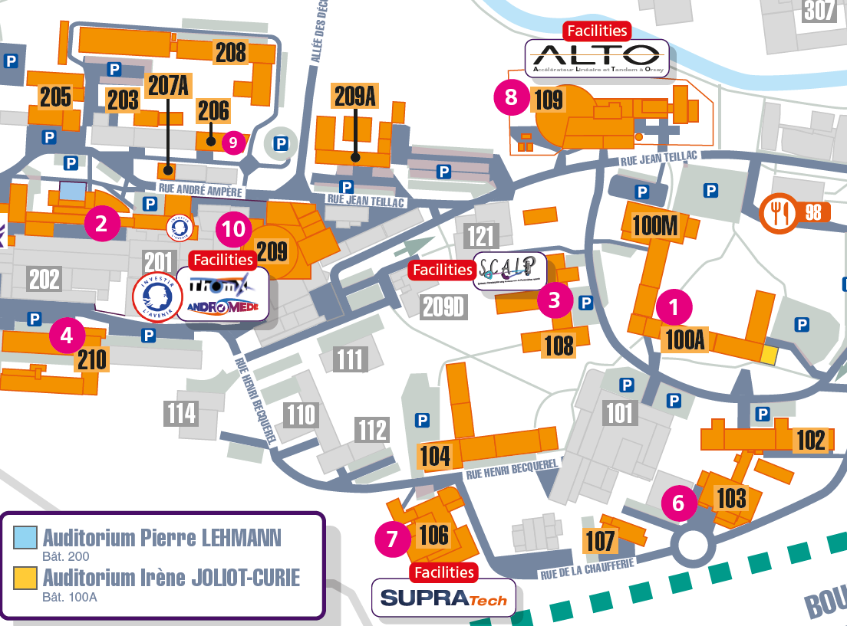
The CNRS – IJCLab SupraTech Technological Platform
SUPRATECH is the CNRS-IJCLab Technological platform dedicated to the development of superconducting RF technology for particle accelerators.
SUPRATECH provides the technical infrastructure to support R&D or construction projects and activities related to superconducting accelerators.
SUPRATECH is located in Orsay, in 3 buildings (103, 106 & 208) and represents a ~ 8 M€ total equipment investment
Access conditions:
  SUPRATECH is opened to any user (academic, industrial)
  For the moment, access is granted upon a “first to ask, first to be served” basis, and after an analysis of the technical feasibility
  Access cost is calculated w.r.t. operational costs and the existence of a collaborative framework

Slide 10
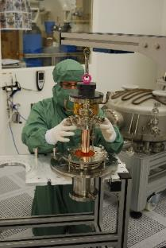
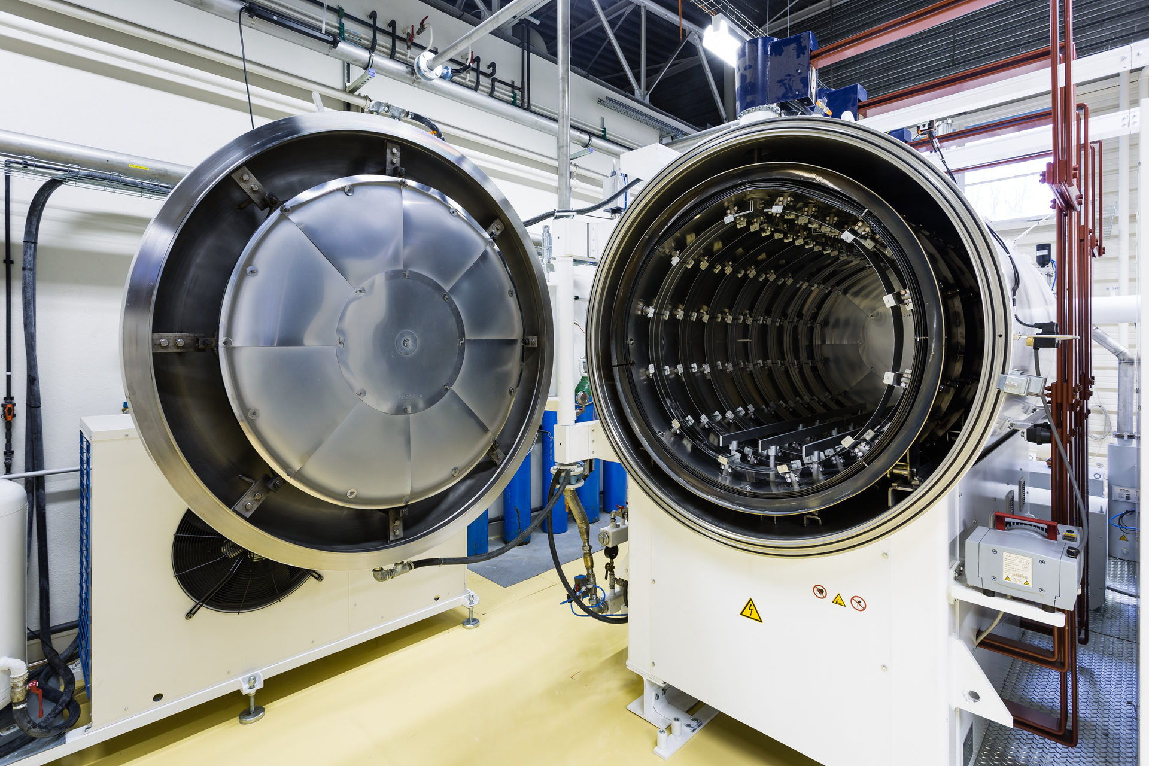
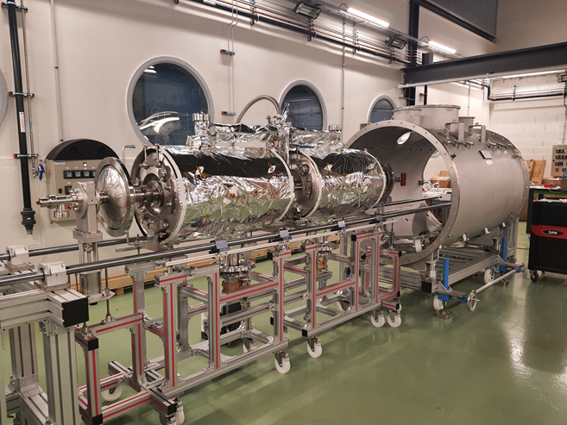
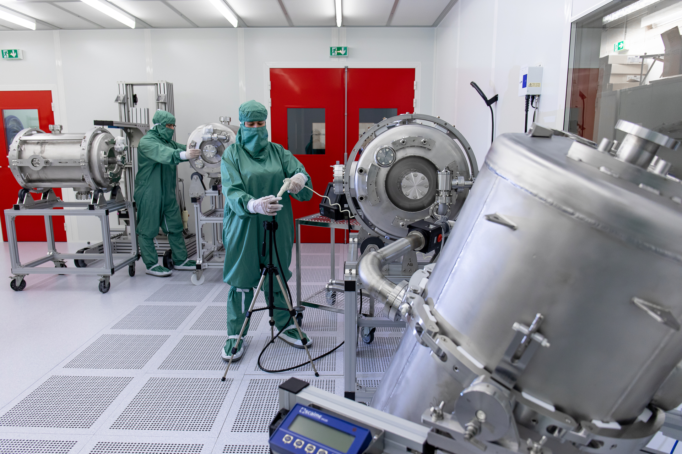
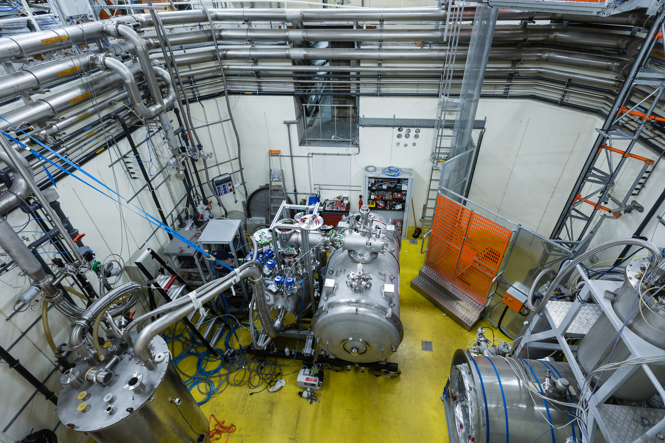
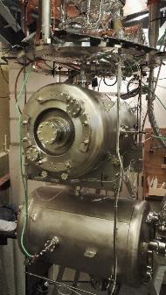
The CNRS – IJCLab SupraTech Technological Platform
SupraTech main equipment:
  A chemical etching facility to perform RF surface preparation
  Three ISO 4 clean rooms, various size, for final surface processing and clean assemblies
  A high temperature vacuum furnace for cavity heat treatments and cavity doping
  Two assembly halls for cryomodule assembly (cryostating)
  Two experimental halls to perform RF and cryogenic tests of accelerators systems, equipped with cryogenic utilities (He pumping, several vertical cryostats) & radioprotection
  An Helium liquefier (70 l/h) with its associated He gas compressor and storage system
  Several RF sources: 352 MHz & 2.8 MW klystron, 704 80 kW IOT, 352 MHz solid state amplifiers
  A unique cryogenic station to perform cryogenic sensors temperature calibration from 300 K to 1.5 K

Slide 11
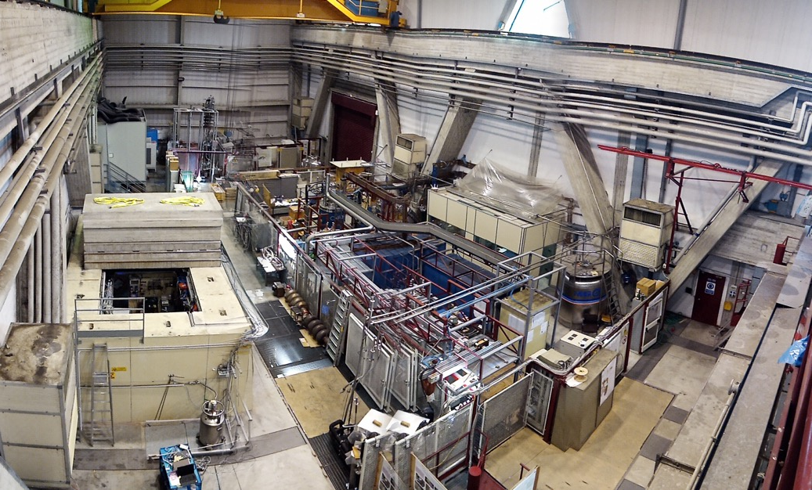

The INFN laboratory LASA (short for Laboratorio Acceleratori e Superconduttività Applicata, i.e., Laboratory for Accelerators and Applied Superconductivity), is a center of excellence at an international level in the field of advanced technology for particle accelerators based in Segrate, near Milan.
The main mission of LASA currently is the development of radiofrequency superconducting resonators for particle beam acceleration and superconducting magnets for particle beam orbit and focusing. Alongside this, LASA perpetuates its tradition in the experimental field by participating in the study and development of experiments in the field of innovative acceleration schemes.
The activities undergoing and starting at LASA foresee the presence of four main test facilities devoted to:
Superconducting Magnets
Superconducting RF Cavities
High Brightness Photocathodes for Electron Sources
Laser Applications to High Power Fabry Perot Cavities and Advanced Timing Systems.
The Superconducting Magnets Group has experience in design, construction and test of superconducting magnets, both for accelerators facility and for detectors. The experimental infrastructure includes facilities for very precise critical current measurements (at 1.9 K or 4.2 K, with back-ground field up to 15 T and current up 2 kA) and for testing of superconducting magnets from medium to large dimensions.
The internal laboratories for model and prototype development include winding machines, a small furnace for high temperature thermal treatment and an oven for vacuum impregnation.

Slide 12
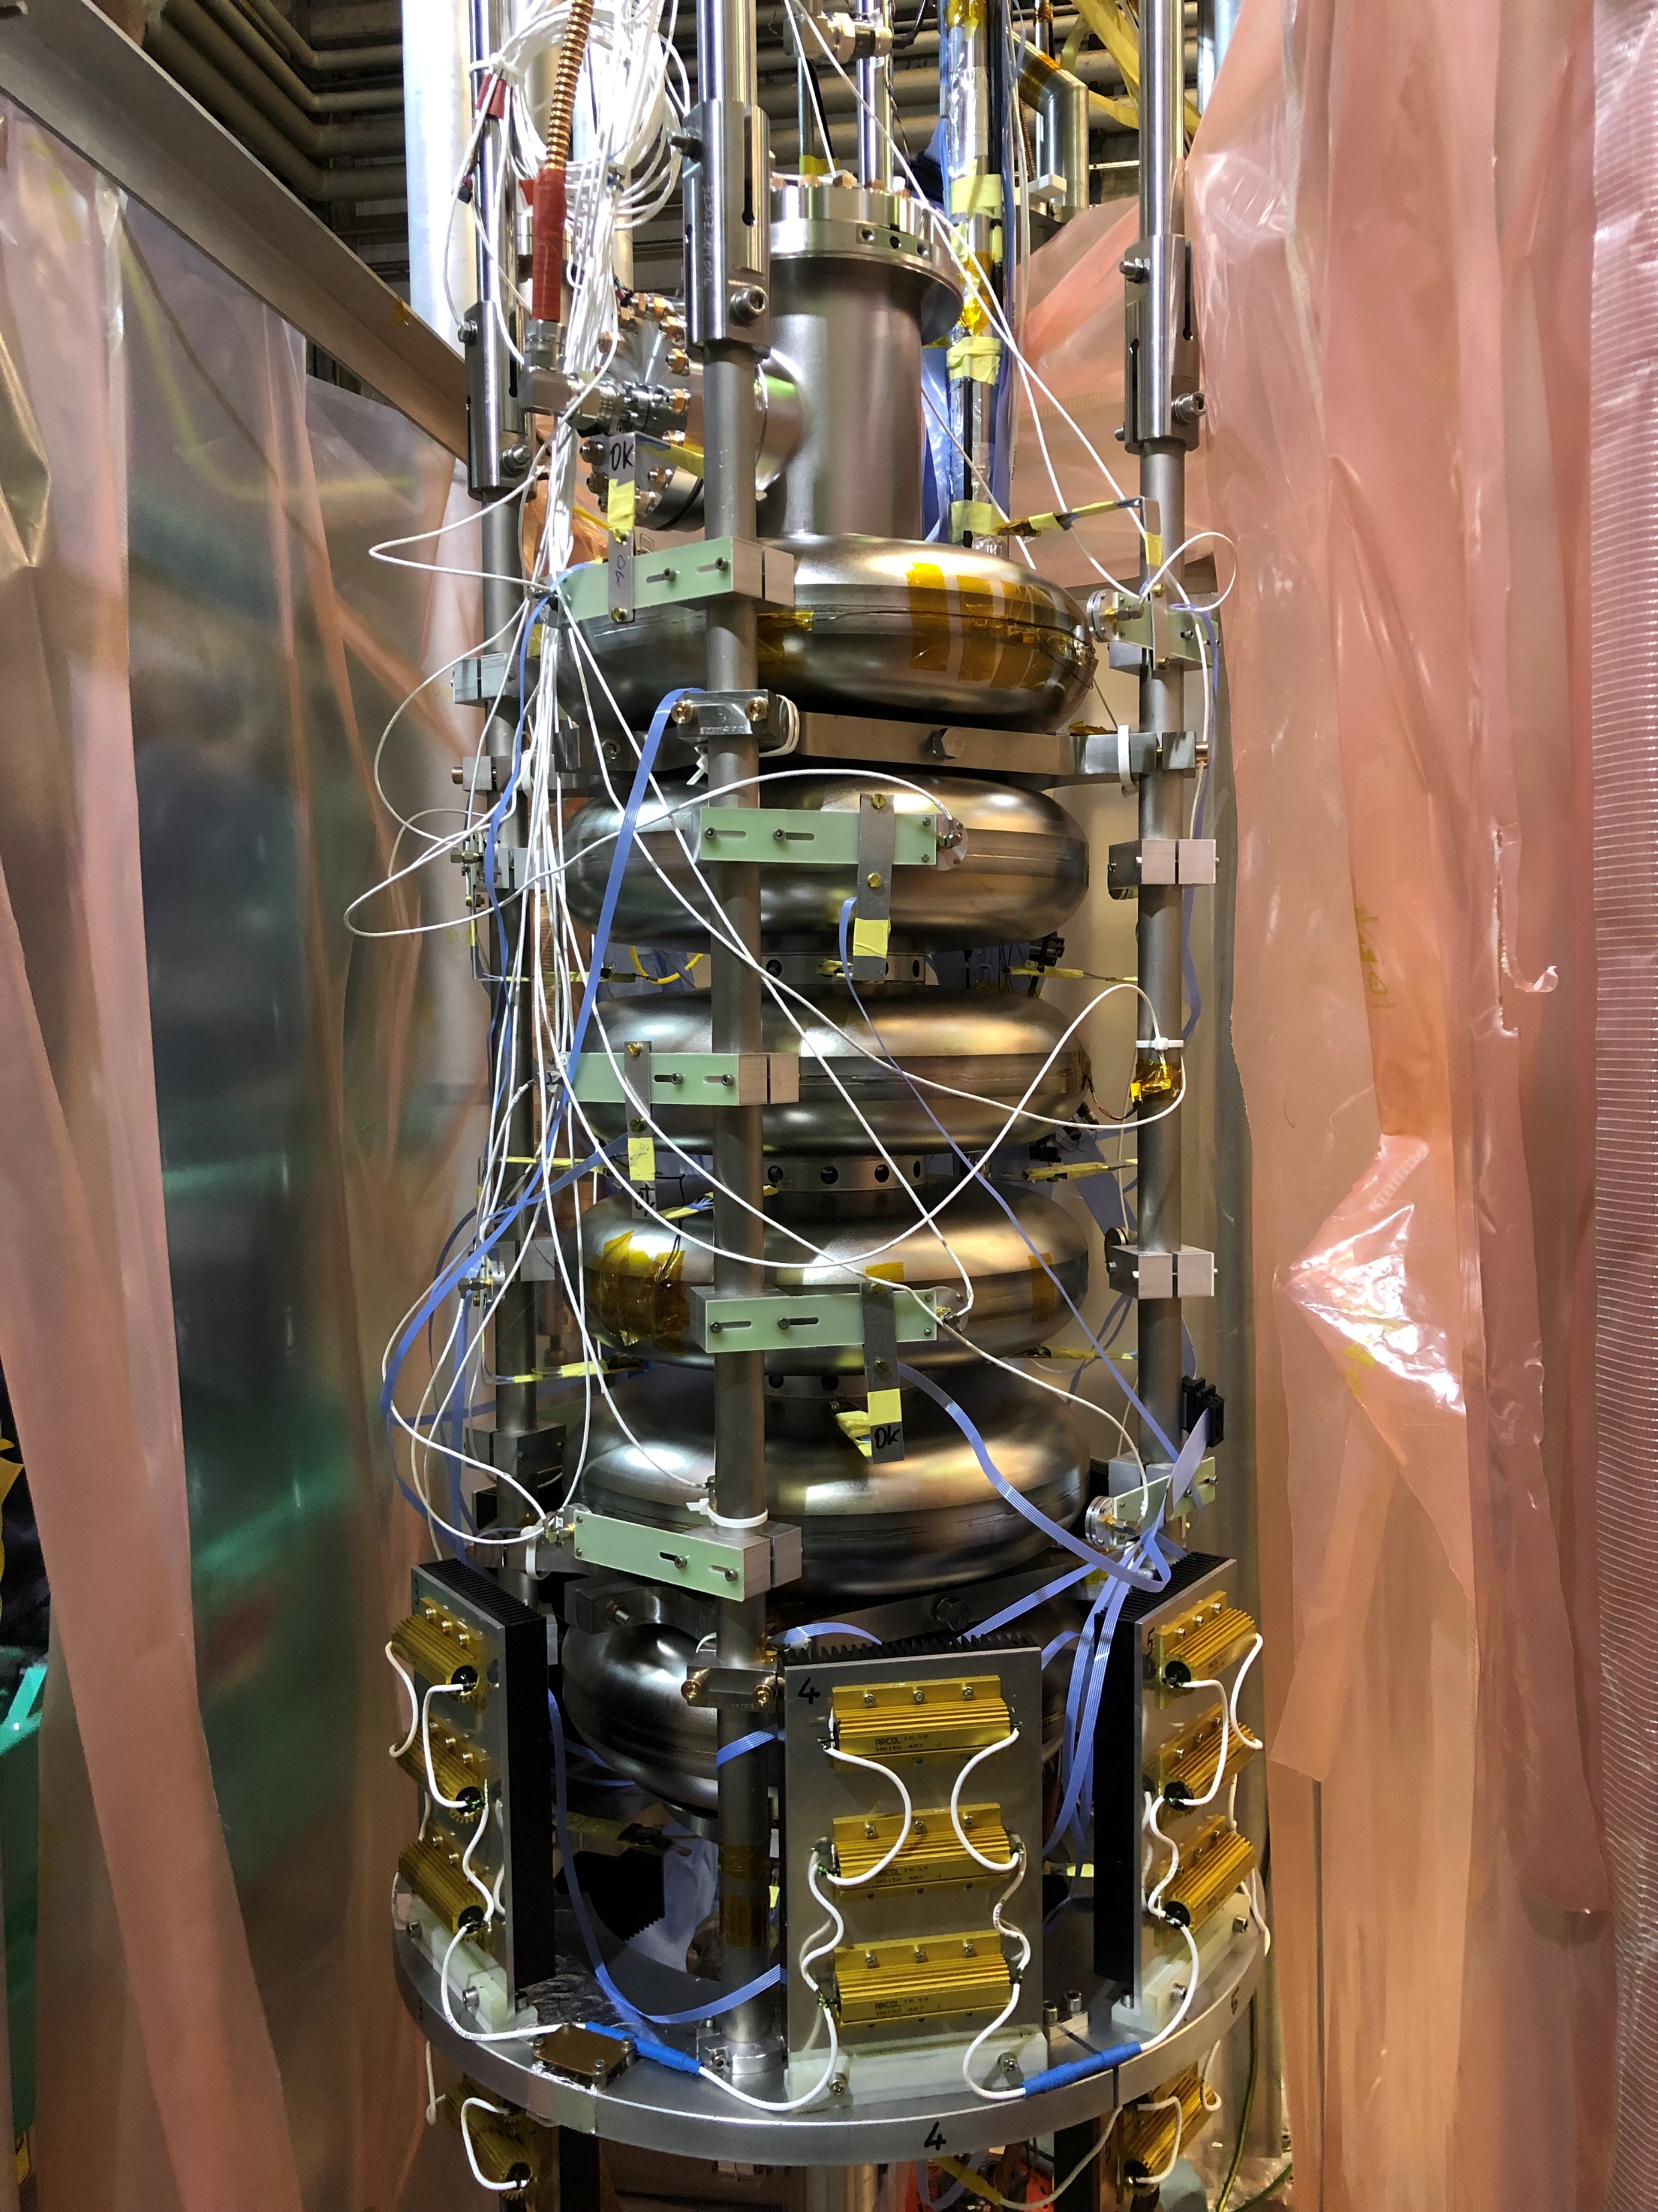
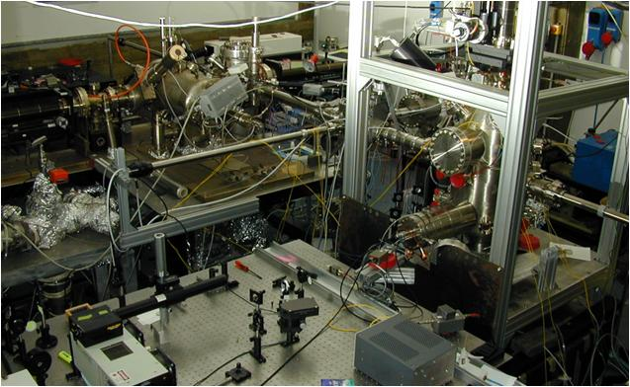
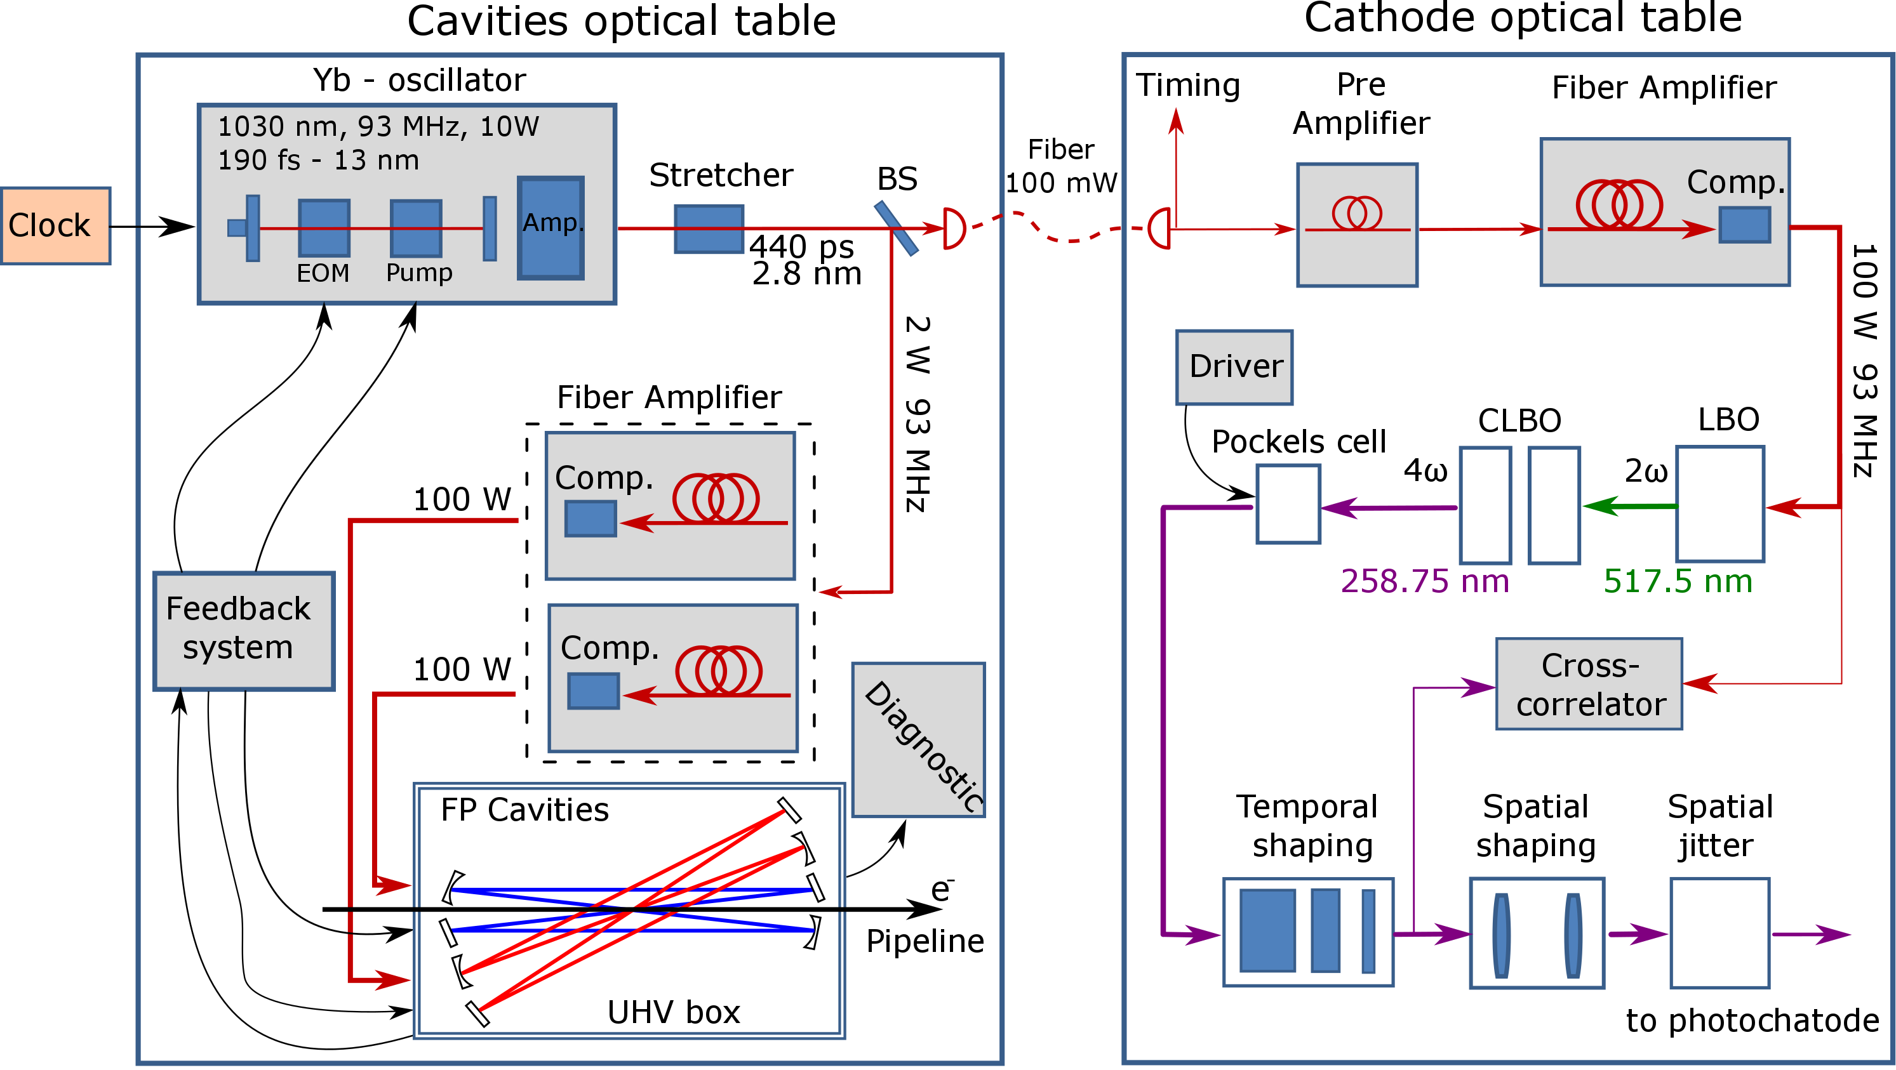
The SRF Group at LASA has a long standing experience in many fields related to Superconducting RF and Photocathodes. The RF experimental infrastructure available at LASA includes a test stand for measuring cavities in cryogenic conditions (lowest temperature 1.5 K) with dedicated diagnostic for quench detection (Second Sound and Fast thermometry) and field emission measurement (photodiodes at cold, energy spectra at warm). An ISO4 Clean Room and High Pressure System complete the facility.
Moreover, a complex UHV system is available for growing alkali based photocathodes that includes different light sources for optical measurement and a Time Of Flight spectrometer for low energy electrons.
The Laser Applications to High Power Fabry Perot Cavities and Advanced Timing Systems facility is devoted to 3 different aims:
provide a suitable setup for investigating the physics and the technology related to Fabry-Pérot (FP) cavities for inverse Compton scattering (ICS) X-Ray sources
provide a high power, tunable repetition rate laser system for exciting a High Voltage photocathode-based test bench to assess the quality and the capability to provide high intensity electron bunches
provide the source for high quality reference timing systems for advanced accelerators and related experimental facilities.
The facilities so far described have been established and maintained for internal users. In the framework of the Eurolabs activities we will improve their structure and services to adapt for external users. The access to these facilities will be greatly facilitated and will be evaluated just in front of a written request to the INFN_LASA Eurolabs contact person with a description of the project underlying the proposal.

Slide 13
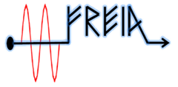
EUROLABS Kick-Off-Meeting
Inputs from FREIA UU
A. Miyazaki on behalf of FREIA team
https://www.physics.uu.se/research/freia/

Slide 14
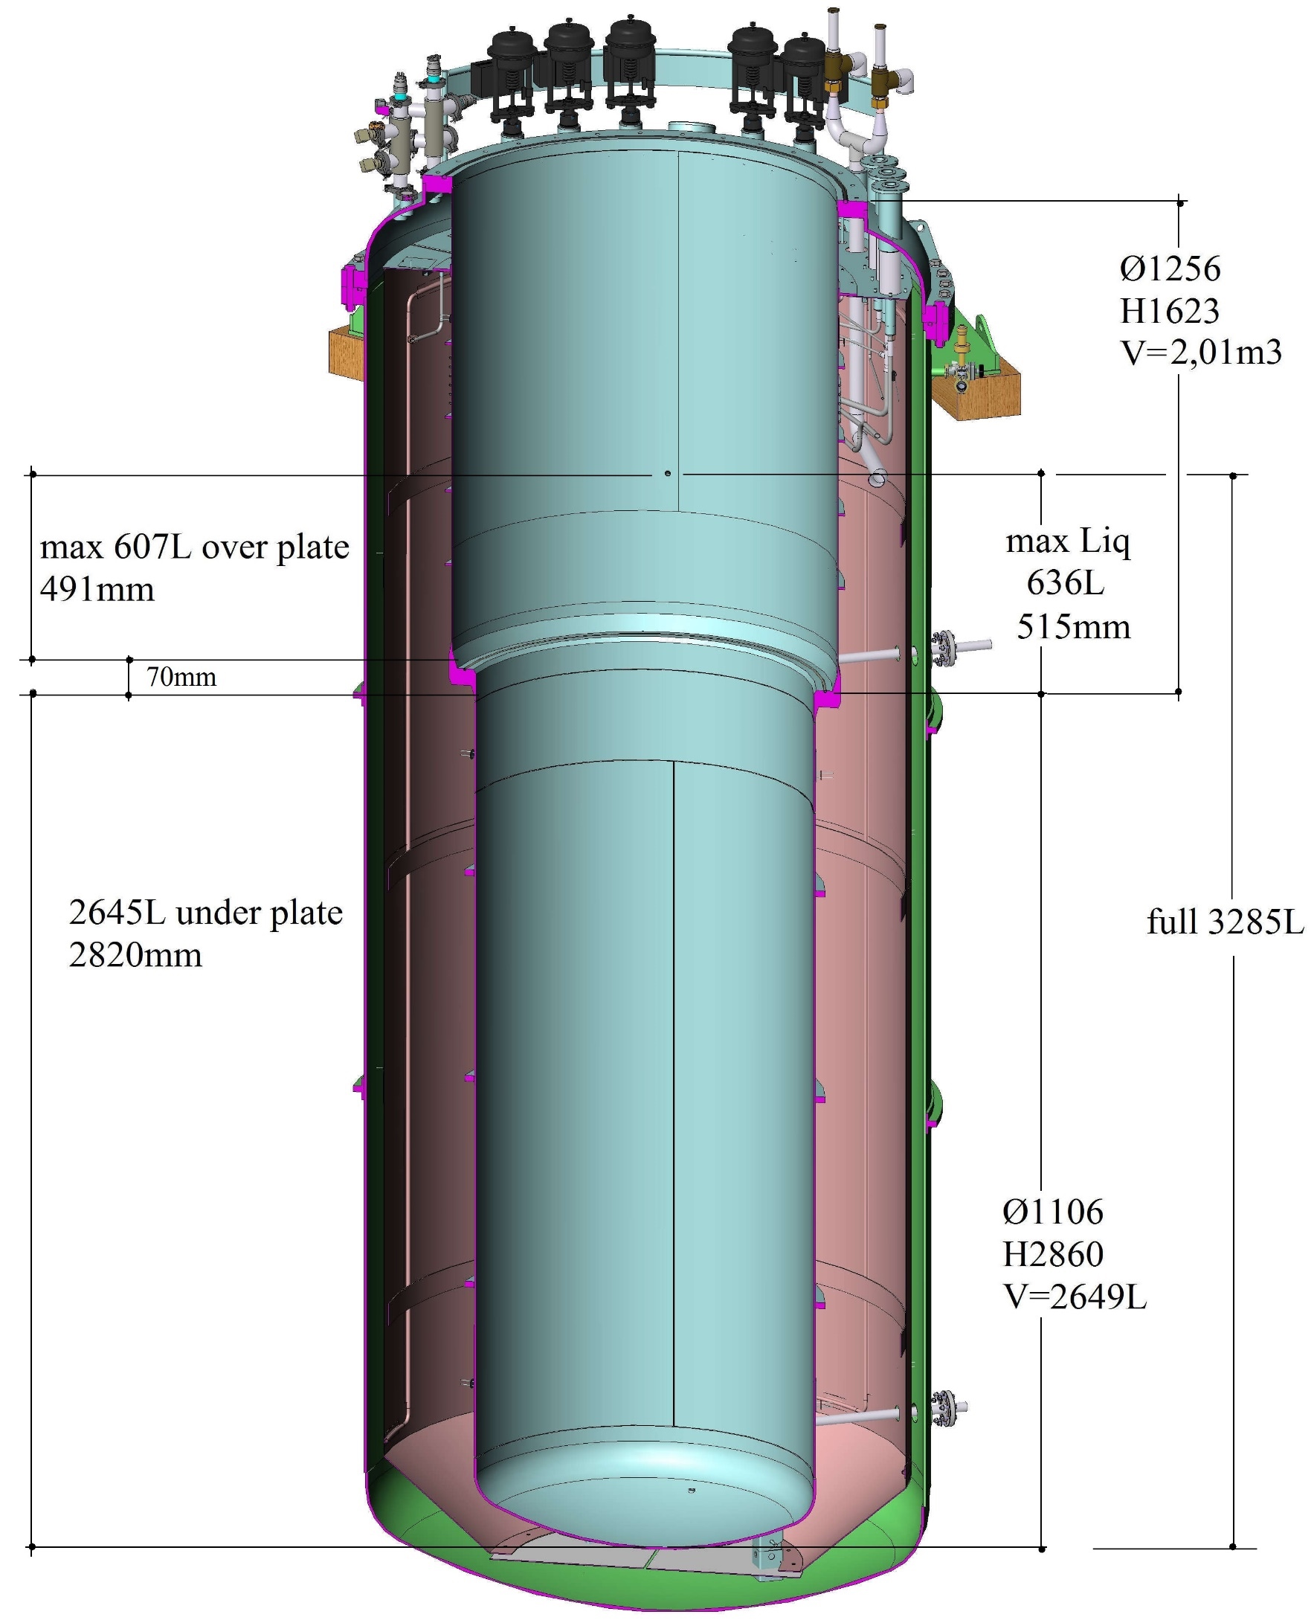
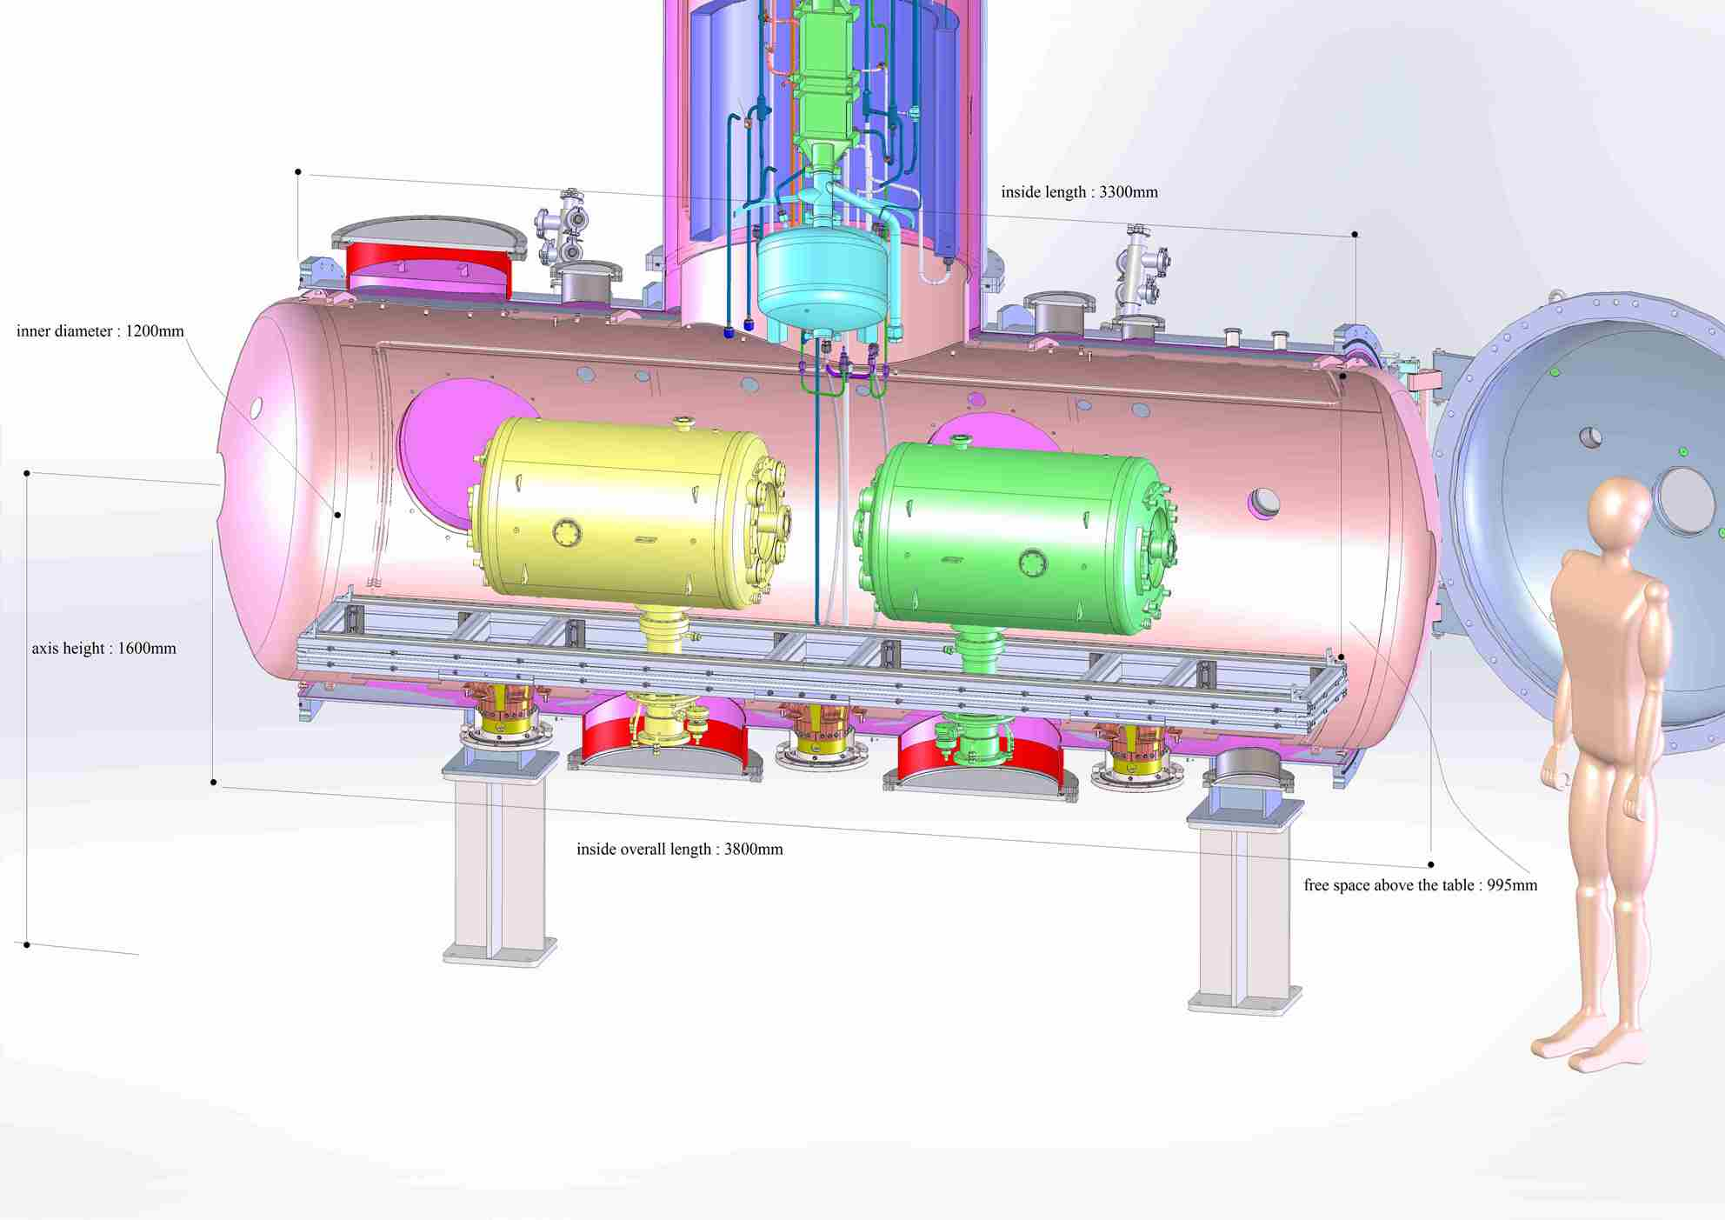
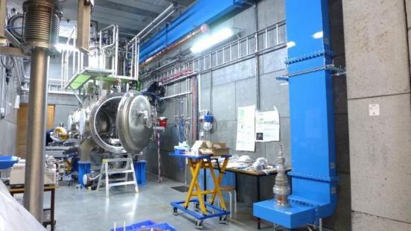
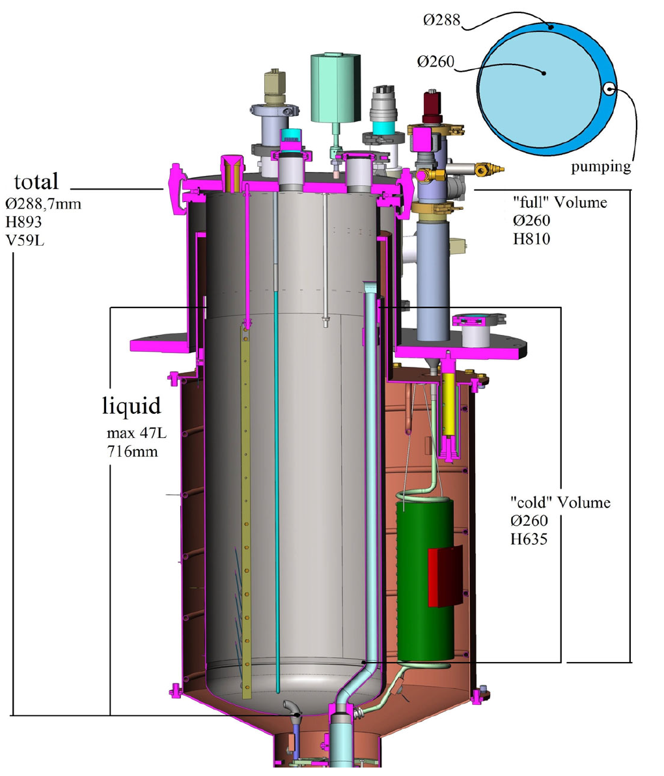
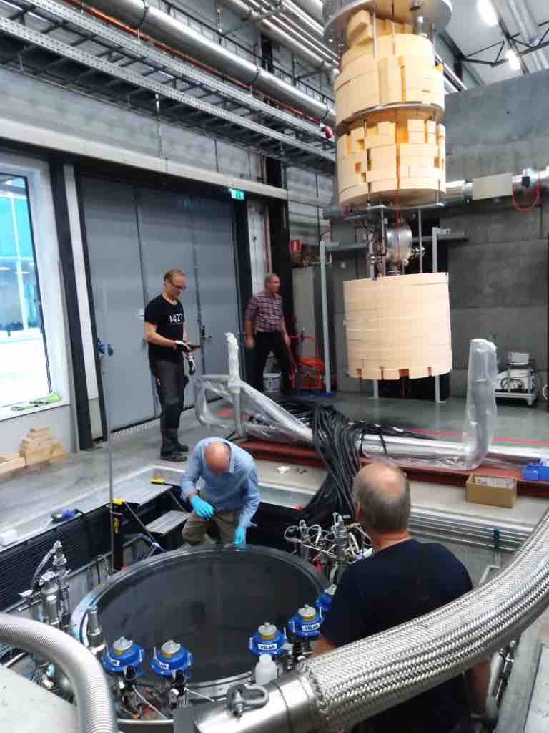
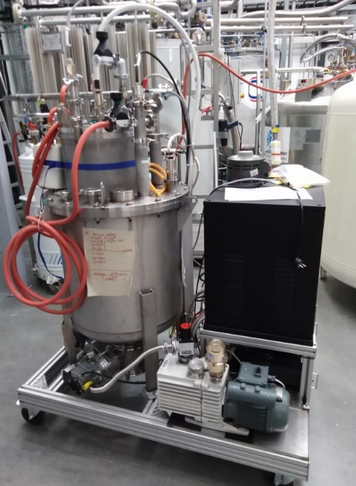
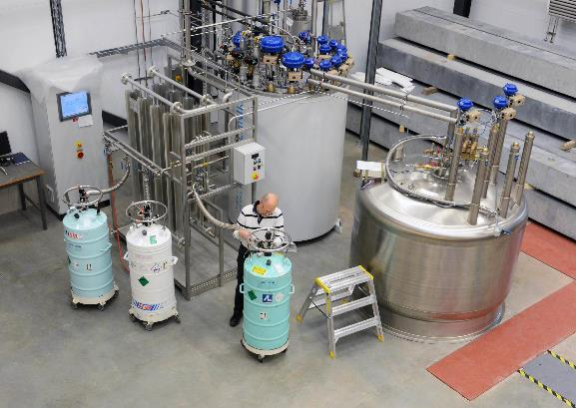
2(+1) cryostats (vertical, horizontal, and small)
For SC cavities and magnets
For He-jacket cavities + coupler
H. Li et al, NIMA 927, 63 (2019)
H. Li et al, LINAC 2018, THOP066
arXiv:2108.10648
arXiv:2011.05210
Inner diameter 1.2 m
Small cryostat (only at 4K)
Inside length 3.3 m
Cryogenic capacitance
110(90)W at 2.0(1.8)K
960 access units:
4 experiments of
6 weeks x 5 days x 8 hours
R. Ruber et al, diva2:814268
E. Waagaard et al, arXiv:2104.10435

Slide 15
Service improvement plan
Priority | equipment | price | Time line | comments
1 | Magnetic field probe for magnets | 100-130 kEUR | One year | Rotational coil inside anti-cryostat inserted inside a magnet bore
2 | Magnetic field probe for cavities | 10-15 kEUR | Half a year | So far only one prototype probe in collaboration with the company
3 | Broadband high-power RF amplifier | 10-15 kEUR | Half a year | So far only 352-400 MHz → 700-3000 MHz for more cavities
Spare | Digital LLRF | 60-72 kEUR | One year | FPGA code was developed → just procurement and deployment
 | Total | 160 kEUR

Slide 16
Technology Infrastructures - Modality of access

Slide 17
Technology Infrastructures - Modality of access
  Selection of the applications
    Validation of the eligibility of the request
    A selection committee composed of 2 to 4 external experts to judge the quality and relevance of the request + the facility representatives ?
    Selected request forwarded to the TP that can accept it or not depending of its availability and own rules

