Slide 1
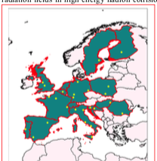
WP 5: Open, Diverse and Inclusive Science
María José G. Borge
Instituto Estructura de la Materia, CSIC
Madrid, Spain
Kick-off Meeting - European Laboratories for Accelerator Based Sciences
3-5 October 2022, Bologna, Italy

Slide 2
WP5
Open, Diverse and Inclusive Science
WP Coordinator Maria Borge
Task 1
Diversity and Dissemination
Enhancing diversity: Nacionality Gender Age Level of expertise Enhancing Dissemination Web site Videos of RI Newsletters,…
Task 2
Open Science & Data Management
Promoting Data Management Plan Creating a portal for Nuclear Physics data tools
Task 3
Machine learning
Machine Learning Beam control and Optimization & Control of the source of Laser driven Accelerator
Task 4
Training
Hands-on training on the facilities 4 events of Basic Training 4 events of Advanced training
Paolo.Giacomelli
paolo.giacomelli@bo.infn.it
Antoine Lemasson
lemasson@ganil.fr
Sabrina Appel
s.appel@gsi.de
Livius Trache
livius.trache@nipne.ro

Slide 3
Main Players in the WP 5
Task 5.1 : Dissemination Paolo Giacomelli
Task 5.2.: Open Science and Data management Antoine. Lemasson (GANIL)
A. Matta (LPC, CNRS)
Thorsten Kollegger (GSI)
Task 5.3: Machine Learning Sabrine Appel (GSI) / Sebastien Rothe (CERN)
Sandrine Dobosz Dufrenoy (CEA)
Task 5.4:Training Maria JG Borge (IEM)
Livius Trache (IFIN-HH)

Slide 4
Task 1: Diversity & Dissemination
FTE taken from Management office
Responsible : Paolo Giacomelli, P.O.
EURO-LABS consortium brings together, at the European level, the Nuclear Physics (NP) and the High-Energy Physics (HEP) accelerator and detector communities. This will result in a cross-fertilization of these disciplines
Diversity:
Within task 5.1 we will work to ensure the largest posible diversity of potential users
Engaging people of Different Nationality
Gender
Age
Level of profesional expertise
Mobility (not included in the Project)
Statistics on Gender → to be taken from previous Projects ENSAR2, AIDA, check evolution in a decade
Mobility: How is the access for people limited mobility in the different Facilities ?
Check and promote that child care is provided in the conferences of the field.
Deliverable: EURO-LABs user’s diversity final report M48
Maria Jose Gª Borge, Coordinator WP5, IEM-CSIC, Madrid Spain

Slide 5
Task 5.1: Dissemination
30K€ for the video
Responsible : Paolo Giacomelli P.O.
EURO-LABS activities and results will be disseminated using several key communication tools:
Project Public Website
https://web.infn.it/EURO-LABS/ (not use frequently, so not easy to find)
https://institucional.us.es/clear/transnational-access
Intranet and collaboration workspaces
EURO-LABS newsletter circulated to project members and to a wider community
every 6 months
Modern media channels, like social media, YouTube
Project mailing lists (available?)
Videos of the various RI, 39 in total
Maria Jose Gª Borge, Coordinator WP5, IEM-CSIC, Madrid Spain

Slide 6
VIDEO OF Louvain-La-neuve @ AIDA2020
https://www.youtube.com/watch?v=mUO3VOfAekk

Slide 7
VIDEO OF ITAINNOVA @ AIDA2020

Slide 8
Task 2 : Data Availability from the Facilities
Responsible : Antoine Lemasson Talk on Tuesday @ 14:15h
5 FTE,
2 FTE GANIL 1,5 FTE IJC & 1,5 FTE GSI
Objetives:
To bring the NP community into the European Open Science Cloud (EOSC) framework
Open science represent a great opportunity for the NP community to improve the management and use of the large data sets produced around Europe and foster new collaborations.
To make a bridge between the raw data and the enormous amount of existing data bases in NP.
How?:
Creating of a Portal of Services: Data producing Institutions
Technical resources to develop and maintain new Tecnologies
Task 1:
Develop a Open NP Catalogue of Dataset and Tools
Definition of the catalogue perimeter, architecture, and standards.
Release of terms of reference (M 36).
Task 2:
Prepare a Platform to integrate existing infrastructures in the EOSC environment
Milestone: Report on existing solution in EOSC ecosystem
Report on how to adapt and integrate existing solutions to NP Ecosystem
Release of the first functional version of the Open NP and data access tools (M36)
Maria Jose Gª Borge, Coordinator WP5, IEM-CSIC, Madrid Spain

Slide 9
Data Management Plan
See talk by Antoine Lemasson Talk on Tuesday @ 14:15h
Collaborative analyses of situations of Data Producers Research Infrastructures
Deliverable ”Inventory and protocol for Data Management Plan” in February 2023
It is time to start the design and development of a European data-storage system using FAIR principles
Findable, Accessible, Interoperable, Reusable
This system must be capable to store the raw data from the detectors and metadata to allow another researcher to analyse the data.
Several RI have moved forward with their own Data Management Plans. It will be important to get them!!!
Reports, papers, slides, data base, videos, statistics,….
Information will be requested beginning of November to WP-Leader→ all RI
However not all RI have one.
We should avoid:
Conflicting policies between Travelling detectors and RI
Data Storage Practices Heterogeneous
Software's : Significant move towards open software’s in the last decade (FAIRroot, GammaWare, …)
Research Infrastructures have a key role in structuring Data Management Plan and we have little time
Maria Jose Gª Borge, Coordinator WP5, IEM-CSIC, Madrid Spain

Slide 10
Task 3 : Machine Learning for accelerator and Plasma
Responsible : Sabrina Appel Talk on Tuesday @ 14:45h
3 FTE, at GSI
Objetive:
Use Machine Learning (ML) methods to improve beam quality, transport efficiency and reproducibility.
Challenges.
The use of machine learning algorithms to accelerators is share and tackle by different facilities
The Project will Focus on open tools and platforms:
Developing a virtual accesible beam diagnostic data base and optimizer toolkit
Task 1: Beam control and optimization Applications
Milestone: The source code of the ML toolkit prototype has been made available on a shared platform (e.g. Gitlab at CERN) (M8). Deliverable : The new toolkit has been deployed at least two facilities (e.g. CERN and GSI) and has successfully been used for an optimitation task. (M24) .
The toolkit is established at the involved facilities and has been applied to at least one user beam line. (M36) Report on the different tested algorithms and reported results in applications beyond ion beam tuning optimitation. (M48)
Task 2: ML applied to the control of the source of the laser driven accelerator
Open source will prevent dual efforts in implementation of common features or modules of software.
The toolkit will be extended to the facility’s users and their experimental beamlines.
In a final step, the optimizer kit may be apply to other fields, such as medical physics
Critics: ML methods to be developed may be used in the medical sector: they could ultimately impact on patients
Maria Jose Gª Borge, Coordinator WP5, IEM-CSIC, Madrid Spain

Slide 11
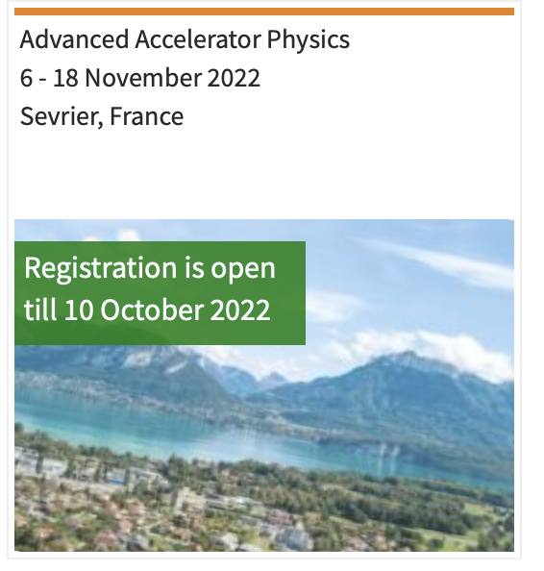
Task 4 : Training
Cost aprox 288 K€
Responsible: Livius Trache Talk on Tuesday @ 16:45h
Objetives: In order to enhance competitiveness of our RI and its technical capabilities we will forge a coherent, stable, and predictable system of training, formation schools and events that uses the strengths and capabilities of all partners providing hands-on training
Plan: 2 set of schools
4 Basic Training (1/year) to take place at smaller accelerator facilities that allows hands-on activities: IFIN-HH, Catania, HIL Warsaw, etc.
4 Advanced Training (1/year) at larger, state-of-the-art facilities: CERN ISOLDE (2023), GANIL (2024), GSI/FAIR (2025) and ELI-NP (2026). Two of these will be dedicated to the technical and engineering staff.
Training schools of 7-10 days, open to 15-20 students, from master’s degrees to PhD students/engineers / technologist
Critics: Details on health and safety procedures for students and researcher were not provided
To coordinate the activities of this task we will select a Training Scientific Board (TSB) in the first 6 months of the Euro-Labs project
Milestones and Deliverables
Milestone: Selection of the Training Scientific Board. M6 of Euro-Labs
Deliverable: Report on activities after 24 months, including follow-ups from participants. M24
Deliverable: Final report. M48
Maria Jose Gª Borge, Coordinator WP5, IEM-CSIC, Madrid Spain

Slide 12
WP5: Service Improvements
Provide and maintain the webpage
Provide regular exchanges by the newsletter
Provide videos of the 39 RI so the users can choose the best RI for their research
Foster diversity by engaging people of different nationalities, gender, age and level of expertise.
Develop a Data Management Plan
Develop an Open NP catalogue of data sets and tools and an associated Open Science Desk
Integrate the Nuclear Physics community to existing infrastructures and services of EOSC environment.
Provide a ML optimizer toolkit for beam control and optimization of friendly use and that it can be applied at different facilities to improve performances.
ML will also be used for the source of the laser-driven accelerators will the same spirit.
Enhance the competitiveness of our research infrastructure and its technical capabilities by training researcher and technical personnel both at the basic and advanced level providing hands-on courses in our facilities.
Maria Jose Gª Borge, Coordinator WP5, IEM-CSIC, Madrid Spain

Slide 13
Gantt Chart of WP 5
Year | Month from start | Milestone /deliverables | Description
1 | 6 | D 5.7 (T 5.1+5.2) | Data Management Plan
 | 6 | MS38 (T 5.4) | Selection of the Training Scientific Board
 | 8 | MS37 (T 5.3) | The source code of the ML toolkit prototype is available on a shared platform
 | 12 | MS34 (T 5.1) | One third of the research infrastructures videos ready
 | 12 | MS35 (T 5.2) | Definition of the catalogue perimeter, architecture, and standards. Release of terms of reference
2 | 18 | D 5.1 (T 5.1) | All research infrastructures videos completed
 | 24 | D 5.4 (T 5.3) | The new toolkit deployed at least two facilities and been used optimization
 | 24 | D 5.5 (T 5.4) | Report on activities after 2 years, including follow-up from participants
3 | 36 | D 5.3 (T 5.2) | Release of the first functional version of the Open NP and data access tools
 | 36 | MS36 (T 5.2) | Identification of existing solutions in the EOSC ecosystem and integration of the Nuclear Physics Ecosystem
4 | 46 | D 5.6 (T 5.2) | Final Report
 | 48 | D 5.2 ((T 5.1) | EURO-LABS users’ diversity final report
Maria Jose Gª Borge, Coordinator WP5, IEM-CSIC, Madrid Spain

Slide 14
Thanks for your attention !!

