Slide 1

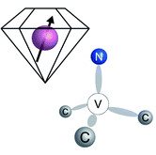
Rome - Frascati - INFN-LNF, Nov 2022
Ben-Gurion University of the Negev
Realization of a complete Stern-Gerlach interferometer:
Towards a test of the foundations of QM
(as well as the interface with gravity)
www.bgu.ac.il/atomchip
Ron Folman
Alternative title:
How do we make verifiable spatial superpositions with large objects?

Slide 2
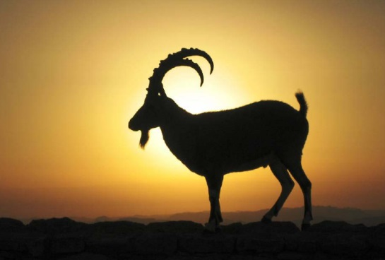
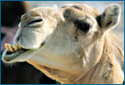
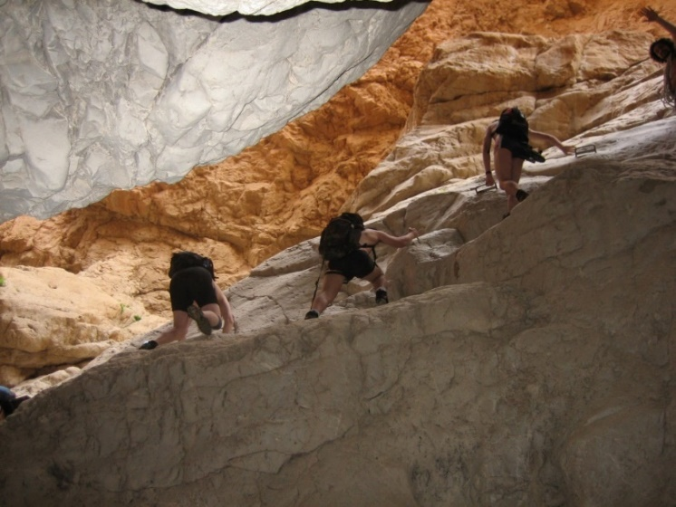
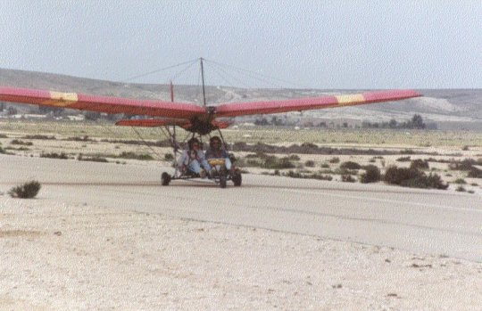
Some picts form the desert around BGU: short drive from the red sea, dead sea and the Mediterranean sea. Short drive from Egypt and Jordan. Very beautiful archaeology, wildlife, and geology.
Outline:
Motivations for superpositions of massive objects…
Stern-Gerlach Interferometry
How are we going about doing a real experiment

Slide 3
Superpositions of massive objects
Method
Largest mass coherent spatial superposition (by 4-7 orders of magnitude beyond the state-of-the-art). Specifically, a superposition of a nano-diamond with 10^7-10^10 carbon atoms.
Realize full-loop SG interferometer (SGI), and conduct cutting-edge fundamental experiments on
TESTING QM, NEW INSIGHT INTO QUANTUM-GRAVITY, HEP (PARTICLE PHYSICS), EXOTIC THEORIES.
Related refs:
Test quantum mechanics in new regimes [How big can the quantum world be? Physicists probe the limits, Quantamagazine (2021)] (e.g., An inherent limit? GRW, CSL, DP, Phonons [arXiv:211201263]. Some even speculate that at some point the complementarity principle will break down). In addition, numerous new papers claiming the specifically SG will teach us new things [EPL 133, 30001 (2021); Phys. Rev. A 103, 042217 (2021), Communications Physics 4, 155 (2021)].
New experimental insight to the gravity-quantum interface (e.g., the graviton, quantum equivalence principle), and test of several related exotic theories (e.g., DP on gravitationally induced collapse, breakdown of complementarity) [PRL 117, 143003 (2016); PRL 119, 240401 (2017); PRL 119, 240402 (2017); Front. Phys. 8, 176 (2020); Nature Physics 17, 74 (2021); Class. Quantum Grav. 38, 245009 (2021)].
New interferometer technology for particle physics and GR fundamental questions (e.g., Fine-structure constant [Science 360, 1919 (2018); Nature 588, 61 (2020) – 10^-12], Equivalence principle [PRL 125, 191101 (2020) - 10^-12], Dark Matter/Energy [Quantum Science and Technology 6, 024014 (2021)], Chameleon fields, Yukawa type extension to Newtonian gravity at short distances, Lorentz and CPT symmetries, G waves, etc.
1:30

Slide 4
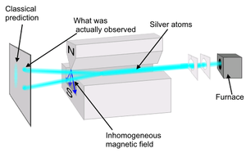

Our route: SG Interferometry
With extremely high magnetic gradients!
Lets consider 10^7 to 10^10 atoms in our ND

Slide 5
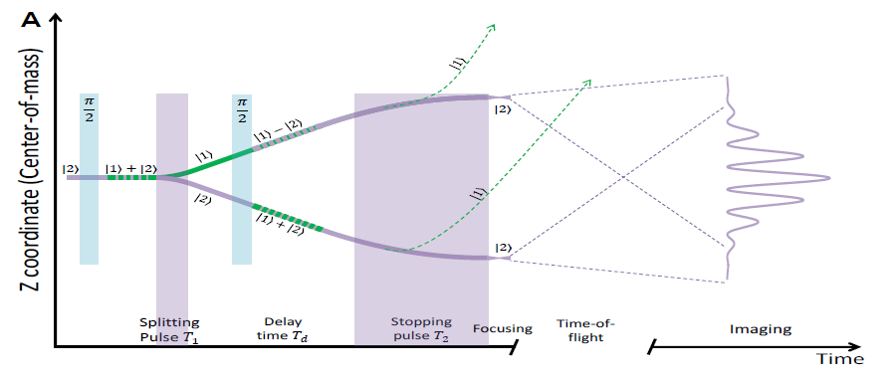
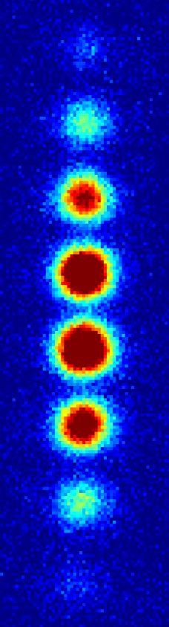
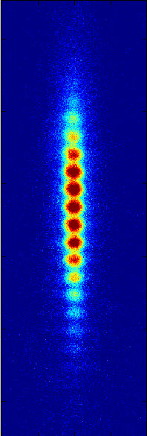
First SG interferometer
(and high magnetic gradients)
The SG half-loop experiment (going beyond beam experiments to a BEC source, and utilizing the accuracy of the atom chip):
BEC
Thermal
cloud
Multi-shot visibility=phase fluctuations (sensitive to stability)
Different realizations in our lab: 2013-2022

Slide 6
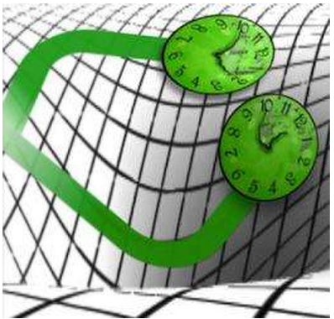
More experiments in SG Interferometry
(and high magnetic gradients)
Clock Interferometry
Yair Margalit, Zhifan Zhou, Shimon Machluf, Daniel Rohrlich, Yonathan Japha, Ron Folman,
A self-interfering clock as a ‘which path’ witness
Science 349, 1205 (2015)
Zhifan Zhou, Yair Margalit, Daniel Rohrlich, Yonathan Japha, Ron Folman,
Quantum complementarity of clocks in the context of general relativity
Classical and Quantum Gravity 35, 185003 (2018)
Geometric phases
Zhifan Zhou, Yair Margalit, Samuel Moukouri, Yigal Meir, Ron Folman,
An experimental test of the geodesic rule proposition for the non-cyclic geometric phase
Science Advances 6, eaay8345 (2020)
Moire patterns (from two parallel interferometers)
Omer Amit, Or Dobkowski, Zhifan Zhou, Yair Margalit, Yonathan Japha, Samuel Moukouri, Yigal Meir, Baruch Horovitz, Ron Folman,
Observation of Anomalous Moiré Patterns
New J. Phys. 24, 073032 (2022).
Full-loop T^3 interferometer
O. Amit, Y. Margalit, O. Dobkowski, Z. Zhou, Y. Japha, M. Zimmermann, M. A. Efremov, F. A. Narducci, E. M. Rasel, W. P. Schleich, R. Folman,
T³ Stern-Gerlach matter-wave interferometer
PRL 123, 083601 (2019)
Dynamic phase
Pancharatnam phase
Geometric phase

Slide 7
Full-loop: Spin oscillations
Lets consider 10^7 to 10^10 atoms in our ND
Unique T^3
signal:
Kennard 1927
PRL2019
Theory by Wolfgang Schleich et al.
Advantages:
No need for high resolution imaging
No need for laser spectroscopy which heats the diamond (and has low contrast)
Its fast! So a good way to fight all types of decoherence (e.g. BBR)
Science Advances 2021

Slide 8
Our work with NV in diamond
NV Physics
Y. Rosenzweig, Y. Schlussel, and R. Folman,
Probing the origins of inhomogeneous broadening in nitrogen-vacancy centers
with Doppler-free-type spectroscopy
PRB 98, 014112 (2018)
NV magnetometry
Victor M. Acosta, Louis S. Bouchard, Dmitry Budker, Ron Folman, Till Lenz,
Patrick Maletinsky, Dominik Rohner, Yechezkel Schlussel, Lucas Thiel,
Color centers in diamond as novel probes of superconductivity
Journal of superconductivity and novel magnetism 32, 85 (2019)
Yechezkel Schlussel, Till Lenz, Dominik Rohner, Yaniv Bar-Haim, Lykourgos Bougas,
David Groswasser, Michael Kieschnick, Evgeny Rozenberg, Lucas Tiel, Amir Waxman,
Jan Meijer, Patrick Maletinsky, Dmitry Budker & Ron Folman,
Wide-field imaging of superconducting vortices with electron spins in diamond
Phys. Rev. Applied 10, 034032 (2018)
A. Waxman, H. Schlussel, D. Groswasser, V.M. Acosta, L.-S. Bouchard, D. Budker, R. Folman,
Diamond Magnetometry of Superconducting Thin Films
PRB 89, 054509 (2014)
* Diamond lattice constant of 0.357 nm including 8 atoms

Slide 9
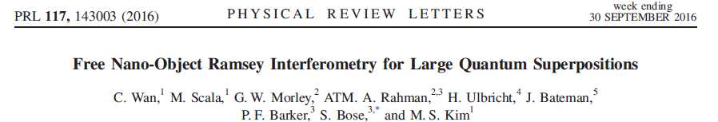
Early and recent suggestions...
Test quantum foundations (collapse?), Measure gravity,
Probe exotic physics e.g., DP,
New tool for precision measurement?

Slide 10
Numerous tests are waiting to be done
e.g., Test Diosi-Penrose collapse models, or other similar models,
Károlyházy, F.: Gravitation and quantum mechanics of macroscopic objects. (1966).
Frenkel, A.: Spontaneous Localizations of the Wave Function and Classical Behavior. (1990).

Slide 11
e.g. at 10^9 atoms @ 100 μm distance, gravity is stronger than spin-spin
Lets consider a 1D SG interferometer: much simpler!
(PS Some people like Englert (2021) claim that 2D is impossible, and we intend to check!)

Slide 12
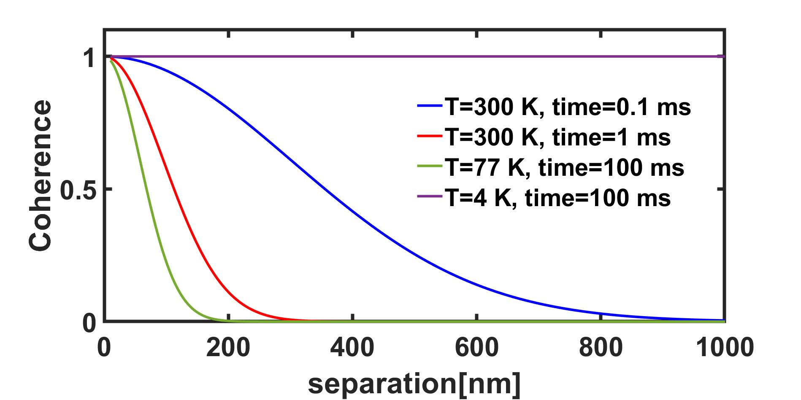
1. First thing to consider: coherence times
Spin coherence times: 200 μs @ 300 K, and several ms @ cryogenic
Dirk Englund 2014
Coherence also sets the lower mass bound of 10^7 atoms
Spin coherence times: 0.5 s @ 77 K (bulk)
Spatial coherence times: E.g. Vacuum (no problem) and BBR:
So lets consider a 0.1-100 ms interferometer
@ 300-4 K, with a splitting of 100-1000 nm.

Slide 13
2. Humpty-Dumpty
It is reasonable to assume a coherence length (CL) of 0.1 nm
(ground state size for 100 kHz @ m=10^7 atoms)
So our experimental recombination precision has to be at least 0.1 nm.
(so far we achieved 100 nm).
We need improved timing and current control and/or increase the CL
What kind of cooling: CoM, rotation, internal
CoM:
Optical, electrical and magnetic feedback (e.g. Brian D’Urso <1 mK)
(Markus Aspelmeyer, GS without a cavity, 2021)
Opto-mechanical red-sideband (Hetet, Kippenberg)
And More exotic, like sympathetic cooling

Slide 14
3. Two experimental extremes
gravity
Coil experiment –
enables to test more theories
Chip experiment – easier but could reach a smaller number of atoms with a smaller splitting
source
BGU double chip (2021)
(already working).
M. Modena, CERN (2011)
(8 mm aperture).
trap
Same
preparation
cool
Z
B’max=500 T/m
Time=100 ms
ΔZ=1 μm
Temp=Cryo
M=10^10 atoms
B’max=10⁶ T/m
Time=100 μs
ΔZ=10 nm
Temp=300 K
M=10^7 atoms
π/2
Very different SGI technology
4 B’ pulses
π/2
Same
measurement
5th B’
image
Observable:
Spin population
oscillations
recapture
Source: Highly homogeneous nano-diamonds (ND)
etched on the surface (fabricated in BGU).
1x1 μm current-carrying wire embedded inside the substrate for maximal heat dissipation.
Also the chemical composition must be carefully controlled to achieve extreme current density of 10^9 A/cm^2.

Slide 15
4. Ion trap for nano-diamond
Diamagnetic, magnetic, ion trap is the strongest.
Assume for example charge of +100e.
Ion trap fabricated at BGU and operated in the lab of
Ferdinand Schmidt-Kaler (Mainz).
The interferometer will take place in between the two chips.
When we neutralize the ND (e.g. Brian D’Urso) it will fall and the interferometer begins
Trapping
Our chip will have 2 planar ring traps, and DC electrodes for compensation of stray fields and gravity. Controlling height above surface is done by V1/V2 of the two rings. Our simulation:
Trapping in a Paul ring trap, Hetet 2018
Planar Paul ring trap, Our published calculation 2017
For optimization of planar traps see also FSK JPB2009, NJP2010
Simulation: 2 rings r=1 mm, 1 mm apart, Ω=2π 47 kHz, ω=2π 5 kHz, q=100, M=2.3 10⁻¹⁹ Kg

Slide 16
5. How to minimize the phase
Its hard to operate an interferometer with a very large phase accumulation
as you become very sensitive to any jitter
Conclusion:
We are going to operate perpendicular to gravity (zeroing the first term)
And with the symmetric +/-1 spin states (zeroing the second term)
To get some phase we can slightly tilt the interferometer axis, OR,
Accumulate phase only due to diamagnetic interaction.

Slide 17
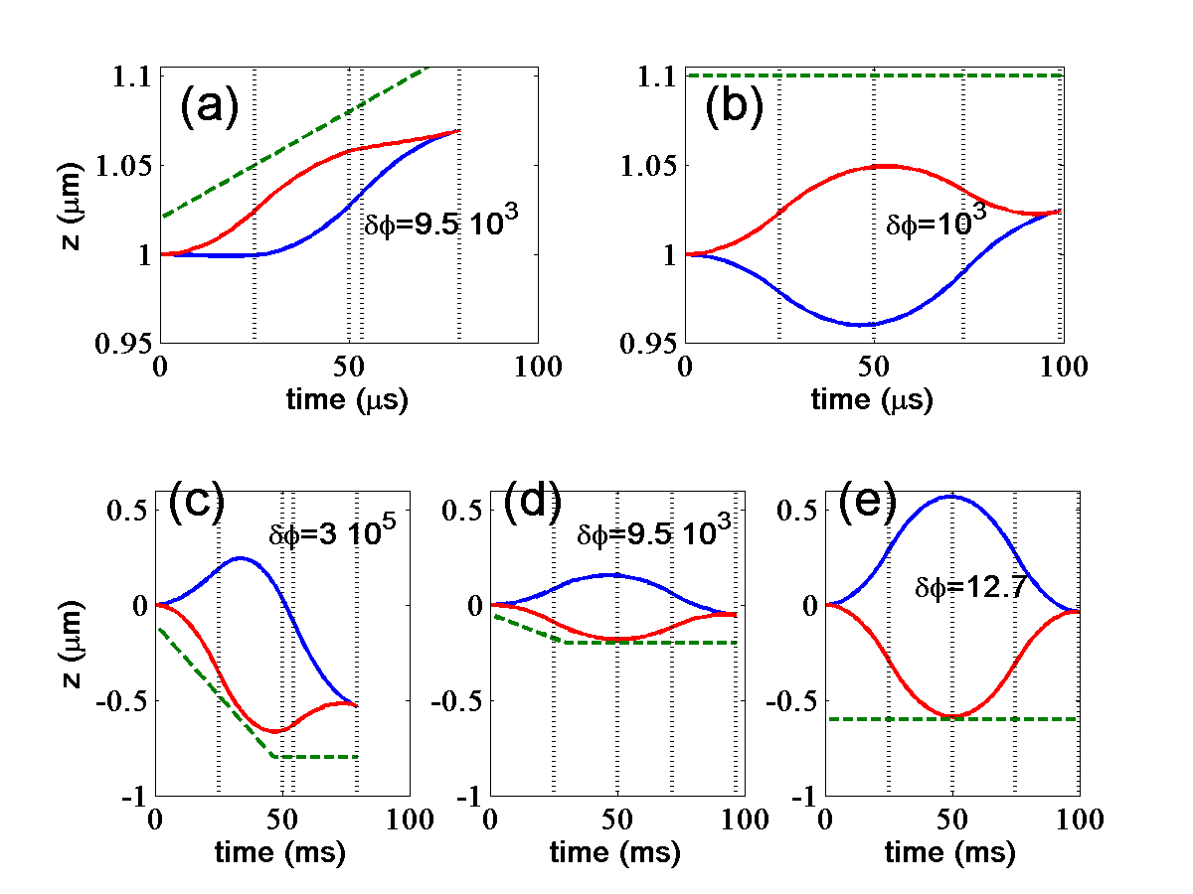
6. An example of interferometer trajectories
0.1 ms
10^9 A/cm^2
1 μm from the ND
9 10^5 T/m
10^-19 kg
Moving quadrupole center
reduces diamagnetism
(diamagnetism can also be
be reduced by coating)
100 ms
500 T/m over
a large volume
10^-17 kg
Trajectories fore 0.1ms (a-b) and 100ms (c-e) experiments (z perpendicular to gravity, phase only due to diamagnetic interaction): visible are the two -/+1 spin trajectories (numerical simulations), and in dashed the position of the zero of the quadrupole field. Also visible in vertical black lines, is the start and finish of the 4 magnetic gradient pulses.
(a) Full diamagnetic force, 6A current in the chip wire and a bias field B₀=1.2 T/(1.52+1.2t), where t is the time in ms (an even better optimization could probably be achieved in the future). The duration of the four gradient pulses are 25,25, 3.5974 and 25.8265 μs. The maximal achieved separation is 38.1 nm and the interferometer phase is 9.6 10³ rad.
(b) A chip current of 10 A and the diamagnetic force reduced to 1% of its natural value. The pulse durations are 25,25, 23.7446 and 25.3995 μs. The bias field is constant such that the quadrupole centre is at a distance of 1.1 μm from the wire surface. The maximal separation is 88.3 nm and the phase is about 10³ rad. (c) The 100ms experiment with a field gradient of 500 T/m (Full diamagnetic force). All the pulses are 25 ms except for the 3rd pulse, which is 4.2973 ms. The maximal separation is 0.848 μm and the phase is 1.53 10⁵ rad. (d) The 100ms experiment with a field gradient of 150 T/m (Full diamagnetic force). All the pulses are 25 ms except for the 3rd pulse, which is 21.8039 ms. The maximal separation is 0.335 μm and the phase is 9.53 10³ rad. (e) The 100ms experiment with a field gradient of 500 T/m, the diamagnetic force reduced to 1% and a constant bias field. All the pulses are 25 ms except for the 3rd pulse, which is 24.2182 ms. The maximal separation is 1.154 μm and the phase is effectively reduced to only 12.7 rad.

Slide 18
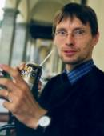
7. An example of unique decoherence
(and perhaps even collapse?)
Carsten Henkel and Ron Folman
Internal decoherence in nano-object interferometry due to phonons
https://arxiv.org/abs/2112.01263 (2022) - invited for special issue in honor of
Roger Penrose.

Slide 19
This in fact constitutes a fundamental limit for any future spatial superposition
of any object by any force!
Calculations by Carsten Henkel:
delta F / F = 0.3, 293K
delta F / F = 0.001, 4K
10^-6L separation, 10^5g.
*The dashed gray lines correspond to an analytical upper limit for the contrast
with power laws L^4, L^5, L^6 from top to bottom.
*The wiggles arise from the oscillations in the finite-time acceleration spectrum

Slide 20
10^-2L separation, 10^2g.

Slide 21
Silicon phonon modes:
For acoustic waves, two "polarisations" appear that may be
called "transverse" and "longitudinal" (shear waves and compressional waves). H. Lamb
called them "torsional" and "spheroidal". The phonon spectrum depends on the ratio
of the corresponding speeds of sound (related to the so-called Poisson ratio).
Horace Lamb has computed back in 1881 the phonon modes,
and Carsten computes numerically by finding about 200 zeros of spherical Bessel functions
the eigenfrequencies. They depend only on the ratio c / D = speed of sound / diameter

Slide 22
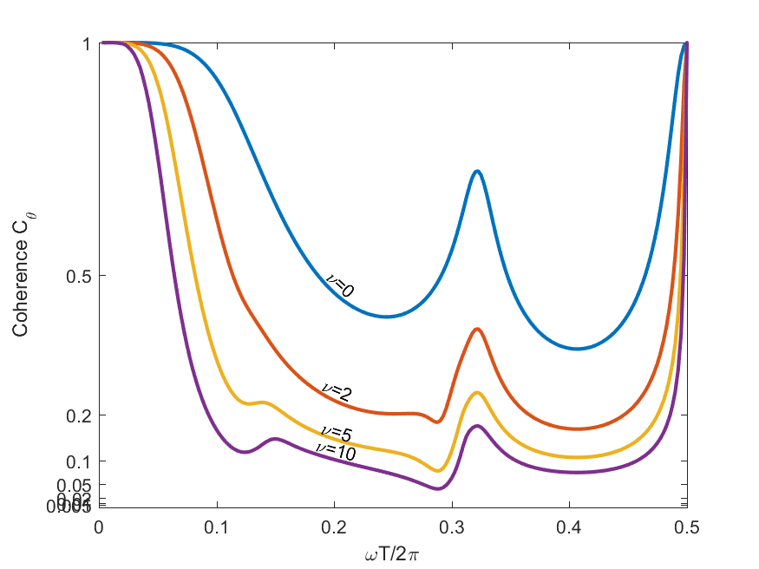
8. Rotation: Alignment and angle-locking
Our starting point is excellent:
Gabriel Hetet observed alignment in the Paul trap (you may then rotate the
NV axis to the direction of the magnetic quantum axis by rotating the ion trap axis)
2. Gabriel also observed at high magnetic fields that the NV becomes diamagnetic,
Thereby aligning automatically with the magnetic field.
Let’s assume we can cool to the rotation ground state, we still have some rotation!
Δθ Δω = ℏ/2I
100 μs
Yonathan Japha and Ron Folman
Role of rotations in Stern-Gerlach interferometry with massive objects
https://arxiv.org/abs/2202.10535 (2022)

Slide 23
9. Advanced fabrication is required

Slide 24
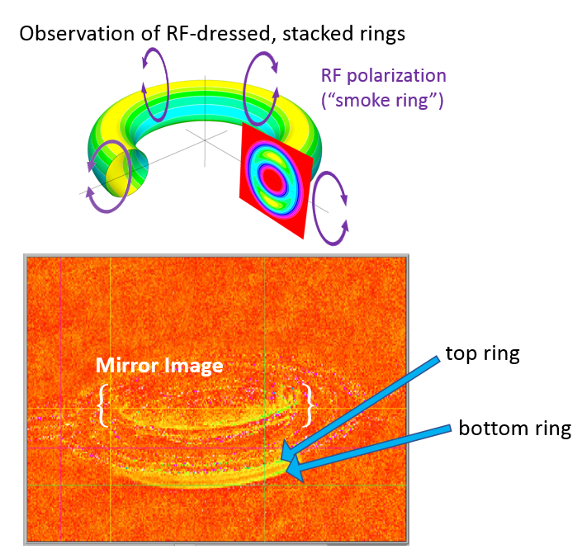
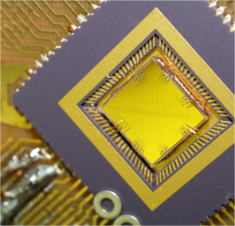
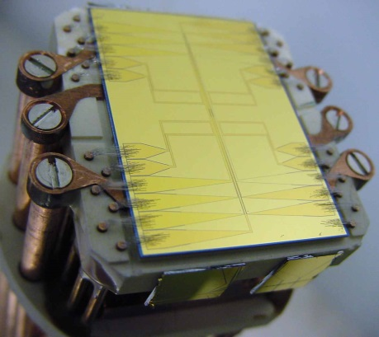
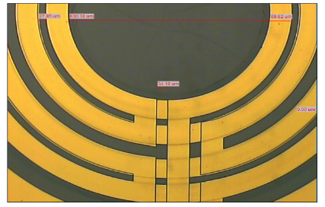
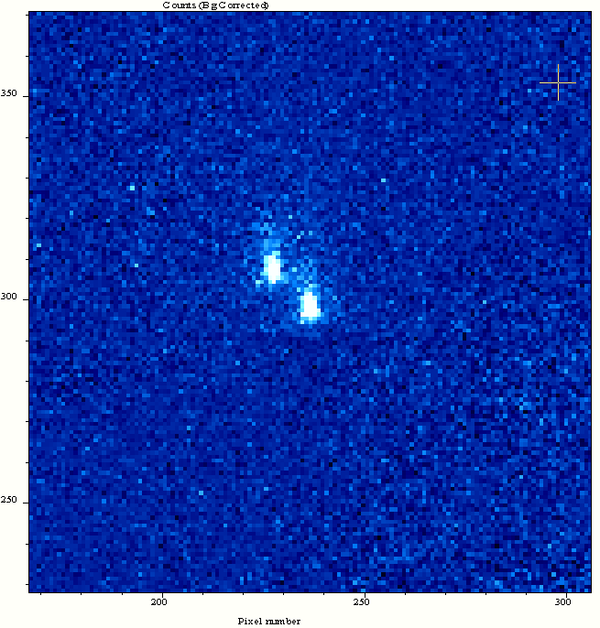
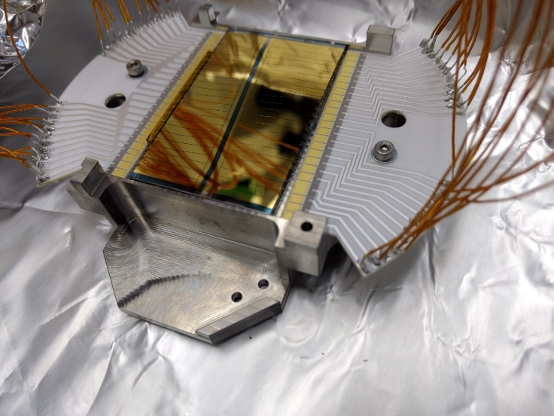
Previous work in fabrication
Flash examples of fabrication in our lab for labs around the world:
For Thomas Fernholz (Nottingham, 2022)
Shown: a loaded BGU 4-layer atom chip
For Joerg Schmiedmayer (Heidelberg).
Published in Science 2008.
For Ferdinand Schmidt-Kaler (Mainz)
Shown: a loaded BGU ion chip
The double chip:
Fabrication of diamond pillars and embedded 1x1 μm wires for high gradients
Double (ITO) BGU ion chip (for anti-hydrogen sympathetic cooling CERN and Ferdinand Schmidt-Kaler). Right: Trapped ions.
We will use exactly the same chip for our SGI chip experiment.
Highly homogeneous nano-diamonds (ND)
etched on the surface (fabricated in BGU).
This will be our ND source
(in the real source the ND density will be much larger). The NDs will leave the surface
by laser-shockwave of transducer vibrations.
BGU highly accurate 1x1 μm current-carrying wire embedded inside the substrate for maximal heat dissipation.
Also the chemical composition must be carefully controlled to achieve extreme current density of 10^9 A/cm^2.

Slide 25
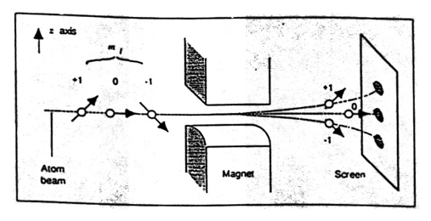
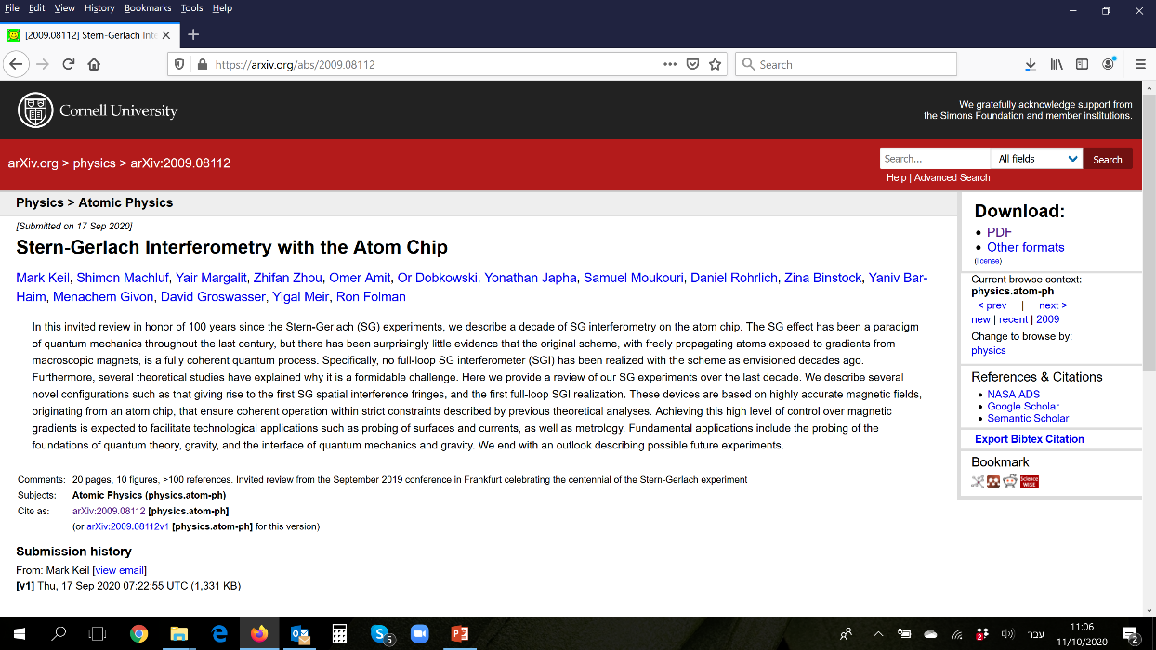
Conclusions
A hard experiment! Numerous cutting-edge technologies.
But at the end of the day, it seems feasible.
It seems the SG effect is far from completing its historical role.
Once working, will shed new light on numerous questions,
including collapse, decoherence, quantum-gravity, and more.
Thanks to the groundbreaking works on: ground-state cooling by Aspelmeyer/Novotny, Stickler/Novotny for rotation cooling, Hetet for nano-diamond manipulation, Brian D’Urso and so on, we are one step closer to realizing the above.
Thanks to
Mark Keil

Slide 26

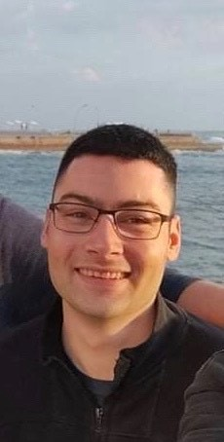
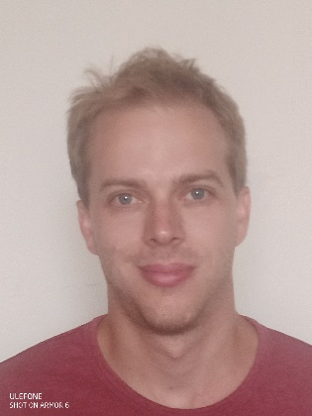
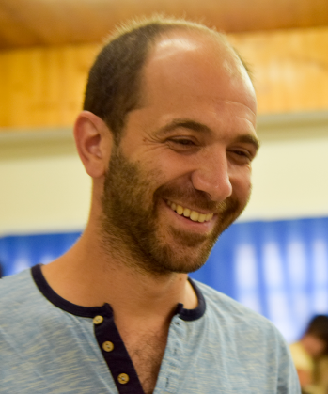
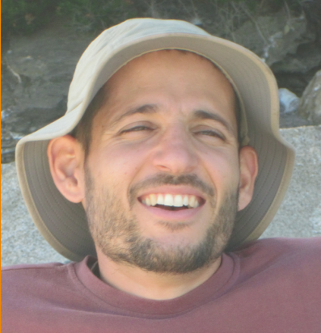
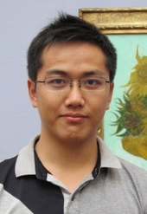
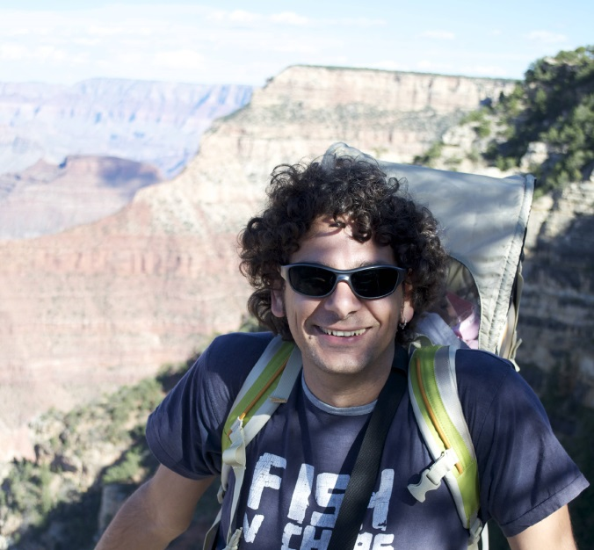
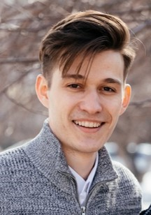

Thanks for your
attention
Always searching for excellent students
and post-docs
The SG Team
(@MPQ)
(@MIT)
(@NIST)
(@Amsterdam)
Barak Trok,
Omer Amit, Or Dobkowski, Yair Margalit, Zhifan Zhou, Shimon Machluf, Dmitrii Kapusta
(With theoretical BGU support by Yonathan Japha, Samuel Moukouri, Daniel Rohrlich,
Yigal Meir, Baruch Horowitz, and international theory collaborators:
Sougato Bose, Anupam Mazumdar, Juan Pablo Paz,
Matthias Zimmermann, Maxim Efremov, Wolfgang Schleich, Carsten Henkel)
Thanks also to Zina Binstock, Yaniv Bar-Haim, David Groswasser,
Meni Givon, and Mark Keil
Atom Chip Group http://www.bgu.ac.il/atomchip/

