Slide 1









Estimating anomalous weak values via a single photon detection
F. Piacentini, E. Rebufello, A. Avella, M. A. de Souza, M. Gramegna, J. Dziewior, E. Cohen, L. Vaidman, R. Lussana, F. Villa, A. Tosi, F. Zappa, I. P. Degiovanni, M. Genovese
Fabrizio Piacentini, HAGQCM, Frascati, November 2nd 2022

Slide 2
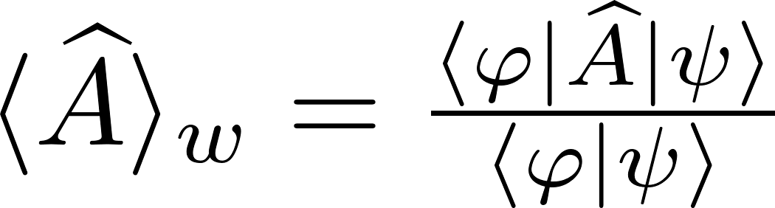

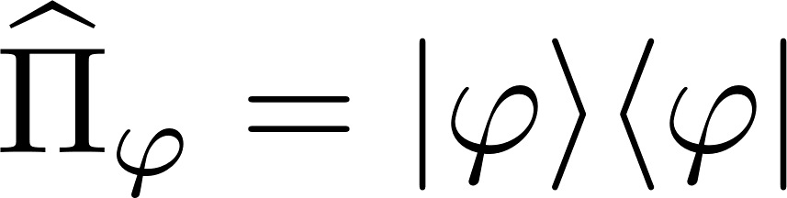
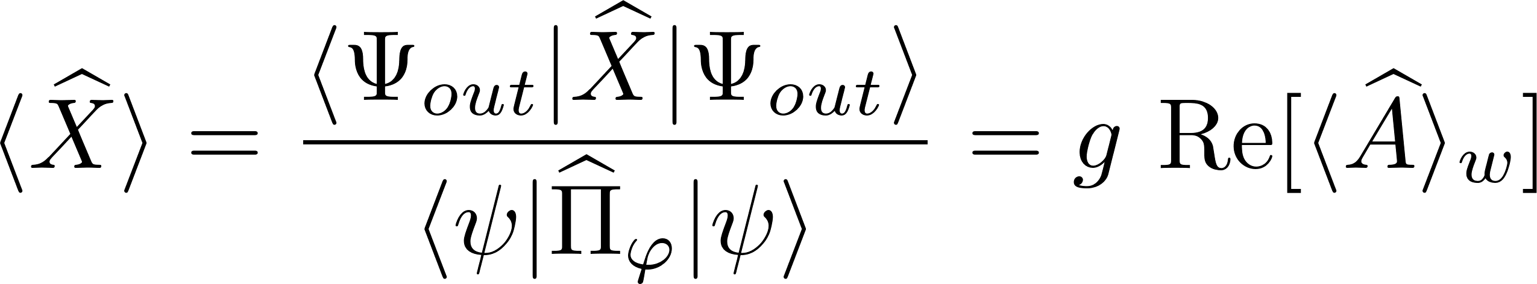

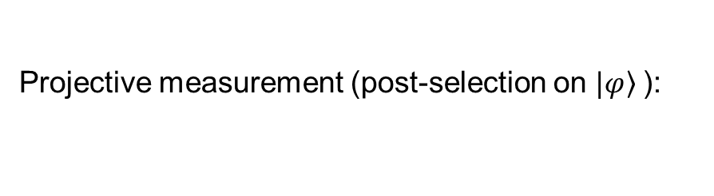
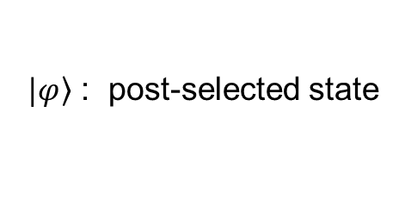
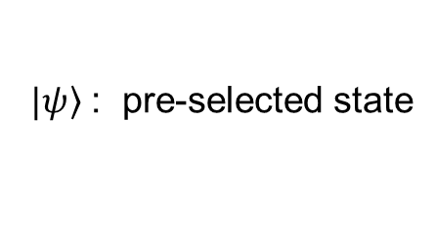
Weak values
Weak measurements [Aharonov, Albert and Vaidman, PRL 60 (1988)]: little information is extracted from a single measurement event, but the state does NOT collapse.
$\left.|ψ\right\rangle$ : pre-selected state
Weak value:
$\left.|φ\right\rangle$ : post-selected state
Von Neumann coupling between an observable $\hat{A}$ and a pointer observable $\hat{P}$:
Projective measurement (post-selection on $\left.|φ\right\rangle$):
and h
canonically conjugated
Weak interaction (1° order approximation):
Fabrizio Piacentini, HAGQCM, Frascati, November 2nd 2022

Slide 3
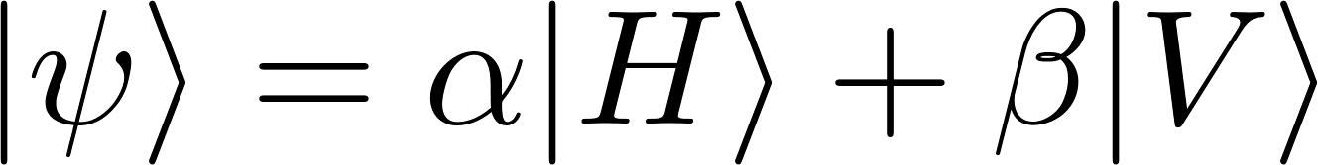

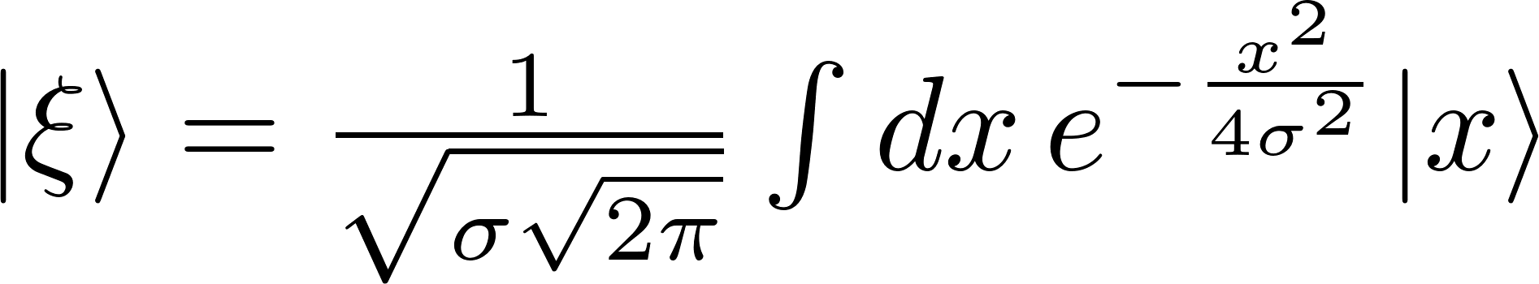
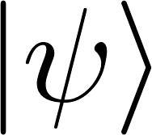
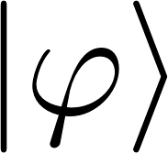
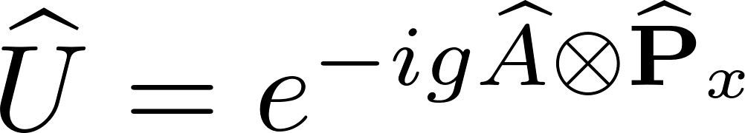
Weak values
Possible implementation
Metrology:
Amplification of coupling strength [Boyd et al.]:
Light beam displacement [Kwiat et al.]
Angular deflection [Dixon et al.]
…
Quantum Foundations:
Direct measurement of the wave function [Lundeen et al.]
Measurement of incompatible observables on the same particle [Mitchinson et al., Piacentini et al., Thekkadath et al., …]
Quantumness tests [Pusey, Piacentini et al., Goggin et al., Avella et al., Kunjwal et al., …]
Hints on Quantum Mechanics interpretations [Aharonov et al., TSVF, …]
Initial state:
Birefringent
crystal
Polarizer
Little information form a single measurement event
Averaging on multiple detection events is needed
Is it possible to extract (anomalous) weak values with just a single event?
Fabrizio Piacentini, HAGQCM, Frascati, November 2nd 2022

Slide 4

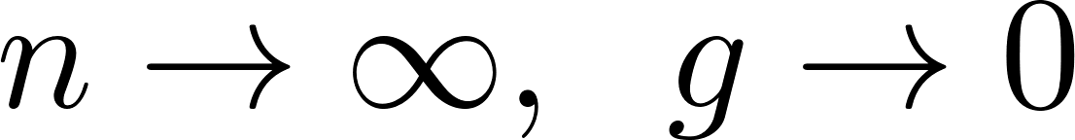
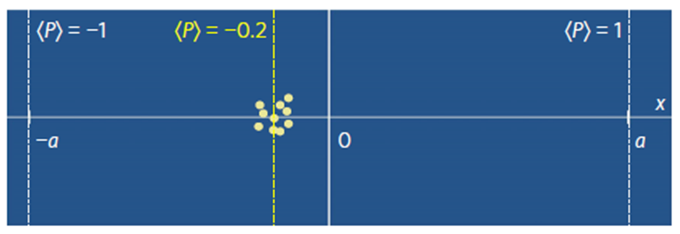
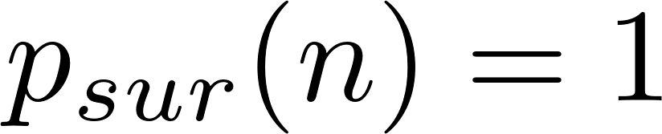
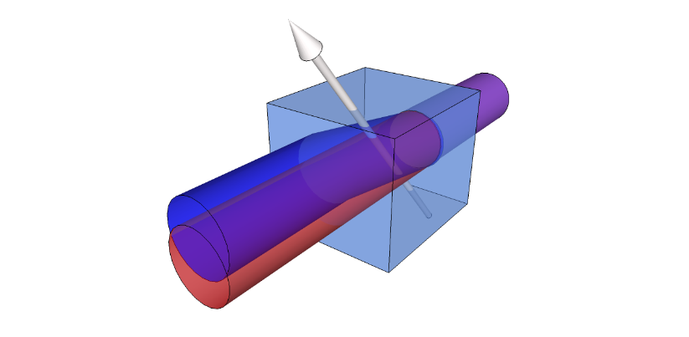
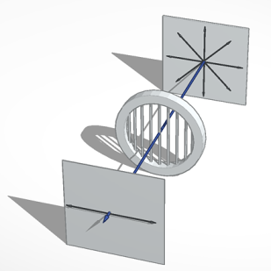
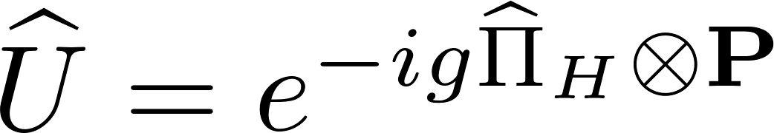
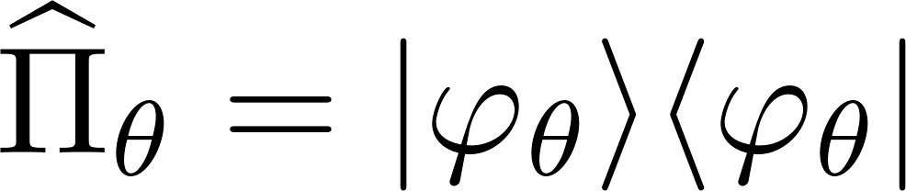


Preliminary step: extracting the expectation value with a single click
Protective Measurement (PM): the interaction is smooth enough to leave the state unchanged. The pointer shift is proportional to the average value of the observable [Aharonov and Vaidman, Phys. Lett. A 178, 38 (1993)]
Ideal case:
…
No losses, photon survival
probability
step 1
Step $n$
Fabrizio Piacentini, HAGQCM, Frascati, November 2nd 2022

Slide 5
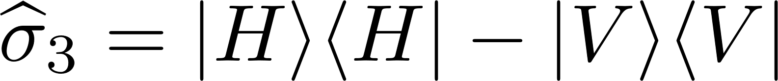



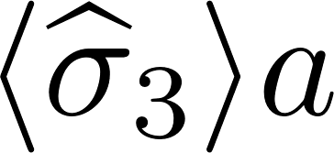
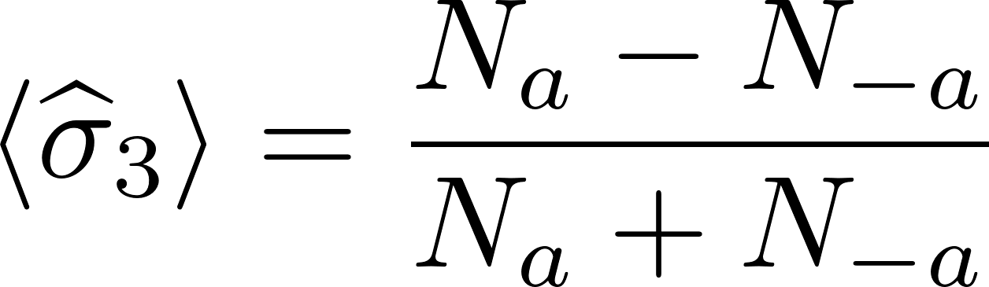
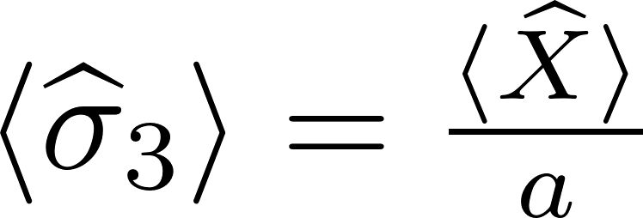
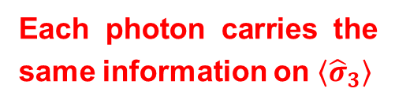
Preliminary step: extracting the expectation value with a single click
Protective Measurement (PM): the interaction is smooth enough to leave the state unchanged. The pointer shift is proportional to the average value of the observable [Aharonov and Vaidman, Phys. Lett. A 178, 38 (1993)]
Measured observable:
Projective measurement
Protective measurement
Each photon carries the same information on $\left\langle {\hat{σ}}_{3}\right\rangle$
Fabrizio Piacentini, HAGQCM, Frascati, November 2nd 2022

Slide 6
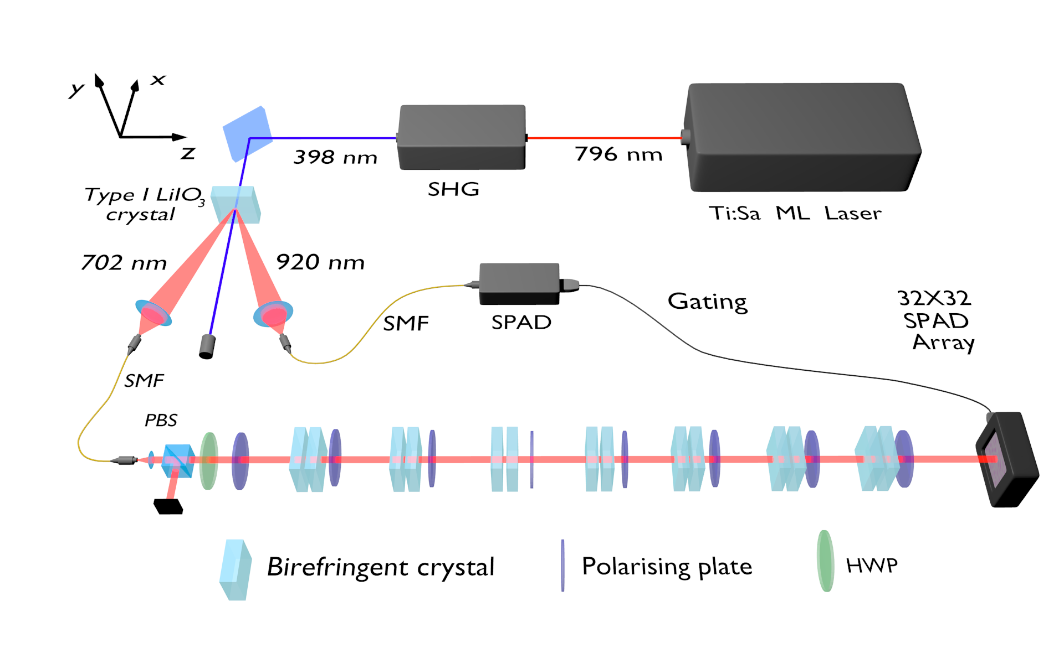
Protective measurements in the lab
Fabrizio Piacentini, HAGQCM, Frascati, November 2nd 2022

Slide 7
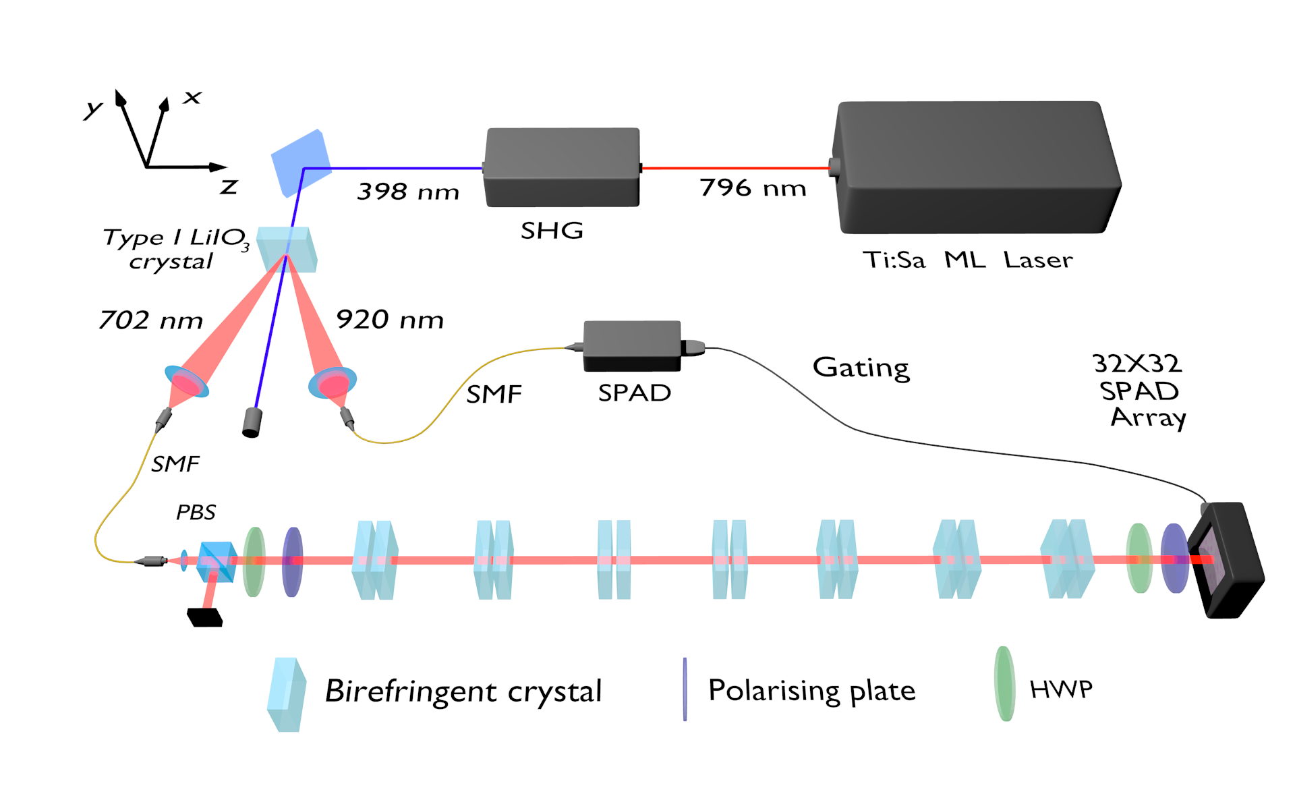
Projective measurements in the lab
Fabrizio Piacentini, HAGQCM, Frascati, November 2nd 2022

Slide 8
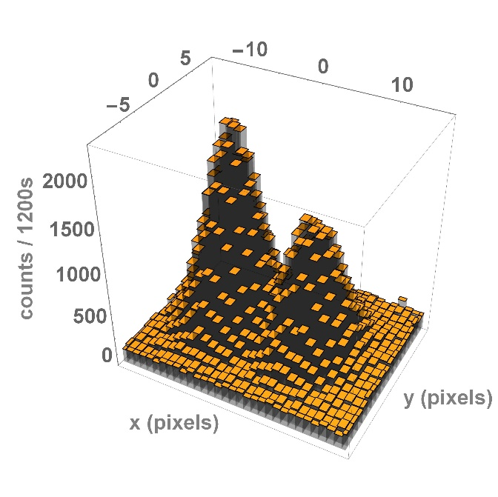
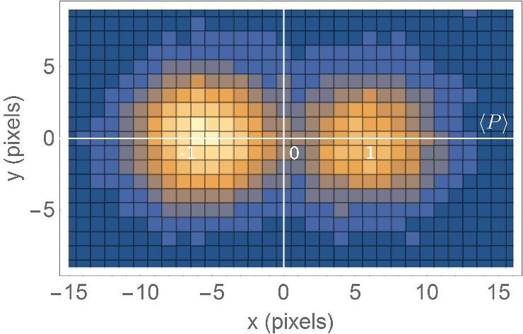
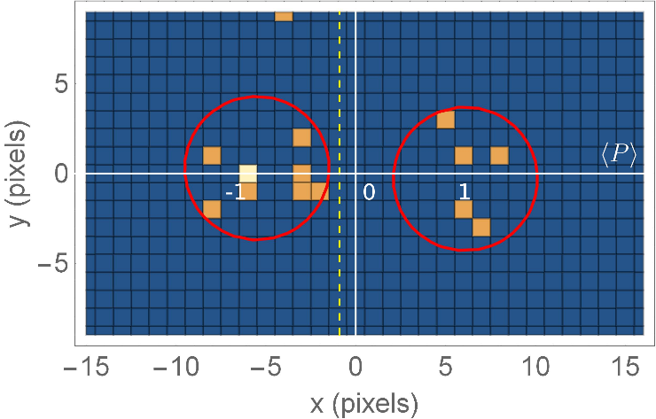
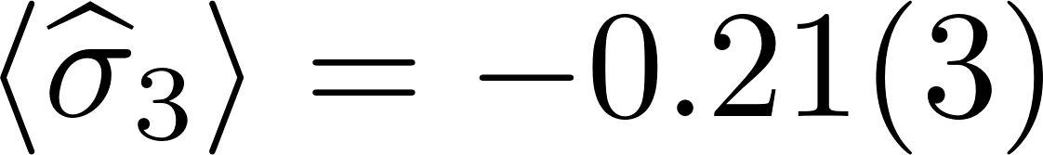
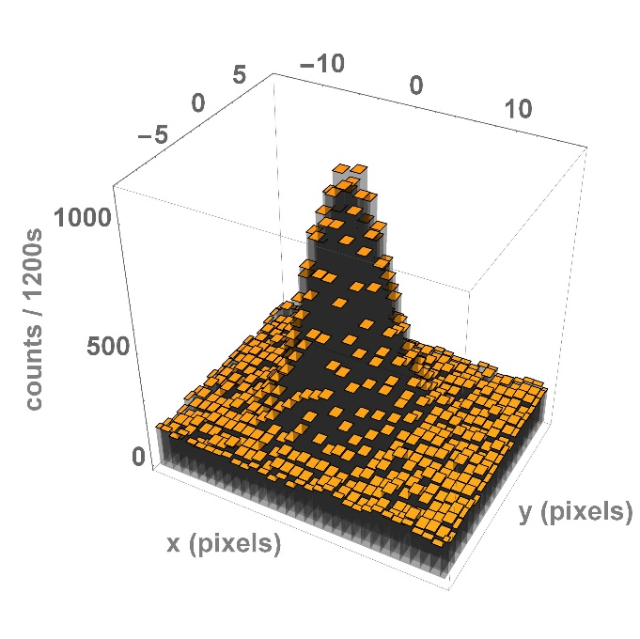
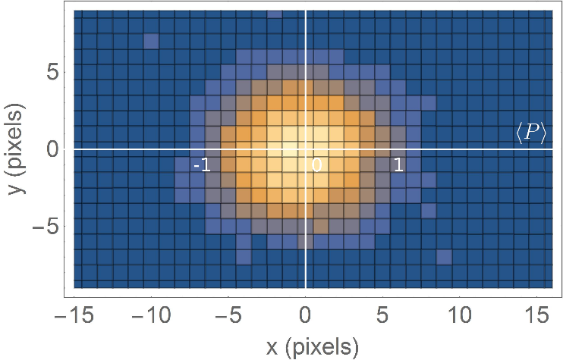
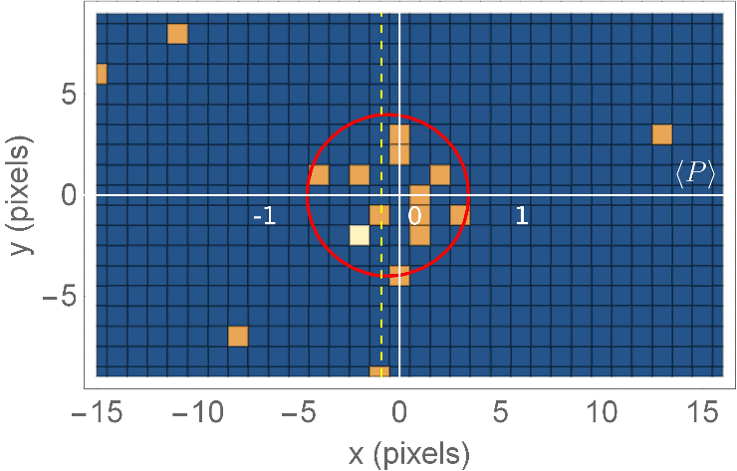
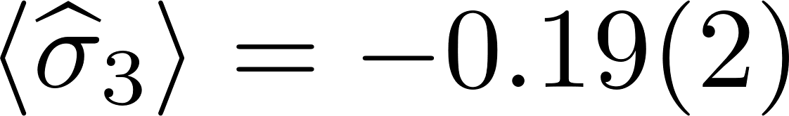
Experimental results
Nat. Phys. 13, 1191 (2017)
Projective measurement
Protective measurement
Fabrizio Piacentini, HAGQCM, Frascati, November 2nd 2022

Slide 9
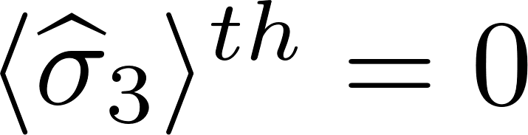
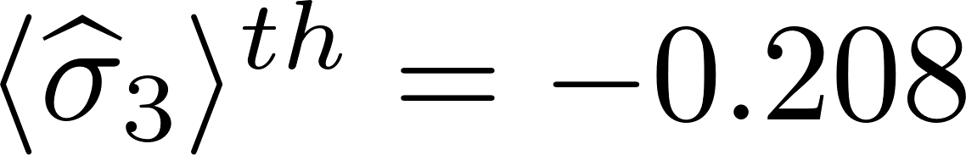
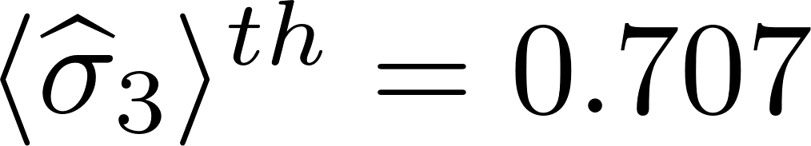
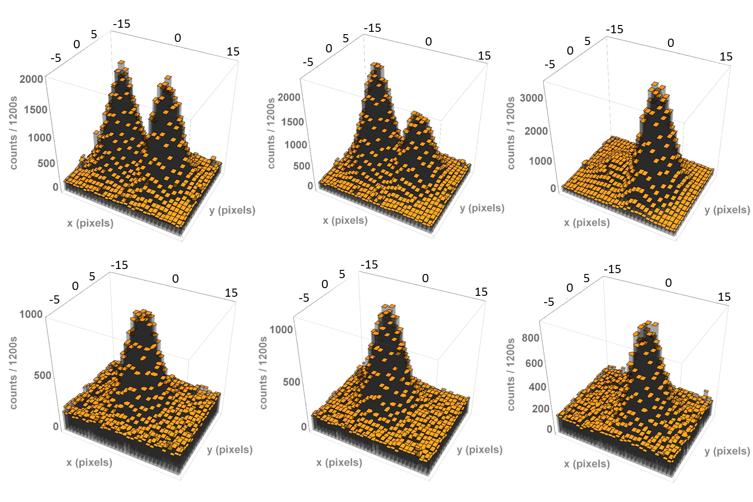
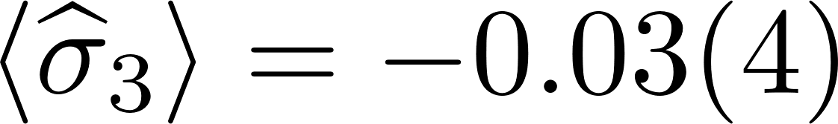
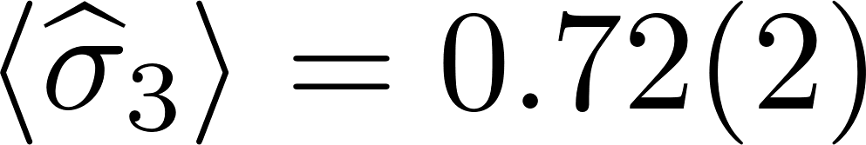
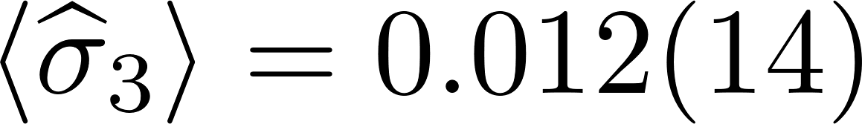
Experimental results
Nat. Phys. 13, 1191 (2017)
Fabrizio Piacentini, HAGQCM, Frascati, November 2nd 2022

Slide 10
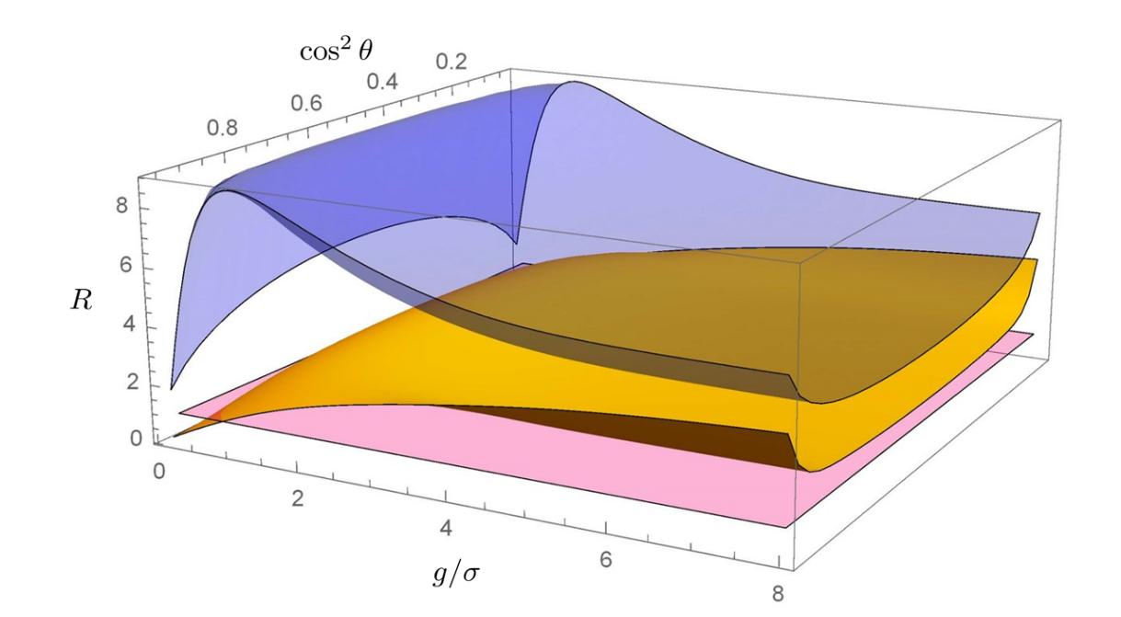
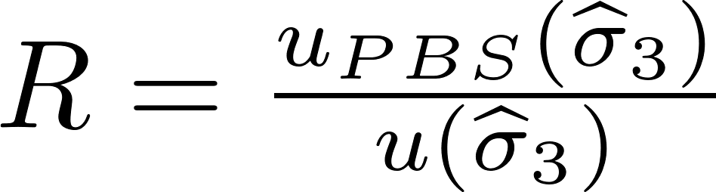
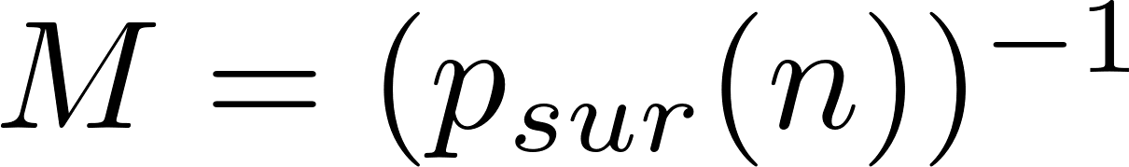
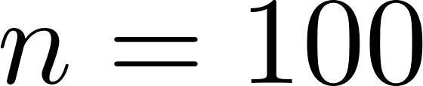
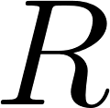
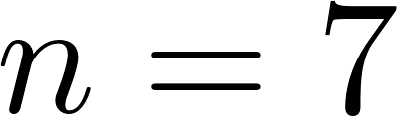
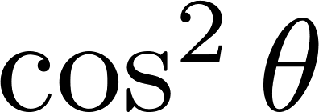
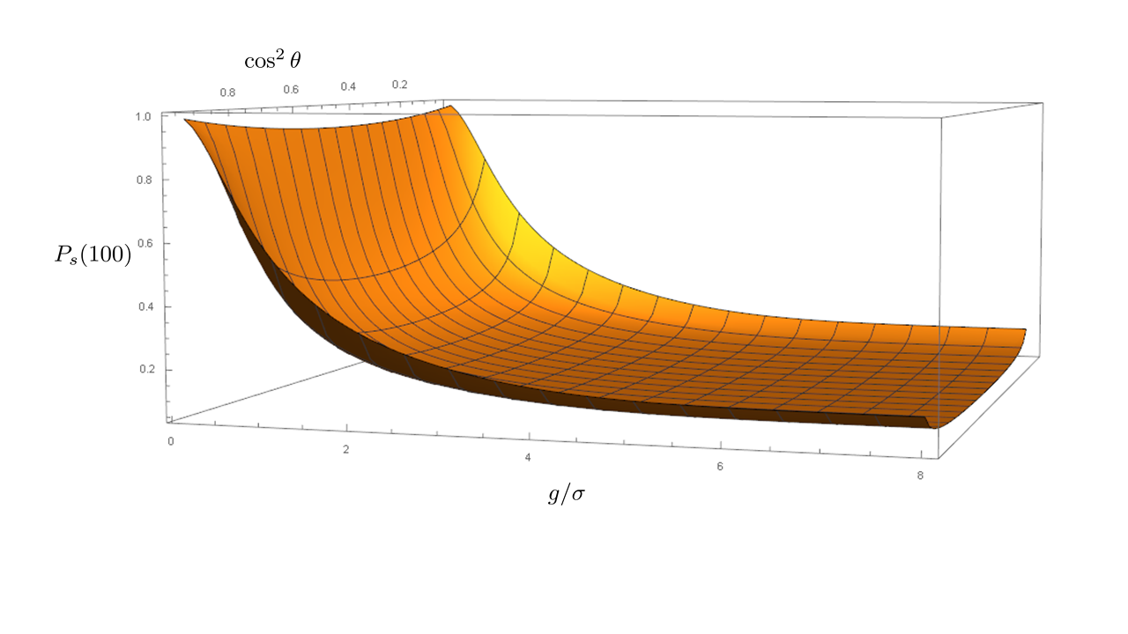
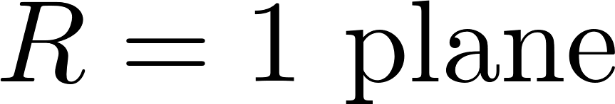
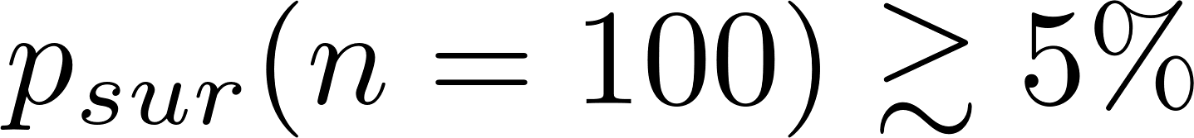



How precise can Protective Measurements be?
Comparing the uncertainty on ${\hat{σ}}_{3}$ given by a $n$-step Protective Measurement ($u\left({\hat{σ}}_{3}\right)$) with the one obtained with a projective measurement ($u_{PBS}\left({\hat{σ}}_{3}\right)$):
Fair comparison:
particles considered for both protocols.
$u\left({\hat{σ}}_{3}\right)<u_{PBS}\left({\hat{σ}}_{3}\right)$, even though in this framework projective measurements saturate the Quantum Cramér-Rao bound!
0.8
0.6
0.4
0.2
0
1.0
0.8
0.6
Nat. Phys. 13, 1191 (2017)
Where does this advantage stem from?
0.4
0.2
0
2
4
6
8
Fabrizio Piacentini, HAGQCM, Frascati, November 2nd 2022

Slide 11
Anomalous weak values with a single click: the Robust Weak Measurement
Fabrizio Piacentini, HAGQCM, Frascati, November 2nd 2022

Slide 12



Weak values with a single measurement event
Robust Weak Measurement: iterative measurement protocol able to extract the weak value of an observable from a single (post-selected) quantum system.
Pre-selection
…
Weak interaction
step 1
step $n$
Post-selection
Anomalous case:
Fabrizio Piacentini, HAGQCM, Frascati, November 2nd 2022

Slide 13








Weak values with a single measurement event
Robust Weak Measurement: iterative measurement protocol able to extract the weak value of an observable from a single (post-selected) quantum system.
Pre-selection
…
Weak interaction
step 1
step $n$
Post-selection
High resolution: large $n$, small $g$
: small $n$
Trade-off conditions for the choice of the ideal $n$ and $g$
[Piacentini et al., Sci. Rep. 8, 6959 (2018)]
Fabrizio Piacentini, HAGQCM, Frascati, November 2nd 2022

Slide 14




Analogy: weak measurement on an $n$-particle system
Measured quantity:
Unitary transformation:
Measuring device $M$ coupled to $n$ particles of a pre- and postselected system.
Measuring device $M$ coupled to the same particle $n$ times, each with particular pre- and postselection.
Fabrizio Piacentini, HAGQCM, Frascati, November 2nd 2022

Slide 15
Robust Weak Measurement in the lab
Fabrizio Piacentini, HAGQCM, Frascati, November 2nd 2022

Slide 16



Robust Weak Measurement in the lab
Fabrizio Piacentini, HAGQCM, Frascati, November 2nd 2022

Slide 17

Robust Weak Measurement in the lab
Fabrizio Piacentini, HAGQCM, Frascati, November 2nd 2022

Slide 18








RWM parameters: fine tuning
21.0
17.5
14.0
10.5
7.0
g
Fabrizio Piacentini, HAGQCM, Frascati, November 2nd 2022

Slide 19




RWM: experimental results
Light: Sci. & Appl. 10:106 (2021)
Single-click anomalous weak value with a three standard deviations separation from the closest eigenvalue
Fabrizio Piacentini, HAGQCM, Frascati, November 2nd 2022

Slide 20

RWM: experimental results
Light: Sci. & Appl. 10:106 (2021)
Fabrizio Piacentini, HAGQCM, Frascati, November 2nd 2022

Slide 21
Summary
We experimentally demonstrated the possibility to achieve an (anomalous) weak value from a single detection event, without averaging on repeated acquisitions.
Preliminary step: experimental implementation of Protective Measurement, able to extract the expectation value of an observable from a single measured particle.
Final result: realization of the first Robust Weak Measurement, obtaining a single-click anomalous weak value with a three-standard-deviations separation from the closest eigenvalue.
Our findings stress the single-particle nature of weak values, overcoming some of the criticisms on their “anomalous nature” being purely statistical and not strictly quantum [Ferrie & Combes].
Possible practical application: implementation of novel amplification methods effectively reducing the uncertainty contribution associated with the measurement of the pointer.
Fabrizio Piacentini, HAGQCM, Frascati, November 2nd 2022

Slide 22






Credits
Enrico Rebufello
Fabrizio Piacentini
Alessio Avella
Marco Gramegna
Giorgio Brida
Ivo P. Degiovanni
Marco Genovese
Muriel A. de Souza
Eliahu Cohen
Lev Vaidman
Jan Dziewior
Rudi Lussana
Federica Villa
Alberto Tosi
Franco Zappa
Nat. Phys. 13, 1191 (2017)
Light: Sci. & Appl. 10:106 (2021)
Fabrizio Piacentini, HAGQCM, Frascati, November 2nd 2022

Slide 23



RWM: sensitivity study
Weak value
Associated single-click uncertainty (final width of the photon distribution)
Initial width of the photon distribution
Dots: theoretical values for acquisition (a), with $β=2.53$
Fabrizio Piacentini, HAGQCM, Frascati, November 2nd 2022

Slide 24

Genetic Quantum Measurement
A bio-inspired measurement paradigm
Fabrizio Piacentini, HAGQCM, Frascati, November 2nd 2022

Slide 25





Let’s toss a (quantum) coin
Classical coin:
Quantum coin:
Q-mint
(state filter)
Quantum mint fairness observable:
Quantum Cramér-Rao bound:
Quantum coins perform exactly like classical ones: quantum mechanics gives no help
… or does it?
Fabrizio Piacentini, HAGQCM, Frascati, November 2nd 2022

Slide 26












A new paradigm: Genetic Quantum Measurement
Paradigm shift: K steps iterative measurement protocol.
Q-Mint
(state filter)
Q-Mint
(state filter)
Interaction
+
Interference
Q-Mint
(state filter)
Interaction
+
Interference
Q-Mint
(state filter)
Q-Mint
(state filter)
Interaction
…
…
…
Step
GQM mimicks the evolution mechanisms of mutation, selection and crossover: a genetic-like approach to quantum measurement, even though at the cost of some losses:
Photon survival probability:
Fabrizio Piacentini, HAGQCM, Frascati, November 2nd 2022

Slide 27


How precise can GQM be?
Comparing the uncertainty on $\hat{P}$ given by a $n$-step GQM ($u\left(\hat{P}\right)$) with the one obtained with a projective measurement ($u_{PBS}\left(\hat{P}\right)$):
Fair comparison:
particles considered for both protocols.
$u\left(\hat{P}\right)<u_{PBS}\left(\hat{P}\right)$, even though in this framework projective measurements saturate the Quantum Cramér-Rao bound!
Nat. Phys. 13, 1191 (2017)
Where does this advantage stem from?
Fabrizio Piacentini, HAGQCM, Frascati, November 2nd 2022

Slide 28

The experiment
K = 7
Fabrizio Piacentini, HAGQCM, Frascati, November 2nd 2022

Slide 29





Results
Fabrizio Piacentini, HAGQCM, Frascati, November 2nd 2022

Slide 30



Results
Fabrizio Piacentini, HAGQCM, Frascati, November 2nd 2022

Slide 31





GQM: better than optimal?
Let’s consider the uncertainty scaling with respect to the amount of initial states M:
In this framework, projective measurements are the optimal ones, saturating the Quantum Cramér-Rao bound. How can GQM go beyond it??
Fisher information associated to the POVM exploited for the estimation of λ:
The optimal estimation saturates the QFI J(λ)
We are outside this framework, since our POVM depends on the parameter to be estimated because of the selection : new bounds have to be considered!
Fabrizio Piacentini, HAGQCM, Frascati, November 2nd 2022

Slide 32



How precise can Protective Measurements be?
Comparing the uncertainty on $\hat{P}$ given by a $n$-steps Protective Measurement ($u\left(\hat{P}\right)$) with the one obtained with a projective measurement ($u_{PBS}\left(\hat{P}\right)$):
Fair comparison:
particles considered for both protocols
Nat. Phys. 13, 1191 (2017)
$u\left(\hat{P}\right)<u_{PBS}\left(\hat{P}\right)$, even though in this framework projective measurements saturate the Quantum Cramér-Rao bound!
Fabrizio Piacentini, HAGQCM, Frascati, November 2nd 2022

Slide 33

Weak values
Weak value [Aharonov, Albert and Vaidman, PRL 60 (1988)]:
Metrology:
Amplification of coupling strength [Boyd et al.]:
Light beam displacement [Kwiat et al.]
Angular deflection [Dixon et al.]
…
Quantum Foundations:
Direct measurement of the wave function [Lundeen et al.]
Measurement of incompatible observables on the same particle [Mitchinson et al., Piacentini et al., Thekkadath et al., …]
Quantumness tests [Pusey, Piacentini et al., Goggin et al., Avella et al., …]
Hints on Quantum Mechanics interpretations [TSVF, Aharonov et al., …]
Initial state:
Birefringent
crystal
Polarizer
Is it possible to extract (anomaolus) weak values with just a single event?
Fabrizio Piacentini, HAGQCM, Frascati, November 2nd 2022

