Slide 1
Preparation of tests of CP invariance in the lepton sector using ortho-positronium annihilation
Damir Bosnar and Ivica Friščić*
Department of Physics
Faculty of Science
University of Zagreb
The Hitchhiker’s Advanced Guide to Quantum Collapse Models
and their impact in science, philosophy, technology and biology
Laboratori Nazionali di Frascati 31.10.-04.11. 2022.
*Horizon 2020 Widening fellowship 2021-2023

Slide 2
Motivation
Matter-antimatter asymmetry
Sakharov’s explanation requires CP violation (Z. Eksp. Teor. Fiz. 5, 32–35 (1967)
CP violation observed in the quark sector, but too small (
No CP violation observed in the lepton sector so far
Some theories assume CP violation in lepton sector, which could fulfill Sakharov’s requirement
Hint in experiments with neutrino oscillations, Kamiokande exp. (K. Abe, et al., Nature 580, 339–344 (2020))
It can be also investigated in ortho-positronium annihilation, table-top experiment, the most precise measurement up to date puts a limit on 10⁻³; limit of the Standard model is ~ 10⁻⁹ (W. Bernreuther, et al., Z. phys. C 41, 143 (1988) )

Slide 3
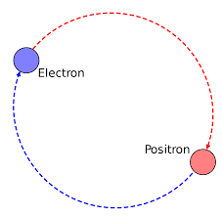
Positronium: para-positronium, ortho-positronium
Positronium: electron-positron bound state
predicted by S. Mohorovičić Astron. Nachr. 253 (1934) 94
discovered by M. Deutsch Phys. Rev. 82 (1951) 455
Para-positronium (p-Ps): S=0, Sz=0, Mean lifetime approx. 125 ps,
Decay mode: 2,4,6, …2n γ
Ortho-positronium (o-Ps): S=1, S_{z}=-1,0,1, Mean lifetime approx. 142 ns,
Decay mode:3,5,7,… (2n+1) γ

Slide 4
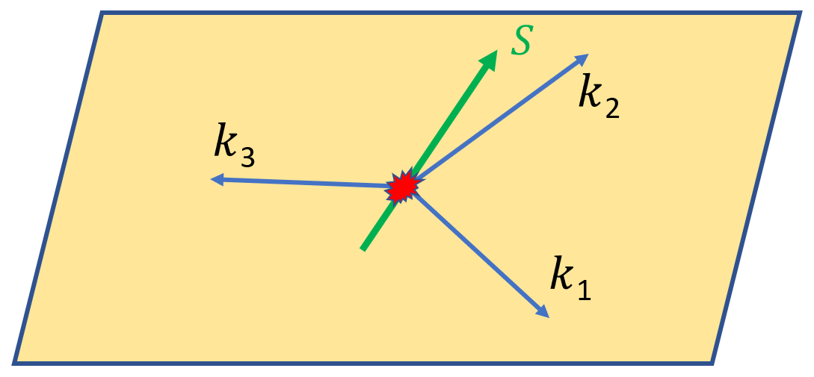
Ortho-positronium annihilation: mainly in 3γ, decay is in a plane, τ approx. 142 ns
o-Ps
E=1.022 MeV
Para-positronium annihilation: mainly in two back-to-back gammas, τ approx. 125 ps
γ₂
γ₁
p-Ps

Slide 5
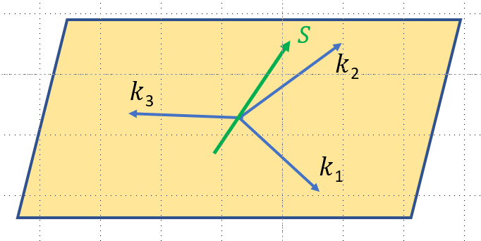
If CP is not conserved in o-Ps annihilation, the annihilation rate should be dependent on CP violating term
H.Cheng, Phys. Rev. D28 (1983) 150)
N(t)=N₀[1+C_{CP}($\vec{S}∙ \vec{k}$₁)($\vec{S}∙ \vec{k}$₁x $\vec{k}2$)] $e^{−t/τ}$
k_{i} is direction of
ith gamma
τ is o-Ps lifetime
C_{CP} is amplitude of CP
violation
S o-Ps spin
k₁ > k₂ > k₃
The standard model prediction for C_{CP} is of the order of 10⁻⁹.
(W. Bernreuther et al. Z. Phys. C41 (1988) 143)

Slide 6
The analyzing power Q is defined:
Q=($\vec{S}∙ \vec{k}$₁)($\vec{S}∙ \vec{k}$₁x $\vec{k}2$)= $\frac{1}{2}∙$P₂ sin2Θ sinψ cosΦ
$$S$$
$$n$$
$$Θ$$
P₂=$\frac{N_{+1 }−2N_{0}+ N_{−1}}{N_{+1 }+N_{0}+ N_{−1}}$
S o-Ps spin
k₁ > k₂ > k₃
$k$₂
$k$₃
$$ψ$$
$$ϕ$$
P₂ is o-Ps spin
alignment
(tensor polarization)
$k$₁
We should somehow distinguish S _{z} =0 and S _{z} = +1, -1 states

Slide 7
How to do the measurement?
Produce Ps
Separate o-Ps
Polarize it
Separate S_{z} = 0 and S_{z} = +1, -1 states
Measure an asymmetry (if exists)

Slide 8
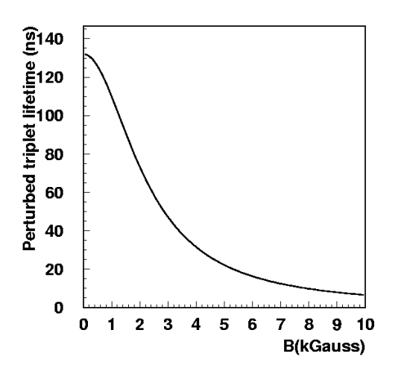
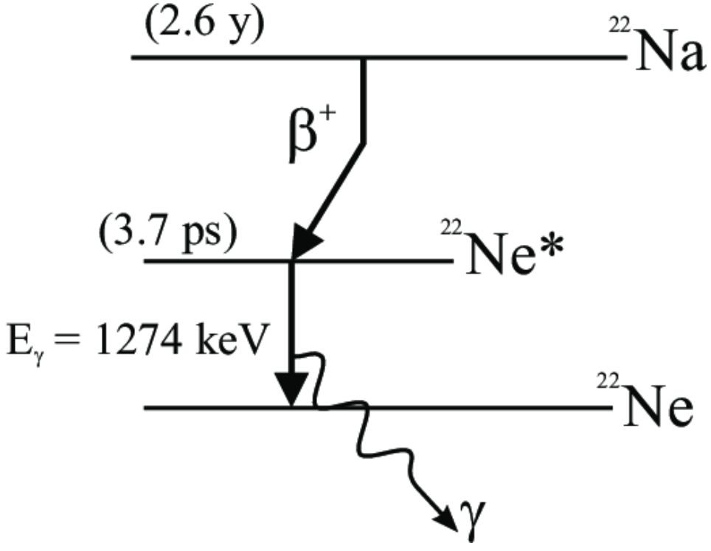
A magnetic field can be used to orient o-Ps spins AND it also perturbs triplet S _{z}=0 state:
In a magnetic field the o-Ps state with S_{z}= 0 and singlet state mix ->
greatly reduced mean lifetime of triplet S_{z} =0 state,
e.g. for 0.5 T to approx. 22 ns
Mean lifetime of triplet S_{z}= +1, and S_{z}= -1 states unchanged ~142 ns.
Q=($\vec{S}∙ \vec{k}$₁)($\vec{S}∙ \vec{k}$₁x $\vec{k}2$)= $\frac{1}{2}∙$P₂ sin2Θ sinψ cosΦ
P₂ = $\frac{N_{+1 }−2N_{0}+ N_{−1}}{N_{+1 }+N_{0}+ N_{−1}}$
Use ortho-positronium lifetime in a magnetic
field to select the Sz=+1,-1 states
(positron annihilation spectroscopy method)
Figure: M. Felcini, Int. J. Mod. Phys A19 (2004) 3853

Slide 9
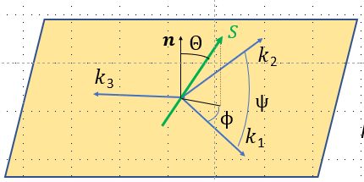
Most precise measurement using this method: T. Yamazaki et al Phys. Rev. Lett. 104 (2010) 083401
Q = $\frac{1}{2}∙$P₂ sin2Θ sinψ cosΦ,
Θ and ψ are constant
is asymmetric function of Φ if CP violation exists
C_{CP}Q(Φ)

Slide 10
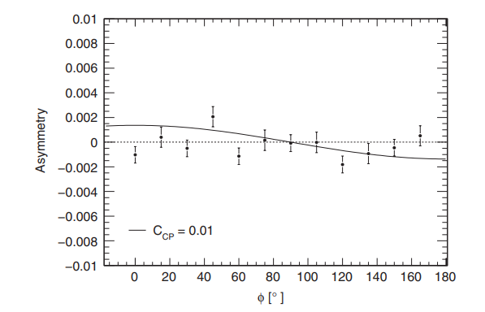
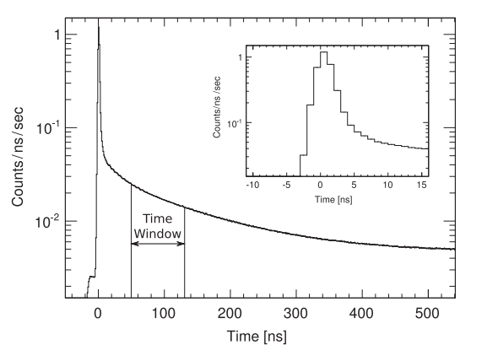
Most precise measurement using this method: T. Yamazaki et al. Phys. Rev. Lett. 104 (2010) 083401
Determined asymmetry:
which is C_{CP}Q(ø)
(Q(Φ) = $\frac{1}{2}∙$P₂ sin2Θ sinψ cosΦ)
The line shows the expected
angular dependence for C_{CP}=0.01
:C_{CP} = 0.0013 $±$ 0.0021 (stat) $±$ 0. 0006 (syst)
P₂=0.87 𝜟t=50-130 ns
Our measurement is using the same approach.

Slide 11
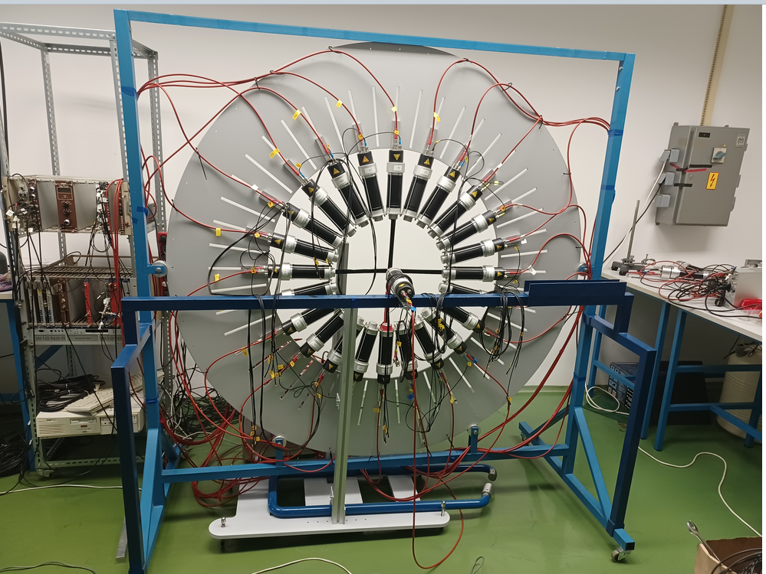
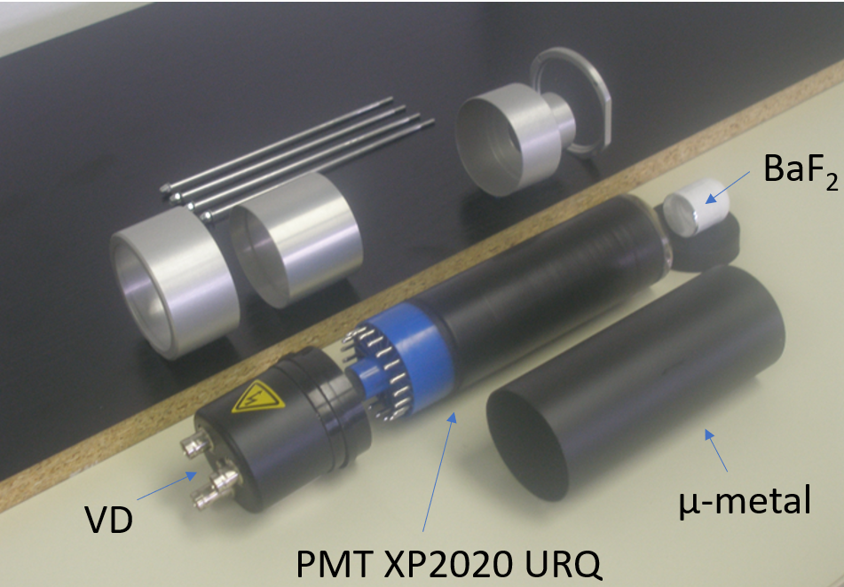
Our measurement: 24 BaF₂ scintillation detectors for detection of gammas from o-Ps annihilation
Each detector:
cylindrical 1”x1” BaF₂ coupled to
Photonis XRQ2020 PMT with
µ-metal shielding
-diameter 48 cm, variable
-rotatable
Built in the framework of diploma work of I. Friščić

Slide 12
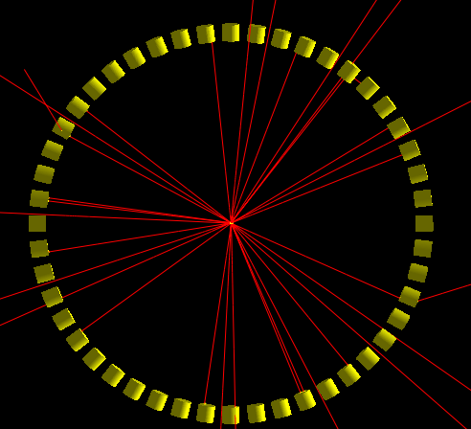
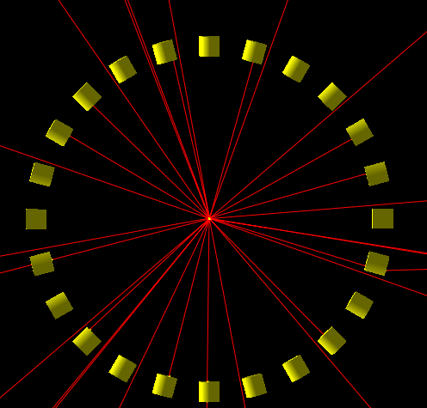
Our measurement: 24 BaF₂ scintillation detectors for detection of gammas from o-Ps annihilation
Altogether 48 detectors,
GEANT4 simulations for
acceptance efficiency, rate,… -> 24 detectors
Recently acquired 2”x1” cylindrical BaF₂

Slide 13
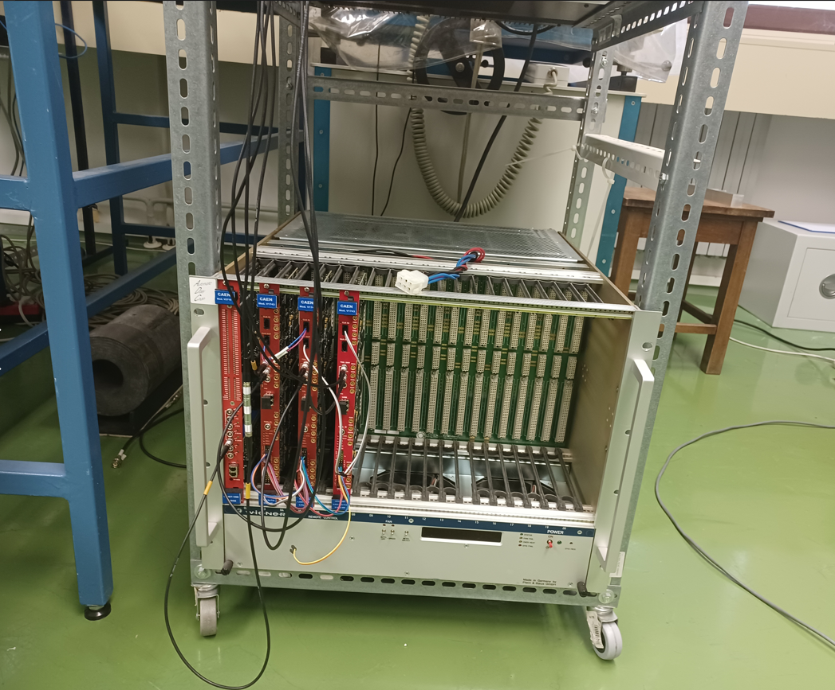
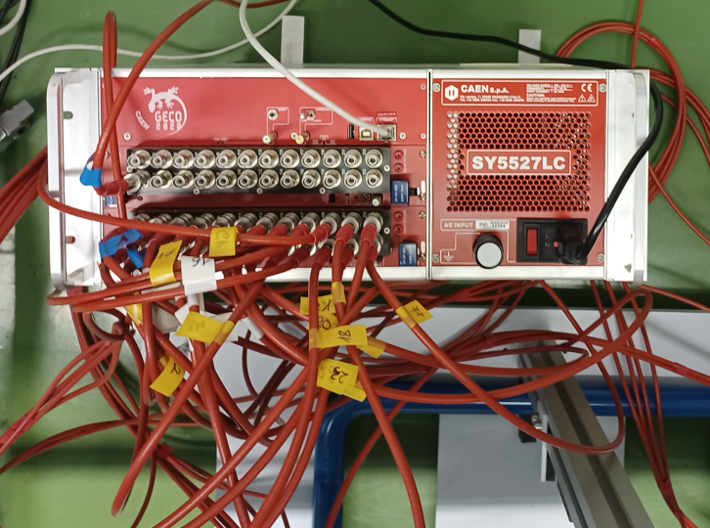
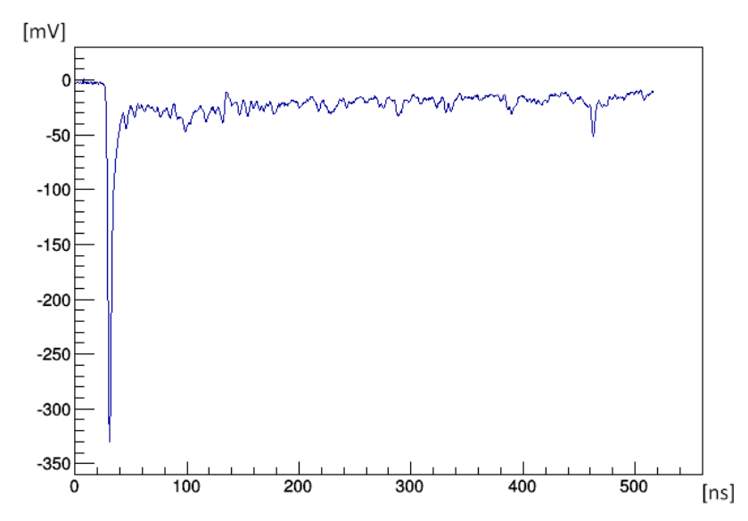
Our measurement: 24 BaF₂ scintillation detectors for the detection of gammas from o-Ps annihilation
Data processing and acquisition:
2 x 16-channel CAEN V1743 fast pulse
digitizers, 3.2 GS/s, 12 bit, OR and AND
capabilities among the channels
This is all electronics
we need to run this
experiment ☺
CAEN 24-channel HV
It processes data and
stores complete signals:
Complexity in off-line
analysis
Large disk storages

Slide 14
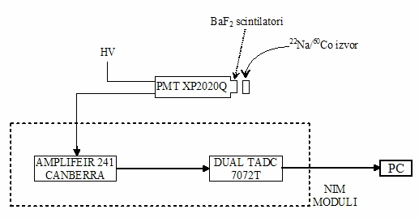
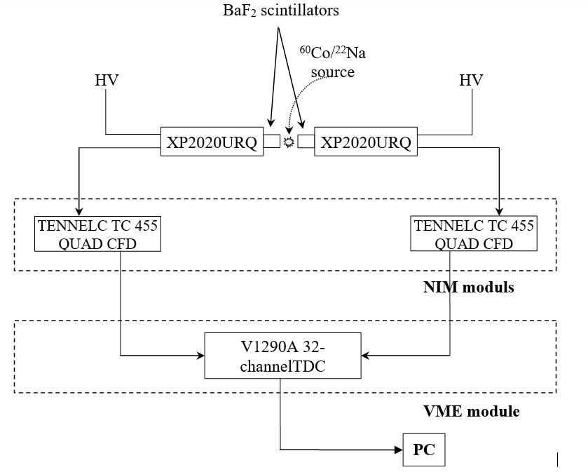
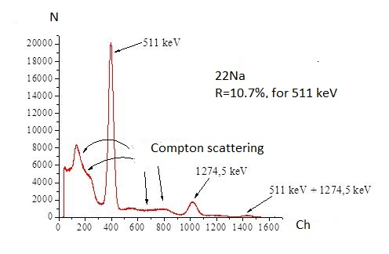
Our measurement: 24 BaF₂ scintillation detectors for the detection of gammas from o-Ps annihilation
Tests of energy and time resolution with
analog electronics:
Energy resolution:
Time resolution:
R(FWHM)=194 ps

Slide 15
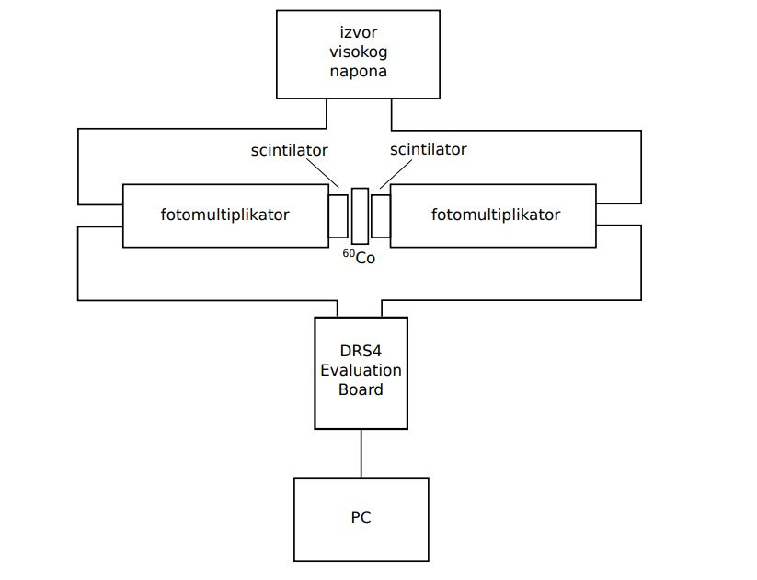
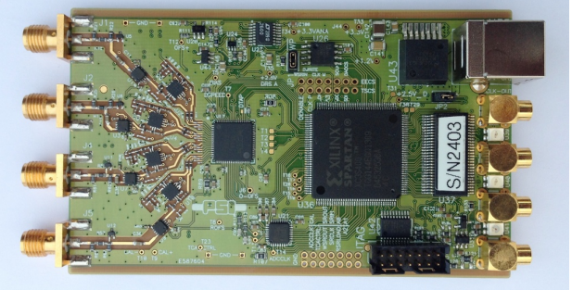
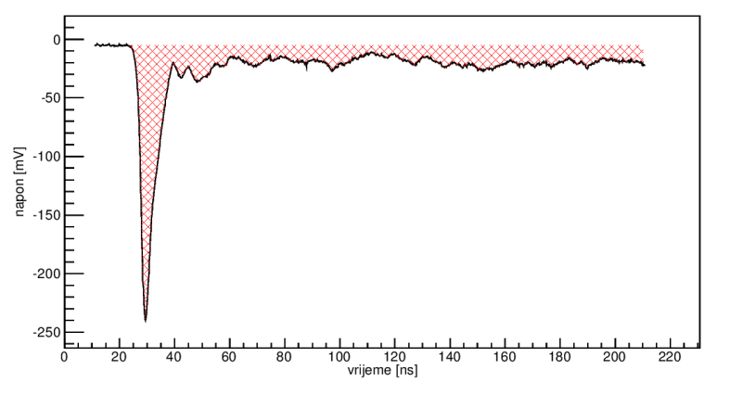
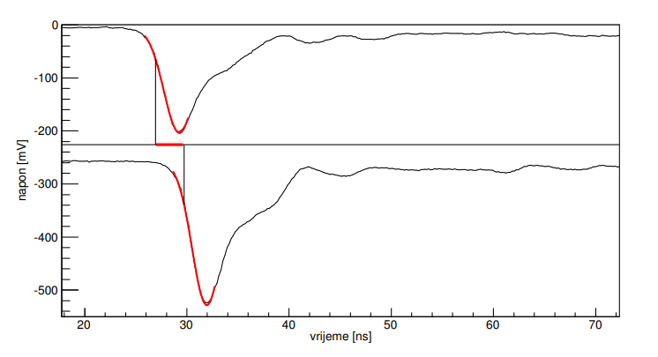
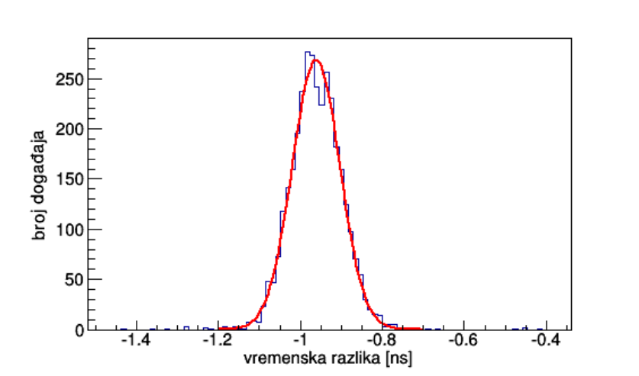
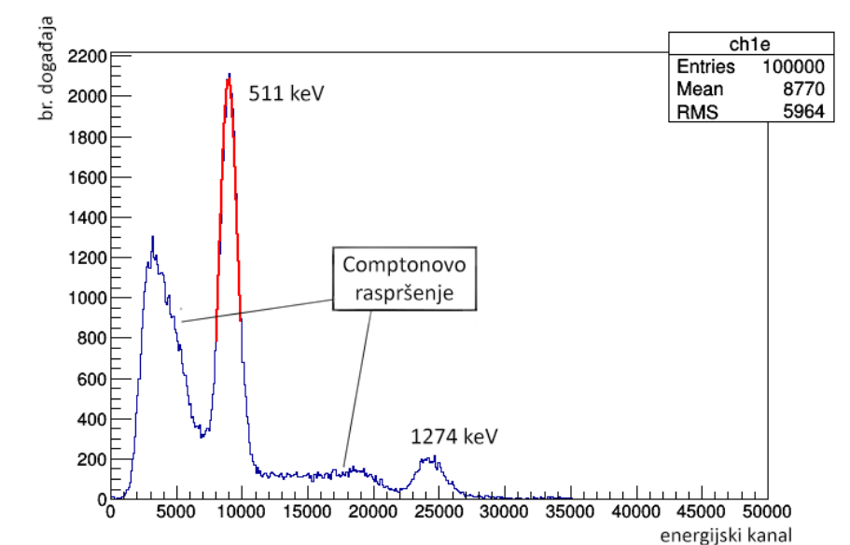
Our measurement: 24 BaF₂ scintillation detectors for the detection of gammas from o-Ps annihilation
Algorithms for energy and time reconstruction in Root
(developed using 4 channel PSI DRS4 evaluation
board with the same characteristics as CAEN V1743 ):
Energy reconstruction and
resolution
Timing determination and time resolution
Measurements with ²²Na
A signal from BaF₂ acquired
with digitizer:
R$≅$11%
for 511 keV
FWHM
~154 ps

Slide 16
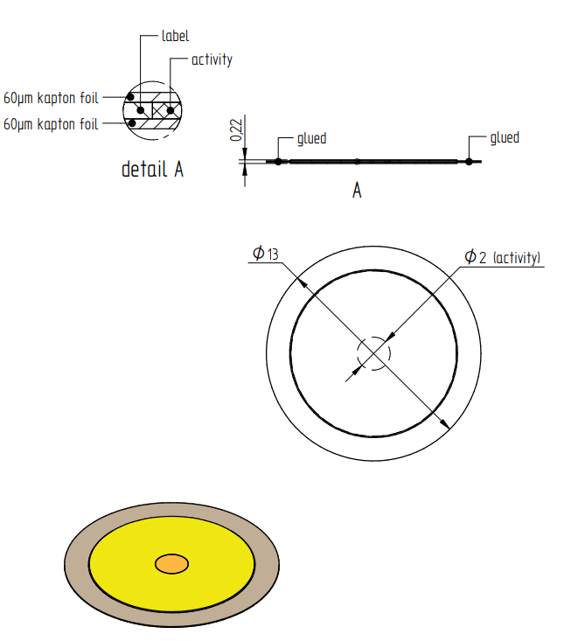
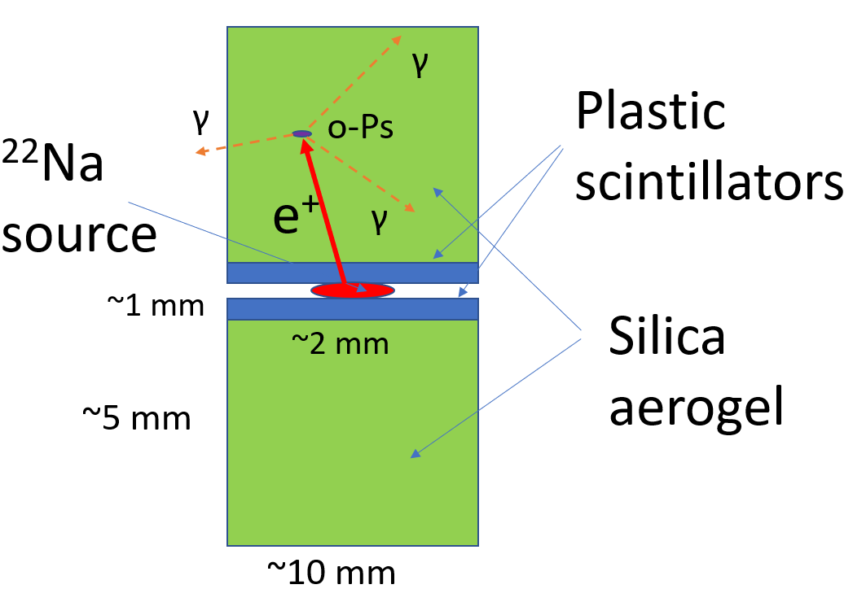
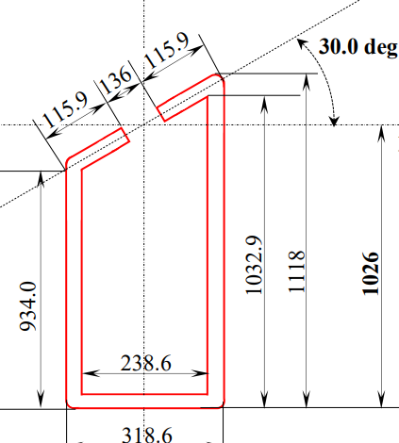
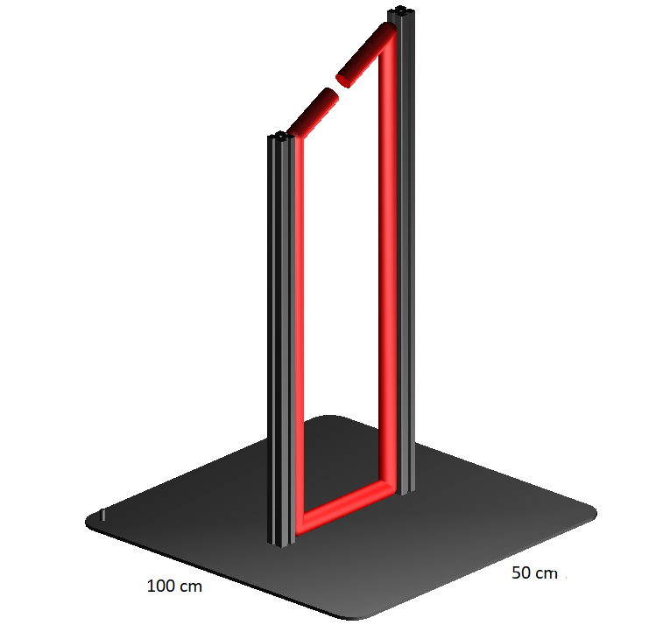
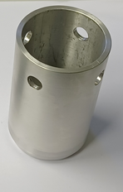
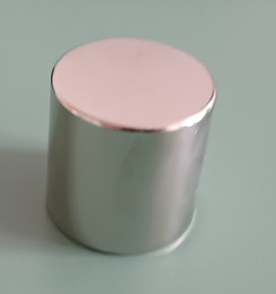
Our measurement: positronium and magnetic field
Positronium production:
1MBq ²²Na source between
two samples of şilica aerogel
²²Na
source
Eckert & Ziegler
Magnetic field production:
Magnet:
0.5 T, 40 mm x 40 mm
2 neodymium permanent
magnets :
Yoke:

Slide 17
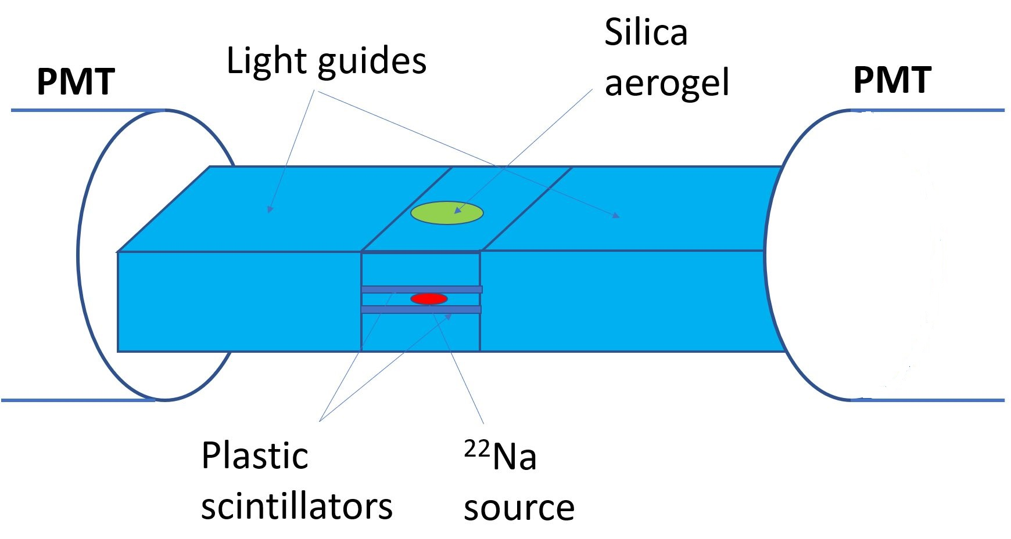
Our measurement: To do: holder for ²²Na source and aerogel + scintillation detectors for positron detection
0.1mm (?) scintillators between ²²Na source and silica aerogel + light guide + PMT (now Photonis XP2020 URQ,
application for Hamamatsu H8409-70 PMZ)
Tests with
25, 50, 100 µm
scintillators,
Shape of the
light guide

Slide 18
Our measurement: expectations and outlook
With the present system the limit on the C_{CP} expected between 10⁻³ and 10⁻⁴.
Time of measurement? -> Strongly dependent on the efficiency of positron detection and positronium production
Upgrade to 2”x1” scintillators
Hamamatsu H8409-70 PMTs?
….

Slide 19
Thank you for your attention!

