Slide 1
3D Printed lightweight and modular lithium-ion Uninterruptible Power Booster for research and medical devices
Frascati 02.11.2022
Mgr inż. Gabriel Moskal Dr hab. Marcin Molenda prof. UJ
Department of Chemical Technology, Faculty of Chemistry of the Jagiellonian University in Kraków

Slide 2
Objective of the work
The aim of the study is to design and build with the use of 3D printing technology, modular UPB for mobile medical equipment, with the possibility of adjusting the shape of modules to optimally use the available space.
enabling simultaneous operation of highly energy-consuming research and medical devices (e.g. PET and MRI)

Slide 3
Uninterruptible power supplies (UPS)
Most important parameters:
Output voltage type (DC, various types of AC)
Backup time
Stored energy
Response time
Construction
Mains voltage imput
AC / DC inwerter
Energy storage
Protected mains output
https://5.imimg.com/data5/KO/XM/MY-56883998/ups-battery-500x500.jpg

Slide 4
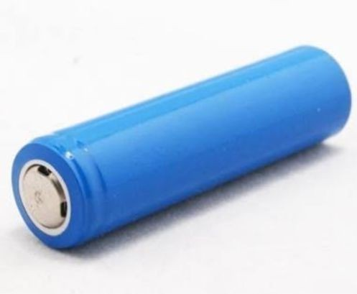
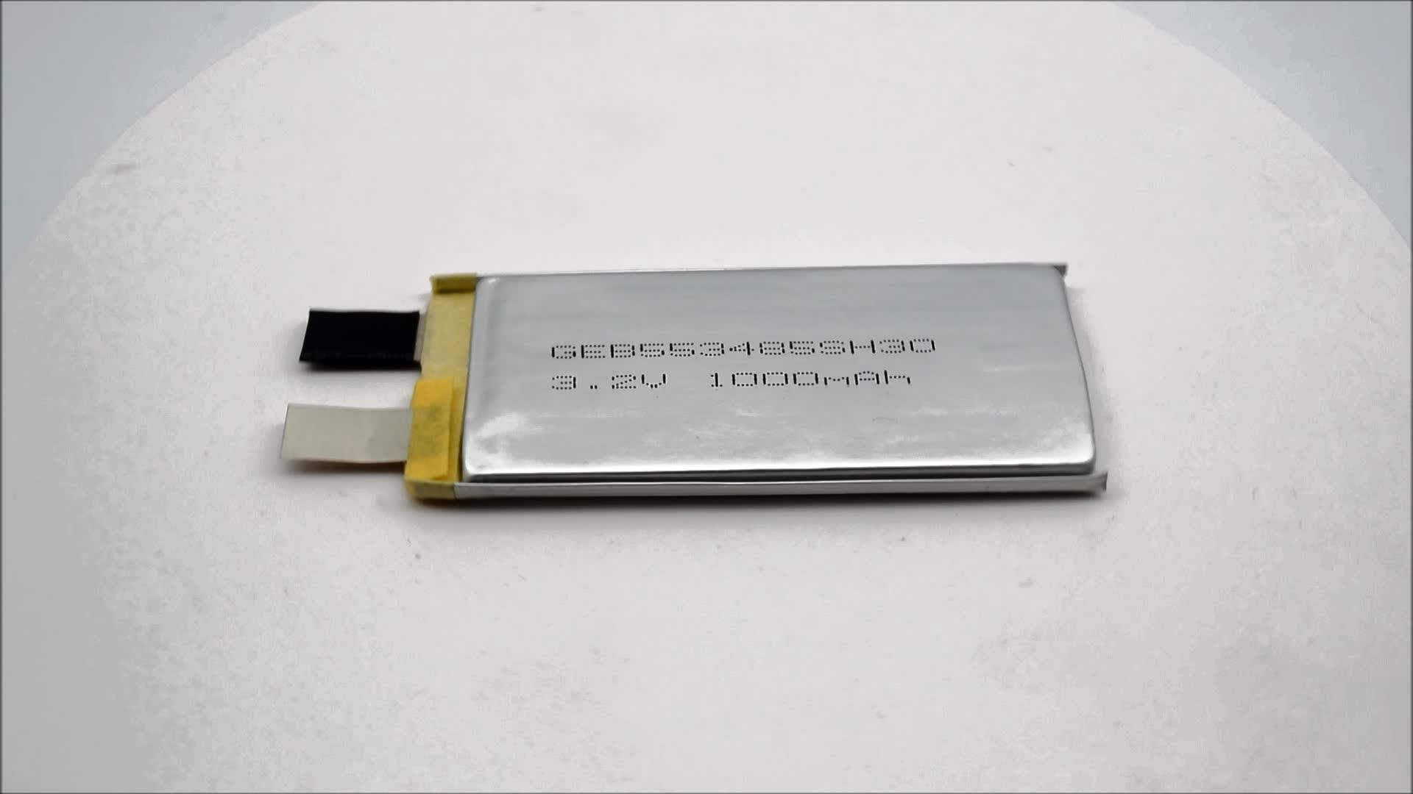
Advantages and challenges of using li-ion cells
High volumetric and gravimetric energy density ( ~200 Wh/kg 650 Wh/dm³)
Fast charging possiblity
High discharge currents
Wide availability of different shapes and parameters of lithium-ion batteries
https://4.imimg.com/data4/EN/TY/ANDROID-3040898/product-500x500.jpeg
https://img.alicdn.com/imgextra/i3/6000000000937/TB2jmc8s1uSBuNjy1XcXXcYjFXa_!!6000000000937-0-tbvideo.jpg

Slide 5
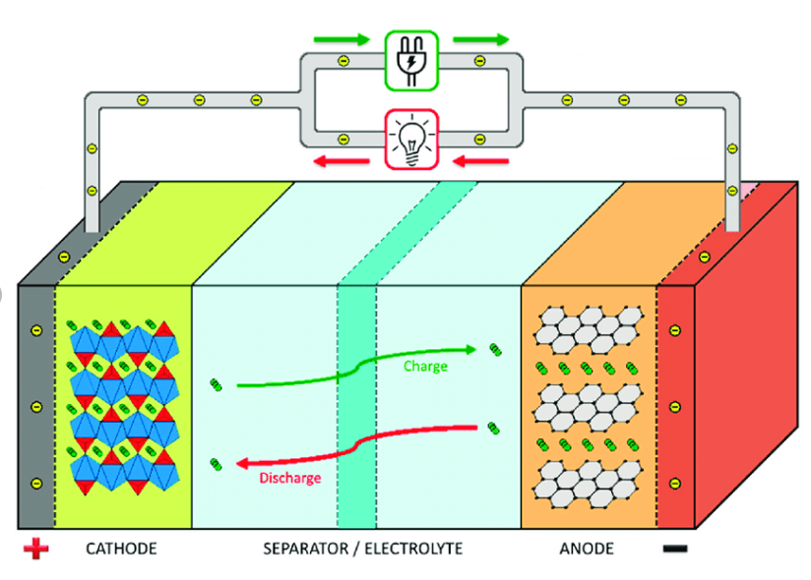
Lithium-ion cells - principle of operation
https://www.researchgate.net/figure/Schematic-representation-of-a-lithium-ion-battery-and-its-working-operation_fig1_326515844

Slide 6
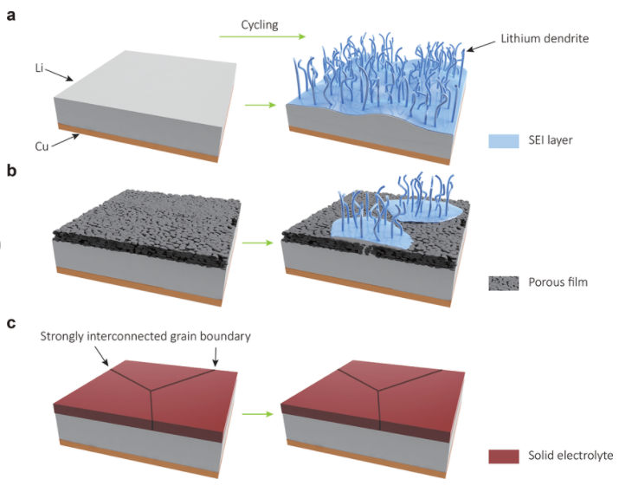
Formation of lithium dendrites
https://www.researchgate.net/figure/Design-and-structure-of-various-Li-metal-anodes-a-A-bare-Li-metal-anode-Upon-cycling_fig1_321695226

Slide 7
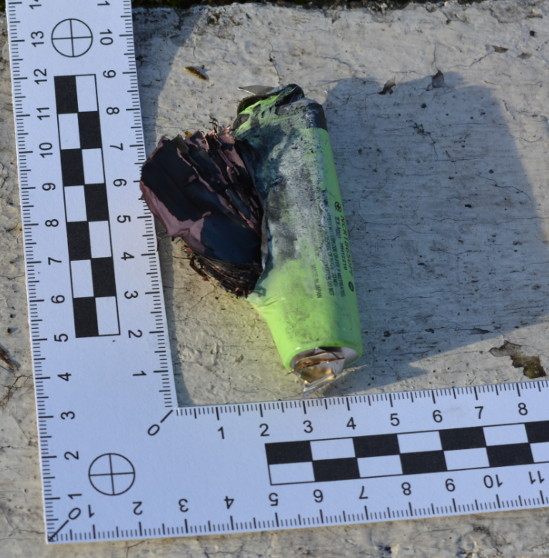
Formation of lithium dendrites
https://www.researchgate.net/figure/Design-and-structure-of-various-Li-metal-anodes-a-A-bare-Li-metal-anode-Upon-cycling_fig1_321695226

Slide 8
Solid electrolytes - advantages and disadvantages
Benefits
Disadvantages
No penetration by lithium dendrites
Possibility to use metallic lithium as anode
Combines the tasks of a separator and electrolyte
Fragility
Limited possibilities of cell shaping
Difficult connection between the electrolyte and the electrode material

Slide 9
The current state of research in the world
Inorganic electrolytes
Organic electrolytes
Hybrid electrolytes
Oxide materials (perovskites, anti-perovskites, NASICON, grenades)
Sulfide materials (layered sulfides, Thio-LISICON, LGPS, agryrodites)
Inorganic glasses with the addition of organic lithium salts
Organic matrices with the addition of inorganic lithium compounds
Based on polymers (polyethers, polycarbonates, polysiloxanes, plastic crystals)
Sources:
S. Anuphappharadorn Et al., Energy Procedia, 56 (2014) 352-358
A. Stan Et al., IEEE 36th International Telecommunications Energy Conference (INTELEC), (2014) 1-8
J. Xie, Y. Lu, Nature Communications, 11 (2020) 2499
F. Zheng Et al., Journal of Power Source, 389(2018) 198-213
[5] A. Manthiram, X. Yu, S. Wang, Nature Reviews Materials, 2 (2017) 16103

Slide 10
J-PET + MRI Uninterruptible Power Booster
Energy storage for a mobile J-PET tomograph
Parameters:
Guaranteed minimum working time - 3 h
Maximum power – 6 kW
Maximum instantaneous power – 12 kW
30 modules, type 7s10p

Slide 11
J-PET + MRI Uninterruptible Power Booster
Energy storage for J-PET tomograph
Parameters:
Guaranteed minimum working time - 3 h
Maximum power – 6 kW
Maximum instantaneous power – 12 kW
30 modules, type 7s10p
Energy storage for MRI
Parameters:
Guaranteed minimum working time - 3 h
Maximum power – 20 kW
Maximum instantaneous power – 35 kW
120 modules, type 7s10p

Slide 12
J-PET + MRI Uninterruptible power Booster

Slide 13
Uninterruptible power booster
3D printed modules:
Ability to match shapes to the available space
Easier prototyping and subsequent service
Low production costs
All of the modules can be tailored to the ideal use of the available space
Modular construction
Optimal use of the available space
Small dimensions and weight of individual modules
No need to separate an additional room
Simplified service and operation
Possibility to increase / decrease the energy storage as needed

Slide 14
Summary
The proposed UPB will power the J-PET tomograph and MRI machine for a minimum of 3 hours
The device isolates and stabilizes the power supply to both devices
At this stage, li-ion cells based on liquid electrolytes are used - solid electrolytes are developed in parallel
It allows for effective and safe powering of medical devices from a network not adapted to the required loads

Slide 15
Literature
S. Anuphappharadorn Et al., Energy Procedia, 56 (2014) 352-358
A. Stan Et al., IEEE 36th International Telecommunications Energy Conference (INTELEC), (2014) 1-8
J. Xie, Y. Lu, Nature Communications, 11 (2020) 2499
F. Zheng Et al., Journal of Power Source, 389(2018) 198-213
[5] A. Manthiram, X. Yu, S. Wang, Nature Reviews Materials, 2 (2017) 16103 [6] P. Moskal, E. Ł. Stępień, PET Clinics 15 (2020) 439-452
[7] P. Moskal et al., Nature Reviews Physics, 1 (2019) 527-529

