Slide 1
Biophotons: general aspects and new experimental data
M. Benfatto
Laboratori Nazionali di Frascati – INFN – Frascati. Italy
On behalf of biophotons collaboration

Slide 2
Biophotons : an ultra-weak E.M. emission of living organism of the order from few to some hundred photons per second, per square centimeter surface area – if you kill the organism this emission goes away
Emission in the visible energy range
Energy between 1.7 e 3 eV
wavelength between 400 e 700 nm

Slide 3
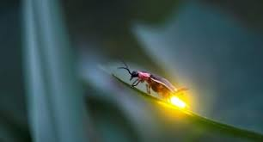
Our biophotons are quite different from known relatively intense bioluminescence emissions which are detectable by the human eyes and for which specific substances are known to be responsible.

Slide 4
A bit of history
In the early 1920s a russian biologist A.G. Gurwitsch proposes the presence of an electromagnetic emission to explain some experiments on the germination and development of plants .
In 1954 L. Colli and U. Facchini published a paper intitled ' Light Emission by Germinating Plants '
In the early 1980s, Popp started working on the subject and his works had a good global resonance. In Italy the Sicilian group of F. Musumeci worked on this topic from the early 1990s up to 2005-2006 - They also used a kind a light stimulated emission
A.G. Gurwitsch, Arc. Entw. Mech. Org. 100, 11 (1923)
L. Colli and U. Facchini, Il Nuovo Cimento 12, 150 (1954)

Slide 5
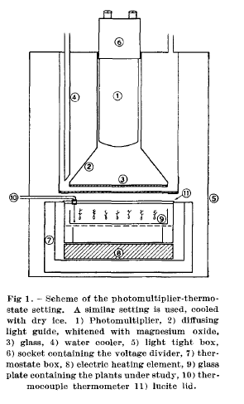
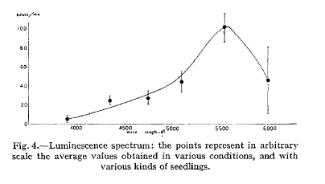
Colli e Facchini experimental set-up
300 hundred plants in a plate of about 14 cm of diameter – The plants were grown in the dark to avoid any phosphorescence residues.
They measured a weak electromagnetic emission of the order of 100 photon/min per cm² in the visible energy range. Such emission has a slight frequency dependence and is influenced by the types of treatment done on the seeds or plants
Counts/min
orange
Angstrom
L.Colli, U. Facchini et al. Experientia 11-12, 479 (1955)

Slide 6
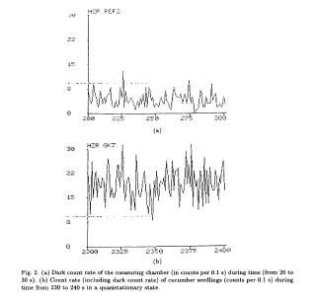
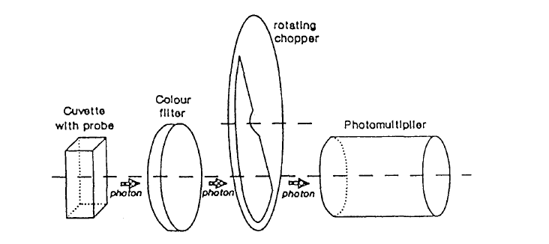
The F.A. Popp work
Diameter of 44 mm
dark counts
Photomultiplier in the range 200 – 800 nm – in reality he had an efficency of 30% at 250 nm that goes down at 500 nm to arrive at almost 0 at 850 nm
counts with cucumber plants
F.A. Popp et al. Modern Physics Letter B8, 1269 (1994)

Slide 7
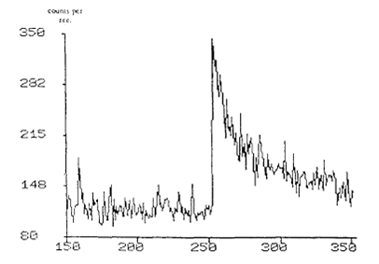
Many different types of experiment
Differences between normal and tumor tissues
A CCD camera to see the biophoton emission from human body
How any tipe of stress changes the biophoton emission – typically very small concentration of toxic agent can cause large variation in the emission – applications in ecology
Cucumber seedlings
Staphisagria D5 1:10⁵ in physiological saline solution
Grasso et al. Experientia 48, 10 (1992)
Kobayashi M, Kikuchi D, Okamura H (2009) Imaging of Ultraweak Spontaneous Photon Emission from Human Body Displaying Diurnal Rhythm. PLoS ONE 4(7): e6256.

Slide 8
some general points
The spectral distribuition n(λ) does not display small peak around definite frequencies. It is quite flat at least in the visible range
The photoncount statistic which account for the probability p(n,Δt) of registering n photon in the time interval Δt seems to follow a Poisson-like distribution
Reaction to stress (temperature, chemical…) are frequently indicated by an increase in biophoton emission

Slide 9
Two possible models (by Popp)
Stochastic metabolic events excite cells that re-emit excess energy in the form of photons rather than in other dissipative processes. The source of such events can be oxidative processes and in particular the interaction with free radicals Notice that we are dealing with an energy of 2-3 eV i.e. well beyond the thermal excitation energy.
The alternative hypotesis assigns biophotons as a kind of a coherent EM emission within and between cells of the living organism. This emission could be used to exchange informations.
Obviously the second hypothesis does not exclude the first one, in any case this emission is strictly connected with the biochemical processes present in the living system.

Slide 10
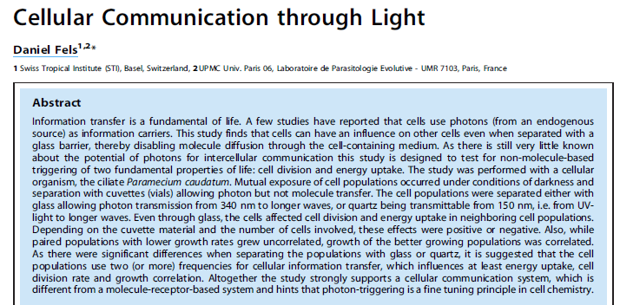
Essentialy he repeated the experiment of Gurwitsch but with the protozoan Paramecium caudatum. He followed mainly the population growth. It depends from the separating material (glass or quartz), and the number of cells.
He found that « ..separated population of the ciliate P.c. interact with each other through glass under condition of complete darkness ..»
D. Fels , Plos One 4, e5086 (2009)

Slide 11
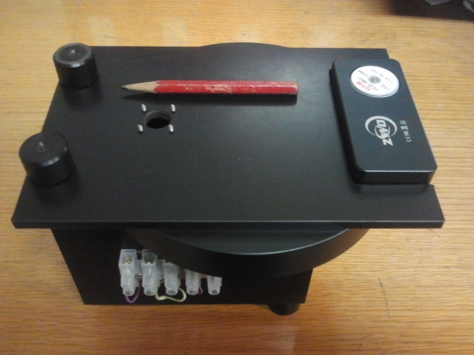
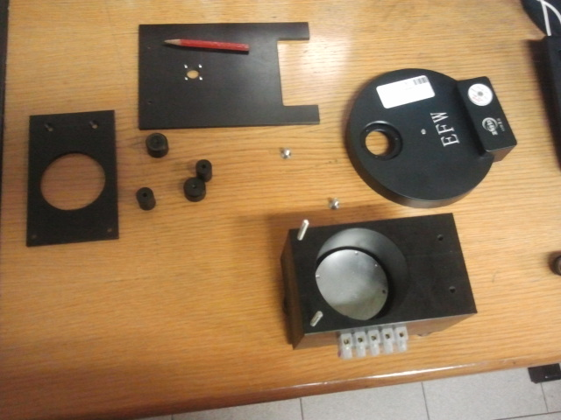
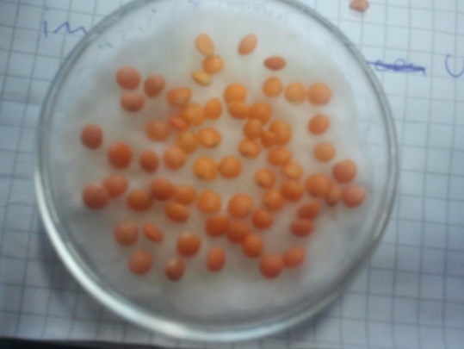
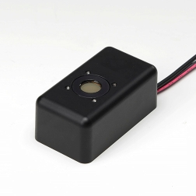
Our experiment
The germination apparatus is formed by a black PVC germination chamber and a turnable wheel posed between the germination chamber and the detector
A Photon Counting Head: Hamamatsu H12386 110
Dark current of about 1-2 Photon/sec
Sensible part of 8mm an acceptance solid angle of about 0.0016 π sr

Slide 12
Our dark – with a black cap
counting / sec (dark)
Because of the rotation of the wheel the data have a bunch-type of structure – the wheel stays in each position for 1 minute - there is a bunch every 443 seconds

Slide 13
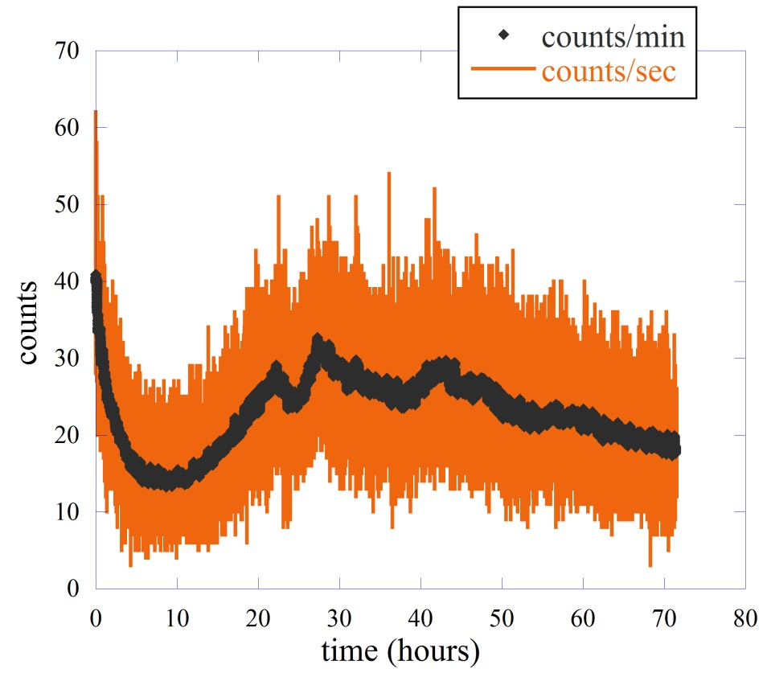
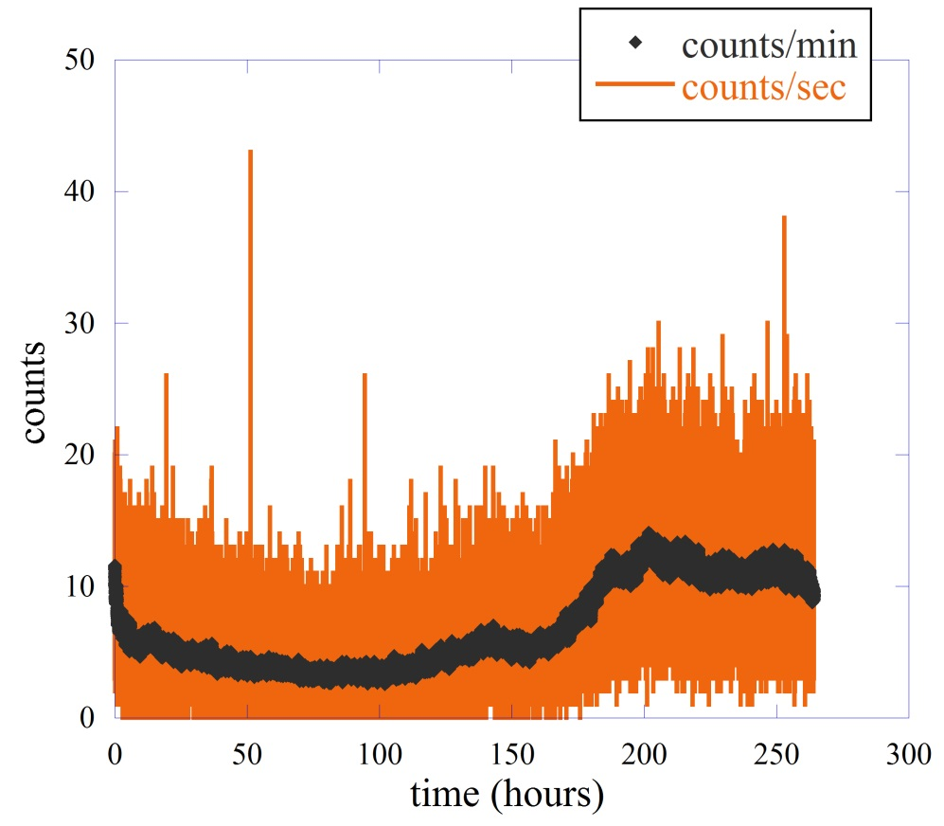
our experimental data without any filter for lentils and bean
75 lentil seeds
The signal to noise ratio bigger than 10
Single bean
Residual luminescence – it goes away after about 12 hours

Slide 14
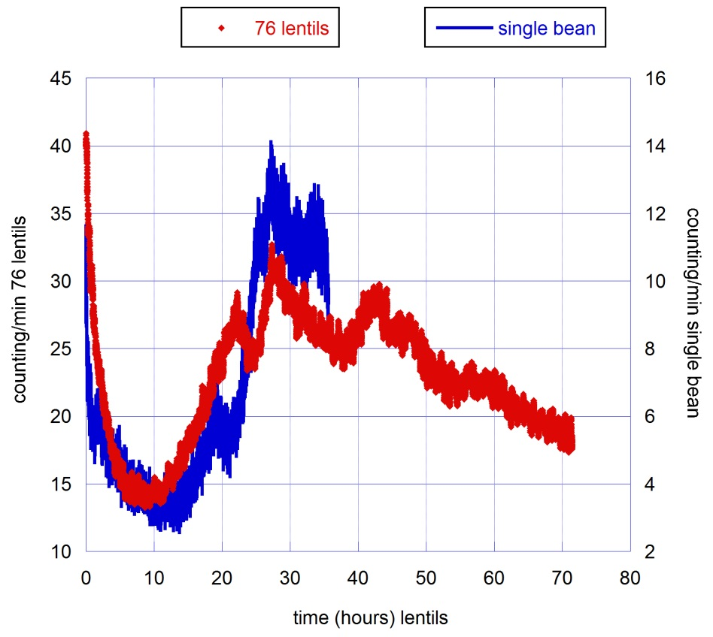
The time scale of single bean has been multiplied by a factor 0.135
Normalizing the emission at the maximum we must multiply the single bean emession scale for a factor of 2.28.

Slide 15
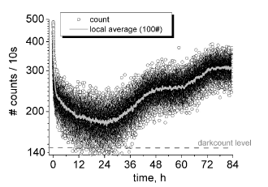
Taking into the account the different numbers of seeds
The emission of a single bean seed seems to be higher than that of a single lentil seed by a factor of about 33
50 seeds of Triticum aestivum – common wheat
Normalizing for the number of seeds and the time window size we obtain alsmost the same counts/sec of the lentil seeds
C.M. Gallep and S.R. dos Santos , Seed Sci. &Technol. 35, 607 (2007)

Slide 16
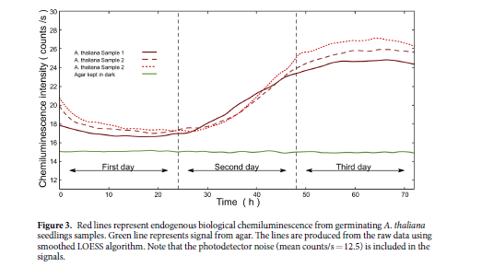
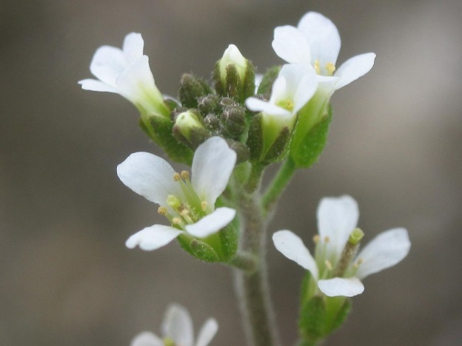
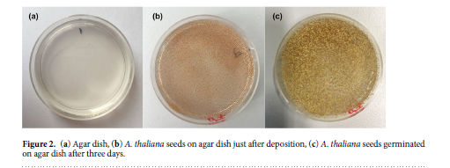
about 7000 seeds of Arabidopsis thaliana placed on a Petri dish with Agar medium
H. Saeidfirozeh et al. Scientific Reports (2018) 8:16231

Slide 17
Lentil ≈ 40 mg
Triticum aestivum ≈ 40-55 mg
White bean ≈ 1100 mg
average weight of a single seed
Looking to these weight and to the previous numbers, we can check if the emission is either proportional to the volume (weight) or to the surface of the seeds
$$N_{lentils}≅N_{Triticum aestivum}≅\frac{1}{33} N_{bean}$$
$$W_{lentils}≅W_{triticum aestivum}≅\frac{1}{27.5} W_{bean}$$
$$\frac{R_{lentils}^{2}}{R_{bean}^{2}}≅0.11$$
if we suppose that seeds are spheres
data from «supplemento Gazzetta Ufficiale – serie generale n.2 Allegato 1 A (4-1-1993)»

Slide 18
Some points:
The emissions of different seeds seems to have similar shape
The time scale of the germination process it depends both on the type of seed, its quality and probably also on the time of sowing.
Perhaps the emission is proportional to the weight
do we have the similar biofotons emission process in seeds?

Slide 19
The analysis in terms of photocounting distribution functions $P_{m}(T)$
we count in an given time interval how many time we get $m$ photons in a window $T$
In our case $T$= 1 sec.
$$P_{m}(T)$$
Statistical distribution of photocounting

Slide 20
It is possible to demonstate that
$$P_{m}(t,T)$$
Probability that m photocounting occur in the time interval t to t+T
$$P_{m}\left(t,T\right)=\frac{[ξ\overline{I}\left(t,T\right)T]^{m}}{m!} e^{−ξ\overline{I}\left(t,T\right)T}$$
where
$$\overline{I}\left(t,T\right)=\frac{1}{T} \int_{t}^{t+T}{\overline{I}\left(t^{′}\right)dt^{′}}$$
$$\overline{I}\left(t\right)=\frac{1}{2} ε_{0}c{\left|E(t)\right|}^{2}$$
with
$E\left(t\right)=E_{1}\left(t\right)+ E_{2}\left(t\right)+…+E_{n}\left(t\right)=E_{0}e^{−iωt}\left\{e^{iφ_{1}t}+e^{iφ_{2}t}+ …+e^{iφ_{n}t} \right\}$
We suppose we have N atoms that emits with different phases - The beam intensity is calculated by the Poynting vector with a cycle-average at frequency $ω_{0}$
$$\overline{I}\left(t\right)=\frac{1}{2}ε_{0}cE_{0}^{2} a^{2}(t)$$
Fluctuation of intensity

Slide 21
$$P_{m}\left(T\right)= \left\langle P_{m}(t,T)\right\rangle$$
The average is over the successive starting time (as in our case) or as a statistical average repeating many time the experiment
Defining the average and the variance we have in general
$$\left\langle m\right\rangle =\sum_{m}{m{ P}_{m}(T)}$$
$${(Δm)}^{2}=\left\langle m\right\rangle + ξ^{2}T^{2}[\left\langle \overline{I}(t.T)^{2}\right\rangle − {\overline{I}}^{2}]$$
R. Loudon, «The Quantum Theory of Light», Oxford Science Pubblication (2000)

Slide 22
Two opposite cases
the emission is a classical stable wave $\overline{I}\left(t,T\right)=\overline{I}$
$$P_{m}\left(T\right)=\frac{{\left\langle m\right\rangle }^{m}}{m!} e^{−\left\langle m\right\rangle }$$
$$\left\langle m\right\rangle =ξ\overline{I}T$$
$$\left\langle m\right\rangle = {\left(Δm\right)}^{2}$$
The average is equal to the variance
The emission is a Gaussian-Lorentzian chaotic light
$$g^{1}\left(τ\right)= \frac{\left\langle E^{∗}\left(t\right)E\left(t+τ\right)\right\rangle }{\left\langle E^{∗}\left(t\right)E(t)\right\rangle }\sim e^{−(iω_{0}τ+\frac{π}{2}(τ/{τ_{c}})^{2})}$$
$$P_{m}\left(T\right)=\frac{{\left\langle m\right\rangle }^{m}}{(1+\left\langle m\right\rangle )^{1+m}}$$
$$P_{m}\left(T,M\right)=\frac{\left(m+M−1\right)!}{m!\left(M−1\right)!}{\left(1+\frac{M}{〈m〉}\right)}^{−m}{\left(1+\frac{〈m〉}{M}\right)}^{−M}$$
with M thermal mode
$$(Δm)^{2}=⟨m⟩+\frac{{\left\langle m\right\rangle }^{2}}{N_{m}}$$
where N_{m} is the number of thermal mode of similar frequency

Slide 23
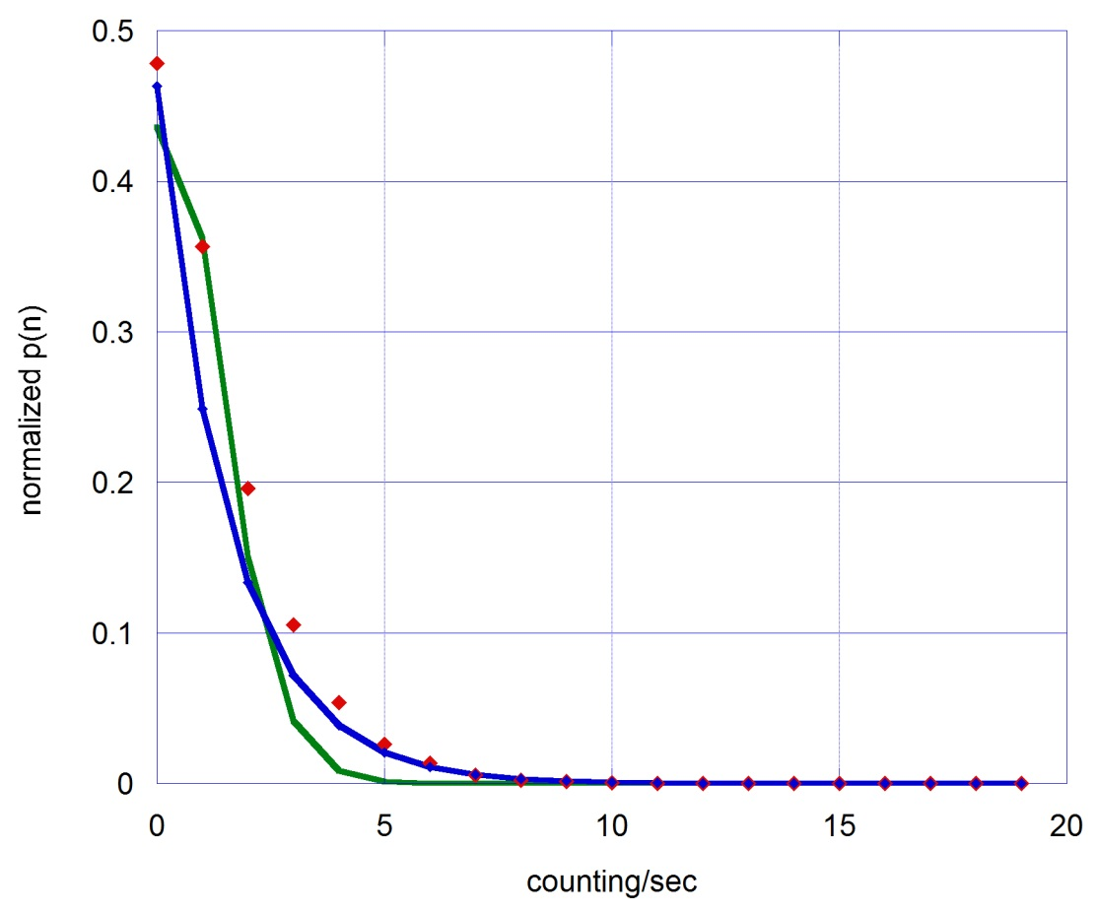
$$P_{m}(T)$$
Normalized dark count
$$P_{m}(T)$$
The Poisson distribution gives an <m> = 0.83±0.04
Poisson fit
The Thermal distribution gives an <m> = 1.16±0.13
Thermal fit
the experimental average is <m>=1.56

Slide 24
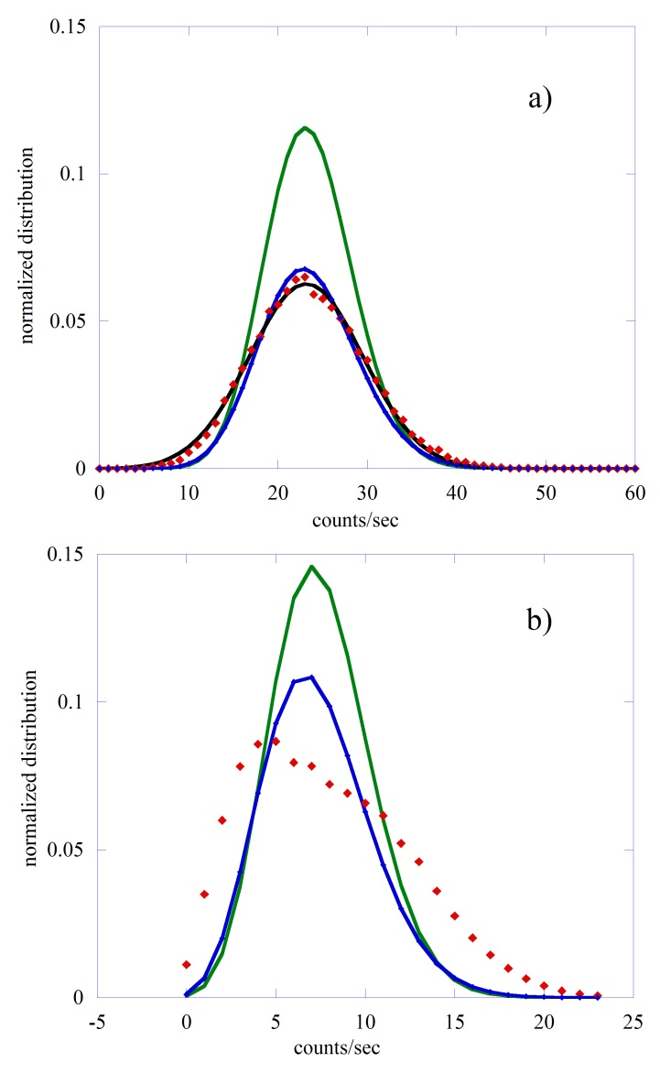
75 lentils
Poisson fit
Exp - <m> = 23.5, σ² = 39.9
Poisson - <m> = 23.5
Gauss - <m> = 23.2, σ² = 40.4
Multi-mode - <m> = 23.7, Μ = 65
Multi-mode
Gaussian
From the end of residual luminescenze up to the end of data
Single bean
Poisson fit
Exp - <m> = 7.9, σ² = 20.2
Poisson - <m> = 7.6
Multi-mode - <m> = 7.6, Μ = 32
Multi-mode

Slide 25
In both cases the fit with a Poisson function is inaccurate, but this is not surprising considering the experimental difference between the mean values and variances and that the stationarity hypothesis is only weakly satisfied having considered the entire time interval of measurement.
The distribution relative to lentils is optimally fitted with Gaussian or Multi-mode functional form. The fact that this distribution is strongly symmetrical and can be optimally fitted with a Gaussian is a clear indication that the various seeds have different germination times which therefore give rise to emissions that are not in phase with each other.

Slide 26
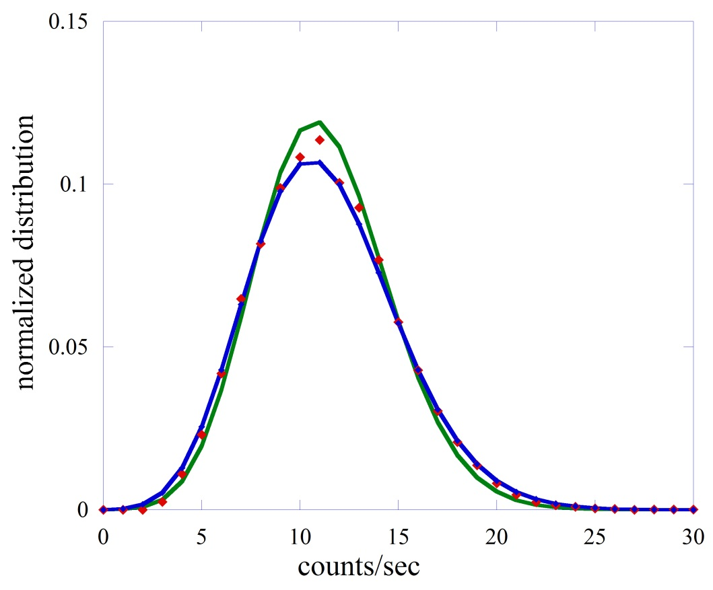
The use of a shorter time period for the calculation of the probability distribution function makes the hypothesis of stationarity more easily satisfied. In the case of a single bean data, using a shorter emission period, we observe a transition to more symmetrical distributions.
Single bean
Poisson fit
from 200 to the end
Multi-mode
Exp - <m> = 11.3, σ² = 12.9
Poisson - <m> = 11.2
Multi-mode - <m> = 11.3, Μ = 50

Slide 27
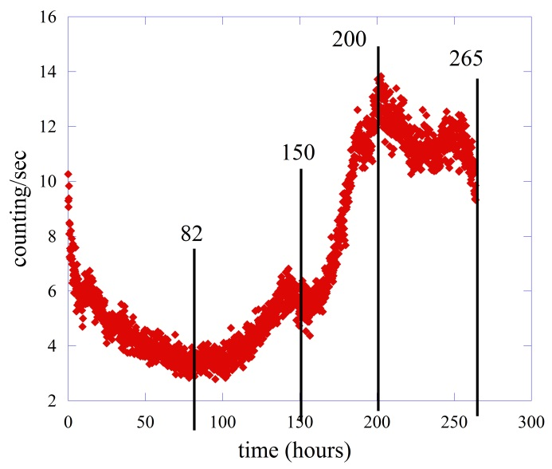
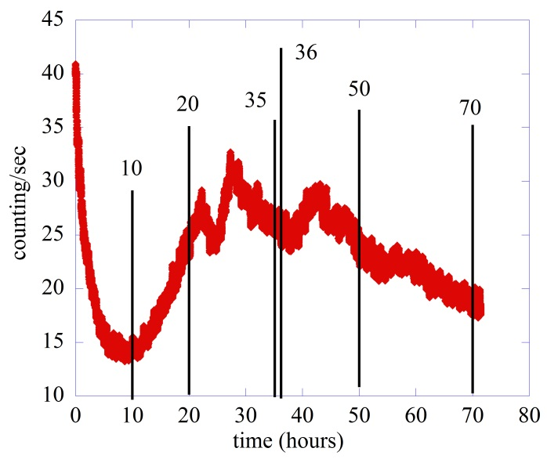
the asymmetry S index
$$S=\frac{μ_{3}}{σ^{3}}$$
variance
$$μ_{3}=\sum_{i=1}^{N}{(x_{i}−\overline{x})^{3}}$$
S=0 indicates a symmetrical distribution
Single bean |  | Lentil seeds
Time interval | S index | Time interval | S index
82-265 | 0.50 | 10-70 | 0.23
82-150 | 0.81 | 20-70 | 0.24
150-200 | 0.30 | 50-70 | 0.28
200-265 | 0.43 | 35-36 | 0.11

Slide 28
The count probability distribution functions related to the lentil seeds are much more symmetrical than those relative to the single bean in all the time intervals considered. This may be due either to a different characteristic of the seeds, but also to the fact that in the case of lentils we used many seeds.
the experimental variance is always bigger than <n>, this indicates a super-Poissonian type of behavior that is typical of either thermal emission or an emission with a very short coherence time compared to the time window of the measurement
M.Cifra, et al. , Journal of Luminesce 164, 38-51 (2015)

Slide 29
A different approach based on the DEA analysis
We detect the number of photons arrived in a window of size T as a fuction of time (in our case T=1 sec)
The time axis is divided into bins of T size
We have a fluctuating time series $\left\{ξ(n)\right\}$ formed by the number of photon emitted in n-th bin

Slide 30
This series is a random variable of which we want to calculate the statistical properties and the degree of complexity by the study the anomalous scaling of the diffusion trajectory
$$\left\{ξ(n)\right\} → ξ(t)$$
For semplicity it becomes a continuous-time function
$$x\left(t\right)= \int_{0}^{t}{ξ\left(t^{′}\right) dt^{′}}+x(0)$$
$$\dot{x}(t)=ξ(t)$$
$$\left\langle x^{2}\left(t\right)\right\rangle = \int_{0}^{t}{dt_{1}\int_{0}^{t}{dt_{2} \left\langle ξ(t_{1})ξ(t_{2})\right\rangle }}$$

Slide 31
With the standard stazionary assumption
$$\left\langle x^{2}(t)\right\rangle =2\left\langle ξ^{2}\right\rangle \int_{0}^{t}{dτ_{1}\int_{0}^{τ_{1}}{dτ_{2} Φ_{ξ}(τ_{2})}}$$
$$Φ_{ξ}\left(τ\right)= \frac{\left\langle ξ(t_{1})ξ(t_{2})\right\rangle }{\left\langle ξ^{2}\right\rangle }$$
$$τ= \left|t_{1} − t_{2}\right|$$
We study the anomalous scaling of the diffusion trajectory looking to the scaling factor of the correlation function – we assume that $\left\langle x^{2}\left(t\right)\right\rangle ∝ t^{2H}$
$$Φ_{ξ}\left(τ\right)∝2H\left(2H−1\right)τ^{2H−2}$$
Note that for H=0.5 the correlation function vanishes – any departure from this value indicates an anomalous behaviour

Slide 32
$$Φ_{ξ}(τ)∝±\frac{1}{τ^{δ}}$$
For the long-time limit
$$δ=2−2H$$
In this case the power spectrum is the Fourier transform of this correlation function according the Wiener-Khinchine theorem
$$S(ω)∝\frac{1}{ω^{β}}$$
$$β=2H−1$$
H=0.5
β=0
white noise
The Diffusion Entropy Analysis (DEA) is a method to generate the diffusion trajectories and calculate the scaling factors
P. Grigolini et al. Fractals 9, 439 (2001)
N. Scafetta et al. Phys. Rev E66, 031906 (2002)

Slide 33
They also exist fluctuations that can not be described by stationary correlation functions
Crucial events
They are events that have an high impact on the statistical properties of the system. The occurence of such events resets the memory of the system.
The time distance between two consecutive crucial events is described by the waiting time distribution density with the scaling properties
$$ψ(τ)∝\frac{1}{τ^{μ}}$$
With μ from zero to $∞$
G. Culbret et al. Entropy 21, 178, (2019)

Slide 34
For example the analysis of the EEG shows that the human brain in good health generates crucials events with μ=2
$$δ=\frac{1}{μ−1}$$
for 2<μ<3 crucial events generates the scaling δ
crucial events with μ > 3 generate the ordinary condition of white noise.
$$S(ω)∝\frac{1}{ω^{β}}$$
with β=3-μ
for 1< μ <3
with β=0
for μ > 3
P. Allegrini et al. Phys. Rev. E 80, 061914 (2009)

Slide 35
We have seen the presence of crucial events in the biophoton emission using the Diffusion Entropy Analysis (DEA) method
M. Benfatto et al. Entropy 23, 554 (2021)

Slide 36
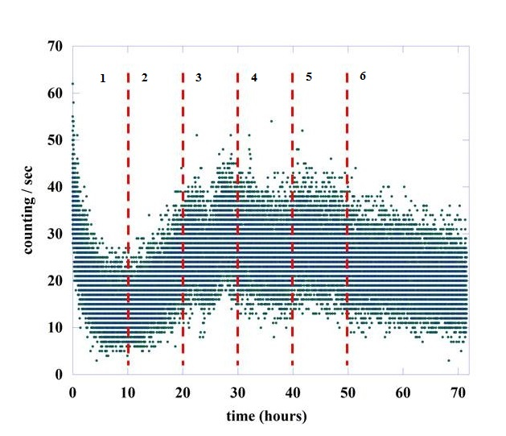
seeds
dark
DEA without stripes - there is not any type of filter to cut the influence of non-crucial events, like FBM, in the scaling factor
Without seeds μ=2.73, close to 3 which is the border of the ordinary statistics, while with seeds μ goes from 2.29 to 2.44 - much less than 3. The difference between dark and seeds is clearly shown

Slide 37
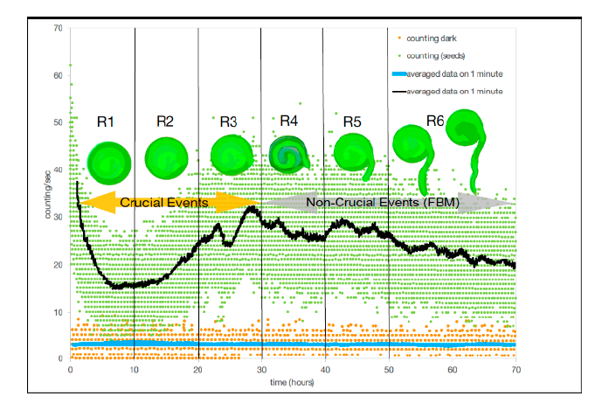
DEA with stripes
μ varies from a value of about 2.6 to one of almost 3.0 going from region #1 to region #6 – the dark counting gives μ=2.96
I.H. von Herbing et al. Entropy 23, 1141 (2021)

Slide 38
Why?
Plants behave differently from humans - example of the Autonomic Neurophaty
There is some kind of stress that starts due to the plants starting to grow in a environment completely devoid of light. The Chlorophyll photosynthesis does not start and the plants can not produce organic elements, mainly carbohydrates.

Slide 39
Some points
The count distributions analysis is not able to asses a clear evidence of coherence or non-classical behavior of biophoton emission.
The DEA analysis of the time series revels the presence of crucial events. – there is a transition between crucial events and FBM during the germination process
The DEA analysis shows a clear difference between the noise and the emission with seeds

Slide 40
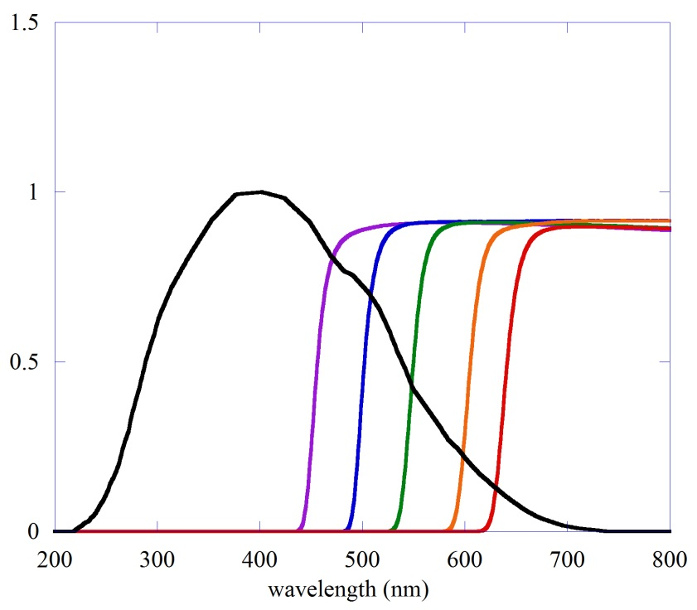
the different spectral components
Photube efficency
long pass glass color filters makes possible an analysis in terms of the different spectral components of the emission - 455,500,550,600 and 645 nm
𝑚(𝜆,𝑡,𝑇) is the number of photon emitted at a given wavelength
$$M_{n}=\int_{λ_{min}}^{λ_{max}}{m\left(λ,t,T\right)f_{n}\left(λ\right)α\left(λ\right)dλ}$$
𝛼(𝜆) is the efficiency of the photo-tube
counting with nth filter
𝑓_{𝑛}(𝜆) is the transmission coefficient of nth filter

Slide 41
we can calculate the difference between two adjacent filters and normalizing for the efficience of the phototube we can derive the average number of photons in the different bandwidths
$$M_{n,s}\left(t,T\right)=\int_{λ_{min}}^{λ_{max}}{m\left(λ,t,T\right)α(λ)\left[f_{n}\left(λ\right)−f_{s}(λ)\right]dλ}$$
$$M_{n,s}(t,T)≅{\overline{m}}_{n,s}(t,T)∙\int_{λ_{min}}^{λ_{max}}{α\left(λ\right)\left[f_{n}\left(λ\right)−f_{s}\left(λ\right)\right]dλ= {\overline{m}}_{n,s}\left(t,T\right)∙I_{n,s}}$$
${\overline{m}}_{n,s}\left(t,T\right)=\frac{M_{n,s}(t,T)}{I_{n,s}}$
the energy resolution is of the order of
$$\frac{ΔE}{E} \sim 0.1$$
${\overline{m}}_{n,s}(t,T)$ is average number of photon in a given wavelength interval

Slide 42
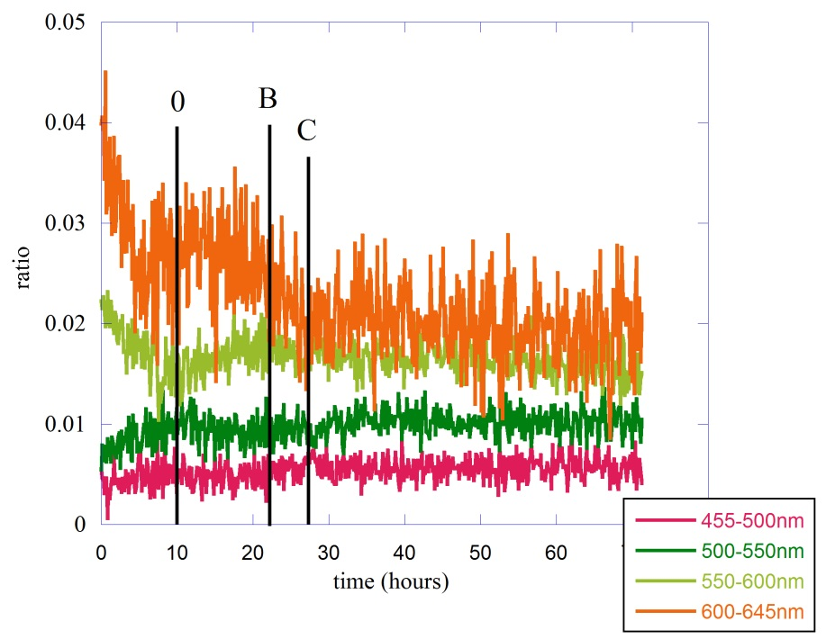
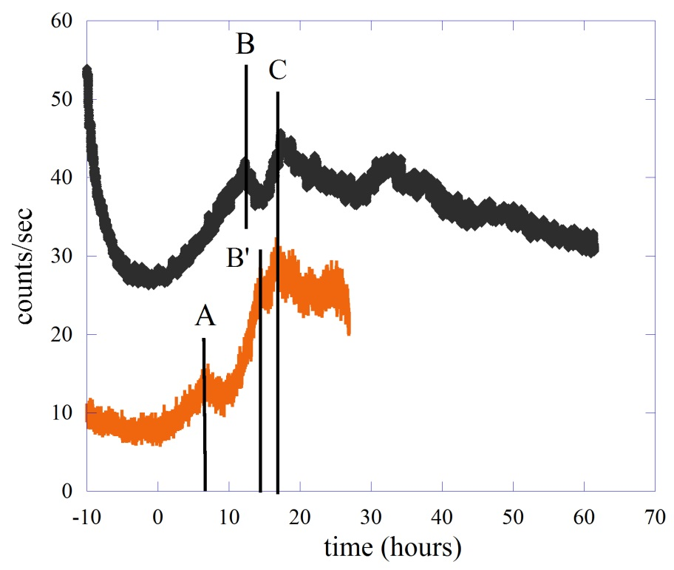
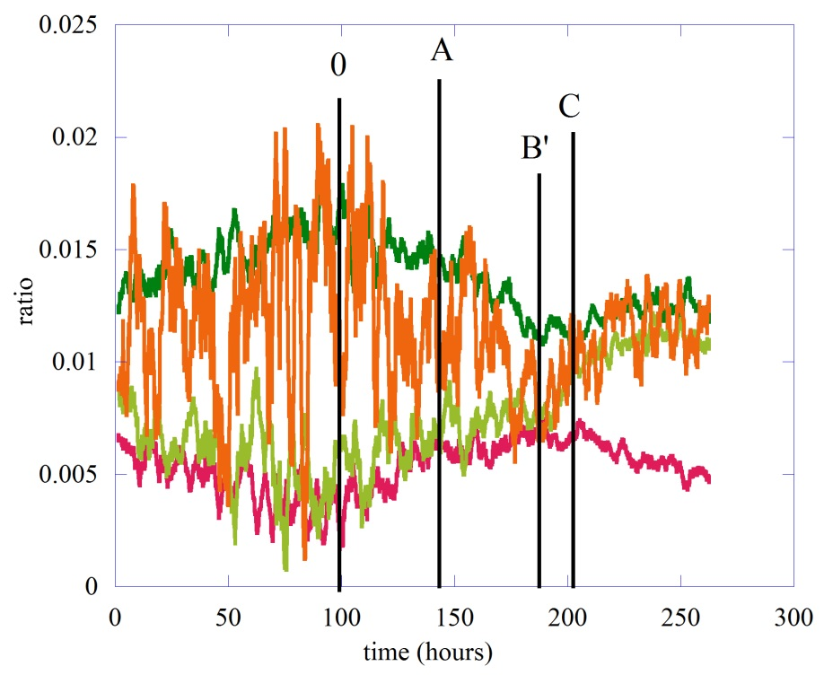
These are the ratio between the different average counts ${\overline{m}}_{n,s}(t,T)$ and the total signal without filters
75 lentil seeds
Single bean

Slide 43
In the case of lentil seeds the dominant components are those of orange (600-645 nm) and yellow-green (550-600 nm), in agreement with the results of Colli and Facchini
the high-energy components remain constant while the lower-energy parts clearly change in the relative intensity along all the duration of the measurement.
In the temporal region between 0 and peak B the orange component is constant at first and then slight decreases, this behavior is associated with a simultaneous increase in the yellow-green component. Here we are in the temporal region where germination began and where DEA analysis tells us that crucial events are present.

Slide 44
The view of the rising part of the biophoton emission clearly shows at least two zones with different rates of growth time
These two temporal regions have different behaviors of the various spectral components of the emission. This could be an indication of the existence of different processes at different time that give rise to the emission of biophotons

Slide 45
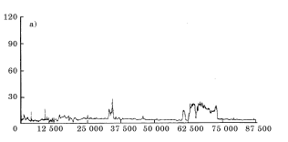
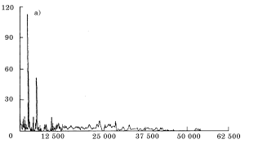
Emission from bacteria
Staphylococcus aureus
Streptococcus suis
Escherichia coli
Streptoccocus suis
time in sec.
Escherichia coli
D. Codazza, U. Facchini et.al. Nuovo Cimento 20, 1767 (1998)

Slide 46
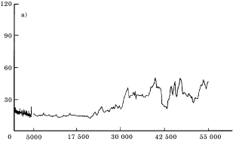
In a Petri plates with BHI agar the four different bacteria has been inoculated – After 10 minutes the start the measurments.
Staphylococcus aureus
time in sec.
Each bacterium has a well defined type of emission, perhaps following the type of growing – It is completely different from the emission during the germination process of seeds

Slide 47
The use of biophotons
Actually biophotons were used
in agriculture:
to monitor the response of plants to to pathogens, to drought stress, saline stress, to herbicides.
To check the germination power of seeds.
in biomedicine
Dermatology, Neuroscience, Oncology and General diagnostics

Slide 48
Open questions
Many
Some of them:
Which part of the living organism emitts biophotons?
How plants can discriminate between this ultra-weak emission and the background light?
Do the light we measure could be just a residul EM emission of a much more intense EM exchange that occurs between and inside the cells that form the living organism?
…….

Slide 49
Next
New experimental set-up to increase the signal/noise ratio - integrating sphere, lens
One, two…more seeds to check the presence of crucial events in all these cases – different type of seeds
Experiment with different Δt in order to check in detail the p(n,Δt)
Experiments with external perturbation (for example atmospheric composition - oxygen / nitrogen ratio)
Experiments with aerobic and non-aerobic bacteria and yeast
…….any suggestions?

Slide 50
We can easily forgive a child who is afraid of the dark, the real tragedy of life is when men are afraid of the light
Plato
We can easily forgive a child who is afraid of the dark; the real tragedy of life is when men are afraid of the light.
Plato

Slide 51
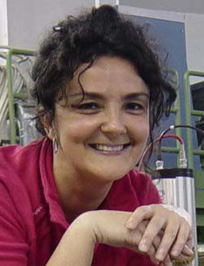
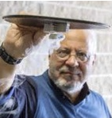
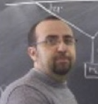
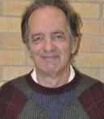
Maurizio Benfatto, Alberto Clozza, Catalina Curceanu, Elisabetta Pace, Alessandro Scordo – INFN, Frascati
Ivan Davoli, Fabio De Matteis, Massimiliano Lucci, Roberto Francini – Università di Tor Vergata, Roma
Maurizio Grandi – Istituto La Torre, Torino
Paolo Grigolini, Rohisha Tuladhar, April Pease, Ione Hunt von Herbing - University of Nord Texas, Denton (USA)
Lucio Tonello - GY Academy Higher Education Institution San Gwann (Malta)

Slide 52
During the preparation period for this work, our friend and colleague M. Lucci passed away. We report this news with great sorrow and sadness. This work also wants to be a way to honor Massimiliano's work and life.

