Slide 1
Space charge effect in the Multi-ionization chamber response signal
A. Nasr¹, A. H. Walenta¹ , W. Schenk¹
¹University of Siegen , Detector Physics Group, Germany

Slide 2
Outline
Introduction
Multi-channel ionization chamber design
Signal pulsed formation
Measurement Setup
Result
Conclusion

Slide 3
Synchrotron Radiation
Synchrotron Beam
Synchrotron radiation
Direction of
central force
N
S
N
S
N
S
N
R
Insertion device
(Bending magnet)
Storage ring
Electron trajectory
S
N
S
N
S
N
S
λ
Synchrotron radiation generated within accelerator known as electron storage ring which is an evacuated annular pipe in which there is a curved sections and straight sections. Electrons are pre-accelerated in a linear accelerator and then injected into a straight section of the storage ring then to the curved section where the electrons are accelerated through.
The synchrotron radiation is produced either by the bending magnet which needed to keep the electrons in a closed orbit, or by an insertion devices such as wiggler’s or Undulators. The lost of the accelerated electrons energy will be emitted in the form of synchrotron radiation.
Albert Hofmann, The Physics of synchrotron radiation, Cambridge (2004).

Slide 4
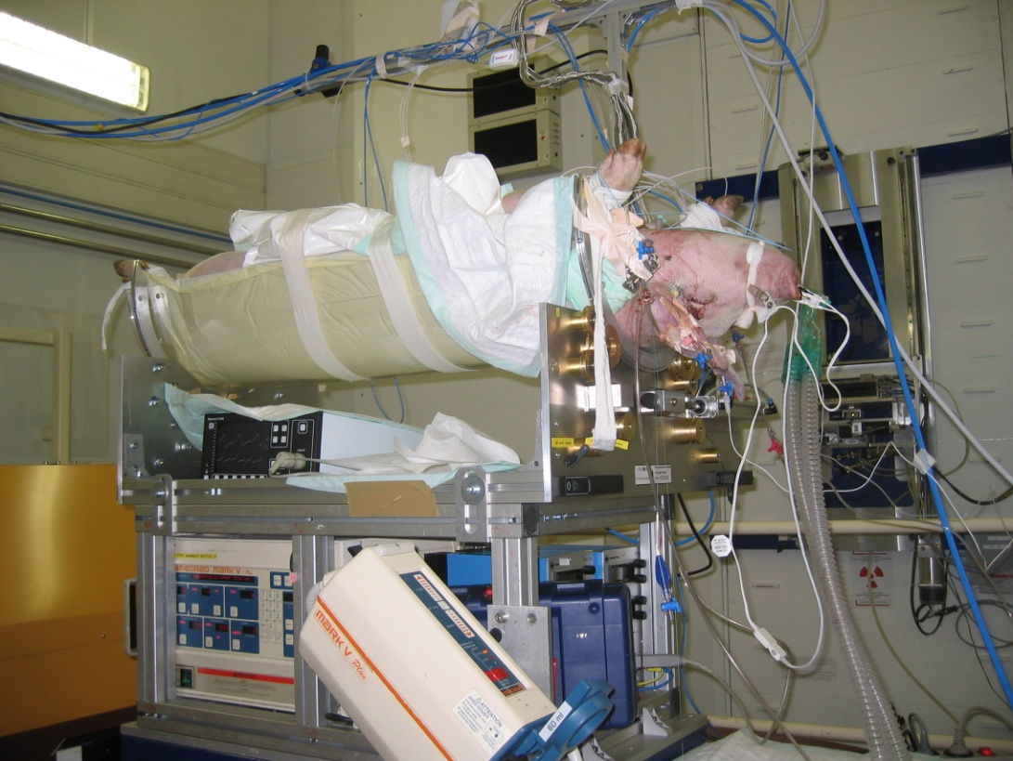
K-edge Digital Subtraction Angiography (KSDA)
The aim of the these project is to build a Beam Monitor for a high Synchrotron photons intensity as apart of K-edge Digital Subtraction Angiography (KDSA) project.
Which will be used for correction the angiograhy images.
W.R.Dix, H.J. Besch, j. de Phys, IV(1994).
A. Nasr ICMP Duabi, ,15Apr2008.

Slide 5
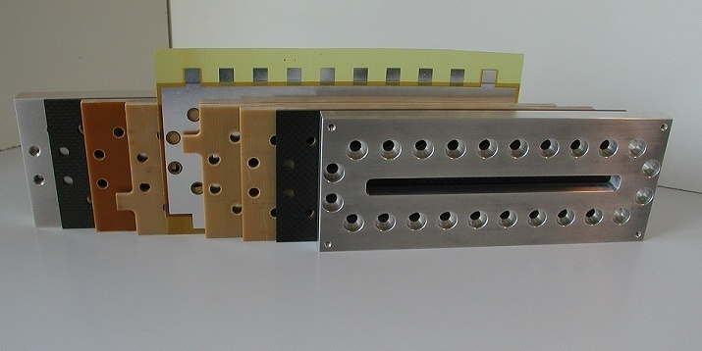
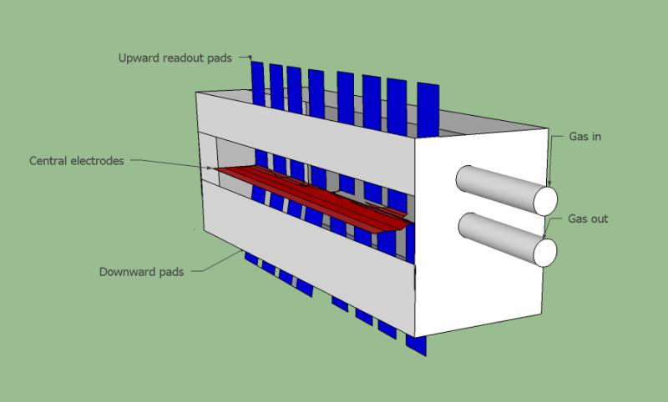
Multi-ionization chamber
(Alu)
(Carbon)
(Cathode)
(active-V)
(Anode)
The photographs of the open chamber with a view of the anode and cathode details as well as the assembled detector
The chamber is designed such a way that it should not absorb more than 1% from the incoming synchrotron beam.
The chamber is divided into two parts by the anode strip each part is 0.5cm depth to decrease the collection time of positive ions
sketch diagram of the Multi-ionization chamber shows the central electrode (red) at the middle of the chamber read out pads (blue)and gas input and output pipes

Slide 6
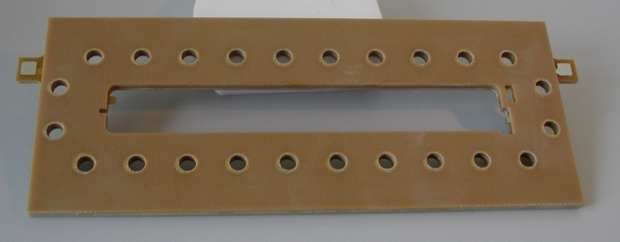
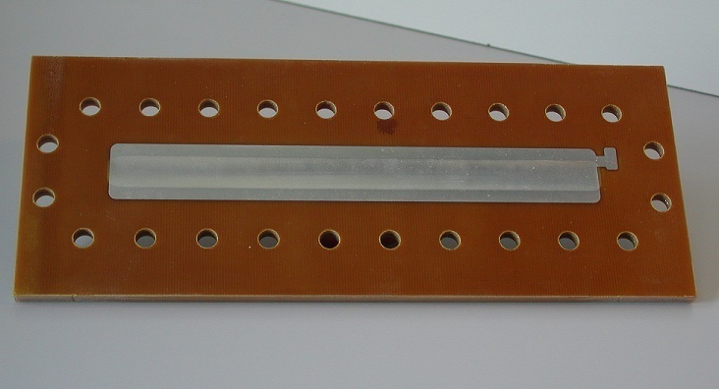
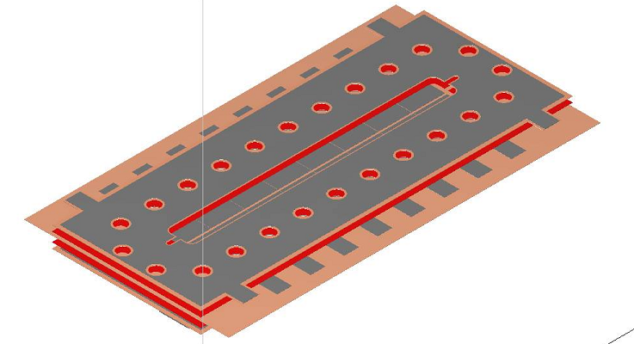
high voltage connection for the
chamber using feed through method
The design of the cathode
(13µm thin aluminum foil)
(1)
(2)
(3)
(4)
The Anode:
The first layer (1) from top to bottom is a thin aluminum used as a guard ring. The careful implementation of guard rings has resulted in an effective isolation resistance of more than 10 to 15 MΩ to the HV electrode (cathode) on a polyimide layer with (e. glass) (2), the low flaw Prepreg polyimide layer (3), another thin aluminum layer for the read out it is divided to 16 read out Pad (4), 8 up line and 8 down line each of a size (4.5x 17.8) mm². The space interval between the pads is 0.2mm, and the space between the rows is 1mm.

Slide 7
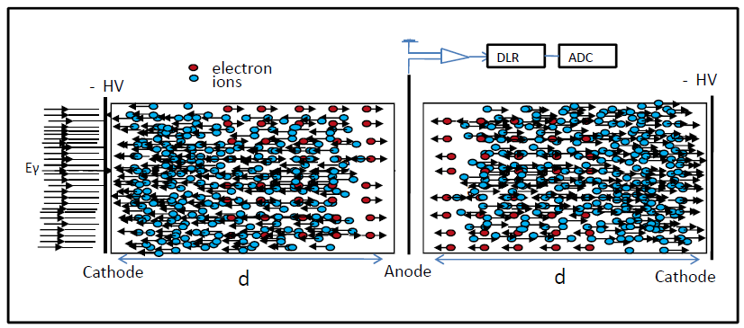

Difinision
Space charge effect
Space charge is a definition of the electric charge when treated as a continuum of charge distributed in a space of a volume.
Cathode
Anode
Q+d/µ+E
Q-d/µ-E
d

Slide 8
Anode
Electron
Cathode
ion
Output current(A)
i
d=5mm
ion signal
Electron signal
j
A
t
Time (s)
The space charge has an influence on the signal amplitude within the signal track were the positive ions need several milliseconds to move from the created position by the incoming photons to the cathode and the arrivals of the electrons in the anode plates is in the order of microseconds
W. Blume, Springer Berlin.( 2008)

Slide 9
Current voltage characteristics with different X-ray photon intensities
Current voltage characteristics measurement at BESSYII synchrotron with different appied pressure

Slide 10
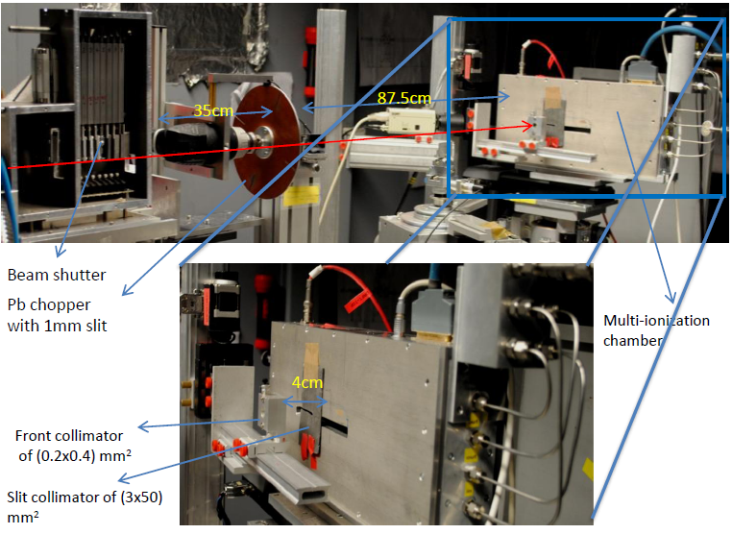
Experimental setup
The measurements were carried out at the EDR synchrotron beam line at BESSYII. The beam size was (1x1.5) mm².
A circular led chopper with diameter of 9cm and 1mm slit in four positions is mounted on a drill machine connected to a power supply is used for chopping the synchrotron beam.
Two collimators are placed in front of the chamber; (3x50)mm horizontal slit Pb collimator is attached to the chamber entrance window to protect the lower parts of the chamber from the beam and (0.2x0.4)mm² collimator is placed at 4cm away from the chamber

Slide 11
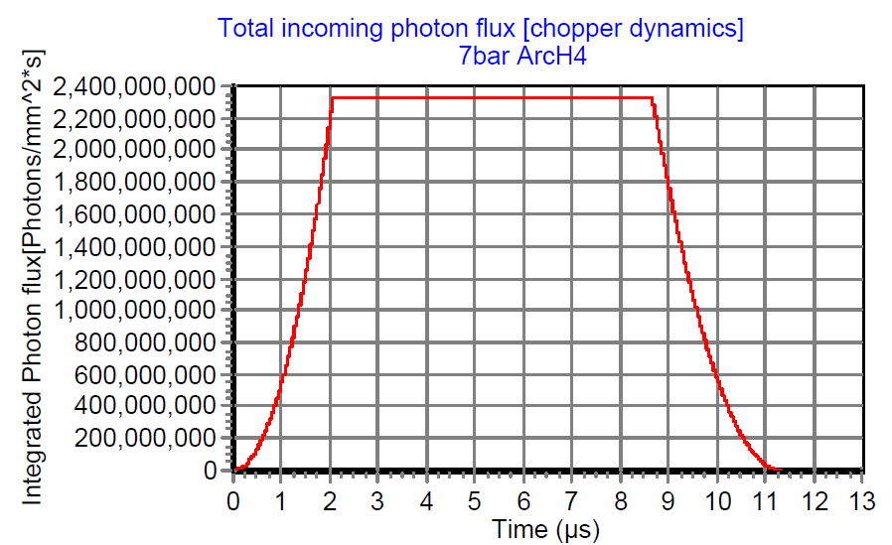
Chopper Dynamics
Time (µs)x10

Slide 12
Result
Time response measurement with 10bar ArcH4 using a slit lead chopper .
[A] when applying low electric field the slit open and a fast current signal appear and immediately it drops down according to the space charge effect which disturb the electric field and drift velocity of the charges till it reach equilibrium and the signal drops down as soon as the chopper closed.
[B]applying a high electric field in the chamber saturation region a time response is measured and a plateau is observed according to the fast drift velocities of the charges as well reduced the recombination of the charges

Slide 13
This figure shows different measurements of the space charge effect as a function of applied electric field from 400V/cm to 2500v/cm were the signal amplitude dedecreases with the increasing of the applied electric field.[B] Magnified long tail signal to study the ions collection time

Slide 14
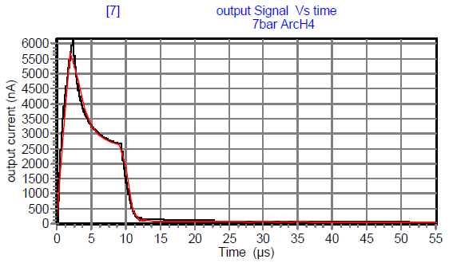
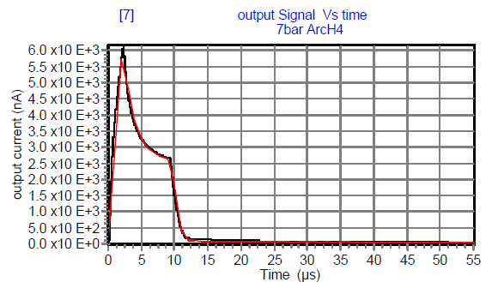
Numerical Simulation
2
3
4
1
5
6
7
Time (µs)x10
To study the space charge effect inside the chamber, we used 7bar ArcH4, appleid electric field of 400V/cm. The chopper frequency is 36.5 Hz. using simulated photon flux for the synchrotron radiation. The simulation program runs till 550µs and the chopper closed after 120µs.

Slide 15
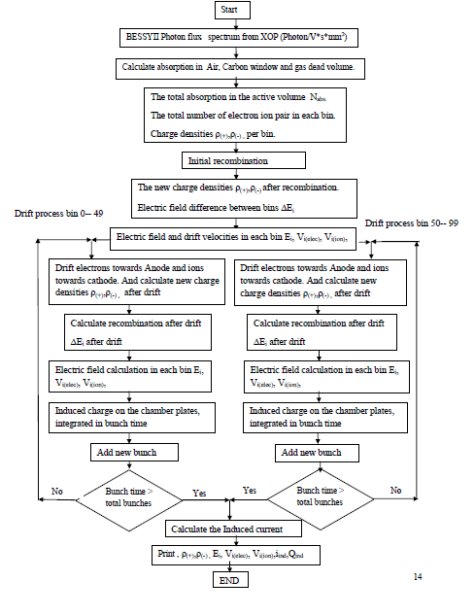

Slide 17

Electric field is calculated from Gauss’s law and Maxwell’s equation.

Slide 18
Numerical Simulation
2
3
4
1
5
6
7
Time (µs)x10
To study the space charge effect inside the chamber, we used 7bar ArcH4, appleid electric field of 400V/cm. The chopper frequency is 36.5 Hz. using simulated photon flux for the synchrotron radiation. The simulation program runs till 550µs and the chopper closed after 120µs.

Slide 19
Conclusion
The Multi-channel ionization chamber is sucessfuly build and operated with Xray tube and high synchrotron photon intensity.
The space charge effect as function of applied electric field has been studied.
The effect of the space charge on the electric field and signal response of the chamber is considered.
The space charge and recombination losses is measured at very low electric field.
The proper operation of the ionization chamber on the saturation region.
Correction algoeithm for the space charge should be implemented when operating the chamber with very low electric field.

Slide 20

Herzlich willkommen im Fachbereich Physik
Welcome in The Physics Department
Thank you for your attention
?

