Slide 1



A CVD diamond detector for (n,α) cross section measurements
C. Weiss ^{1, 2}, G. Badurek ², E. Berthoumieux ³, M. Calviani ¹, E. Chiaveri ¹, D. Dobos ¹,
E. Griesmayer ⁴,C. Guerrero ¹,E. Jericha ², F. Kaeppeler ⁵, H. Leeb ²,T. Rauscher ⁶, V.Vlachoudis ¹ and the n_TOF collaboration
¹ CERN, Geneva, Switzerland
² Vienna University of Technology, Austria
³ CEA Saclay, IRFU, F-91191 Gif-sur-Yvette, France
⁴ CIVIDEC Instrumentation GmbH, Vienna, Austria
⁵ Karlsruhe Institute of Technology, Campus Nord, Germany
⁶ University of Basel, Basel, Switzerland

Slide 2
Introduction
    CVD diamond as detector material
    The n_TOF experiment at CERN
    ¹⁰B(n, α)⁷Li measurement 2011 @ n_TOF, with the prototype detector
    Outlook on future measurements

Slide 3
    CVD diamond as detector material

Slide 4
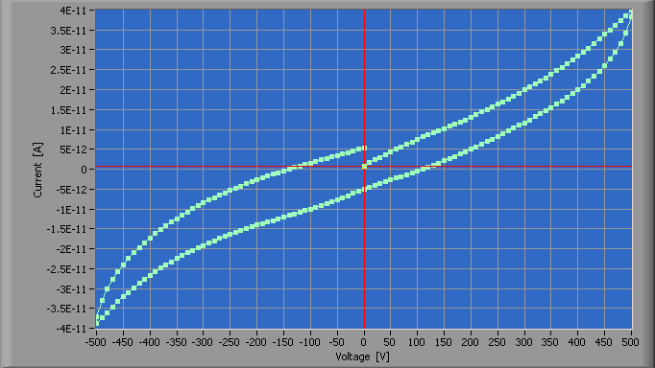
CVD diamond as detector material
    Chemical vapor deposition (CVD) diamond is a
    Semiconducting material
        Band gap = 5.5 [eV]
        Energy to create an e⁻-hole pair = 13 [eV]
        typical IV curve (pCVD):
        low leakage current
        sCVD ~ 2E-12
    Particle Interaction with the diamond:
        => Neutrons: nuclear reactions with ¹²C
      Solid state ionization chamber
Charged particles | Uncharged particles (photons)
Excitation | Photoelectric effect
Ionization | Compton scattering
Bremsstrahlung | Pair production

Slide 5
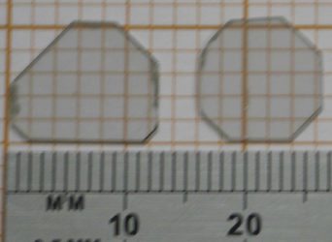
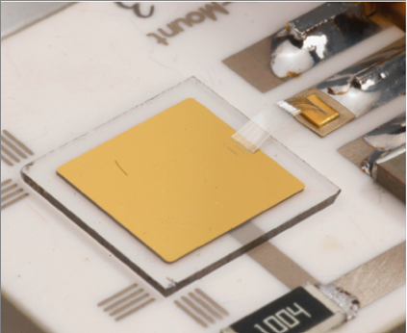
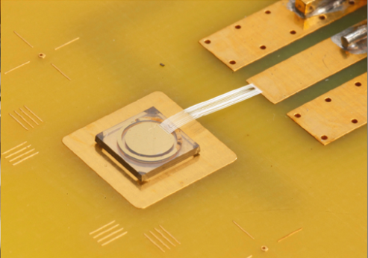
CVD diamond as detector material
    Different materials:
      Poly crystalline (pCVD)
      Different charge collection distance
      Single crystalline (sCVD)
      Pulse shapes
grown on
non-diamond
Substrate
< 12 cm ∅
< 2 mm thickness
grown on
HTHP diamond
Substrate
~ 1 cm²
< 1 mm thickness
grow direction
High radiation tolerance
Rapid response (~ ns)
Low dark current

Slide 6
CVD diamond as detector material
Examples:
Properties are in general not Temperature dependend
Small dark current: Noise comes from the electronics, not the material
Energy resolution sCVD :
  E.Griesmayer et al., CERN BE-Note-2009-028: 0.6 % (22.8 MeV ¹²C Ions)
  M.Pillon et al., NIM A 640 (2011) 185: 0.3 % (5 – 20.5 MeV Neutrons)
Double pulse discrimination (DPD) vor MIP:
Current Amplifier: CIVIDEC Instrumentation GmbH
    t _{rise} = 180 [ps]
    FWHM (electronic DPD ) = 300 [ps]
  500 μm pCVD with 1V / μm
    DPD = 2 [ns]
  500 μm sCVD with 0.8 V / μm
    DPD = 6 – 9 [ns]

Slide 7
The n_TOF Experiment

Slide 8
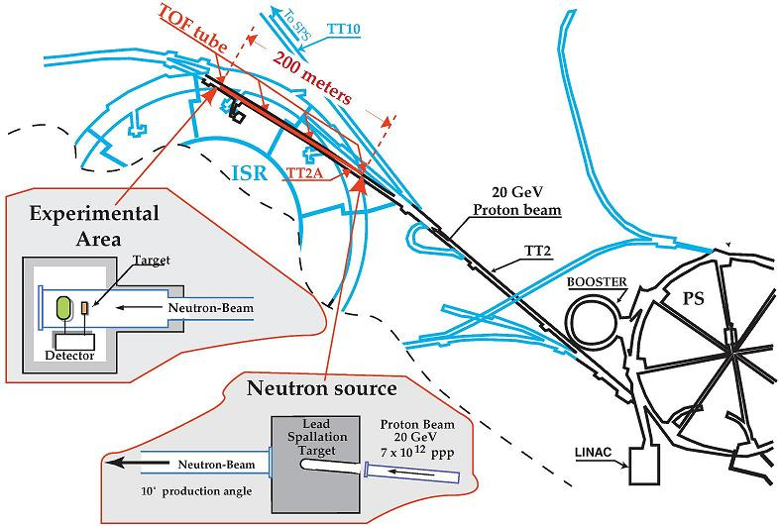
        The n_TOF experiment

Slide 9
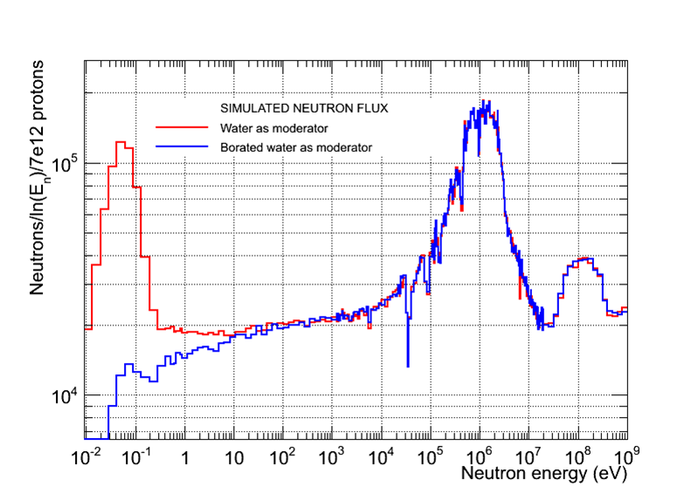
        The n_TOF experiment
High
instantenous flux
Neutron Fluence
Wide energy range

Slide 10
¹⁰B(n, α)⁷Li Measurement 2011
with the prototype detector

Slide 11
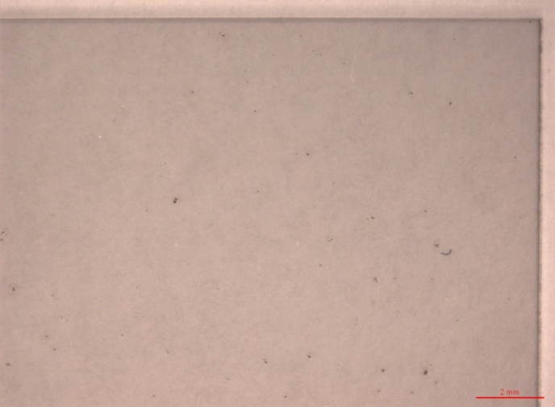
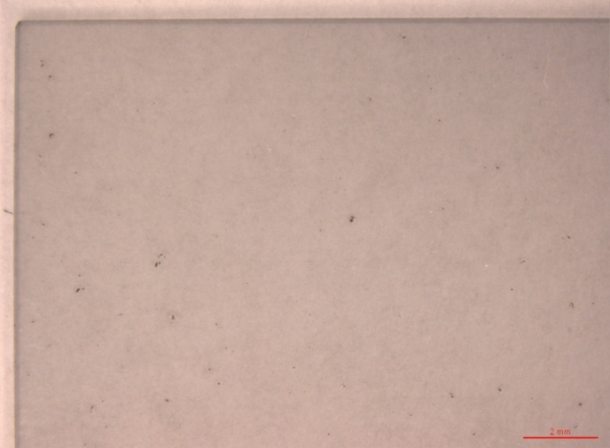
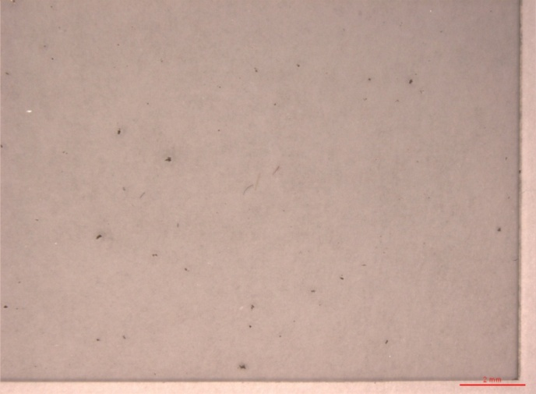
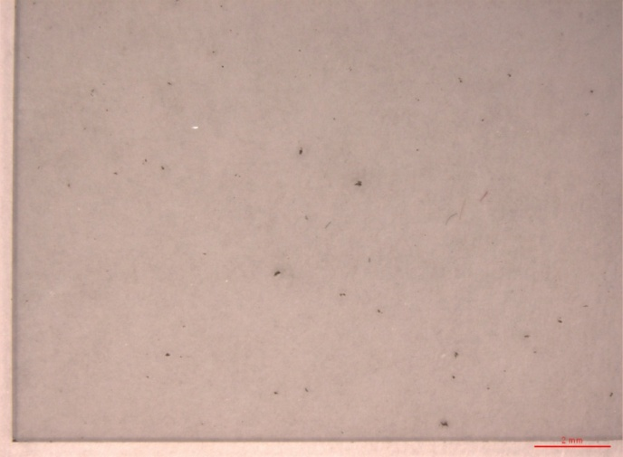
The CVD Diamond Detector
20 mm
d = 500 μm
Metallization:
In coll.with CEA Saclay
4 pads of 100 nm Al
20 mm

Slide 12
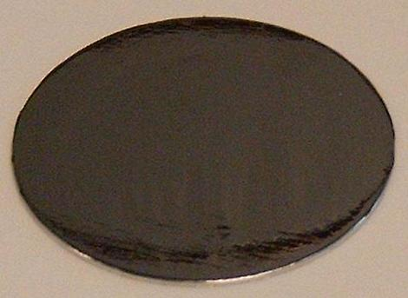
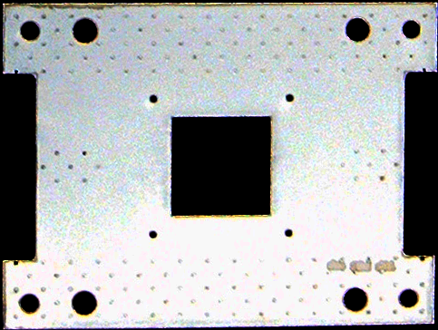
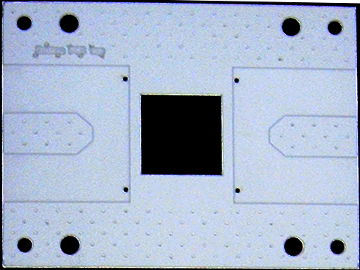
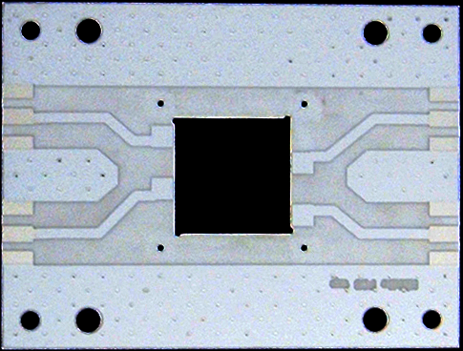
The Detector Prototype
¹⁰B₄C sample
PCB structure with diamond
Neutron Beam
Distance Sample to Diamond
d = 0.5 mm

Slide 13
        ¹⁰B (n, α) ⁷Li measurement @ n_TOF
    16.June 2011 – 29.June 2011
    OBJECTIVES OF THE TEST MEASUREMENT :
    Investigate the background level in the region of interest
    Identify aspects to be improved for the future detector
    Investigate the detection efficiency for the (n, α) reaction
Reaction Yield:

Slide 14
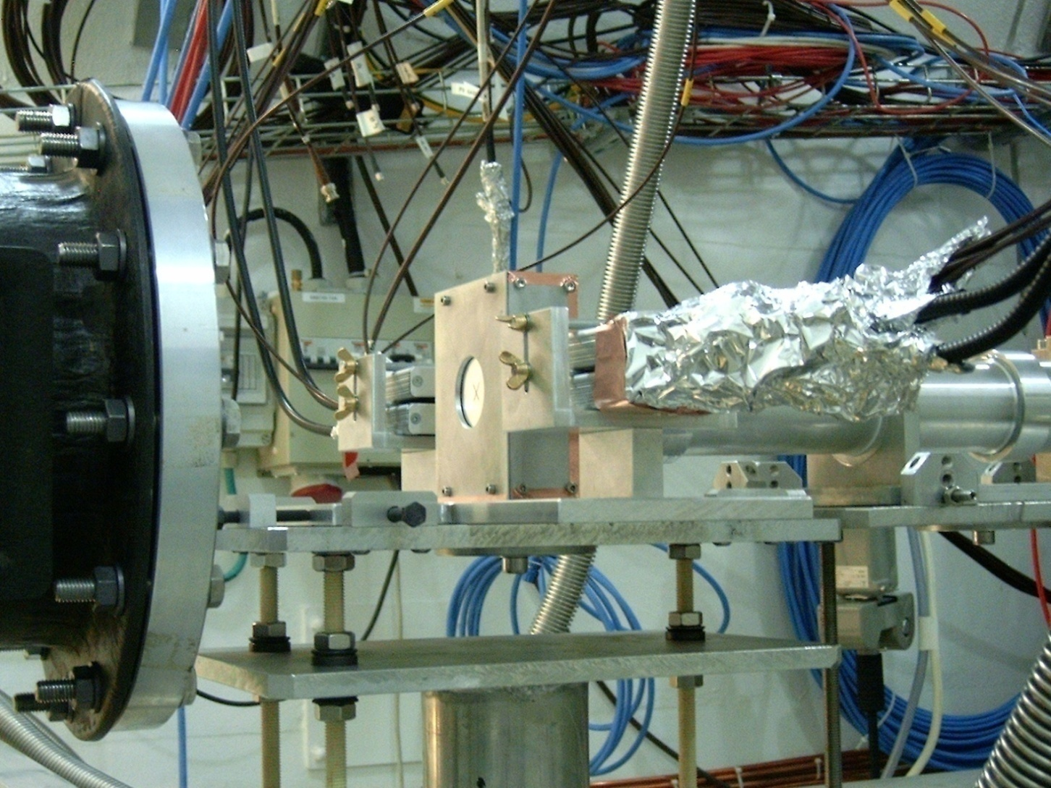
¹⁰B (n, α) ⁷Li measurement
Detector box with
Sample inside
Preamplifiers *
Neutrons
    Preamplifiers *

Slide 15
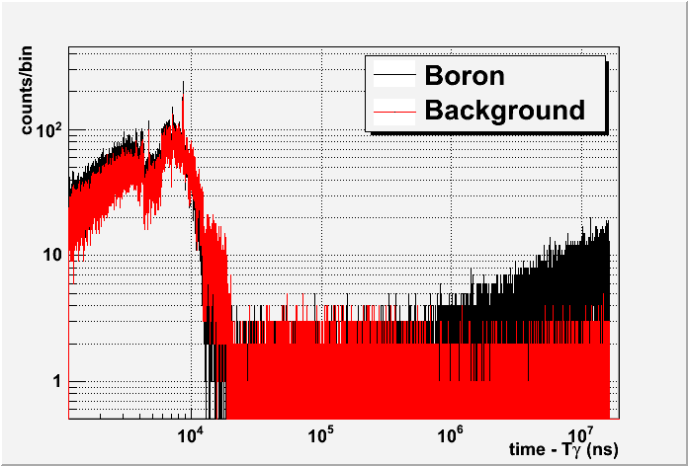
Preliminary Results – TOF Pad 2

Slide 16
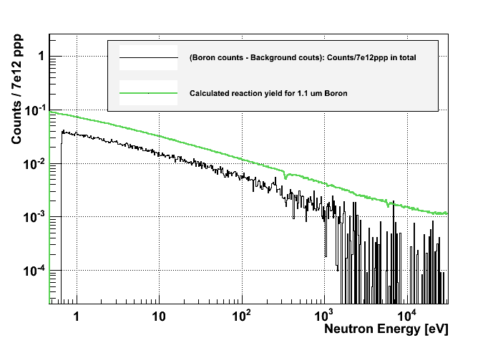
Preliminary Results – Reaction Yield

Slide 17
Outlook
Intended Measurements

Slide 18
Proposed Isotopes
keV < E_{n} < MeV Candidates:
  ³³S
  ⁵⁹Ni
  ⁶⁷Zn
  ⁹⁵Mo
  ¹⁴⁹Sm
E_{n} > MeV Candidates:
  ¹⁶O
  ²⁵Mg

Slide 19
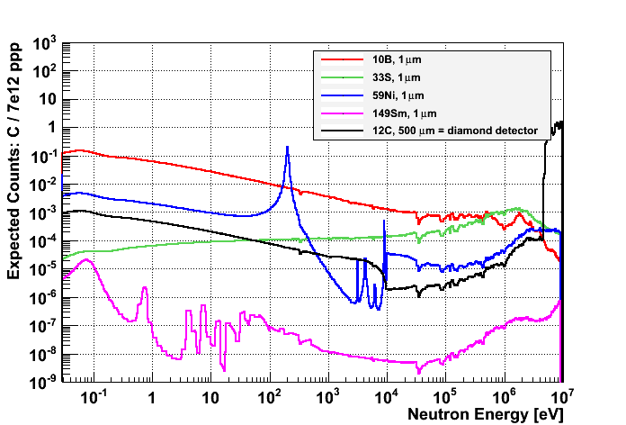
Prototype: Expected Counting rates

Slide 20
Intended Measurements
2011: Background measurement at PTB Braunschweig
2012: ³³S (n, α) ³⁰Si
  30 x 30 [mm²] pCVD diamond detector
  For background reduction: thickness only 250 μm
  ³³S sample at both sides of detector
  Assembly under Vacuum
Future (2014?):
  Ringdetector with sCVD diamonds
    Elimination of ¹²C induced background
    Reduction of in-beam γ-ray background at n_TOF

Slide 21
Thank you for your attention!

Slide 22
Backup

Slide 23
Diamond Properties
Property | Diamond | Silicon
Band gap [eV] | 5.5 | 1.12 | ☺ Low leakage
Breakdown field [V/cm] | 10⁷ | 3x10⁵
Intrinsic resistivity @ R.T. [Ω cm] | > 10¹¹ | 2.3x10⁵
Intrinsic carrier density [cm⁻³] | < 10³ | 1.5x10¹⁰
Electron mobility [cm²/Vs] | 1900 | 1350 | ☺ Fast signal
Hole mobility [cm²/Vs] | 2300 | 480
Saturation velocity [cm/s] | 1x 10⁷ | 0.82x 10⁷
Density [g/cm³] | 3.52 | 2.33
Atomic number – Z | 6 | 14
Dielectric constant - ε | 5.7 | 11.9 | ☺ Low capacitance
Displacement energy [eV/atom] | 43 | 13-20 | ☺ Radiation hard
Thermal conductivity [W/m.K] | ~2000 | 150 | ☺ Heat spreader
Energy to create e-h pair [eV] | 13 | 3.61
Radiation length [cm] | 12.2 | 9.36
Spec. ionization loss [MeV/cm] | 6.07 | 3.21
Aver. signal created / 100 μm [e₀] | 3602 | 8892 | ☹ Low signal
Aver. signal created / 0.1 X₀ [e₀] | 4401 | 8323

Slide 24
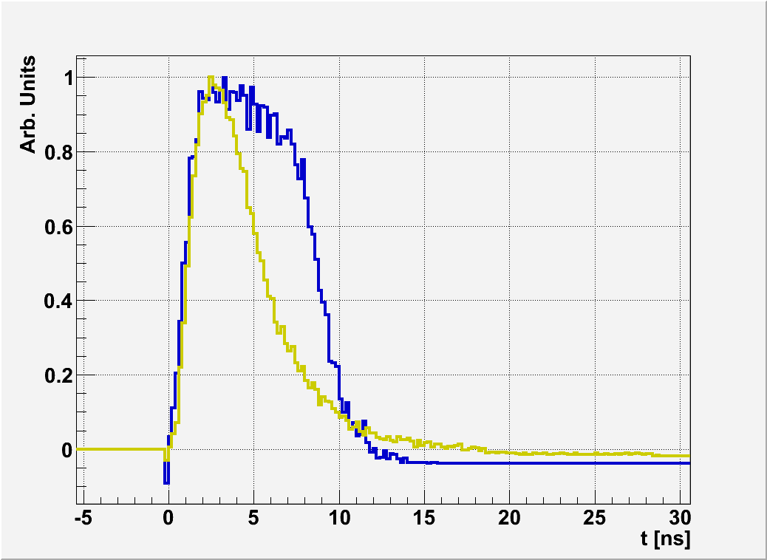
CVD diamond as detector material
sCVD typical pulse shapes: Testbeam Oct.2010 @ n_TOF
Rectangular
Triangular ≈ pCVD signal

Slide 25
CVD diamond as detector material
Successfully used in various applications, for example:
  CERN: RD42 => ATLAS, CMS, ALICE, LHCb
  CERN: LHC – beam loss monitor => cryogenic applications under investigation at the moment
  Geel: Fission fragment monitor
  CEA: Neutron applications
  Beam position monitors at synchrotrons
  Industrial applications: Cyclotron - Phase monitor
  …

Slide 26
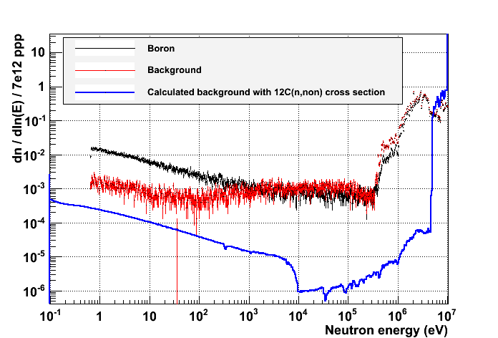
Preliminary Results – Pad 2
n_TOF
γ –Background - Moderation

Slide 27
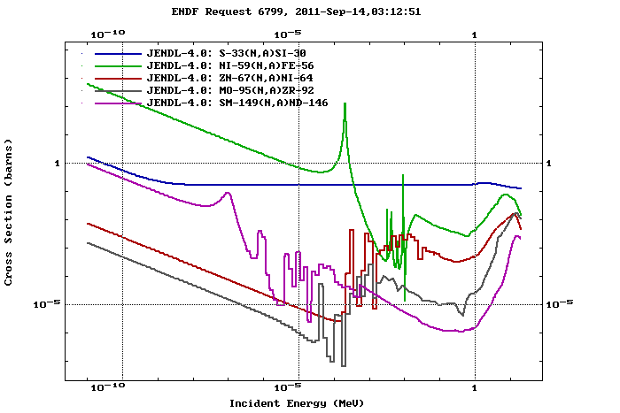
Suggested Isotopes @ n_TOF

Slide 28
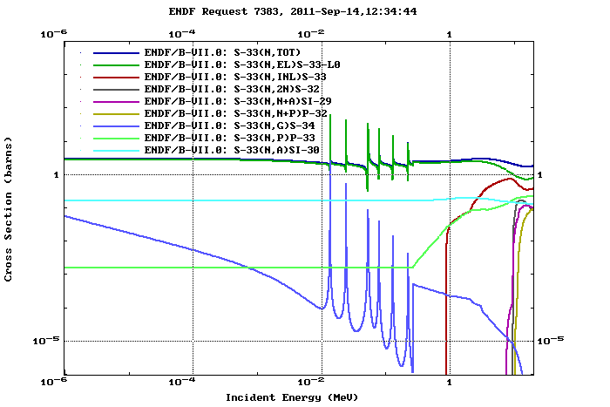
2012: ³³S

Slide 29
Abstract
In astrophysics, the determination of the optical α-nucleus potential for low α energies has turned out to be a challenge, crucial in understanding the origin of the stable isotopes. Theory still cannot predict the optical potentials required for the calculation of the astrophysical reaction rates in the Hauser-Feshbach statistical model and there is scant experimental information on reactions with α particles at the relevant astrophysical energies. Measurements of (n, α) cross sections offer a good opportunity to study the α channel.
At the n_TOF experiment at CERN a prototype detector, based on the chemical vapor deposition (CVD) diamond technology has been developped for (n, α) measurements. A reference measurement of the 10B(n, α)7Li reaction has been performed in 2011 at n_TOF as a feasibility study for this detector type.
The preliminary results of this measurement and an outline for future experiments will be presented.

