Slide 1

New Results for Enhanced Electron Screening in the Deuteron Fusion Reactions
M.Kaczmarski¹, K. Czerski^{1,2}, N. Targosz-Sleczka¹,
P. Heide² , A. Huke^{2,4} , D. Weissbach⁴ and G. Ruprecht^{3,4}
¹ University of Szczecin, Poland
² Technical University Berlin, Germany
³ TRIUMF, Vancouver, Canada
⁴ Institute for Solid-State Nuclear Physics, Berlin, Germany

Slide 2
Introduction- Electron Screening Effect
P(E)
P(E+U_{e})
Z₁ Z₂ e ²
exp (- r /a )
V(r) =
r
Z₁ Z₂ e ²
- U_{e}
≈
r
Z₁ Z₂ e ²
U_{e} =
a
strong screening
Wigner-Seitz Radius

Slide 3
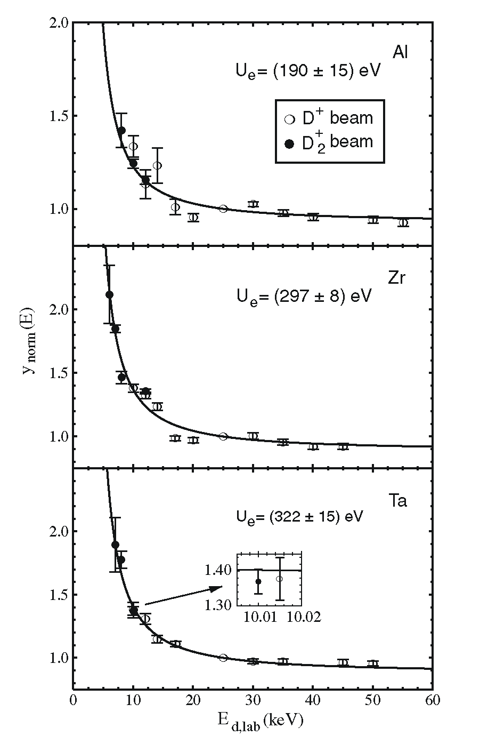
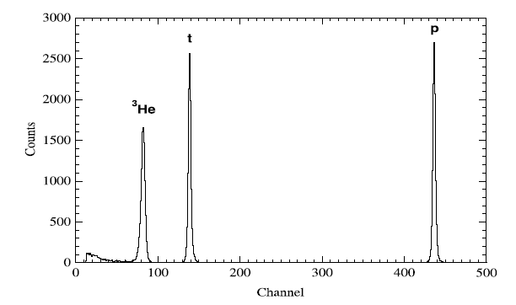
Experimental Results for HV
metal target:
NIC 1998, p. 152
Europhys. Lett. 54 (2001) 449
Similar results:
J. Kasagi et al., J.Phys.Soc.Jap. 71 (2002) 2281
F. Raiola et al., Eur.Phys.J. A13 (2002) 337
F. Raiola et al., Eur.Phys.J. A19 (2004) 283
d + d
³He + n
d + d
³H + p
gas target:
U_{e} = 25±5 eV
U.Greife et al., Z.Phys. A351 (1995) 107

Slide 4
Experimental Results for HV
dielectric function theory:
free and bound electron polarization
cohesion screening
electron-gas parameter r_{s}
Phys. Rev. C 2008

Slide 5
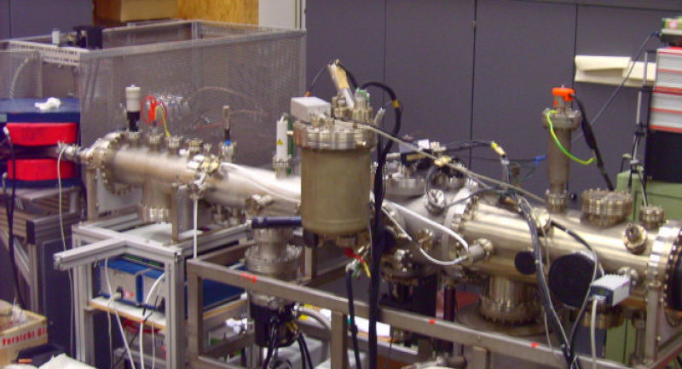
UHV Experimental Setup
I: 10-30 µA
V: 30 kV
V: ~ 1 V
ECR ion source
mass
spectrometer
analyzing
magnet
electron detector
target chamber
p: 10⁻¹¹ – 10⁻¹⁰ mbar

Slide 6
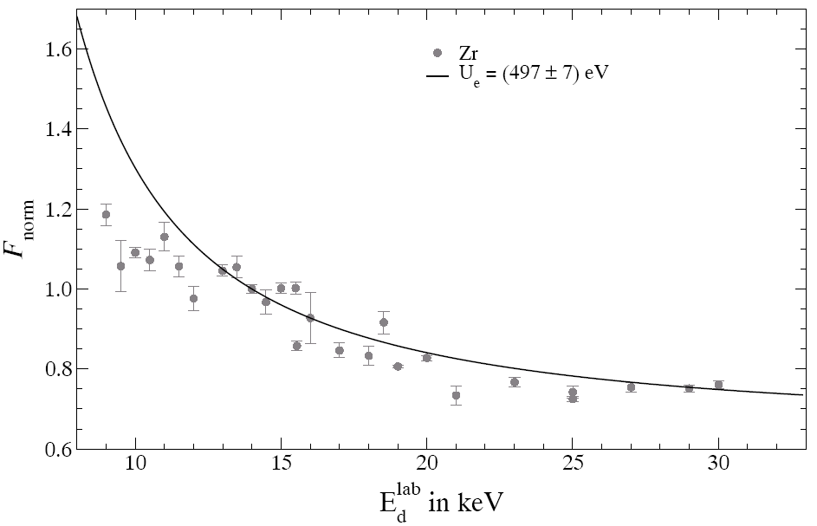
Experimental results for UHV
P~ 8x10⁻¹⁰ mbar
with LN₂ cooling
p_{H2O} ~ 5x10⁻¹² mbar
Target contamination

Slide 7
Auger Spectroscopy Results
C
O
c
O
Zr
electron beam 1 keV
electron beam 3 keV
New
Old

Slide 8
NEW RESULTS FOR UHV EXPERIMENT
P~2x10⁻¹⁰ mbar
Time Dependency of Screening Effect
Crystal structure Damage couse of increasing electron effective mass

Slide 9
Effective Electron Mass
crystal lattice defects effective electron mass > m_{e}

Slide 10
Summary
UHV screening energies larger than previous values
Theoretical values much smaller, but the target material dependence can be explained – renormalization factor ?
Crystal defects increase the effective electron mass
New UHV accelerator under construction at the University of Szczecin

Slide 11
Auger Spectroscopy
vacuum level
L_{2,3}
L₁
γ
γ
e⁻
K
creation of vacancy
de-excitation
Roentgen fluorescence
Auger process
E_{γ} = E_{K} - E_{L1}
E_{e} = E_{K} - E_{L1} - E_{L2}

