Slide 1
Decay spectroscopy for nuclear astrophysics
Livius Trache
Texas A&M University
College Station, TX, USA
6th European Summer School on Experimental Nuclear Astrophysics
Santa Tecla, Sept 18-27, 2011

Slide 2
Nuclear Physics for Astrophysics Indirect methods with RIB
Indirect methods in NPA with or w/o RIB
  A. Coulomb dissociation
  B. Transfer reactions (ANC method)
  C. Breakup of loosely bound nuclei
  D. Spectroscopy of resonances: β-decay, transfer reactions, resonant elastic scatt., etc
    Decay spectroscopy
  E. Trojan Horse Method
  …

Slide 3
Motivation
Proton capture – a class of reactions important in nuclear astrophysics
  Radiative proton capture reactions: X(p,γ)Y
Reactions take place in a narrow range of energies: (Gamow window) due to Coulomb repulsion & Maxwell distribution
Stars are cold! E_{p}=10s -100s keV
Can have: non-resonant (continuum) and resonant capture
* C. Rolfs and W. Rodney, “Cauldrons in the Cosmos”.

Slide 4
Radiative capture reactions in stars
Projectile X
* Radiative capture reactions A(p,γ)B, A(α,γ), A(n,γ)
* Non-resonant or resonant reactions.
* At low energy, the probability that the incoming
charged particle penetrates the Coulomb barrier:
* The cross section – astrophysical S-factor:
* Reaction rate per particle pair (integrate over E distr):
Reactions (that matter) take place in the Gamow energy window.
Direct, or non-resonant part
γ
Plane
Wave
^{Target}
^{A}
^{Target}
^{A}
Final Orbit
Nucleus B
Coulomb Barrier
Projectile
Potential V(r)
Distance
r
to determine
Nuclear
Radius R_{n}
* C. Rolfs and W. Rodney, “Cauldrons in the Cosmos”.
Notes:
Nuclear capture reactions play a major rule in defining our universe.
In direct reactions, the nucleon transferred quickly and proceed directly from the initial state to the final state without forming an intermediate compound nucleus or state.
These reaction are called also Peripheral, the primary goal is to determine these rates.
It is nonresonant since it occurs at all projectile energies with a cross section varying smoothly with energy.
The probability that the incoming particle penetrates the coulomb Barrier is given by this formula, where η is the Sommerfeld parameter.
The cross section for a charged particle is a function of this penetrating probability and the square of the De Broglie wavelength which reflects the aspect of the quantum mechanics this introduces 1/E factor.
S(E) is the constant of the relation, and named as Astrophysical factor (S-factor).
The reaction rate for the nonresonant case is given by:
The convolution between the MB distribution function and the tunneling function through Coulomb barrier leads to the Gamow peak near the effective energy burning E_{o} that allow several nuclear reactions to occur.

Slide 5
Resonant Reaction Rate
* Resonant reaction is a two-step process.
* The cross section (Breit-Wigner):
* The contribution to the reaction rate:
where
Stars are cold!
E_{p}=10s-100s keV
* C. Rolfs and W. Rodney, “Cauldrons in the Cosmos”.
to determine
ωγ= resonance strength
Notes:
The resonant reaction through isolated and narrow resonances is a two step process.
The process involves two matrix elements, first is the formation of the compound state E_{r} and the other matrix describes the gamma decay of E_{r.}
The cross section value for the resonant reaction is given by this formula, where (J-part) represents the statistical weight that the spins of the projectile and target will lead to the final angular momentum angular momentum of the excited states. This excited state is characterized by an energy width or the resonant term.
For a narrow resonance, the Maxwell-Boltzmann distribution changes very little over the resonance region, so the reaction rate is approximated to this formula.
Where the width ratio γ is referred to the resonance strength.

Slide 6
also ³⁸Ca, ⁴⁶V, ⁵⁷Cu, ⁶²Ga, …
³¹Ar
³²Ar
³³Ar
³⁴Ar
³⁵Ar
³⁶Ar
= studied at TAMU
³⁰Cl
³¹Cl
³²Cl
³³Cl
³⁴Cl
³⁵Cl
sd-shell : resonant components
dominant
²⁷S
²⁸S
²⁹S
³⁰S
³¹S
³²S
³³S
³⁴S
= planned
²⁵P
²⁶P
²⁷P
²⁸P
²⁹P
³⁰P
³¹P
²³Si
²⁴Si
²⁵Si
²⁶Si
²⁷Si
²⁸Si
²⁹Si
³⁰Si
²¹Al
²²Al
²³Al
²⁴Al
²⁵Al
²⁶Al
²⁷Al
²⁰Mg
²¹Mg
²²Mg
²³Mg
²⁴Mg
²⁵Mg
²⁶Mg
¹⁹Na
²⁰Na
²¹Na
²²Na
²³Na
p-shell : direct component
dominant or important
¹⁶Ne
¹⁷Ne
¹⁸Ne
¹⁹Ne
²⁰Ne
²¹Ne
²²Ne
¹⁴F
¹⁵F
¹⁶F
¹⁷F
¹⁸F
¹⁹F
stable
¹²O
¹³O
¹⁴O
¹⁵O
¹⁶O
¹⁷O
¹⁸O
used at TAMU
¹¹N
¹²N
¹³N
¹⁴N
¹⁵N
(p,n) possible
⁹C
¹⁰C
¹¹C
¹²C
¹³C
¹⁴C
¹⁵C
(p,2n) possible
⁸B
⁹B
¹⁰B
¹¹B
⁷Be
⁸Be
⁹Be
Notes:
Prospects with MARS

Slide 7
Decay spectroscopy
Resonant Capture
a two-step process
5/2⁺
Energy
Selection rules
²³Al
Coulomb Barrier
Γ_{p}
p
Γ_{γ}
Radius
S_{p}
Resonance strength
Conditions:
Q_{EC} >S_{p}+2m_{e}c²
J=3/2+, 5/2+, 7/2+
γ+²³Mg← ²³Mg*←²²Na+p
²³Mg
5/2⁺, 7/2⁺ ← 3⁺+1/2⁺ +0⁺
Nuclear Potential
Same compound system: ²³Mg
Resonant contributions to reaction rate:
ωγ=(2J+1)/(2j+1)(2I+1)b_{γ}b_{p}*Γ
Need energy, J_{r} and resonance strength
Notes:
7

Slide 8
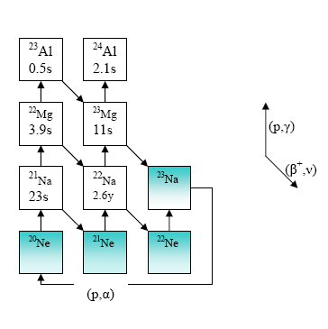
Decay spectroscopy
Beta- and beta-delayed proton-decay
Explosive H-burning in novae
&
IAS in T_{z}=-3/2 nuclei
Isospin mixing
GT strength distribution
²²Na depletion in novae
²³Al→²³Mg* ⇒ ²²Na(p,γ)²³Mg*
& ²²Mg(p,γ)²³Al
bottleneck r. in novae
³¹Cl→³¹S* ⇒ ³⁰P(p,γ)³¹S*
See Jordi’s list!

Slide 9
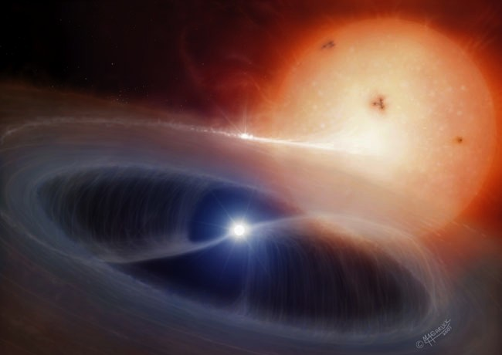
Explosive H-burning in novae: “²²Na puzzle”
- novae: explosive H-burning of accreting material in binaries star-WD. ~ 30/yr.
- γ rays from the decay of long-lived isotopes like ²⁶Al have been detected
- E=1.275 MeV γ ray following the decay of ²²Na predicted (Clayton, Hoyle), but not observed by space gamma-ray telescopes
NeNa cycle
T_{1/2}=2.6 yr
Q: why?!
Novae model(s) inappropriate?!
Nuclear data incorrect?! Not enough
²²Na produced or depleted?!
²²Na depletion in novae: how does it happen?
what are the stellar reaction rates for the ²²Mg(p,γ)²³Al and ²²Na(p,γ)²³Mg?

Slide 10

²³Al
MARS
In-flight RB production
²⁴Mg 48A MeV
²³Al 40A MeV
Purity: 90%, or >99% after en degrader
Intensity: ~ 4000 pps
First time - very pure & intense ²³Al
Primary beam ²⁴Mg @ 48A MeV – K500 Cycl
Primary target LN₂ cooled H₂ gas p=1.6-2 atm
Secondary beam ²³Al @ 40.2A MeV
(p,2n) reaction

Slide 11
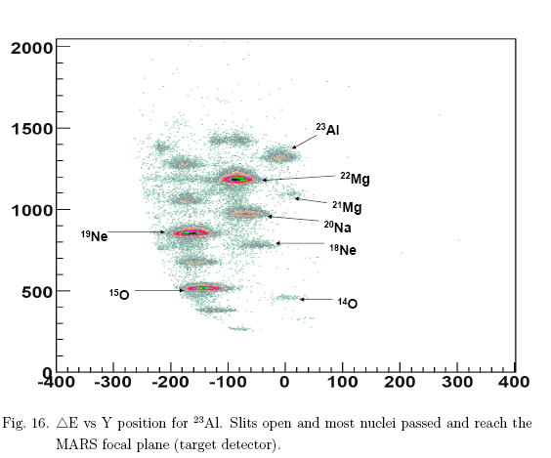
Isotope selection with MARS
N=Z-2
N=Z-3
N=Z-1
E
Pos ~ q/m
²⁴Al used for en and eff calibration
of Ge detector to E_{γ}=8 MeV
Final cut with focal plane slits

Slide 12
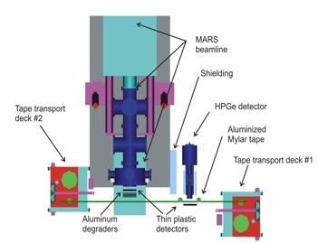
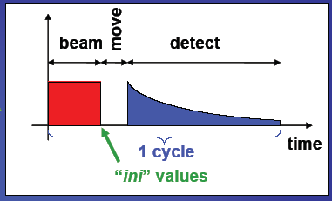
β decay study of pure RB samples

Slide 13
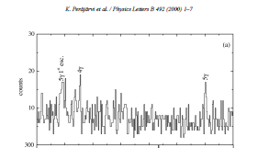
²³Al β-γ coincidence spectrum
IAS
BGO

Slide 14
²³Al β-decay results
First clean and intense ²³Al source
Found decay scheme
established g.s. J^{π}=5/2⁺ (not 1/2⁺) [VE Iacob ea, PRC 74, Oct 2006; also A. Ozawa ea, PRC 74, Aug 2006 from magn mom meas] ⇒ ²²Mg(p,γ)²³Al not important for depletion of ²²Na in novae
absolute branching ratios (not easy or common!)
measured T_{1/2}=446(4) ms (<1% accuracy) - w. γ-ray multiscaling
and absolute log ft
identified IAS E*=7802.9(5) keV by logft=3.31(2) – meas!
used IMME to get new ²³Al mass ⇒ S_{p}(²³Al)=143(3) keV
  Note: after mass meas in Jyvaskyla, became best IMME check! and S_{p}=141.11(43) keV
Located IAS & state at E*=7787 keV – important resonance in ²²Na(p,γ)²³Mg

Slide 15
²³Al β-decay results
First clean and intense ²³Al source
Found decay scheme
established g.s. J^{π}=5/2⁺ (not 1/2⁺) [VE Iacob ea, PRC 74, Oct 2006; also A. Ozawa ea, PRC 74, Aug 2006 from magn mom meas] ⇒ ²²Mg(p,γ)²³Al not important for depletion of ²²Na in novae
absolute branching ratios (not easy or common!)
measured T_{1/2}=446(4) ms (<1% accuracy) - w. γ-ray multiscaling
and absolute log ft
identified IAS E*=7802.9(5) keV by logft=3.31(2) – meas!
used IMME to get new ²³Al mass ⇒ S_{p}(²³Al)=143(3) keV
  Note: after mass meas in Jyvaskyla, became best IMME check! and S_{p}=141.11(43) keV (A. Saastamoinen ea, PRC 80, 2009)
Located IAS & state at E*=7787 keV – important resonance in ²²Na(p,γ)²³Mg

Slide 16
PRC 80, 044330 2009

Slide 17
²³Al β-decay results
First clean and intense ²³Al source
Found decay scheme
established g.s. J^{π}=5/2⁺ (not 1/2⁺) [VE Iacob ea, PRC 74, Oct 2006; also A. Ozawa ea, PRC 74, Aug 2006 from magn mom meas] ⇒ ²²Mg(p,γ)²³Al not important for depletion of ²²Na in novae
absolute branching ratios (not easy or common!)
measured T_{1/2}=446(4) ms (<1% accuracy) - w. γ-ray multiscaling
and absolute log ft
identified IAS E*=7802.9(5) keV by logft=3.31(2) – meas!
used IMME to get new ²³Al mass ⇒ S_{p}(²³Al)=143(3) keV
  Note: after mass meas in Jyvaskyla, became best IMME check! and S_{p}=141.11(43) keV
Located IAS & state at E*=7787 keV – most important resonance in ²²Na(p,γ)²³Mg

Slide 18
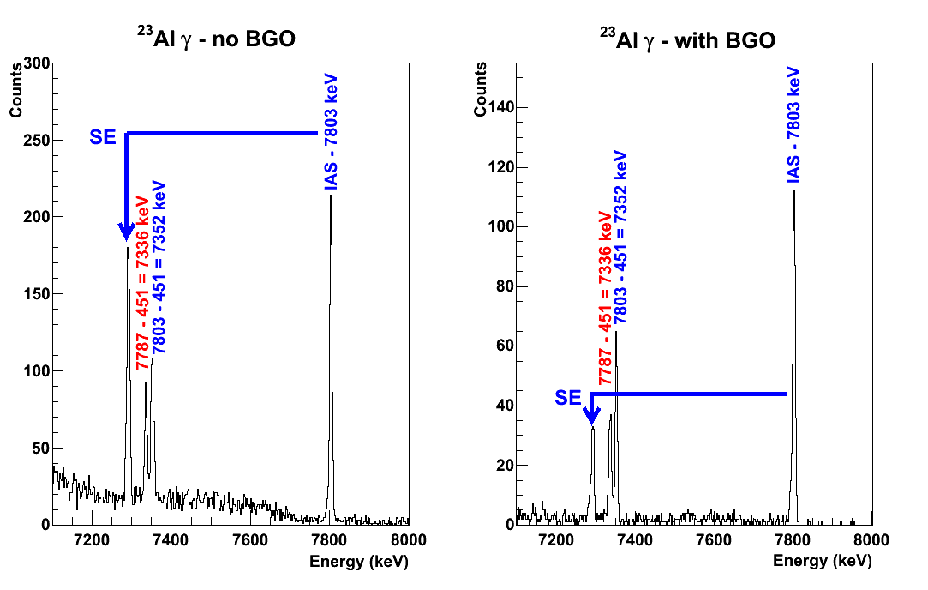
²³Al βγ no-BGO vs BGO shield
7803
IAS, T=3/2
7787
?!% p
451
gs
²³Mg

Slide 19
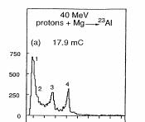
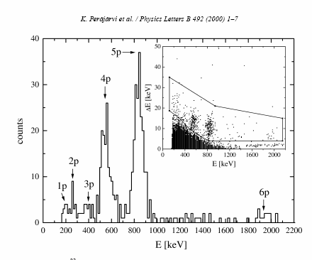
Tighe ea, LBL 1995
Perajarvi ea, JYFL 2000
(p,γ) vs p-decay
5/2+
²³Al 0.446(4)s
Q_{ec}=12240keV
Proton br. total=?!%
β⁺
²²Mg(p,γ)²³Al
β⁺
?!%
9548
8456
8164
8003
7877
p
IAS: ft=2140 s +/-5%
7803 IAS 5/2+
7787 (7/2)+
6985 5/2+
6575 5/2+
2905 (3,5/2)+
2359 1/2+ NO!
2051 7/2+
450 5/2+
0 3/2+
?!%
²²Na
Sp=7580 keV
E=207 keV => ΔE=16 keV
Unusually strong
isospin mixing! (?!)
²²Na(p,γ)²³Mg
resonances
Most important:
ωγ₇₇₈₇=__._?! meV
VE Iacob, et al., PRC 74, Oct. 2006
& Y Zhai thesis
²³Mg

Slide 20
Method: implantation in very thin Si detectors!
MARS implantation station
Energy degrader
275 mm
OD Φ=150 mm
thermocooler
connectors
64 mm
>110 mm
E=E_{p}+kE_{recoil}+<ΔE_{β}>
18” dia chamber
Φ=80 mm
p-detector – v. thin DS Si strip 65 or 45 μm
W1-65 BB2-45
β-detector – thick Si det 1 mm
γ-detector – HPGe 70% effic
Pulsed beam

Slide 21
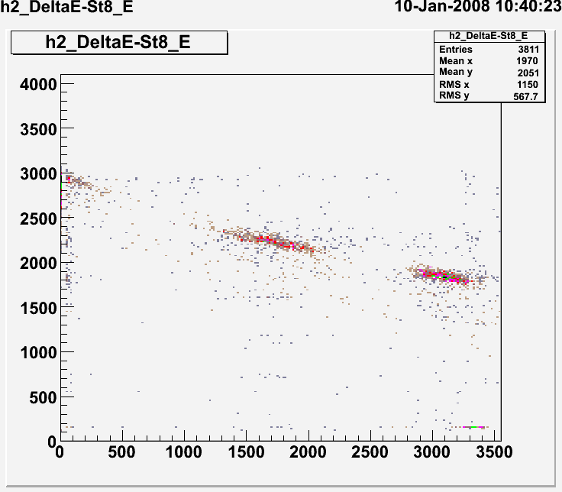
Si 1000 μm
Si strip
61 μm
17 μm
“HI telescope mode” – control implantation
Signal=E_{ΗΙ}
Signal=ΔE_{HI}
HI
Δp/p=+/-0.25%
proton
36°
β
ΔE (p)
Gamma-ray
30°
0°
Signal=ΔE_{β}
Signal=E_{p}+ΔE_{β}
“β-proton mode”
measure simultaneously:
β-proton and
β−γ coinc.
Si stops protons:
½ 65 μm E_{p}<1.5 MeV
E (β)

Slide 22
²³Al β-delayed p-decay sp – after bkg subtraction
Resonances for ²²Na(p,γ)²³Mg
Gamow window
866
579
267
207
1204
367
394
440
E=223 keV IAS
Antti Saastamoinen et al., PRC 83, 2011
“world record”

Slide 23
β allowed GT
Superallowed F
ωγ=(2J+1)/(2j+1)(2I+1)b_{γ}b_{p}*Γ
5/2⁺
Most important resonance:
E_{res}=207 keV
ωγ=1.4 meV (+.5,-.4)
Γ from τ=10(3) fs Jenkins ea, PRL 2004
²³Al
(5/2, 7/2)⁺
p
IAS, 5/2⁺ T=3/2
 | Eres (keV) | Eexc (keV) | br-p (of 100 beta)
 | 207 | 7787 | 0.14(3)%
IAS | 223 | 7803 | ?!
 | 267 | 7848 | 0.18(4)%
 | 337 | 7917 | 0.03(1)%
 | 443 | 8024 | 0.04(2)%
 | 579 | 8160 | 0.65(2)%
 | 866 | 8447 | 0.95(3)%
 | 1204 | 8785 | 0.04(1)%
 |  | total | 1.22(5)%
?!
7787 (7/2)⁺
3⁺
3.7%
²²Na + p
78.2%
18.0%
7/2⁺
5/2⁺
3/2⁺, T=1/2
Rare case (2nd known!) s of γ & p-branching
measured simultaneously !
²³Mg

Slide 24
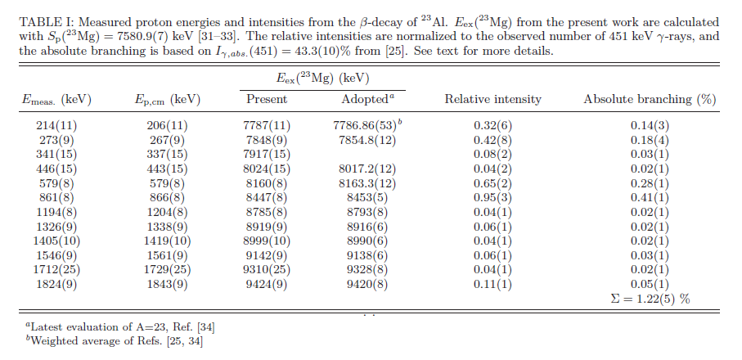
Results ²²Na(p,γ)²³Mg
Most important resonance:
  E_{res}=207 keV, J^{π} =(7/2)⁺, T=1/2
  ωγ=1.4 meV (+.5/-.4)
    - using our branchings and t_{1/2}=10(3) fs from Jenkins et al. (PRL 2004)
    direct meas, p on radioactive ²²Na target: ωγ=1.4(3) meV – Stegmueller et al. NPA1996
New resonances found: 267, 337 keV
No resonance at E_{p}=198 keV - as suggested in Jenkins ea, PRL 92 (2004)
ωγ=5.7(16) meV – Sallaska et al. PRL 2010

Slide 25
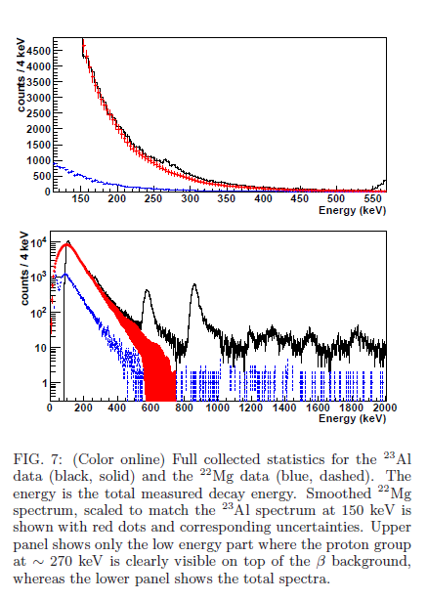
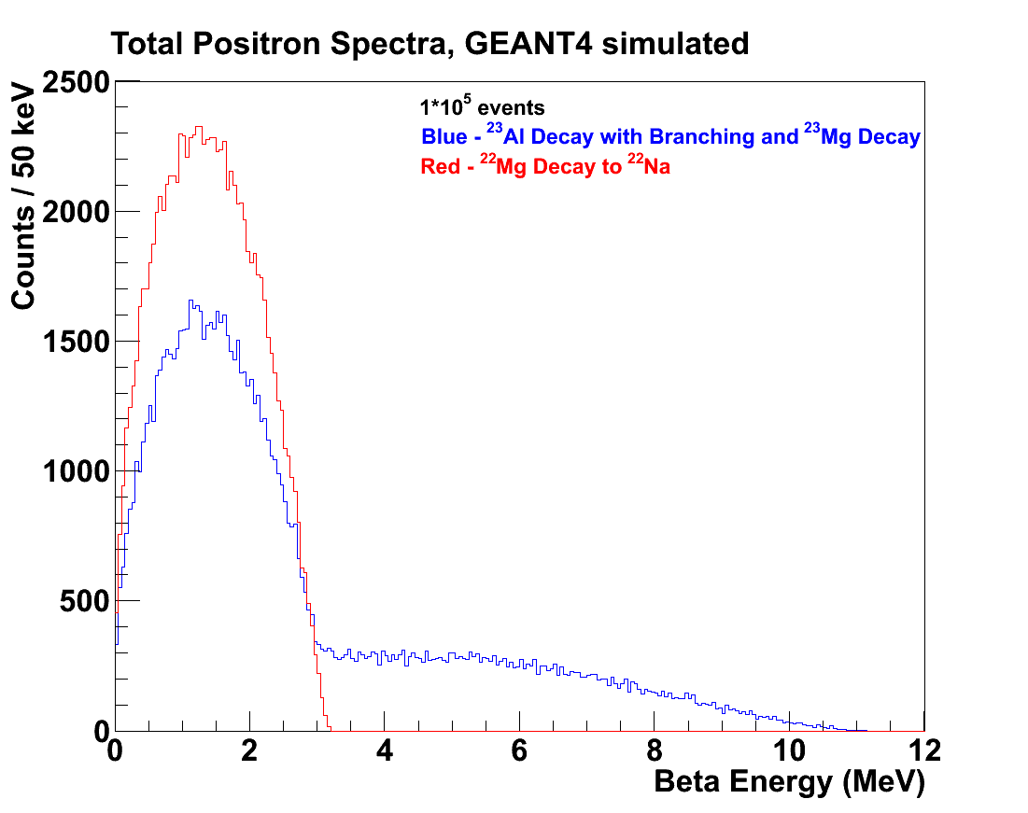
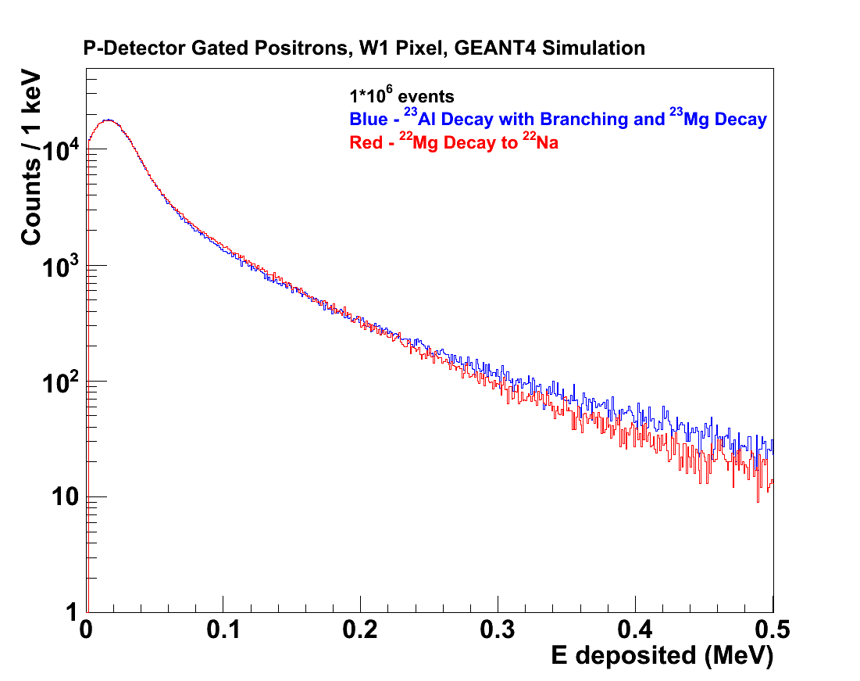
Full disclosure!
Background subtracted using decay of ²²Mg (not a proton emitter)

Slide 26
²³Al βp meas with Si det
Low energy beta background hurts!

Slide 27
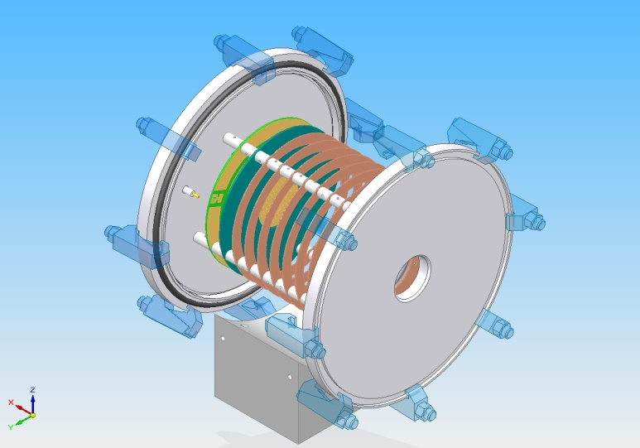
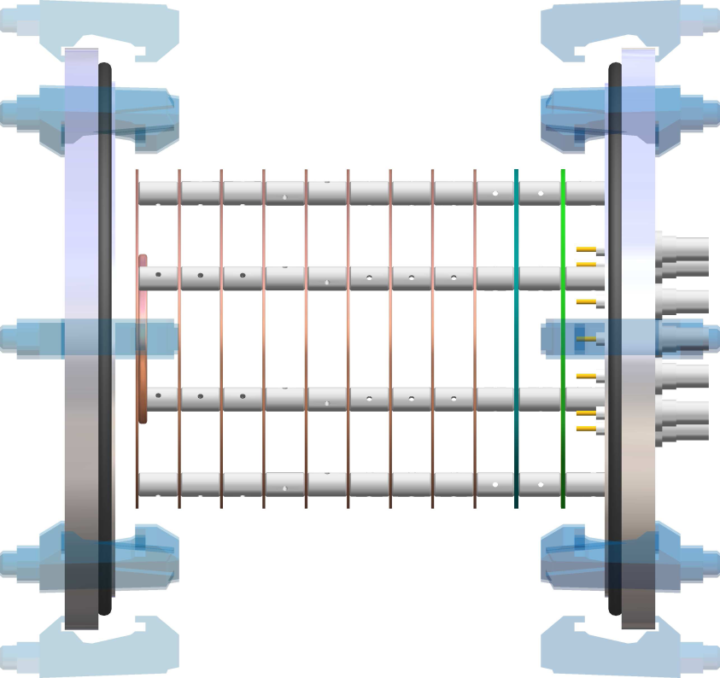
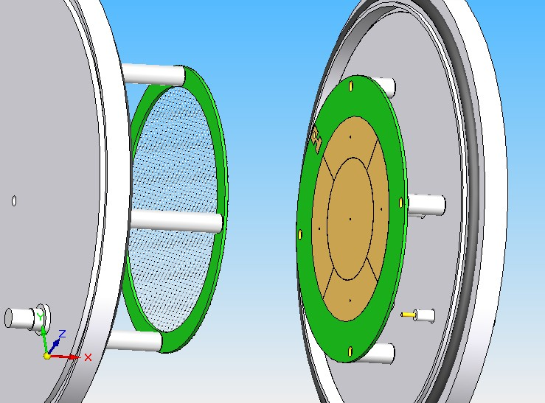
Solution: ASTROBOX
This spring
emitted proton
electrons
beam
E Pollacco (CEA Saclay) proposed:
Gas detector w MICROMEGAS
Low proton energies (~1-200 keV), good resolution (5-10%)
Reduced β background

Slide 28
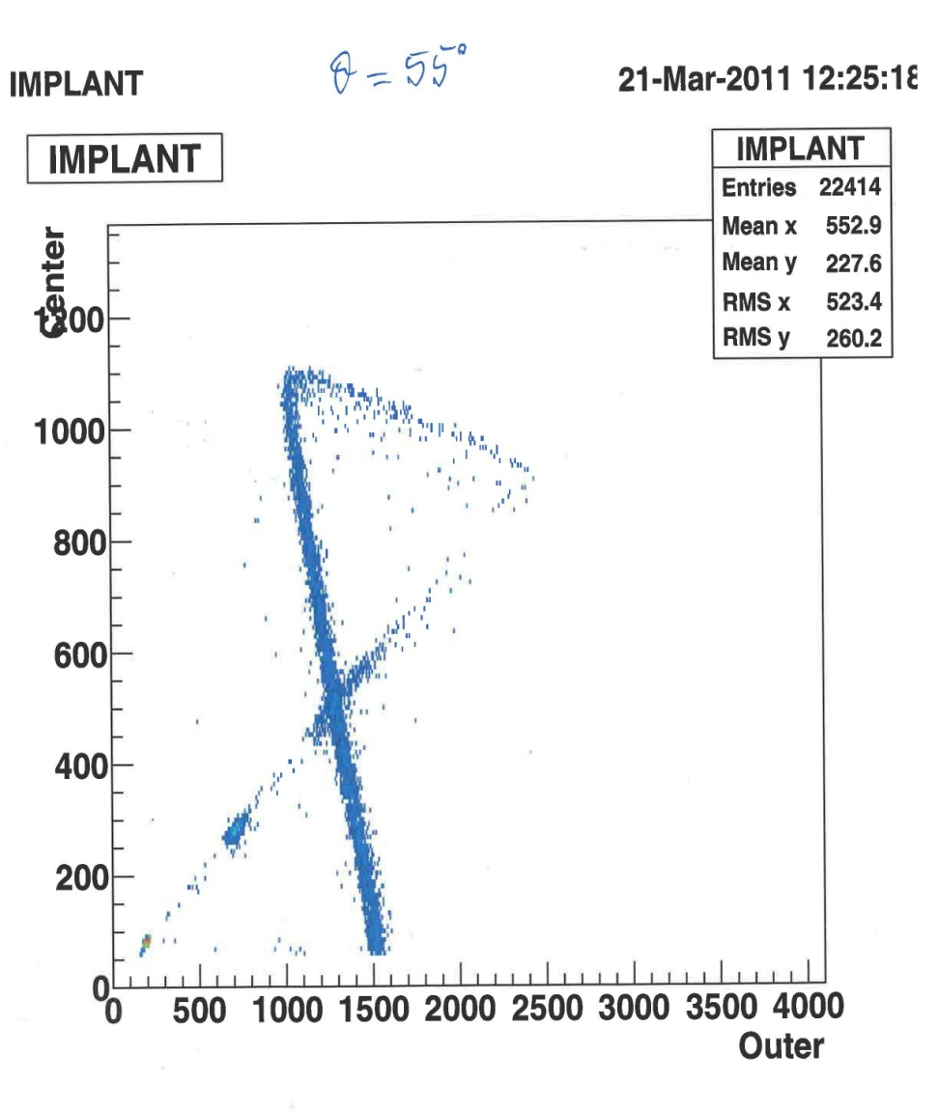
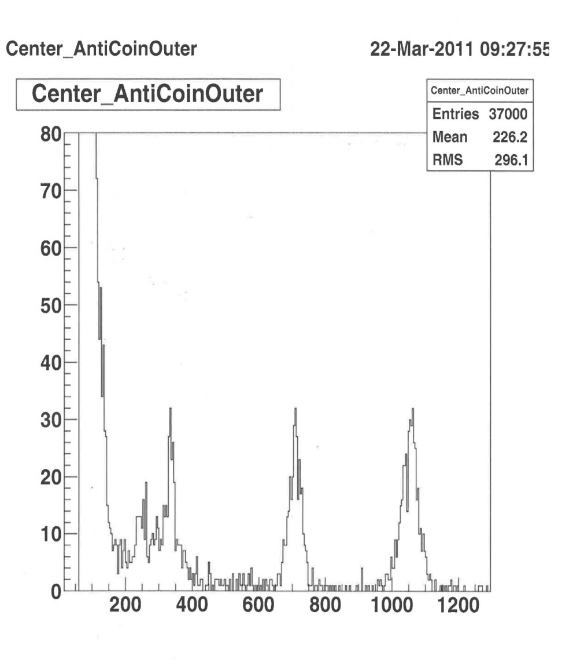
Run0311B: ²³Al βp-decay with ASTROBOX
Implantation control
Off-beam spectrum
Outer-far
betas
223 IAS
866
267
579
Center
detector
206 keV
Outer + center
337
(See talk by Alexandra Spiridon, later)

Slide 29
β allowed GT
Superallowed F
ωγ=(2J+1)/(2j+1)(2I+1)b_{γ}b_{p}*Γ
5/2⁺
²³Al
No unusual isospin mixing!
IAS resonance has small b_{p}: (?!)
(5/2, 7/2)⁺
p
IAS, 5/2⁺ T=3/2
 | Eres (keV) | Eexc (keV) | br-p (of 100 beta)
 | 207 | 7787 | 0.12(3)%
IAS ?! | 234 | 7813 | 0.06( )%
 | 267 | 7848 | 0.18(4)%
 | 337 | 7917 | 0.03(1)%
 | 443 | 8024 | 0.04(2)%
 | 579 | 8160 | 0.65(2)%
 | 866 | 8447 | 0.95(3)%
 | 1204 | 8785 | 0.04(1)%
 |  | total | 1.26(5)%
0.4%
7787 (7/2)⁺
3⁺
3.7%
²²Na + p
78.2%
18.0%
7/2⁺
5/2⁺
3/2⁺, T=1/2
Rare cases of γ & p-branching
measured simultaneously !
²³Mg

Slide 30
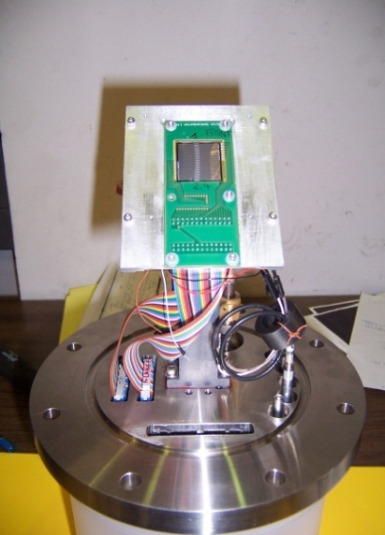
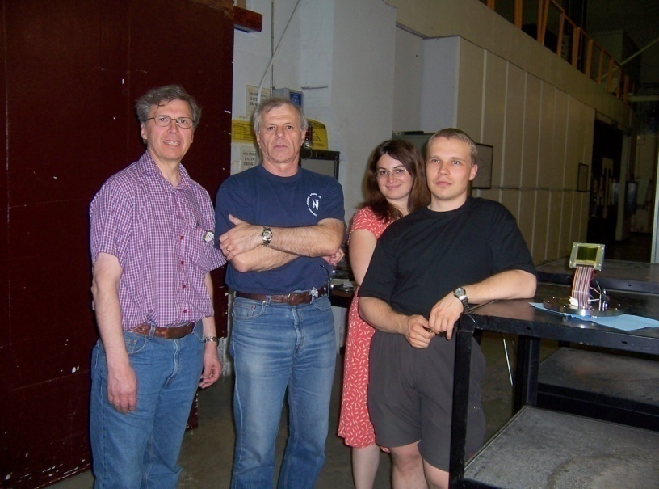
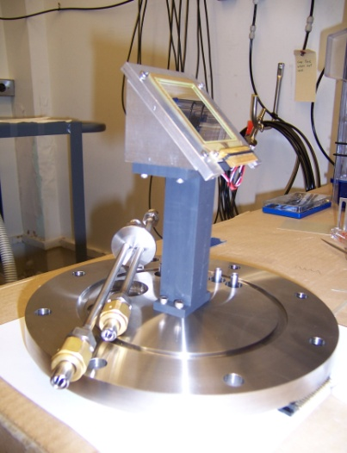
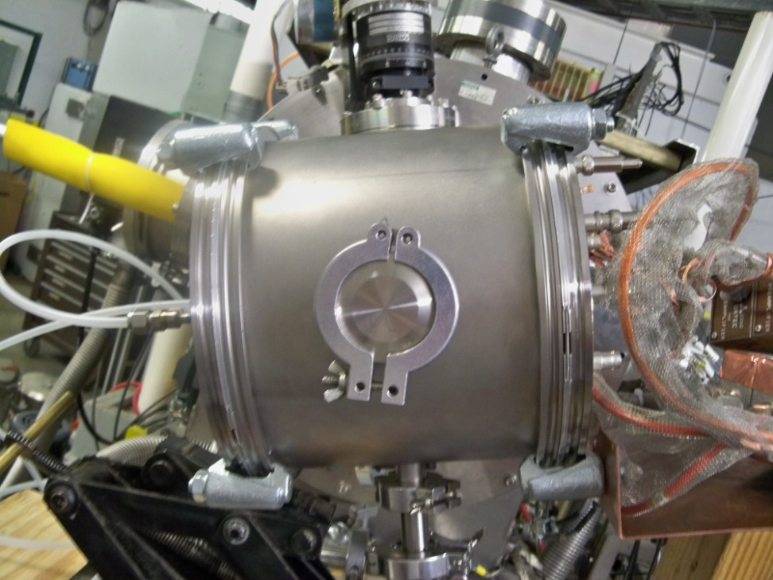
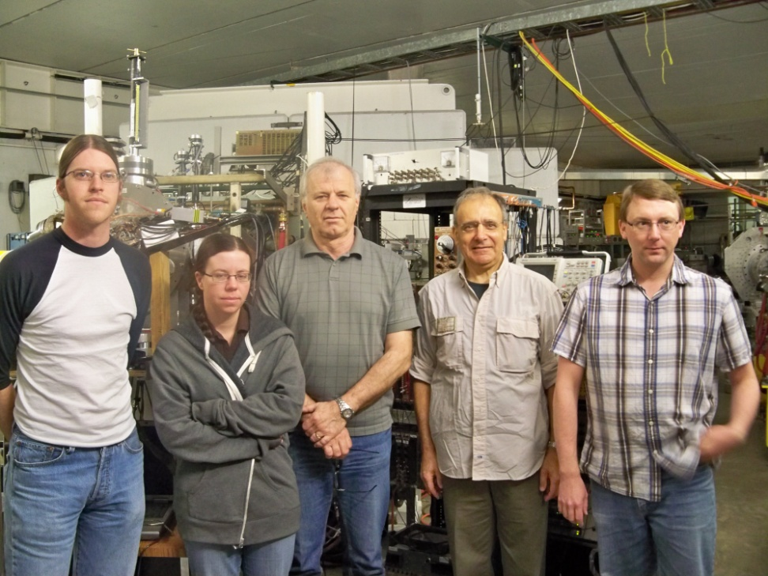

A few images are worth a thousand words!
W1-65 det 16 x 16 strips 3.1 mm
BB2-45 det 24 x 24 strips, 1 mm

Slide 31
³¹Cl
A. Coc – OMEG07 !!!
See Jordi’s list!

Slide 32
Decay of ³¹Cl
Resonant Capture
³⁰P(p,γ)³¹S
3/2⁺
³¹Cl
Energy
Coulomb Barrier
Γ_{p}
p
Γ_{γ}
Radius
S_{p}
Conditions:
Q_{EC} >S_{p}+2m_{e}c²
J=1/2+, 3/2+, 5/2+
γ+³¹S← ³¹S*←³⁰P+p
³¹S
1/2⁺, 3/2⁺ ← 1⁺+1/2⁺
Nuclear Potential
Same compound system: ³¹S
resonance strength:
Γ_{tot}= Γ_{p}+Γ_{γ}
Top of barrier Γ_{p}>>Γ_{γ} ⇒ ωγ ~ Γ_{γ}
Bottom of barrier Γ_{γ}>>Γ_{p} ⇒ ωγ ~ Γ_{p}
Lower proton energies most important, but very difficult:
  lower branching
  increased exp difficulties (det windows, background, etc…)
Notes:
32

Slide 33
MARS
In-flight RB production
³²S 40A MeV
³¹Cl 34A MeV
Purity: > 85 % (at target det)
Intensity: ~ 2-3000 pps
difficult - pure & intense ³¹Cl
Primary beam ³²S @ 40A MeV – K500 Cycl
Primary target LN₂ cooled H₂ gas p=2 atm
Secondary beam ³¹Cl @ 34 A MeV
(p,2n) reaction

Slide 34
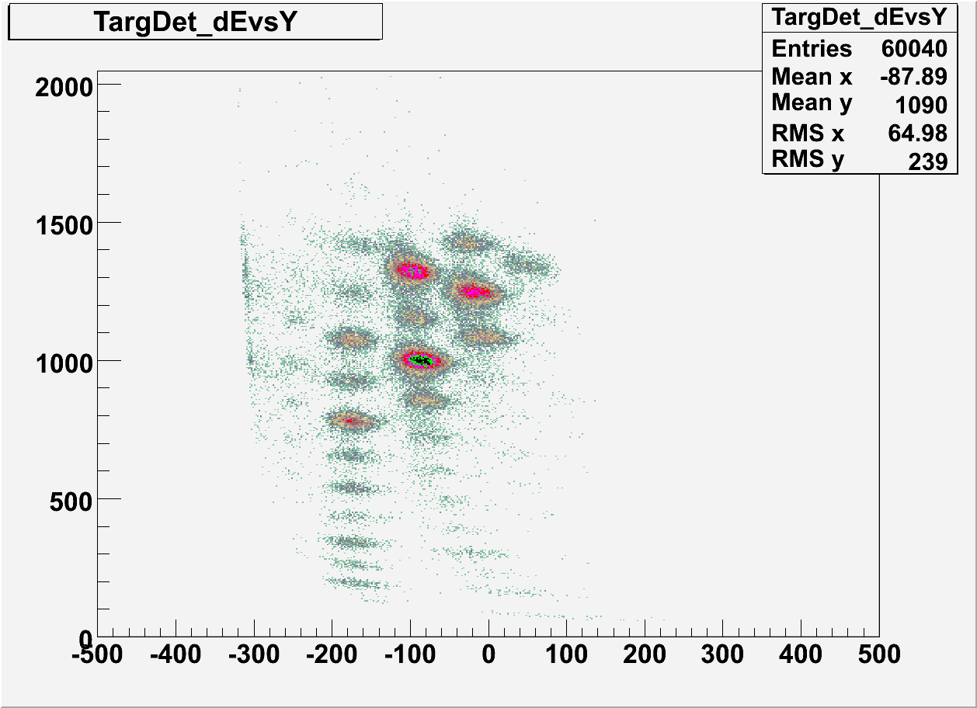
³¹Cl production and separation
Energy (a.u.)
³²Cl
³¹Cl
²⁹S
Position (0.1 mm) = q/m

Slide 35
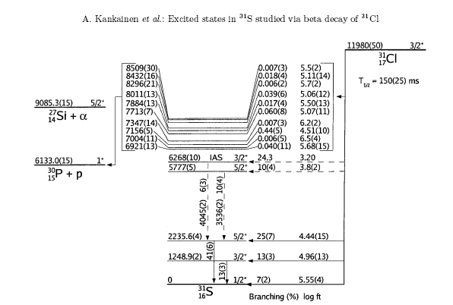
³¹Cl β-decay - status 2006
Old: Τ_{1/2} =150(25) ms

Slide 36
³¹Cl βγ decay
IAS

Slide 37
³¹Cl β-decay - status 2006/present exp
Old: Τ_{1/2} =150(25) ms
New: T_{1/2} = 190(1) ms
S_{p}=6.133 MeV

Slide 38
³¹Cl Half-Life Stability versus Detection Settings
Time [s]
Half Life [ms]
Run Apr09: more than 6×10⁶ β⁺ events (³¹Cl & ³¹S)
Run Number

Slide 39
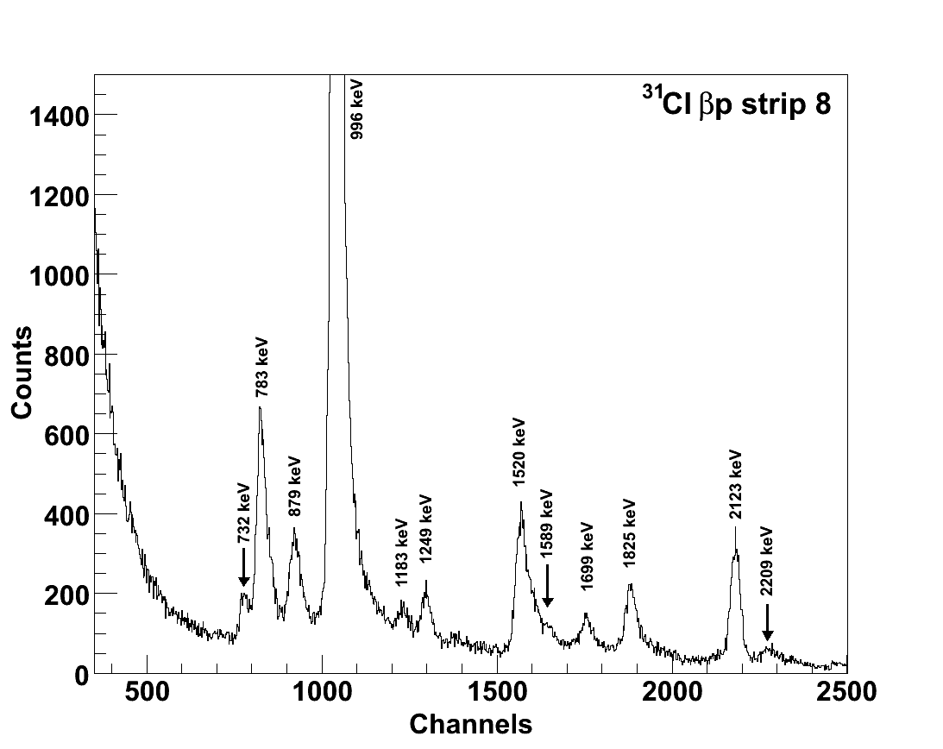
³¹Cl proton-spectrum
Gamow window
400 keV

Slide 40

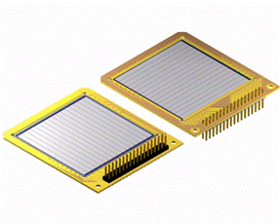
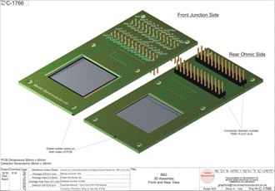

Proton Detectors
W1
The W1 Detector:
  Thickness: 65 μm
  Number of Strips: 16
  Width of Strips: 3.1mm
  Detection Volume: ~0.625 mm³
    Used in our ²³Al 2007 and ³¹Cl 2007 Experiments
The BB2 Detector:
  Thickness: 45 μm
  Number of Strips: 24
  Width of the Strips: 1mm
  Detection Volume: ~0.045 mm³
    Used in our ³¹Cl 2008 and ²³Al 2009 Experiments
Both made by Micron Semiconductor LTD.
BB2

Slide 41
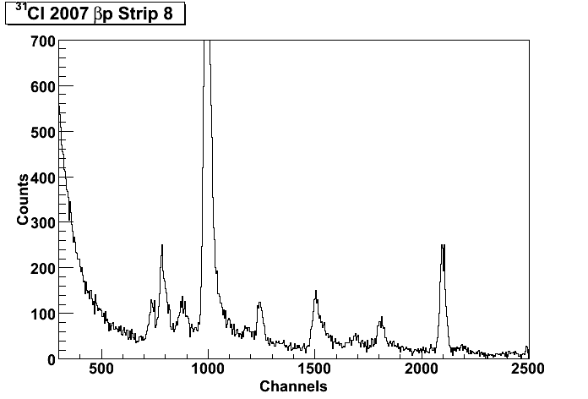
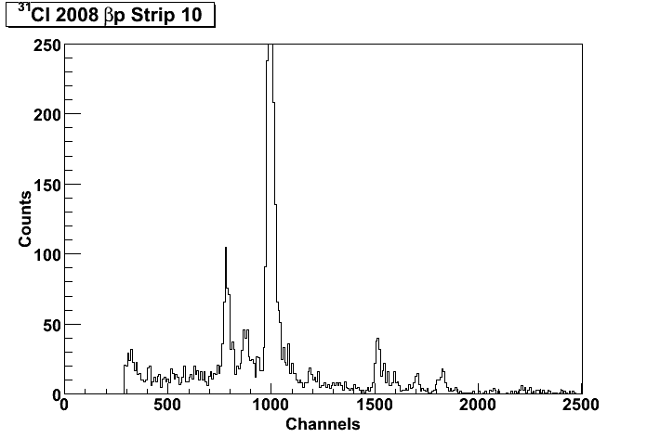
Lowering β background:
W1-65
  Large amount of background in the regions of 500 keV or lower
BB2-45
  Only part of the statistics are shown, but
    Resolution is visibly better
    And the minimum energy threshold goes below 300 keV
    Lose efficiency at E_{p}> 1.5 MeV
Conclusions:
  Thinner detector with thinner strips was better at measuring the proton energies as low as 2-300 keV
W1
BB2
Un-fortunately: no new states here! And no AstroBox measurements. Yet!

Slide 42
³¹Cl β-decay results
First clean and intense ³¹Cl source
established β-decay scheme
determined relative branching ratios
measured T_{1/2}=190(1) ms (<1% accuracy)
identified IAS E*=6279.5±0.3±1.5 (syst) keV and its decay
used IMME to get new, more precise ³¹Cl mass ME(³¹Cl)=-7064(8) keV ⇒ Q_{EC}=11,980(8) keV and S_{p}(³¹Cl)=289(8) keV (imp for ³⁰S(p,γ)³¹Cl !)
found precise energy of E*=6256(1) keV ⇒ E_{res}=123(2) keV – important reson in ³⁰P(p,γ)³¹S
did not find IAS proton branching (at E_{p}=146 keV – very difficult !!)

Slide 43
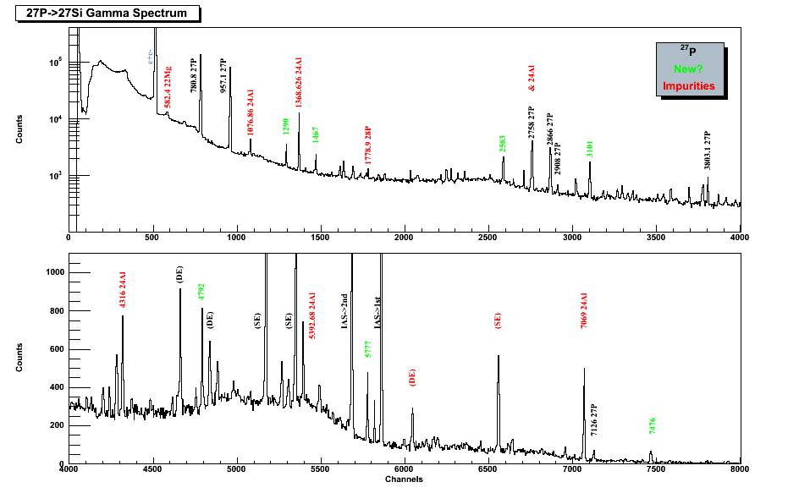
²⁷P decay
Most recent: see talk by Ellen Simmons, this afternoon!

Slide 44
Results β-delayed p-decay
Technique works well – can go to E_{p}~100 keV and, maybe, lower
Can work with lifetimes ~100 ms or less
Very selective: can separate well beam cocktails (by implantation depths)
Very sensitive: could obtain results for ²¹Mg, ²⁹S at rates ~ 1-10 pps in 8 hrs
Could study very weak branches (e.g. ²⁰Mg 50 pps) Strengths:
  Good isotope separation (MARS)
  In-flight production: need 30-50 MeV/u (can be implanted)
  ASTROBOX opens new possibilities

Slide 45
Collaborators
M McCleskey, E Simmons, A Spiridon, BT Roeder, G Tabacaru, RE Tribble, JC Hardy, VE Iacob, A Banu* – Cyclotron Institute, Texas A&M University (* now at J Madison University, VA)
PJ Woods, T Davinson, G. Lotay – Univ of Edinburgh
J Aysto, A Saastamoinen, A Jokinen – Univ of Jyvaskyla
MA Bentley – Univ of York
E Pollacco et al. –CEA Saclay

