Slide 1



Study of the ¹⁷O(n,α)¹⁴C reaction: extension of the Trojan Horse Method to neutron induced reactions
Giovanni Luca Guardo
Notes:
Hello, I’m Giovanni Luca Guardo and I’ll talk about the possibility for the deuteron to be a source of virtual neutrons with the application of the THM So, the aim of this work was to study the reaction oxigen seventeen n alpha because of her importance in many astrophysical scenario.

Slide 2


Astrophysical scenario
Temperature → 0.8<T₈<11 K
Energy range→ ~0-100 keV
Inhomogeneus Big Bang Nucleosinthesys (IBBN)
The reaction ¹⁷O(n,α)¹⁴C represents one of the main channel for ¹⁴C production, a key element for the ²²Ne production via
¹⁴C(α,γ)¹⁸O(n,γ)¹⁹O(β)¹⁹F(n,γ)²⁰F(β)²⁰Ne(n,γ)²¹Ne(n,γ)²²Ne
Weak component s-process
¹⁷O(n,α)¹⁴C and ¹⁷O(α,n)²⁰Ne since they act as a neutron poison and a recycle channel during s-process nucleosinthesys in massive stars (M>8M_{Θ})
Notes:
In particular, the reaction could be an important source of carbon during the primordial nucleosinthesys in the IBBM. In the model, the parameter eta (baryon to photon ratio) is not costant but it is divided, for simplycity, in two zone: one with an enhancement in baryon density and one with less density because of the avarage value is fixed by WMAP observation. In the etaplus zone the carbon abundance grow up from ten minus twelve to ten minus seven. Once produced, the carbon could activate the network that synthetized the neon tuentytu, fondemantal to activate the s-process and the production of the heavy elements. One of the most important principal source to synthetized the carbon is the reaction oxygen seventeen n alpha because of the presence of at least two resonant peak in the energy range corrisponding to the temperature that characterize the model.

Slide 3
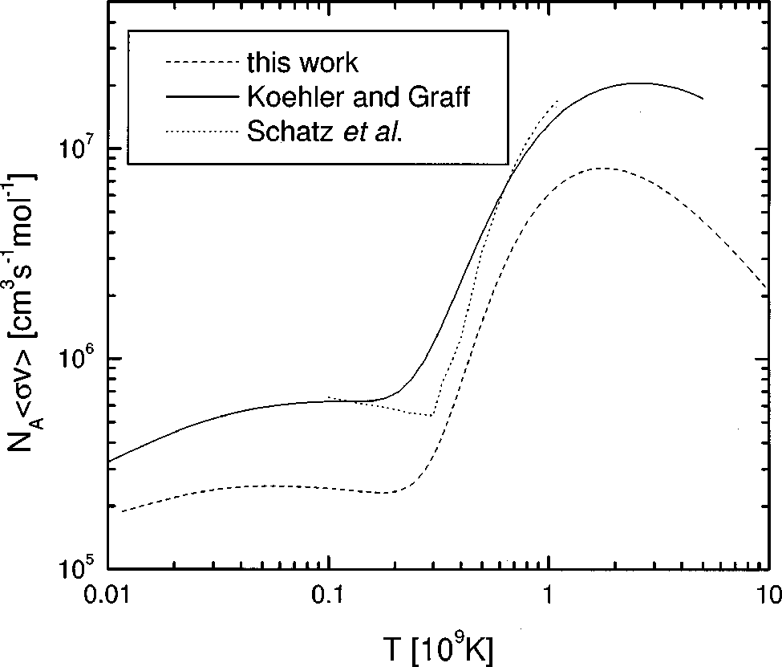

Status of art of the reaction
P.E.Koehler & S.M.Graff, Ph. Rev., C44(6), 2788 (1991) (line)
Wagemans et al
H. Schatz et al., Astroph. J., 413, 750 (1993)
(dotted)
FACTOR 2 DISCREPANCY
J. Wagemans et al., Ph. Rev., C65(3), 34614 (2002) (dashed)
THM
Notes:
In particular, the reaction could be an important source of carbon during the primordial nucleosinthesys in the IBBM. In the model, the parameter eta (baryon to photon ratio) is not costant but it is divided, for simplycity, in two zone: one with an enhancement in baryon density and one with less density because of the avarage value is fixed by WMAP observation. In the etaplus zone the carbon abundance grow up from ten minus twelve to ten minus seven. Once produced, the carbon could activate the network that synthetized the neon tuentytu, fondemantal to activate the s-process and the production of the heavy elements. One of the most important principal source to synthetized the carbon is the reaction oxygen seventeen n alpha because of the presence of at least two resonant peak in the energy range corrisponding to the temperature that characterize the model.

Slide 4
Astrophysical scenario
Principal source: ¹⁴N(n,p)¹⁴C , ¹⁵N(p,α)¹²C , ¹⁷O(n,α)¹⁴C , ¹⁸F(n,α)¹⁵N
Temperature interval: 0.7<T₉<1 K
Energetic range: 70<E<100 keV
Inhomogeneous Big Bang Model
with
Applegate et al., Astroph. J., 329, 572 (1988)
¹⁴C(α,γ)¹⁸O(n,γ)¹⁹O(β)¹⁹F(n,γ)²⁰F(β)²⁰Ne(n,γ)²¹Ne(n,γ)²²Ne
Heavy elements production
Notes:
In particular, the reaction could be an important source of carbon during the primordial nucleosinthesys in the IBBM. In the model, the parameter eta (baryon to photon ratio) is not costant but it is divided, for simplycity, in two zone: one with an enhancement in baryon density and one with less density because of the avarage value is fixed by WMAP observation. In the etaplus zone the carbon abundance grow up from ten minus twelve to ten minus seven. Once produced, the carbon could activate the network that synthetized the neon tuentytu, fondemantal to activate the s-process and the production of the heavy elements. One of the most important principal source to synthetized the carbon is the reaction oxygen seventeen n alpha because of the presence of at least two resonant peak in the energy range corrisponding to the temperature that characterize the model.

Slide 5

Astrophysical scenario
Two way:
¹⁷O(α,n)²⁰Ne ➔ Recycle channel
¹⁷O(n,α)¹⁴C ➔ Poison channel
Temperature interval: 2.2<T₈<10 K
Energetic range: 20<E<100 keV
s-process nucleosynthesis
STRONG and MAIN component:
TP-AGB stars in He-intershell
(¹³C-pocket)
¹³C(α,n)¹⁶O @ T₈~1 K , ρ_{n}=10⁷ cm⁻³
²²Ne(α,n)²⁵Mg @ T₈≥2.5 K , ρ_{n}=10¹⁰ cm⁻³
WEAK component:
Massive stars (M*>8M_{Θ}) in convective core He burning and convective C shell
²²Ne(α,n)²⁵Mg @ T₈~2.2-3.5 K , ρ_{n}≤10⁶ cm⁻³
²²Ne(α,n)²⁵Mg @ T₉~1 K , ρ_{n}=10¹¹-10¹² cm⁻³
¹⁶O RICH
NEUTRON POISON!!!
¹⁶O(n,γ)¹⁷O
Notes:
In the other way the reaction can be a neutron poison during the s-process nucleosynthesis. As we already know, to reproduce the abundances of the heavy elements that are synthetized during the s-process, we need at least 3 component. The main and the strong component take place during the Asymptotic Giant Branch in the He-intershell by the formation of the carbon pocket. The weak componente, that is responsible for the production of the “light” heavy elements (from fiftysix to ninety mass number), take place in massive stars. In particular, during the He burning in convective core, the neon tuentitu is produced and when the temperature t-eight arrive at 2.2 the neon alpha capture can start. But the core is rich in oxigen because of the CNO cycle and this elementi is a very strong neutron poison trought the reaction oxigen sixteen n gamma oxigen seventeen. One produces the oxigen seventeen have two principal possibility: an alpha capture that recycle the neutron lost in the precedent reaction or another neutron capture that represent another poison channel. So the knowledge of the ratio between this two channel is important to determine the neutron flux avaiable for the s-process.

Slide 6
Status of art of the reaction
R. M. Sanders, Ph. Rev., 104, 1434 (1956)
INVERSE REACTION ¹⁴C(α,n)¹⁷O
P.E.Koehler & S.M.Graff, Ph. Rev., C44(6), 2788 (1991)
H. Schatz et al., Astroph. J., 413, 750 (1993)
J. Wagemans et al., Ph. Rev., C65(3), 34614 (2002)
Factor 2 DIFFERENCE
¹⁸O* (MeV) | J^{π}
8.039 | 1⁻
8.125 | 5⁻
8.213 | 2⁺
8.282 | 3⁻
Subthreshould peak contribution
THM
Suppressed by centrifugal barrier
F. Ajzenberg-Selove, Nucl. Ph., A475, 1 (1987)
Notes:
As I already mentioned, in the energy range of interest the reaction has at least two resonant peak. So now I show the status of art of the reaction in order to point out the measurement present in lecterature. The first measurement was performed by Sanders in nineteen fiftysix. This is an inverse measurement and show two peak around 170 and 240 kev in center of mass system. The first direct measurement was performed in nineteen ninetyone by Koheler and Graff in which they pointed out the evidence of a structure close to 140 kev but the experiment performed by Shatz at al in ninteenninetythree denied this evidence: they measurement, in fact don’t show any peak before 200kev. Recently, in 2002, the direct measurement of wagemans at al showed again the two peaks pointed out by sanders but whit a factor 2 of difference. Moreover the data showed an enhancement in the cross section close to zero maybe due to a subthreshould resonance. Summerizing the ozigen eitin level in the energy range of interest are four, showed in the table. Is important to underline two question: the presence of a subthreshould peak close to zero that can influence the reaction rate and the precence of a peak caracterized by a j pai of five mainus that is suppressed by the centrifugal barrier. For these reason the reaction was chosen to test the THM with neutron induced reaction!!

Slide 7
Trojan Horse Method

Slide 8
Experimental setup
²H
p
The reaction ¹⁷O(n,α)¹⁴C was studied via the ²H(¹⁷O,α¹⁴C)p , V_{coul}=2.3 MeV;
The deuteron is the TH nucleus. Strong cluster n+p; B=2.2 MeV, |p_{s}|=0 MeV/c .
n
¹⁴C
¹⁷O
α
Experiment performed at ISNAP at the University of Notre Dame (USA);
E_{beam}(¹⁷O)= 43.5 MeV;
Target thickness CD₂ ∼150 µg/cm²;
IC filled with 48.7 mbar isobutane gas;
Angular position to cover the QF angular region
Symmetric set-up in order to increase the statistic.
Notes:
To study the reaction blabla was applied the THM at the three body reaction riblabla with a coulombian energy of 2.3 MeV. The deuteron was chosen as TH nucleus because of is strong cluster configuration and is low binding energy. In addiction the momentum distribution of the intercluster motion is known and is centered at zero MeV/c. For these reasons the deuteron can be used as source of virtual neutrons.
The experiment was performed at institute for structure and nuclear astro physics at the university of notre dame (indiana, usa) with an energy beam for the oxigen seventeen of 43.5 MeV. A target of deuterated plyethylene with a thickness of 150 microgram on square centimeter. For the identification of the carbon was used the deltaE-E technic formed by a inization chamber filled whit 48.7 mbar of isobutane gas and a thousand micrometer thickness position sentive detector. The detection of the alpha particle was done by 2 psds covered the angular range from fifteen to thirty degrees in the laboratory system. Was chosen a symmetric set-up in order to increase the statistic. Because of the time only the results of a couple of detector will be shown.

Slide 9
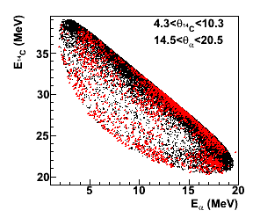
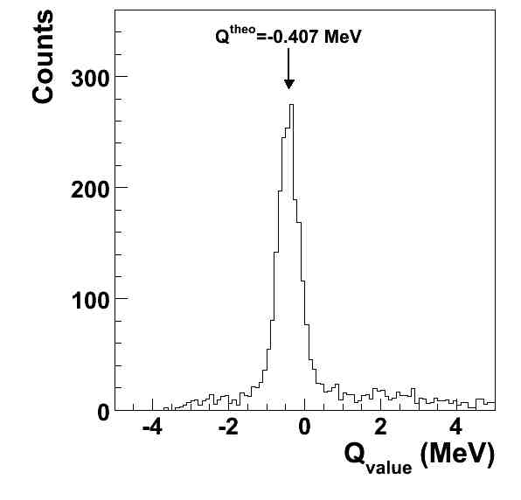
Data analysis: channel selection
²H(¹⁷O,α¹⁴C)p -> Q_{value}=-0.407 MeV
Selection of the events with carbon in the final state
Presence of a peak close to the expected value
Comparison between experimental and simulated kinematical locus
Notes:
The first step of the data analysis consist in the identification of the reaction channel. In order to do this, first of all was selected the events caracterized by the carbon in the final state with the deltaE-E technique. After this, using the conservation laws, the reconstruction of the qvalue spectra was performend. This spectra show a narrow peak centered to the theoretical value. After these data selection, the events were compare with the cinematical locus calculated by a monte carlo simulation showing a good agreement.

Slide 10
Data analysis: sequential mechanism
Presence of vertical loci corresponding to ¹⁸O;
Presence of ¹⁵N level but far
from zone of interest;
Absence of horizontal loci of ⁵He.
Notes:
After the channel selection, it is important to distriminate the event coming from the oxigen eiteen decay from the other possible relative energy as shown in figure. Therefore, the relative energy spectra were studied. The matrix shown the presence of clear vertical loci corresponding to oxigen eitin levels and also the presence of 2 excited level of nitrogen fifteen but they ar far from the zone of interest. Moreover there isn’t no presence of hilium five level.

Slide 11
Data analysis: QF selection
Is |p_{s}| correlated with the coincidence yield??
YES – Evidence of QF mechanism
Is |Φ(p_{s})|² centered at 0 MeV/c?
YES – Necessary condition for the presence of QF mechanism
Notes:
In order to select the quasi free mechanism contribution is important to study the correlation between the momentum of the spectator (in this case the proton) and the coincidence yield of the reaction. As shown, with increasing of the moment the coincidence yield decreasing. This is an evidence of the presence of qf mechanism. Another test to be sure for the presence of QF mechanism is to study the momentum distribution of the proton beacause of if it is the spectator is momentum distribution must be the same that he had in the cluster motion. For this, it was selected and energy range characterized by the presence of a narrow peak in the coincidence yield and was studied the momentum. The result shown a tipical hulten distribution centered at zero MeV/c that made us confortable for the presence of quasi free mechanism.

Slide 12
Data analysis: QF selection
By following the PWIA approach it is possible to extract the experimental momentum distribution (Prof. Spitaleri talk):
Necessary condition for the presence of
the QF mechanism
Comparison between the experimental data and the theoritical Hùlten function
Φ(P_{S}) =
ab(a+b)
1
1
1
2π
(a-b)²
a²+P_{S}²
b²+P_{S}²
Notes:
In order to select the quasi free mechanism contribution is important to study the correlation between the momentum of the spectator (in this case the proton) and the coincidence yield of the reaction. As shown, with increasing of the moment the coincidence yield decreasing. This is an evidence of the presence of qf mechanism. Another test to be sure for the presence of QF mechanism is to study the momentum distribution of the proton beacause of if it is the spectator is momentum distribution must be the same that he had in the cluster motion. For this, it was selected and energy range characterized by the presence of a narrow peak in the coincidence yield and was studied the momentum. The result shown a tipical hulten distribution centered at zero MeV/c that made us confortable for the presence of quasi free mechanism.

Slide 13
Data analysis: ¹⁷O(n,α)¹⁴C angular distributions
After the study of the 3-body channel and the QF selection, it is important to study the 2-body one. The angular range covered in the experiment in the c.m. system allows one to study the angular distributions
PRELIMINARY
ℓ=3 distribution: no data present in literature (suppressed in direct measurements)
ℓ=0 distribution: no data present in literature
ℓ=1 distribution: will be compared with the available data

Slide 14
Data analysis: ¹⁷O(n,α)¹⁴C cross section
 | ¹⁸O* (MeV) | J^{π} | E_{c.m.} (MeV) | l_{in}
A | 8.039 | 1⁻ | -0.007 | 1 ; 3
B | 8.125 | 5⁻ | 0.075 | 3
C | 8.213 | 2⁺ | 0.166 | 0 ; 2
D | 8.282 | 3⁻ | 0.236 | 1
PRELIMINARY
F. Ajzenberg-Selove, Nucl. Ph., A475, 1 (1987)
-0.8<Q_{value}<0 MeV
|p_{s}|< 40 MeV/c
90°<θ_{c.m.}<140° (integrated with theoretical distribution)
Notes:
The figure shown the cross section of the two body reaction in arbitrary units. The horizontal error bars represent the integration energy bin, the vertical bars take into account the statistical error, the black line is the result of a fit using five gaussian that are shown as red dashed line. It is possible to recognize at least 4 exited level of the oxigen eitin indicated by the arrow. It is also shown which kind of cut was chosen to select the data.

Slide 15
Conclusions
-7 keV in center of mass system correspondig to 8.039 MeV level of ¹⁸O
➔ SUBTHRESHOLD LEVEL
75 keV in center of mass system correspondig to 8.125 MeV level of ¹⁸O
SUPPRESSED IN DIRECT MEASUREMENTS BECAUSE OF THE CENTRIFUGAL BARRIER
FUTURE GOALS
Determination of the resonance strenght of the level
Extraction of the reaction rate

Slide 16
Thank you for your attention

