Slide 1
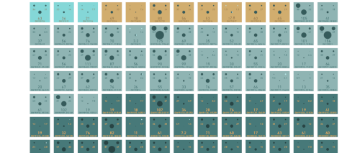
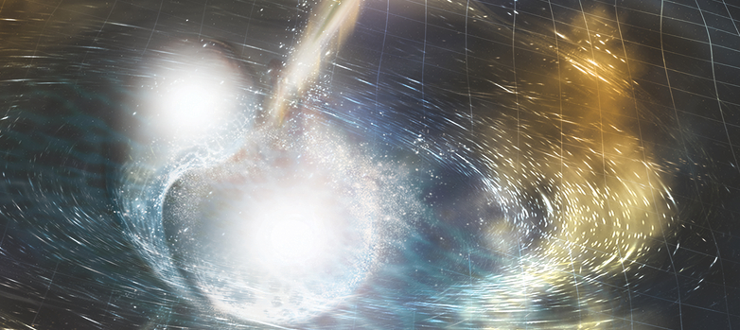
Gravitational waves and their role in multimessenger astrophysics
N. Sorrentino on behalf of the LVK collaborations
University of Pisa and INFN Pisa
SEXTEN HANDS ON THE EXTREME UNIVERSE
WITH HIGH ENERGY GAMMA RAYS
21/07/2022

Slide 2
OUTLINE
GW theoretical background:
Spacetime curvature and its perturbation;
Wave solution and its effect on test masses;
Accelerating massive objects and GW emission.
GW detectors and observations:
First generation: from Michelson interferometer to Advanced GW detectors;
Second generation: Advanced LIGO , Advanced Virgo and GW170817;
Improvement of sensitivity and GW catalogues.
Updates and work in progress:
Get ready for the future data collection;
Way to the third-generation detector: the Einstein Telescope.

Slide 3
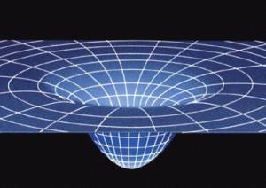
«The gravitational field is not diffuse in space: the gravitational field is space. This is the idea of ​​the theory of general relativity.» (C. Rovelli)
Dimensional scale factor:
$$\sim 2×{10}^{−43}\frac{s^{2}}{kg m}$$
EINSTEIN EQUATION
$$G_{μν}=\frac{8πG}{c^{4}}T_{μν}$$
LINEARIZED PERTURBATION THEORY
$g_{μν}≈η_{μν}+h_{μν}$ ; $h_{μ}^{μ}≪1$ ⟶ $□h_{μν}=−\frac{16πG}{c^{4}}T_{μν}$
Spacetime curvature
Energy Density Tensor
D'Alembert Operator
The metric perturbation is traveling at speed of light (c) along $\vec{k}$ direction.
This wave solution is what we call Gravitational Wave (GW).

Slide 4
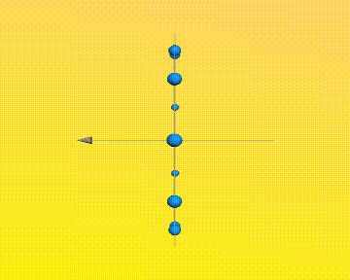
GW PHYSICAL PROPERTIES
Consider free propagation in spacetime $x^{μ}=(ct, \vec{x})$ in vacuum ($T_{μν}=0$):
$${□h}_{μν}=0 ⟹h_{μν}=A_{μν}e^{ik^{μ}x_{μ}} where k^{μ} =(ω/c,\vec{k})$$
The linearized Einstein equation results in a wave equation in Lorenz Gauge:
$$\frac{∂h^{μα}}{∂x^{μ}}=0$$
$A_{μν}$ is the amplitude tensor factor, which perturbation affect spacetime geodetics on transverse plane.
Are GW physical or artifacts of the gauge choice?
$h_{+}=\frac{1}{2}(A_{11}−A_{22})$;
$h_{×}=A_{12}=A_{21}$;
${\ddot{h}}_{+, ×}$ are gauge-invariant quantities [1, 2]

Slide 5
TRANSVERSE TRACELESS (TT) GAUGE
The remaining gauge freedom is chosen to be traceless and purely spatial (assume z-propagation):
$h_{ij}^{TT}\left(t,z\right)=\left(\begin{matrix}h_{+} & h_{×} & 0 \\ h_{×} & −h_{+} & 0 \\ 0 & 0 & 0\end{matrix}\right)\cos\left[ω\left(t−z/c\right)\right]$ if $\vec{k}=(0,0, ω/c)$
“Free falling” geodetics of test masses: ${\left.\frac{d^{2}x^{i}}{{dτ}^{2}}\right|}_{τ=0}=0$, remain at rest even after wave passage [2].
TT gauge ⟶ $h_{ij}^{TT}$ valid for generic superposition of monochromatic plane waves with 2 independent polarization modes ($h_{+}$, $h_{×}$);

Slide 6
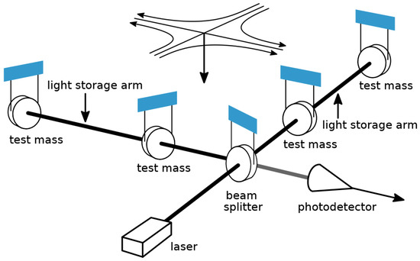
GW EFFECT ON TEST MASSES
$h_{+}$ propagating in Z direction, masses free on X-Y plane:
In DETECTOR REFERENCE FRAME, mass coordinate separation is proportional to ${\ddot{h}}_{+}$ [2]. In TT gauge GW affect the light propagation for masses at distance $L$. Propagation on $x$ axis and then back again:
$$ds^{2}=−c^{2}dt^{2}+\left[1+h_{+}\cos\left[ω\left(t−z/c\right)\right]\right]dx^{2}$$
$$1/ω≫L ⟶ Δt≅\frac{L}{c}h_{+}\cos{(ωt)}$$
Phase difference at photodetector in case of two interferometric light rays (Michelson):
${Δφ }_{Mich}={Δφ }_{x}−{Δφ }_{y}= {2Δφ }_{x}=\frac{2π}{λ_{laser}}2Δtc=\frac{4πL}{λ_{laser}}$ $h_{+}\cos{(ωt)}$
0
Image from [3]

Slide 7
GW EMISSION FROM ENERGY DISTRIBUTION
Binary Pulsar B1913+16 – Weisberg, J.M., Taylor, J.H. (2005)
GW emission of non-relativistic sources ($v≪c)$ with size $R$ ($1/ω≫R$) at distance $r$ [1, 2]:
$$h_{μν}(t)≈\frac{2}{r}\frac{G}{c^{4}}{\ddot{I}}_{μν}(t−\frac{r}{c})$$
Energy tensor leaded by mass density;
GW leaded by quadrupole moment ${\ddot{I}}_{μν}$ radiation;
For an orbiting binary pulsar systems (right figure):
$I≈MR^{2}$, $\ddot{I}≈4MR^{2}ω_{orb}^{2}$,
$h≈\frac{8G}{c^{4}}\frac{M}{r}R^{2}ω_{orb}^{2}≈{10}^{−21}$ at $ω=2ω_{orb}$

Slide 8
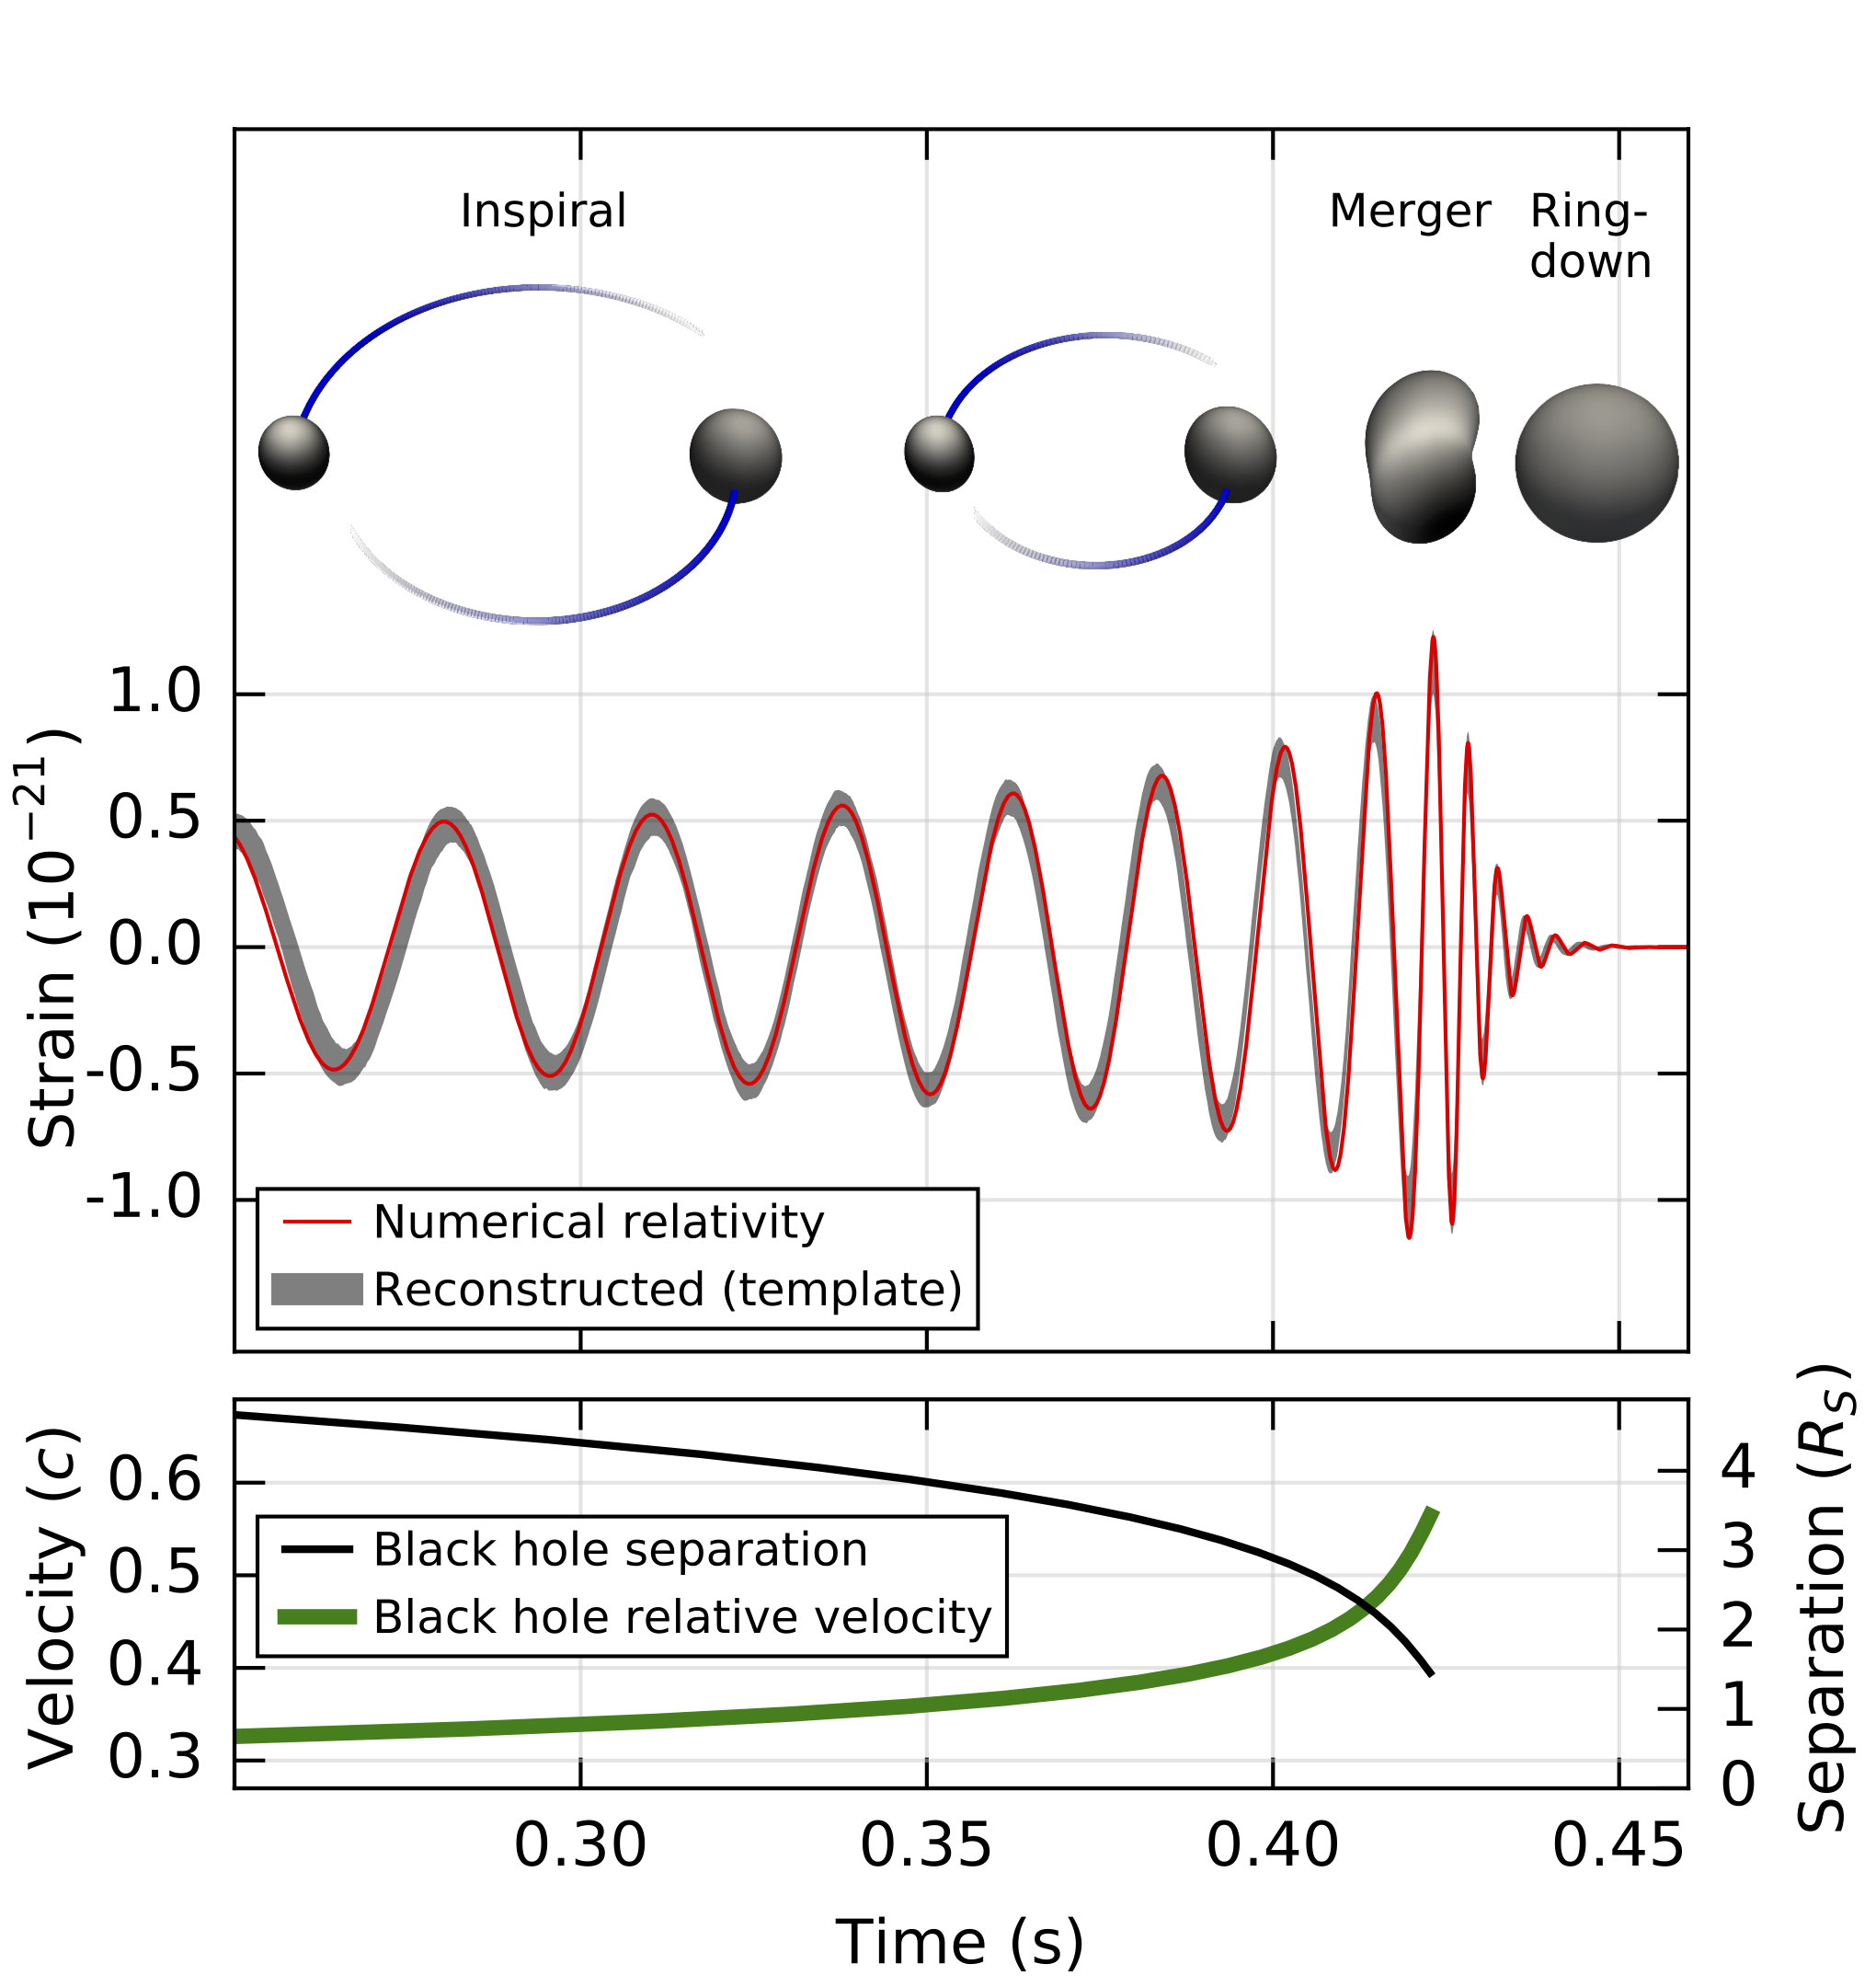
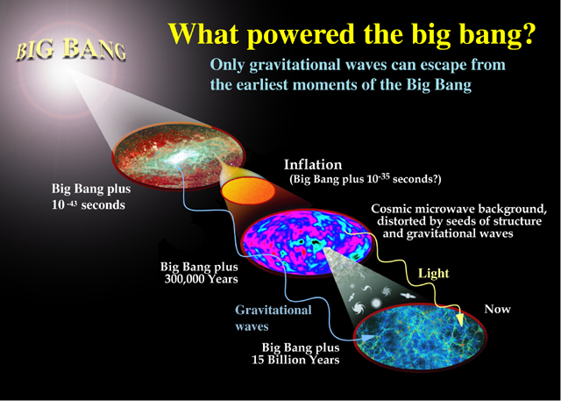
GW EMISSION MECHANISMS
Images from https://www.ligo.org/science/
Binary Compact Objects (BH or NS): inspiral, merger ringdown (last for BHs);
Non-spherical spinning NSs: narrow frequency band signal with well defined spectral components;
GW stochastic background, cosmological origin or superposition of unresolved astrophysical sources: continuous GW with broad-band spectra;

Slide 9
A MODERN MICHELSON INTERFEROMETER FOR GW DETECTION
GW signal reconstructed from variation of destructive interferometry of splitting laser beams:
Image from [4]
Estimated sensitivity :
$$Δφ →h≈\frac{ΔL}{L}∼\frac{λ_{L}}{L}∼{10}^{−9}$$
Using photon count:
$$N_{ph}\underset{→}{variance}\sqrt{N_{ph}}$$
$P_{Laser}=1$ W, $f_{gw}=300$ Hz:
$$h≈\frac{ΔL}{L}∼\frac{λ_{L}}{\sqrt{N_{ph}}L}∼{10}^{−17}$$
[5]

Slide 10
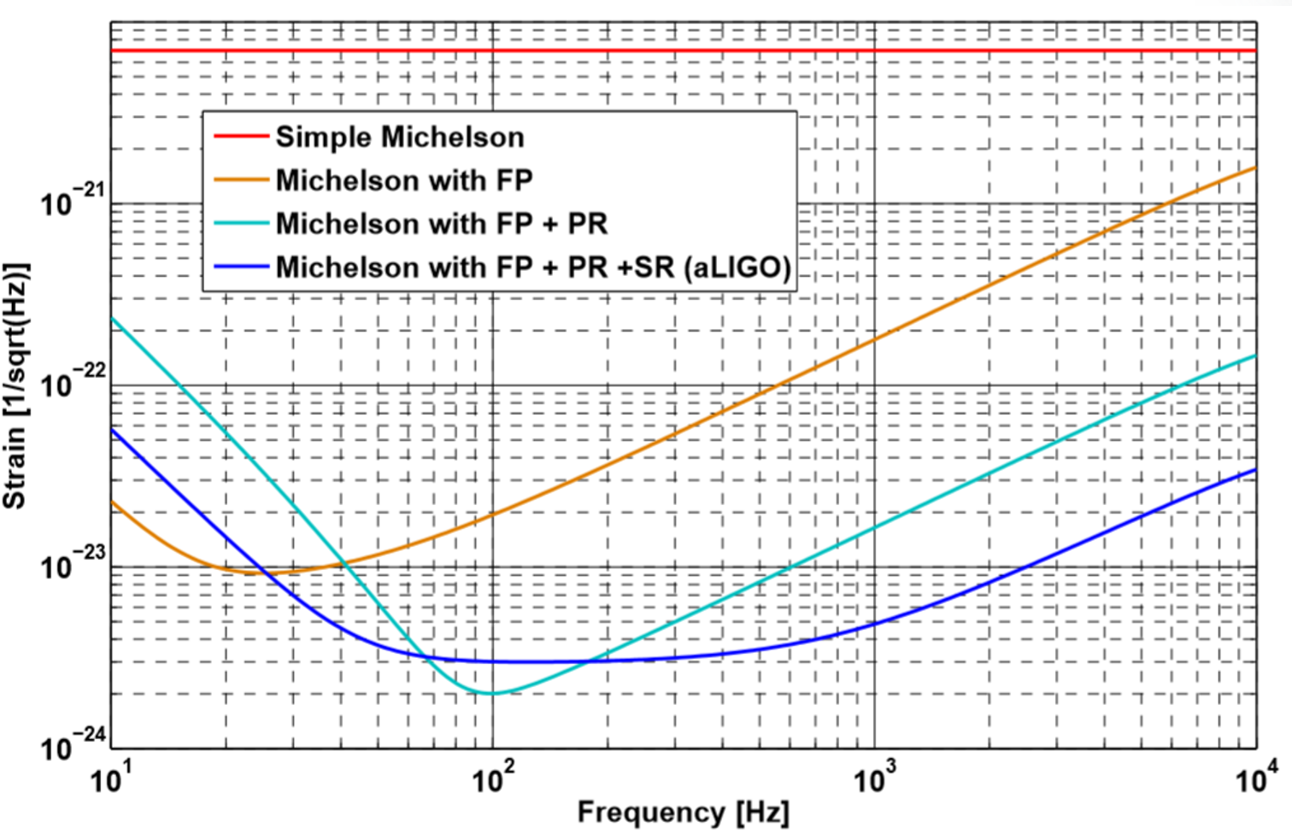
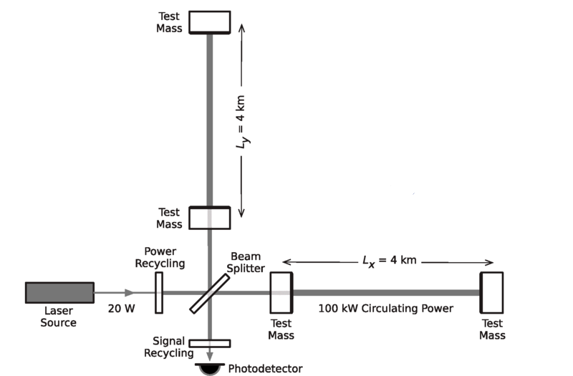
ADVANCED MICHELSON INTERFEROMETER FOR GW DETECTION
Advanced LIGO interferometer design
Image from [5]
Image from [4]
Fabry-Perot Cavities:
GW passage ⟶ more power leaks out of the cavity
$$h∼{10}^{−20}$$
Power Recycling:
More the $N_{ph}$⟶ lower the shot-noise ⟶ more the radiation pressure;
Signal Recycling:
resonant tuning of the signal increases the signal sideband amplitude in a certain frequency band.
[5]

Slide 11
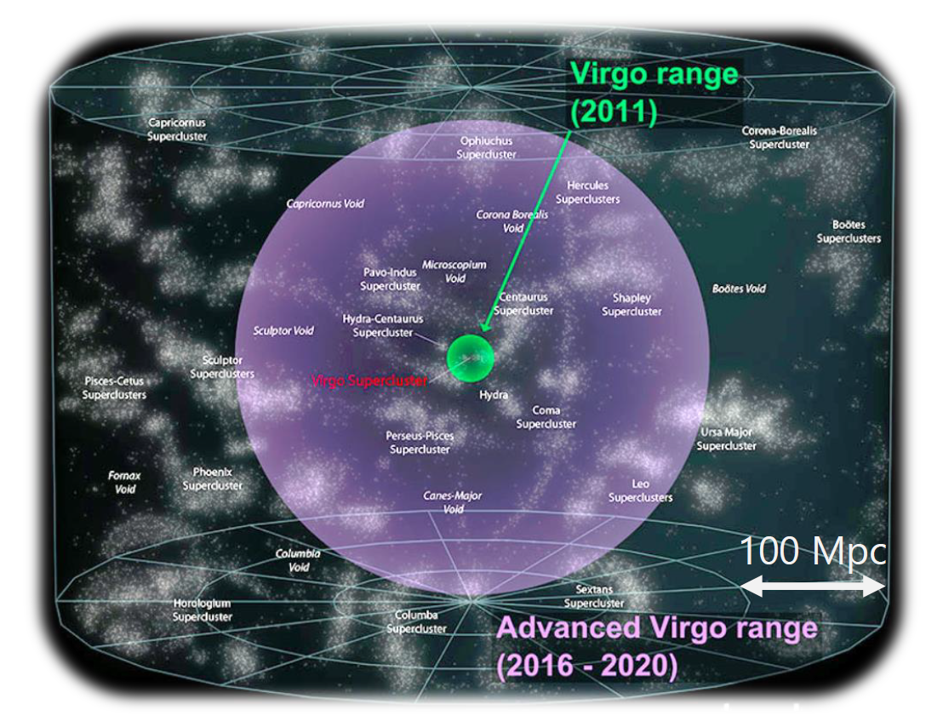
Detector sensitivity to GWs
BNS range [Bassan 2014]:
$$\frac{drange}{1 Mpc}=0.86×{10}^{−20}{\left(\frac{ℳ}{M_{⊙}}\right)}^{5/6}\sqrt{\int_{fmin}^{fISCO}{\frac{f^{−7/3}}{{\left|h(f)\right|}^{2}}df}}$$
Strain [$1/\sqrt{Hz}$]

Slide 12
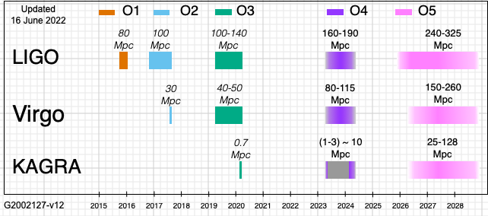
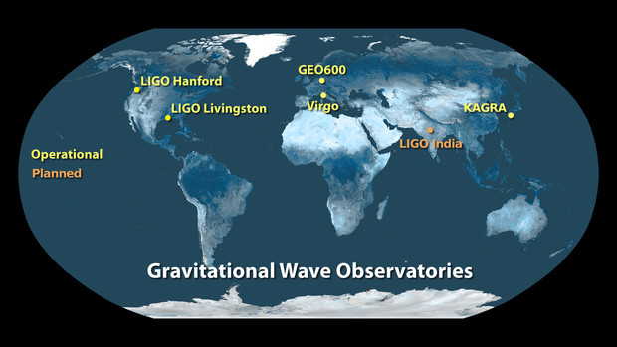
ADVANCED INTERFEROMETERS NETWORK
We are here!
Images from [6]

Slide 13
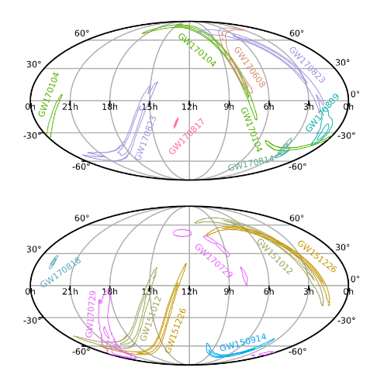
O1 AND O2 OBSERVATIONS (GWTC-1)
O1: Advanced LIGO Livingston (L1) and Hanford (H1) [3, 4];
O2: Advanced Virgo joined Advanced LIGO in August 2017⟶ restricting area of sky localization [7];
11 events detected, including:
GW150914: first GW observation, with higher energy emitted ($3M_{⨀}$);
GW170814: coherently observed with three interferometers: 1160 deg2 ⟶ (LIGOs) 60 deg2 (LIGOs + Virgo);
GW170817: first observation of binary NS merger and relative electromagnetic counterparts;

Slide 14
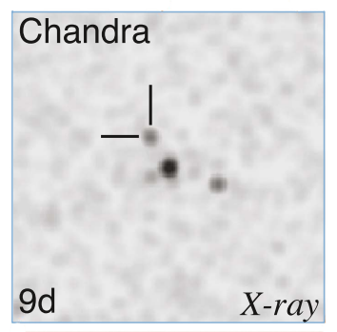
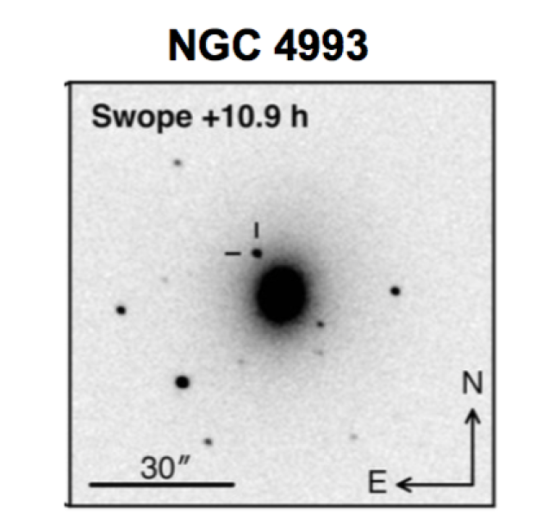
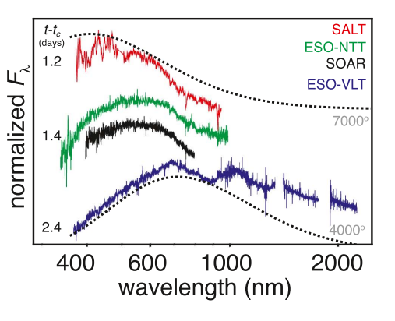
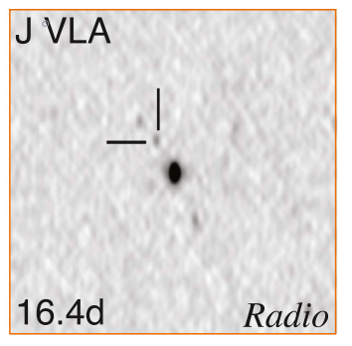
GW170817 AND GRB170817A
Probability of $∼5×{10}^{−8}$ that GW170817 occurred close in time and with a certain level of location agreement with a short GRB [11, 12, 21].
Time delay $∼1,7 s$ , burst duration $T_{90}≈2,0 s$.
GRB 170817A prompt sub-luminous, bright optical transient identified it in NGC 4993 host galaxy:
Kilonova radioactive decay of r-process nuclei
$$\underset{→}{afterglow}$$

Slide 15
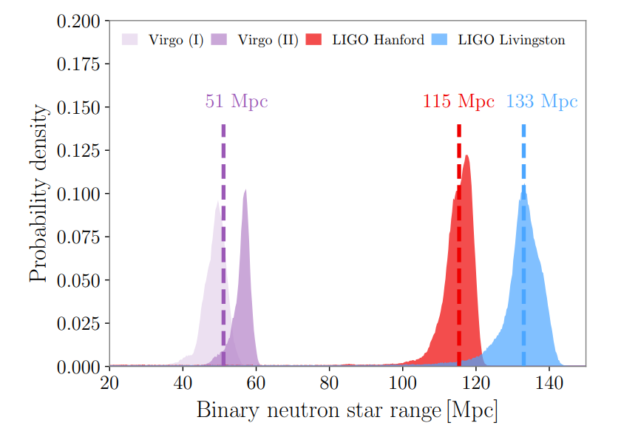
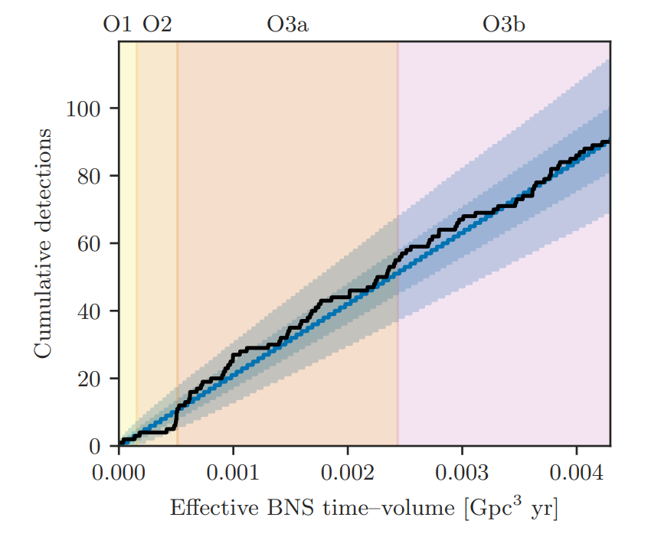
SENSITIVITY INCREMENT DURING O3
During O3 Advanced Virgo installed new increased laser power and new wires suspending the mirrors [8, 10]:
Maintenance activities increased Virgo BNS range during O3b VIR-0462A-20

Slide 16
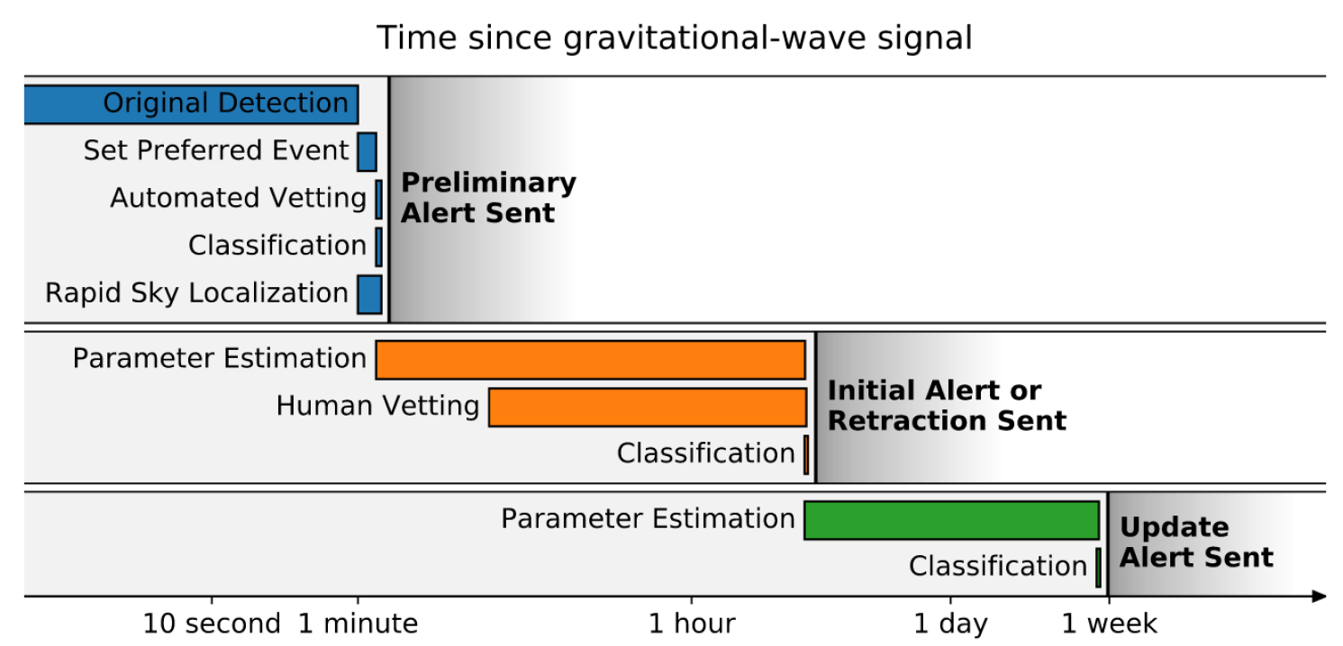
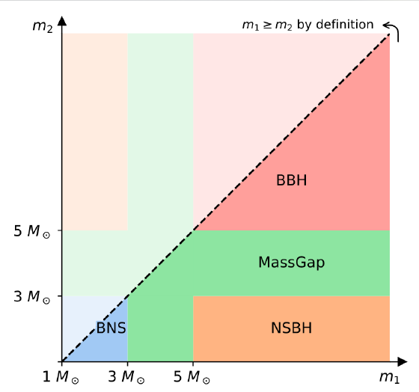
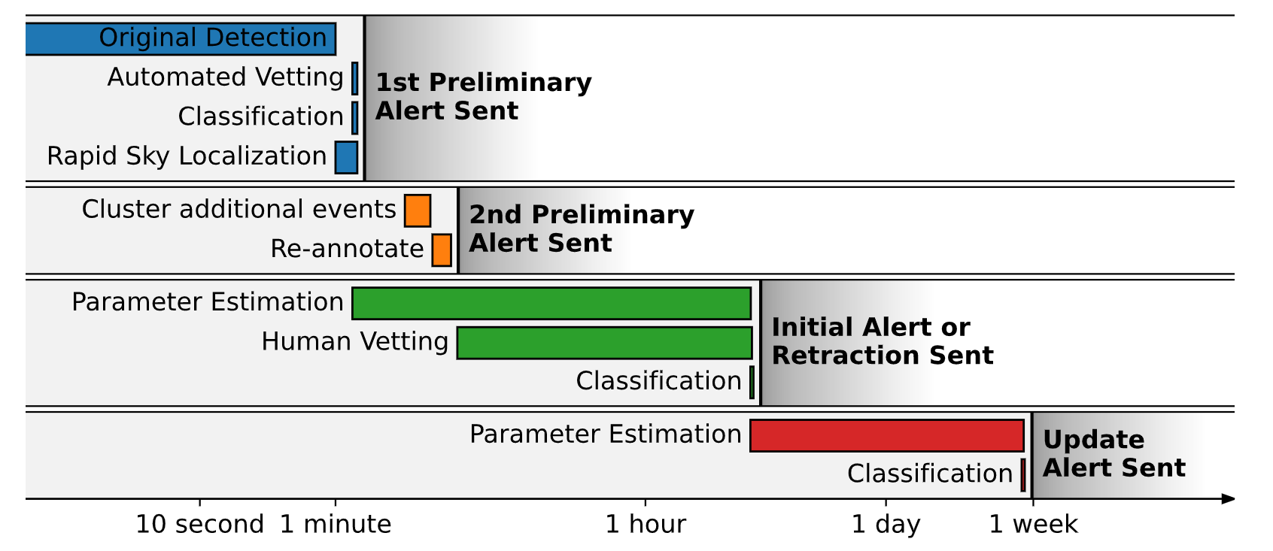
ALERTS SYSTEM
During O3 alerts to astronomers were public [6]:
O3a
Contents:
False Alarm Rate ;
Sky localization;
For bursts:
Central frequency;
Duration;
GW fluence;
For compact binary coalescences:
Luminosity distance;
Classification: BNS, mass gap, NS-BH, BBH,
Terrestrial;
Properties: source classifier (prob. at least one NS), remnant classifier (prob. the system ejected a non-zero amount of NS matter);
O3b
For more information see also: https://emfollow.docs.ligo.org/userguide/index.html

Slide 17
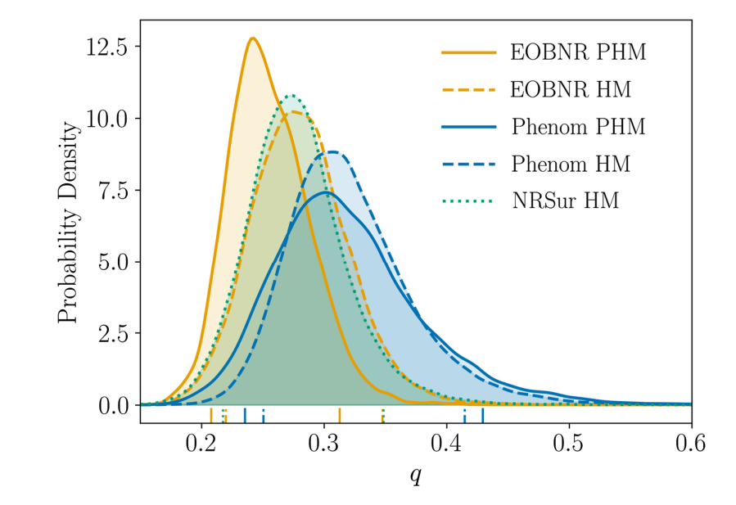
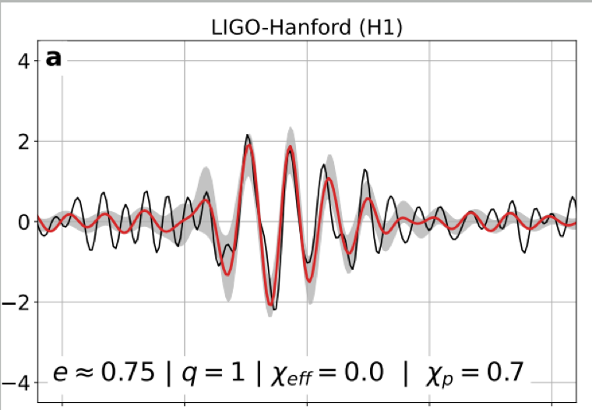
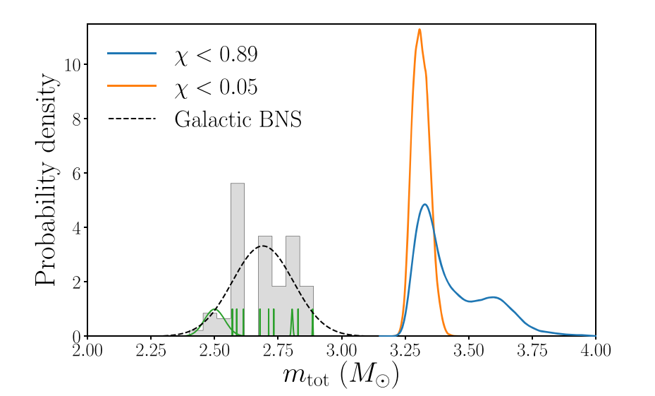
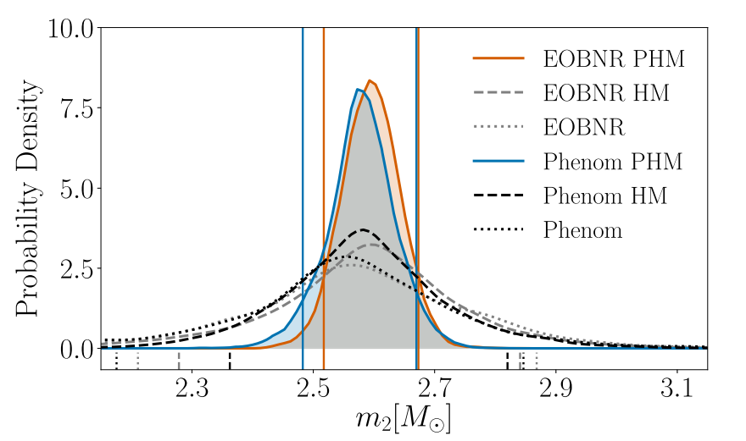
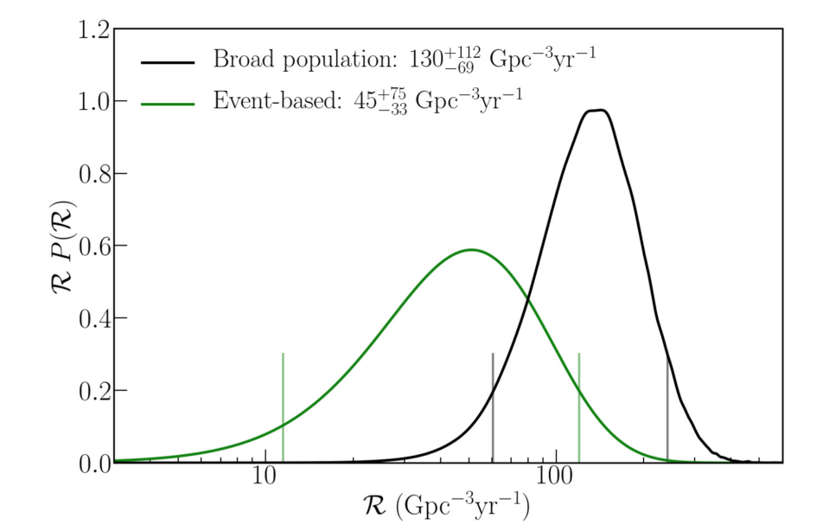
O3 MOST RELEVANT GW EVENTS
GW190412: BBH with asymmetric masses ($q$):
GW190425: consistent BNS, BH components cannot be ruled out:
GW190521: BBH with final mass ${150 M}_{⨀}:$
GW190814: ${23 M}_{⨀}$ BH and ${2. 6 M}_{⨀}$ compact object:
Strong evidence of emission beyond quadrupole approximation [18];
Very short inspiral ⟶ estimated to be a high eccentric merger [19, 20];
Total mass: significantly larger than any observed BNS system (${\sim 3.4 M}_{⨀}$) [14]
Does the system contain the lightest BH or the heaviest NS ever discovered, or a strange star? [15, 16]
GW200105 and GW200115: first two NS-BH events detected:
probably coming from the same NS-BH population [17]

Slide 18
GWTC-2, GWTC-2.1 and GWTC-3
https://www.ligo.org/detections/O3bcatalog/files/gwmerger-poster-white-md.jpg
90 candidates found with $p_{astro source}$ > 0.5
Looking forward to check the remaining sources of GWs:
spinning NSs and stochastic background

Slide 19
GWOSC OPEN SOURCE AND GRACEDB PUBLIC ALERTS
LIGO-Virgo data become public after an initial proprietary period:
Around a relevant event after article published;
Chunks of 6 months after the end of the data taking (e.g. O3);
https://www.gw-openscience.org

Slide 20
ADVANCED VIRGO+ BEFORE AND AFTER O4
Main updates for Advanced Virgo Plus [13]:
Signal recycling mirror: enhance middle/high frequency sensitivity band (right figure);
Frequency dependent squeezing: light squeezed on output with different angles on a certain frequency band. Reduce shot noise and radiation pressure;
Additional updates:
New laser system: inject ∼75 W in the interferometer, reducing shot-noise;
Newtonian Noise Cancellation: array of seismic sensors around the main mirrors, expected to be relevant in low-frequency band.
These and other updates are almost ready for O4, which should start on March 2023, with the goal of $100 Mpc$ BNS range reached.

Slide 21
O5 PRESPECTIVES
Towards the limit of second-generation detectors [13]:
Large beam area inside arm cavities ⟶ smaller thermal noise effects;
Larger test masses (40 →105 kg, 35 →55 cm diameter) ⟶ better free-falling condition;
New suspensions and seismic insulation mechanisms ⟶ reduce thermal noise;
New coatings with lower mechanical losses;
Aim to work for O5 (maybe 2026) at 200 Mpc BNS range.

Slide 22
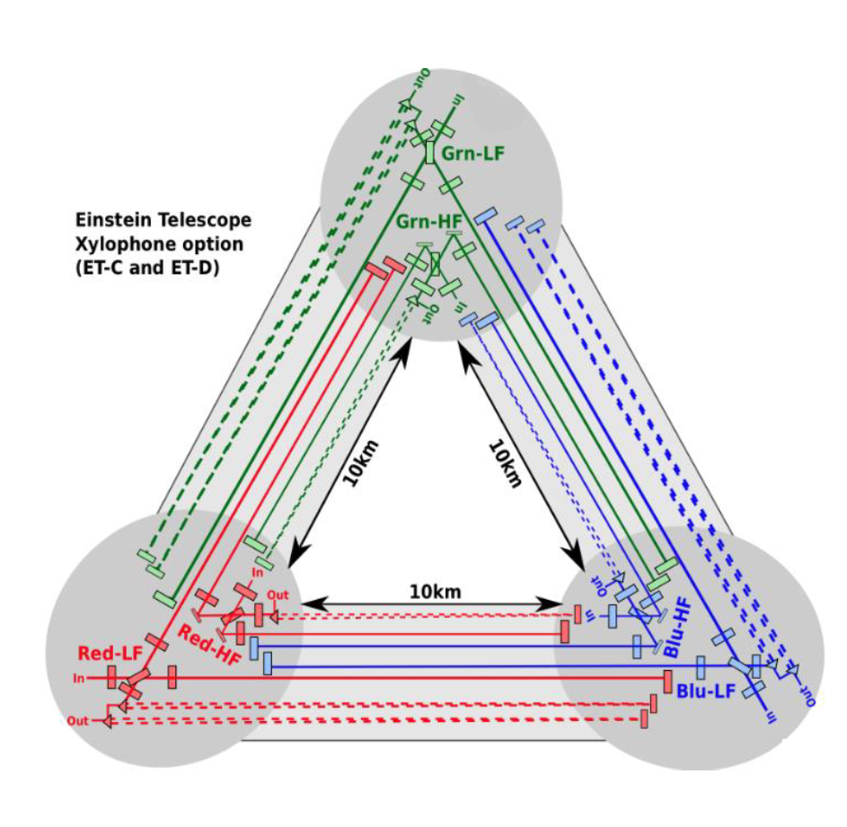
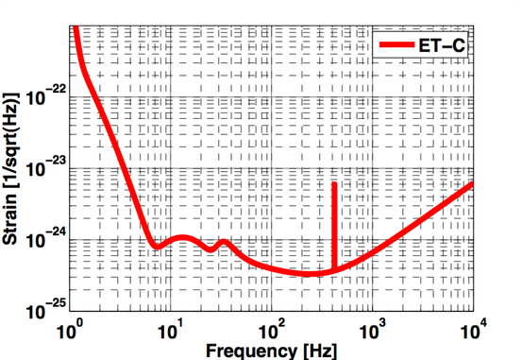
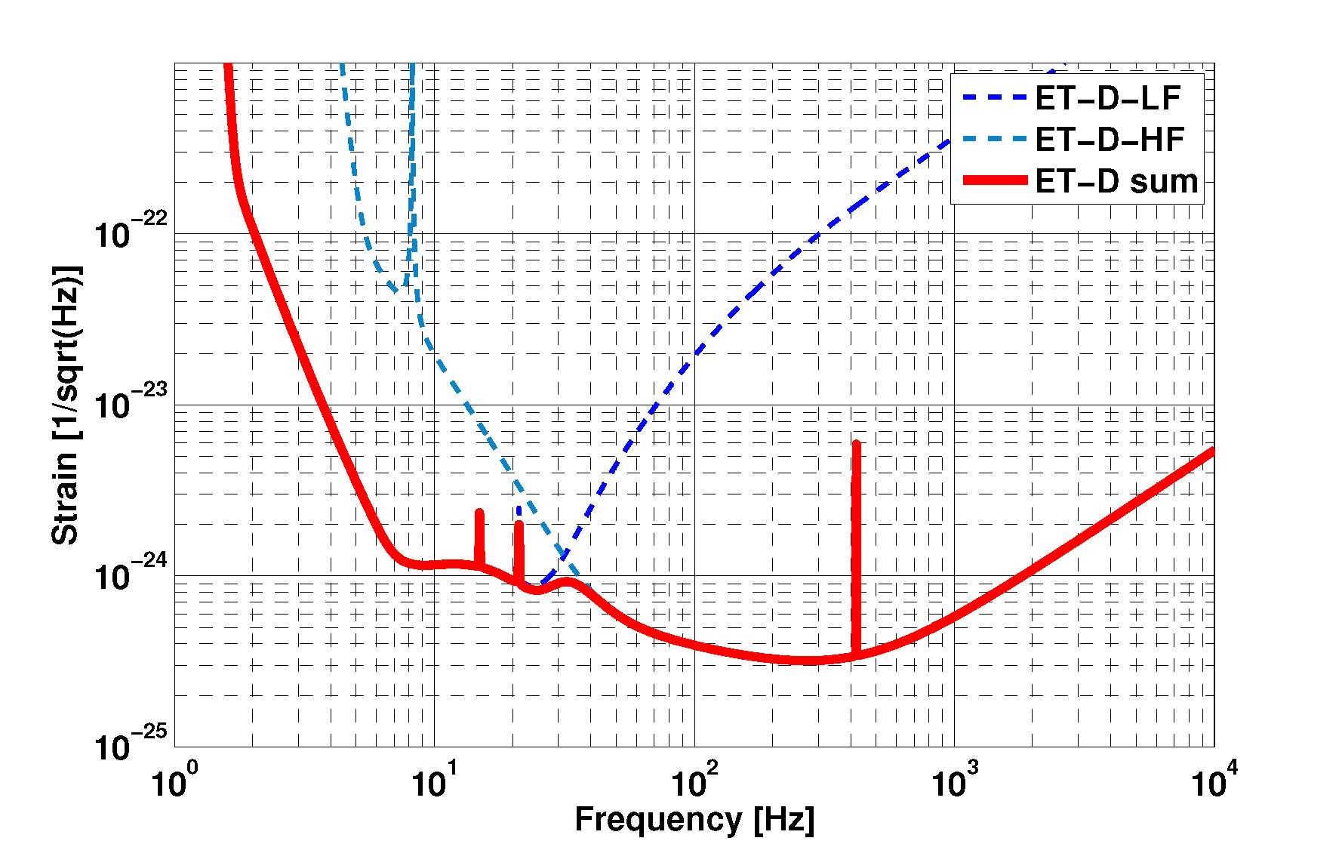
EINSTEIN TELESCOPE (ET) AND LOW-FREQUENCY GW
10 times more sensitive than second-generation detectors;
Three detector with shared arms;
Located underground ⟶ reduce seismic and Newtonian noise;
10 km long arms, in an equilateral triangle configuration: resolve GW polarization and make self localization;
Xylophone configuration: three nested detectors, each composed of two interferometers, one optimized for operation below 30Hz and one optimized for operation at higher frequencies;
ET DESIGN
GW below 30 Hz: higher mass mergers, tidal effects on NSs, BHs close encounters.
Details about ET project: http://www.et-gw.eu/index.php/etsensitivities

Slide 23
THANK YOU FOR THE ATTENTION
Photo wall from Racconti dal BarAonda: https://www.asimmetrie.it/archivio

Slide 24
REFERENCES
Maggiore, M. Gravitational waves. vol 1, theory and experiments. (2008). Oxford: Retrieved from https://archive-ouverte.unige.ch/unige:12993;
Creighton, J. and Anderson, W. Gravitational-Wave Physics and Astronomy: An Introduction to Theory, Experiment and Data Analysis, Wiley Series on Cosmology, 2011. ISBN 978-3527408863. Wiley-VCH (Weinheim, Germany);
Królak, A.; Patil, M. The First Detection of Gravitational Waves. Universe 2017, 3, 59. https://doi.org/10.3390/universe3030059;
B. P. Abbott et al. Phys. Rev. Lett. 116, 061102 (2016) https://doi.org/10.1103/PhysRevLett.116.061102;
Hammond, G., Hild, S. and Pitkin, M. (2014) Advanced technologies for future ground-based, laser-interferometric gravitational wave detectors, Journal of Modern Optics, 61:sup1, S10-S45, DOI: 10.1080/09500340.2014.920934 ;
Abbott, B.P., Abbott, R., Abbott, T.D. et al. Prospects for observing and localizing gravitational-wave transients with Advanced LIGO, Advanced Virgo and KAGRA. Living Rev Relativ 23, 3 (2020). https://doi.org/10.1007/s41114-020-00026-9;
Abbott, B.P. et al. GWTC-1: A Gravitational-Wave Transient Catalog. Phys. Rev. X 9, 031040, (2019), https://doi.org/10.1103/PhysRevX.9.031040;
Abbott, R. et al. GWTC-2: Compact Binary Coalescences Observed. Phys. Rev. X 11, 021053, (2021), https://doi.org/10.1103/PhysRevX.11.021053;
Abbott, R. et al. GWTC-2.1: Deep Extended Catalog. arXiv:2108.01045, (2021);
Abbott, R. et al. GWTC-3: Compact Binary Coalescences Observed. arXiv:2111.03606 (2021), https://doi.org/10.48550/arXiv.2111.03606;
Abbott, B. P. et al Gravitational Waves and Gamma-Rays from a Binary Neutron Star Merger: GW170817 and GRB 170817A (2017) ApJL 848 L13: https://doi.org/10.3847/2041-8213/aa920c;
Abbott, B.P. et al. GW170817: Observation of Gravitational Waves from a Binary Neutron Star Inspiral, Phys. Rev. Lett. 119, 161101 (2017): https://doi.org/10.1103/PhysRevLett.119.161101;
Di Pace, S. on behalf of the Virgo Collaboration, Status of Advanced Virgo and upgrades before next observing runs (2021) Phys. Scr. 96 124054, https://doi.org/10.1088/1402-4896/ac2efc;
B. P. Abbott et al, GW190425, 2020 ApJL 892 L3, https://doi.org/10.3847/2041-8213/ab75f5;
R. Abbott et al, GW190814, 2020 ApJL 896 L44, https://doi.org/10.3847/2041-8213/ab960f;
I. Bombaci et al, Was GW190814 a Black Hole–Strange Quark Star System?, Phys. Rev. Lett. 126, 162702, https://doi.org/10.1103/PhysRevLett.126.162702;
R. Abbott et al 2021 ApJL 915 L5, https://doi.org/10.3847/2041-8213/ac082e;
R. Abbott et al, GW190412, Phys. Rev. D 102, 043015, 2020, https://doi.org/10.1103/PhysRevD.102.043015;
Gayathri, et al. Eccentricity estimate for black hole mergers. Nat Astron 6, 344–349 (2022), https://doi.org/10.1038/s41550-021-01568-w;
R. Abbott et al. GW190521, Phys. Rev. Lett. 125, 101102 (2020), https://doi.org/10.1103/PhysRevLett.125.101102;
B. P. Abbott et al. Multi-messenger Observations, ApJL 848 L12 (2017), https://doi.org/10.3847/2041-8213/aa91c9;

Slide 25
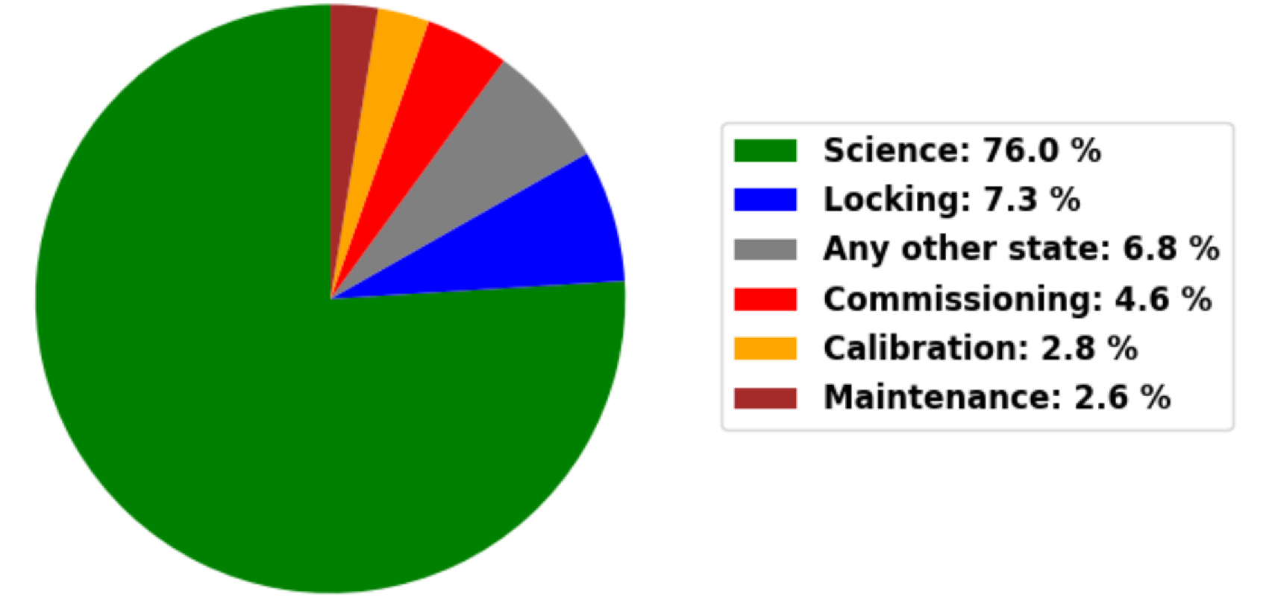
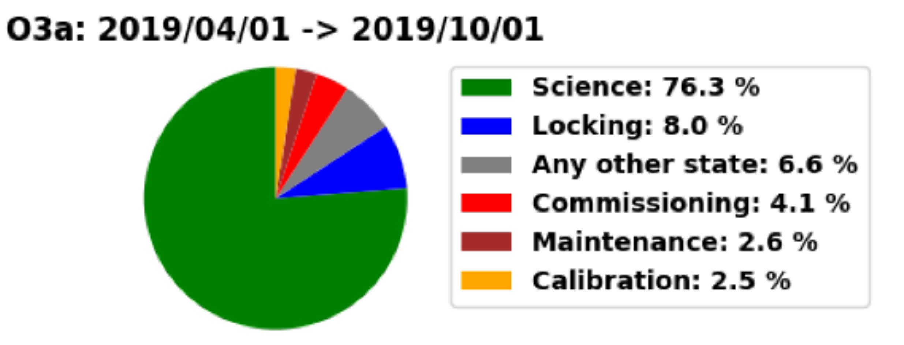
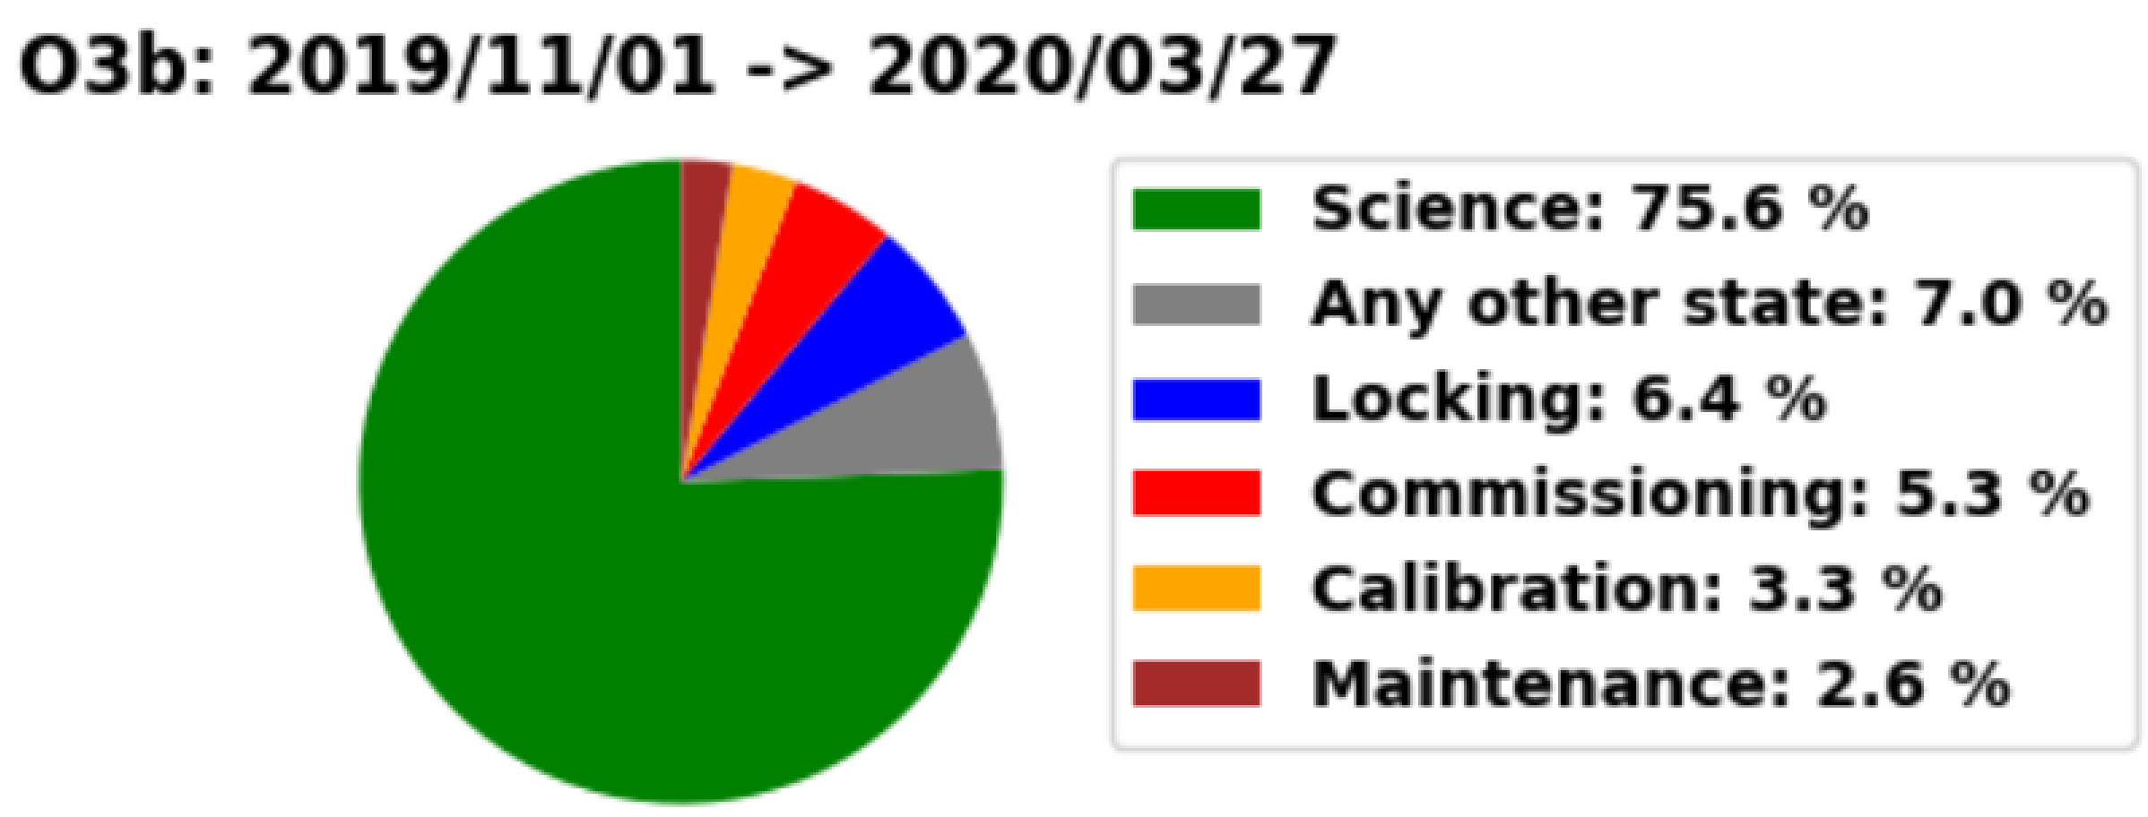
O3 DUTY CYCLE
BACKUP SLIDE
Network Duty Cycle
Advanced Virgo Duty Cycle during O3

