Slide 1
On-line training advertisement:
Lectures on Superconducting Magnet test stands, Magnet protections and Diagnostics
20 lectures
Speakers from worldwide laboratories (BNL, CEA, CERN, EPFL, FNAL, IFJ PAN, LBNL, Tampere)
First part
  the main aspects of a superconducting magnet test stand (cryogenics systems, power supplies, current leads).
Second part
  the design and use of magnet protection systems (high voltage electrical integrity checks, energy extraction, strip heaters, CLIQ, quench detection)
Third part
  the various measurement techniques related to magnet health monitoring (magnetic, thermal, mechanical behaviors and AC loss).
Last part
  a dedicated talk will introduce the problematic of the protection of large fusion superconducting coils.

Slide 2
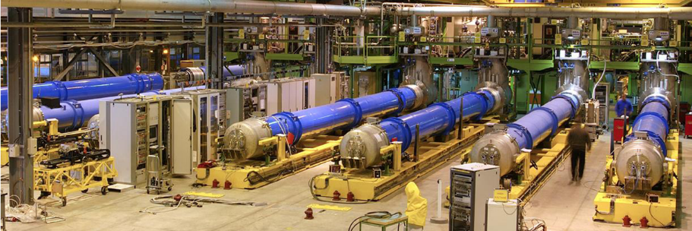
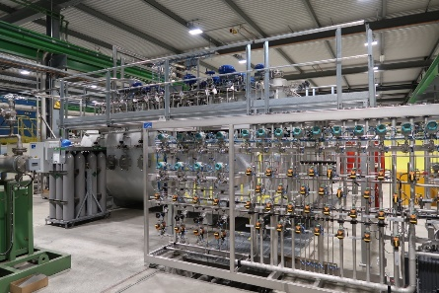
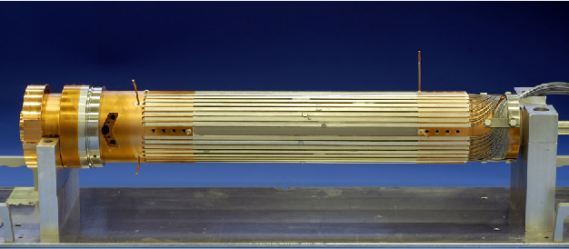
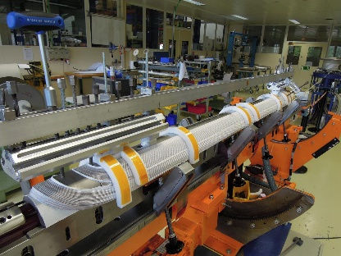
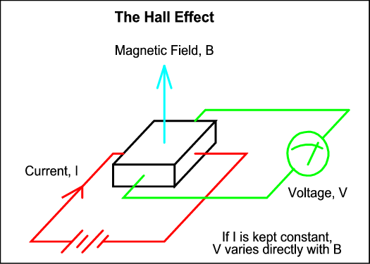
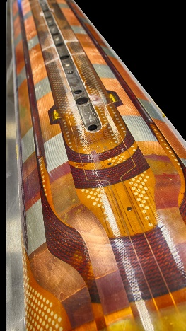
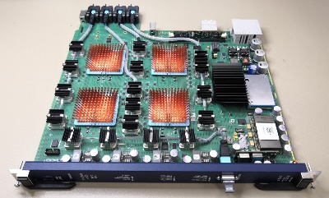
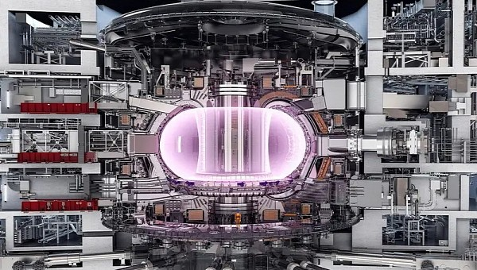
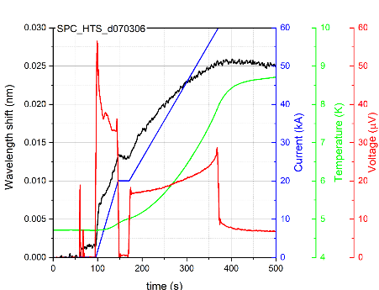
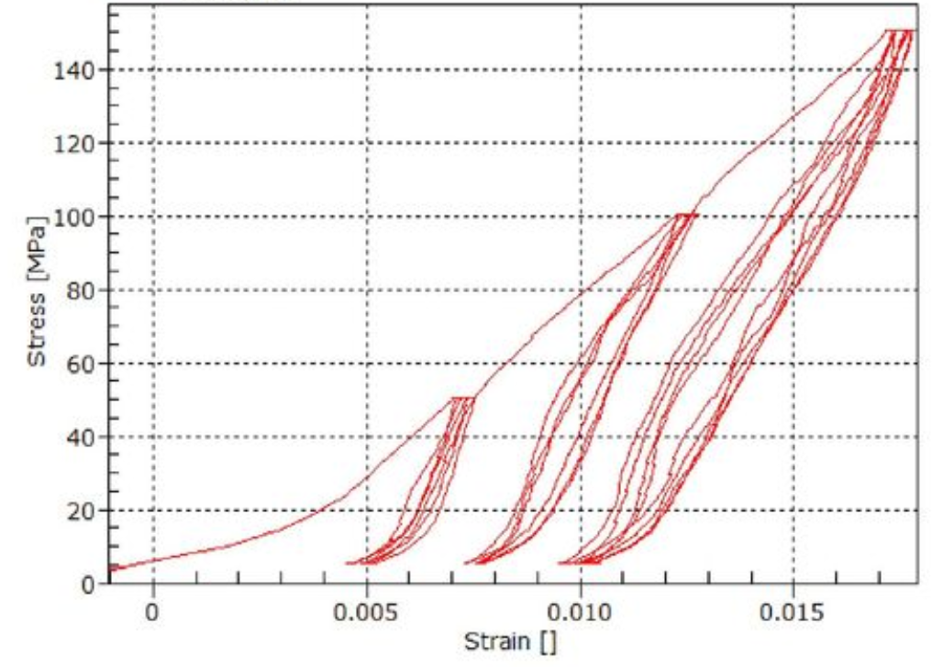
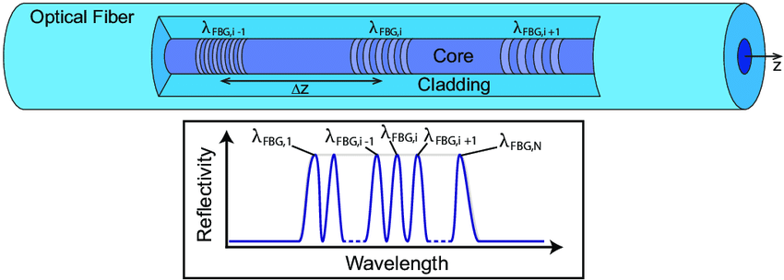
On-line training advertisement:
Lectures on Superconducting Magnet test stands, Magnet protections and Diagnostics

