Slide 1
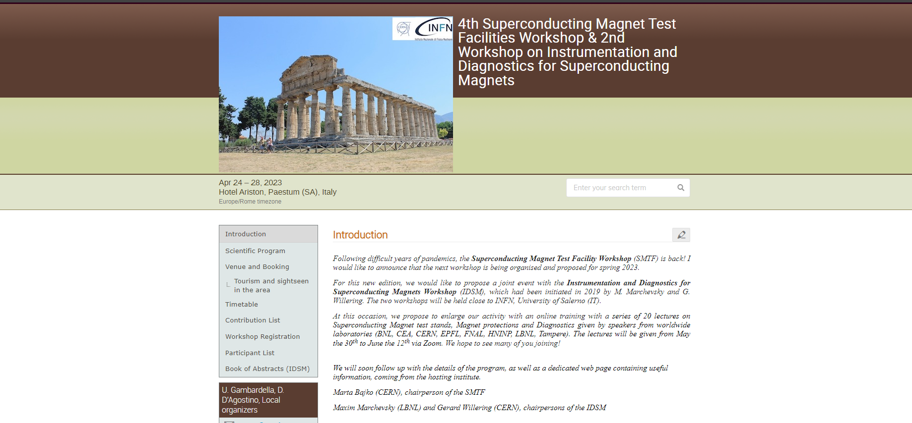
Welcome to the IDSM’02 Workshop!

Slide 2
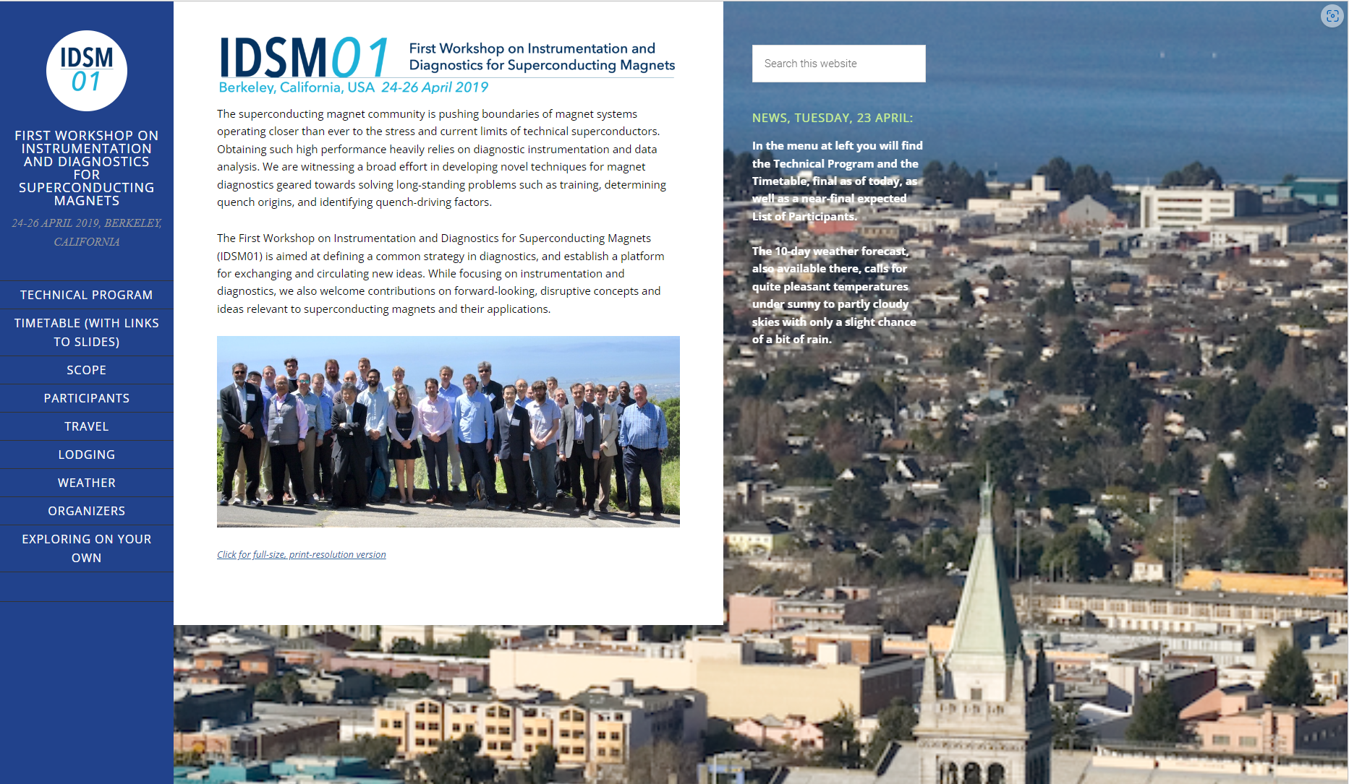

Slide 3
IDSM’01 Workshop Summary: directions going forward
Paradigm change for quench diagnostics: from investigating quench causes and locations after the event towards guarding magnet system to stay within its operational and safety margins in real-time.
Multi-technique diagnostics: combining voltage, acoustic and magnetic methods to get a full picture. Advanced, multi-functional probes for magnet disturbance spectra
Need for well-designed and calibrated experiments to study training and build a database of diagnostic signals for typical transient events in magnets.
Make more magnet data available for developers of Deep Learning models; adopt ML and DL as standard analysis tools for our field
Quench detection for HTS under extreme ac background/noise conditions
Way to detect the presence and accumulation of micro-cracks in HTS tapes in high-field solenoids
Ways to visualize and monitor current sharing in HTS cables, NI coils
Cryogenics DAQs and digital processing integrated with the magnet
FPGAs for various diagnostics and magnet safety functions

Slide 4
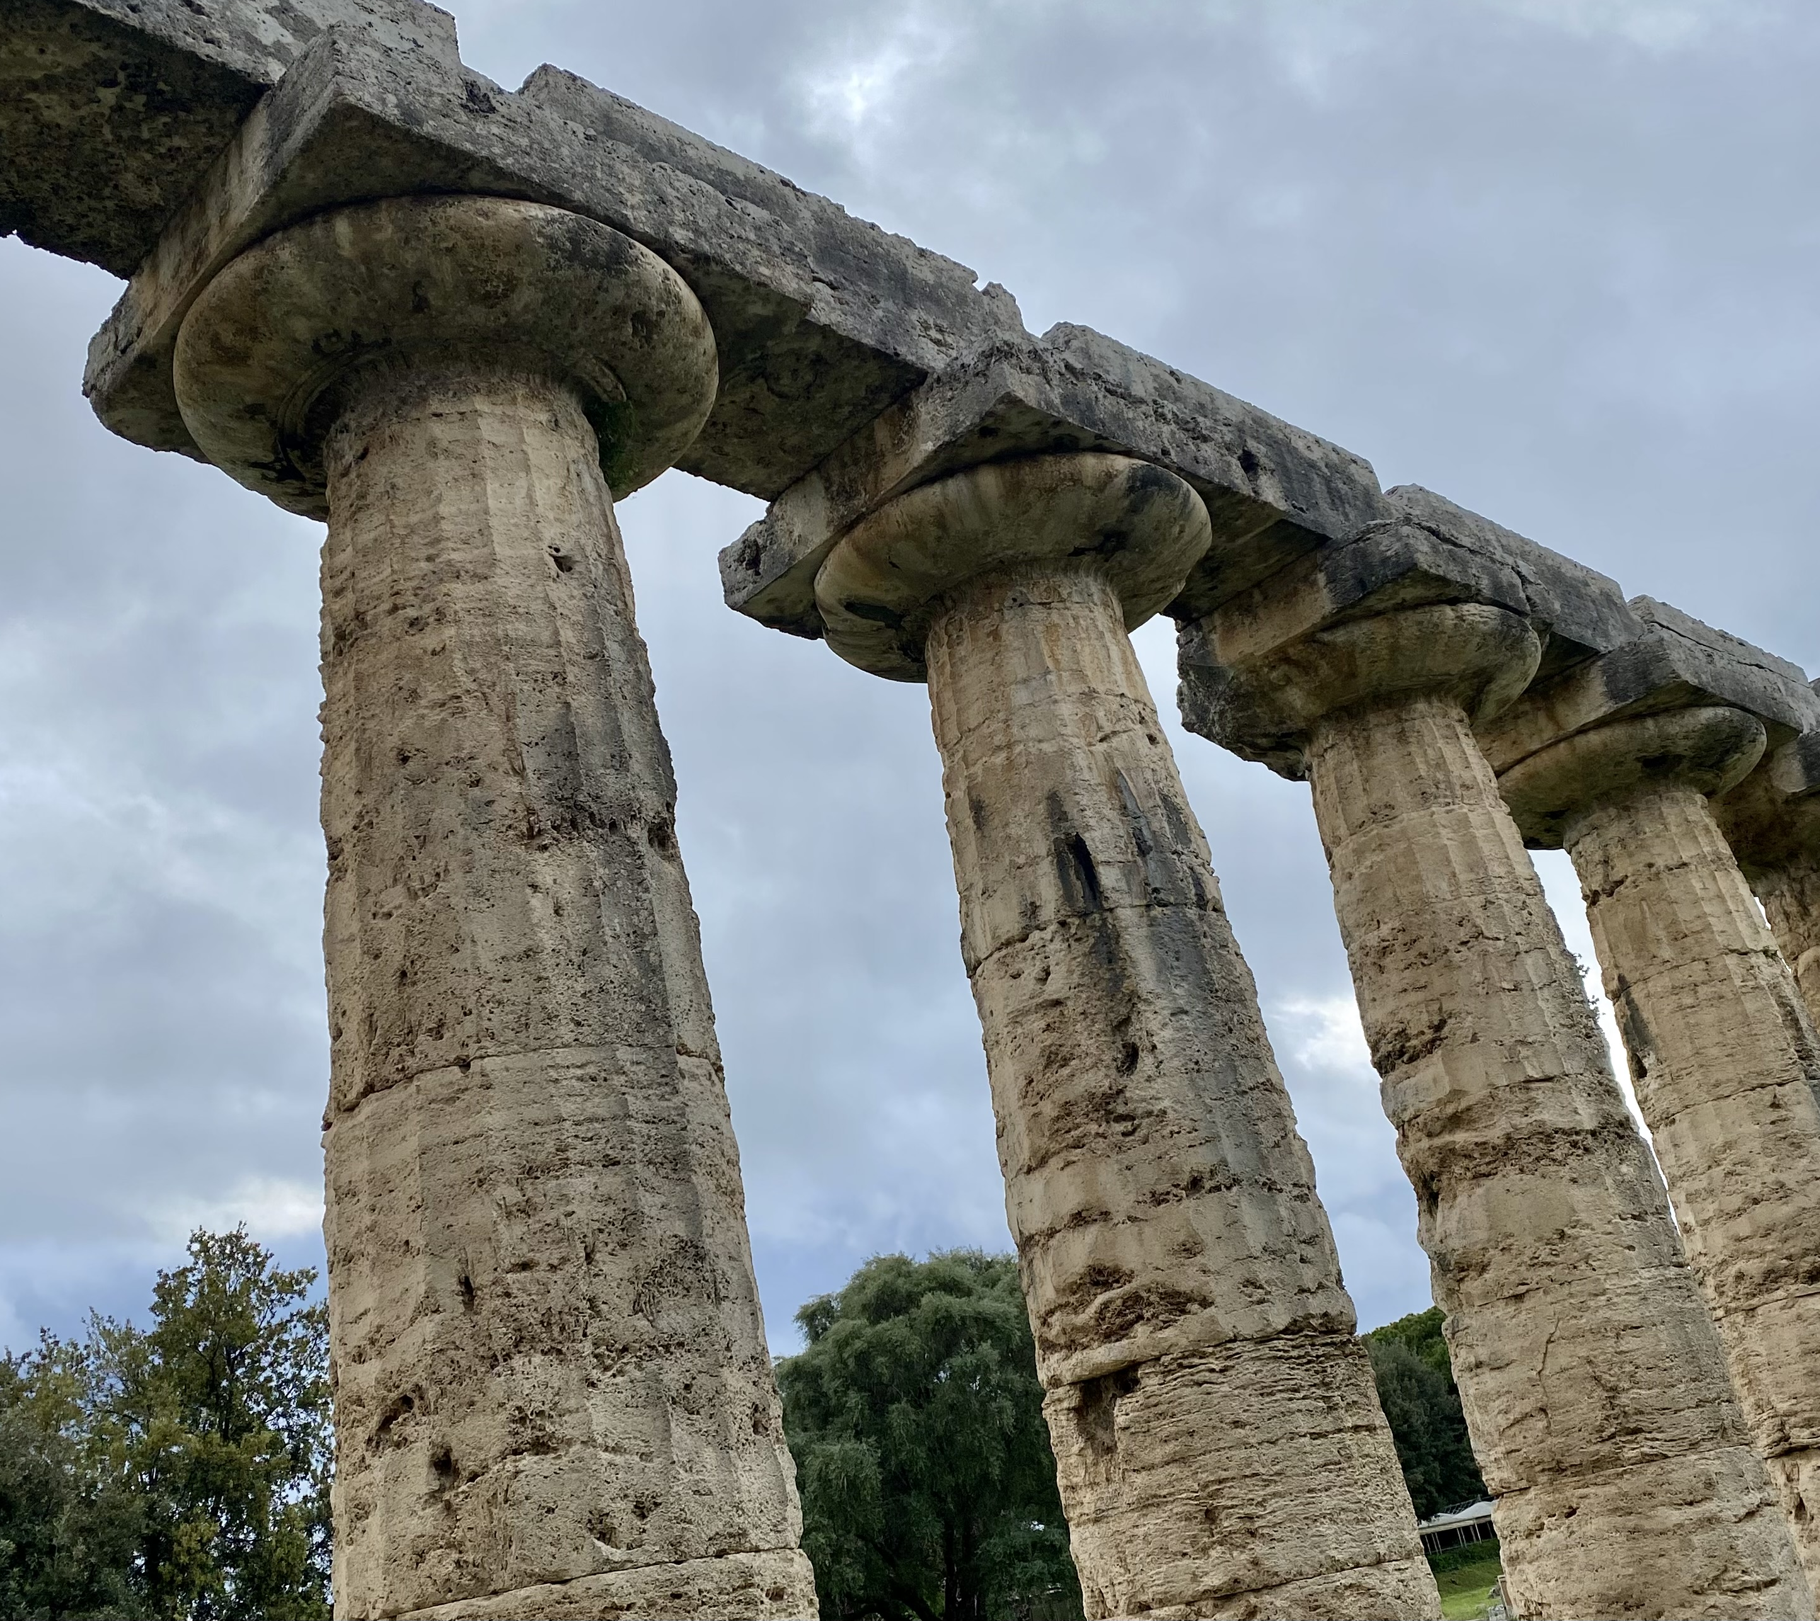
IDSM’02 Workshop: key topics
Understanding of magnet training (or lack thereof). Disturbance spectra of LTS high-field magnets
Quench detection and protection for HTS / hybrid magnet for HEP and Fusion
Novel diagnostic instrumentation approaches and techniques
Novel (cryo) electronics, data analysis, modeling

Slide 5
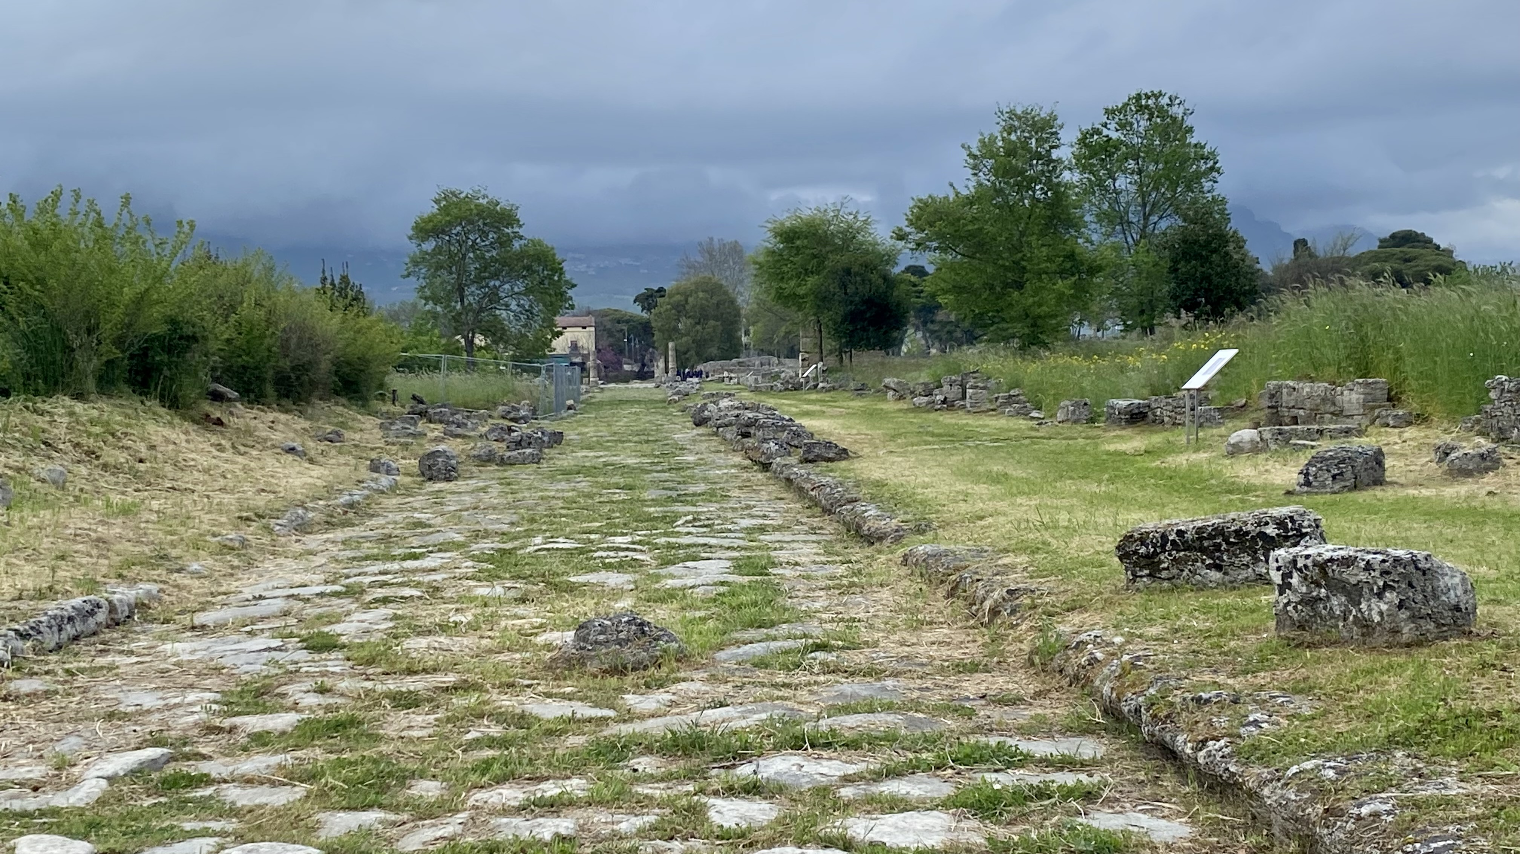
27 presentations on various aspects of diagnostics, instrumentation, modeling, and strategic planning based on current and future needs.
Key challenges - Setting the Scene
Mechanical diagnostics for transients and precursors
Novel diagnostic techniques and data analysis
Fiberoptic diagnostics for strain and quench
Innovative electronics and devices, electrical diagnostics
Magnetic measurement methods
We combined 3-4 talks based on the subject, followed by a topical discussion.
Presentations can be either uploaded into Indico OR shown directly via Zoom connection:
https://lbnl.zoom.us/j/7561301868

Slide 6
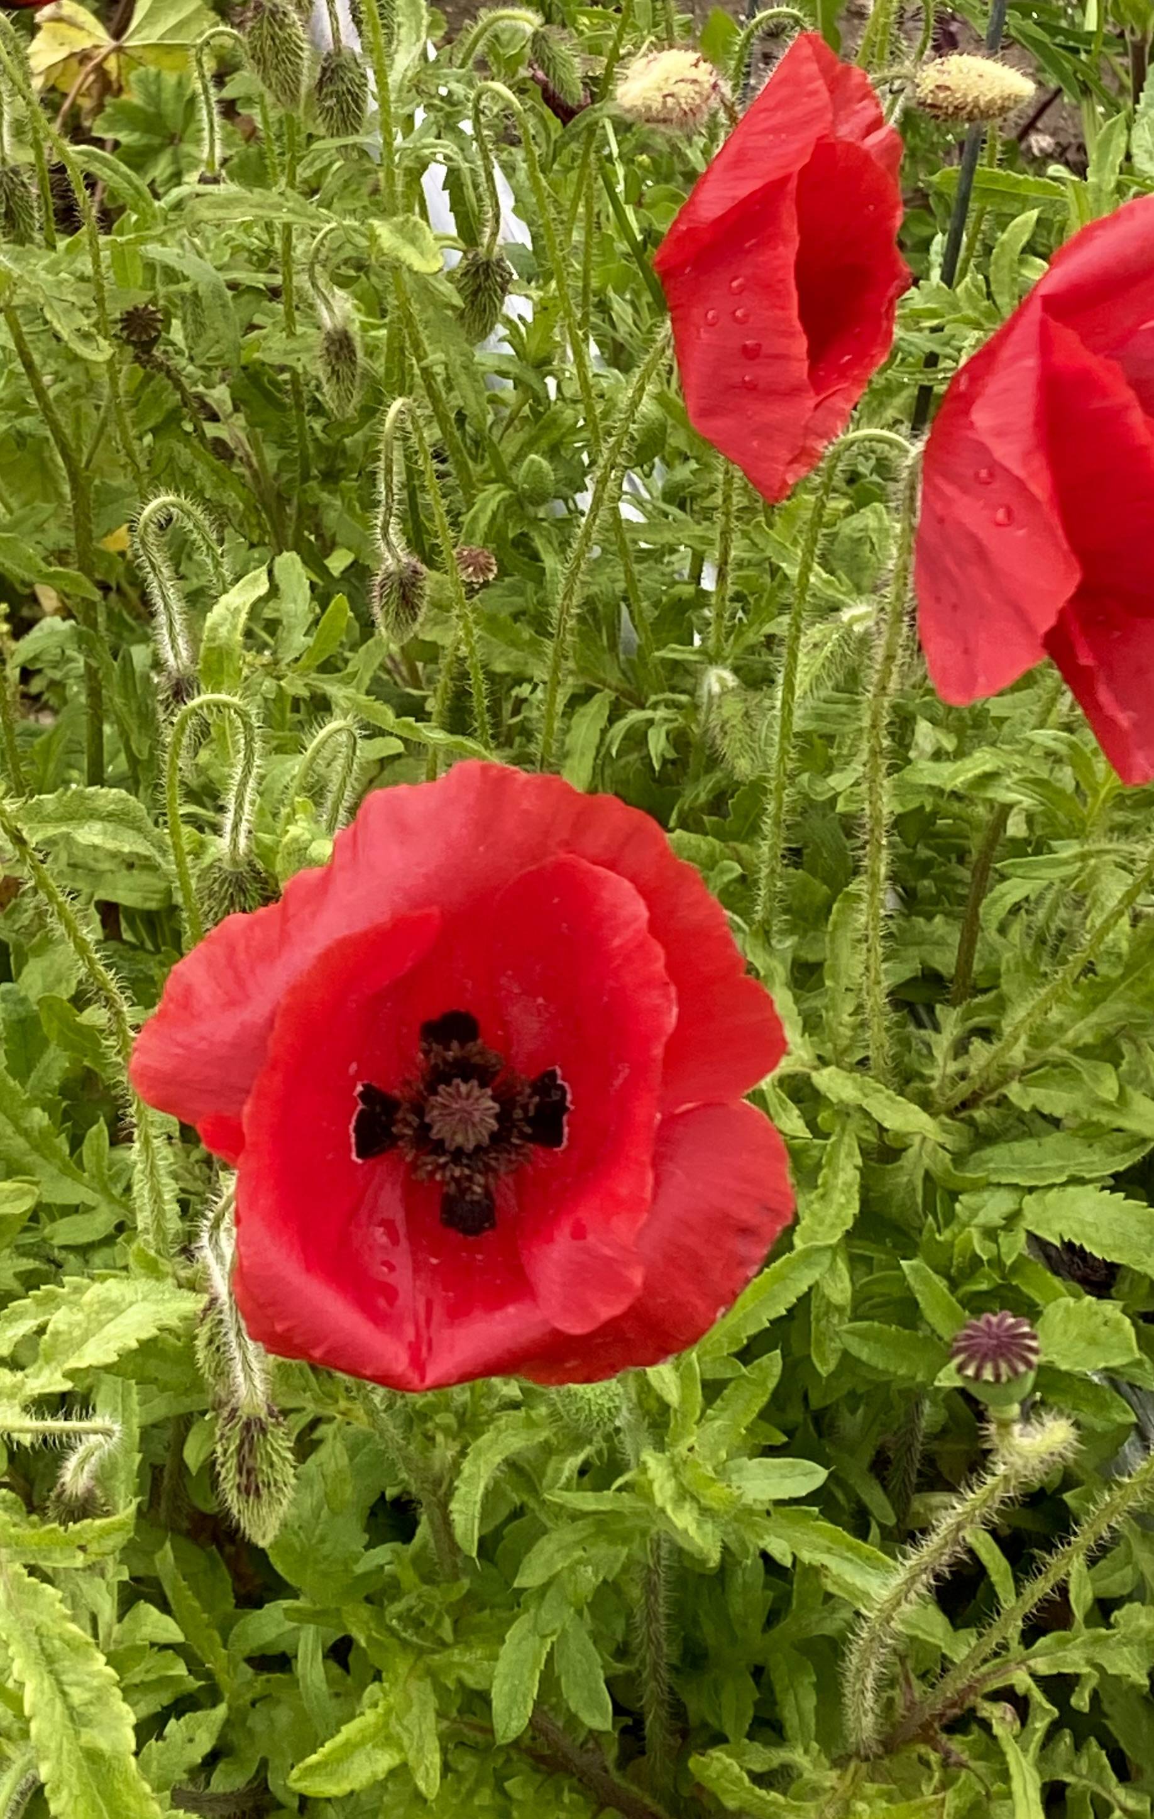
Many thanks to:
Marta Bajko for coordinating the joint workshop organization
Umberto Gambardini and his team for the local organization
CERN and INFN for providing financial support

