Slide 1
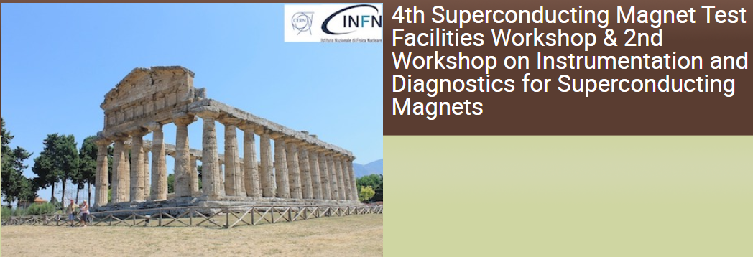
Research on NI HTS Magnet for Quench Simulation, Imitation, Protection, and Detection
Jeseok Bang, Kwangmin Kim, Griffin Bradford, Jonathan Lee, and David Larbalestier
Applied Superconductivity Center
National High Magnetic Field Laboratory
Florida State University
A portion of this work was performed at the National High Magnetic Field Laboratory, which is supported by the National Science Foundation Cooperative Agreement No. DMR-2128556 and the State of Florida. This work is also supported by the Office of Fusion Energy Sciences Grant DE-SC0022011.
ISDM02-2023, Novel quench detection and localization methods, Friday, April 28
J. Bang (jbang@asc.magnet.fsu.edu)
1/20

Slide 2
Part I. Introduction:
‘Little Big Coil’ Project
ISDM02-2023, Novel quench detection and localization methods, Friday, April 28
J. Bang (jbang@asc.magnet.fsu.edu)
2/20

Slide 3
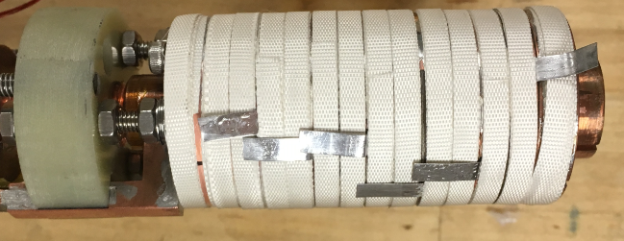
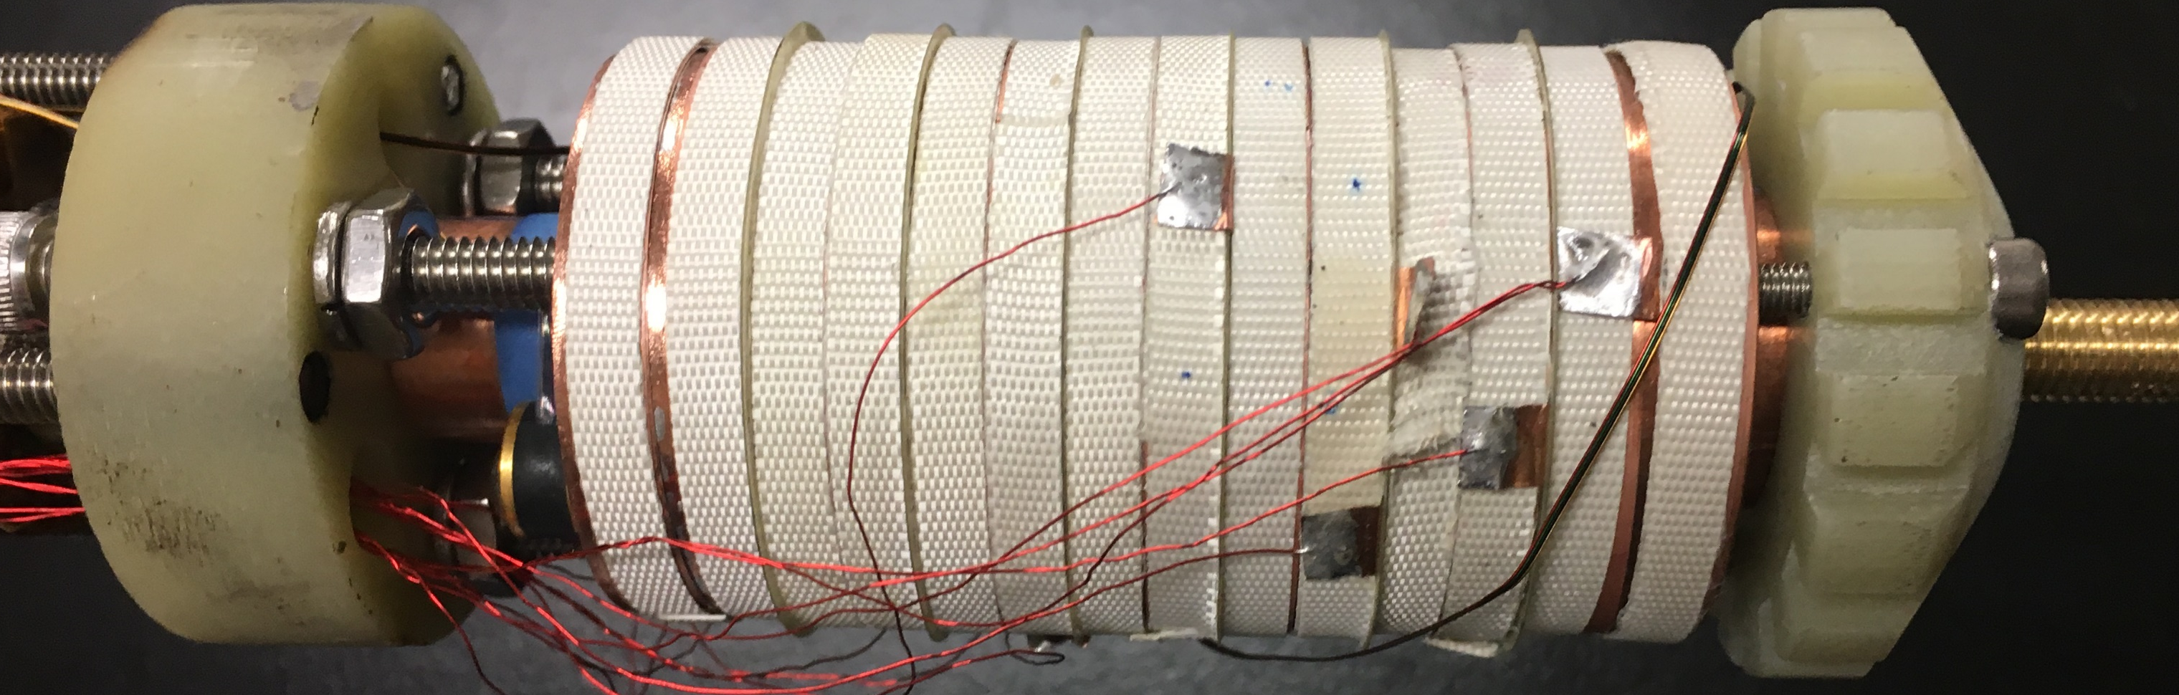
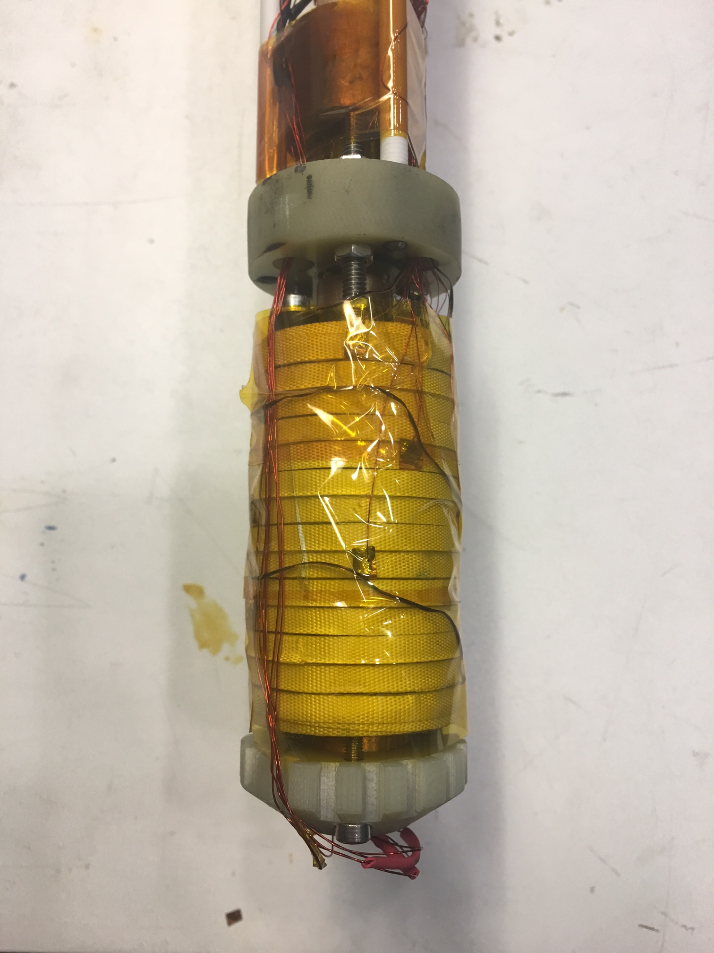
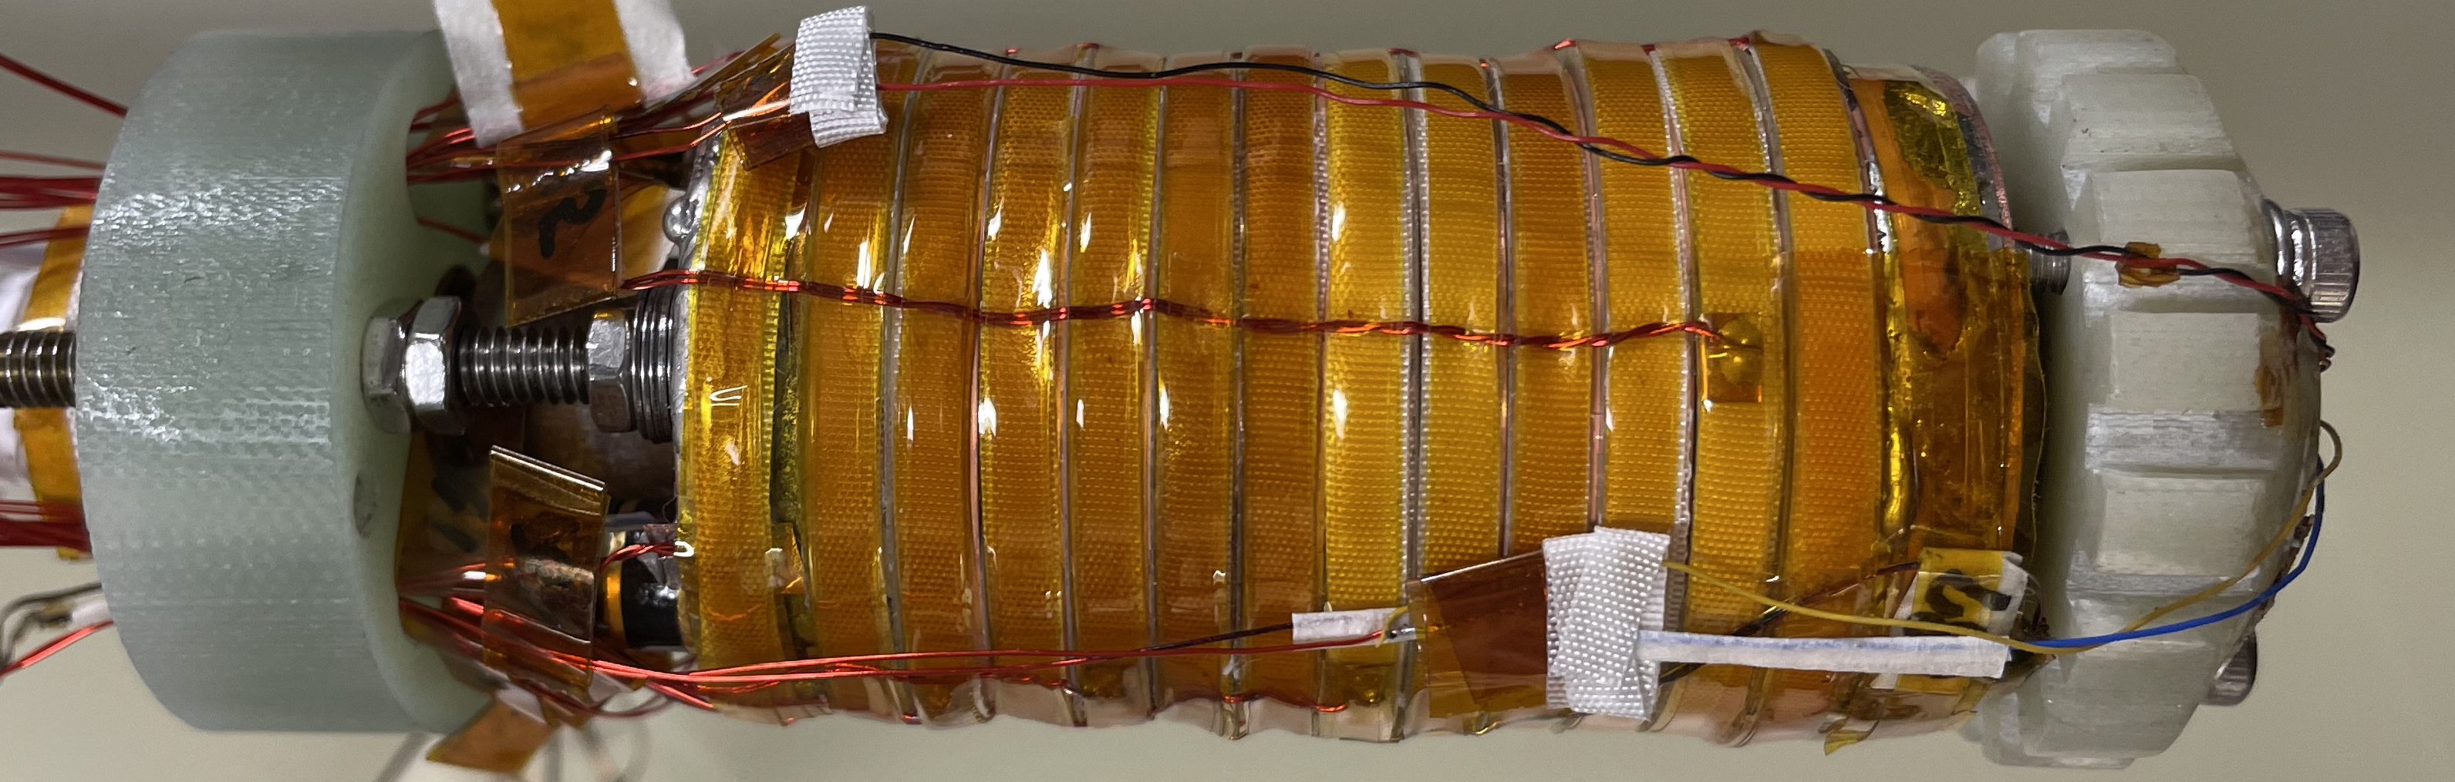
Dream to Reality: High Fields >40 T with NI HTS Magnet
‘Little Big Coil (LBC)’ framework to explore high fields beyond 40 T
  A stack of 12 double pancake module coils
  Background magnetic field: 31.1 T
  Bore size: 40 mm / cooling mechanism: LHe
[ref] S. Hahn et al., “45.5-Tesla direct-current magnetic field generated with a high-temperature superconducting magnet,” Nature, vol. 570, no. 7762, pp. 496–499, 2019
LBC1 (40.2 T)
LBC2 (42.5 T)
LBC3 (45.5 T)
LBC4 (44.0 T)—Last Month
World-record DC field
Slit-edge effect demonstration
Lessons learned from the LBC framework
  Excessive/non-uniform mechanical stress is applied to REBCO CC due to screening current.
  SCS can induce plastic deformation and the consequent magnet quench.
  Slit-edge side and plastic deformation on REBCO CC have a correlation.
  Instrumentation to measure local temperature/voltage/strain is needed.
Now, we are aiming to reach 50 T through the LBC framework!
ISDM02-2023, Novel quench detection and localization methods, Friday, April 28
J. Bang (jbang@asc.magnet.fsu.edu)
3/20

Slide 4
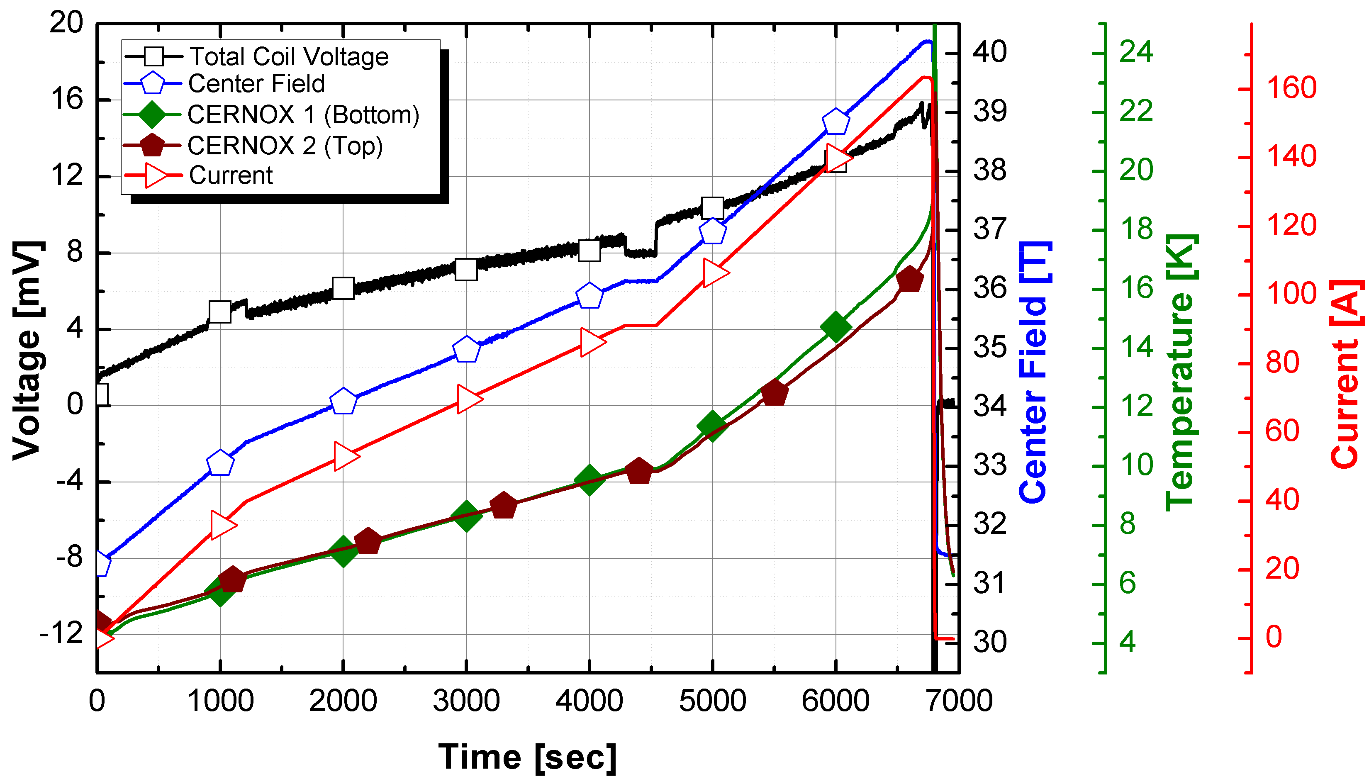
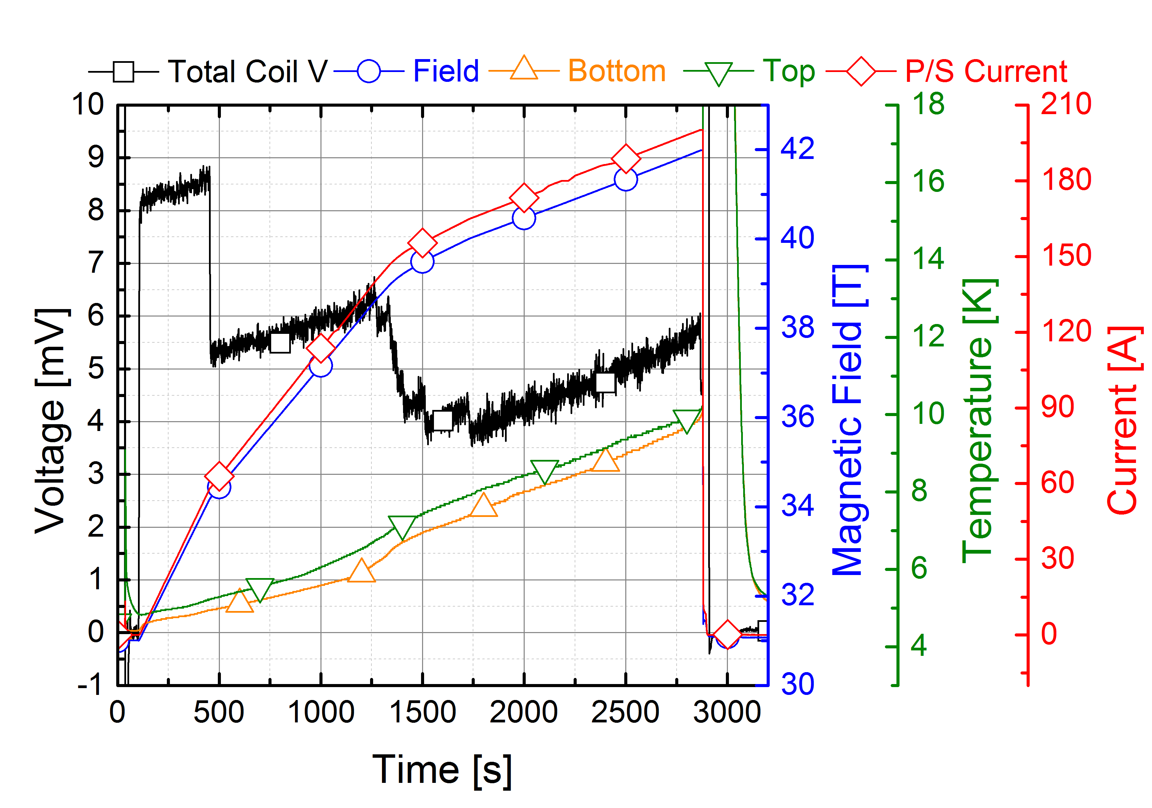
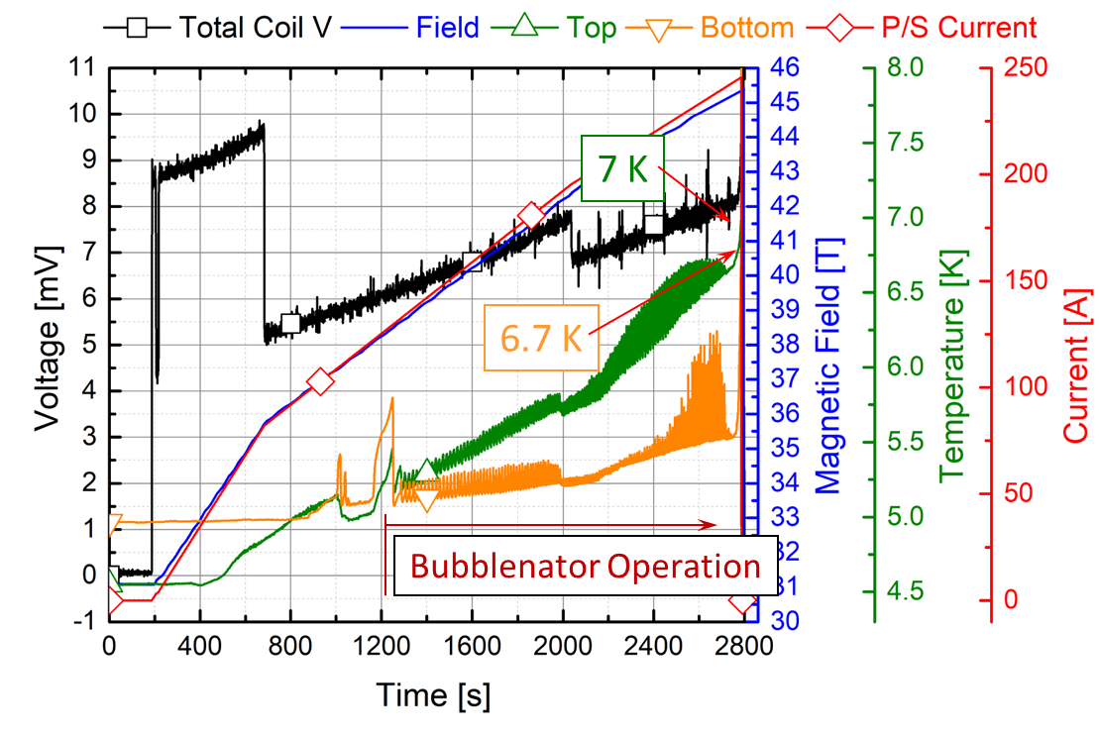
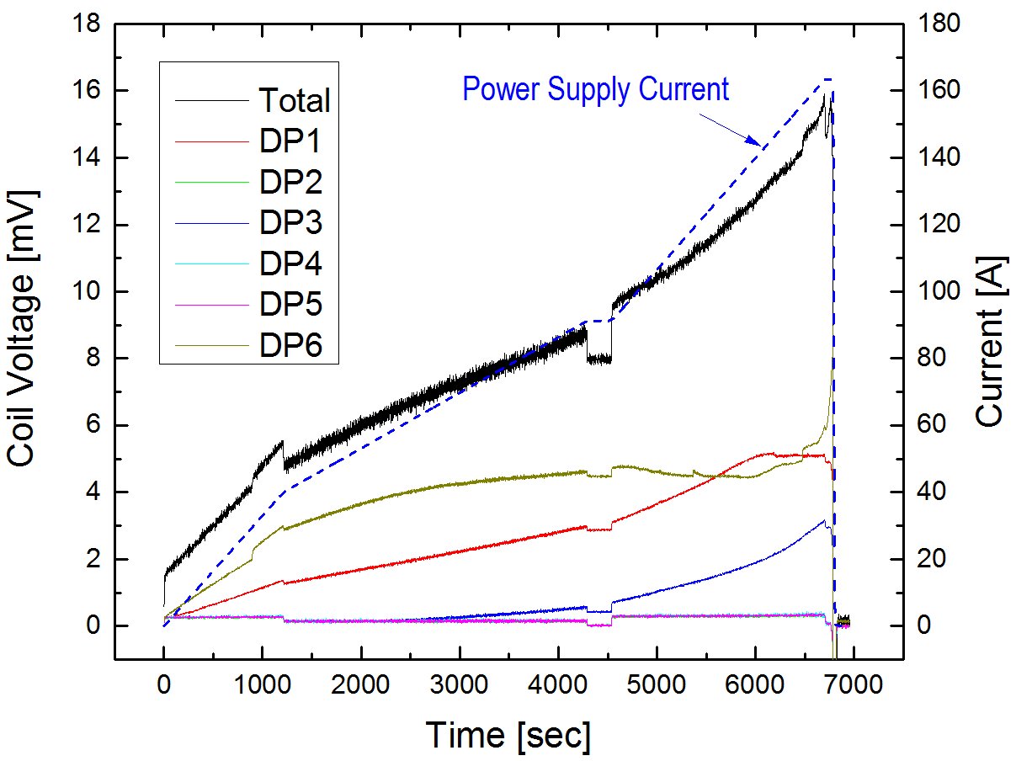
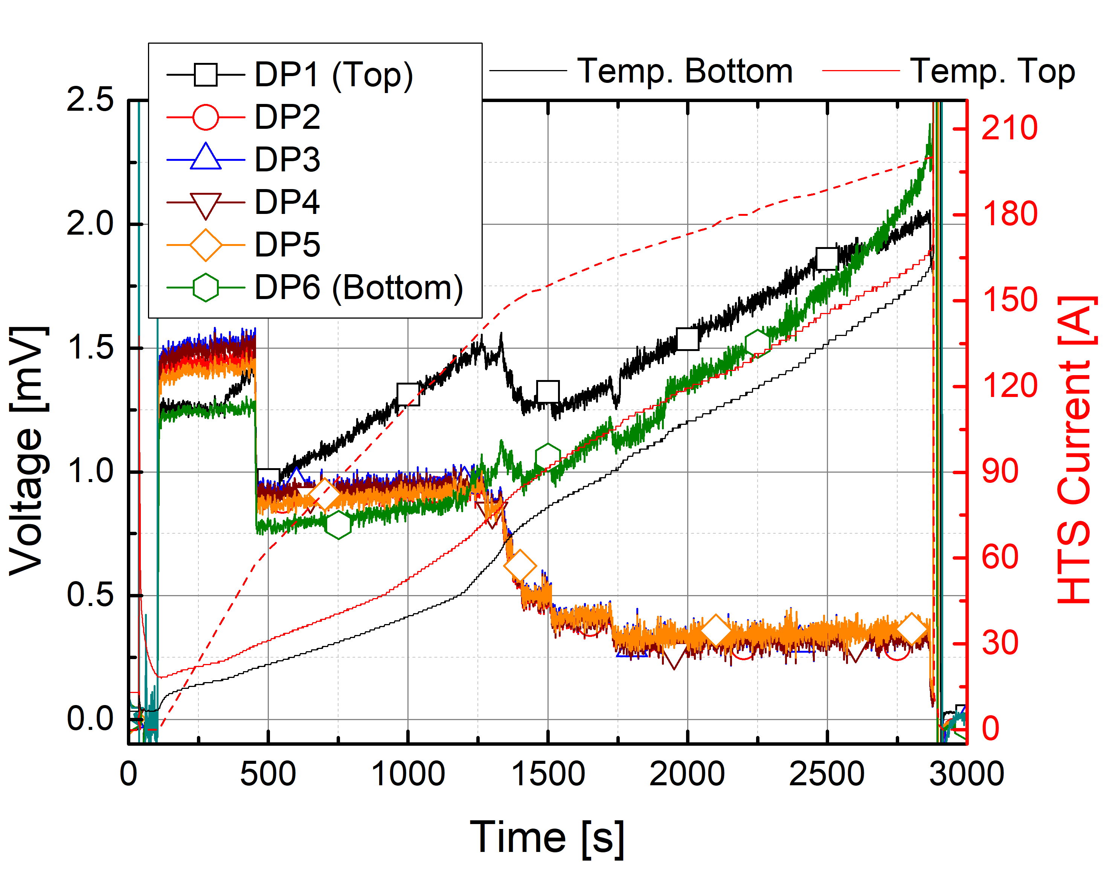
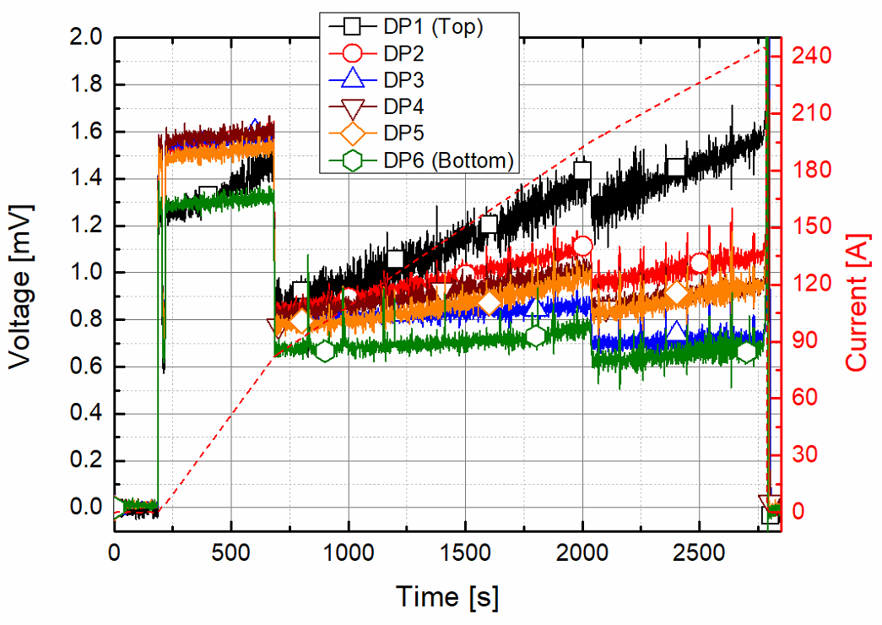
Practical Challenge in Exploring >40 T: LBC1—3 Quench
Test results of LBC1
Test results of LBC2
Test results of LBC3
LBC4 also experienced quench at 44 T (not analyzed yet).
We are being trained by LBC1—4 quench data!
Quench @ 40 T (160 A)
Quench @ 42.5 T (200 A)
Quench @ 45.5 T (245 A)
ISDM02-2023, Novel quench detection and localization methods, Friday, April 28
J. Bang (jbang@asc.magnet.fsu.edu)
4/20

Slide 5
Part II. Research on Quench:
what we have done and
what we are going to do
ISDM02-2023, Novel quench detection and localization methods, Friday, April 28
J. Bang (jbang@asc.magnet.fsu.edu)
5/20

Slide 6
Core Component Technologies to Address Quench Issue
Detection
Voltages
Voltage taps
Strains
Strain gauges and others
Temperatures
Thermocouple wires & temperature sensors
Vibration
Acoustic sensors
Ultimate goal:
  Definition of quench initiation criteria (when, where, why starts?)
  Development of magnet design/analysis program
  Investigation of REBCO CC performance limit
Fields and others
Hall sensors & waveguides & optics sensors
Protection
Full-quench
Electric heater
Optimal-quench
Optimized electric heater
Energy transfer
Dump resistor & magnetic dam
Imitation
Series-connection
Local defects & heat source
Parallel-connection
Selected coil quench or open
Simulation
Electromagnetics
Mechanics
Fully-coupled Multiphysics Simulation
Thermodynamics
ISDM02-2023, Novel quench detection and localization methods, Friday, April 28
J. Bang (jbang@asc.magnet.fsu.edu)
6/20

Slide 7
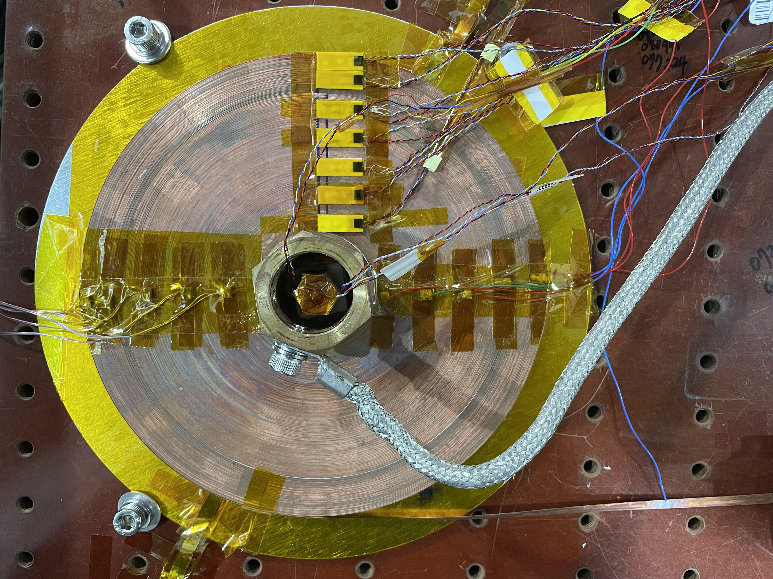
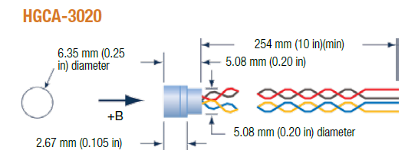
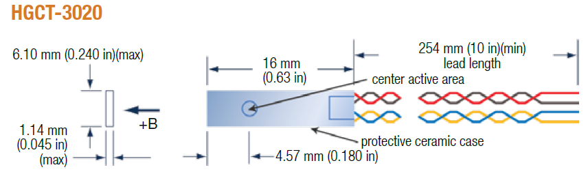
Research on Quench Detection I: Measurement of Local Voltages, Magnetic Fields, and Temperatures
“Real-time” Monitoring of magnetic fields, temperatures, and voltages in LN2
Five terminals for local temperature measurement
Three axial Hall sensors
Azimuthal current
B_{cen,3}
6 mm
LakeShore
DT-670
Thermocouple wires
B_{cen,2}
B_{cen,1}
(>$1000 per each)
Voltage taps
100th turn
200th turn
300th turn
400th turn
450th turn
Coil mandrel
Radial current
Hall sensors
(calibrated)
Seven transverse Hall sensors
Six terminals for local voltage measurement
10 mm
6 mm
NI HTS coil (single pancake)
B₁
B₂
B₃
B₄
B₅
B₆
B₇
(>$1000 per each)
1st turn
100th turn
200th turn
300th turn
400th turn
450th turn
[ref] J. Bang, S. H. Park, J. Park, G. Kim, J. T. Lee, K. Kim, S. Hahn, and D. C. Larbalestier, “A real-time monitoring system for investigating electromagnetic behaviors of an HTS coil,” IEEE Trans. Appl. Supercond. , vol. 32, no. 6, pp. 1–5, 2022.
ISDM02-2023, Novel quench detection and localization methods, Friday, April 28
J. Bang (jbang@asc.magnet.fsu.edu)
7/20

Slide 8
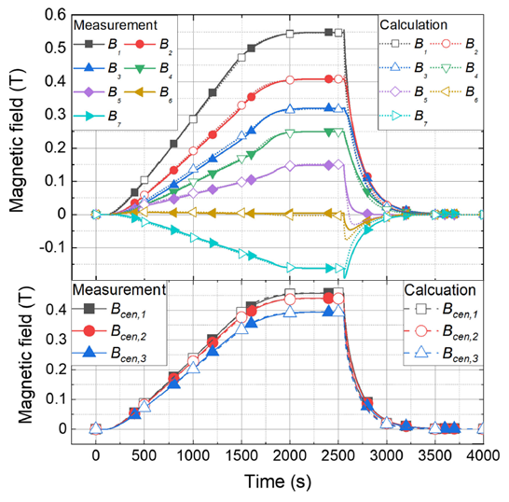
LN2 Test: Measurement of Local Voltages and Fields
The coil was charged up to 100 A with 0.05 A/s, where coil Ic was ~70 A (estimated).
Charge end
Charge start
83 A
65 A
73 A
81 A
91 A
Discernible non-linear behaviors were observed.
ISDM02-2023, Novel quench detection and localization methods, Friday, April 28
J. Bang (jbang@asc.magnet.fsu.edu)

Slide 9
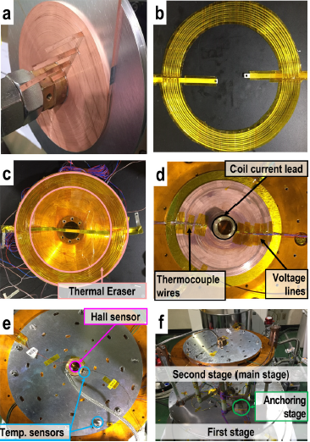
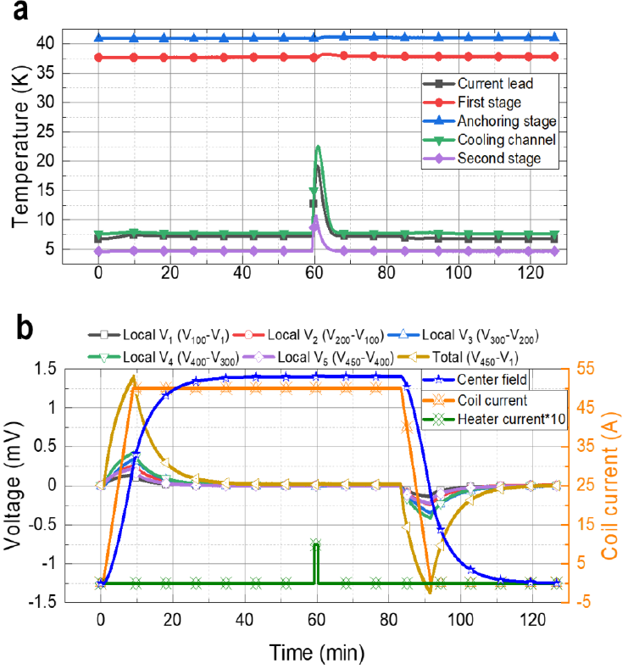
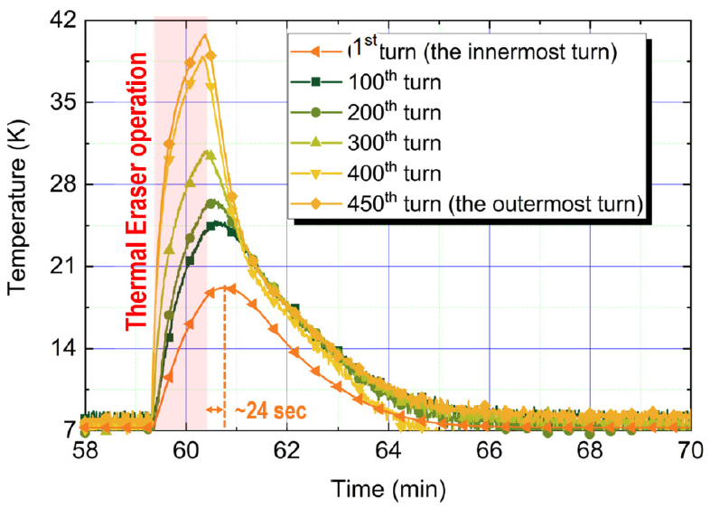
Conduction Cooling Test to measure Local Temperatures
Design, construction, and test
Instrumentation and measurement
Voltage → Temperature
(LakeShore E-type Thermocouple wire)
Feasibility to measure local temperatures confirmed
Not yet proven during the coil/magnet quench
[ref] J. Bang et al., “A customized electric heater to mitigate screening current by optimal control on temperature distribution in a high-temperature superconductor coil,” J. Appl. Phys., vol. 132, no. 18, 2022, Art. no. 183911.
ISDM02-2023, Novel quench detection and localization methods, Friday, April 28
J. Bang (jbang@asc.magnet.fsu.edu)
9/20

Slide 10
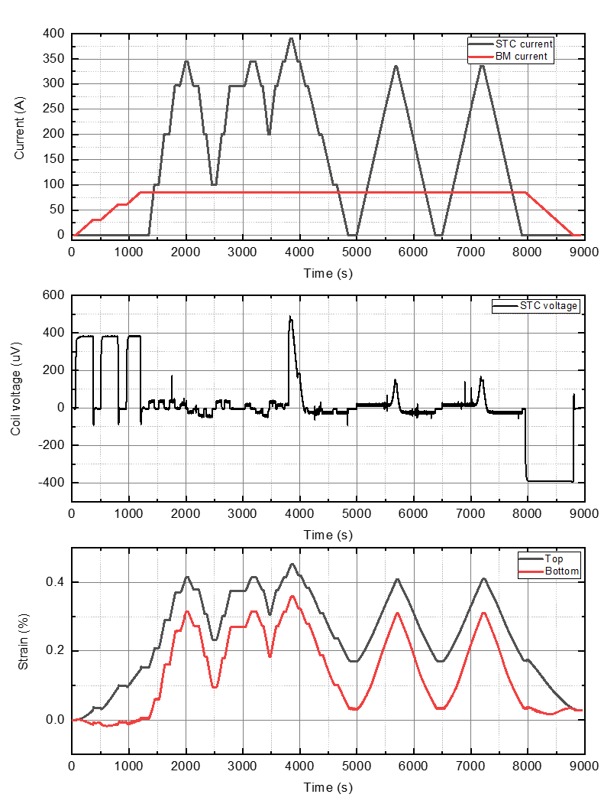
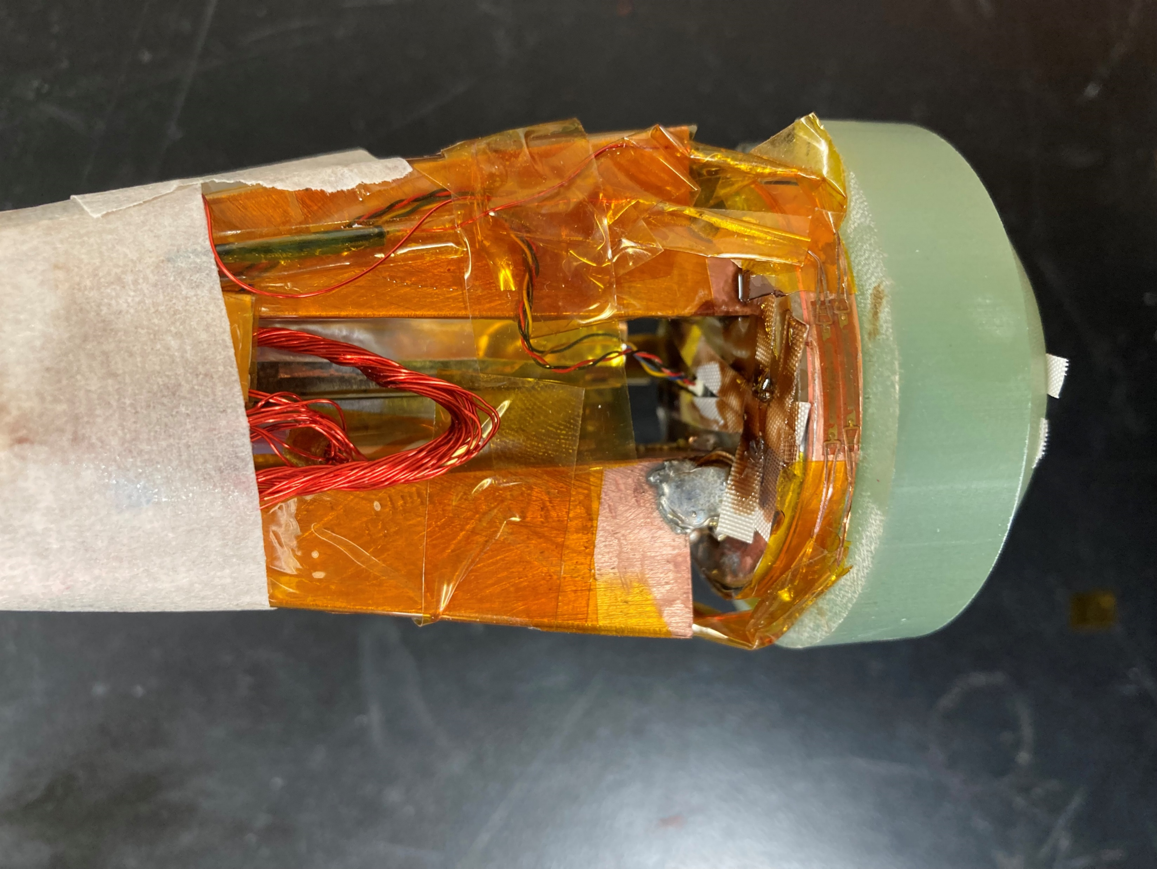
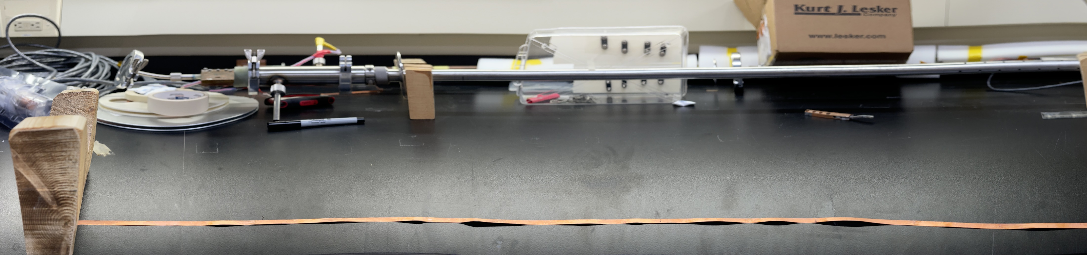
Research on Quench Detection II: Measurement of Strains at the Outermost Turn of NI HTS Coil
Small test coil (STC) framework to investigate Ic degradation/Quench of REBCO CC by SCS
Coil parameters | Value
Tape thickness [mm] | 0.045
Tape width [mm] | 4.00
I.R. [mm] | 19.5
O.R. [mm] | 20.4
Hight [mm] | 4.00
Magnet inductance [μH] | 29.95
No. of SPC's turns | 20.00
Total total length [m] | 2.51
Strain gauges (top/bottom)
Flux-flow voltage
Periodic one-side edge-wave* (maybe due to SCS) observed
Overstress >0.4%
ISDM02-2023, Novel quench detection and localization methods, Friday, April 28
J. Bang (jbang@asc.magnet.fsu.edu)
10/20

Slide 11
Experimental Results of STC
: Correlation Confirmed
① Background field test (Time: 0 – 1300 s + 8000 – 9000 s )
①
②
③
④
Ox3 magnet was charged only up to 14 T.
Peak strain was 0.15% near the top edge at 14 T.
The measured strain near the bottom edge was negligible.
There was a reasonable agreement with previous STC tests.
② Main test (Time: 1300 – 3500 s)
STC6 was charged up to 350 A.
Coil voltage spikes and inductive voltage degradation were observed.
The reproducibility of coil behavior was confirmed.
Peak strain was over 0.4%, but no flux flow voltage was measured.
③ Over current/stress test (Time: 3500 – 5000 s)
STC6 is charged up to 400 A.
Peak strain is over 0.45%→ flux flow voltage was measured.
Critical current degradation occurred by excessive stress.
Notable voltage spikes and degradation were not observed.
④ Post- $I_{c}$ degradation test (Time: 5000 – 8000 s)
After critical current degradation, an additional test was performed.
Inductive voltage degradation was observed, compared ② and ④.
Flux flow voltage at the coil current of 300 A.
The reproducibility of coil behavior was confirmed.
ISDM02-2023, Novel quench detection and localization methods, Friday, April 28
J. Bang (jbang@asc.magnet.fsu.edu)
11/20

Slide 12
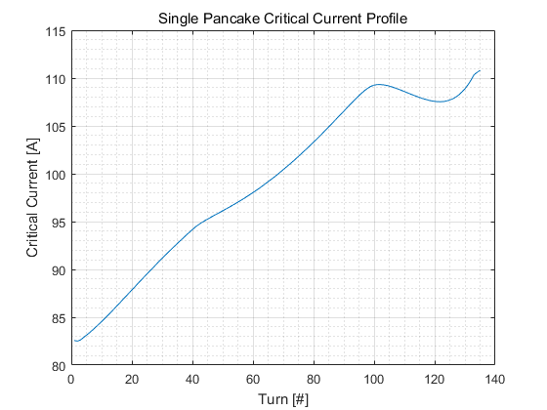
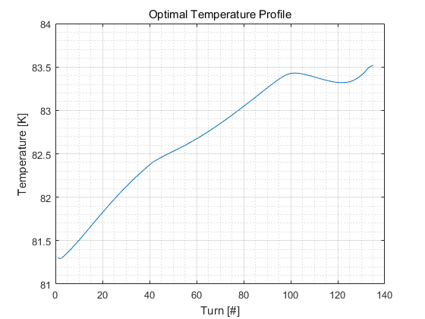




Research on Quench Protection: A Customized Electric Heater to Manipulate Local Critical Current
Key principle: Creation of Pre-determined T(r) using Customized Heater (Thermal Eraser)
Customized Heater
$⋅⋅⋅$
$⋅⋅⋅$
HTS pancake coil
Critical Current $I_{c}(r)$
Target Temperature: T(r)
customized heater
Current (A)
Temperature (K)
$I_{c}$ margin
Operating current
Operating temperature
Turn (#)
Turn (#)
ISDM02-2023, Novel quench detection and localization methods, Friday, April 28
J. Bang (jbang@asc.magnet.fsu.edu)
12/20

Slide 13
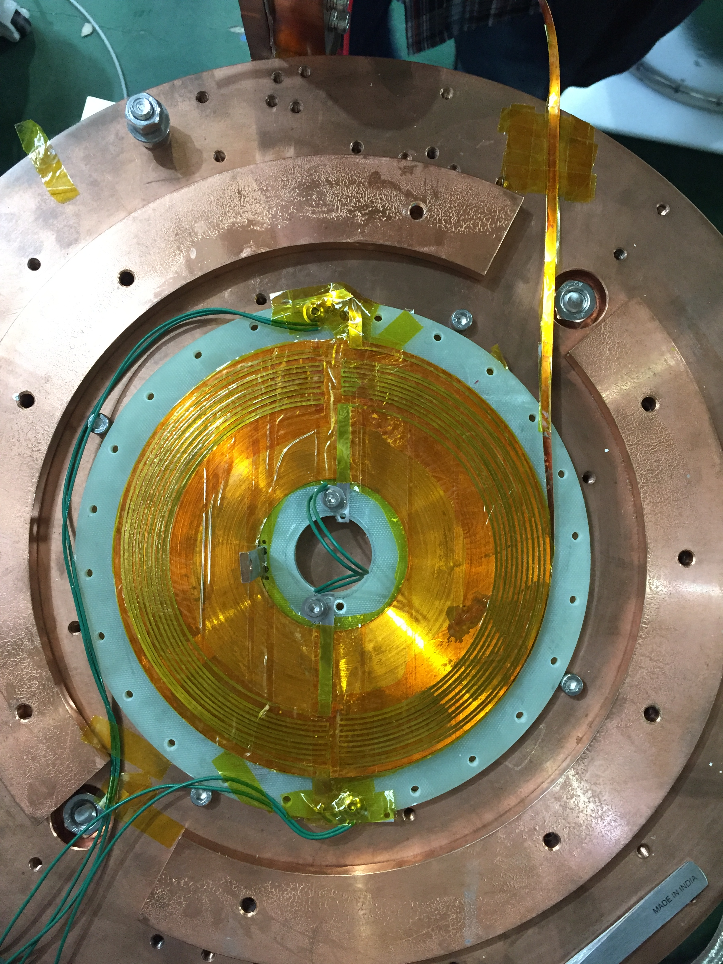
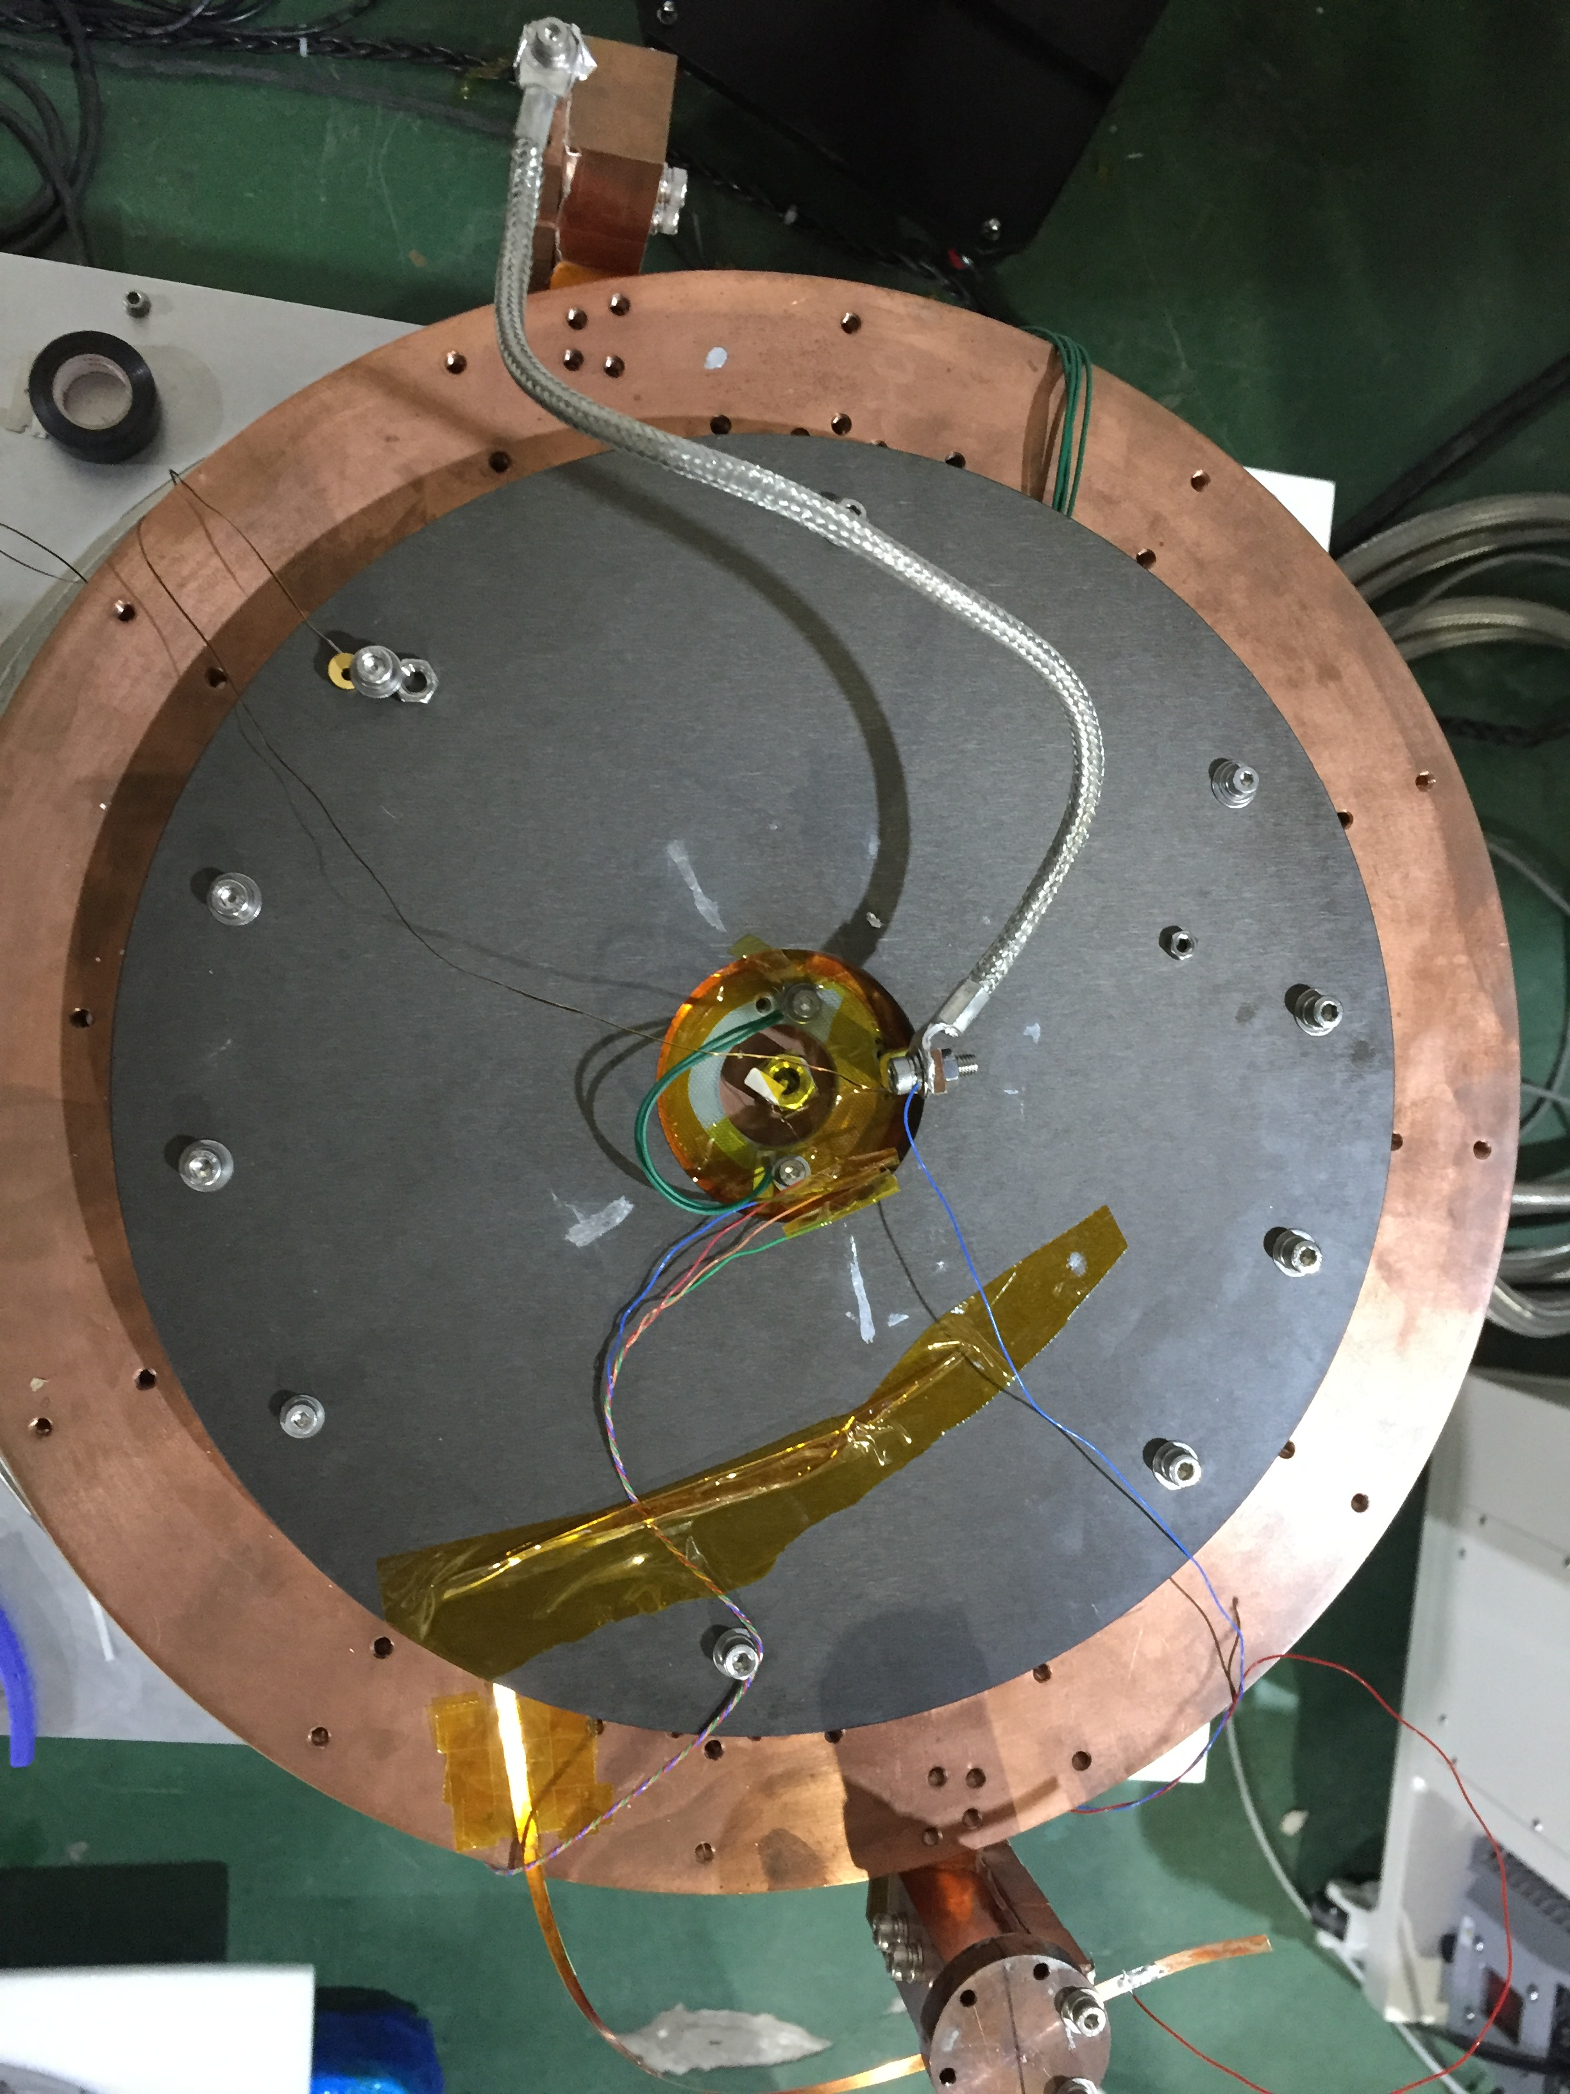
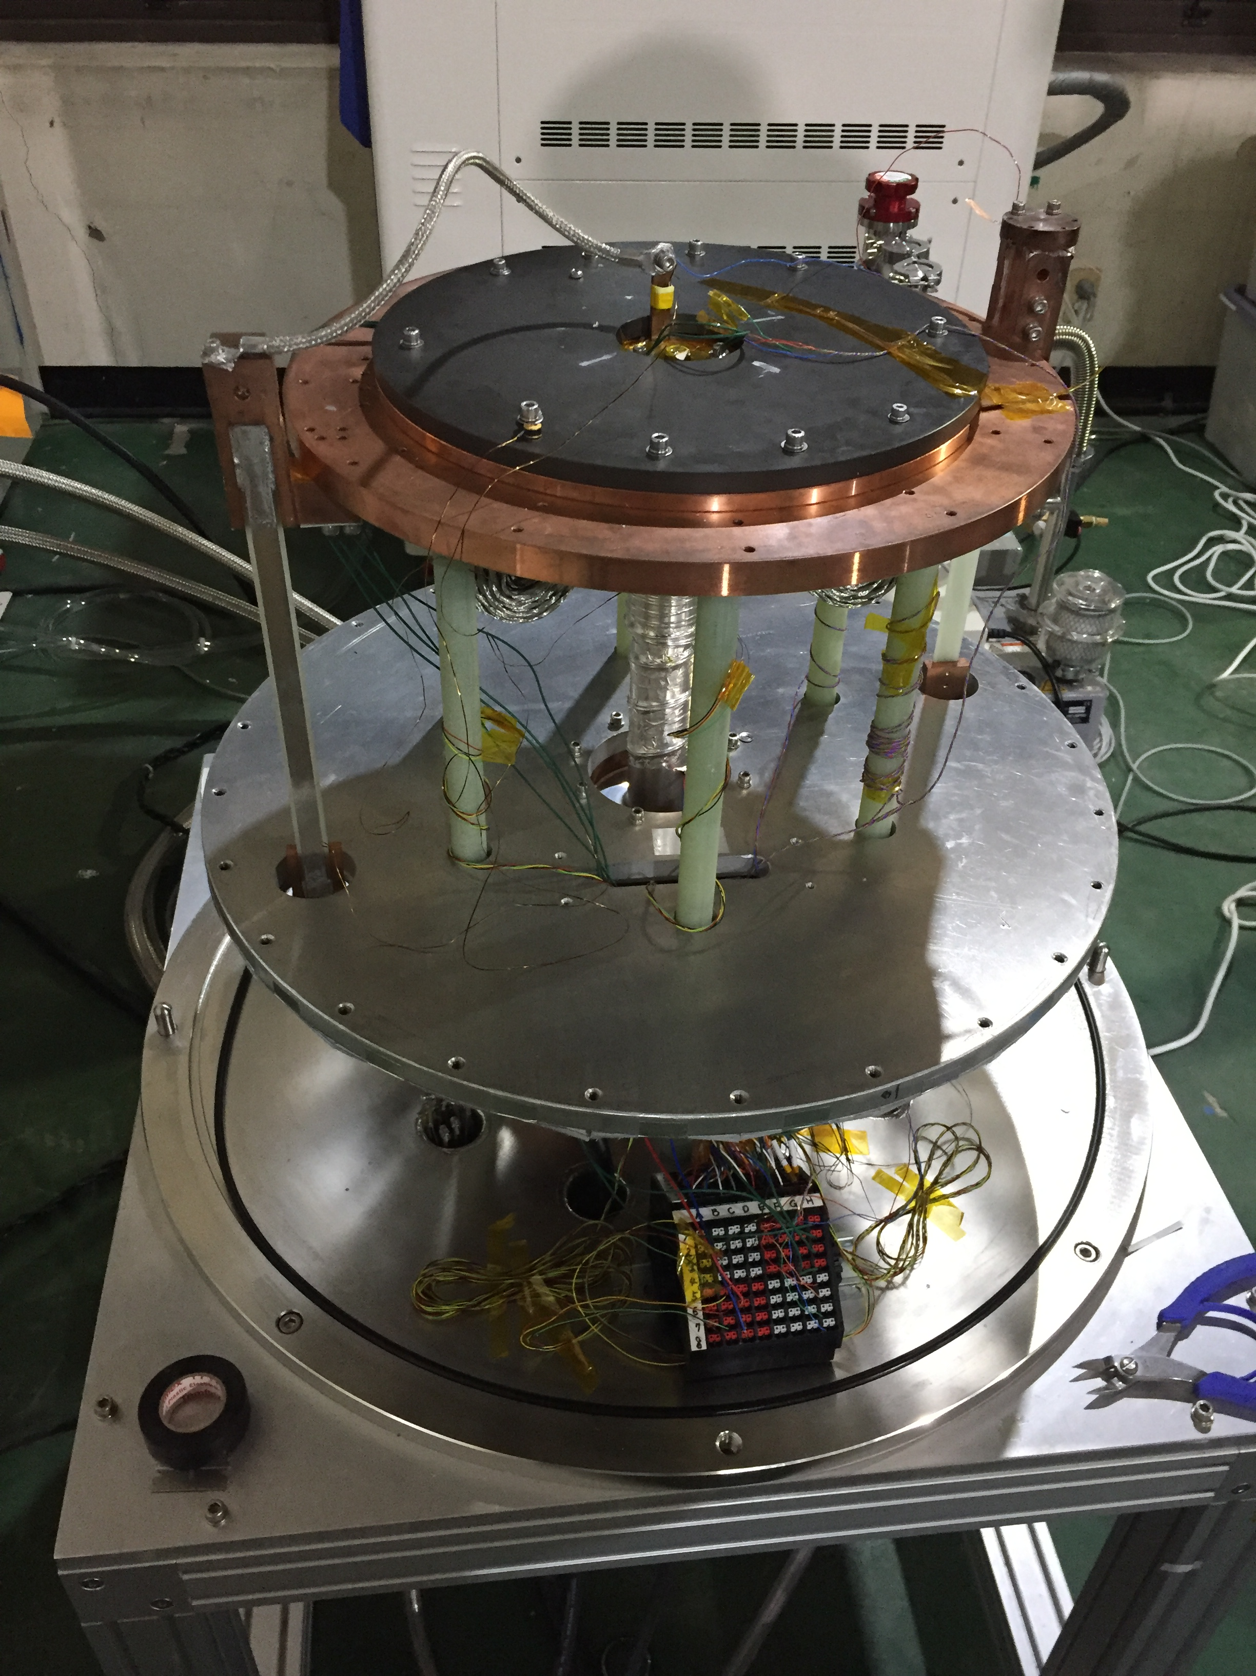
Instrumentation and Test Apparatus with an In-house Conduction-Cooling System
Test Coil and Thermal Eraser
Instrumentation
Final Assembly
Thermal Eraser
Hall sensor
Temp.
sensor
Heater current
ISDM02-2023, Novel quench detection and localization methods, Friday, April 28
J. Bang (jbang@asc.magnet.fsu.edu)
13/20

Slide 14
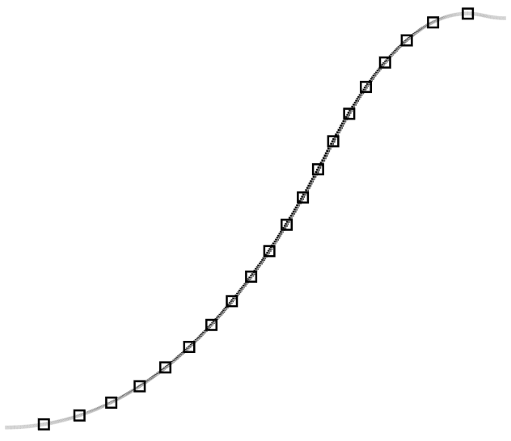
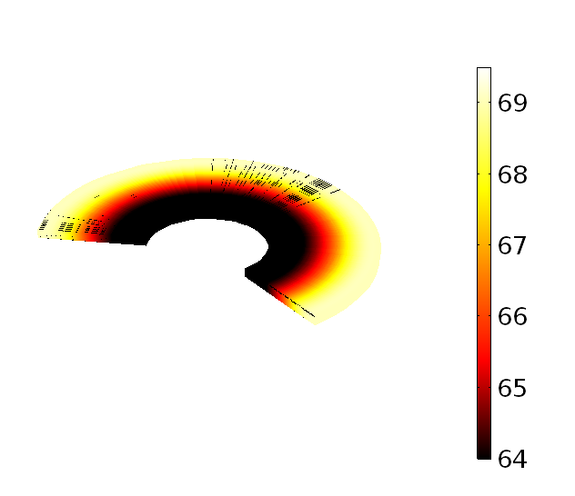
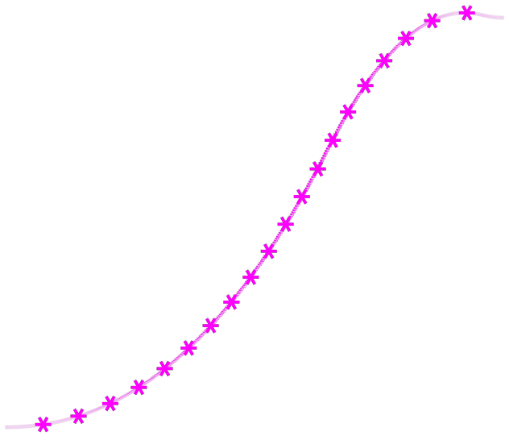
Feasibility Demonstration Test: Reasonable Agreement in 𝑻(𝒓) Patterns; Errors in Magnitude
  Spatially Distributed Temperatures
  Final (measured) Temperature in Test Coil
71
Target temperature
70
69
68
Temperature (K)
67
Temperature (K)
66
65
Measured temperature
The first turn
64
0
100
200
300
400
Turn (#)
The last turn
ISDM02-2023, Novel quench detection and localization methods, Friday, April 28
J. Bang (jbang@asc.magnet.fsu.edu)
14/20

Slide 15
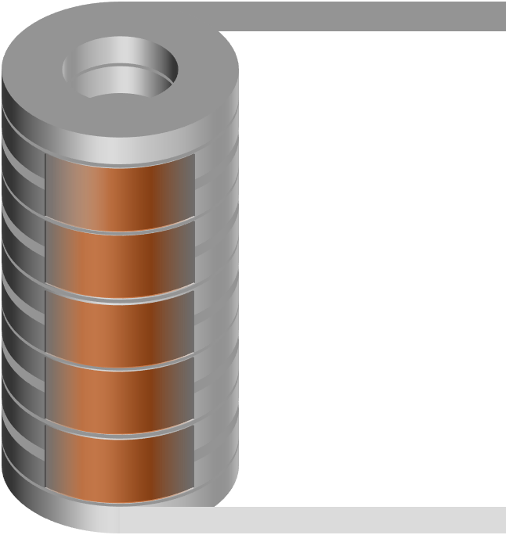
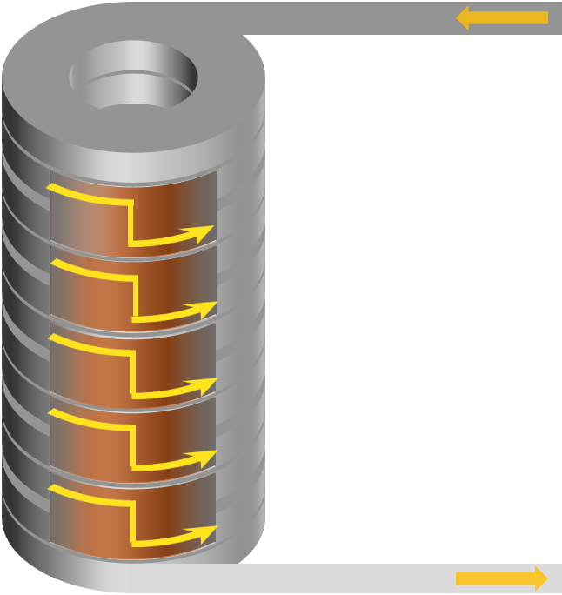
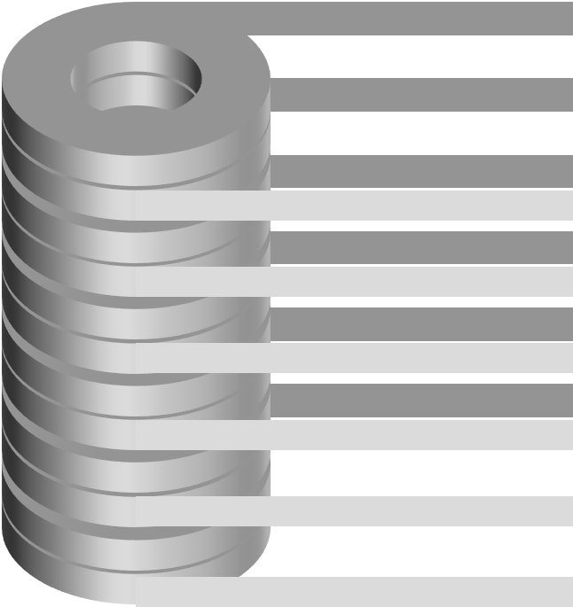
Research on Quench Imitation: Preliminary Study with A Stack of HTS Coils Connected in Parallel
Conventional coil connection: series
Proposed coil connection: parallel
Ref. Joint
Current lead (in)
DP 1
DP 2
Joint 1
DP 3
Joint 2
DP 4
Joint 3
DP 5
Joint 4
DP 6
Joint 5
Current lead (out)
A reference joint resistance of each coil should be measured at preliminary tests (to be used for coil current measurement).
What can we demonstrate?
Current bypassing between coils (like no-insulation feature between winding turns), degree of freedom to manipulate coil current in a given coil stack, and feasibility of quench imitation.
ISDM02-2023, Novel quench detection and localization methods, Friday, April 28
J. Bang (jbang@asc.magnet.fsu.edu)
15/20

Slide 16
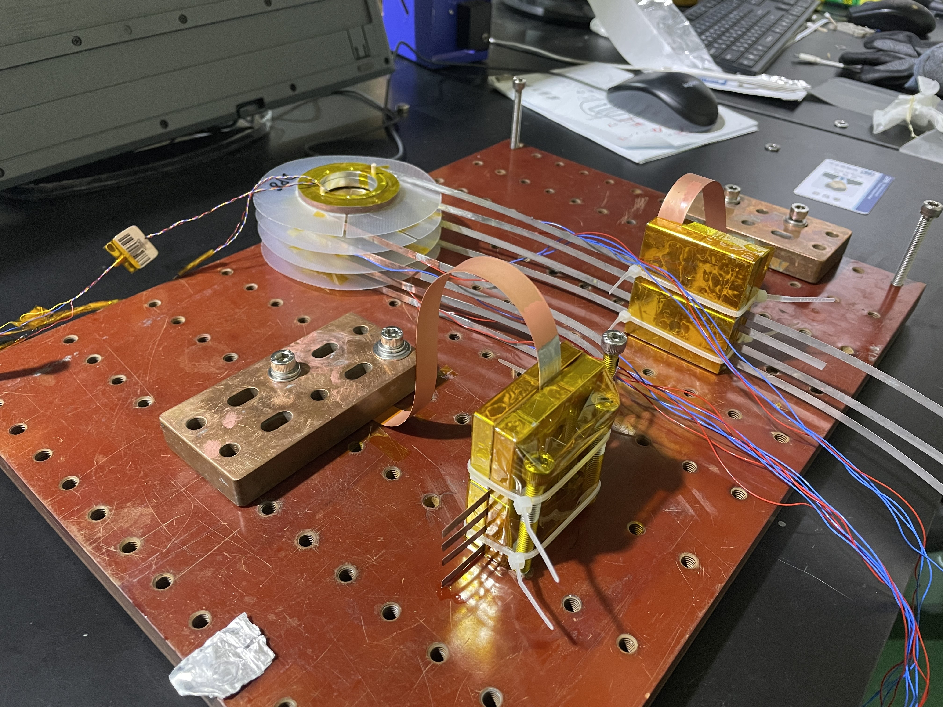
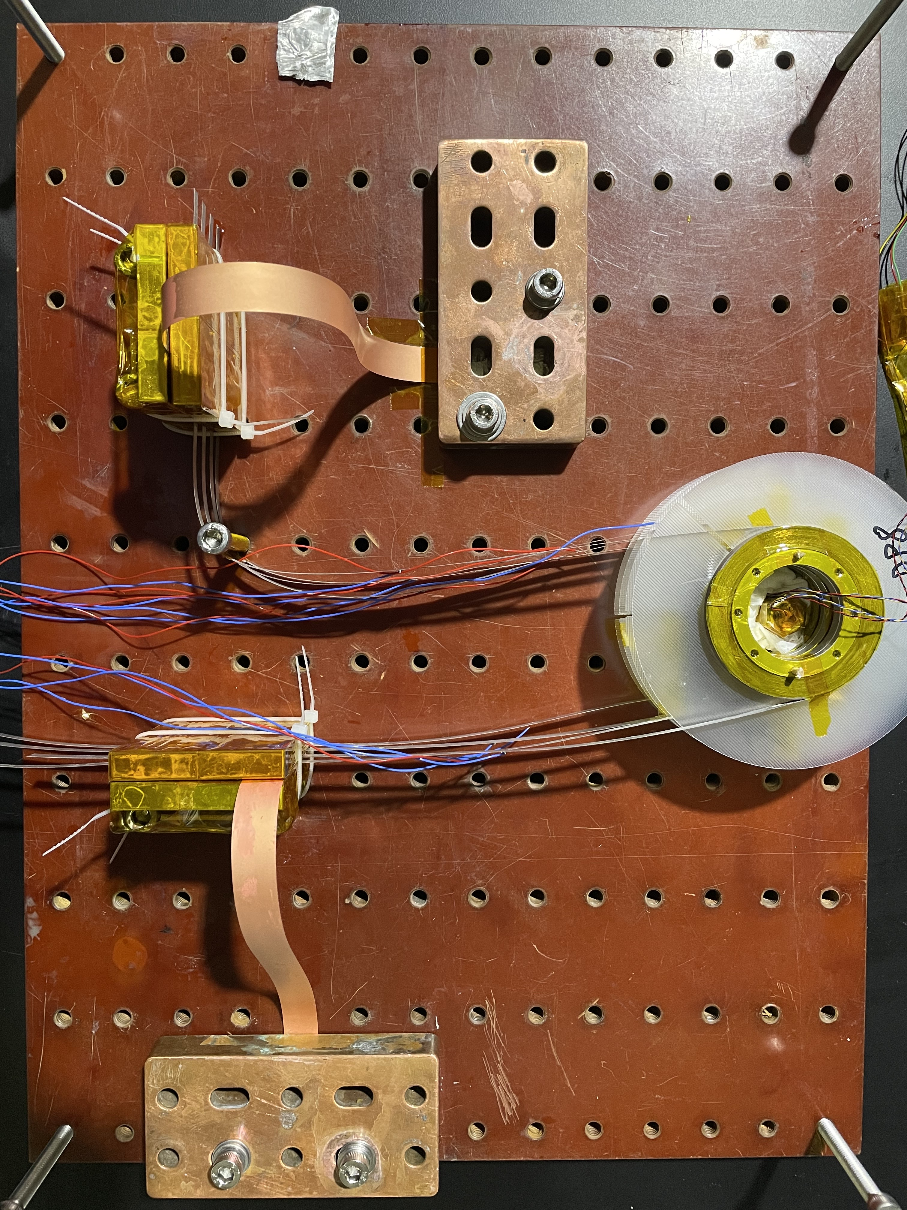


Experimental Set-up of A Parallel-connected HTS Magnet
Ref. Joints
(intentionally inserted)
Ref. Joints
Each coil current lead (in)
Joints (coil$↔$lead)
Coil 1
Coil 2
Current Lead (in)
Coil 3
Coil 4
Each coil current lead (out)
Superconductor current lead (in/out)
Current Lead (out)
Joints (coil$↔$lead)
Superconductor current lead (out)
ISDM02-2023, Novel quench detection and localization methods, Friday, April 28
J. Bang (jbang@asc.magnet.fsu.edu)
16/20

Slide 17
Measurement Results: Non-linear Current and Voltage Behaviors of Individual Coils
[ref] J. Bang et al., “An HTS magnet with individually controllable coil currents energized by a single power source,” IEEE Trans. Appl. Supercond., vol. 32, no. 4, Jun. 2022, Art. no. 4603005.
Automatic current bypassing
(measured by a Ref. joint of each coil)
Feasibility to manipulate coil currents so that to imitate quench confirmed.
Ultimately, we will open a coil in a stack of coils in high fields, and then we will measure I, V, and B.
ISDM02-2023, Novel quench detection and localization methods, Friday, April 28
J. Bang (jbang@asc.magnet.fsu.edu)
17/20

Slide 18
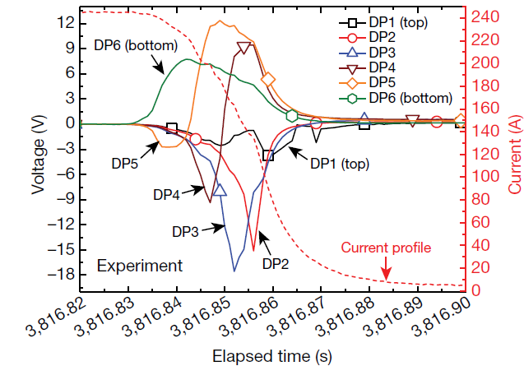
Research on Quench Simulation: FEM-based Model Development for LBC Quench Analysis
[Conventional] Circuit simulation: Electromagnetics + Thermodynamics coupled
Mea.
Cal.
[ref] S. Hahn et al., “45.5-Tesla direct-current magnetic field generated with a high-temperature superconducting magnet,” Nature, vol. 570, no. 7762, pp. 496–499, 2019
FEM simulation: Electromagnetics + Thermodynamics + Solid-Mechanics coupled (in progress)
  Field/strain/temperature-dependent critical current
  Screening current and the consequent effects
  Field/temperature-dependent contact resistance
To be presented at MT28 Conference in detail:
High Field Magnets - HTS Magnets (3PoA06) session,3PoA06-02, 2023-09-13 14:30 ~ 16:30.
ISDM02-2023, Novel quench detection and localization methods, Friday, April 28
J. Bang (jbang@asc.magnet.fsu.edu)
18/20

Slide 19
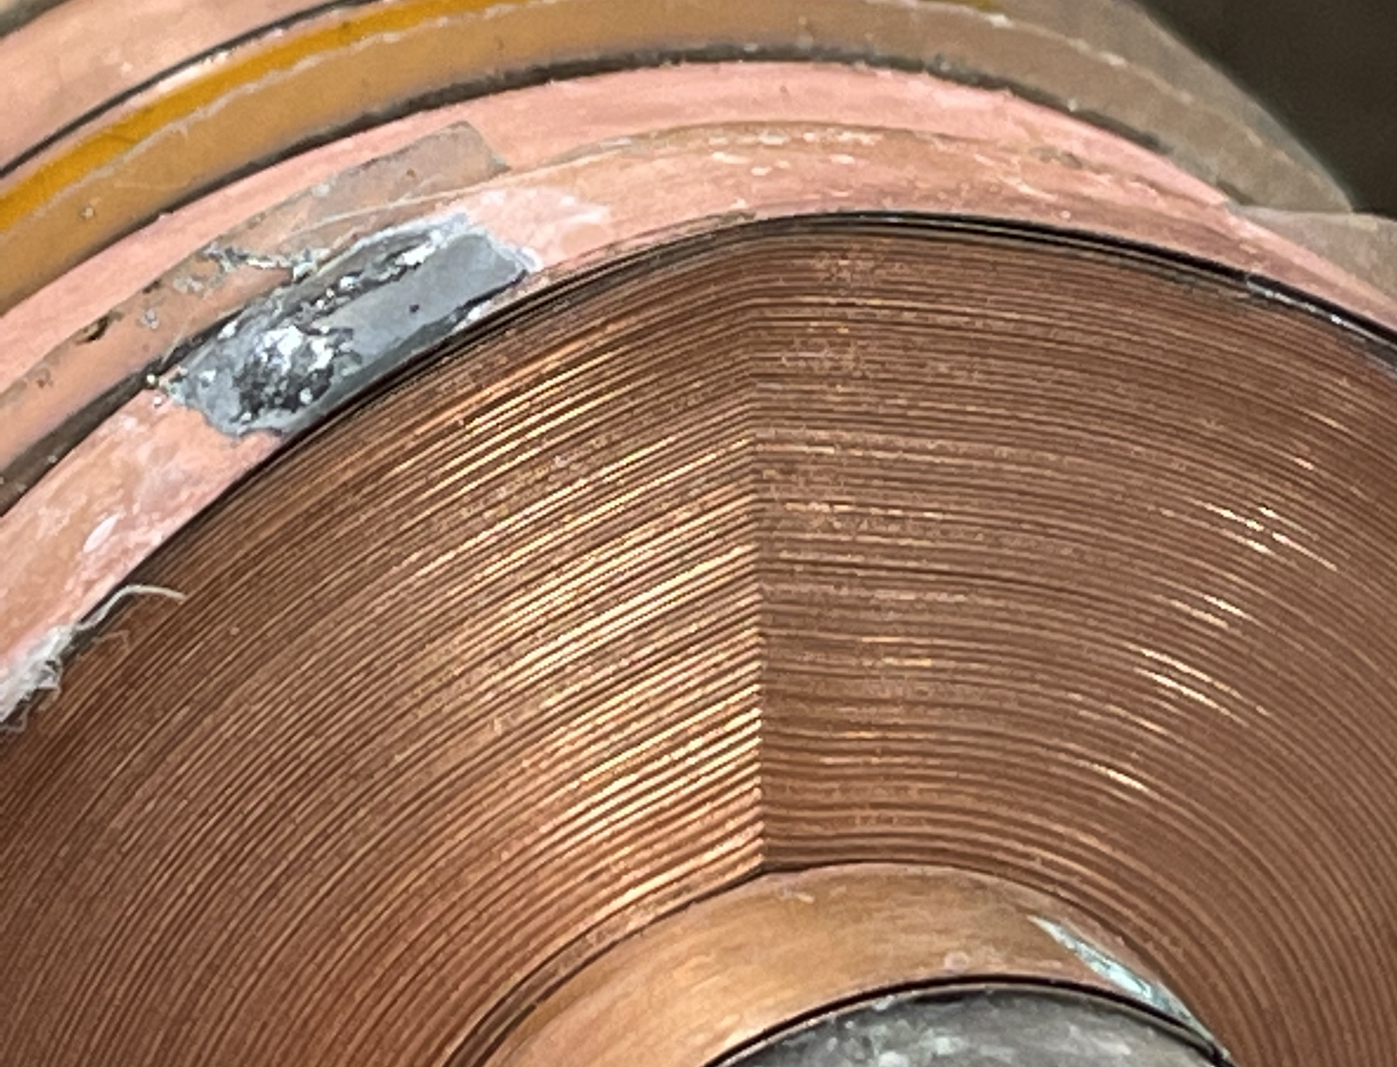
Discussion and Conclusion: What We Need More?
Can we define what quench is or when the quench starts in terms of “voltage”?
  → Is the critical electric field of 0.1 or 1 $μV/cm$ indeed “practical” for discussion on quench?
Can we measure local voltages or temperatures without using voltage taps insertion?
  →Voltage taps can cause “kinks” in HTS coil exposed to high fields.
Can we detect quench with acoustic sensors and waveguides?
  →Is it possible to attach the sensors on coils in a limited (small) bore?
Kinks
Can we make an instrument to address/measure local heat dissipation in high fields?
  →Helium gas bubbles trapped in liquid helium in a high magnetic field can accelerate local temperature rise, thermal runaway, and the consequent quench.
[ref] H. Bai, S. T. Hannahs, W. D. Markiewicz, and H. W. Weijers, “Helium gas bubble trapped in liquid helium in high magnetic field,” Appl. Phys. Lett., vol. 104, no. 13, Mar. 2014, Art. no. 133511.
Can we do reach 50 T with a superconducting magnet?
  →We can do it based on NI HTS and instrumentation/diagnostics technologies!
ISDM02-2023, Novel quench detection and localization methods, Friday, April 28
J. Bang (jbang@asc.magnet.fsu.edu)
19/20

Slide 20
Thank you
Q&A
ISDM02-2023, Novel quench detection and localization methods, Friday, April 28
J. Bang (jbang@asc.magnet.fsu.edu)
20/20

