Slide 1
MEMS Microphones for Quench Detection in Fusion Cables
Peter Moore
M. Takayasu, L. Chiesa, R. White, M. Emerling, A. Desai
2nd Workshop on Instrumentation & Diagnostics
for Superconducting Magnets
April 28, 2023

Slide 2
Acoustic Quench Detection for HTS and fusion – why?
HTS has much lower normal zone propagation velocity than LTS: quenches involve localized temperature excursions
Challenges for voltage detection: small normal zone → small voltage signal and localized heating, in magnetic fusion reactors inductive voltages in conductors give false signals
Voltage taps & other diagnostic systems can also dramatically increase complexity and be sources of damaging events
Fiber optic sensors are sensitive to temperature excursions, but also sensitive to changes in strain
Thermal stress-induced acoustic emission may not be easily applied to cables and non-impregnated coils
Redundant quench detection systems based on different physics is desirable

Slide 3
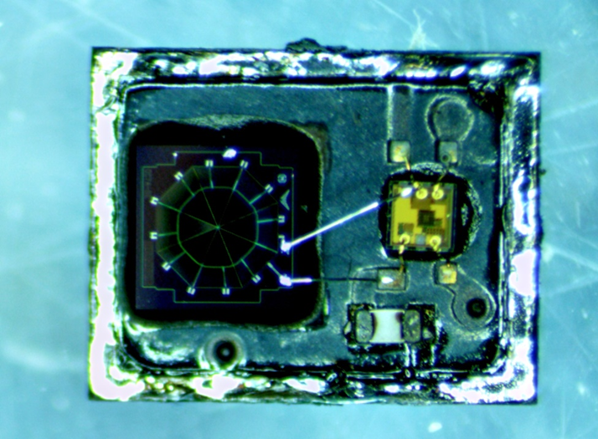
Our approach
Heat created by a quench vaporizes liquid coolant and expands gaseous coolant, creating pressure waves that can be picked up by microphone
Acoustic waves travel very quickly through coolant (~3 orders of magnitude faster than quench)
OUR APPROACH: use of a linear array of inexpensive MEMS (Micro-Electro-Mechanical System) microphones inside the coolant channel of a Cable-in-Conduit Conductor (CICC) to detect and localize quench through the detection of acoustic pressure waves
Sensors must operate at desired temperatures ~20 K
MEMS Mic
ASIC Preamp
1 mm
L = 1 m → t < 2 ms (He gas)
t < 0.5 ms (LN₂)
M. Takayasu, 2020

Slide 4
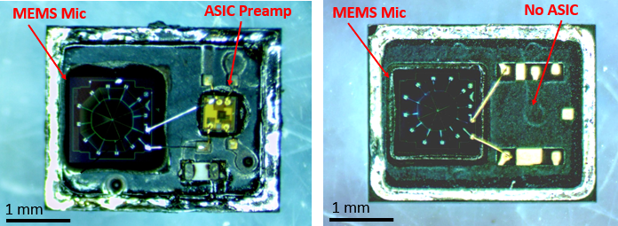
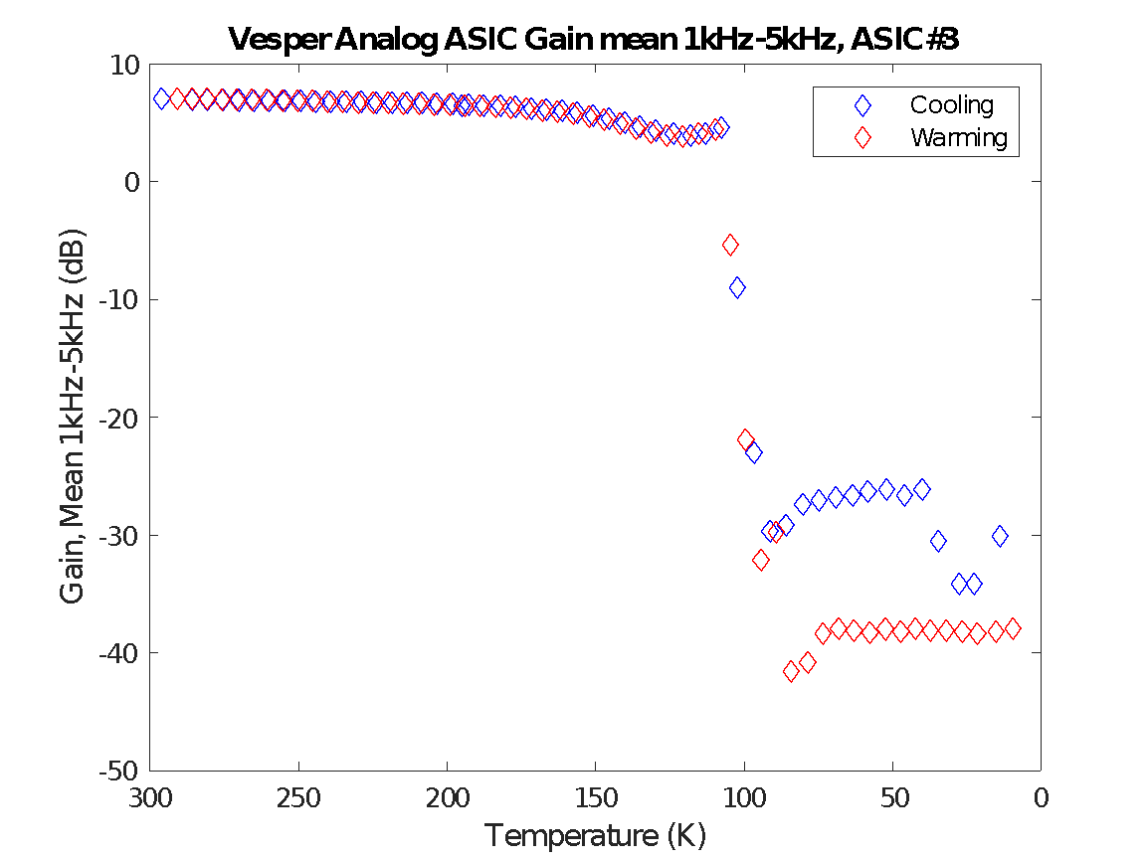
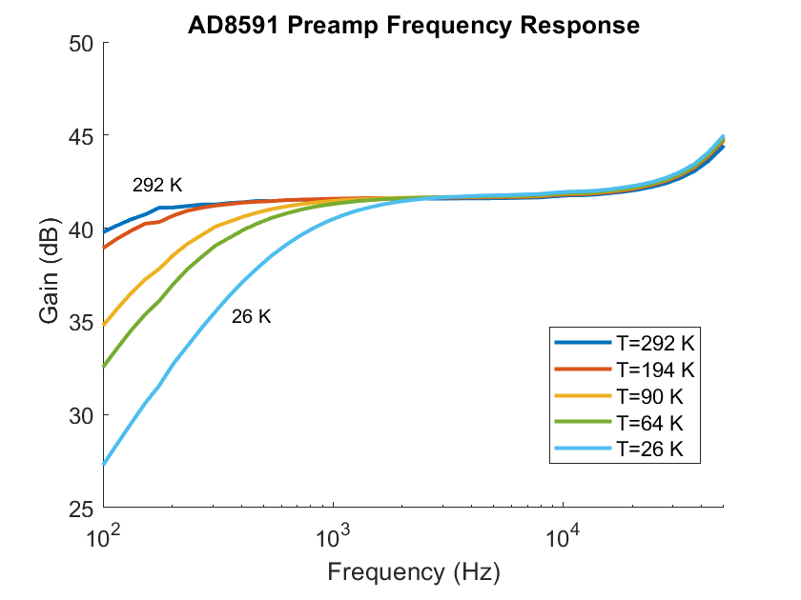
MEMS microphones at low temperature
MEMS microphones like Vesper VM1000 typically include an ASIC (application specific integrated circuit) for amplification.
A high input-impedance preamplifier is needed near MEMS sensor to boost the small charge signal
After testing different compact preamps, we settled on AD8591 op-amp and integrated into custom PCB
U-Sound UT-P2017 MEMS speaker was also used successfully as a low-temperature microphone
Amplifier | Test Temperature | Result
Low Input Impedance:
OPA344 | 60 K | Fails below 230 K
LMH6629 | 60 K | OK down to < 60 K
High Input Impedance:
LT1464 | 18.7 K | Fails below ~90 K
AD8591 | 8.6 K | OK down to < 8.6 K
AD8057 | 14.4 K | Fails below ~55 K
AD8628 | 14.4 K | OK down to < 14.4 K
AD8065 | 17.7 K | Fails below ~80 K
Vesper ASIC | 9.6 K | Fails below ~110 K
Vesper ASIC gain vs temperature
AD8591 Preamp frequency response

Slide 5
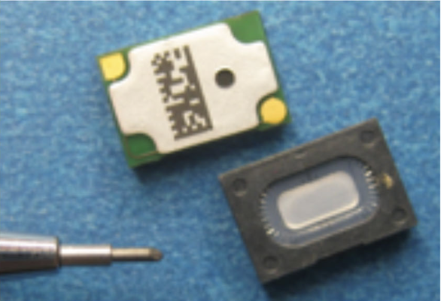
Custom MEMS boards
U-Sound UT-P2017 MEMS Microphone
Tested as a MEMS piezo-sensor microphone without preamplifier
Not as sensitive to small pressure pulses as VM1000 with preamps
Inexpensive and robust
Vesper provided MEMS microphone with the built-in preamp removed
Custom boards with two AD8591 op-amps that were tested down to 9 K
Each board can be daisy-chained into a linear array using flex cables
6 independent analog channels available.
In the final application, these can be used with a resistive ladder configuration to provide unambiguous signaling from 2⁶ -1 = 63 elements
Vesper MEMS (no ASIC)
AD8591 opamps
FFC connector
2.95 mm
42.9 mm
5.52 mm

Slide 6
Testing overview
1.
1. Quench testing a single REBCO tape in LN₂ using U-Sound MEMS speaker as microphone
2. Quench testing stacked-tape cable in stagnant and flowing subcooled LN₂ using custom MEMS boards
3. Quench testing single REBCO tape in He gas between 30 K and 60 K using custom MEMS boards
He pressure pulses
Non-destructive quench
Destructive quench
Copper cable control test
2.
3.

Slide 7
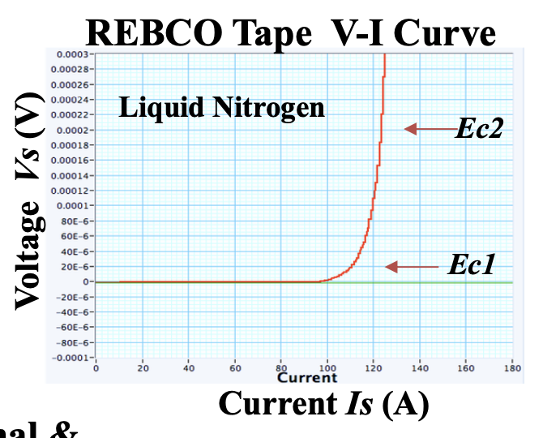
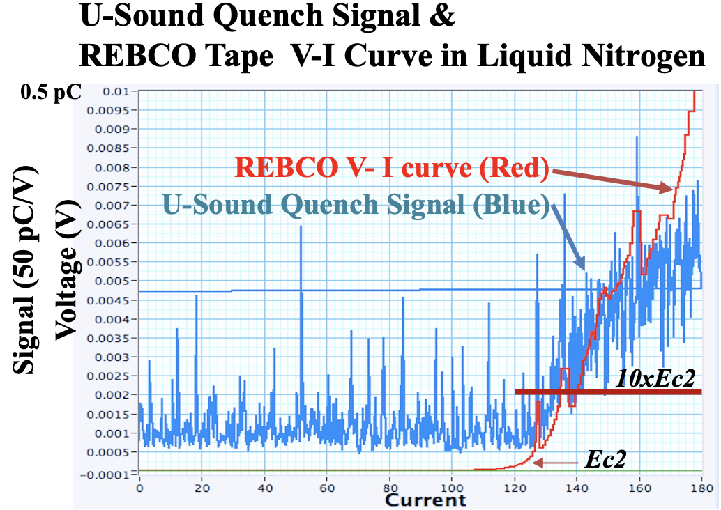
1. Quench test on single REBCO tape in LN₂
Ec1 = 1 μV/cm
Ec2 = 10 μV/cm

Slide 8
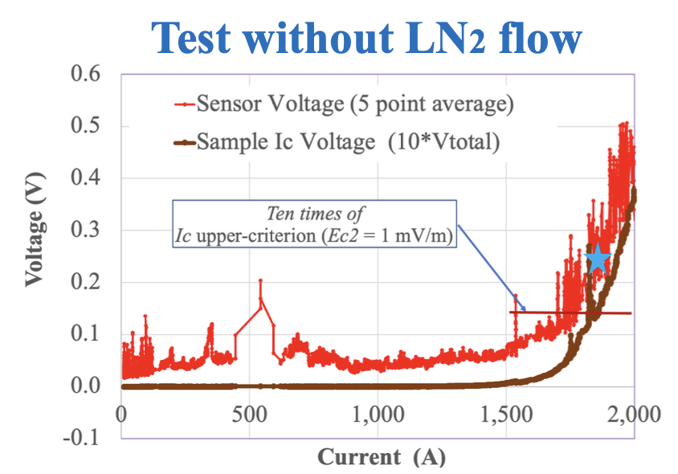
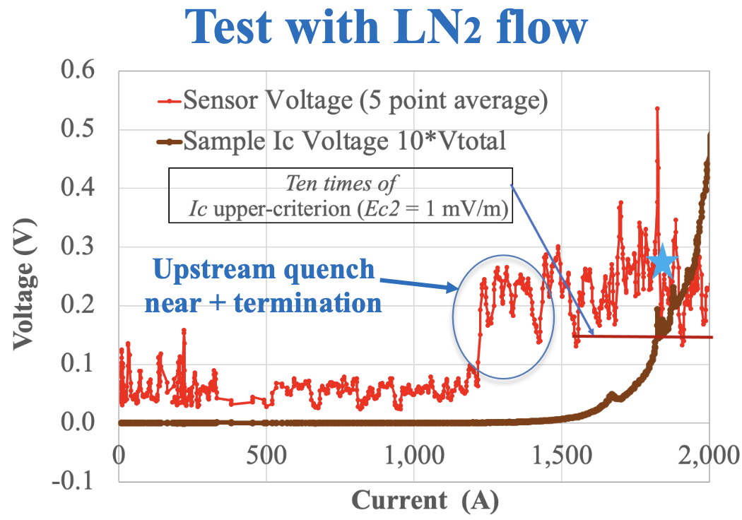
2. Quench test on REBCO stacked-tape Cable in LN₂
32 tapes – 4 mm SuperPower
2 m long
Voltage tap: 1.68 m

Slide 9
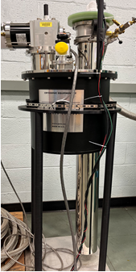
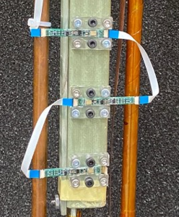
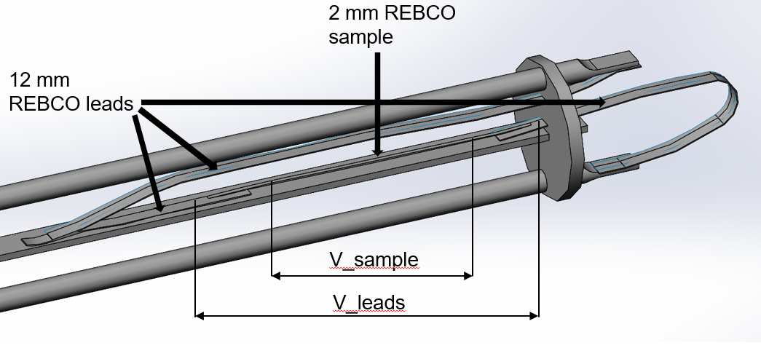
3. Quench test probe in He gas (27 K – 60 K)
Sample is a 2 mm wide REBCO tape (SuperPower). Voltage monitored over 10 cm
Sample is mounted inside a G10 tube on which 6 MEMS sensors are mounted
MEMS connected together with non-shielded ribbon cables and consumed ~7 mW of power each from external supply
Two-stage Gifford- McMahon cryocooler filled with gaseous helium
Custom probe designed for measuring HTS quench acoustics

Slide 10
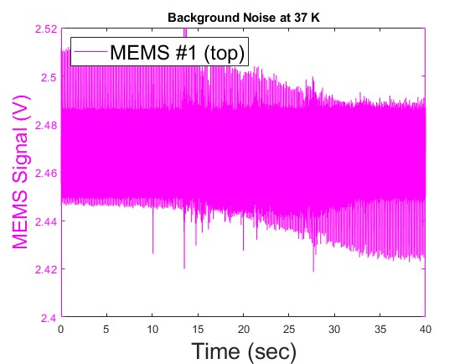
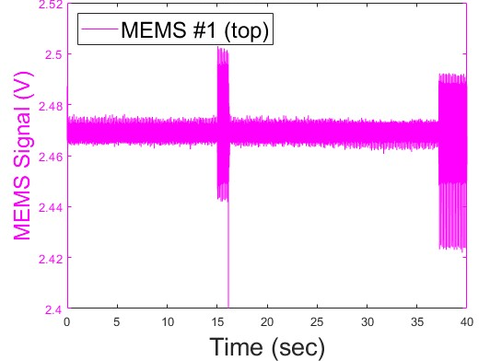
Challenges with He gas testing at 30 K - 50 K
Temperature distribution: copper current leads conduct heat into cryochamber setting up temperature gradient and leading to issues with upper HTS current lead burning
Low temperature → high critical current → small sample (2 mm width) necessary due to power supply limits but small sample burns very easily ending the test
Current ramps must be quick because cryocooler is turned off reducing noise and current leads heat up quickly
Noise in MEMS signals: isolating sources of noise and grounding the necessary components
Cu rods floating
Cu rods grounded
T = 37 K
Sampling frequency: 150 kHz
Grounding connection was broken

Slide 11
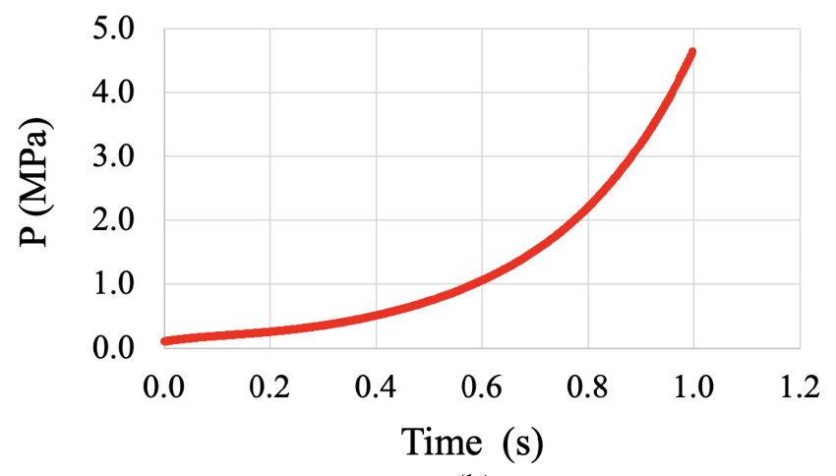
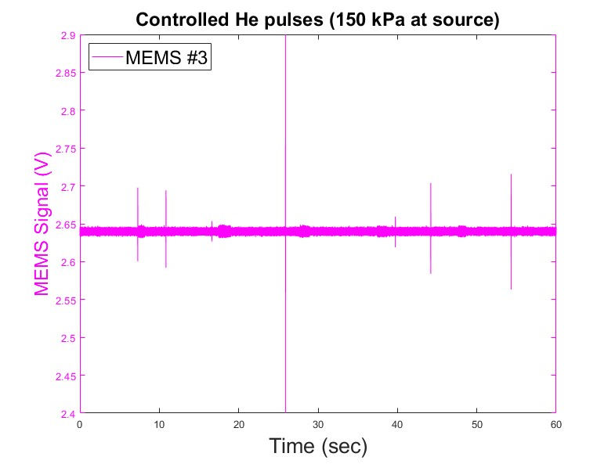
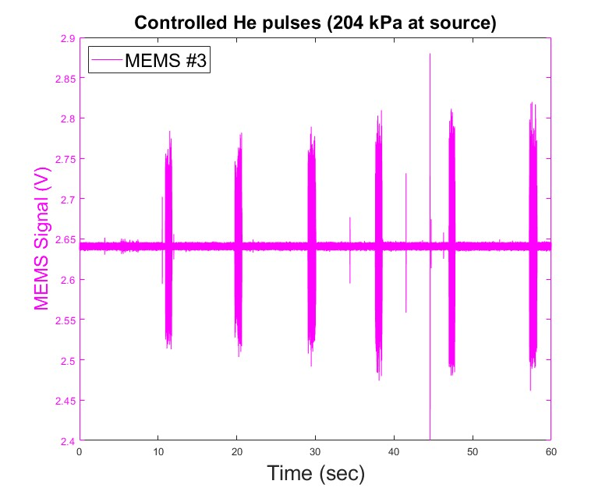
He pressure pulse sensitivity testing:
Coolant pressure vs time for 20 kA quench of REBCO cable: analytical model
Routed tube from He tank directly into sample tube between MEMS #1 and MEMS#2 to test response to pressure pulses. Pressure inside cryostat was at 120 kPa
M. Takayasu, 2021
Controlled He pulses
Controlled He pulses
The other spikes are of unknown origin

Slide 12
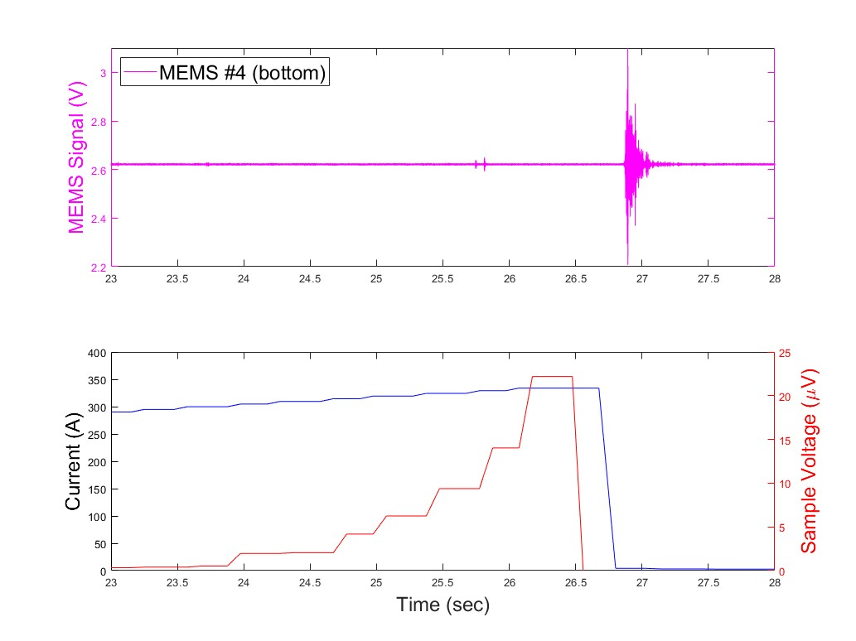
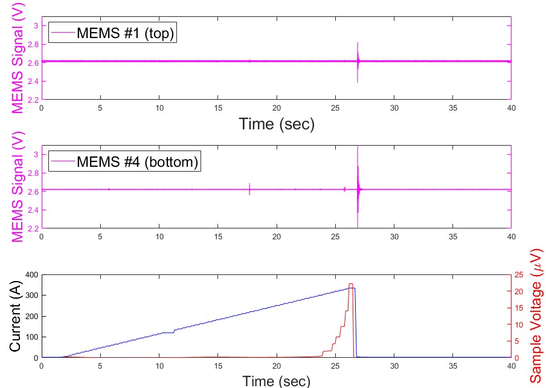
Quench test: non-destructive
E_{c1} = 1 μV/cm → V_{c1} = 10 μV
E_{c2} = 10 μV/cm → V_{c2} = 100 μV
T = 45 K
P = 120 kPa
Heating energy: 7.6 mJ
The MEMS response seems delayed. Nearly simultaneous with current dump.

Slide 13
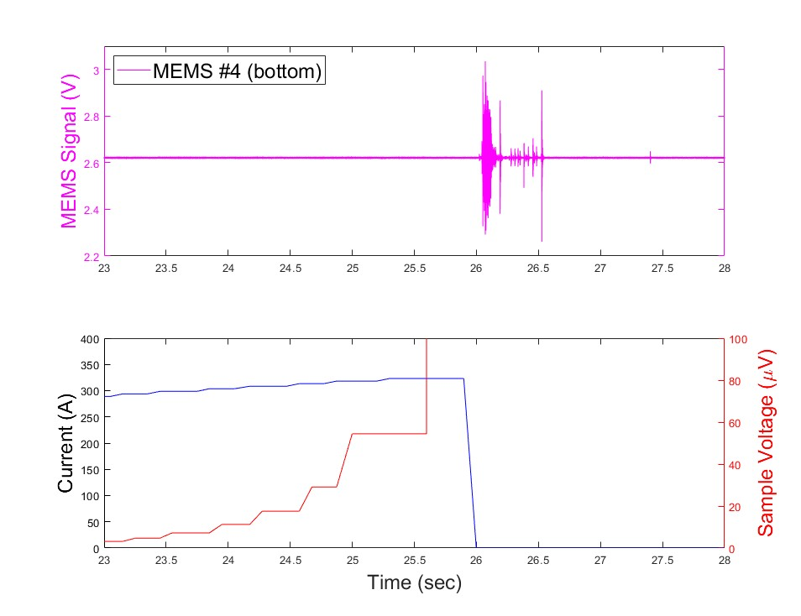
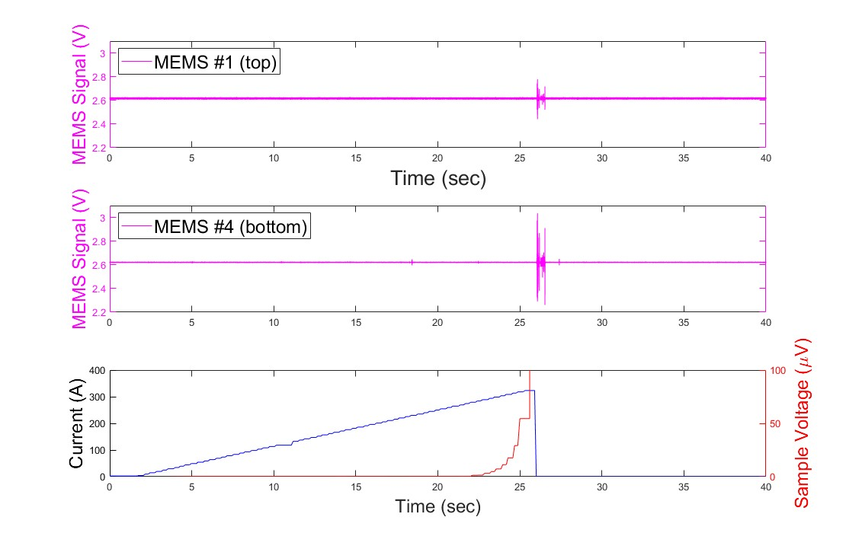
Quench test: destructive
E_{c1} = 1 μV/cm → V_{c1} = 10 μV
E_{c2} = 10 μV/cm → V_{c2} = 100 μV
T = 47 K
P = 120 kPa
Signal is even more delayed when compared to non-destructive quench at 20 μV. Not larger in magnitude but in duration.
Heating energy: 22 J

Slide 14
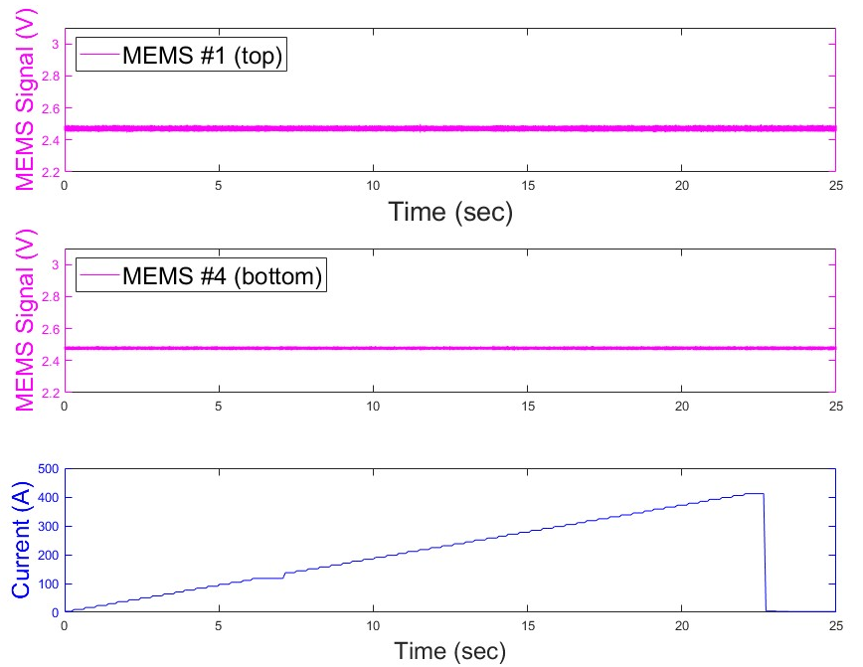
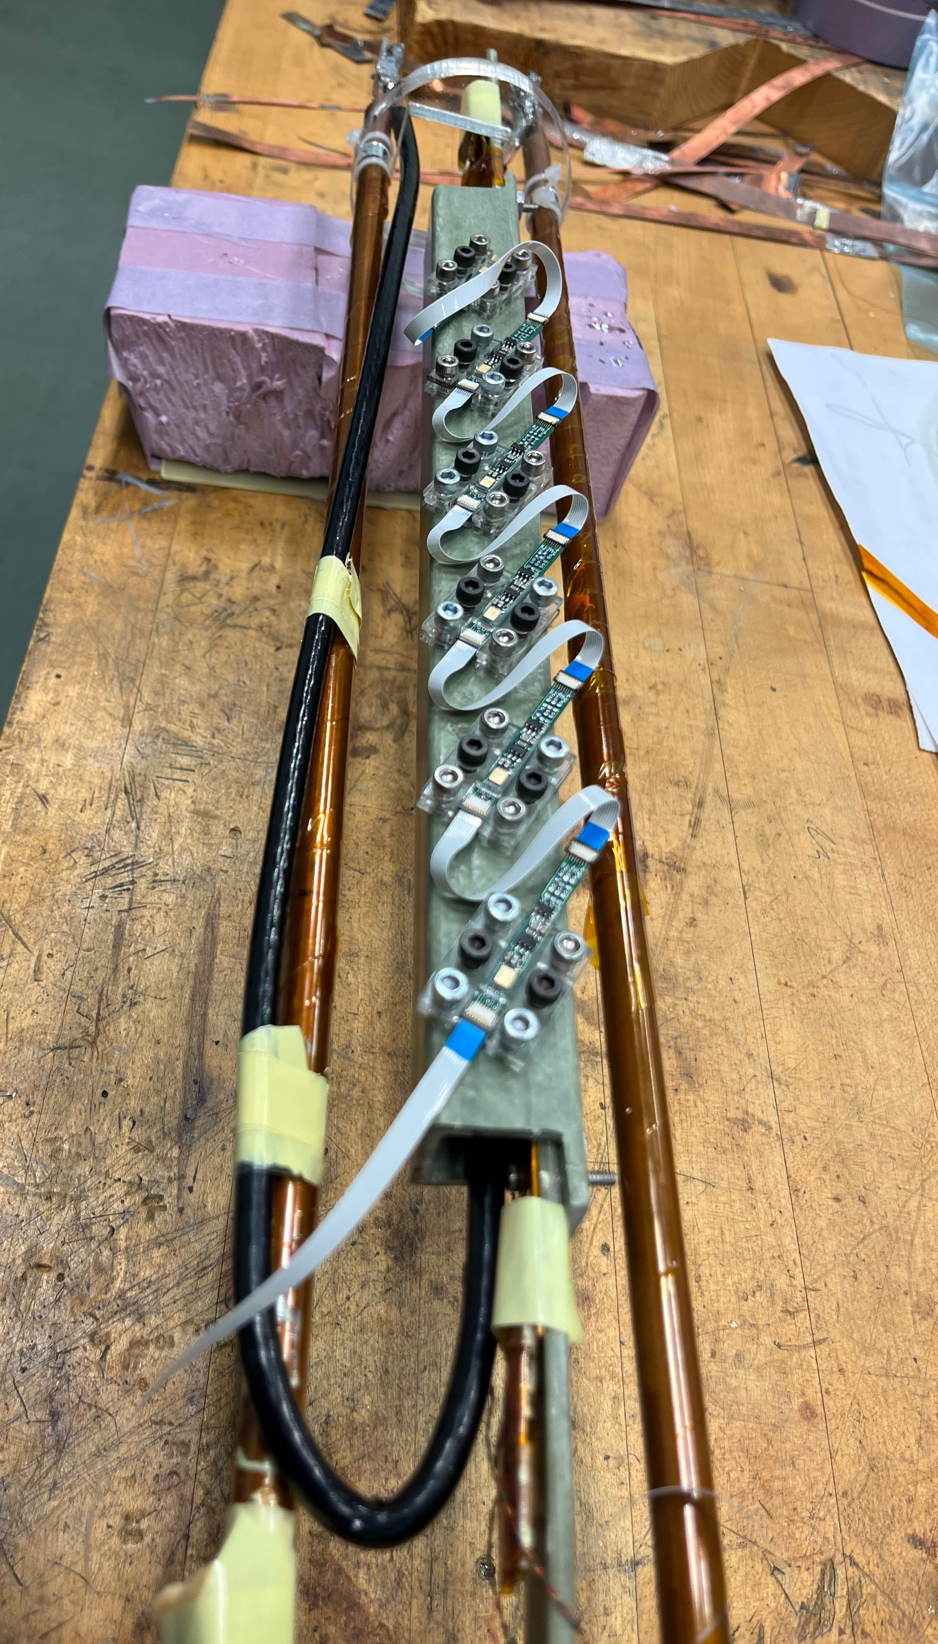
Results from control test with copper cable (no REBCO)
T = 57 K
P = 18.6 kPa
None of these 27 tests showed any MEMS signals correlating with high-current or current dump. Black plastic insulation would not block EM fields.

Slide 15
Conclusion
Our hope is that MEMS sensor arrays can provide low complexity, fast, and sensitive quench detection for HTS magnets
Further development and testing of MEMS sensors is necessary to:
Demonstrate repeatable and unambiguous response to HTS quench onset before damage
Obtain appropriate sensitivity and optimized frequency responses in various mediums for reliable quench detections
Calibrate for signals produced by quench and filter out false signals and noise
Reduce size of MEMS boards to reduce coolant obstruction
Determine requirements for electromagnetic shielding of boards and connectors
Next steps:
Maintain constant current at the transition hopefully without damaging sample
More testing of MEMS sensitivity using controlled energy and pressure pulses
Use those results in combination with quench analytical models or FEA simulations to predict the response time in different cases

