Slide 1
Temperature-based quench detection methods via integrated superconducting wires and thermocouple chains
This work has been carried out within the framework of the EUROfusion Consortium, via the Euratom Research and Training Programme (Grant Agreement No 101052200 — EUROfusion) and funded by the Swiss State Secretariat for Education, Research and Innovation (SERI). Views and opinions expressed are however those of the author(s) only and do not necessarily reflect those of the European Union, the European Commission, or SERI. Neither the European Union nor the European Commission nor SERI can be held responsible for them.
N. Bykovskiy
H. Bajas
D. Uglietti
P. Bruzzone
K. Sedlak
IDSM workshop
April 2023

Slide 2
Outline
Superconducting quench detection wires (SQD)
State of the art
Candidate materials
Experimental demonstration in SULTAN
Further development
Thermocouple chain
Detection concept
First test results
Summary

Slide 3
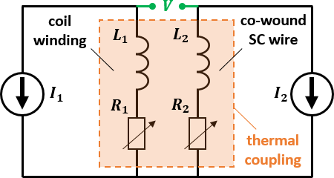
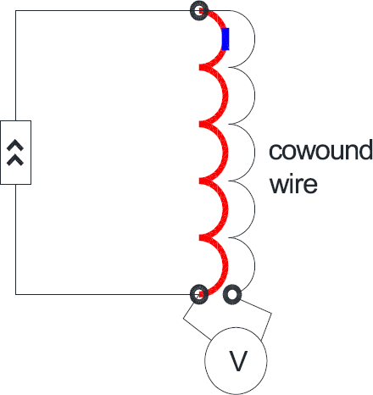
Superconducting quench detection wires (SQD)
https://doi.org/10.1109/TPS.2022.3212554
$$R$$
electrically insulated from the main conductor
Electrically insulated from the main conductor, thus operated independently at current $I_{2}$,
In thermal contact with the main conductor: $T_{1} (x)≈T_{2}\left(x\right)$
$V={V_{R}}_{2}−{V_{R}}_{1}+{V_{L}}_{2}−{V_{L}}_{1}≈{V_{R}}_{2}(≫V_{R_{1}})$, assuming
$T_{c}\left(B_{max}\right)$ of detection wire $>$ T quench,
High voltage along normal zone of the wire due to the absence of low resistivity protection material (copper or silver), and eventually higher operating current ($I_{2}$).
$$V=V_{R}+{V_{L}}_{2}−{V_{L}}_{1}≈V_{R}$$
Inductive compensation is not perfect
Slow rise of resistive component in HTS
→ How to improve detection sensitivity?

Slide 4
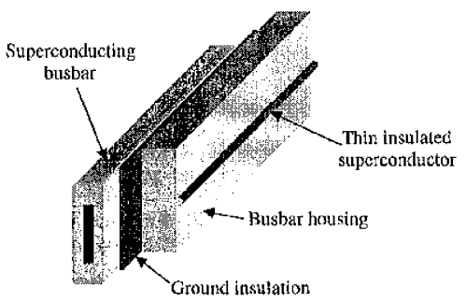
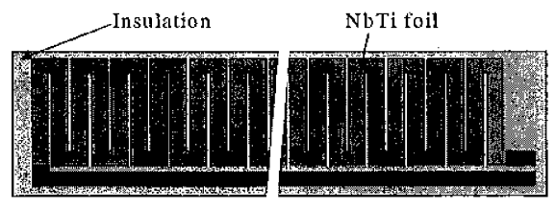
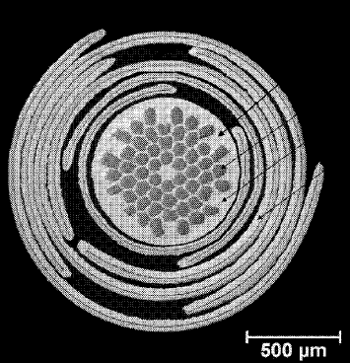
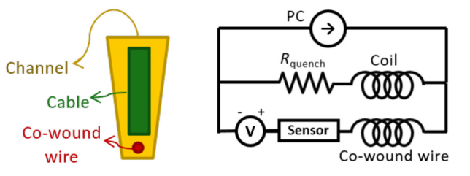
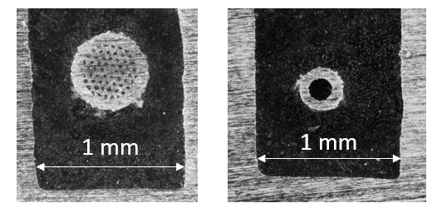
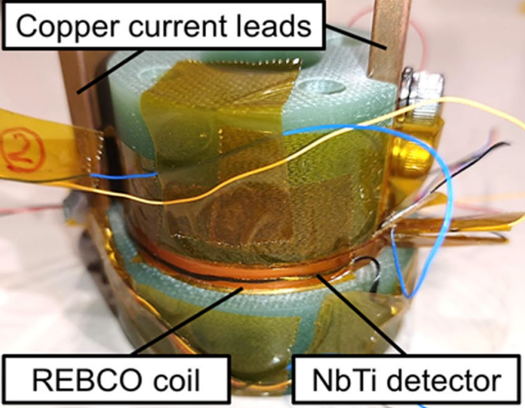
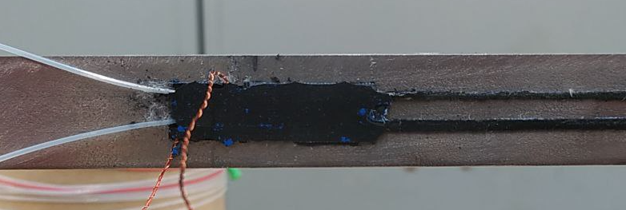
Background
Year | Application | SQD type
2000, 2014 10.1109/77.828253 10.1109/TASC.2013.2286813 | Detector magnets | Nb-Ti wire or foil
2016, 2021 https://cds.cern.ch/record/2228249/files/CERN-THESIS-2016-142.pdf https://patents.google.com/patent/WO2021173216A1 | HTS cables | LTS wires
2019 10.1109/TASC.2019.2900633 | HTS pancakes | Nb-Ti wire
2021 10.1109/TASC.2021.3059602 | CCT coils | Nb₃Sn wire
2022 https://doi.org/10.1109/TASC.2022.3171185 | General | LTS wires
2022, 2023 (this work) https://doi.org/10.1109/TASC.2022.3140706 https://iopscience.iop.org/article/10.1088/1361-6668/acb17b | Fusion conductors | Nb₃Sn, MgB₂, IBS wires

Slide 5
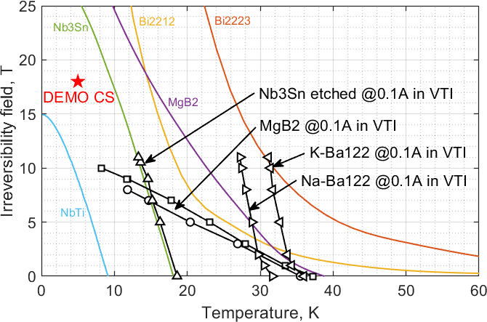
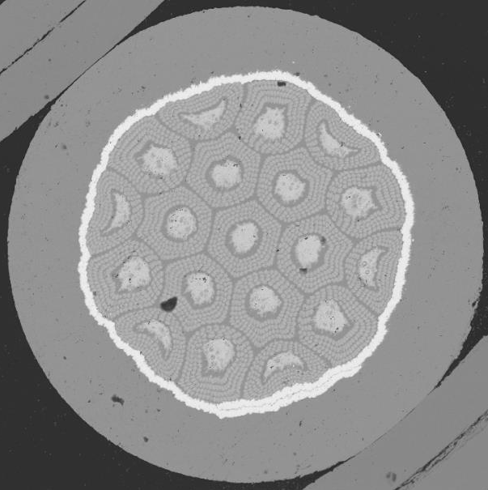
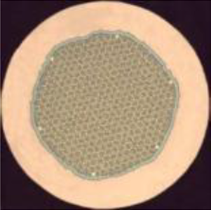
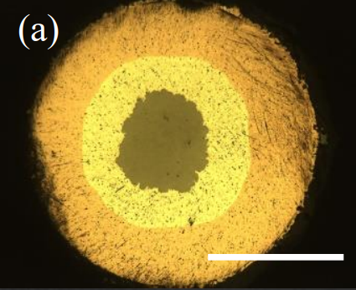
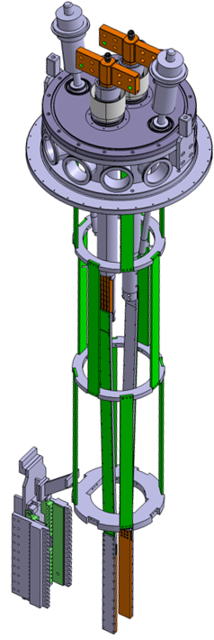
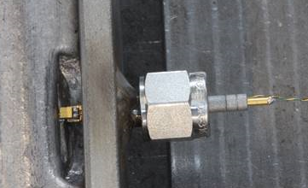
SQD wires: material selection for fusion conductors
MgB2 wires (not doped)
Nb3Sn wires
Iron-based SC wires
Measurements in VTI insert :
Cu-Ni matrix
0.5 mm
SS matrix
0.3 mm
Internal tin 1.0 mm
Bronze route 0.8 mm
0.5 mm
~2 Ω/m
~14 Ω/m
~0.5 Ω/m
~0.3 Ω/m
~< mΩ/m (Ag and Cu)
(after etching)
T quench ~15 to 25 K for HTS fusion conductors, thus broad, but still limited choice to fulfill the $T_{c}\left(B_{max}\right)$ target
V sqd ~ 1 V/m in order to ensure superior performance
→ New tool – ‘quench experiment’ in the SULTAN test facility, i.e.
Direct current drive up to 15 kA / 10 V
Temperature from ~5 K up to ~300 K
Helium cooling 1 – 10 g/s at ~10 bar
A pair of 3.6 m-long straight conductors:
internal CERNOX
https://doi.org/10.1109/TASC.2021.3063997

Slide 6
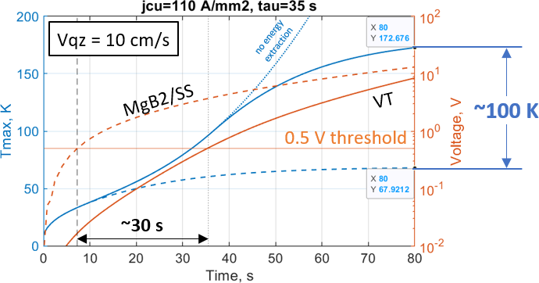
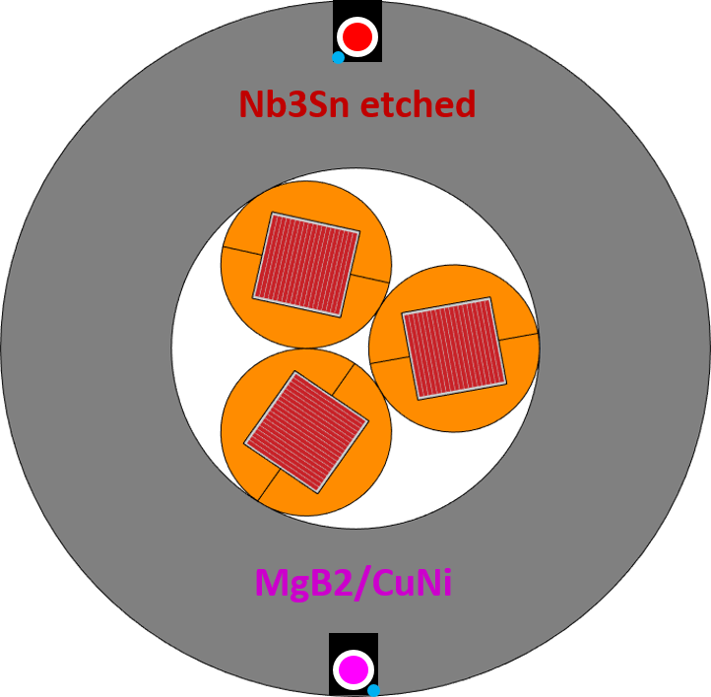
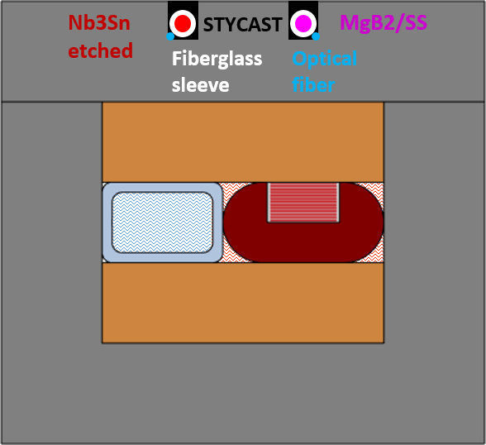
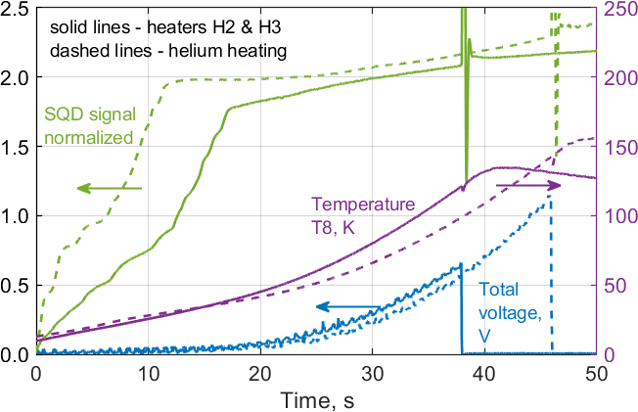
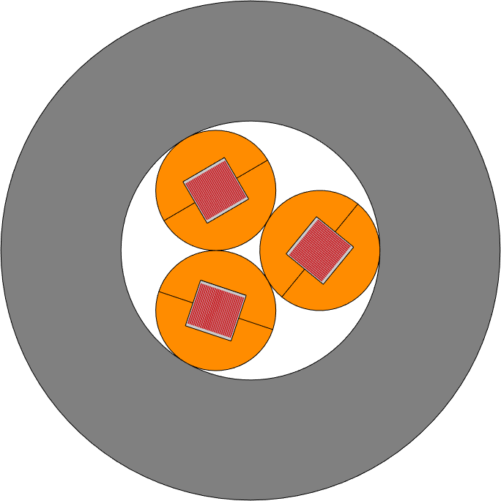
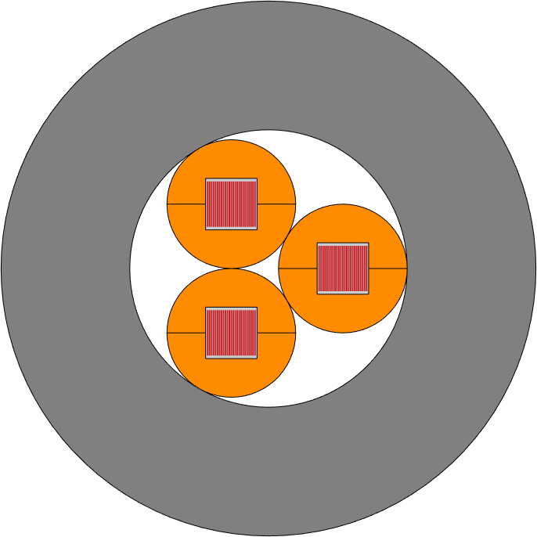
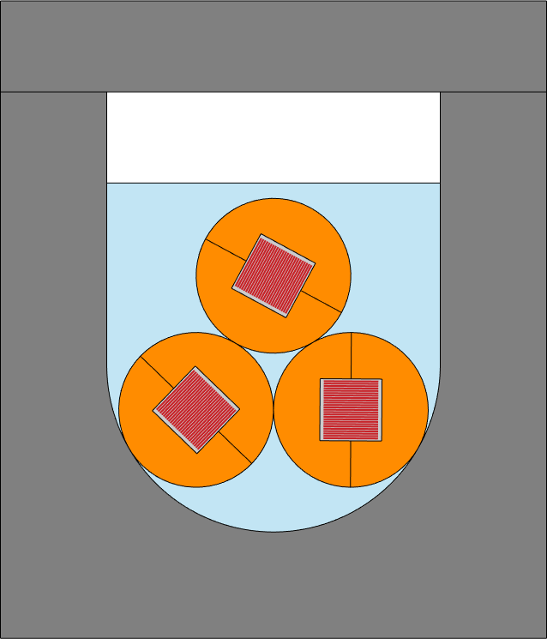
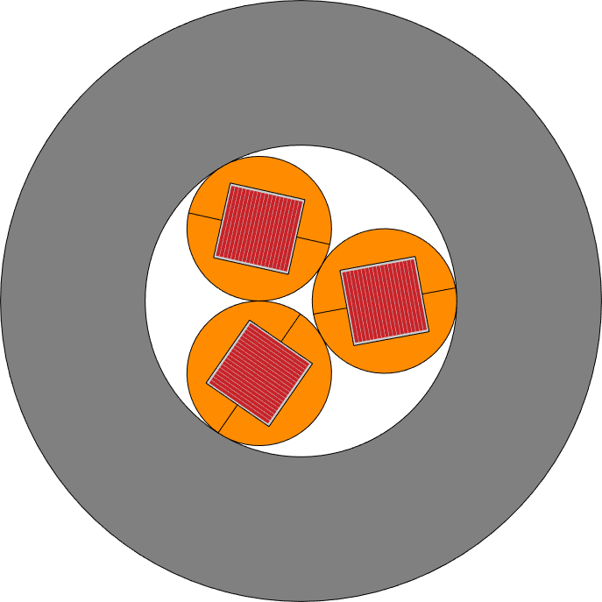
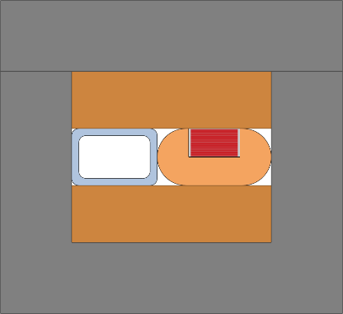
SQD wires: expected & measured performance
Conductors for quench experiment in SULTAN:
2 m-long SQD wires
ASTRA2 @12 kA, 10.9 T
SQD integration in the conductor jacket → simple, robust and eventually sufficiently sensitive for the SQD operation at 0.1 A
https://doi.org/10.1088/1361-6668/acb17b
→ Summary on conductor stability and quench propagation

Slide 7
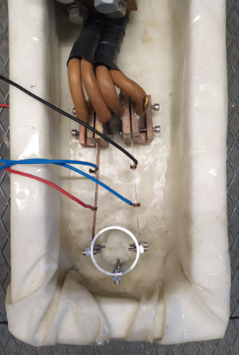
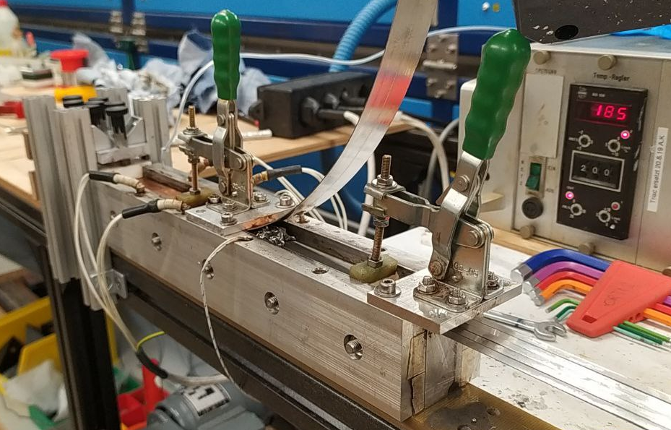
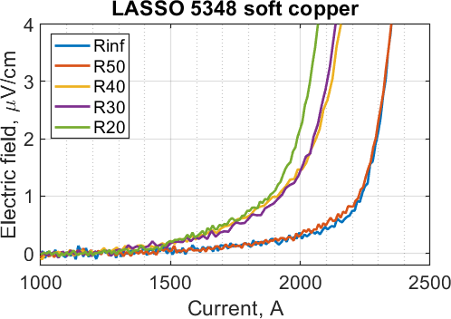
Quench experiment on long lengths
Task challenges:
HTS conductor development
Ultra-thin SQD wires
Embedded optical fibers
Laminated stacked-tape soldered conductor (LASSO)
Copper pre-tinning & Cable soldering
Ic bending test at 77 K, self-field
Initial Ic reduction ~12% due to self-field effect
By mistake, hard-way deformation at R40 → 15% Ic drop
Annealed copper to reduce shear stress on ReBCO

Slide 8
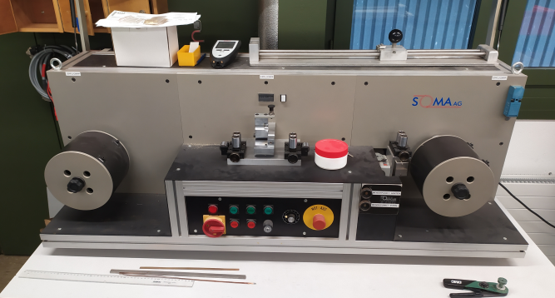
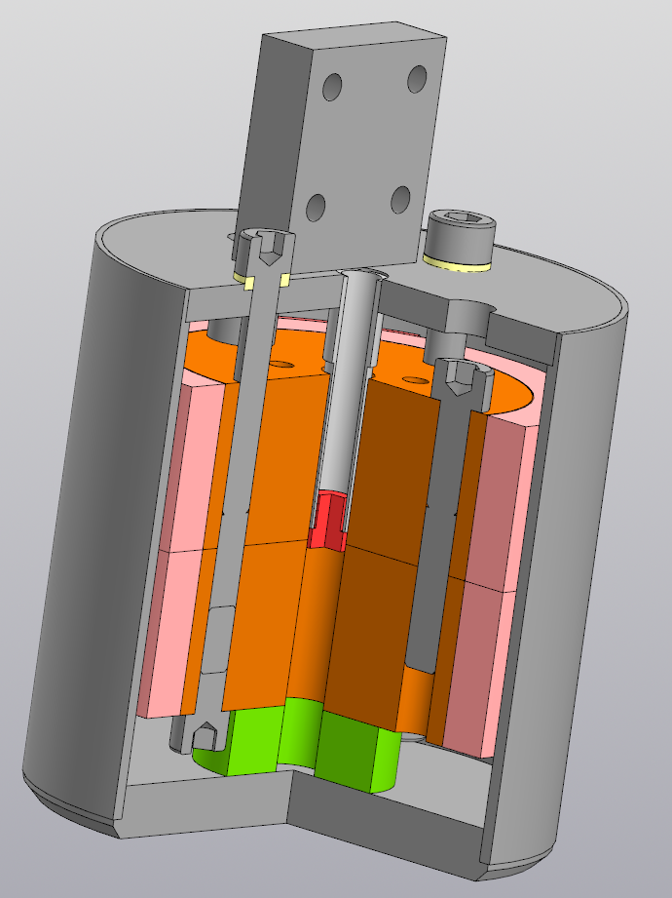
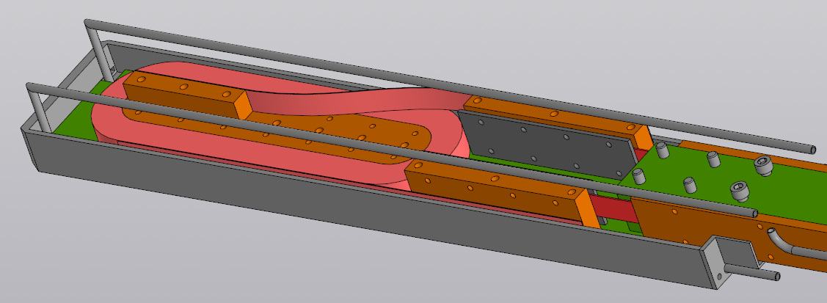
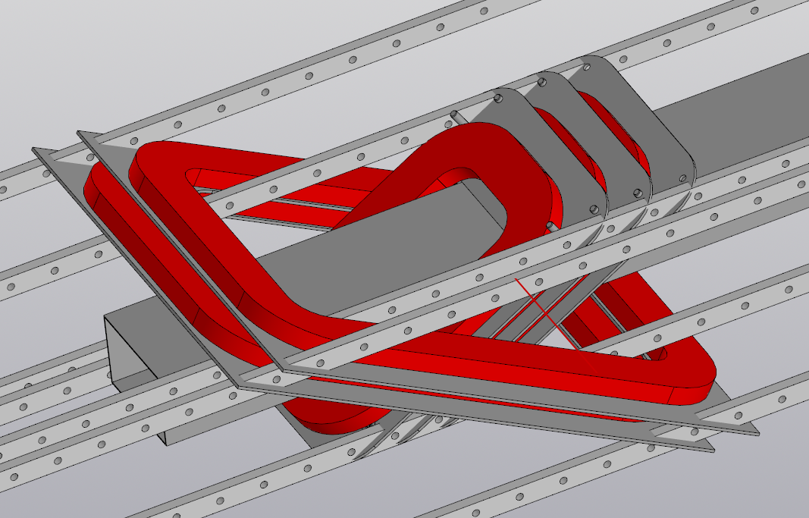
Quench experiment on long lengths
Ultra-thin Nb₃Sn SQD wires:
Bronze-route ‘1st stack’ (19 Nb rods in bronze matrix) OD 3.6 mm by JASTEC
Wire drawing down to OD 0.2 mm by external company and also at EPFL-SPC
Internal-tin etched wire (3000 filaments) OD 0.25 – 0.30 mm by WST
Embedded optical fibers…
15 T insert
SULTAN QE insert: pancake coils
JORDI stand: x-coil dipole
~1 m
~20 m conductor per coil
~50 m
* insulated windings

Slide 9
Detection by a twisted pair
Twisted pair
V
Twisted-pair SQD wires in order to enhance cancellation of inductive signal + complete electrical insulation
As an alternative, twisted-pair made of distributed thermocouples?
Thermal coupling
Conventional thermocouple: response on ΔT only at the ends
Welded or soldered joints
Continuous response on temperature rise, but discrete sensing locations (i.e. opposite to SQD with continuous spatial sensing at a certain T threshold)
→ Multiple TC connected in series: response on ΔT along the length

Slide 10
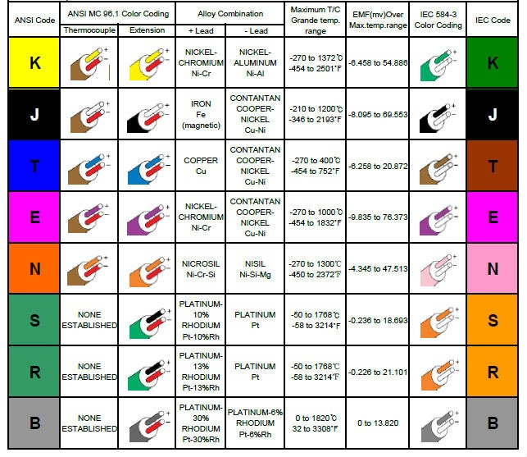
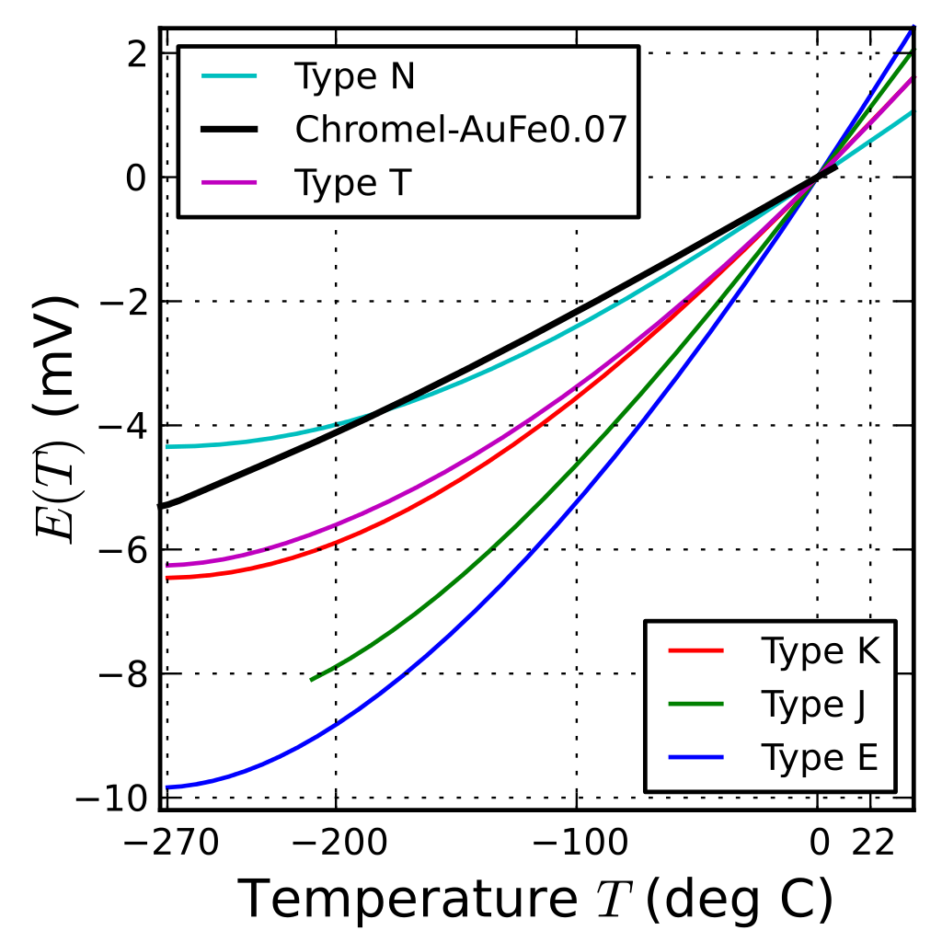
Thermocouple materials
Type K further studied:
+ Chromel Ni₉₀Cr₁₀ – Alumel Ni₉₅Al₂Mn₂Si₁
→ OD 0.2 mm, 20 m length procured (10 $/m by a Swiss company, but down to ~0.1 $/m for a km-long order in China)
https://en.wikipedia.org/wiki/Thermocouple

Slide 11
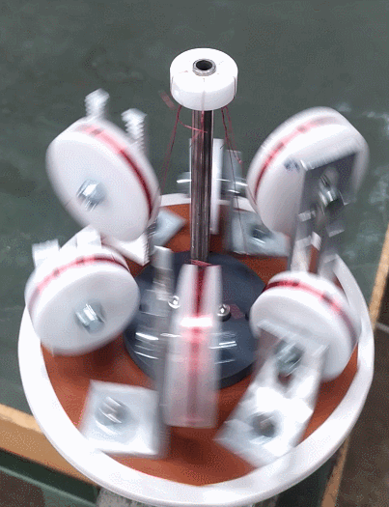
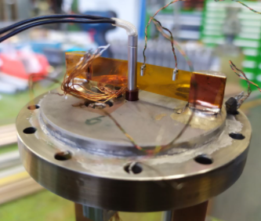
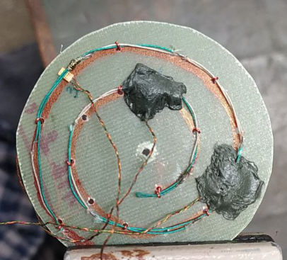
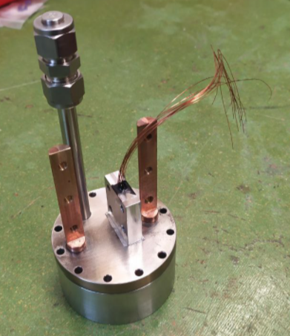
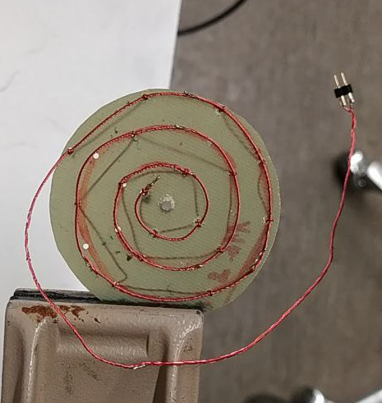
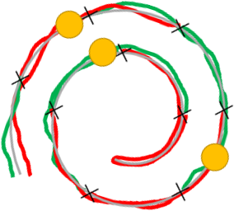
Test samples
Sample 1:
Manual wire twisting
9 TC joints at ~2.5 cm distance, ~25 cm length in spiral shape
Heaters and temperature sensors at 3 locations along the length
Sample 2:
6-around-1 return wire wrapping (semi-automated)
7 TC joints at 5 cm distance, ~40 cm length in spiral shape
Test insert:
Central cartridge heater
Impregnation by 62% aqueous glycerol in a steel container
Filling port
Heater + CERNOX at each position
TC joints
TC joints
3
pos 1
2
‘blind spot’ ? (by symmetry)

Slide 12
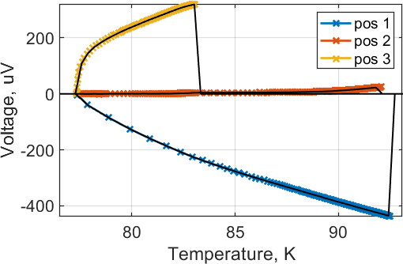
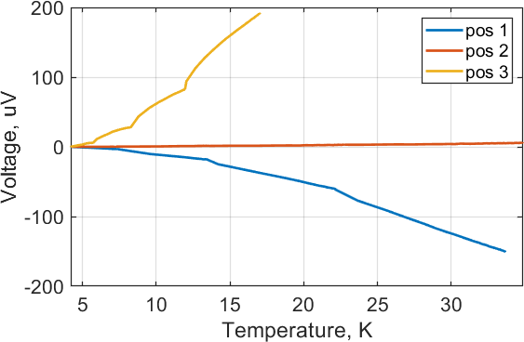
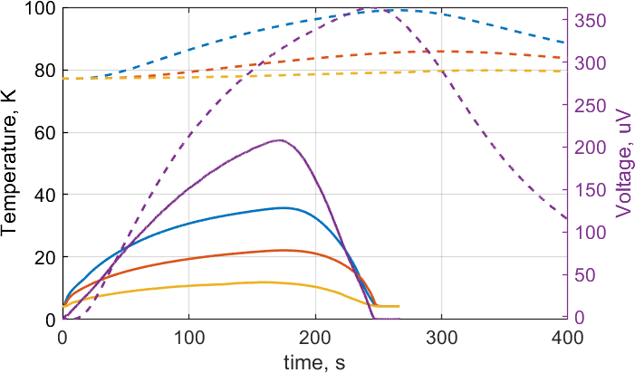
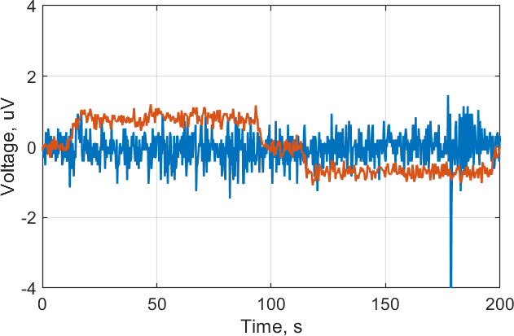
Voltage response at 77 K and 4.2 K
Local heaters on S1 (fired separately)
Central heater on S1
T₁
T₂
T₃
V
@ LN2
@ LHe
LN2
LHe
Magnet ramp, operation at 4.2 K
Voltage response rate (V/K) varies along the length periodically with altering polarity.
Symmetric temperature distribution centered at a blind spot of a symmetric thermocouple chain cannot be detected. In real cases, detection signal is determined by the hottest joint (e.g. see response on the central heater).
Inductive voltage not observed on S2 at ~12 mT/s also using longer integration time (0.1 uV voltage resolution). Assuming negligible inductive contribution, absolute response can be arbitrarily amplified for the desired sensitivity.
+12 mT/s
-12 mT/s
S1
S2

Slide 13
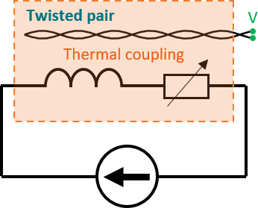
Summary
Temperature-based quench detection, nearly immune to mechanical strain and EM noise, is being developed at SPC using superconducting wires and thermocouple chains.
SQD wires can be tuned to a large extent for specific application requirements. Ultimately, one can always use the same sc material for SQD as in the main winding and increase the voltage response by higher current and elimination of low resistivity protection material.
Thermocouple chains offer continuous response on temperature, but long-length manufacturing of a short-segment chain of joints requires further development.
Both can be used in a twisted-pair configuration to exclude electrical contact with the main winding, enhance noise cancellation and allow signal amplification.
THANK YOU FOR YOUR ATTENTION!

