Slide 1
Quench conditioning device. Vibrational quench conditioning
Stoyan Stoynev et al. (many people contributed to the first topic)
2nd IDSM
28 April 2023

Slide 2
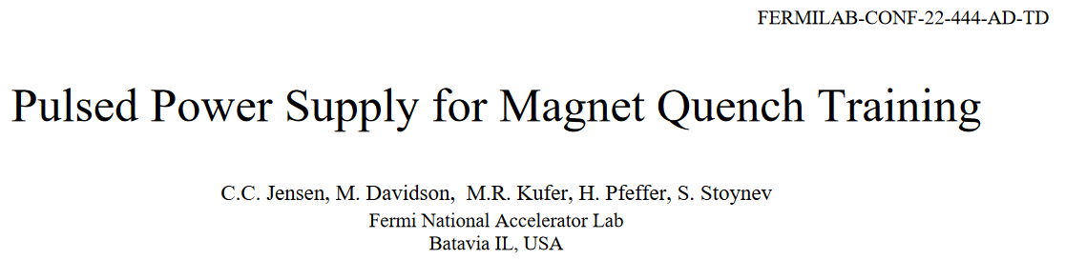

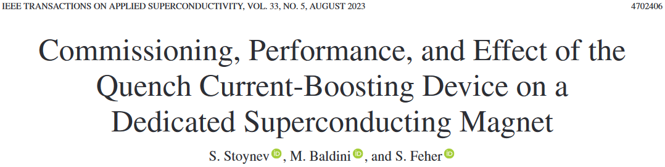
Quench Current-boosting Device (QCD)
[1]
QCD is a capacitor-based device (0.4 F, up to 1 kV)
intended for providing “over-current” to a magnet
during powering (relevant for SC magnet training)
It is integrated into an existing 30 kA power supply
at FNAL
Here I am discussing the “instrumentation” aspects
of this device and technique
The material in this presentation is mostly from
[1], [2] (basic principles of operation) and [3] (results from testing)
[2]
[3]
Many contributors
acknowledged
in the paper

Slide 3
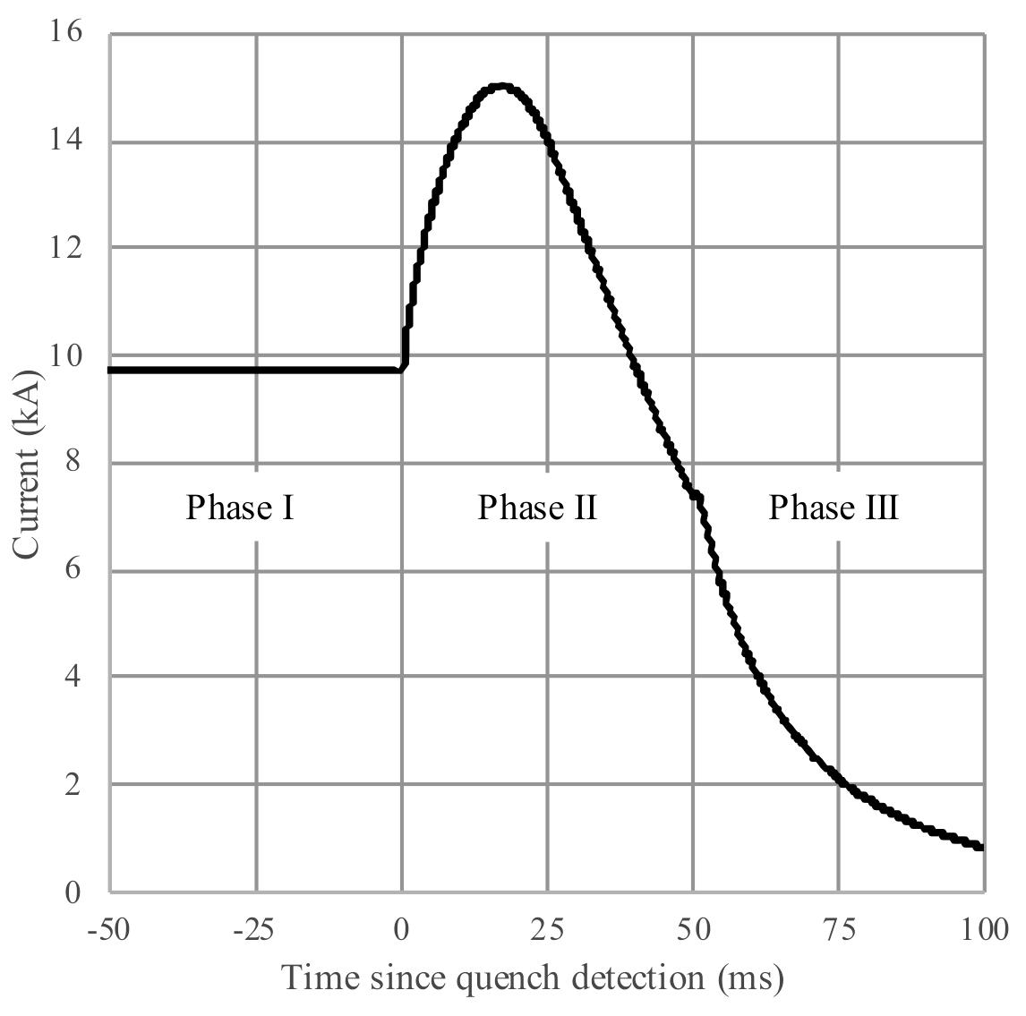
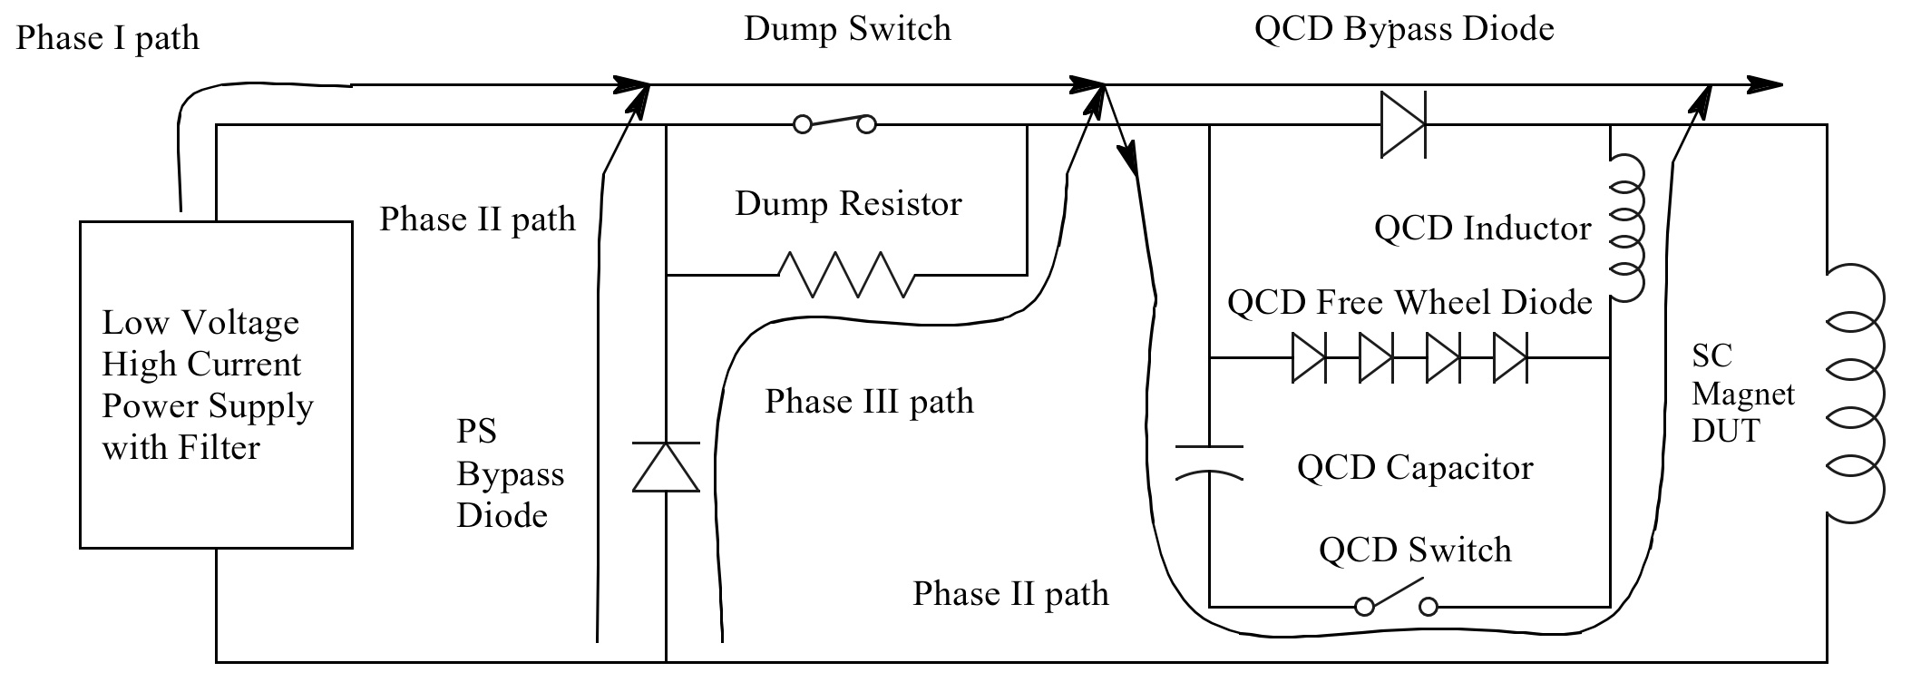
QCD operation
Phase I – The regular power supply (PS) ramps the magnet current up, main current flows through the QCD bypass diode
Phase II – The QCD capacitor is switched into the circuit (by QCD switch) while the main current transfers through the PS bypass diode (PS is “ramped down”, “phase-back”)
Phase III – The dump switch is opened, QCD is already discharged, current flows through the QCD bypass diode, QCD switch opens (no need to synch)
Measured SC Magnet Current
actual data
Simplified Schematic of SC Magnet Power Supply with QCD Circuit

Slide 4
QCD elements and their protection
Exact specifications are found in [1]
Capacitor and capacitor protection – the QCD is based on 24 16.7 mF/1.2 kV capacitors, a series resistor (0.12 Ω, 1kV/10 kJ) limits the peak capacitor fault current; there are 100 kΩ bleeder resistors as a backup/safe discharge
Switch and switch protection – parallel circuit of eight IGBT switches (2.5 kA max) with a commercial gate driver; inductor L limit (40 μH) with max rise in current 100 A/μs; a snubber network (i.e. surge protector; 30 μF in series with 0.4 Ω) protects each IGBT
QCD bypass diode and diode protection – two groups of four water cooled diodes protected by a snubber capacitor of 3 x 5.6 μF, 1.5 kV and resistor of 1.8 Ω in parallel with each set
Charging supply – 1.5 kVA, through isolation transformer (rated at 2.5 kV), resistors/diodes used for fault current protection
cRio control system plays a major role in real-time
monitoring, fault detection and reaction.

Slide 5
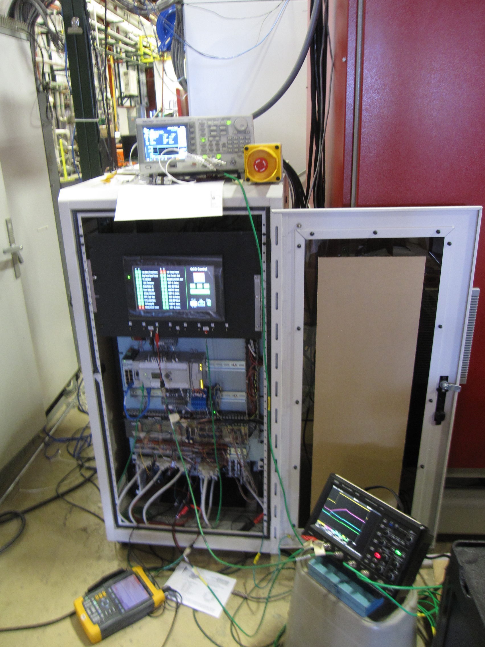
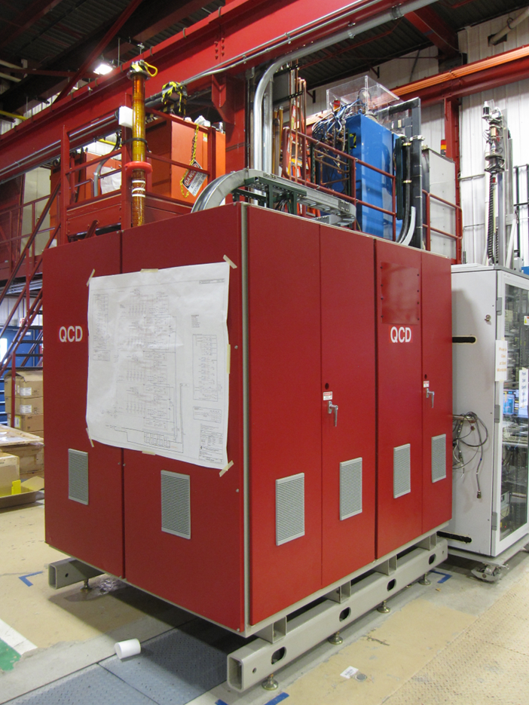
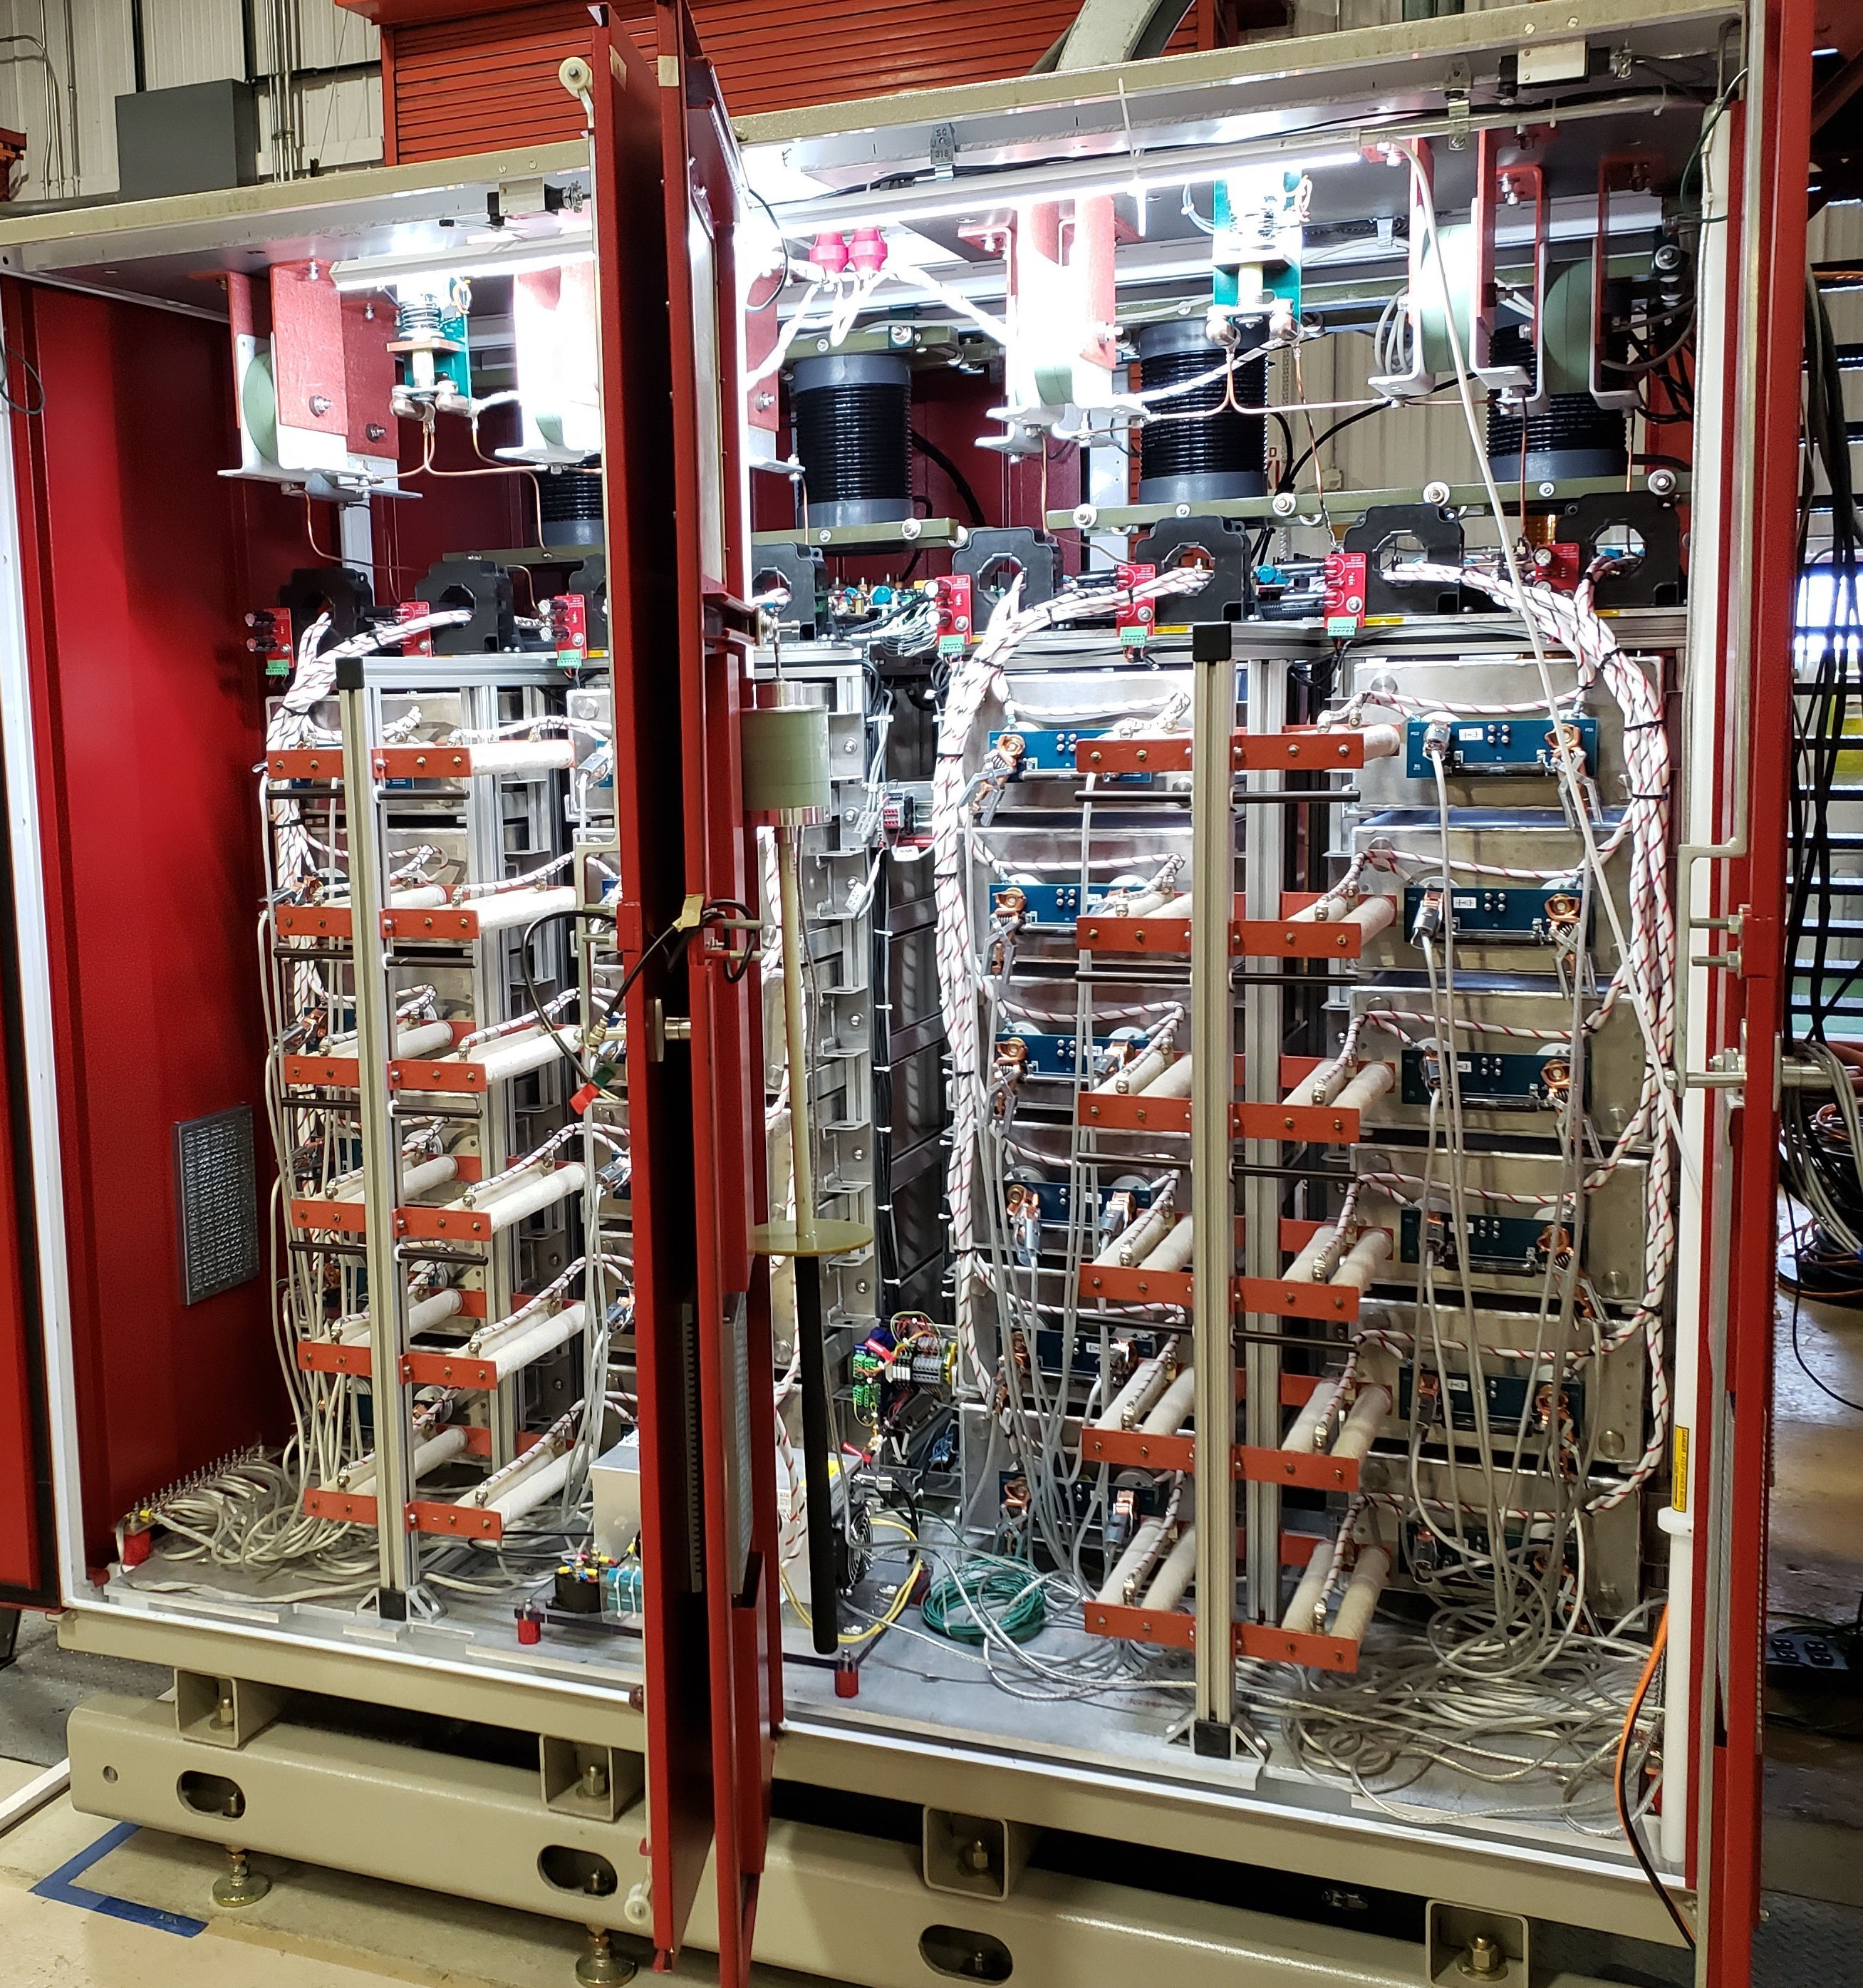
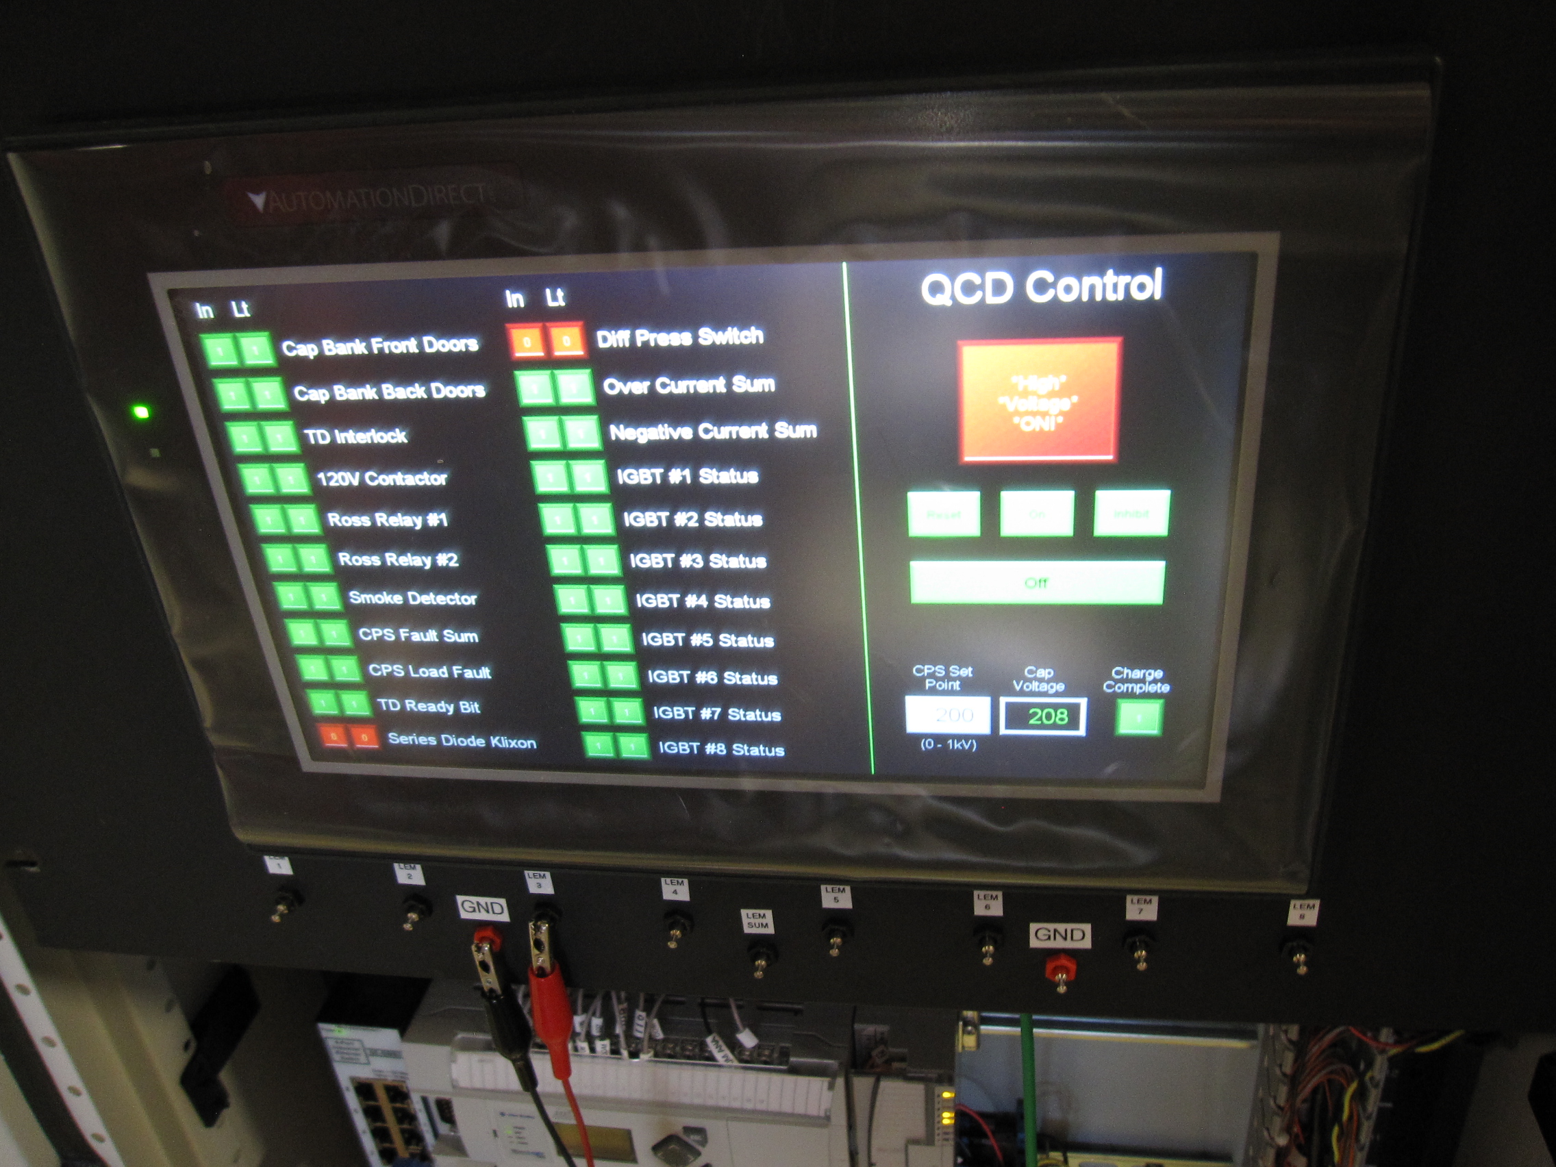
QCD photos
QCD cabinet
Full QCD Circuit, Front View
QCD controls
(cRio based)

Slide 6
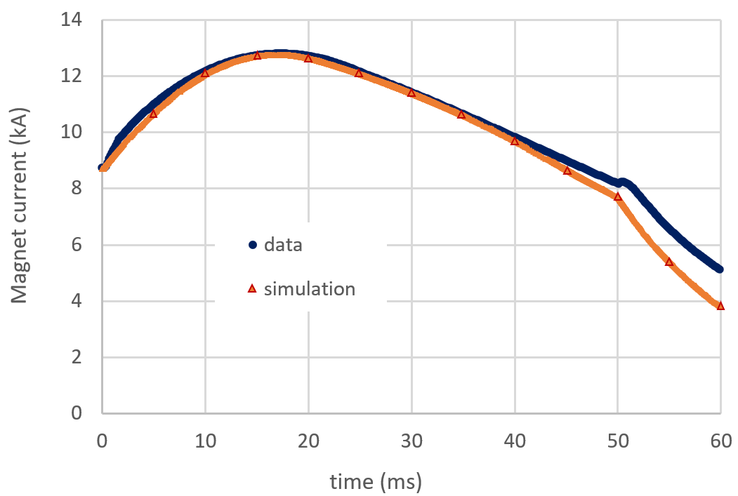
QCD Simulation
Simulation developed
by Matt Kufer
The QCD circuit was simulated by LTspice with fixed inductance of 1.4 mH, reflecting the test object (a small “mirror” magnet) at high current, but time dependent resistance
Resistance was extracted from recorded quench data (voltage development) and approximately followed linear trends: 0-35 mΩ from 5 to 22 ms after quench detection and 35-50 mΩ from 22 to 42 ms after detection
Magnet current development after quench detection
The current decays because of resistance in the circuit.
If only the initial quench was responsible for resistance rise
the current would be nearly flat for tens of ms.
Dump resistor firing is also simulated (at 50 ms ).
Protection heaters are fired in data at 30 ms but there is natural
delay of the effect of them + the coil is largely quenched already.
There is no simulation of heater firing

Slide 7
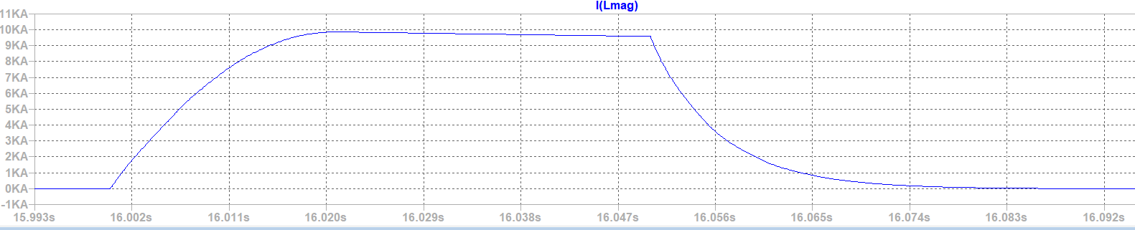
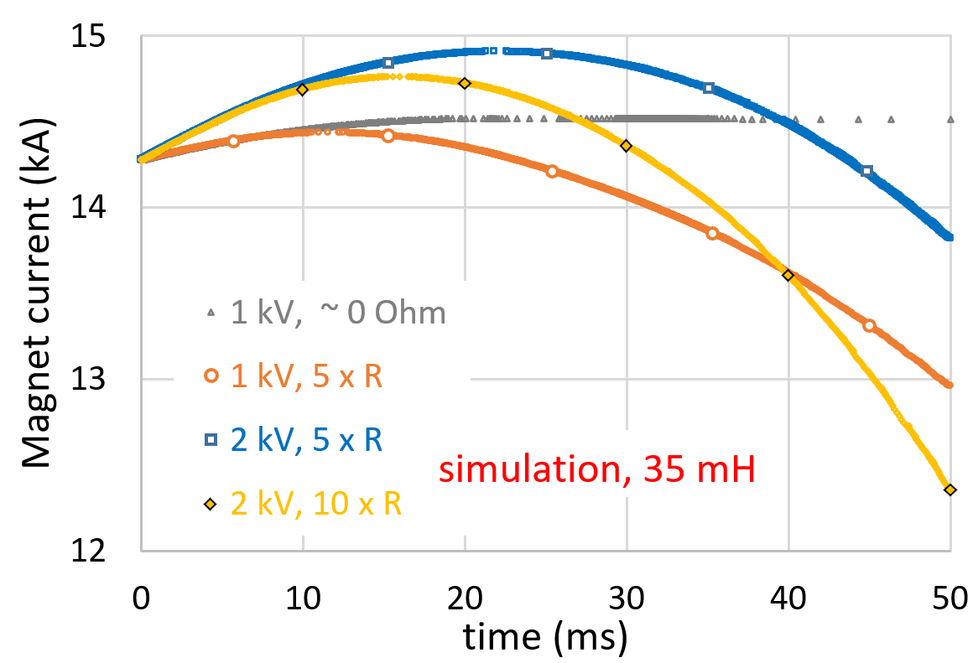
QCD Simulation – what if
QCD doesn’t need a quench to operate (could be discharged at any time)
QCD doesn’t need current through the magnet either
QCD is currently limited to 0.4 F and 1 kV. We explored what could be achieved with 0.4 F and 2 kV as well
Magnet current - LTspice simulation with 0.5 mH magnet (no magnet resistance), QCD with 0.4 F/1 kV
10 kA
Dump resistor firing
QCD discharge at 0 A magnet current
Our “test object” was a 35 mH magnet (like a HL-LHC quad) and
resistance R was modeled after our only test so far taking into account proper RRR dependencies and 300 K resistances
(resulting in a factor of 5-10 higher R for the “test object”
including some margin)

Slide 8
Comparative behavior and QCD combined operations
With the highest over-current reached in testing (~ + 5kA) QCD drove the rise at dI/dt ~ 1 MA/s in the first 2 ms and ~ 0.5 MA/s in the next 2 ms (much less thereafter ); the average increase to peak was 0.3 MA/s
CLIQ discharges typical for HL-LHC magnets have average increase of 0.15 MA/s and overall similar dI/dt characteristics within first ~ 10-15 ms
Quench protection for small magnets gives dI/dt ~ 0.5 MA/s in the first 5 ms
When the dump resistor is fired it induces negative voltage on the magnet (driving the current down)
When QCD is applied the voltage on the magnet is positive (boosting the current) – QCD voltage and dump resistor voltage don’t add up, no higher voltage develops
The QCD capacitors are discharged in ~20 ms, corresponding voltage on the magnet drops - protection heaters applied with some delay would not interfere with voltage development
QCD does not put the magnet in drastically different conditions than known ones

Slide 9
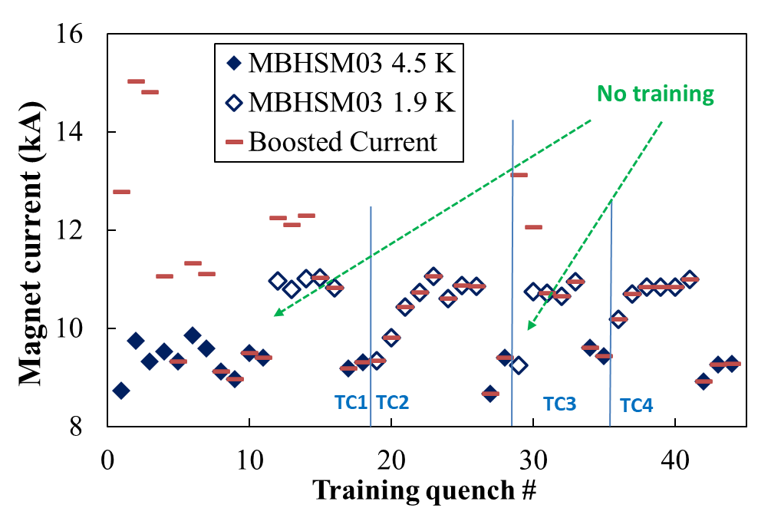
QCD used multiple times on a test object (SC magnet)
Peak magnet current reached, including
QCD boost, is denoted by red marks (lines).
Quench current is denoted by blue marks.
Much more
details in [3].

Slide 10
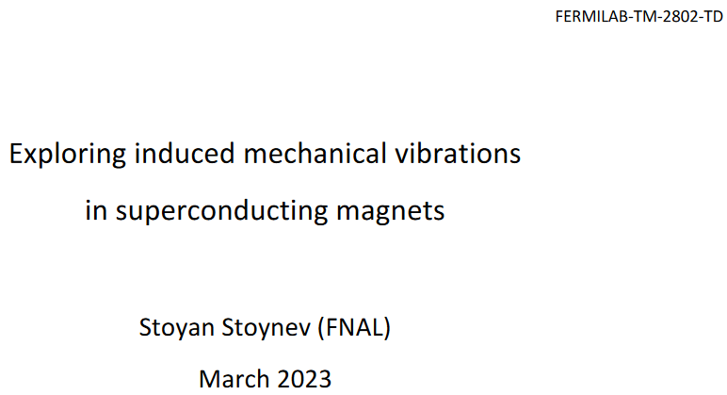
Vibrations
[4]
(New topic)
Mechanical vibrations are currently used for magnet monitoring and possibly even for quench detection (Maxim covers those topics)
There are not yet active developments to affect magnet operations through mechanical vibrations
How does this may look like (see [4] for details)?
I: Exploring mechanical vibrations to affect SC magnet training
II: Exploring mechanical vibrations for SC magnet protection

Slide 11
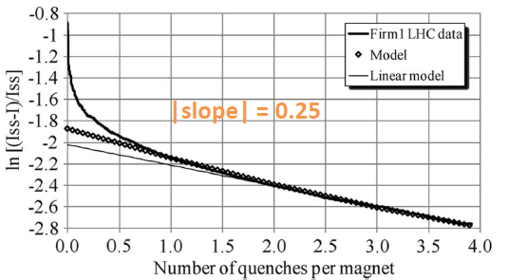
(I) Friction and magnet training
[1a] P. P. Granieri et al., “Slip-Stick Mechanism in Training the Superconducting Magnets in the Large Hadron Collider”, IEEE Trans. Of Appl. Supercond., Vol 21, No. 5 (2011).
There are reasons to think that SC magnet training relates to (static) friction
According to [Ia] (LHC data):
frictional energy = α (I-In) and energy margin = β (ISS - In), n – quench number ( more realistic models do not change the narrative)
Friction can be changed by (proper) mechanical vibrations – there is well developed science and descriptions for earthquakes*, for instance:
$\ln\left(1−\frac{I_{n+1}}{I_{SS}}\right)=\ln\left(1−\frac{I_{1}}{I_{SS}}\right)−n\ln\left(1+\frac{β}{α}\right) ; slope ≡ln⁡(1+\frac{β}{α})$
The equation is an example, not a prerequisite;
some relation between training and friction is what is needed for the current discussion
[Ib] R. Capozza et al., “Suppression of Friction by Mechanical Vibrations”, PRL 103, 085502 (2009).
[Ic] H. Lastakowski et al., “Granular friction: Triggering large events with small vibrations”, Sci Rep 5, 13455 (2015).
https://doi.org/10.1038/srep13455
*Context: pressure gradient in rocks is ~ 25 MPa/km

Slide 12

(I) Affecting friction
Visualization of friction processes from [Ib]
It can be shown [Ib] that friction is suppressed for frequencies ω₀
such that ω₁<ω₀<ω₂ with limiting frequencies described by equations.
Now imagine the top plate is cable, the “substrate” is pole/wedge/cable
and there is non-rigid material (damaged insulation) in between.
In [4] I argue that for magnets ω₁ = sqrt[F_{N}/(MA)] and ω₂ = sqrt(2π) ω₁
(the latter comes directly from [Ib]). M is the mass of the top plate
(coil section), A is oscillation amplitude, F_{N} relates to Lorentz force.
Realistically one can get the range in the tens of kHz
(P~100 MPa leading to F~100 kHz and M~ few kg; A ~0.5 μm).
In [Ic], there are only two granular (hard) surfaces pressing against each other and the main equation is:
Above some critical frequency ω_{c}, slip-stick behavior transforms into continuous sliding, i.e. granular barriers of size
ξ_{c} are overcome and movement is “unstuck”.
For magnets Aω ~ 0.5 m/s is reasonable to achieve and ξ_{c} < (Aω)² x M/F_{N} ≈ 10 μm.
In all cases friction is reduced even if the movement is not “unstuck”.
Much more
details in [4].

Slide 13
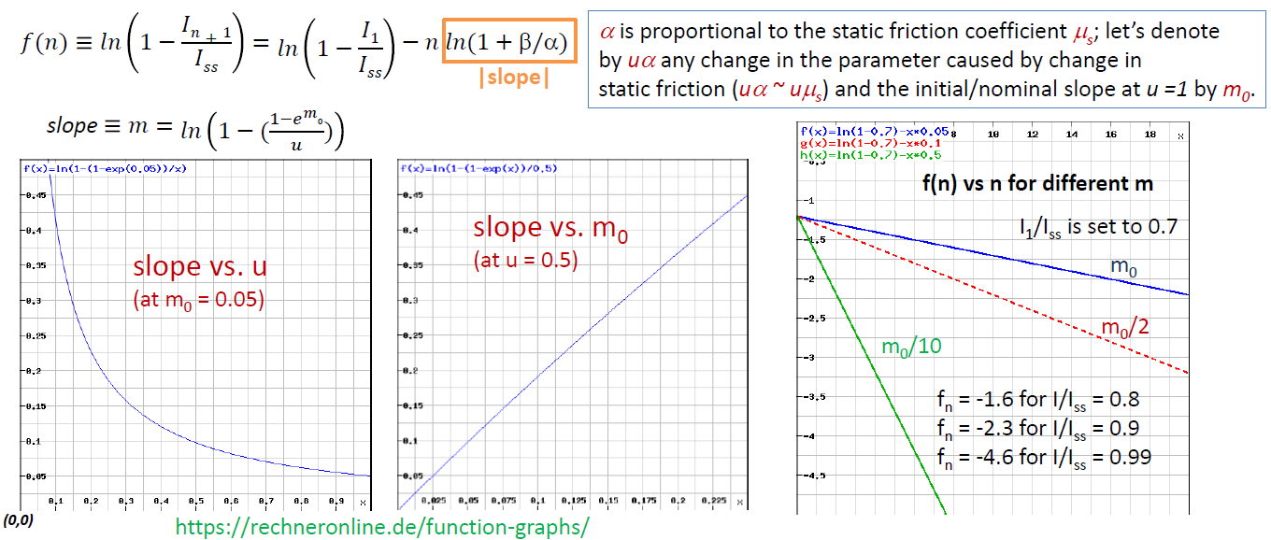
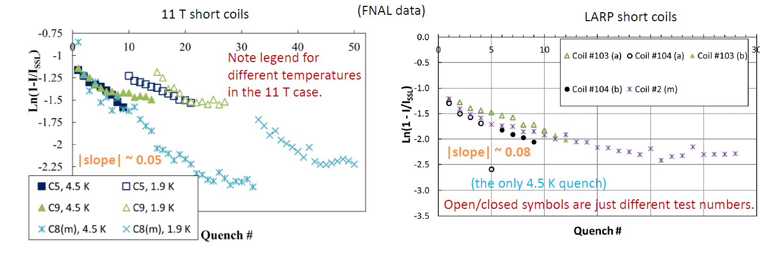
Training with less friction (model dependent)
10 x m₀
2 x m₀
m₀ = 0.05
Different training slopes
for different friction
Alternative slopes are shown – 2 x m₀ and 10 x m₀

Slide 14
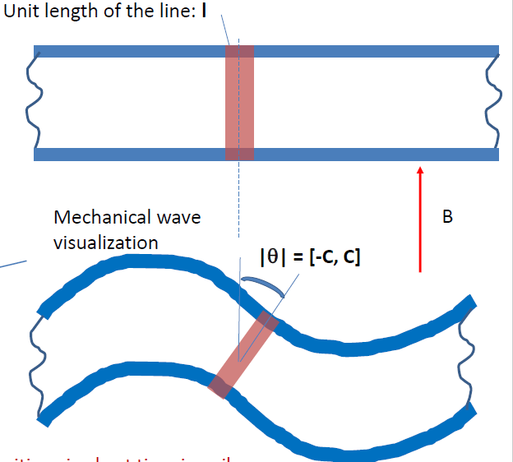
(II) Vibrations in magnetic field
Can we transform mechanical energy to heat for magnet protection?
Using “thin” wire approximation for eddy-current density:
to calculate power losses
This is obviously too simplistic for a magnet but we’ll notice few things:
  Calculating power goes through flux changes and we end up with “𝜕B/𝜕t”; however the change doesn’t have to come from B, it could be coming from “A” (“exposed surface area”); if we have sin(ωt) dependence of flux change it will be described in the same way coming from B or A
If our description is too simplistic, what is already used for quench protection and explores oscillations of some kind? CLIQ
Something like this?
Different “θ”
Faraday-Lenz law
ξ = - dΦ/dt =
-d(BA)/dt

Slide 15
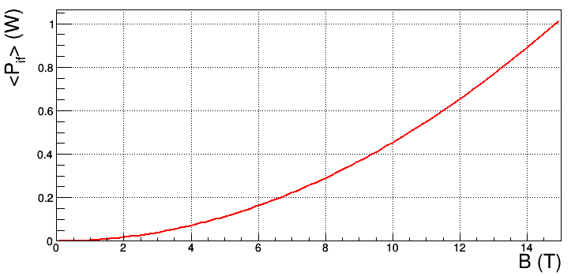
(II) Inter-filament power loss from mechanical wave
[IIa] E. Ravaioli, “CLIQ: A new quench protection technology for superconducting magnets”, PhD Thesis. University of Twente (Universiteit Twente), 2015, https://doi.org/10.3990/1.9789036539081
According to [IIa], inter-filament losses are:
I want to keep B = const for the argument and vary “A” (surface); as I argued, nothing changes, the equation is really about time-dependency which we’ll parametrize as sin(ωt):
C would be a normalization coefficient which depends on the concrete type of vibration and is ultimately related to some “maximum angle” (see figure on the previous slide). In [4] I make simplistic estimates and arrive at C~16 μrad (i.e. this is achievable magnitude).
Then, within a factor of two, I get this with parameters mostly based on Fresca-2 cable
Power loss in a strand over one wavelength (20 cm)
averaged over one wave period

Slide 16
(II) Mechanical energy higher than eddy-current losses
(per unit length)
Could this work for magnets?
  At 10 T, each one cm of strand would lose about 23 mW of power due to eddy currents. Adiabatic approximations (all energy heats the strand) are valid within at least tens of ms and we can rewrite the loss as 230 mJ / 10 ms / 1 cm (multiply by 20-40 for a cable)
  In Nb₃Sn strands, minimum quench propagation zone is typically several mm to cm at nominal magnet currents/high fields and minimum quench energy is typically of the order of few hundreds μJ
  Proper vibrational (possibly ultrasonic) machine can deliver at least 1 kW (1000 mJ/ms)
  It is very unlikely that all sections of the cable/strands and coil will act in the same way, and the magnetic field vector (and stress on conductor, etc.) changes significantly through the coil. Regardless, there is plenty of (mechanical) energy to transform to heat and observe quenching; better modeling will help optimizing (quench distribution within the coil will depend on magnet design)
There are good indications this can be made to work
Much more
details in [4].

Slide 17
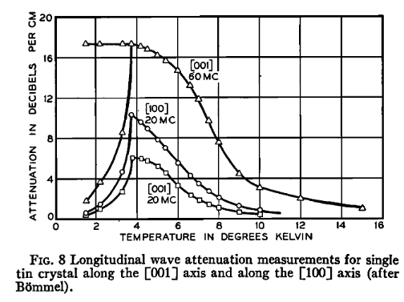
Practical considerations
[k] W. P. Mason, “Physical Acoustics and the Properties of Solids”, The Journal of the Acoustical Society of America 28, 1197 (1956).
Attenuation - workable
For magnets (copper/steel) we verified the validity at kHz range of :
α = C_{d} x f and C_{d}~30 dB/m/MHz (~0.1 dB/m at 3.3 kHz), A(x) = A₀ exp (-αx)
Moreover, superconductors attenuate much less [k]
Bundles of “rods” are very good ultrasonic waveguides (little dispersion) for radius/wavelength ratio <<1, and the explored “rods” in [l], [m] and in other references therein were at ~ 1 mm (similar to strand diameters)
Acoustic impedances between conductor and magnet insulation are very different
Combining all this, it may be possible to use cables as wave guides, and even filaments as long-range sources of vibrations along the cable (input power at the leads)
If not, the pole area may be possible to use as the core source of ultrasonic power
[l] L. C. Lynnworth et al., “Extensional Bundle Waveguide Techniques for Measuring Flow of Hot Fluids”, IEEE Transactions on Ultasonics, Ferroelectrics, and Frequency Control”, Vol. 52, No 4 (2005)
[m] Y. Liu et al., “Buffer waveguides for flow measurement in hot fluids”, Ultrasonics 36, 305-315 (1998)

Slide 18
Thanks

Slide 19
Example training behavior
(IF the model described earlier is correct)
m₀ = 0.05
Different training slopes
for different friction
Alternative slopes are shown – 2 x m₀ and 10 x m₀ (NOTE: the figure wrongly indicates division instead of multiplication).

