Slide 1
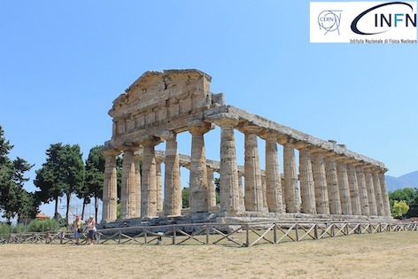
Quench Antenna and Non-Rotating Probe Development
(part I)
Quench Antennas at FNAL
28Apr2023
J. DiMarco, S. Stoynev

Slide 2
Quench Antennas (QA) highlights :
  Cold test of ‘slant antennas’ in mirror magnet (single coil test) MBHSM03
  Other non-symmetric (minimal dead-zone) antennas
  Use of new Warm Test Stand (WTS) to test QA designs without cold magnet, and comparison to simulation
  Development of ‘binary-coded’ QA to attempt to reduce number of channels
  Preparation for test of additional antennas in coming mirror magnet test
S. Stoynev and J. DiMarco, “Assessment and Performance of Flexible Quench Antenna Array Diagnostics for Superconducting Magnets”, Proceedings of ASC2022.

Slide 3
Quench antennas can apply magnetic measurement techniques by using sets of ‘multipole windings’ to perform quench localization (for QAs in a quadrupole these would be normal and skew windings of both sextupole and octupole) – this is currently being done at CERN and KEK, for example, as presented at this Workshop. The axial localization then depends on replication of these at (or being able to move to) multiple locations along the magnet length.
As an alternative, even complementary, technique, we have been developing QAs based on an array of elements that have local sensitivity to flux change from individual channels or from grids of intersecting channels – these can then be used even without a bore or built between magnet layers; the use of these then requires sensitive elements over the entire surface of interest and read-out of the resulting (typically large) number of channels.

Slide 4
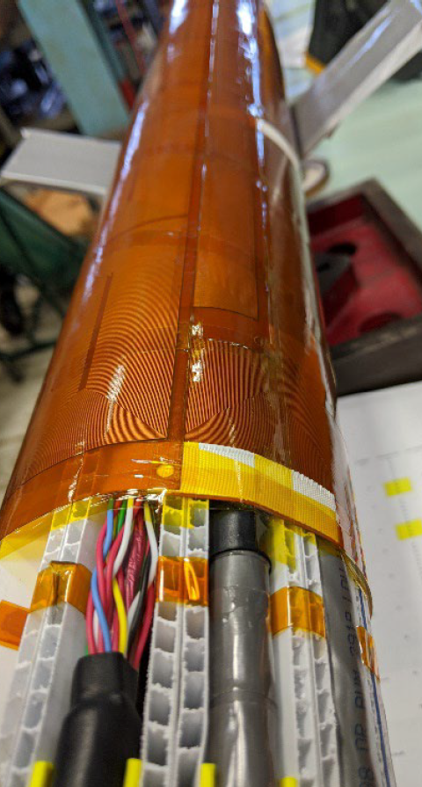
Full-length QA array for MQXF testing
Sextupole symmetry of loops in azimuthal direction with ‘dead zones’ in sensitivity covered by shifted, overlapping antennas.
Full coverage of every quench over 4.8m length, ~120 channels
100mm QA, 50mm overlap

Slide 5
Number of channels is an important component of high resolution localization. Have tried to keep this down in some designs, but have also explored antennas which could take advantage if large number of channels are available.
  Mitigate, e.g., with asymmetric QA designs. Could also just accept large number and try to deal with it by cold electronics, multiplexing, etc.

Slide 6
Cold Test of Slant Antennas

Slide 7
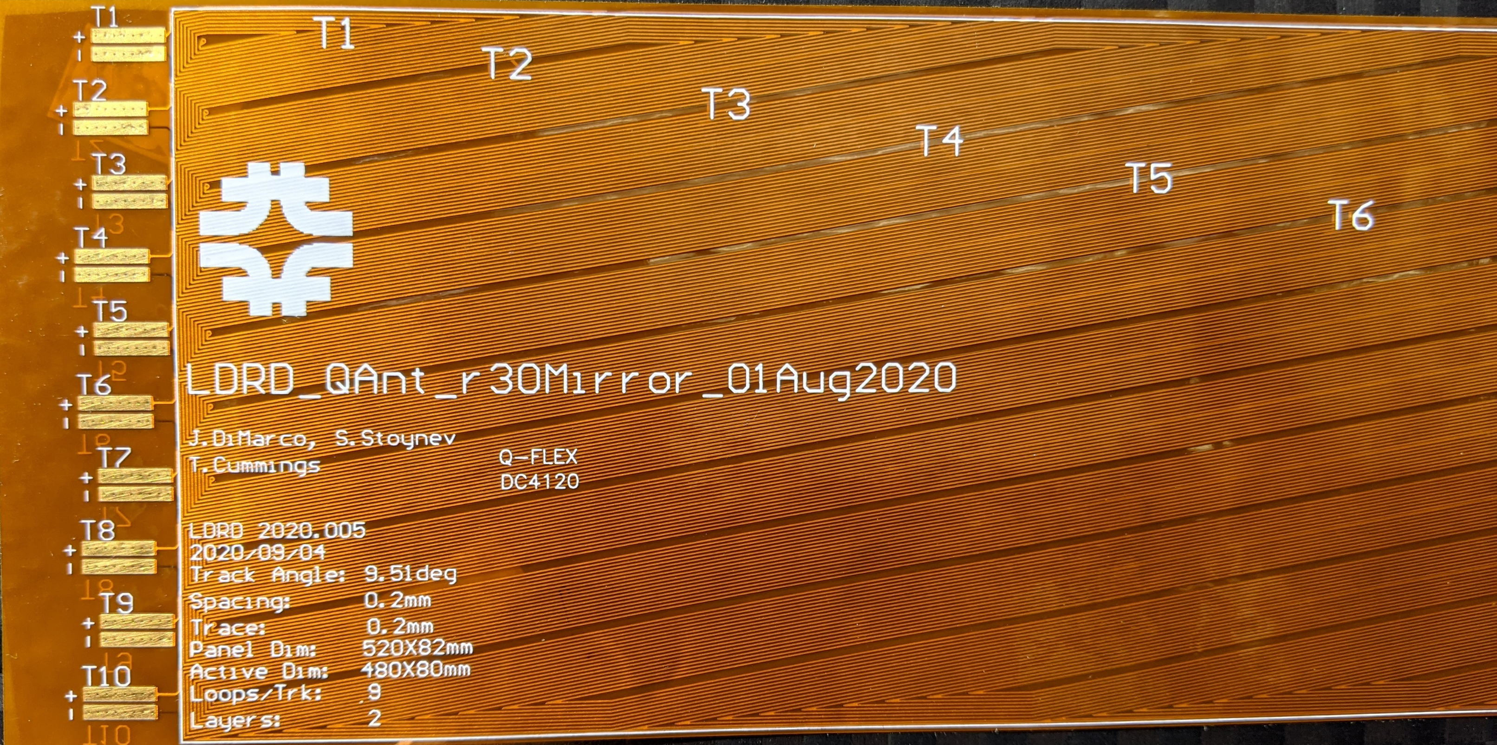
Slant Antenna
Slant QA on straight conductor avoids ‘dead zones’ present with symmetrical (e.g. rectangular) windings. Saves havingto have overlapping QA.
  To be clear, zones of low sensitivity exist, but are short in axial extent
Crossing pair of these allows for localization in z and angle within some range determined by angle, etc.
0.5m long, 20 channels
(10 read from each end, with even division about diagonal)

Slide 8
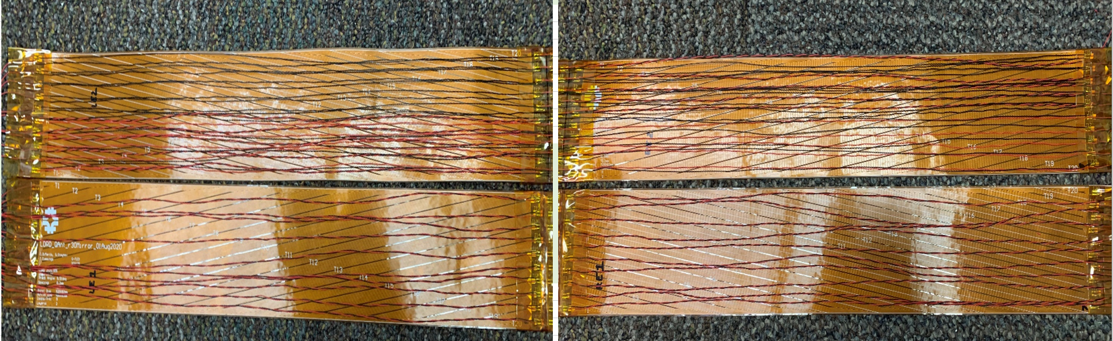
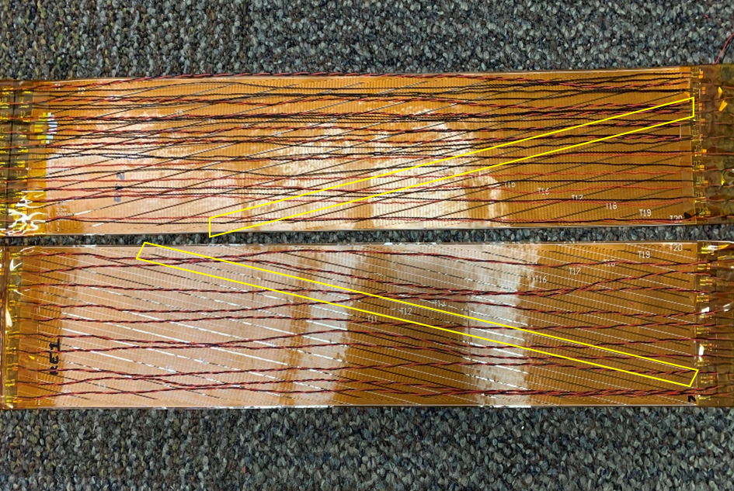
Loops for these two antennas wired in series
20 channels
“series”
20 channels
“RE”
20 channels
“LE”
Loops for other two QA brought out with individual signals
Note that the top two series QA lie on top of the bottom two to form intersecting areas of coverage with ~8mm x 48mm pixel size.
The diagonals of the rhombus formed
are 8.1 mm and 48 mm (its side is 24.6 mm)

Slide 9
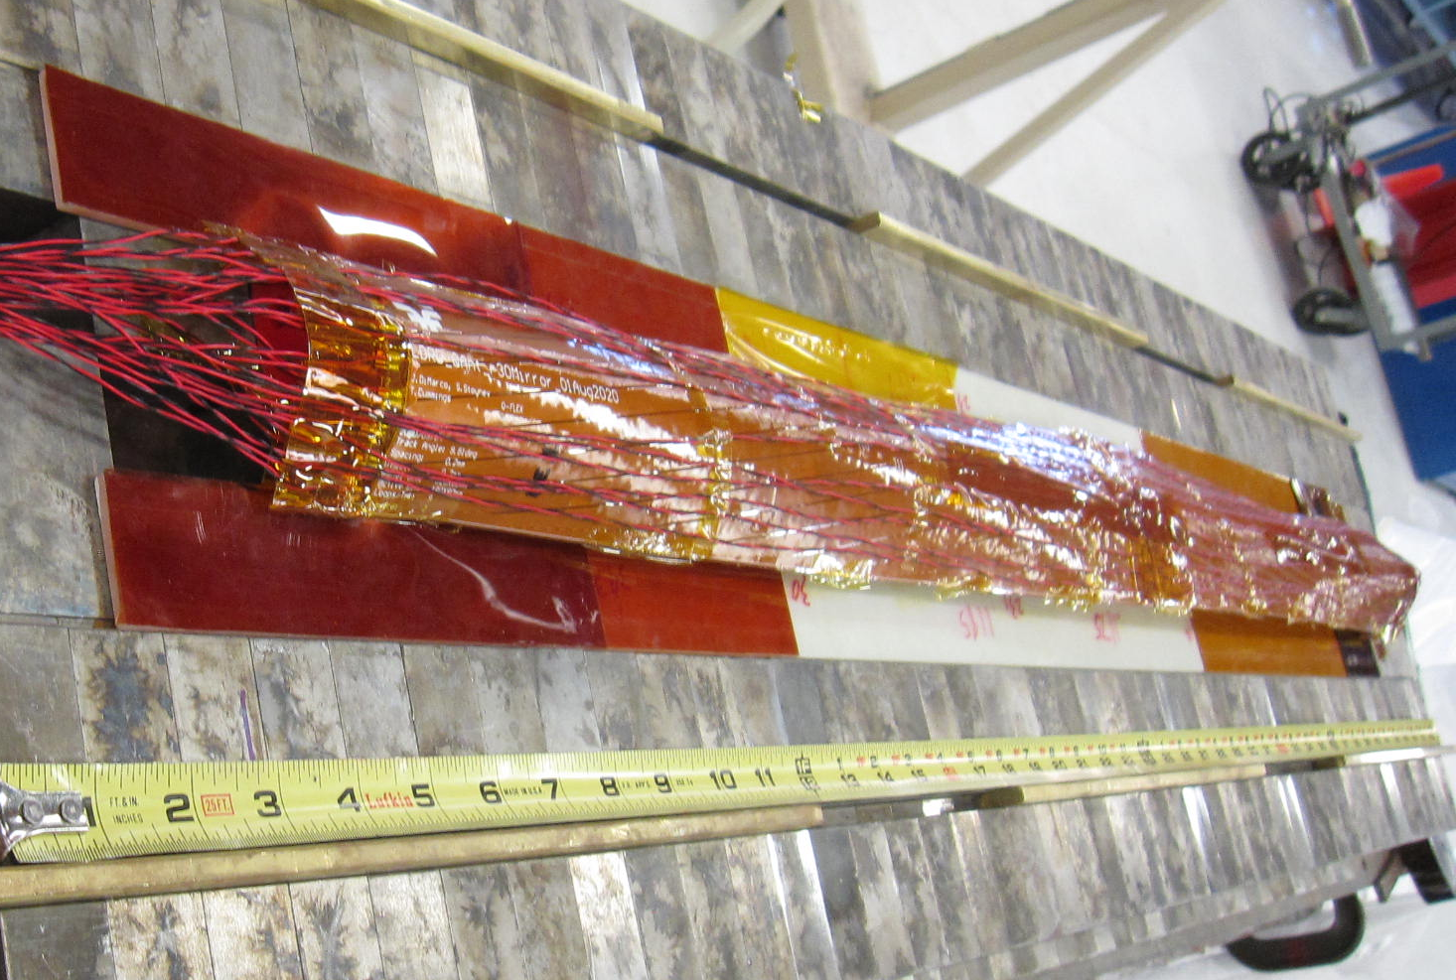
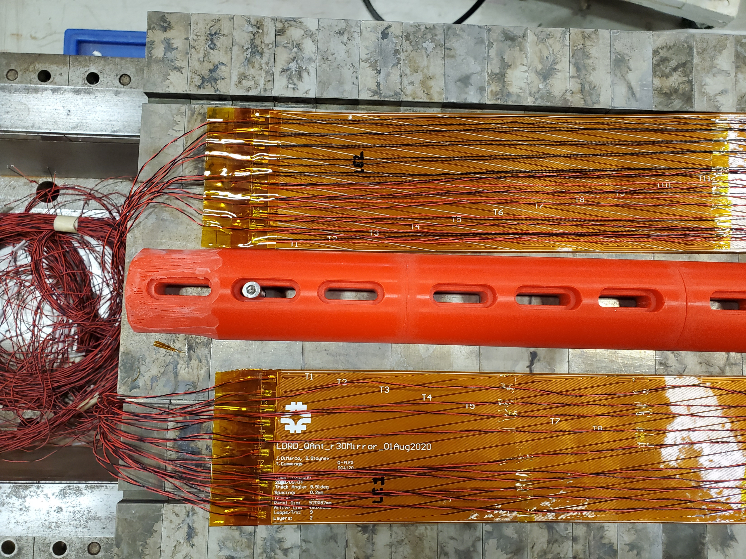
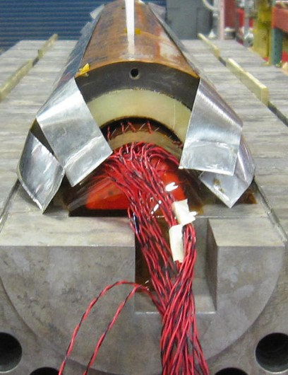
Slant QAs wired for mirror magnet MBHSM03
Full 1m coverage with 2*0.5m slant QA back-to-back (40 channels)
Second set with opposite slant but connected in series ➔ 20 channels
Total 60 channels

Slide 10
Quench localization
To visualize the quench location, can plot the channels with emphasis on the intersection of channels that both have high magnitude.
Sensitivity $s=\sqrt{\left(\left|M_{1}\right|∗\left|M_{2}\right|\right)}$where M’s are from crossed QA signals given below (right).
Data here are for an Outer Layer (OL) quench (QA saw all quenches including OL ones)
We can visually see where a quench starts and how it develops over time
Quench 6
Sensitivity
M:
Running average over 1 ms, followed by average and std. dev. computation “pre-quench” ([-0.2, -0.1] s) which is used as the normalization factor for each measurement point; resulting in “M”
This is a single time slice of data (some micro-seconds worth of data)
In addition to quench events, there are many other QA events during current ramps; indications are that we might be able to discriminate between them and the quench event (machine learning techniques in mind)

Slide 11
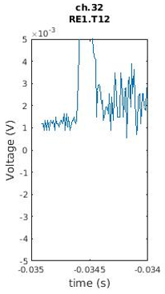
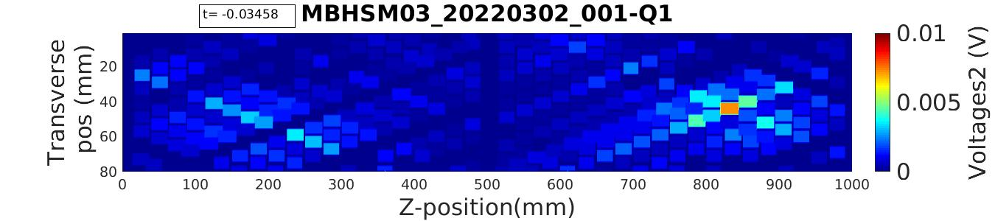
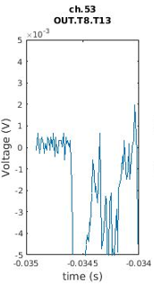
Quench 1
This can be done for each time slice
Time stamp of slice shown here
Quench location

Slide 12
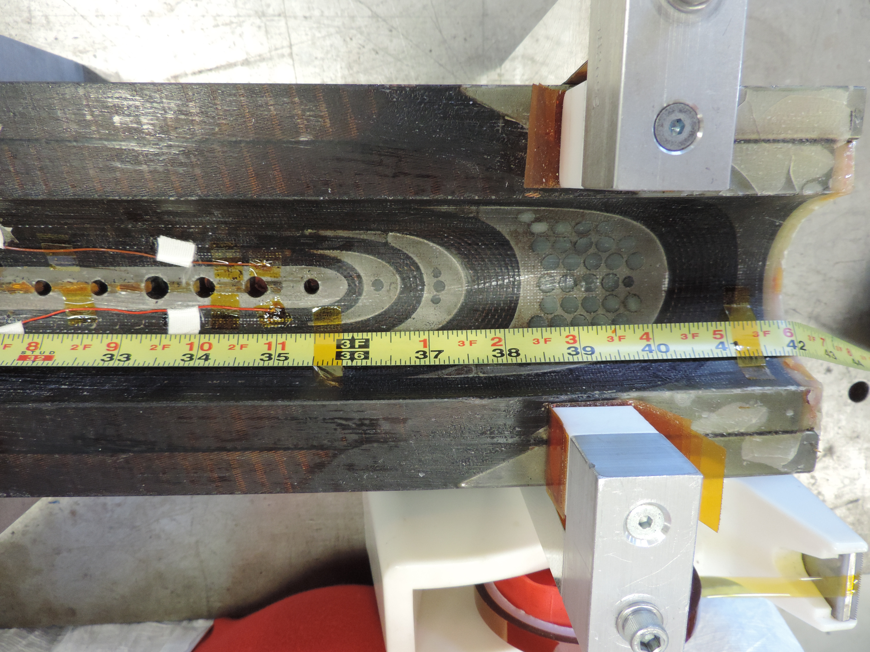
Overlay with coil photo to show location in end pack

Slide 13
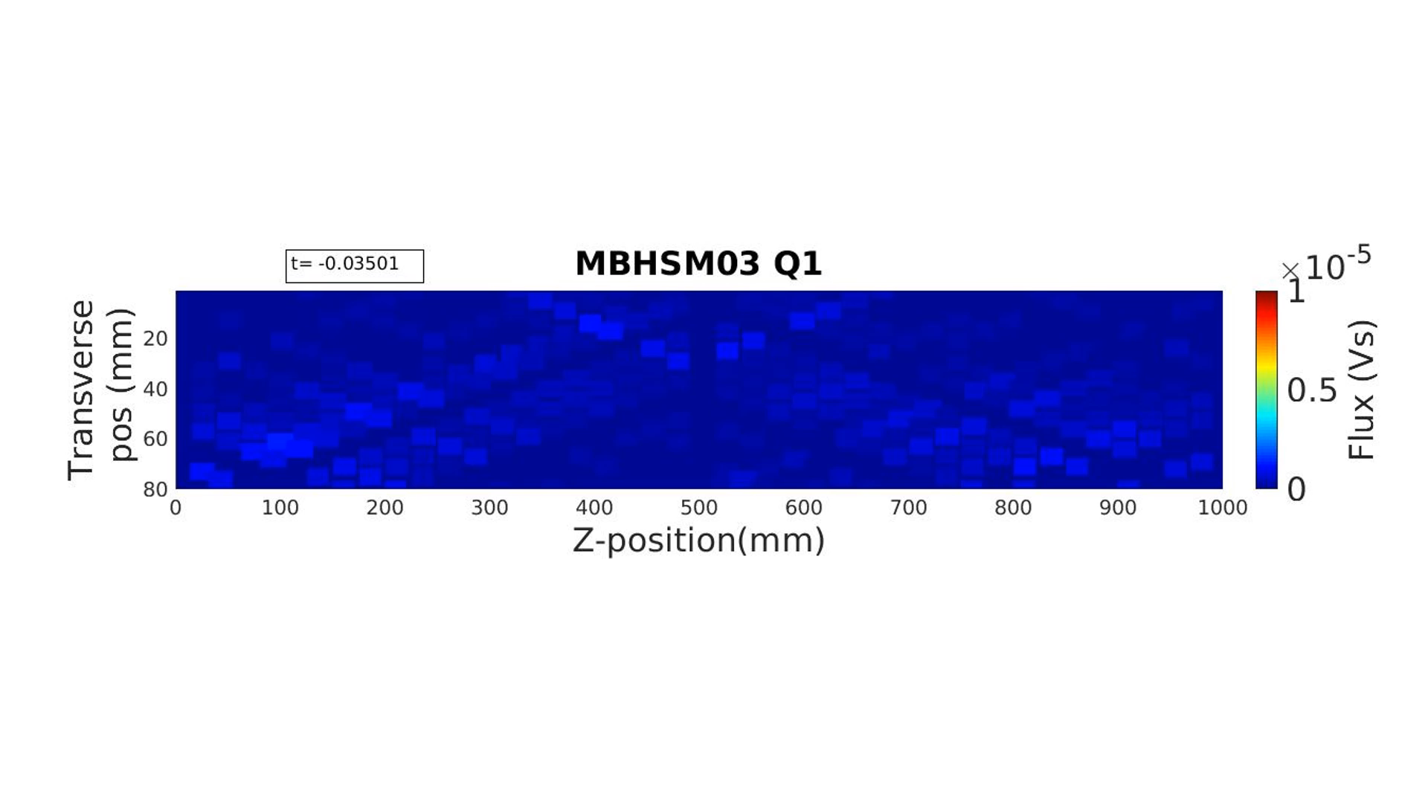
Can try to look at quench activity across sequence of time slices
Here look at flux change over first 8ms of quench (sampled every 0.1ms)

Slide 14
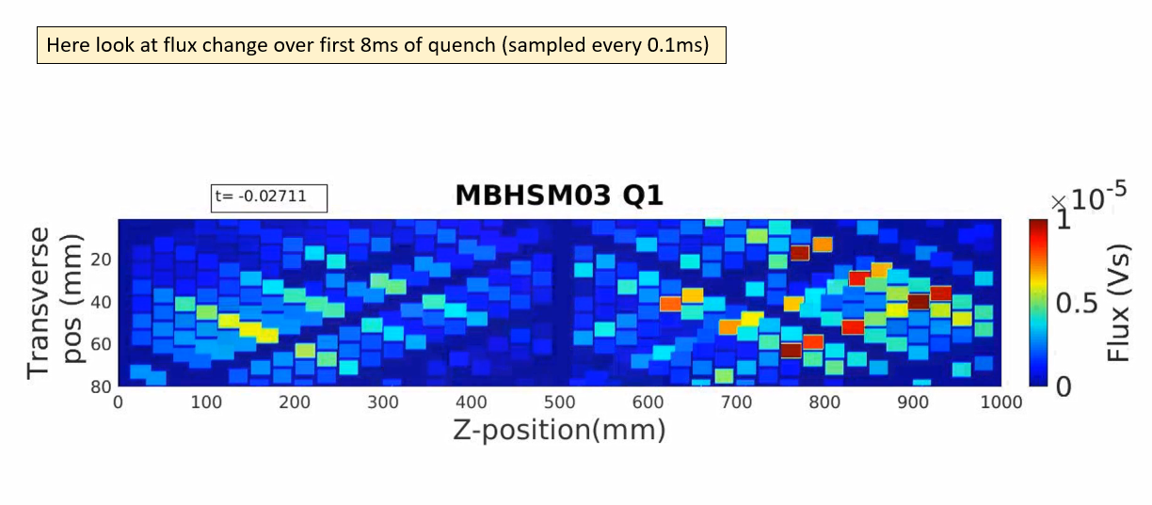
Note that this kind of analysis has the ability to produce spurious results; e.g the two ‘hot’ regions nearer the edges are each formed by two active intersecting lines – which then form other intersections.
➔ Limits to how much can track quench development

Slide 15
After cold test disassembly showed that the coil had non-planarity and cracks in the area of the outer coil quenches
S. Stoynev et al., “Commissioning, Performance, and Effect of the Quench Current-boosting Device on a Dedicated Superconducting Magnet”, Proceedings of ASC2022.

Slide 16
Other asymmetric QA designs to be tested shortly

Slide 17
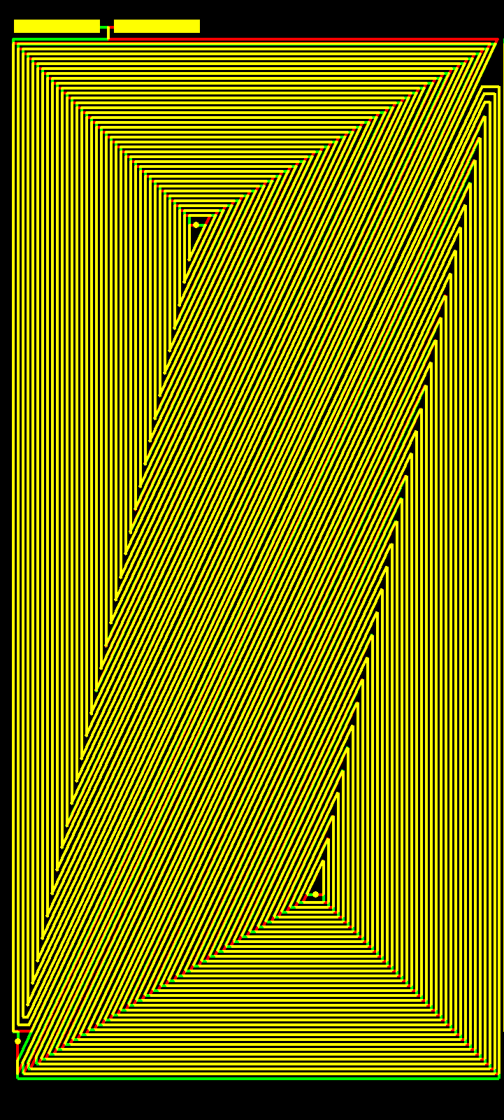
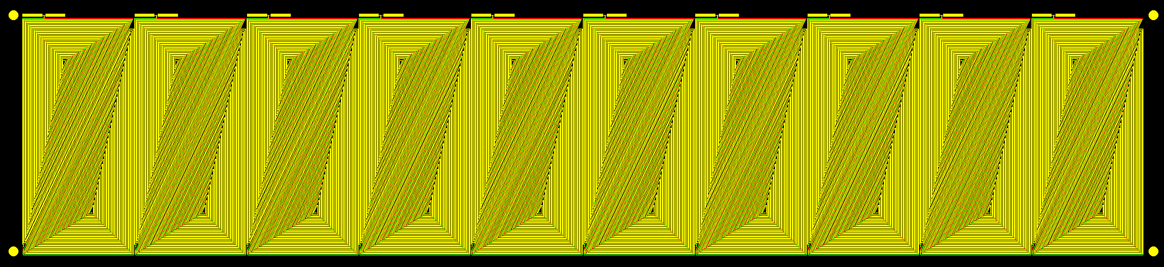
Triangle-pair array for detecting quenches in axial direction
85mm x 400mm
comprised of 10 triangle pair QA, each 85mm x 40mm.
Triangle asymmetry avoids ‘dead zones’.
The triangle pair QA does have areas of low sensitivity, but as quench propagates axially, the triangle pair antenna’s sensitivity varies repeatedly from minimum to maximum ➔ areas of insensitivities have limited axial scope.

Slide 18
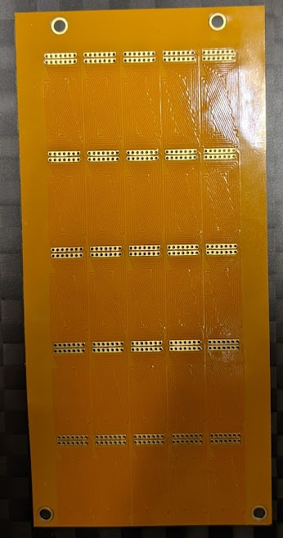
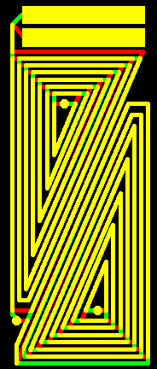
5x5 pixel antenna
Small sensor array that could give fine resolution. Number of turns is 14 and loops are small but could be used interlayer and have sufficient sensitivity from proximity.
Very channel intensive!
25 channels for 50mm x 100mm
50mm
10mm
The two triangles have opposite chirality to buck local field
100mm
20mm

Slide 19
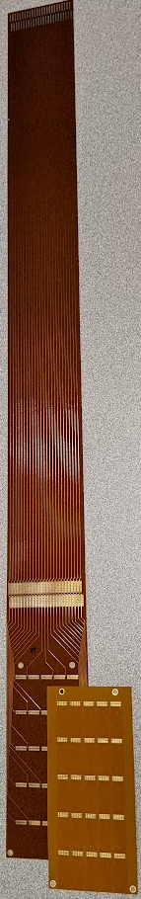
Wiring panels have been fabricated which have 50 wires (25 pair) and are 0.5m long, to transfer signals from 5x5 pixel QA.
The wire pairs travel front/back of the panel to be low noise.
The 5x5 QA is aligned using the matching holes on both flex circuits and soldered after tinning the surfaces.
Could be very useful to get signals out from between coils, anticryostat, etc…
The wiring panels can be chained to extend the signals as needed; or truncated to simply provide easier wiring to the 25 circuits.

Slide 20
Warm Test Stand for QA

Slide 21
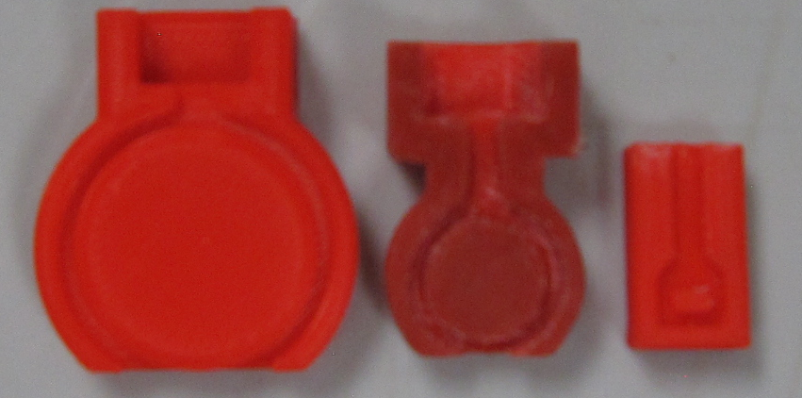
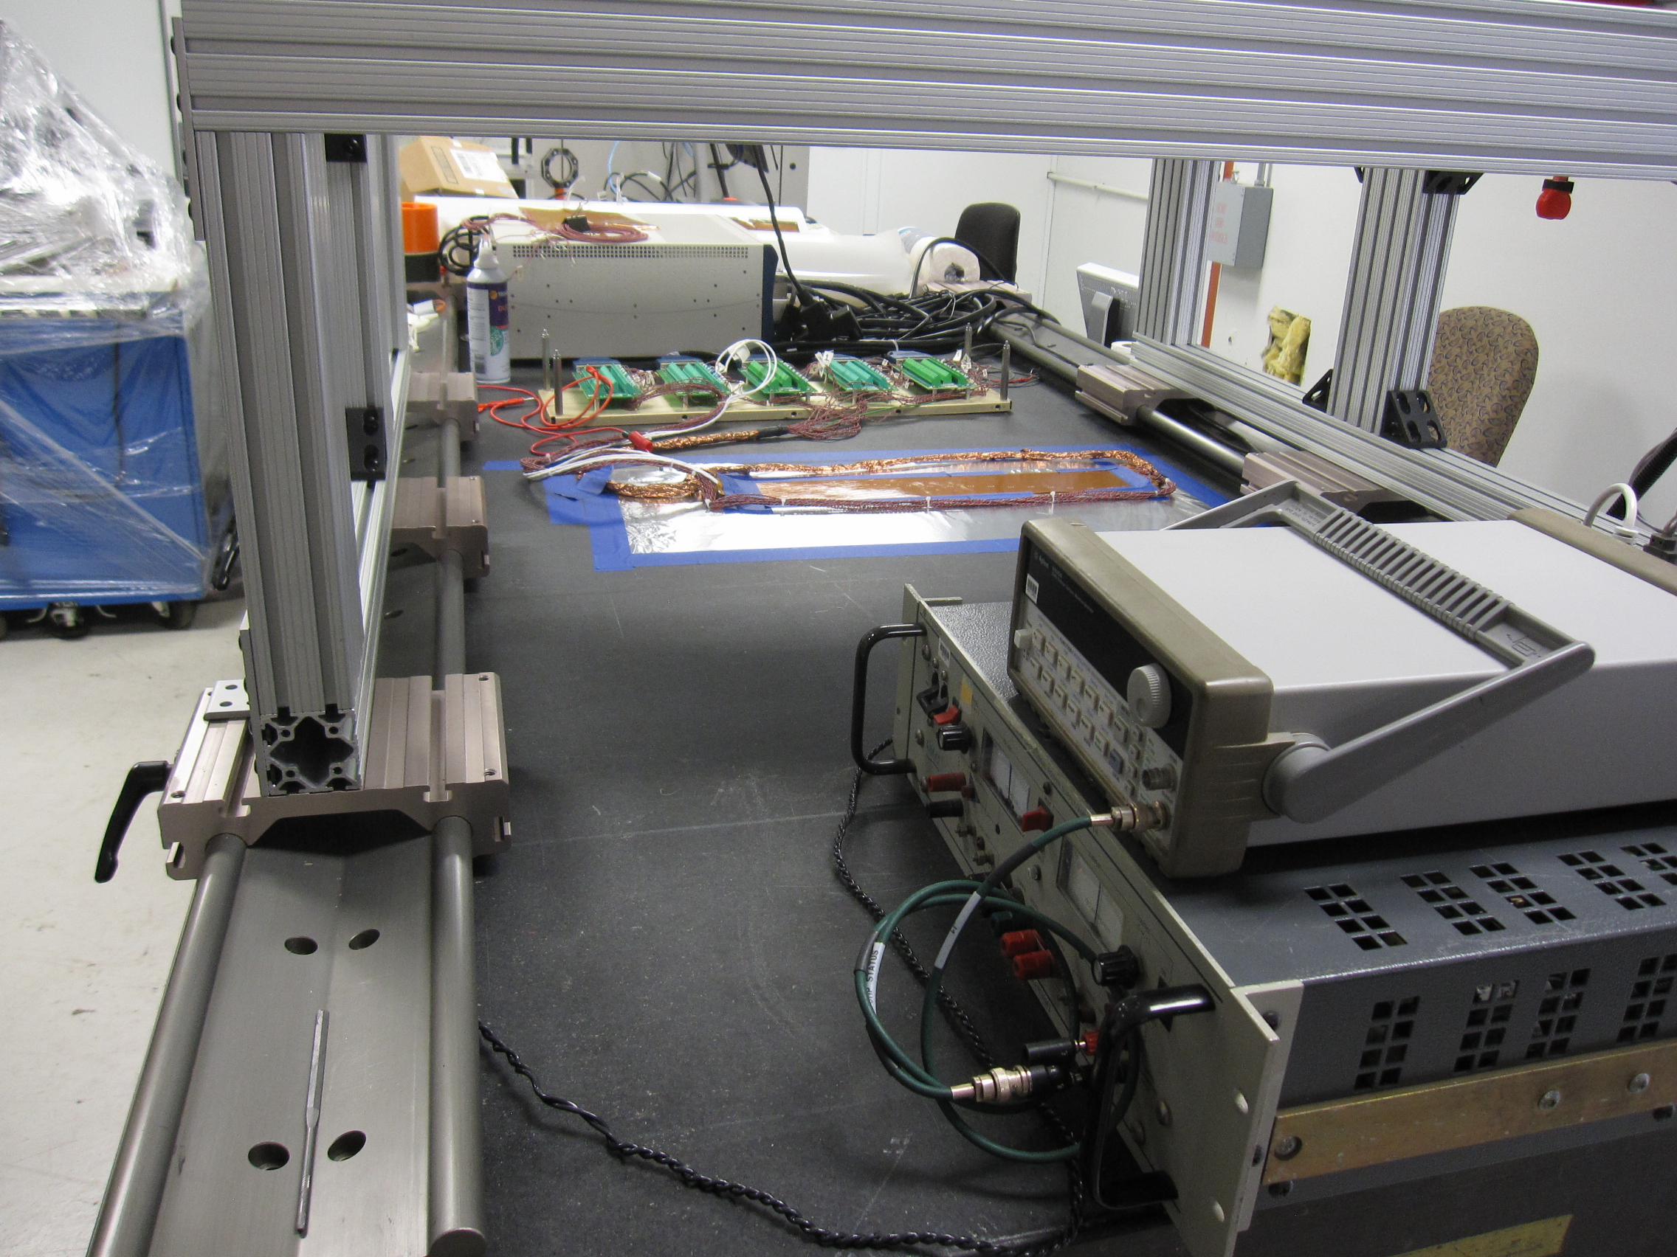
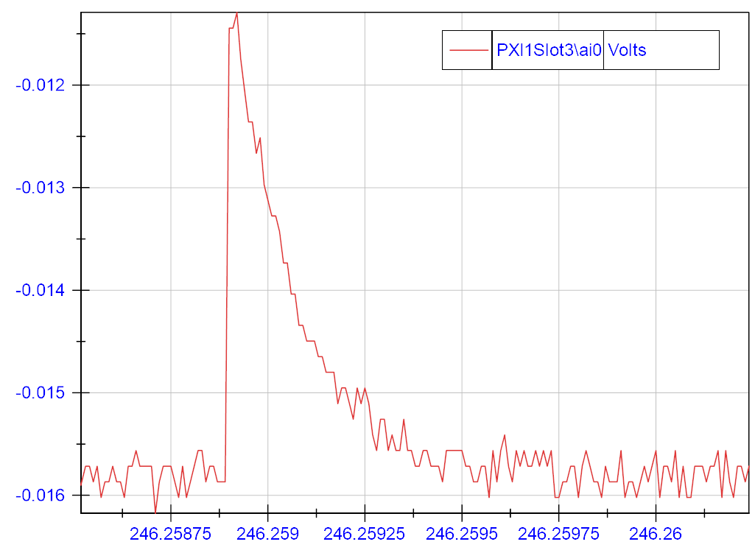
Warm test stand (WTS) measurements
Flux variation
source positioning
(loop holder)
Investigating QA designs/boards pre- or post- “cold” tests.
On the long path to reproduce/emulate “cold” data…
(2 cm diameter loop)
(the loop plane is perpendicular
to the QA board plane and
along the QA’s length)
WTS (positioning system)
frame
(positioning
to within tens of microns)
(over grounded
aluminum foil)
Flex-QA
DAQ
QA response to a pulse
(100 kHz)
Current generator
τ~0.2 ms
(square waves,
100 Hz, ±12 A)

Slide 22
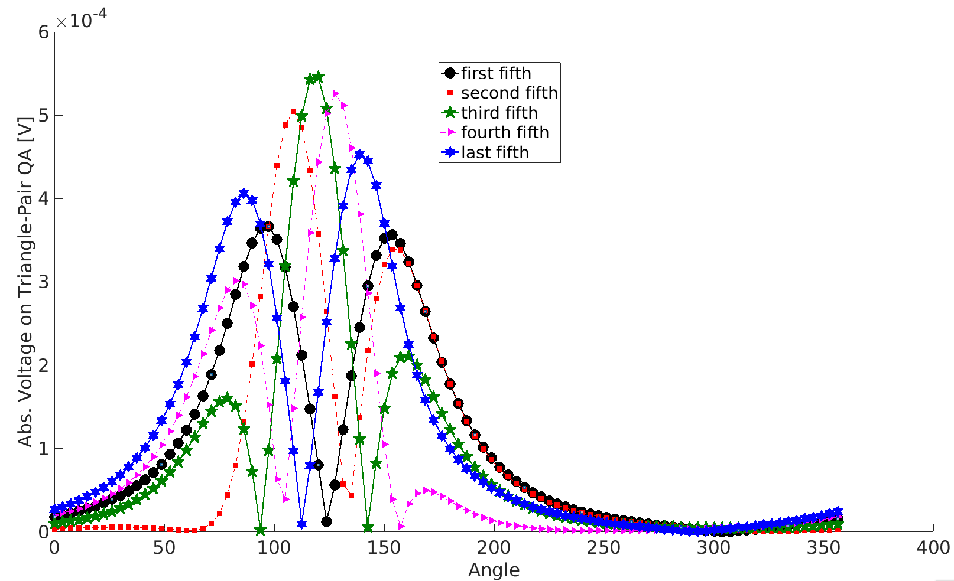
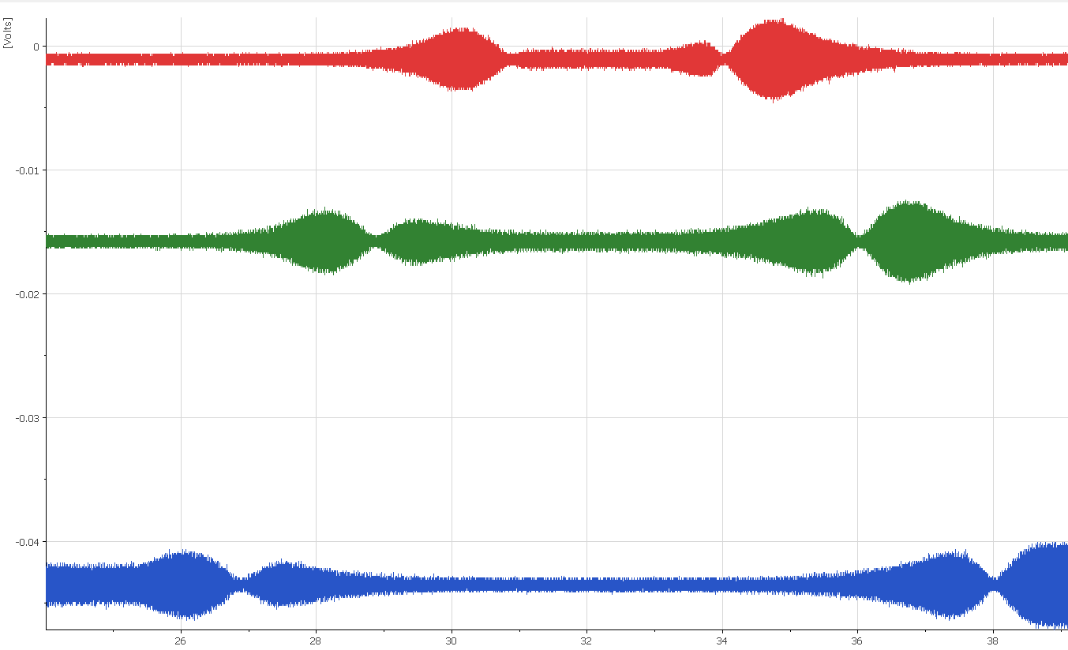
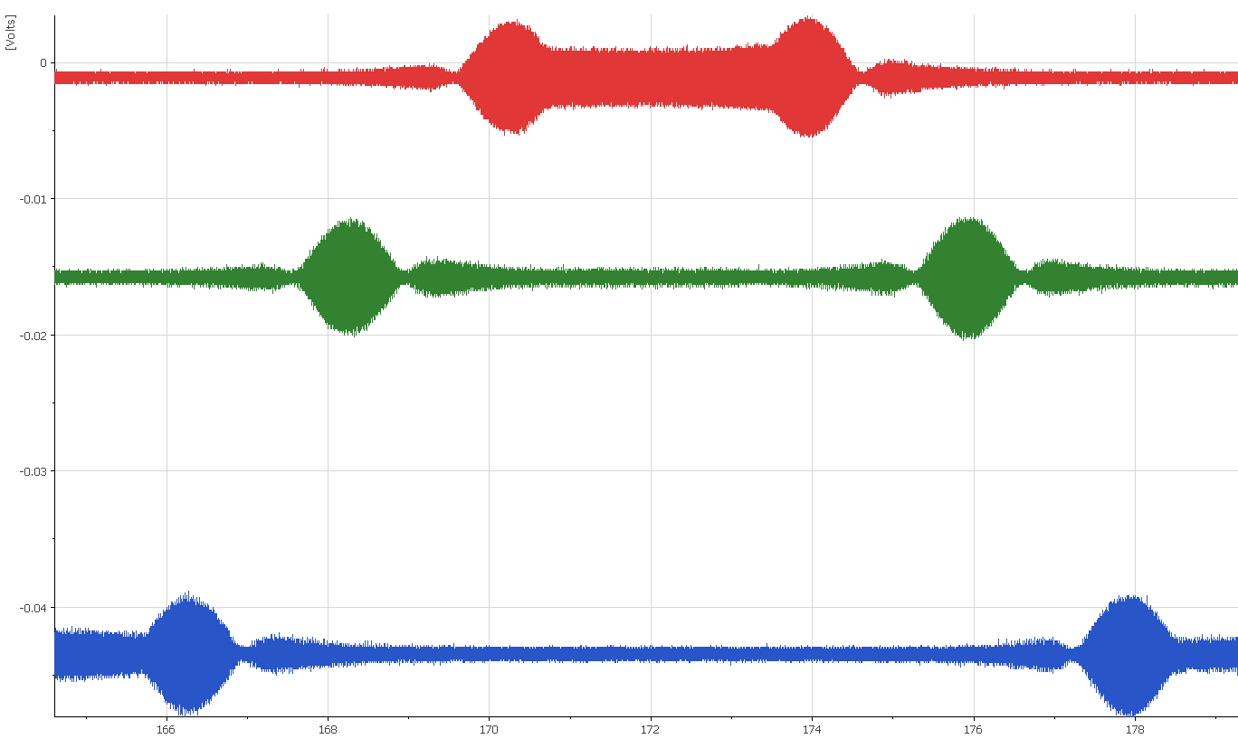
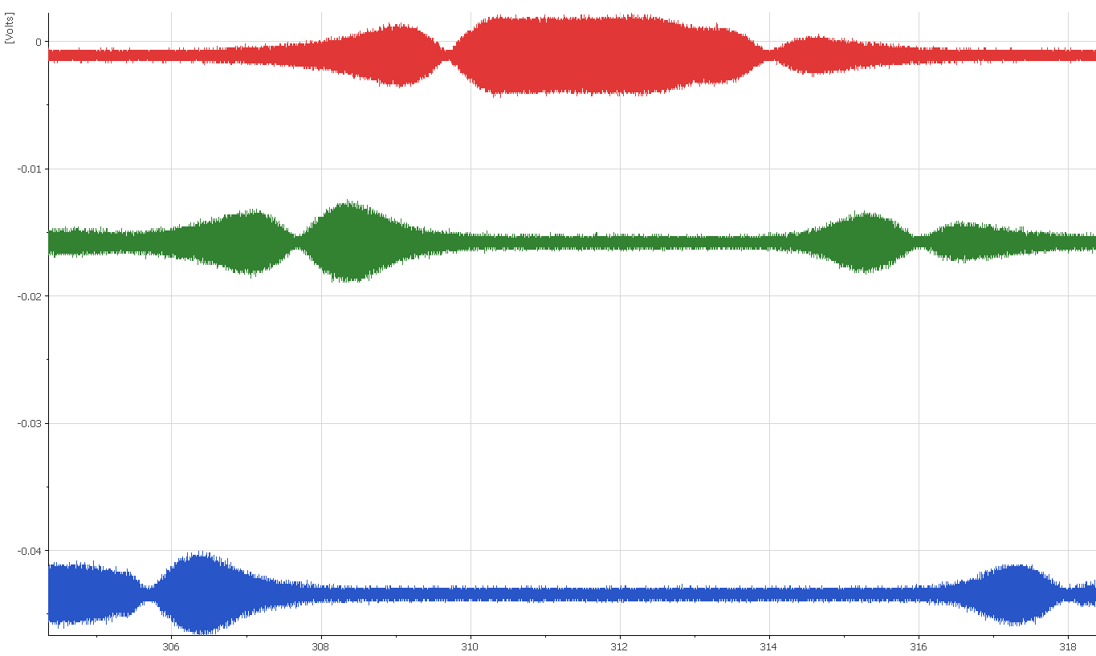
Simulations
➔ Emulating current redistribution at quench time by a current element of 1/5 of channel length; at five positions along the QA, covering the length.
Not all relative geometry is exactly simulated yet.
The dependence shows sensitivity to current redistribution at various axial positions as the source moves across the sensor.
Simulations:
Current element at:
Data shapes
from WTS:
of sensor
length
Location along channel width at fixed axial location
(deg)
Simulations and WTS data agree well about data features. The ultimate goal is to be able to
emulate real quench data at WTS, for elaborate QA designs, and be able to simulate it as well.

Slide 23
Binary-coded quench antenna arrays

Slide 24
Binary-coded antenna arrays
If try to monitor long magnets completely with QA arrays, end up having large number (100’s) of channels/wires – becomes difficult to implement and maintain.
Try to explore mitigating this by having a pattern of active antennas connected in series. There are multiple layers of these series arrays stacked on top of each other, sampling the same area but with different pattern variations. Their response provides a binary code for location of activity.
Example:
Channel 1
Up to 30 QA connected in series
QA active
Channel 2
QA shorted
Channel 3
Channel 4
Channel 5
⬅Magnet Z-location➔
Uses only 5 signals to resolve 30 locations of activity.
(e.g., if each QA is 100mm long, monitor 3m of magnet at that resolution while using only 5 channels)
e.g. if only channels 1, 3, 5 show voltage above threshold, then the quench must have occurred at this location

Slide 25
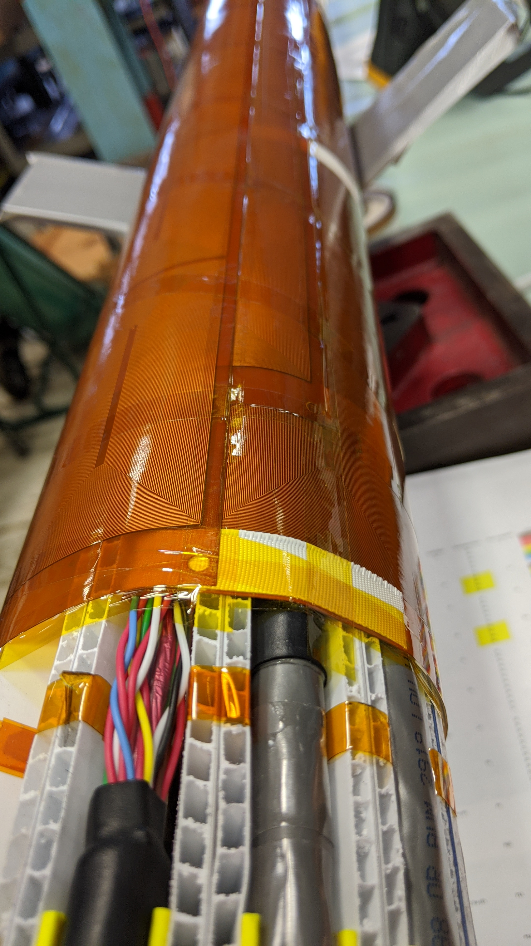
Simulation to test binary-coded QA (BQA) concept
  Have previously built a full length (4.8m) quench antenna array for monitoring quench events in LHC Hi-Lumi AUP production quadrupoles.
  Each antenna is 100mm long, ~110 channels of simultaneously monitored data with 50mm overlap.
  Use data from the AUP quad antenna array to simulate BQA response.
  In the region of a quench, sum up the individual raw voltage channels that would represent the digital pattern of a BQA antenna
  Do this for 4 different patterns, thereby creating 4 ‘encoded’ channels of voltage data from the original 15 channels of actual data
  Try to ‘decode’ the 4-channel BQA data to determine quench location
  Compare to the quench location determined by the original 15 channels
Digitally make binary-encoded QAs and compare to individual response
(note because of the overlap and sensitivity gaps, the ‘encoded’ signals will not necessarily yield a fair comparison)

Slide 26
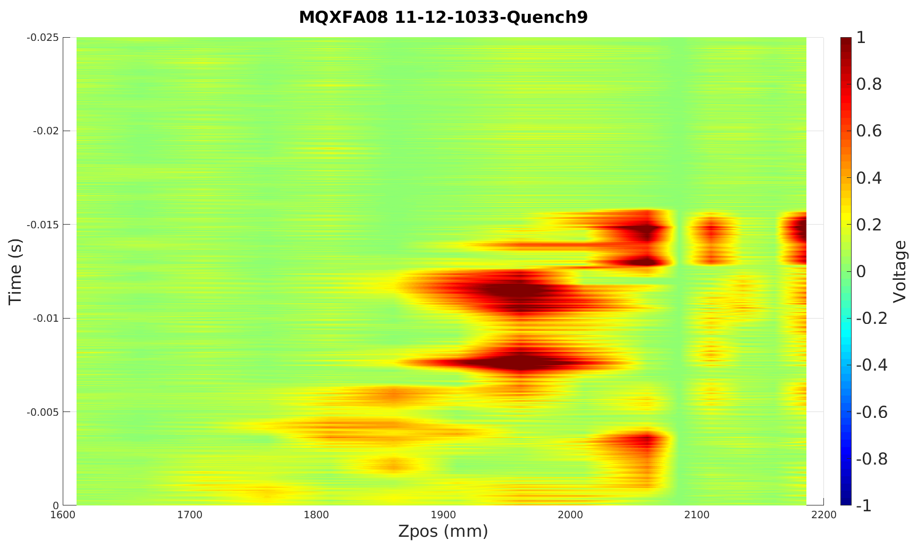
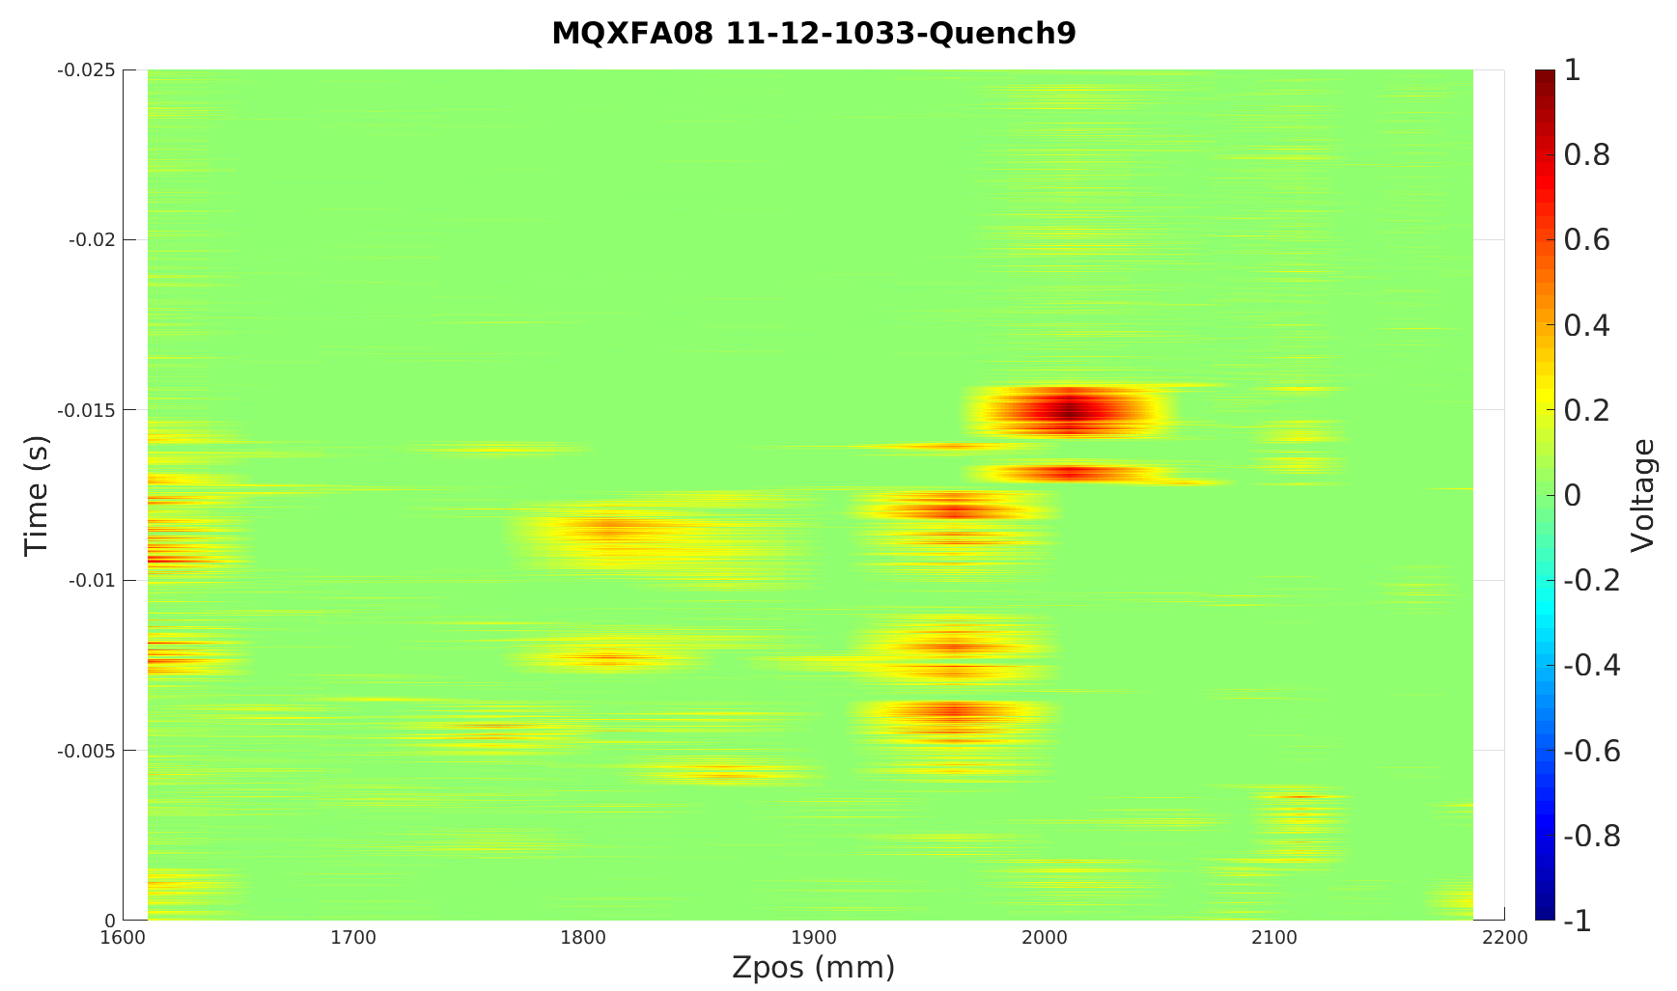
Binary-encoded QA simulation preliminary results:
Original data quench location result
BQA result
Used normalized signals
Evaluate at each time sample (10 µs)
For each time slice, evaluate with various thresholds
Technique seems promising - optimizing algorithms is still work in progress
Summer student (Atharva Kulkarni) helped with this effort

Slide 27
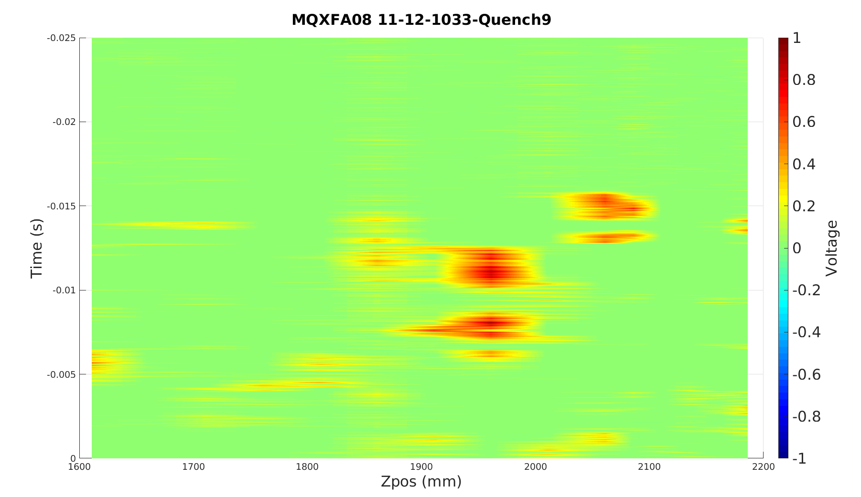
Encoded with binary numerical sequence
Original data quench location result
BQA result
BQA result
Encoded with Gray (reflected binary) code sequence – i.e. only 1 bit change between adjacent positions.
If quench occurs at boundary of two QA, using Gray-code pattern gives reasonable response

Slide 28
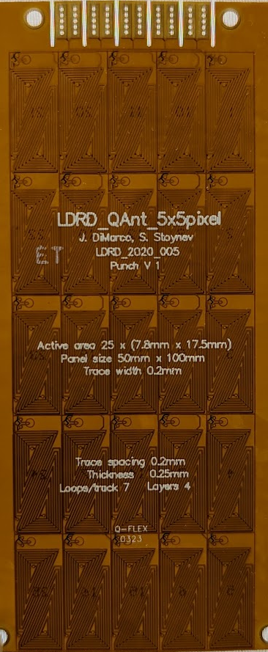
Binary-coded QA test in preparation
5x5 ‘pixel’ PCB
with extra internal connections to make BQA patterns.
BQA PCBs were procured that were essentially same as 5x5 pixel antennas but with series connections on additional layers.
Circuits are initially shorted (no sensitivity) but can be individually activated to obtain whatever series pattern is needed (designed by T. Cummings)
Will compare results of individually wired 5x5 grid (25 signals) with stack of 5 BQA-type QA on next cryo mirror magnet test.
In the longer term, further use of quench simulation and/or testing at WTS ➔ test reliability and accuracy of quench start localization and development - especially whether there would be some quenches that would not be registered accurately, behavior if there are multiple quenches, etc…

Slide 29
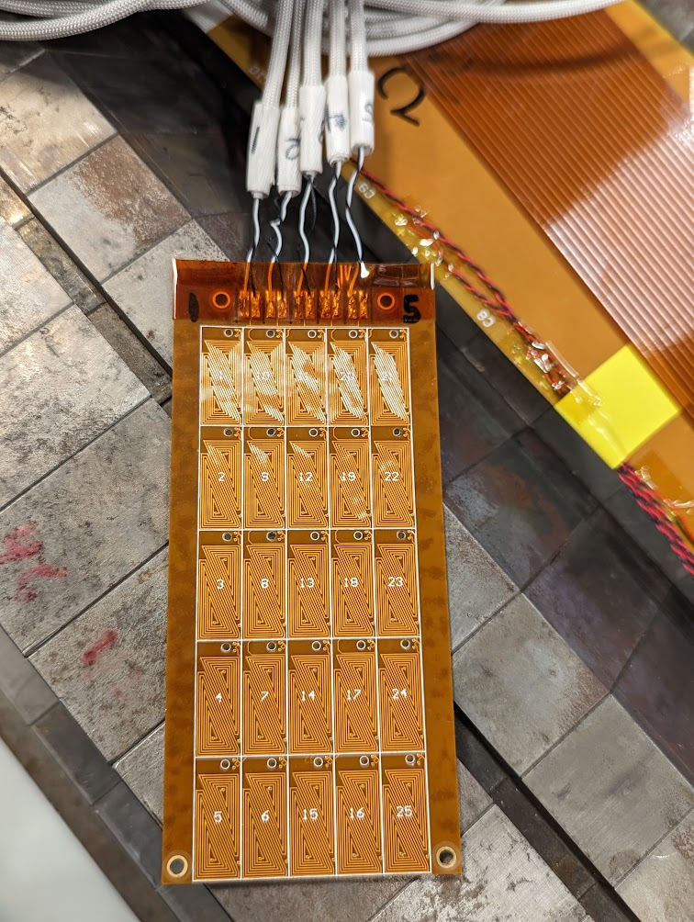
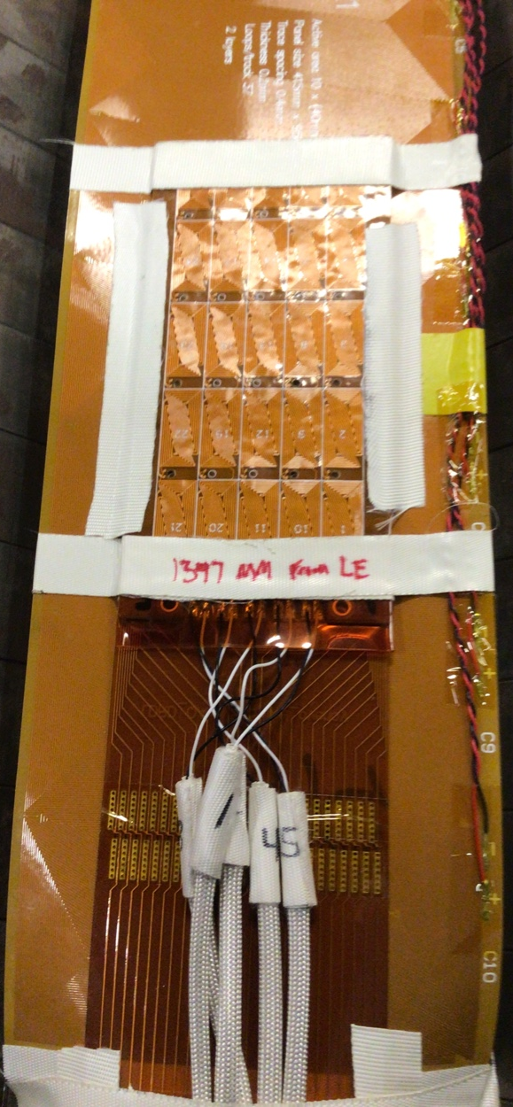
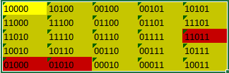
Assembled stack of 5 BQA antennas
BQAs mounted on individually-wired 5x5 QA and on larger triangle-pair QA array
This 5-Layer BQA uses a 2D- Gray coded pattern (as much as possible; for 5 signals, the 2D Gray code fits a 4x8 shape – so there are a couple areas that have a 2-bit distance with neighbors and 1 area with 3 bit).

Slide 30
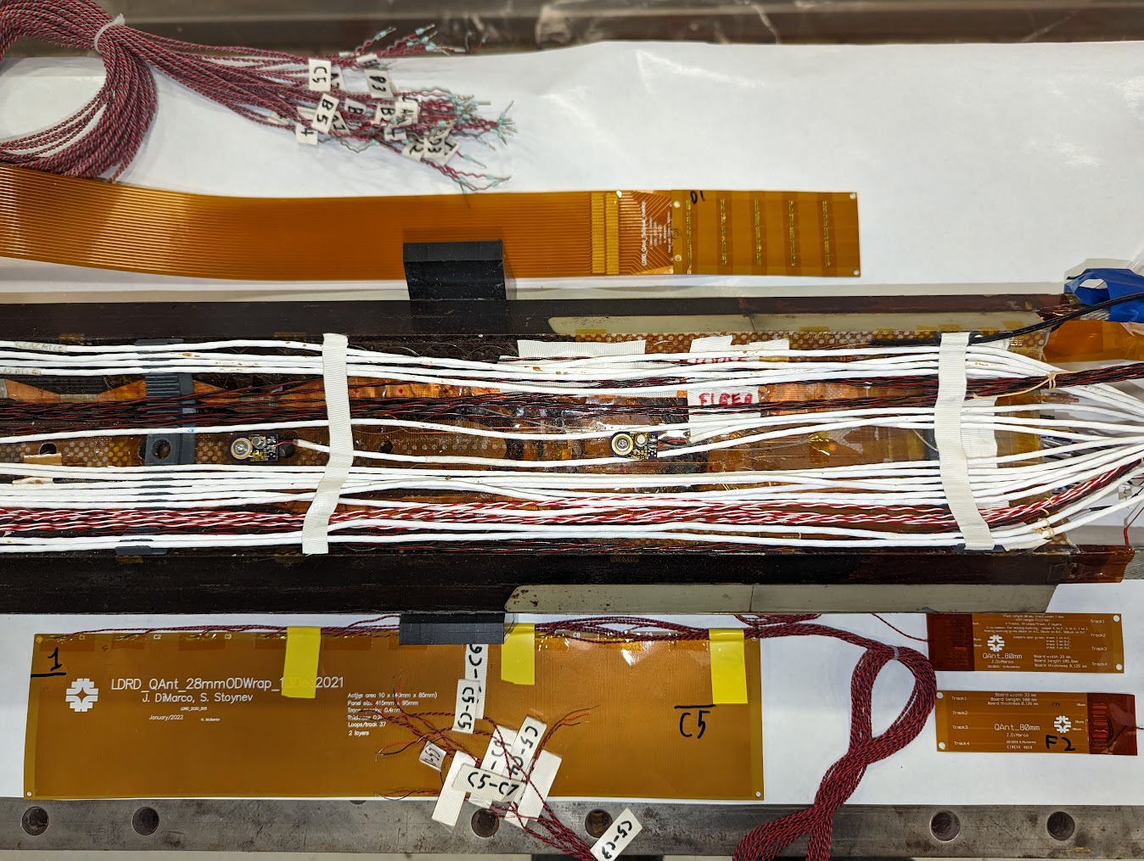
Wiring panel
5x5 pixel QA array
Binary-enc QA is mounted directly on top of 5x5 pixel array
DQBuck ‘magMeas’ QA
Large ‘bucked-triangle’ QA array

Slide 31

(part II)
Non-rotating Probe Development
28Apr2023
J. DiMarco, M. Marchevsky

Slide 32
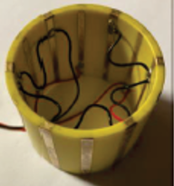
Torsionally oscillating piezo probe for magnetic measurements
Original idea from Maxim
Torsional piezo-transducer attached to cylindrical probe form
Wires on probe cylinder excited with AC current at piezo resonance
Get piezo torque response as a function of angle ➔ sensitive to all harmonics.
Use piezo transducer amplitude at resonance vs angle to determine main field and harmonic content
Eventually would calibrate against known rotating coil
Torsional piezo-transducer

Slide 33
Why make such a device?
Piezo transducers have the resolution necessary
Probe could be simple and robust
Probe could be used without an anticryostat or mechanical feed-through to cryogenic conditions.
Depending on time to settle at resonance when multiplexing, the measurement may be very fast and even useful for seeing transients

Slide 34
First step – torque vs angle
Single wire measurements at radius of probe
  16 single wires on sturdy flex PCB (2 oz. copper) mounted on cylindrical form
  Powered AC with few Amps of current.
  Frequency control of AC current so can tune to piezo resonance.
  Use multiplexer to select power applied to each wire at angle paired with neighboring wire.
Piezo probe is comprised of some number of wires precisely positioned around perimeter of cylinder (shown are 16).
Power each wire in turn with AC current corresponding to resonant frequency of piezo, with return of circuit being on neighboring wire.
Each wire will be sensitive to all harmonic fields and torque will depend on field vs angle.

Slide 35
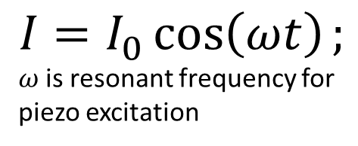

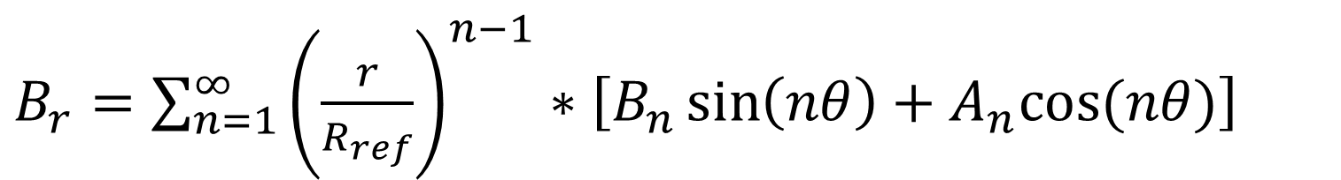
S
$$\vec{F}=\vec{I}L x \vec{B}$$
B
I into page
F
$$I=I_{0}\cos\left(ωt\right);$$
$ω$is resonant frequency for piezo excitation
Radial portion of field contributes to torque on current carrying windings
N
$B_{r}=\sum_{n=1}^{∞}{{\left(\frac{r}{R_{ref}}\right)}^{n−1}∗\left[B_{n}\sin\left(nθ\right)+A_{n}cos⁡(nθ)\right]}$
At each perimeter position, since the winding is being excited at resonance frequency, can use an FFT (or lock-in amp) to determine the amplitude of the torque at each angle. Then determine the harmonic fields as a function of angle around the perimeter from the torque amplitudes.

Slide 36
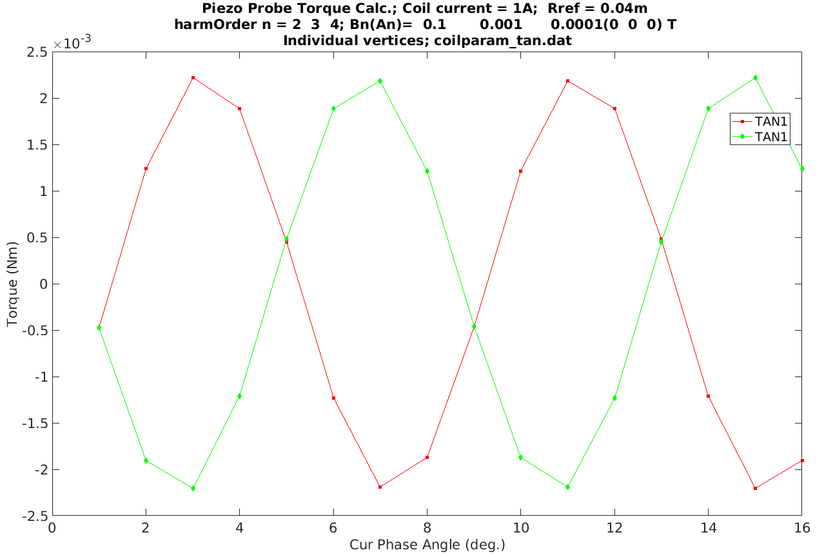

Slide 37
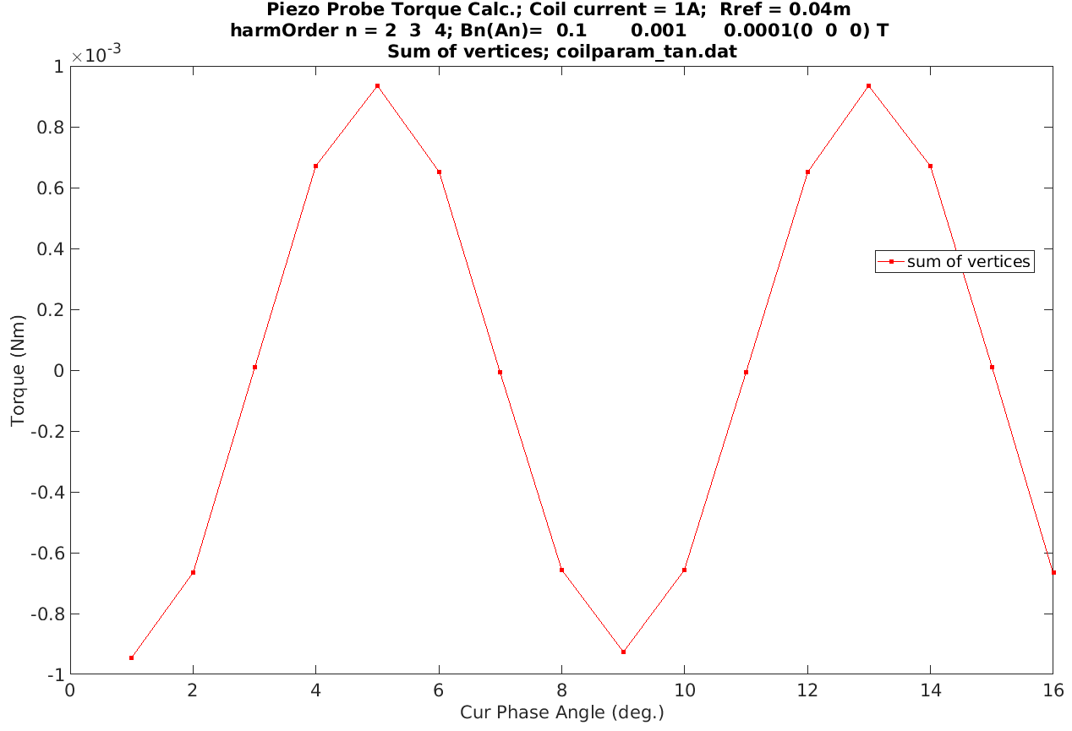

Slide 38
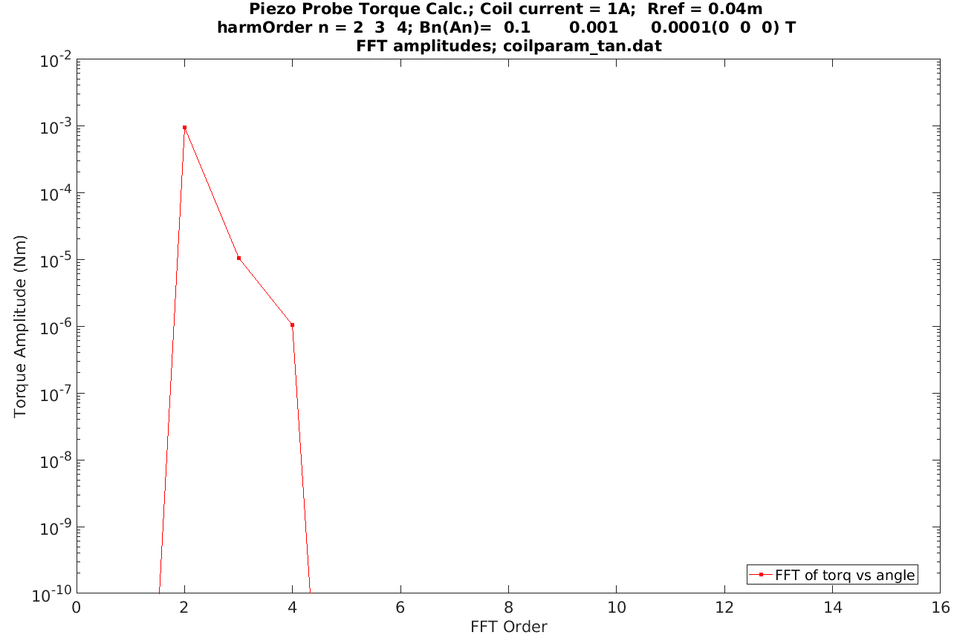

Slide 39
Possibility exists to have bucking of main field:
  Can either power e.g. wire at 90 degree (for quad) (or at 80 deg. and 110 deg. with current amplitude balanced so as to match phase of quad exactly)
    Note that for different harmonics, may have to buck in different ways
    Note also that there might be a more elaborate calibration since each vertex might have a different sensitivity to the quad and slightly different phase errors that have to be compensated.
  Or can have another set of wires at much smaller radius (in quad symmetry e.g., and normal and skew so can match any phase of the main wire at the full radius) with power in reverse of main wire – this will create a torque that will buck the torque on the single wire from the quad and leave us more sensitivity to higher harmonics.
Probe assembly will begin in summer 2023…

