Slide 1
Quench antenna development at CERN
Lucio Fiscarelli
2nd Instrumentation and Diagnostics for Superconducting Magnets Workshop
Paestum, 26-29 April 2023

Slide 2
Outline
Requirements
Design principles
Details of our implementation
Examples of results
Further developments

Slide 3
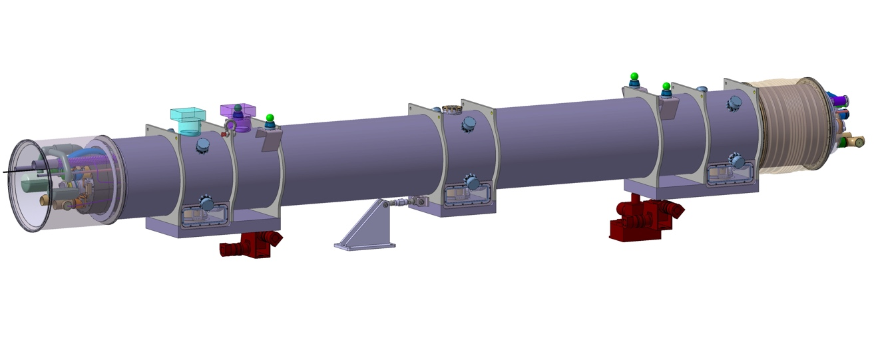
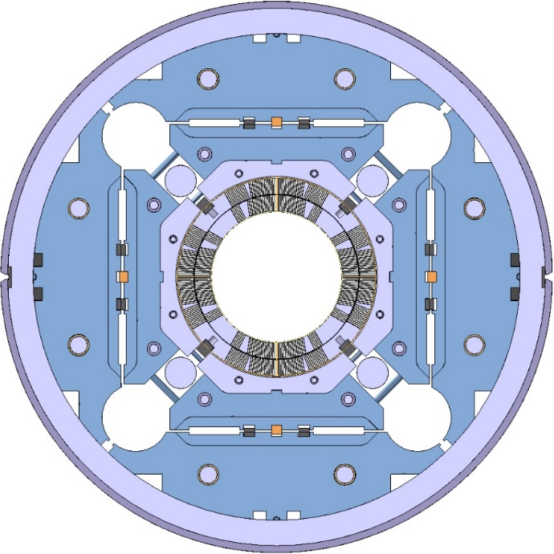
Requirements
~8 m
Test of the series MQXFB magnets
~8-m-long quadrupoles
No voltage taps in the coils
Horizontal test
Anti-cryostat (Ø110 mm)
Transverse localization with resolution at the level of one turn
150 mm

Slide 4
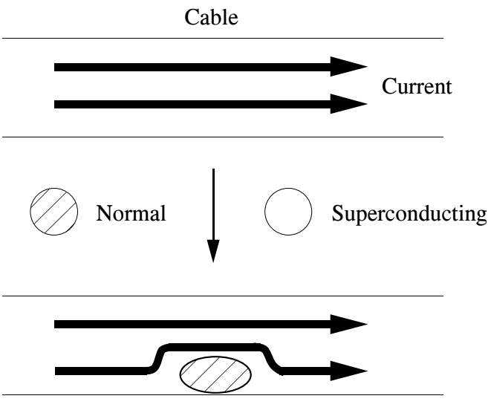
Magnetic perturbation generated by a quench
At the quench onset, some current must bypass the forming resistive region.
Considering only the change, it is equivalent to a −∆ current flowing in the resistive region, and a +∆ current flowing at a certain distance.
Magnetic moment
T. Ogitsu, Review of Magnetic Quench Antenna
for Accelerator Magnets, IDSM01 2019

Slide 5
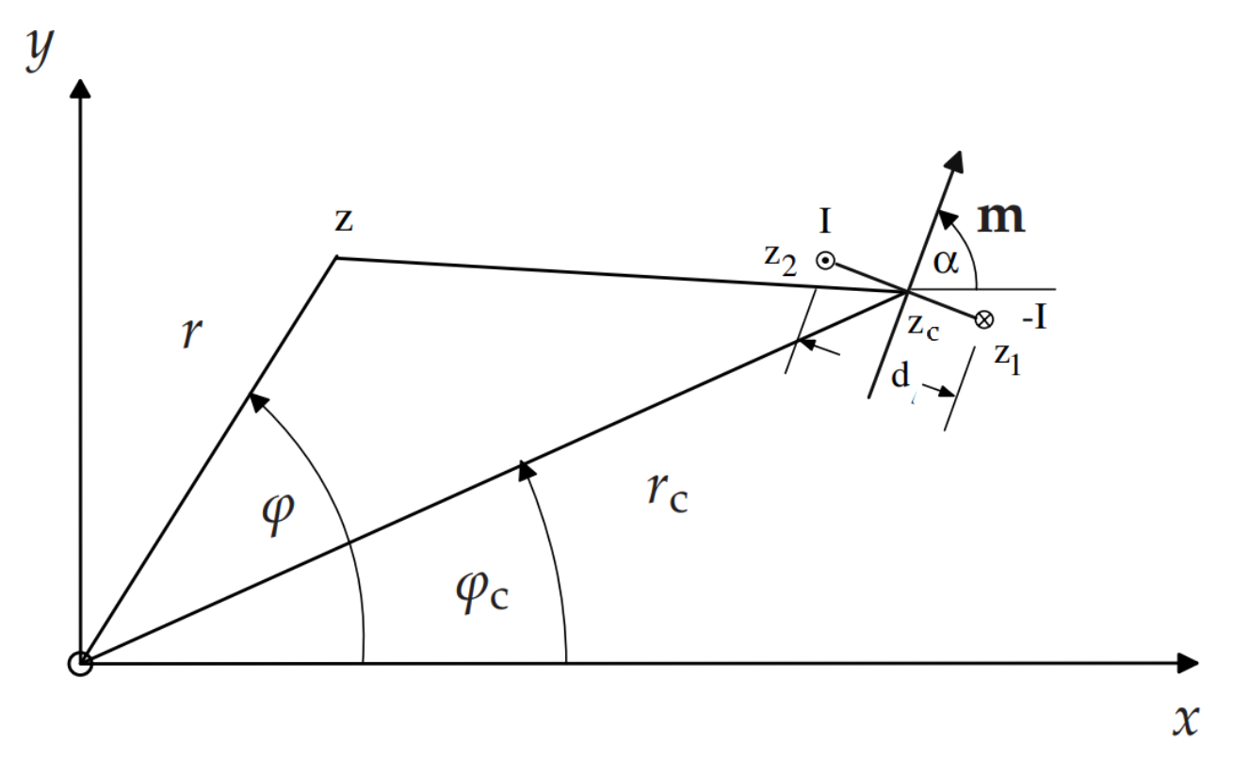


Field generated by a magnetic moment
$C_{n}=B_{n}+i$ $A_{n}$
In 2D, the field generated by a magnetic moment can be written in terms of multipoles:
Knowing two multipoles of different order, for example C₃ and C₄, we can retrieve z_{c}
$$z_{c}=\frac{4}{3} \frac{C_{3}}{C_{4}} r$$
S. Russenschuck, Field Computation for Accelerator Magnets, WILEY 2010

Slide 6
Sensitivity of a pickup coil
Coil
A pickup coil is sensitive to almost all multipoles.
A combination of coils can be used to tune the sensitivity (compensation).
Which is the best combination for quench localization?
Minimum number of signals
Noise cancellation (no sensitivity to main field and lower orders)

Slide 7
Coil configuration sensitive to one multipole
Coil 2
Coil 1
Playing with
number of coils
winding size
angle
we can build a sensor sensitive to one specific multipole only
Example for B₃
Coil 3

Slide 8


Ideal configuration
Quench Antenna for Superconducting Particle Accelerator Magnets, T. Ogitsu; A. Devred; K. Kim; J. Krzywinski; P. Radusewicz; R. Schermer; SSCL, T. Kobayashi; K. Tsuchiya; KEK, J. Muratore; P. Wanderer; BNL, 1993
$C_{n}=B_{n}+i$ $A_{n}$
B₃
A₃
$$z_{c}=\frac{4}{3} \frac{C_{3}}{C_{4}} r$$
B₄
A₄

Slide 9
More practical configuration
The 4 sets of coils can be “easily” realized on different layers of a flexible PCB, then wrapped around a support tube.
The multilayer PCB guarantees the alinement among coils.
Need of areas free of traces for:
making a cut along the PCB
alignment holes
Smaller coils at the price of a not-perfect sensitivity (first allowed)

Slide 10
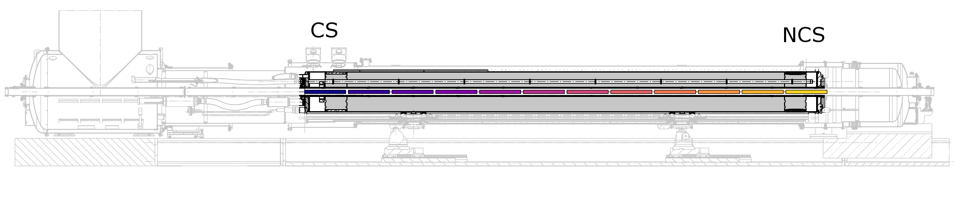
Length of the coils
The coil length gives the resolution in the longitudinal direction but:
the total number of signals should stay reasonable (<100)
the sensitivity is affected by some errors at the coil ends (2D and multipoles)
some space is needed for the connections (sensitivity “holes”)
12 segments with a length of 600 mm (12 x 4 = 48 signals)

Slide 11
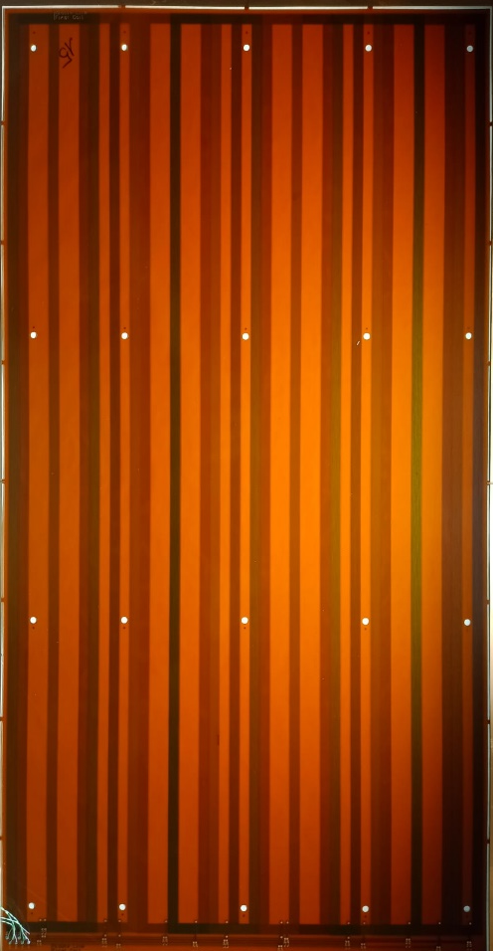
Our flexible PCB
600 mm
Credit to Jens Kaeske
314 mm

Slide 12
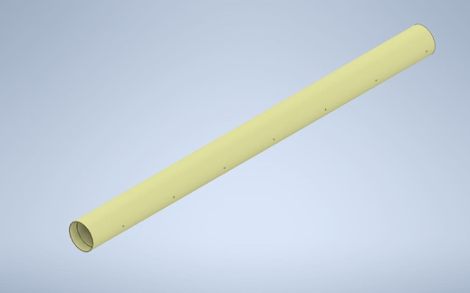
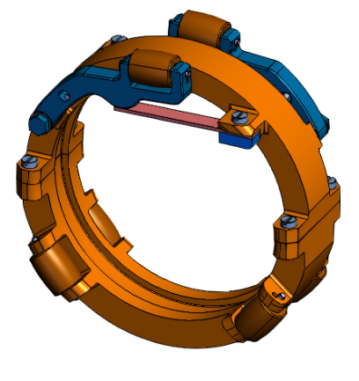
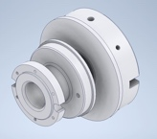
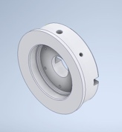
Support structure
Rollers are required to slide the shaft in/out of the anti-cryostat.
The support tube has a length of 1200 mm to reduce the number of rollers and “holes”.
EPGM tube Ø100 mm
Alignment holes
End-cup adapters
Rollers (from rotating coil)
Credit to Ricardo Beltron

Slide 13
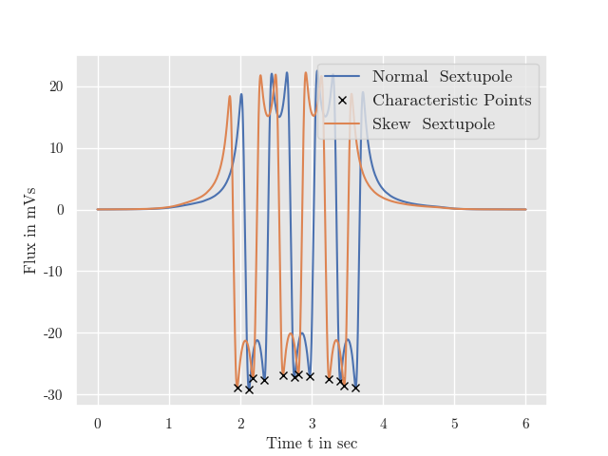
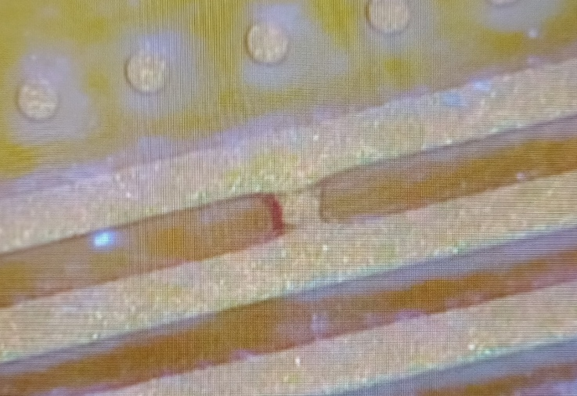
Check before assembly
Acquisition while sliding a small permanent magnet across the coils

Slide 14
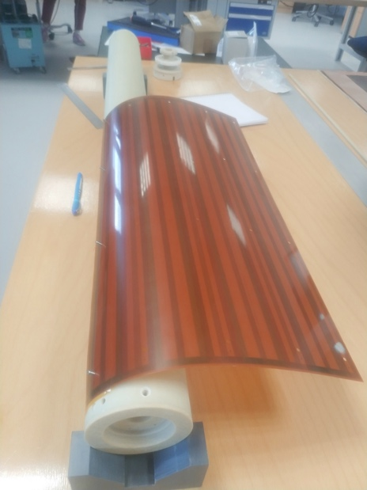
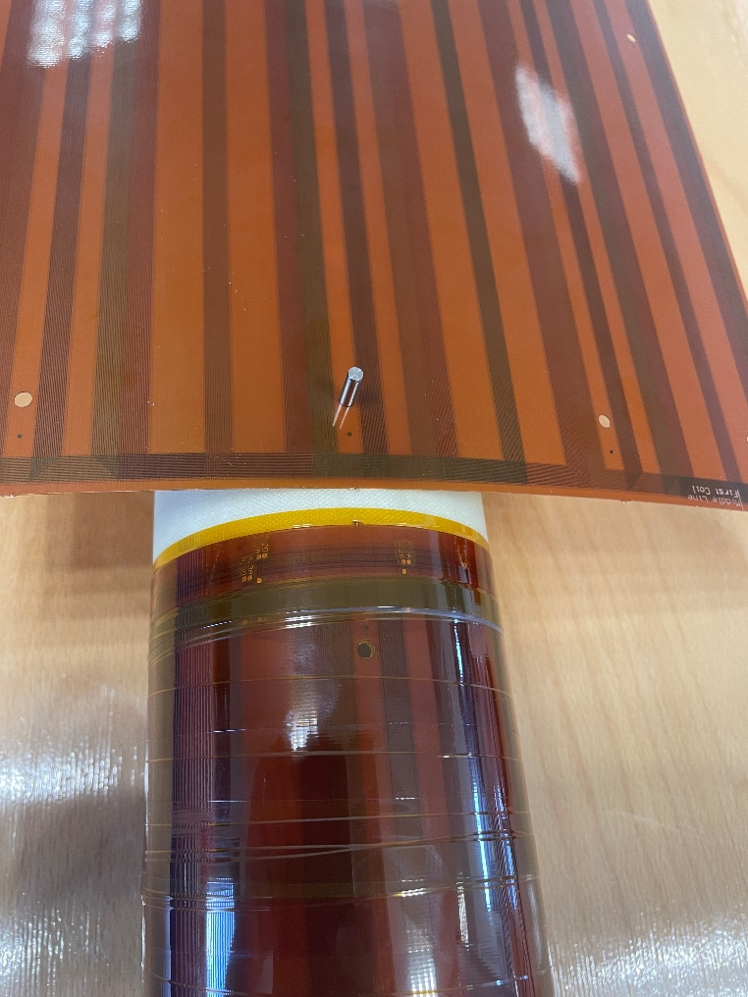
Assembly of the flexible PCB on the tube
The flexible PCBs are aligned on the tube thanks to removable pins.
The PCBs are wrapped with Kapton tape.
Thickness of the PCB is an important parameter:
~0.3 mm
sufficiently stiff and robust

Slide 15
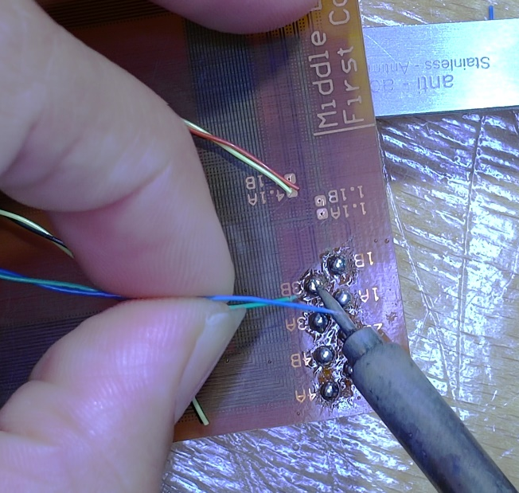
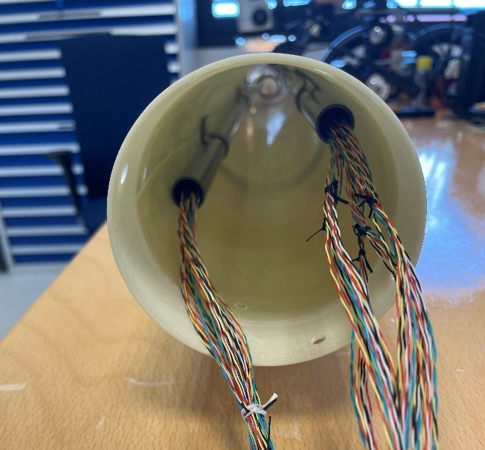
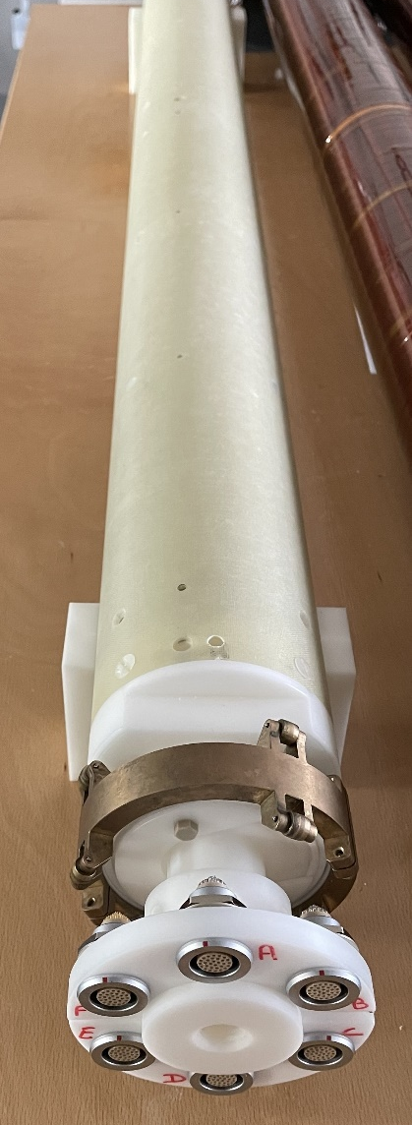
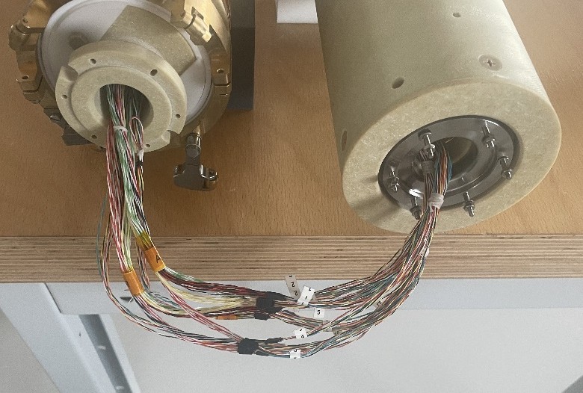
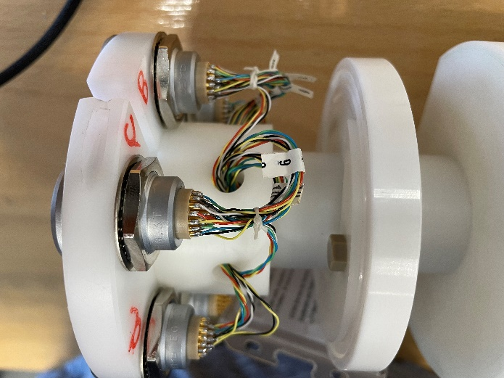
Cabling

Slide 16
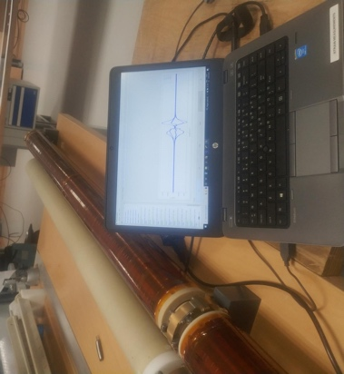
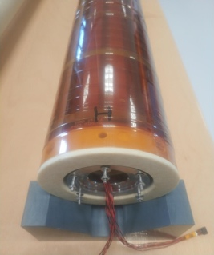
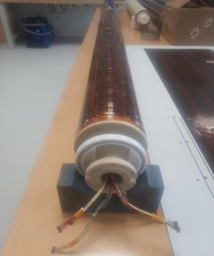
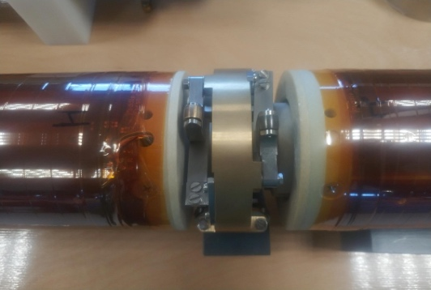
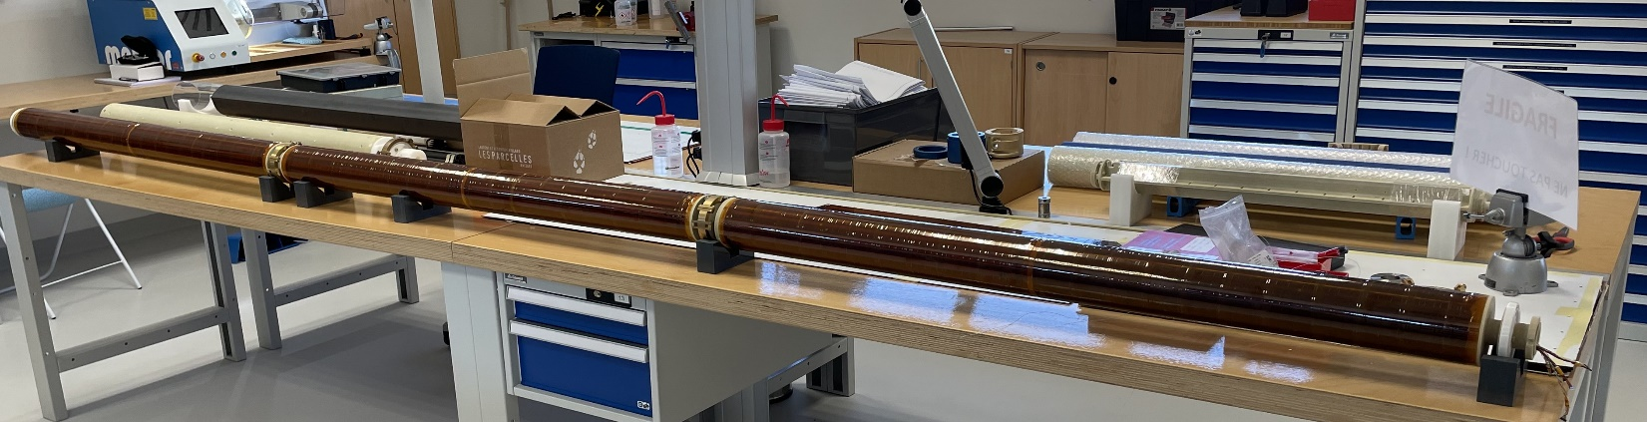
More checks…

Slide 17
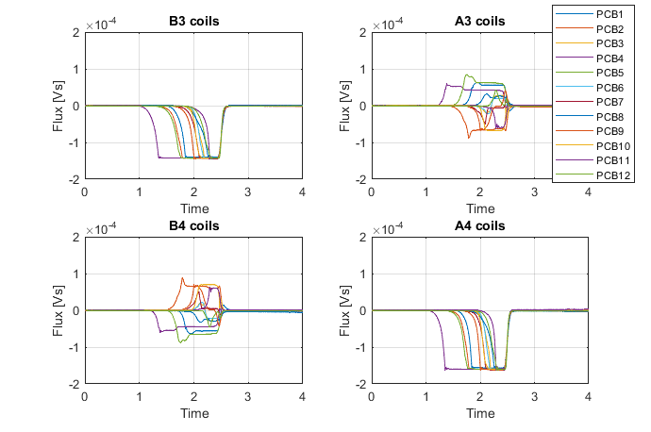
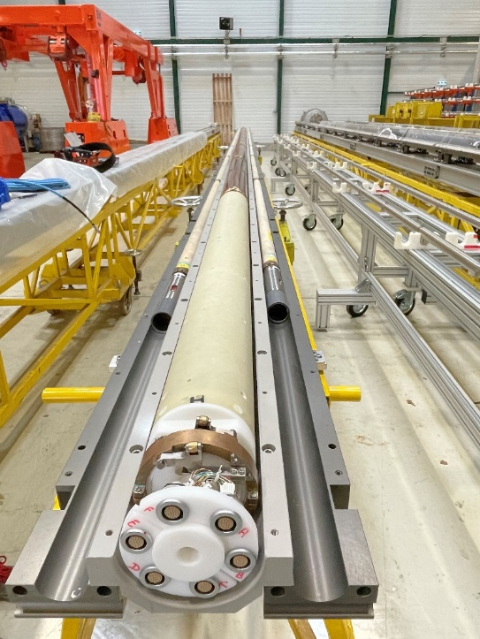
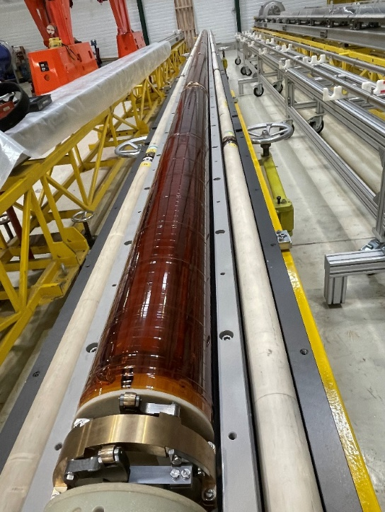
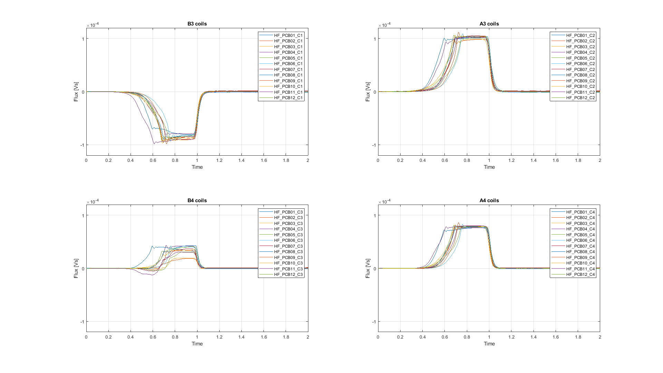
And more checks…
Check of the full assembly including cable extensions and acquisition system
Sliding a permanent magnets along the shaft

Slide 18
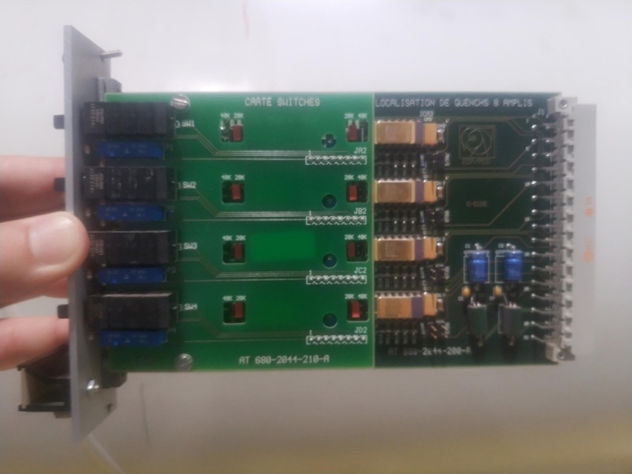
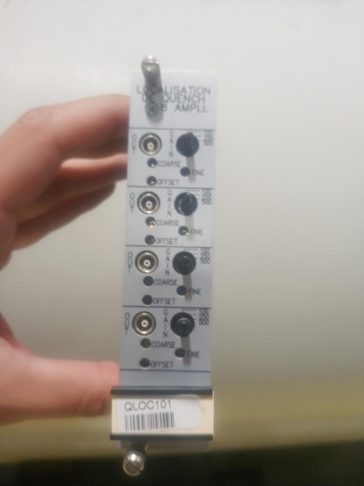
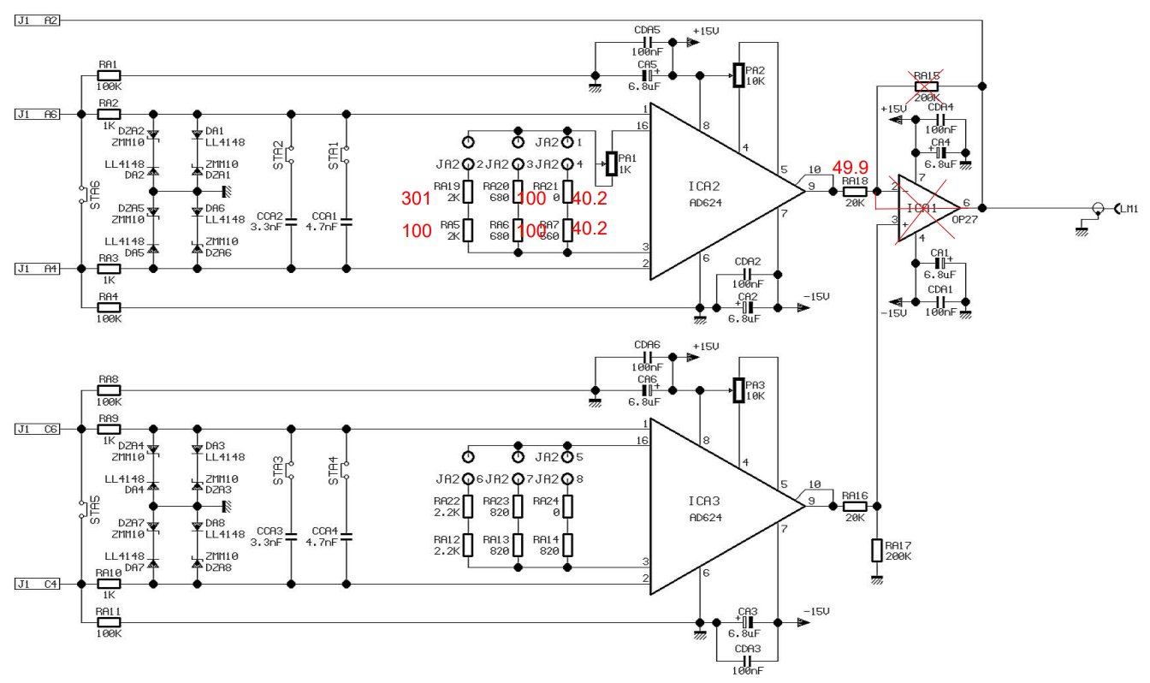
Signal conditioning
Due to the small number of turns, the voltage signals are tiny (~1 mV).
Low-noise amplifiers are required.
We reused existing amplifier cards with modifications:
no need of balancing
one amplification stage (x500)
Credit to Vincenzo Di Capua

Slide 19
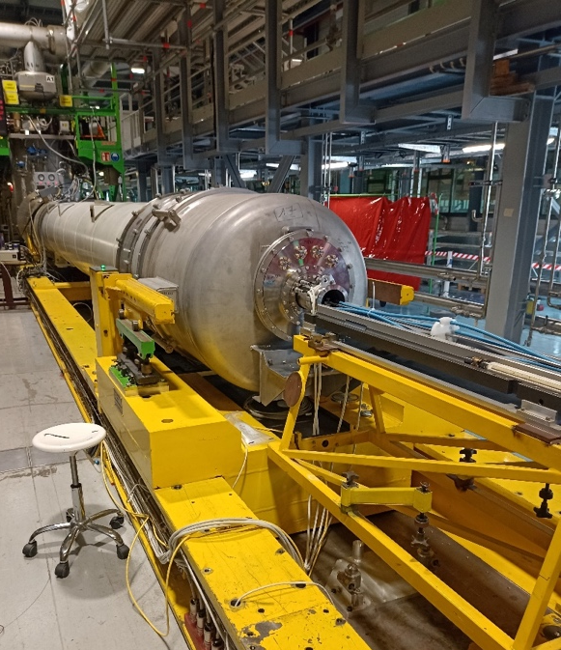
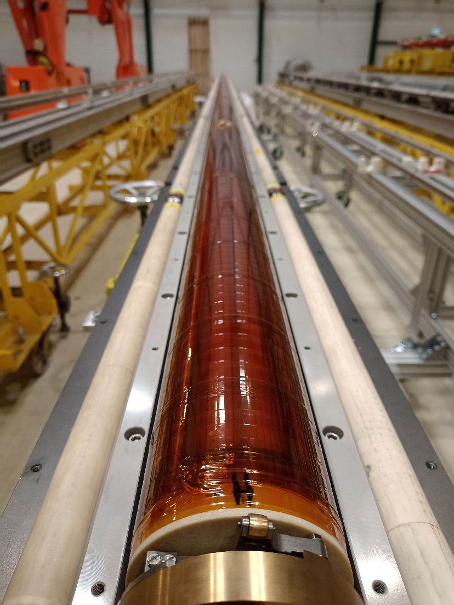
Ready for use

Slide 20
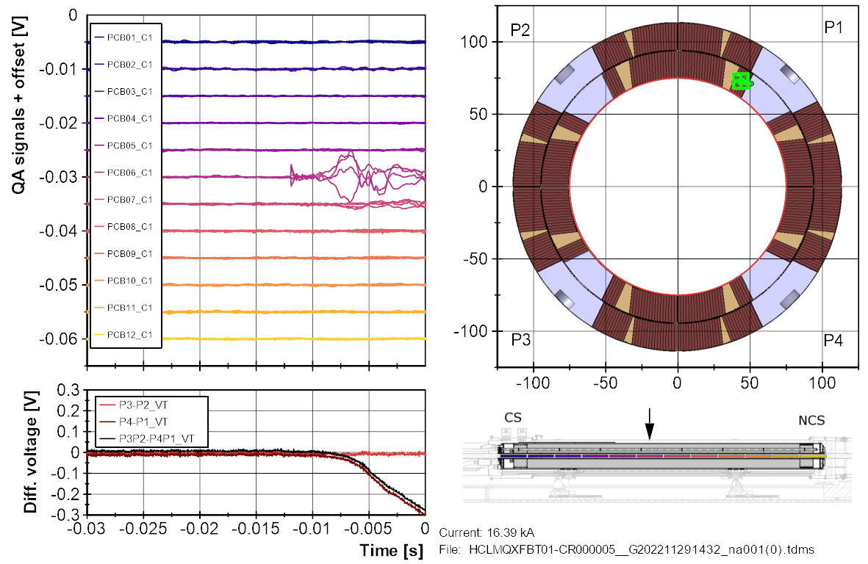
Credit to Piotr Rogacki and Franco Mangiarotti
Quench

Slide 21
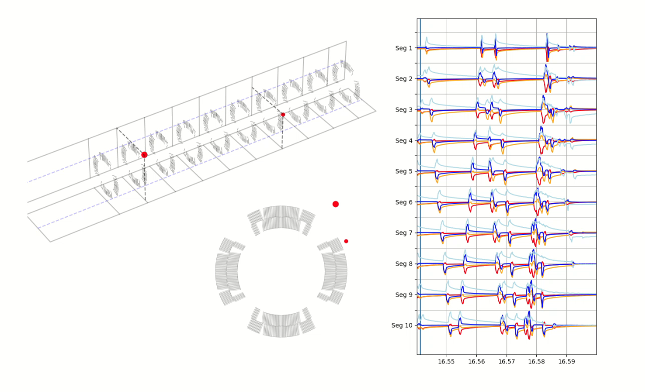
Flux jumps
1.27 kA (0.8 T)
Credit to Piotr Rogacki

Slide 22
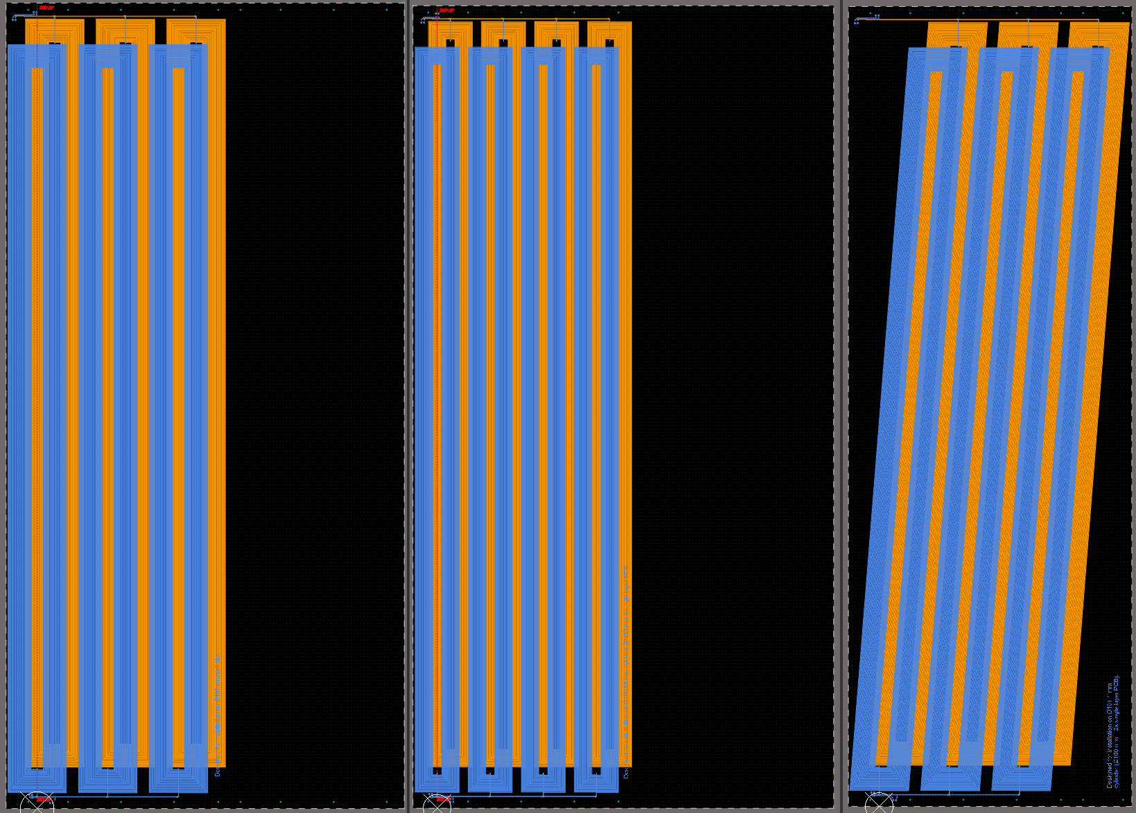
Can we improve the longitudinal localization?
Two additional set of coils sensitive to one of the multipoles and twisted along the longitudinal direction
B₃, A₃ and B₄, A₄ are used for the transverse localization.
B₃, A₃ and the twisted B₃, A₃ are used for the longitudinal localization.
The twist angle of the additional coils is proportional to the position along the segment:
we can retrieve the longitudinal position by comparing the phase of the “twisted” signals respect to the “straight” signals
B₃, A₃ B₄, A₄ B₃, A₃
twisted

Slide 23
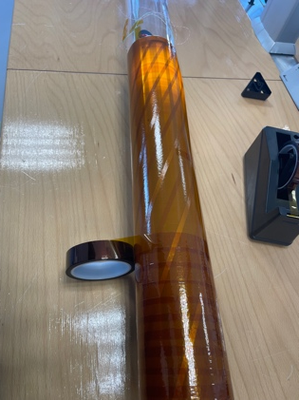
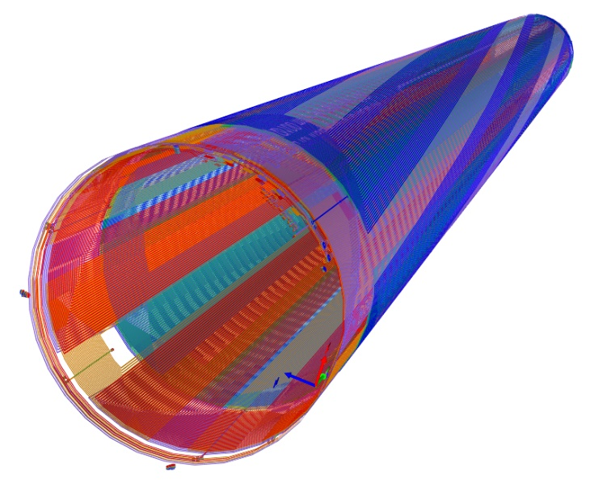

Slide 24
Preliminary test of longitudinal localization
Simple test by using a permanent magnet as source
±3 mm / 200 mm
Credit to Piotr Rogacki

Slide 25
Conclusions
  Recently we designed, built, and tested a new quench antenna for the 8-m-long MQXFB quadrupoles
  Based on the “old” idea of the “multipole coil configuration” (T. Ogitsu et al)
  With further development on sensitivity, reconstruction, practical implementation
  Already used for the test of two full length magnets
  Accurate transversal localization (< 5 mm)
  Work ongoing for improving the longitudinal localization

Slide 26
Thanks for your attention

Slide 28
Extra slides

Slide 29
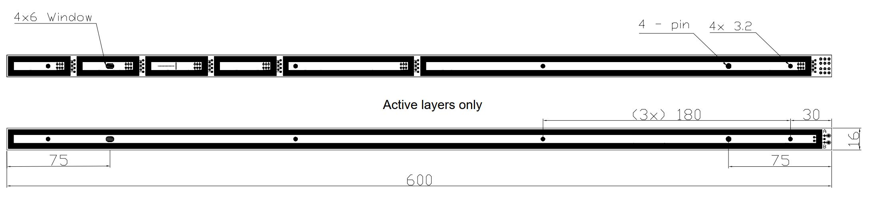
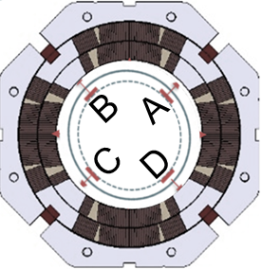
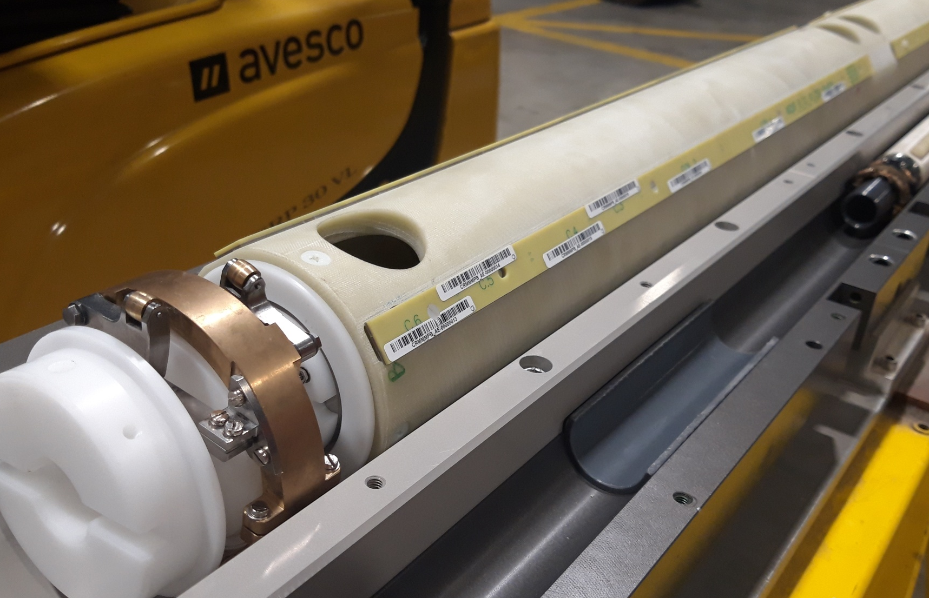
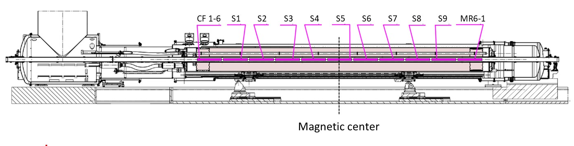
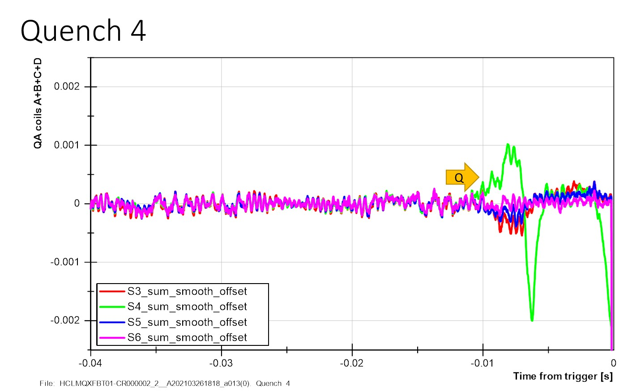
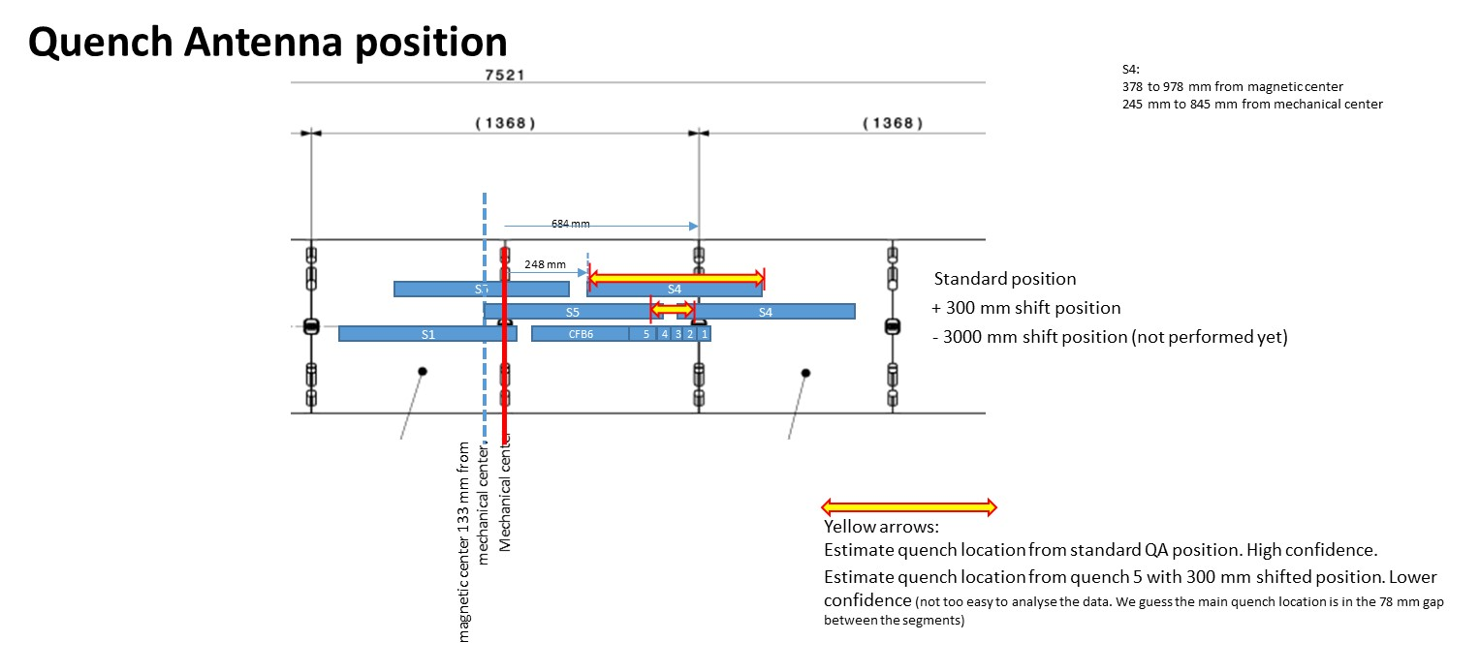
Previous work
Full length quench antenna
4 tangential coils
9 long segments (600 mm)
6+6 short segments (40 mm)
Good results for the longitudinal localization
Transverse localization not easy (noise)

