Slide 1
2nd Instrumentation and Diagnostics for Superconducting Magnets Workshop
Advances in Cryo-Electronics
Marcos Turqueti
2023

Slide 2
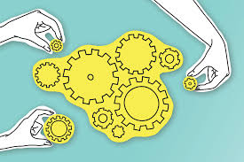
Collaboration

Slide 3
Why?
Reduced noise: Analog signals are susceptible to noise and interference from various sources, such as electromagnetic interference (EMI) and radio frequency interference (RFI). Digitizing signals close to the sensor reduces the distance the signal has to travel before being converted to a digital signal, enhancing the SNR;
Improved accuracy: Digitizing signals close to the sensor can improve accuracy by reducing signal attenuation, distortion, and other losses that can occur when signals are transmitted over long distances;
Lower power consumption: Digitizing signals close to the sensor can reduce the power consumption of the overall system. This is because analog signals require more power to transmit over longer distances, while digital signals can be transmitted with less power;
Eliminating high voltage on signal lines outside the cryostat;
Simplifying interfaces. For a fully immersed DAQ a single optical fiber can come from the cryostat instead of hundreds of lines for a fully instrumented system.

Slide 4
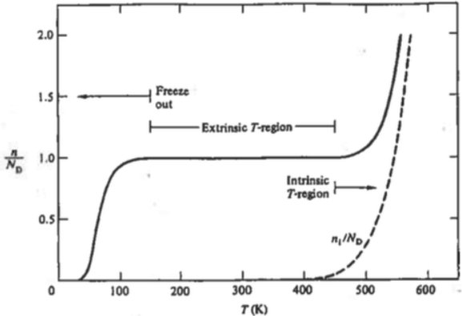
Problems with Cold Electronics
Freeze-out reduces the carrier concentration at the conducting band with decreasing temperature. Freeze-out, however, depends on the dopant type and semiconductor type.
Temperature dependence of majority carrier concentration in n-doped silicon. The phosphorus concentration is 10¹⁵ cm⁻³
At very high E-fields the electron (hole) does not remain in the same band during transport. For example, an electron can scatter with an electron which is in the valence band an knock it into the conduction band
In a semiconductor electrons can become “hot” at any temperature, by attaining energy E>kT . Some hot electrons exceed the energy required to create an electron-hole pair, resulting in impact ionization.
A very small fraction of hot electrons exceeds the energy required to create an interface state (e.g., an acceptor-like trap), in the Si-SiO₂ interface, for electrons (~4.6eV for holes). This alters the transistor characteristics.
FD2-VD Photon Detector Cold Electronics Workshop

Slide 5
Ongoing Activities
ATAP, Nuclear Sciences and Engineering
Commercial off-the-shelf cryogenic components (4k-77k)
ADCs, Amplifiers, Diodes, FPGAs, Laser Diodes, Optical Isolators , Voltage Regulators, Transistors and Passives
Field Programmable Gate Array (FPGA) on Cryogenic Environments
Cryogenic Magnetic Sensors
Optical Power Converter
Plastic Fiber Optic Communications
GFET for Cryogenic Applications
Custom Cryogenic Application Specific Integrated Circuit

Slide 6
Typical Readout Chain
Head Interface
Computer
Laser P. Supply
DC Power
Power Fiber
OR
Comm Fiber
ISOADC
Optical
Power Conversion
FPGA
Voltage Taps
ADC
Strain Gauges
Quench Antenna
ADC
Other
ADC

Slide 7
Typical Readout Chain
Head Interface
Computer
Laser P. Supply
Power Fiber
Comm Fiber
Optical
Power Conversion
FPGA
+
ISODIGITIZER
Voltage Taps
Strain Gauges
Quench Antenna
Other

Slide 9
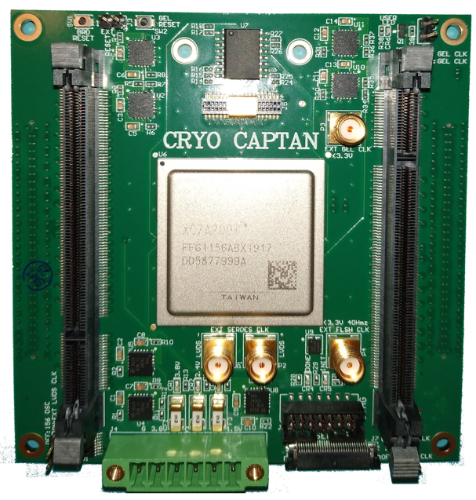
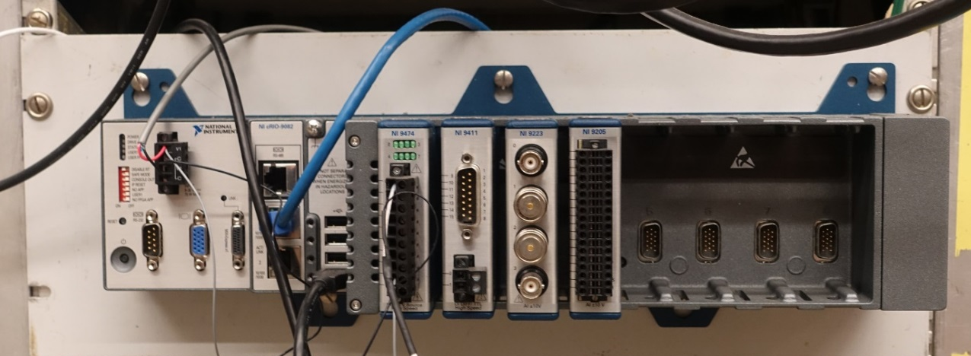
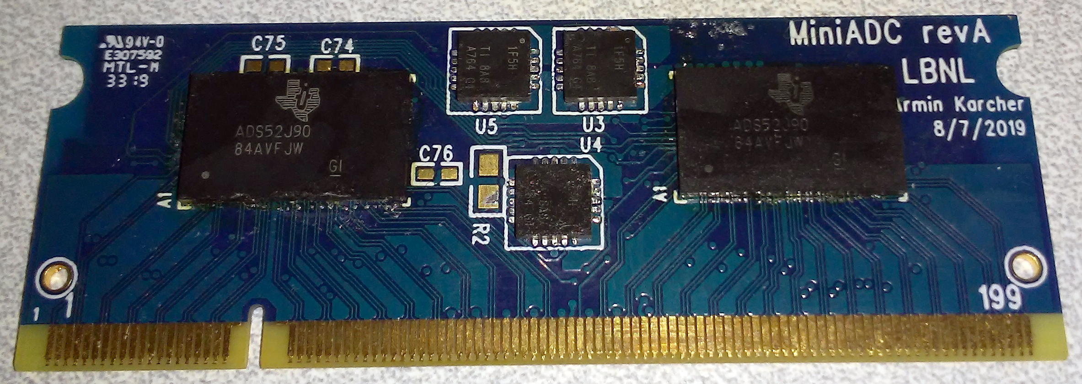
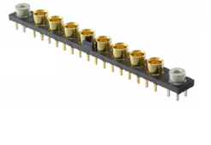
Field Programmable Gate-Array
Circa 2016
500 I/Os
fADC

Slide 10
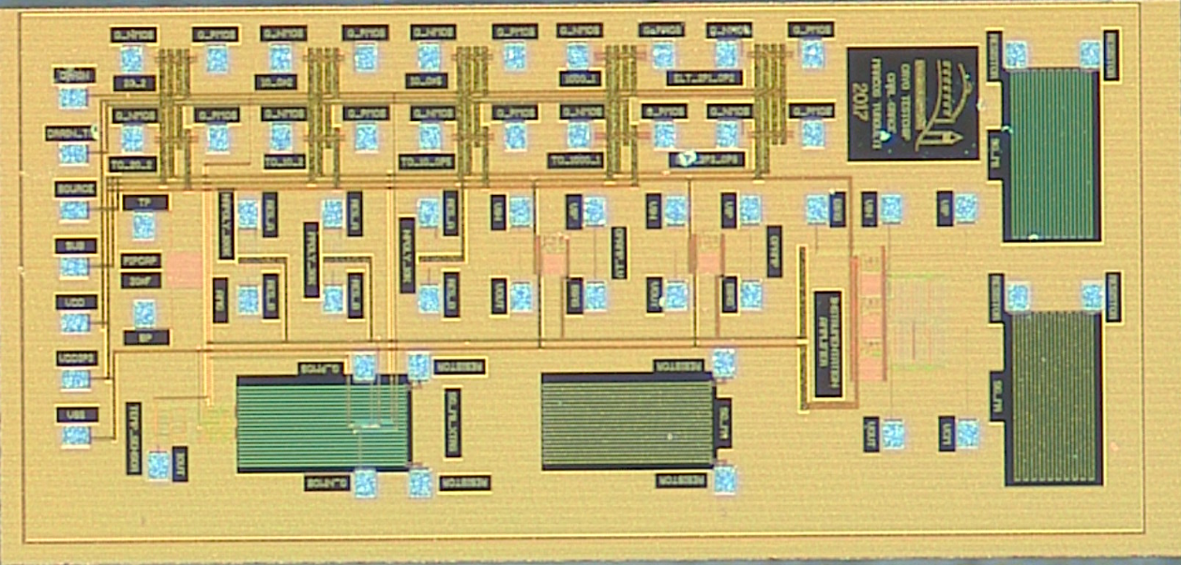
Integrated Sensors
3 mm
Power + Serial Digital Line

Slide 11
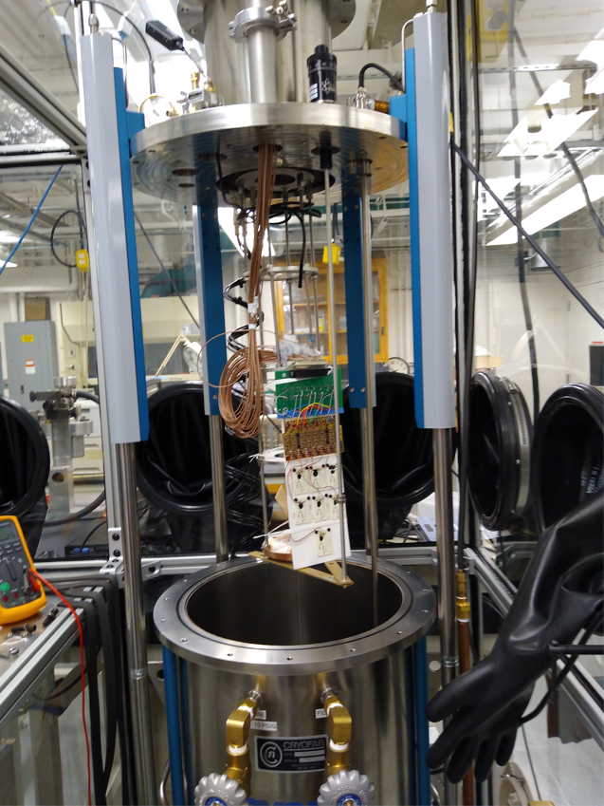
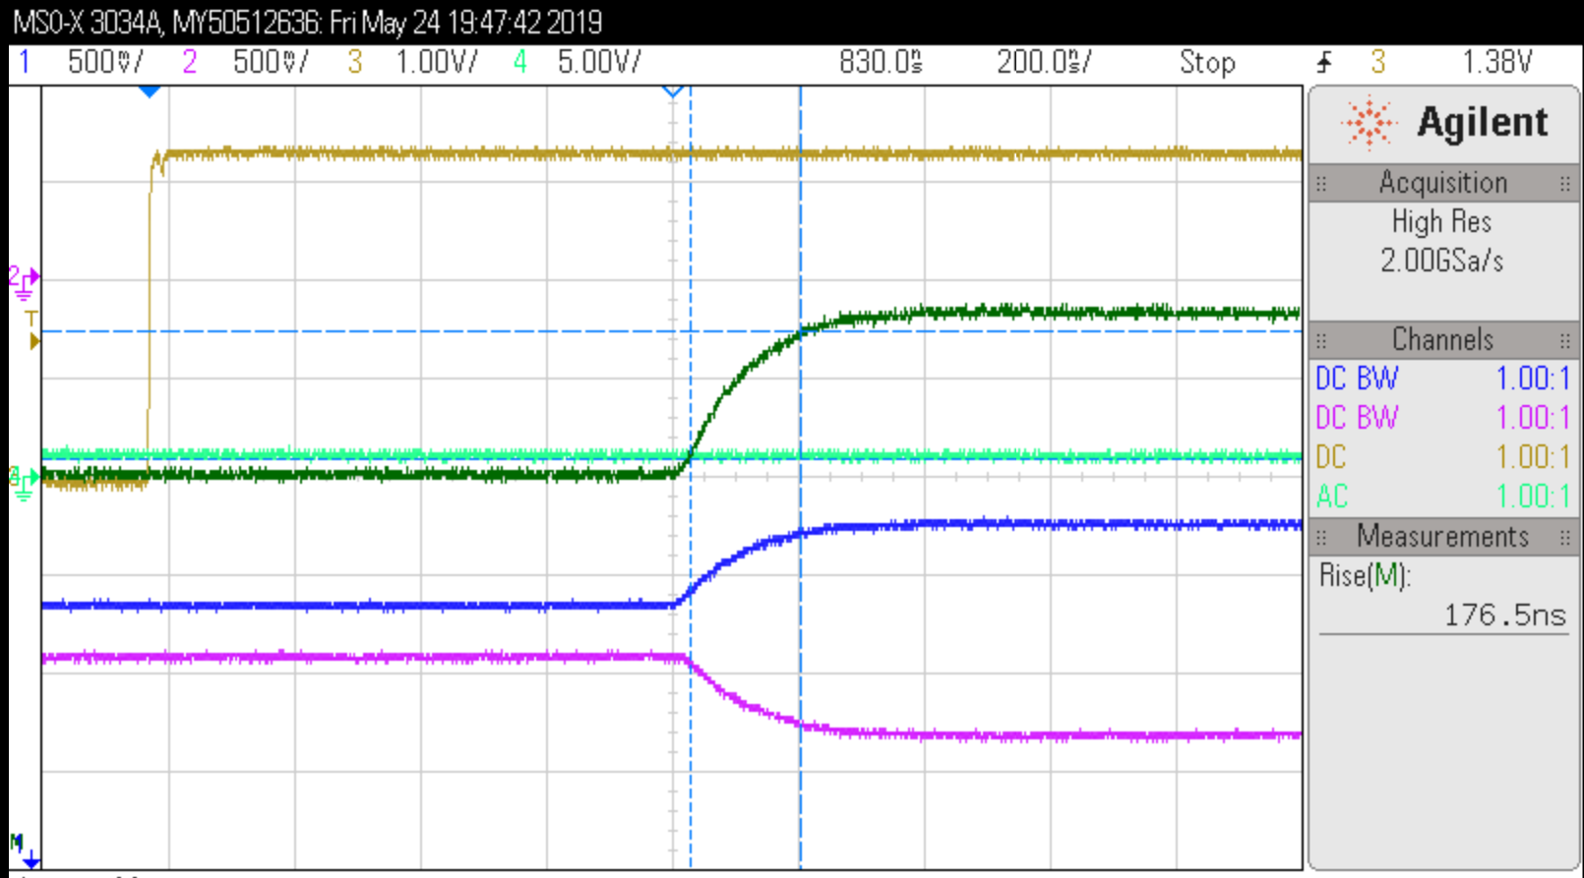
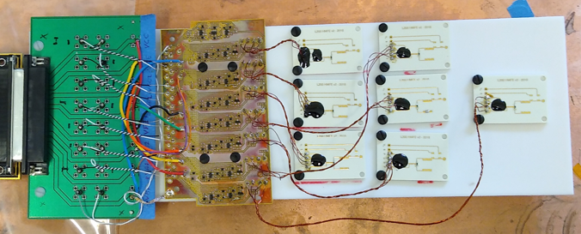
Signal Amplifier
Pre-amp
qAMP(THS4131)
Cables
FE-qAMP (1.1m) – 105pF (per line)
qAMP-DAQ (11m) – 1nF (per line)
JFET
MX11 cooled LN i=8mA

Slide 12
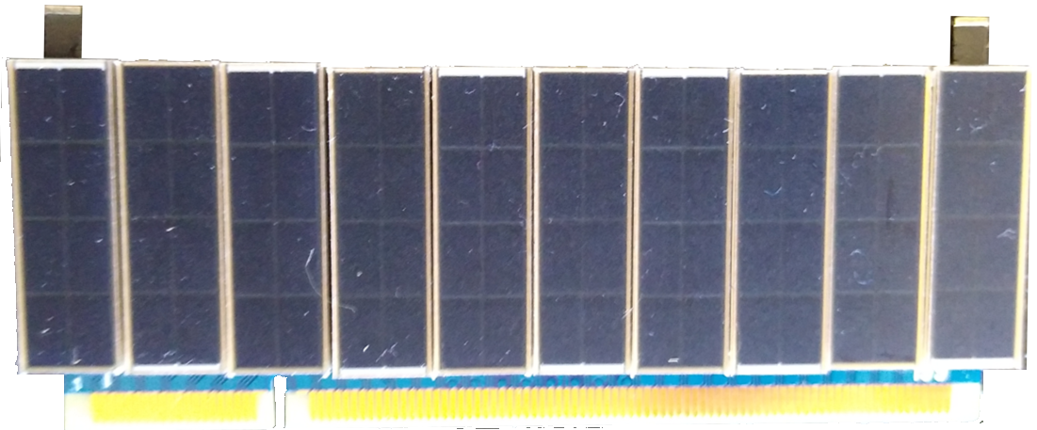
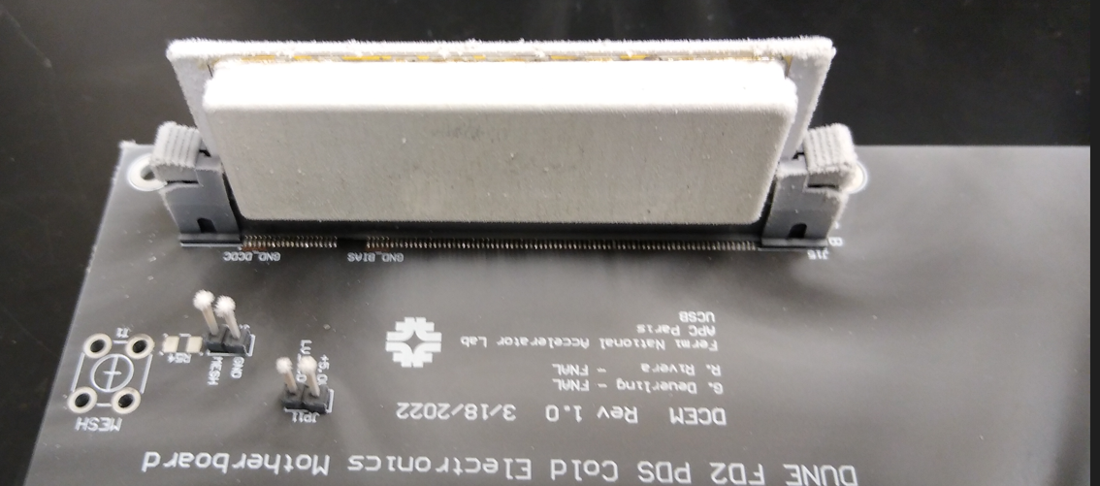
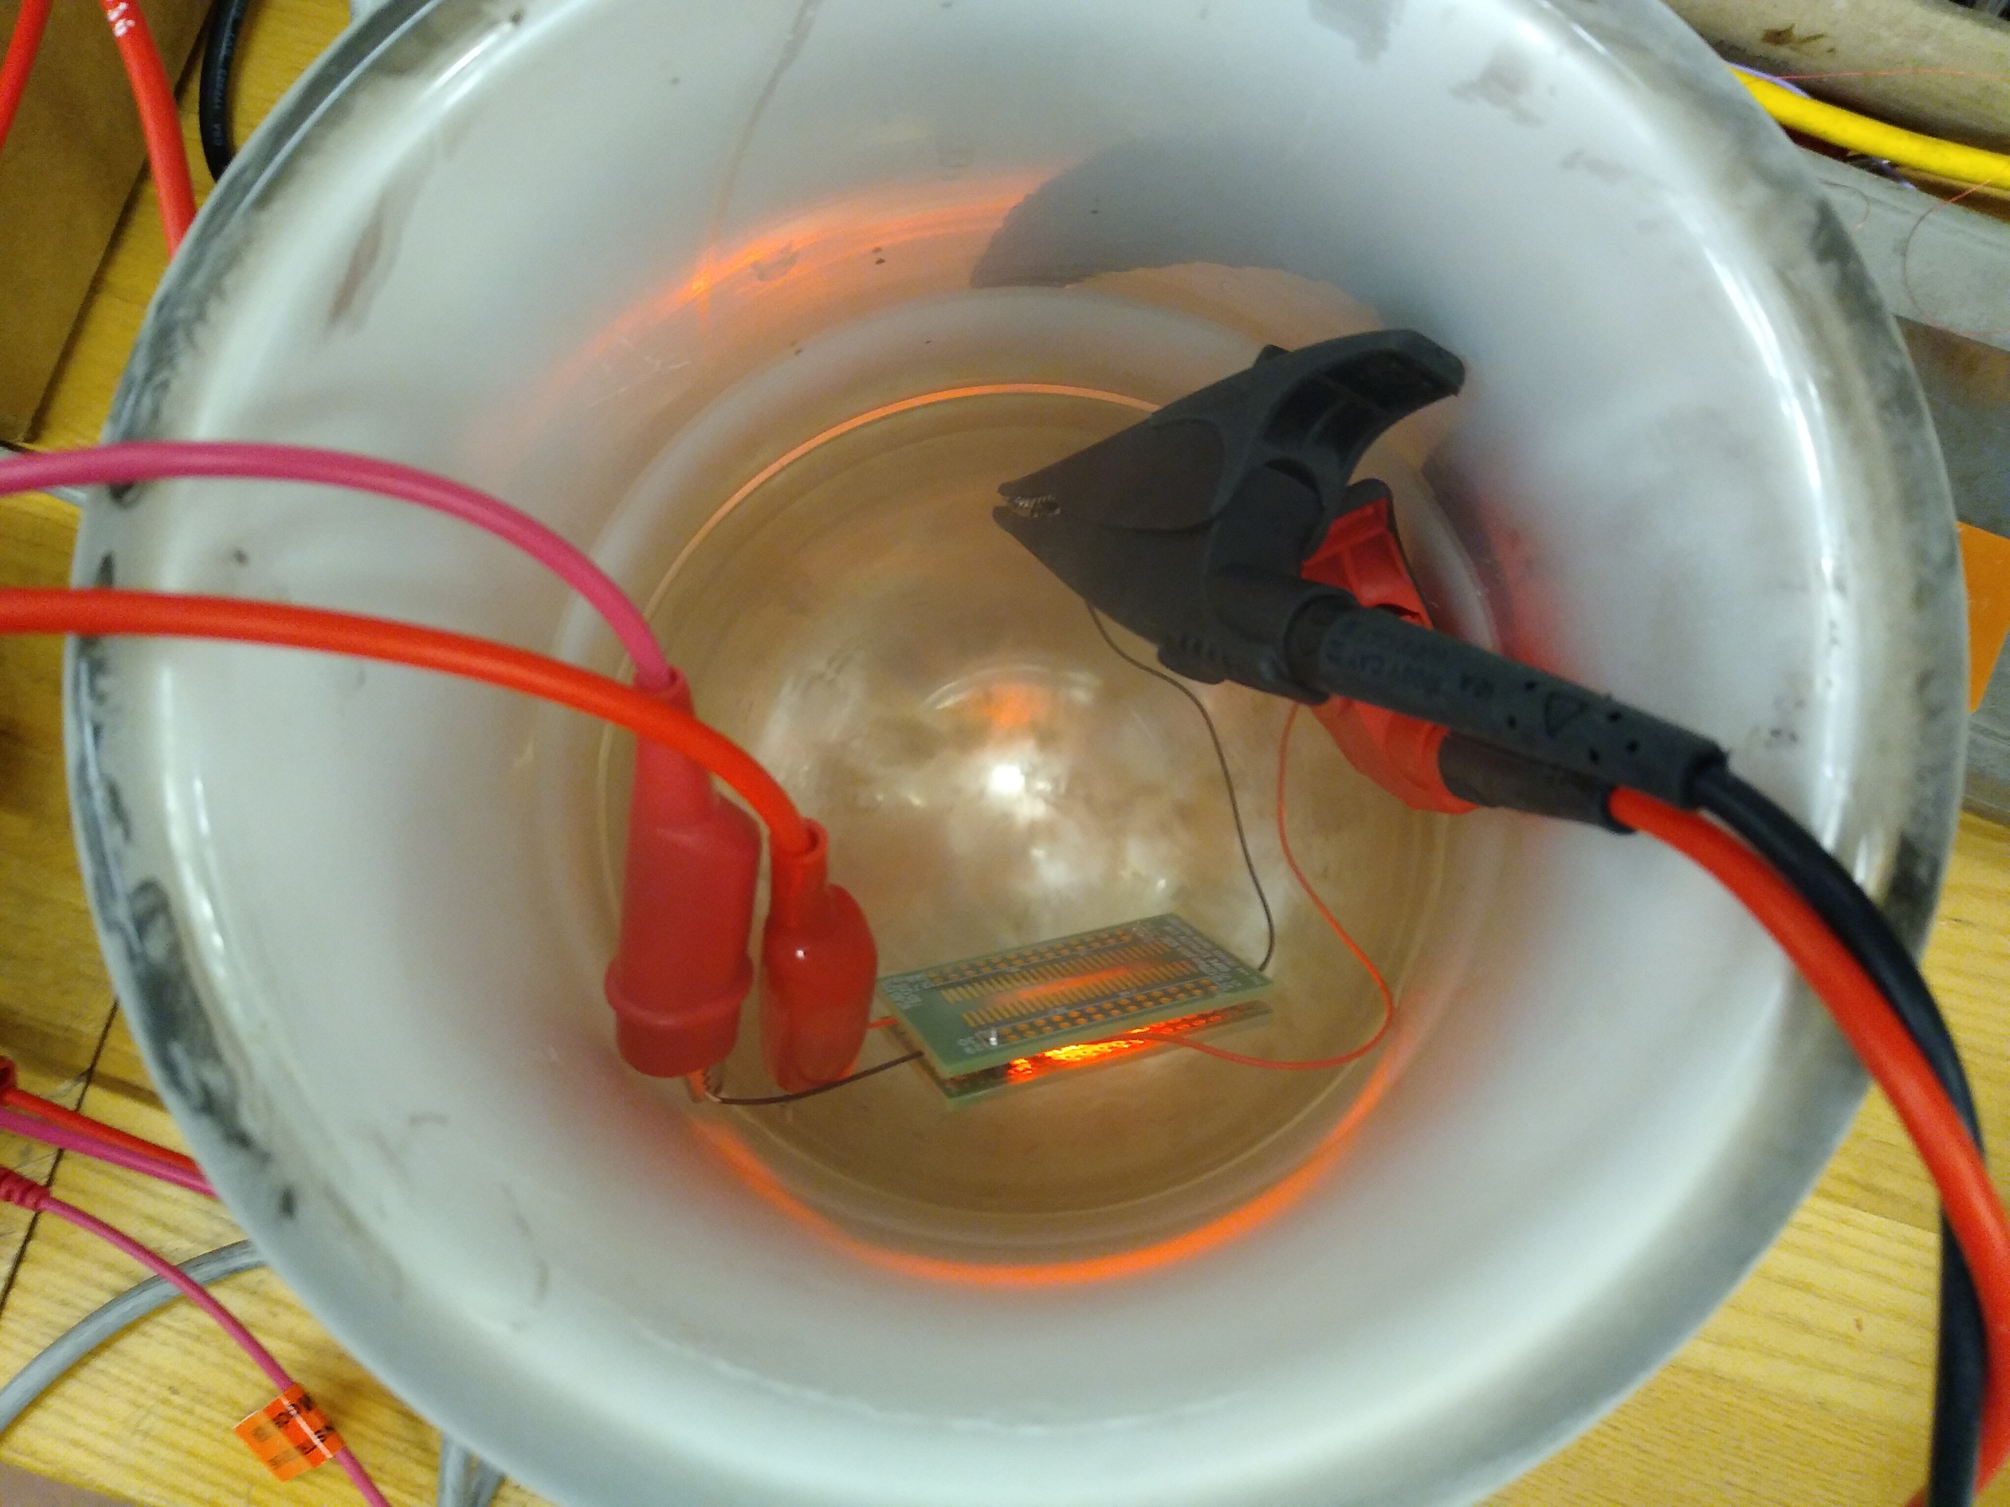
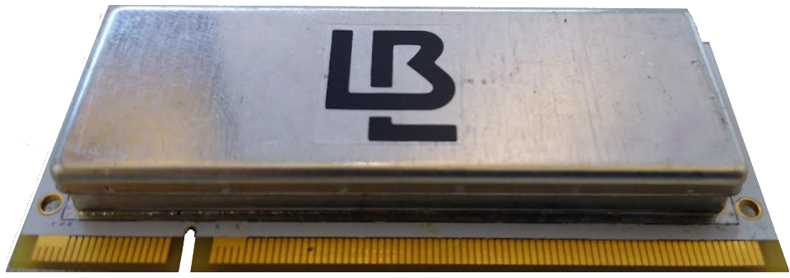
Optical Power

Slide 13
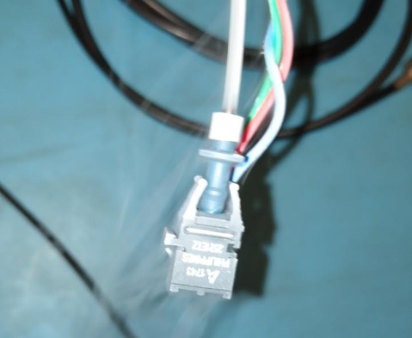
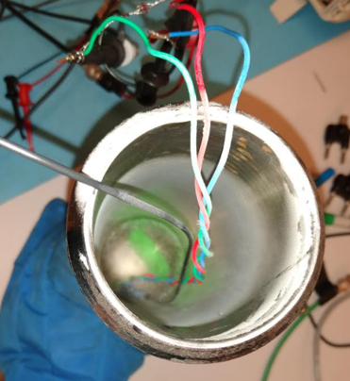
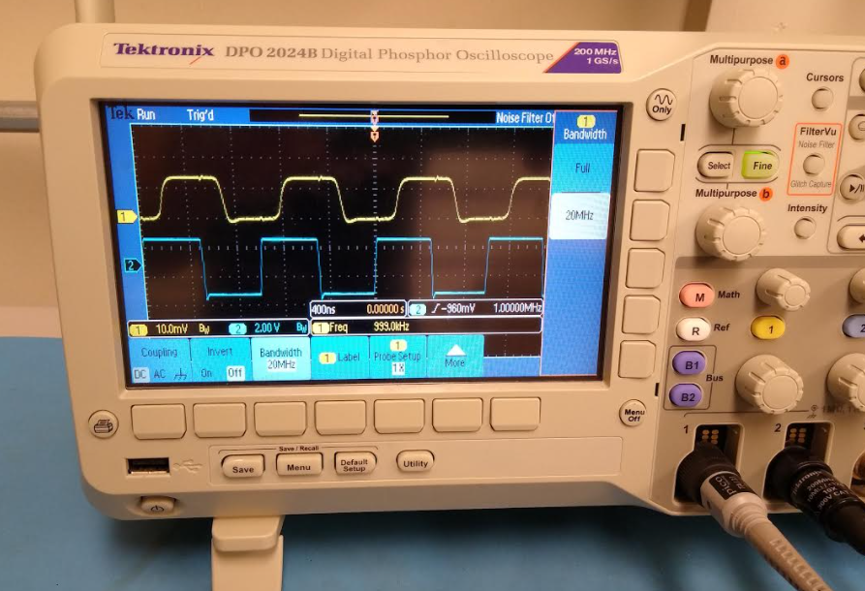
Optical Communications
Plastic Optical Fiber
POF Receiver
POF Under Test
LN - Blue TX, Yellow RX (1MHz)
POF Receiver – When cold requires the receiver voltage bias to be increased. Generally the transmitter needs to work on top of a higher light intensity. Clock speeds up to 100MHz are achievable with POF.
13

Slide 14
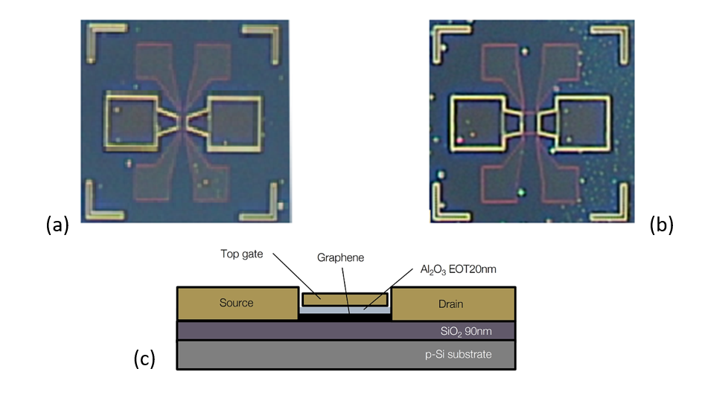
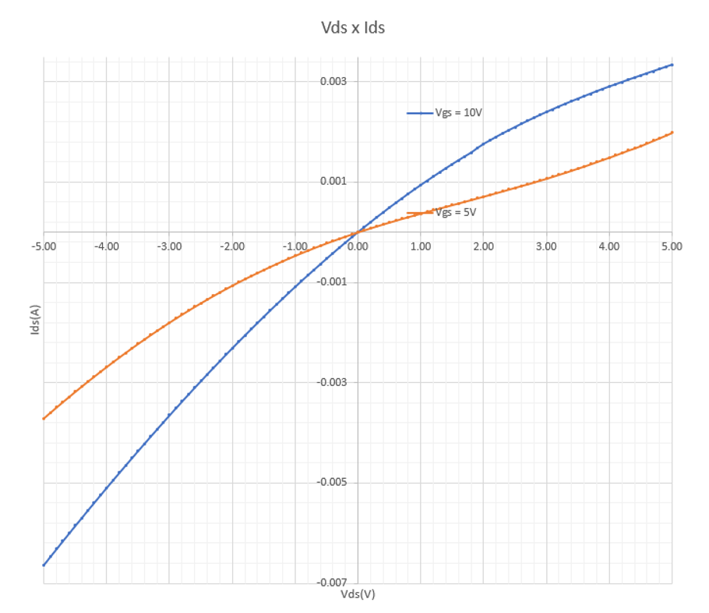
Graphene Field Effect Transistor (GFET)
Electrical properties: Graphene has a very low resistivity at room temperature, as well as intrinsic mobility over 100 times that of silicon and ideal coupling between charge carriers in an atomic layer.
Superior Noise Performance can be achieved
Lower Power Dissipation
Fast devices
High thermal conductivity: Graphene is an isotropic conductor that dissipates heat in all directions and has better thermal conductivity than other materials.
Good optical properties: Graphene is extremely thin and has very high conductivity, when combined with the right substrate it is an attractive material for building highly efficient magnetic detectors.
Cryogenic operation: Graphene is not a semiconductor and therefore is not subjected to carrier-freeze out. GFETs improve its noise performance when operating cold.
Excellent Radiation Hardness
W=L=50 μm

Slide 15
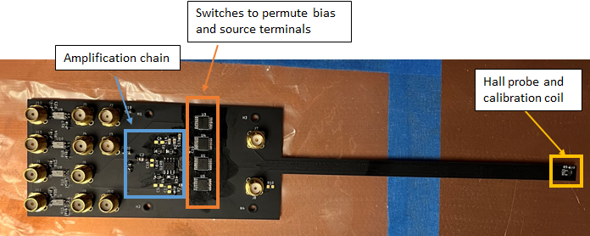
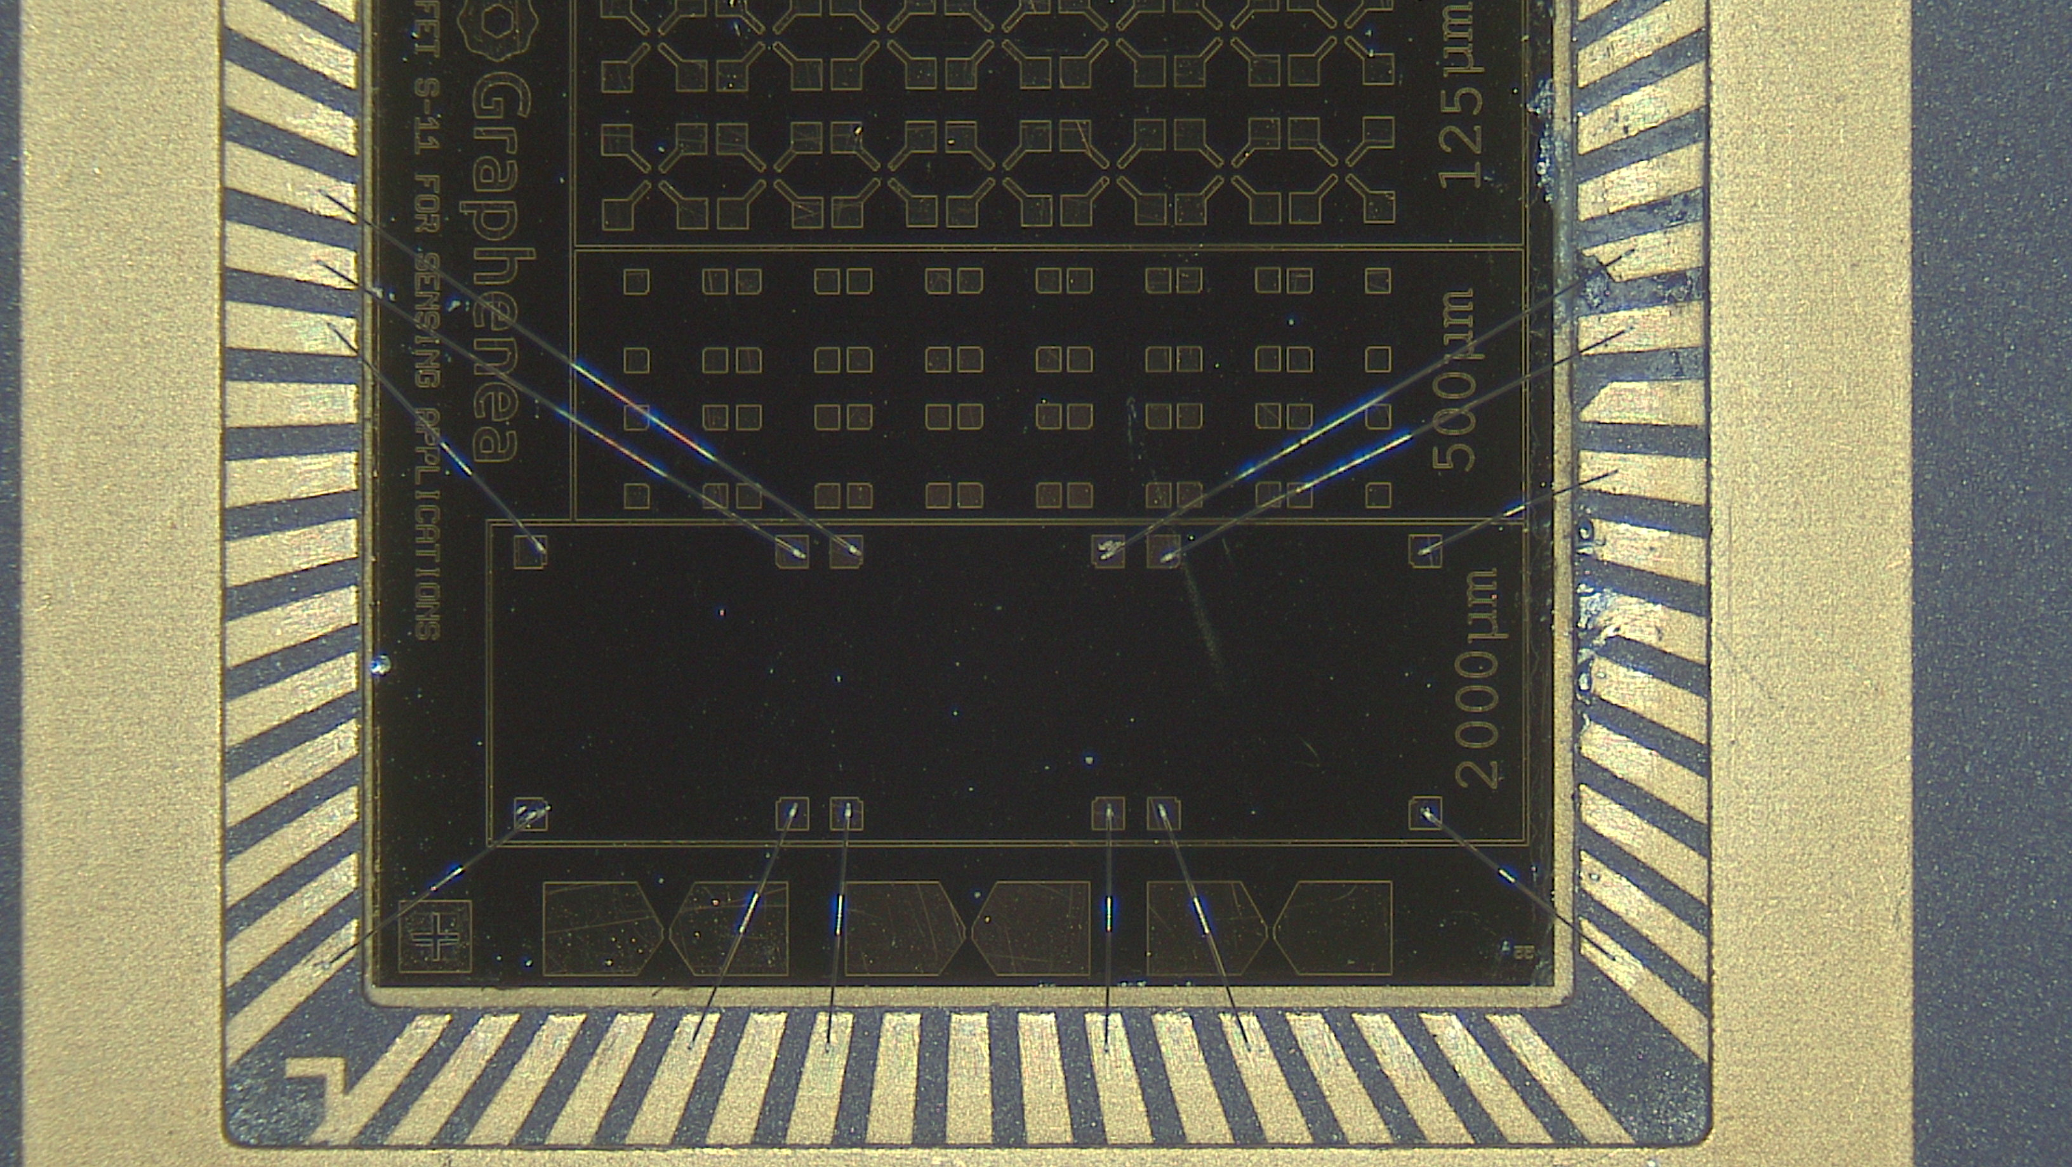
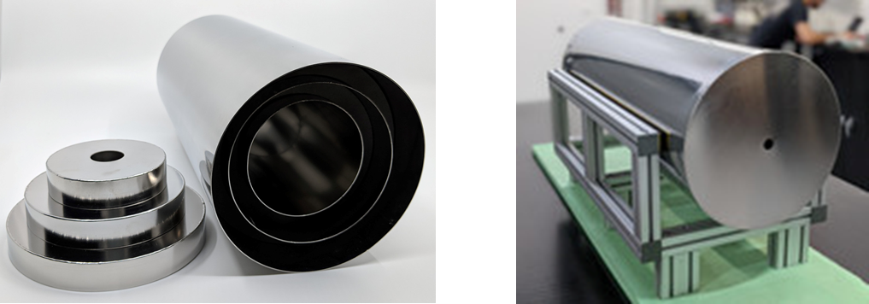
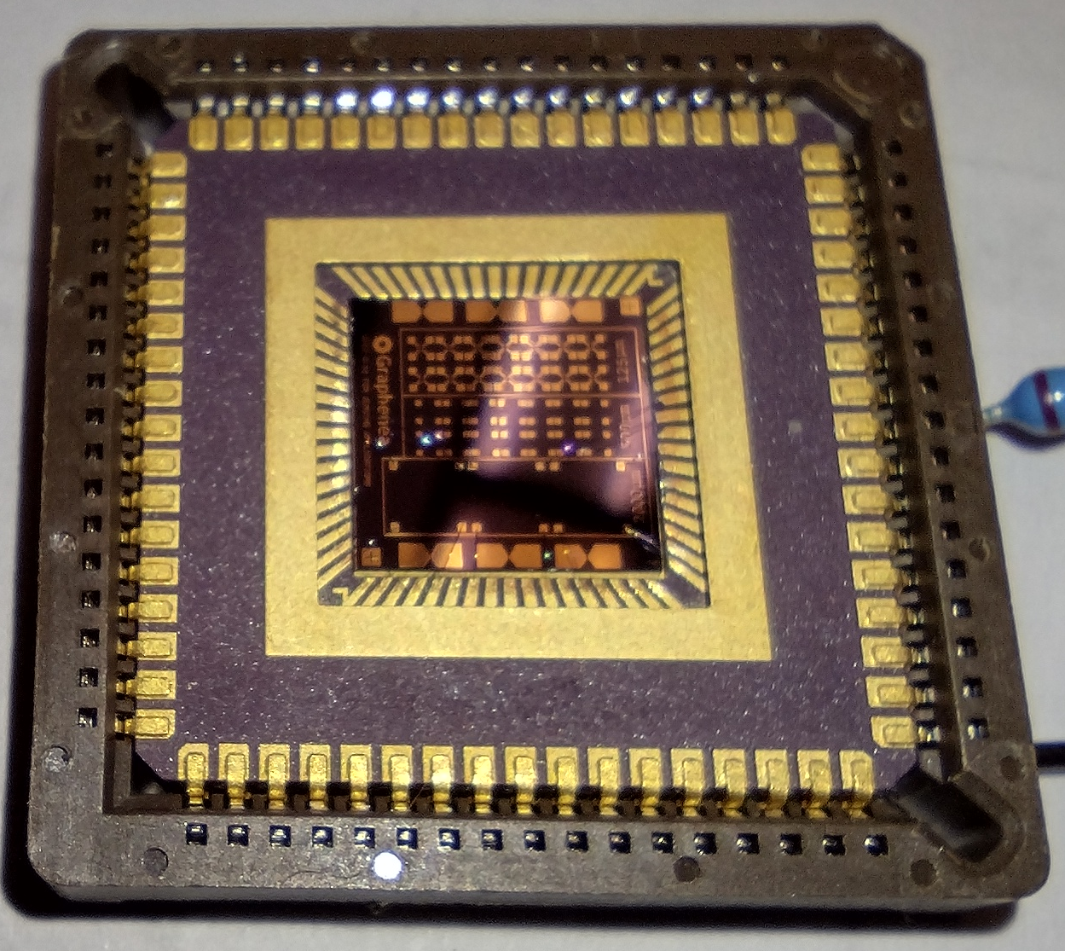
GFET Hall Effect Probe
Demonstrate the spinning current noise cancellation technique with GFET.
Lucas Brouwer LNBrouwer@lbl.gov / Marcos Turqueti Mturqueti@lbl.gov

Slide 16
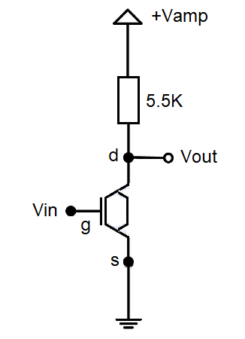
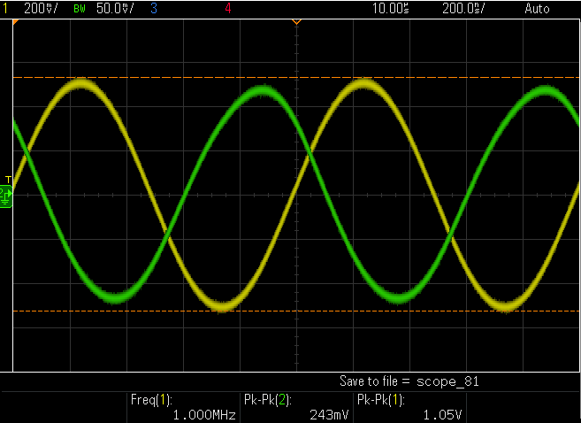
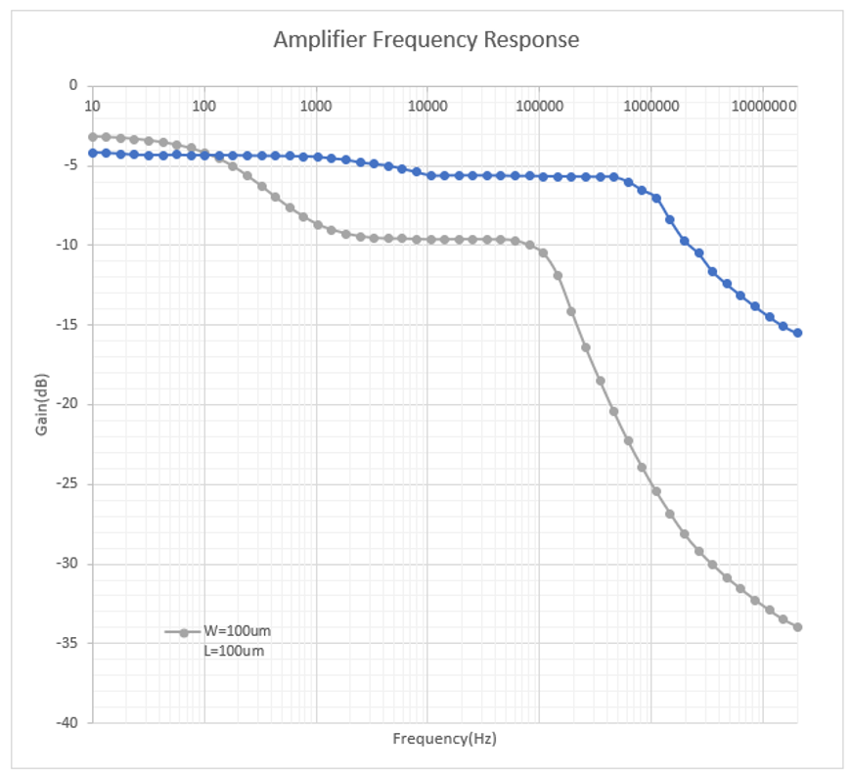
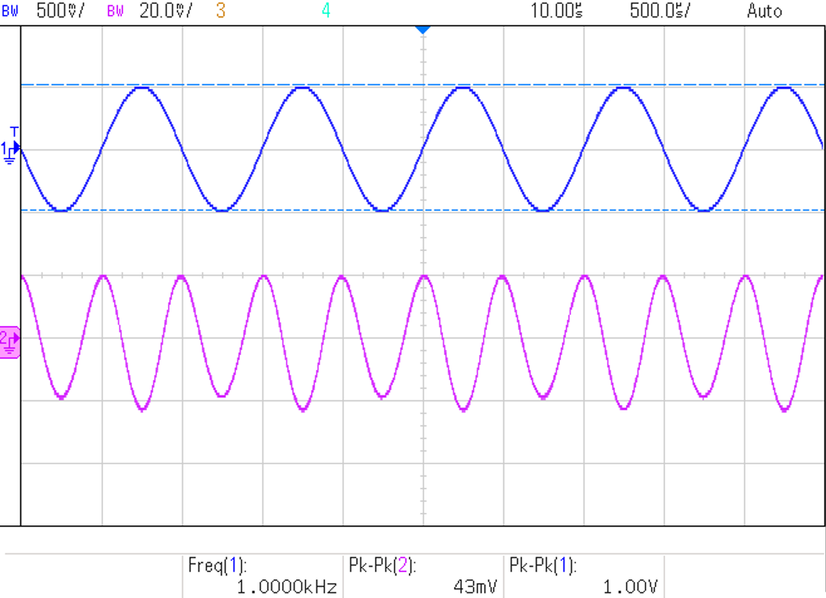
GFET Amplifier

