Slide 1

Classifying the electromagnetic behaviour of a series of superconducting magnets
E. Ravaioli (CERN)
Thanks to many CERN colleagues
in particular M. Bednarek, Z. Charifoulline, P. Hagen, M. Janitschke, C. Obermair, A. Verweij
IDSM 02 – Salerno, Italy
27 April 2023

Slide 2
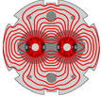
1232 main dipole magnets
double aperture
Nb-Ti
8 T
1.9 K
LHC

Slide 3
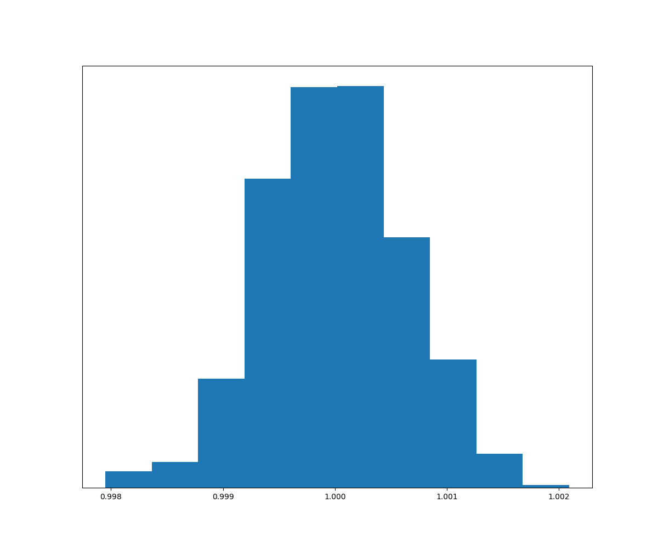
±0.2%

Slide 4
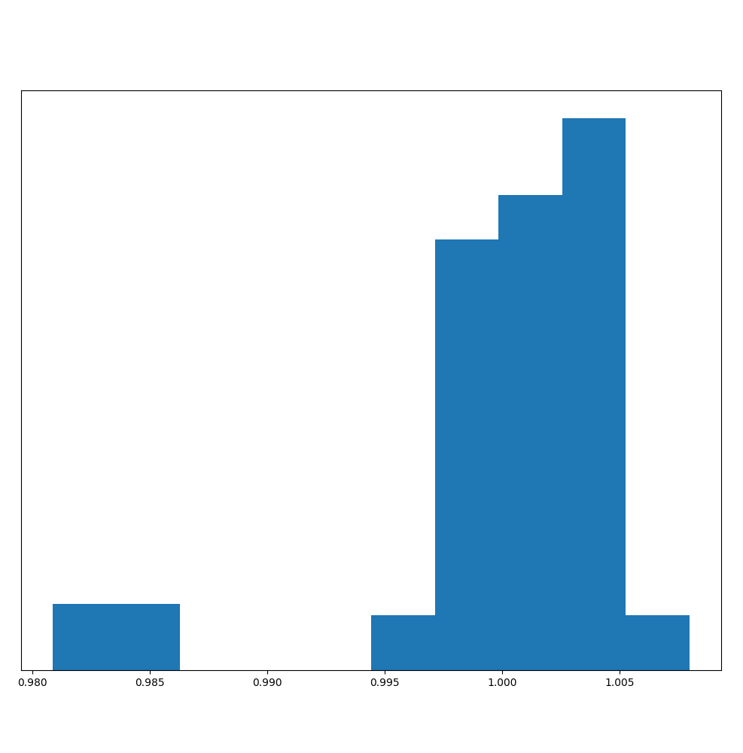
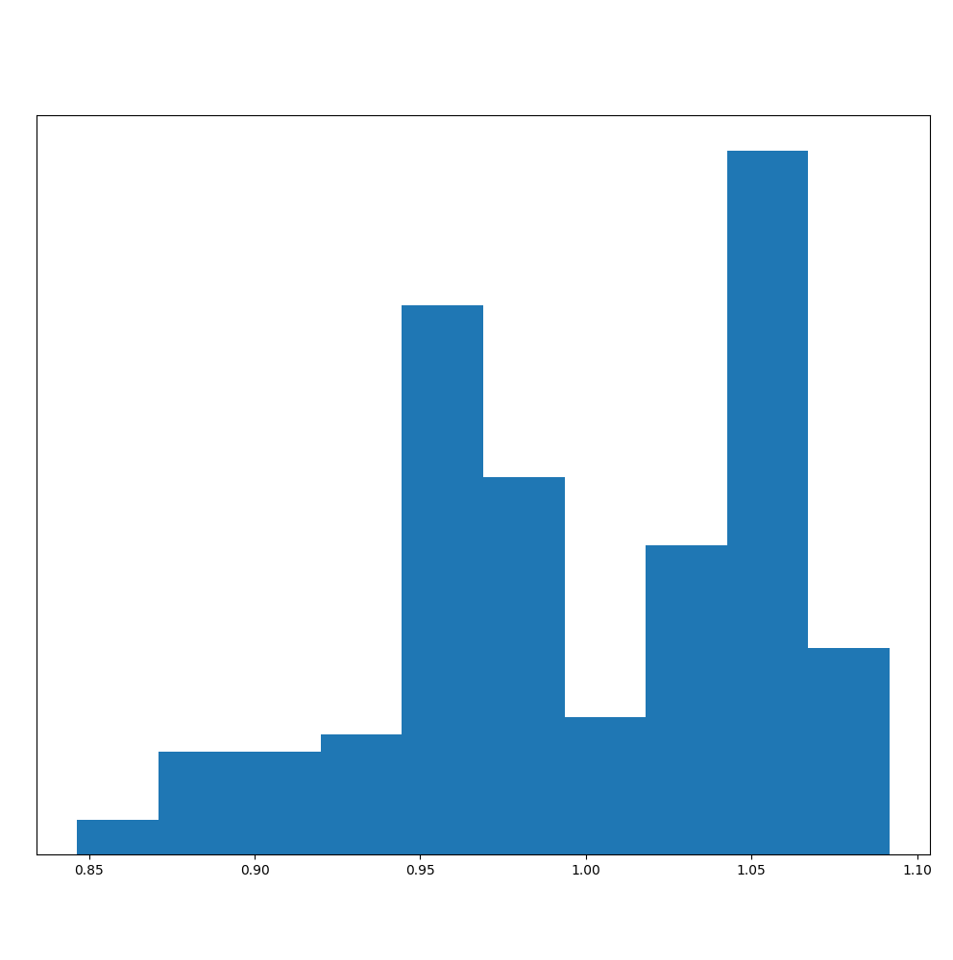
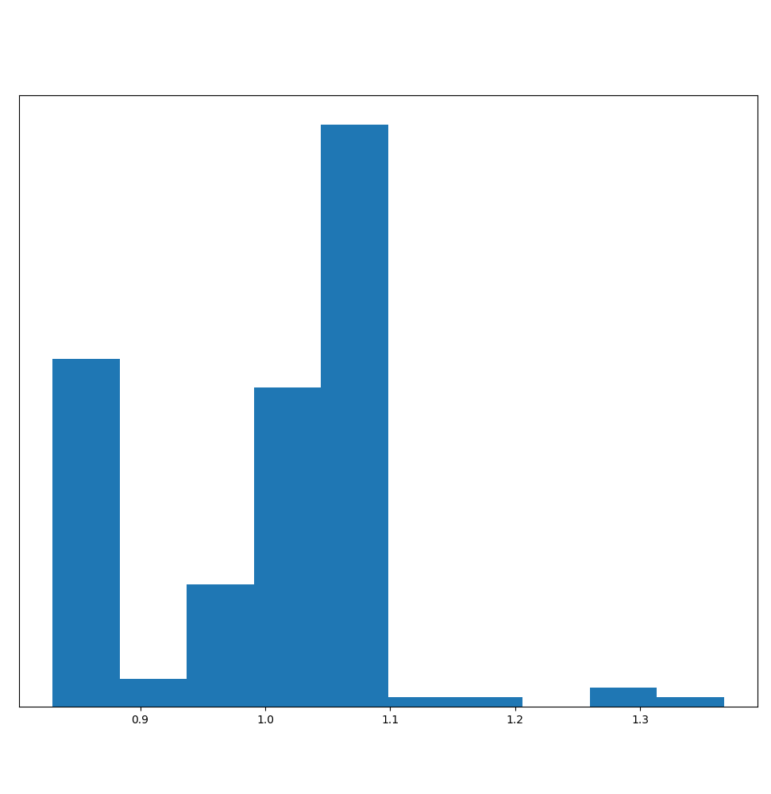
DC
1 Hz
30 Hz
3000 Hz
±0.2%
±2%
±15%
±30%

Slide 5
magnet length ±30% ?
magnet aperture ±30% ?
magnet turns ±14% ?

Slide 6
My motivation
Reduce spurious quench detection triggering
Predict the effect of hardware changes, operation scenarios, failure cases, etc
Analyze unexpected transients
Look for eventual precursors to failures

Slide 7
Observed
events
Known
features
Circuit discharges
Cable
Magnet quenches
Strand
Operating
conditions
Frequency
Coil geometry
…
Magnet parts
…

Slide 8
Observed
events
Known
features
Spikes
Epoxy
Precursors
Preload
Operating
conditions
Critical current
Heat treatment
Quench performance
Binder
Pulse tests
Former material

Slide 9
















Design
Simulate
Optimize
Build
Test
Analyze

Slide 10

Design
Analyze
Simulate
Test
Optimize
Build

Slide 11
Simulate
Test
Analyze
Build
Optimize
Design
Simulate
Test
Analyze
Build
Optimize
Design
Simulate
Test
Analyze
Build
Optimize
Design
Simulate
Test
Analyze
Build
Optimize
Design
Simulate
Test
Analyze
Build
Optimize
Design
Simulate
Test
Analyze
Build
Optimize
Design
Field of expertise
Analysis techniques
Software tools

Slide 12
Labs
Series
Magnet
Types

Slide 13
DATA SCIENCE

Slide 14



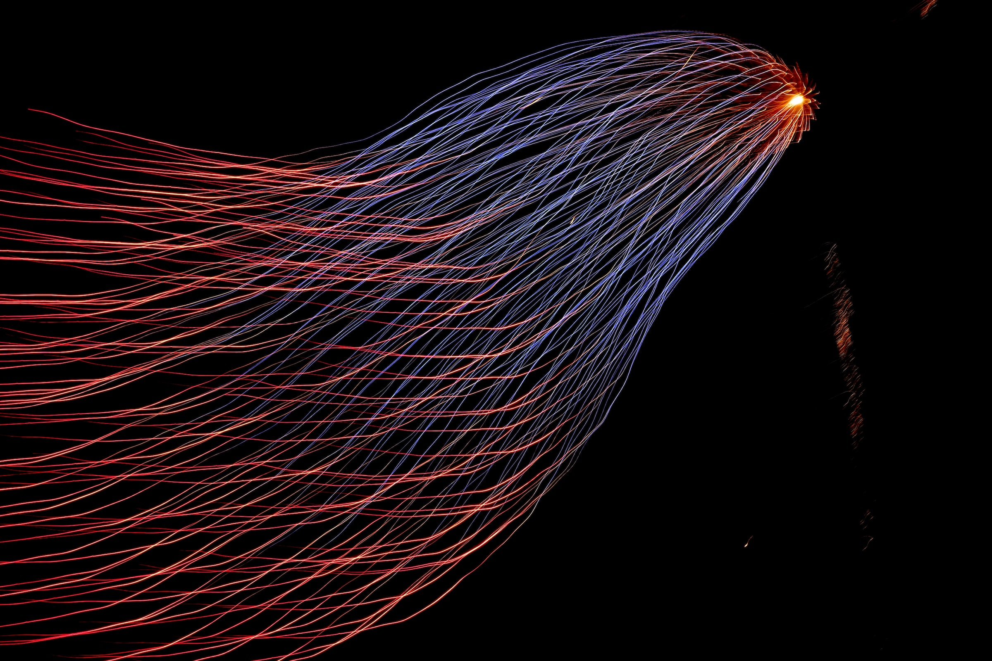
Expectation
Reality

Slide 15
…an ideal example

Slide 16
Simulating eddy currents in the beam screen
Beam screen measured surface resistance
Beam screen Cu layer thickness and RRR
Physics-based magnet model
Compare to FTM frequency domain measurements
Compare to FPA time domain measurements
Beam screen figure from the LHC Design Report

Slide 17
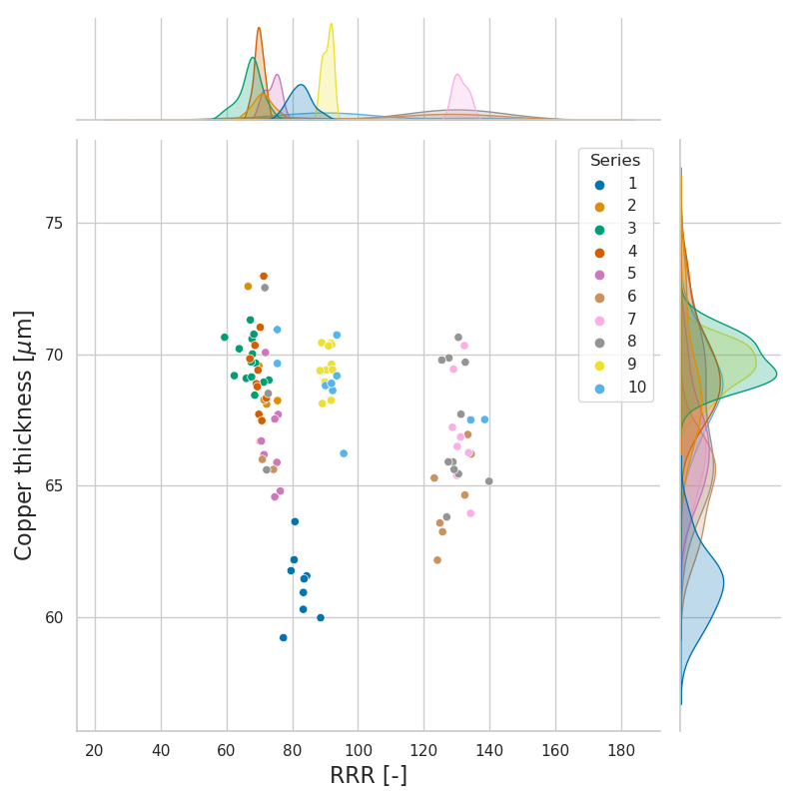
Simulating eddy currents in the beam screen
Beam screen measured surface resistance
Beam screen Cu layer thickness and RRR
Physics-based magnet model
Compare to FTM frequency domain measurements
Compare to FPA time domain measurements
Analysis by M. Janitschke

Slide 18
Simulating eddy currents in the beam screen
Beam screen measured surface resistance
Beam screen Cu layer thickness and RRR
Physics-based magnet model
Compare to FTM frequency domain measurements
Compare to FPA time domain measurements

Slide 19
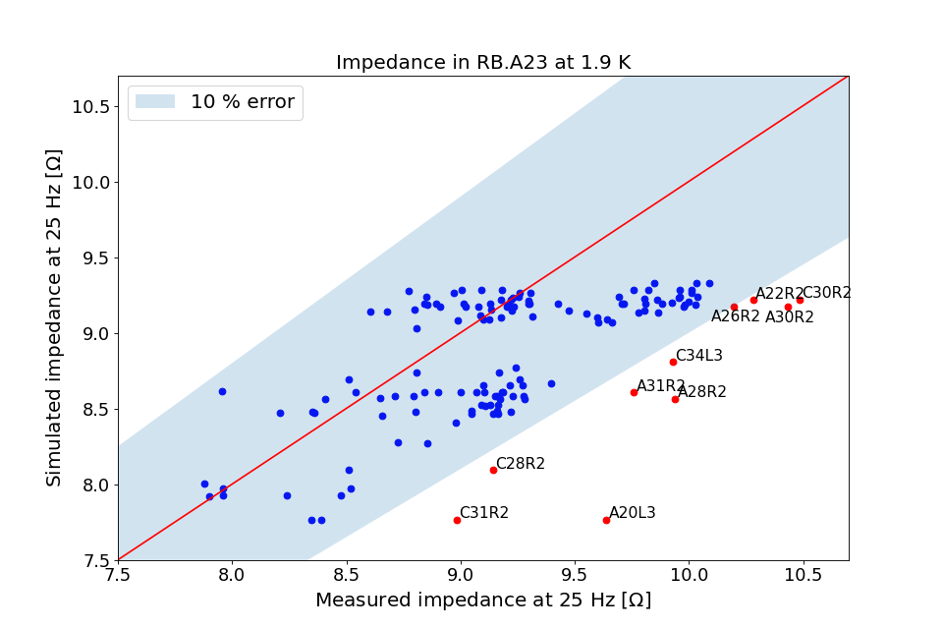
Simulating eddy currents in the beam screen
Beam screen measured surface resistance
Beam screen Cu layer thickness and RRR
Physics-based magnet model
Compare to FTM frequency domain measurements
Compare to FPA time domain measurements
Analysis by M. Janitschke

Slide 20
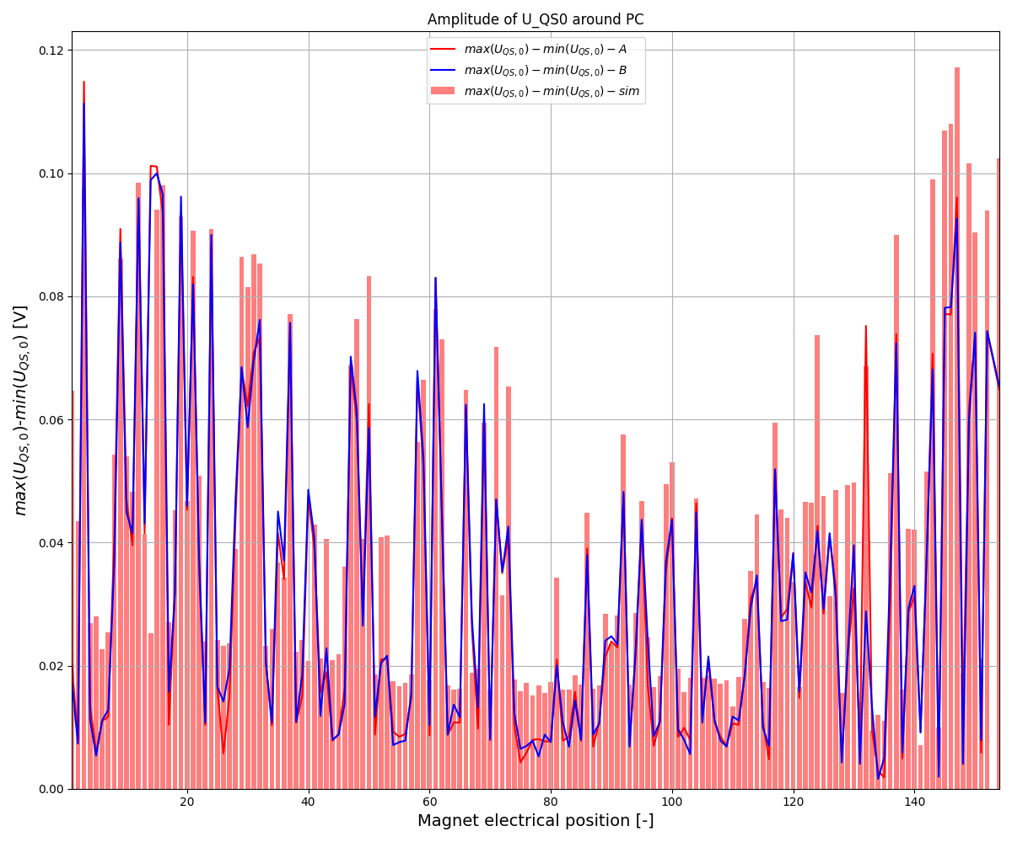
Simulating eddy currents in the beam screen
Beam screen measured surface resistance
Beam screen Cu layer thickness and RRR
Physics-based magnet model
Compare to FTM frequency domain measurements
Compare to FPA time domain measurements
Analysis by M. Janitschke

Slide 21
Analyze features
Identify normal behavior
Identify outlier behavior
Simulate physical behavior
Analyze unexpected events
Correlate events and features

Slide 22
Analyze features -1
cable manufacturer
Cu/noCu
RRR
dimensions
performance reached
peak current reached
number of quenches
spikes occurred
number of spikes
amplitude
frequency
Whenever possible choose significant, independent, non-categorical quantities

Slide 23
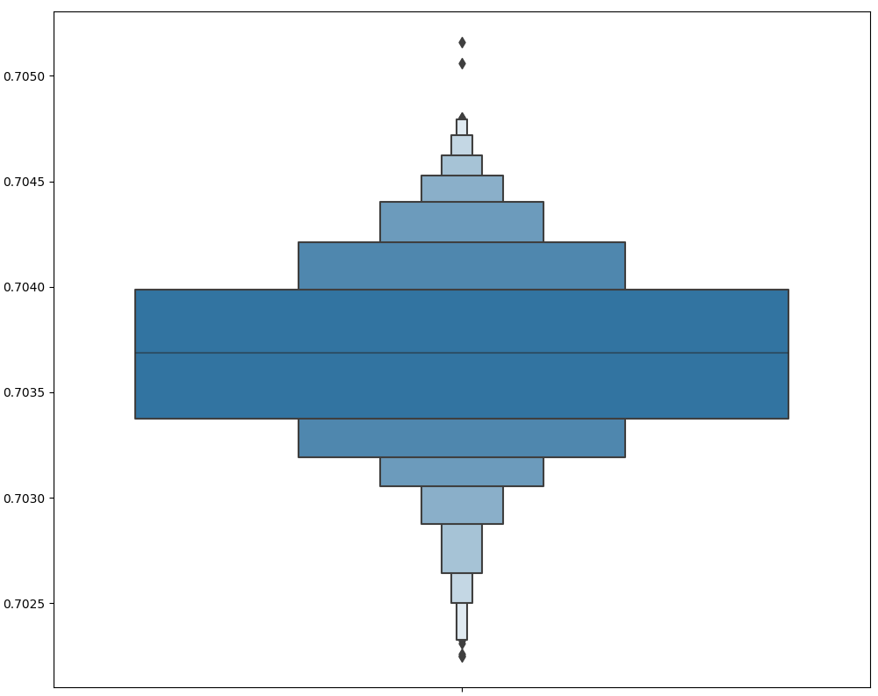
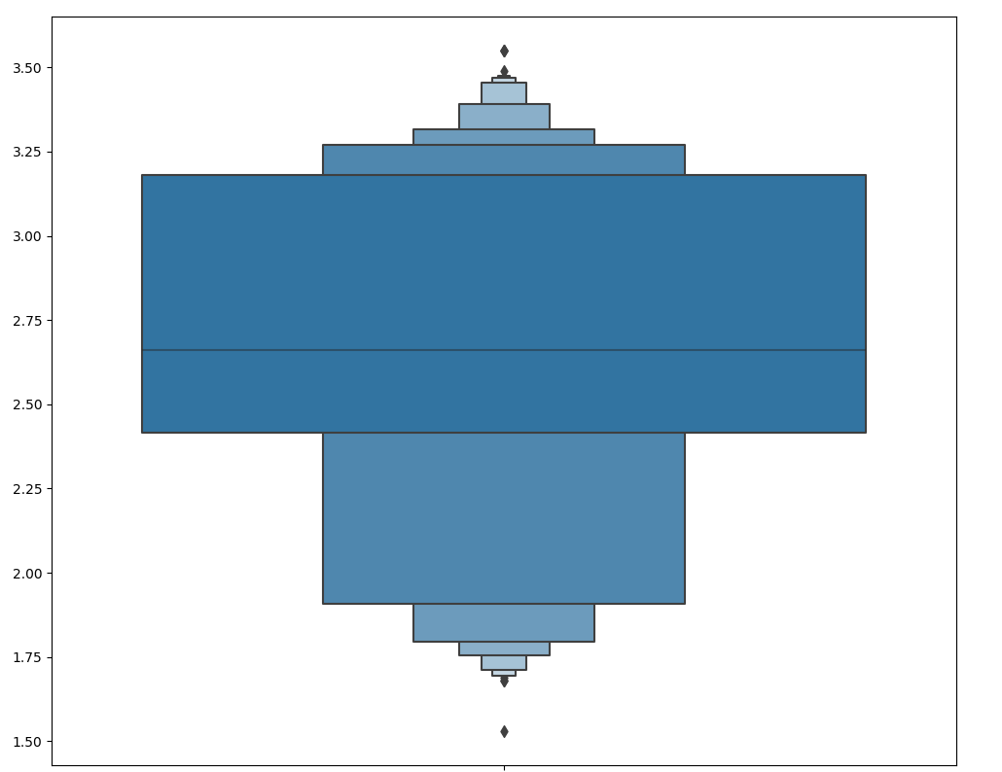
Analyze features -2
Box plots or boxen plots quickly give insights on the feature distribution

Slide 24
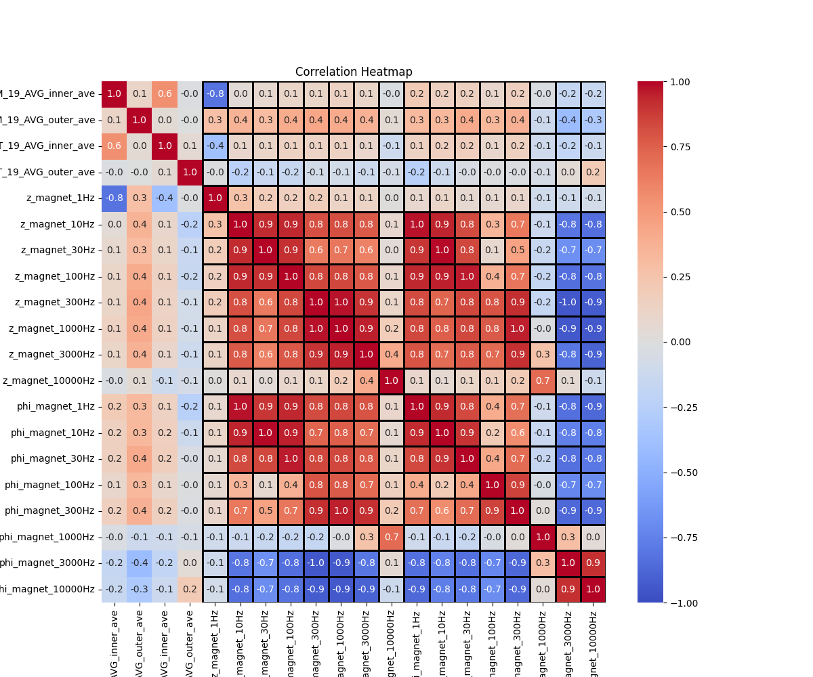
Correlate events and features -1

Slide 25
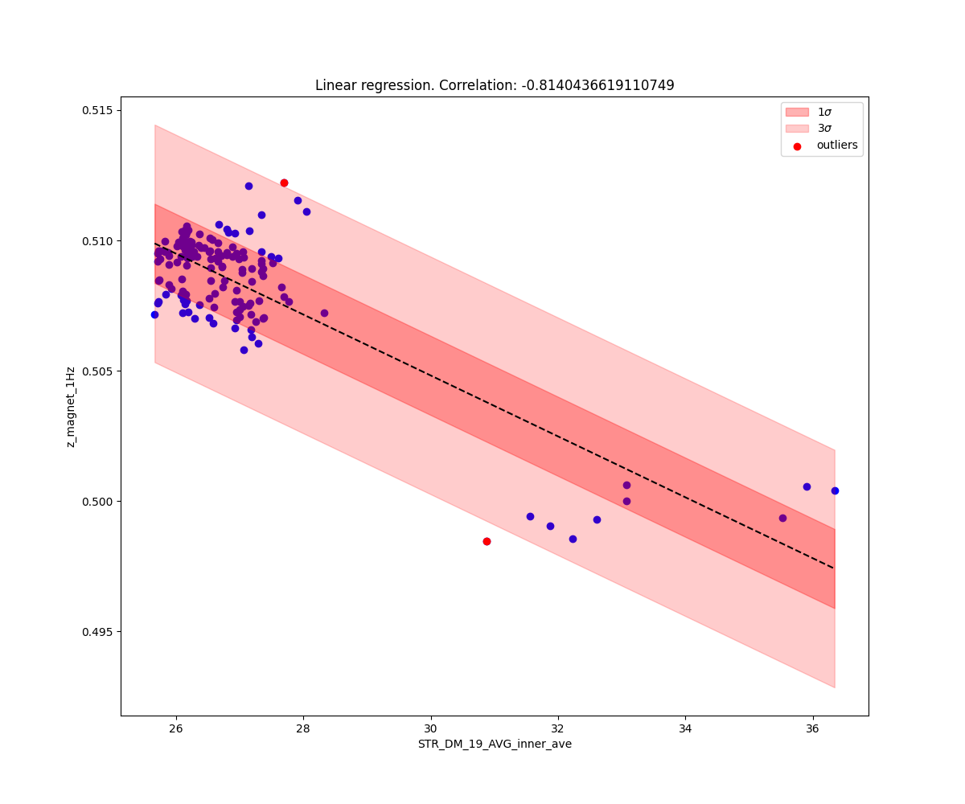
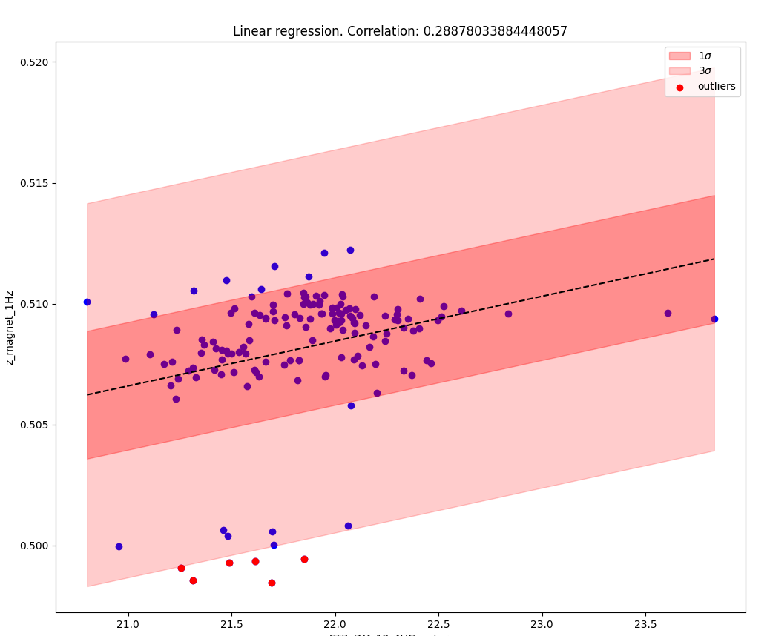
Correlate events and features -2
Don’t trust blindly correlation values

Slide 26
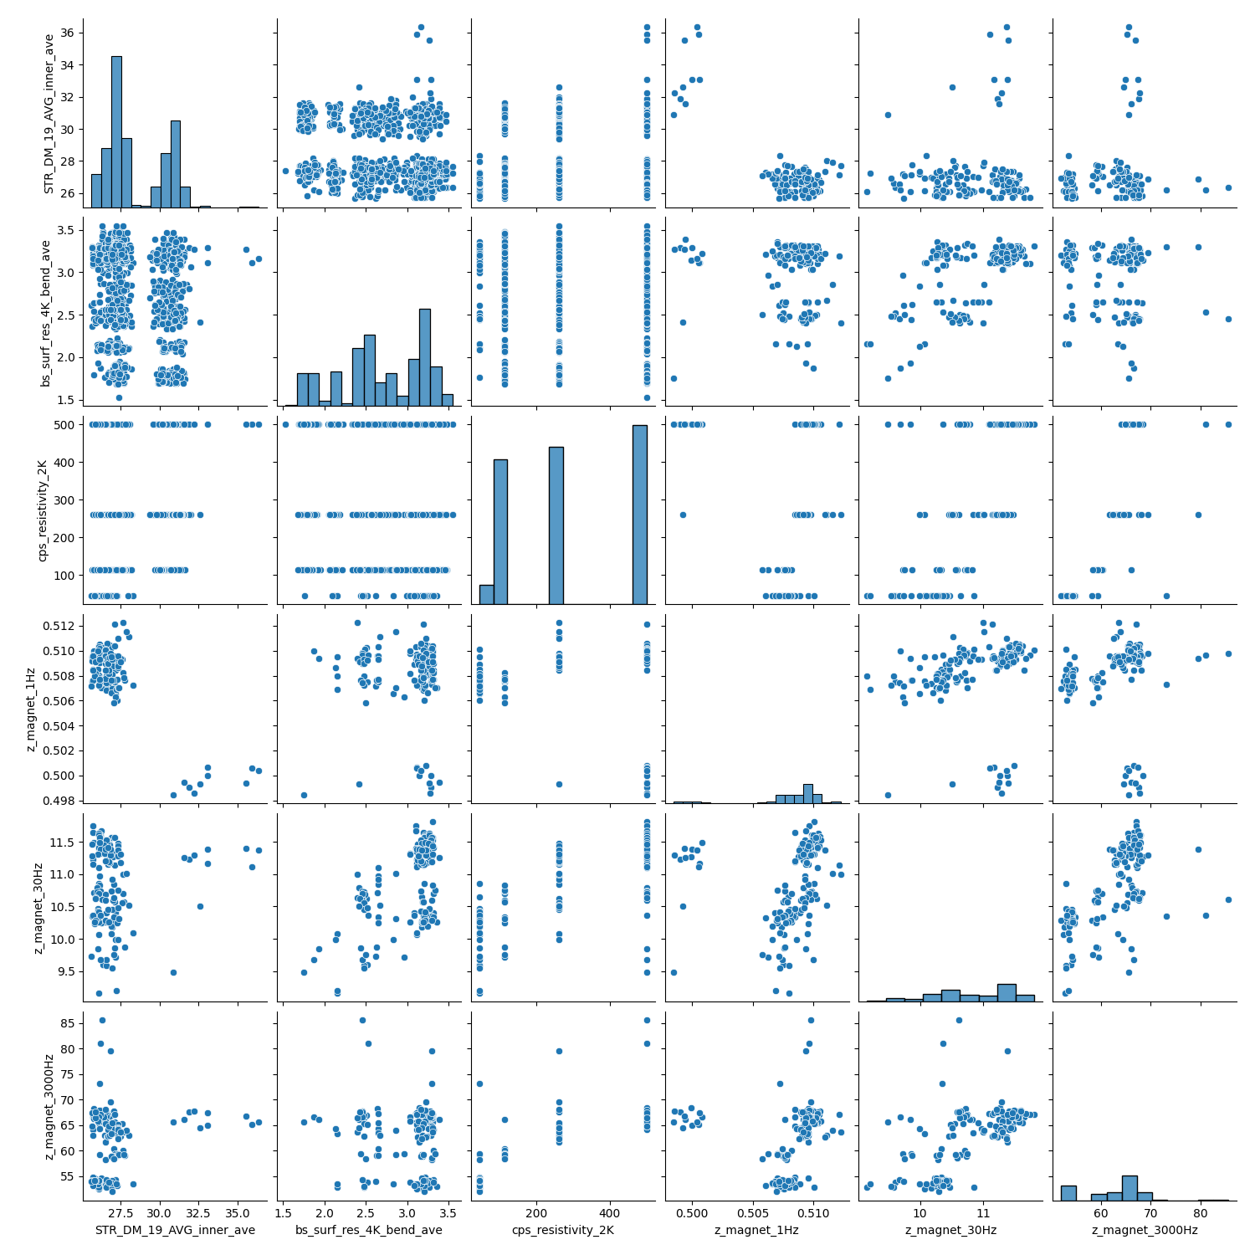
Correlate events and features -3
Magnet features
Visually confirm correlations using a scatter plot
Event features
Magnet features
Event features

Slide 27
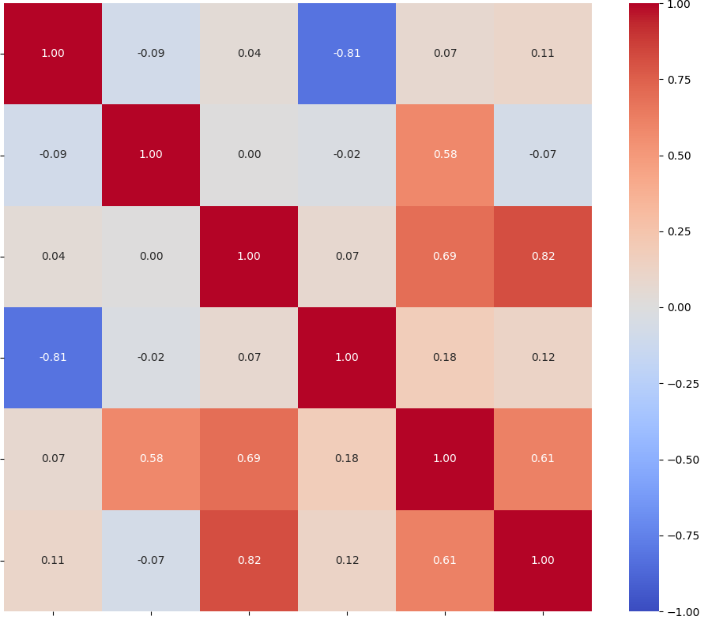
Correlate events and features -4

Slide 28
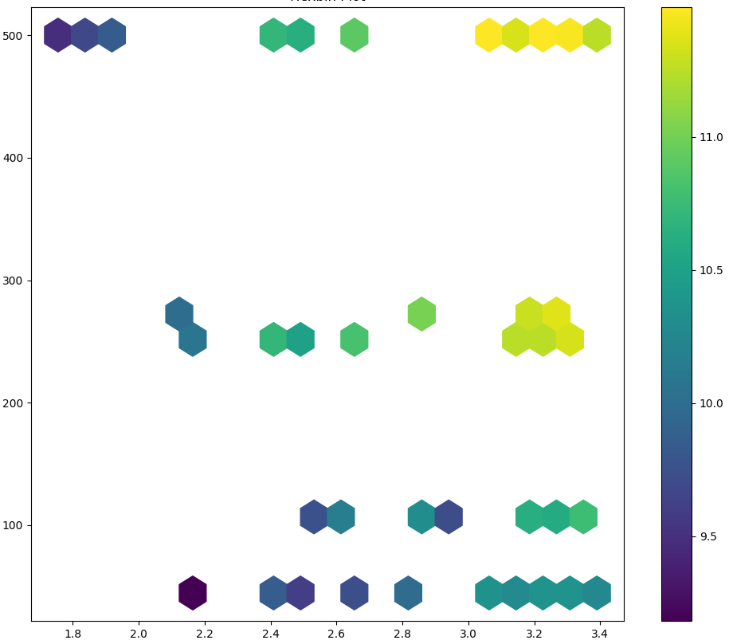
Correlate events and features -5
An hexbin plot can help identifying how two features influence a third one

Slide 29
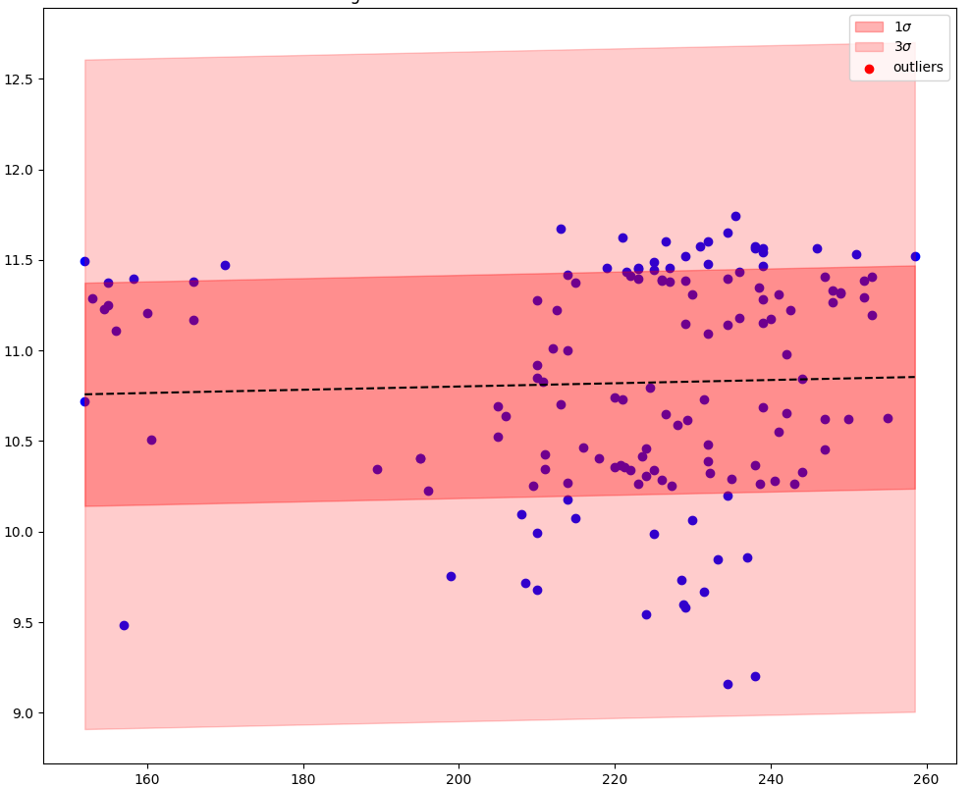
Correlate events and features -6
Correlation does not give relevant information on outliers

Slide 30
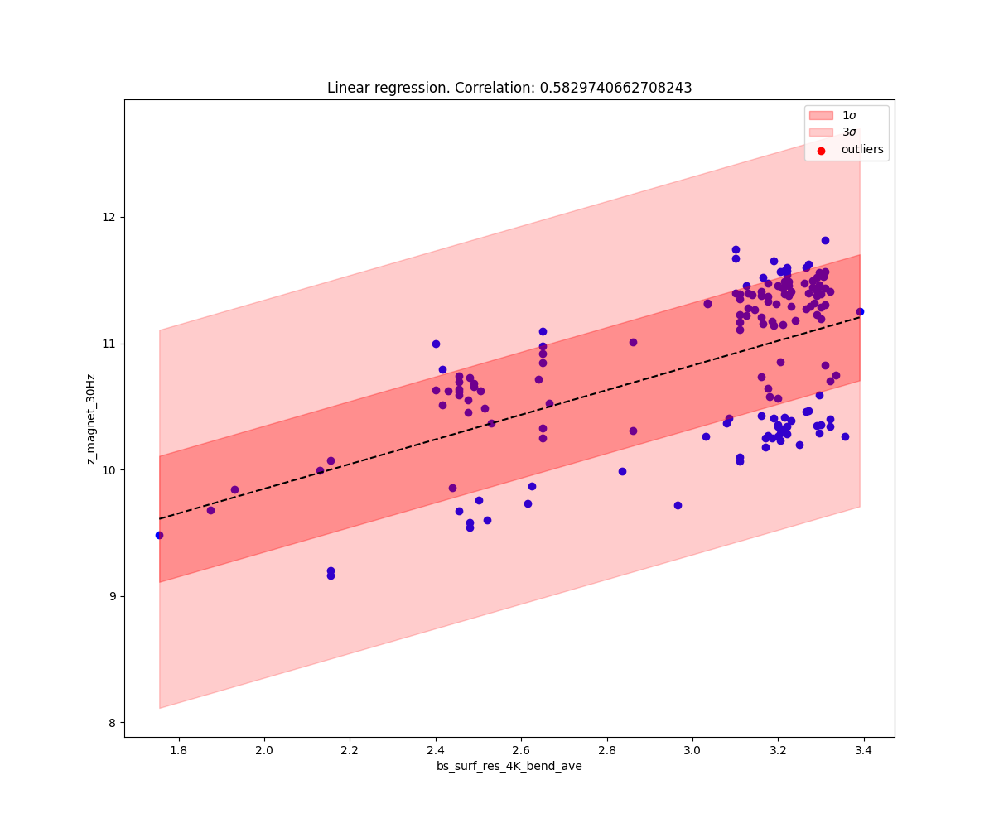
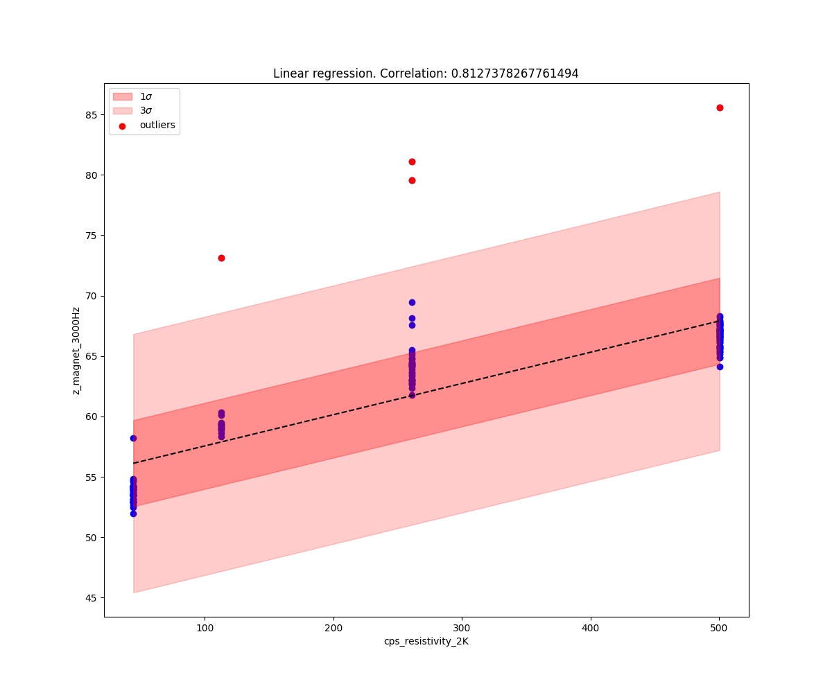
Identify normal behavior
1 Hz
30 Hz
3000 Hz
Scatter plots with regression line and standard-deviation intervals help confirming correlations

Slide 31
Identify outlier behavior -1
1 Hz
30 Hz
3000 Hz
After establishing normal behavior, relevant outliers may appear

Slide 32
Identify outlier behavior -2
positions | 1 | 2 | 3 | 4 | 5 | 6 | 7 | 8 | 9 | 10 | 11 | 12 | 13 | 14 | 15 | 16 | 17 | 18 | 19 | 20 | 21 | 22 | 23 | 24 | 25 | 26 | 27 | 28 | 29 | 30 | 31 | 32 | 33 | 34 | 35 | 36 | 37 | 38 | 39 | 40 | 41 | 42 | 43 | 44 | 45 | 46 | 47 | 48 | 49 | 50 | 51 | 52 | 53 | 54 | 55 | 56 | 57 | 58 | 59 | 60 | 61 | 62 | 63 | 64 | 65 | 66 | 67 | 68 | 69 | 70 | 71 | 72 | 73 | 74 | 75 | 76 | 77 | 78 | 79
A13R1 |  |  |  |  |  |  |  |  |  |  |  |  |  |  |  |  |  |  |  |  |  |  |  |  |  |  |  |  |  |  |  |  |  |  |  |  |  |  |  |  |  |  |  |  |  |  |  |  |  |  |  |  |  |  |  |  |  |  |  |  |  |  |  |  |  |  |  | 3.4003 |  |  |  |  |  | 4.0242 |  |  | 3.6767 | 3.0365
A15L6 |  |  |  |  |  |  |  |  |  |  |  |  |  |  |  |  |  |  |  |  |  |  |  |  |  |  |  |  |  |  |  |  |  |  |  |  |  |  |  |  |  |  |  |  |  |  |  |  |  |  |  |  |  |  |  |  |  |  |  |  |  |  |  |  |  |  |  |  | 7.4132 |  |  |  |  | 3.1007 |  |  | 4.4523 | -3.1019
A16L2 |  |  |  |  |  |  |  |  |  |  |  |  |  |  |  |  |  |  |  |  |  |  |  |  |  |  |  |  |  | 9.2503 |  |  |  |  |  |  |  |  |  |  |  | -6.7817 |  |  |  |  |  |  |  |  |  |  |  |  |  |  |  |  |  |  |  |  |  | 4.4095 |  | 3.2384 | 4.1067 | 3.4003 |  |  |  |  | 3.0134 |  |  | 7.2999 | 3.9316 | 4.7699 | 6.8992
A16L8 |  |  |  |  | 4.3835 |  |  |  |  |  |  |  |  | -3.0861 |  |  |  |  |  | 3.5529 |  |  |  |  |  | 6.0012 |  | 4.0413 |  |  |  |  |  |  |  | -4.2188 |  | 5.5813 |  | 7.6692 | -10.072 | 21.773 |  |  |  | 7.5412 |  |  | -35.071 | 3.4679 |  |  | 5.0673 |  | -10.799 | -15.855 |  |  |  |  |  | 3.0722 | 6.3712 |  | 3.2261 | 6.0597 | 3.4198 | 3.4003 |  |  |  |  |  | 5.2725 | 9.207 | 5.0281 | 5.2172 | 8.841 | 5.7655
A18R2 |  |  |  |  |  |  |  |  |  |  |  |  |  |  |  |  |  | -3.4565 |  |  |  |  |  |  |  |  |  |  |  |  |  |  |  |  |  |  |  | -3.698 |  |  |  |  |  |  |  |  |  |  |  |  |  |  |  | 3.2968 |  |  |  |  |  |  |  |  |  |  |  |  |  | 3.4003 |  |  |  |  |  | 4.929 | 3.9288 |  | 3.712
A20L5 |  |  |  |  |  |  |  |  |  |  |  |  |  |  |  |  |  |  |  |  |  |  |  |  |  |  | -3.0238 |  |  |  |  |  |  |  |  |  |  |  |  |  |  |  |  | 4.0556 |  |  |  |  |  |  |  |  |  |  |  |  |  |  |  |  |  |  | -3.0269 |  |  |  |  | 3.4003 |  |  |  |  |  | 3.7997 | -4.2124 |  | 3.358
A22L2 |  |  |  |  |  |  |  |  |  |  |  |  |  |  |  |  |  |  |  |  | 3.1757 |  |  |  |  |  |  |  |  |  |  |  |  |  |  |  |  |  |  |  |  |  |  |  |  |  |  |  |  |  |  |  |  |  |  |  |  |  |  | -3.2658 |  |  |  |  |  |  |  | 3.4003 |  |  |  | -3.3764 |  | 3.8996 |  |  | 3.4324
A22R4 |  |  |  |  |  |  |  |  |  |  |  |  |  |  |  |  |  |  |  |  |  |  |  |  |  |  |  |  |  |  |  |  |  |  |  |  |  |  |  |  |  |  |  |  |  |  |  |  |  |  |  |  |  |  |  |  |  |  |  |  |  |  | -3.491 | -3.7754 |  | -4.0684 | -3.6103 | 3.4003 |  |  |  |  |  | 3.0383 | -4.8751 | -5.8127 | 4.4736 | -5.7736 | -5.8368
A23R4 |  |  |  |  |  |  |  |  |  |  |  |  |  |  |  |  |  |  |  |  |  |  |  |  |  |  |  |  |  |  |  |  |  |  |  |  |  |  |  |  |  |  |  |  |  |  |  |  |  |  |  |  |  |  |  |  |  |  |  |  |  |  |  |  |  |  |  | 3.4003 |  |  |  |  |  | 3.4502 |  |  | 3.4749
A24L6 |  |  |  |  | 5.5308 |  |  |  |  |  |  |  |  |  |  |  |  |  |  |  |  |  |  |  |  | 13.314 |  |  |  |  |  |  |  |  |  |  |  |  |  |  |  |  |  |  |  |  |  |  |  |  |  |  |  |  |  |  |  |  |  |  |  |  | 3.369 |  |  |  |  | 3.4003 |  |  |  |  |  |  | 4.9203 |  | 3.0923 | 3.8953 | 3.0398
A28R1 |  |  |  |  |  |  |  |  |  |  |  |  |  |  |  |  |  |  |  |  |  |  |  |  |  |  |  |  |  |  |  |  |  |  |  |  |  |  |  |  |  |  |  |  |  |  |  |  |  |  |  |  |  |  |  |  |  |  |  |  |  |  |  |  |  |  |  | 3.4003 |  |  |  |  |  |  | -3.384 | -3.8598 | 3.0924 | -4.0084 | -3.497
A29R4 |  |  |  |  |  |  |  |  |  |  |  |  |  |  |  |  |  |  |  |  |  |  |  |  |  |  |  |  |  |  |  |  |  |  |  |  |  |  |  |  |  |  |  |  |  |  |  |  |  |  |  |  |  |  |  |  |  |  |  |  |  |  |  |  |  |  |  | 3.4003 |  |  |  |  |  | 3.7872 |  | -3.8997 | 3.4324 |  | -3.69
A31L3 |  |  |  |  |  |  | 4.5728 |  | 3.6132 |  |  |  |  |  |  |  |  |  |  | 5.5089 |  |  |  |  |  |  |  |  |  |  |  |  |  |  | 4.0339 | 3.8025 |  | -4.6259 | -5.1437 | -3.7505 | -4.0837 | 3.4741 |  |  |  | -5.7892 |  |  |  |  |  |  |  |  |  |  |  |  |  |  |  |  |  |  |  |  |  | 3.4003 |  |  |  |  |  | 3.6559 |  |  | 3.6487
A34R4 |  |  |  |  |  |  |  |  |  |  | 3.0256 |  |  |  |  |  |  |  |  |  |  |  |  |  |  |  |  |  | -3.9661 |  |  |  |  |  | -3.3552 |  |  |  |  |  |  |  |  |  |  |  |  |  |  |  |  |  |  |  |  |  |  |  |  |  |  |  |  | -4.1237 |  | -3.341 | -4.1511 | 3.4003 |  |  |  |  |  | 3.5501 |  | -6.3707 | 5.0048 | -4.724 | -6.7292
A8L6 |  |  |  |  |  |  |  |  |  |  |  |  |  |  |  |  |  |  |  |  |  |  |  |  |  |  |  |  |  | 3.2173 |  |  |  |  |  |  |  |  |  | -3.886 |  |  |  |  |  |  |  |  |  |  |  |  |  |  |  |  | 4.1394 |  |  |  |  |  |  |  |  |  |  | 3.4003 |  | 4.2703 |  |  |  |  |  |  | 3.0711
B13L5 |  |  |  |  |  |  |  |  |  |  |  |  |  |  |  |  |  |  |  |  |  |  |  |  |  |  |  |  |  |  |  |  |  |  |  |  |  |  |  |  |  |  |  |  |  |  |  |  |  |  |  |  |  |  |  |  |  |  |  |  | 3.4277 |  |  |  |  |  |  | 3.4003 |  |  |  |  | 5.1357 | 4.1241 |  | 4.3505 | 3.8891 | 3.3705 | 4.077
B14R6 |  | 3.148 |  |  |  |  |  |  |  |  |  |  |  |  |  |  |  |  |  |  |  |  |  |  |  |  |  |  |  |  |  |  |  |  |  |  |  |  |  |  |  |  |  |  |  |  |  |  |  |  | -3.1905 |  |  |  |  |  |  |  |  |  |  |  |  |  |  |  |  |  | 7.4132 | 4.2703 |  |  |  | 3.138 |  | 3.7926 | 3.5173 |  | 3.9323
B17L8 |  |  |  |  |  |  |  |  |  |  |  |  |  | -4.2463 | -3.5822 |  |  | -3.6238 | -3.0564 |  |  |  |  |  |  |  |  |  |  |  |  |  |  |  |  |  |  |  |  |  |  |  |  |  |  |  |  |  |  |  |  |  |  |  |  |  |  |  |  |  |  | 3.0853 | -5.1879 |  |  | -5.0933 |  | 3.4003 |  |  |  |  |  | 5.2851 | -7.298 |  | 4.6861 | -7.2525
B18L4 |  |  |  |  |  |  |  |  |  |  |  | 3.3767 |  |  |  |  |  |  |  |  |  |  |  |  |  |  |  |  |  |  |  |  | 3.3362 |  | -3.2854 |  |  | -3.698 |  |  |  |  |  |  |  |  |  |  |  |  |  |  |  |  |  |  |  |  | 3.7385 | 3.0742 |  |  |  |  |  |  |  | 3.4003 |  |  | 3.3725 | 3.3774 |  |  |  | 3.952 | 3.7298 |  | 3.4258
B18R5 |  |  |  |  |  |  |  |  |  |  |  |  |  |  |  |  |  |  |  | 7.1093 |  |  |  |  |  |  |  |  |  |  |  |  |  |  |  |  |  |  |  | -4.7845 |  |  |  |  |  |  |  |  |  |  |  |  |  |  |  |  |  |  |  |  |  |  | -3.375 | -3.3774 |  | -3.6276 | -3.1426 | 3.4003 |  |  |  |  |  |  | -4.7094 | -5.175 | 3.0075 | -5.1375 | -5.0649
B20L5 |  | 3.148 |  |  |  |  |  |  |  |  |  |  |  |  |  |  |  |  |  |  |  |  |  |  |  |  |  |  |  |  |  |  |  |  |  |  |  |  |  |  |  |  |  |  |  |  |  |  |  |  |  |  |  |  |  |  |  |  |  |  |  |  |  |  |  |  |  | 3.4003 |  | 4.2703 |  |  |  | 3.2255 |  |  | 3.2731
B21L3 |  |  |  |  |  |  |  |  |  |  |  |  | 3.1573 |  |  |  |  |  |  |  | 3.1757 |  |  |  |  |  |  |  |  |  |  |  |  |  |  |  | -3.2789 |  |  |  |  |  |  |  |  |  |  | 3.549 |  |  |  |  |  |  |  |  |  |  |  |  |  |  |  |  |  |  |  | 3.4003 |  |  |  |  |  | 4.3908 |  | 3.5615 | 4.3159 | 3.069
B21L6 |  |  |  |  |  |  |  |  |  |  |  |  |  |  |  |  |  |  |  |  |  |  |  |  |  |  |  |  |  |  |  |  |  |  |  |  |  |  |  |  |  |  |  |  |  |  |  |  |  |  |  |  |  |  |  |  |  |  |  |  |  |  |  |  |  |  |  | 3.4003 |  |  |  |  |  |  |  |  | 3.3474 | -3.1178
B21R2 |  |  |  |  |  |  |  |  |  |  |  |  |  |  |  |  |  |  |  |  |  |  |  |  |  |  |  |  |  |  | -3.6011 | 3.7033 |  |  |  |  |  |  |  |  |  |  |  |  |  |  |  |  |  |  |  |  |  |  |  |  |  |  |  |  |  | 3.7573 |  |  |  |  |  | 3.4003 |  |  |  |  |  | 5.9321 | 3.8476 |  | 4.3575
B21R4 |  |  |  | -23.446 |  |  |  |  |  |  |  |  |  |  |  |  |  |  |  |  |  |  | 27.891 |  |  |  |  |  |  |  |  |  |  |  |  |  |  |  |  |  |  |  |  |  |  |  |  |  |  |  |  |  |  |  |  |  |  |  |  |  | -5.229 |  | -3.1285 | -6.5369 |  | -4.6966 | -6.168 | 3.4003 |  |  |  |  |  |  | -4.3573 | -10.237 | 4.4205 | -6.68 | -10.058
B25L3 |  |  |  |  |  |  |  |  |  |  |  | 3.477 |  |  |  |  |  |  |  | -8.3609 |  |  |  |  |  |  |  | -6.5184 |  |  |  |  |  |  |  |  |  |  |  |  |  |  |  |  |  |  |  |  |  |  |  |  |  |  |  |  |  |  |  |  |  |  |  |  |  |  |  | 3.4003 |  |  |  |  |  | 3.51 | 3.1576 | 4.0302 | 3.4621 | 3.3807 | 3.5706
B25L6 |  |  |  |  |  |  |  |  |  |  |  |  |  |  |  |  |  |  |  |  |  |  |  |  |  |  |  |  |  |  |  |  |  |  |  |  |  |  |  |  |  |  |  |  |  |  |  |  |  |  |  |  |  |  |  |  |  |  |  |  |  |  |  |  |  |  |  | 3.4003 |  |  |  |  |  | 4.3239 |  |  | 3.6449
B25R3 | 3.8331 |  |  |  |  |  |  |  |  |  |  |  |  |  |  |  |  |  |  |  |  |  |  |  | 4.3026 |  |  |  |  |  |  | 3.7033 |  | 3.5399 |  | -3.2639 |  |  | 3.1542 | 3.8681 | 4.7216 |  | -5.156 |  |  |  |  |  |  |  |  |  |  | 3.2353 | -3.1361 |  |  |  |  |  |  |  |  |  |  |  |  | 3.4003 |  | 4.2703 |  |  |  | 3.1755 | 4.0505 | 4.6295 | 4.1547 | 3.8794 | 4.6559
B27L8 |  |  | 3.6204 |  |  |  |  |  |  |  |  |  |  |  | -3.5822 |  |  |  |  |  |  | -5.7905 |  |  |  |  |  |  |  |  |  |  |  |  |  |  |  |  |  |  |  |  |  |  |  |  |  |  |  |  |  |  |  |  |  | -3.2865 |  |  |  |  |  |  |  |  |  |  |  | 3.4003 |  | 4.2703 |  |  |  |  |  |  | 3.0923 |  | 3.0398
B28R1 |  |  |  |  |  |  |  |  |  |  |  |  |  |  |  |  | -3.5799 |  |  |  |  |  |  |  |  |  |  |  |  |  |  |  |  |  |  |  |  |  |  |  |  |  |  |  |  |  |  |  |  |  |  |  |  |  |  |  |  |  |  |  |  |  |  |  |  |  |  |  | 7.4132 |  |  |  |  | 3.1505 |  | 4.3107 | 4.6435 | 3.2432 | 4.1494
B29R3 |  |  |  |  |  |  |  |  |  |  |  |  |  |  |  |  |  |  |  |  |  |  |  |  |  |  |  |  |  |  |  |  |  |  |  |  |  |  |  |  |  |  |  |  |  |  |  |  |  |  |  |  |  |  |  |  |  |  |  |  |  |  |  |  |  |  |  | 3.4003 |  | 4.2703 |  |  |  |  |  | 3.115 | 3.3367 | 3.1319 | 4.3906
B8R7 |  |  |  |  |  |  |  |  |  |  |  |  |  |  | -3.5822 |  |  |  |  |  |  |  |  |  |  |  |  |  |  |  |  |  |  |  |  |  |  |  |  |  |  | 3.6444 |  |  |  |  | 3.9161 |  |  |  |  |  |  |  |  |  |  |  |  |  |  |  | -3.3605 |  |  |  |  | 3.4003 |  |  |  |  |  | 3.6998 | -4.6887 | -3.262 | 3.2731 | -3.6267 | -3.1111
C15L6 |  |  |  |  |  |  |  |  |  |  |  |  |  |  |  |  |  |  |  |  |  |  |  |  |  |  |  |  |  |  |  |  |  |  |  |  |  |  |  |  |  |  |  |  |  |  |  |  |  |  |  |  |  |  |  |  |  |  |  |  |  |  |  |  |  |  |  | 3.4003 |  |  |  |  |  | 3.0132 | 3.6363 | 3.0752 | 3.5704 | 3.4659 | 3.0157
C20R5 |  |  |  |  |  | 10.841 |  | 5.0536 |  |  |  |  |  |  |  |  |  |  |  |  |  |  |  |  |  |  |  |  |  |  |  |  |  |  |  |  |  |  |  |  |  |  |  |  |  |  |  |  |  |  |  |  |  |  |  |  |  |  |  |  |  |  | -4.2742 | -4.7954 |  | -4.3329 | -4.8818 | 3.4003 |  |  |  |  |  | 3.3628 | -5.9933 | -7.4468 | 4.038 | -6.1553 | -7.9353
C21L6 |  |  |  |  |  |  |  |  |  |  |  |  |  |  |  |  |  |  |  |  |  |  |  |  |  |  |  |  |  |  |  |  |  |  |  |  |  |  |  |  |  |  |  |  |  |  |  |  |  |  |  |  |  |  |  |  |  |  |  |  |  |  |  | 3.3895 |  |  | 3.5221 |  | 7.4132 | 4.2703 |  |  |  | 3.4376 |  | 5.6658 | 4.4628 | 4.2451 | 5.9344
C21R6 |  |  | 7.3722 |  |  |  |  |  |  | -3.473 |  |  |  | -4.2463 | -3.5822 | 3.7569 |  |  |  |  |  | 15.737 |  |  |  |  |  |  |  |  |  |  |  |  |  |  |  |  |  |  |  |  |  | 5.6806 | 9.7375 |  |  |  |  |  |  |  |  |  |  |  |  | 6.6818 |  | 3.07 | 4.3808 | 7.1367 | 11.146 | 7.0985 | 6.8597 | 9.404 | 6.1004 | 3.4003 |  |  |  | 3.3729 | 6.4169 | 9.186 | 16.025 | 11.608 | 8.6055 | 13.667 | 10.19
C22R5 |  |  |  |  |  | 10.911 |  | 5.0536 |  |  |  |  |  |  |  |  |  |  |  |  |  |  |  |  |  |  |  |  |  |  |  |  |  |  |  |  |  |  |  |  |  |  |  |  |  |  |  |  |  | 6.9514 |  | 3.3254 |  |  |  |  |  |  |  |  |  |  |  |  |  |  |  | 3.4003 |  |  |  |  |  |  |  | 3.1549 | 3.0817 |  | 3.4258
C23L2 |  |  |  |  |  |  |  |  |  |  |  |  |  |  |  |  |  |  |  | 3.5529 |  |  |  |  |  |  |  |  |  |  |  |  |  |  |  |  |  |  |  | -5.7713 |  | -3.4943 |  |  | -3.1706 |  |  |  |  |  |  |  |  |  |  |  |  |  |  |  |  |  | 3.7606 |  |  |  |  | 3.4003 |  | 4.2703 |  |  |  | 5.0852 | 5.4794 | 4.3904 | 4.9303 | 4.0384 | 3.8358
C23L4 |  |  |  |  |  |  |  |  |  |  |  |  |  |  |  |  |  |  |  |  |  |  |  |  |  |  |  |  |  |  | -3.6011 |  |  | -3.5152 |  |  |  |  |  |  |  |  |  |  |  |  |  |  |  |  |  |  |  |  |  |  |  |  |  |  |  |  |  |  |  |  |  | 3.4003 |  | 4.2703 |  |  |  | 3.9495 | -3.6946 |  | 3.6874
C24R1 |  |  |  |  |  |  |  |  |  |  |  |  |  |  |  |  |  |  |  |  |  |  |  |  |  |  |  |  |  |  |  |  |  |  |  |  |  |  |  |  |  |  |  |  |  |  |  |  |  |  |  |  |  |  |  |  |  |  |  |  |  |  |  |  |  |  |  | 3.4003 |  |  |  |  |  | 3.9495 |  |  | 4.2398
C25L6 |  |  |  |  |  |  |  |  |  |  |  |  |  |  |  |  |  |  |  |  |  |  |  |  |  |  |  |  |  |  |  | -3.2059 |  |  |  |  |  |  |  |  |  |  |  |  |  |  |  |  |  |  |  |  |  |  |  |  |  |  |  |  |  |  |  |  |  |  |  |  | 7.4132 |  |  |  |  | 3.3877 |  |  | 3.7617
C28L3 |  | 3.148 |  |  |  |  |  |  |  |  |  |  | 4.2756 |  |  |  |  |  |  |  |  |  |  |  |  |  |  |  |  |  |  |  |  |  |  |  |  |  |  |  |  |  |  |  |  |  |  |  |  |  |  |  |  |  |  |  |  |  |  |  |  |  |  |  |  |  |  | 3.4003 |  |  |  |  |  | 3.9749 |  |  | 4.0452
C28R3 |  |  |  |  |  |  |  |  |  |  |  |  |  |  |  |  |  | -3.4361 |  |  |  |  |  |  |  |  |  |  |  |  |  |  |  |  |  |  |  |  |  |  |  |  |  |  |  |  | 14.266 |  |  |  |  |  |  | -4.1239 | 5.3098 |  |  |  |  |  |  |  |  |  |  |  |  | 3.4003 |  | 4.2703 |  |  |  |  |  |  | 3.0286
C29R5 |  |  |  |  |  |  |  |  |  |  |  |  |  |  |  |  |  |  |  |  |  |  |  |  |  |  |  |  |  |  |  |  |  |  |  |  |  |  |  |  |  |  |  |  |  |  |  |  |  |  |  |  |  |  |  |  |  |  |  |  |  |  | 3.1224 | 3.4144 | 3.3401 | 3.0621 | 3.2882 | 3.4003 |  | 4.2703 |  |  |  | 3.862 | 4.5682 | 5.7057 | 5.3234 | 4.5155 | 5.5484
C34L6 |  |  |  |  |  |  |  |  |  |  |  |  |  |  |  |  |  |  |  |  |  |  |  | 3.6194 |  |  |  |  |  |  |  |  |  |  |  |  |  |  |  |  |  |  |  |  |  |  |  |  |  |  |  |  |  |  |  |  |  |  |  |  |  |  | 3.7751 |  |  |  |  | 3.4003 |  | 4.2703 |  |  |  | 3.138 | 5.5001 | 3.4737 | 3.5704 | 4.4041 | 3.3534
Find whether individual magnets exhibited outlier behavior in multiple features or events

Slide 33
After identifying outliers, check whether outliers can be explained by
For another time!
operating conditions
another feature not yet considered
a combination of features
a different physical behavior

Slide 34
Main takeaways for interested colleagues
Don’t start from the last step
Analyze features
Identify normal behavior
Identify outlier behavior
Simulate physical behavior
Analyze unexpected events
Correlate events and features
Choose numerical quantities
Don’t trust blindly correlation values
Confirm correlations with scatter plots
Correlation does not give relevant information on outliers
Experiment with various plots!

Slide 35


Slide 36
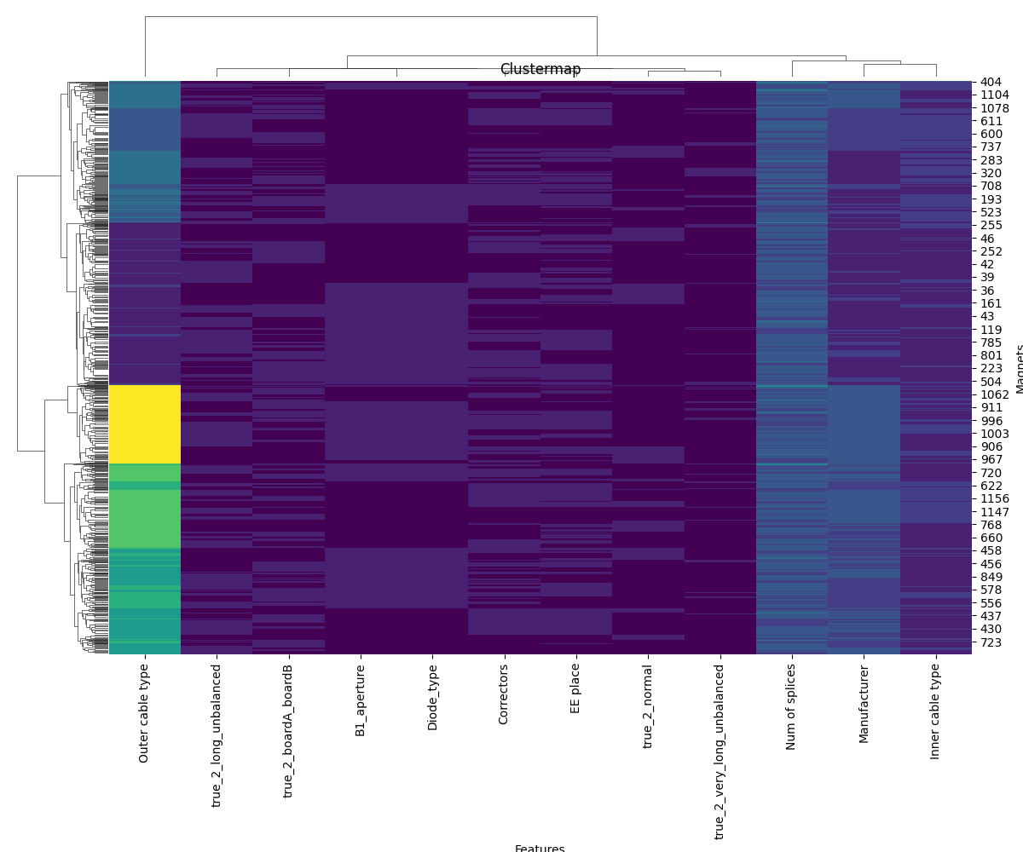
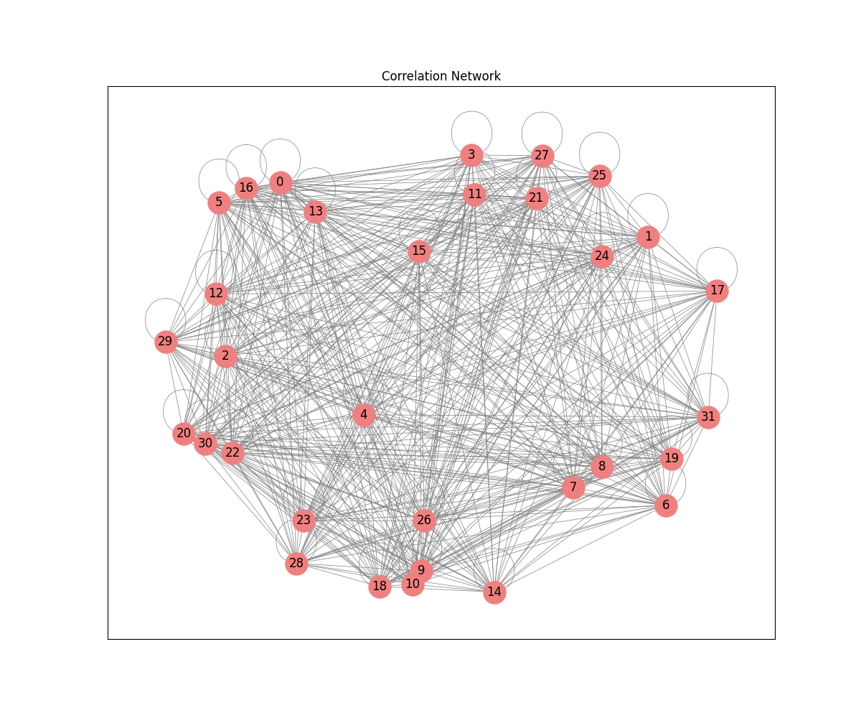
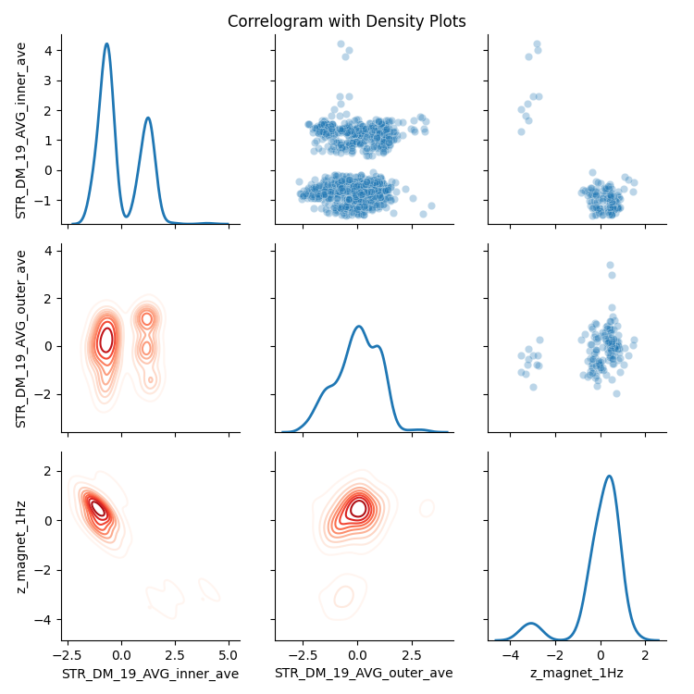
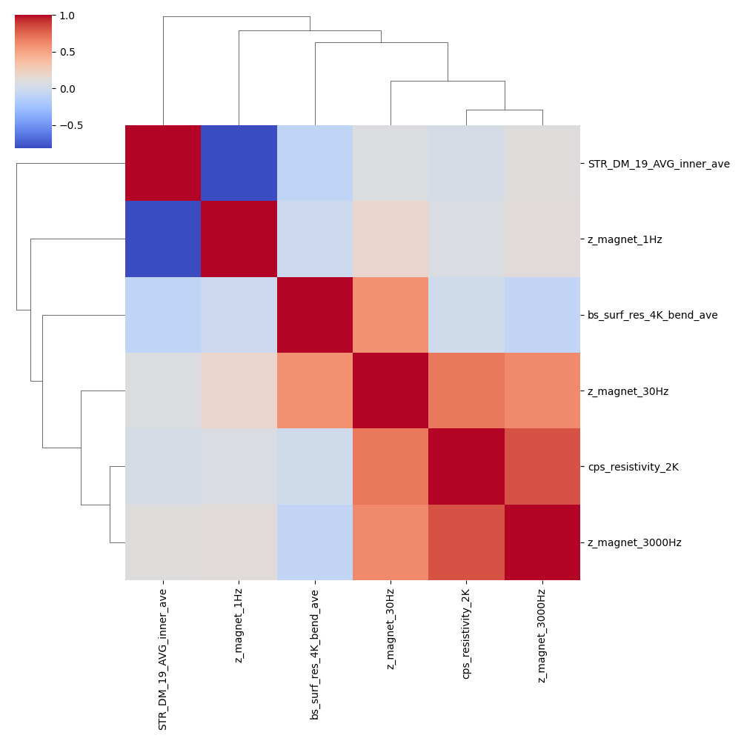
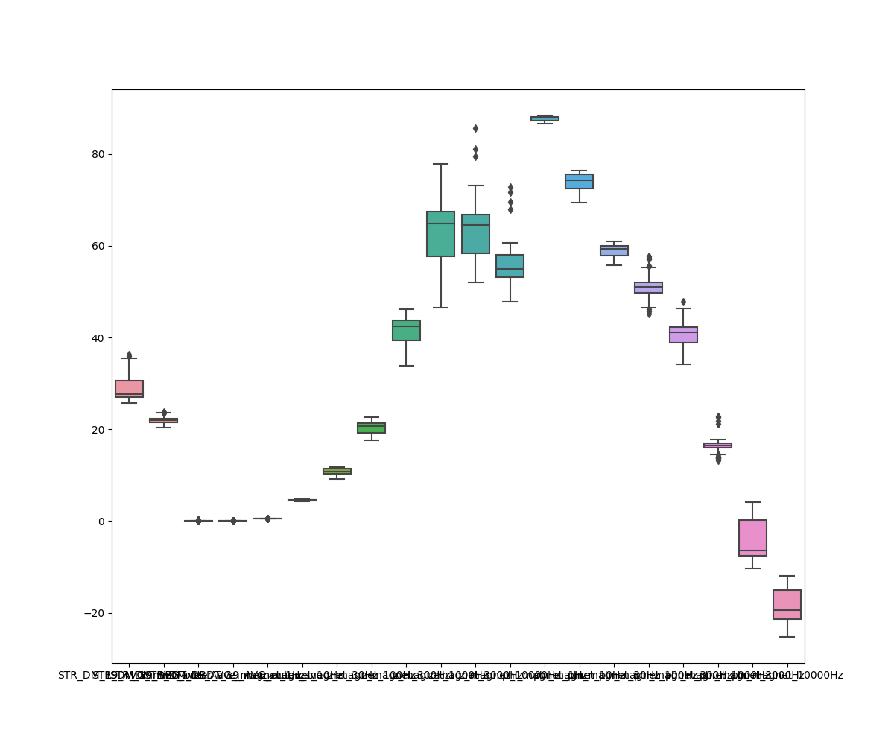
A lot more fancy plots are possible…

Slide 37


Slide 38
Annex

Slide 39
I hid the relevant physical quantities on purpose in many plots contained in these slides because I’m not ready to share my conclusions. They come from real analyses performed on LHC main dipole magnet data.

Slide 40
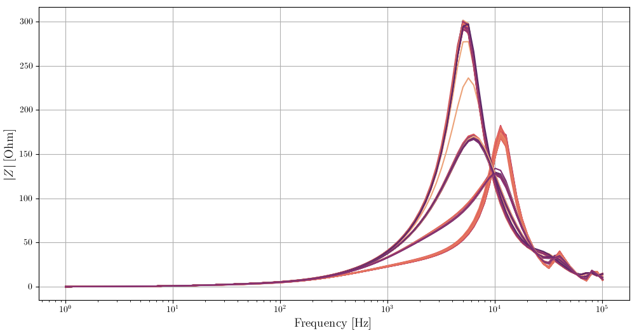
Impedance amplitude versus frequency measured on 154 magnets

Slide 41
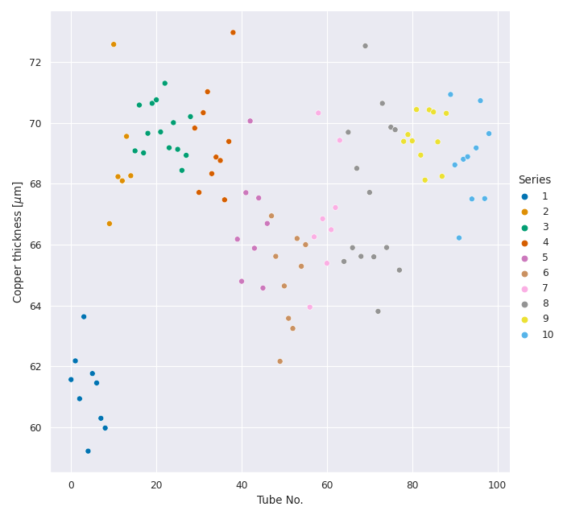
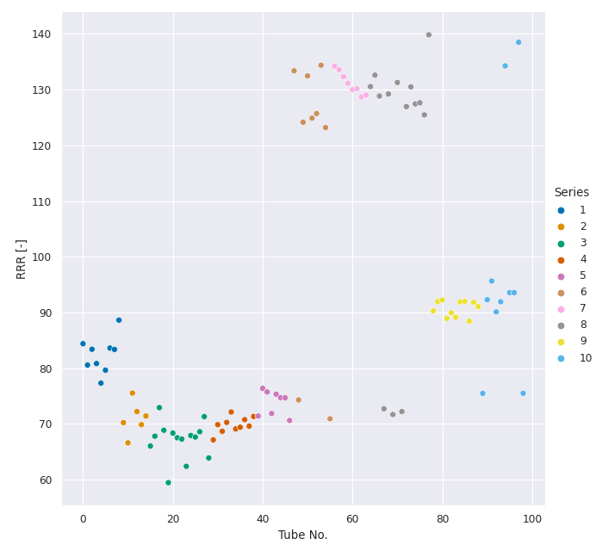
Beam screen Cu thickness and RRR deduced from measurements -1
Thickness of Cu layer
RRR

Slide 42
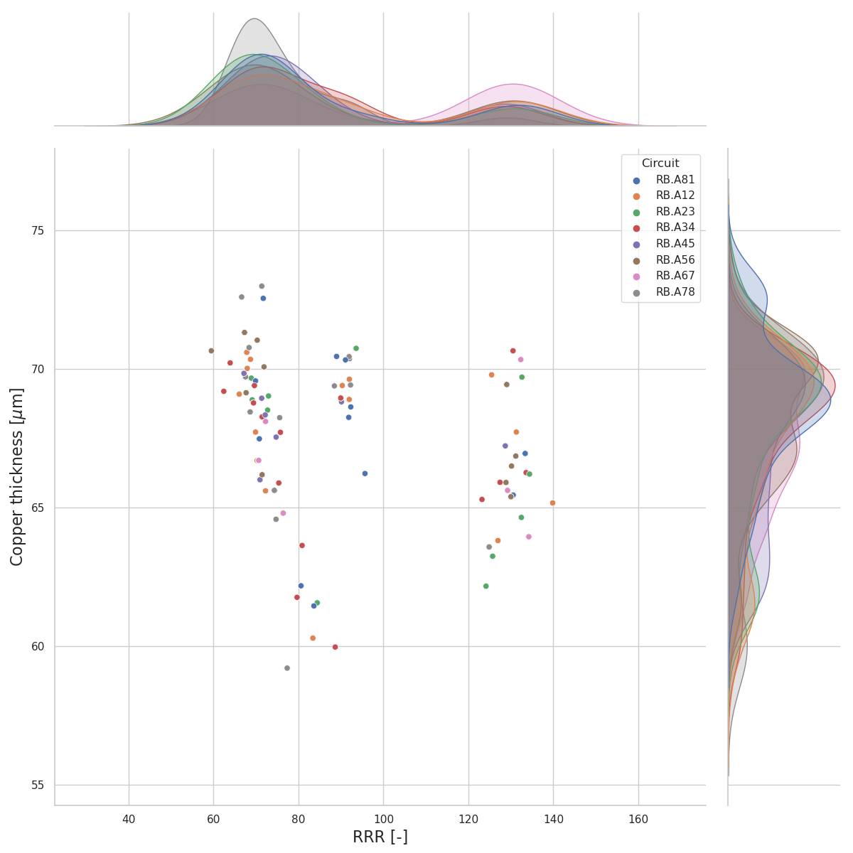
Beam screen Cu thickness and RRR deduced from measurements -2
plotted by circuit
plotted by beam screen batch

Slide 43
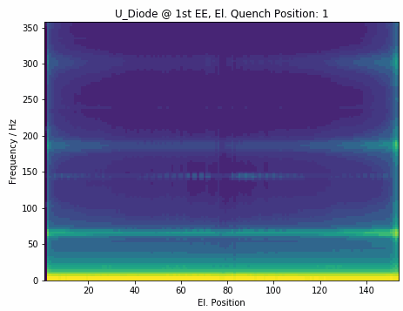
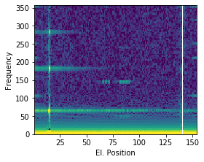
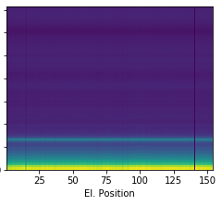
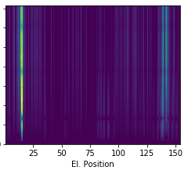
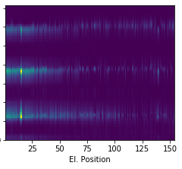
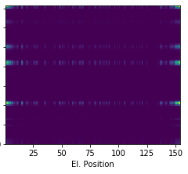
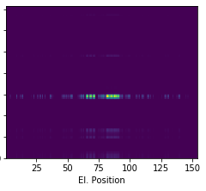





Extra: Frequency analysis by Christoph Obermair – 2
Systematic approach to analyze frequencies:
Show occurrence and the spread of frequencies
Decompose frequencies based on origin
Display expected frequencies depending on a quench
Event:
RB_RB.A78_1617170255140000000 2021-03-31 07:57:35.120000 Primary Quench at el. Position 141
$$≈$$
$$+$$
$$+$$
$$+$$
$$+$$
Common Oscillation
Physical Propagation
Electrical Propagation
Power Converter
Energy Extraction

