Slide 1
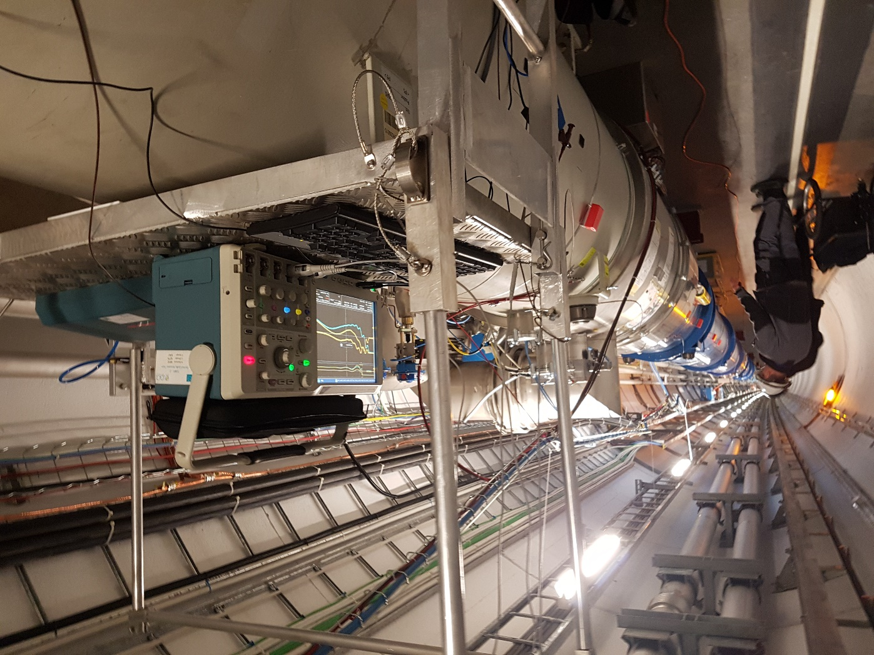
Electrical fault diagnostic techniques applied for superconducting magnets and circuits
Mateusz Bednarek
on behalf of the CERN ELQA team

Slide 2
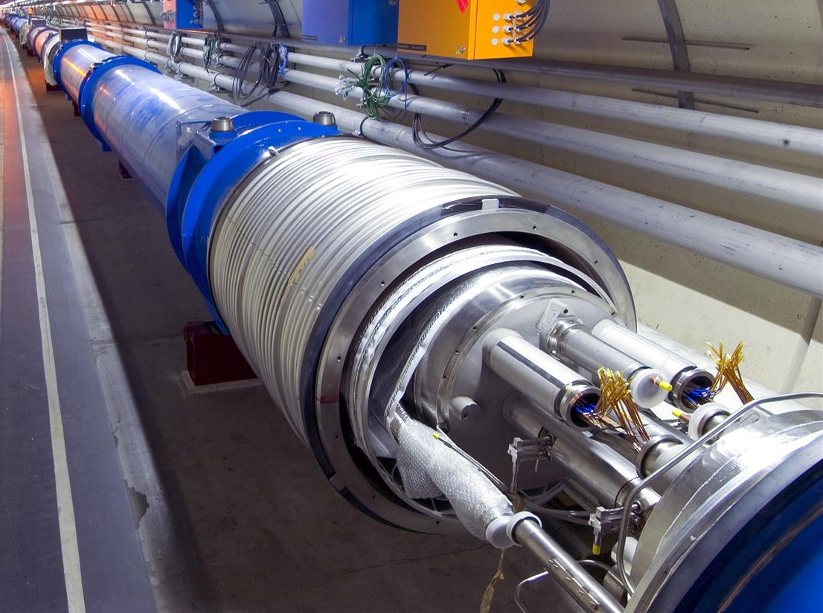
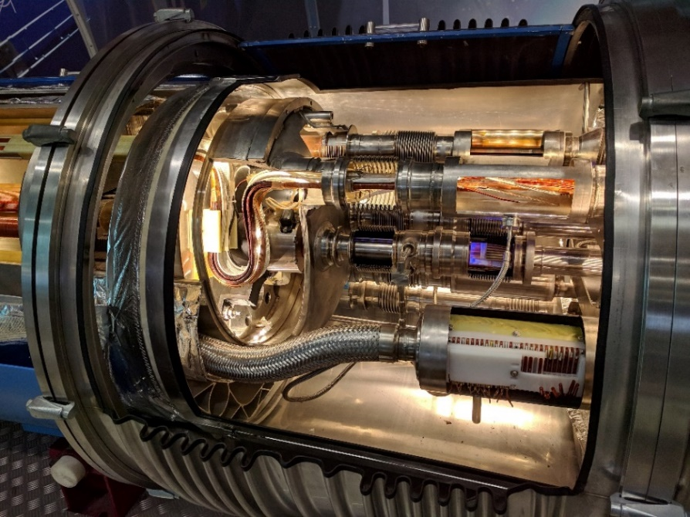
Introduction
Electrical faults can lead to serious damage when powering superconducting magnets or circuits
Superconducting magnets are complex devices that operate in cryogenic environment inside of a cryostat
Live parts can be only accessed using V-taps (limited number!) and at the level of current leads
Large thermal gradients might be present
Circuit integrity needs to be checked before high current operation
Faults can appear during high current operation in various situations, for example following high current magnet quenches
Precision fault localization and diagnostics is needed
In this presentation selected electrical faults are described and methods to diagnose and localize them are given
© CERN

Slide 3
Commissioning
Early fault detection is preferred
Regular testing:
  Electrical quality assurance (ELQA)
  Individual system tests (IST)
  Powering tests
Circuit signals need to be continuously monitored and analyzed
Several types of complementary checks are needed to ensure correct result interpretation and completeness of tests
  Example: Continuity test of a circuit that precedes a HV insulation test
See also the online course: ‘Electrical integrity tests and electrical failure diagnostics in superconducting circuits’

Slide 4
Fault scenarios
Many fault scenarios are possible (the following list is not exhaustive):
Insulation failure
  To ground (earth fault)
    Solid low impedance short
    Solid high impedance short
    Multiple shorts
    Short that appears above a certain voltage (breakdown)
  Between circuits
  Within one circuit
    Inter turn short
    Between bus-bars
    Between V-taps
Resistive circuit (special case: open circuit)
Polarity error
Faults can appear at warm, during thermal transitions or at cold
Faults sometimes occur only when powering one or more circuits
Faults can be intermittent
Faults can be introduced by manipulation of circuit components (eg. disconnecting and connecting a connector)
    (example 1 in slide 6)
    (example 2 in slide 11)
    (example 3 in slide 15)
Multiple configurations possible!

Slide 5
Diagnostic procedures
Once the fault appeared it is clear that there is a weakness in the circuit
The fault needs to be diagnosed and localized before it disappears
Selection of the right diagnostic method is important
  In the scope of this presentation, it is not possible to give a clear unambiguous procedure due to large a number of possible configurations
Typical approach:
Global diagnostics – needed at the circuit level
Local diagnostics – narrow down the fault location to identify the faulty component
Insulation failure localization techniques:
At warm – DC methods based on resistive voltage drop measurements
At cold – AC methods based on inductive voltage drop measurements (complex impedance measurements)
It can be useful to warm-up slightly the circuit to transition from superconducting state to normal conducting state (for NbTi 20 K gives good results)
Reflectometry techniques
    (example 1 in slide 6
    example 2 in slide 11)
    (example 4 in annex, slide 27)

Slide 6

Example 1: Earth fault, low impedance
Earth fault detected during cool-down phase of an LHC sector (77 magnets connected in series) after 4 days of cooling with the ELQA insulation monitoring system operating at 48 V
  Report: EDMS 2446717
Localization methods:
  Global resistive voltage drop measurement
  Local resistive voltage drop measurement

Slide 7
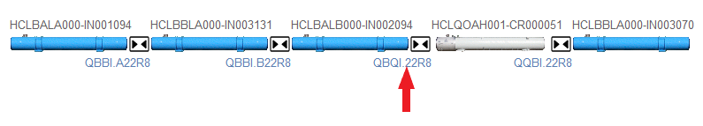
Example 1: Global resistive voltage drop measurement
Visual inspection
Ensure personnel safety: electrical lock-out
Global resistive voltage drop measurement
  Applicable if the circuit is in resistive state
  Avoid stressing the fault before it is localized
  DC current is fed through the circuit from a floating power supply
  Voltage to ground is measured at various locations in the circuit
  If the fault is low impedance, the voltage at that location is zero
  For higher impedance faults more aspects need to be considered
Floating current source
100 mA
V

Slide 8
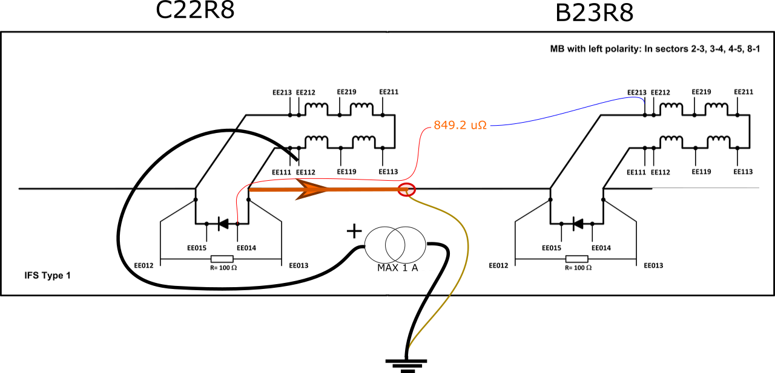
Example 1: Local resistive voltage drop measurement
The final stage of fault localization involves passing the current through the fault
  Initially the measurements are taken at very low current
  Subsequently the current can be increased: this will likely make the fault disappear at one point
Local precision measurement need to be taken to localize the fault with the best possible accuracy
In this example the resistance between the so-called T-junction of C22R8 and the fault is 849.2 ±2 µΩ

Slide 9
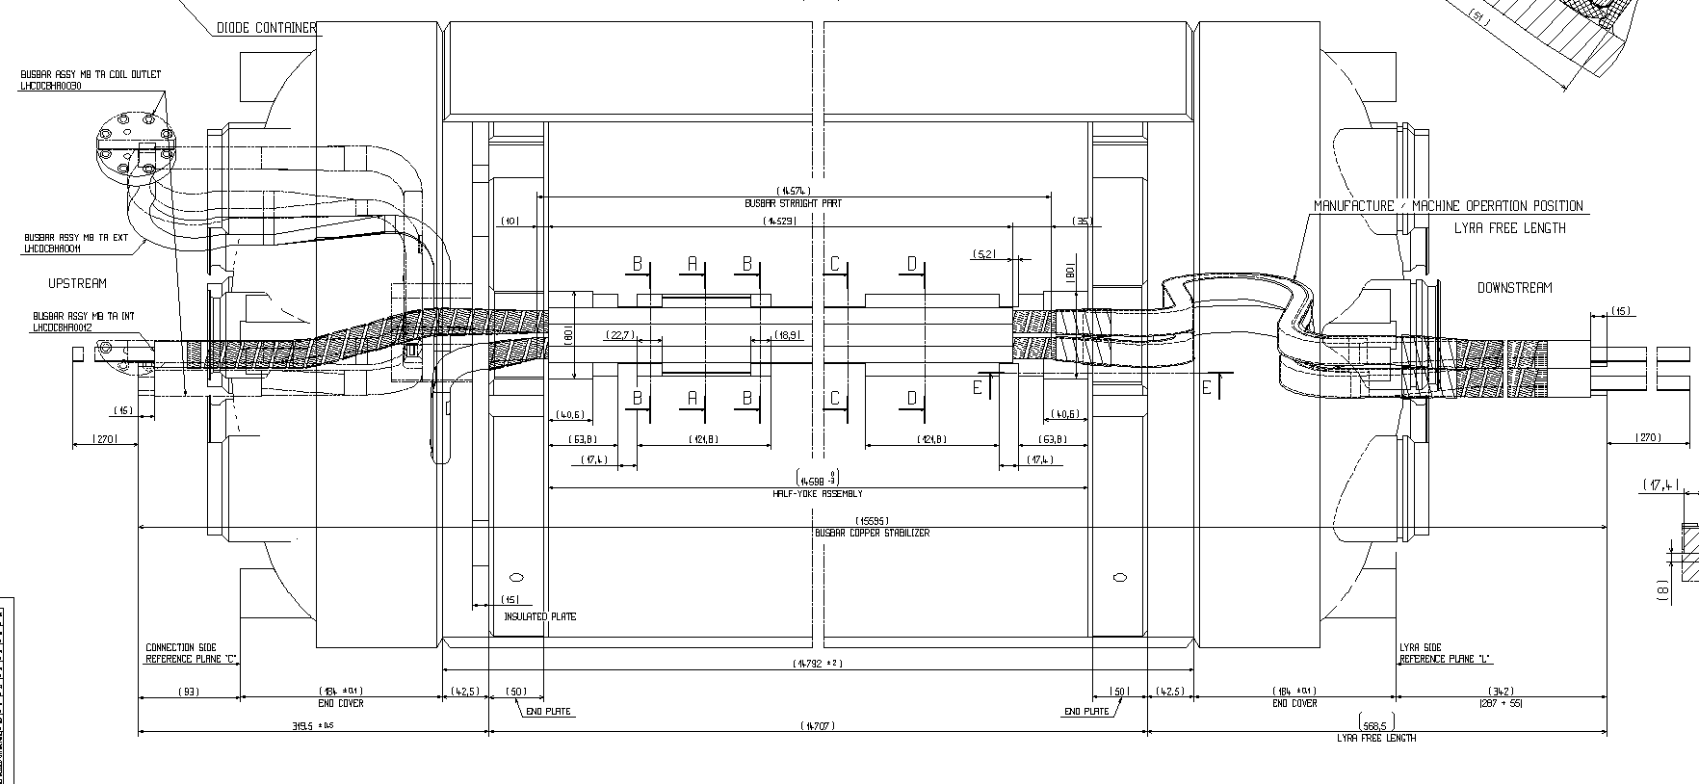
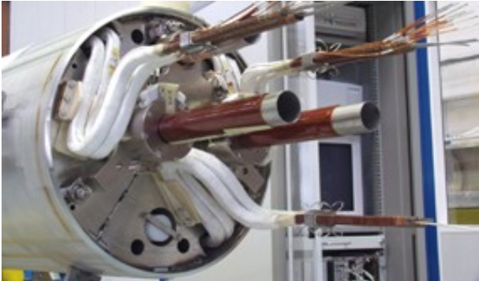
Example 1: Faulty component identification
In case of thermal gradients in the circuit the non-uniform resistivity of components needs to be considered, in the example:
  Resistance of C22R8 dipole at the room temperature is 5.66 Ω
  Linear resistance of the dipole bus bar at warm is approx. 62.8 µΩ/m
  Knowing the magnet resistance in the current conditions is 5.23 Ω we can estimate the current bus bar linear resistance to be 58.8 µΩ/m
  Therefore, the fault is located 14.5 m along the bus bar from the T-junction.
  The precision of this location is estimated to be in the order of ±0.4 m.
Length estimate combined with circuit geometry can pinpoint faulty components

Slide 10
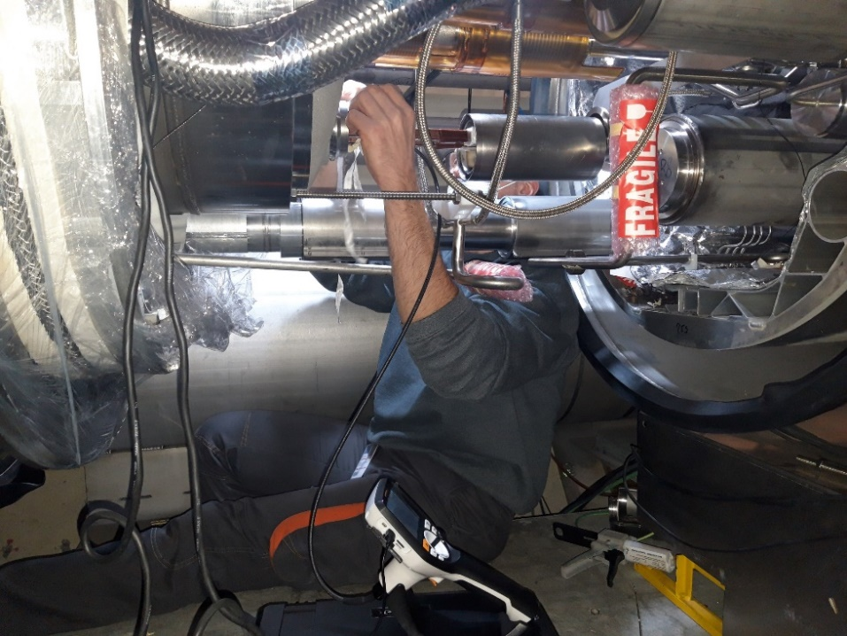
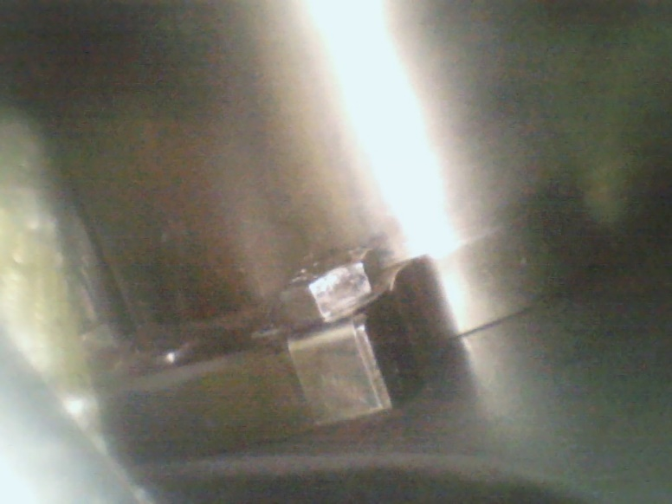
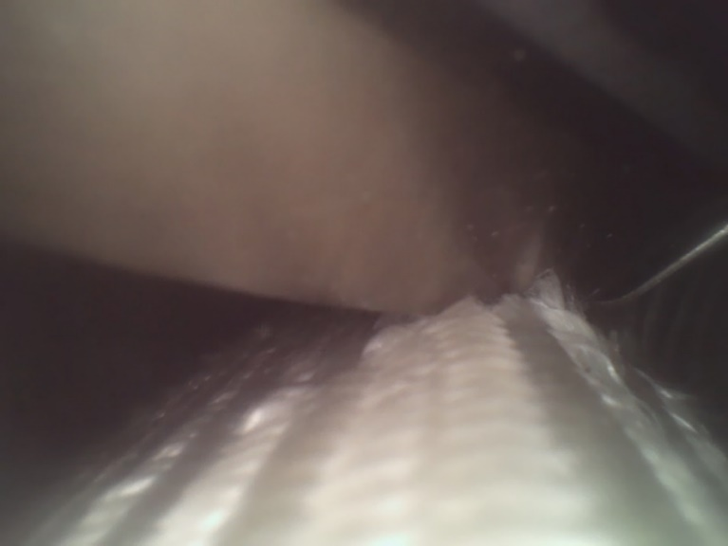
Example 1: Endoscopy and repair
Following fault localization, the cryostat was opened, and the identified component was inspected with an endoscope
The bus-bar was found in contact with the corrector support and by pushing on the bus-bars, the fault to ground could be reproduced
The faulty area was consolidated
Courtesy of S. Le Naour

Slide 11
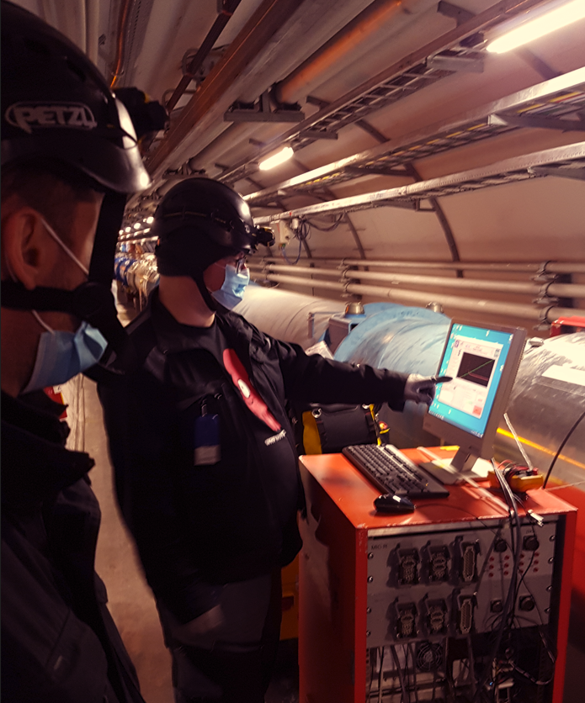
Example 2: Earth fault, multiple faults
Earth fault detected after sector warm-up before a long shutdown
  Report: EDMS 1285057
Localization methods:
  At warm - measurement of resistive voltage drops
  In case of multiple faults, the voltage drop profile along the chain is not as simple
  Important not to forget about this scenario

Slide 12
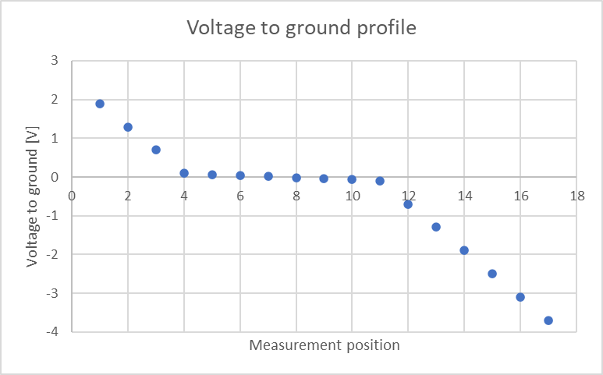
Example 2.1: Earth fault, multiple faults
Depending on values of each fault resistance the voltage profiles can be misleading in a variety of ways.
Example 2.1:
R_{fault1} = 2 Ω
R_{fault2} = 3 Ω
R_{ground} = 0 Ω
Floating current source
100 mA
1
2
3
4
5
6
7
8
9
10
11
12
13
14
15
16
17
R_{fault1}
V
R_{fault2}
R_{ground}

Slide 13
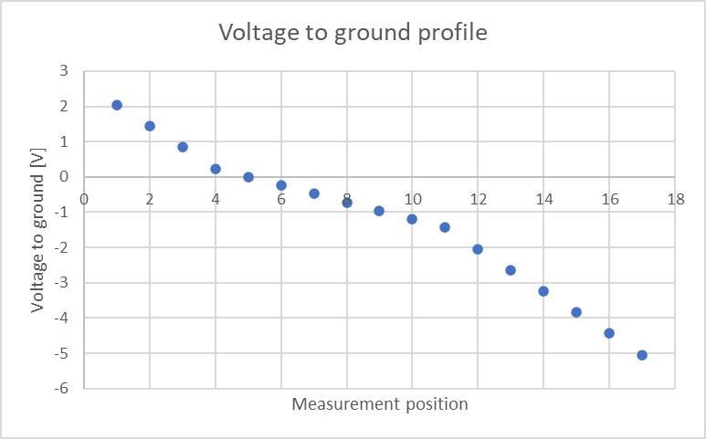
Example 2.2: Earth fault, multiple faults
Example 2.2:
R_{fault1} = 4 Ω
R_{fault2} = 24 Ω
R_{ground} = 0 Ω
0 V in position 5!
Floating current source
100 mA
1
2
3
4
5
6
7
8
9
10
11
12
13
14
15
16
17
R_{fault1}
V
R_{fault2}
R_{ground}

Slide 14
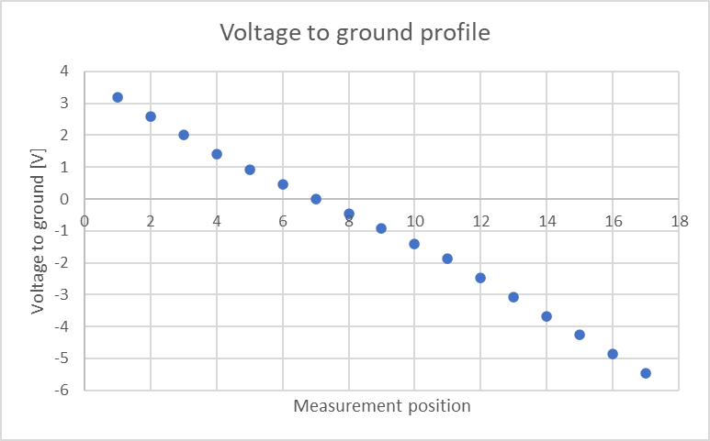
Example 2.3: Earth fault, multiple faults
In the following example a virtual 0 V is at a completely different location than the real faults
Voltage drop across magnets does not differ much from what would be expected in a single fault scenario
Example 2.3:
R_{fault1} = 63 Ω
R_{fault2} = 84 Ω
R_{ground} = 0 Ω
0 V in position 7!
Floating current source
100 mA
1
2
3
4
5
6
7
8
9
10
11
12
13
14
15
16
17
R_{fault1}
V
R_{fault2}
R_{ground}

Slide 15
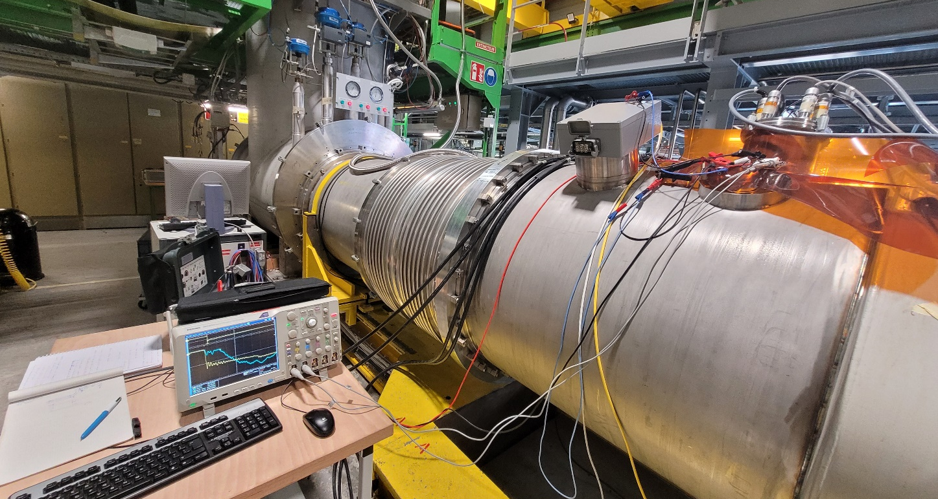
Example3: Earth fault, breakdown
HV test of quench heaters at 2300 V failed
  Heater YT123 breaks down at ~900 V
Breakdown level does not degrade
  Report: EDMS 2785911
Localisation methods:
  Time domain breakdown process analysis

Slide 16
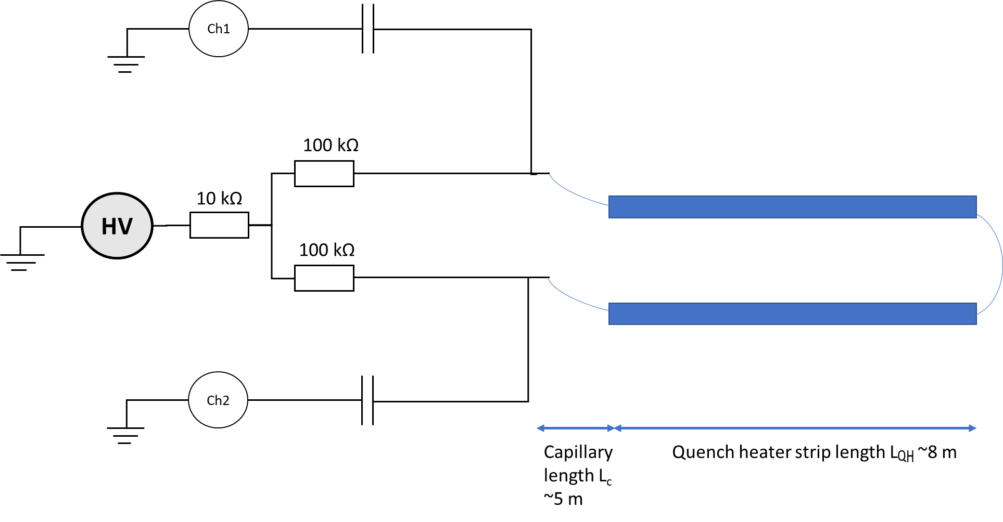
Example 3: Diagnostics set-up
Symmetric connection to the tested circuit
Oscilloscope probes connected via capacitors (AC coupling)
  Constant trigger level
  Limited leakage current via the probes
cryostat
Pin 1
Pin 2
YT123 quench heater circuit

Slide 17
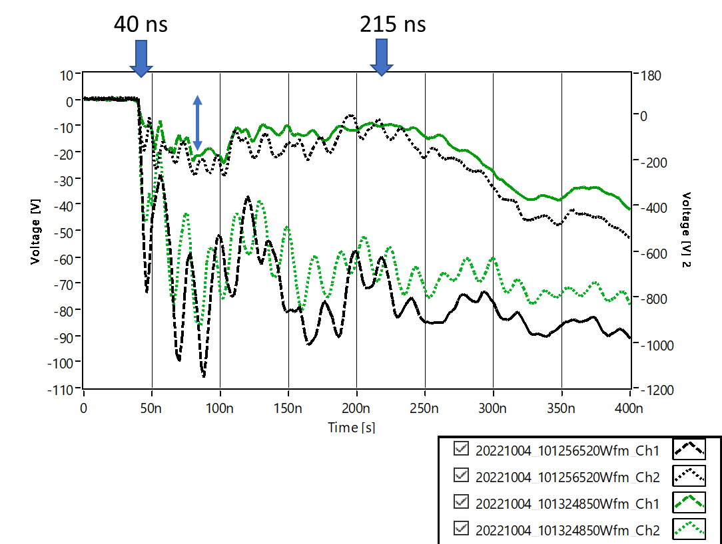
Example 3: Reference tests
Artificial fault at 100 V provoked at the level of quench heater terminals
Black curves – short at the level of Pin 1
Green curves – short at the level of Pin 2
The voltage wave initiated by the breakdown (negative polarity step function) propagates through the circuit (transmission line)
The propagation time is estimated at 175 ns
The length of the circuit is approx. 26 m
The effective average propagtion speed is therefore ~6.7 ns/m, which equals to 0.5 c
Typical velocity factors for coaxial cables are 0.6 - 0.9 c

Slide 18
Example 3: results interpretation
Red curves show the breakdown on YT123
The reference discharges are in black and green
The continuous line corresponds to the terminal connected to Pin 1
The real breakdown process is very similar to the reference discharge
Pin 1 is close to the breakdown
The delay between the two terminals is only slightly shorter (~5-10 ns shorter) than in the reference discharge. This suggests that the fault is likely to be just below the feedthrough system
The falling edge of the breakdown is very steep, further indicating that the breakdown occurs very close to the feedthrough system

Slide 19
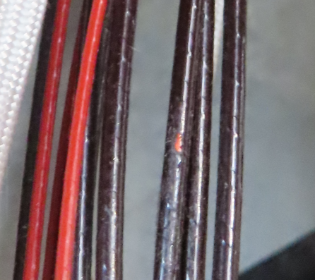
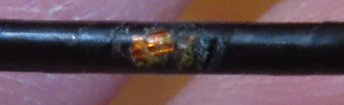
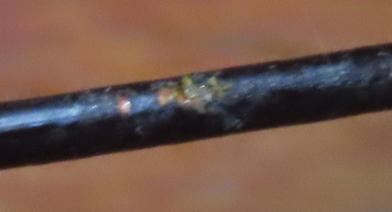
Example 3: Final inspection
The electrical diagnostics localized the defects to be in the capillary tube just below the feedthrough system
After opening of the feedthrough system, the faut was confirmed to be in that location
It was possible to repair it without affecting the magnet coils

Slide 20
Summary
Faults in electrical superconducting circuits need to be detected as early as possible
  Important for safe operation
  Sets of several complementary tests are needed for a complete qualification of magnets and circuits
Detected faults need to be correctly diagnosed and localized
Multiple fault scenarios exist
Fault localization is challenging
Appropriate diagnostic methods need to be selected
Examples of real-life electrical faults were presented

Slide 21
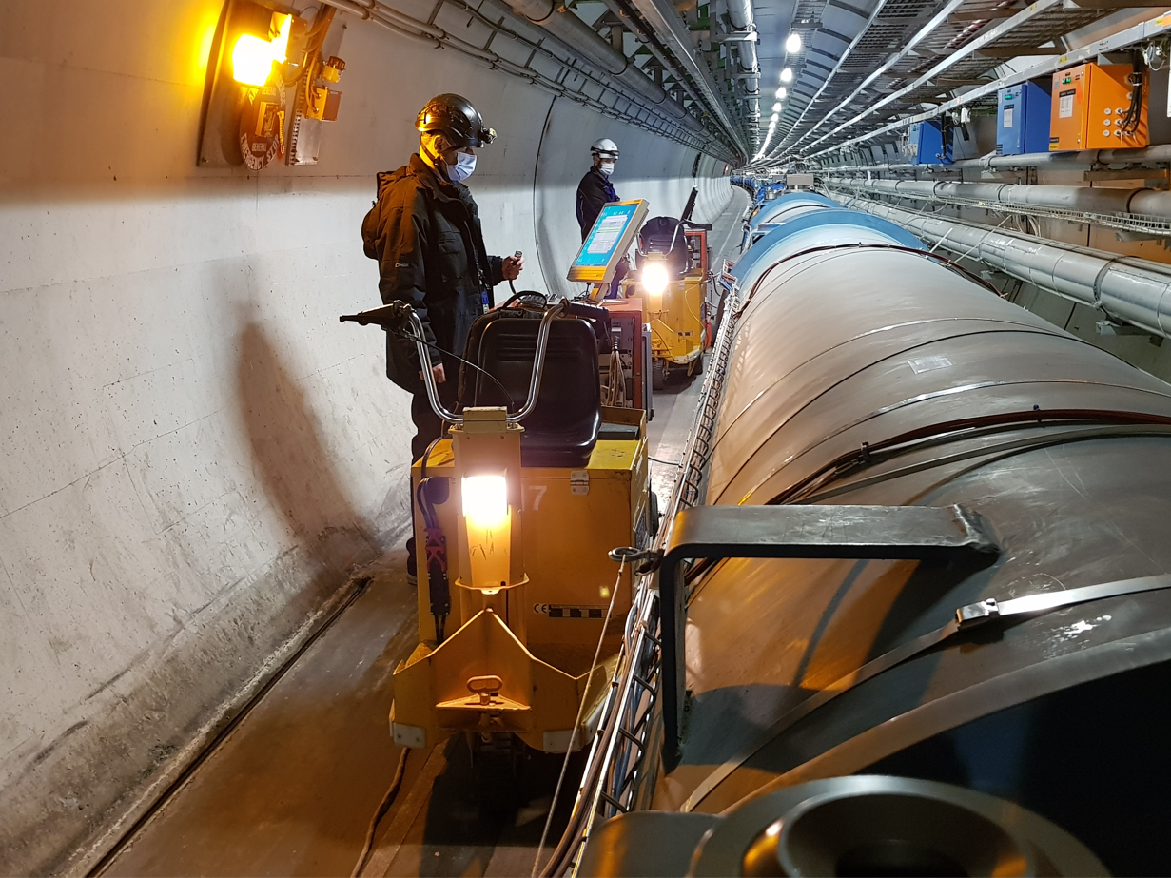
Thank you for your attention!

Slide 22
Annex slides

Slide 23
Components’ lifecycle
Following the Electrical Design Criteria documents the ELQA tests at an adapted level of voltage need to be performed at multiple stages of a component lifecycle
At the manufacturing stage the tests are performed by the manufacturers
Reception tests are carried out
Regular tests in the tunnel during machine lifetime are performed
NOC – Nominal Operating Conditions

Slide 24
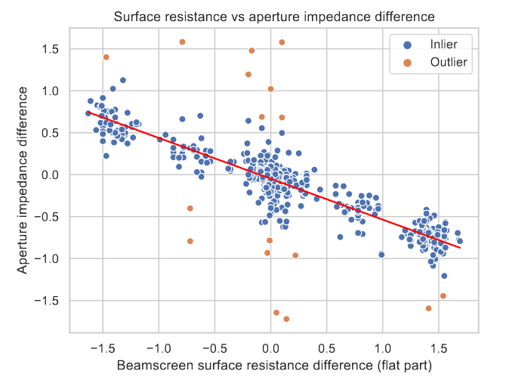
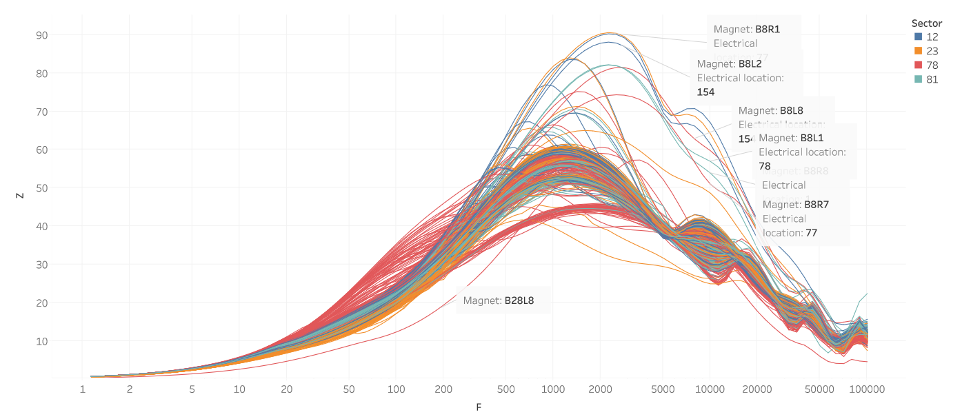
Analysis of test data
Tests results:
Reveal faulty components
Point to fault precursors
Detect ageing or trends
Important to store the data and to analyze the results over time and among a number of similar devices

Slide 25
Example 3.1: Diagnostics set-up
Diagnostics on the second faulty quench heater (YT124) on the same magnet
Results are similar, but slightly different
Pin 3
Pin 4
YT124 quench heater circuit

Slide 26
Example 3.1: YT124 - results interpretation
The blue curves show the breakdown on YT124
The reference discharges are in black and green
The continuous line corresponds to the terminal connected to Pin 3
Pin 3 is close to the breakdown
The falling edge of the breakdown is not as steep as it was on YT123, this could indicate that the breakdown occurs farther from the feedthrough system than in the previous case
The delay between the two terminals is shorter (~20 ns shorter) than in the reference discharge. If the fault was at the connection to the quench heater the expected delay would be
larger than 5 ns/m * 5 m * 2 = 50 ns, conservatively assuming that the propagation velocity through the capillary is 5 ns/m. This means that the fault is unlikely to be at the cold end of the capillary, it is most likely below the feedthroughs or at the top part of the capillary tube

Slide 27
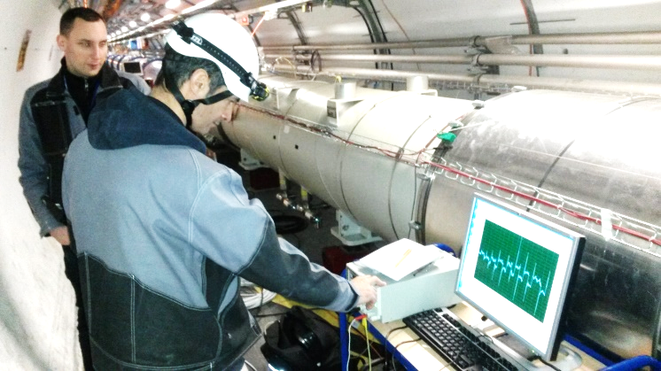
Example 4: Earth fault, low impedance, at cold
Detection circumstance: following a multiple training quench, RB.A34 had a fault to ground
  Report: EDMS 1741891
At cold resistive voltage drops are 0 across the circuit, DC methods are not effective
AC methods (based on complex impedance measurements) need to be employed
Localization of the fault in the cold part follows these diagnostic stages:
  Global AC method
  Local AC method
  Local precision AC method
  Verification if the fault is in the instrumentation wires
  Local precision DC method

Slide 28
Example 4: Global AC method
Floating AC voltage source is connected across the circuit
RMS voltage between each magnet and ground is measured
Fault is near the lowest measured value
The voltage across magnets typically is not constant. It depends on many parameters of the circuit (powered length and fault impedance)
Max. 1 A
About 10 V, 100 Hz
Floating!
~
V_{RMS}

Slide 29
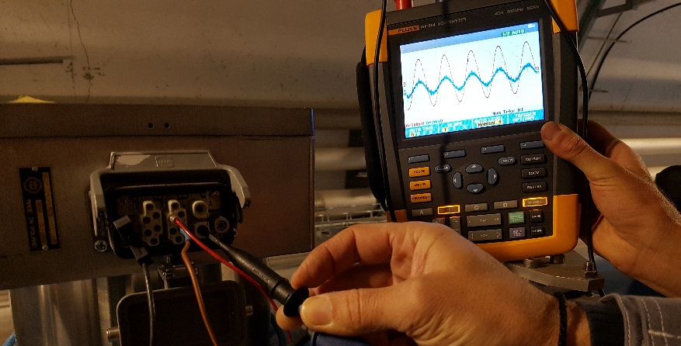
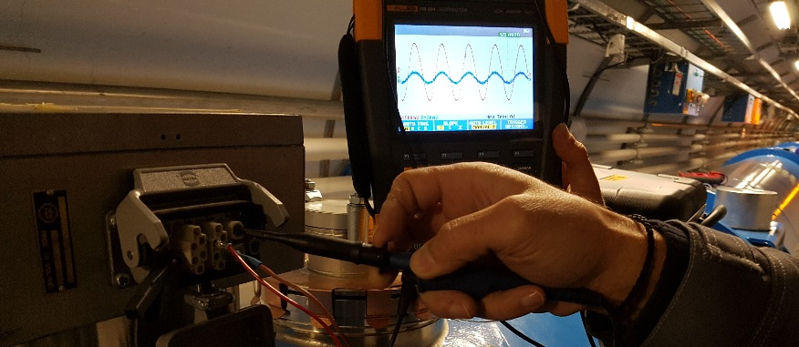
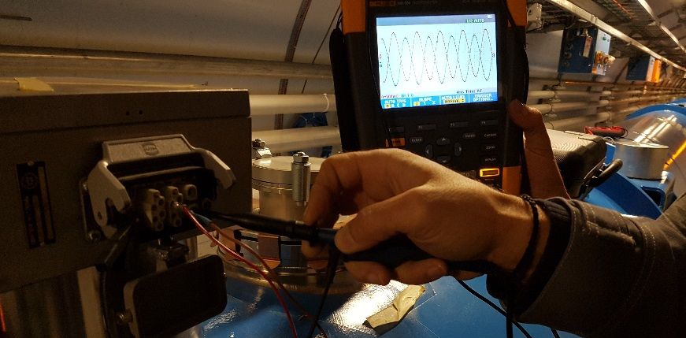
Example 4: Local AC method
Powering only the suspected circuit segment with a floating AC voltage source, 10 Vpk-pk, max 1 A.
Two channels are used: one is measuring a reference signal across a part of the coil, second is measuring the voltage to ground from the extremities of the magnet.
If the signals are in phase, the signals are measured on one side of the fault
If they are in anti-phase this means they are measured on the other side of the fault
This method allows identifying two magnets and one busbar segment on which the fault is located

Slide 30
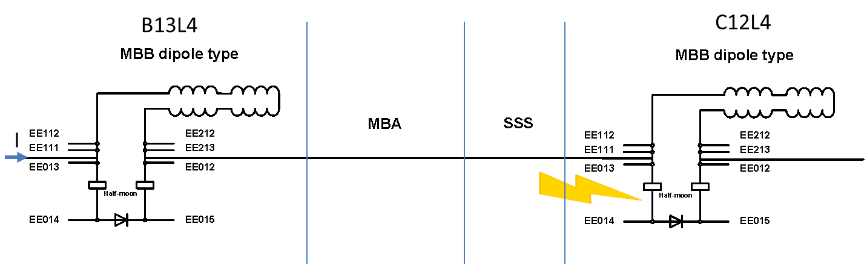
  Example 4: Local precision AC method
1 Vpk
Shunt = 10 Ohm
~
V
The current is measured across the shunt resistor so that the apparent impedance modulus can be calculated.
3 powering variants have been performed (each time measuring between the same V-taps):
a. Powering from EE013 on A12L4 to GND
b. Powering from EE012 on A14L4 to GND
c. Powering from EE013 on A12L4 to EE012 on A14L4
Resulting apparent impedance points to the fault location where subsequent steps should be executed

Slide 31
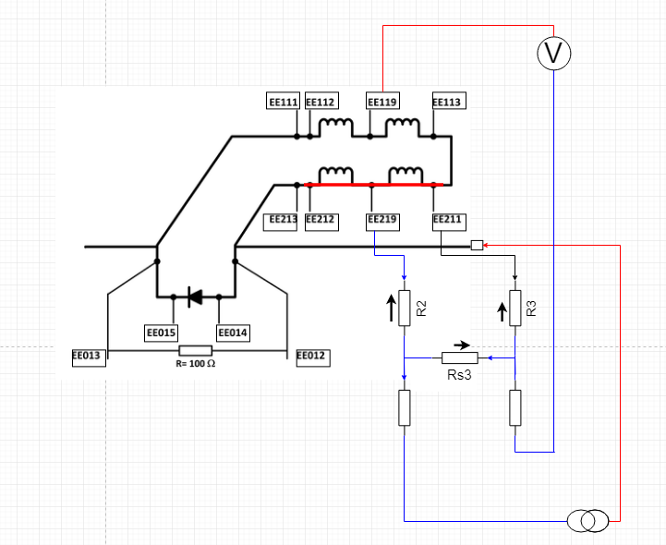
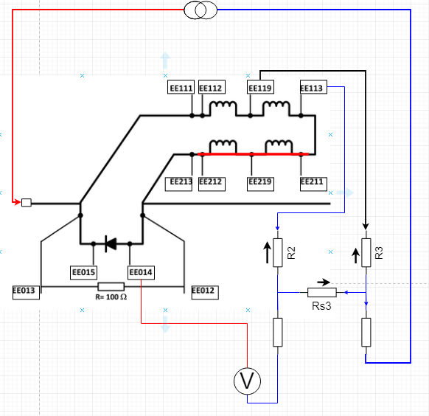
Example 4: Verification of instrumentation wires
The fault is likely to be present in V-tap wires
The V-tap wires are used for localization of the fault in the next step, therefore the fault in the wires would load the measurement and cause an erroneous result interpretation
  Result interpretation is not always obvious
  Well selected 4-wire resistance measurement points need to be used to confirm or exclude this scenario

Slide 32
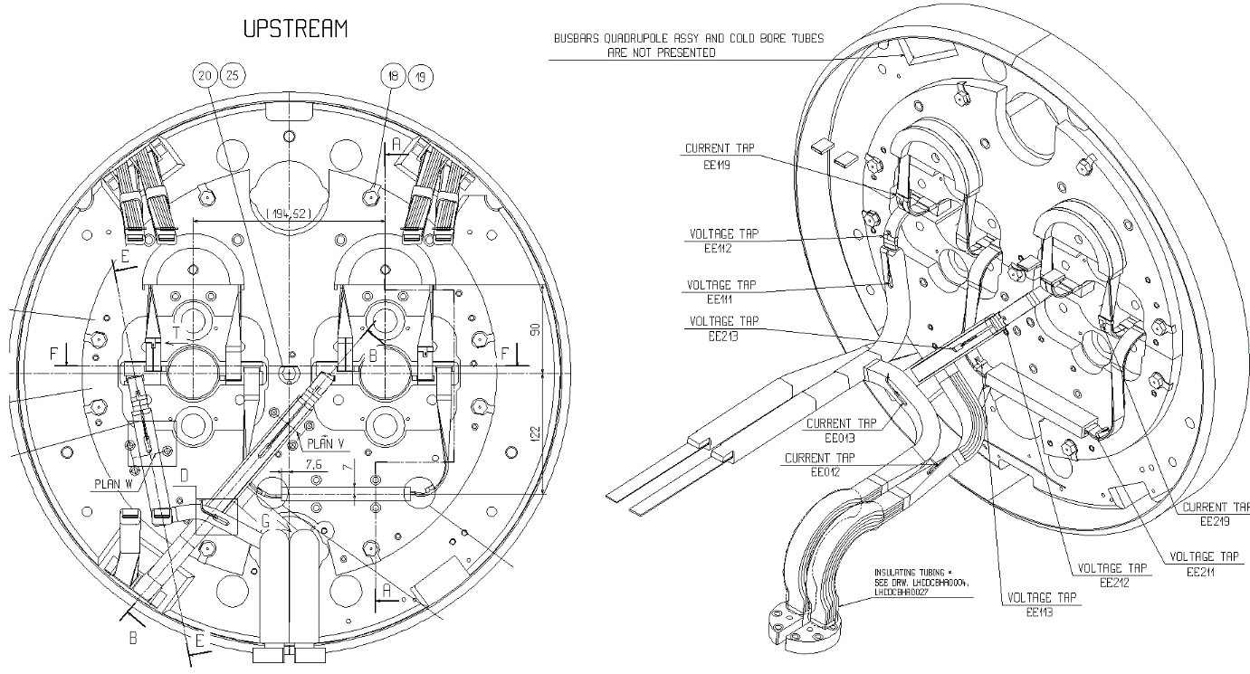
Example 4: Local precision DC method
This method uses voltage drops across resistive parts of the magnet
To be used to confirm the findings of previous steps and further increase the precision of fault localization
Requires a μV level of voltage measurement and a good noise rejection strategy
Current stimulus needs to be correctly selected

Slide 33
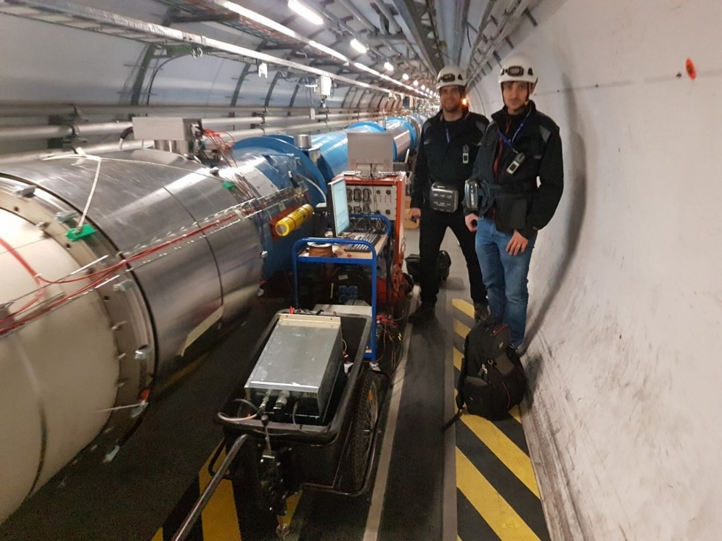
Example 4: Fault elimination
The fault was successfully eliminated without the need of sector warm-up using a high current controlled pulse that burned and displaced the metallic chip that originated the fault
Total machine down-time ~5 days instead of several months
All standard qualification tests passed, machine successfuly operated until the next shutdown

