Slide 1
Quench Protection using Quasi-distributed array of fiber Bragg grating
Shahna M Haneef¹, Bart Ludbrook¹, Xiyong Huang¹, Fernando Fernandez, Jofferson Gonzalez¹, Dominic Mosely¹, Mike Davies¹, Owen Duke², Erica Salazar², Rod Badcock¹
¹Paihau- Robinson research institute, Victoria University of Wellington, Lower Hutt,5012, New Zealand
²Commonwealth Fusion Systems, 501 Massachusetts Ave, Cambridge, MA 02139, United States of America
shahna.muhammadhaneef@vuw.ac.nz

Slide 2
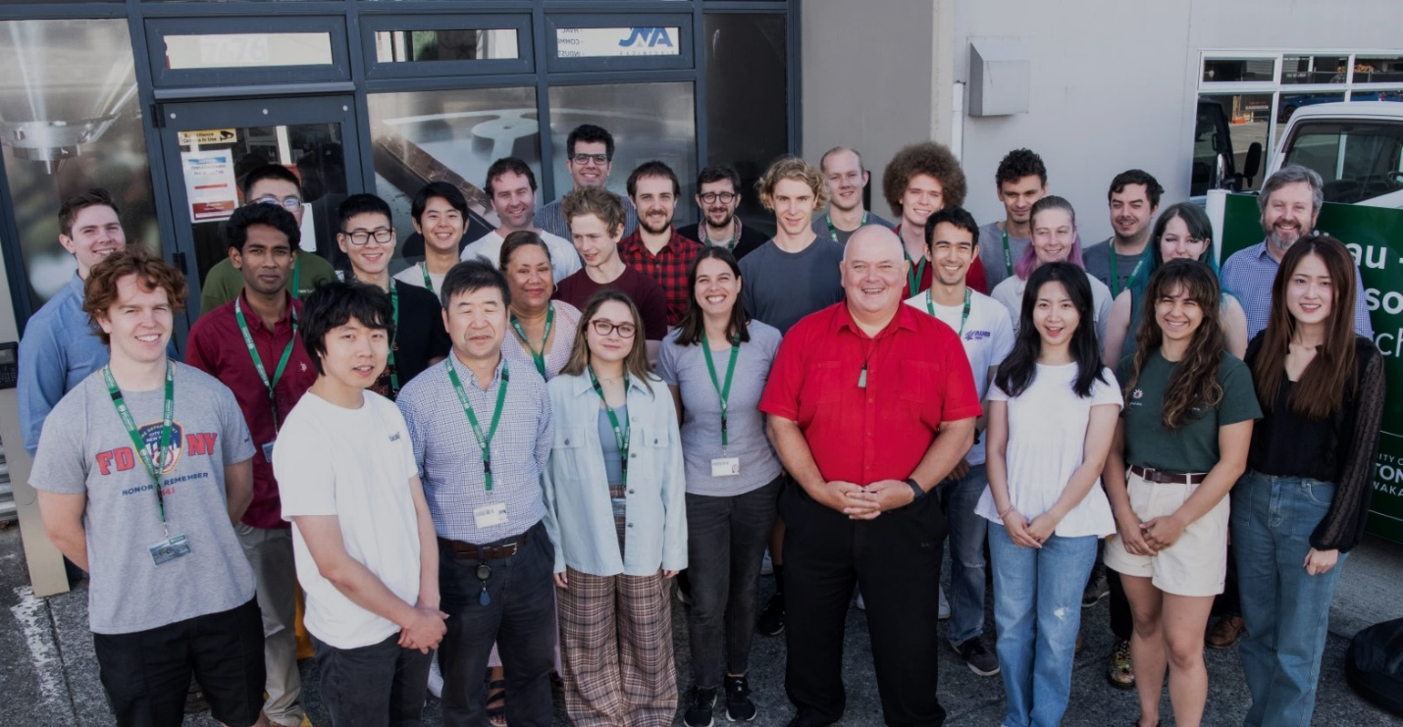
Outline
Introduction and motivation
Working principle of FBG and ULFBG
Experimental validation
Controlled laboratory environment
At SULTAN magnet facility
Optimization of embedding methods
Signal processing methods
Conclusion
Notes:
Superconductivity
High-temperature superconductors and their applications—ultra-efficient motors, generators, bearings, flywheels, and transformers—are one of our key strengths.

Slide 3
Quench in HTS magnets
What is a Quench in HTS magnet?
Quench occurs when superconductors start to become resistive
If quench is not detected early, irreversible damages could be done to magnets
Hotspot in LTS
Hotspot in HTS
Transverse propagation
Transverse propagation
Longitudinal propagation (10-40 m/s)
Longitudinal propagation (2-40 cm/s)
Quench propagation velocity is 3-4 times slower in HTS
Conventional methods using voltage taps does not work well for HTS
electromagnetic noise
slow heat dissipation
Notes:
Basically quench evolves from a local temperature rise, and
we might need a sensing solution which can detect the small perturbations rapidly from anywhere along the length of the fiber

Slide 4
What can be done?
Ideal sensing solution
Sensor for distributed monitoring
Passive and Immune to EMI
Withstand harsh environments
Easy to Embed and cost -effective
Optical fibers

Slide 5
Optical fiber sensors for quench protection
Sensing Scheme | Distributed Sensing | Spatial resolution | Response time | Sensitivity at Cryogenic temperature | Cost-effective | Data Acquisition + post Processing
Rayleigh | ✓ | ✓ | ~ 1 s | Less sensitive | Expensive interrogators | Computationally expensive
Raman | ✓ | ✓ | ~ 1 s
Brillouin | ✓ | ✓ | ~ 1 s
FBG | ✗ | ✓ | ~ 1 ms | ✓ | Cheaper | Simple algorithm
Notes:
Here im summarizing key aspects we are interested in , especially to meet the objectives of this particular work!

Slide 6
Working principle of fibre Bragg grating (FBG)
incident spectrum
P
Λ
λ
transmitted spectrum
Cladding
n₁
P
reflected spectrum
Core
n₃
n₂
P
$$λ_{B}=2Λn_{eff}$$
λ_{B}
λ
1 FBG
λ_{B}
λ
Refractive index
n₃
$λ_{B}$: Bragg wavelength
$Λ$: periodic spacing
$n_{eff}$: effective refractive index
Monitored sensor signal
n₂
n₁
A FBG is typically a point sensor ($\sim 10$ mm)
Periodic modulation of refractive index in the fiber core
Reflects a Gaussian-like spectrum centred at Bragg wavelength ($λ_{B}$)
$λ_{B}$ increases with an increase in temperature, so spectrum shifts towards higher wavelength

Slide 7
Limits of quasi-distributed sensing
Optical Interrogator
The total sensing length can be improved by using multiple monitoring wavelength (multiple FBGs with different wavelengths)
But the number of FBGs is limited to the Bandwidth of the interrogator
Reflected spectrum
P
…
…
λ₁
λ₂
λ₃
λ₄
λ₅
λ₆
λ
So, what do we need?
FBG1
FBG2
FBG3
FBG4
FBG5
FBG6
Fibre
…
…
Distributed sensors for detecting hotspot occurring anywhere along the HTS coils
Improve the sensing distance for a given wavelength window of an interrogator
A wavelength multiplexed array of FBGs

Slide 8
Distributed sensing using Ultra long FBG (ULFBG)
Sensing solution based on quasi-continuous array of identical Fiber Bragg Gratings.
This sacrifices spatial resolution in favour of rapid detection, and a strong signal.
https://doi.org/10.1088/1361-6668/ac5d68

Slide 9
Response to random thermal and mechanical strain
https://doi.org/10.1088/1361-6668/ac5d68

Slide 10
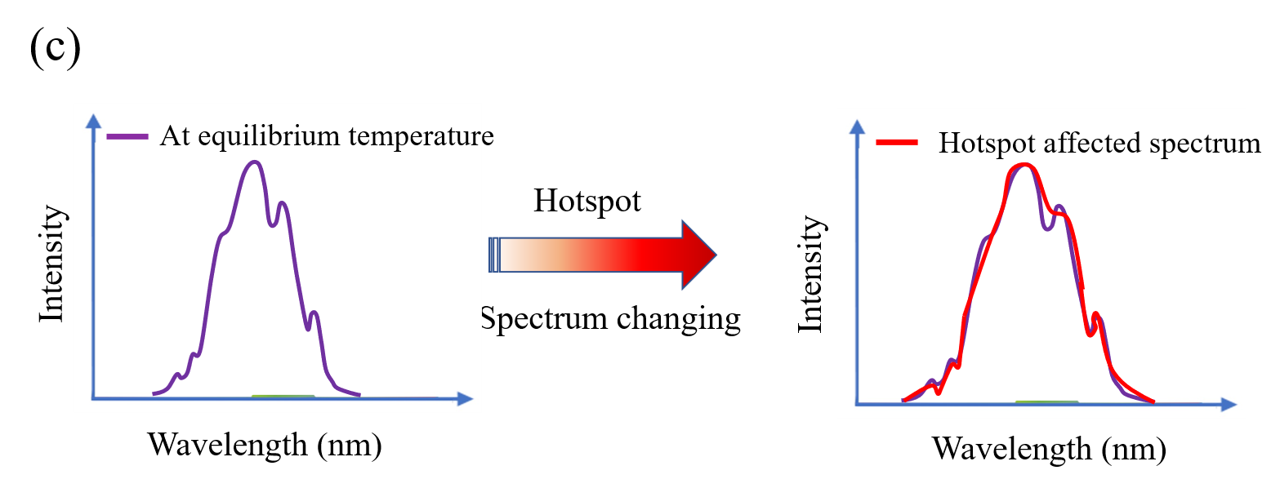
Response to local perturbations
Peak tracking algorithm as in single FBG case do not work well
Necessary to develop an algorithm which can take into account of the entire spectral changes for hotspot detection
https://doi.org/10.1088/1361-6668/ac5d68

Slide 11
Can we detect hot spots anywhere along the length of ULFBG??
Localized hotspots are created over 10 m ULFBG
The temperature of the sensors are maintained at 80 K in a cryostat

Slide 12
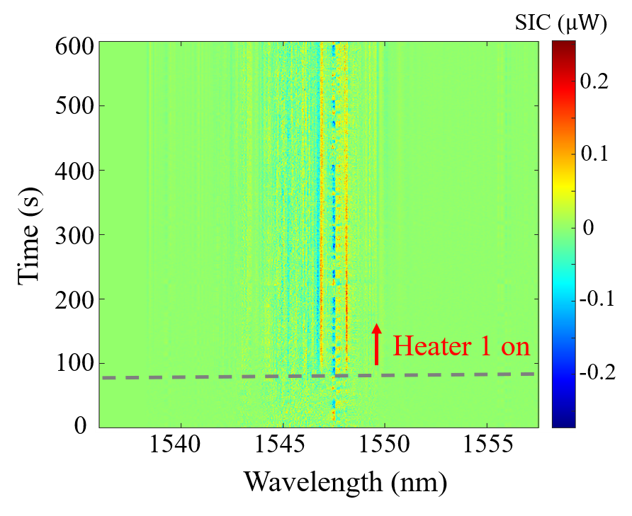
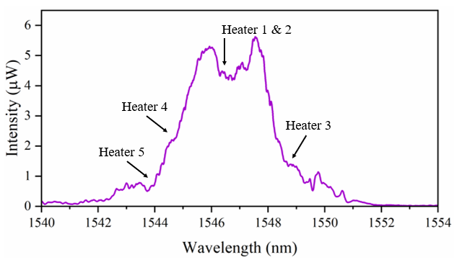
Spectrum of 10 m ULFBG (array of 1000FBGs)
Spectral changes are too small to be identified without further processing
Spectra subtracted by the reference spectrum
1 complex spectrum at 80 K due to strain distribution

Slide 13
Responses of 10 m ULFBG to 30-40 mm hotspots at 80 K
10 m distributed sensors can detect 30-40 mm of 2-5 K temperature rise
Anywhere along the length; Anywhere in the spectrum; Any bonding materials (Apiezon N, epoxy, silicone)
Hotspot alert can be sent out based on the rate of change
Notes:
Each of these figures represent spatially and spectrally distributed events which are successfully captured using the ULFBGs

Slide 14
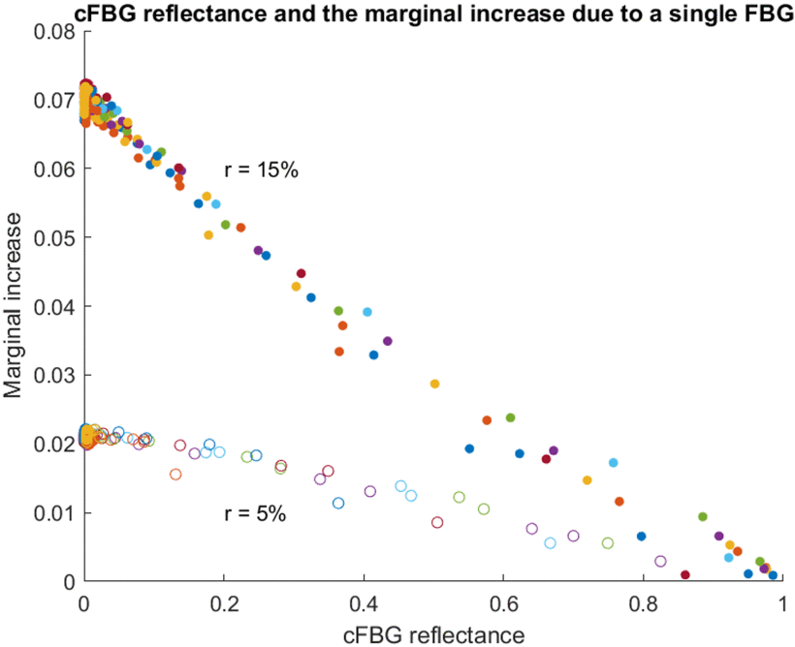
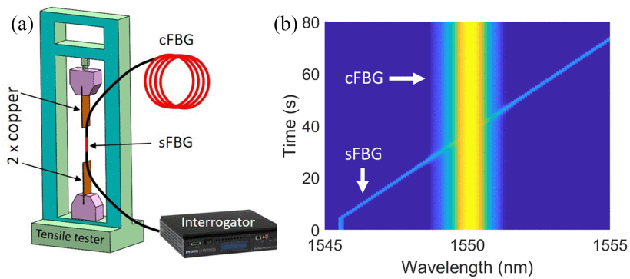
Sensitivity of ULFBG
Performed the experiment using tension to draw a single FBG through the ULFBG spectrum.
Sensitivity can be predicted based on
the reflectivity of the sensor,
the attenuation profile of the fiber, and
the spectrum of the cFBG array
doi: 10.1109/TASC.2023.3244762
https://doi.org/10.1109/TASC.2023.3244762.
Notes:
Immediate question on this would be the sensitivity!
Can we detect the signal corresponding to the change over a single FBG?

Slide 15
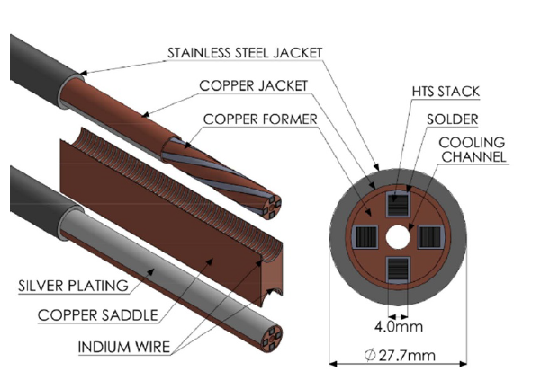
Experiments on VIPER cable at SULTAN
Objectives of campaign:
Assessing optical sensors embedded on the VIPER cable
Under the operating conditions:
10 K
10.9 T
41 kA
VIPER cable is fitted with:
Voltage taps tto measure the voltage rise along the cable
CernoxTM temperature sensors to measure the temperature at various locations
Surface resistive heaters to induce a localized quench
Optical fibers with Bragg grating array to test quench detection feasibility
https://doi.org/10.1088/1361-6668/abdba8
https://doi.org/10.1088/1361-6668/abb8c0

Slide 16
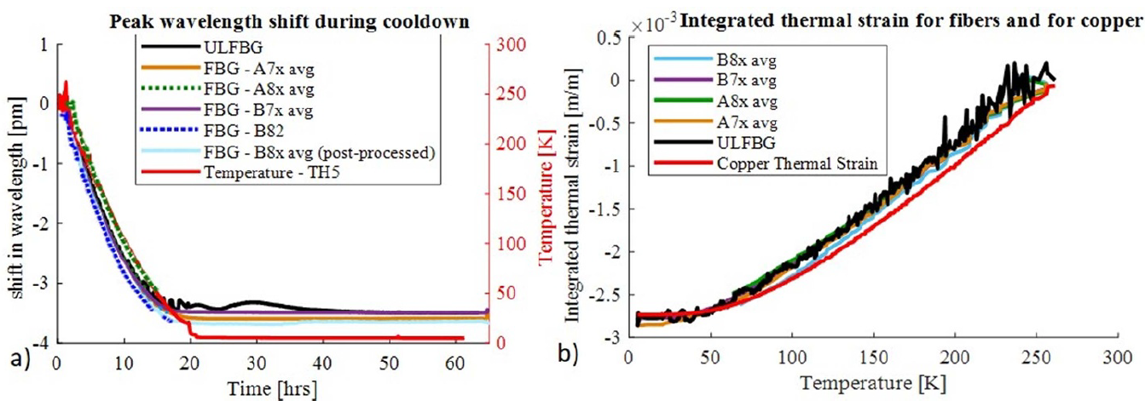
Characterization of VIPER cable
Thermal response during cool down
HTS cable is cooled down from room temperature to 4K over 60h
Shift in FBG and ULFBG reflected spectrum were tracked
ULFBG and FBG followed the temperature response
Dominated by the Cu thermal strain
https://doi.org/10.1088/1361-6668/abdba8
https://doi.org/10.1088/1361-6668/abb8c0

Slide 17
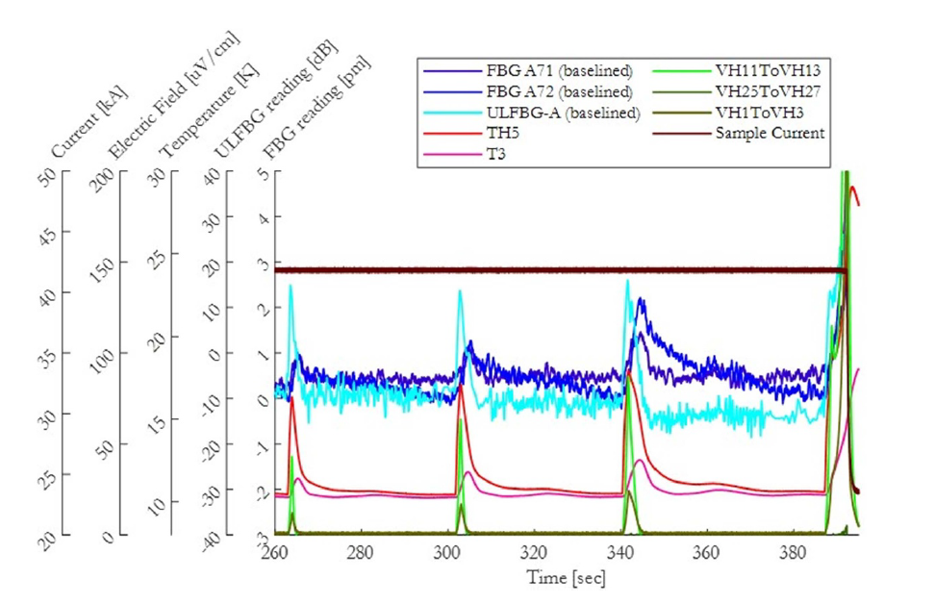
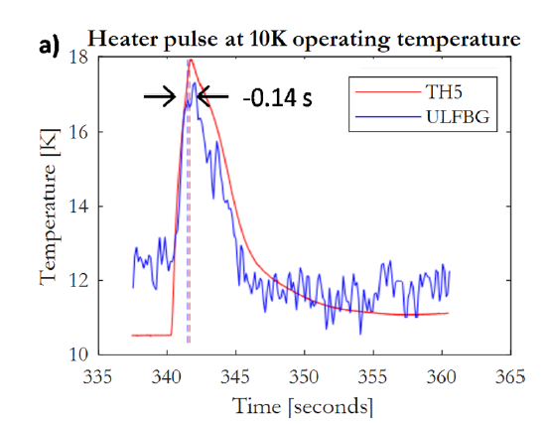
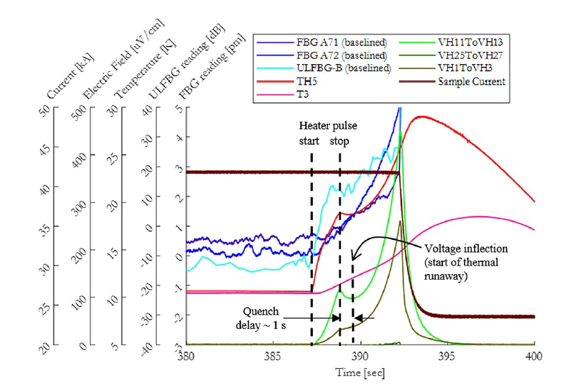
Characterization of VIPER cable
Heater pulses with current
Operating condition:
10 K, 10.9 T, 41 kA, and
0.9 Iop/Ic
FBG and ULFBG shows clear response to the heater pulses and the actual quench event
Response time of both the fiber sensors match to the voltage and temperature sensors with ULFBG response preceding all other sensors
https://doi.org/10.1088/1361-6668/abdba8
https://doi.org/10.1088/1361-6668/abb8c0
Notes:
The scheme shows the promise
But still needs a lot of research and development to translate this to ‘the quech detection system’

Slide 18
Impact of coating and adhesives on the optical measurements
Evaluating the impact of different bonding and surface embedding method
Including non-traditional vacuum grease
Fibre Reference | Coating material | Bonding material
F1 | Ormocer | None
F2 | Ormocer | Stycast
F3 | Polyimide | Stycast
F4 | Ormocer | Apiezon N
F5 | Ormocer | Stycast
F6 | Ormocer | Apiezon N
https://doi.org/10.1364/AO.460218
Notes:
The next step we took is to evaluate the…

Slide 19
Impact of coating and adhesives on the optical measurements
Temperature sensitivity:
FBGs that are bonded onto the copper is about 2 times higher than the unbonded one
FBGs embedded in V-grooves shows stronger sensitivity compared to surface bonded FBGs
The vacuum grease, Apiezon provides a good bond of the fibre to the copper below 230 K.
The overshoots, during the warmup, indicate that the frozen Apiezon N transitions to grease at 230-240 K
https://doi.org/10.1364/AO.460218

Slide 20
Impact of coating and adhesives on the optical measurements
Stycast Apiezon
Stycast, with the higher Young’s modulus, is shown to transfer thermal strain better than the frozen Apiezon N
But, Stycast leads to non-uniform shear stress which induces spectral peak splitting
Owing to its higher elasticity at cryogenic temperatures, Apiezon N can retain the FBG’s spectrum shape as a single peak
https://doi.org/10.1364/AO.460218

Slide 21
Impact of coating and adhesives on the optical measurements
Polyimide Ormocer
Polyimide Ormocer
Polyimide coated grating shows negligible changes in the peak intensity and FWHM
Can be due to the following reasons:
Ormocer coating or the adhesion between the Ormocer coating and cladding is non-uniform.
Non-uniform thermal strain transferred from the copper.
https://doi.org/10.1364/AO.460218

Slide 22
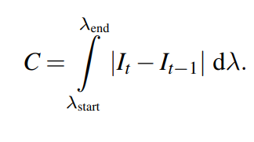
Signal processing methods
https://doi.org/10.1088/1361-6668/ac5d68
Notes:
Integrating the area under the curve in figure 4(c) using equation (3), we can calculate the hotspot indicator, C. This processed single
value from the spectra of ULFBG will be continuously monitored to detect the occurrence of a hotspot

Slide 23
Can we differentiate heating and cooling?
@ RT
@ 77 K
https://doi.org/10.1016/j.measurement.2023.112796

Slide 24
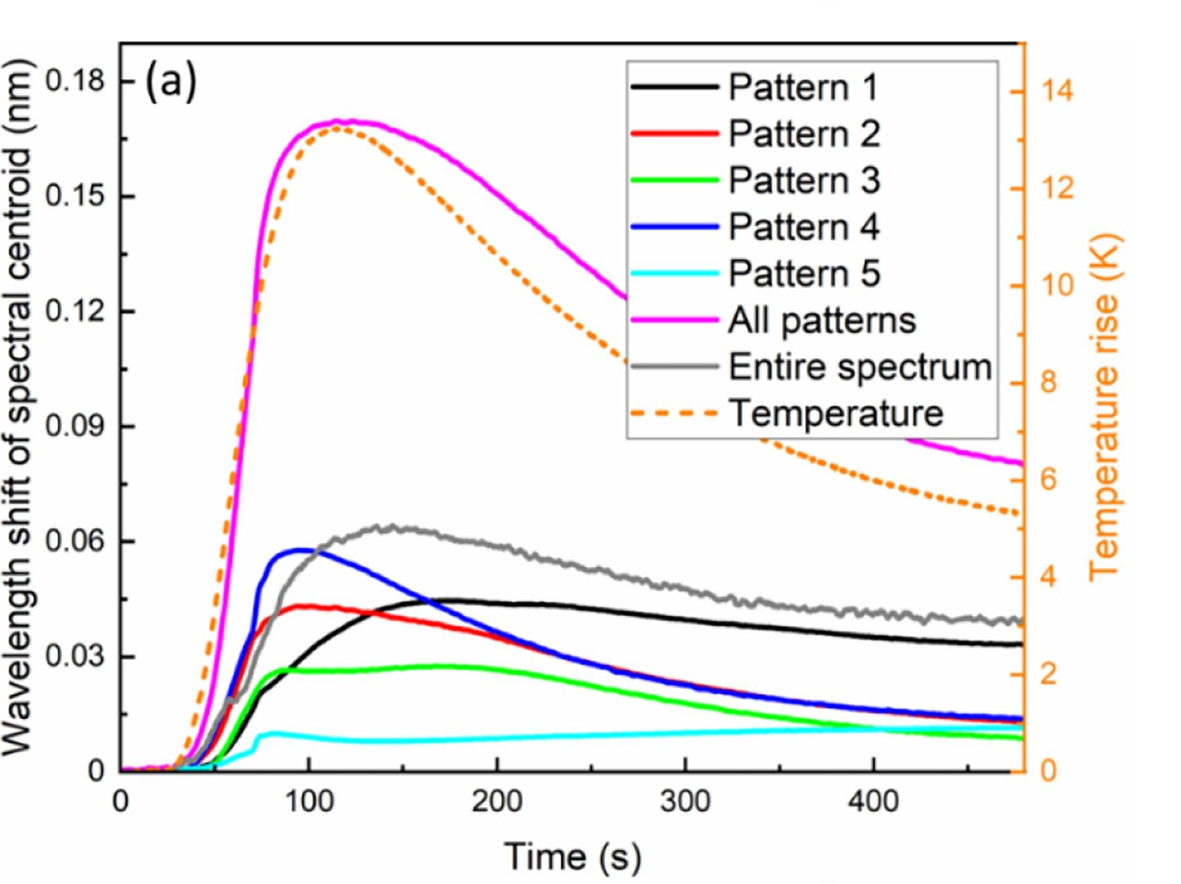
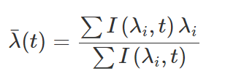
Sensitivity enhancement !
Calculated the centre wavelength of the ULFBG’s spectrum using a weighted average of the spectrum’s intensities at each wavelength
SNR of the signal can be improved by selecting the Region of interest (ROI) instead of analysing the entire spectrum
https://doi.org/10.1016/j.measurement.2023.112796
https://www.doi.org/10.1109/JSEN.2022.3174894

Slide 25
Summary
Quench detection and protection for superconducting device
Rapid detection of localized hotspot anywhere along the Superconducting magnet is necessary to take actions to prevent magnet from quench damage
Proposed and demonstrated the unique method of using ULFBG for quench detection
ULFBG can detect :
30-40 mm localized hotspots over 10 m at 80 K
2-5 K temperature anywhere along its length
Tested the proposed technique in the large magnet facility at SULTAN
Studied the effect of
cryogenic adhesives
Embedding method
Fiber coating
Ongoing research
Machine learning algorithm for rapid quench detection in extreme environments*
Developed a numerical model to design and optimize the sensitivity of the ULFBG array
*https://doi.org/10.1088/1361-6668/acbb34

