Slide 1
Fiber optic sensing for strain and temperature
Instrumentation and Diagnostics for Superconducting Magnets Workshop
Apr 24 – 28, 2023, Paestum
Maria Baldini, S. Krave

Slide 2
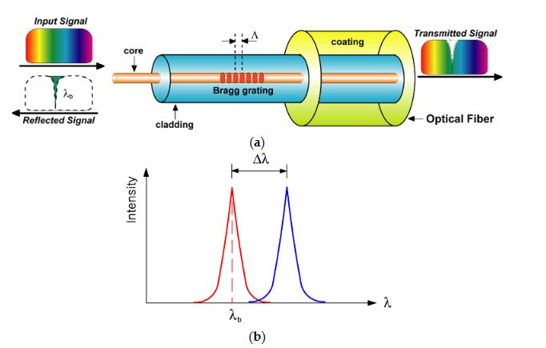
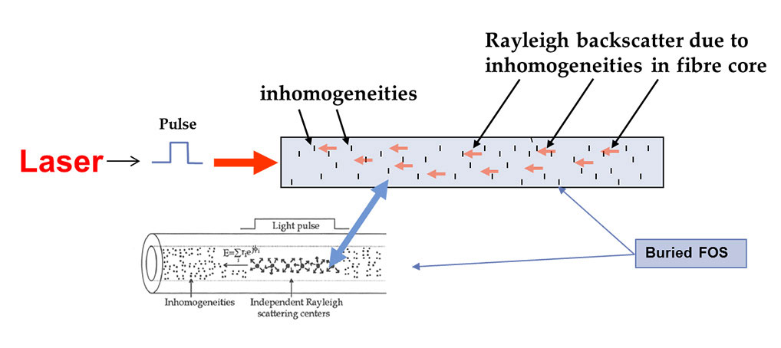
Fiber optics sensor
Rayleigh sensor: distributed sensor
FBG sensor: discrete sensor

Slide 3
Outline
Fiber optics implementation at FNAL
FBG fibers:
    Calibration test
    Feedthrough line for the Vertical magnet test facility
Distributed fiber optics for strain and temperature measurements
    Calibration test
    Strain maps (Steve K.)
    Quench detection
Future plans

Slide 4
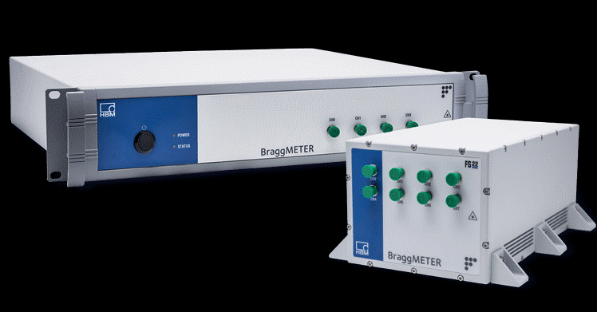
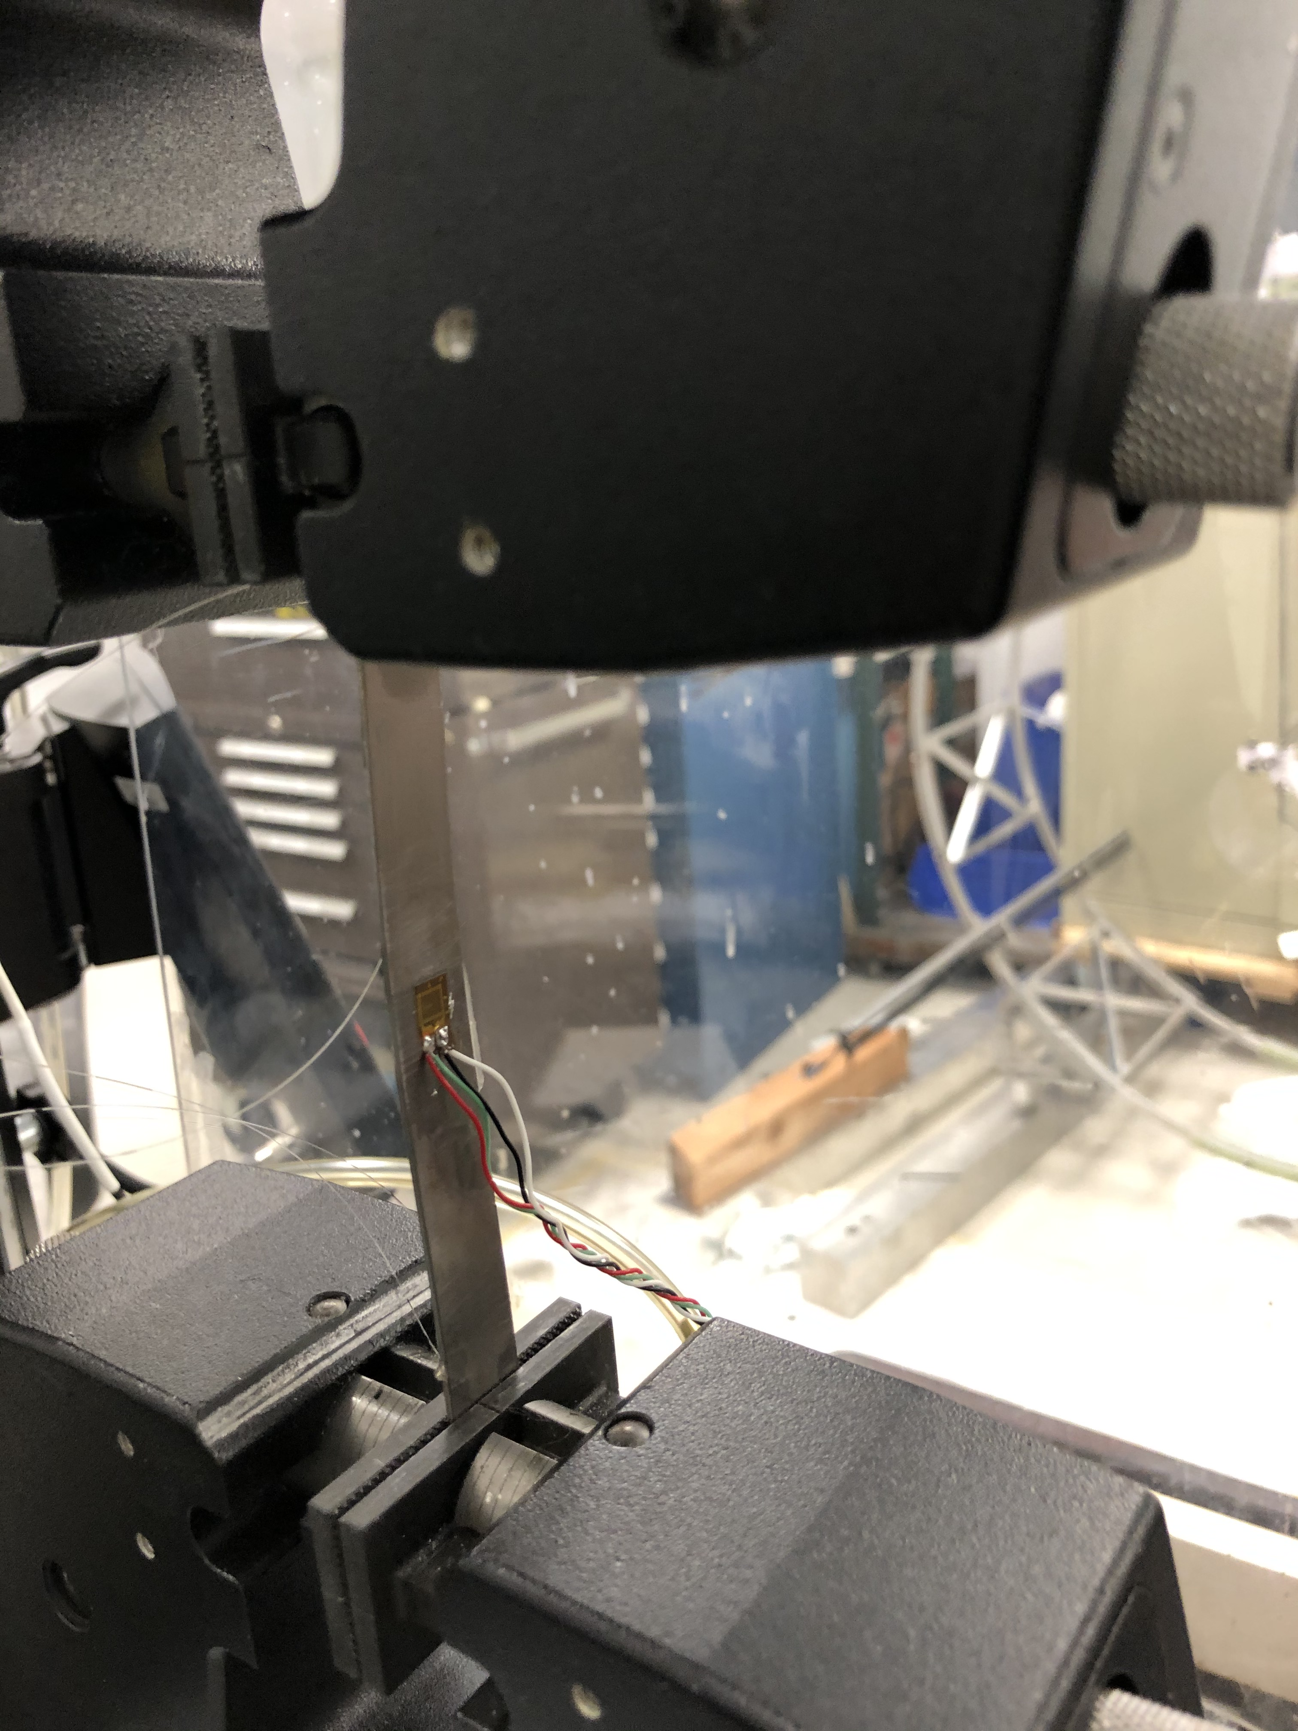
Tensile stress test at 300 K (2020)
Purchase FBG fiber for HBM
8ch interrogator
Polyimide or Ormocer fibers with 4 sensors
Sensor length 6 mm
AISI 1080 steel and Ti
Instron press in IB3 up to 200 MPa
Fibers vs strain gauges
Tensile vs Poisson strain
Young modulus measured with FBG sensors is in very good agreement with what is expected for steel and Ti.

Slide 5
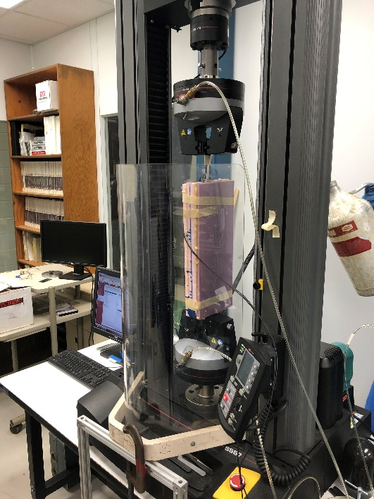
Tensile stress test in Liquid Nitrogen
Strain gauges
Tensile stress was applied up to 200 MPa in Liquid Nitrogen
Strain variation is around 800 me for both strain gauge and fibers
Poisson ratio is 0.3
Issues during cooldown
Signal was lost on some sensors
Absolute value after cooldown was not correct
FBG sensors

Slide 6
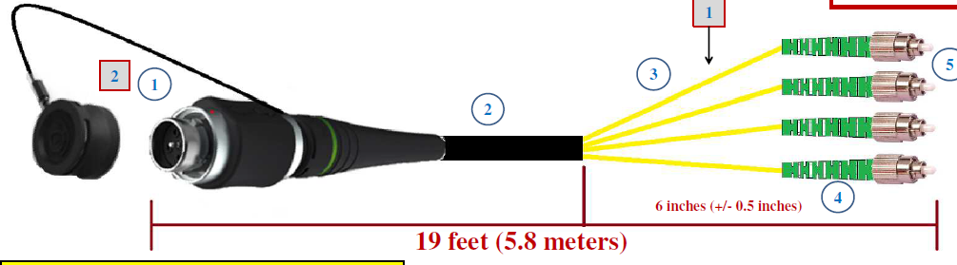
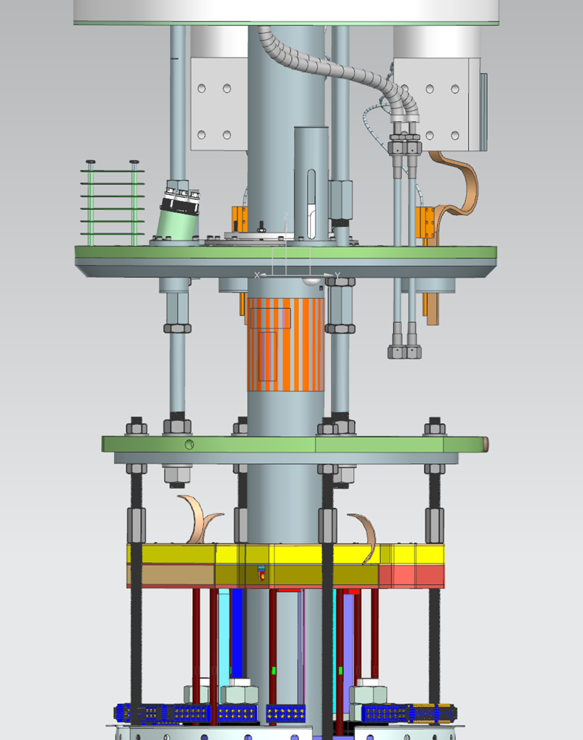
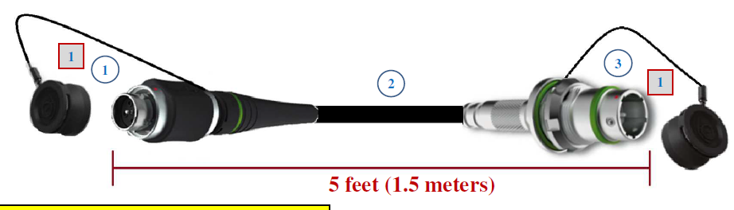
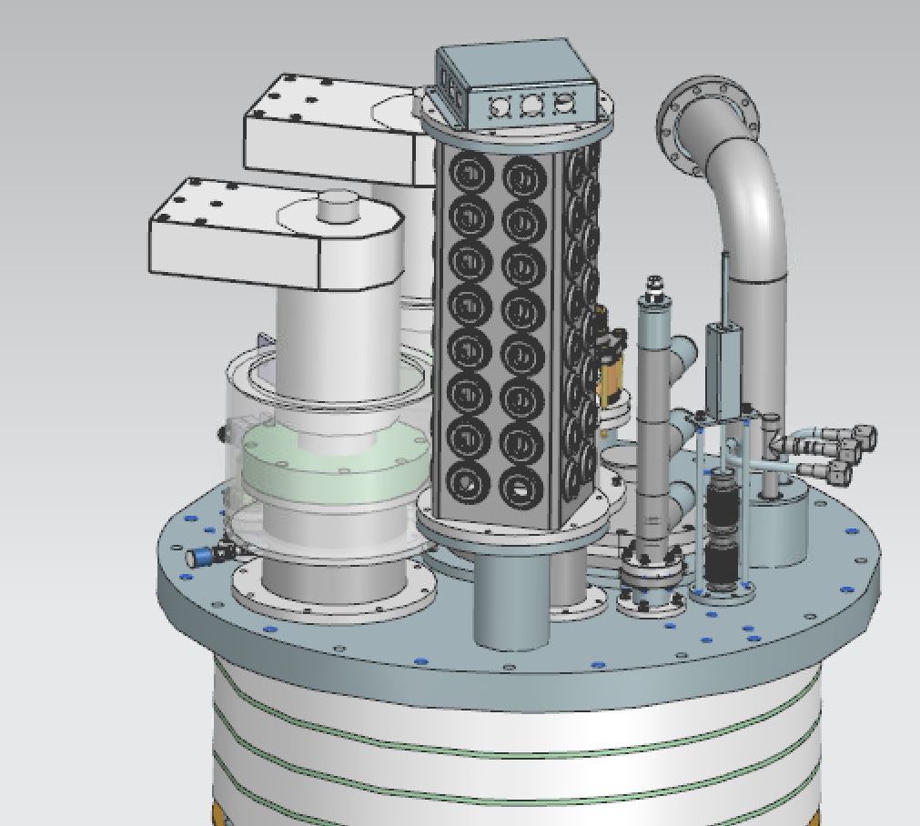
Fiber feedthrough in vertical magnet test facility
Fiber Cables to Top Plate
G-10 Lambda Plug
Fisher connectors
Connector potted with Stycast 2850
4x4 Fibers con FC/APC

Slide 7
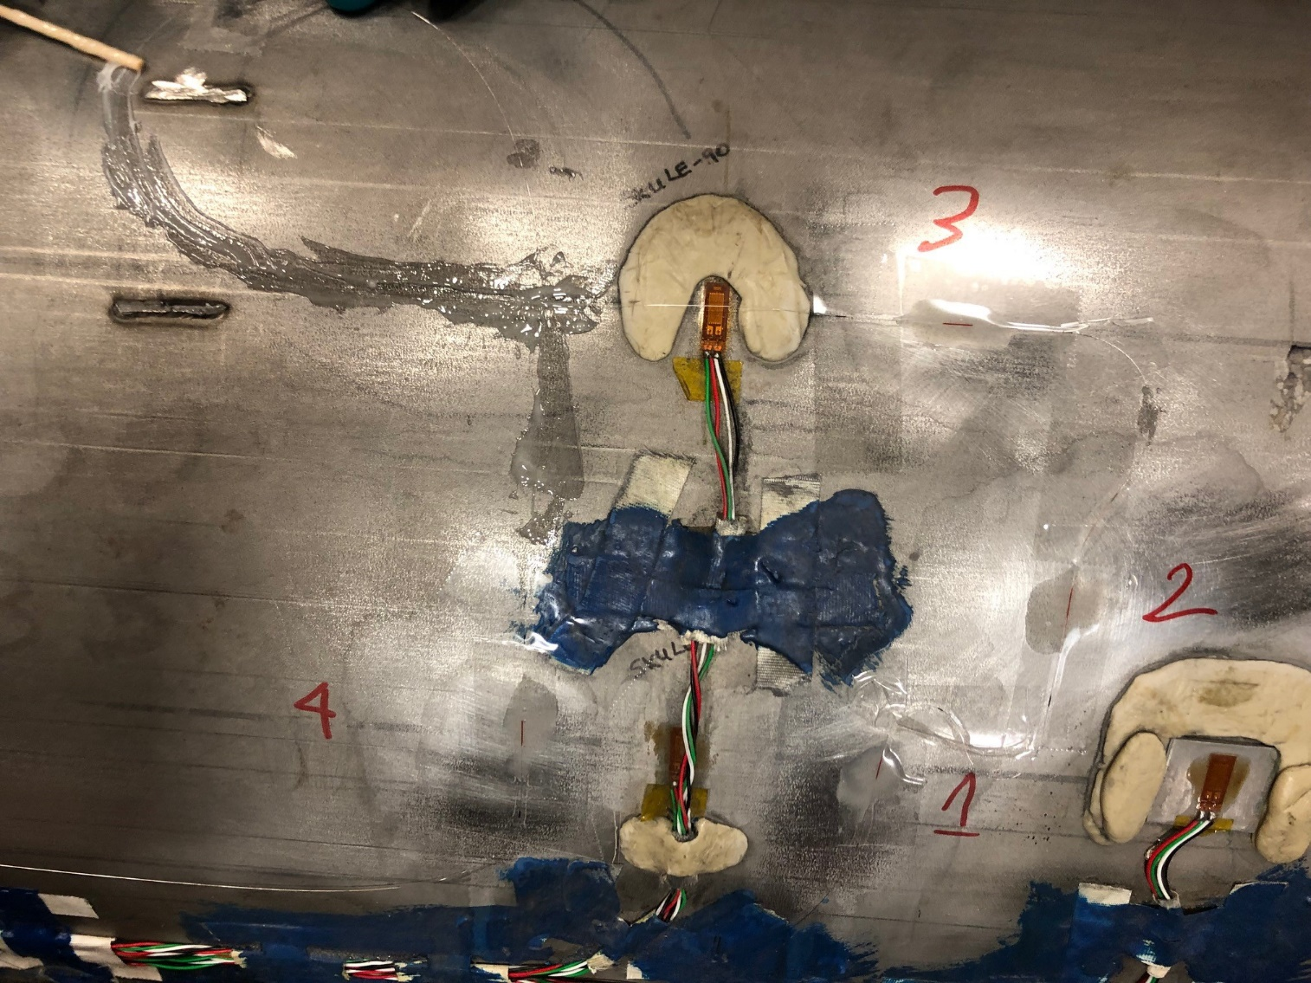
Mirror magnet cooldown (March 2022)
FBG3 Longitudinal
FBG4 Azimuthal
FBG2 Azimuthal
FBG2= 1508.013 nm
FBG3= 1514.049 nm
FBG4=1520.063 nm
@4.5 K only two sensors are still alive
Strain is consistent for each FBG sensor
At cold the strain variation without T compensation is around 4000 um/m

Slide 8
Mirror magnet powering
At cold only two sensors are still alive
FBG3 is longitudinal
FBG4 is azimuthal
The closest strain gauge is labeled ULE60
Training and quench 1
Training and quench 2
Training and quench 3

Slide 9
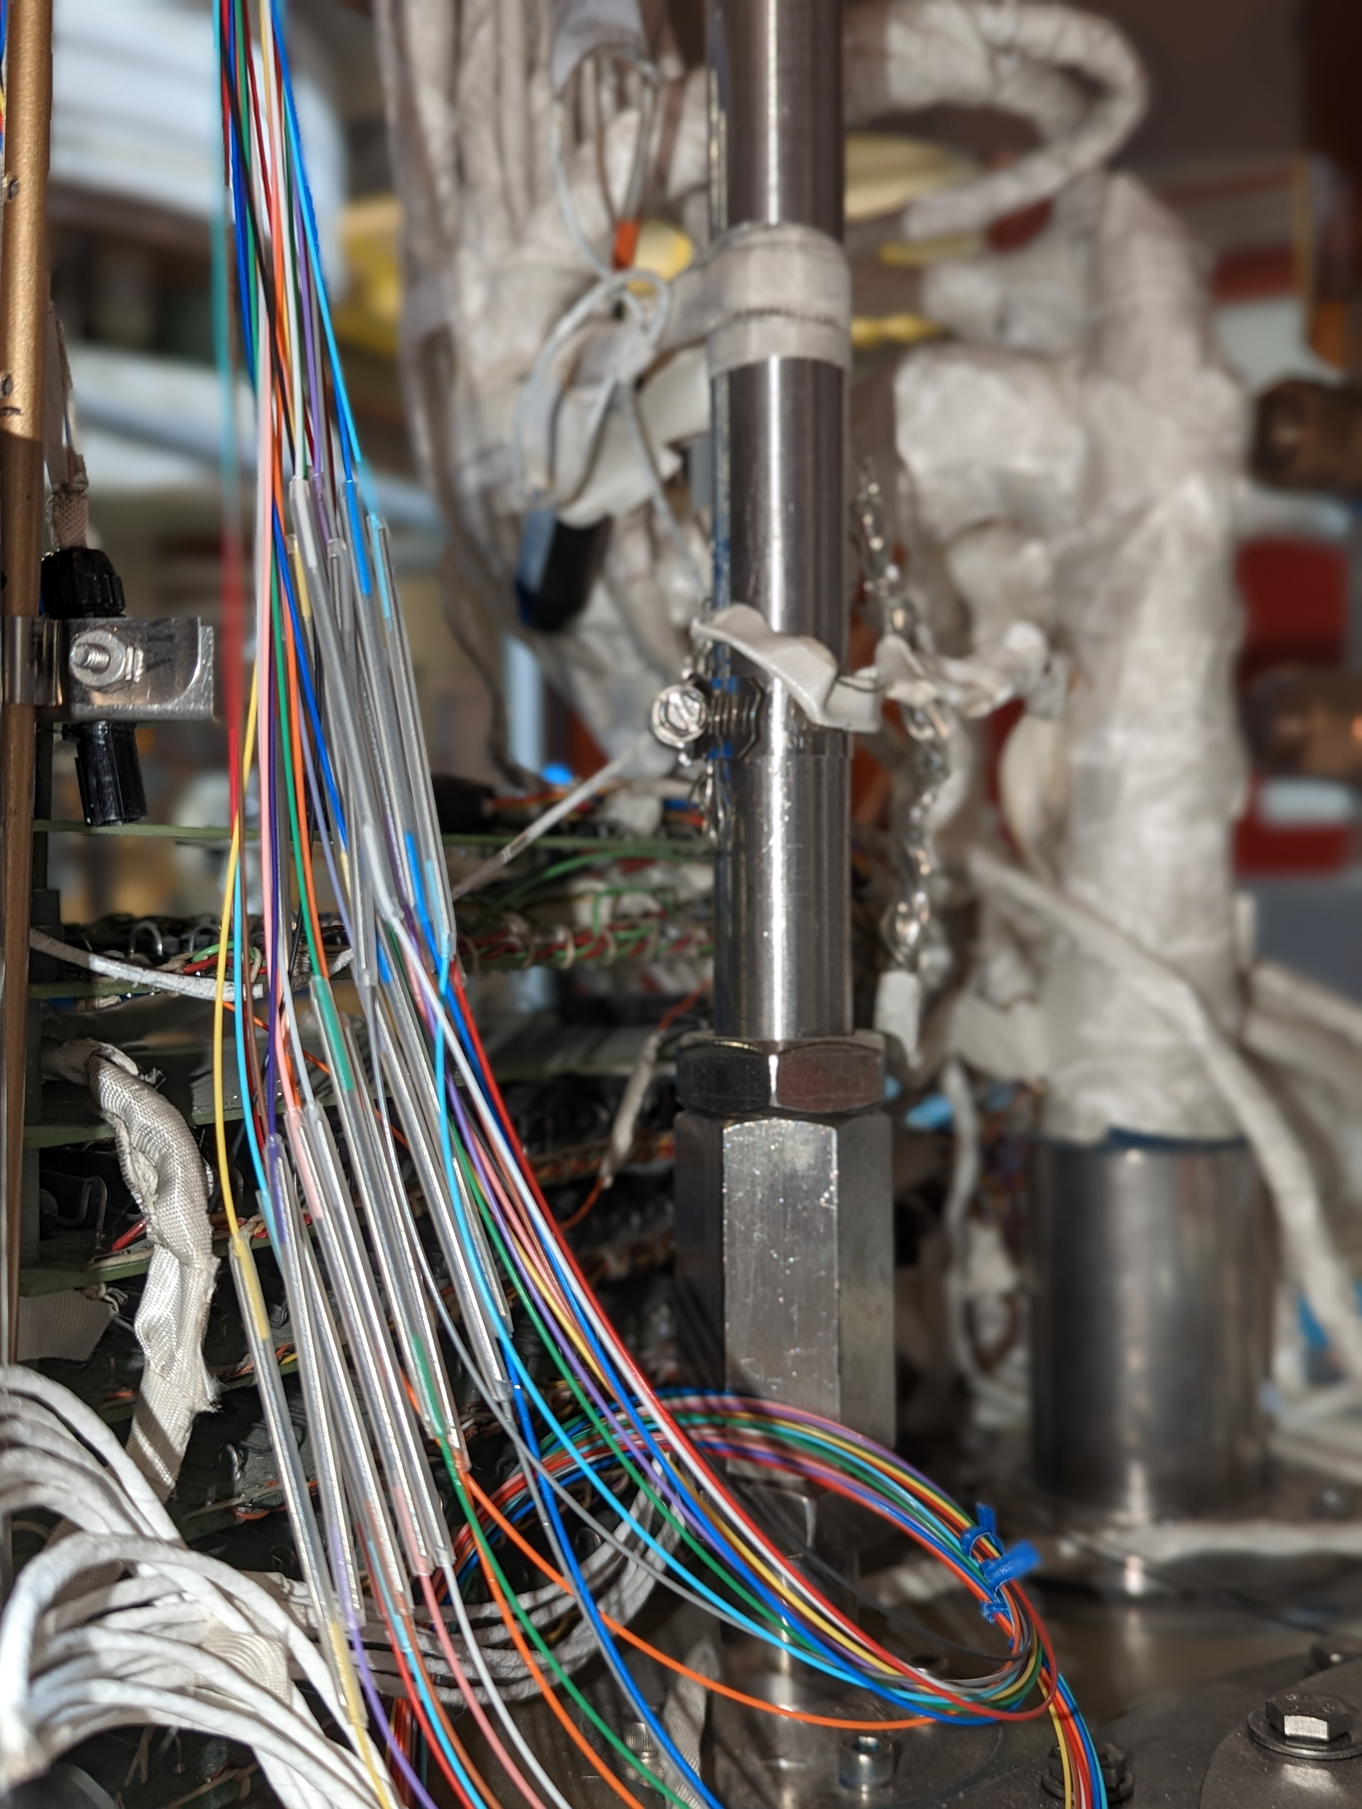
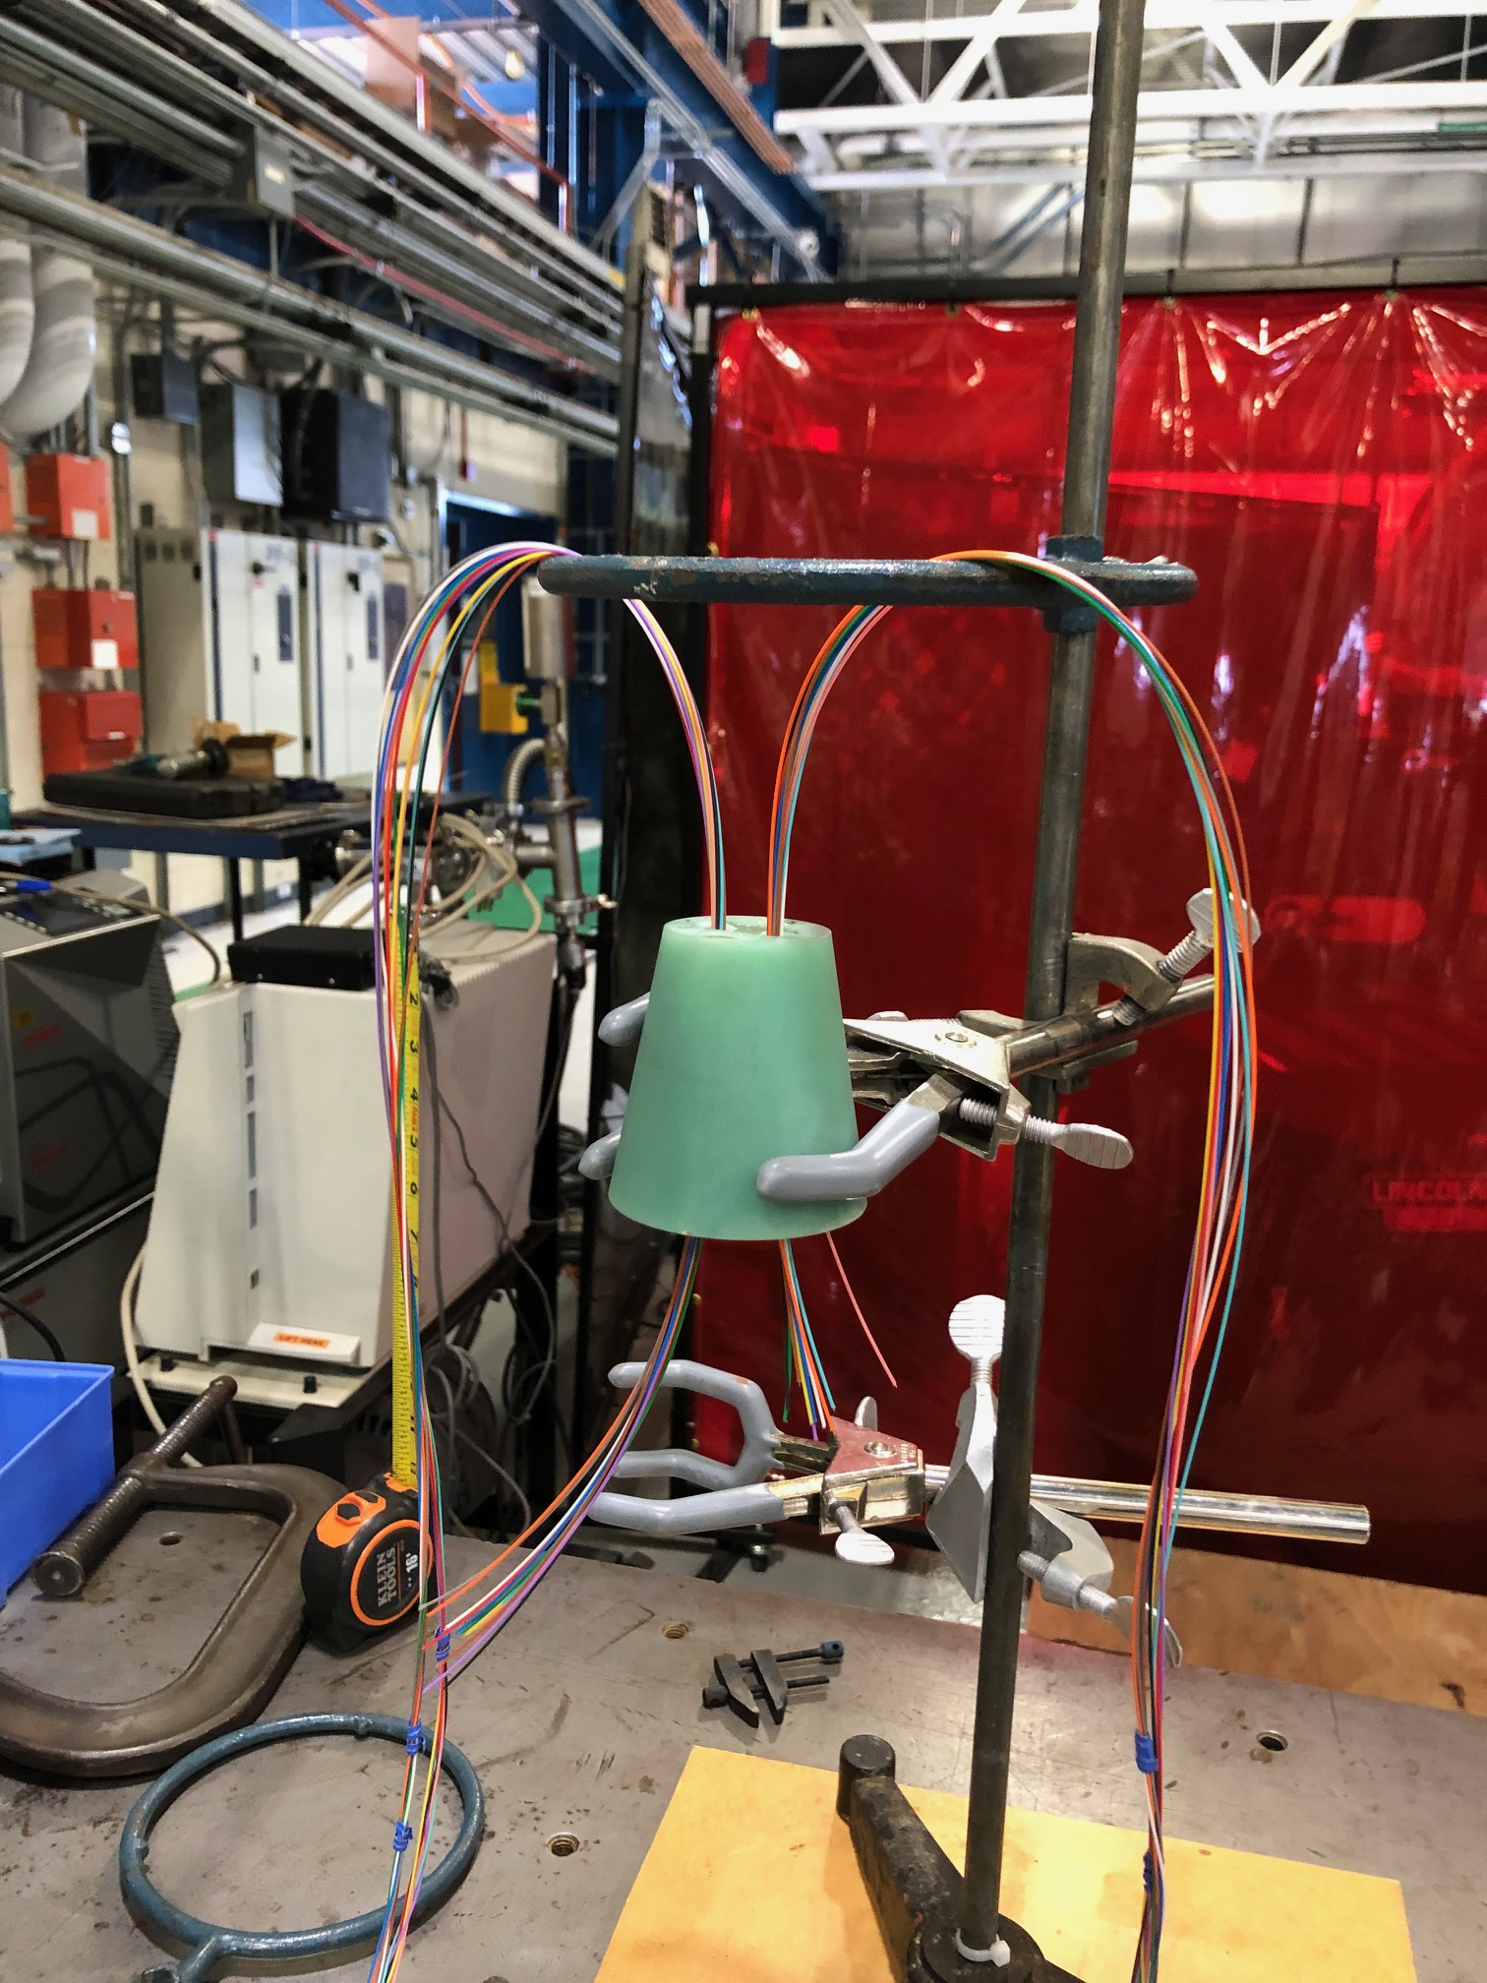
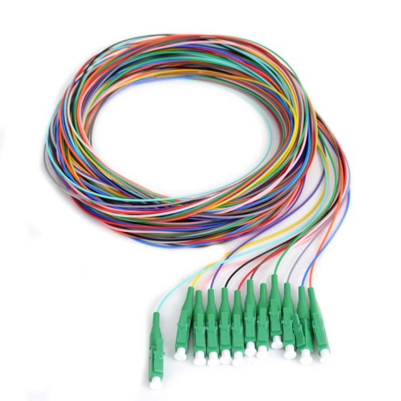
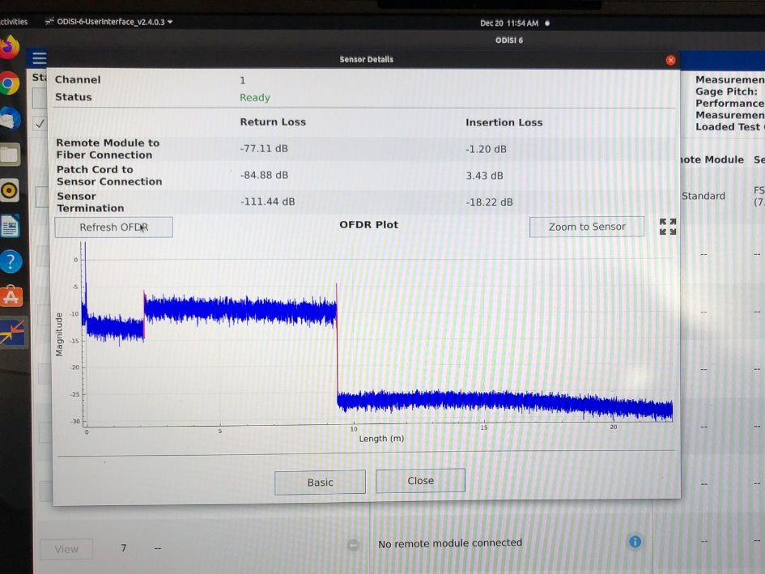
New feedthrough line for the Vertical magnet test facility
T < 70 K
Very low signal < 70 K
Implemented solution: use of pigtail cables spliced below the lambda plate
Both FBG and Rayleigh
TOP PLATE
No signal loss at the splice
LAMBDA PLATE
Line will be tested in the next couple of months
Implemented solution: use of pigtail cables spliced below the lambda plate

Slide 10
Outline
Fiber optics implementation at FNAL
FBG fibers:
    Calibration test
    Feedthrough line for the Vertical magnet test facility
Distributed fiber optics for strain and temperature measurements
    Calibration test
    Strain maps (Steve K.)
    Quench detection
Future plans

Slide 11
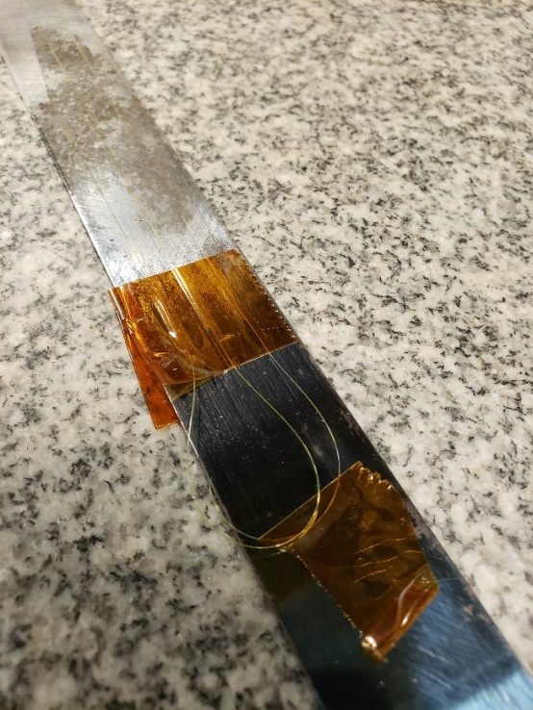
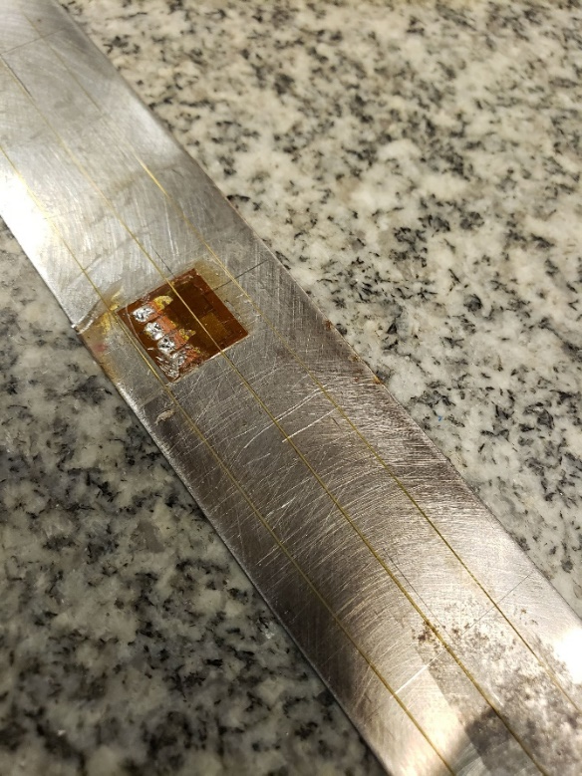
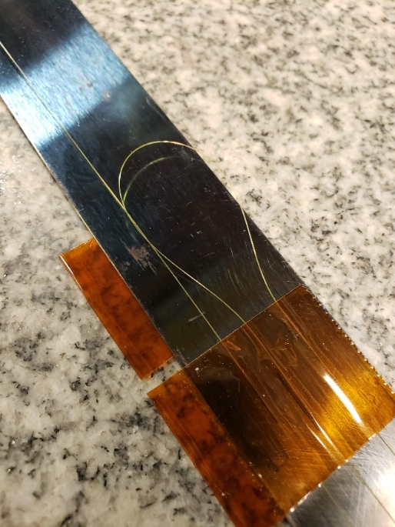
Distributed fibers: calibration on steel bar
Laboratory Directed R&D
Purchase the interrogator
  strain sensors
  fibers encapsulated in Teflon tube: temperature sensors
3 segments of fiber were glued on each side of the steel bar
Observe the spectrum of entire length of the fiber
Pinch the fiber and identify specific position along the sensor

Slide 12
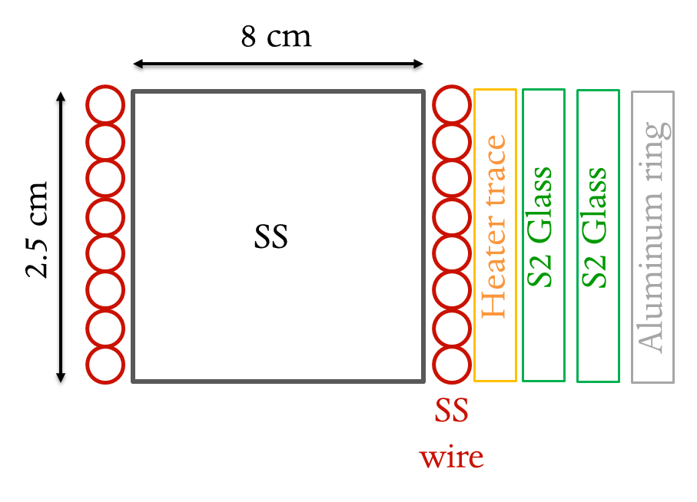
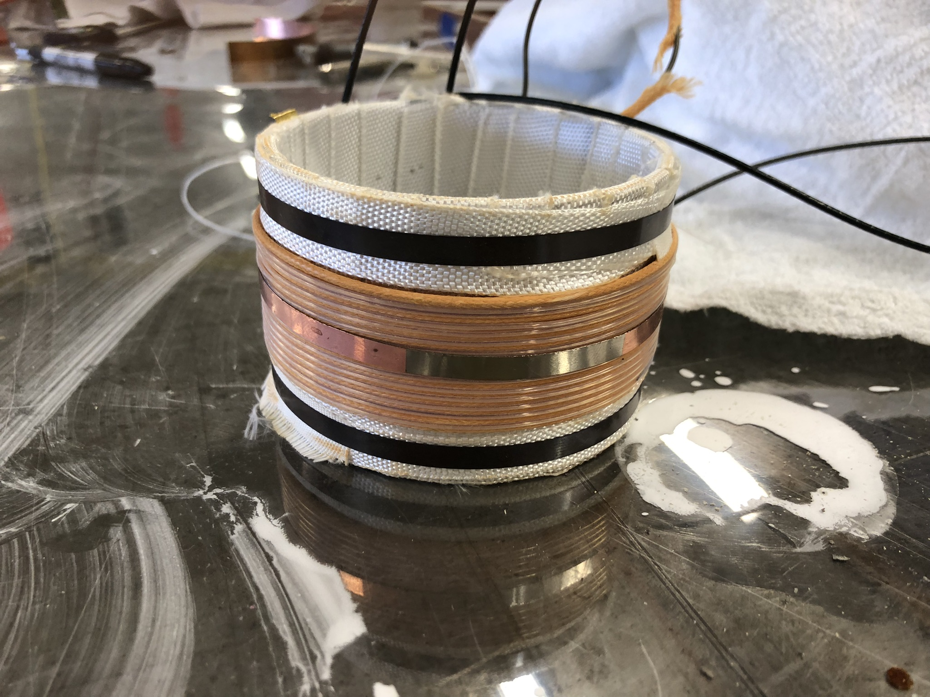
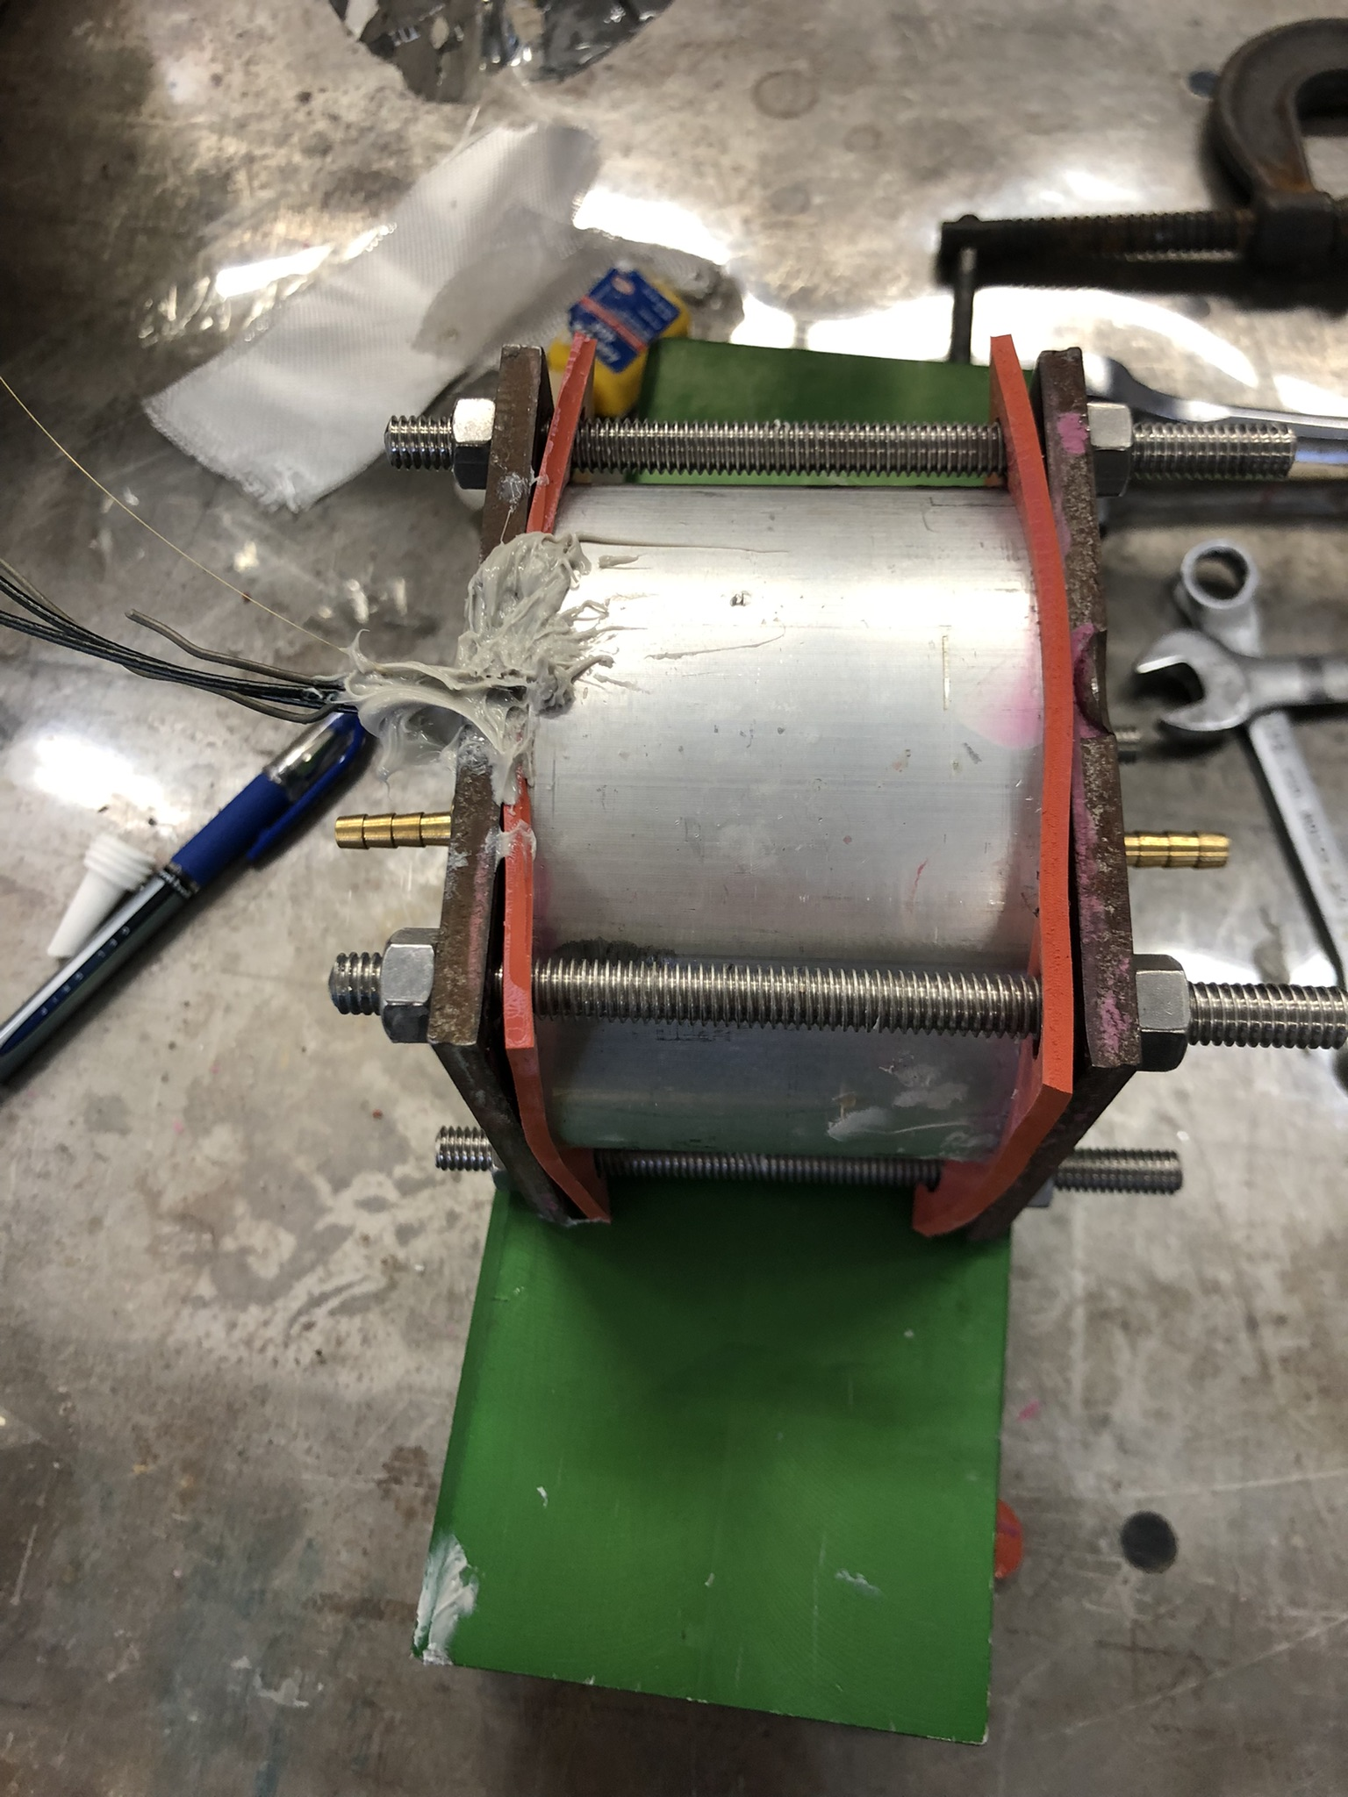
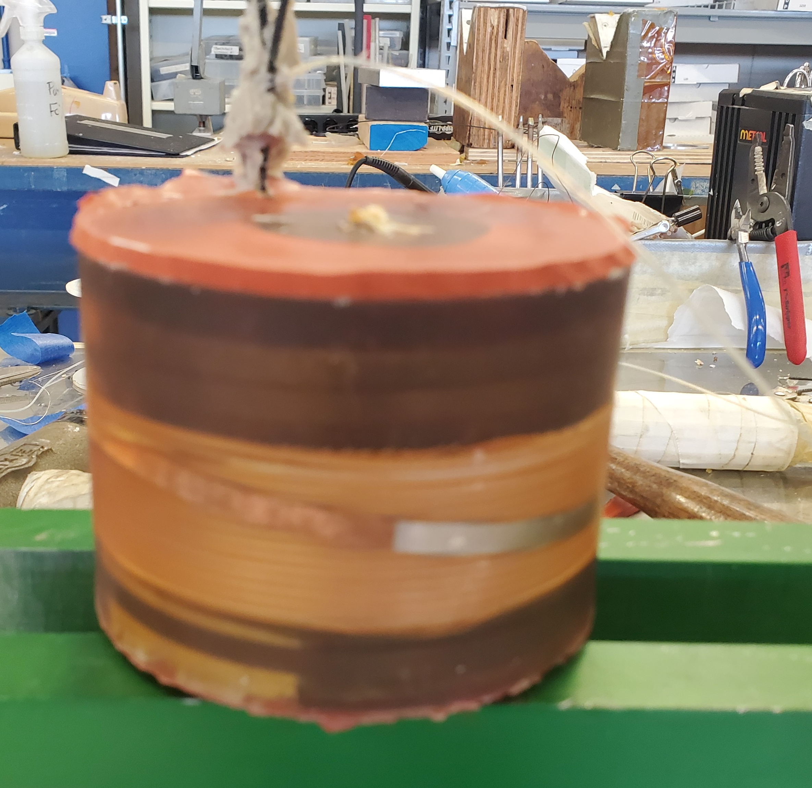
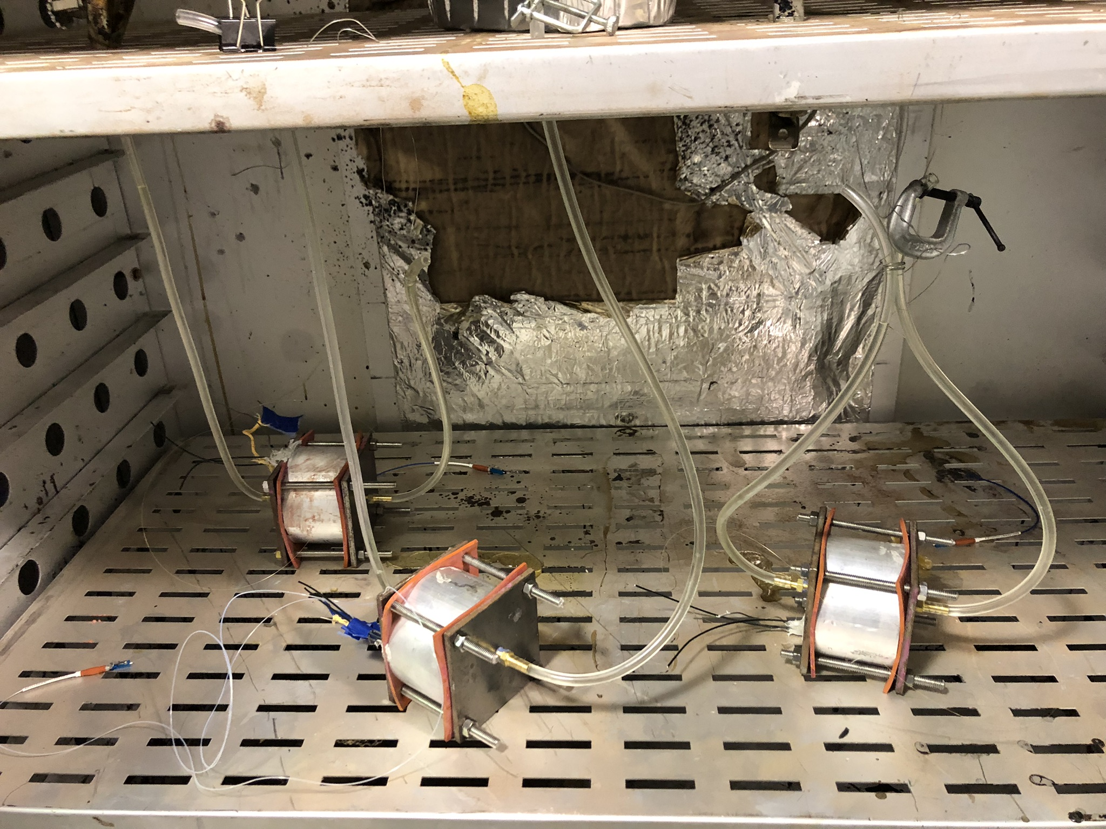
Distributed fiber sensor: quench detection
Fabricate several small solenoids with NiCr wire and wind a standard strain and temperature fibers sensors

Slide 13
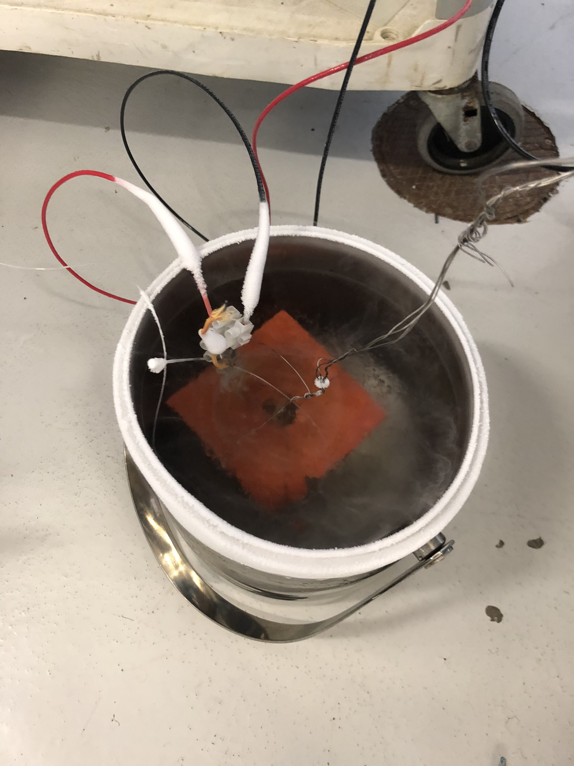
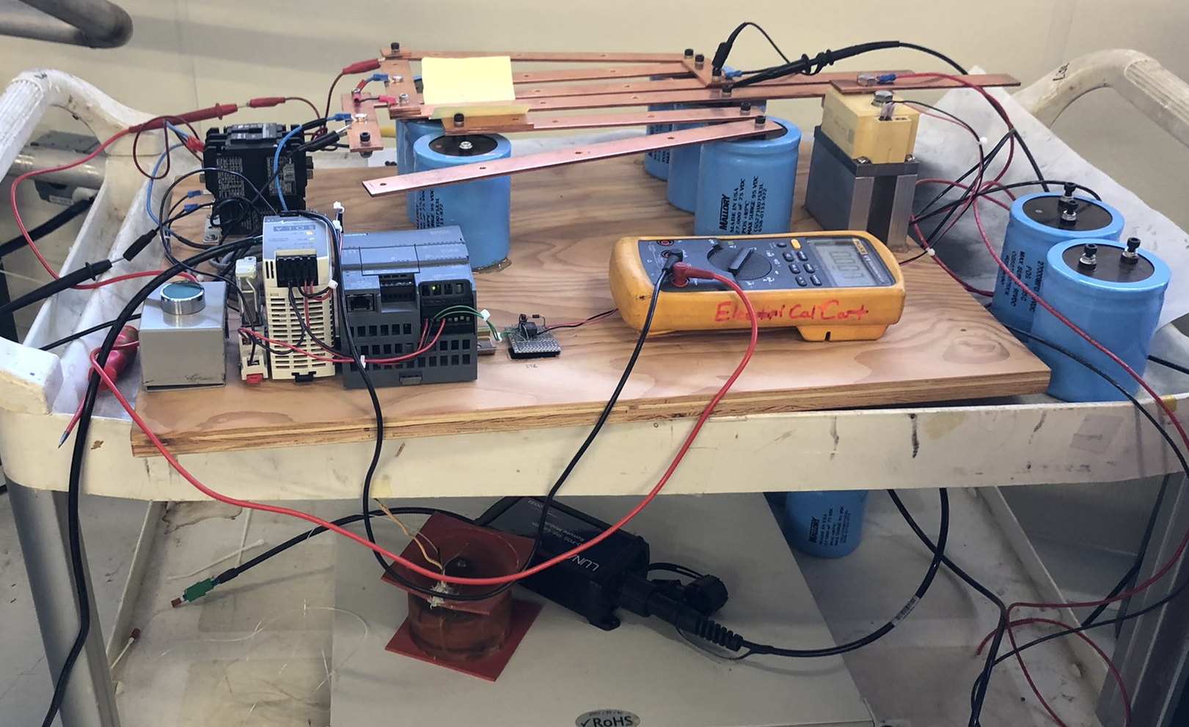
Distributed fiber sensor: quench detection
Capacitor bank (up to 12 capacitors): 27 to 324 mF
TEST # | Voltage | Capacitance | t | Energy stored
 | V | mF | ms | J
1 | 10 | 27 | 13.5 | 1.3
2 | 35 | 27 | 13.5 | 16.5
3 | 40 | 27 | 13.5 | 21.6
4 | 28 | 54 | 27 | 21.1
5 | 40 | 54 | 27 | 43.2
6 | 28 | 108 | 54 | 42.3
7 | 20 | 162 | 81 | 32.4
8 | 25 | 162 | 81 | 50.6
9 | 30 | 162 | 81 | 72.9
10 | 21 | 324 | 162 | 71.4
TEST PARAMETERS
5 m long temperature sensors
Sample rate 160 Hz and spatial pitch 2.6 mm.
Spot heater size (covering 3 solenoid turns): 5 mm wide, 40 mm long and 2.5 um thick
Test in Liquid N

Slide 14
Distributed fiber sensor: quench detection
38 mm
40 mm
25 cm

Slide 15
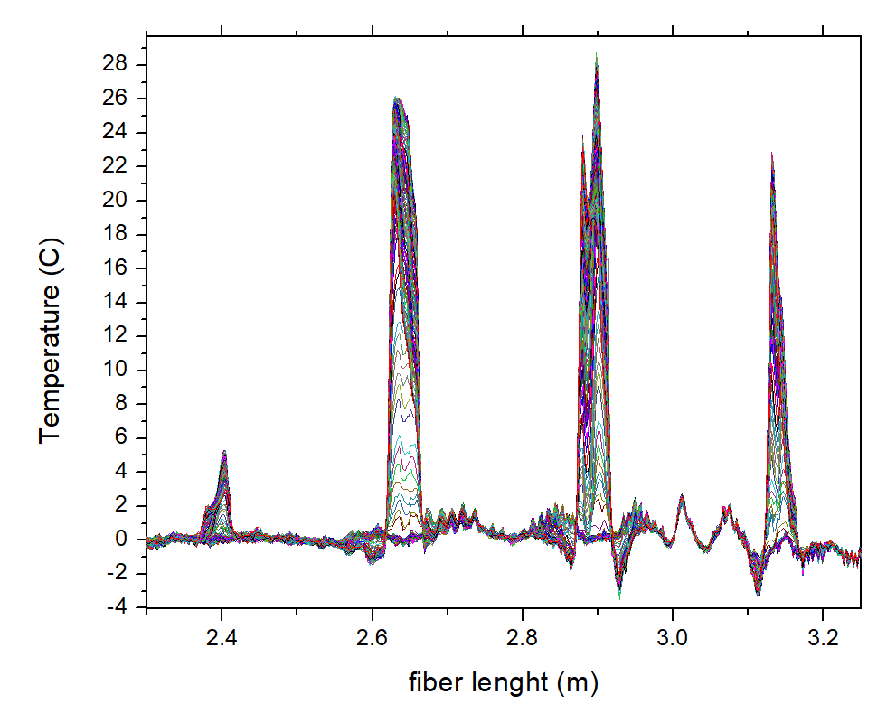
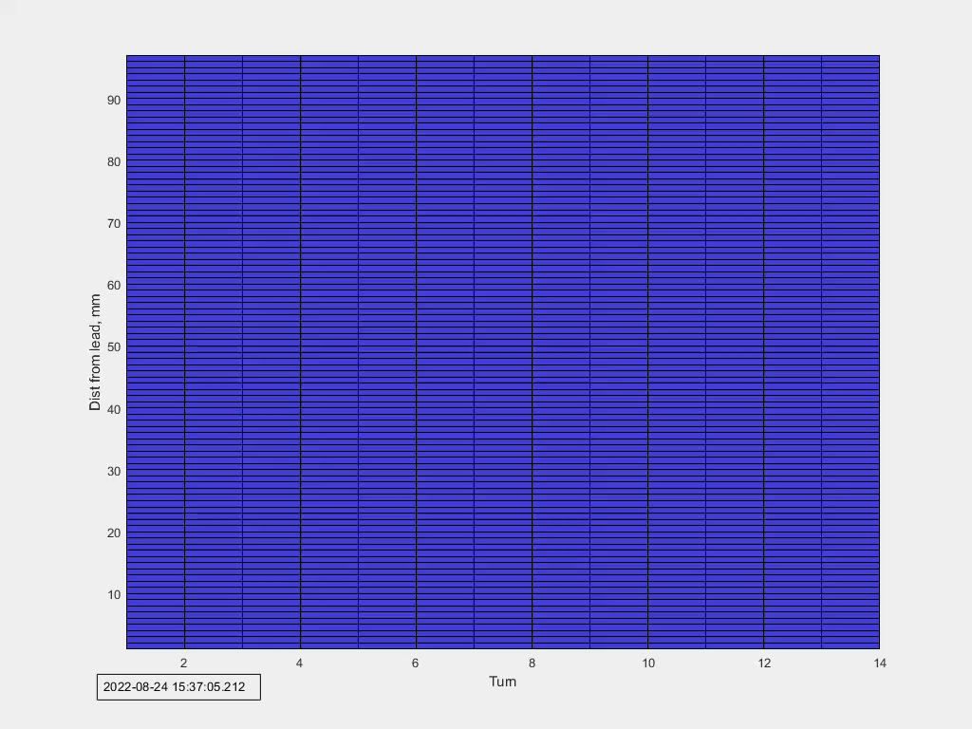
Distributed fiber sensor: quench detection
40 V 54 mF

Slide 16
Distributed fiber sensors: quench detection
Temperature variation vs time constant
200 K variation in 100ms which is consistent with Nb3Sn coils during quench

Slide 17
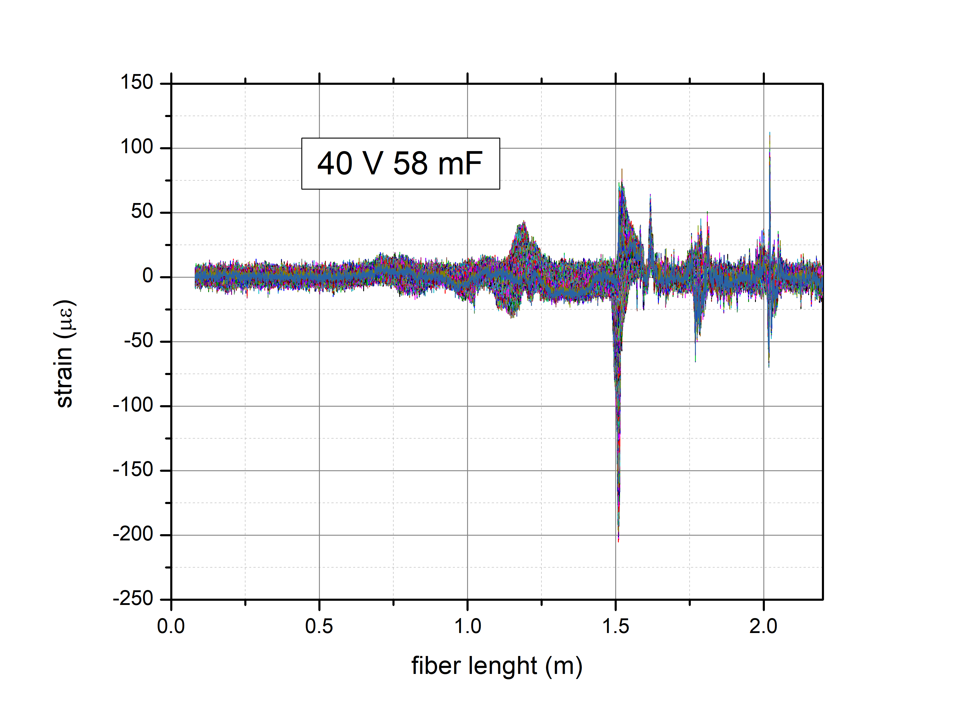
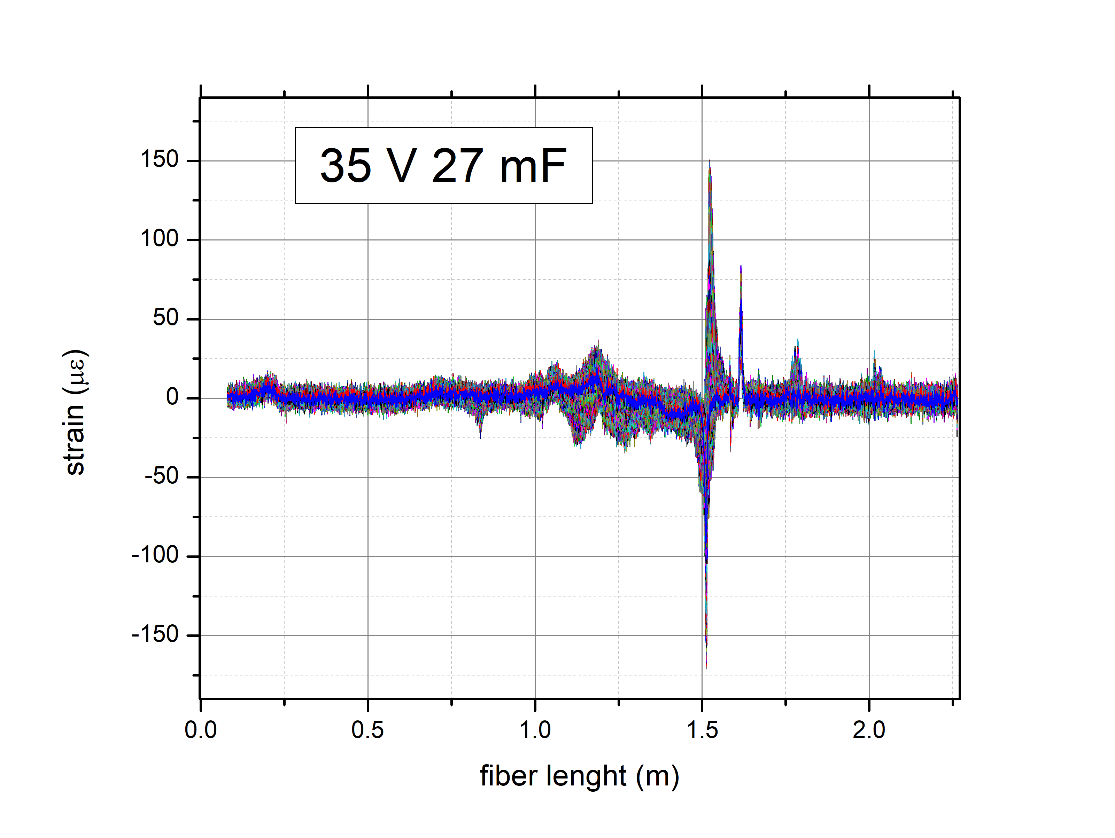
Distributed fiber sensors: quench detection
Outside the coil

Slide 18
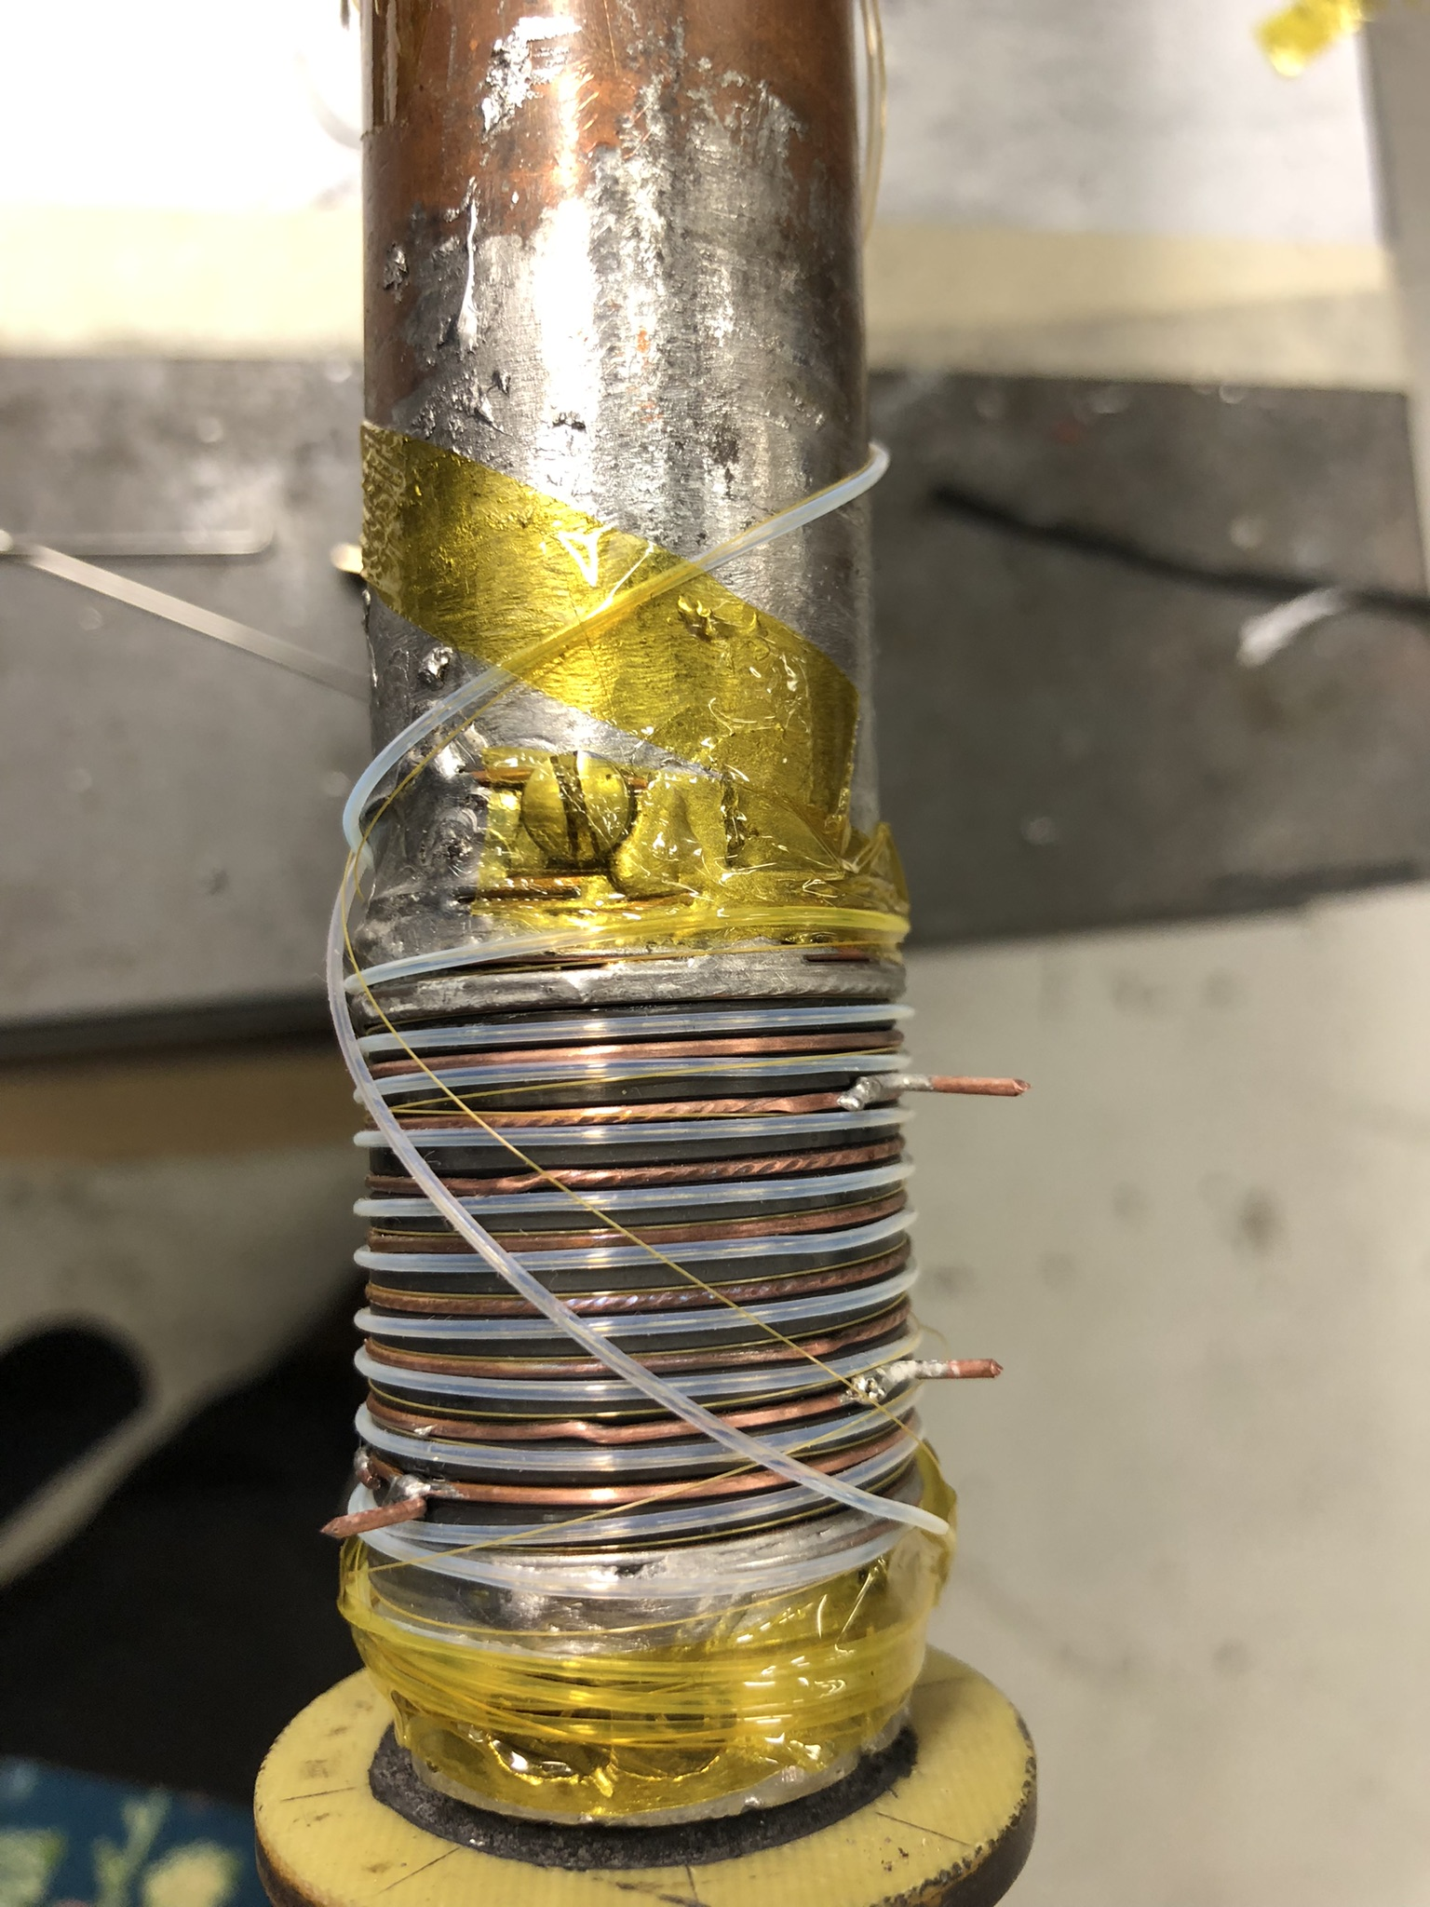
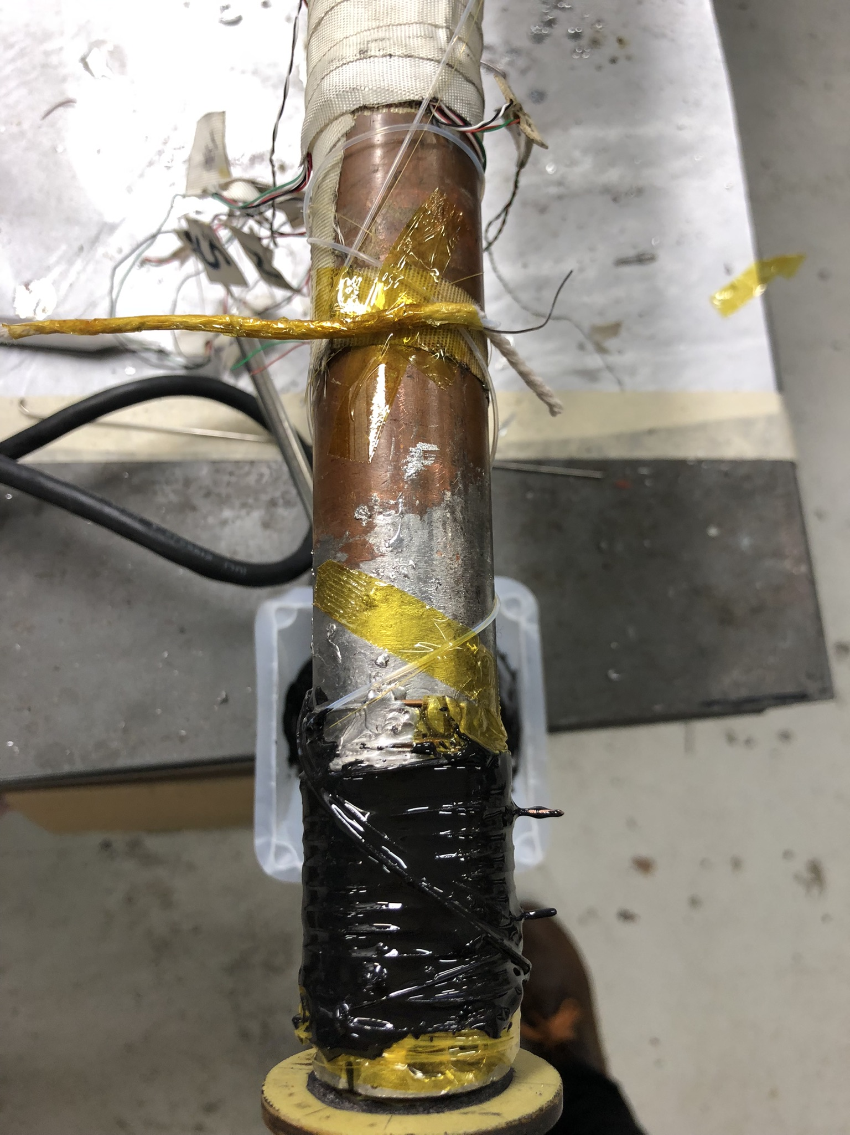
Temperature sensor in Li He
Test sensitivity of
Strain and temperature sensors in Liquid He
Nb3Sn witness sample
Ic measurements
Repeat experiment with a spot heater

Slide 19
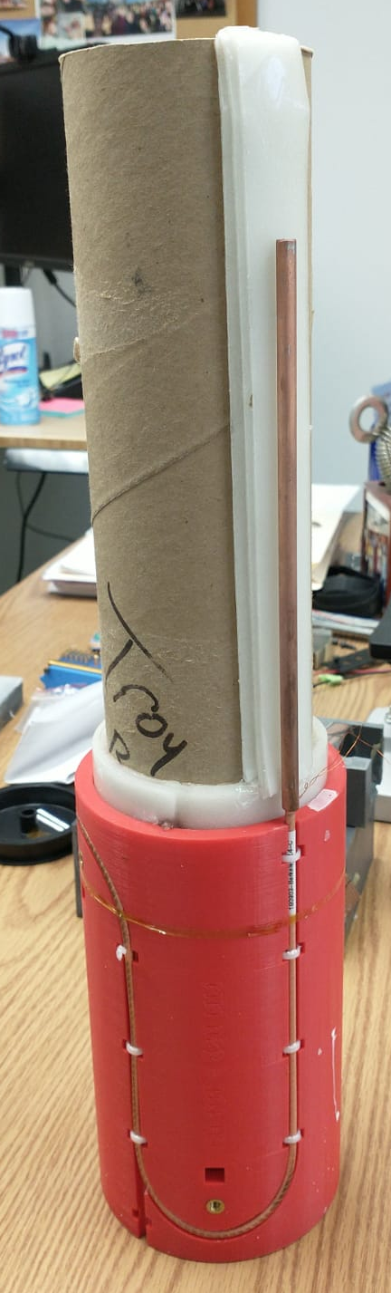
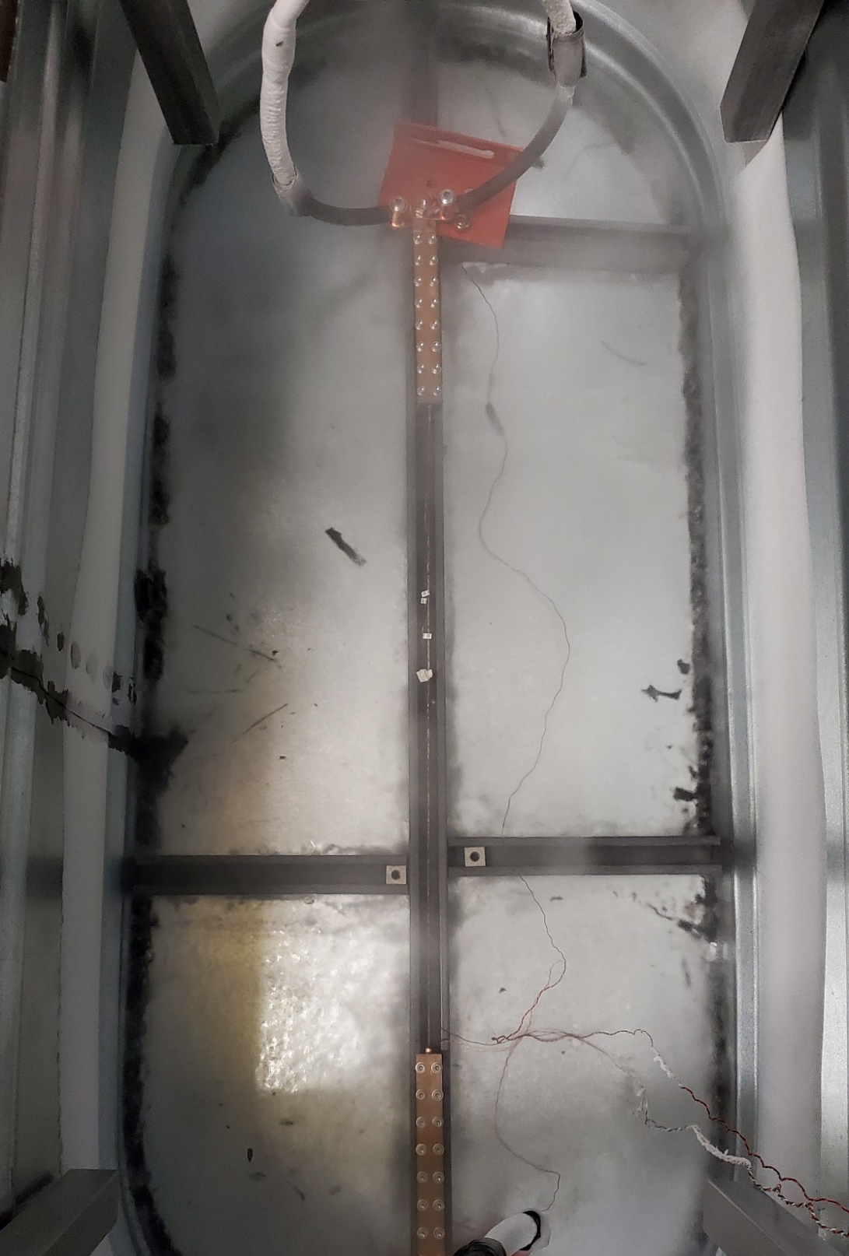
Future plan: test REBCO cable in Liquid N and He
Star REBCO cable
Corc REBCO cable
Wrap a temperature and a strain distributed optical sensor around it
Perform a quench propagation study in Li Nitrogen
Repeat the test in Liquid He

Slide 20
Conclusions
Fiber feedthrough line have been implemented in the vertical magnet test facility at FNAL
Stable diagnostic probe for testing of R&D Magnets at FNAL
DISTRIBUTED SENSORS
QUENCH DETECTION:
  temperature fiber sensors were successfully used to measure T variations in quench like conditions in small solenoid
  Data collected with temperature fiber sensors are easier to interpreter than strain sensors
FUTURE PLAN
  Investigate T sensitivity at 1.9 K
  Quench propagation study on a REBCO cable

Slide 21
Distributed fiber optics

