Slide 1
Digital Transformation in Mechanical Measurements Applied to Superconducting Magnets
Óscar Sacristán
EN-MME-EDM

Slide 2
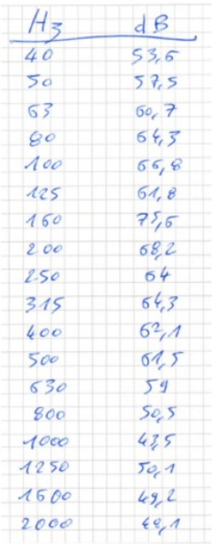
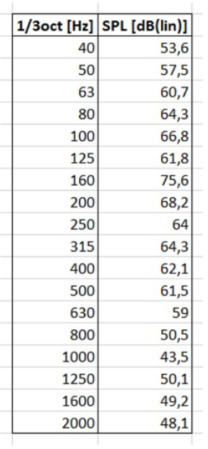
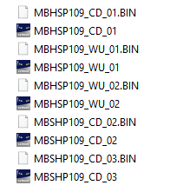
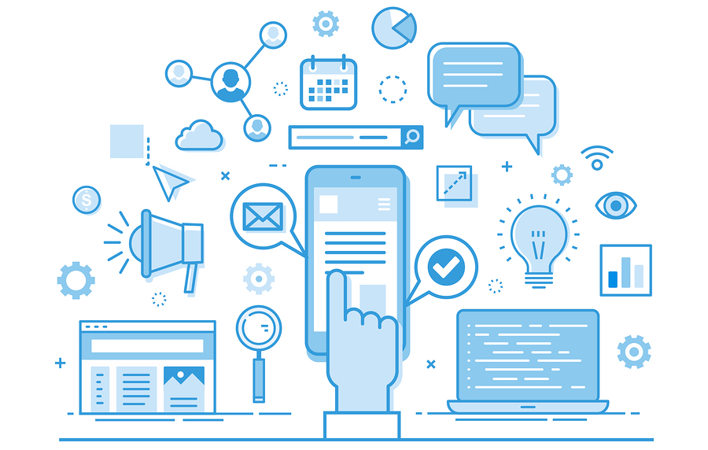
Outline
Context
Requirements
Workflow
Digital Twin Project
Notes:
Context
Lab
ESA Ways
ECOSYSTEM of electronics
The solution
Requirements
Architecture
Grafana
Use cases
Live demo 11T Hybrid
Digital Twins

Slide 3
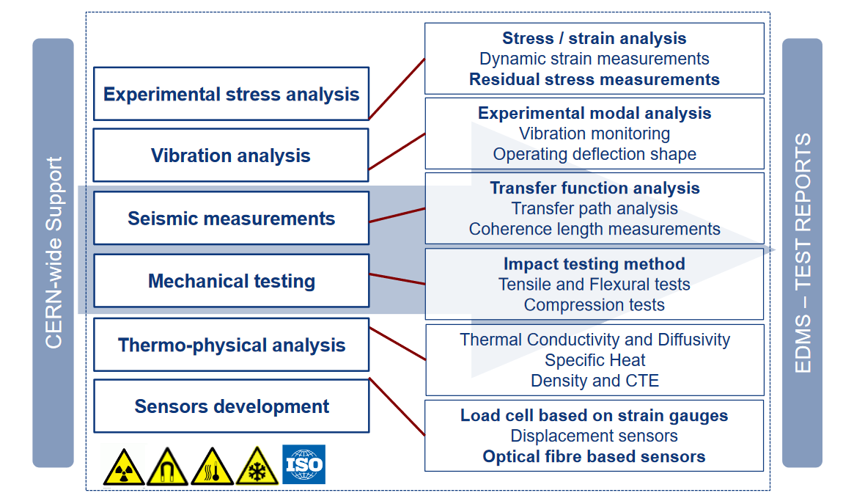
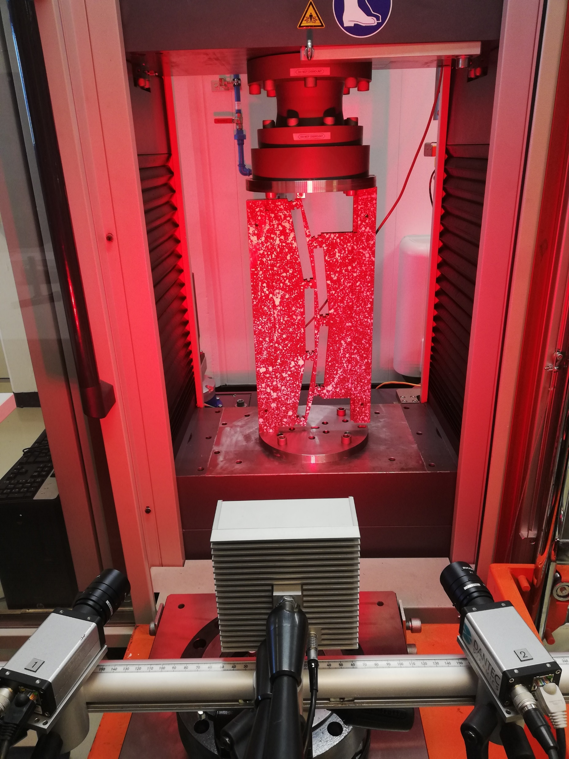
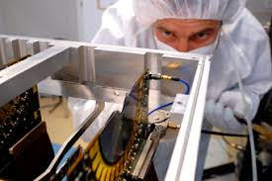
Multidisciplinary Laboratory

Slide 4
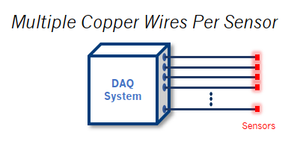
Strain Measurements Ecosystem
<2000
2011
2022
Staying in the forefront of the measurement technology imposes a heterogeneous and complex measurements ecosystem
In most of the cases, the wisest approach to the projects involves a hybrid solution combining different measurement techniques
Electrical Strain Gage
Fiber Bragg Grating
Distributed optical sensing
Single optical fiber,
Static and dynamic measurements up to 1 kHz,
Challenging bonding process for cryogenic temperatures
Limited number of sensors at 1.9 K due to optical loss.
Single optical fiber,
Static and dynamic measurements up to 250 Hz,
Ultra-high spatial resolution <1 mm,
Challenging bonding process for cryogenic temperatures.
Bulky sensors and cabling,
Multiple steps for the installation.

Slide 5
Lab Data Management Context
Increasing complexity of the measurements ecosystem
In order to keep up with state-of-the-art technology
Rapid decision making needs
Many stakeholders need to converge into decisions swiftly
Increased international collaboration
Development team is not forcibly in the same place where assembly and test happen
Technologies available to push forward digital transformation in the laboratory
Not only from measurements industry, but the Internet of Things, cloud computing, etc.

Slide 6
Takeaways from Previous Talks
“Diagnostics experts must interact closed with modeling experts, magnet designers, and magnet operators – communication is vital in both directions!”
Soren Prestemon. US MDP instrumentation and diagnostics needs.
“Clear need for optimization software to handle large datasets”
Gerard Willering. CERN needs for diagnostics and instrumentation.

Slide 7
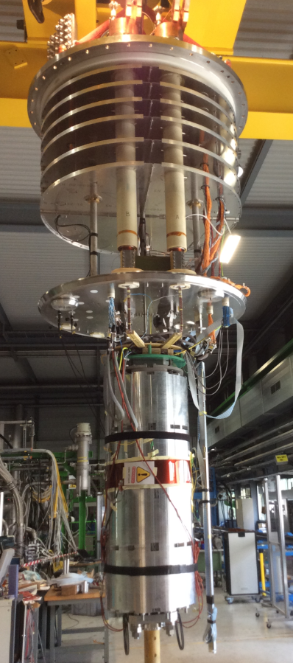
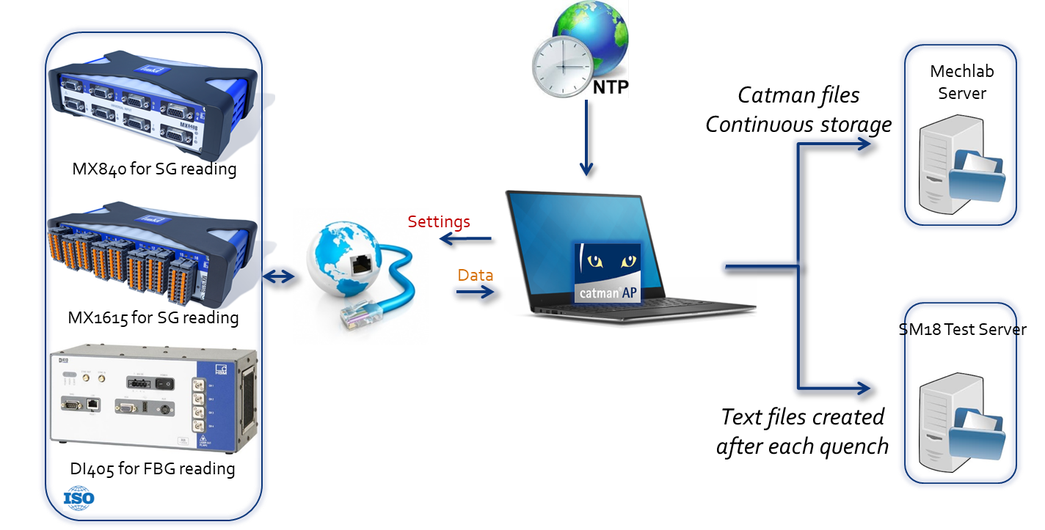
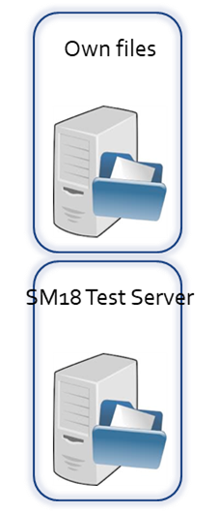
Starting Point
Mechanical Measurements
Post-processing
Other measurement data
Many types of files, lots of exports to convert files and huge data storage;
Multiplication of the efforts towards data analysis;
Difficulties to merge data from several systems due to the time stamping, sampling frequency, meta data, labels, etc…
Merge data are not accessible real time.
Third party

Slide 8
Requirements
Alarming capabilities are essential for long term monitoring activities
Avoid getting tied to a certain technology or supplier
Real Time
Secured Multi-User
Multi-source
User Friendly
Monitoring and alarming
Open Source
No coding capabilities needed for daily work
Needed to make decisions based on the most current and accurate information available
Coping with the increasingly complex eco-system of measurement systems in the laboratory
Multiple stakeholders are involved during the lifetime of the magnet that need to have concurrent access to the data

Slide 9
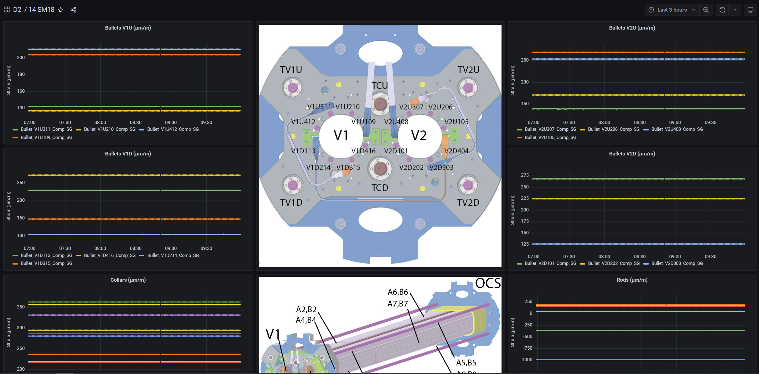
Live Demo: D2 Magnet

Slide 10
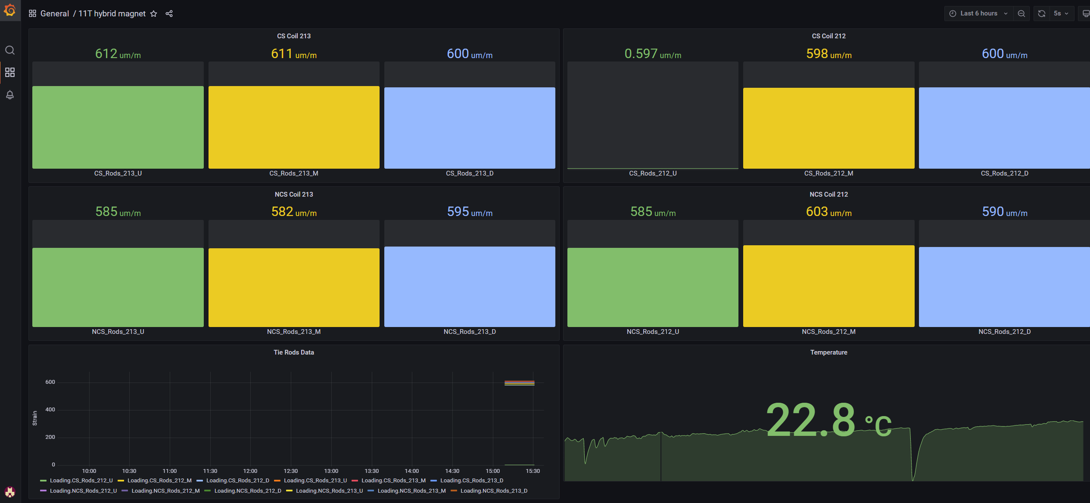
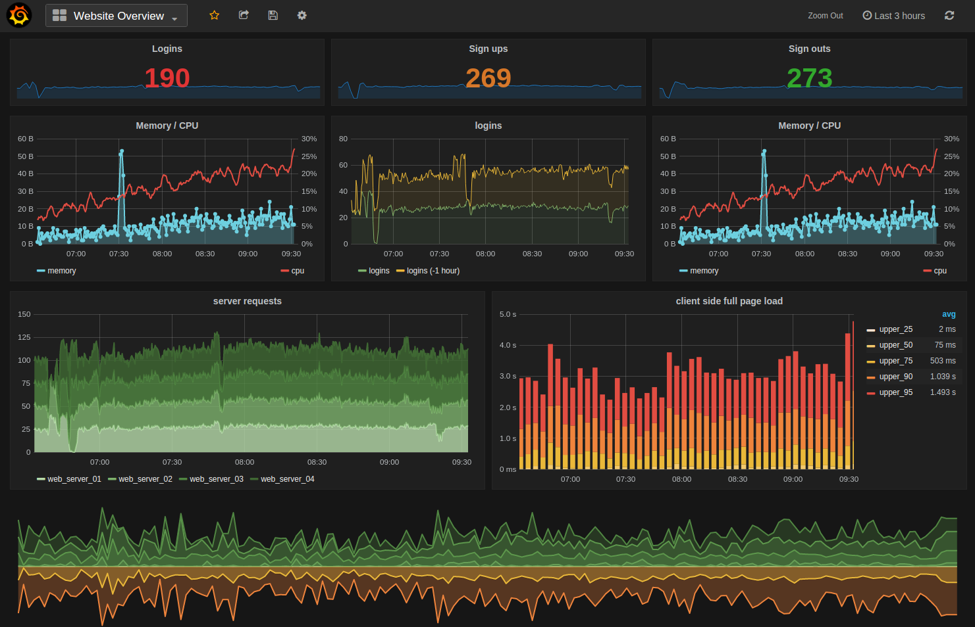
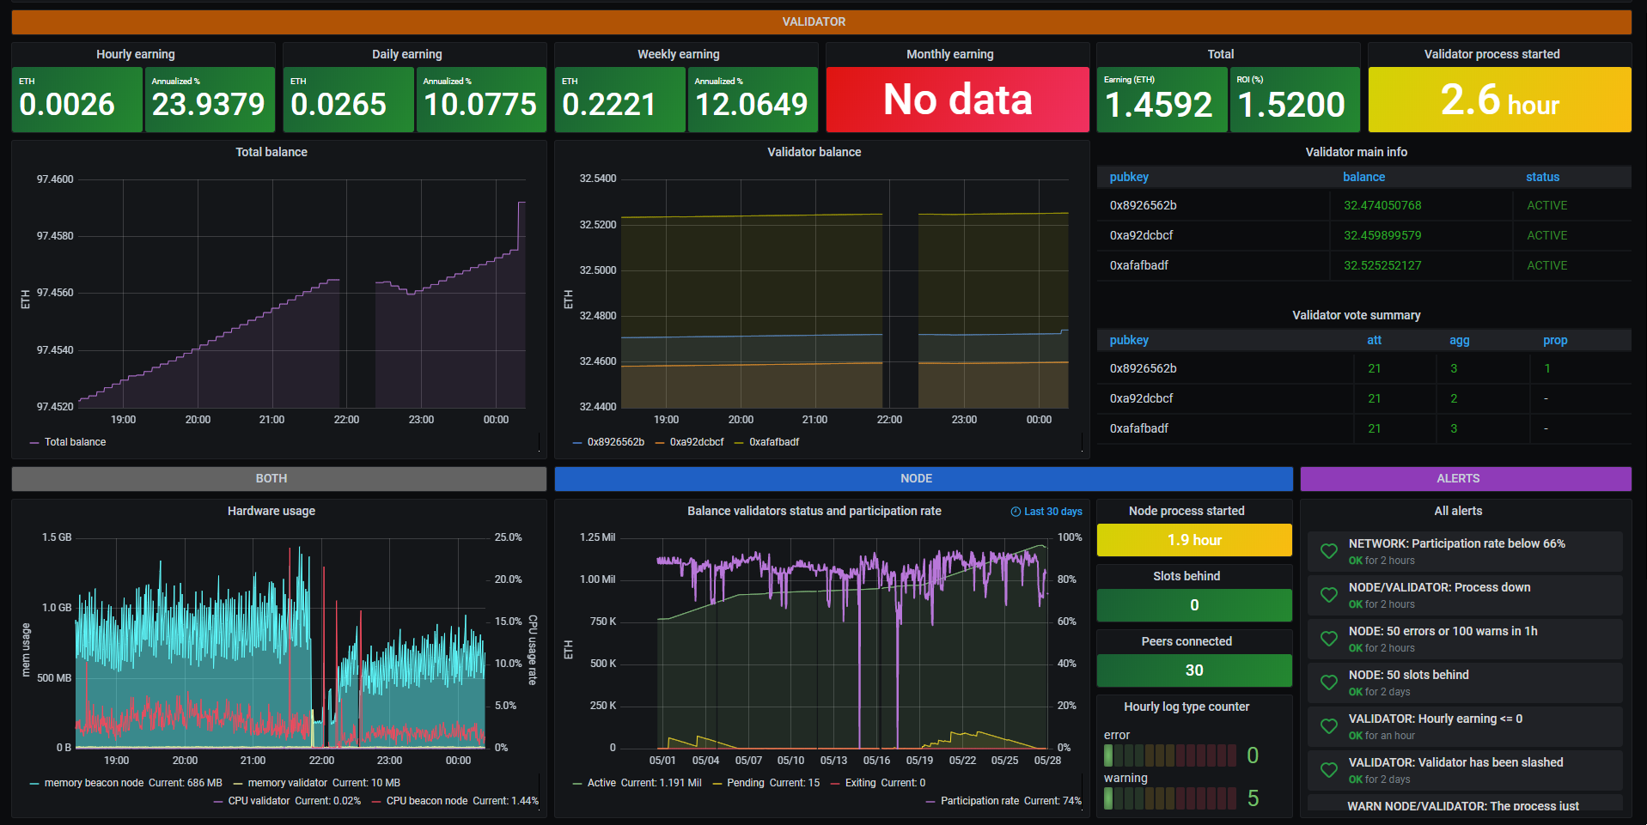
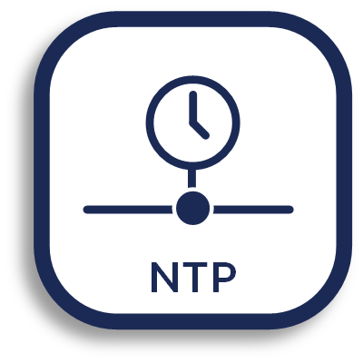
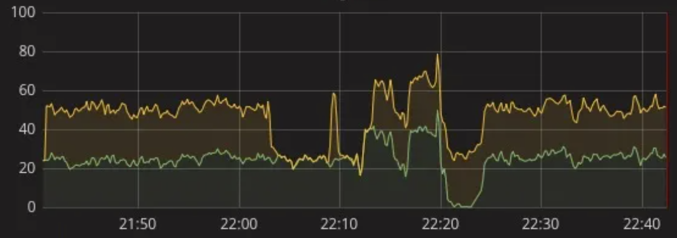
Solution Architecture
Dedicated Real Time Data Visualization
Online Monitoring and Alerting
Data Acquisition
Assembly
Thermal Cycle
NTP/PTP Synchro
Powering
Centralized Data Repository
Any other measurement system
Notes:
Say it is not exhaustive list
NTP/PTP

Slide 11
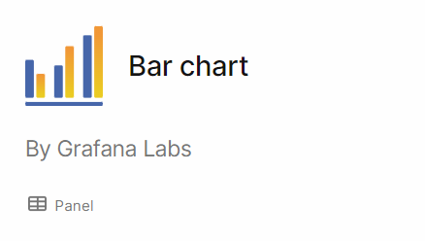
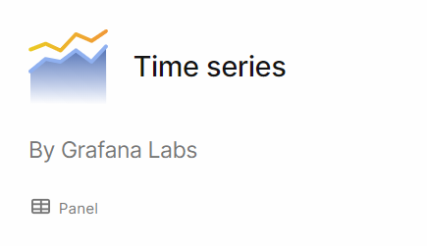
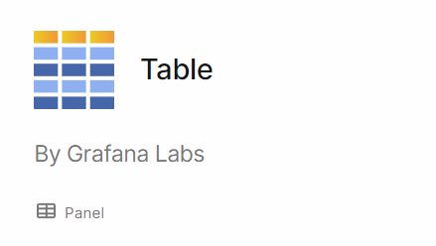
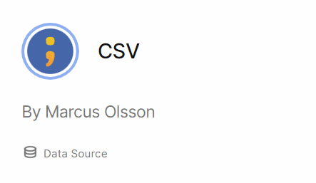
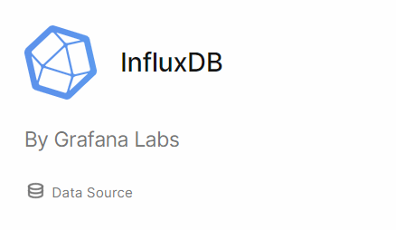
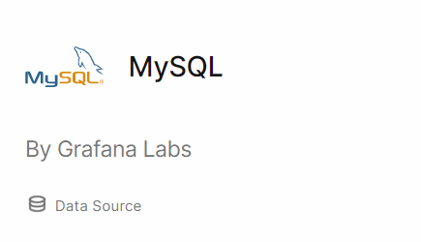
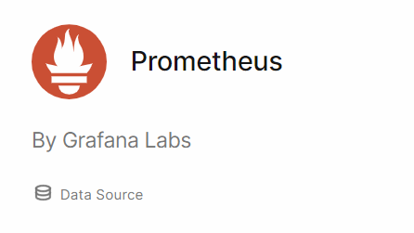
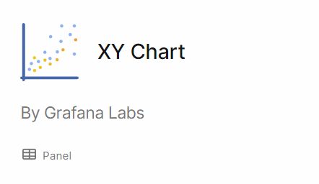
Grafana
An open-source data visualization and monitoring tool that allows users to query, visualize, alert, and understand metrics from different data sources.
It supports a wide range of data sources, including Graphite, Elasticsearch, InfluxDB, Prometheus, and many others
More than 150 off the shelf data-source plugins
More than 130 off the shelf panel plugins
Framework
Panel Plugins
Data Source Plugins
Apps Plugins
Grafana Local Server
End User 1
Manage front-end functions
Manage the back-end functions
Manage data source and panel plugins
End User 2
End User 3
Notes:
REVERSE PANEL and DATA SOURCE
Grafana is an open-source data visualization and monitoring tool that allows users to query, visualize, alert, and understand metrics from different data sources. It supports a wide range of data sources, including Graphite, Elasticsearch, InfluxDB, Prometheus, and many others.
With Grafana, users can create customizable dashboards that provide real-time insights into their data. Grafana also offers features such as alerting, annotation, and plugins that can be used to extend its functionality. It is widely used in IT infrastructure monitoring, application performance monitoring, and business analytics.
Grafana's popularity and versatility have made it a popular tool in the data visualization and monitoring community. It has a large and active community that creates and shares dashboards, plugins, and integrations to make it easier for users to visualize their data.
Advantages of Grafana:
Grafana is an open-source tool, which means it is freely available for use and modification by anyone.
Grafana supports a wide range of data sources, which allows users to visualize and monitor data from various sources using a single platform.
Grafana's dashboard creation is intuitive and user-friendly, which makes it easy for non-technical users to create and customize their dashboards.
Grafana offers a large number of plugins and integrations that can be used to extend its functionality, allowing users to tailor their monitoring and visualization to their specific needs.
Grafana provides real-time monitoring and alerting capabilities, which allows users to quickly respond to issues and avoid downtime.
Disadvantages of Grafana:
Grafana's open-source nature can lead to slower development and support compared to commercial tools.
Grafana requires technical knowledge to set up and maintain, which may be a barrier for non-technical users or small teams.
Grafana does not provide advanced data analytics or machine learning capabilities, which may limit its usefulness for certain use cases.
Grafana's alerting system can be limited in terms of functionality and flexibility, which may require users to integrate with external alerting tools.

Slide 12
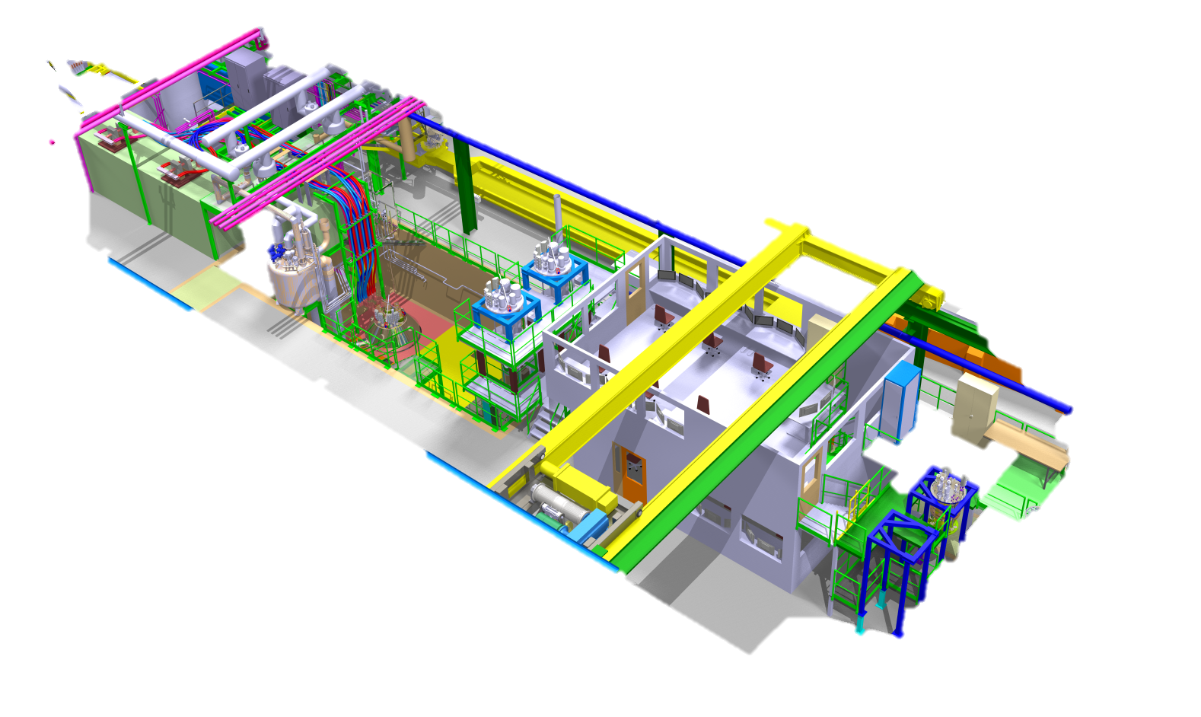
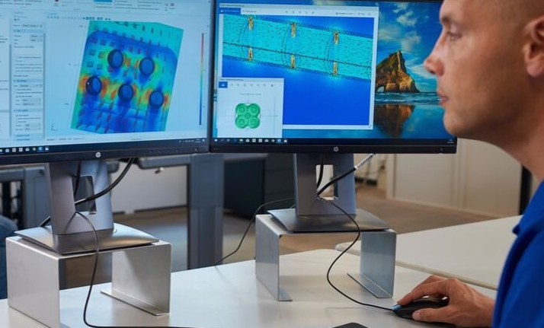
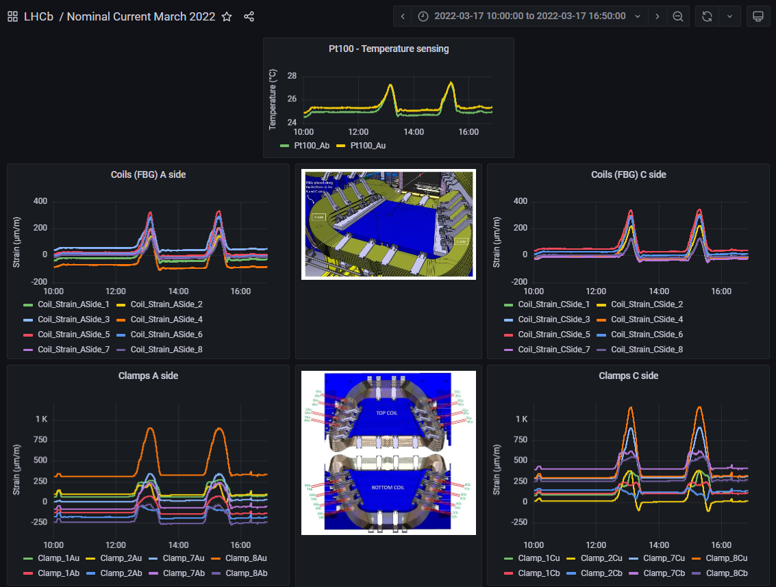
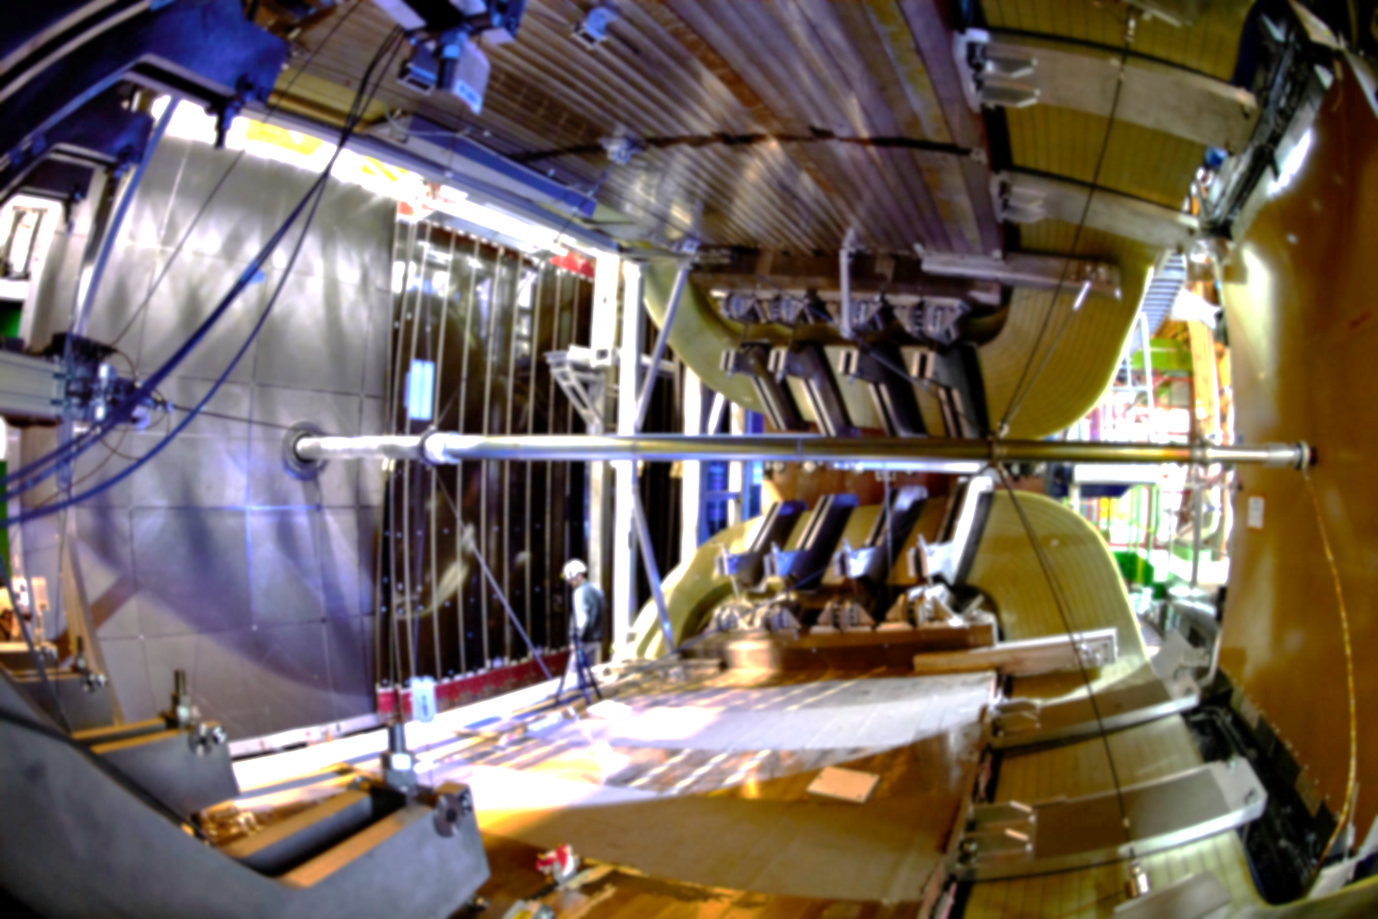
Magnet Test and Assembly Use Cases
Assembly
Test
Live monitoring of the assembly of the process
Swift decision making process
Portable devices in the workshop
Concurrent access to the most current and accurate information available
Avoid duplicity of efforts in analysing the data
Monitoring and Alert (LHCb)
Repository of previous data
Long term monitoring of mechanical structures
Anomaly detection capabilities
Reference repository of the mechanical behaviour of a particular structure

Slide 13
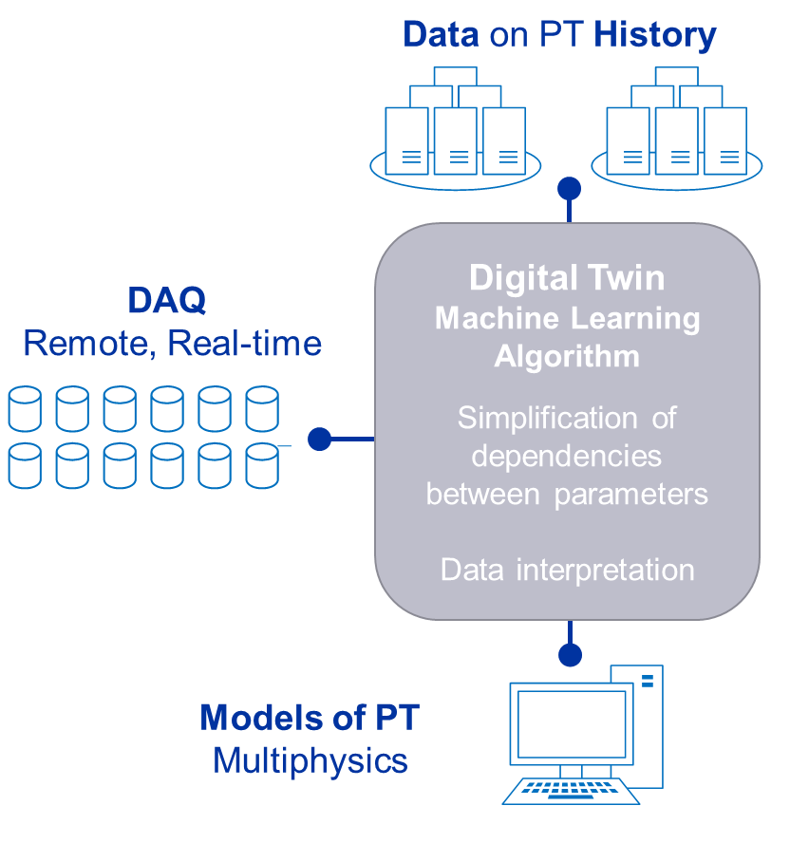
Digital Twins: Our View
Calculates/outputs present asset states, through integrated models and acquired data
Acquisition from ‘Virtual sensors’ : parameters conventionally unmeasurable, due to: accessibility, multiphysics (e.g. RF cavity EM field distribution from beam pipe strain values), cost (less sensors).
Future scenarios analysis (variables : ambient conditions, loads & design changes) to evaluate readiness or adjustments to current system set-points
Anomaly detection: flags deviations of operational vs. expected behavior

Slide 14
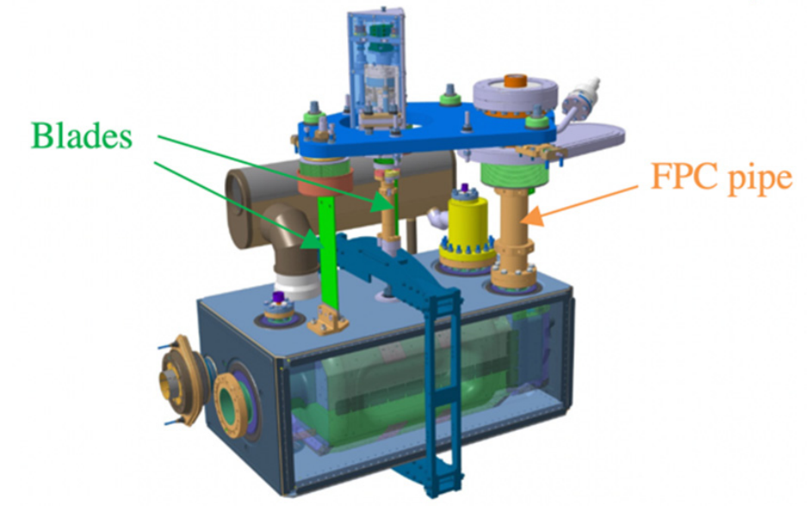
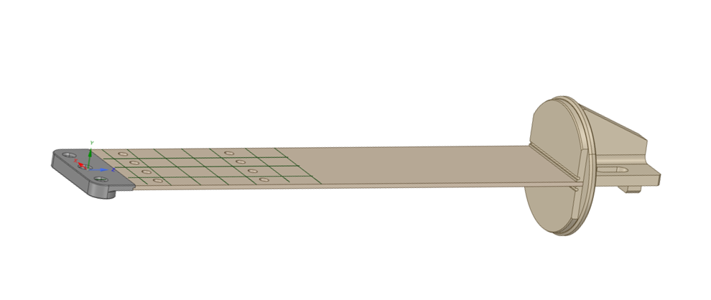
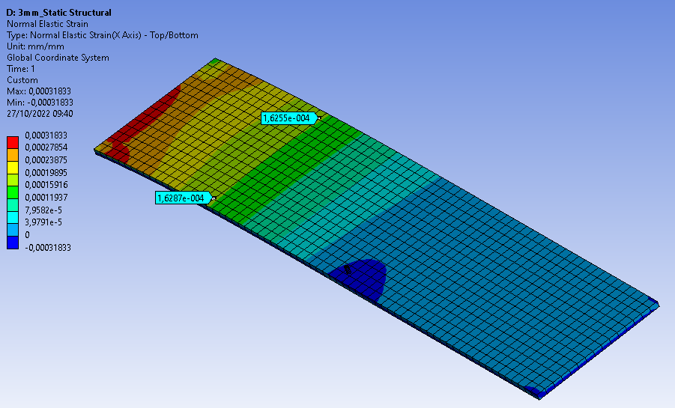
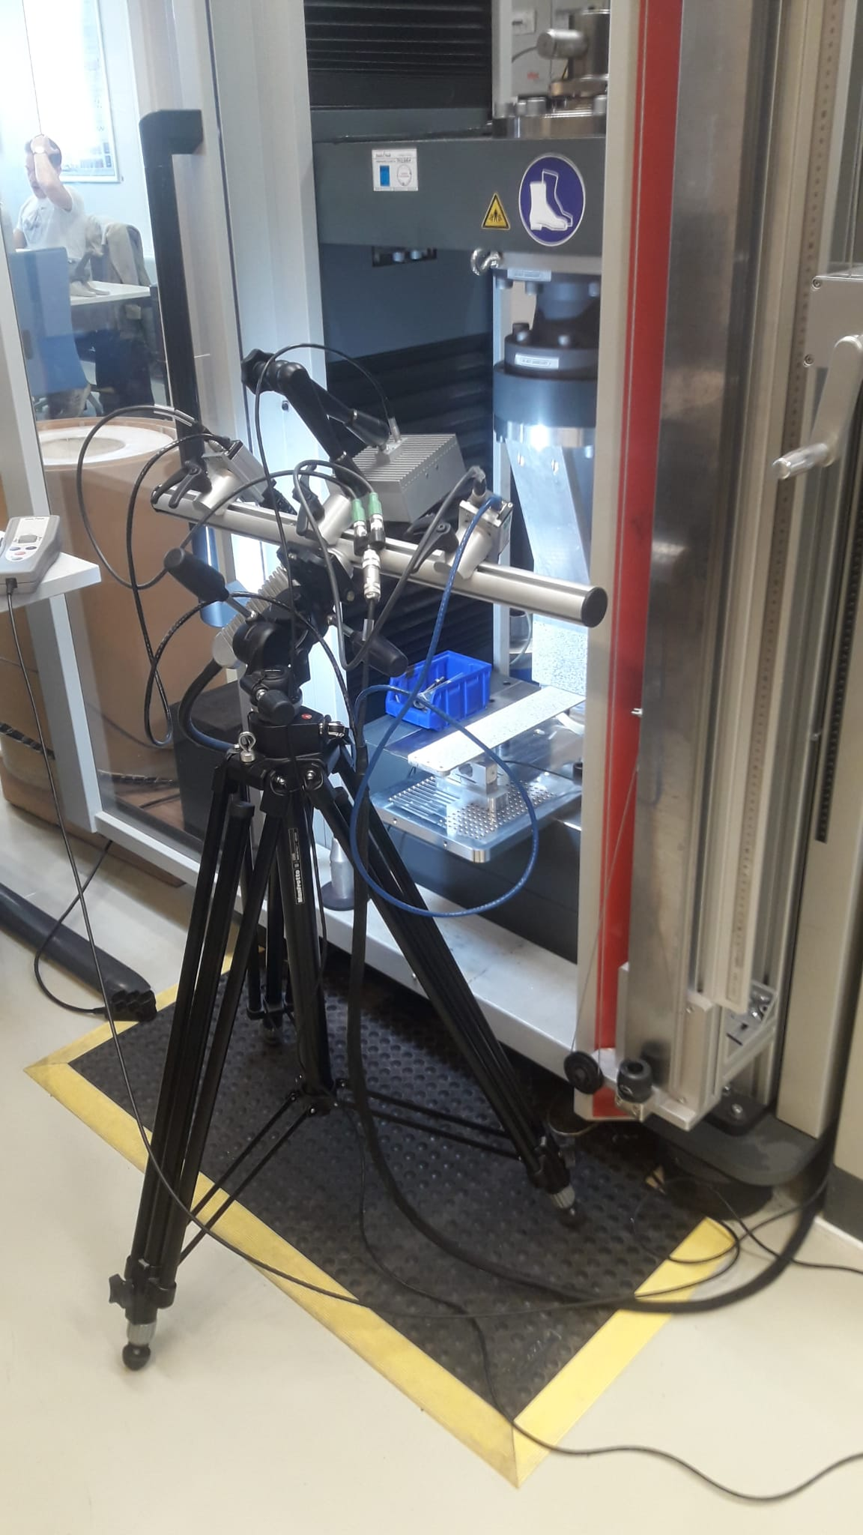
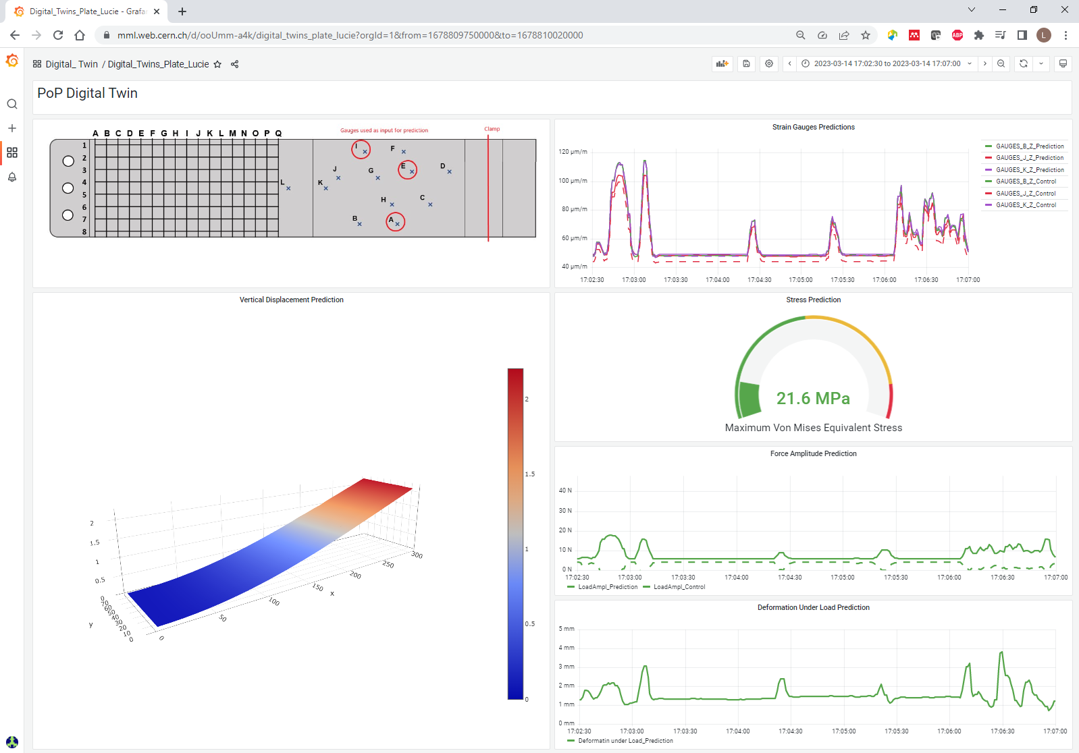
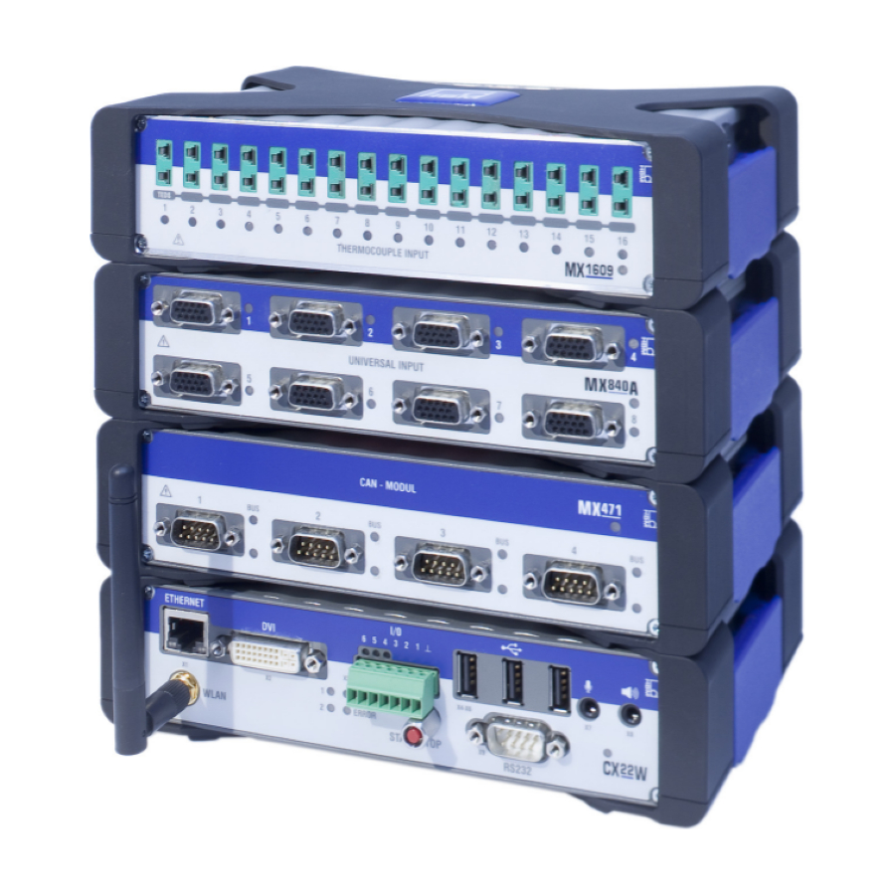
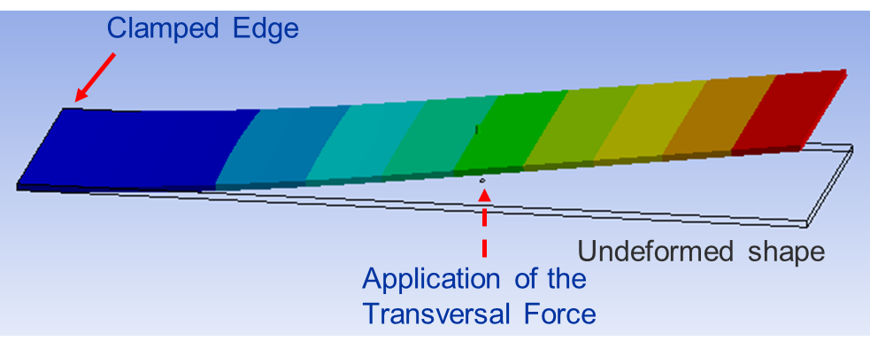
Digital Twins: Prove of Concept
Crab Cavities Supporting Structure
Simple, yet real and critical accelerator component
Learning curve. Debug the primary technological challenges
Pave the way to a fully fledged demonstrator in 2024
Model Training
Live Acquisition and Prediction
Experimental Campaign
FEA

Slide 15
Conclusions
Digital transformation occurs everywhere and open a new way to measure!
Industrial companies have already implemented this kind of solution based on Cloud technologies;
Cloud technology are available on several commercial measurement solutions, yet generally in closed environments
Request some efforts to standardized our processes (labels, etc…) as it was done in the automotive industries 20 year’s ago with ASAM-ODS ;
Mechanical Measurements Laboratory at CERN deployed Cloud technology under Grafana framework
Granting concurrent access to all the relevant stakeholders has proved very beneficial in terms of communication

