Slide 1
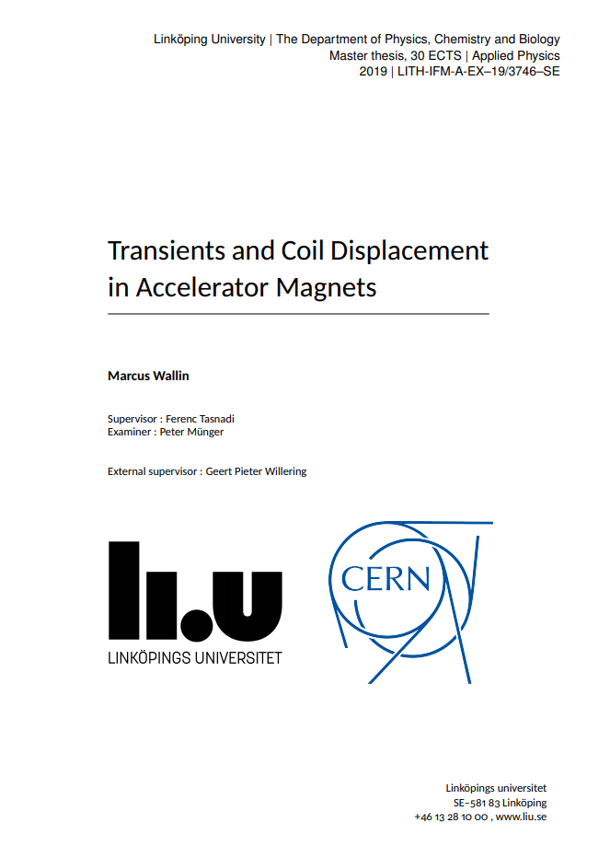

Transients and quantification of Coil Displacement in Accelerator Magnets
Gerard Willering
CERN, TE-MSC
Work done by Marcus Wallin, master student in 2019 CERN and Linköping University
Thesis: EDMS 2254195
https://agenda.infn.it/event/32061/

Slide 2
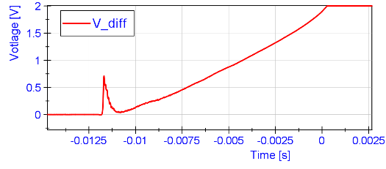
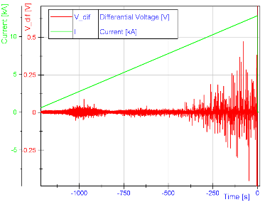
Introduction
Resistive voltage build up (quench)
A quench in superconducting magnets is sometimes preceded by a precursor.
Note that this signal is a generally a filtered signal (300 Hz low-pass) to optimize quench detection.
precursor
When measuring during a full ramp of a magnet, we can distinguish sometimes hundreds of these ‘precursors’ without them leading to a quench.
We know that these ‘precursor’ type of events are linked to motion or “mechanical transients” (damped oscillation, accelerometer, acoustic emission sensor, pickup coils).
See seminar by H. Arnestad, https://indico.cern.ch/event/738168/
“Measurement of Electrical and Mechanical Transients in Nb3Sn magnets”, 2018
Intermediate current
Flux jumps
‘precursor’ type of events

Slide 3
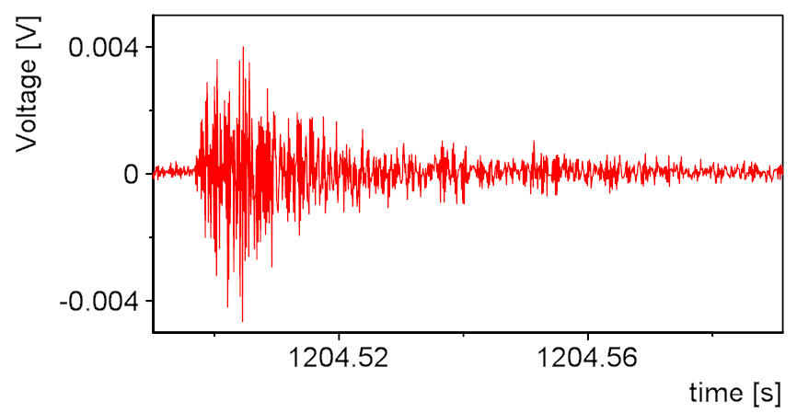
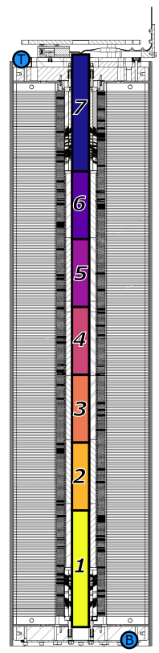
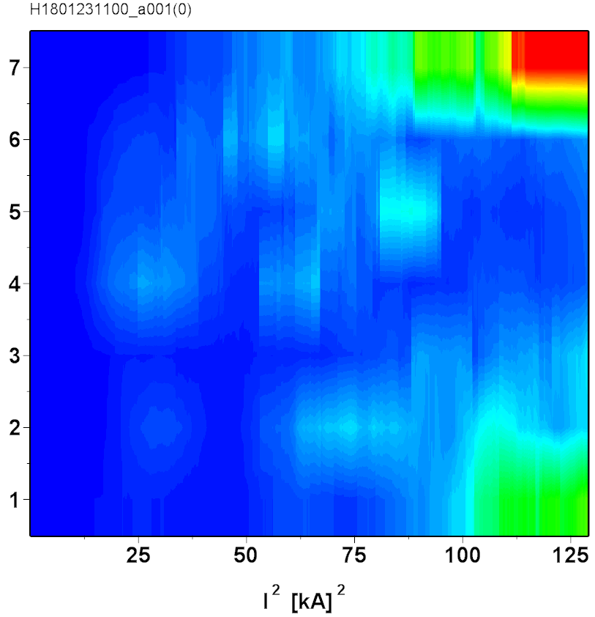
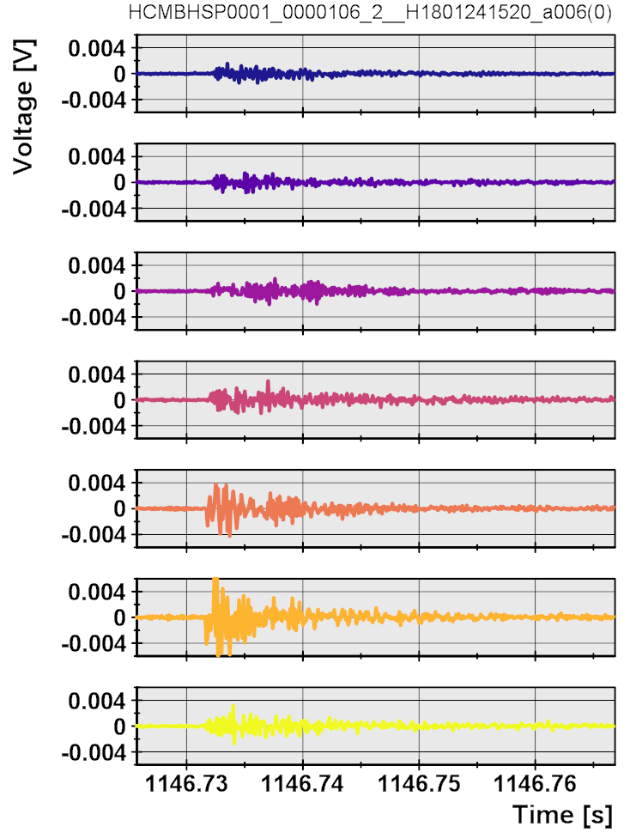
Reminder: Overview of vibrations
When using quench antenna pickup coils, we can map all the mechanical transients longitudinally
See seminar by H. Arnestad, https://indico.cern.ch/event/738168/
“Measurement of Electrical and Mechanical Transients in Nb₃Sn magnets”, 2018
Amplitude A
Activity mapped
[combination of number and amplitude of the vibrations]
Each vibration analyzed
Origin

Slide 4
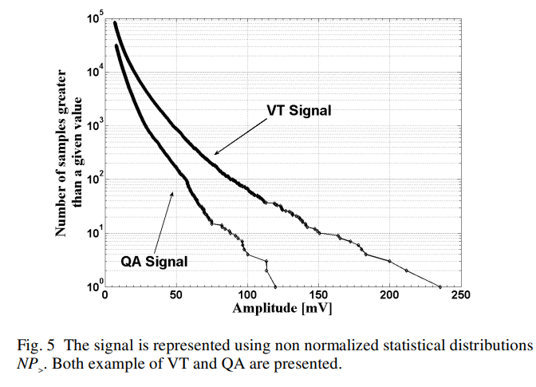
History: Statistics LHC MB magnets
For LHC MB magnets mainly statistical analysis was done.
Note the use of different words to describe the same phenomenon.
Attempts to predict a magnet quench using these data has not been successful.
Mechanical Perturbations
Spike
Quench Precursor
Conductor Motion
Transient Energy Release
Example of a ‘random’ slow training MB magnets, with 100 mV precursor.
M. Calvi, et al., Statistical Analysis of Conductor Motion in LHC Superconducting Dipole Magnets IEEE Trans. Appl. Supercond., Vol 14, No2, June 2004
Further reading:
M. Calvi, Impact of the Mechanical Perturbations on the Performance of the LHC superconducting Dipole Magnets, University of Geneva, PhD thesis, 2004
M. Calvi, et al., Data Analysis of Transient Energy Releases in the LHC Superconducting Dipole Magnets, IMTC conference 2006, Sorrento, Italy.
P. Pugnat, et al., Statistical Diagnosis Method of Conductor Motions in Superconducting Magnets to Predict their Quench Performance, IEEE Trans. Appl. Supercond., Vol 11, No 1, March 2001
P. Pugnat and A. Siemko, Review of Quench Performance of LHC Main Superconducting Magnets, IEEE Trans. Appl. Supercond., Vol 17, No 2, June 2007
M. Calvi, et al., Statistical Analysis of Conductor Motion in LHC Superconducting Dipole Magnets, IEEE Trans. Appl. Supercond., Vol 14, No2, June 2004

Slide 5
New in this work
precursor
Detailed precision measurements on single spikes for Voltage, Pickup coils and current.
Ignore voltage ‘oscillation’ but focus on integral.
Use the law of conservation of energy
Define a simple physics model to describe mechanical motion qualitatively
Quantify coil motion

Slide 6
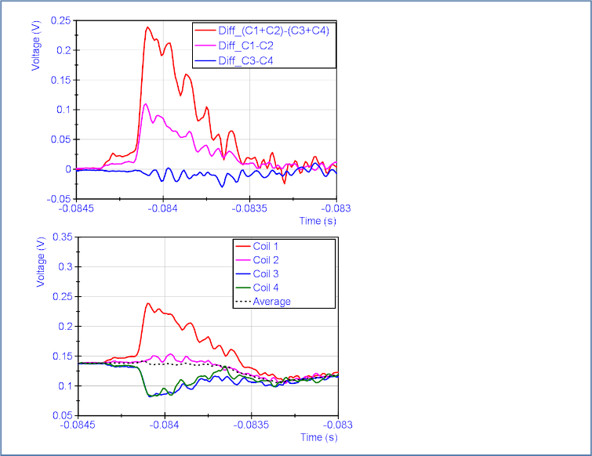
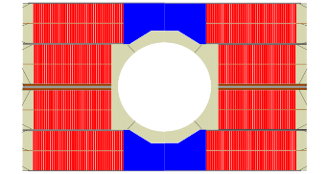
Coil voltage measurement
Familiar voltage data as we typically use in presentations/reports:
Differential voltage (C1+C2) – (C3+C4)
Differential voltage is also used for quench detection.
I
differential
Coil 1
Coil 1
Coil 2
Coil 2
absolute
Coil 3
Coil 3
Coil 4
Coil 4
I
Fresca2. Block coil design. 4 coils, each coil has two layers and 36 to 42 turns per layer.
The direct voltage per coil gives additional information.
Example: positive precursor in coil 1 and negative precursor in coil 3 and 4.

Slide 7
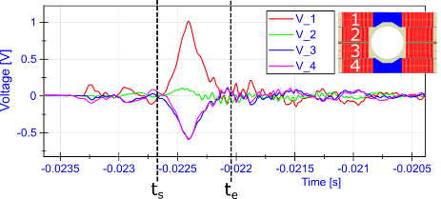

Energy: from voltage measurement
I = 11.7 kA
Energy calculation
Voltage smoothed &
offset applied
$$E=\int_{t_{0}}^{t_{1}}{UIdt}$$
ΔE_{V_1} = 2.29 J
ΔE_{V_2} = 0.13 J
ΔE_{V_3} = -1.37 J
ΔE_{V_4} = -1.30 J
t₀
t₁
For reference: Stored energy in this magnet (1/2*L*I^2) is about 4 MJ
We know that even 10 µJ to 1 mJ can quench a magnet.
Why does this event not quench the magnet?
Sum of energy is about 0 J → The energy is not dissipated in the coil
Hypothesis → The energy is redistributed due to coil geometry changes

Slide 8
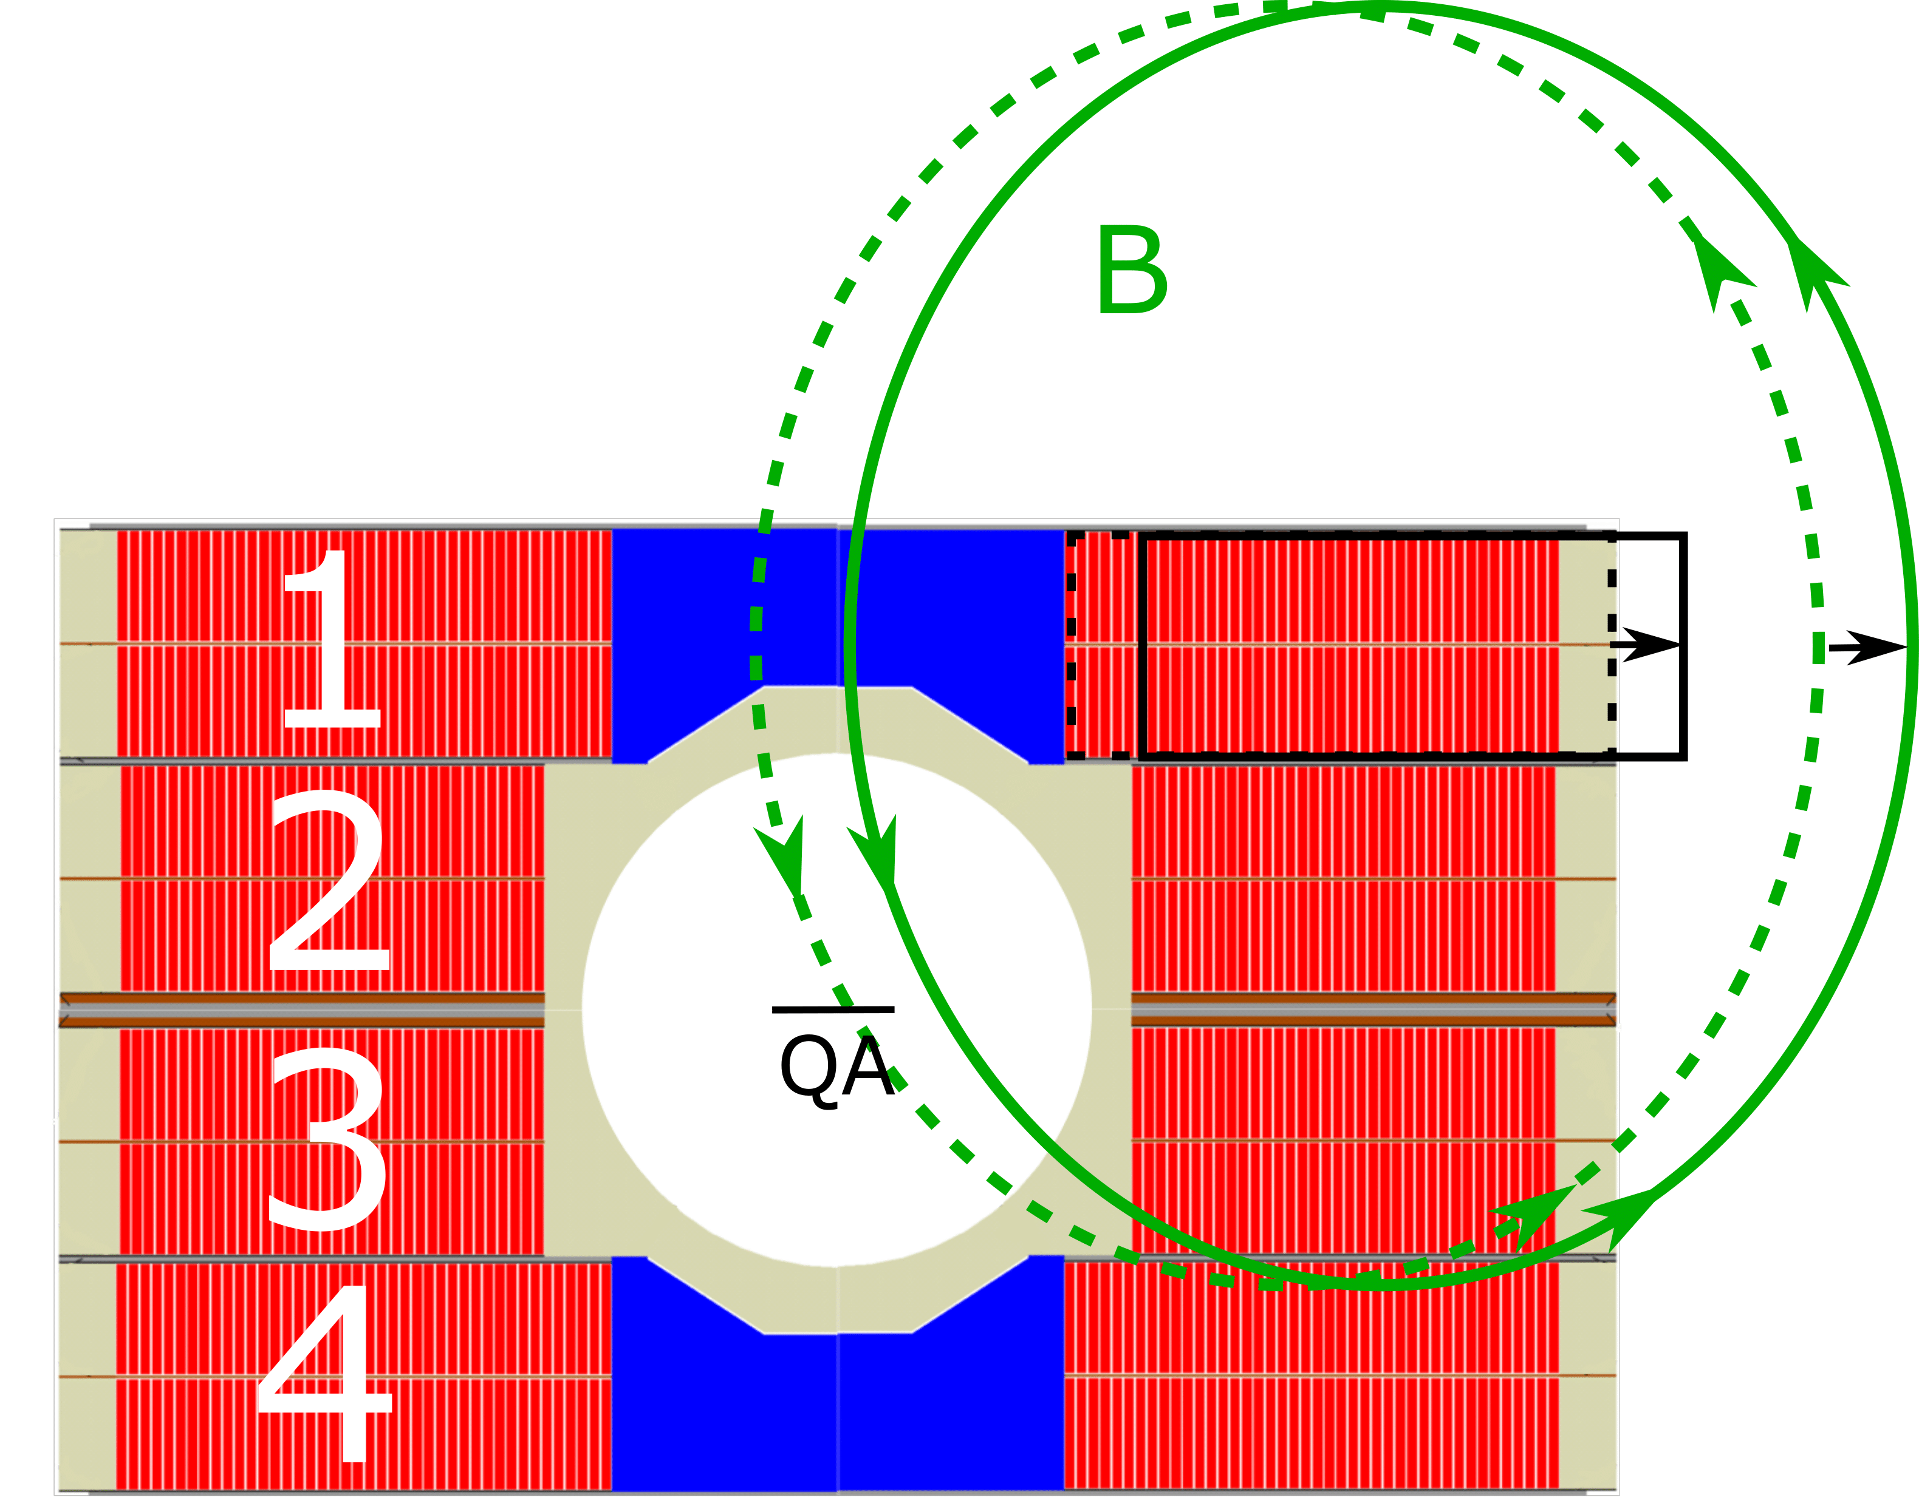
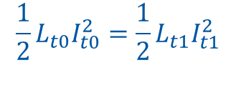
Main assumptions
Assumptions
Stick-slip is geometry change
Geometry change is inductance change
Outward forces would likely give coil growth.
Expectations in this case:
Total inductance increases
Total Energy must be conserved:
so magnet current must drop (if faster than PC response)
Redistribution of energy with net increase in coil 1.
Changes in quench antenna pickup coils
E_{V_1} = 2.29 J
E_{V_2} = 0.13 J
E_{V_3} = -1.37 J
E_{V_4} = -1.30 J

Slide 9
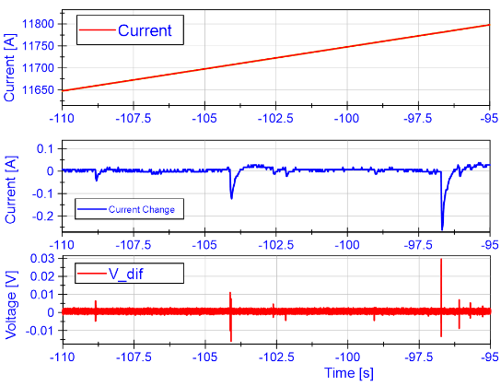

Measured current during precursor
Current ramp seems smooth, but we can calculate the deviation of current compared to the linear ramp.
Clear correlation between ‘redistributed energy’ in a ‘precursor’ event and the drops in current.
Basic physics:
Conservation of energy
$$\frac{1}{2}L_{t0}I_{t0}^{2}=\frac{1}{2}L_{t1}I_{t1}^{2}$$
ΔI always negative
→ ΔL positive
→ suggests coil growth
The power supply has a regulation cycle of 20 to 100 ms and will bring back the current to the requested ramp.

Slide 10
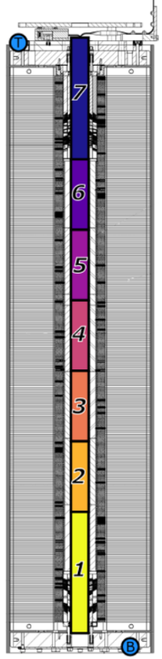
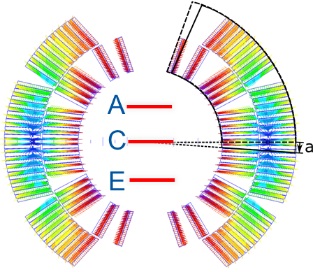
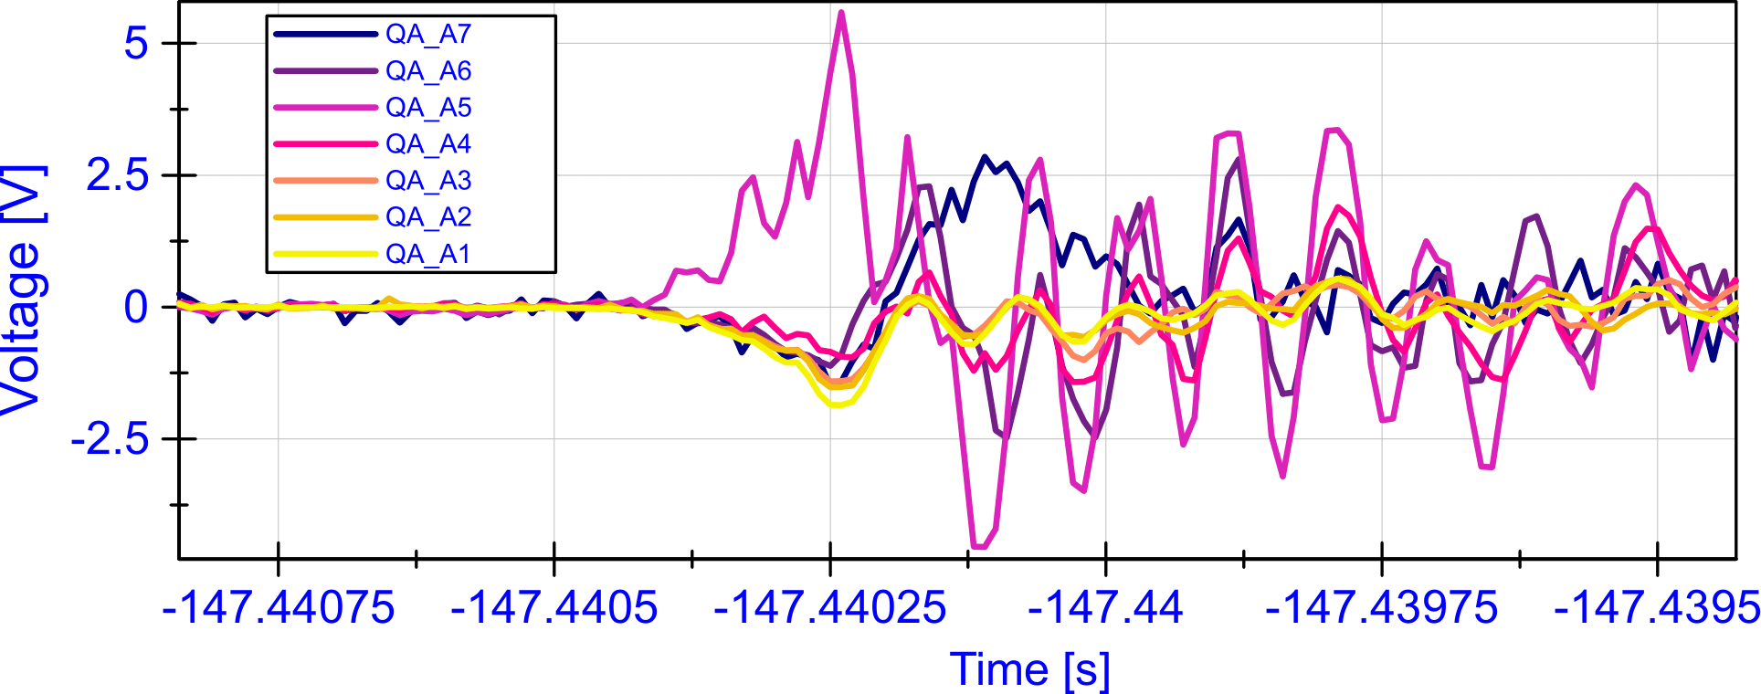
Quench Antenna pickup coils during precursor
Measurements on FRESCA2 were saturated, so signals cannot be integrated. Measurements for MBHSP 11T are shown.
7 times 3 pickup coils, each 25 cm long.
For this example the A-coils have been used with a direct measurement.
Local effect in quench antenna A5 suggests coil movement is limited to this segment.
Global effect in all other pickup coils: drop in magnet current drops the magnetic field.

Slide 11
Qualitative summary on measurements of transients
Conservation of energy – no energy deposited
Energy exchange between coils –> Coil geometry change
Current Drop confirmed
Local field change in Quench Antenna
Global field change in Quench Antenna

Slide 12
Quantification – Modeling with ROXIE

Slide 13
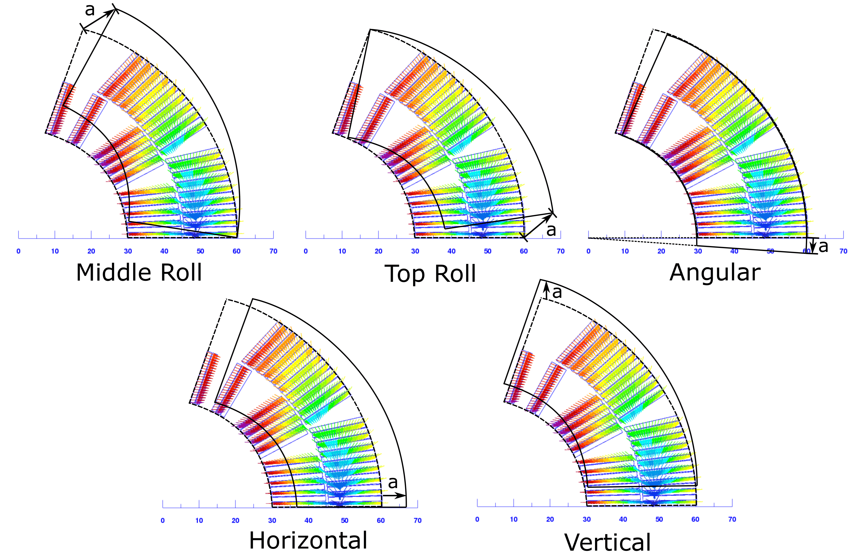
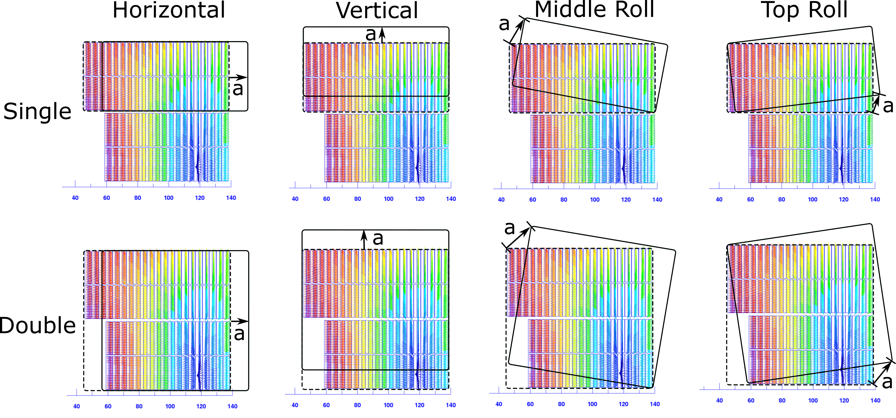
Quantification – Modeling with ROXIE
Use ROXIE to explore the change in inductance when changing geometry.
Include mutual inductances.
Define the movement modes of interest.
11T CosƟ
FRESCA2 Block coil
Assumption:
Coil blocks are impregnated and move as one piece.
Note: There could also be flexing of the coil blocks, or a combination of modes. This has not been investigated.
Many thanks to Susana Izquierdo Bermudez for helping set up ROXIE.

Slide 14
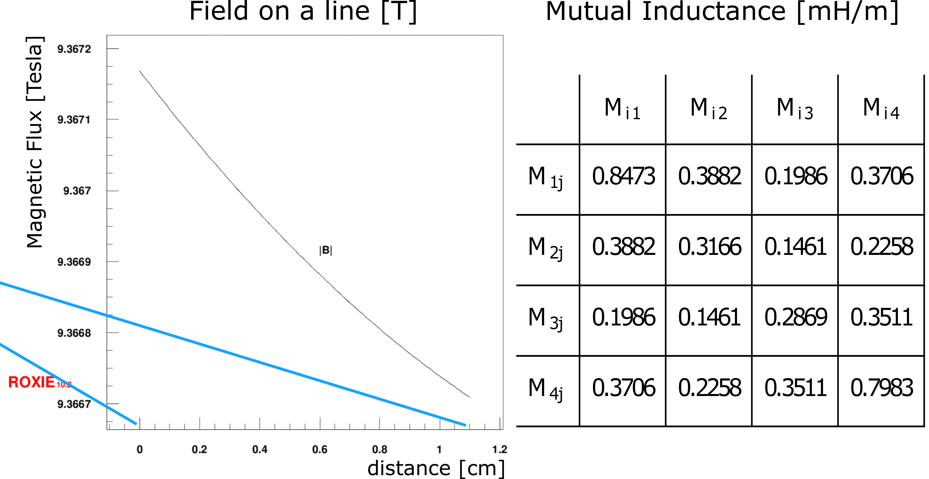
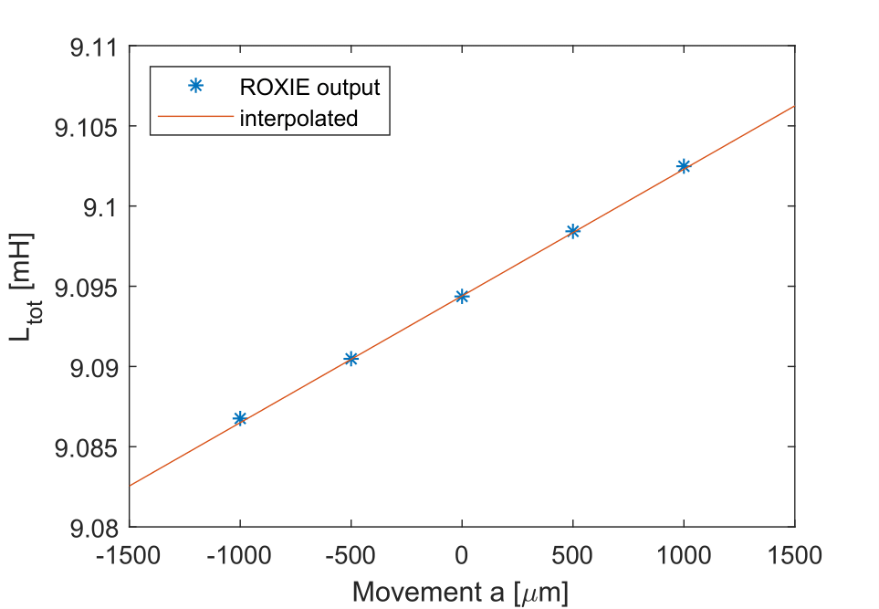
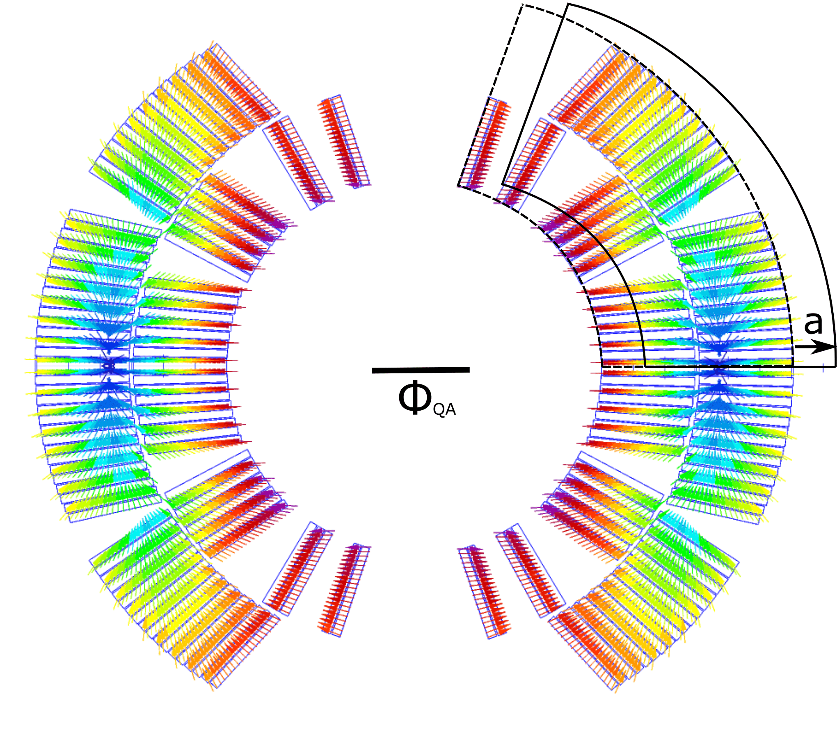
How to simulate coil movement
Move part of magnet with various displacements
Calculate field and mutual inductance
Calculated field on a line (quench antenna)
Calculate for several position shifts a it L, B, I and E.
Note: in an 11T single aperture the voltage is measured on the inner and outer layer of both upper an and lower coil.

Slide 15
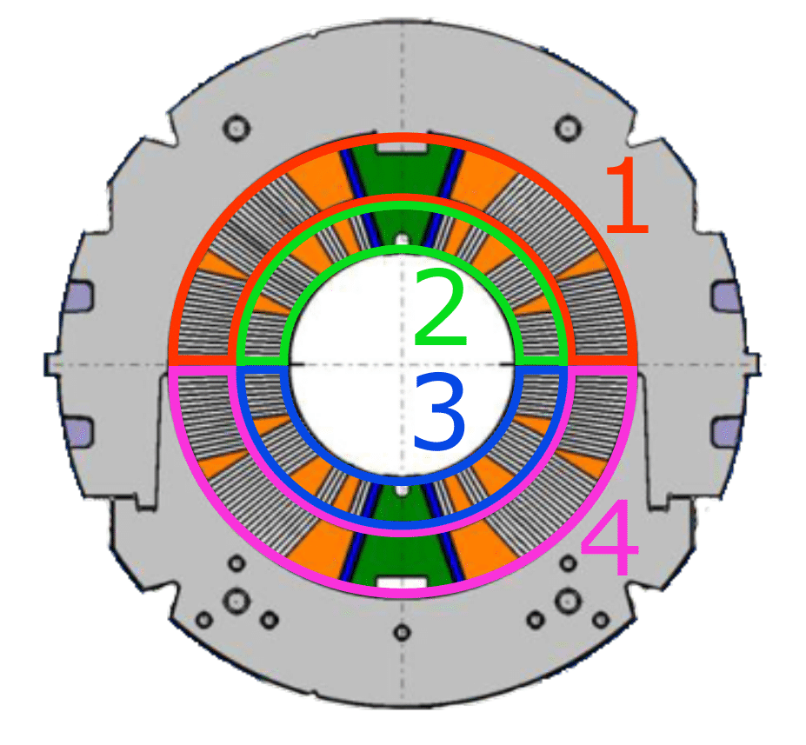

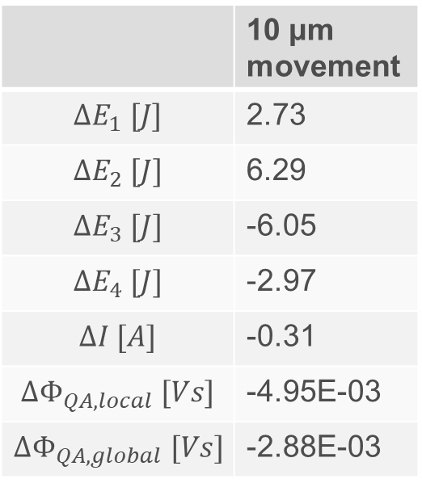
Simulation Results – horizontal shift
Simulated movement of entire coil length
 | 10 μm movement
$$∆E_{1} [J]$$ | 2.73
$$∆E_{2} [J]$$ | 6.29
$$∆E_{3} [J]$$ | -6.05
$$∆E_{4} [J]$$ | -2.97
$$∆I [A]$$ | -0.31
$$∆Φ_{QA, local} [Vs]$$ | -4.95E-03
$$∆Φ_{QA, global} [Vs]$$ | -2.88E-03

Slide 16
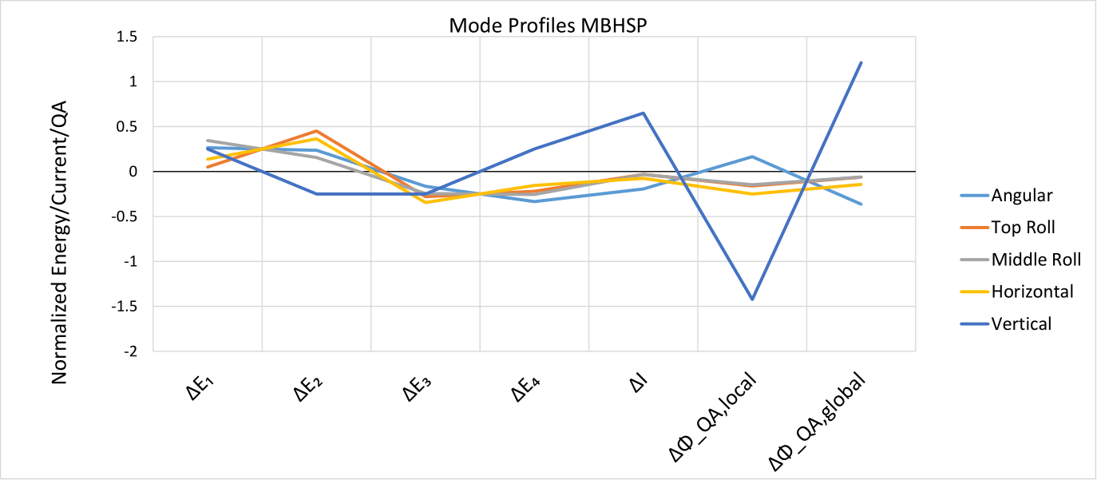
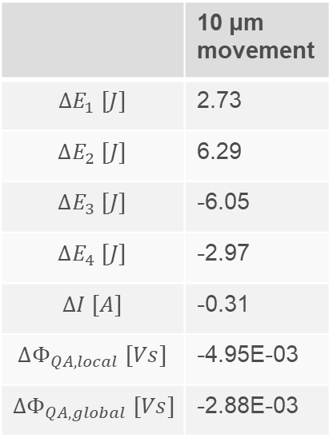
Normalizing calculated movements
 | 10 μm movement
$$∆E_{1} [J]$$ | 2.73
$$∆E_{2} [J]$$ | 6.29
$$∆E_{3} [J]$$ | -6.05
$$∆E_{4} [J]$$ | -2.97
$$∆I [A]$$ | -0.31
$$∆Φ_{QA, local} [Vs]$$ | -4.95E-03
$$∆Φ_{QA, global} [Vs]$$ | -2.88E-03
Normalize result
for all modes
Depending on the mode, the changes in energy, pickup coil and current vary.

Slide 17
Measurement vs Calculation:
Example: 11T model coils
Cosine Theta design

Slide 18
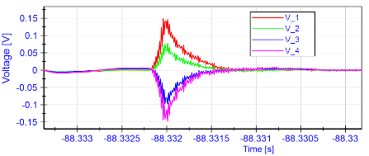
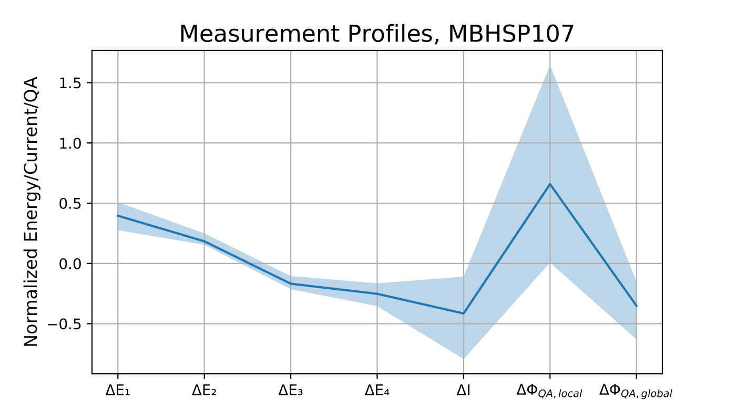
MBHSP107 example
Gather data from transients and put in same format
40 transients per magnet were analyzed
Voltage
Quench antennas
The 40 events gives a measurement profile:
Blue area contains all transient values
Blue line is the average

Slide 19
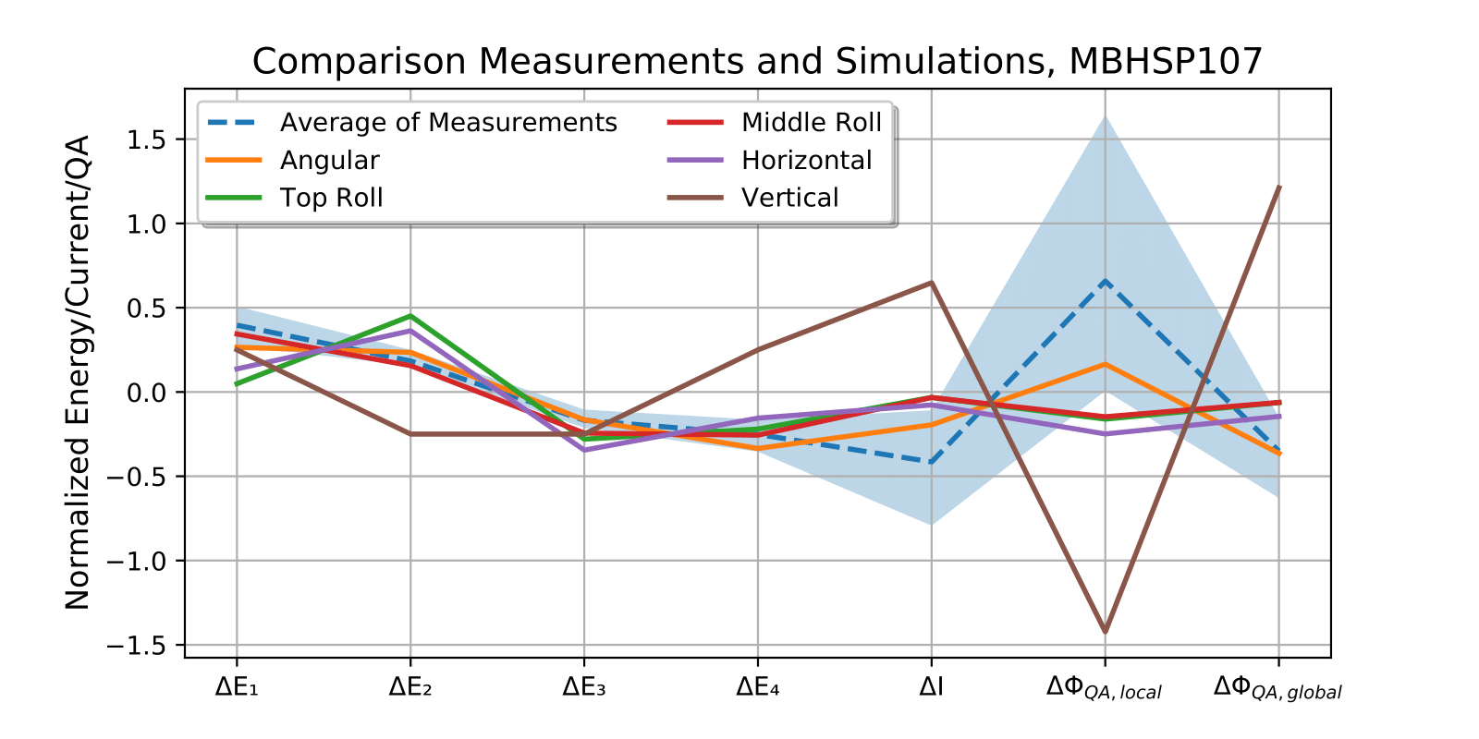
MBHSP107: measurement vs calculation
Analyze which profile is matching the measurements the best
Angular motion is the most plausible from the studied modes, since the local quench antenna change is positive.
Not a perfect match.

Slide 20
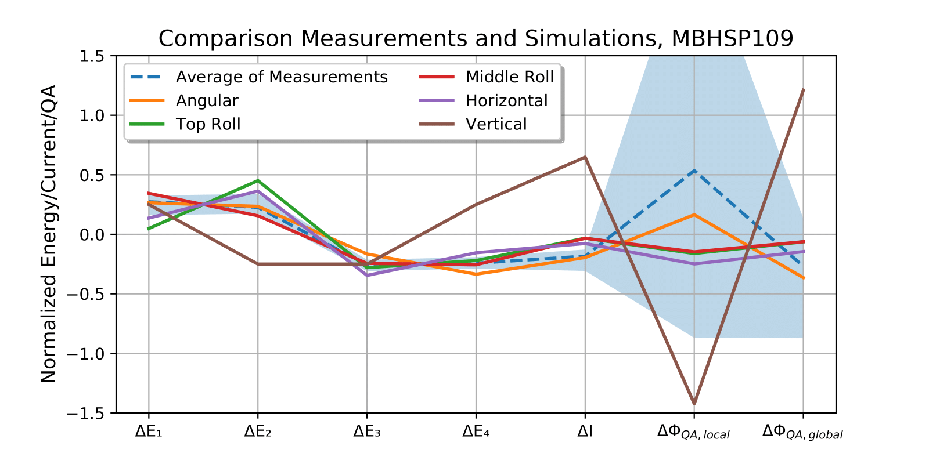
MBHSP109 : measurement vs calculation
Data rather similar to MBHSP107
Angular motion is the most plausible from the studied modes, since the local quench antenna change is positive.
Not a perfect match.

Slide 21
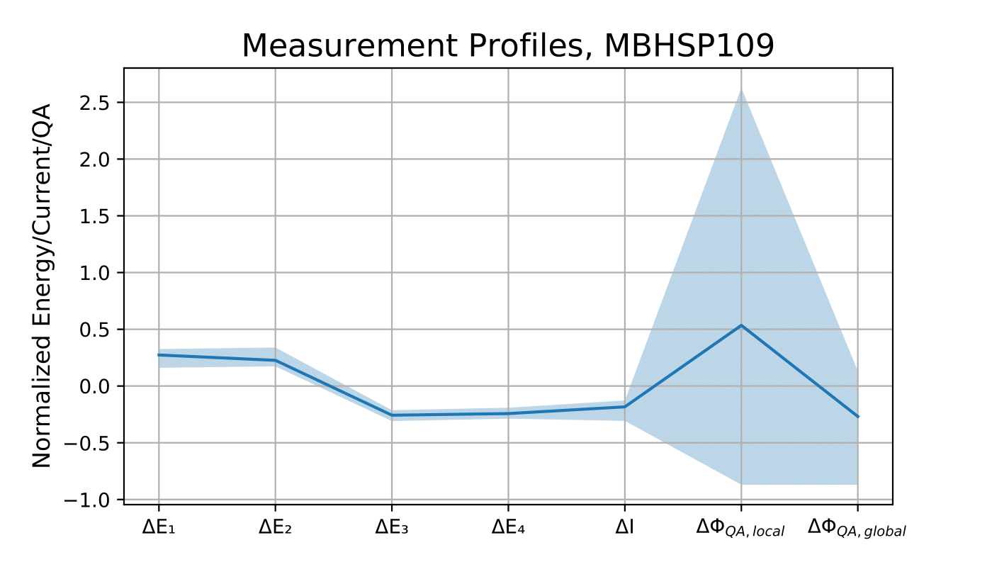
MBHSP107 vs MBHSP109
Two 11 T model magnets with identical design
Average ‘profile’ rather similar.
A bit more spread in the events of MBHSP109

Slide 22
Measurement vs Calculation:
Example – FRESCA2
FRESCA2 Block coil

Slide 23
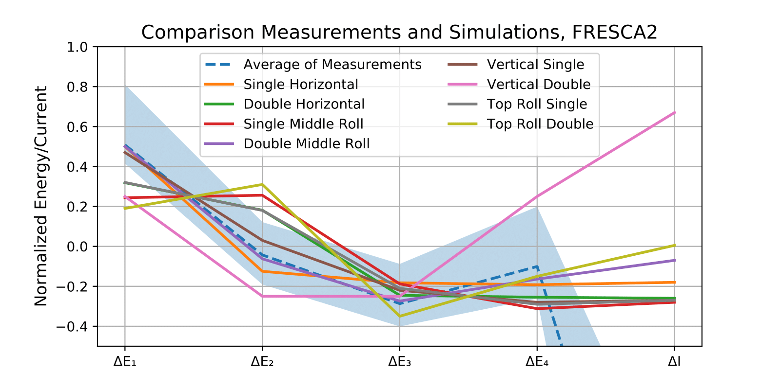
FRESCA2
Much larger normalized current drop than expected from any of the motion modes.
Missing direct quench antenna measurement
Single Horizontal or Double Mid Roll have the most characteristics in common with the measurements.

Slide 24
Quantifying motion

Slide 25
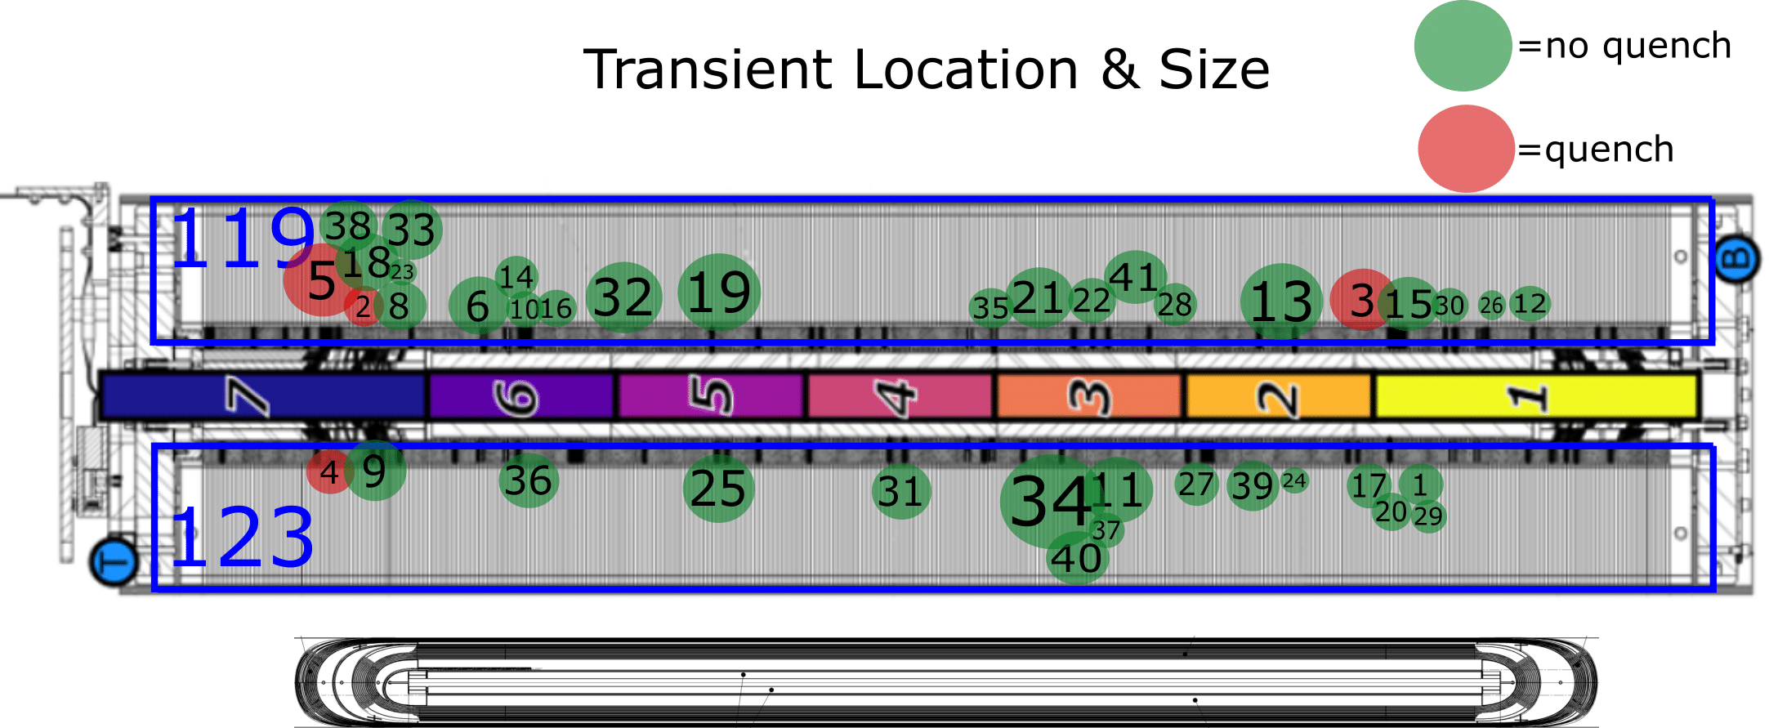
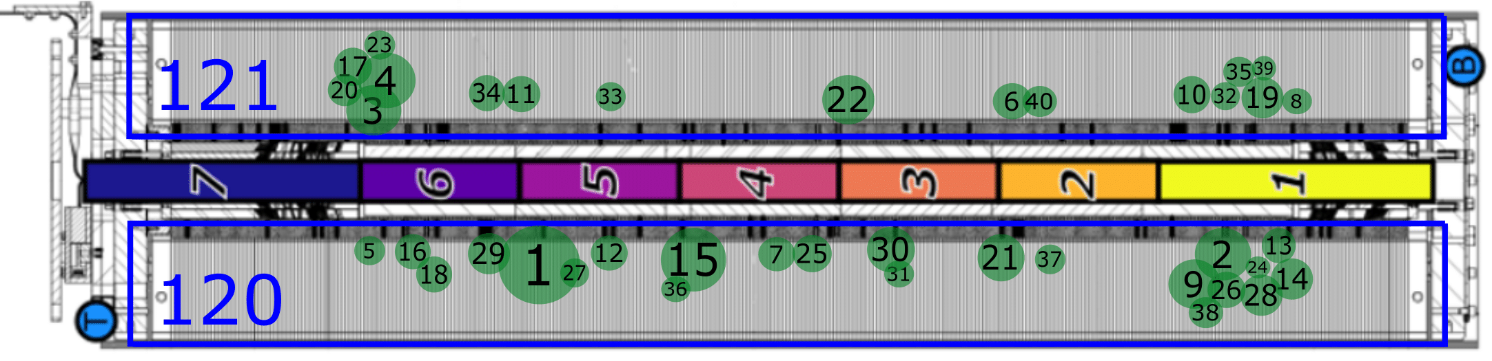
Transient Location & Size – 11 T models
Dots show transient size
Index is transient number as listed in thesis
Events spread out → indicates cross-section movement
MBHSP109
MBHSP107
Transients with quench are not necessarily the largest transients.

Slide 26
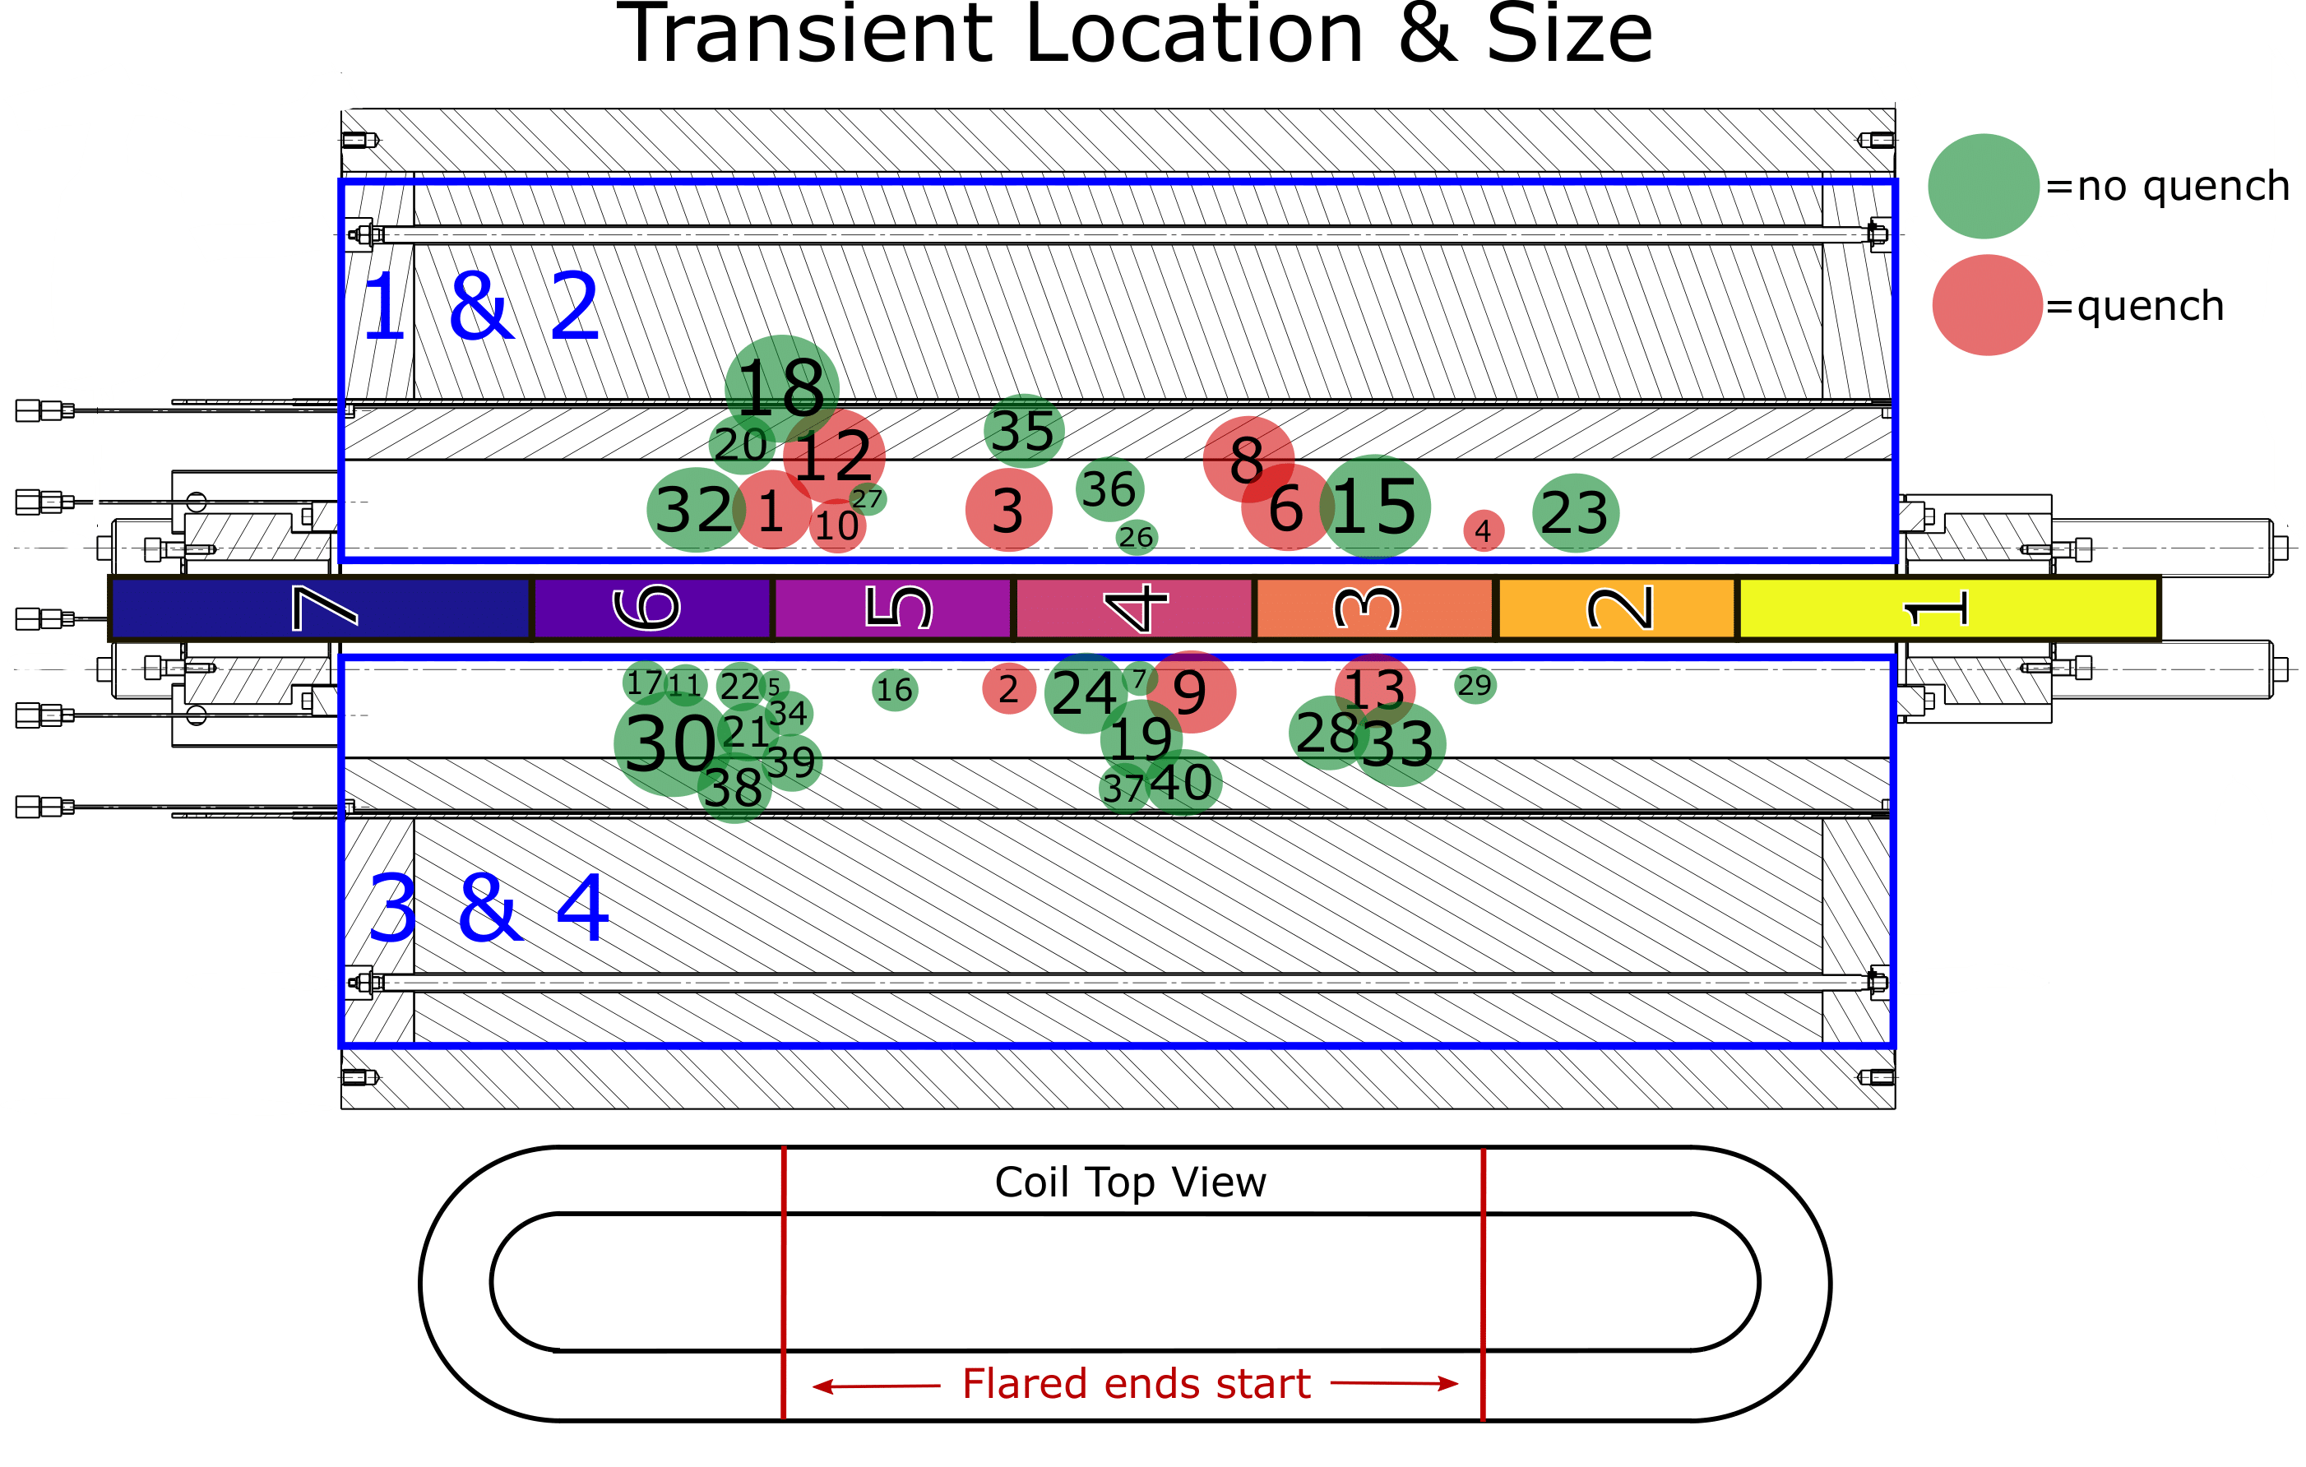
Transient Location & Size – FRESCA2
Movements in the middle and where flared ends start

Slide 27
Movement length – 11T coils
Coil near QA 5 moves first, followed by QA 6 and 7
Assume this length moved

Slide 28
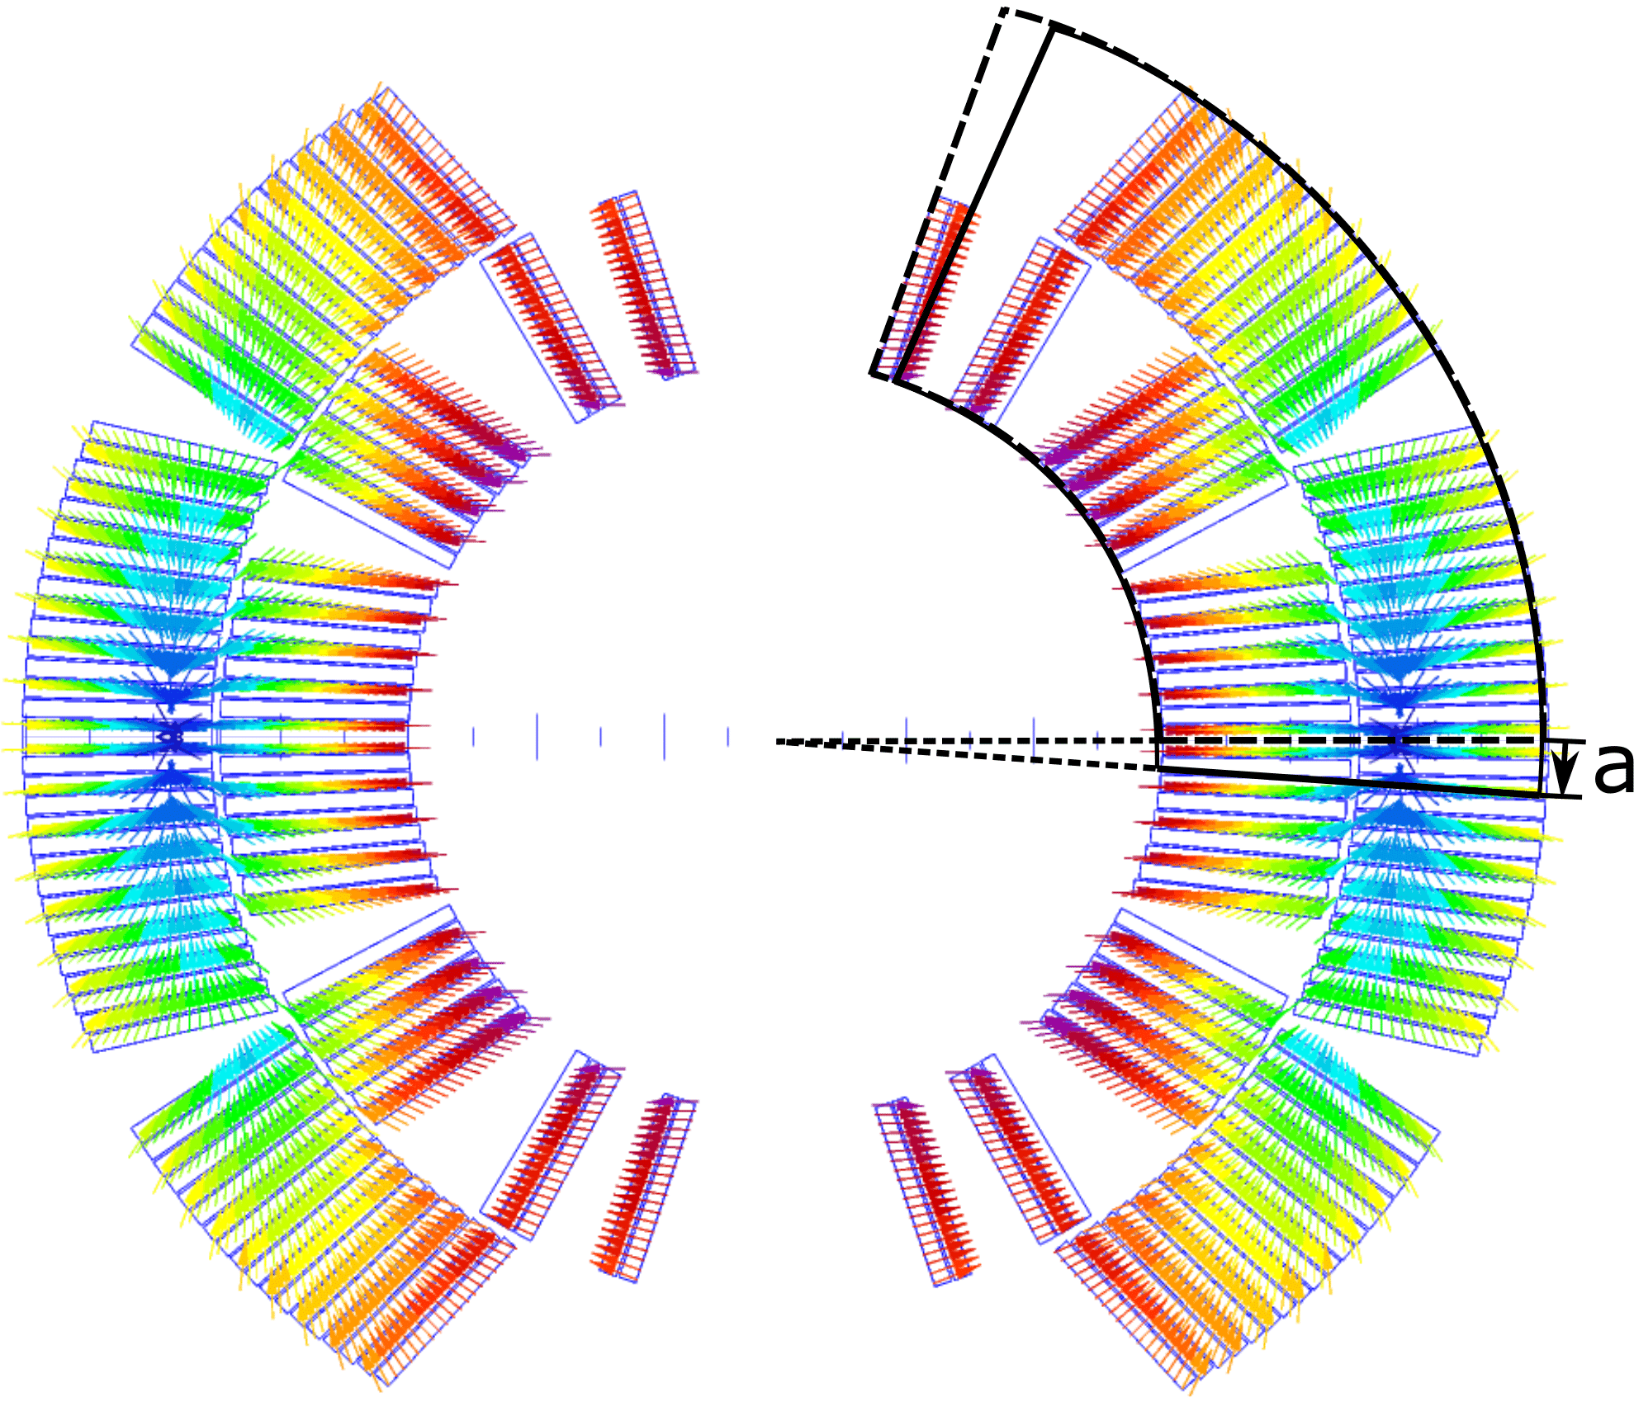
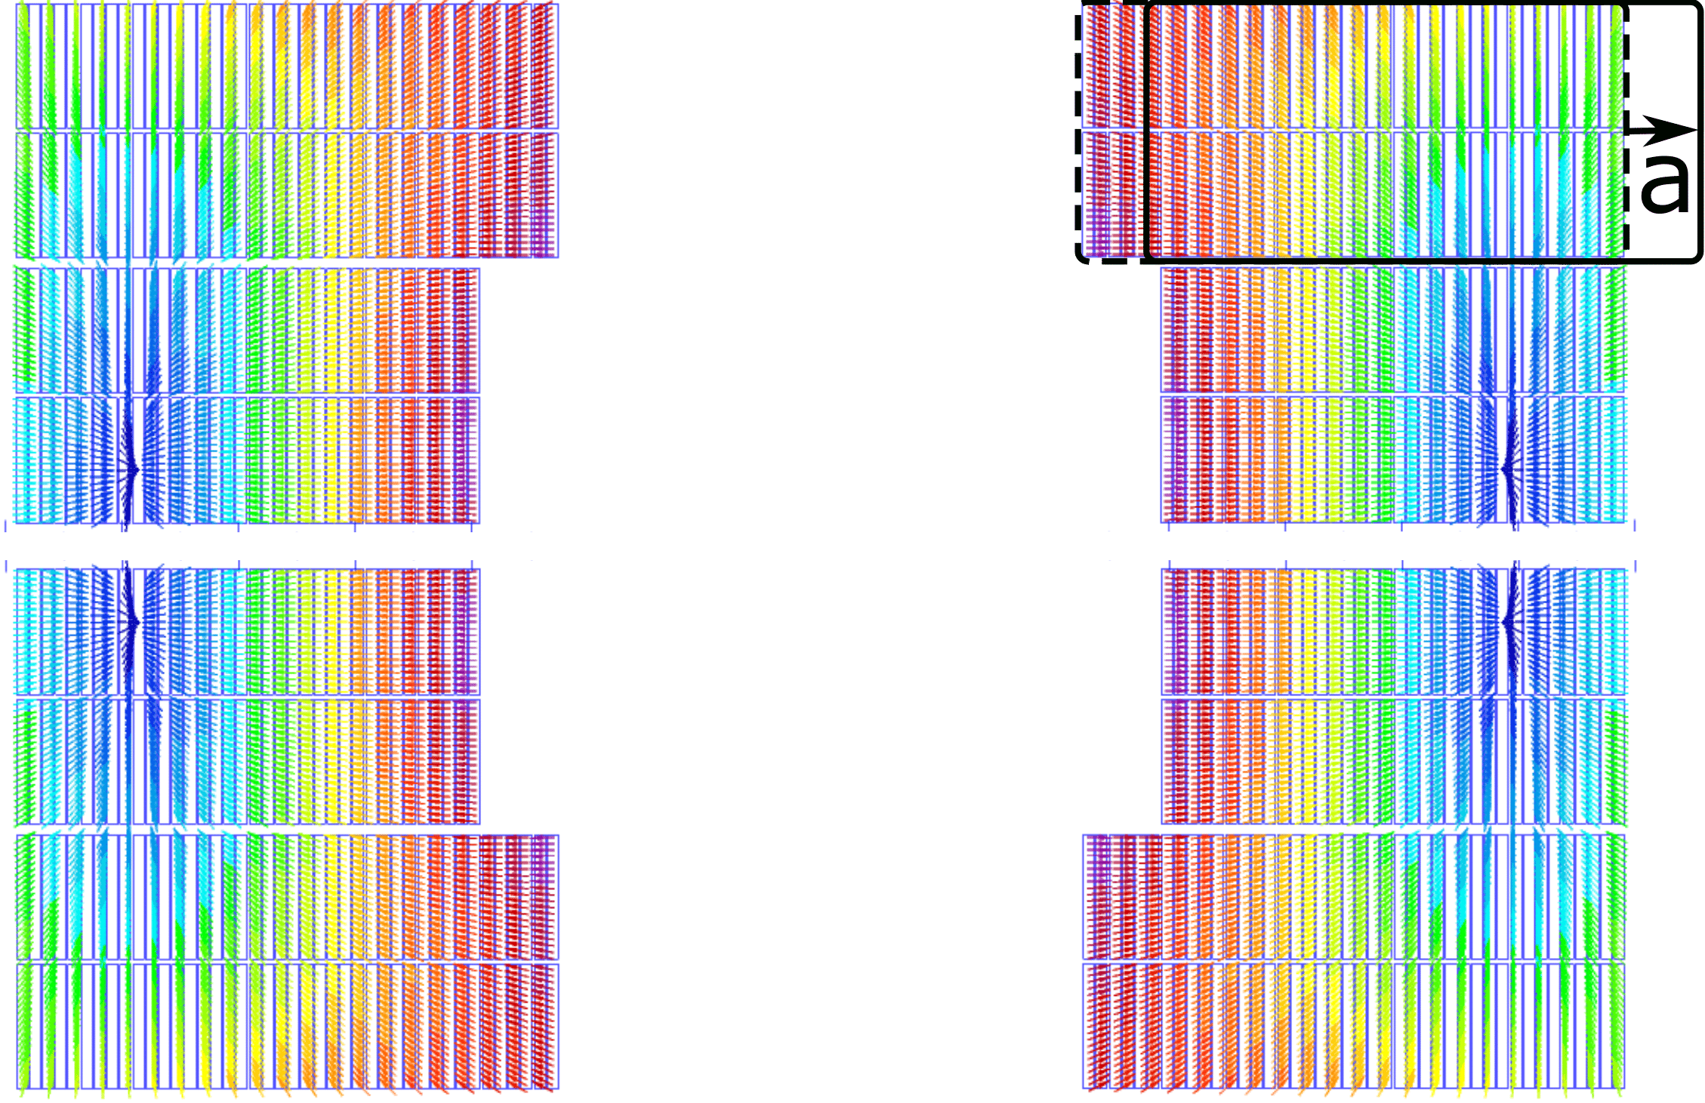

Movement length
50 cm 11T—max. 10 $μm$
40 cm FRESCA2—max. 5 $μm$
Majority much smaller < 1 $μm$
Off course, if we change the length or the number of turns moving, the displacement length will change accordingly.
If we assume only 1 cable to move (instead of 56 to 80 cables impregnated in one block, the displacement length would be many times larger, and this is deemed impossible.

Slide 29
Conclusions
Precursors (with significant ∫VIdt in differential voltage) are indeed changes in coil geometry, sometimes leading to a quench, but many times not.
Combining precision measurements and simulations, we can learn something about
- Movement mode
- Displacement length
The size of the precursor (integrated energy displacement) is an important characteristic.

Slide 30
Possible future work
Only 2D taken into account. 3D calculations are needed for quantifying coil displacement in the magnet head.
The quench antenna pickup coils are mostly used in differential measurement mode, but in direct measurement they give valuable information (We used direct measurements for MQXF magnets)
Looking more often at non-quench data could gives useful insight in magnet mechanics.
Investigate possible coil block changes too, compared to only full block motion investigated now.

Slide 31
Precursor characteristics for a variety of magnets

Slide 32

Transient Interpretation Flow Chart
Transient
Damped oscillation?
No
Single sharp rise followed by decay
Yes
Localized Flux Jump
Yes
No
Multiple voltage rises, propagation in Quench Antenna
Yes
Traveling Flux Jump
$$\int_{t_{0}}^{t_{1}}{UIdt}$$
~ 0
> 0
Coil geometry changed
Impregnation cracking ??
Structural change outside coils??

Slide 33
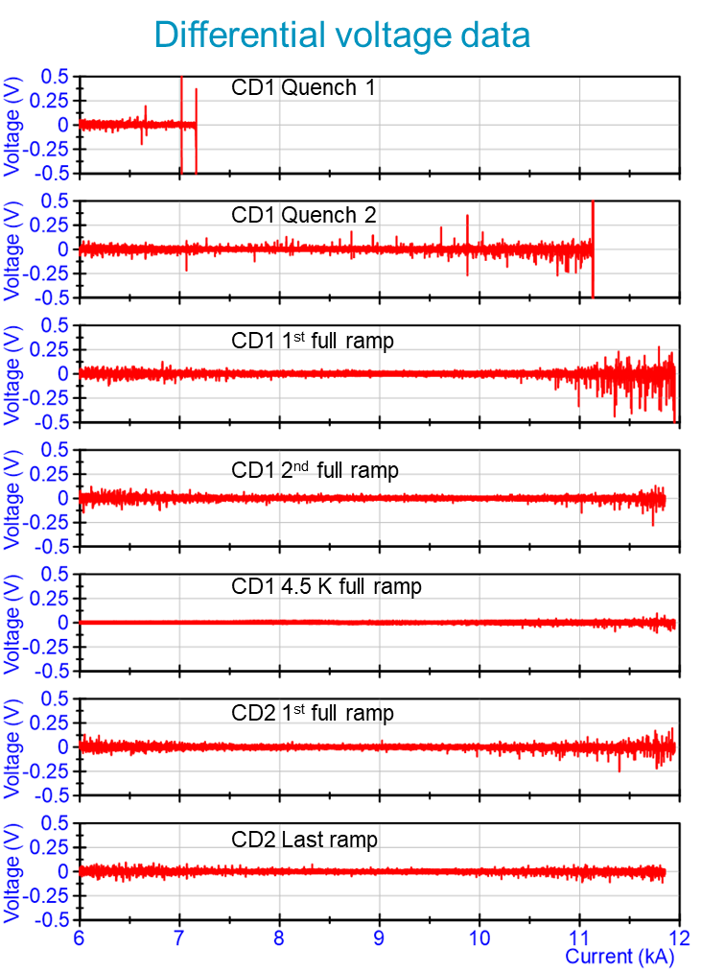
MBH – 11T
Example: MBHB-002 (S1)
Reduction of vibration activity while training the magnet.
After thermal cycle small activity.
Conclusion:
Mechanical transients due to structural movements are not an issue for 11T magnets.

Slide 34
MBH – 11T
Differential voltage all quenches in MBH-series
Largest precursor: ~5 J
Measured in MBHB-002 in quench 2 at 11.1 kA.
Large precursors only, but not always during training phase of the magnets.
No precursors for quenches at magnet limit.

Slide 35
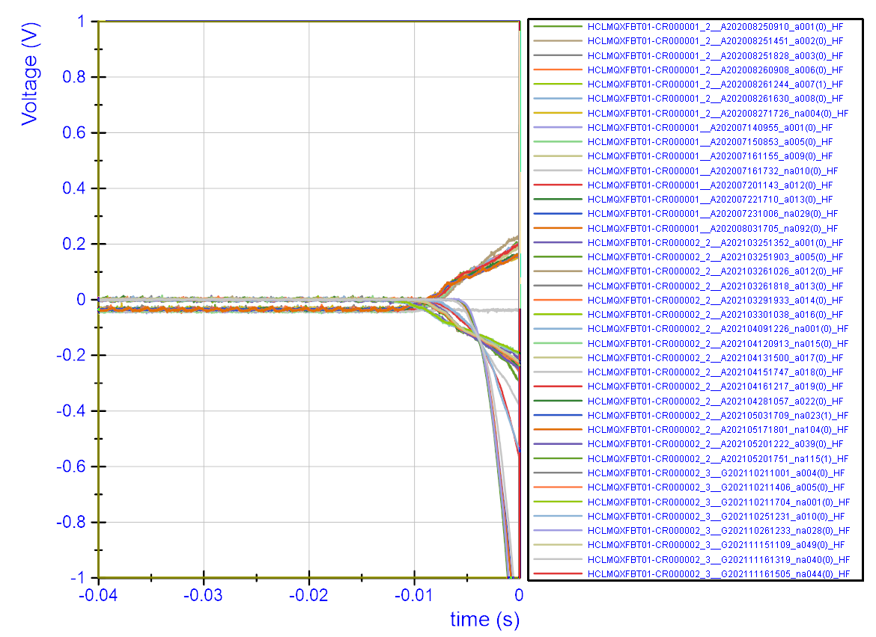
MQXF-Prototype 1 and 2
No significant precursors during training.
Note: quadrupole configuration has not been investigated and it may change sensitivity of precursor to motion.
No study to movement modes possible/needed without precursors.

Slide 36
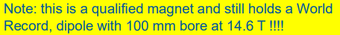
FRESCA2c
Always significant precursor before a quench up to 5 J
Often a double motion: example first in top half (positive) then in bottom half (negative)
Study to movement modes gives interesting information.
Conclusion
Quench limit seems mainly mechanical of origin, so no sign of conductor degradation.
See also: Methods for quench localization and performance diagnostics of Nb₃Sn magnets in SM18 https://indico.cern.ch/event/820811/

Slide 37
eRMC
Sometimes significant precursor before a quench.
Up to 1.5 J
Training stopped at target level.

Slide 38
RMM
Except for the first quench, always a significant precursor measured.
Training limited by mechanical transients, not conductor degradation.
Largest precursor ~1.5 J
Magnet has a very limited bore, and no quench antenna can be installed to identify displacement mode or location.

Slide 39
Many thanks to the whole team in SM18, always making an effort to get the highest precision measurement.
Thank you
TE-MSC magnet seminar contributions on magnet test result interpretation methods
2018, H. Arnestad, G. Willering, Measurement of Electrical and Mechanical Transients in Nb₃Sn magnets,
https://indico.cern.ch/event/738168/.
2019, G. Willering, Methods for quench localization and performance diagnostics of Nb₃Sn magnets in SM18
https://indico.cern.ch/event/820811/
2021, R. Keijzer, Modelling V-I measurements and characterizing performance degradation in 11T and MQXF magnets
https://indico.cern.ch/event/1025824/
2022, M. Wallin, G. Willering, Transients and Coil Displacement in Accelerator Magnets
https://indico.cern.ch/event/1112725/

