Slide 1
Fast strain measurements in superconducting magnets at CERN
Michael Guinchard
Mechanical Measurement Lab / EN-MME

Slide 2
Outline
Introduction
Electrical strain gauges
Fast strain measurement applications
Conclusions

Slide 3
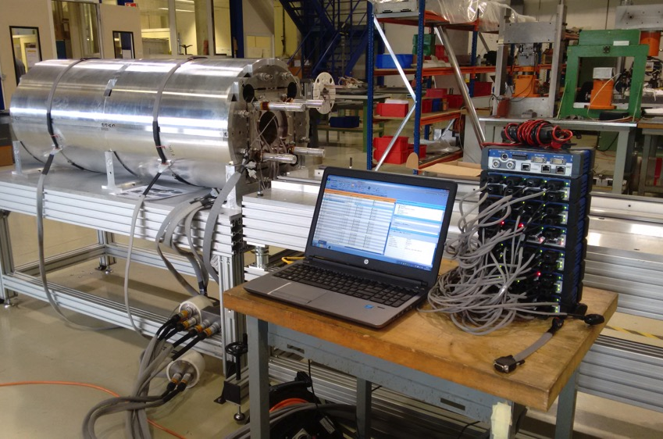
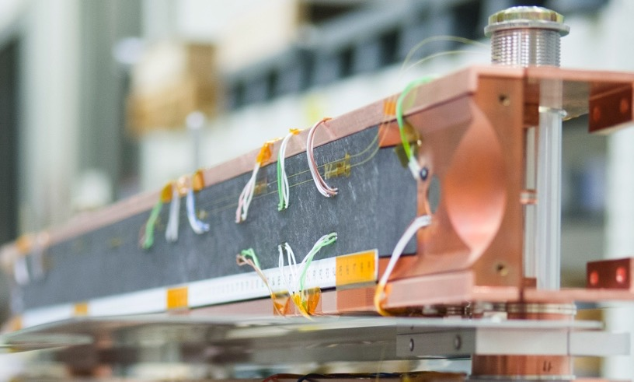
Introduction - Why mechanical measurements ?
Why mechanical measurements ?
Validate Finite Element Analysis (FEA) and/or control the integrity of the structure during assembly phases;
Monitor the structure during thermal cycles down to 1.9 K and during powering phases;
Mechanical measurements at CERN are done on several types of components : superconducting magnets, dumps, RF cavity, detectors in different conditions as electro-magnetic field, vacuum, radiation, water, etc…

Slide 4
Introduction – How to perform measurements ?
 | Electrical strain gauges | Optical fiber sensors | Optical fiber sensors | Non-contact video systems
 |  | FBG (Local) | RBS (Distributed)
Principle | Resistive | Bragg | Rayleigh Backscattering | Digital Image Correlation
Magnetic effects | Affected | Non affected | Non affected | Affected
Cryogenic temp. | Affected | Affected | Affected | Only RT
Bandwidth | 2 MHz | Few kHz | Few kHz | Few 100 Hz
Resolution | 0,1 μm/m | 0,5 μm/m | 0,5 μm/m | 5 μm
Repeatability | 0,42 % | 0.16 % | In progress | -
Reproducibility | 0,20 % | 0.31 % | In progress | -
Trueness | < 5.12 % @4.2 K | < 5.19 % @4.2 K | In progress | -
Accuracy @4.2 K | < 5.1 % @4.2 K | < 5.2 % @4.2 K | In progress | < 5 %
https://edms.cern.ch/document/2490767/1

Slide 5
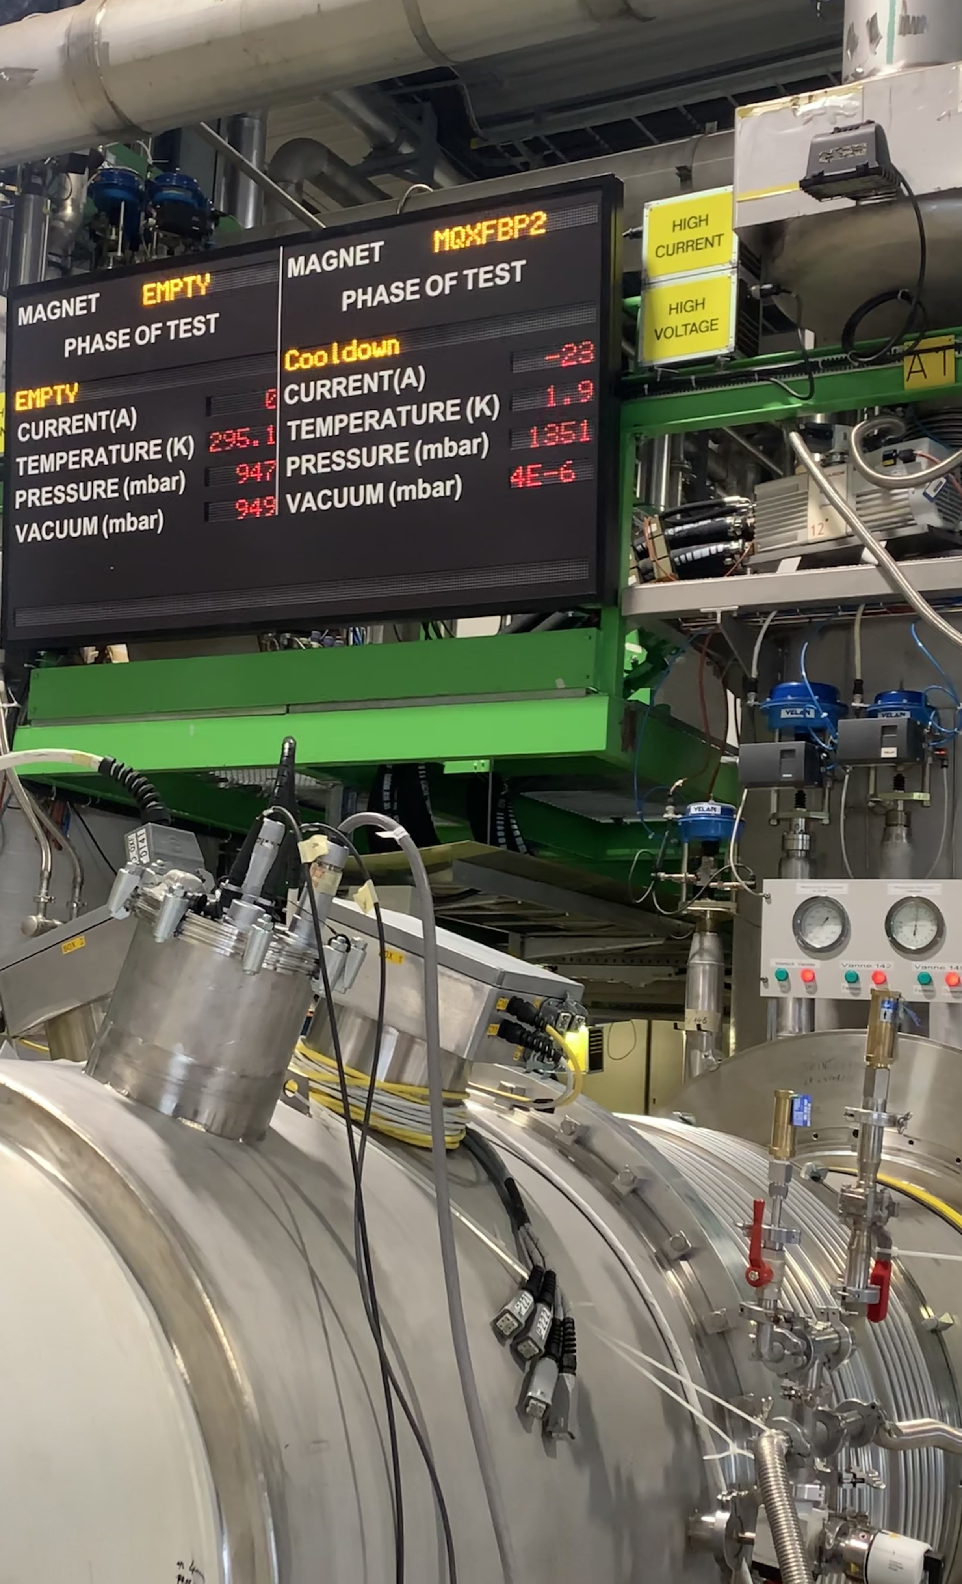
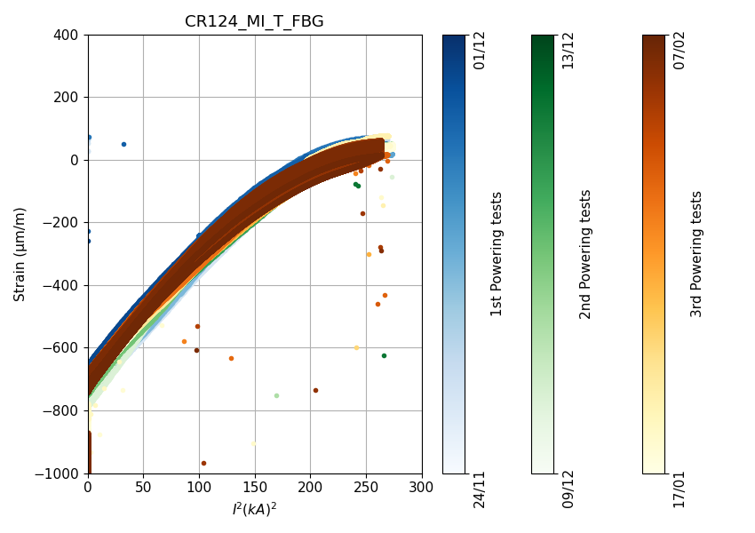
Introduction
Strain measurements with FBG
Powering of MQXFB structures
Optical strain measurement reliability in MQXF Structures
 | Loading | At Cold | Powering | After TC
MQXFS4 a→ f | 100% | 50% (1) | 50% (1) | 50% (1)
MQXFS5 a→ d | 100% | 75% (1) | 75% (1) | 75% (1)
MQXFS6 a→ d | 100% | 100% | 100% | 100%
MQXFS7 a→ h | 100% | 90% (2) | 90% (2) | 100%
MQXFS8 a | 100% | 100% | 100% | 100%
MQXFBP1 | 100% | FAILED (2) | FAILED (2) | 100%
MQXFBP2 | 100% | 100% | 75% (1) | 100%
MQXFBP3 | 100% | 12 % (2) | 12 % (2) | 100%
MQXFB02 | 100% | 100% | 95% (2) | 100%
MQXFMT4 | 100% | Not Tested | Not Tested | Not Tested
MQXFB03 | 100% | Not Tested | Not Tested | Not Tested
: Software issues - SPD tracking
: Hardware optical line issues (connectors or feedthrough)
EDMS 2421521

Slide 6
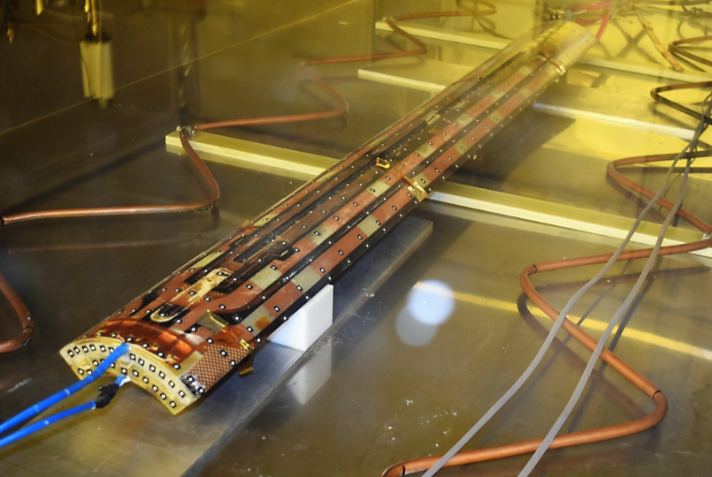
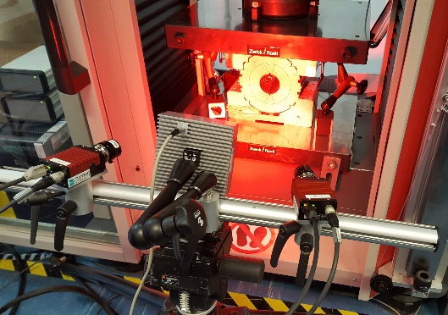
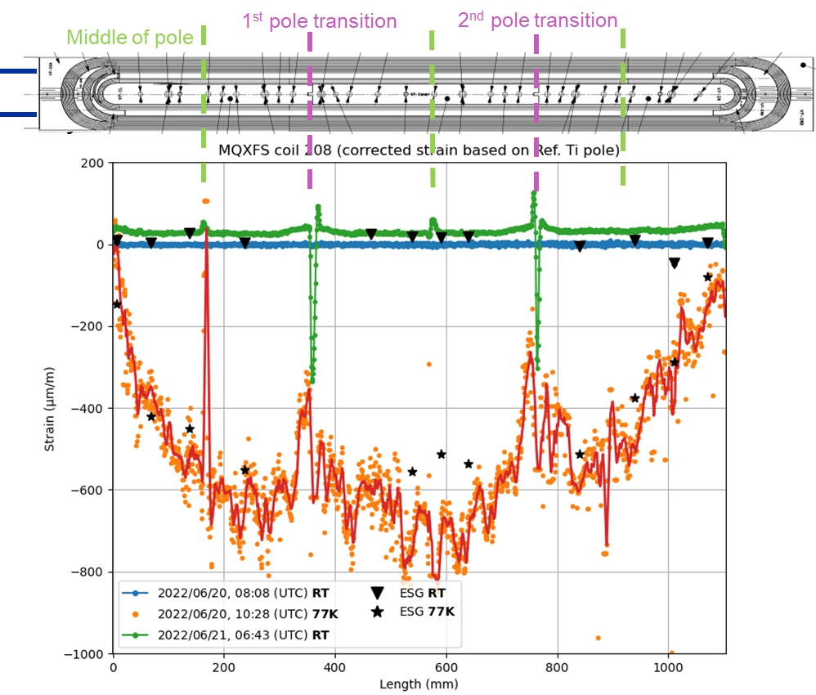
Introduction
Strain measurements with FBG
Powering of MQXFB structures
Strain measurements with RBS
Coil CTE Assessment
Collaring process study with DIC
Mechanics and peak stresses on the coil
EDMS 2598050
EDMS 2421521
FEM
Measurement

Slide 7
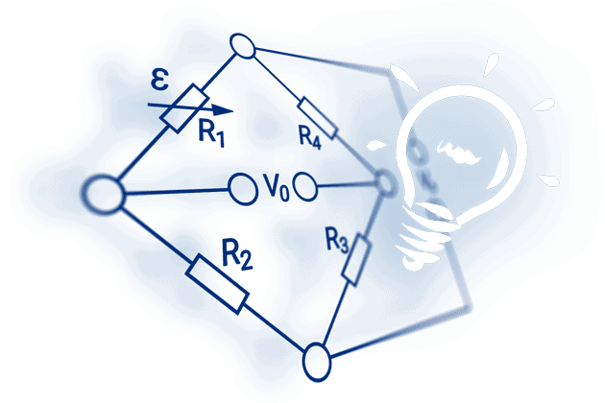
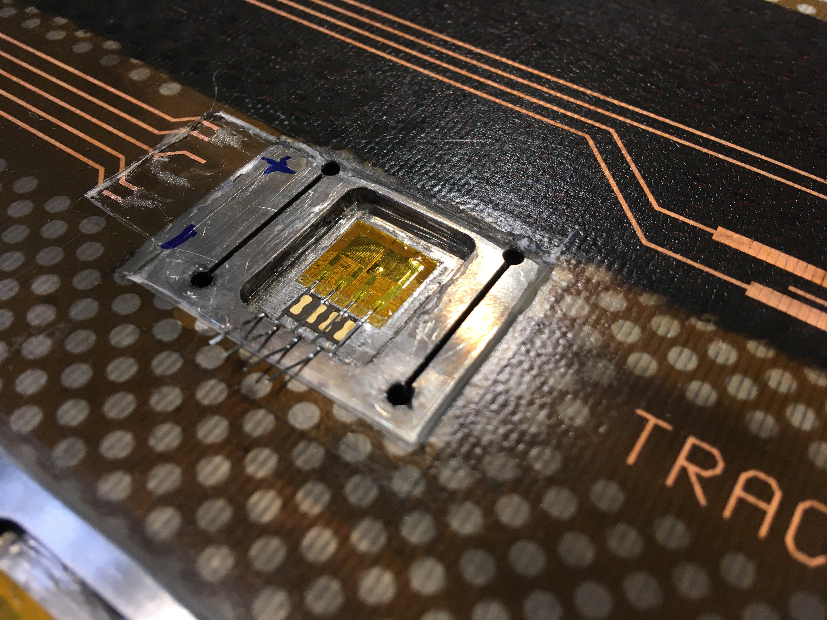
Electrical strain gauges
Integrated strain over the grid surface;
Sensitivity :
Wheatstone bridge solution;
Robust and well-known techniques;
K factor variation with temperature;
Temperature and magnetic fields sensitive;
Apparent strain with temperature :
$${ΔR}/{R_{0}}=k∙ε$$
$${\left(\frac{ΔR}{R_{0}}\right)}_{T}=k_{(∆T)}ε_{ax} +\left[β_{G}+k\left(\frac{1+K_{t}}{1−v_{0}K_{t}}\right)\left(α_{s}−α_{G}\right)\right]∆T$$
$β_{G}$ = Temperature coefficient of resistance of grid conductor
$k$ = Gauge factor of strain gauge
$K_{t}$ = Transverse sensitivity of the strain gauge
$\left(α_{s}−α_{G}\right)$ = Difference of thermal expansion coefficients between the substrate and grid

Slide 8
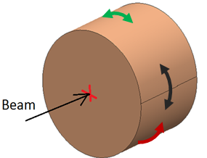
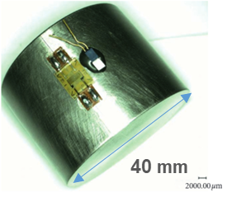
Electrical strain gauges
Why using electrical strain gauges to measure dynamic effects ?
Closest position to the physical effects ;
Low mass (thin film) → High bandwidth ;
Stiff connection to the mechanical structure ;

Slide 9
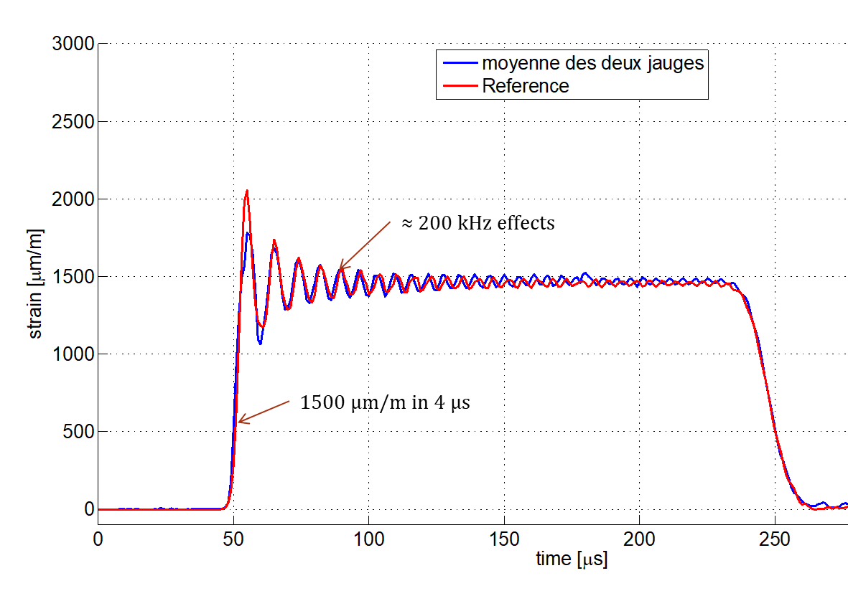
Electrical strain gauges
Dynamic response of the strain gauges is limited to 50 kHz by the suppliers, additional tests were performed on Hopkinson bars test bench to evaluate the real bandwidth of the gauges and the adhesive system.

Slide 10
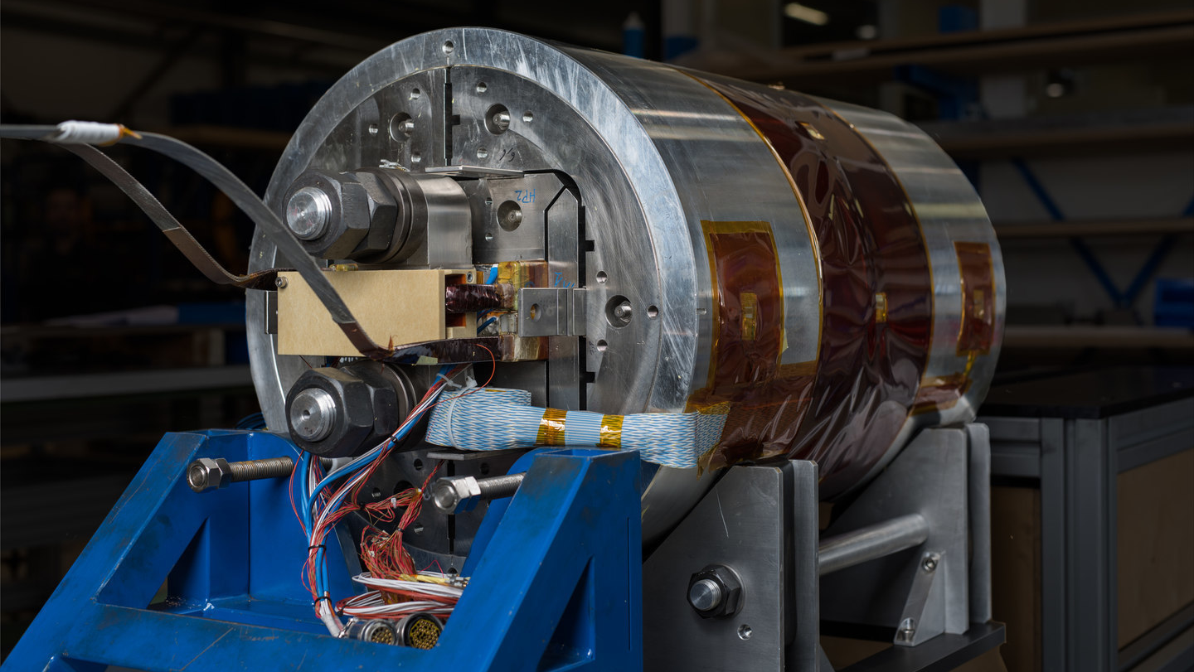
Applications : RMM (Racetrack Model Magnet) SMC (Short Model Coil)

Slide 11
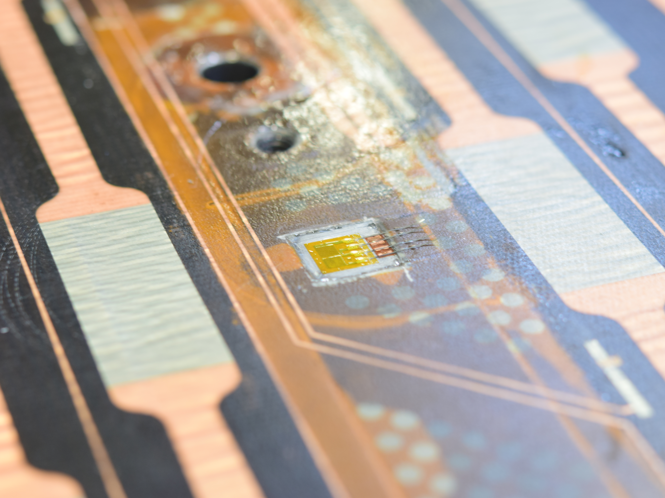
Mechanical instrumentation
RMM Structure :
Tie rods – Full bridge;
Aluminum shell – ½ bridge;
Coils – Double ¼ bridge:
SMC Structure :
Tie rods – Full bridge;
Aluminum shell – ½ bridge;
Coils – ½ bridge:
Data presented in the following slides were sampled at 1200 Hz

Slide 12
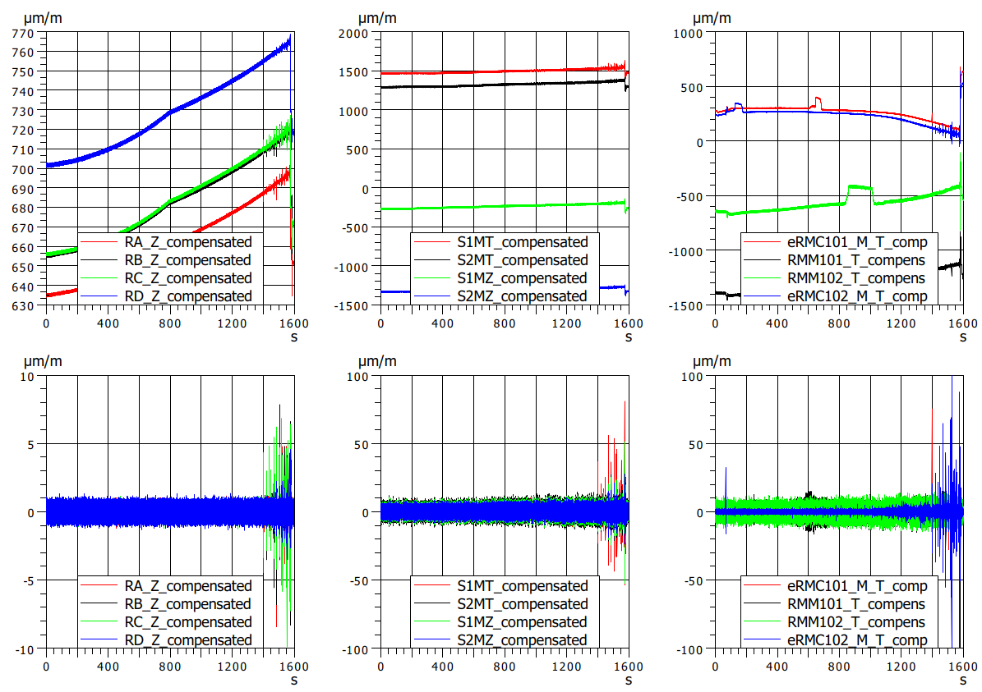
RMM structure
Temperature : 1.9 K
Powering phase up to 12 kA

Slide 13
RMM structure
Temperature : 1.9 K
Powering phase up to 12 kA
DC filtering

Slide 14
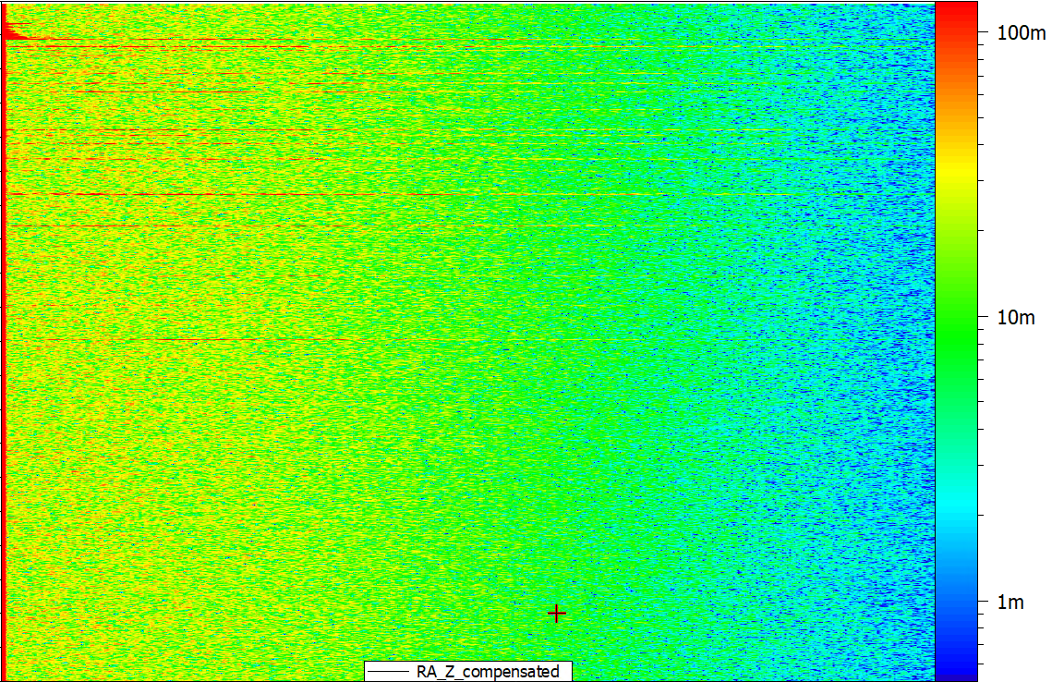
RMM structure
Temperature : 1.9 K
Powering phase up to 12 kA
DC filtering + FFT Analysis
Wide spectrum excitation (shocks)
Mechanical coil instability / stick-slip effects ?
50 Hz and harmonics
Wide spectrum excitation (shocks)

Slide 15
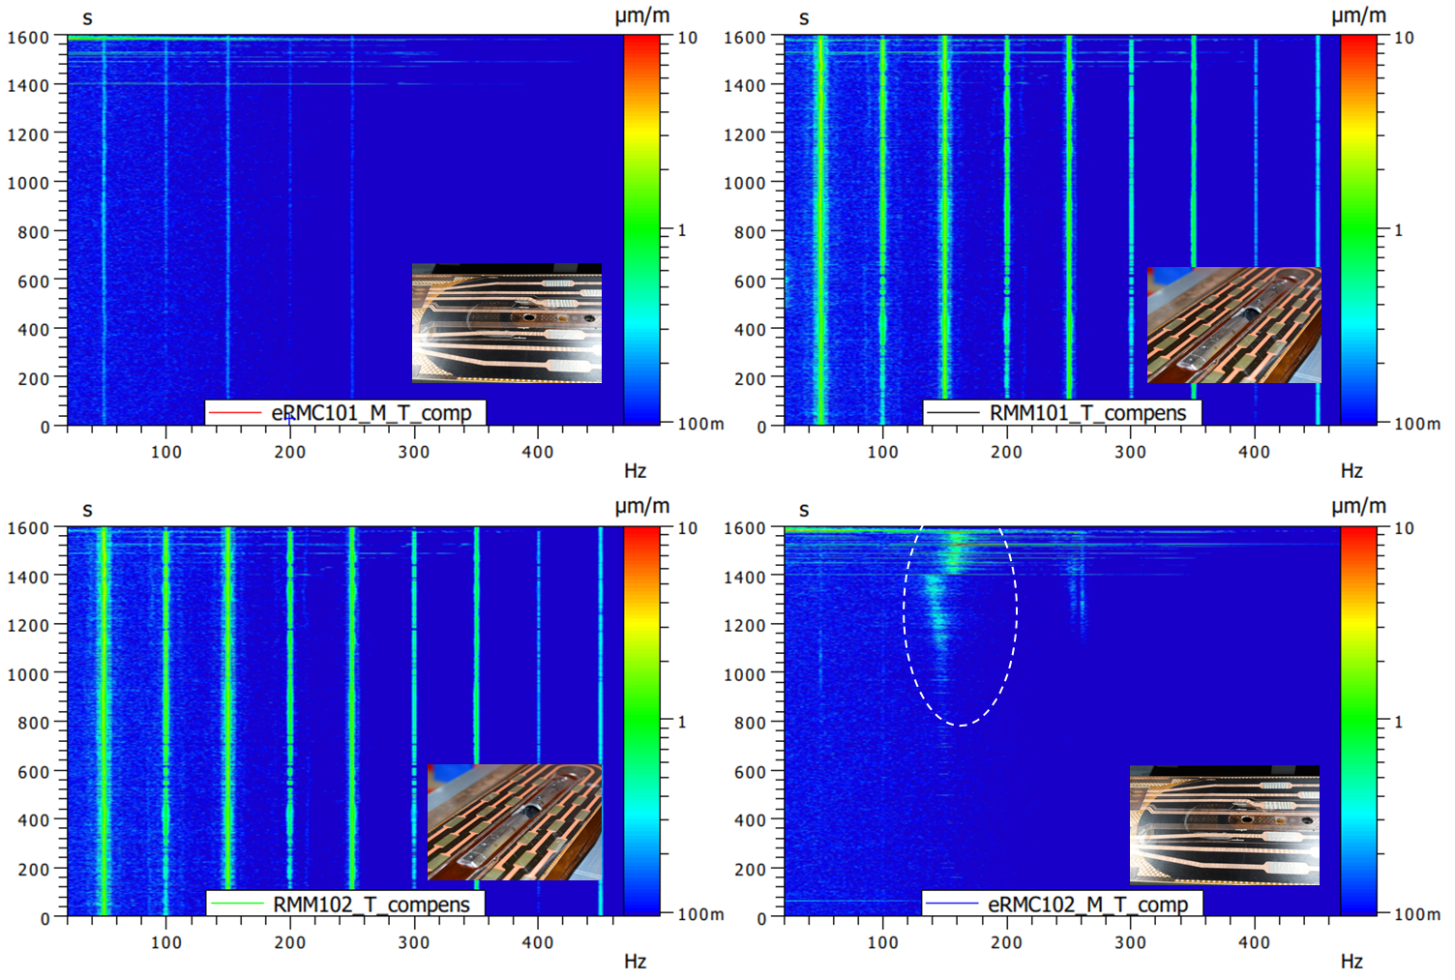
RMM structure
Temperature : 1.9 K
Powering phase up to 12 kA
DC filtering + FFT Analysis
Wide spectrum excitation (shocks)

Slide 16
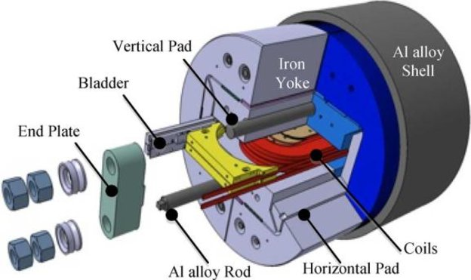
SMC structure, 2G-Coil#101
Strain gauge sampling : 1200 Hz
Temperature : 1.9 K
Powering phase up to 9.1 kA
DC filtering
SM18 Voltage : Precursor signal provided by SM18 team
Wide spectrum excitation (shocks)

Slide 17
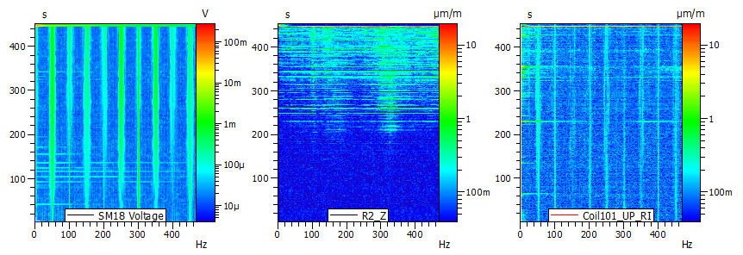
SMC structure, 2G-Coil#101
Strain gauge sampling : 1200 Hz
Temperature : 1.9 K
Powering phase up to 9.1 kA
DC filtering
SM18 Voltage : Precursor signal provided by SM18 team
Wide spectrum excitation (shocks)

Slide 18
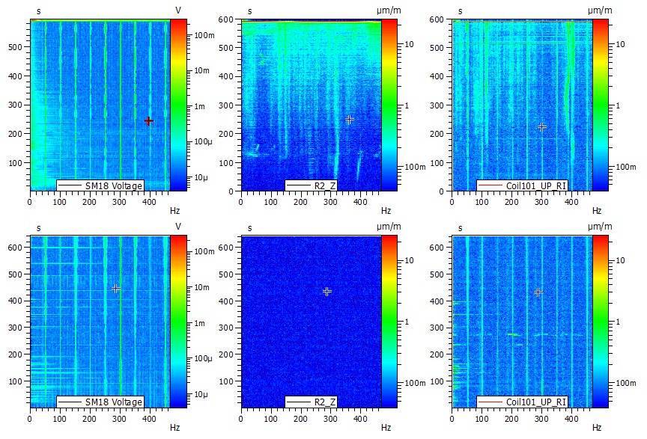
SMC structure, 2G-Coil#101
Strain gauge sampling : 1200 Hz
Temperature : 1.9 K
Powering phase up to 9.1 kA
DC filtering + FFT Analysis
TRAINING
SMC 2G Coil#101
First Ramp at 4.2 K
SMC 2G Coil#101
Last Ramp at 4.2 K
Wide spectrum excitation (shocks)

Slide 19
SMC structure, 2G-Coil#102
Strain gauge sampling : 1200 Hz
Temperature : 1.9 K
Powering phase up to 9.1 kA
DC filtering + FFT Analysis
Acoustic Emission sensor signal provided by SM18 team

Slide 20
Conclusion
Many papers confirmed the electrical strain gauge capability for fast strain measurements (shockwave measurements) up to MHz scale ;
Installation is already performed for static measurements, so why not also used it to evaluate dynamic effects (mass and position advantages) ;
As a first step, with a limited bandwidth, several magnets were measured, and a specific data processing was developed to assess the magnet dynamic behavior.
Next steps :
Repeat measurements by increasing the sampling frequency up to MHz with the AE, precursor signals synchronization.
Test matrix should be launched to understand what we are “listening” ?

Slide 21
Thank you for your attention!

