Slide 1

CERN needs for instrumentation and diagnostics
Gerard Willering
26 April 2023
2nd workshop Instrumentation and Diagnostics for Superconducting Magnets
https://agenda.infn.it/event/32061/

Slide 2
It is difficult to focus, the rnage .
Superconductor
NbTi
Nb₃Sn
HTS
Voltage measurements
Strain measurements
Vibration
Other electical methods
Temperature
Pickup coils
Rotating coils
Hall probes
Stretched wires
Quench detection
Flux jumps
Coil strain state
Conductor degradation
Quench localization
Magnetic field
Magnet form factor
CosTheta
Common Coil
Block coil
CCT
Curved CCT
New HTS shape
Cable form factor
Rutherford
Single wire
Roebel
Stack tape
CORC
Advanced diagnostics
Combining all instrumentation
Develop knowledge
Develop interpretation methodology

Slide 3
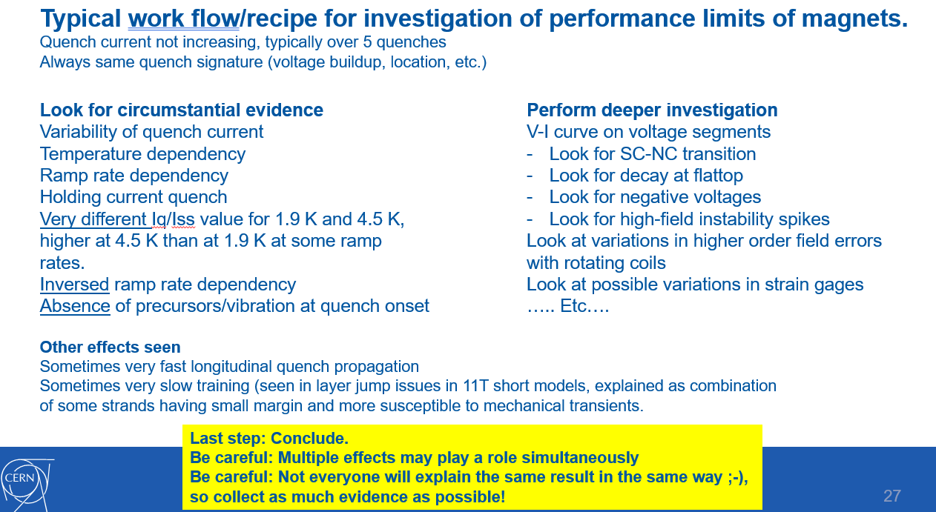
Starting with my last slide of the IDSM workshop in 2019 (today exactly 4 years ago)
- Circumstantial evidence and qualitative description
IDSM01: Link to slides

Slide 4
Starting with my last slide of the IDSM workshop in 2019
Circumstantial evidence and qualitative description
Often used, but also often mis-used
Interpretation of magnet behavior can sometimes feel ‘random’ and base on ‘personal preferences’.
Quantification is key
V-I measurements quantify degradation
Quench antenna to localize quenches or motion
Vibration measurements
Strain measurements
Temperature measurements
All this comes with insturmentation and diagnostic tools.

Slide 5
Nb₃Sn accelerator magnet quench localization

Slide 6
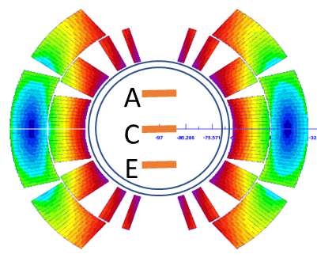
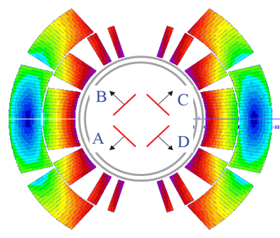
Available quench antenna at CERN – part 1
B1 sensitivity. Noise compensation by A+C, C+E and A+E computation.
Available for LHC MB and 11T magnets on horizontal bench, but also for others on vertical bench. Serve both as rotating magnetic measurement shaft and as quench antenna.
Horizontal bench: warm shaft, 125 cm length segments.
Vertical bench: cold shaft, 25 cm length segments.
Noise compensation by B+D and A+C computation.
Available for LHC MB and 11T magnets. 11 segments per magnet head of 4 cm long (44 cm in total)
Warm shaft, dedicated quench antenna.

Slide 7
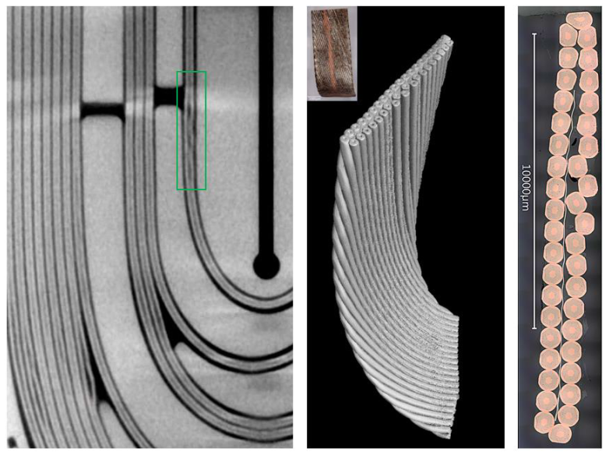
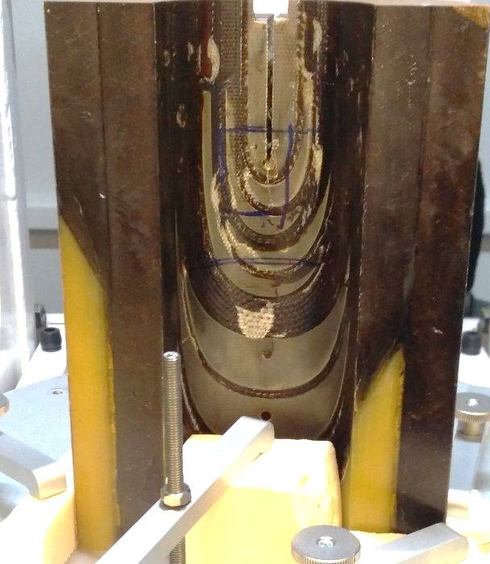
Achievement at CERN in 2018-19:
For 5.5 meter long 11T series magnets, we could identify the zones of interest to study in post-mortem analysis.
Not very precise….
To be published: I. Alviles Santilliana, S. Sgobba, et al., Advanced examination of Nb₃Sn coils and conductors for the HL LHC: a methodology based on computed tomography and materialographic analysis.

Slide 8
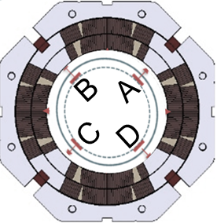
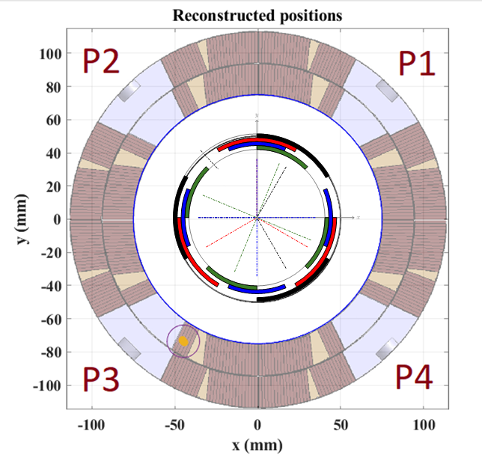
Available quench antenna at CERN – part 2
B2 sensitivity.
Noise compentation by A+B+C+D computation
Available for MQXF magnets on horizontal bench.
Warm shaft, dedicated quench antenna. 60 cm long segments, but down to 5 cm length in the magnet head.
B3,B4,A3,A4 sensitivity. Radial and angular positioning due to calculation of shift in magnetic moment.
Newest development, using flexible PCBs.
Warm shaft, dedicated quench antenna.
See talk Lucio Fiscarelli

Slide 9
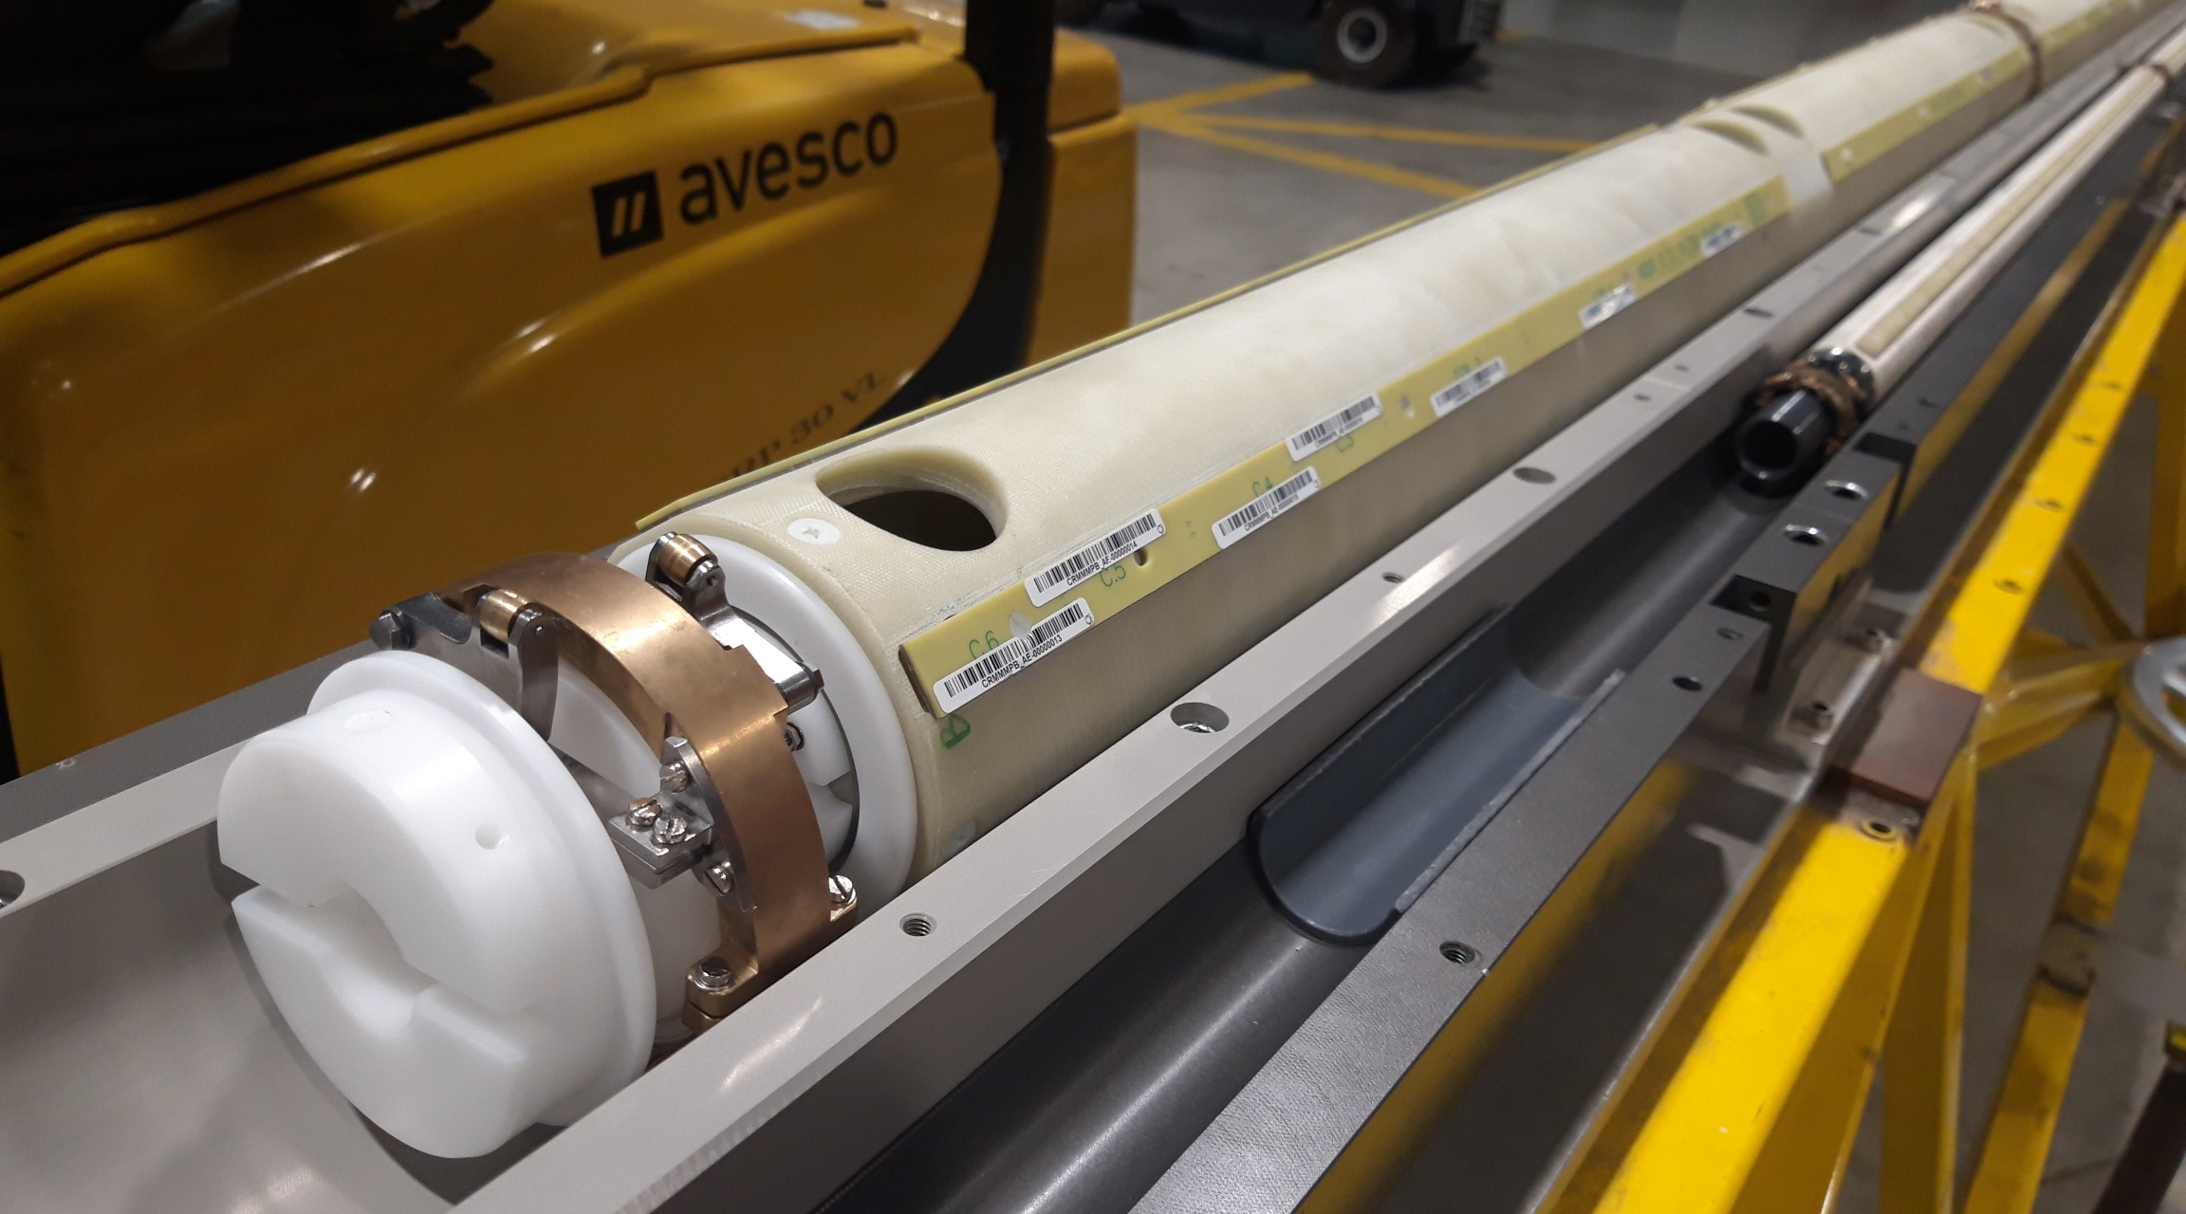
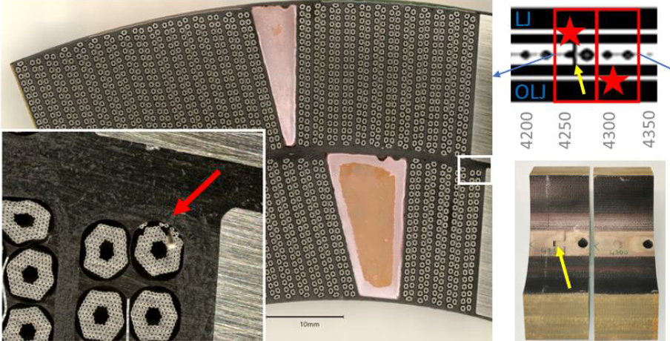
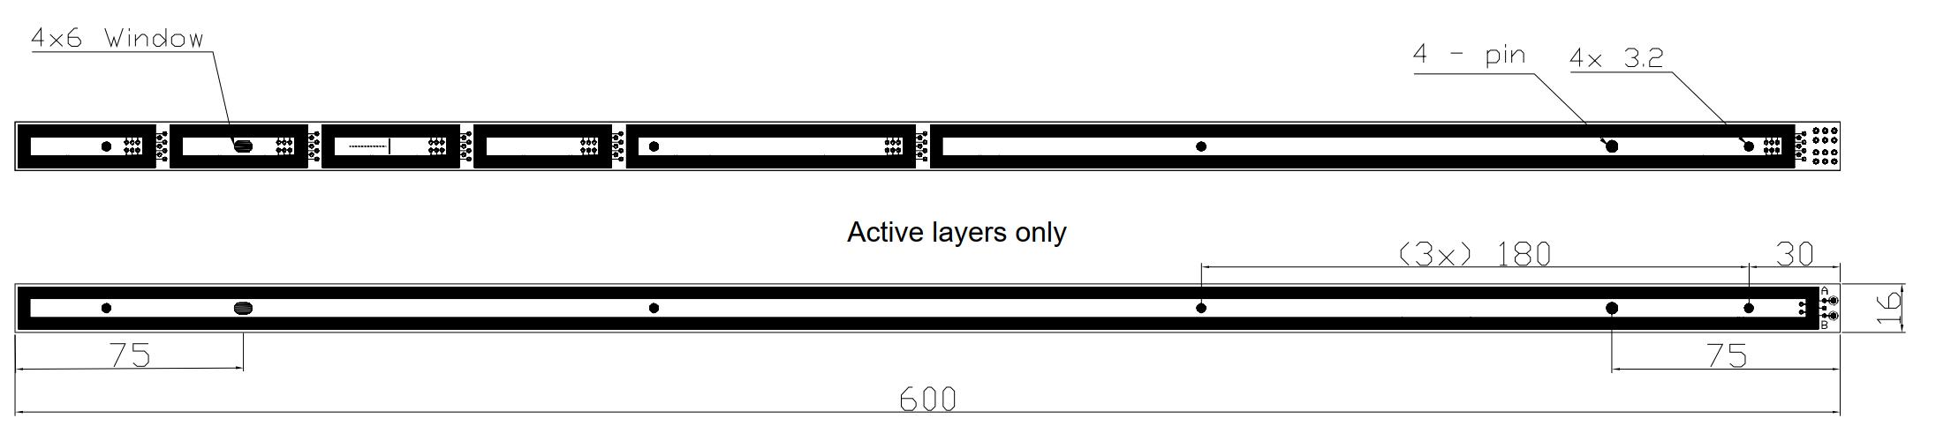
Major achievement at CERN in 2020:
New ‘B2 sensitive’ shafts for MQXF magnets was prepared (good synergy between MM and TF section at CERN).
Longitudinal quench localization in MQXFBP1 magnets within ±5 cm
Defected turn was identified by voltage taps
Thanks to this instrumentation, the exact location for investigation of the coil could be identified to find damaged strands.
Ruben’s work (see tomorrows presentation) developing models for V-I measurements predicted 5-10 damaged strands, which was indeed the case.
Piotr Rogacki, Lucio Fiscarelli
To be published: I. Alviles Santilliana, S. Sgobba, et al., Advanced examination of Nb₃Sn coils and conductors for the HL LHC: a methodology based on computed tomography and materialographic analysis.

Slide 10
More difficult cases in Nb₃Sn magnets

Slide 11
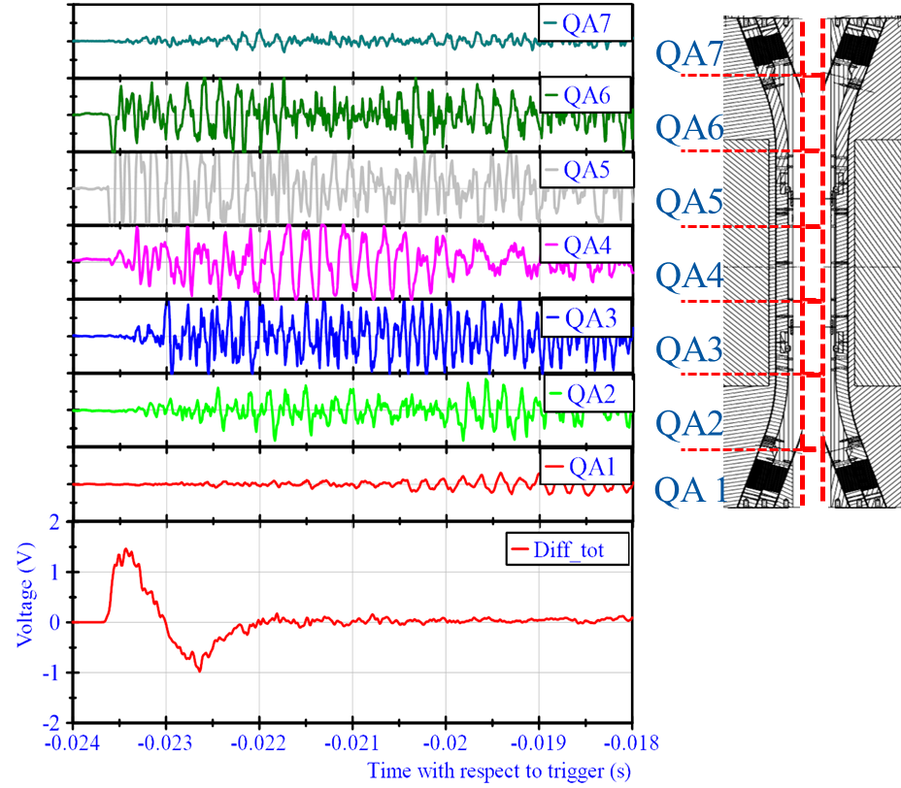
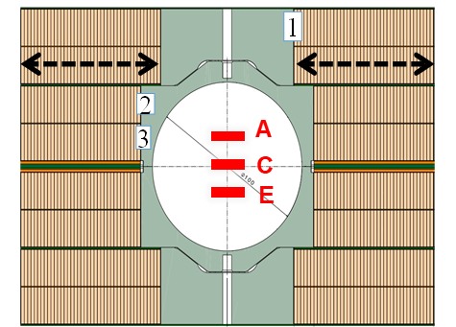
Difficulties in quench localization Nb₃Sn
FRESCA2 (~2018): Large bore, but also very large vibrations.
Quench antenna gave clear indication where the ´mechanical precursors´ started.
4 double layer block coils with flared ends.
All quenches occurred in the second layer, but not in the pole turn.

Slide 12
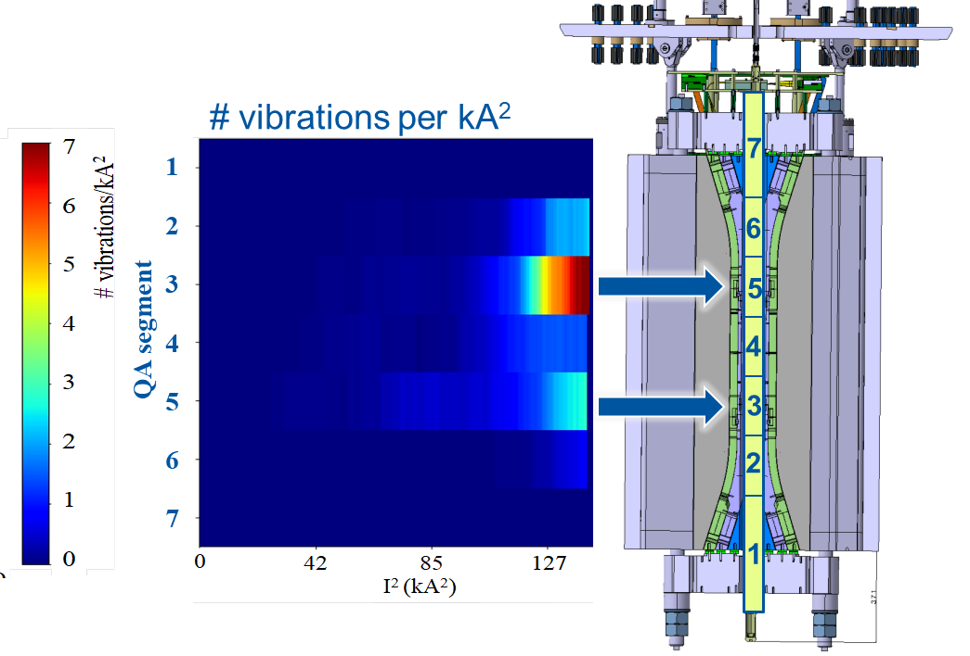
Investigation of all vibrations picked up by the quench antenna.
Training effect: less vibrations after consecutive ramps.
Vibration analysis fully trained magnet
Highest activity seen by QA 5, consistent with quench locations in the magnet.
Rather satisfactory.

Slide 13
Difficulties in quench localization Nb₃Sn
Quench localization not satisfactory due to:
Large signal from the motion in the magnet.
Aspect ratio of pickup coil to quench location position

Slide 14
Discussion quench antenna for Nb₃Sn
I always questioned if the classical quench antenna (B1 or B2 type) we had in SM18 could be used to localize a quench in a cable with non-homogeneous current distribution. Don’t know the answer yet…
Multipole flex PCB quench antenna are excelent for calculating exact position of current redistribution during the quench.
  It cannot work for single strand wires?
  Has anyone tried with HTS Roebel cables so far? (typically the bore is small and this may be difficult to achieve).
  Great for localizing flux jumps
  We did not yet exploit all possibilities.
Interesting investment at CERN for vertical test benches could be:
Cold shafts that combine rotating coil magnetic measurement with Flex PCB multipole quench antenna.
Or make an anti-cryostat such that during a cool down a rotating coil shaft can be exchanged for a multipole quench antenna. Note that the anticryostat diameter needs to be chosen wisely. (ongoing)

Slide 15
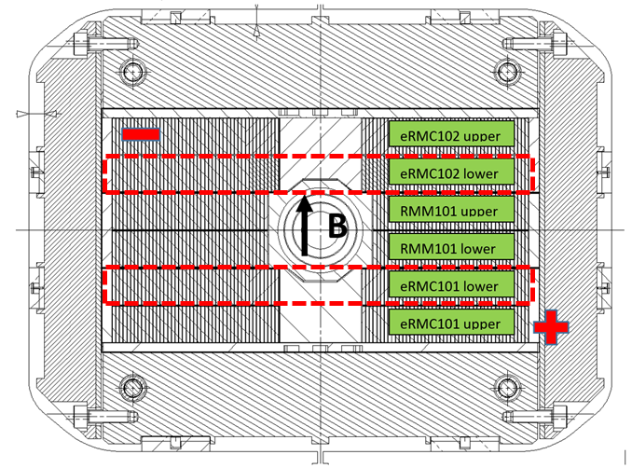
Discussion quench antenna for Nb₃Sn
Block coil magnets without bore
Currently quench localization can only be done with voltage taps, which we would like to avoid for risk of shorts and complication in the coil production.
RMM coil, reaching 16.7 T peak field.
Closed bore for magnetic measurements, but no quench antenna.
We have no longitudinal quench localization, nor radial localization.
We expect block coil magnets without bore for 12T-14T+ magnets.
Brainstorming on type of quench antenna we can place.
Possibly flex pcb antenna integrated in the impregnation?
High frequency accoustics measurement?
Most quenches started in the eRMC lower coils.

Slide 16
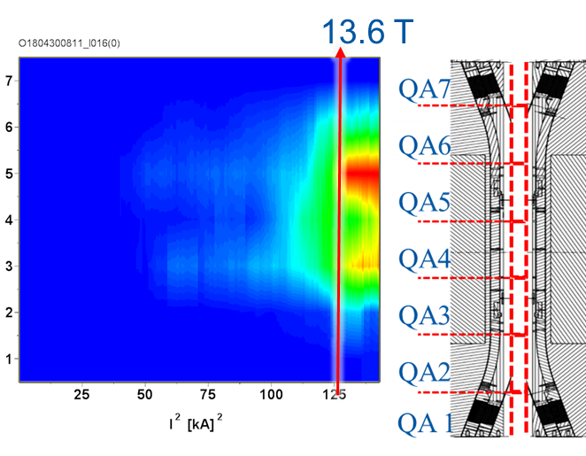
Motion/precursor measurements
Needs
We try to have for each magnet type a full ramp up (20 minutes) of medium frequency measurements (10 kHz) to investigate vibration spectrum.
Prefered device are the quench antenna to localize the vibration and quantify the ‘activity’ as good as possible.
Clear need for optimization software to handle large datasets.
We could profit from further development of analysis (frequency domain)
Possibly the ideal data for machine learning/AI techniques to spot patterns and outliers.
Accoustic emission/accelerometers
At CERN we have implemented them
Localization of motion source is not advanced
Considered very useful to have statistical reference data.

Slide 17
Nb₃Sn accelerator magnet conductor damage measurements

Slide 18
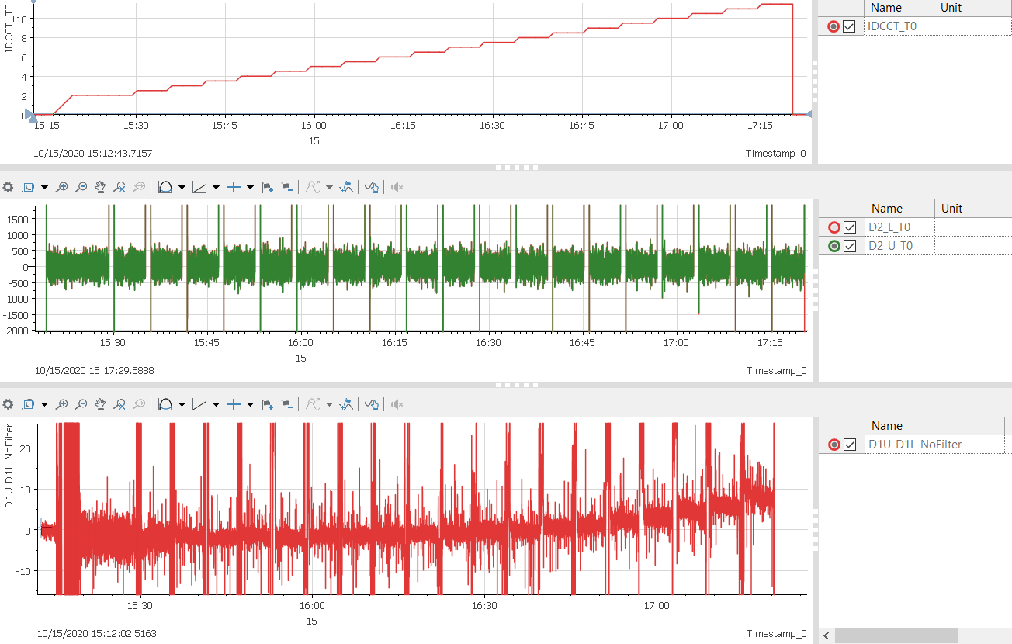
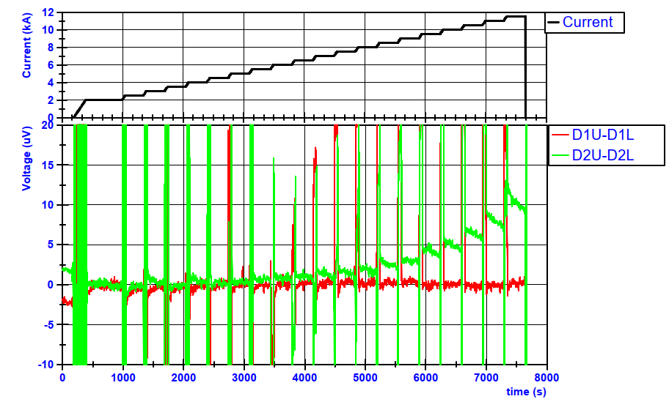
Voltage based measurements – V-I
Measurement of ±500 mV noise on 2 coils of the 11T 5.5 meter long magnet.
Some additional filtering applied show even decaying voltages in a full scale Nb₃Sn magnet.
Method is available. 4.5 K measurements on Nb₃Sn magnets are necessary to investigate conductor health.
Here the key is to have right DAQ system in combination
Calculated differential signal between the two coils (removing all noise from power converter and noise on all coils).
Method only works with multiple identical coils.
Assume that the best coil has no transition.

Slide 19
CERN focus also shows in the contributions to the workshop
CERN contributions this workshop:
Ruben Keijzer Diagnostics in Nb₃Sn accelerator magnets
Mateusz Bednarek Electrical investigations
Oscar Sacristan Digital Twin in mechanical measurements
Michael Guinchard Fast data acquisition strain sensors
Emmanuele Ravaioli Electromagnetic behavior in series of magnets.
Lucio Fiscarelli Quench Atenna

Slide 20
Quench detection
Voltage based detection will remain the main mechanism over the next years for LTS magnets.
Investments in FPGA based systems, (uQDS at CERN) is ramping up and has large flexibility.
For HTS I would expect two cases:
Magnets that are allowed to quench
  Voltage based detection remains the main detection
Magnets that are not allowed to quench
  Use voltage to identify transistion early in long time scale
  Fiber optics (or other thermometers) to see temperature increase
Currently if we have a magnet that is not allowed to quench, we have ‘manual’ quench prevention, relying on test operators.

Slide 21
Important reminder on the basics
Power converters can be a main source of noise
Shielding and twisting of cables needs to be optimized.
Grounding issues and input impedance are important, (At CERN especially for high-precision voltage measurement for V-I)
Amplification as close as possible to the source (no cryogenic amplifiers used at CERN so far)

Slide 22
Summary
Targets at CERN
Nb₃Sn quench investigation for the next 20 years during HL-LHC operation.
Nb₃Sn conductor health (degradation) has a strong focus. Mechanical strain measurements and V-I are key.

