Slide 1
Instrumentation and diagnostics for Test Facility Dipole at Fermilab
G. Velev
2nd Instrumentation and Diagnostics for Superconducting Magnets Workshop

Slide 2
Outline
Introduction - HTS cable test facility at Fermilab
Test Facility Dipole (TFD) from LBNL - 15 T background field
Quench protection and characterization
Instrumentation and diagnostics for the TFD and HTS cable sample
New multichannel Digital Integrator
Nanovolt Multiplexer Meter for splice and VT measurements
New signal conditioner system
EMMA: Software Framework for Measurement Systems
Fibers - covered by Maria’s and Steve’s talks
Quench antennas - Joe’s talk
Summary
Examples:
EMMA – Extensible Magnetic Measurement Application

Slide 3
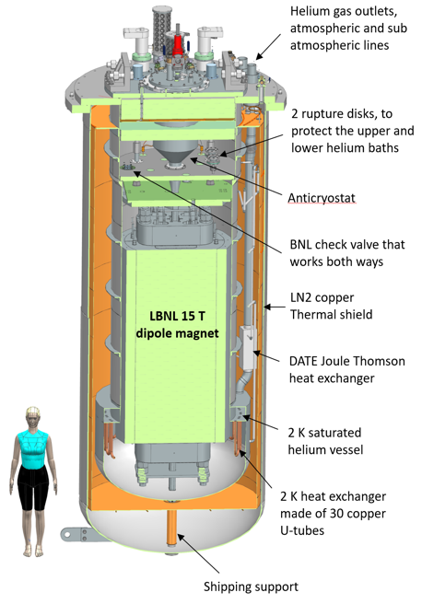
Introduction
US DOE Offices of High Energy Physics and Fusion Energy Sciences joined their effort to build HTS cable-testing facility.
This facility is currently in construction at Fermilab.
For the US FES and HEP, it will serve as a test stand for HTS cables in high dipole field and at increased temperatures.
It is designed to provide similar or better capabilities than EDIPO at PSI, and FRESCA2 at CERN
For the US Magnet Development Program, it will be the main facility for testing of magnets with 16-20 plus T fields, including hybrid magnets
15 T dipole (TFD) - provided by LBNL
For more information - see the talk in the TF workshop

Slide 4
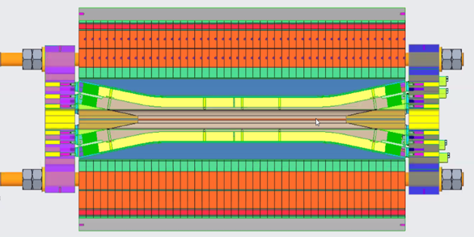
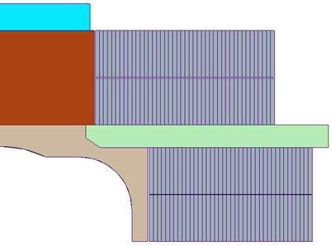
Test Facility Dipole
Field: 16 T design target with >15% margin on the load line at 1.9 K
15 T is used as reference for operation
Clear aperture: 144 mm (H) x 94 mm (V) superimposed with 106 mm round for compatibility with FRESCA2 samples
Magnet design is based on past development and studies of block-coil dipoles (HD, FRESCA2 and HEPdipo)
Mechanical design: Rutherford cable, accelerator coil with shell-based structure with axial pre-load
Quench Protection: energy extraction (dump resistor) is sufficient for safe magnet discharge: stored energy ~ 12 MJ
Coupling Loss induced Quench (CLIQ) system is included in the baseline plan for redundancy, no quench heaters
R_{min}:
54 mm
Layer 4: 44 turns
Coil 2
Layer 3: 44 turns
Layer 2: 40 turns
Coil 1
Layer 1: 40 turns
D. Arbelaez, P. Ferracin, R. Hafalia, P. Mallon, D. Martins Araujo, J. L. Rudeiros Fernandez, G. Vallone et al.

Slide 5
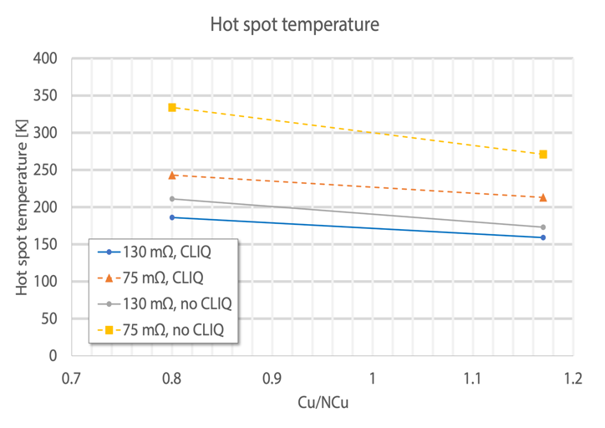
Quench Protection Simulation
V. Marinozzi
Studies were performed with STEAM-LEDET code
Conductor: Cu/NonCu: 0.8-1.17 (selected 0.9)
At operation at current corresponding to 15 T
Dump resistor: two options 130 mΩ (2 kV) – 75 mΩ (1 kV)
For redundancy CLIQ is used: 40 mF, 600 V (AUP specs)
Expected Detection + validation time: 15 ms
If quench detection is increased by factor of 3 (45 ms), temperature increases by ~ 30K
Failure to activate dump on time may damage the coils - need reliable QP system

Slide 6
QP system - Requirements and Specifications
QP developed for the muon-to-electron (mu2e) conversion experiment to protect 3 solenoids with ~105 MJ stored energy
It is designed to minimize false quench triggers and unscheduled downtime that causes unnecessary interruptions to the operation of experiment
The quench detection system monitors the superconducting magnet coils and bus, the HTS power leads, and the vapor-cooled copper power leads
QP system: 3 tiers
Tier-I – Digital Quench Detection (DQD);
Tier-II (redundant) – Analog Quench Detection (AQD);
Tier-III – Quench System Monitoring and Data Manager + Operational GUIs & Quench Analysis
DQD and AQD provide independent quench triggers and designed to minimize the false trips
DQD and AQD features:
Two operation modes – production and expert modes
User settable validation times
Built in signal conditioning: filtering, gains, and attenuation
First application: AUP cryo-assembly testing as we speak

Slide 7
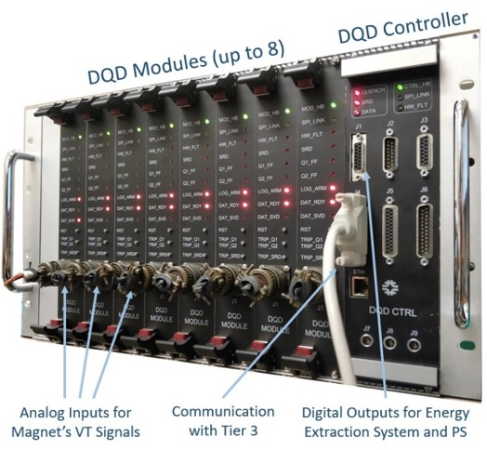
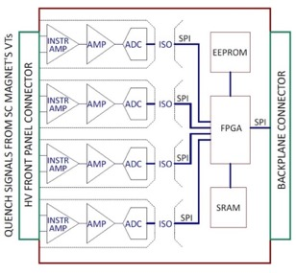
DQD System
Modular Hardware System:
Minimum number of connections
Built-in high voltage isolation;
Simple FPGA algorithms implemented on lower level (Verilog)
Data is stored in the DQD module SRAM independently from PC
DQD Module:
Digital Isolation
Programable:
Gains;
Trigger validation and delay times;
Multiple current dependent thresholds;
Channels for bucking;
Fast quench loggers
Pre and post trigger data windows
DQD Controller:
Communicates with TIER-III
Provides current ramp rate (dI/dt) for DQD & AQD
Digital Quench Detector 4 ch board
Note: The DQD quench detectors are commercially produced
using Class 3 assembly standards (high reliability electronics).

Slide 8
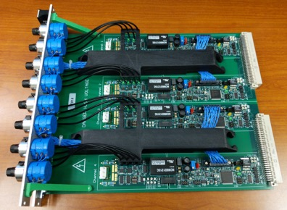
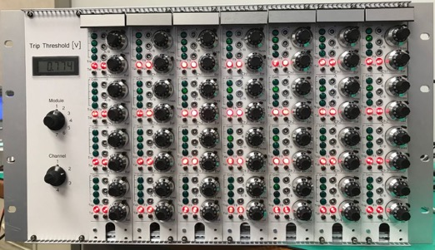
Analog Quench Protection
Full chassis of Analog Quench Detector Modules – 28 Channels
AQD Module
AQD Hardware System Features:
Channel isolation
Ability to perform analog bucking of two near by channels
Ability to buck a channel against magnet current I or dI/dt
Settable QD threshold
Balance adjustment
Selectable gains for each channel (0.25 to 256)
Selectable validation time for each channel
Selectable input filter
Isolated quench output signals
Isolated AQD status outputs
AQD Channel/Bucking Circuit
Courtesy of T. Cummings (FNAL)

Slide 9
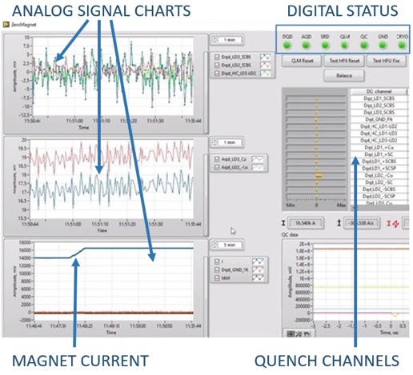
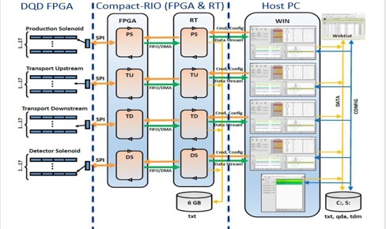
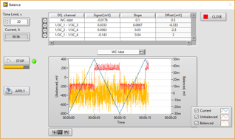
TIER-III Software System
Quench Software Layout
Tier-III is based on National Instruments C-RIO.
Configurable GUI includes a Change of State Monitor, an Event Logger, and launch buttons for Quench Monitoring, Quench Analysis, and Expert Mode.
Tier-III collects quench data pre- and post- event analysis.
Expert Mode: QD Balance

Slide 10
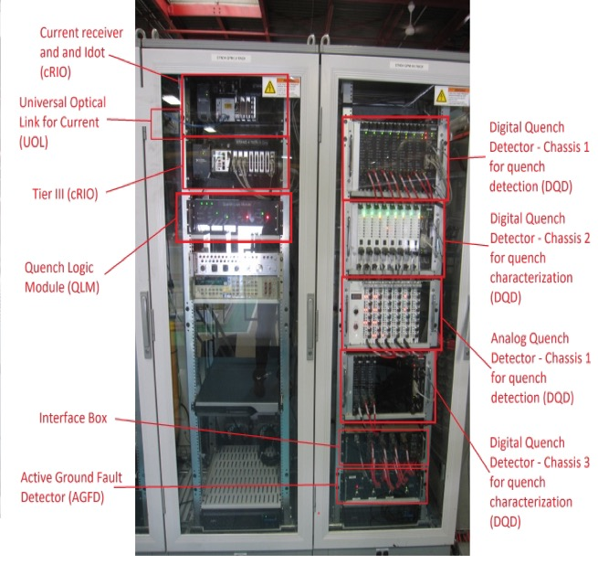
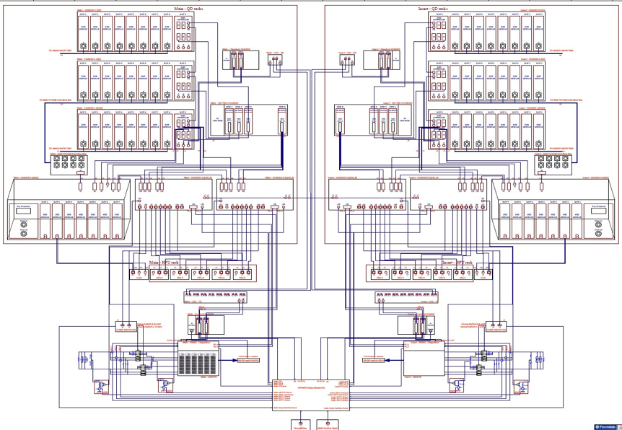
QP Architecture for HTS Cable Test Facility
Two branches:
Branch 1: Magnet protection
Branch 2: Test Sample protection
Branch 1
Branch 2
Quench Detection & Management
Quench Logic
Module & Protection
PS Control and Monitoring

Slide 11
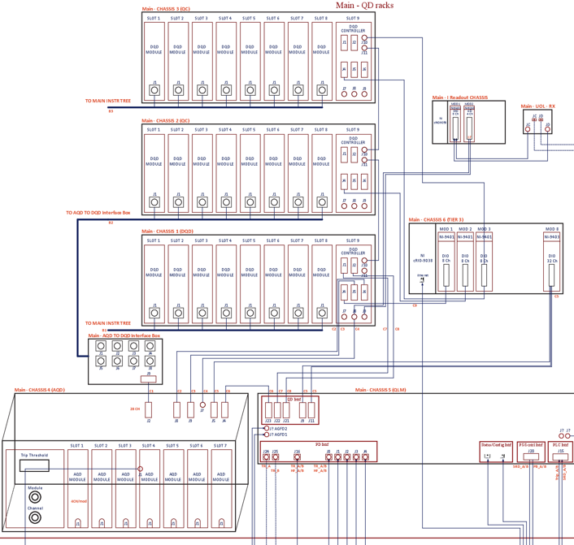
HFVMTF QP Details – Quench Detection & Management
Primary Custom Digital Quench Detection System (DQD) – 96 Channels
Quench management system, based on National Instruments C-RIO (Tier III). Provides quench configuration, real time control and monitoring, and quench data management for offline analysis.
Redundant Custom Analog Quench Detection System (AQD) – 28 Channels
The detectors can monitor:
Temperature sensors
Strain gauges
Hall sensors

Slide 12
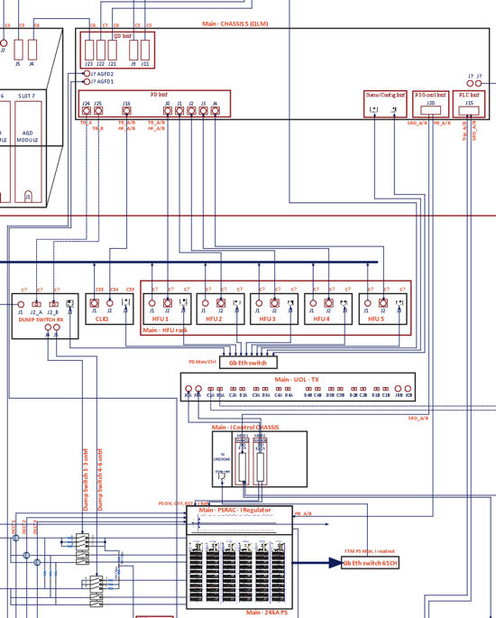
HFVMTF QP Details – Quench Logic & Protection
A set of two redundant custom Quench Logic Modules (QLMs) carry out the critical hardware-based quench logic, such as:
Energy extraction system enable and discharge control via DUMP switches
Heater control logic via Heater Firing Units (HFU)
CLIQ control logic (CLIQ)
Slow Ramp Down request for the Current control
Phase Back control for the power system

Slide 13
Powering Hi-Lumi test stand to Nominal I (16.3kA), Quench at 17.289kA

Slide 14
Instrumentation and data acquisition for test sample
On November 21-22, we hosted a workshop with the fusion user community. The users' feedback is summarized as follows:
Provide a standard “base” instrumentation layout for all tests
User samples: Voltage taps (high-field, joints), Cernoxes, etc.
Facility: Voltages (e.g. sample-facility joints), Cryogenics, B-field, etc.
Flexibility to accommodate user-requested/supplied instrumentation
Additional voltage taps and Cernoxes specific to user sample
Surface heaters (with larger gauge wires and in-house power supplies)
Strain gauges (w/ 3 or 5 wire cable runs), acoustic sensors, hall probes, fiber optics
Cryogenic measurements (pressure, mass flow, etc.)
Ensure sufficient spare low- (~0.1Hz) and high-rate channels (~100 Hz) in DAQ

Slide 15
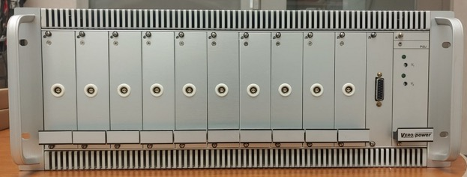
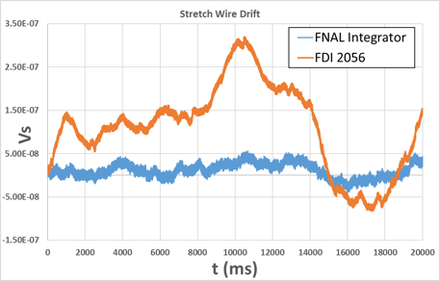
10 channels Digital Integrator
Fermilab is developing a Digital Integrator needed for magnet characterization and measurements
It is based on the 24-bit ADC
Individual channels have own ADCs - not multiplexing
Cost efficient
The goal is to substitute the expensive Metrolab FDIs
Can be used as precision digitizer needed for HTS samples
Current Status: one 10-Channel chassis has been assembled and compared to commercial alternatives (FDI-2056)
Items | Value | Units
Channels | 10
Input Range | ±10 | V
Drift | <5x10⁻⁹ | Vs/s
Resolution | 1.49x10⁻¹⁴ | Vs
Trigger modes | Pulse Encoder Auto
Max Sample rate | 20 | MHz
Buffer Size | 1M | Samples/ch
Channel-Channel Isolation | 1 | kV
Channel-Chassis Isolation | 1 | kV
Max Chassis Power | 60 | W
Output Gain Range | 1/64 - 16384 | V/V
Trigger Interface | Differential
Trigger input impedance | 120 | Ohm
A. Makulski and T. Cummings

Slide 16
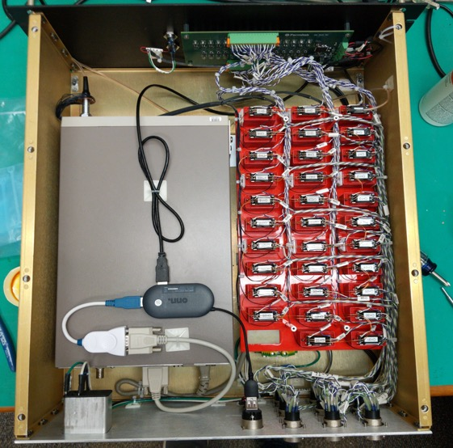
Nanovolt Multiplexer Meter (NMM)
It very effective and useful tool to measure splice resistance
Effective segment voltages
Provide information for potential conductor damage and type of the damage
Recently build - 31 channels
Using Keithley 2182A Nanovolt Meter for measurement
Standalone Python UI - no license/drivers needed
Easy readout: single USB Interface
Splices bellow 1 nOhm is measured
Courtesy of T. Cummings and S. Stoynev (FNAL)

Slide 17
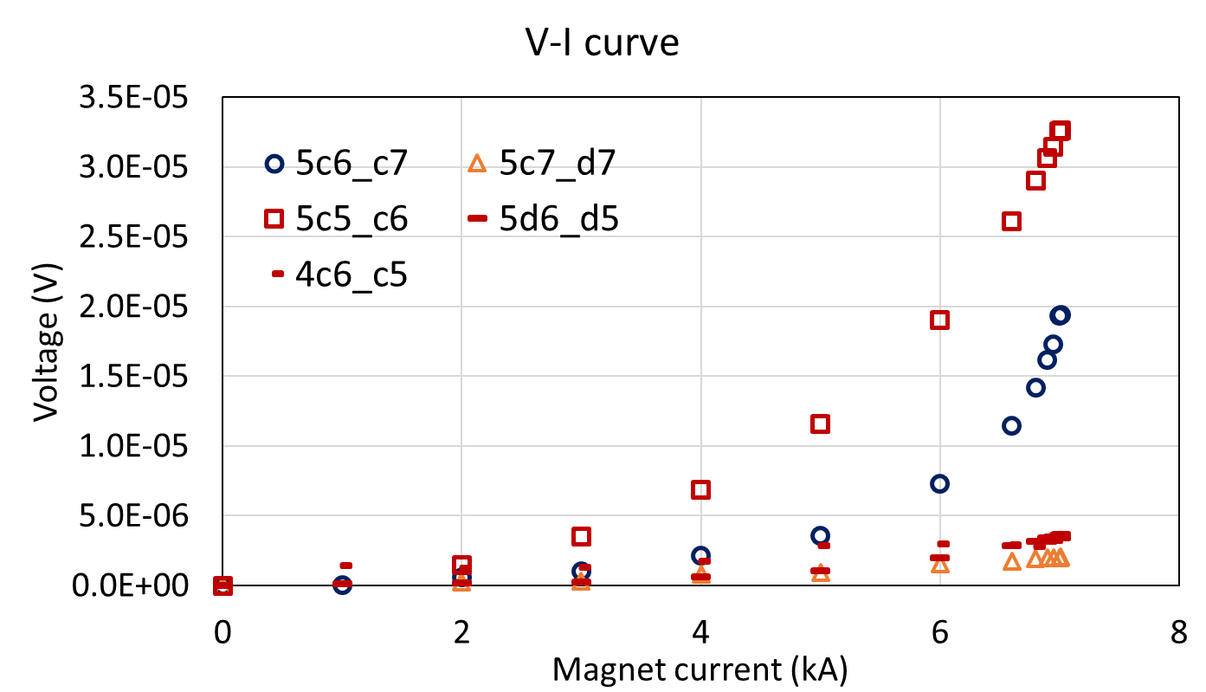
Example: 15 T Dipole Measurements
Used after magnet degradation
A characteristic V-I curve is observed in the two segments quenching most with the limiting one showing faster growth after 2 kA.
Other segments are showing similar signs but at much lower level.
NMM is going to be used during the commissioning of the TFD and for better diagnostics of the test samples
Courtesy of S. Stoynev (FNAL)

Slide 18
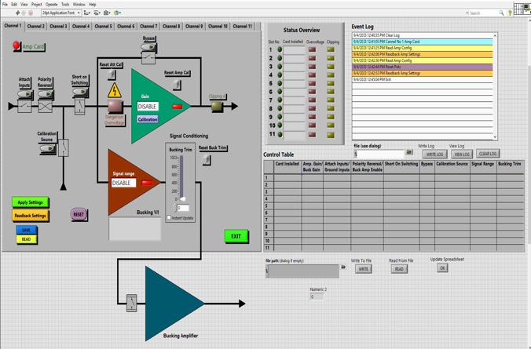
Signal Conditioner (SC) Module
Needed for testing HTS samples
convert signals to desired levels and types, and to allow longer cable runs
Main Requirements:
Number of input channels: 10
One output for each signal conditioning channel, and one bucking output
Input and Output Type: Differential
Input voltage range: ± 10mV to ± 200V
Input overvoltage protection: ± 300V
Input voltage offset:
50μV non calibrated
<5μV after calibration
Crosstalk channel to channel: < -130dB
Output voltage range: ± 10V
Attenuation and amplification of the signals in 0.01 - 1000 range
Development is in progress

Slide 19
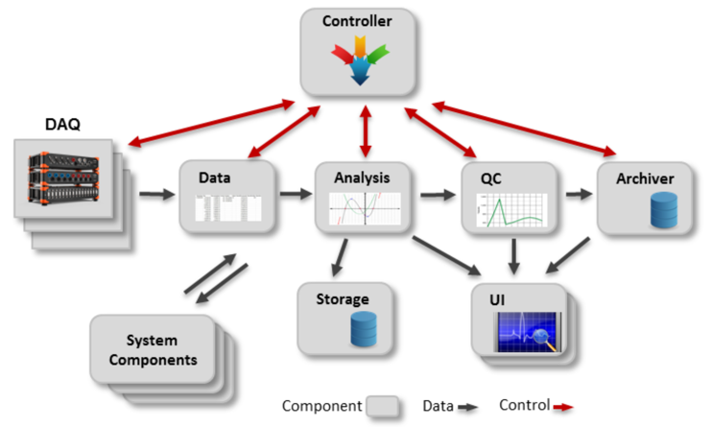
EMMA Framework for Measurement Systems
Software and Comp. system group
EMMA is a modern component-based framework and an example of flexible system, where a family of applications is built based on a common design and implemented on a common framework.
Architecture based on a publish-subscribe software bus via socket-based TCP/IP.
Applications configurable from standardized local and remote components.
Measurements automated via Python scripts.
On-line analysis developed in MATLAB and integrated as DLLs.
Easy debugging capabilities (data flow monitoring, component debug info)
Configurable user interfaces

Slide 20
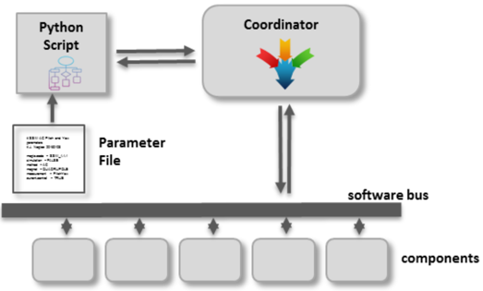
Measurement System Family
The software product line method is used to develop a family of measurement systems. These systems are based on a common architecture and a common framework.
All EMMA components have properties that are externally settable (configuration file) to tailor their behavior. The components in the system are coordinated by a Python script, which allows for additional flexibility in designing measurement systems.
SSW ROTATING COIL FIELD MAP MISCALLENOUS
SSW
(QUADRUPOLE)
SSW (DIPOLE)
VIBRATING WIRE
FLAT COIL (PPU)
SUPERCONDUCTING HORIZONTAL (HL-LHC)
CONVENTIONAL HORIZONTAL
SUPERCONDUCTING VERTICAL
Mu2e FMS
POINT SCAN (VERTICAL)
POINT SCAN (HORIZONTAL)
3D Field Mapping (PPU)
SPLICE SYSTEM
Commissioned
Under development
Planned development

Slide 21
Summary
Fermilab has developed or is in the process of developing a full set of tools needed to protect TFD, as well as to protect and characterize the HTS cable samples.
QD/QP system for TFD is commissioned
QD/QP/QC for test samples
The system is tested in real operation as we speak
We always increasing our “toolbox”:
Nanovolt meter module – done
Digital integrator module – in progress
Signal conditioning module - in progress
Development of the fiber systems
Quench antennas and new MM probes
New software monitoring and measurement system is developed.

Slide 22
Extras

Slide 23
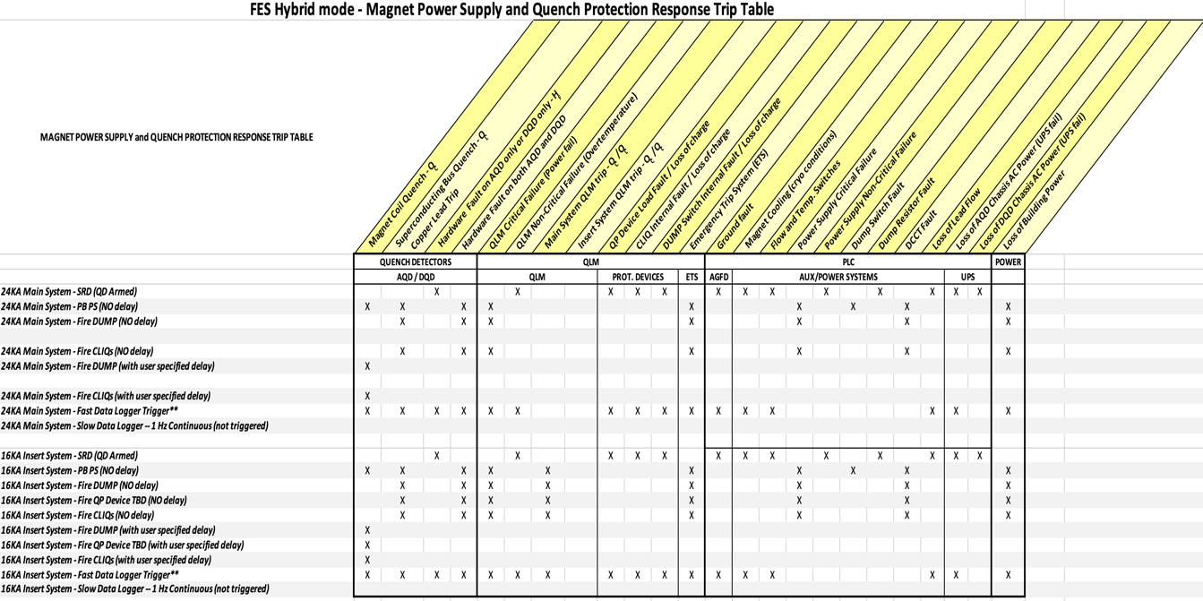

Slide 24
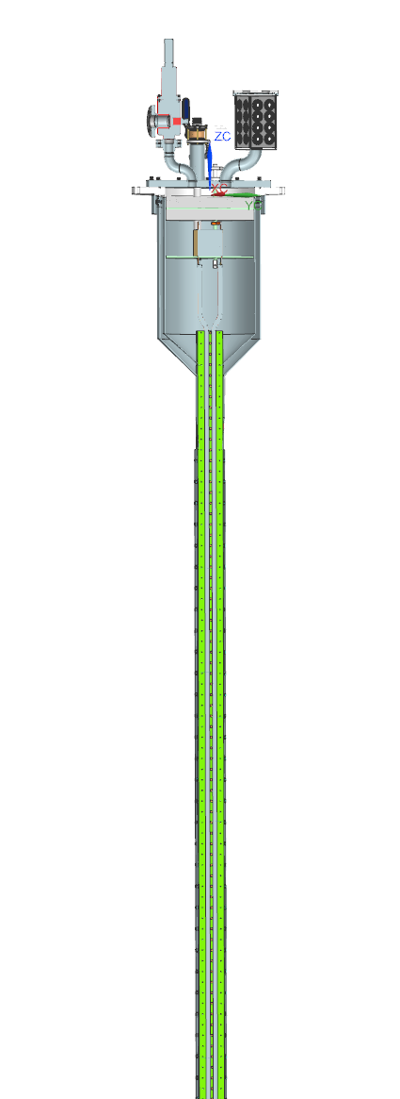
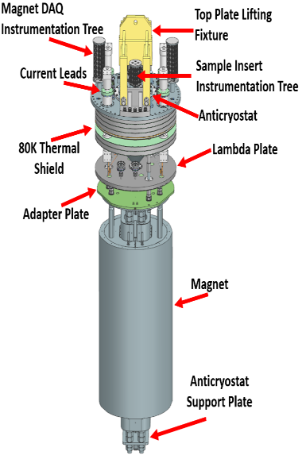
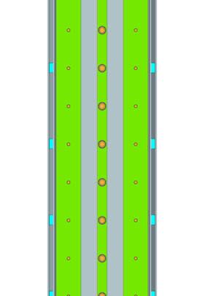
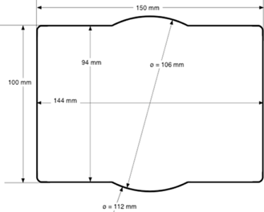
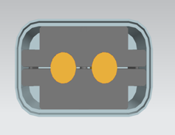
Anti-cryostat and sample holder
Instrumentation tree for HTS cable
We have a conceptual design of the anti-cryostat
Expected operational mode: field is perpendicular to the test sample
Clear aperture: (EDIPO) 144 mm (H) x 94 mm (V)
B=15 T
F=1.5MN/m
EDIPO/Sultan configuration
HTS CICC cable (Viper)
I_{max}=100 kA

Slide 25
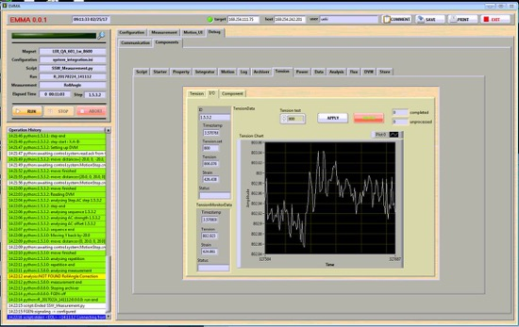
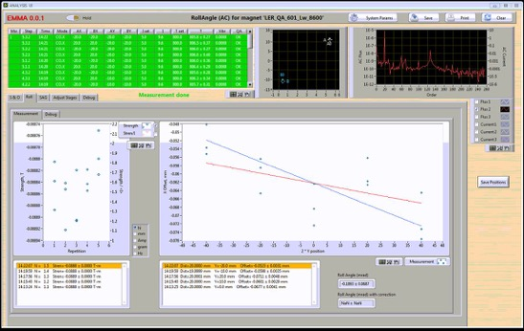
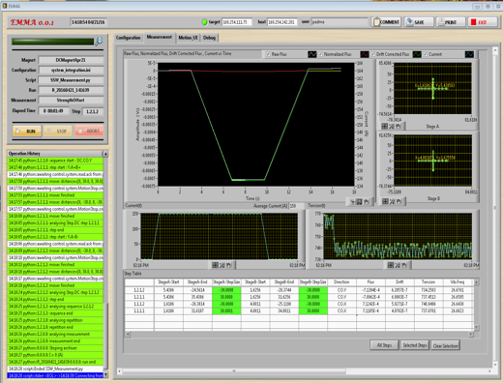
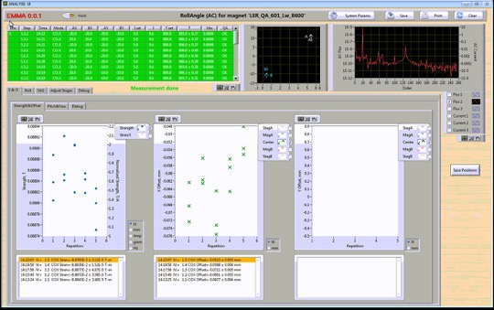
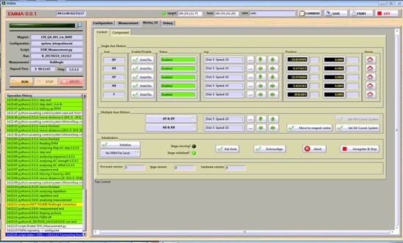
EMMA – User Interface

