Slide 1
4th SMTS Workshop in Salerno April 24th - 25th 2023
https://agenda.infn.it/event/32061
Helium medium & long term availability
Frederic Ferrand
on behalf of the CERN Cryogenics Group

Slide 2
Introduction
This presentation based on available public and none sensitive information
Not an economist nor a seller, only interest is to supply necessary helium volumes for the laboratory and users in the coming years
Helium market has suffered a major shortage since early 2022 and is currently evolving really fast, the situation may be significantly different in a few months
Many thanks to all colleagues involved in the helium supply at CERN over the years and their contribution to the preparation of this talk

Slide 3
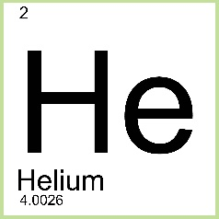
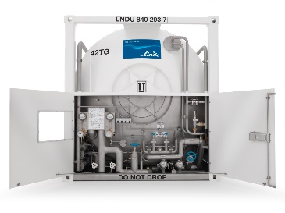
What is helium ?
For physicists
& astronomers
For geologists & supply chain specialists
Second lightest element in the known universe
It is also the second most abundant
According to some estimates accounts for as much as 24% of the Universe’s mass
0.00052% of Earth’s atmosphere
Available as a by-product of LNG Liquid Natural Gas production
But present worldwide in a limited number of sources above 0.3%
Transported by boat & road using thermally insulated ISO-containers (4.5t)
Limited geological resource

Slide 4
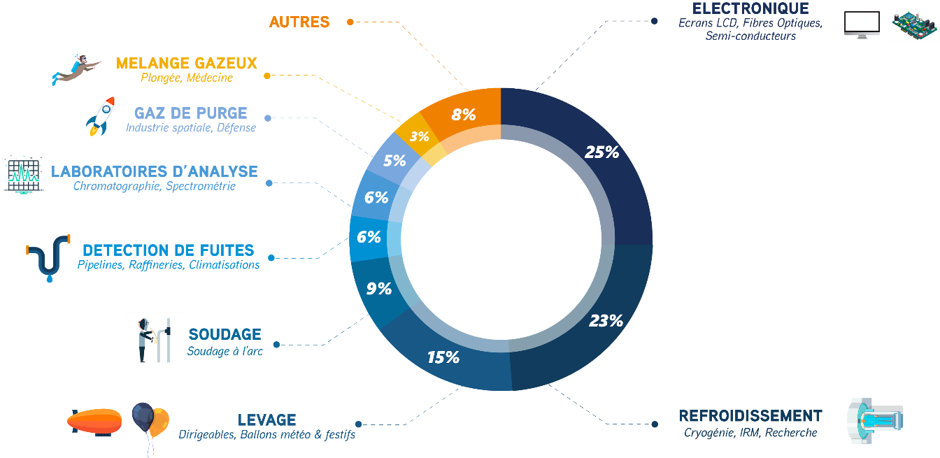
What is helium ?
For engineers & technicians
For helium exporting countries & commercial companies
Widely used commodity in industrial, space, electronics, optical fiber, medical, scientific & recreational
None regulated pricing based on offer/demand balance
European market is a captive customer producing 1% and using 25% of the WW volume
Opportunities for 3% growth per year mainly driven by the Asian market
Source 45-8 energy
Cryogenics for superconductivity & high magnetic field mainly use for MRI/MNR
Helium is irreplaceable for low temperature cryogenics applications below 20K
Notes:
https://458energy.com/index.php/l-helium

Slide 5
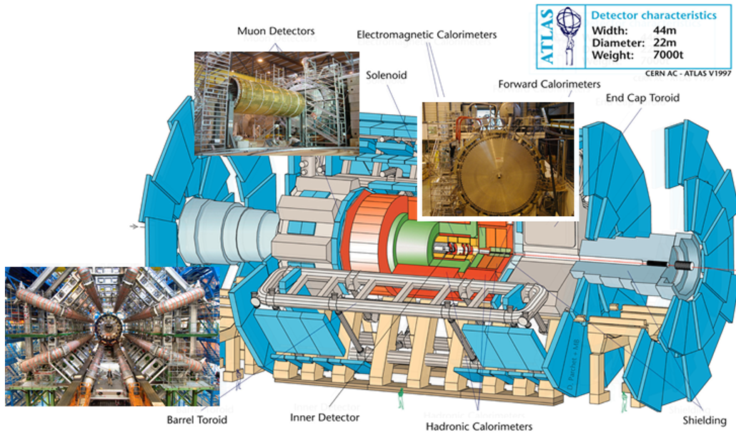
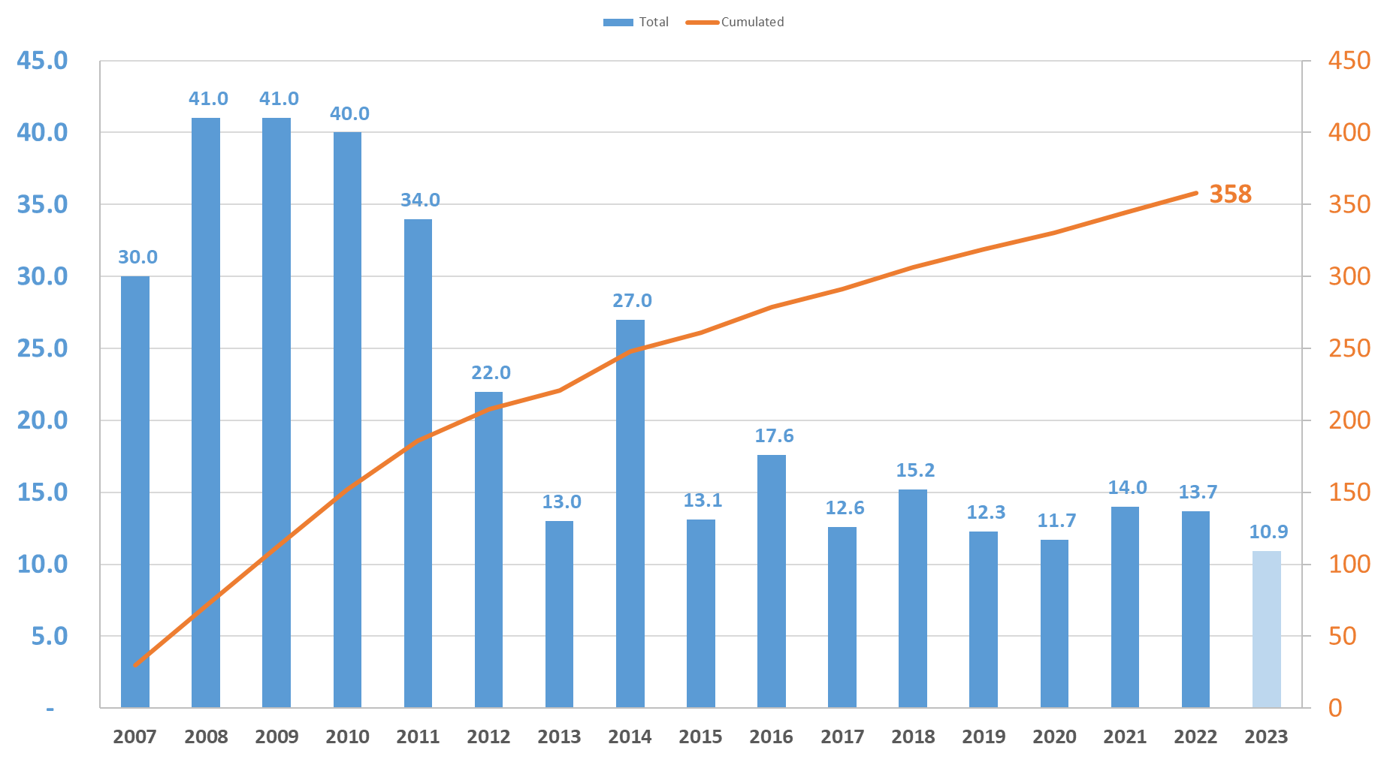
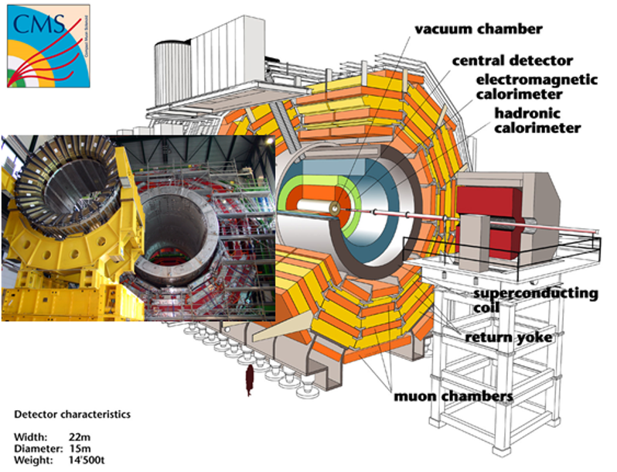
Use of helium cryogenics at CERN
For LHC machine constant effort to reduce losses showed significant results over the past 15 years
LHC & Experiments
ATLAS cooling at 4.5 K of the superconducting magnetic system
1.5 t
of losses for EXP in 2022
LHC Filling
RUN1
LS1
RUN2
LS2
RUN3
LHC machine cooling of the superconducting magnets at 1.9 K
CMS cooling at 4.5 K of the superconducting solenoid
130 to 150 t
of helium in LHC machine stock
13.7 t
of losses for the
LHC machine in 2022

Slide 6
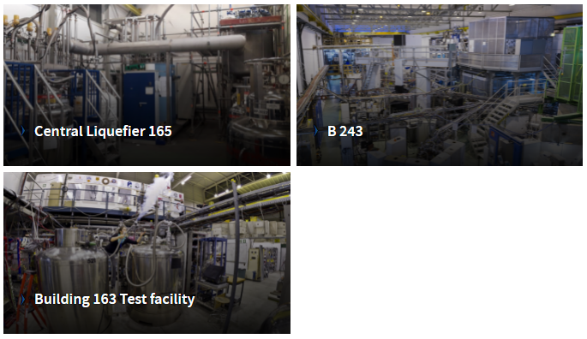
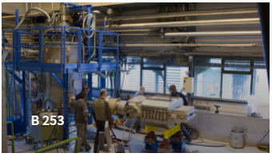
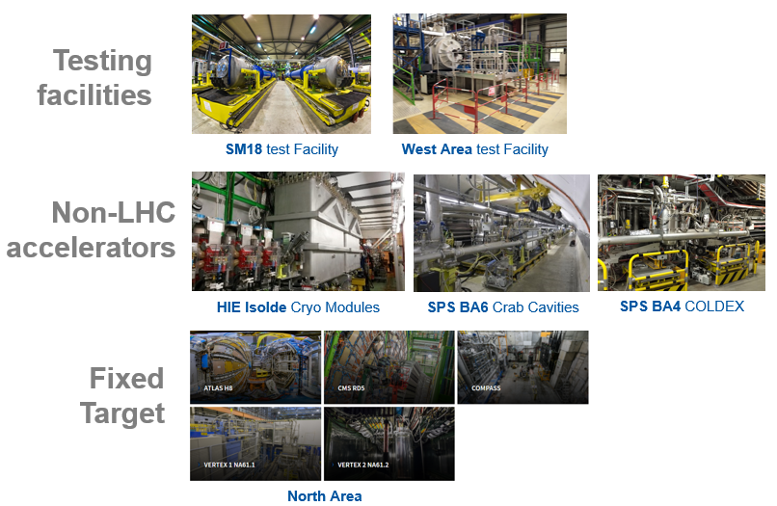
Use of helium cryogenics at CERN in 2022
Central Liquefier
High
rotation
stock
Almost 1’000 Dewars
53 t
of helium delivered
to users in 2022
8.4 t
to compensate losses
Central Liquefier & helium recovery
3 t
of helium inventory
5 t
to compensate losses
Helium Bottles
1.6 t
Delivered in 2022
1.5 t
Not recovered
Separated contracts for cylinders
supplied CERN-wide to delivery points
145 orders in 2022

Slide 7
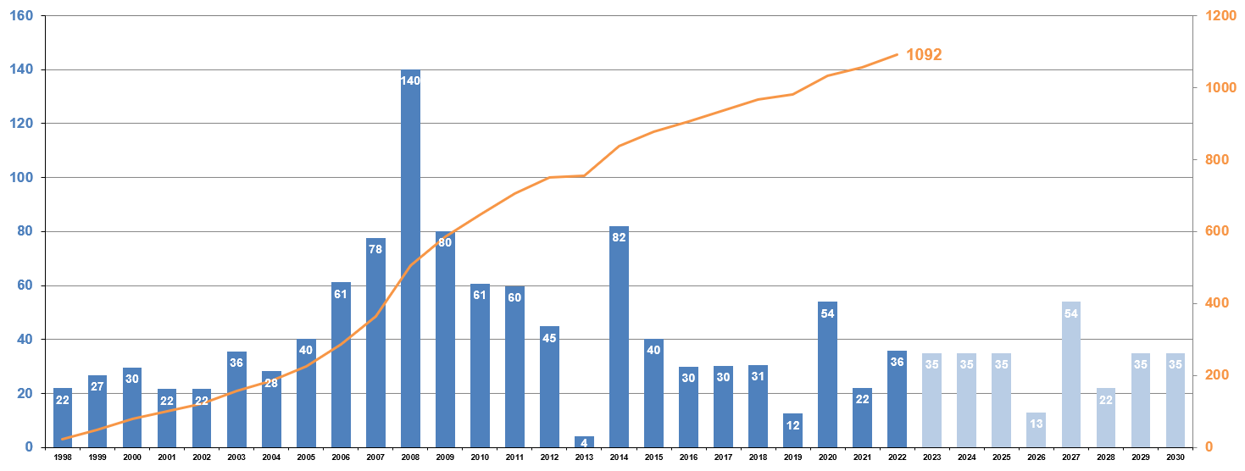
Scope of supply for helium contracts 2022-2026
In 2022:
8
ISO-containers delivered
35.9
Tons of liquid helium in 2022
Liquid helium supply
200 tonnes
to compensate helium losses
LHC Tests
LHC Filling
RUN1
LS1
RUN2
LS2
RUN3
LS3

Slide 8
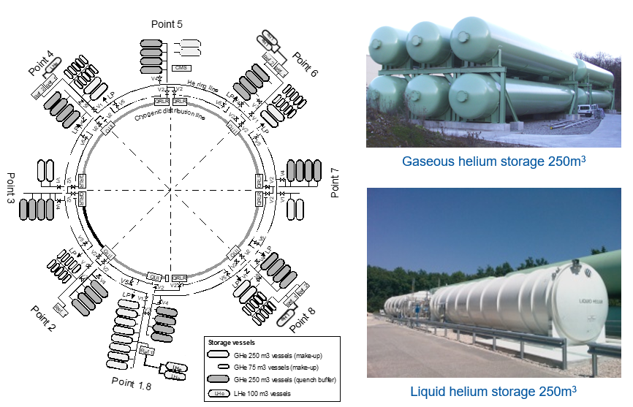
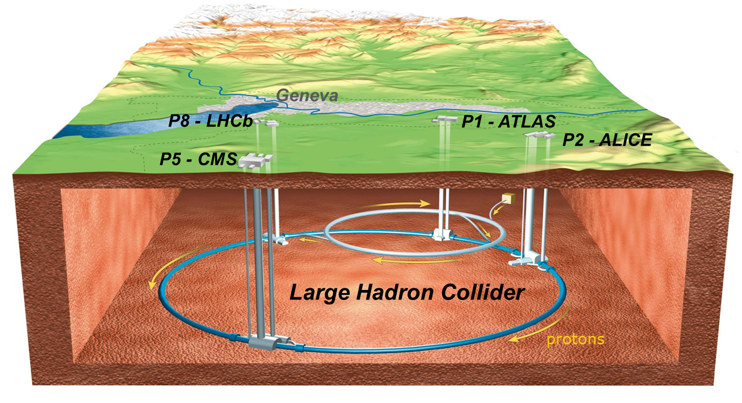
LHC cryogenics infrastructure
Surface storage & distribution
The surface storage capacity is limited and full inventory cannot be stored when the LHC machine is warmed-up
 | RUN | YETS | LS
LHC machine sectors condition | 8s@1.9K | 8s@20K | 8s@300K
Helium management | N/A | 18 t | 80 t
Gas management with our contractor, helium is temporary sent out from CERN to contractual suppliers and returned on demand. Included in the scope of the contract.
Underground storage in the machine
Helium preservation strategy with helium inventory maintained at CERN during YETS 2022-2023

Slide 9
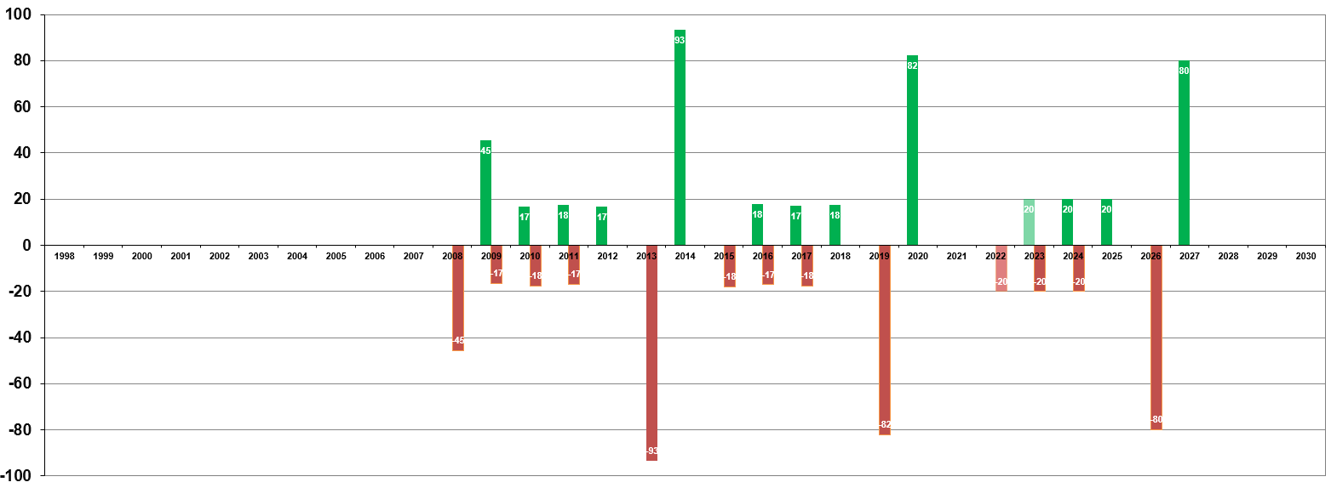
Scope of supply for helium contracts 2022-2026
In 2020 supply + gas management return equal:
30
ISO-containers delivered
135
Tons of liquid helium
0.5%
of the WW production
Helium returned
to CERN
Helium management
140 tonnes
temporary sent out from CERN to contractual suppliers and returned on demand
Helium back
to supplier
LHC Tests
LHC Filling
RUN1
LS1
RUN2
LS2
RUN3
LS3

Slide 10
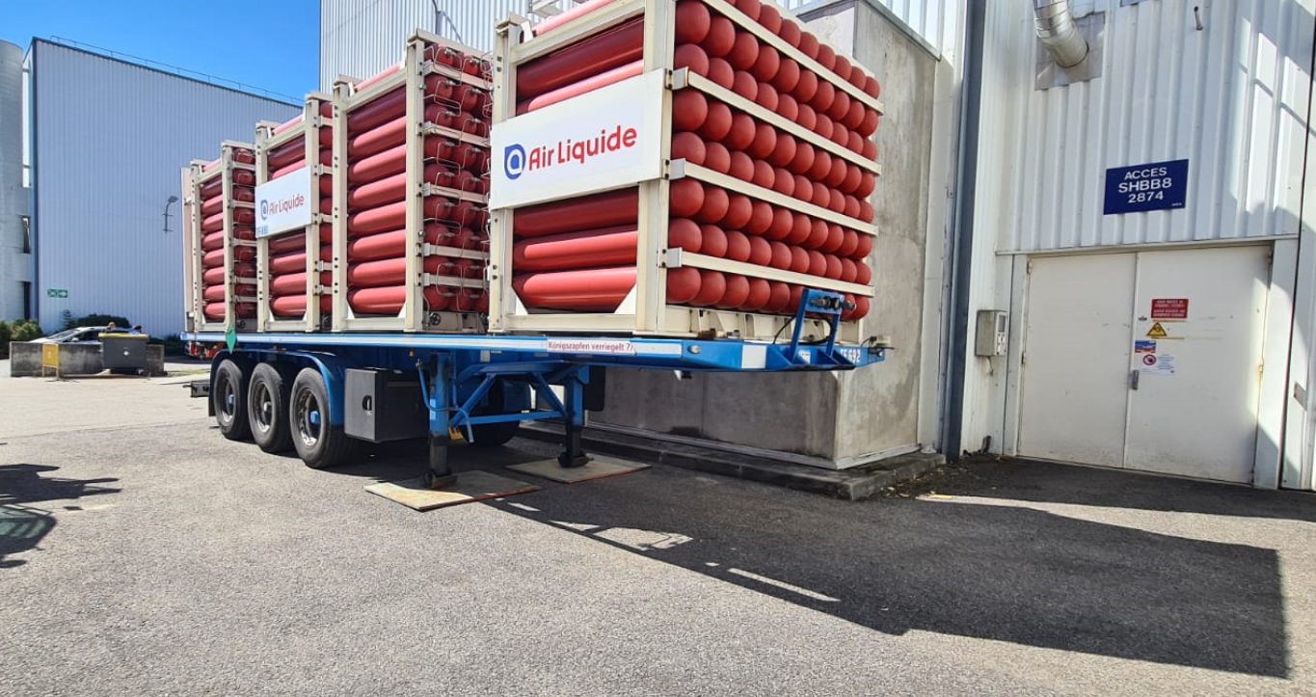
Scope of supply for helium contracts 2022-2026
Liquid helium supply
200 tonnes
to compensate helium losses
Helium management
140 tonnes
temporary sent out from CERN to contractual suppliers and returned on demand
Gaseous helium supply
6 tonnes
for LHC machine pressure tests
Mainly for testing and experiments
For LHC machine constant effort to reduce losses showed results over the past 15 years
This is a necessary extension of CERN storage capacity when LHC machine is partially or completely warm
High Pressure helium trailers are used to pressurized sectors for safety pressure test
Helium quantities including requirement for new HL LHC cryogenic infrastructure
During YETS 18 tonnes and LS 80 tonnes are sent out for about 2 months

Slide 11
Helium procurement strategy at CERN
RISK MATRIX
Single tender Liquid helium, Helium management, Gaseous helium
Partnership with leading companies European branches of worldwide gas companies
Direct access to several sources Supplier operating in different locations
Two contractual suppliers with maximum flexibility for CERN
Contract aligned with LHC cycle Master schedule for Run3 & LS3
Supplier capability CERN requirements during peak period known logistics patterns of LS1 & LS2
Unbalanced supply & demand Helium Shortages 2006, 2011, 2018
Geopolitical stability in the country of extraction, Qatar 2017
Logistics complexity blockage of Suez Canal in 2020
Shutdown or issue at source Event on LNG feed or helium liquefaction plants
RISK MITIGATION

Slide 12
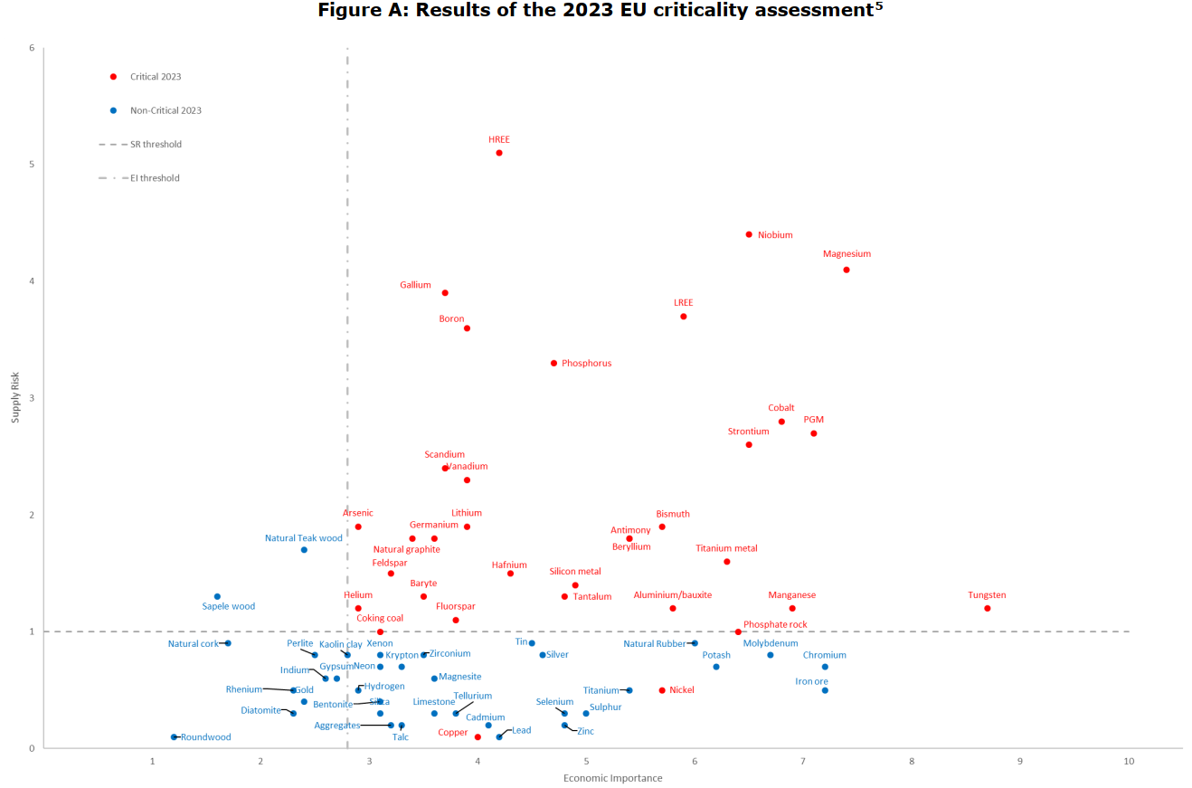
Helium from EU perspective
Supply Risk (SR)
Helium is considered in EU assessment as a Critical Raw Material in 2023
In the CRM report for Strategic Technologies and Sectors in the EU 2020
Other raw materials that are not used in ICT (Ed, Information & Communication Technology) equipment are equally relevant to ensure its proper functioning and may become critical for the deployment of next generation computing. For example, helium is used to create the low operating temperature close to absolute zero that is needed for quantum computing technologies, supra and semiconductors.
Economic Importance (EI)
Notes:
https://rmis.jrc.ec.europa.eu/
See ISBN 978-92-79-68051-9 METHODOLOGY FOR ESTABLISHING THE EU LIST OF CRITICAL RAW MATERIALS
------------------------------------------------------
Nothing to do with Helium:
LREE/HREE = Light/Heavy Rare Earth Elements

Slide 13
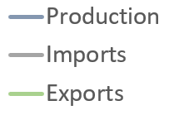
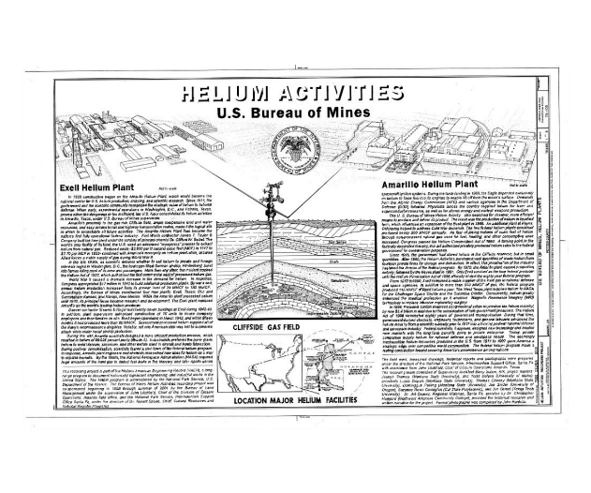
Helium long term market evolution originally driven by US strategic decisions
Helium Shortages
1.0 2.0 3.0 4.0
2006 2011 2018 2022
2008 2013 2020 …
Helium US production, imports, exports and storage in Tonnes, based on US geological survey data
1925
Helium Act
Creation of helium extraction activities and development at the Cliffside infrastructure and underground storage of the federal strategic reserve
Significant increase of the production in the 60’s with incentive to the private sector to increase the US Federal strategic stock
Rapid decrease of the production in 70s when stock reached an equivalent of about 7yr consumption
Increase of the production in 80s at stable stock to supply demanding market
Managed by the state BLM with significant associated costs. Comfort zone low prospecting and investment elsewhere
1996
Helium privatization Act
2013
Stewardship Act
Federal government decided to sell the stock to the private sector till 2012 to payback US federal accumulated costs
Large industrial investment in Algeria in the 90’s and Qatar since 2008
Regulation of the of the market by selling of the strategic reserve through yearly auctions to the private sector till 2018
Make the bridge with new international extraction capacity development
Regulation of the US domestic market, but reduction of exports over the years
Market is not regulated anymore at the end of this period
Production capacity developments in the private sector was too low at the end of
this period
Notes:
No more than 3 minutes !

Slide 14
Helium extraction evolution worldwide
In 1995
USA
17’300 t
Poland
230 t
Russia
700 t
Algeria
630 t
18.9 Kt
of helium extracted worldwide
92%
in the US
Main sources of helium extracted from natural gas in 1995 according to US Geological survey in tonnes
From a market regulated by the US…
frederic.ferrand@cern.ch

Slide 15
Helium extraction evolution worldwide
In 2021
Russia
1’500 t
USA
11’800 t
Poland
165 t
Canada
165 t
Algeria
2’300 t
Qatar
8’450 t
China
165 t
25.2 Kt
of helium extracted worldwide
Australia
660 t
47%
in the US
Main sources of helium extracted from natural gas in 2021 according to US Geological survey in tonnes
… to a deregulated market with geopolitical challenges
frederic.ferrand@cern.ch

Slide 16
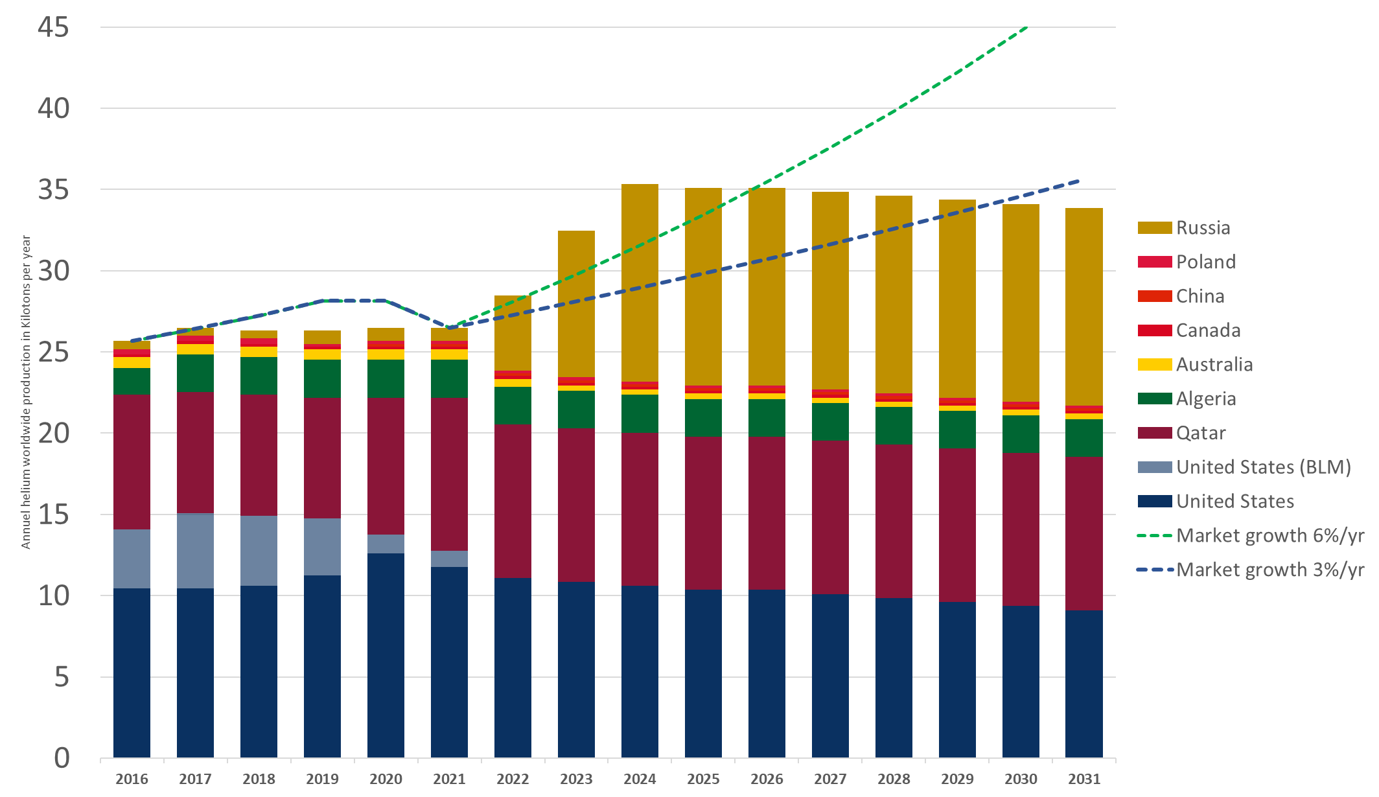
Helium supply evolution expected back in 2021
What happened in 2022 ?
Helium Shortage
3.0
2018
2020
Explosion in Russia at Amur site on January 5th stopping production.
Conflict in Ukraine leading to commercial limitation for with Russia
Cliffside temporary closure for 6 months in the US due to safety issues
Planned maintenance on other sites during spring period
Post Covid restart of industrial activities in demand of helium
US Geological survey helium extraction 2016 to 2021 in tonnes
& announcement of new capacities in Qatar (He3) and Russia
frederic.ferrand@cern.ch

Slide 17
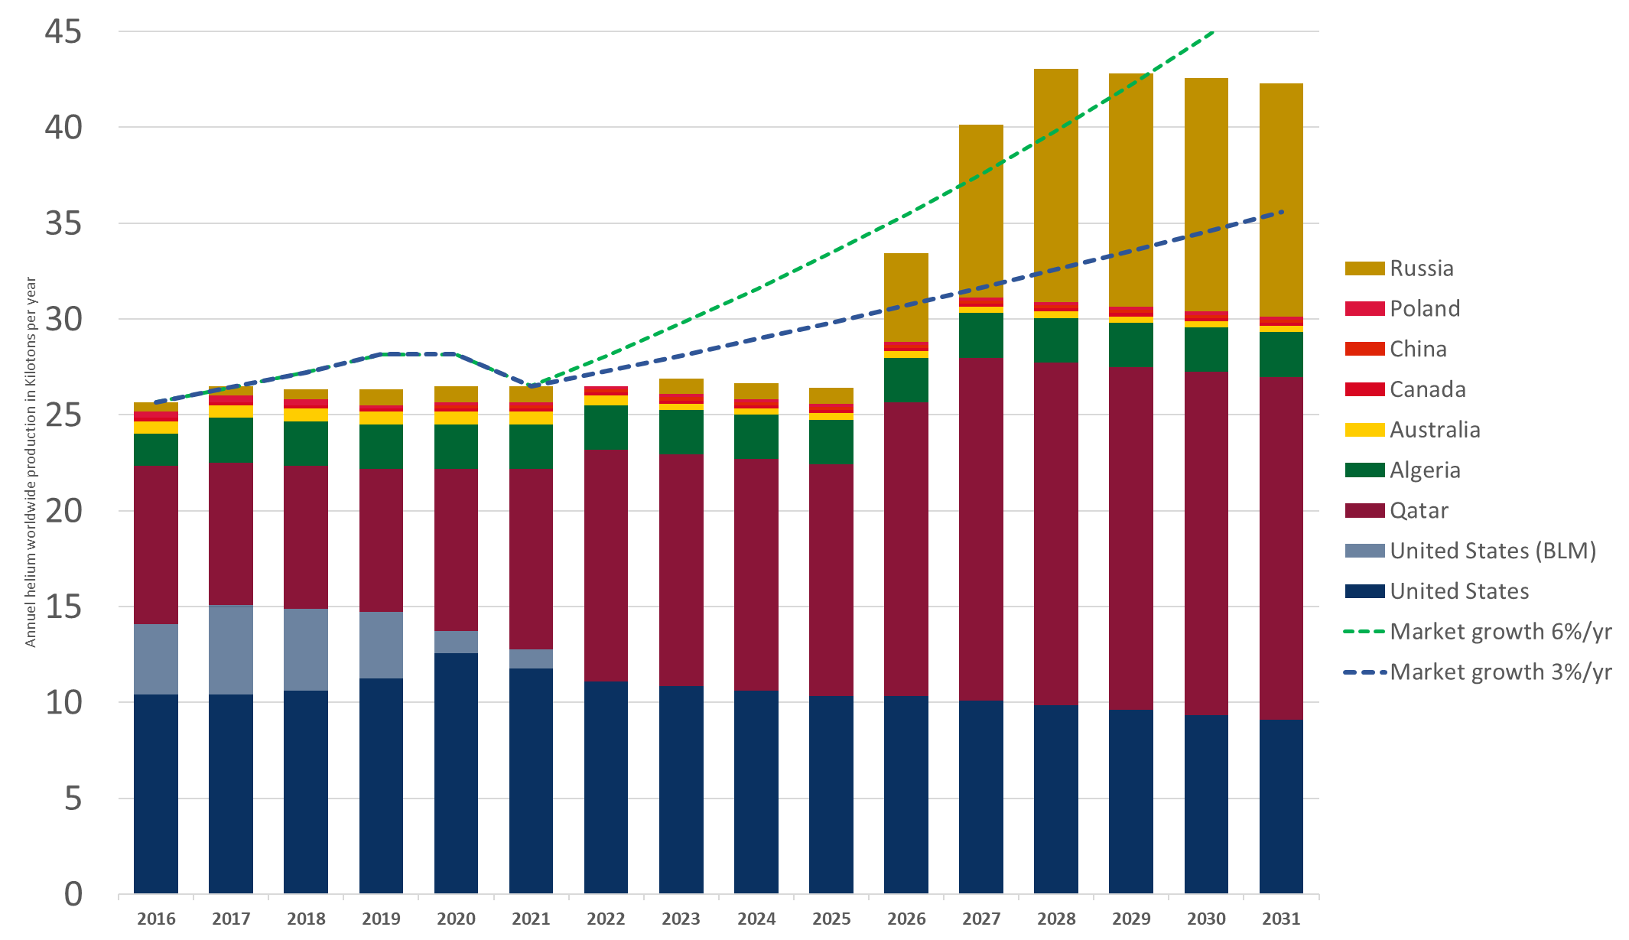
Helium supply tentative forecast
Helium Shortages
3.0
2018
2020
4.0
2022
…
?
Shortage 4.0 is affecting all industrial and scientific customers worldwide
Volume allocations applied to manufacturing industry contracts
No more back-up from the US federal authorities
Worst Case scenario voluntary presented here considering Amur restart may take significant time
One good news with new Qatar Helium IV plant in the pipeline
US Geological survey helium extraction 2016 to 2021 in tonnes
& announcement of new capacities in Qatar (He3 and He4)
and Russia AMUR restart considered at the very end of supply contract (Worst Case)

Slide 18
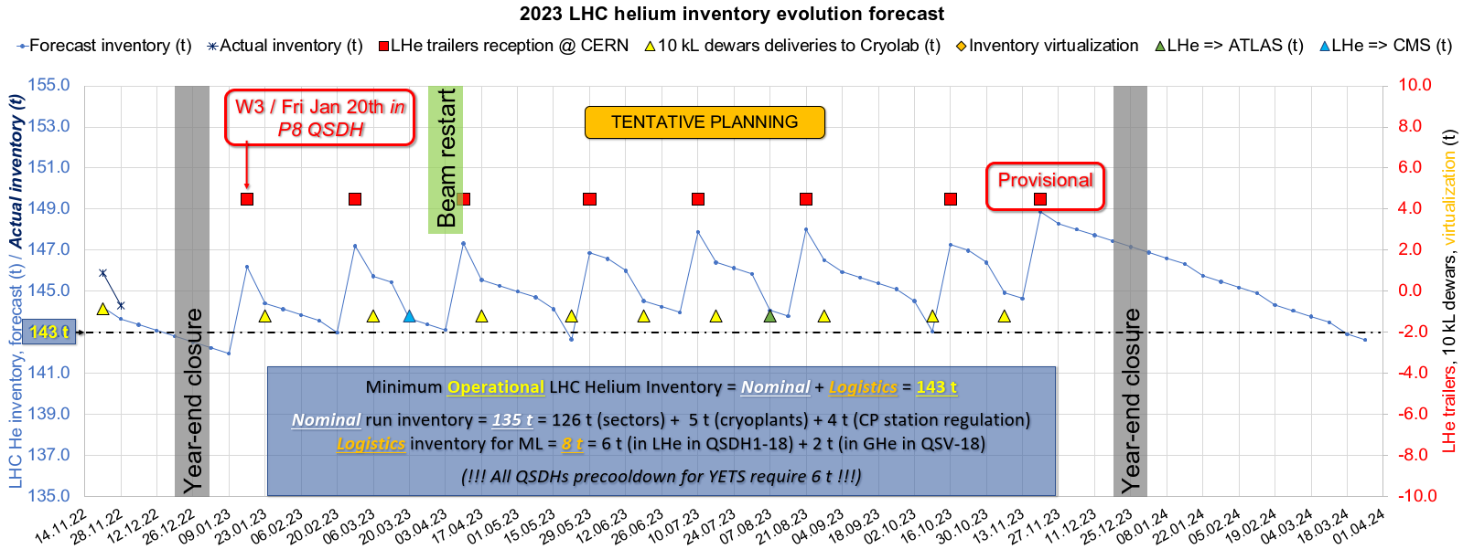
Action taken by CERN
Helium supply contract management
CERN benefits from a contract signed before the shortage but the supply chain is under pressure
Partnership between CERN and supplier's management team at EMEA and worldwide level with strengthen the relationship and mutual understanding of operational constraints
Development of the helium inventory management tool by cryogenics LHC operation team to manage logistics need precisely
Planned helium volume have been delivered in 2022 (35.9t) & Q1-2023
Courtesy of CRG-OP Laurent Delprat
Gas Management of 18 t during YETS 2022-2023
Helium preservation strategy with helium inventory maintained at CERN to avoid market risk
Storage in the LHC machine was not chosen considering energy crisis scenarios
Operation “Cold Dragon”. Storage was done on site in 4 rented ISO-containers for 8 weeks.
Extension of the storage capacity under study for next YETS
YETS2022-2023, ISO-containers used for temporary storage at LHC P6 and P8

Slide 19
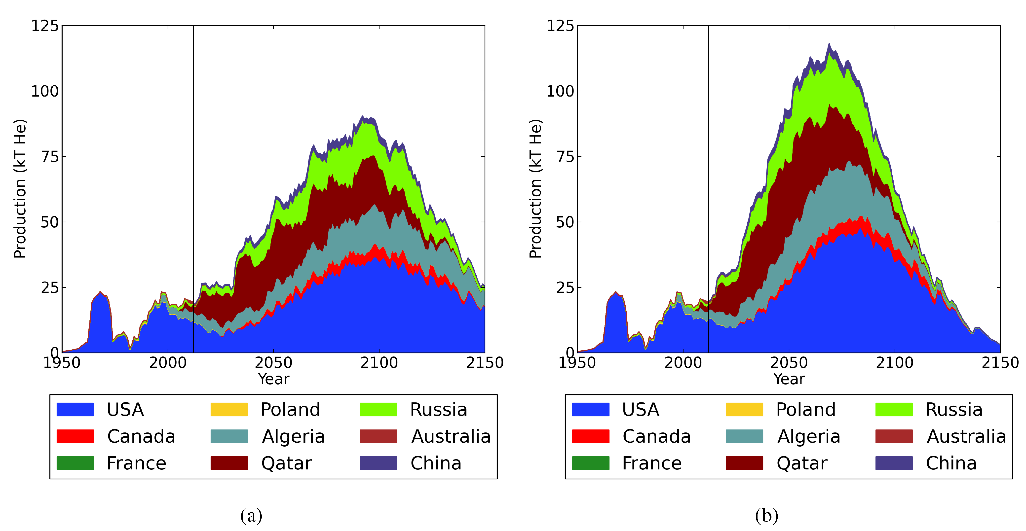
Worldwide total helium resource estimates
Helium availability is highly dependent on LNG production continuity even in the long run. Complementary claimed reserves in South Africa (1’600 Kt TBC) not consolidated.
Russia
1’150 Kt
Canada
330 Kt
Primary helium based on extraction of helium in nitrogen-based deposits remains marginal, but exploration and developments are expected in Tanzania (650 Kt TBC) & Canada (TBC)
Poland
4 Kt
Qatar
1’700 Kt
China
180 Kt
Algeria
1’350 Kt
USA
1’400 Kt
Long term projections are risky, but some models are published
Tanzania
South Africa
Others
500 Kt
Worldwide total helium reserves and resources of estimated by the US geological survey in 2006 & complementary resource claimed by some countries in between
6’600 Kt
of helium WW estimated reserve according to USGS report in 2021
Source Minerals 2014 by Steve Mohr and James Ward
based on WW estimated reserve of 8’300 Kt
Helium footprint and supply & gas management risk shall be integrated in the risk matrix of large scientific studies
Notes:
Helium Production and Possible Projection
Minerals 2014, 4(1), 130-144; by Steve Mohr and James Ward

Slide 20
Conclusion & perspectives L’hélium, un sujet à ne pas prendre à la légère
Helium market is still at risk for RUN 3
For 2023, CERN volumes are secured so far, and logistics plan is reviewed with suppliers regularly
We are confident but risks of disruption remain possible in case of issue on supplier side at the extraction site or significant accidental loss of helium on CERN infrastructure
New source in Amur site restart will be game changer to rebalance the market even if CERN does not supply helium from Russia
Many solicitations from external laboratories and universities since beginning of the shortage
Helium preservation strategy during accelerators shutdowns
For YETS, extension of our helium storage is under study for storage of the full inventory at CERN if necessary for the coming years
For LS3, we is studying helium management strategy during next Long Shutdown 3 (2026-2028)
Medium and Long term
There are reasons to be optimistic for helium availability possibly by the time we extend or renew current contract
Helium market could finally take off with LNG development in the coming decade
Helium footprint and supply & gas management risk shall be integrated in the risk matrix of large scientific studies
Primary helium source development should be followed with interest

Slide 21
Main sources & interesting further reading
Helium Statistics and Information from the US Geological Survey
Statistics and information on the worldwide supply of, demand for, and flow of the mineral commodity helium.
Historical Statistics for Mineral and Material Commodities in the United States. By Thomas D. Kelly and Grecia R. Matos, with major contributions provided by David A. Buckingham, Carl A. DiFrancesco, Kenneth E. Porter, and USGS mineral commodity specialists.
National Assessment of Helium Resources Within Known Natural Gas Reservoirs. Scientific Investigations Report 2021-5085 by: Sean T. Brennan, Jennifer L. Rivera, Brian A. Varela, and Andy J. Park
Hélium : les nouvelles géographies d’une ressource critique (in French)
Institut français des relations internationales. Briefings du 16 juin 2022, by Aurélien REYS and Vincent BOS
There’s a shortage of helium and the pricing environment is right – if explorers can find any
Published on January 16, 2023, by Emma Davies Based on interview of Phil Kornbluth founder of Kornbluth Helium Consulting
Gasworld helium publications history & webinars
Various publications & webinars on the helium gas market are available.
Helium Production and Possible Projection
Minerals 2014, 4(1), 130-144; by Steve Mohr and James Ward

Slide 23
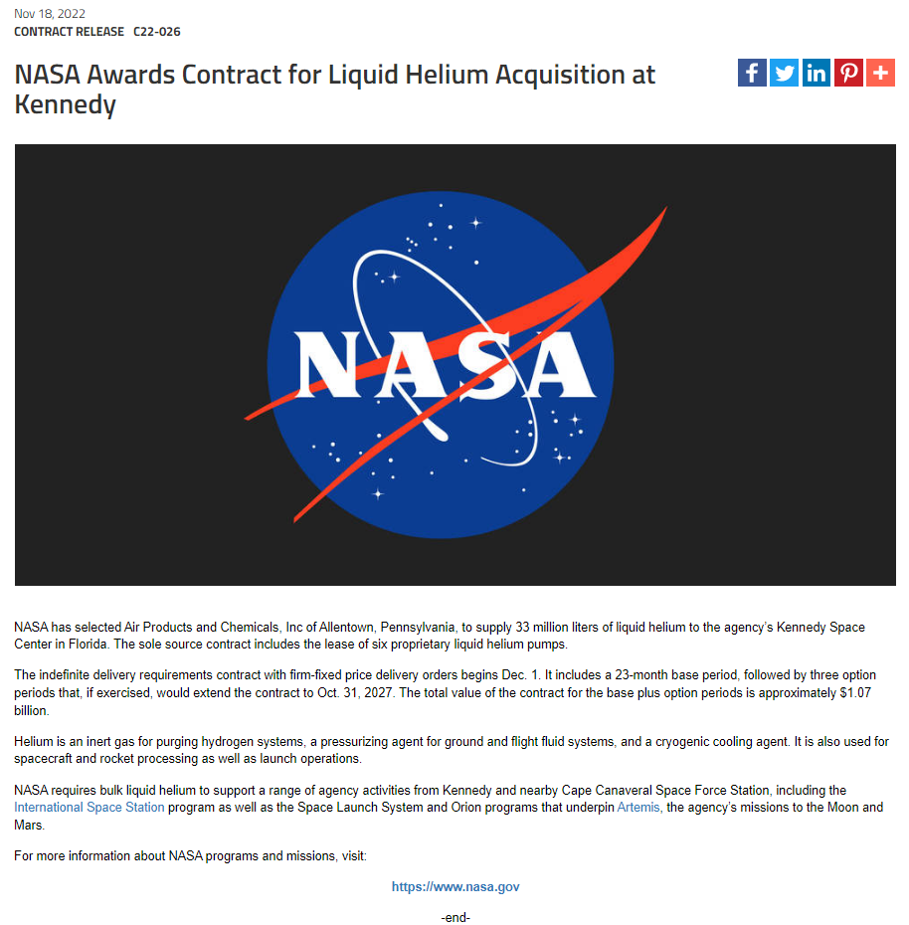
33 million liters LHe = 4’120 t
5-yr contract from 2022 till 2027
825 t/yr.
214 M$/yr.
259 $/kg
3% current WW production

