Slide 1
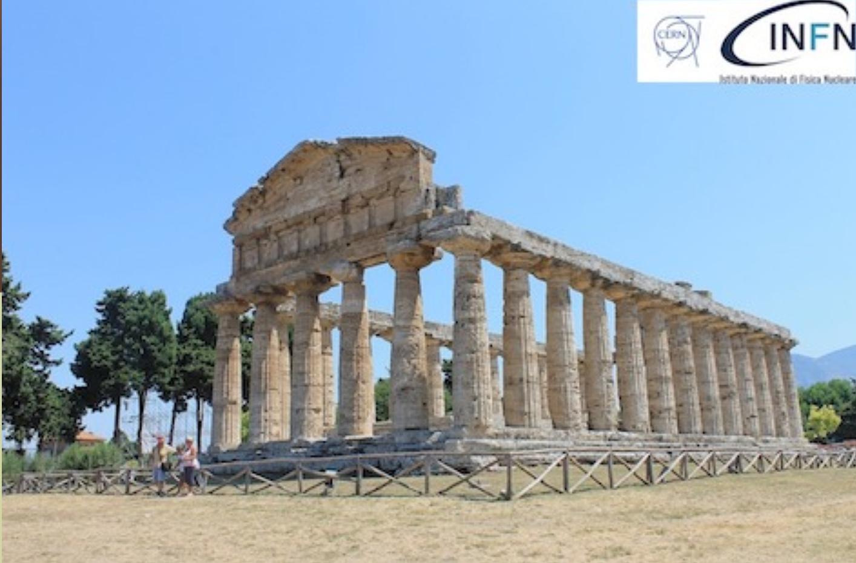

Challenges of test infrastructures for fusion in the US
G. Velev
4th Superconducting Magnet Test Facility Workshop

Slide 2
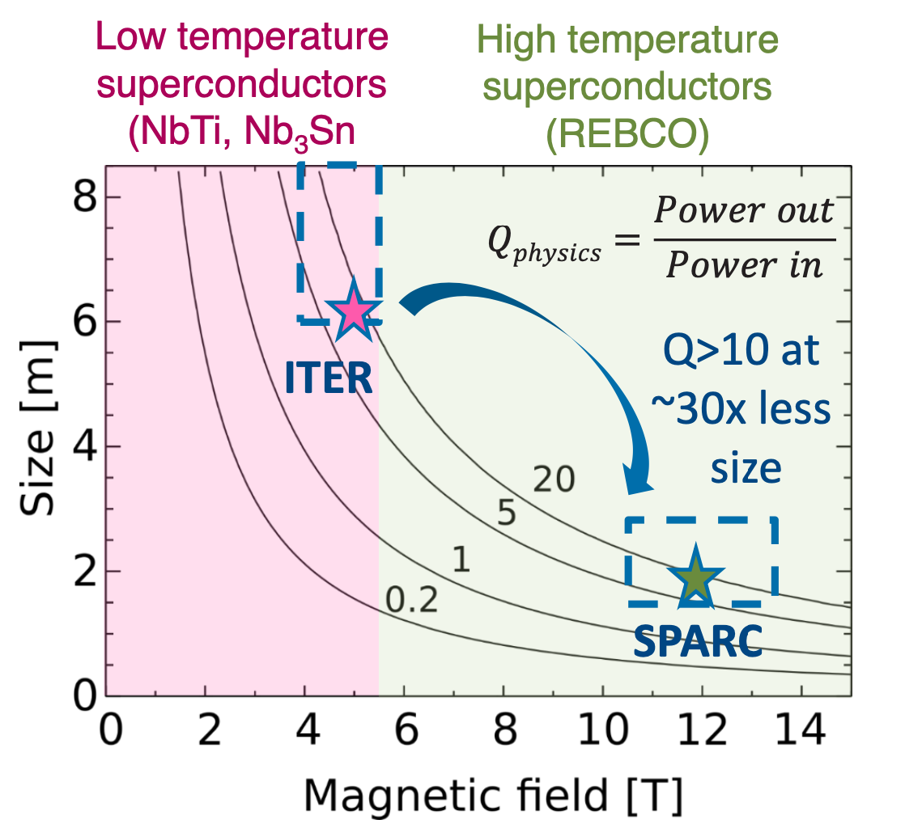
Preamble
High magnetic fields offer an attractive path to achieving net fusion energy.
The fusion community in the USA has been investigating the use of REBCO magnets, which could potentially facilitate the development of smaller Tokamak devices operating at higher fields.
Infrastructure for testing components for these magnets is currently under development.
This talk does not include commercial test stands – for example, GA test stand for ITER central solenoid.
Courtesy of Z. Hartwig (MIT/PSFC)
Notes:
MIT/Plasma Science and Fusion Center
CFS

Slide 3
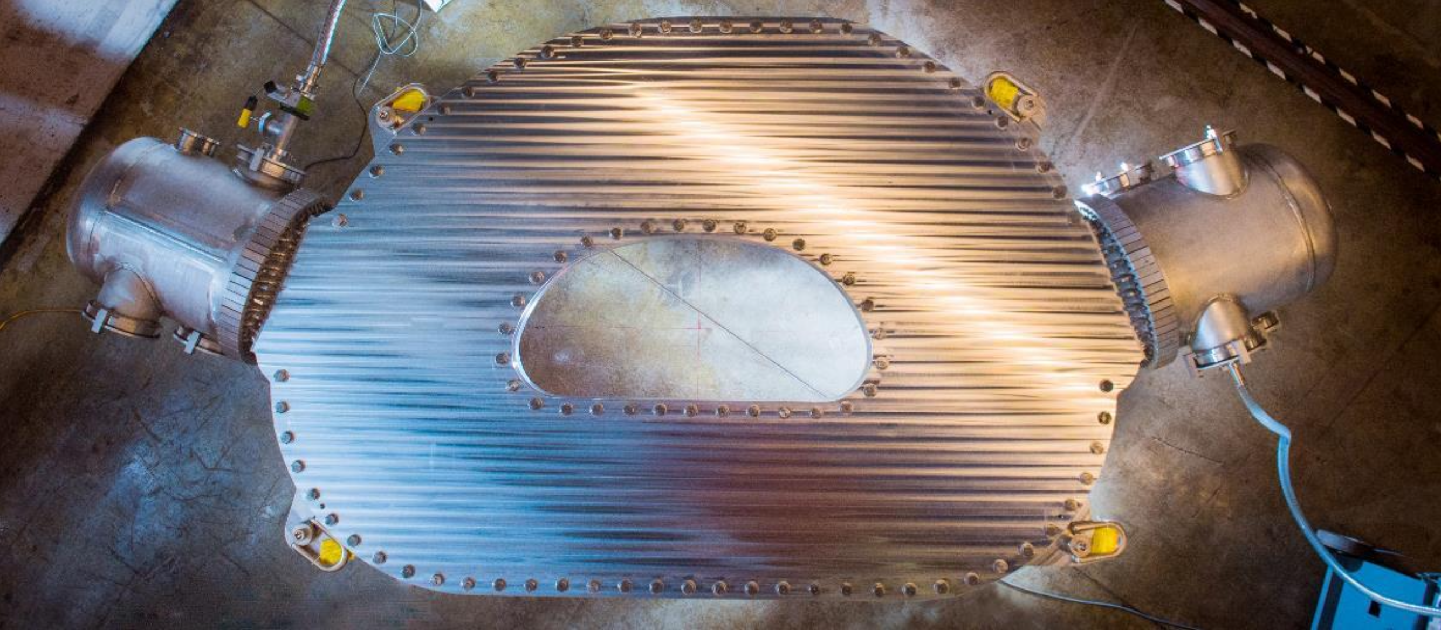
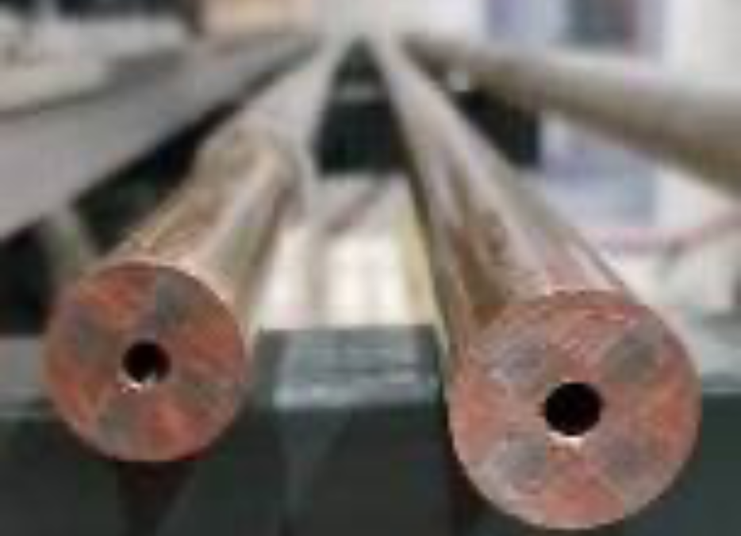
Challenges
TORIODAL COIL
Recently MIT/Plasma Science and Fusion Center built a model toroidal coil for the first conceptual design machine (SPARC)
This device should produce the same power as ITER, in the volume, but significantly smaller than ITER
New CICCs was developed – e.g., VIPER
Challenges for US – to have in short time an operational test facility where cable optimizations and splice characterization can be performed
  at high currents ~ 100kA
  at variable temperatures
  at external fields up to 15 T
  quench characterization I_{c}
  efficient and user-friendly facility
VIPER CICC
Courtesy of Z. Hartwig (MIT/PSFC)

Slide 4
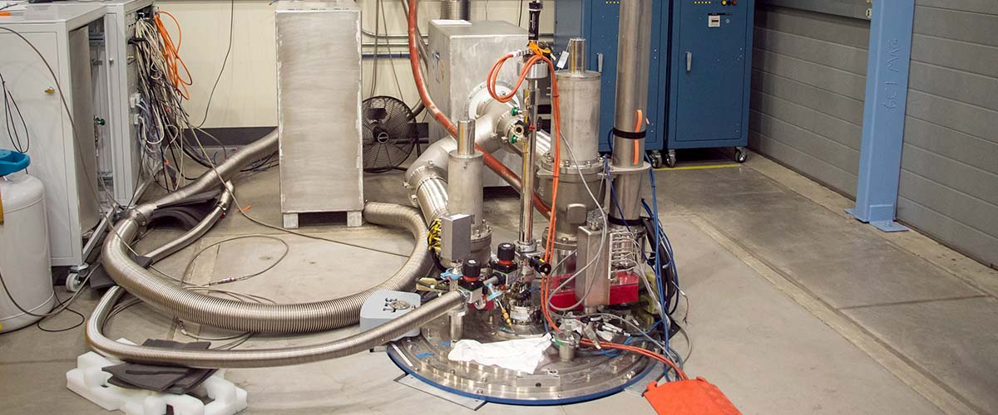
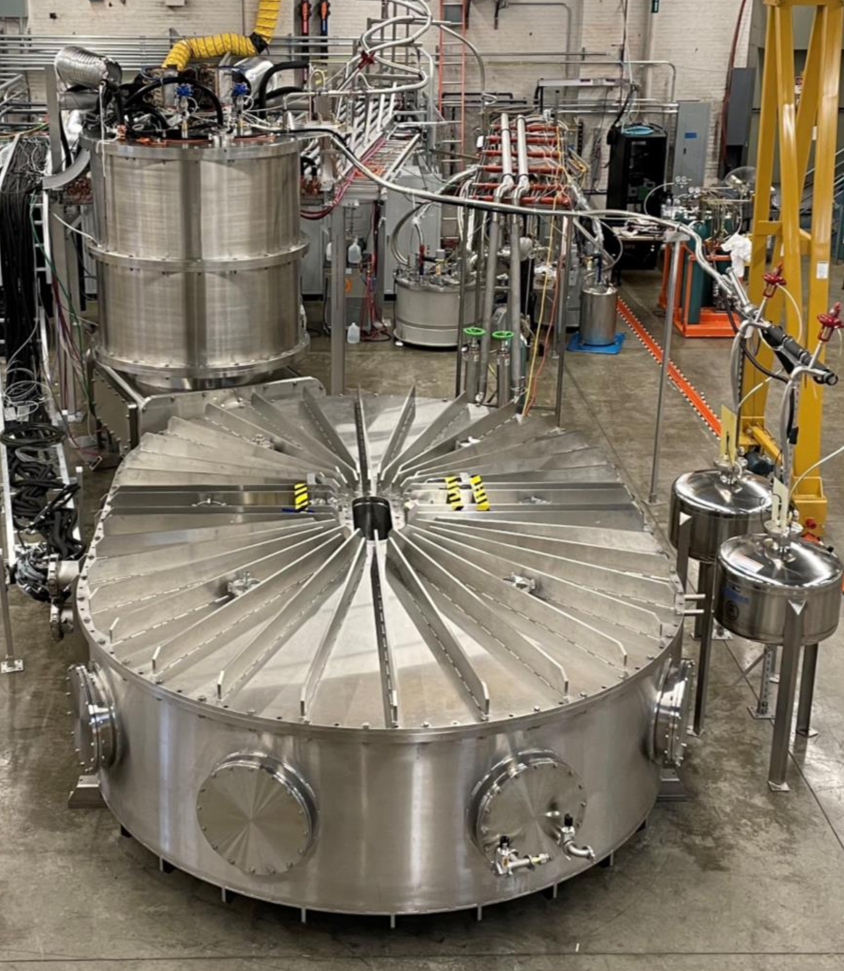
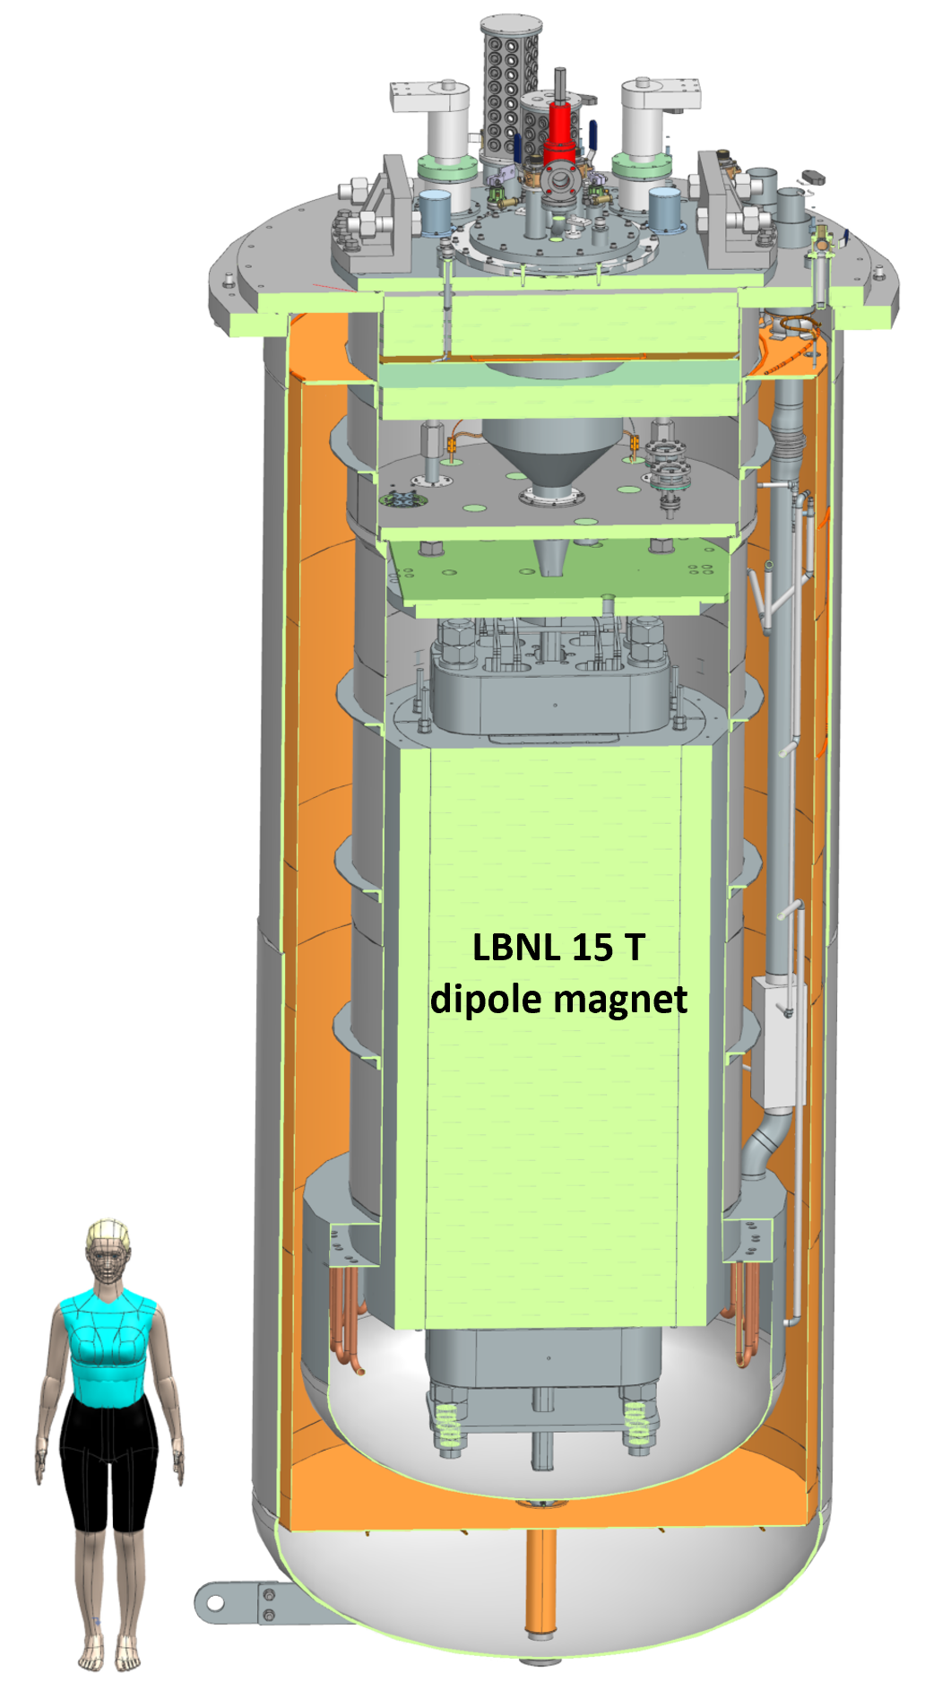
Outline
Summary of the test facilities
  MIT/PSFC facility
  NHMFL (Florida State University)
  BNL test facility - talk by J. Piyush
  ORNL – Material Irradiation
  Other US labs and Universities
New test facility at Fermilab
  Parameters and operational modes
  Current status
    Test pit construction
    Cryostat
    Quench protection and monitoring systems (QP/QM)
    Power supplies
15 T dipole (TFD) - provided by LBNL
Test insert, cable (sample) holder, anti-cryostat design
Summary
Special thanks to: Zach Hartwig (MIT), Mark Bird and Dan Davis (NHMFL), Fermilab and Berkeley teams
NHMFL and FSU
Test Facility (MIT) Magnet testing
Fermilab cable
HTS test facility

Slide 5
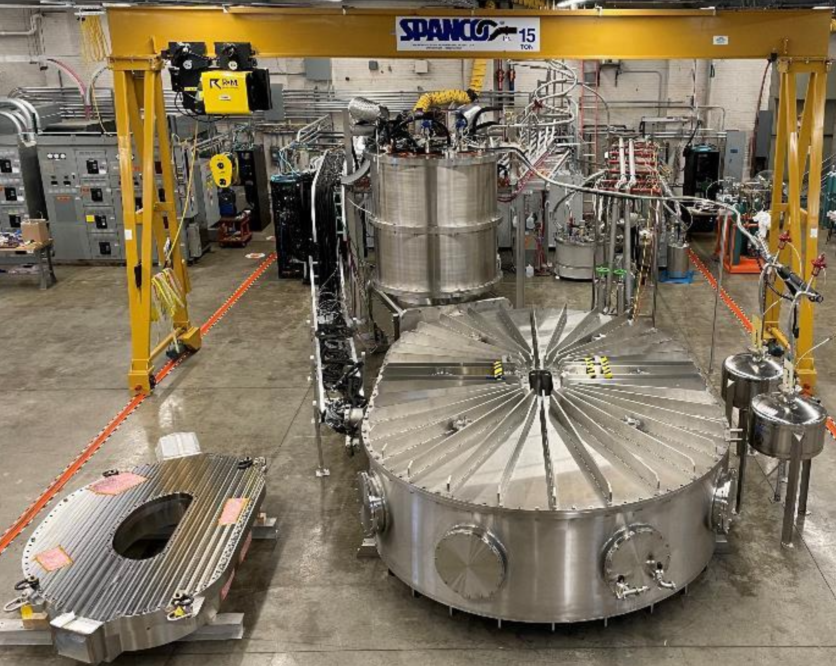
SPARC TFMC (MIT)
Courtesy of Z. Hartwig (MIT/PSFC)
Facility built to test a Toroidal Field Model
Suitable for testing large-scale coils
No background magnetic field
Formally does not operate it as a "user
facility" - would be open if there are users out there who see a need.
Some key parameters might be:
  Coils <3m in x-y scale, <0.5m in z-scale
  Temperatures between 20-40 K
  Currents up to 50 kA (at voltages < 100 V only)
  Full set of diagnostics capabilities: V-taps, heaters, Cernoxes, flow meters, strain gauges, etc.
Cannot be used directly to test SC cables
50 kA feeder system
The Toroidal Field Magnet Coil
https://indico.cern.ch/event/1165664/attachments/2487093/4273745/CERN_TFMC_Hartwig_20220727.pdf
Notes:
Toroidal Field Magnet Coil

Slide 6
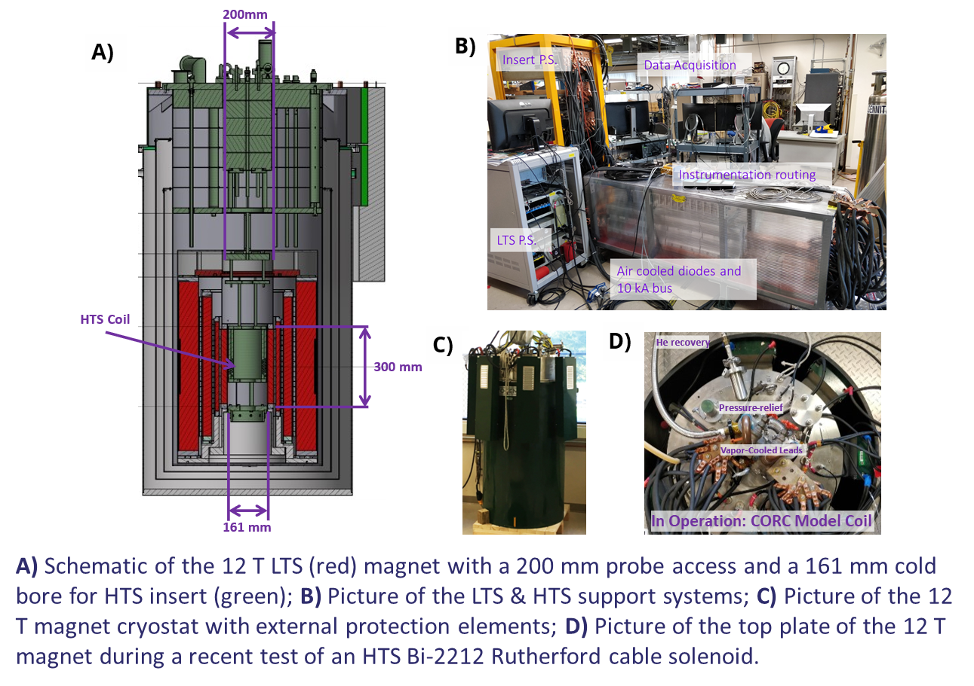

NHMFL: HTS Test-bed
14 T HTS Coil Test Bed
Solenoidal field
Magnet bore 161 mm, 200 mm access bore for leads, 128 ppm homogeneity
Large bore enables insert magnets:
To explore field generation and mechanical limits cables and coils
Implement novel HTS quench management
Upgrades underway: 2 more 1.2 kA supplies, 10 kA, FPGA control, and faster IGBT replacement to mechanical contactors for quench management
Cannot be used for test of the large diameter CICC
Courtesy of D. Davis (NHMFL)
G. Velev | 4th Superconducting Magnet Test Facility Workshop
6

Slide 7
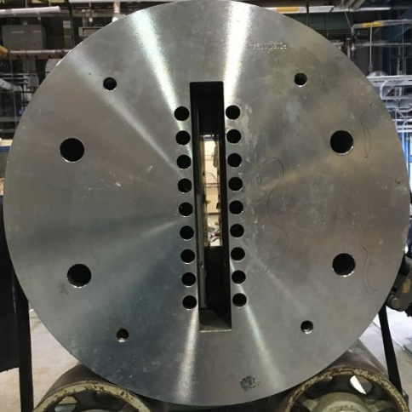
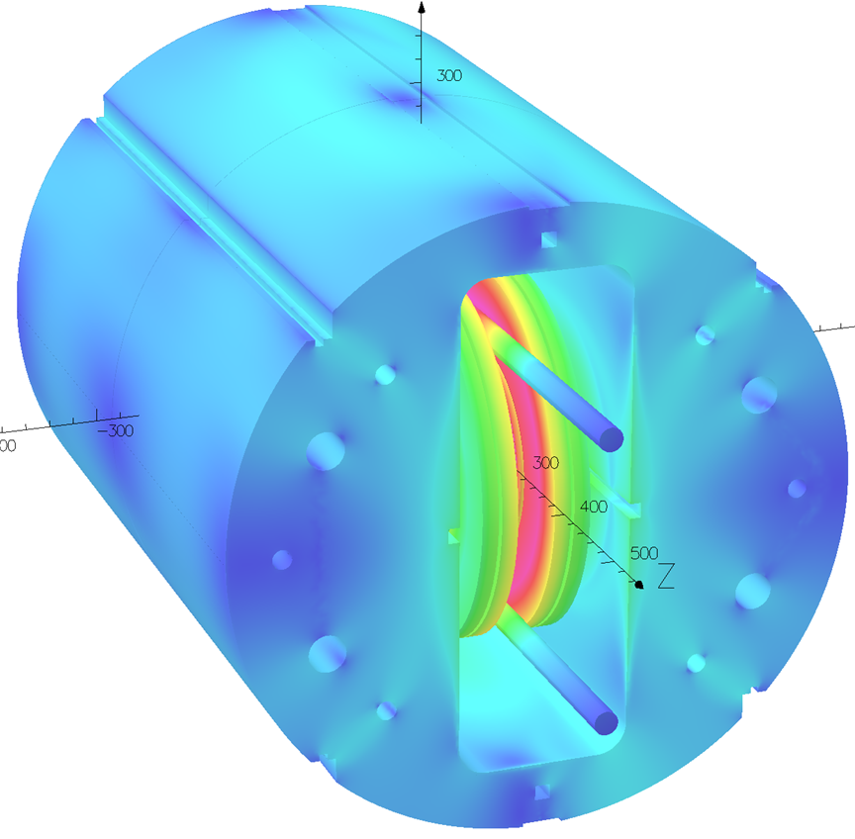
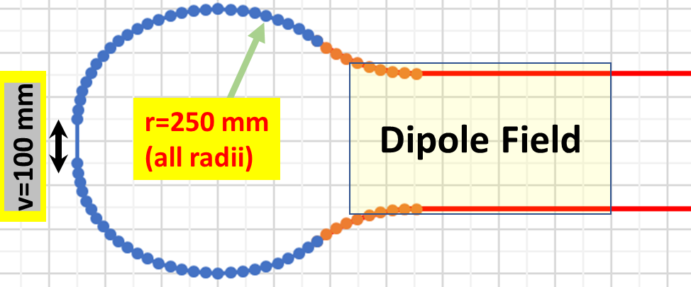
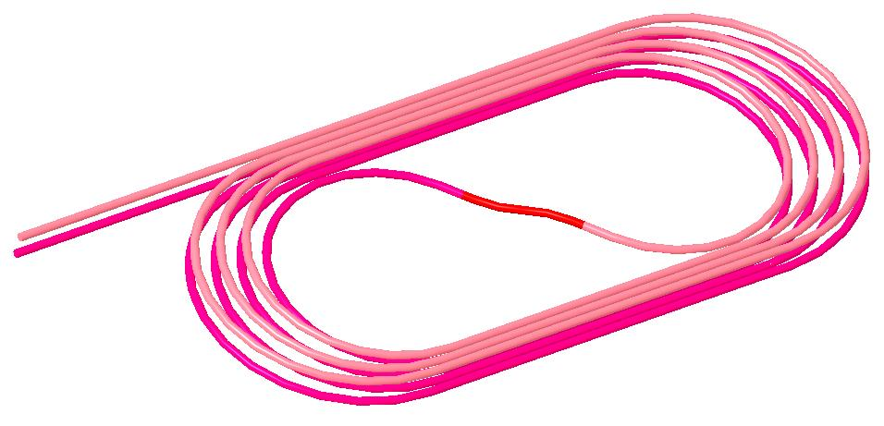
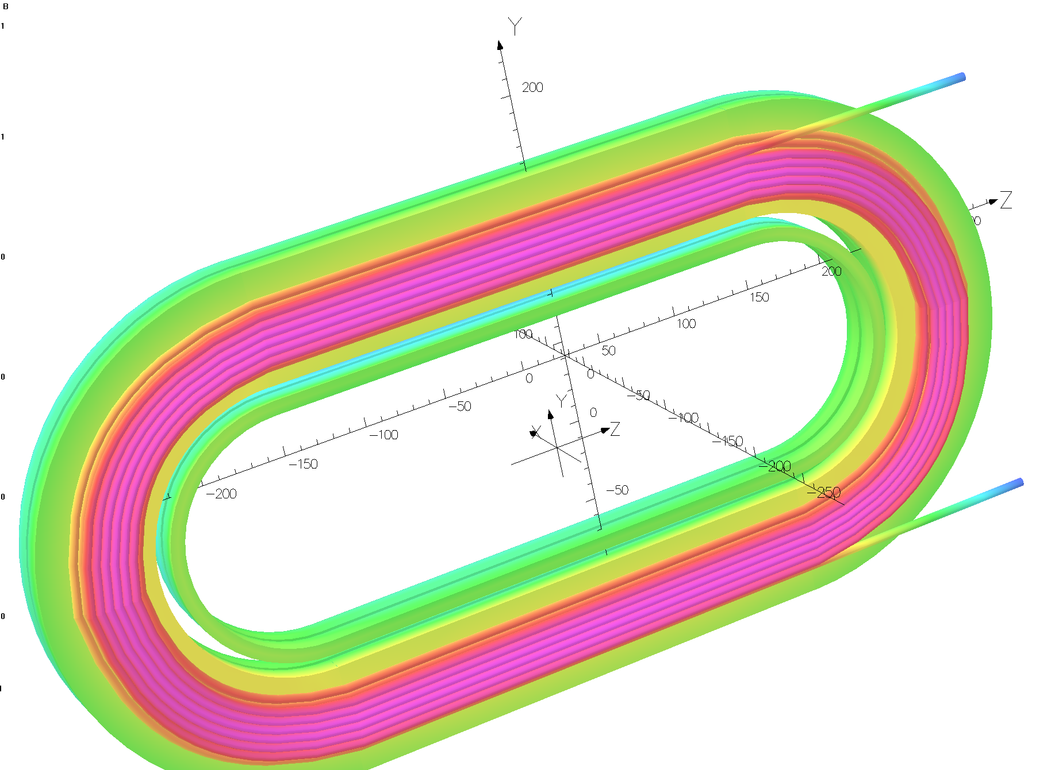
Nb₃Sn Common Coil Dipole for High Current HTS Cable Testing - BNL
A Nb₃Sn dipole with a large opening (335 mm x 31 mm) providing a field of 10.2 T
Unique Features: High current, long length, HTS cables with large bend radius can be tested in applied dipole field (important for Fusion cables)
HTS cables can be tested at high temperatures (4K – 50⁺ K) with small upgrades
Advanced instrumentation (quench protection)
Innovative R&D facility offers unique opportunities to fusion
Empty space
https://www.bnl.gov/magnets/staff/gupta/commoncoil/cc-bnl-rapid-rnd-testing.pdf

Slide 8
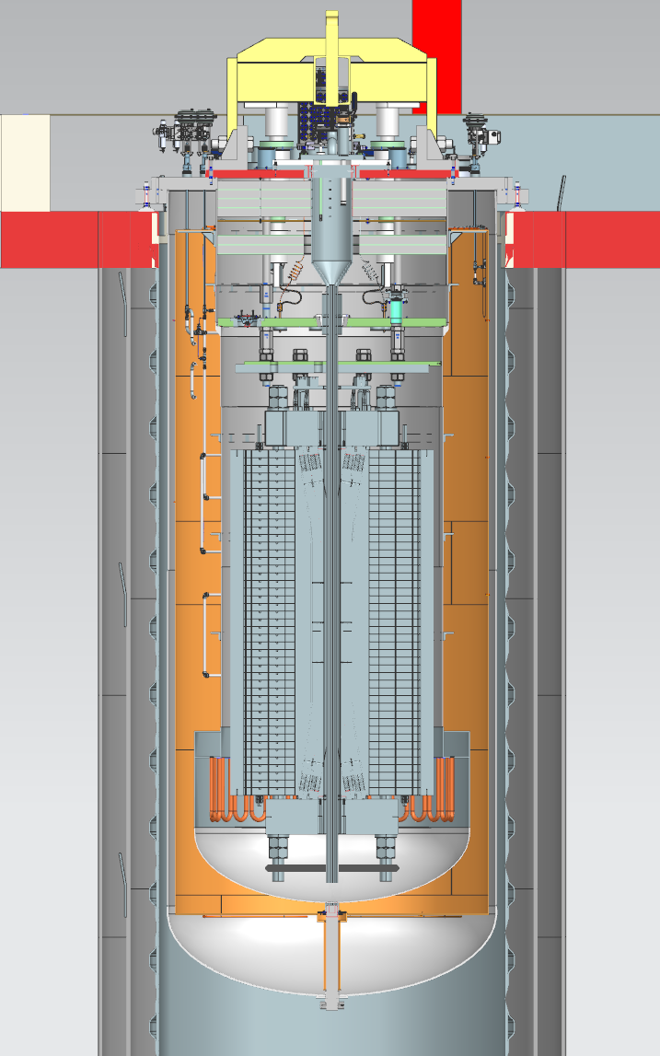
New test facility at Fermilab
US DOE Offices of High Energy Physics and Fusion Energy Sciences joined their effort to build HTS cable-testing facility.
This facility is currently constructed at Fermilab.
  For the US FES and HEP, it will serve as a test stand for HTS cables in high dipole field and at increased temperatures.
  It is designed to provide similar or better capabilities than EDIPO at PSI, and FRESCA2 at CERN
  For the US HEP Magnet Development Program, it will be the main facility for testing of magnets with 16-20 plus T fields, including hybrid magnets

Slide 9
Test Facility – parameters
The place was selected based on the proximity to the needed base infrastructure, including cryogenic, power, water and cranes
Two (one new) liquefiers with capacity of ~ 640 l per hour.
Minimum operating temperature of the facility is 1.9K for the magnet providing the background field and with min 4.5 K for the test samples, variable to ~50 K.
The test pit cryostat should accommodate a magnet with maximum dimensions of 1.3 m and length of ~3 m
The maximum energy stored in the test field dipole should be < 20 MJ
The maximum weight of the dipole cold mass should not exceed 20 ton
The test facility should be efficient and safe, minimizing the time for experiment preparation and no helium losses.
Operational lifetime of the facility at least 20 years.

Slide 10
Summary of the parameters
Parameter | Value
Background Dipole Field | 15 T
Minimum Operational Temperature | 1.9 K
Maximum Magnet Diameter | 1.3 m
Maximum Magnet Length | 3.0 m
Maximum Stored Energy | 20 MJ
Maximum Weight | 20 t
Test Sample Temperature | 4.5-50.0 K
Maximum Test Sample Current (direct) | 16 kA
Maximum Test Sample Current (transformer) | 100 kA

Slide 11
Operational Modes
TWO OPERATIONAL MODES
Fusion mode - HTS cable test:
  In 15 T@1.9K ( ~15 kA)
  Anti-cryostat with sample holder for cable test, (CICC)
  Variable temperature for the cable 4.5 to 50 K
  SC transformer to provide 100kA
  Full diagnostic and protection
  Dedicated top and lambda plates
  Sample holder for HTS cables
Magnet R&D mode for the US Magnet Development Program
  Large aperture/large diameter magnets LTS@1.9 K powered up to 24 kA
  Hybrid magnet tests (LTS + HTS) at 1.9 K powered with 16 kA PS
  Full diagnostic and protection
  Dedicated top and lambda plates

Slide 12
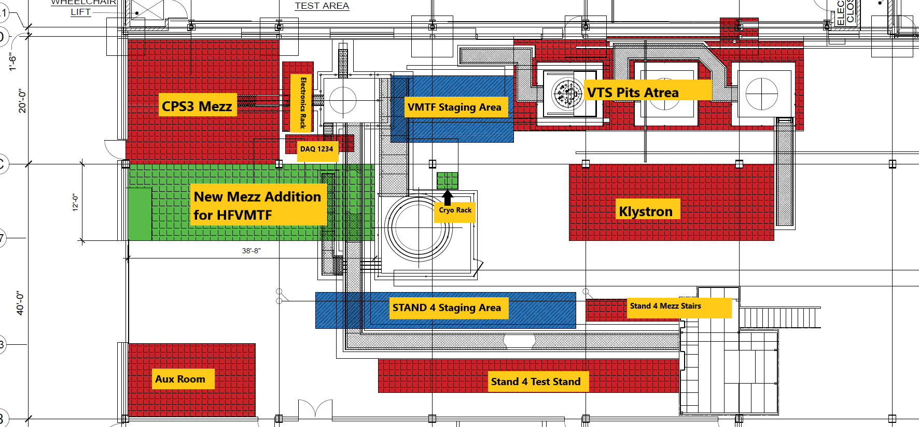
TF layout

Slide 13
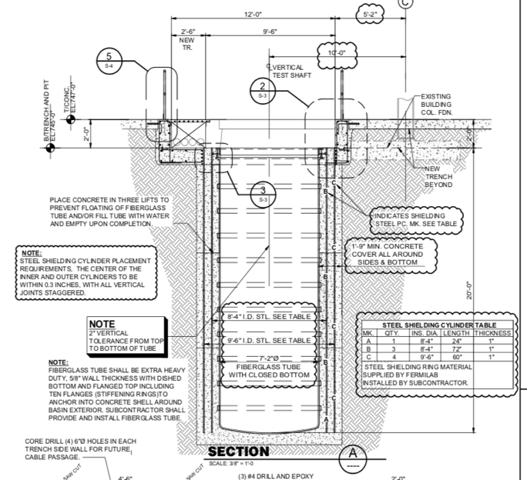
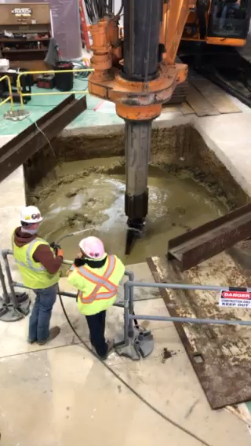
Pit Construction - Done
Status
  Pit construction - started in October 2020 –finished in May 2021
We added two cylindrical steel shields to contain the fringe magnetic field.
Construction challenges:
  Heavy construction machines were used in the tight building space
  Preventing walls to collapse
Pit continues to be dry even during strong Midwest rains
9’-6’’ (2.9m)
20’ (6.1m)
Steel shields

Slide 14
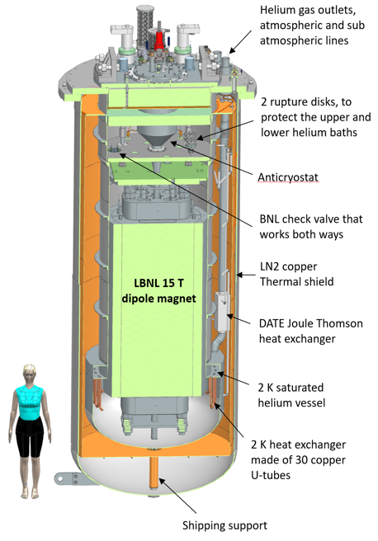
Cryostat
It is a large double-bath vessel with a lambda plate that separates the 4.5 K normal liquid helium on the upper section from the pressurized superfluid helium at 1.9 K and 1.3 bar
The current design of this helium vessel is similar to the existing test stands at Fermilab
Vendor is selected
Final cryostat design is finalized and reviewed, PRR is expected at the end of May
  Expected delivery in the fall of 2023

Slide 15
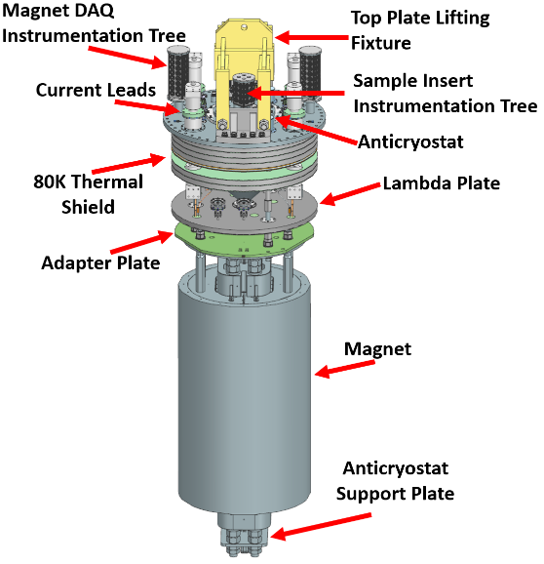
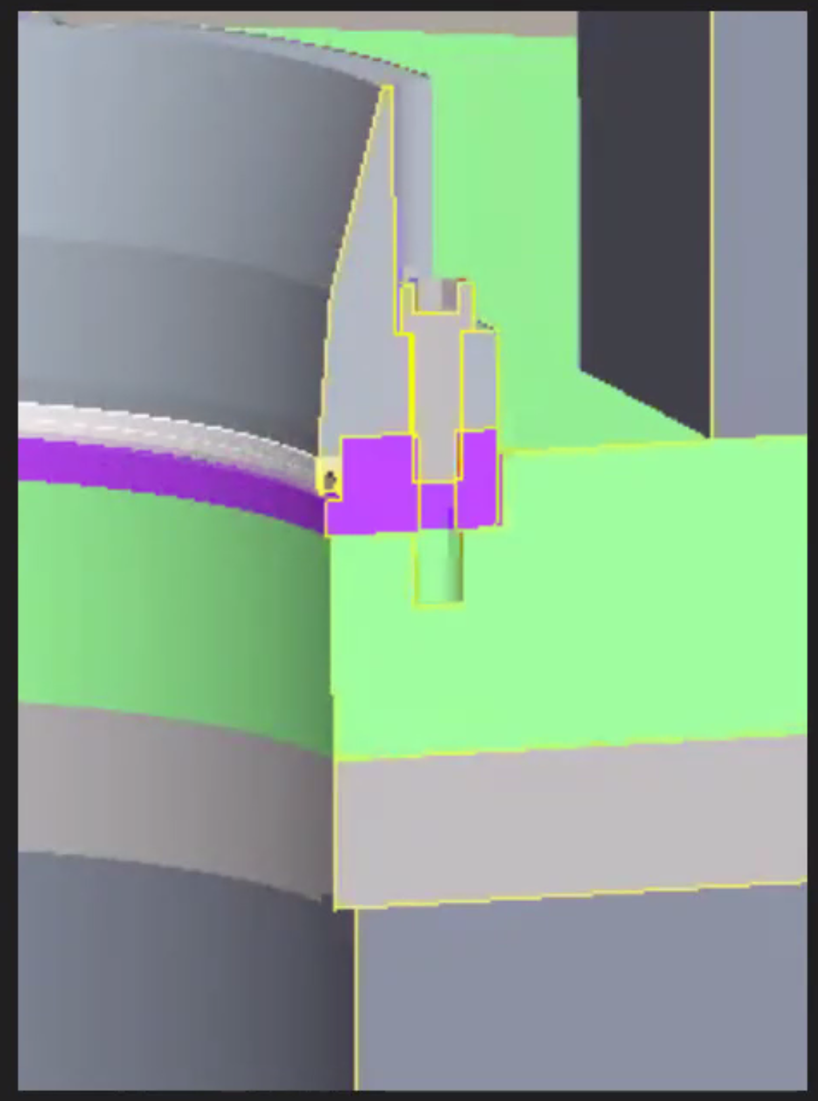
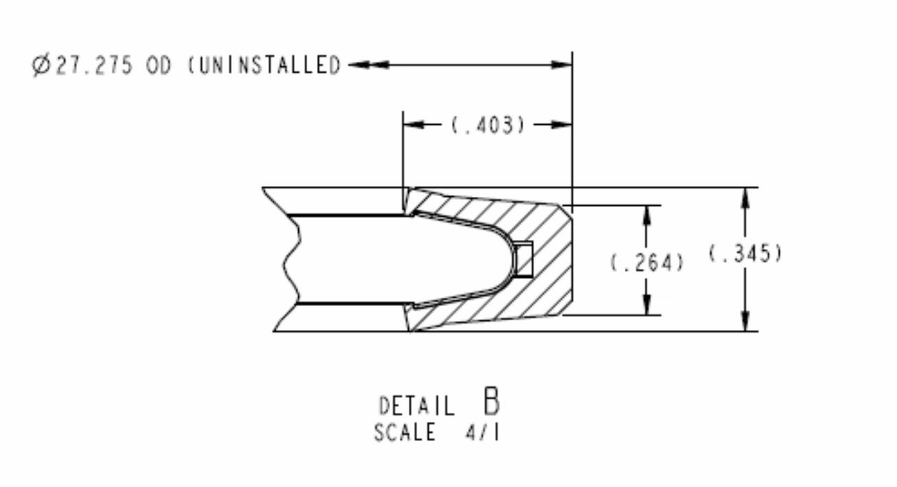
Top and lambda plates
Top and lambda plates design is in progress
The goal is to deliver the top and lambda plate in the fall of 2023 to start cold commissioning of the cryostat
We entertained 3 different options for lambda plate sealing to the cryostat and decided on spring energized Teflon type seal (used in BNL TF)

Slide 16
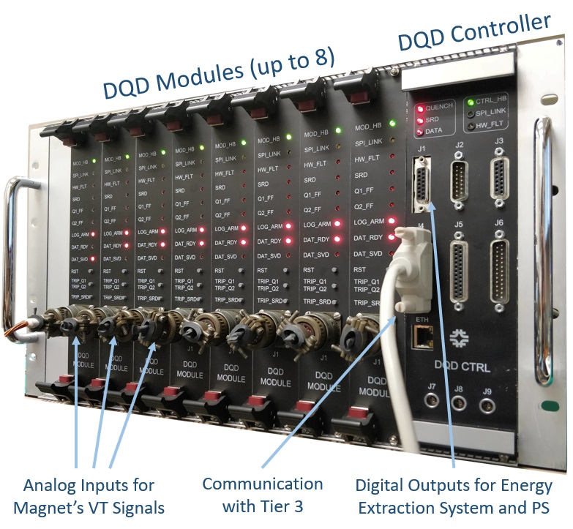
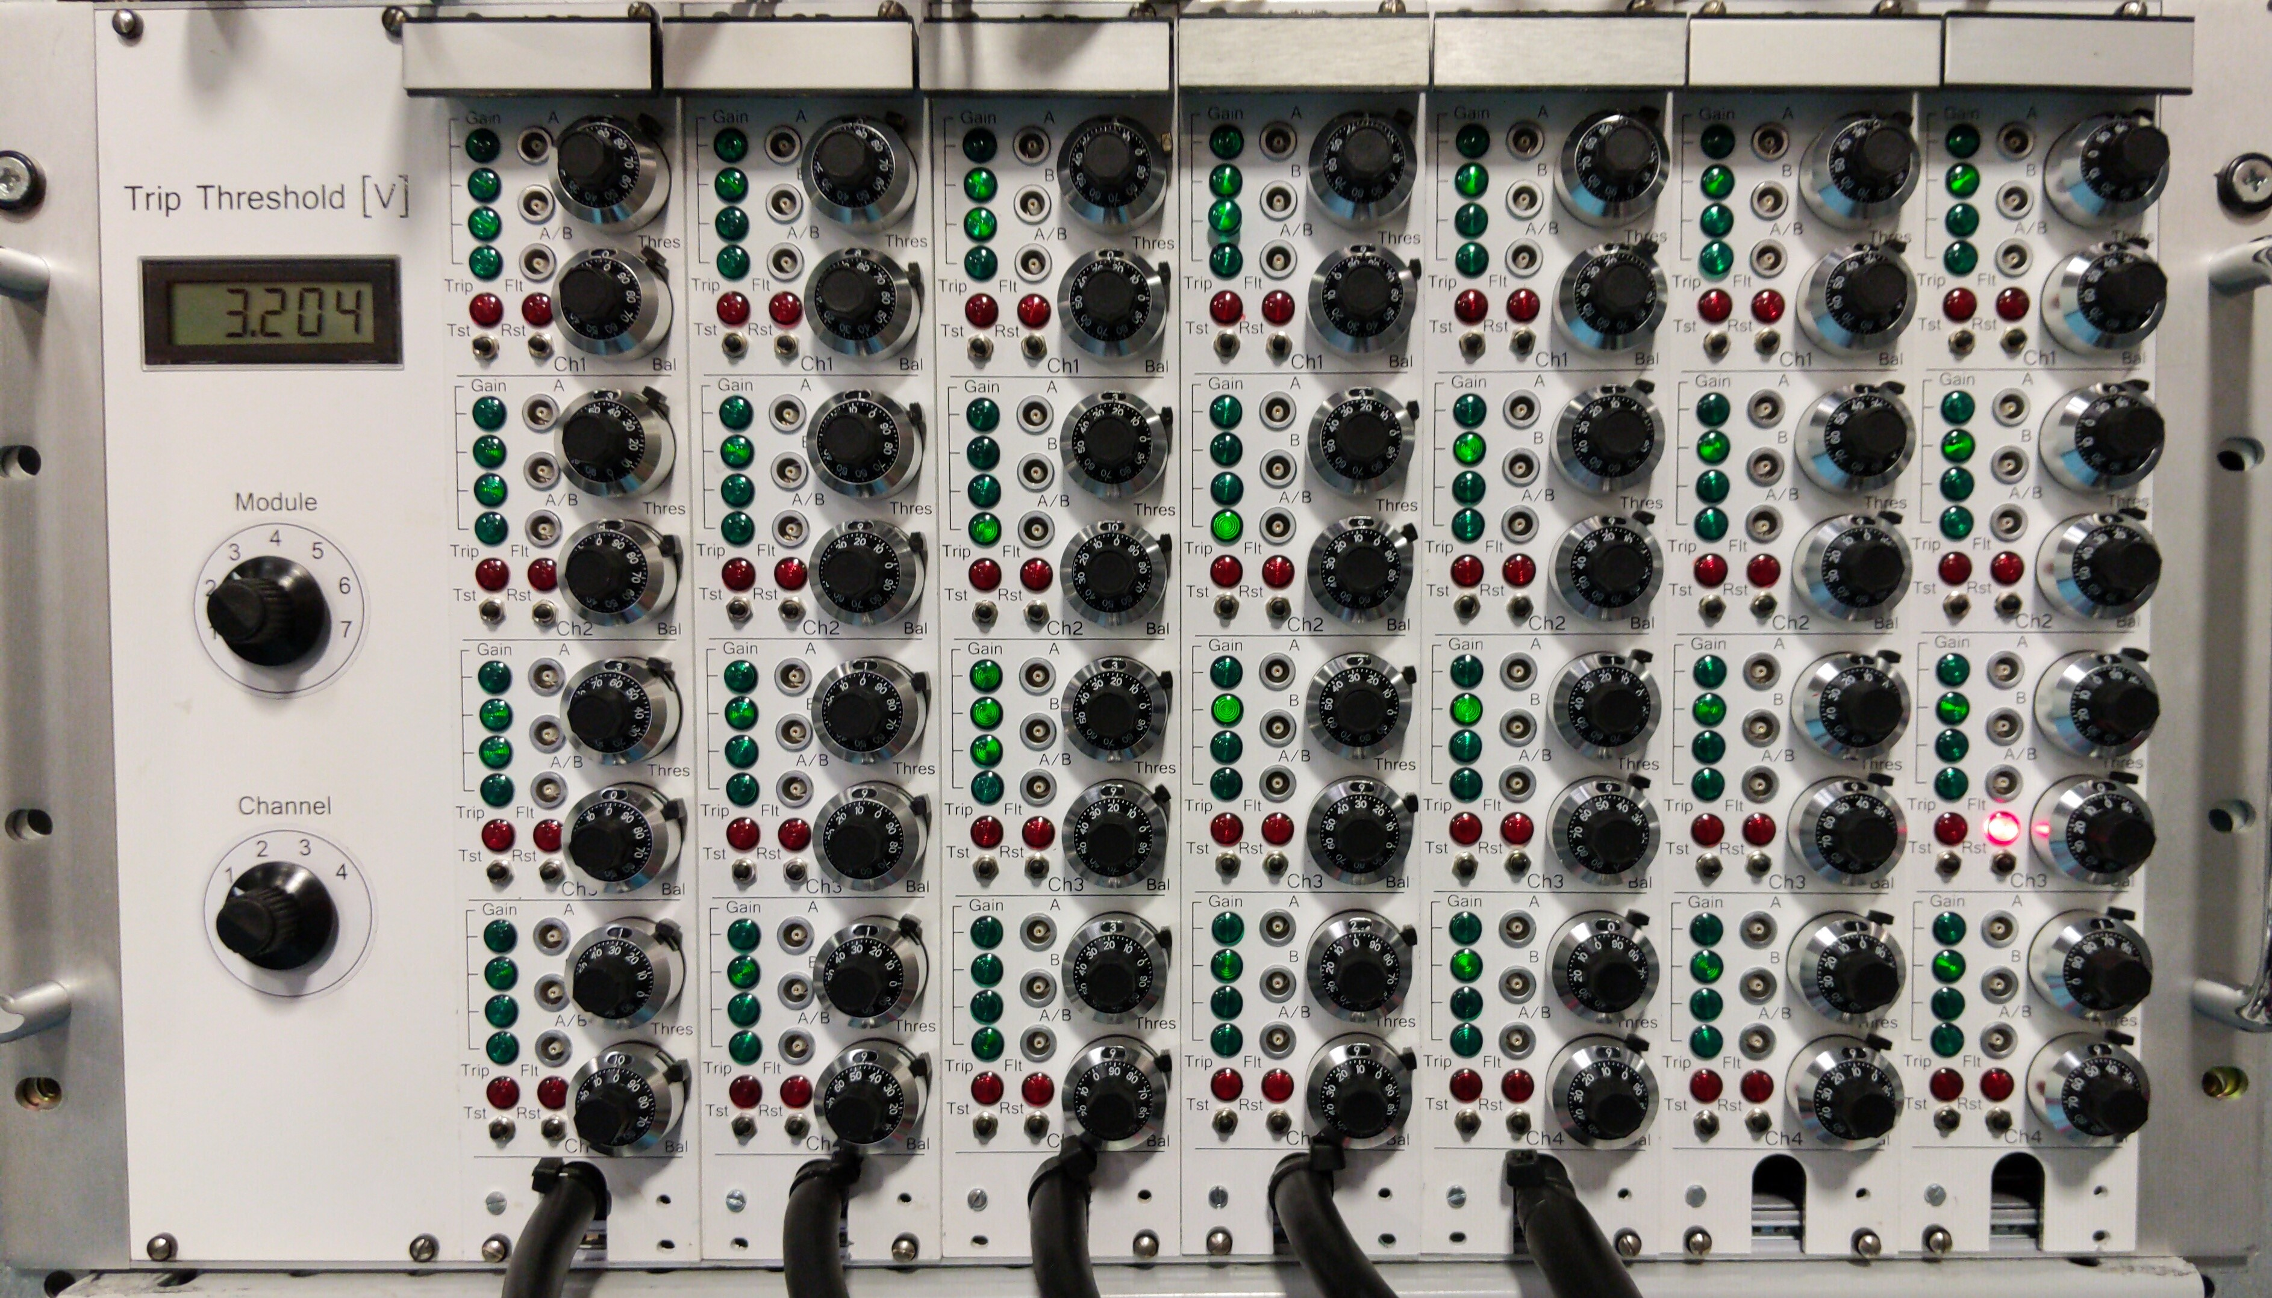
Quench Protection
Developed at Fermilab, benefiting from the projects, mostly QP for Mu2e solenoids
Production/Operational grade QP - two paths, based on primary DQD and redundant AQD modules for failproof
AQD system

Slide 17

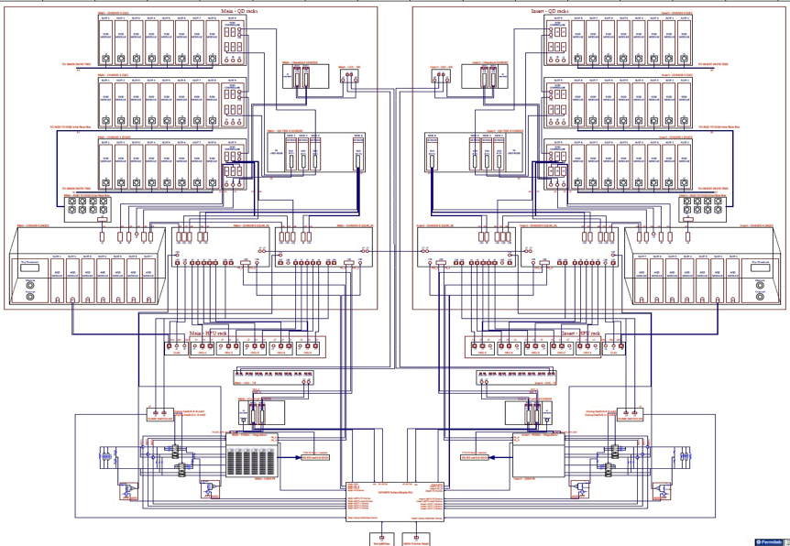

QPM Architecture
Two branches protecting main dipole and test sample
Branch 1
Branch 2
Quench Detection & Management
Quench Logic &Protection
PS Control and Monitoring

Slide 18
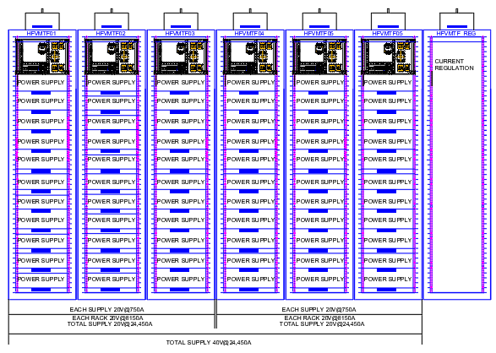
Power Supplies
We are procuring two sets of PSs:
  Min 20 V @24 kA to power the main magnet (LTS in case of hybrid magnet tests)
  Min 20 V @16 kA to power the sample (SC transformer or HTS inset of hybrid magnet tests).
Specifications are finalized
We are asking for modular system built on switch-mode power supply modules, interchangeable
Procurement process is finalized – company is selected, contract is pending
24 kA PS system

Slide 19
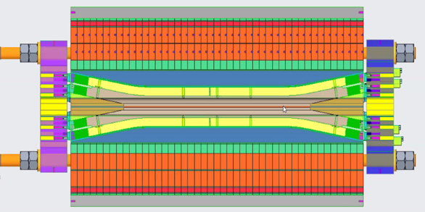
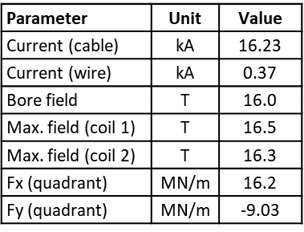
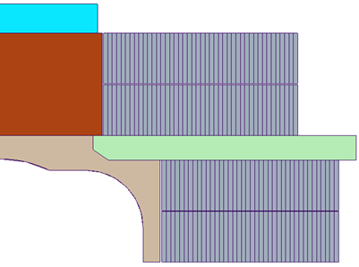
Magnet Specification
Field: 16 T design target with >15% margin on the load line at 1.9 K
  15 T is used as reference for operation
Magnet design is based on past development and studies of block-coil dipoles (HD, FRESCA2 and HEPdipo) - Rutherford cable for the coils with shell-based structure with axial pre-load
Quench Protection: energy extraction (resistor dump) is sufficient for safe magnet discharge
Coupling Loss Induced Quench (CLIQ) system is included in the baseline plan for redundancy, but no quench heaters
Uniform field length: 750 mm within 1% variation at 30 mm radius
Coil 2
R_{min}:
54 mm
Layer 4: 44 turns
Layer 3: 44 turns
Layer 2: 40 turns
Layer 1: 40 turns
Coil 1
Shell OD | m | 1.3
Shell length | m | 2.0
Total length | m | 2.9
D. Arbelaez, P. Ferracin, R. Hafalia, P. Mallon, D. Martins Araujo, J. L. Rudeiros Fernandez, G. Vallone et al.

Slide 20
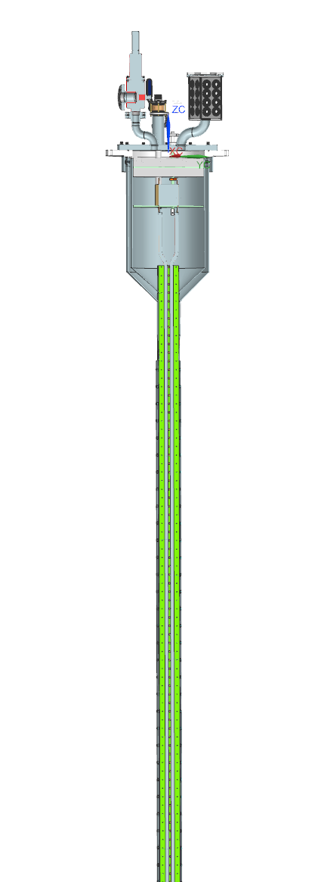

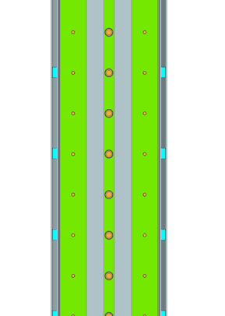
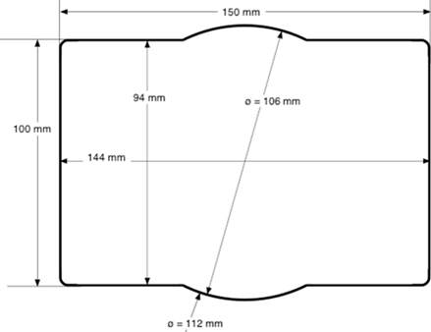
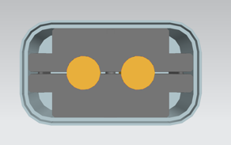

Anti-cryostat and sample holder
We have a preliminary design of the anti-cryostat
Expected operational mode: field is perpendicular to the test sample
Clear aperture: (EDIPO) 144 mm (H) x 94 mm (V)
superimposed with 106 mm round for compatibility with FRESCA2
B=15 T
F=1.5MN/m
EDIPO/Sultan configuration
I_{max}=100 kA

Slide 21
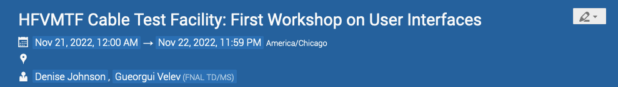
First Workshop on User Interfaces
Nov. 21-22, we had a virtual meeting with the users' community - ~ 33 potential users were registered, more connected: Indico event: https://indico.fnal.gov/event/57027/
It was very productive: a lot of recommendations, some of them difficult to implement
The team categorized the recommendations in 4 categories: easy to implement, moderate to implement, difficult but not impossible, very difficult
Example: Cable temperature: 4.5 – 50 K
  [M] Supercritical helium (not bath-cooled) with programmable mass flow rates
  [M] Flexibility in cryogenic routing (series vs. parallel in cables, top vs. bottom inlets, etc.)
  [M-D] Mechanism to cycle sample 4-300-4 K rapidly (1-2 times a day) for thermal testing - 4.5 K - 100ºK
Example: external field: 0 – 15 T
  [M-D] Ability to raise samples and place joints in-field for IxB and magnetoresistance testing
  [M-D] DC power supply (up to 50 kA or more) for full quench evolution
  [D- VD] Fast ramp (1-2 T/s) for pulsed external field testing of joint and conductor stability

Slide 22
Summary
The USA fusion community has been exploring the use of high-temperature superconducting (HTS) magnets for smaller Tokamak devices
The existing test facility cannot provide testing capabilities for SC cables, similar to EDIPO and SULTAN
US DOE Offices of High Energy Physics and Fusion Energy Sciences joined their effort to build HTS cable-testing facility at Fermilab:
  The test pit construction is done
  Cryostat procurement is finalized. It is expected in the fall of 2023
  The QP system is a close copy of Fermilab’s mu2e experiment production systems
    Main electronic parts are ordered in Nov 2021 – Dec 2022 (some Covid delays)
  Power supplies bidding process is finalized: contract pending
  The anticrystal/sample holder is in preliminary design
  Workshop with potential user community was held in November – recommendations are in
  The current estimation of the stand completion of TF is the fall 2024, with TF magnet - 2025.
  Having experience in the SC magnets and cryo technologies, Fermilab LBNL are fully committed to support in the US fusion community with a near-term goal to build and operate a SC cable testing facility

Slide 23
Backup slides

Slide 24
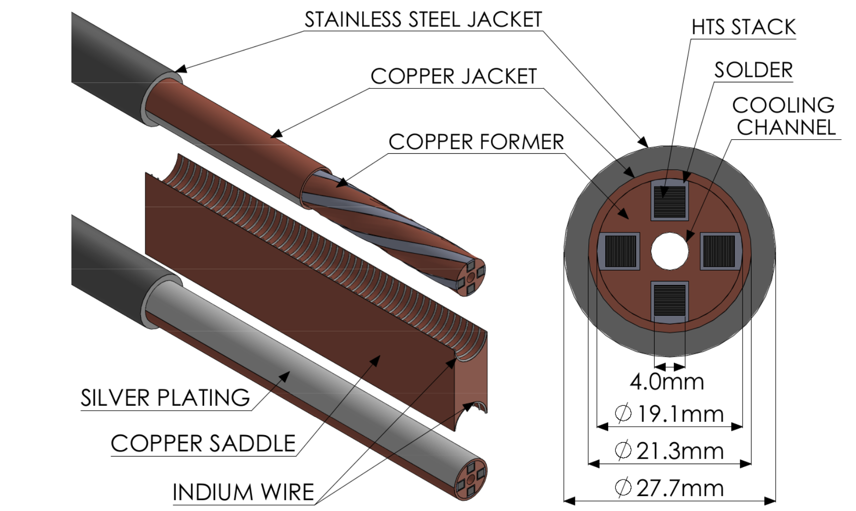
VIPER

Slide 25
Summary of the test facilities

Slide 26
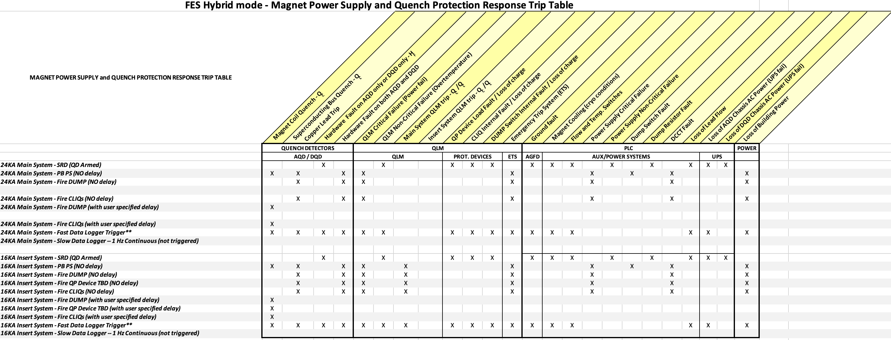

Slide 27
Fermilab Site
For this project, we take advantage of relevant studies, designs and activities performed at Fermilab past:
  Operating 4 vertical tests stands for SC magnet and SRF programs.
  Operating 1 horizontal test stand (12 m long) for HL-LHC production cryoassembly test
  Experience with designing, assembling and commissioning of complex quench monitoring and quench protection systems for High Field magnet stand, mu2e experiment and HL-LHC production stand.
  Experience in the design and commissioning of complex measurement system, including magnetic field measurement devices.
  Design, fabrication and test capabilities of SC magnets (e.g. current LHC IR quadrupoles).
  Strong cryogenic expertise with roots in Tevatron operation.

Slide 28
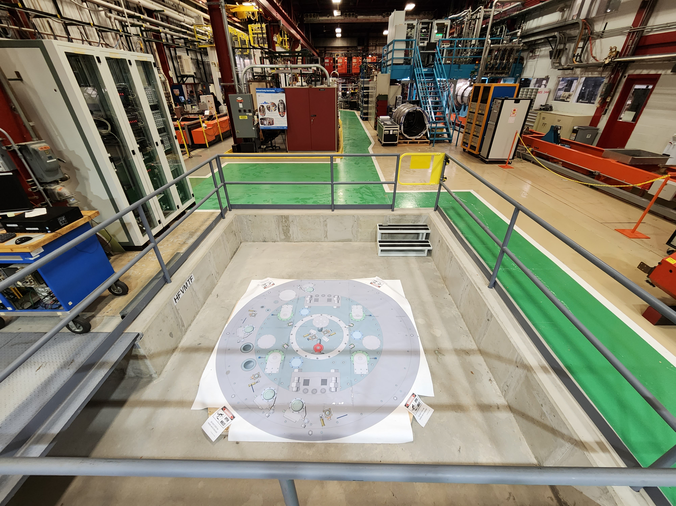
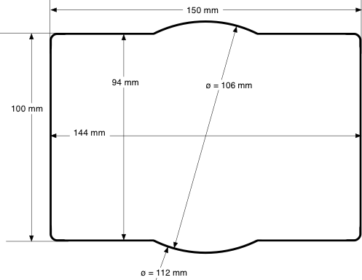
TFD aperture

Slide 29
HFVMTF QPM Architecture
Quench Detection & Management
Quench Logic & Protection
PS Control & Monitoring

Slide 30
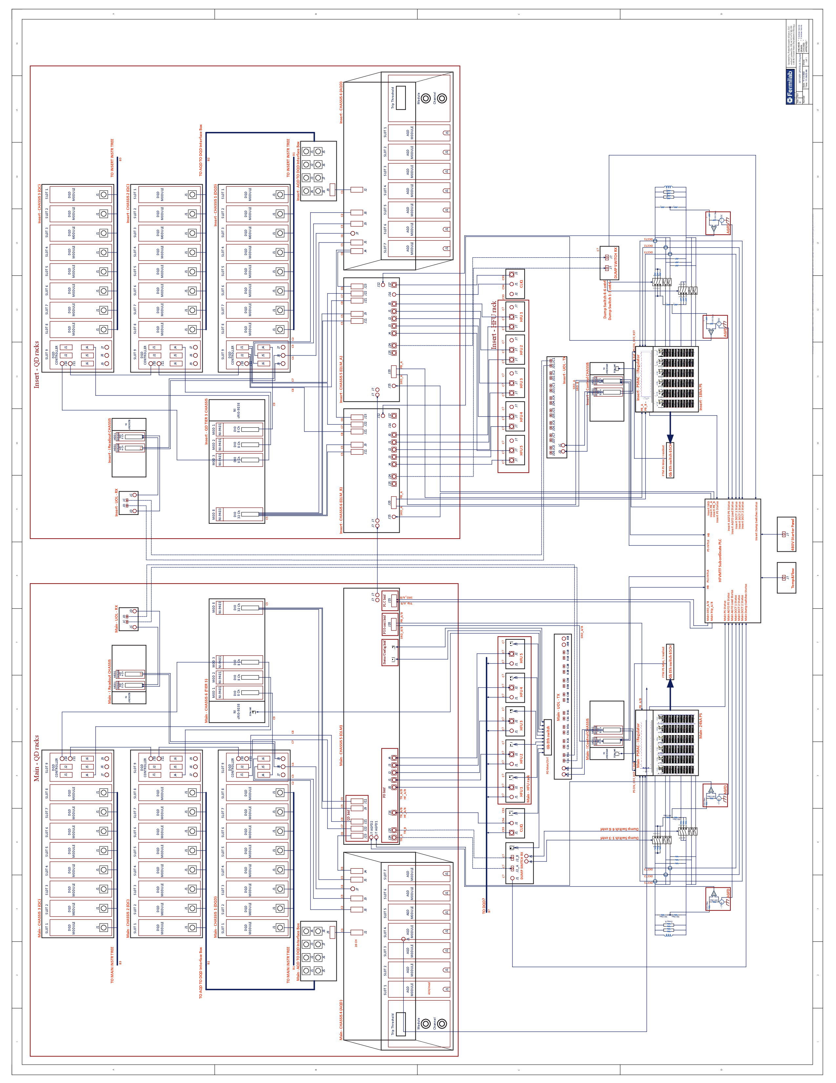
HFVMTF QPM Details – Quench Detection & Management
The HFVMTF QPM system is based on a Quench Detection system developed for the Mu2e experiment.
Primary Custom Digital Quench Detection System (DQD) – 96 Channels
Quench management system, based on National Instruments C-RIO (Tier III).
Provides quench configuration, real time control and monitoring, and quench data management for offline analysis.
Redundant Custom Analog Quench Detection System (AQD) – 28 Channels
The detectors can monitor:
Temperature sensors
Strain gauges
Hall sensors

Slide 31
HFVMTF QPM Details – Quench Logic & Protection
A set of two redundant custom Quench Logic Modules (QLMs) carry out the critical hardware-based quench logic, such as:
Energy extraction system enable and discharge control via DUMP switches
Heater control logic via Heater Firing Units (HFU)
CLIQ control logic (CLIQ)
Slow Ramp Down request for the Current control
Phase Back control for the power system

Slide 32
HFVMTF QPM Details – PS Control & Monitoring
- Subordinate PLC to monitor temp, water pressure, DCCTs and Dump Switches status
- 2x Active Ground Fault Detectors (AGFD)
- PS based on Switching Power Supply modules and I-regulator
- NI c-RIO based I-control produces open loop Current set-point (Supports manual set-point, custom current profile or pre-set periodic profiles)
- PS Ethernet monitoring and imbalanced current protection
- Current readout and optical fiber-based distribution to the detectors to implement current dependent thresholds and I derivative

