Slide 1
Status of the EDIPO2 Test Facility
X. Sarasola
H. Bajas
N. Bykovskiy
K. Sedlak
P. Bruzzone
April 25th, 2023

Slide 2
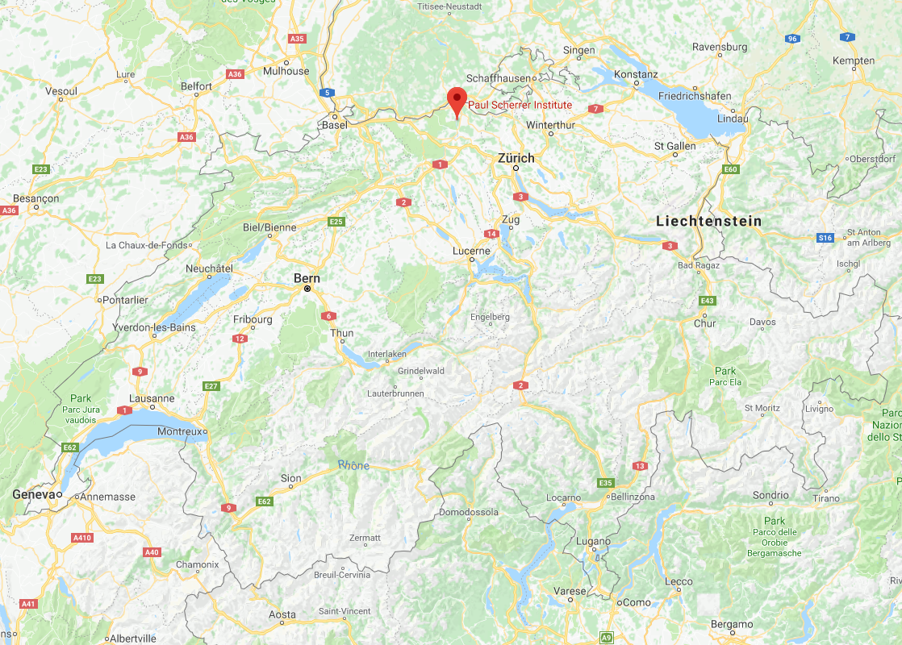
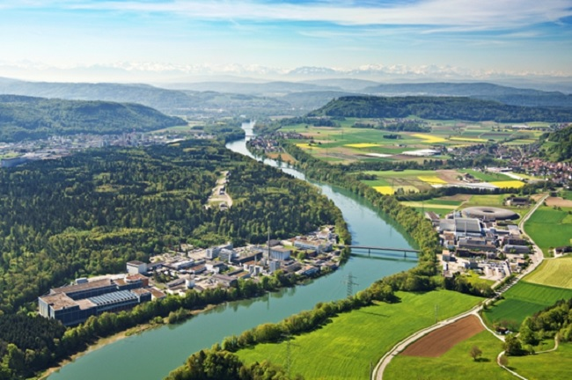
Swiss Plasma Center
The Swiss Plasma Center (SPC) belongs to the École Polytechnique Fédérale de Lausanne (EPFL)
The main site of EPFL-SPC is the campus of Lausanne
However, the Superconductivity Group is located in the premises of the Paul Scherrer Institute (PSI)
Paul Scherrer Institute

Slide 3
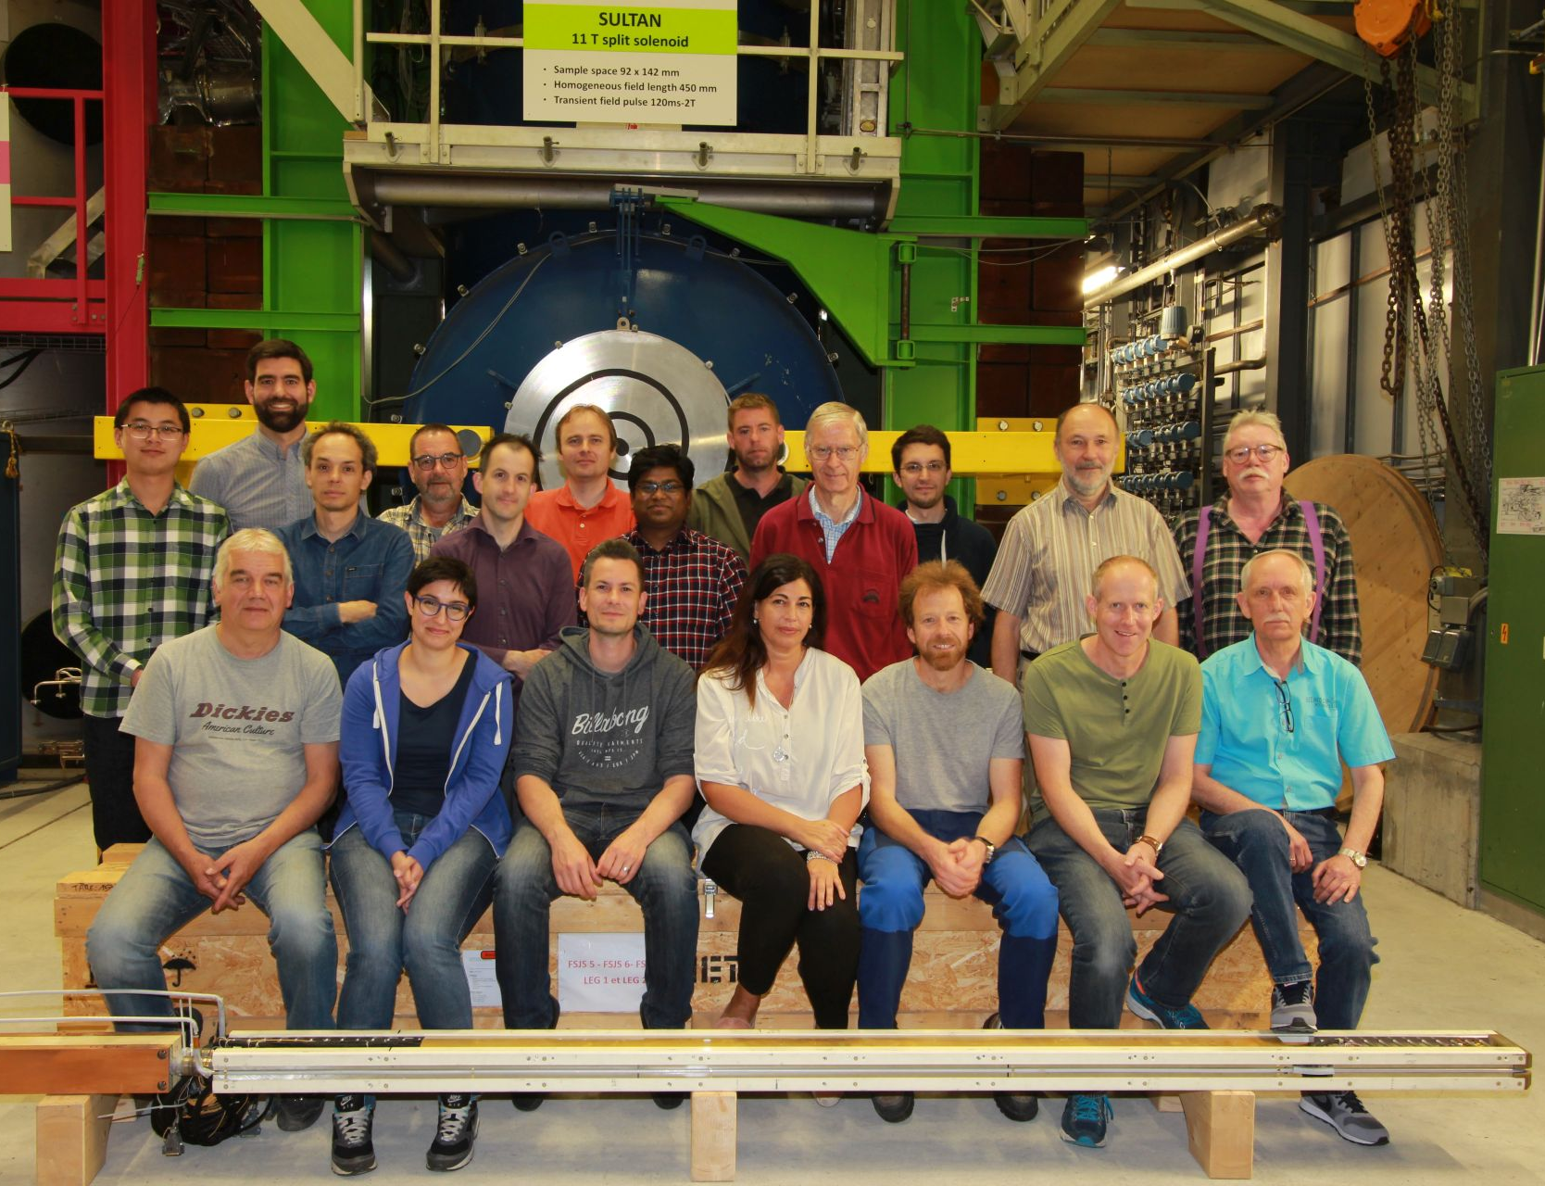
The Superconductivity Group of EPFL-SPC
21 members:
  10 scientists + 2 PhD students
  5 technicians + 3 operators
  1 secretary
2 test facilities: SULTAN & EDIPO
Main activities:
  Test of superconductor samples and joints, mainly for ITER, but also for DEMO, JT60-SA, DTT, CFETR, BEST and SPARC
  Tests of sub-sized coils and joints for accelerator magnets (CERN)
  Development of conductors and joints for DEMO magnets
  Other projects: current leads, R&D on HTS magnets, EDIPO2
May 2018

Slide 4
Outline
The EDIPO accident
Motivation, design targets and boundary conditions
The baseline magnet design:
  Magneto-static design
  Quench protection
  Mechanical analysis
Alternative magnet design
Other activities:
  Helium vessel
  Cable qualification
Conclusions and outlook

Slide 5
Outline
The EDIPO accident
Motivation, design targets and boundary conditions
The baseline magnet design:
  Magneto-static design
  Quench protection
  Mechanical analysis
Alternative magnet design
Other activities:
  Helium vessel
  Cable qualification
Conclusions and outlook

Slide 6
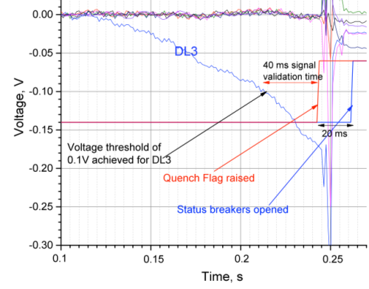
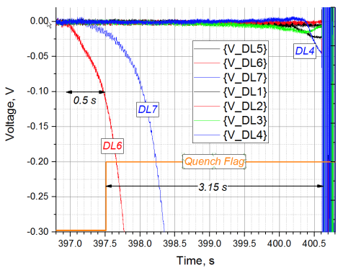
The EDIPO accident
On May 31st 2016 voltage developed in Double Layer #6 of coil #1.
After 0.5 s, the voltage in DL6 reached the 100 mV threshold and the quench flag went up.
In normal circumstances, it takes ~20 ms for the breakers to open, however on May 31st 2016 it took 3.15 s.
July 2013
May 31st, 2016

Slide 7
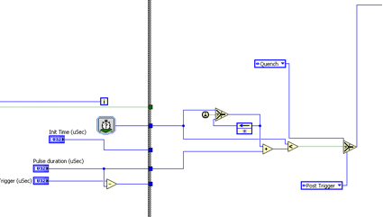
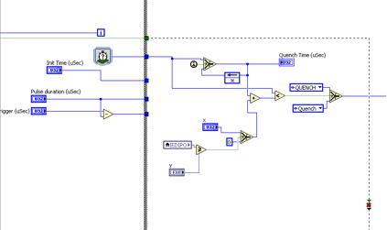
The EDIPO accident
The delayed opening of the breakers was not accidental. It was the result of the malicious manipulation of the quench detection software.
A timer (set at 5 s) and a comparator of the operating current (set for >80%*I_{op}) were inserted to delay the signal for opening the breakers.
Original
Manipulated

Slide 8
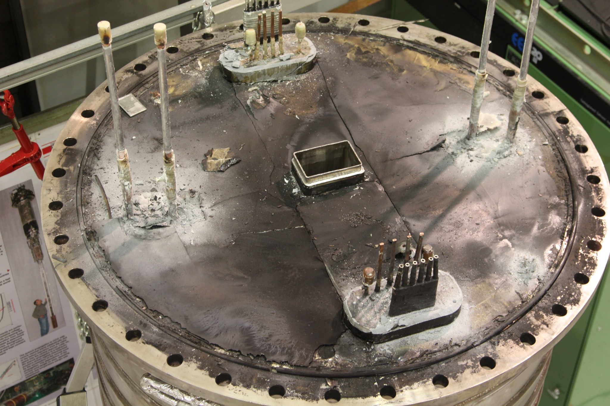
The EDIPO accident
The overheating of the conductor at the quench location (estimated up to 300 C) caused the thermo-mechanical failure and softening of the electrical insulation.
The damaged insulation didn’t withstand the high voltage (1.7 kV) when the breaker opened. An arc to ground developed and a large fraction of the stored energy (16 MJ) was dissipated in the arc.
The coil assembly was fully impregnated and not designed to be disassembled
No repair action is possible

Slide 9
Outline
The EDIPO accident
Motivation, design targets and boundary conditions
The baseline magnet design:
  Magneto-static design
  Quench protection
  Mechanical analysis
Alternative magnet design
Other activities:
  Helium vessel
  Cable qualification
Conclusions and outlook

Slide 10
Motivation and design targets
In the last 20 years, all major superconducting fusion facilities worldwide have qualified their conductors in SULTAN: ITER, JT60-SA, SPARC, BEST, CFETR, DTT, and the EU-DEMO
There is a growing demand towards:
  High current conductors (close to 100 kA)
  Conductors for high field magnets (partly driven by the development of HTS)
 | SULTAN (SPC) | EDIPO (SPC) | FRESCA2 (CERN) | EDIPO 2 | Units
B_{center aperture} | 10.9 | 12.35 | 14.6 | 15 | T
Aperture size | 94×144 | 90×141 | Ø100 | 144×144 | mm
Homogeneous field length (1%) | 320 | 680 | 540 | 1000 | mm
Sample current | ≤100 | ≤100 | ≤ 32 | ≤100 | kA
Sample operating temperature | 4.5 to 50 | 4.5 to 50 | 1.9 & 4.2 | 4.5 to 50 | K

Slide 11
Boundary conditions
Given by the existing facility:
  Maximum dimensions of magnet assembly:
    Diameter ≤ 1320 mm
    Length ≤ 2500 mm
  Overall assembly weight ≤ 20 t (overhead crane)
  Operating current ≤ 18 kA (existing power supply)
Other assumptions:
  Operating temperature: 4.2 K (liquid He bath)
  Nominal field reached at 85% of short sample
  Dump voltage to ground ≤ 1 kV (symmetric grounding)
  Allowable coil hot spot temperature: ~300 K
~2500

Slide 12
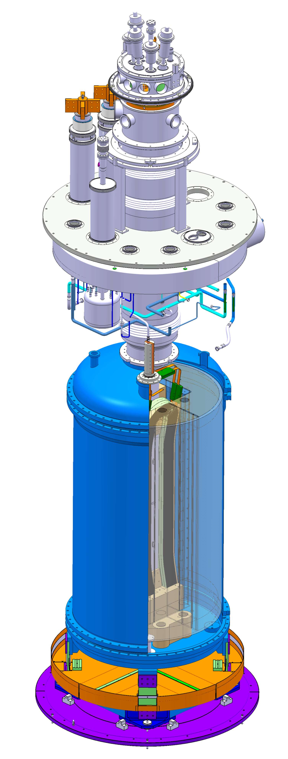
Boundary conditions
Given by the existing facility:
  Maximum dimensions of magnet assembly:
    Diameter ≤ 1320 mm
    Length ≤ 2500 mm
  Overall assembly weight ≤ 20 t (overhead crane)
  Operating current ≤ 18 kA (existing power supply)
Other assumptions:
  Operating temperature: 4.2 K (liquid He bath)
  Nominal field reached at 85% of short sample
  Dump voltage to ground ≤ 1 kV (symmetric grounding)
  Allowable coil hot spot temperature: ~300 K

Slide 13
Outline
The EDIPO accident
Motivation, design targets and boundary conditions
The baseline magnet design:
  Magneto-static design
  Quench protection
  Mechanical analysis
Alternative magnet designs
Other activities:
  Helium vessel
  Cable qualification
Conclusions and outlook

Slide 14
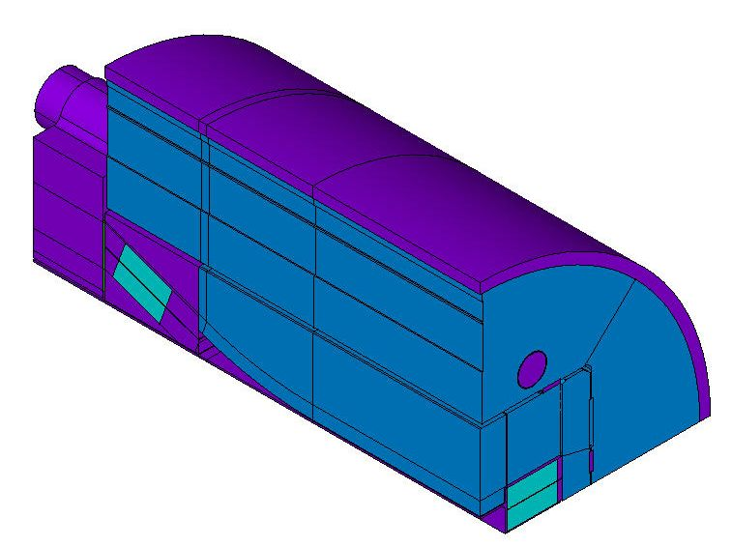
EDIPO 2: Magnet design
“Accelerator-type” magnet:
  Flared-end block coil design
  Shell-based mechanical structure:
    Outer shell made of steel
    Adjustable pre-compression
    Use of detachable winding poles
Unlike accelerator magnets, the field quality of the generated background field is not a crucial design target in a test facility
4 and 6-coil designs are considered
(purely rectangular winding pack: windings aligned in low and high field side)

Slide 15
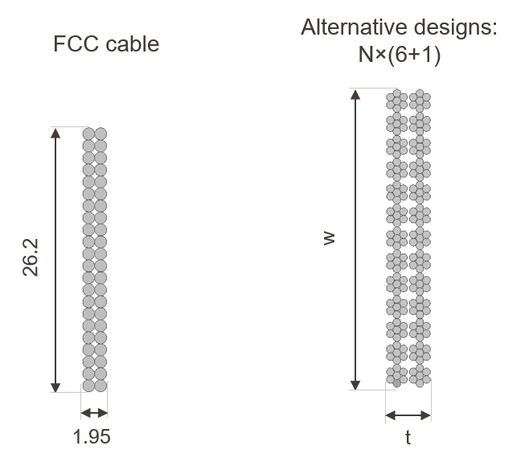
Cable design
Rutherford cable considered until 2020 (44×1.1 mm FCC strands):
  I_{op} limited to ~10.6 kA
  One of the largest aspect ratio Rutherford cables ever built (quite stiff)
A two-stage cable layout can operate at a current closer to 18 kA and might result in a more flexible design.

Slide 16
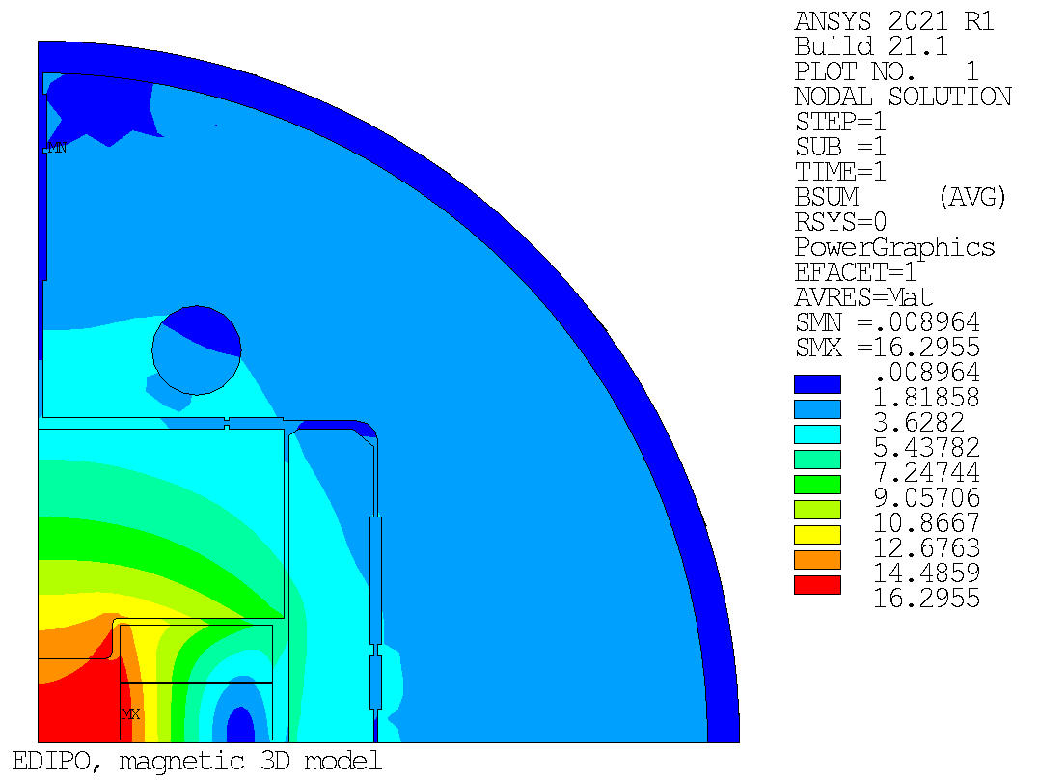
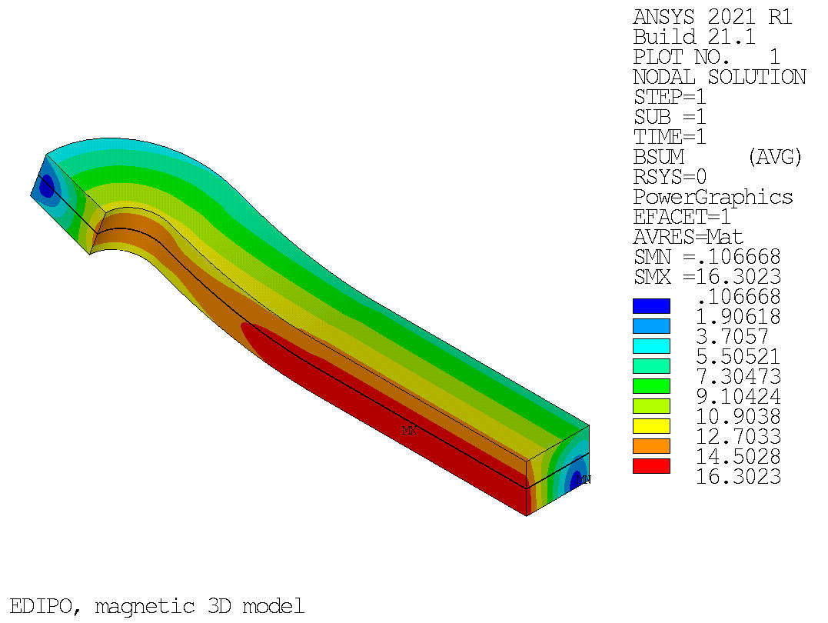
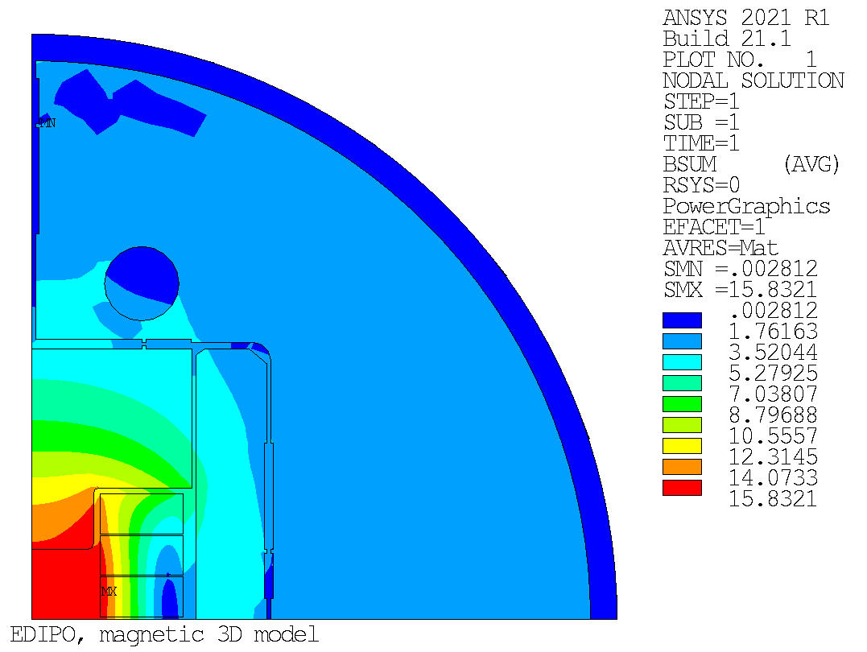
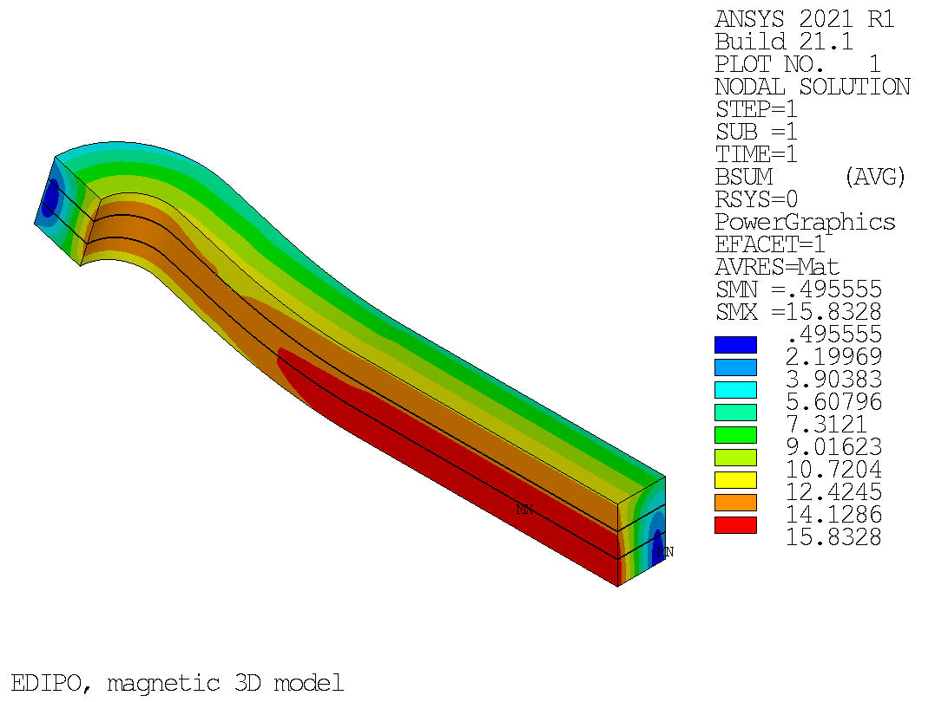
Magnet design: Magnetostatic 3D model
Our first model in LEDET has been validated against the latest quench analysis performed in the previous baseline:
  6 coil design
  FCC cable
  I_{op} = 14.1 kA
Results for the comparison taken from E. Ravioli’s presentation of Nov 22nd, 2019
 | 4-coil design | 6-coil design | Units
Cable layout | 26×(6+1) | 22×(6+1)
Total area of insulated conductor | 30538 | 25254 | mm²
Operating current, I_{op} (85%×I_{ss}) | 17.12 | 17.37 | kA
B field in the center of the aperture, B_{center} | 15.11 | 15.10 | T
Peak B field in the coils, B_{peak} | 16.30 | 15.83 | T
Number of turns per pancake, n_{pan} | 37 | 24
Total number of turns, n_{total} | 296 | 288
Total ampere-turns, I_{total} | 5.07 | 5.00 | MAt
Total magnet stored energy, E_{total} | 13.5 | 12.0 | MJ
Magnet self-inductance, L | 92.1 | 79.5 | mH
Engineering current density, j_{eng} | 165.9 | 198.1 | A/mm²
Copper current density, j_{Cu} | 488.9 | 586.2 | A/mm²
4-coil design
6-coil design

Slide 17
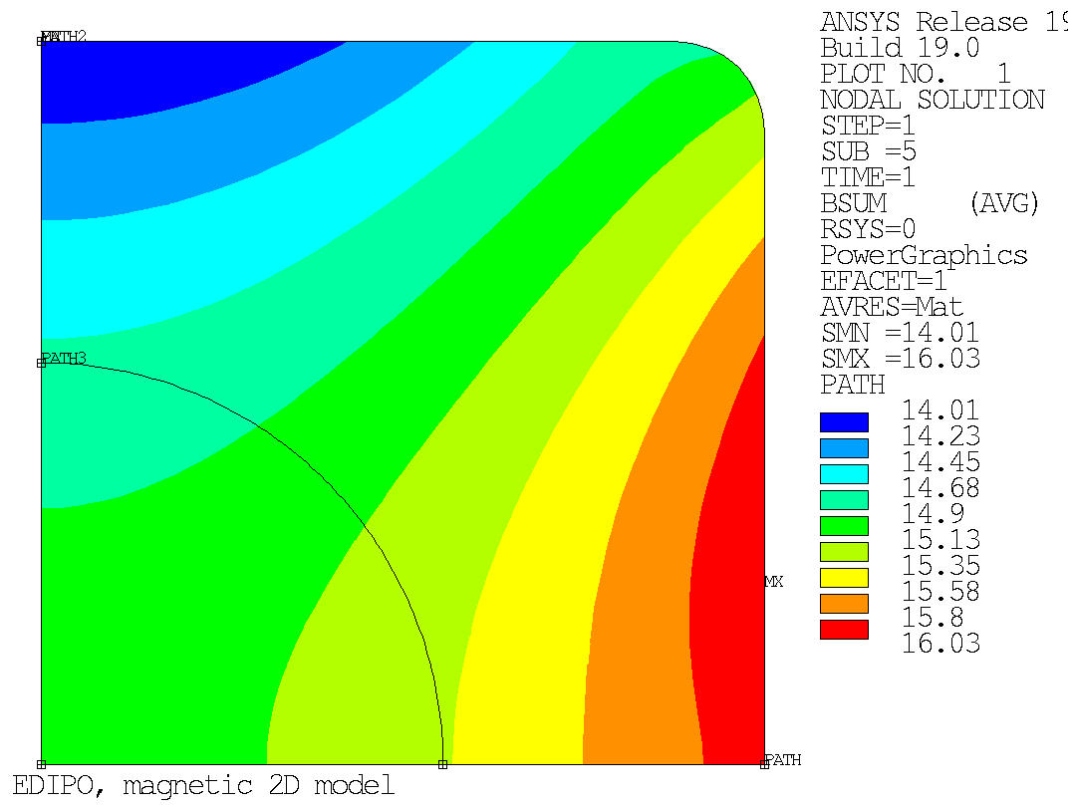
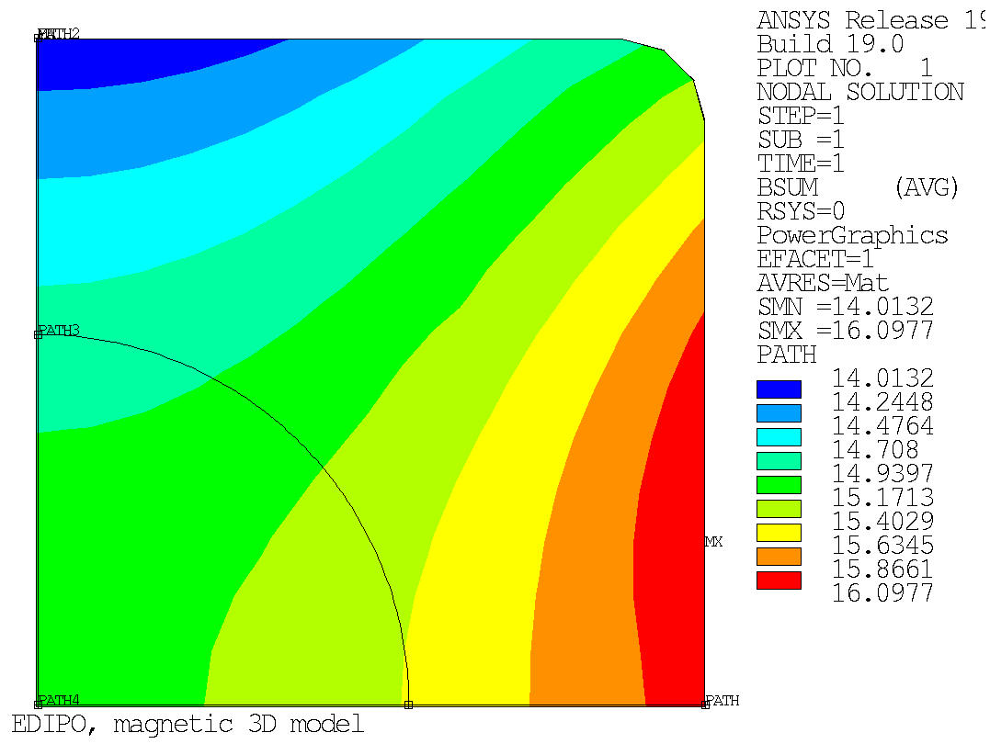
4-coil design: 2D vs 3D. Field quality
Magnetic 2D model
Magnetic 3D model
R_{ref} = 40 mm
R_{ref} = 40 mm

Slide 18
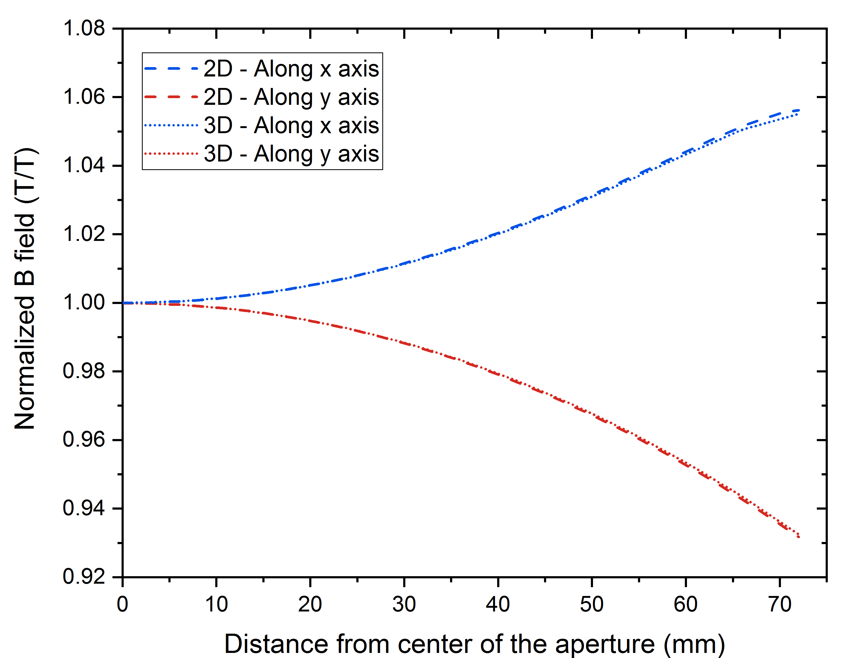
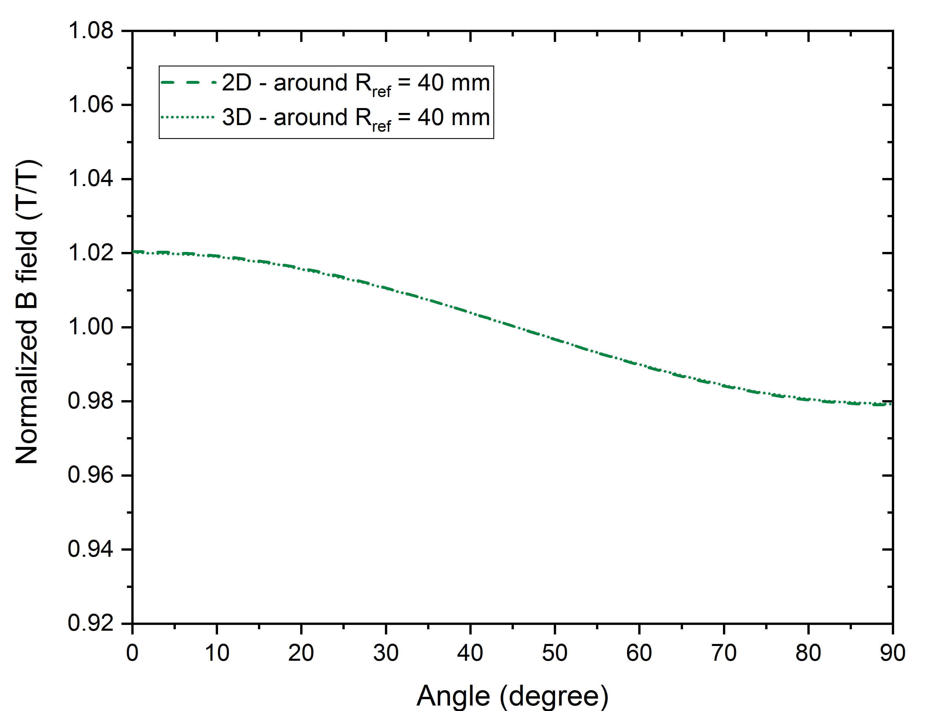
4-coil design: 2D vs 3D. Field quality
Good agreement between 2D and 3D models:
  Uniformity along x and y axis: -7% / +5%
  Uniformity around a circumference of R_{ref} = 40 mm: ±2%

Slide 19
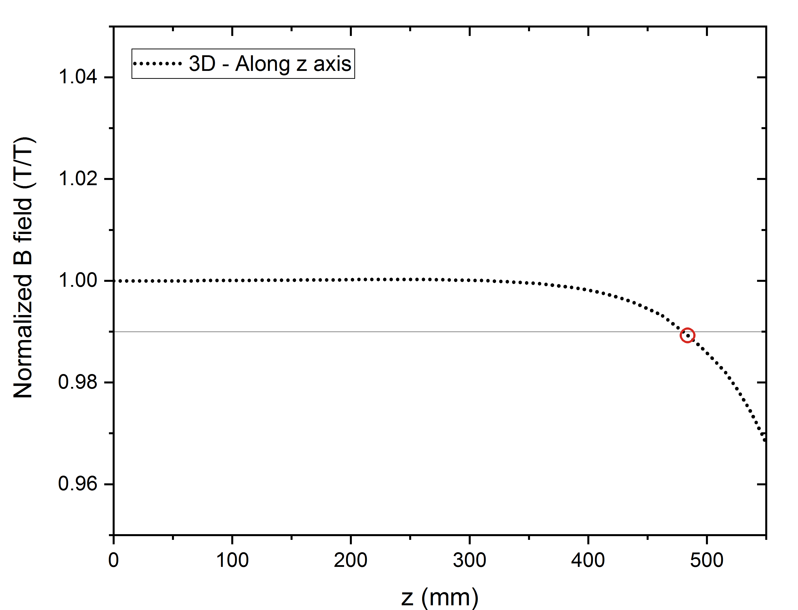
4-coil design: 2D vs 3D. Field quality
Uniform field length along z axis: L = 2 × 479.3 mm = 958.6 mm

Slide 20
Outline
The EDIPO accident
Motivation, design targets and boundary conditions
The baseline magnet design:
  Magneto-static design
  Quench protection
  Mechanical analysis
Alternative magnet design
Other activities:
  Helium vessel
  Cable qualification
Conclusions and outlook

Slide 21
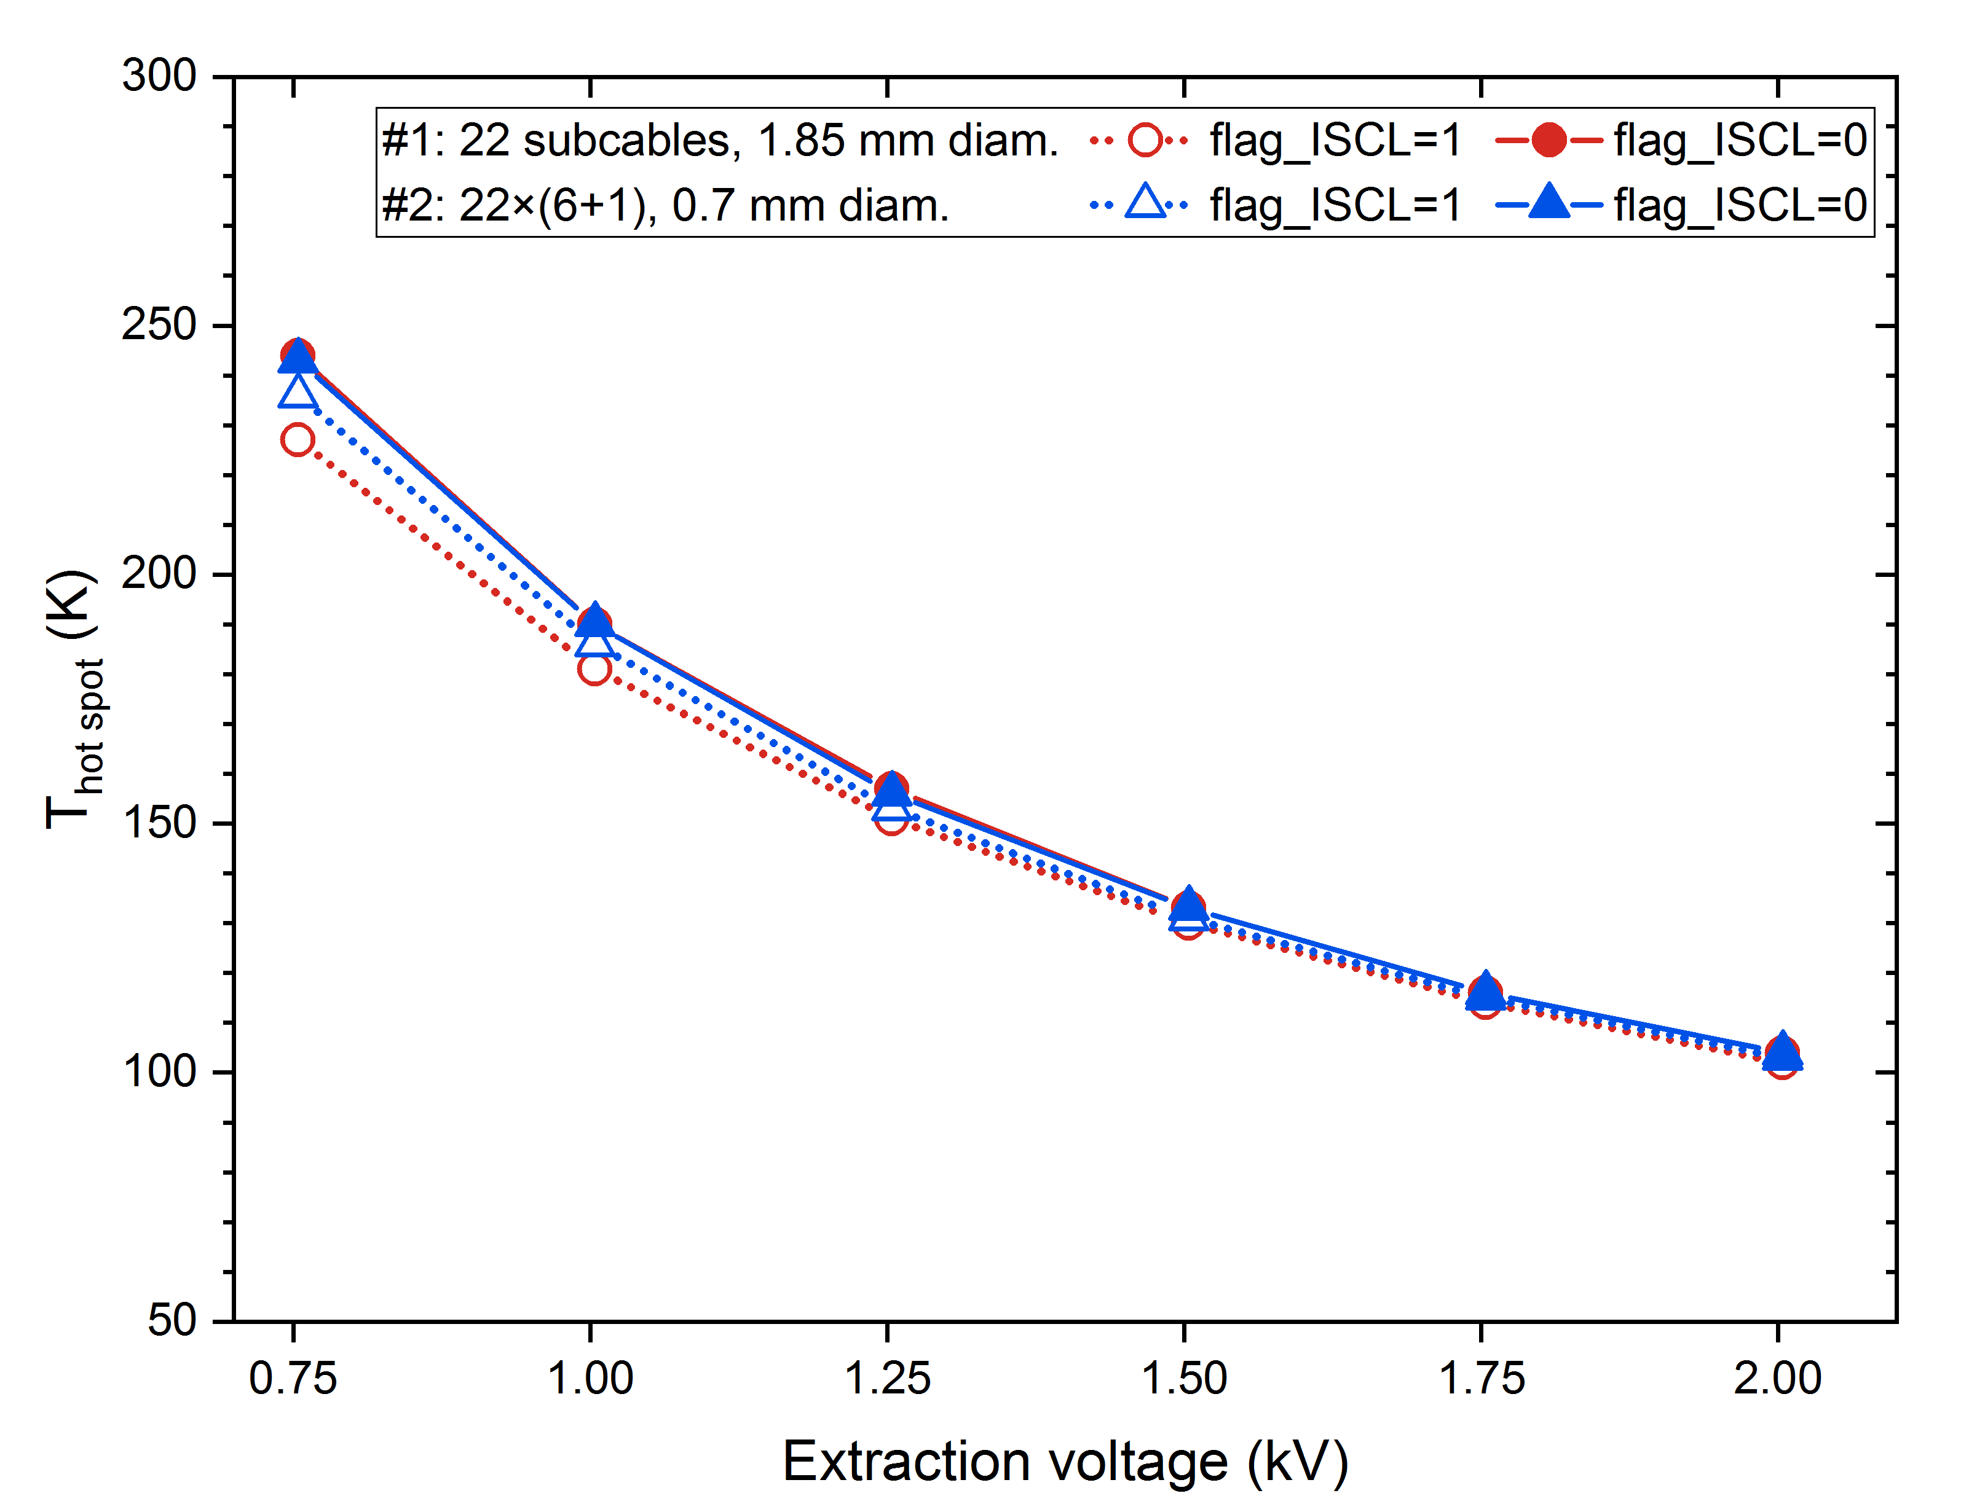
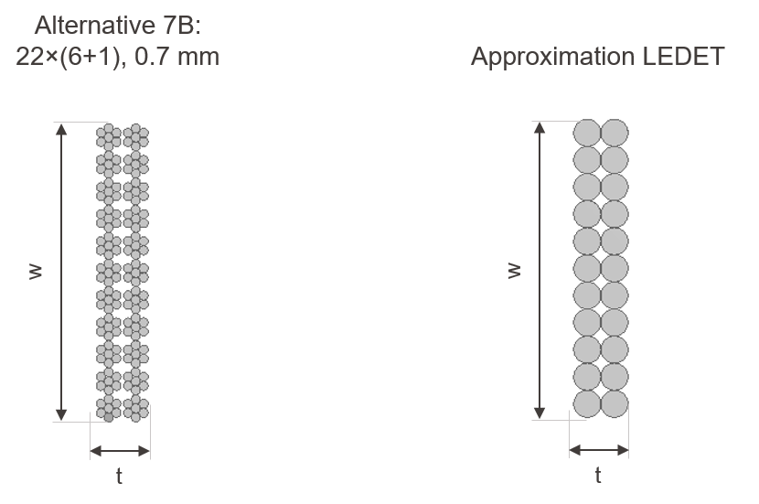
Simulation of two-stage cables in LEDET
Two approaches were used:
  Simulation of 22 sub-cables of equivalent cross-section (1.85 mm diameter)
  Simulation of the actual cable: 22×(6+1) 0.7 mm diam. The magnetic field had to be interpolated at the center of each of the 154 strands.
Inter-strand coupling losses (ISCL) in two stage cables are not precisely simulated
The additional resolution (and computation time) didn’t change the results
Approx. 1
Approx. 2

Slide 22
Assumptions
Simulations performed with STEAM-LEDET [1], [2] (v1.08.03)
2D model
Energy extraction protection scheme:
  Quench detection + validation time: 15 ms
  Energy extraction triggering time: 1 ms
Cu:nCu: 1.0
 | Nominal | Parametric variation
RRR | 100 | 100 - 300
Filament twist-pitch | 14 mm | 10 - 30 mm
Effective transverse resistivity factor | 1 | 0.5 - 2
[1] E. Ravaioli, “CLIQ”, PhD thesis, 2015
[2] E. Ravaioli et al., Cryogenics 2016 https://cern.ch/steam/LEDET/

Slide 23
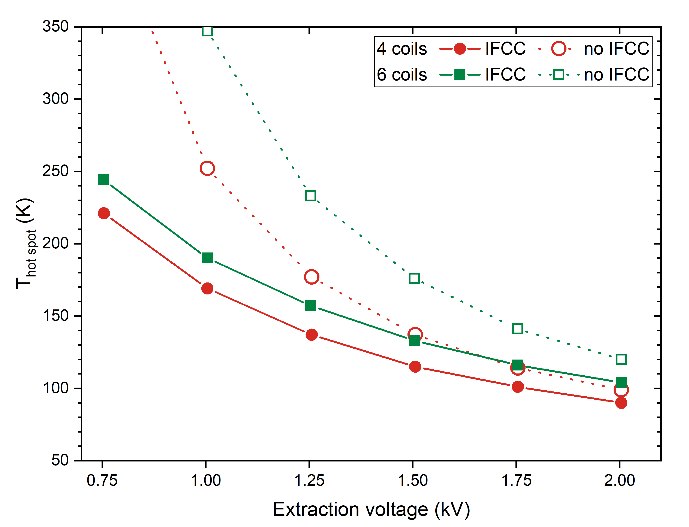
Hot spot temperature: 4 coils vs 6 coils designs
Protection based on energy extraction should work (even without interfilametary coupling currents)

Slide 24
Outline
The EDIPO accident
Motivation, design targets and boundary conditions
The baseline magnet design:
  Magneto-static design
  Quench protection
  Mechanical analysis
Alternative magnet design
Other activities:
  Helium vessel
  Cable qualification
Conclusions and outlook

Slide 25
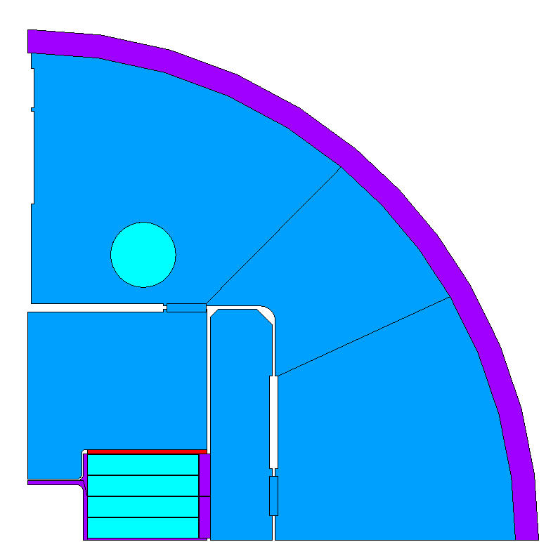
Mechanical design
Pre-compression can be adjusted, but it is kept at a minimum level
  Outer shell is made of steel
  Coils are allowed to detach from the test well during operation
Use of detachable winding poles
The test well is stress-free during operation

Slide 26
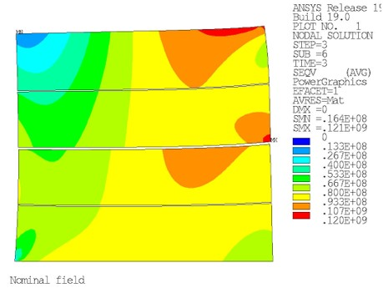
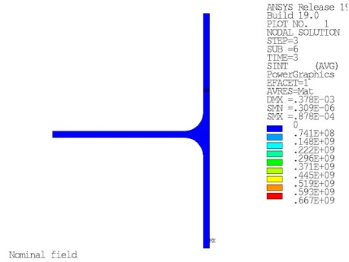
Mechanical design
The coils are essentially stress-free during insertion of the keys at room temperature and after cool-down
The von Misses stress in the coils is always below 121 MPa (<80 MPa in the high field region)
A gap of <1.5 mm opens between coils and test well during operation
Stress in the test well:
  Moderate during key insertion and cool-down
  Stress-free during operation

Slide 27
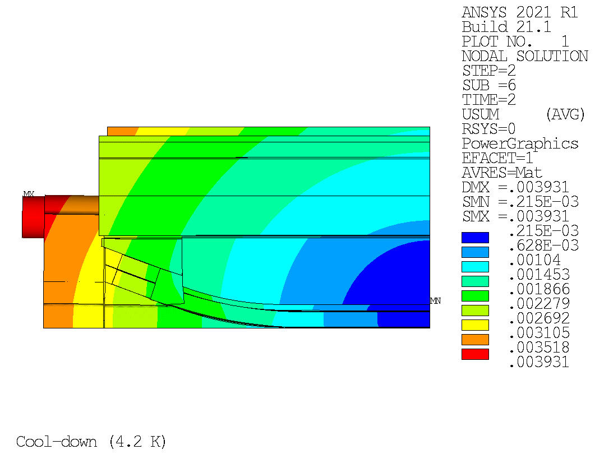
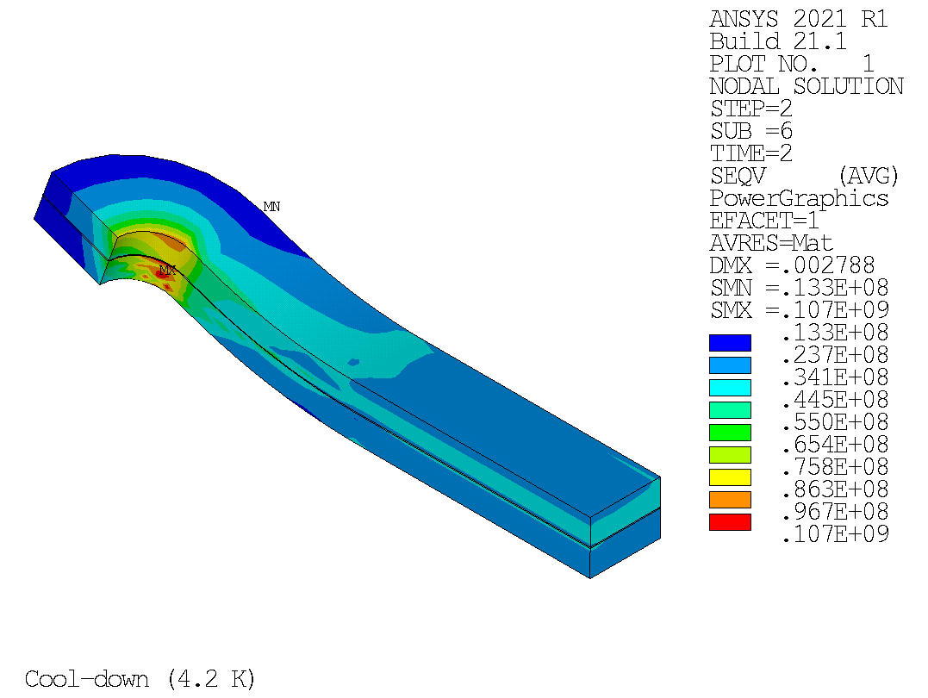
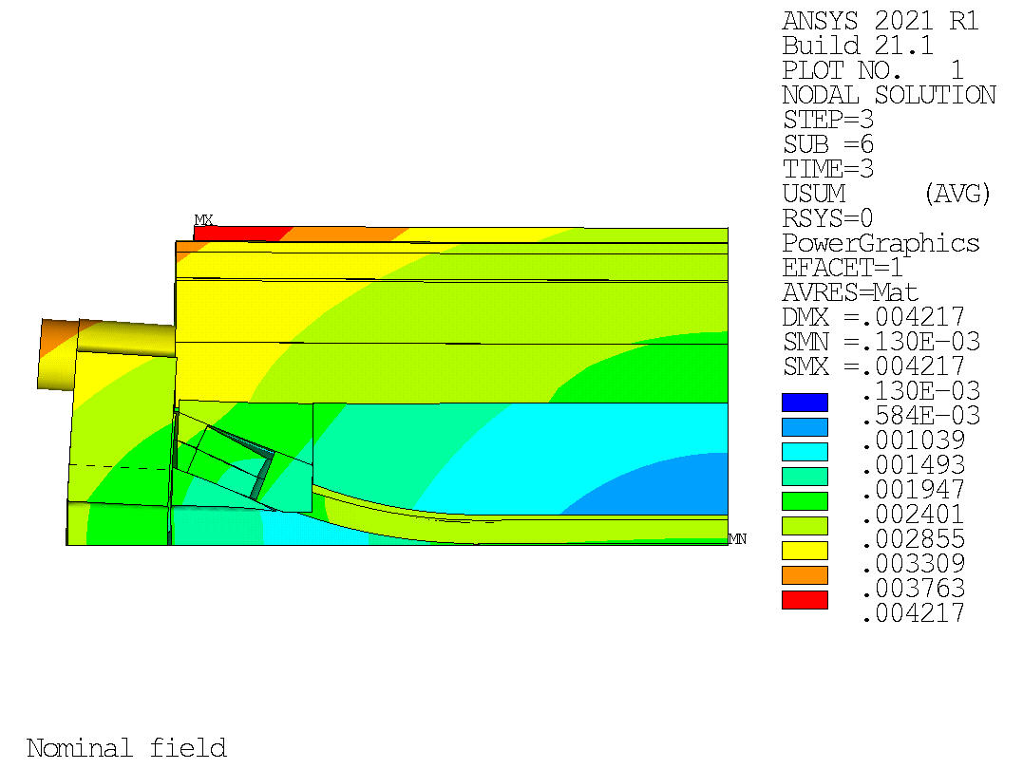
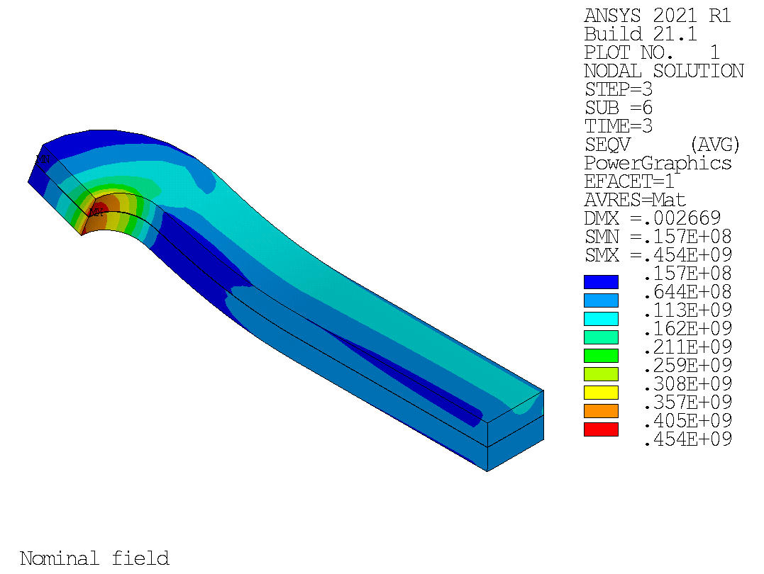
Displacement and stress in the coil ends (3D)
Displacement
Equivalent stress
Cool-down
Cool-down
Nominal field
Nominal field

Slide 28
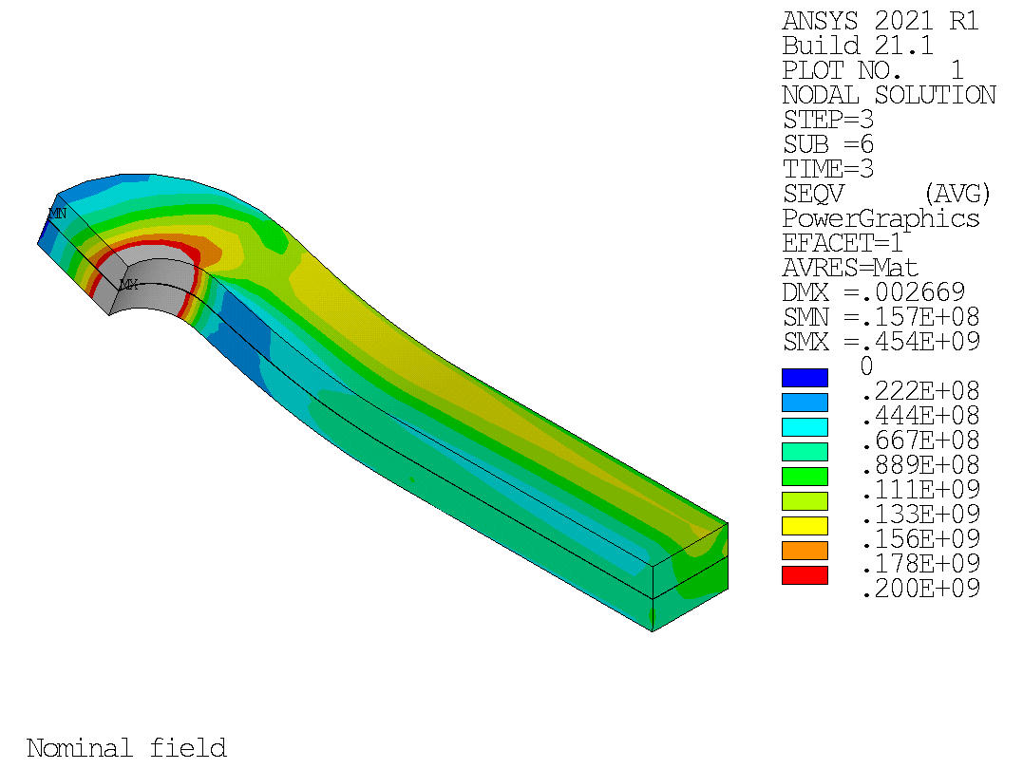

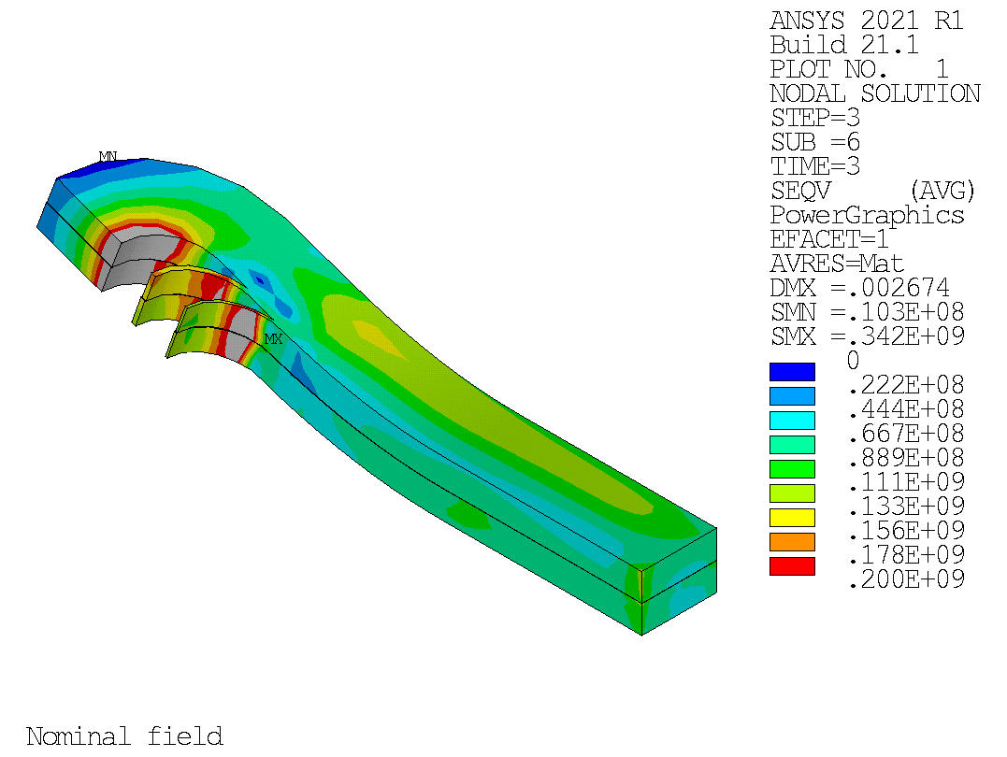
Possible solution: end spacers
The equivalent stress in the coils at nominal field is reduced by the use of end spacers, but it remains above 200 MPa
Sliding contact between coil and end spacers
Baseline:
No end spacers
1 block: 37 turns
Straight section: 960 mm
Peak σ_{eqv} = 454 MPa
Option 1:
2×30 mm spacers
3 blocks: 2+2+33 turns
Straight section: 847 mm
Peak σ_{eqv} = 333 MPa
Option 2:
2×60 mm spacers
3 blocks: 1+2+34 turns
Straight section: 734 mm
Peak σ_{eqv} = 342 MPa

Slide 29
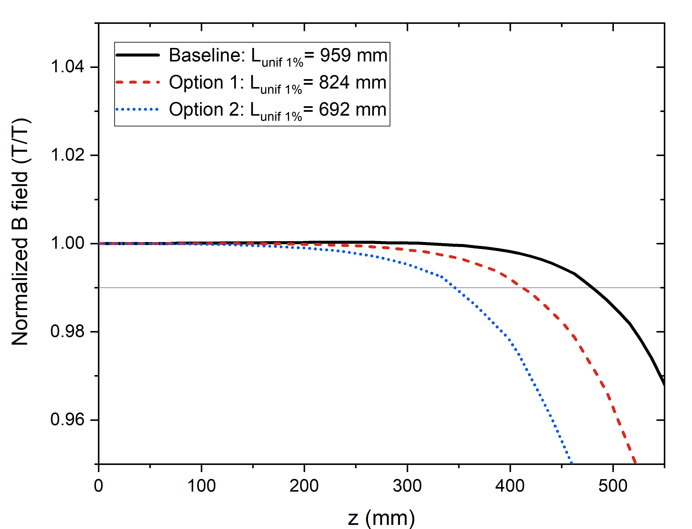
3D magnetic model
Unfortunately, lowering the field at the ends comes at the expense of reducing the uniform field length

Slide 30
Outline
The EDIPO accident
Motivation, design targets and boundary conditions
The baseline magnet design:
  Magneto-static design
  Quench protection
  Mechanical analysis
Alternative magnet design
Other activities:
  Helium vessel
  Cable qualification
Conclusions and outlook

Slide 31
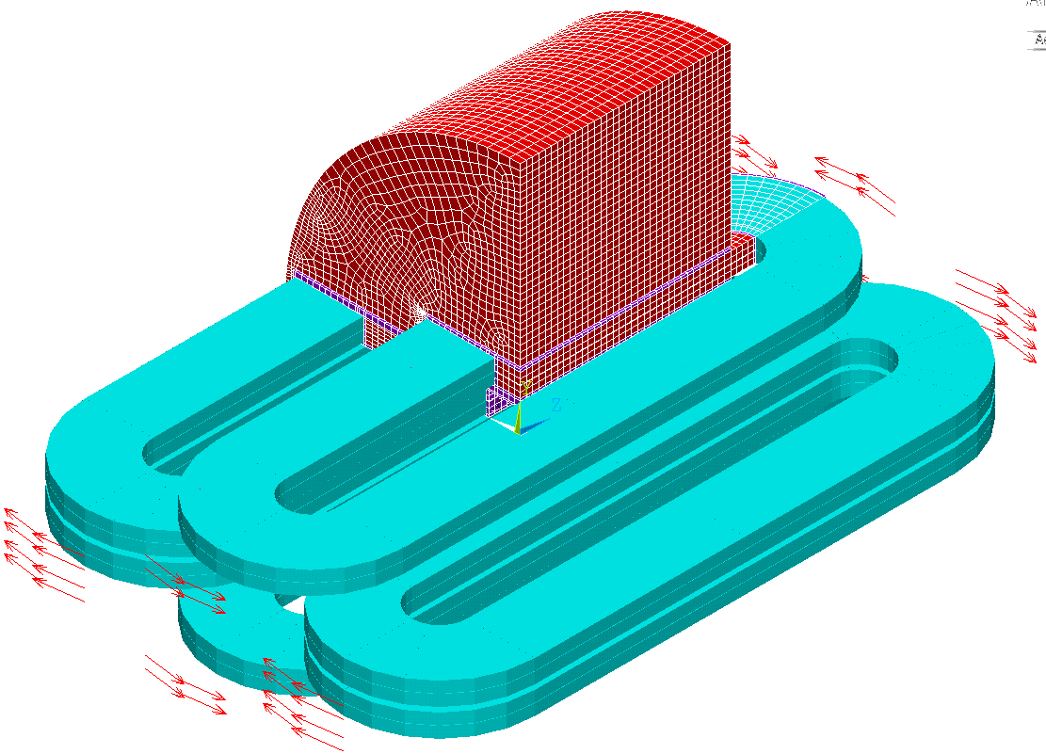
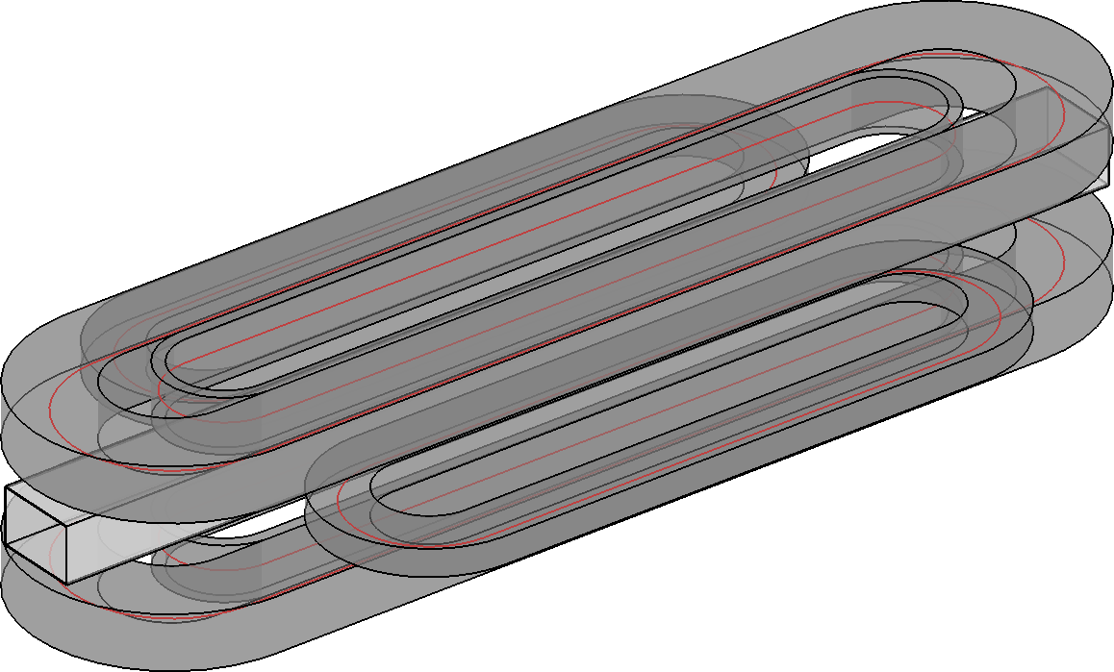
Alternative design
Magnet design purely based on racetrack coils:
  It may simplify the manufacturing (planar coils)
  It might simplify the management of mechanical stress
  It requires a larger cross-section of superconductor
  Field quality will be worse but acceptable for a test facility

Slide 32
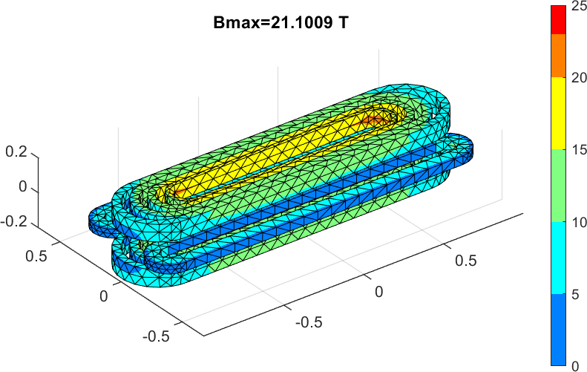
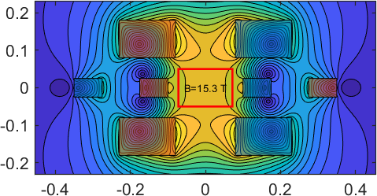
Alternative design
We may consider the use of REBCO

Slide 33
Outline
The EDIPO accident
Motivation, design targets and boundary conditions
The baseline magnet design:
  Magneto-static design
  Quench protection
  Mechanical analysis
Alternative magnet design
Other activities:
  Helium vessel
  Cable qualification
Conclusions and outlook

Slide 34
Liquid helium vessel
The EDIPO 2 magnet will be bath-cooled at 4.2 K.
Three main parts of the helium vessel:
  Bottom base (interface with the existing facility)
  Cylindrical body
  Lid (not final design)
Main parameters:
  Operating pressure: 1 bar
  Accident pressure: 3 bar
  Leak rate < 10⁻⁸ mbar·l/ s

Slide 35
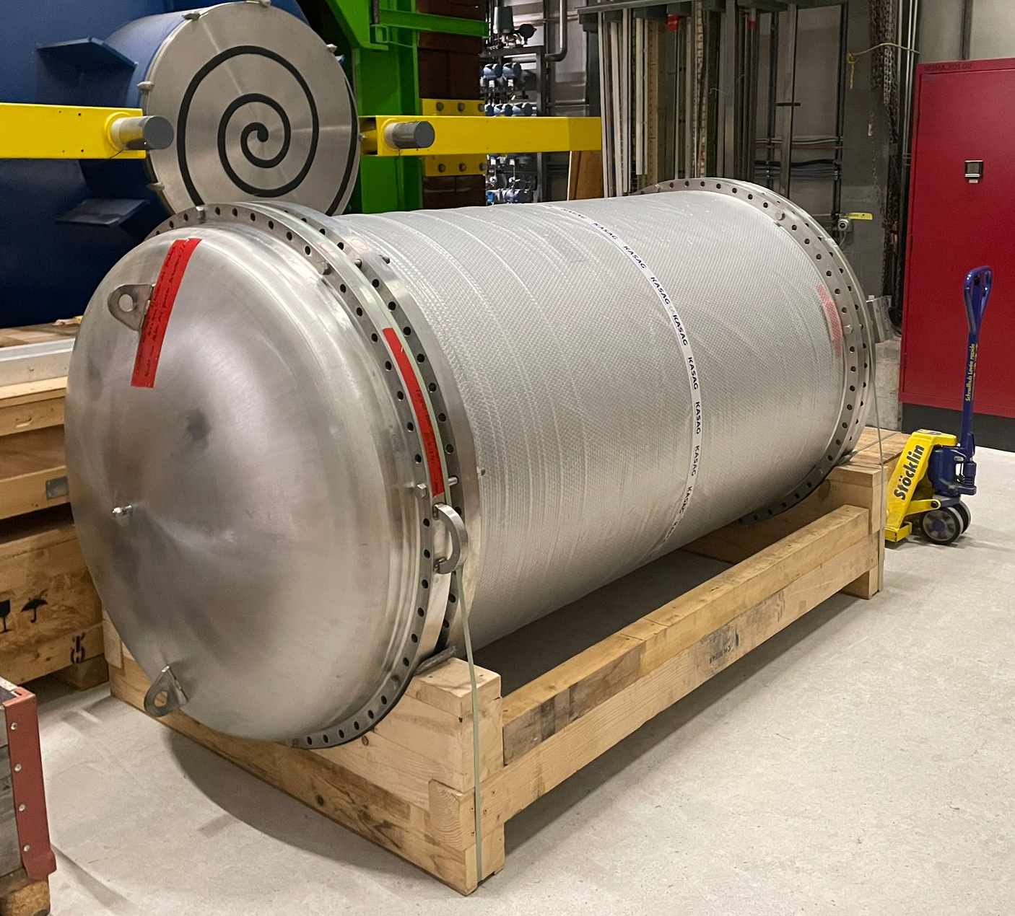
Liquid helium vessel
The EDIPO 2 magnet will be bath-cooled at 4.2 K.
Three main parts of the helium vessel:
  Bottom base (interface with the existing facility)
  Cylindrical body
  Lid (not final design)
Main parameters:
  Operating pressure: 1 bar
  Accident pressure: 3 bar
  Leak rate < 10⁻⁸ mbar·l/ s
During 2021 a Swiss company has manufactured the vessel.
It was delivered at SPC in December 2021.

Slide 36
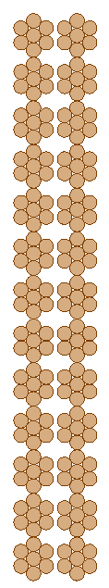
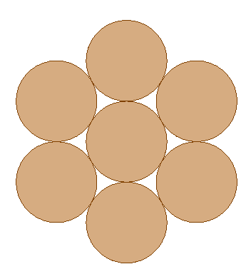
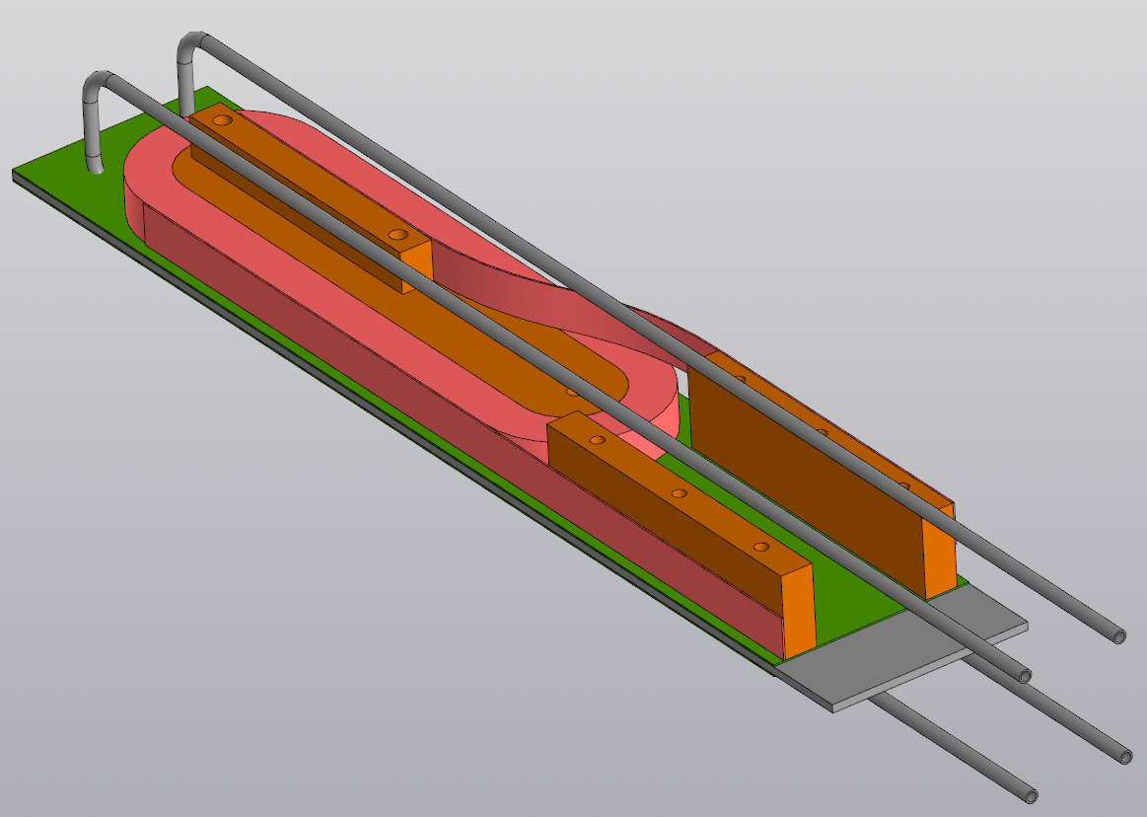
Cabling and winding trials
105 kg of high-j_{c} strand (>2200 A/mm² at 12T and 4.2 K) have been purchased
Cabling trials will follow
Ultimately, the goal is to produce a prototype coil and test it in SULTAN
25.9 mm
Ø 0.7 mm
3.48 mm

Slide 37
Outline
The EDIPO accident
Motivation, design targets and boundary conditions
The baseline magnet design:
  Magneto-static design
  Quench protection
  Mechanical analysis
Alternative magnet design
Other activities:
  Helium vessel
  Cable qualification
Conclusions and outlook

Slide 38
Conclusions and outlook
Magnet design:
  Distinctive features of EDIPO2:
    15 T in a 144×144 mm² aperture.
    Use of a two-stage cable design.
  The stress in the coil ends is a critical aspect of the baseline design.
  Other aspects of the design satisfy the stringent criteria to generate a background field of 15 T in a large aperture.
  Design efforts are concentrated on:
    Reduction of the mechanical stress in the coil ends
    Simplification from the manufacturing point view (racetrack coils)
He vessel has been manufactured and delivered.
105 kg of high-j_{c} strand have been purchased for cabling and winding trials
Funding approved by the ETH board (2025-2028)

Slide 39
We are hiring
Postdoc: EDIPO2
https://www.psi.ch/en/pa/job-opportunities/56605-post-doctoral-researcher-epfl
Postdoc: DEMO (+ EDIPO2)
https://www.psi.ch/en/pa/job-opportunities/56602-post-doctoral-researcher-epfl
PhD student: EDIPO2
https://www.psi.ch/en/pa/job-opportunities/56608-phd-student-in-applied-superconductivity-epfl
Join our team!

Slide 40
Thanks for your attention!

